Slide 1
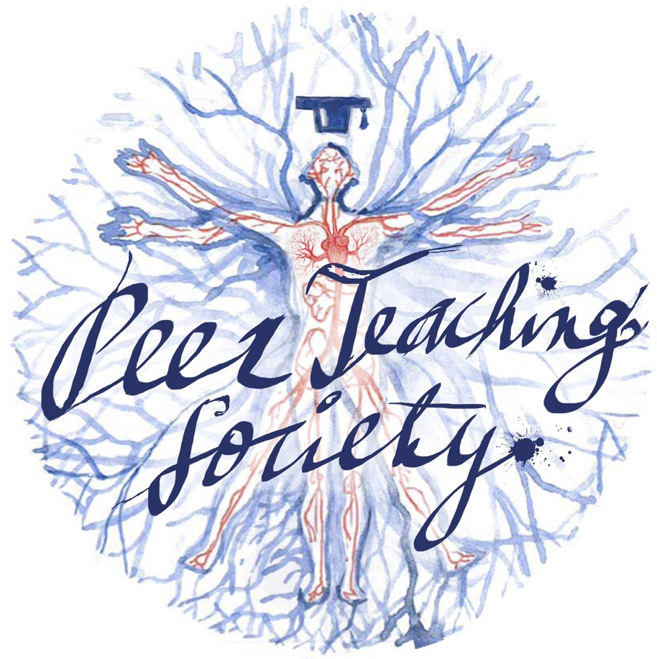

Slide 2
MSK Revision
MSK Wrap-Up Revision Session
Will Giles and Faith Solanke
18/5/2021

Slide 3
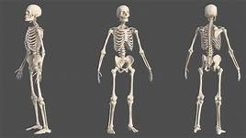
What we will cover today
Skeletal Physiology
Bone classification & function
Formation, Growth & Turnover
Hormones & Homeostasis
Fractures & Healing
Joint Physiology
Joint classification
Collagen
Tendons & Ligaments
Muscular Physiology
Components
Contraction coupling
Sarcomere contraction
The Peer Teaching Society is not liable for false or misleading information…

Slide 4
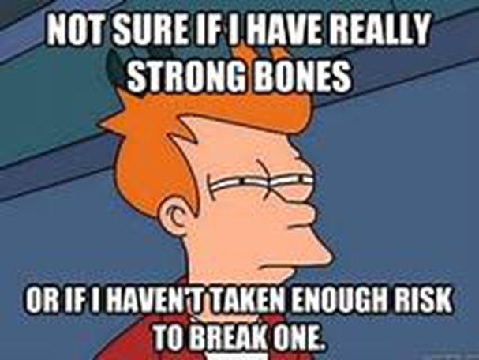
Bone Classification and Function

Slide 5
Skeletal: Bone Function
Bones have 7 key functions...
Storage of minerals (eg. calcium hydroxyapatite)
Transmission of body weight
Protection of vital organs and structures
Anchorage - lever system for movement
Determination of body shape
Raises body from ground against gravity
Houses bone marrow to facilitate haematopoiesis

Slide 6
Skeletal: Bone Classification
BY SHAPE
LONG BONES | Tubular shape Hollow shaft Expanded, articulate ends | Femur, tibia, fibula, metatarsals, humerus, ulna, radius, metacarpals, phalanges
SHORT BONES | Cuboidal in shape | Carpals, tarsals
FLAT BONES | Plates of bone Often curved Protective | Sternum, ribs, scapulae, cranial bones
IRREGULAR BONES | Shapes vary Often specific to function | Mandible, Vertebrae
SESAMOID BONES | Round Contain nodules for tendon attachment | Patella

Slide 7
Skeletal: Bone Classification
BY MICROSCOPIC STRUCTURE
Primary (Woven) | Rough Plan * Made quickly Disorganised No clear structure
Secondary (Lamellar) | Final Piece * Made slower Organised Clearly structured

Slide 8
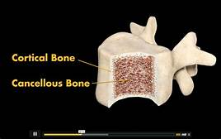
Skeletal: Bone Classification
BY MACROSCOPIC STRUCTURE
Cortical (Compact) | Dense, solid Incorporates spaces for blood vessels and cells
Trabecular (Spongy) | Formed from a network of struts Spongy appearance Many spaces filled with bone marrow

Slide 9
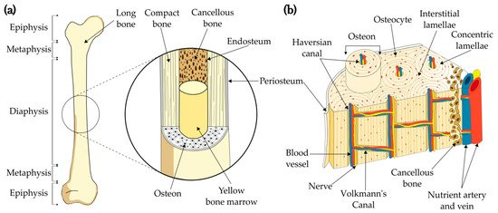
Skeletal: Bone Classification

Slide 10
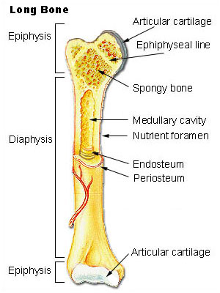
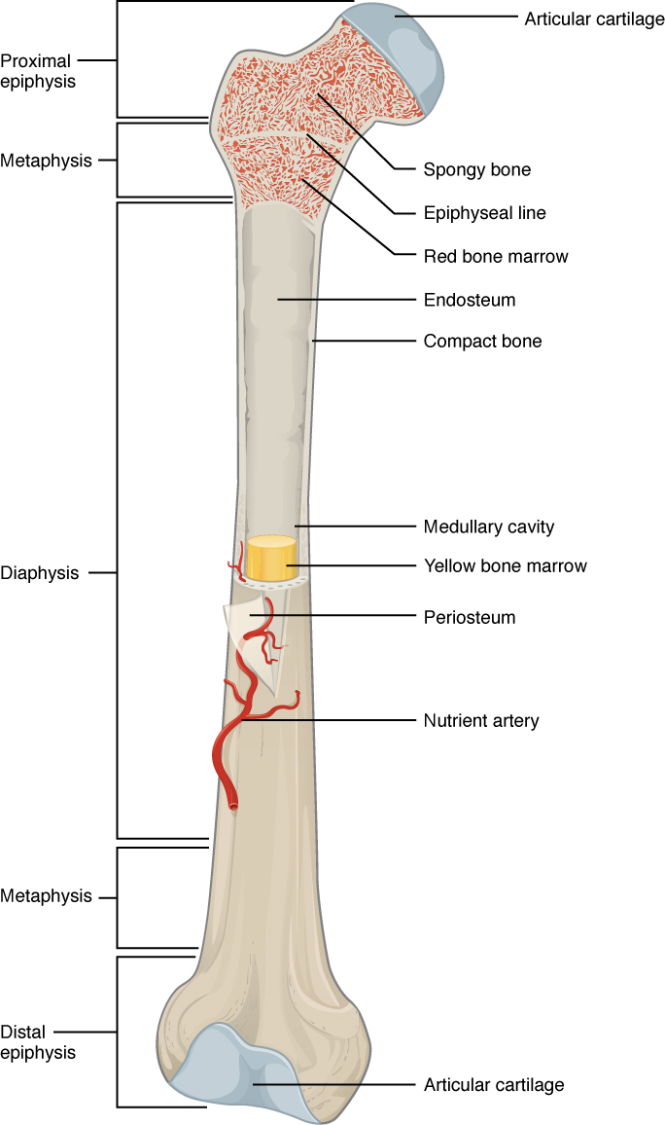
Skeletal Bone Classification

Slide 11
Bone Formation, Growth and Turnover

Slide 12
Skeletal: Bone Formation
Bone formation process is called ossification
Two main types:
Endochondral ossification
Bone forms from a hyaline cartilage precursor.
Occurs during foetal development, long bone formation and fracture healing
Intramembranous ossification
Bone forms directly from mesenchyme.
Occurs during foetal development to form flat and irregular bones.

Slide 13
Endochondral Ossification
Chondrocytes produce a cartilaginous precursor
Primary ossification centre is formed as osteoblasts lay bone onto the cartilage
Osteoclasts break down the cartilage
POC is vascularised as blood vessels invade
Periosteum collar is formed outside the bone as perichondrium is broken down
Parts of the spongy bone making up the POC are broken down to form the medullary cavity
Process repeats at ends of long bones to form secondary ossification centre
Some layers of cartilage remain between the SOC and POC, known as the epiphyseal (growth) plate

Slide 14
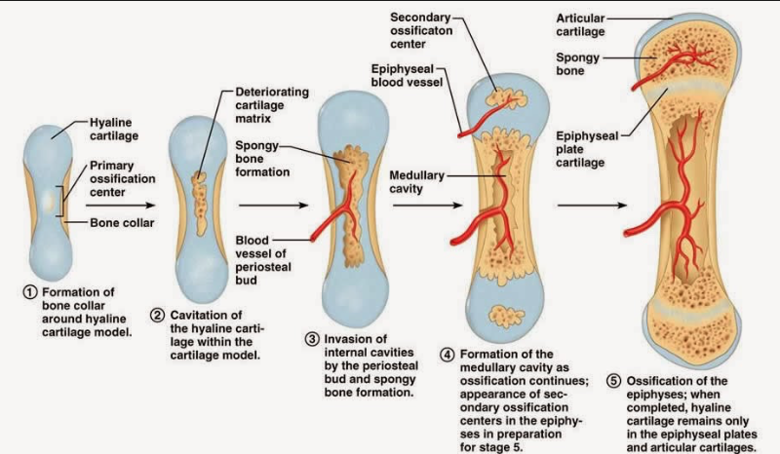
Endochondral Ossification

Slide 15
Intramembranous Ossificatiom
Mesenchymal stem cells replicate, forming clusters called nidus
Stem cells in nidus become osteoprogenitor cells
Osteoprogenitor cells differentiate into osteoblasts
Osteoblasts produces extracellular matrix containing T1 Collagen fibres
Some osteoblasts become trapped in matrix, forming osteocytes
Bone spicules form via mineralisation
Spicules grow and fuse to form trabeculae, around which periosteum is now formed
Useful Video:
https://youtu.be/Vwethc4jt7U

Slide 17
Skeletal: Long Bone Growth
Epiphyseal Plate = Growth plate allowing continued growth of long bones in childhood and adolescence.
Size of growth plate increases with constant chondrocyte division
Some chondrocytes simultaneously degenerate - they are then ossified by osteoblasts
This process continues throughout growth, after puberty the epiphyseal plate is completely ossified (fused) and growth ceases

Slide 18
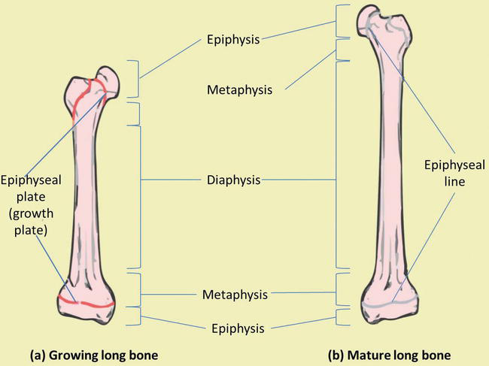
Skeletal Long Bone Growth

Slide 19
General Aspects of Bone Growth
Mineralisation
Hydroxyapetate crystals being deposited into the bone fibrous matrix
Hardens bone
Vitamin D and PTH mediated
Modelling
Occurs during growth
Osteoblasts building and osteoclasts breaking down bone to form overall shape
Remodelling
Occurs after growth
Alteration and replacement of old bone w/ new
Occurs via blast and clast activity similar to modelling

Slide 20
Bone Remodelling
Occurs in 5 steps...
Activation
Monocytes on bone surface differentiate to become osteoclasts
Reabsorbtion
Osteoclasts secrete acid to dissolve the bone mineral
Reversal
Osteoblasts are stimulated/recruited
Formation
Osteoblasts secrete osteoid to form bone matrix
5. Quiescence
Without stimulation there is no action
Why?
Forming bone shape
Replacing woven bone with lamellar
Reorientation of fibrils and trabeculae to reinforce mechanical strength
Response to load
Calcium release
Damage repair

Slide 21
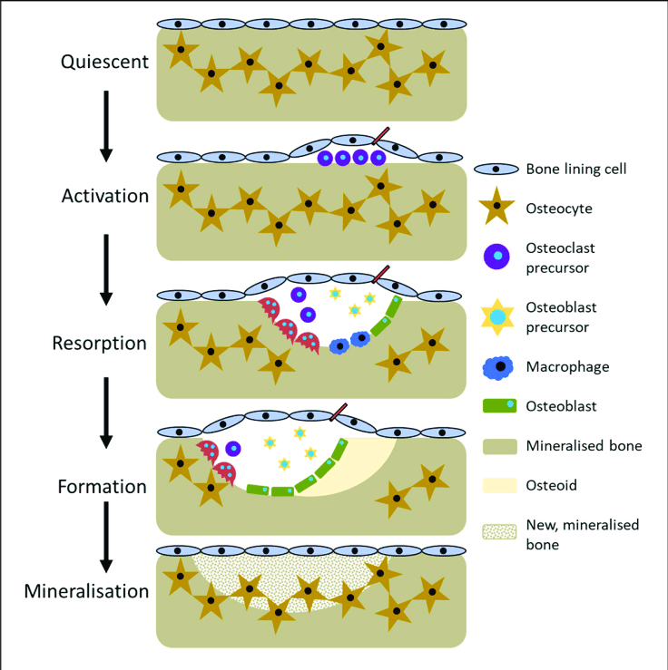
Bone Remodelling

Slide 22
Communication & Signalling
Osteoblast and osteoclast activity is balanced in health - a loss of balance is PATHOLOGICAL.
They usually communicate via cytokines, with some OPG and RANK signalling.
Cytokines are...
REDUNDANT: many different types can perform one job
PLEIOTROPIC: can initiate effect on many different tissues

Slide 23
RANK L and OPG Signalling
RANK Ligand stimulates increased osteoclast activity, increasing bone reabsorbtion.
Secreted by osteoblasts
Binds to RANK receptors on monocytes
Monocytes differentiate to osteoclasts which actively reabsorb bone
Osteoblasts secrete more RANK L in the presence of oestrogen (as well as other hormones, GFs, and cytokines)
Osteoprotegerin (OPG) inhibits osteoclast activity, allowing increased bone formation.
Produced by osteoblasts and stromatolites cells
Binds to RANK L, preventing osteoclast activation
Decreases reabsorbtion rates

Slide 24
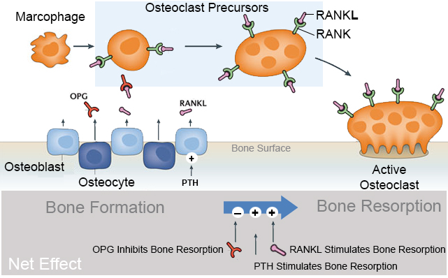
RANK L & OPG

Slide 25
Response of bones to activity level
Wolff’s Law:
In a healthy individual, bone will adapt to the loads under which it is placed
If bone loading increases, bone will remodel itself to become more resistant to loading.
These changes result in responsive variation of bone density in appropriate areas.

Slide 26
Hormones and Homeostasis

Slide 27
Hormones and Homeostasis
PTH (parathyroid hormone)
Calcitriol (active vitamin D)
Calcitonin
FGF-23

Slide 28
Parathyroid Hormone
Decreased serum calcium results in increased PTH secretion
PTH increases bone remodelling rates and calcium RESORPTION
Presence of PTH leads to conversion of 25-hydroxyvitamin D (calcidiol) to the active 1,25-dihydroxyvitamin D (calcitriol)
Combined effect lead to increase in serum Ca²⁺ levels

Slide 29
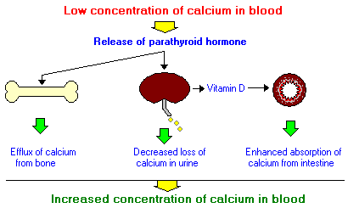
Parathyroid Hormone

Slide 30
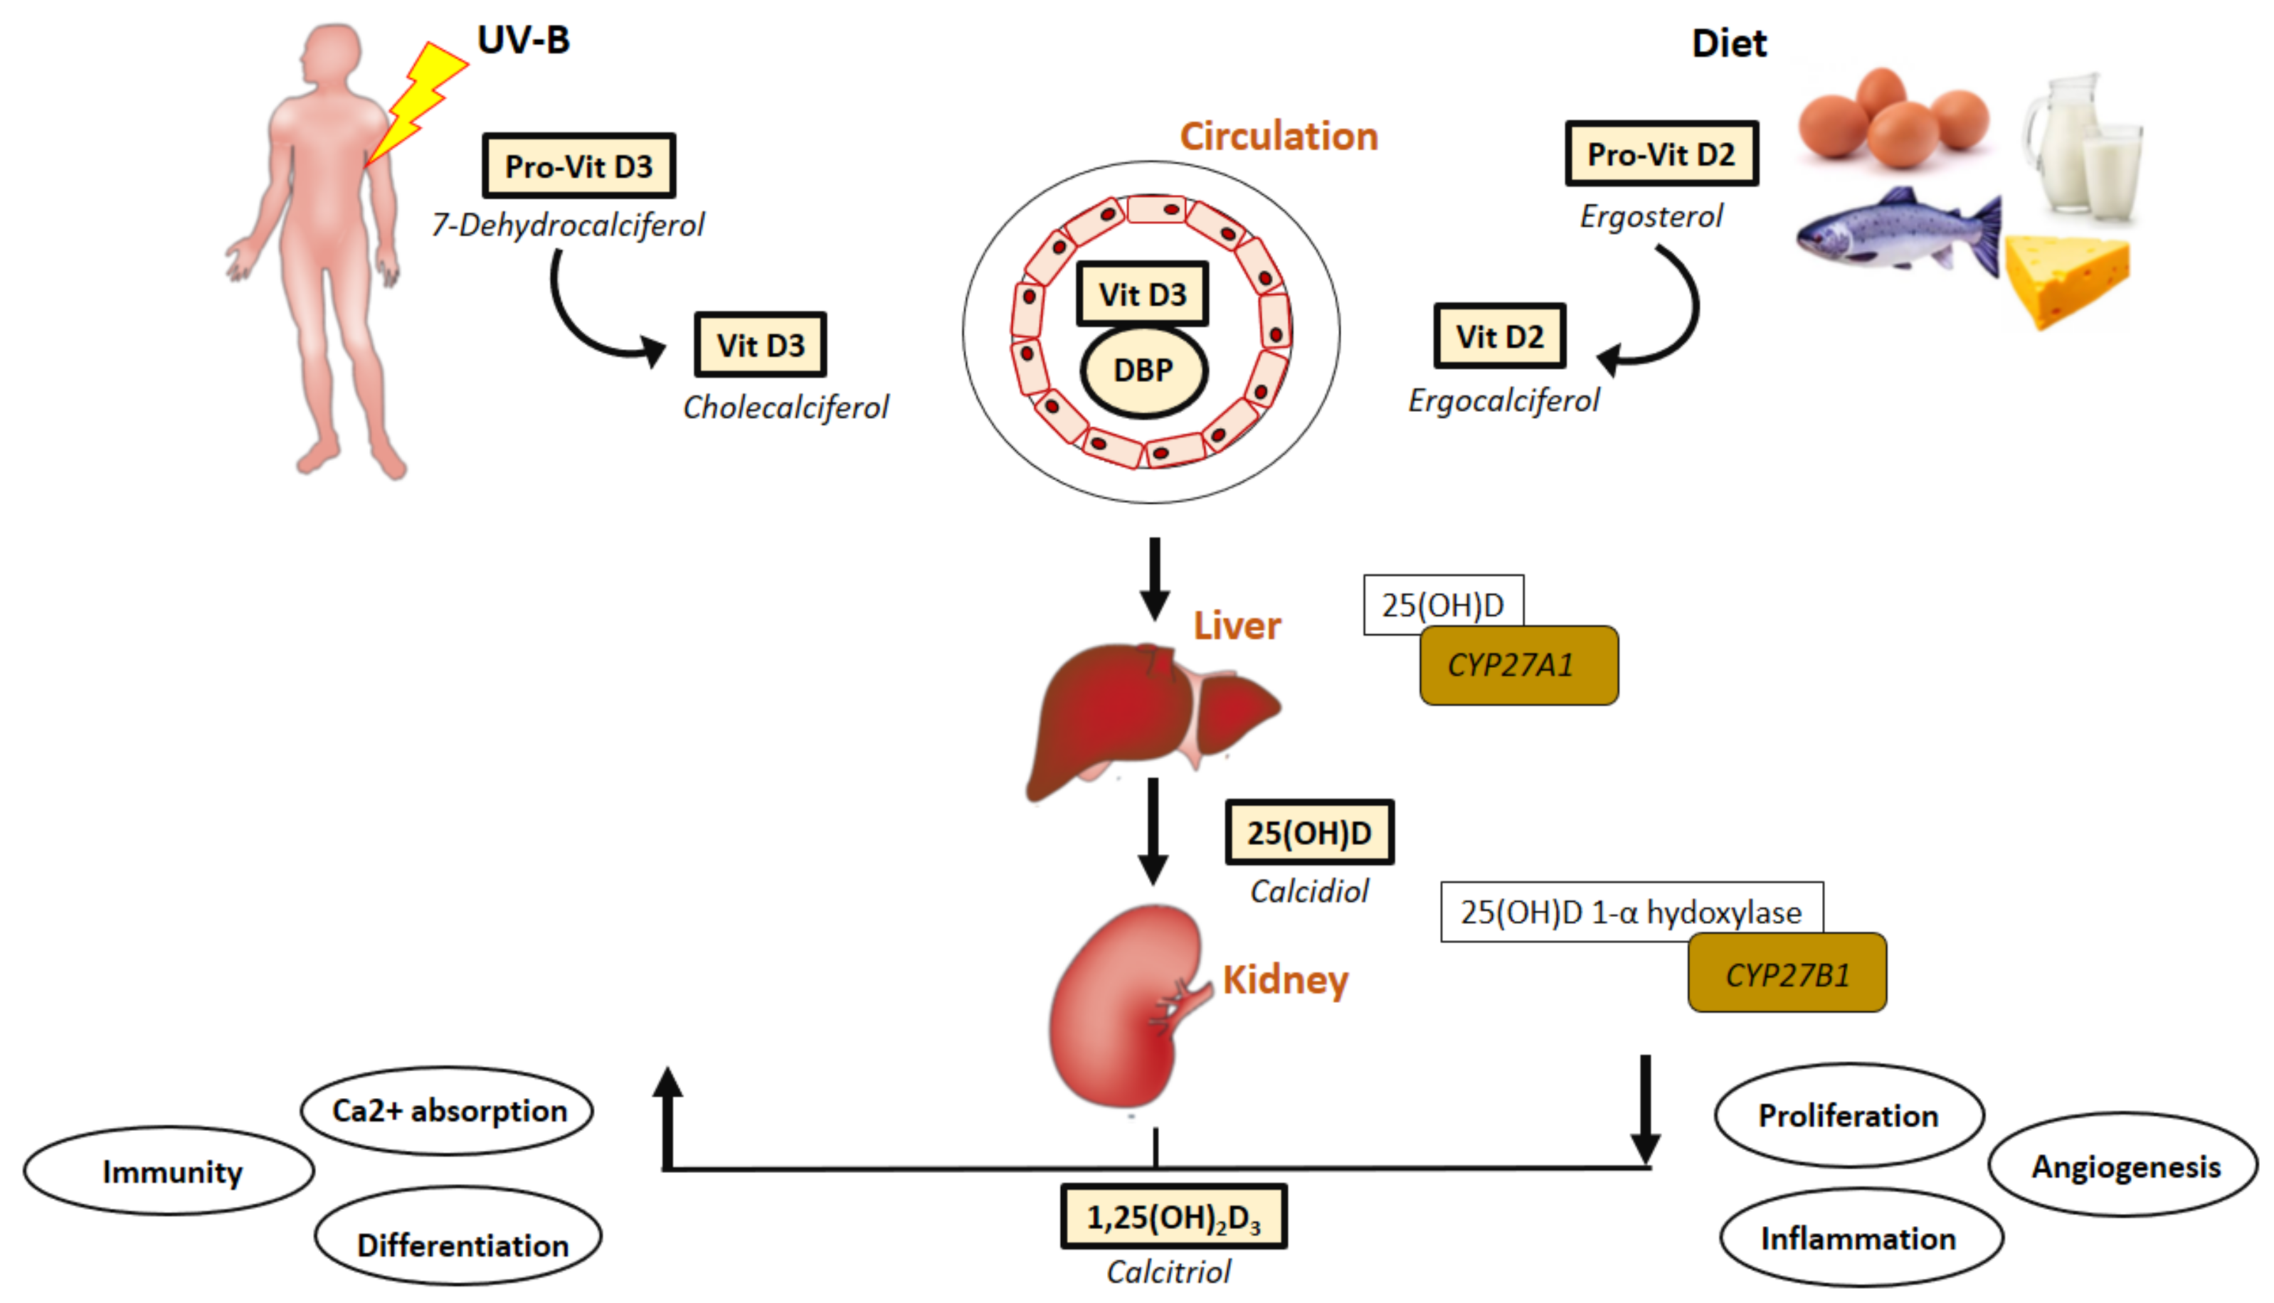
Vitamin D Pathway
Vitamin D cannot be directly consumed, and we don’t actually absorb it from the sun. Active vitamin D increases calcium absorption and is therefore fundamental in maintaining bone mineral density. Vitamin D is synthesised as follows (see next slide for steps):

Slide 31
Vitamin D Pathway
7-dehydroxycholesterol is synthesised directly from ingested cholesterol (found in fatty foods)
This is converted to Vitamin D3, facilitated by UVB radiation from the sun
Vitamin D3 is converted to 25-hydroxyvitamin D (aka CALCIDIOL) in the liver, via the cytochrome P450 system
Calcidiol is converted to 1,25-dihydroxyvitamin D (aka CALCITRIOL) in the presence of PTH
The presence of calcitriol can then go on and promote gut calcium ion absorption

Slide 32
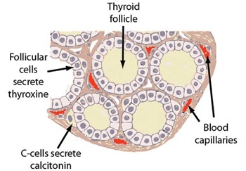
Calcitonin
Calcitonin is produced by thyroid gland C-Cells.
Action is not really known in humans, however it is secreted in response to serum calcium ion increase, so it is potentially involved in a negative feedback mechanism to reduce bone resorption.

Slide 33
FGF-23 and Phosphate Homeostasis
FGF-23 is the MOST IMPORTANT regulator of serum phosphate concentration.
Produced by osteocytes in response to...
Rise in serum PO4-
Presence of PTH
Presence of Calcitriol
It binds to Klotho-FGF receptors, resulting in decreased expression of Na+ cotransporters in renal tubules
It also decreases calcitriol formation
Resulting in increased PO4- excretion & decreased reabsorption
FGF-23 secretion is inhibited by PHEX when serum phosphate levels fall

Slide 34
Phosphate and Calcium Homeostasis
Extracellular phosphate is either used in bone formation, or is excreted (urine/faeces)
Extracellular phosphate is accumulated via bone resorption, gut absorption, or renal reabsorbtion
Dietary phosphate is sourced from meat, dairy, nuts, and seeds.
Calcium homeostasis runs off essentially the same principles as phosphate homeostasis
Dietary calcium sourced include dairy, vegetables, and oily fish
The most important thing to get to know for these is the diagram (see next slide)

Slide 35
Phosphate and Calcium Homeostasis

Slide 36
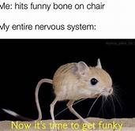
Fractures

Slide 37
Fracture Assessment
SITE | Which bone and which section? Eg. Proximal 1/3 of the tibial shaft
PATTERN | What is the nature of the fracture (aka what type)? Eg. Transverse, comminuted etc
ANGULATION | What angle is the displacement is the most distal section of the break - not that important at your stage and you wont be asked to measure anything!
JOINT INVOLVEMENT | Is it intra-articular (involving the joint) or extra-articular (outside the joint)?
SKIN INVOLVEMENT | Is the fracture open or closed?

Slide 38
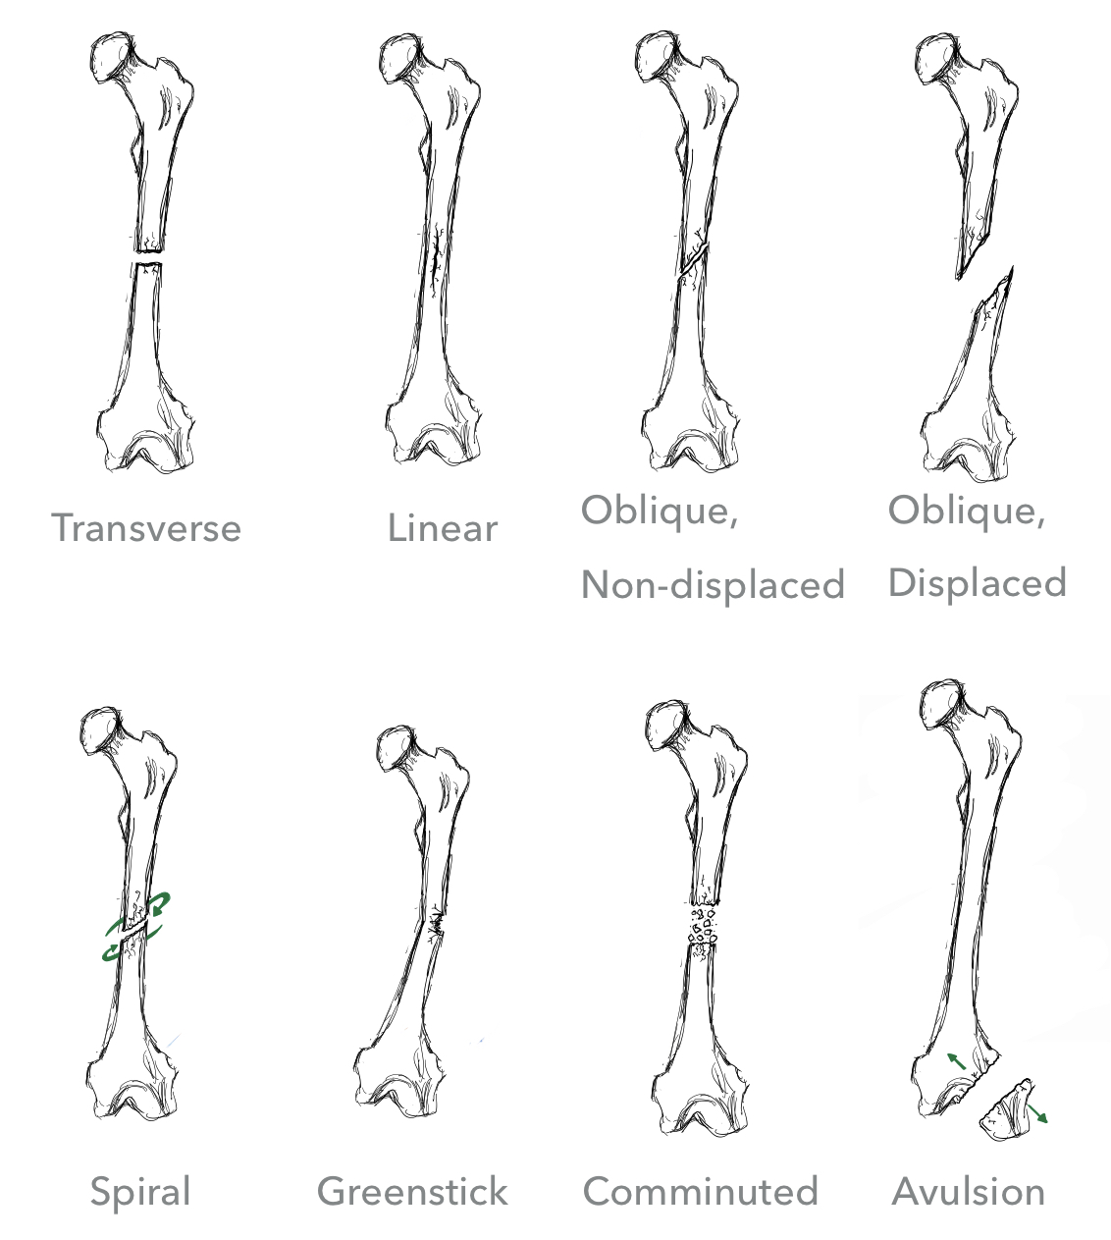
Types of Fracture...

Slide 39
Types of Fracture...

Slide 40
Fracture Healing
Step 1 - Haematoma Formation
Traumatic rupture of blood vessels at fracture site
Bleeding —> Haematoma formation
Reduced blood supply to bone cells, starving them of nutrients
Step 2 - Fibrocartilage (soft) Callus Formation
New capillaries grow at fracture site, supplying nutrients for repair
Dead tissues undergo phagocytosis
Connective tissues (collagen and fibrocartilage) form a repair tissue (soft callus) splinting the bone

Slide 41
Fracture healing
Step 3 - Bony Callus Formation
Osteoblasts and osteoclasts migrate to fracture site and divide
They replace soft fibrocartilage with spongy bone to form a hard callus
Forms a bulge at fracture site
Step 4 - Bone Remodelling
Bony callus is remodelled in response to mechanical stress (see Wolff’s law)
Strong, permanent patch at the fracture site is formed
New bone is stronger and more compact

Slide 42
Joint Classification

Slide 43
By Degree of Movement
Synarthroses | Amphiarthroses | Diarthroses
Immobile | Slightly Mobile | Freely mobile
Mostly fibrous | Mostly cartilaginous | Mostly synovial
Eg. Between skull sutures, manubriosternal joint | Eg. Intervertebral discs, pubic symphysis | Eg. Hip,shoulder joint, elbow joint

Slide 44
By Structure
Fibrous | Cartilaginous | Synovial
Held together by fibrous tissue | - Held together by cartilage | Held together by a synovial fluid filled capsule All have articulations cartilage, a joint capsule, a joint cavity, synovial fluid, and reinforcing ligaments In some joints bursa (eg. in hip) or menisci (eg. In knee) are present

Slide 45
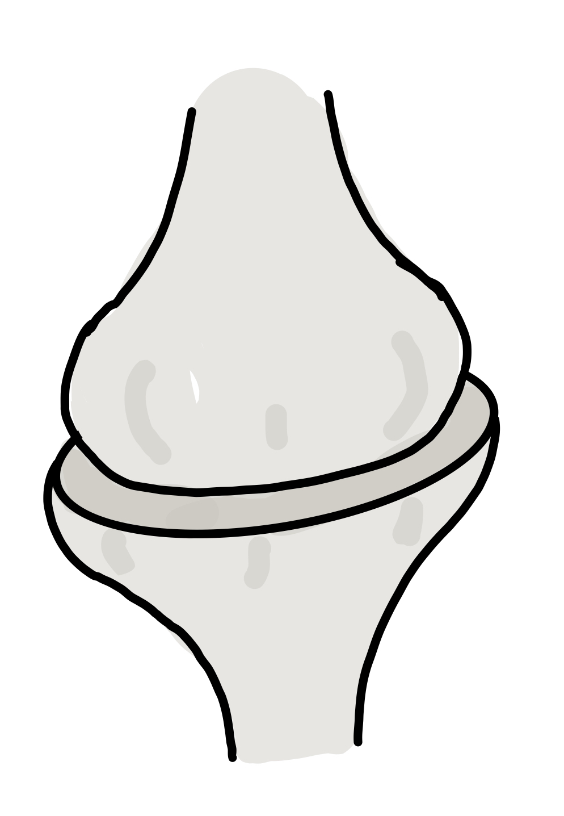
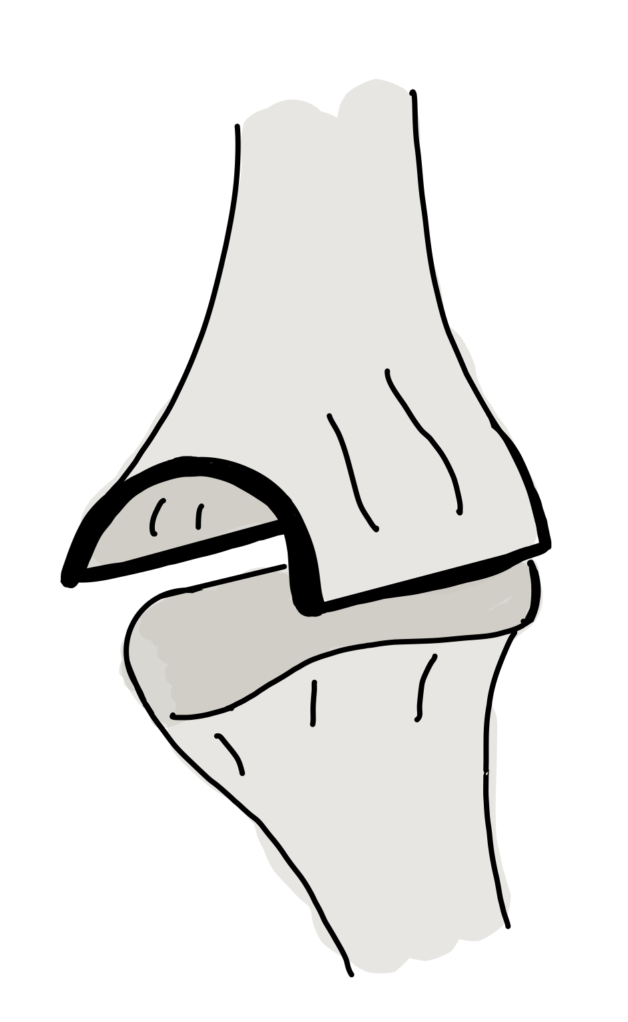
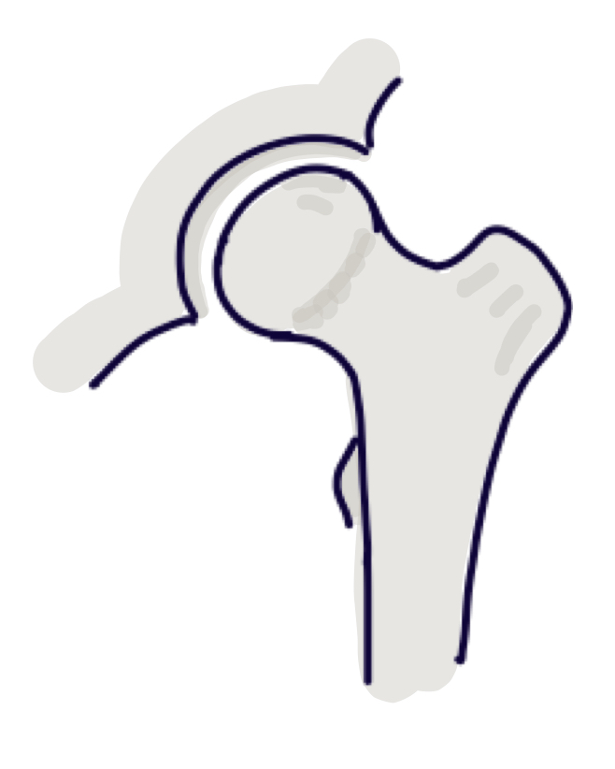
Classification of synovial joints...
Hinge Joint
Elongated oval in a curved socket
Large range of movement in a single plane
Elbow
Ball & Socket
Ball within a socket (pretty much as the name suggests)
Wide range of movement in all planes
Shoulder and hip joint
Condyloid
Oval sitting within oval cavity
Movement in two planes
Metacarpophalyngeal

Slide 46
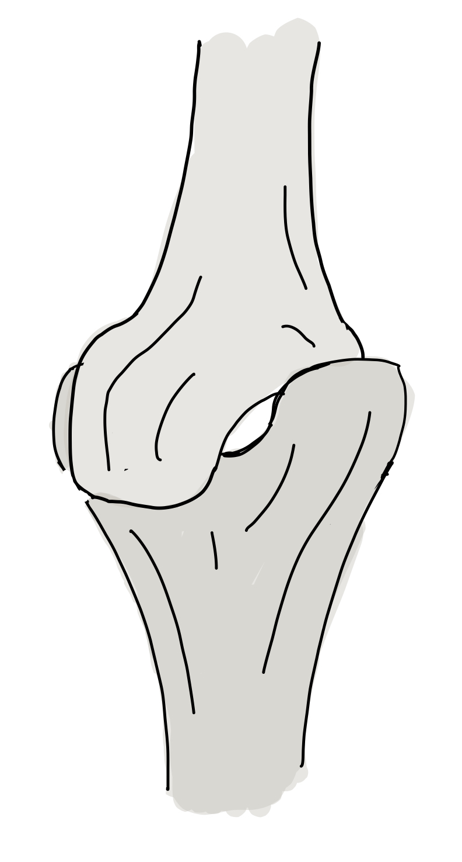
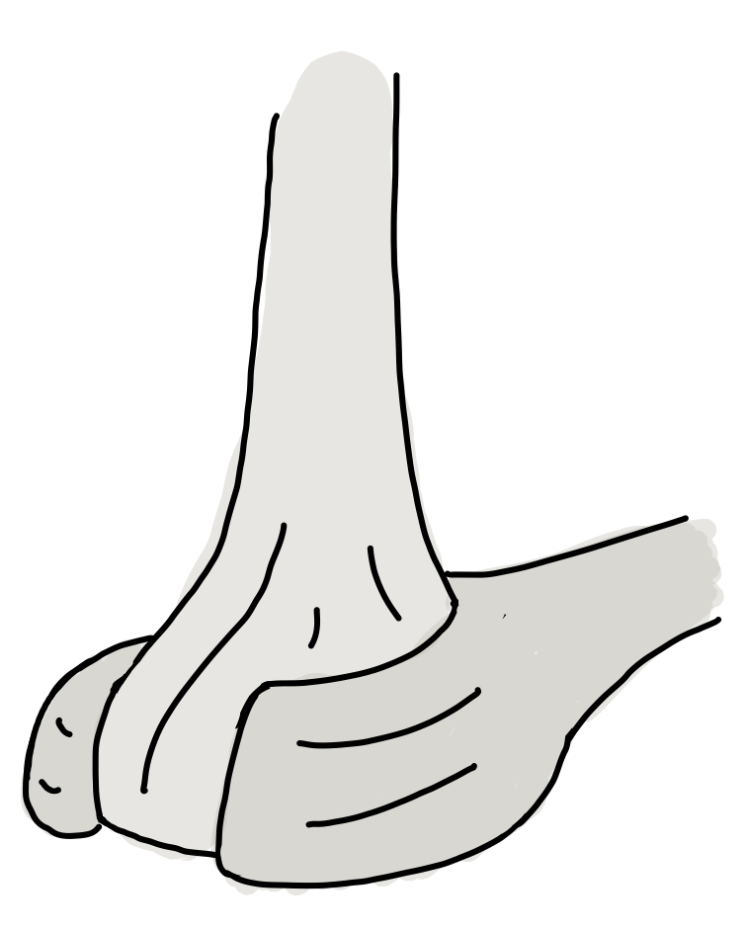
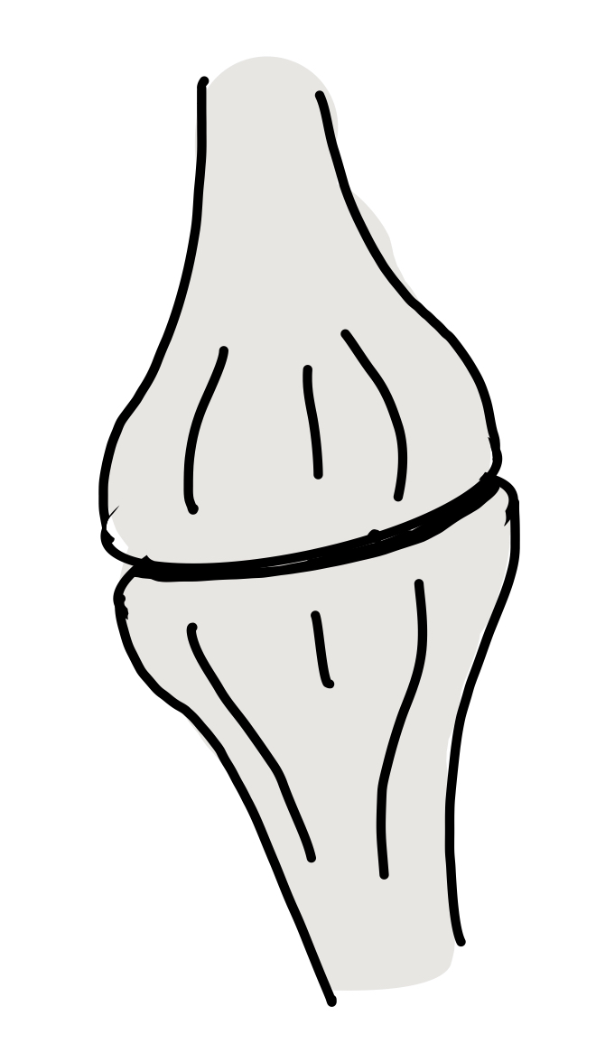
Classification of synovial joints...
Pivot
Bone pivots around an axis
Allows a large amount of rotation
C1/C2
Gliding
Two flat surfaces articulating
Limited movement in 2 planes
Carpal joints
Saddle
Two saddle shaped surfaces articulating
Movement in two planes
Thumb

Slide 47
Collagen, Tendons, and Ligaments

Slide 48
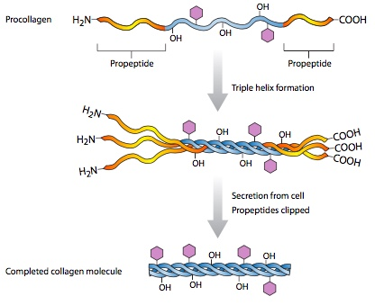
Collagen Synthesis
The Makeup of Collagen:
One collagen fibre = around 1000 amino acids
Every third AA is glycine
3 collagen models come together to form a triple helix called tropocollagen
It is secreted from a fibroblast, here it’s terminal polypeptides are removed
Tropocollagen molecules then form covalent cross links between one molecules lysine, and another’s adjacent hydrolysine - this process forms microfibrils
Microfibrils combine forming fibrils
Fibrils combine to form fibres
Fibres form fascicles which are enclosed in the endotendon
The tendon is enclosed in the epitendon

Slide 49
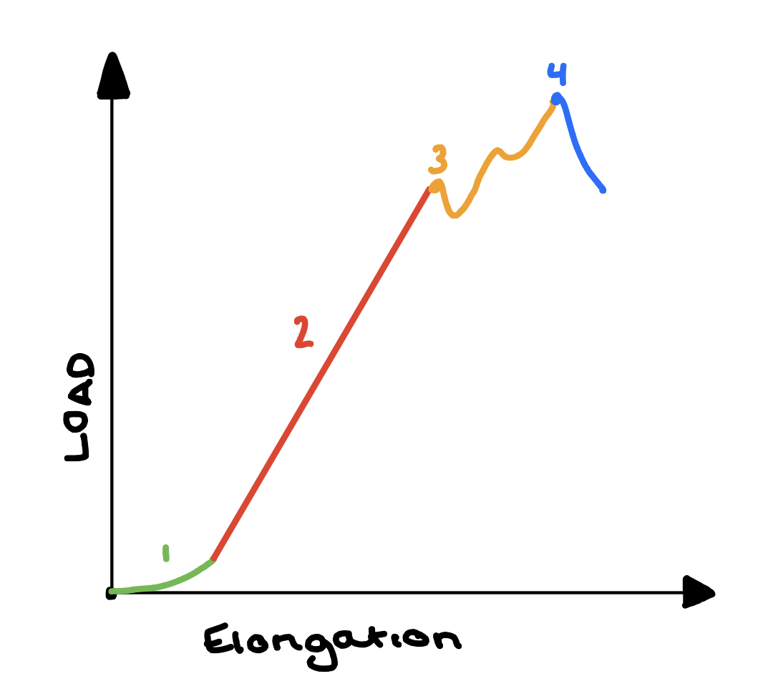
Stress and Strain in Tendons and Ligaments
Phase 1
“Toe” region of graph
Increase in load results in crumpled collagen fibres
Phase 2
Linear region
Fibres straighten and stiffness rapidly increases with loading
Phase 3
Maximum deformation and ultimate tensile strength
At this point, progressive fibre failure occurs
Phase 4
Yield point
Beyond this there is complete failure of connective tissues to support loads

Slide 50
Ligaments vs Tendons
Ligaments | Tendons
Bone to bone | Bone to muscle
Low Type I Collagen levels | High Type I Collagen levels
High elastin content | Low elastin content
Random organisation | Highly organised
Blood supply from insertion points | Many are avascular, but some receive blood from surrounding sheath

Slide 51
Types of Attachment (enthuses)
Fibrous
Formed via intramembranous ossification
Tendon or ligament attached to bone via sharpey’s fibres
Fibrocartilagenous
Formed via endochondral ossification
Tendon or ligament attached to the bone through a gradual change from collagenous ligament, to fibrocartilage, to mineralised bone

Slide 52
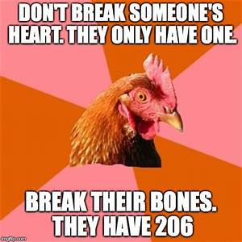
Muscle Components and Contraction

Slide 53
Fibre Components
Actin | Thin filament comprising of 2 g-strands, forming an f-actin helix Globular protein Interacts with myosin
Myosin | Thick filament comprised of 2 heavy chains and 4 light chains Hydrolyses ATP Interacts with actin
Tropomyosin | Thin filament made of 2 helical peptide chains Occupies each of the longitudinal grooves between 2 actin strands Regulates muscle contraction
Troponin | 3 types, all thin filaments... Troponin C - binds to calcium ions Troponin I - inhibits actin and myosin action Troponin T - binds to tropomyosin

Slide 54
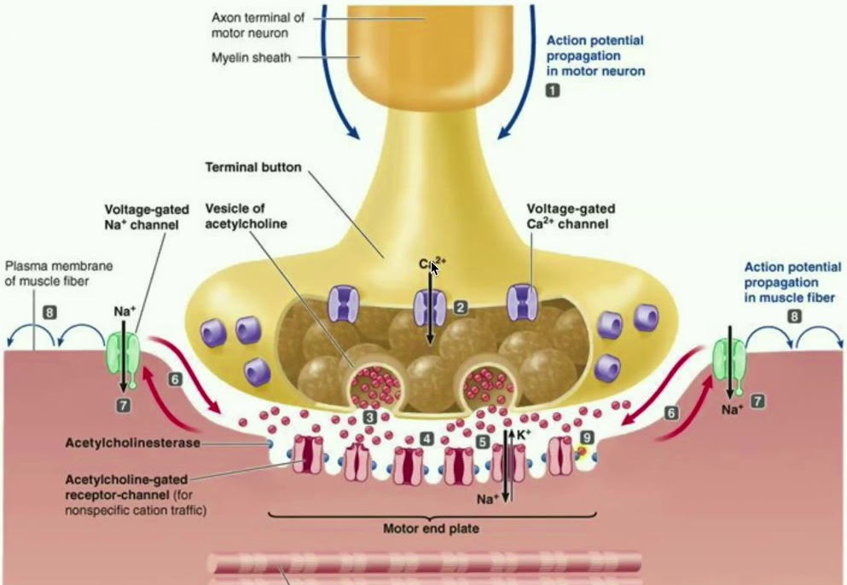
Contraction Coupling
An impulse reaches the neuromuscular junction
Presynaptic membrane depolarises, opening voltage gated calcium ion channels, enabling Ca²⁺ influx
Vesicles migrate and fuse with the presynaptic membrane, releasing ACh into the synaptic cleft via exocytosis
ACh binds to receptors on the sarcomere, depolarising the sarcolemma (through LGSICs and Na+ influx)
This results in T-Tubule depolarisation, and subsequent depolarisation of the sarcoplasmic reticulum
Sarcoplasmic reticulum releases Ca²⁺ - this initiates sarcomere contraction (see next slide)

Slide 55
Molecular Sarcomere Contraction
Ca2+ ions from the sarcoplasmic reticulum bind to troponin C, resulting in a conformational change of troponin
Troponin moves, exposing actin filament binding sites
Myosin head binds to actin, forming cross links - power stroke is formed, shortening the sarcomere
ATP binds to myosin head and is hydrolysed, this releases energy, breaking the cross links, resulting in detachment of actin and myosin
Myosin head reattaches to the next actin binding site and the cycle is repeated, continuing sarcomere shortening and muscle contraction

Slide 56
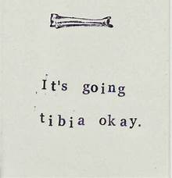
Question time

Slide 57
Question
1. In endochondral ossification, what happens to the chondrocytes?
They develop into osteocytes.
They die in the calcified matrix that surrounds them and form the medullary cavity.
They grow and form the periosteum.
They group together to form the primary ossification center.

Slide 58
Answer
1. In endochondral ossification, what happens to the chondrocytes?
They develop into osteocytes.
They die in the calcified matrix that surrounds them and form the medullary cavity.
They grow and form the periosteum.
They group together to form the primary ossification center.

Slide 59
Question
2. Which of the following bones is (are) formed by intramembranous ossification?
the metatarsals
the femur
the ribs
the flat bones of the cranium

Slide 60
Answer
2. Which of the following bones is (are) formed by intramembranous ossification?
the metatarsals
the femur
the ribs
the flat bones of the cranium

Slide 61
Question
3. Why is cartilage slow to heal?
because it eventually develops into bone
because it is semi-solid and flexible
because it does not have a blood supply
because endochondral ossification replaces all cartilage with bone

Slide 62
Answer
3. Why is cartilage slow to heal?
because it eventually develops into bone
because it is semi-solid and flexible
because it does not have a blood supply
because endochondral ossification replaces all cartilage with bone

Slide 63
Question
4. The fibrous membrane covering the outer surface of the bone is the ________.
periosteum
epiphysis
endosteum
Diaphysis
Metaphysis

Slide 64
Answer
4. The fibrous membrane covering the outer surface of the bone is the ________.
periosteum
epiphysis
endosteum
Diaphysis
Metaphysis

Slide 65
Question
5. Long bones enable body movement by acting as a ________.
counterweight
resistive force
lever
Fulcrum
Bolt

Slide 66
Answer
5. Long bones enable body movement by acting as a ________.
counterweight
resistive force
lever
Fulcrum
Bolt

Slide 67
Conclusion
Wikipedia is great, especially for MSK physiology
TeachMeAnatomy is your best friend
Look at specimens in the MTU and make sure you can easily identify which muscles are which etc.
Gray’s anatomy is a really good textbook but contains far too much detail for Phase 1

Slide 68
