Slide 1
2020/2021

Slide 2
Phase 1 Liver and Friends
Peer Teaching
NOTE: WHAT’S NOT WRITTEN IN RED IS BONUS INFO. WHAT’S WRITTEN IN RED IS A ‘MUST LEARN’
Phase 1 Revision Session
Neima E. Roodbari
Muhammad Shehroz
10/02/2021
The Peer Teaching Society is not liable for false or misleading information…

Slide 3
COVERING TODAY…
Liver Storage
Liver Detoxification
Production of Proteins
Nitrogen Balance
Fat Metabolism
Gall Bladder
Exocrine Pancreas

Slide 4
Liver Storage
What we’ll cover:
Fat soluble vitamins (A, D, E, K)
Vitamin B12
Iron storage and metabolism
Glycogen
The Peer Teaching Society is not liable for false or misleading information…

Slide 5
Vitamin Storage
Vitamin A aka retinol :
Stored in stellate cells
Stored as retinyl ester
Converted to active form by lecithin retinol acyltransferase (LRA)
Active form: retinol
Vitamin D aka cholecalciferol:
Produced in body as cholecalciferol
Found in food as ergocalciferol
Metabolised in the liver before becoming the active form
Vitamin E:
Family of 8 fat soluble compounds
Anti-oxidants
Stored in either liver or adipose tissue
Vitamin K:
Two forms of vit K. Acquired from either plant or meat sources
Phylloquinone = green leafy vegetables
Menaquinones = animal sources
Vitamin B12 aka cobalamin:
Acquired from animal sources
2 - 5mg stored in the body.
Stored mainly in the liver
Vitamins A, D, E, K are FAT SOLUBLE
B12 is WATER-SOLUBLE
Notes:
Vitamin A may be stored or removed from storage several times a day, regulating the amount in circulation and preventing damage that may occur as a result of excess. This is known as retinal recycling.
Food wish vit D – oily fish, red meat, liver, egg yolks

Slide 6
Iron Storage
Iron is bound to TRANSFERRIN after being absorbed by duodenal epithelial cells
Most is utilised by the body, rest is stored
Most stored iron is in the liver
More specifically, in Kupffer cells
Stored in cells as FERRITIN
Iron distribution:
50% is in haemoglobin
25% is in haem-containing proteins
25% is in liver ferritin
Notes:
Kupffer cells are macrophages that are found and stay in the liver
Note: other cells also have the ability to store iron as ferritin however this role is mostly carried out by the liver.
Extra info: in iron overload, ferritin stores are saturated so iron is haemosiderin instead- this comes with problems

Slide 7
Glycogen
Liver maintains blood glucose levels
Excess glucose is stored as glycogen
Formation is stimulated by insulin release
Breakdown is stimulated by glucagon release
Liver is normally stores 100g of glycogen
300g is stored in skeletal muscle

Slide 8
Liver Detoxification
Xenobiotics
Phase 1 and phase 2 reaction
Cytochrome P450

Slide 9
Xenobiotics
Definition:
- A foreign chemical substance not normally found or produced in the body which cannot be used for energy requirements
Drugs are xenobiotics
Absorbed across lungs, skin, or ingested
Metabolic reactions are carried out by microsomal and non-microsomal enzymes
Microsomes: They’re fragments of endoplasmic reticulum with attached ribosomes
Microsomal-enzymes: Found in microsomes
Non-microsomal enzymes: Found anywhere but microsomes

Slide 10
Phase 1 reactions
Pharmacologically active compounds:
Lipophilic
Non-ionised at pH 7.4
Bound to plasma proteins to be transported
Phase 1 reactions:
Makes the drug more HYDROPHILLIC to be excreted by kidneys
Introduce/ expose hydroxyl (-OH) and other polar groups
Carried out via oxidation, reduction, and hydrolysis
Reactions facilitated by MICROSOMAL enzymes
Cytochrome P450:
Important type of microsomal enzyme
Uses haem group (Fe2+) to oxidise substances
Cytochrome p450 reductase - transfers electron from NADPH to CYP450 using flavoprotein
Notes:
Lipophilic – able to pass through plasma membranes
Non-ionised = at pH 7.4
Bound to plasma proteins to be transported
Oxidation, reduction, and hydrolysis reactions each have different types. Go over in own time
Process of adding groups is called functionalisation - this increases hydrophilicity by a little and reactivity by a lot. Preparation for phase 2 reactions
UGT =Uridine 5’- diphosphoglucuronosyltransferase = glucuronosyltransferase
UDGPA = uridine diphospho-glucuronic acid, conjugates glucuronic acid (makes more reactive) before it is added to another compound / drug

Slide 11
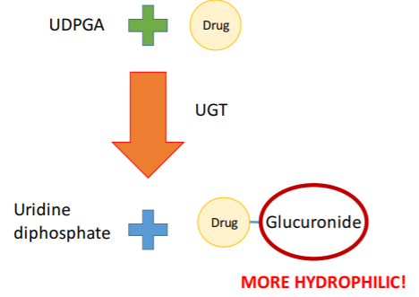
Phase 2 reactions
Phase 2 reactions:
Conjugation reactions:
- Attachment of substituent groups
- Inactive products
- Catalysed by transferases
- Significantly increases hydrophilicity
Glucuronidation reactions:
Adding a glucuronic acid group
Increases hydrophilicity
Done by glucuronosyltransferase/ UGT
UDPGA is an essential co-enzyme for glucuronidation reactions
Most phase 2 reactions are done by NON-MICROSOMAL enzymes.
EXCEPT for glucuronidation which is done by a MICROSOMAL enzyme (UGT)
Notes:
UGT = Uridine diphosphate glucuronosyltransferase
UDPGA = Uridine diphosphate-glucuronic acid

Slide 12
Production of protein
3 types of protein:
Plasma protein:
- E.g. Albumin, fibrinogen, globulin
Clotting Proteins
- Required for coagulation
Complement proteins
- Part of innate immune response
Albumin:
Most common plasma protein 2 main functions:
- Maintain colloid osmotic pressure
- Binding & transporting
large/hydrophobic molecules
Clotting factors:
Produces ALL factors EXCEPT: calcium (IV) and von Willebrand factor (VIII)
Liver facilitates vitamin K absorption
Vitamin K= 1972 (10,9,7,2)
Notes:
Vit k essential for synthesis of clotting factors 10, 9, 7, 2

Slide 13
Nitrogen balance
Glucose-alanine cycle
Urea cycle

Slide 14
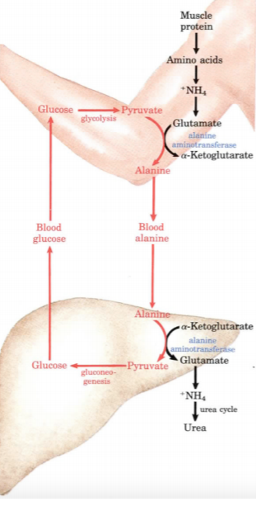
Glucose-alanine cycle
Learn this in own time pls ☹
A good way to learn it is to keep drawing it out by memory
The purpose of this cycle is to move proteins from muscles to the live when glycogen stores are low
Alanine aminotransferase (ALT) is an important enzyme clinically as its concentration in serum is used to measure liver health

Slide 15
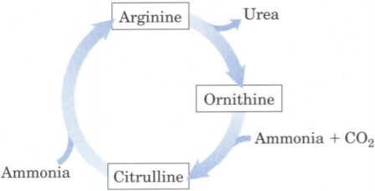
Urea cycle
All enzymes involved are found in hepatocytes
Cycle steps:
Ammonia and CO2 are added to ornithine
Another ammonia is then added to citrulline to make arginine
Arginine is cleaved by arginase into urea and ornithine and the cycle goes around again
Urea is the only compound generated, rest are recycled
High levels of ammonia is associated with neurotoxicity
Notes:
Metabolism of amino acids via oxidative deamination produces ammonia, Ammonia is highly toxic so we must be able to remove it.
Ammonia is removed via the urea cycle where converted into urea which then enters circulation and is excreted in the kidneys

Slide 16
Metabolism of lipids
Cholesterol, lipoproteins, and beta-oxidation
Enzyme – lipoprotein lipase, hepatic lipase
Fatty Acid Catabolism
Hepatic metabolism of lipids

Slide 17
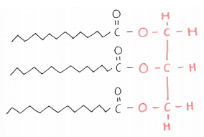
Energy reserves of the body
Most body fat is stored in adipocytes
Some is stored in the liver in hepatocytes
Liver oxidizes triglycerides when necessary
Energy is stored in three forms:
Triglycerides – 78%
Protein – 21%
Carbohydrate – 1%
Fatty acid “tails”
Glycerol backbone

Slide 18
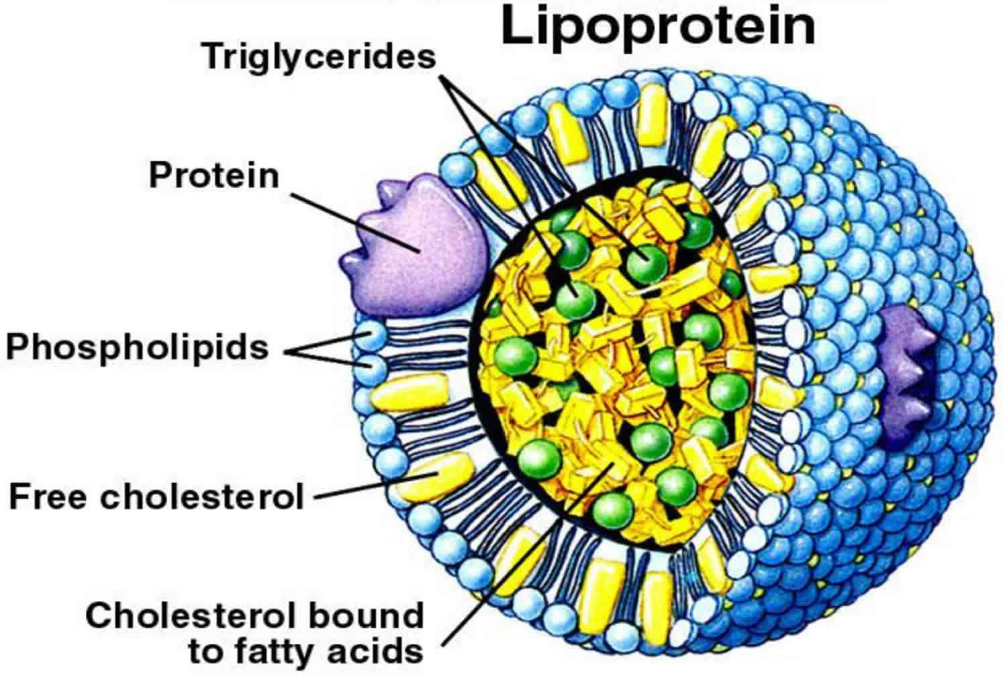
Metabolism of lipids
Low density lipoproteins (LDL)
Formed in plasma
Main cholesterol carrier
Delivers cholesterol to all cells in body
Essential for cell membrane and steroid hormone production
High density lipoproteins (HDL)
Formed in liver
Removes excess cholesterol from blood and tissues delivering it to the liver to be secreted into bile
“Good” cholesterol
Very low density lipoproteins (VLDL)
Synthesised in hepatocytes
Deliver triglycerides from liver to adipocytes
HDL is commonly considered to be “good cholesterol”
Notes:
HDL can cause for the excess cholesterol to be excreted into the bile but it can also used to convert into bile salts+ good cholesterol as it removes cholesterol from the plasma -> lowers chance for atherosclerosis / other disease
High level of LDL-> will be taken up by cells via endocytosis and deposition will increase risk factors for heart attacks etc

Slide 19
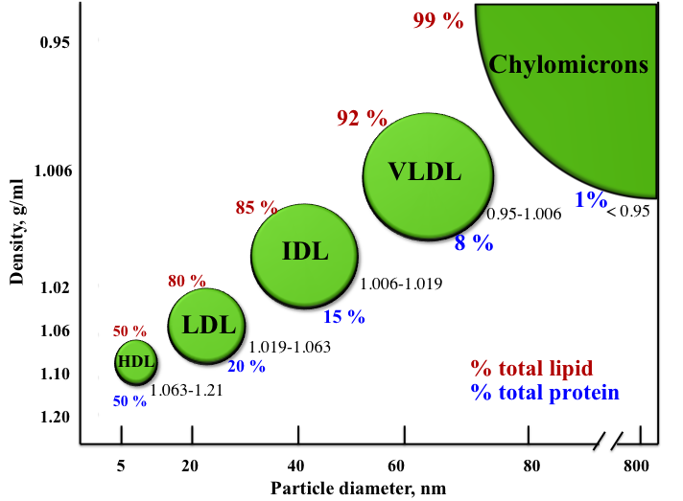
Hepatic Metabolism of Lipids
Lipoprotein lipase:
- Hydrolyses triglycerides in lipoprotein into 2 free fatty acids and 1 monoglyceride molecule
Hepatic lipase:
Found in the liver and adrenal glands
Converts IDL (intermediate density lipoprotein) into LDL thereby packaging it with more triglycerides to be released in the body
Notes:
Lipoprotein lipase (LPL) is an extracellular enzyme on the vascular endothelial surface that degrades circulating triglycerides in the bloodstream

Slide 20
Fatty Acid Catabolism
Fats broken down via Fatty acid beta oxidation:
It is the catabolism of fatty acids to produce energy
Occurs in mitochondria of hepatocytes
Notes:
Learn this cycle in own time – refer to KP - explains quite well

Slide 21
Gall Bladder
Production and concentration of bile
Bilirubin and enterohepatic secretion of bile salts

Slide 22
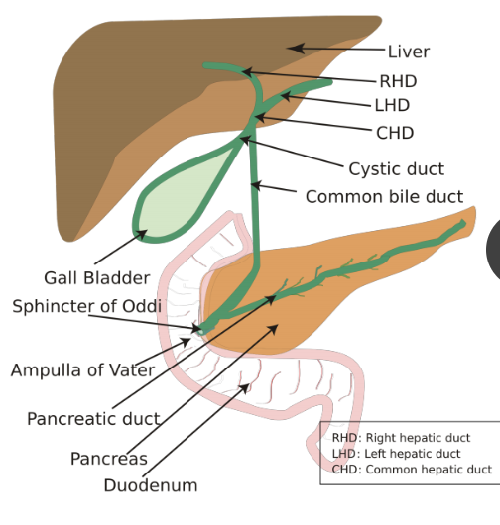
Bile
Produced and secreted by LIVER hepatocytes
Emulsifies fats
Excretory pathway e.g. hormones
Stored and concentrated in the GALL BLADDER by absorbing NaCl & H2O
Secreted under the action of cholecystokinin (CCK)
CCK released in response to increased fatty acid conc in duodenum
Bile constituents:
Bile salts
Lecithin (a phospholipid)
HC03-
Cholesterol
Bile pigments e.g. bilirubin

Slide 23
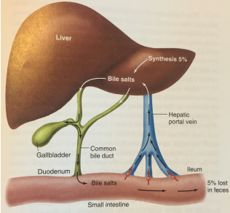
Enterohepatic Circulation (EC)
EC process:
95% of secreted bile salts are recycled
Bile salts enter intestinal tract via bile
Reabsorbed by Na+ coupled transporters
Majority of reabsorption is in terminal ileum and some in jejunum
Returned to liver by hepatic portal vein (HPV) to be used again in bile
Small amount of bile salts escape (5%)
Liver synthesises new bile salts from cholesterol
Notes:
Enter in the 2nd portion of the duodenum

Slide 24
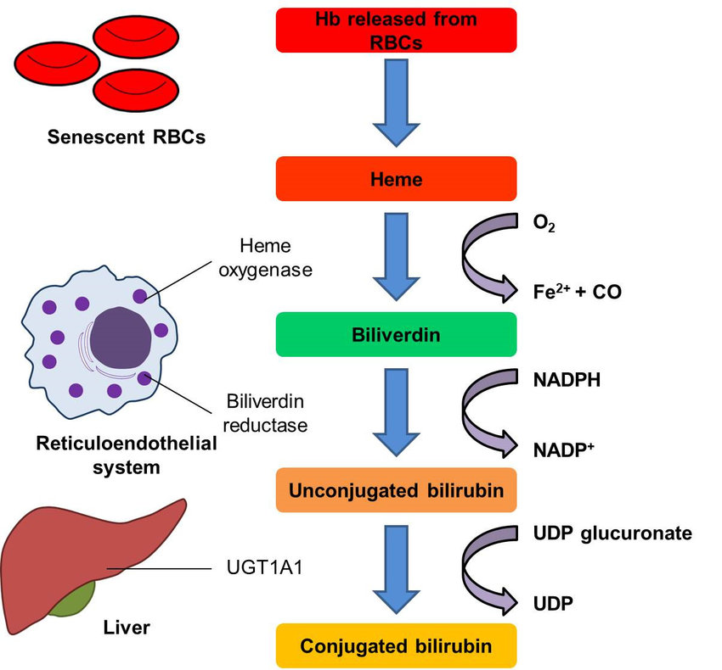
Bilirubin metabolism
Some background info:
Spleen and liver breakdown old/damaged erythrocytes
Breakdown done by macrophages (spleen) or Kupffer cells (specific to liver)
Breakdown of haemoglobin to haem and globin
Further breakdown of haem forms bile pigments
Predominant pigment is bilirubin
Bilirubin is yellow
Notes:
Kupffer cells are just resident macrophages of the liver

Slide 25
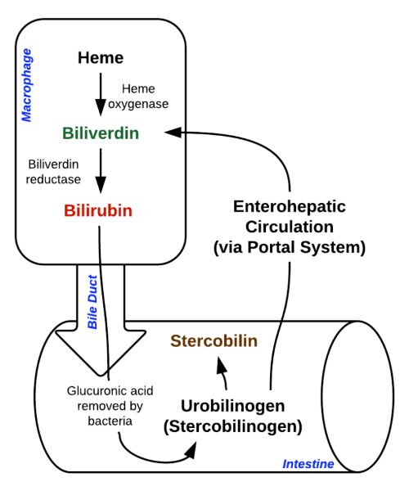
Bilirubin metabolism
RBCs ingested by macrophages/ Kupffer cells
Haemoglobin broken down into haem and globin
Globin broken into amino acids – used to make new RBCs in bone marrow
Haem is further broken down into biliverdin and Fe2+ & CO. Catalysed by haem oxygenase (HO)
Biliverdin (green pigment) is reduced by biliverdin reductase to make unconjugated bilirubin
Notes:
Kupffer cells are just resident macrophages of the liver
Fe2+ is bound to transferrin and send to bone marrow to make more RBCs

Slide 26
Bilirubin metabolism
6. Unconjugated bilirubin (UCB) is bound to albumin and transported to liver
Undergoes glucuronidation to make conjugated bilirubin. Catalysed by enzyme UDP Glucuronyl Transferase (UDPGT)
Conjugated bilirubin (CB) is now soluble and is dissolved in bile
Excreted into the duodenum with the rest of the bile
Intestinal bacteria in terminal ileum REDUCE the CB into urobilinogen
Urobilinogen is lipid-soluble. 10% is reabsorbed into blood, bound to albumin, transported to liver, and oxidised to urobilin
Notes:
Note: unconjugated bilirubin is toxic. It is bound to albumin before being transported since it’s lipid soluble and therefore insoluble in blood
UDP = uridine 5’ diphosphate
UC bilirubin is conjugated to make it soluble so it can be excreted – think xenobiotics and phase 2 reactions

Slide 27
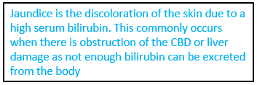
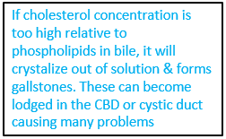
Bilirubin metabolism
12. Urobilin is re-cycled into bile or transported to kidneys and excreted in urine (responsible for yellow urine colour)
13. Remaining 90% of urobilinogen is OXIDISED by a different intestinal bacteria into stercobilin
14. Stercobilin is excreted in the faeces (responsible for brown colour)
Notes:
Note: unconjugated bilirubin is toxic. It is bound to albumin before being transported since it’s lipid soluble and therefore insoluble in blood
UDP = uridine 5’ diphosphate
UC bilirubin is conjugated to make it soluble so it can be excreted – think xenobiotics and phase 2 reactions

Slide 28
Exocrine Pancreas
Phases of secretion – buffer, enzyme
Secretion of bicarbonate
Control of secretion – stimulation and inhibition

Slide 29
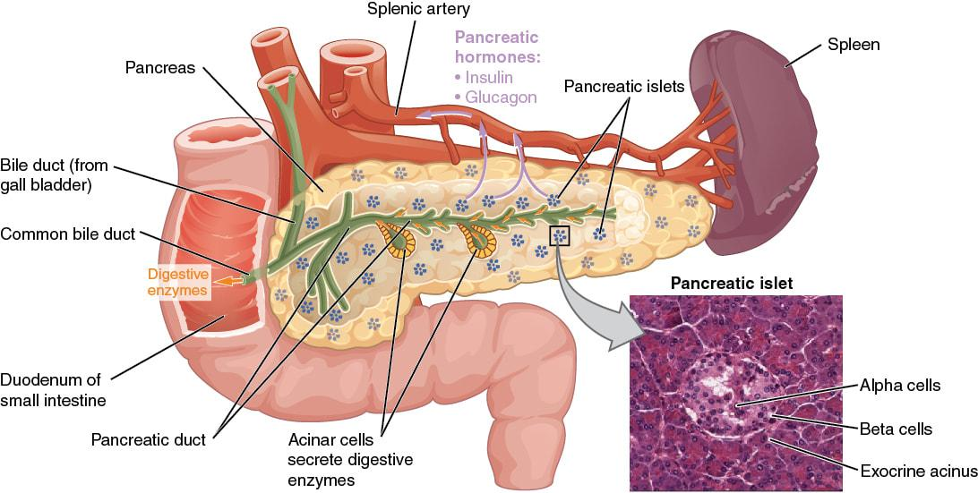
Physiology of the pancreas
2 Functions:
Exocrine
Acini of pancreas produce digestive enzymes
Released via pancreatic duct into duodenum
Endocrine
Islet of Langerhans produce insulin, glucagon & somatostatin
Large role in regulating glucose
The endocrine functions of the pancreas become more important in SUGER

Slide 30
Exocrine Pancreas
Exocrine pancreas secretes:
HCO3- (bicarbonate) – neutralises chyme
Digestive enzymes
Zymogens (precursor enzymes)
Secretes from acinar tissue of pancreas
Secretions pass through common bile duct
Notes:
Zymogens are activated in the duodenum

Slide 31
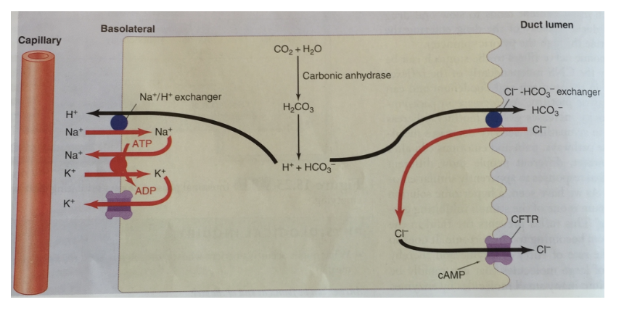
Exocrine Pancreas
HCO3- :
Protects duodenum from gastric acid
Buffers chyme to a suitable pH
HCO3- Secretion:
Stimulated by secretin release
Pancreatic duct cells secrete HCO3- into the duct lumen via Cl-/HCO3- exchanger
HCO3- comes from the disassociation of H2CO3 (carbonic acid)
The Cl- is recycled back into the lumen via a CFTR channel
Notes:
Address KP for the entire mechanism
CFTR = cystic fibrosis transmembrane conductance regulator

Slide 32
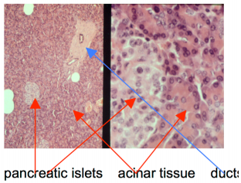
Enzyme secretion and Inhibition
Cholecystokinin (CCK) is principle stimulus for delivery of pancreatic enzymes into duodenum
Secreted enzymes are either active or precursors (zymogens)
Active enzymes:
Alpha-amylase – converts starch into maltose
Lipase – Converts triglycerides into monoglycerides + fatty acid
Precursors (zymogens):
Protects pancreatic cells from autodigestion
Zymogens are mostly activated by enterokinase in intestinal epithelial cells
Trypsinogen -> Trypsin
Chymotrypsinogen -> Chymotrypsin
Inhibition:
Somatostatin is a powerful inhibitor of pancreatic exocrine secretion and gastric acid secretion
Produced by delta/ D cells in the Islets of Langerhans

Slide 33
Phases of secretion
Most secretion is controlled by intestinal stimuli and release of CCK
However, two other phases also play a role
Cephalic phase:
Sensory experience
Seeing and eating food
Parasympathetic vagus nerve stimulation to acinar cells
Produce digestive enzymes
Gastric phase
Presence of food within stomach
Parasympathetic X nerve stimulation to acinar cells
Produce digestive enzymes
By the end of these phases, pancreas ducts are filled and ready to release enzymes, zymogens, and bicarbonate into duodenum

Slide 34
Questions
What is produced from D cells and what are its effects on the pancreas?
What is bile made of?
Where do bile salts begin to be reabsorbed and where is the majority reabsorbed?
Vitamin K is important for coagulation. Why would a patient with low bile content have a coagulation disorder?
Where in the gut is iron absorbed and where is it stored?
Notes:
Somatostatin – Inhibits pancreatic exocrine secretion and gastrin
Bile salts, lecithin, cholesterol, bile pigments, carbonate ions
Reabsorption begins in jejunum, majority in terminal ileum
Bile contains bile salts that facilitate vitamin K absorption. Vitamin K is essential for the synthesis of coagulation factors X, IX, VII, II. So low bile content means less synthesis of these coagulation factors -> coagulation disorder
Absorbed by duodenal epithelial cells, transported to liver via transferrin and stored in Kupffer cells in the form of ferritin

Slide 35
Questions
6. How is the pigment conjugated bilirubin formed? (start from haem)
7. What is the purpose of the entero-hepatic system?
8. Most of the coagulation factors are produced where in the body? With the exceptions of which factors?
9. What are the fat soluble vitamins?
10. What is the purpose of phase 1 and 2 reactions and what type of enzymes facilitate this?
Notes:
Haem oxidised to biliverdin and Fe2+ and CO by HO. Biliverdin is reduced to unconjugated bilirubin by biliverdin reductase. Unconjugated bilirubin undergoes glucuronidation and is conjugated by UDPGT to form conjugated bilirubin
Liver. Coagulation factor IV (calcium) and VIII (von Willebrand factor)
A,D,E,K
To make drugs, or any other xenobiotic compound, more hydrophilic to be excreted by the kidneys. Phase 1 done by microsomal, phase 2 done by non-microsomal EXCEPT for glucuronidation

