Slide 1
GEM SBA-Style Revision Series
2022/23

Slide 2
Neurophysiology
Phase 1 Content GEM SBA Revision Session
[Hannah Peachey]

Slide 3
Aims and Objectives
Anatomy and function of the brain
Basal ganglia
Anatomy of the spine
Cranial Nerves

Slide 4
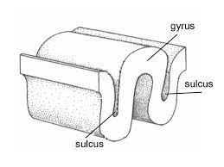
Cerebral hemisphere
Grey matter – made up of cell bodies and from the surface of the cerebral hemisphere.
White matter – made up of glial cells and myelinated axons. Connect different areas of grey matter.
Gyri – folds in the brain
Sulci – grooves / valleys in the brain.

Slide 5
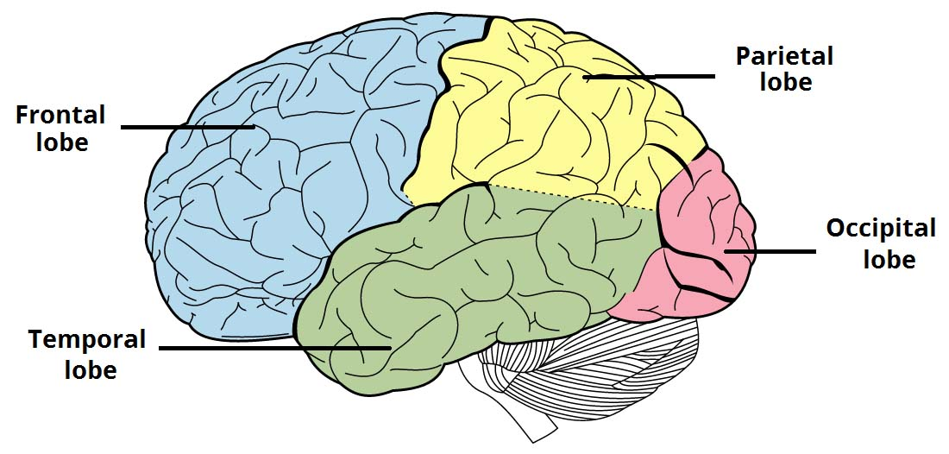
Cerebral hemisphere
Frontal lobe- voluntary movement,
Language, problem solving
Processing sensory information (touch, pain, temperature and proprioception).
Visuospatial processing, distance and depth perception, facial recognition
Processing auditory information and
Encoding memory

Slide 6
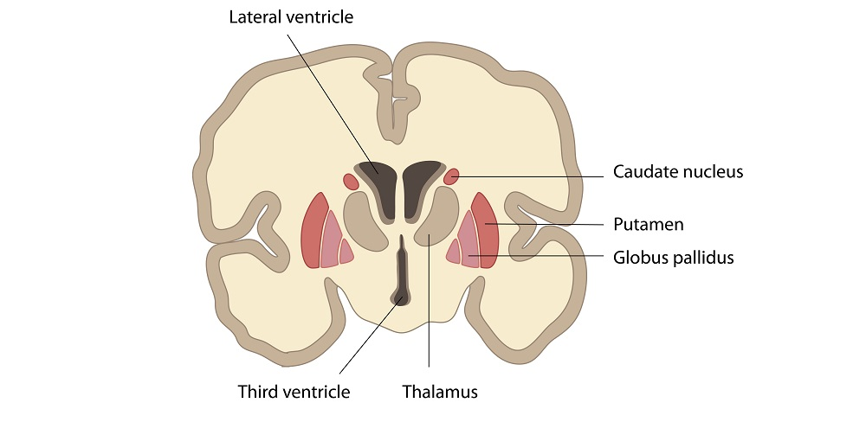
The Basal Ganglia

Slide 7
The Basal Ganglia
Made up of the; caudate nucleus and putamen, external and internal globus pallidus, subthalamic nucleus and the substantia nigra.
Provides a feedback mechanism to the cerebral cortex, It modulates and refines movement. It inhibits unwanted movement and in linked to emotional responses.

Slide 8
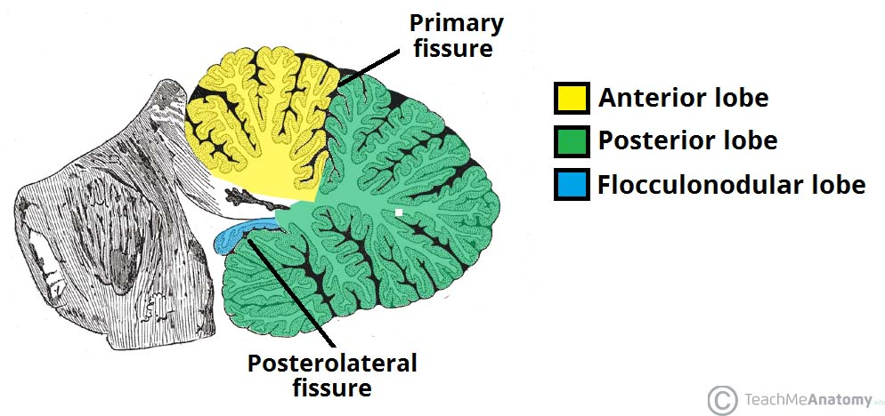
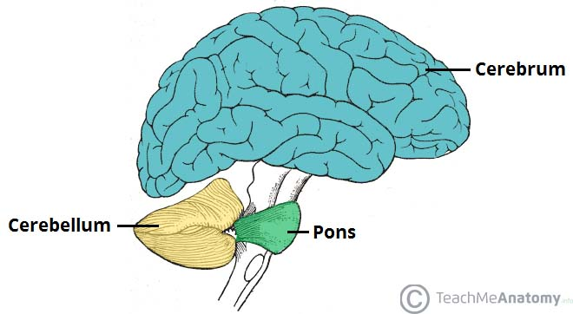
Cerebellum
Involved in motor control, planning and motor learning.
Grey matter is located on the surface and the white matter is located underneath .
made up of an anterior ,posterior and flocculonodular lobe

Slide 9
Functional division of the cerebellum
Cerebrocerebellum – formed by the lateral hemispheres. Involved in planning and motor learning
Spinocerebellum – made up of the vermis and intermediate zones. Involved in regulating body movement.
Vestibulocerebellum – involved in controlling balance and ocular reflexes.

Slide 10
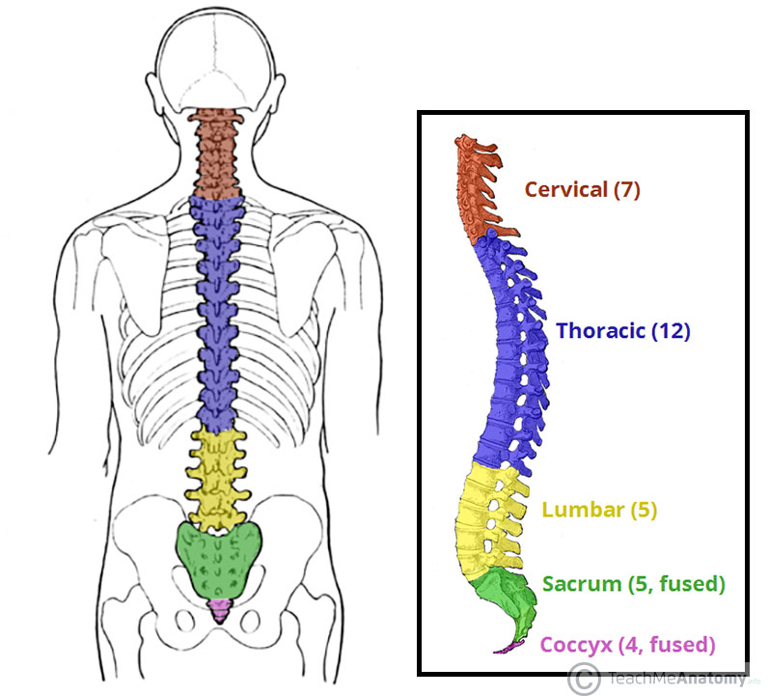
Vertebrae
7 cervical vertebrae
12 thoracic vertebrae
5 lumbar vertebrae

Slide 11
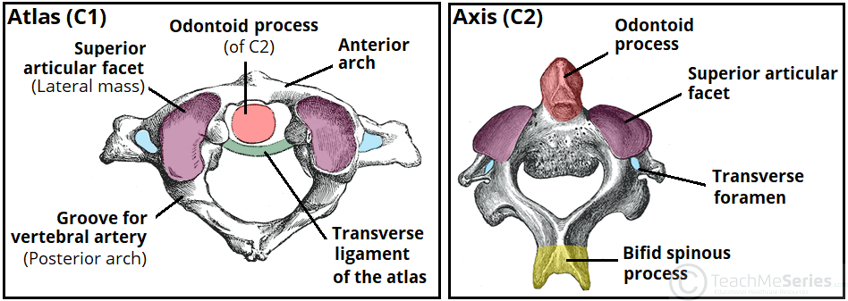
Cervical Vertebrae; axis and atlas
Atlas (C1) – has no vertebral body and no spinous process. Has an anterior arch which is completed by the transverse ligament. The odontoid process of the axis slots into here.
Axis (C2) – has an odontoid process which extends superiorly. Forms the atlanto-axial joint with the atlas

Slide 12
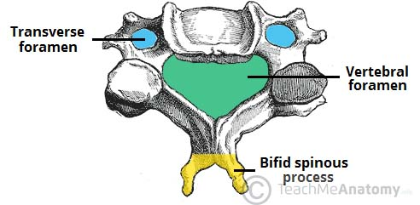
Cervical Vertebrae
Triangular vertebral foramen
Bifid spinous process
Transverse foramina

Slide 13
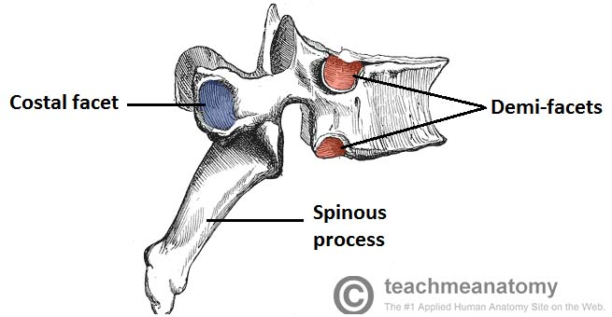
Thoracic Vertebrae
Heart shaped vertebral body
Demi facets on the side of the vertebral bpdy
Costal facets on the transverse process
Spinous process is long and slants inferiorly

Slide 14
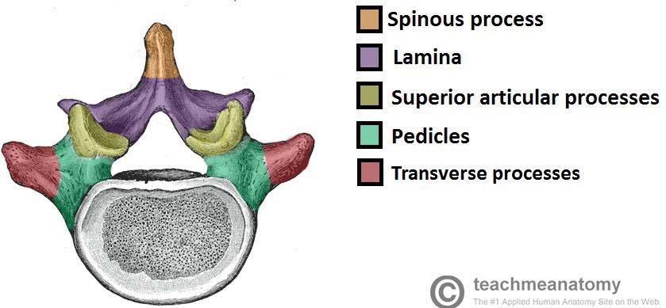
Lumbar Vertebrae
Transverse process is long and thin
Spinous process is short and broad
Vertebral bodies are large and kidney shaped
Vertebral foramen is triangular in shape

Slide 15
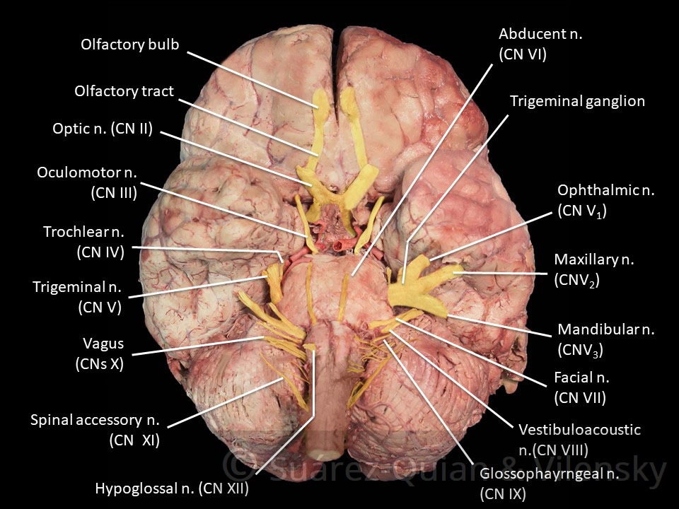
Cranial Nerves
12 pairs of nerves that arise directly from the brain.
They can be sensory (afferent), motor (efferent) or both.

Slide 16
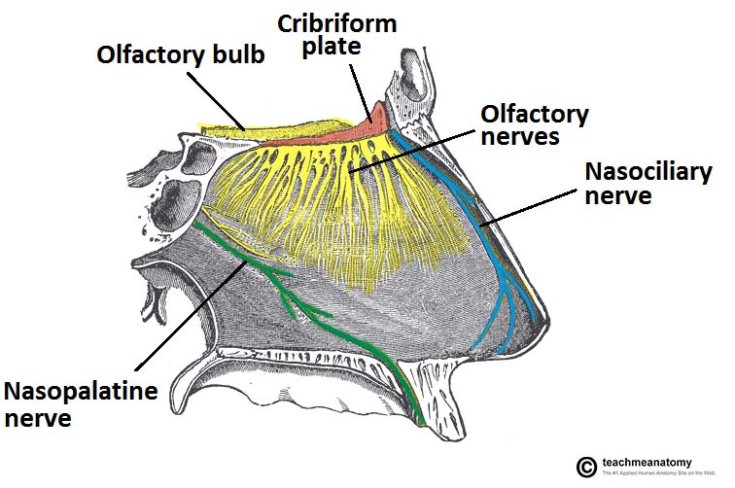
CNI – olfactory nerve
Originates from the cerebrum
Afferent sensory nerve
Carries the special sense of smell
Exits the cranium via the cribriform plate.

Slide 17
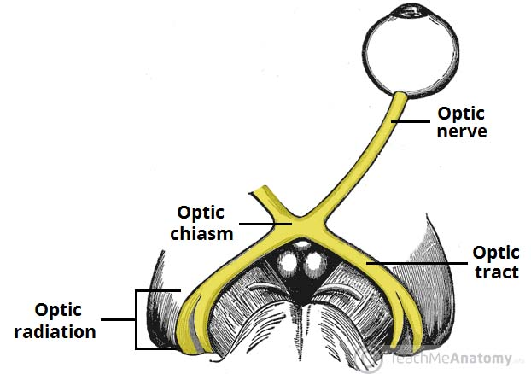
CNII – Optic nerve
Originates from the cerebrum.
Exits the cranial foramina via the optic canal
Sensory
Carries the special sense of vision

Slide 18
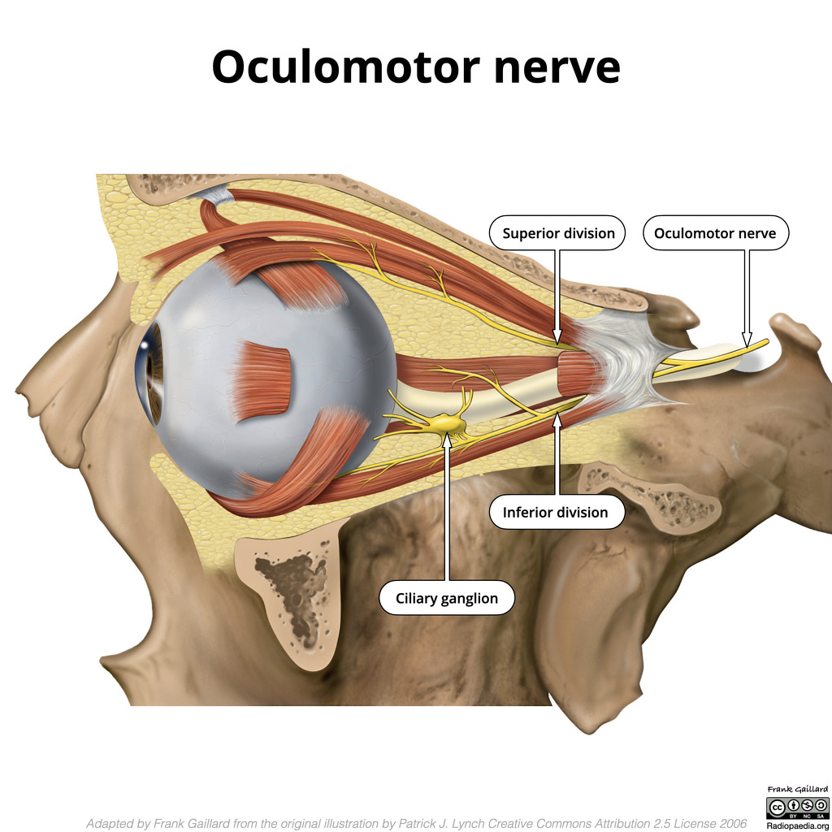
CNIII – Oculomotor nerve
Originates form the brain stem
Exits the cranium via the superior orbital fissure.
Motor efferent nerve
Moves 4 extrinsic eye muscles; levator palpebrae superioris, superior rectus, inferior rectus, medial rectus and inferior oblique

Slide 19
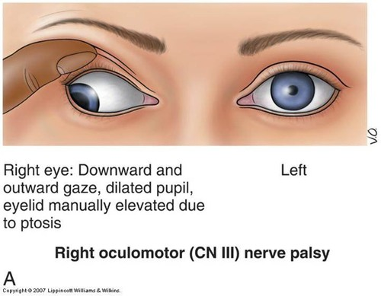
CNIV – Trochlear nerve
Originates from the posterior midbrain
Exits the cranium via the superior orbital fissure.
Provides motor innervation to the superior obliquw muscle (allows down and out movement of the eye)

Slide 20
CNV – Trigeminal nerve
Made up of 3 branches;
Opthalamic – exits the cranium via the superior orbital fissure. Provides sensory information to the scalp, forehead and nose
Maxillary – exits the cranium via the foramina rotundum. Provides sensory information to the cheeks, lower eye lid, nasal mucosa, upper lip, upper teeth and palate
Mandibular – exits the cranium via the foramen ovale. Provides sensation to the anterior 2/3 of the tongue and motor innervation to the muscles of mastication

Slide 21
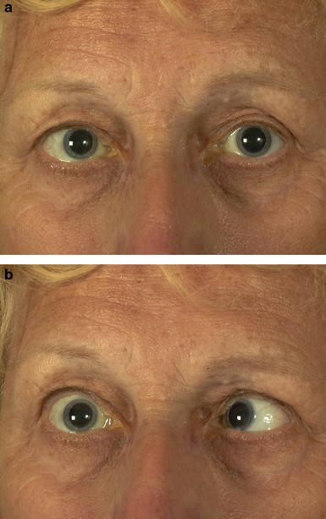
CNVI – Abducens
Exits the cranium via the superior orbital fissure.
Provides motor innervation to the lateral rectus muscle (allows abduction of the eye)

Slide 22
CNVII – Facial nerve
Exits the cranium via the internal acoustic meatus.
Provides sensation to the external ear, taste from the anterior 2/3 of the tongue and the hard and soft pallarte.
Provides motor innervation to the muscles of facial expression
Provides parasympathetic innervation to the lacrimal, submandibular, sublingual and mucous glands.

Slide 23
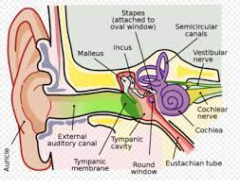
CNVIII – Vestibulocochlear nerve
Exits the cranium via the internal acoustic meatus.
Provides sensory information about hearing and balance

Slide 24
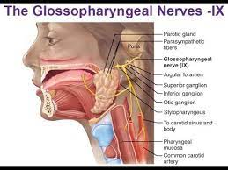
CNIX – Glossopharyngeal nerve
Exits the cranium via the jugular foramina.
Provides taste and sensation to the posterior 1/3 of the tongue.
Provides motor innervation to the stylopharyngeus muscle
Provides parasympathetic innervation to the parotid gland.

Slide 25
CNX – Vagus nerve
PARASYMPATHETIC
Provides general sensation to the larynx and pharynx.
Provides taste sensation to the epiglottis
Provides parasympathetic motor innervation to the smooth muscles of the pharynx, larynx and most of the GI tract.
Longest nerve
Exits the cranium via the jugular foramina.

Slide 26
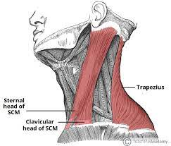
CNXI – Spinal accessory nerve
Exits the cranium via the jugular foramina.
Provides motor innervatino to the trapexius and sternocleidomastoid muscles (shrug shoulders and shake head)

Slide 27
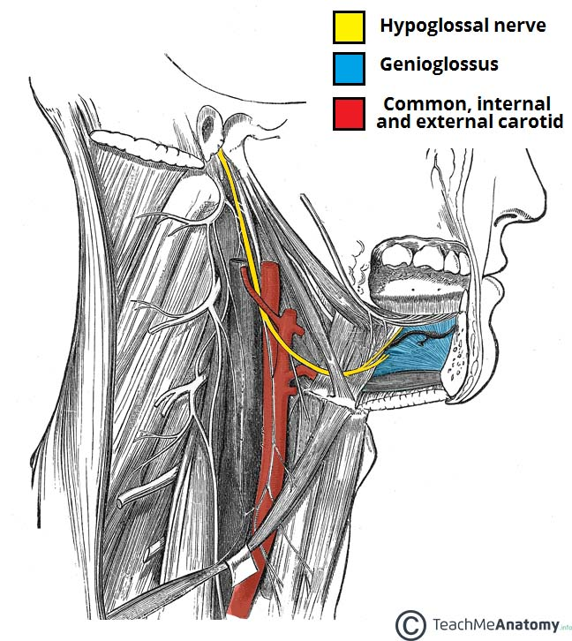
CNXII – Hypoglossal nerve
Exits the cranium via the hypoglossal canal
Provides motor innervation to the intrinsic and extrinsic muscles of the tongue APART FROM THE PLATOGLOSSUS MUSCLE.

Slide 28
Origins
CN I and CNII originate from the cerebrum
CN III arises from the midbrain-pontine junction
CN IV arises from the posterior midbrain
CN V arises from the pons
CN VI, VII and VIII arises from the pontine-medulla junction
CN IX, X, XI and XII arise from the medulla oblongata.

Slide 29
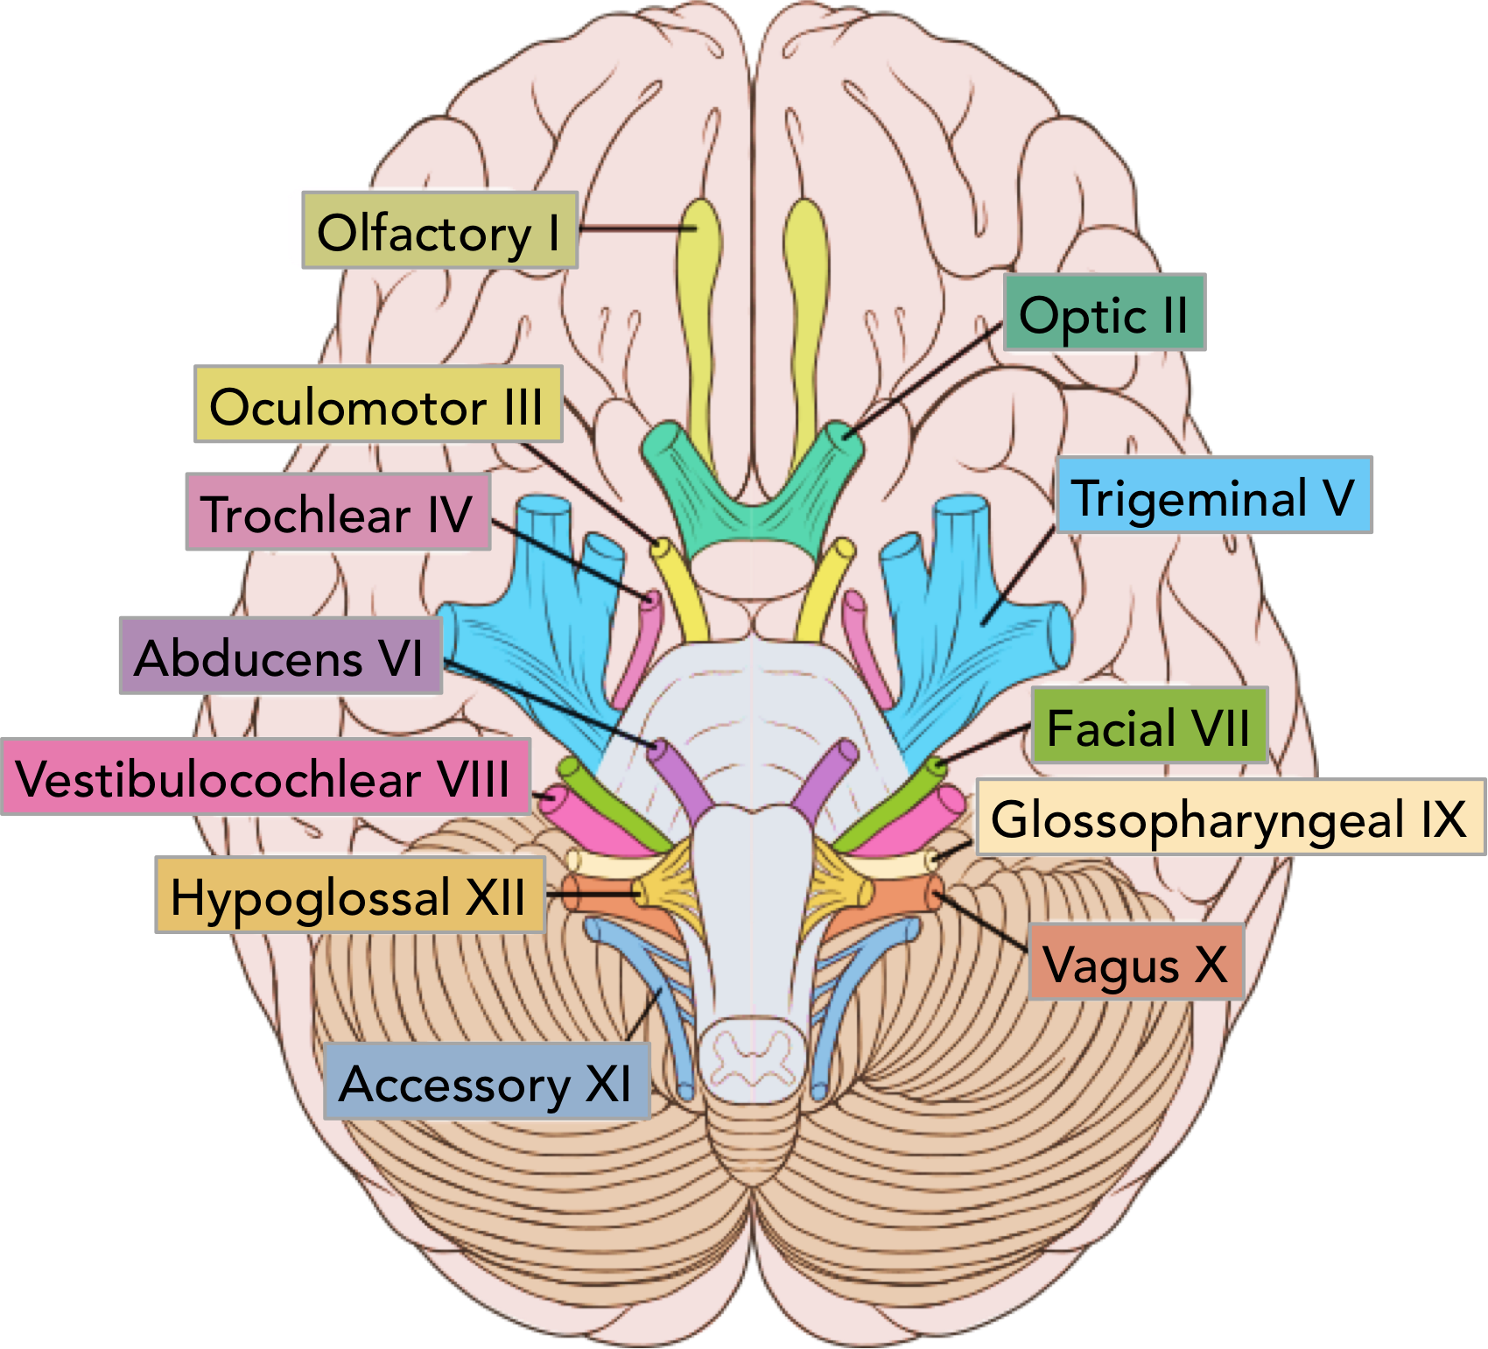
Origins

Slide 30
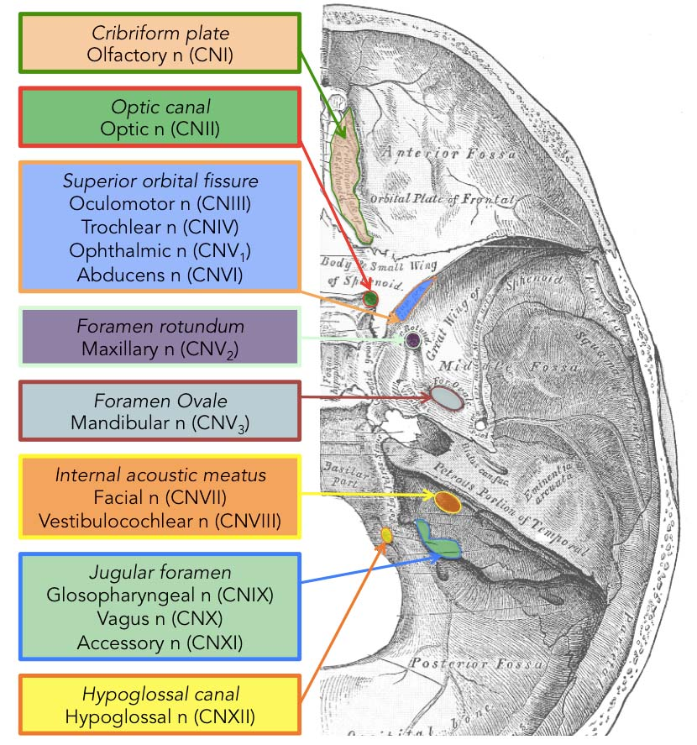
Cranial Foramina

Slide 31
Mnemonics
Some Say Marry Money But My Brother Says Big Brains Matter more
On Occasions Our Trusty Truck Acts Funny, Very Good Vehicle Any How

Slide 32
Conclusion
What have you covered?

Slide 33
Feedback

