Slide 1
GEM SBA-Style Revision Series
2022/23

Slide 2
What are the symptoms of CNIV palsy?
Can’t adduct the eye
Can’t look ‘down and out’
Can’t close the eye
Can’t abduct the eye (look outwards)

Slide 3
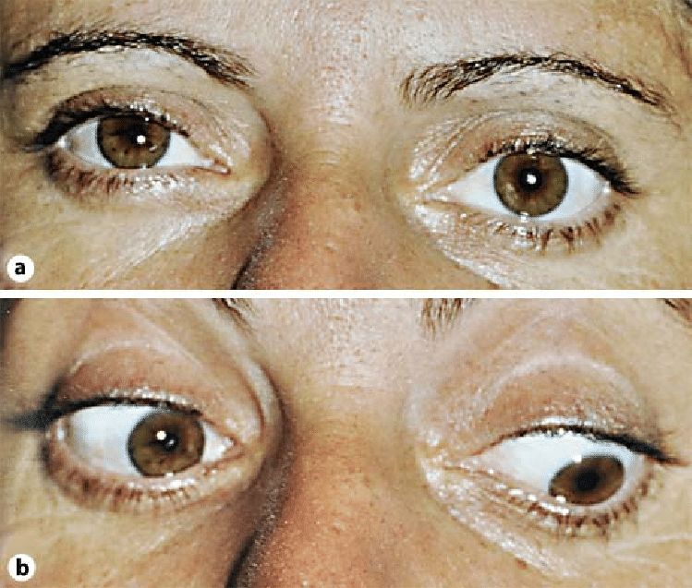
Answer
B - Can’t look ‘down and out’
CN IV is the trochlear nerve. This controls the superior oblique muscle which enables the eye to look down and out.

Slide 4
John has been in a car accident whilst driving home from work. He has since been experiencing some confusing symptoms. He cannot move or feel his right leg and he did not feel anything when he spilled hot tea on his left leg. Doctor’s suspect damage to his CNS. Where in the CNS is the lesion located?
Left hemisection of the spinal cord
Right fasciculus gracilis
Right hemisection of the spinal cord
Subthalamic nucleus

Slide 5
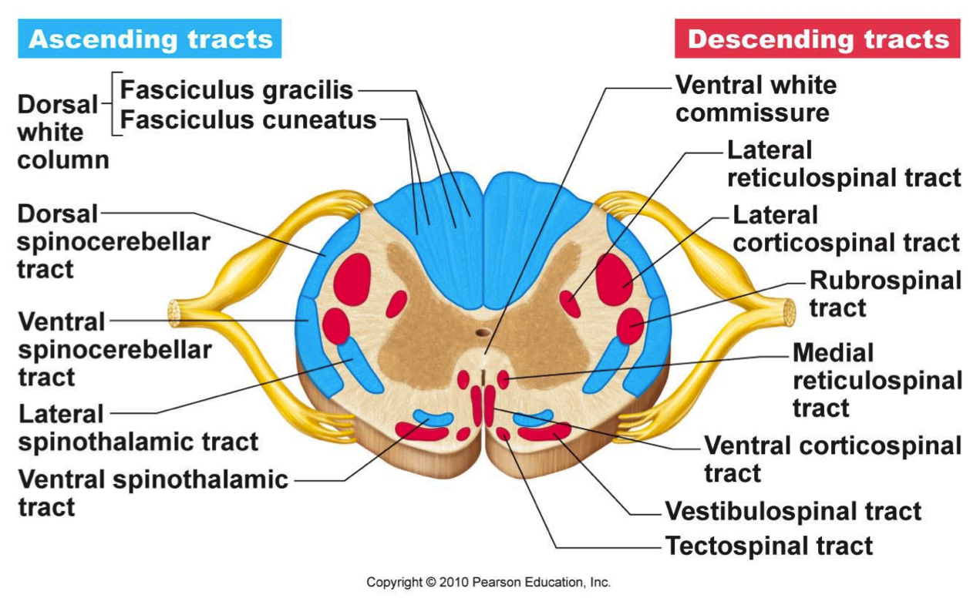
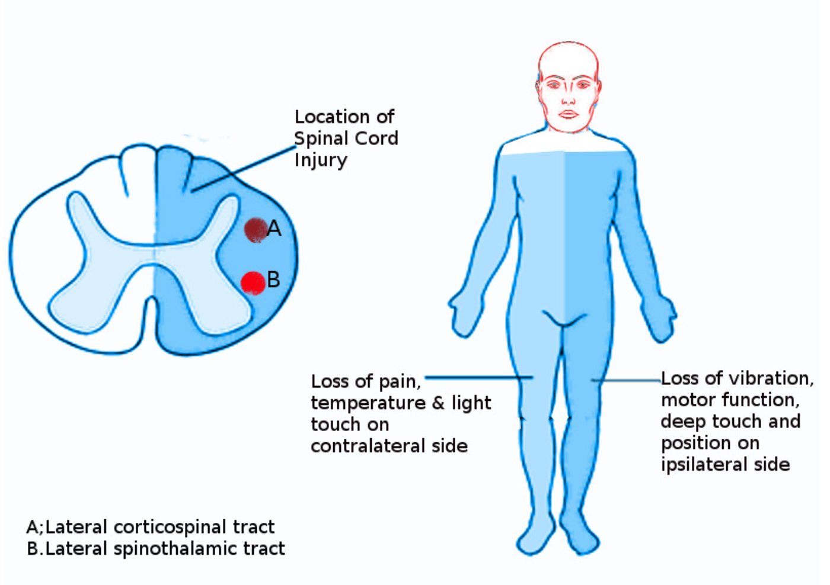
Answer
C - Right hemisection
of the spinal cord

Slide 6
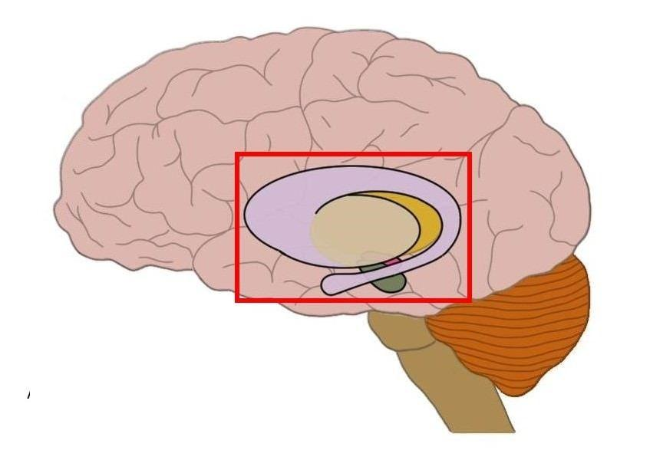
What component of the basal ganglia is shown by the blue arrow?
Amygdala
Globus pallidus
Putamen
Thalamus

Slide 7
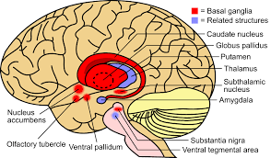
Answer
A- Amygdala

Slide 8
Cerebrospinal fluid is found in the brain’s ventricles and the subarachnoid space. The total volume of CSF is replaced around four times a day. How is CSF drained from subarachnoid space into the venous system?
Via arachnoid granulations in the superior sagittal sinus
Via small protrusions of the pia mater
Via the choroid plexus
Via the cerebral aqueduct

Slide 9
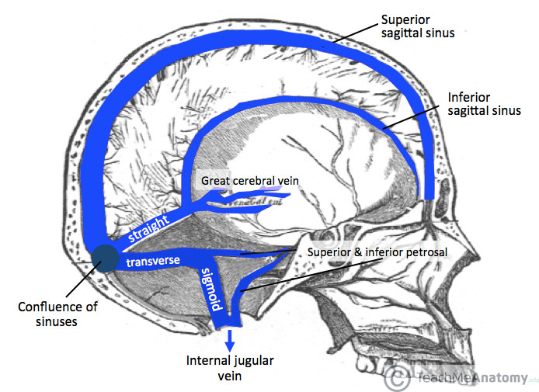
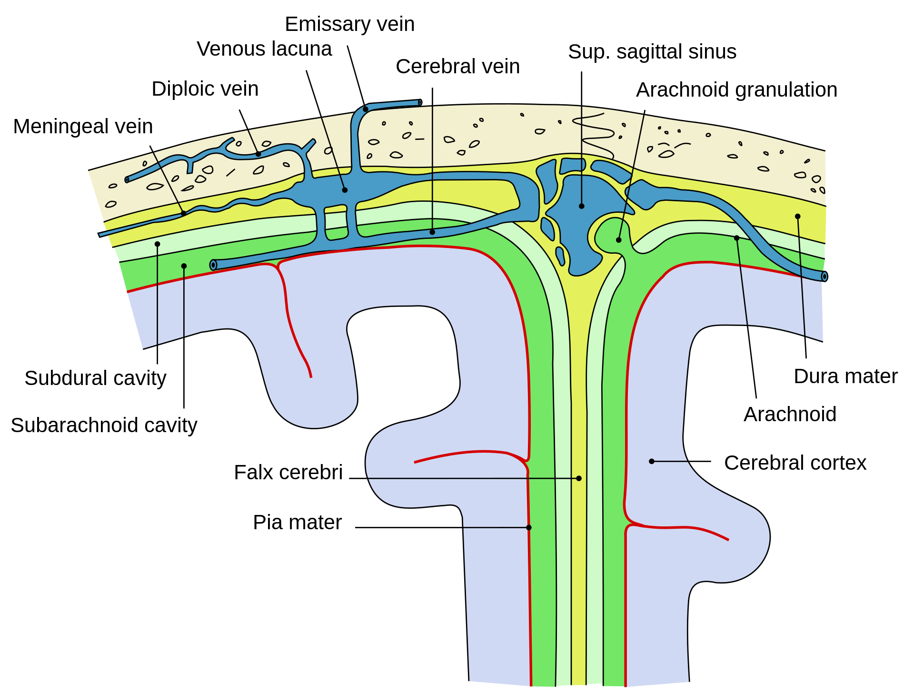
Answer
A - Via arachnoid granulations in the superior sagittal sinus

Slide 10
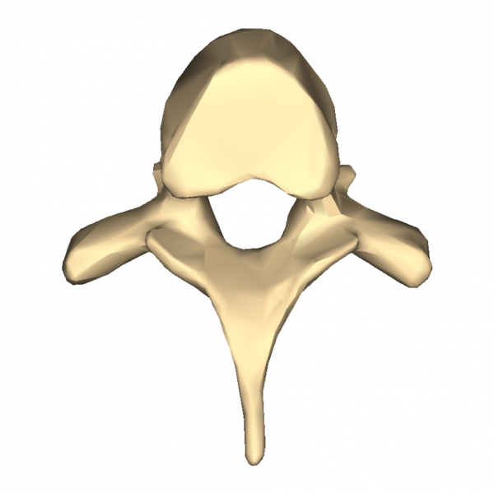
In which region of the spine is the following vertebral bone located?
Thoracic
Lumbar
Cervical
Sacral

Slide 11
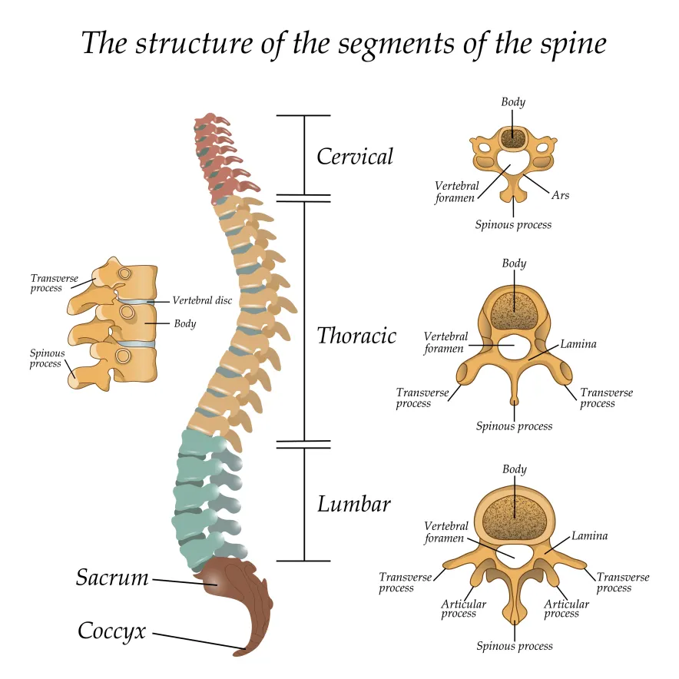
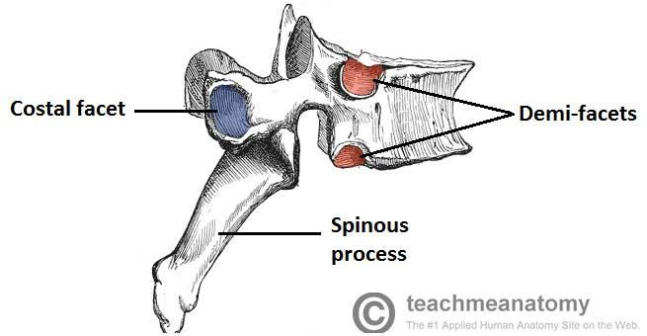
Answer
A - Thoracic

Slide 12
Which of the following demonstrates the auditory pathway within the CNS.
CNVIII -> cochlear nucleus -> inferior olivary nucleus -> lateral lemniscus -> Inferior colliculus -> lateral geniculate body -> auditory cortex
CNVIII -> cochlear nucleus -> superior olivary nucleus -> lateral lemniscus -> superior colliculus -> lateral geniculate body -> auditory cortex
CNVIII -> cochlear nucleus -> superior olivary nucleus -> lateral lemniscus -> Inferior colliculus -> medial geniculate body -> auditory cortex
CNVIII -> cochlear nucleus -> superior olivary nucleus -> lateral lemniscus -> superior colliculus -> medial geniculate body -> auditory cortex

Slide 13
Answer
C - ECOLIMA (eight CN, cochlear nucleus, superior olivary nucleus, inferior colliculus, medial geniculate body, auditory cortex)
REMEMBER - I’M Auditory (inferior colliculus, medial geniculate)
Visual (superior colliculus, lateral geniculate)

Slide 14
Mark has recently been diagnosed with Parkinson’s disease. A neurologist has prescribed Levodopa to manage his symptoms, which works by increasing the amount of a certain neurotransmitter in the brain. Which neurotransmitter does Levodopa increase within the brain?
Acetyl-choline
Dopamine
GABA
Serotonin

Slide 15
Answer
B- Dopamine
Dopamine is a neurotransmitter in the basal ganglia. This controls movement and co-ordination
Acetyl choline is the neurotransmitter of the parasympathetic nervous system
Serotonin is responsible for learning, memory and mood in the central and peripheral nervous system
GABA is an inhibitory neurotransmitter in the central nervous system

Slide 16
A 42-year-old man is experiencing a ‘pie in the sky’ visual field defect (see diagram). Imaging reveals he has a tumour within the brain. In what region of the brain is the tumour located?
Left frontal lobe
Left temporal lobe
Pituitary gland
Right parietal lobe

Slide 17
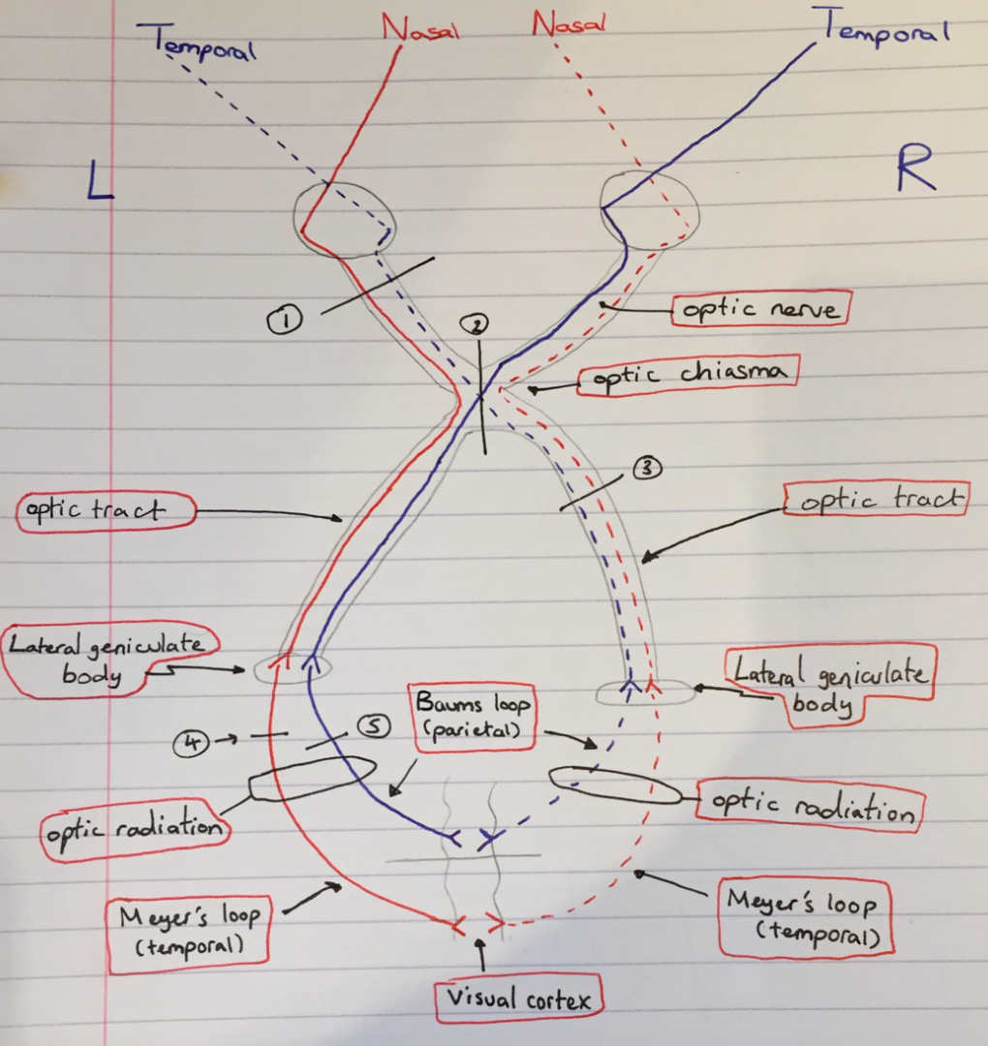
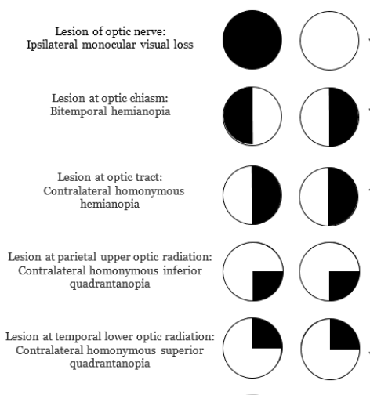
Answer
B - Left temporal lobe

Slide 18
Alice presents to her GP with ongoing dizziness and difficulty balancing. The GP believes this is being caused by inflammation of a nerve. Which nerve has likely been affected?
Vagus nerve
Trigeminal nerve
Cochlear component of the vestibulocochlear nerve
Vestibular component of the vestibulocochlear nerve

Slide 19
Answer
D - The vestibular component of the vestibulocochlear nerve.
This is responsible for maintaining body balance and eye movements.

Slide 20
Which components of the basal ganglia make up the lentiform nucleus?
Caudate nucleus and putamen
Globus pallidus and putamen
Substantia nigra and nucleus accumbens
Substantia nigra and subthalamic nucleus

Slide 21
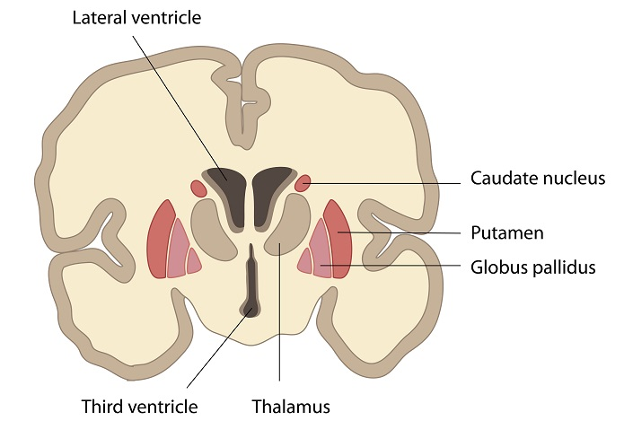
Answer
B - Globus pallidus and putamen
Caudate nucleus + putamen =
Striatum

Slide 22
Which of the following shows the correct path of CSF circulation through the ventricular system of the brain?
Lateral ventricles > Intraventricular foramen > third ventricle > cerebral aqueduct > fourth ventricle >exits via the foramen of Luschka or magendie.
Lateral ventricles > cerebral aqueduct> third ventricle > Intraventricular foramen > fourth ventricle >exits via the foramen of Luschka or magendie.
Lateral ventricles > Intraventricular foramen > third ventricle > foramen of luschka> fourth ventricle > exits via the cerebral aqueduct

Slide 23
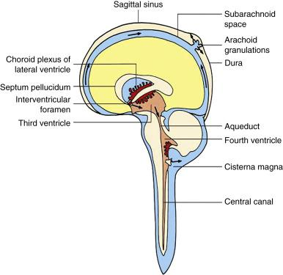
Answer
A - Lateral ventricles > Intraventricular foramen > third ventricle > cerebral aqueduct > fourth ventricle >exits via the foramen of Luschka or magendie.

Slide 24
What is the correct order of the meningies from in-to-out?
A. Arachnoid > CSF > pia mater > Dura
B. Pia mater > CSF > arachnoid > Dura
C. Pia mater > arachnoid > CSF > Dura

Slide 25
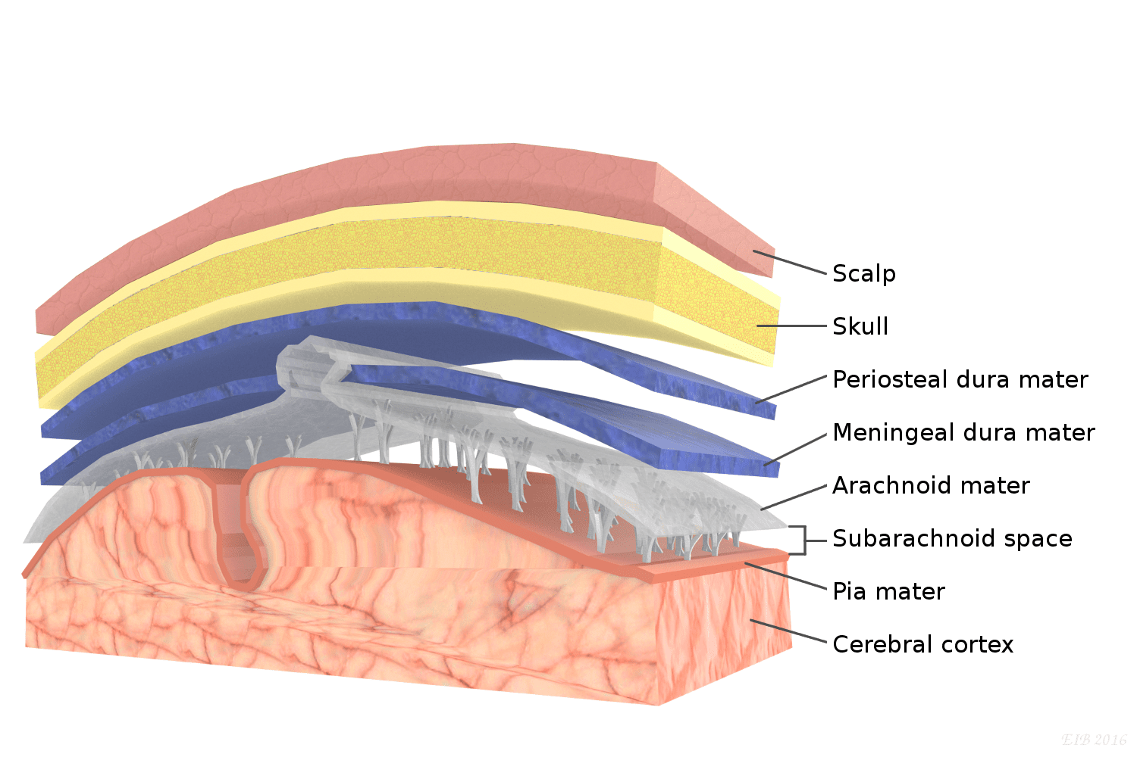
Answers
C. Pia mater > arachnoid > CSF > Dura
CSF is in the subarachnoid layer

Slide 26
Where should lumbar punctures be taken from?
L1-2
L2-3
L3-4
L4-5

Slide 27
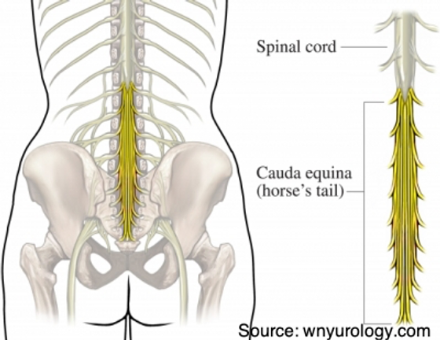
Where should lumbar punctures be taken from?
C. L3-4
This is to prevent injury to the spinal cord.
The spinal cord ends at L2 to become the cauda equina

Slide 28
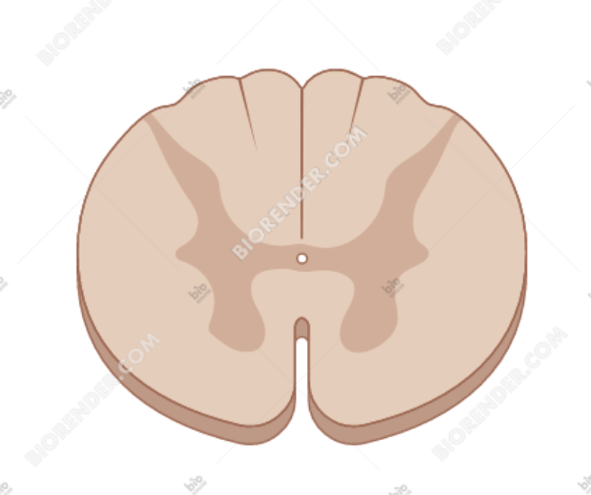
The diagram below shows a cross section of the spinal cord at the level of T8. A lesion in the area marked in red will produce what symptoms?
Absence of motor function in the left leg
Absence of sensory function in the right leg and lower right trunk
Absence of light touch and proprioception to the right leg and right lower trunk
Absence of sensory function in the right arm and right trunk

Slide 29
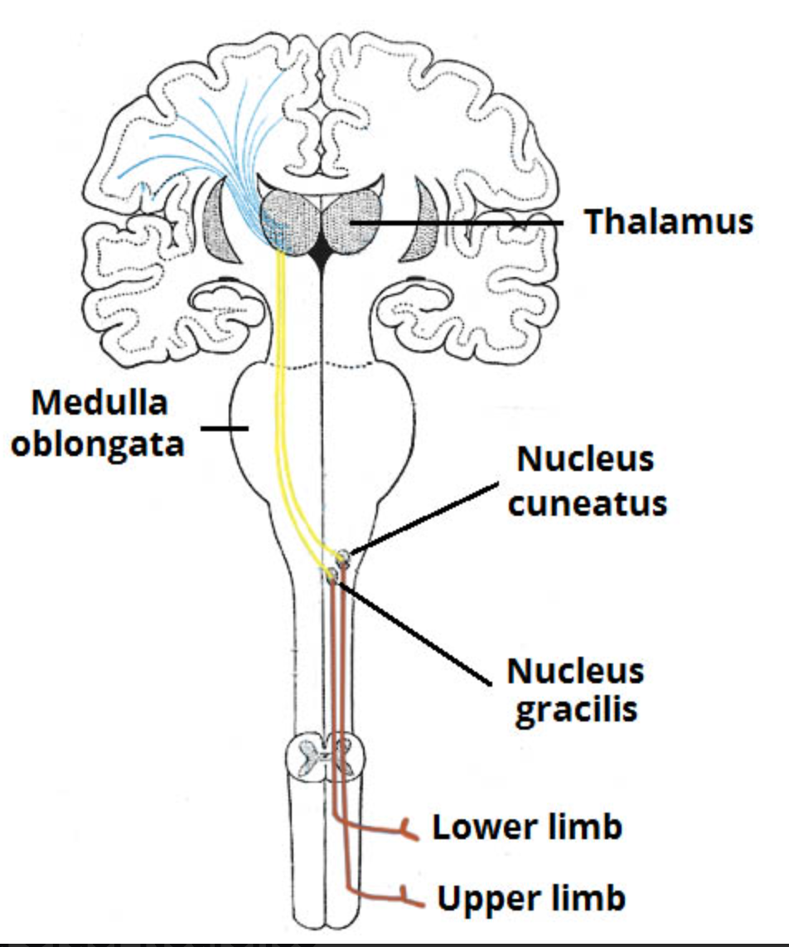
Answers
C - This tract is one of the components of the DCML pathway
The fasciculus gracilis
Think gracile = grass, for the legs
So, cuneate = arms

Slide 30
A 78-year-old man presents to A&E with a suspected stoke. His symptoms include weakness in his left leg, gait apraxia and urinary incontinence. Which artery has been occluded to produce his symptoms?
Right middle cerebral artery
Left middle cerebral artery
Right anterior cerebral artery
Left anterior cerebral artery

Slide 31
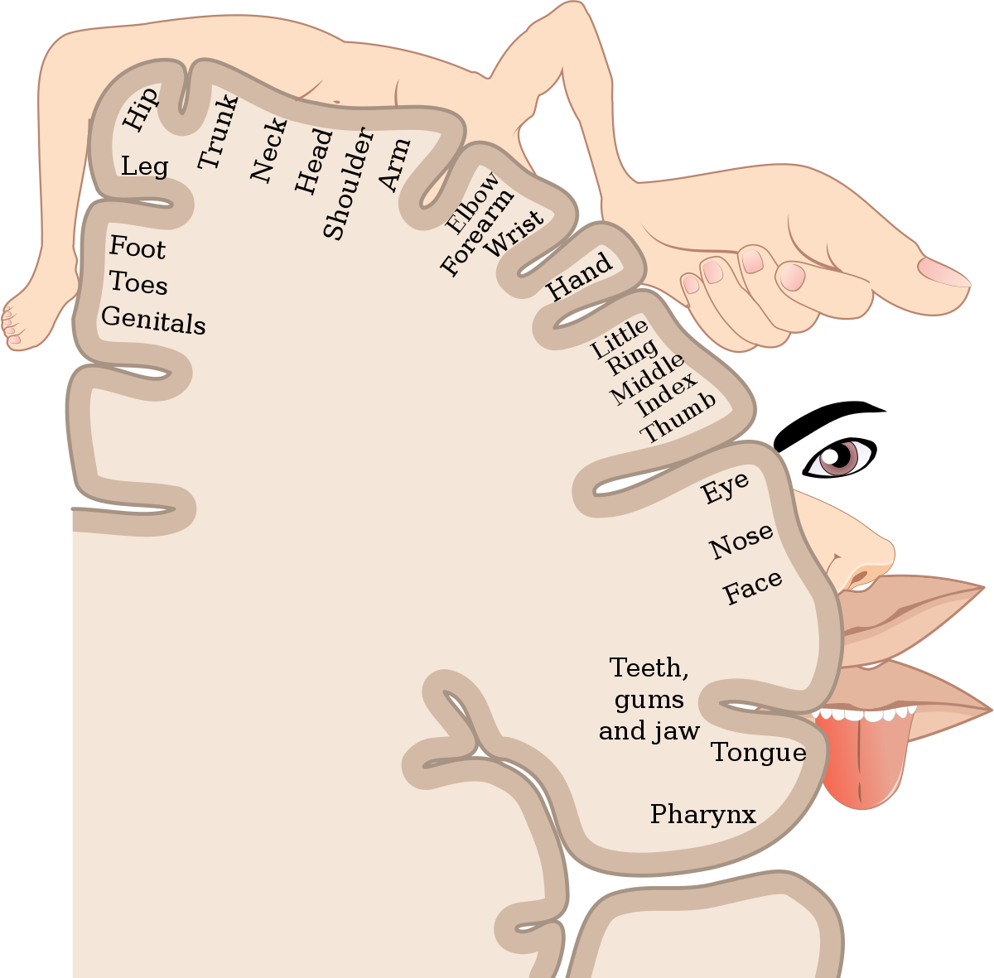
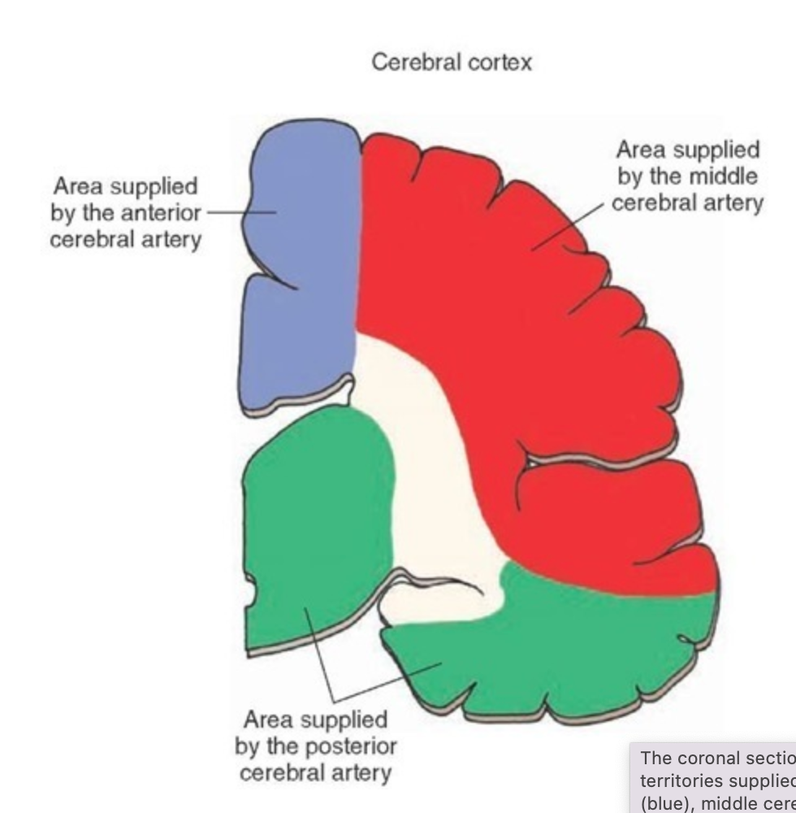
Answers
C - Remember the vascular supply of the brain
and the motor and sensory homunculi

Slide 32
The straight sinus receives blood from which two vessels
Superior sagittal sinus and emissary veins
Transverse sinus and occipital sinus
Inferior sagittal sinus and superior sagittal sinus
Inferior sagittal sinus and great cerebral vein

Slide 33
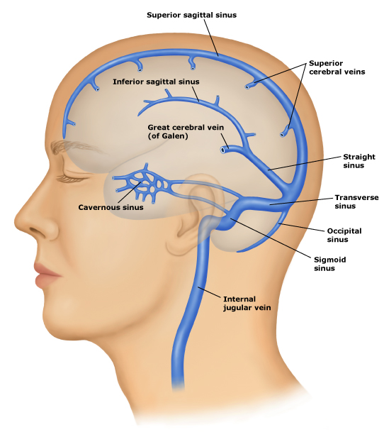
Answers
D – inferior sagittal sinus and the great cerebral vein

Slide 34
A 67-year-old woman with metastatic cancer presents with a peculiar set of symptoms. Imaging of the head shows an obstructive right-sided mass on the base of the skull. A diagnosis of Jugular Foramen Syndrome (Vernet’s Syndrome) is made. Which signs and symptoms would best fit with this diagnosis?
Voice hoarseness, tongue deviation to the right, and total right-sided blindness
Loss of sensation from right-posterior 1/3 of tongue, voice hoarseness, and a partial loss of the gag-reflex.
Weakness lifting the right shoulder, tongue deviation to the right, and a partial loss of the gag-reflex.
Loss of taste-sensation from right-anterior 2/3 of tongue, tongue deviation to the right, and loss of gag-reflex..

Slide 35
Answers
B - The Glossopharyngeal (IX), the Vagus (X), and the Spinal Accessory Nerve (XI) all pass through the Jugular foramen

Slide 36
Feedback
If you haven’t done so please scan the QR code to fill out the feedback form!!
Thank you

