Slide 1
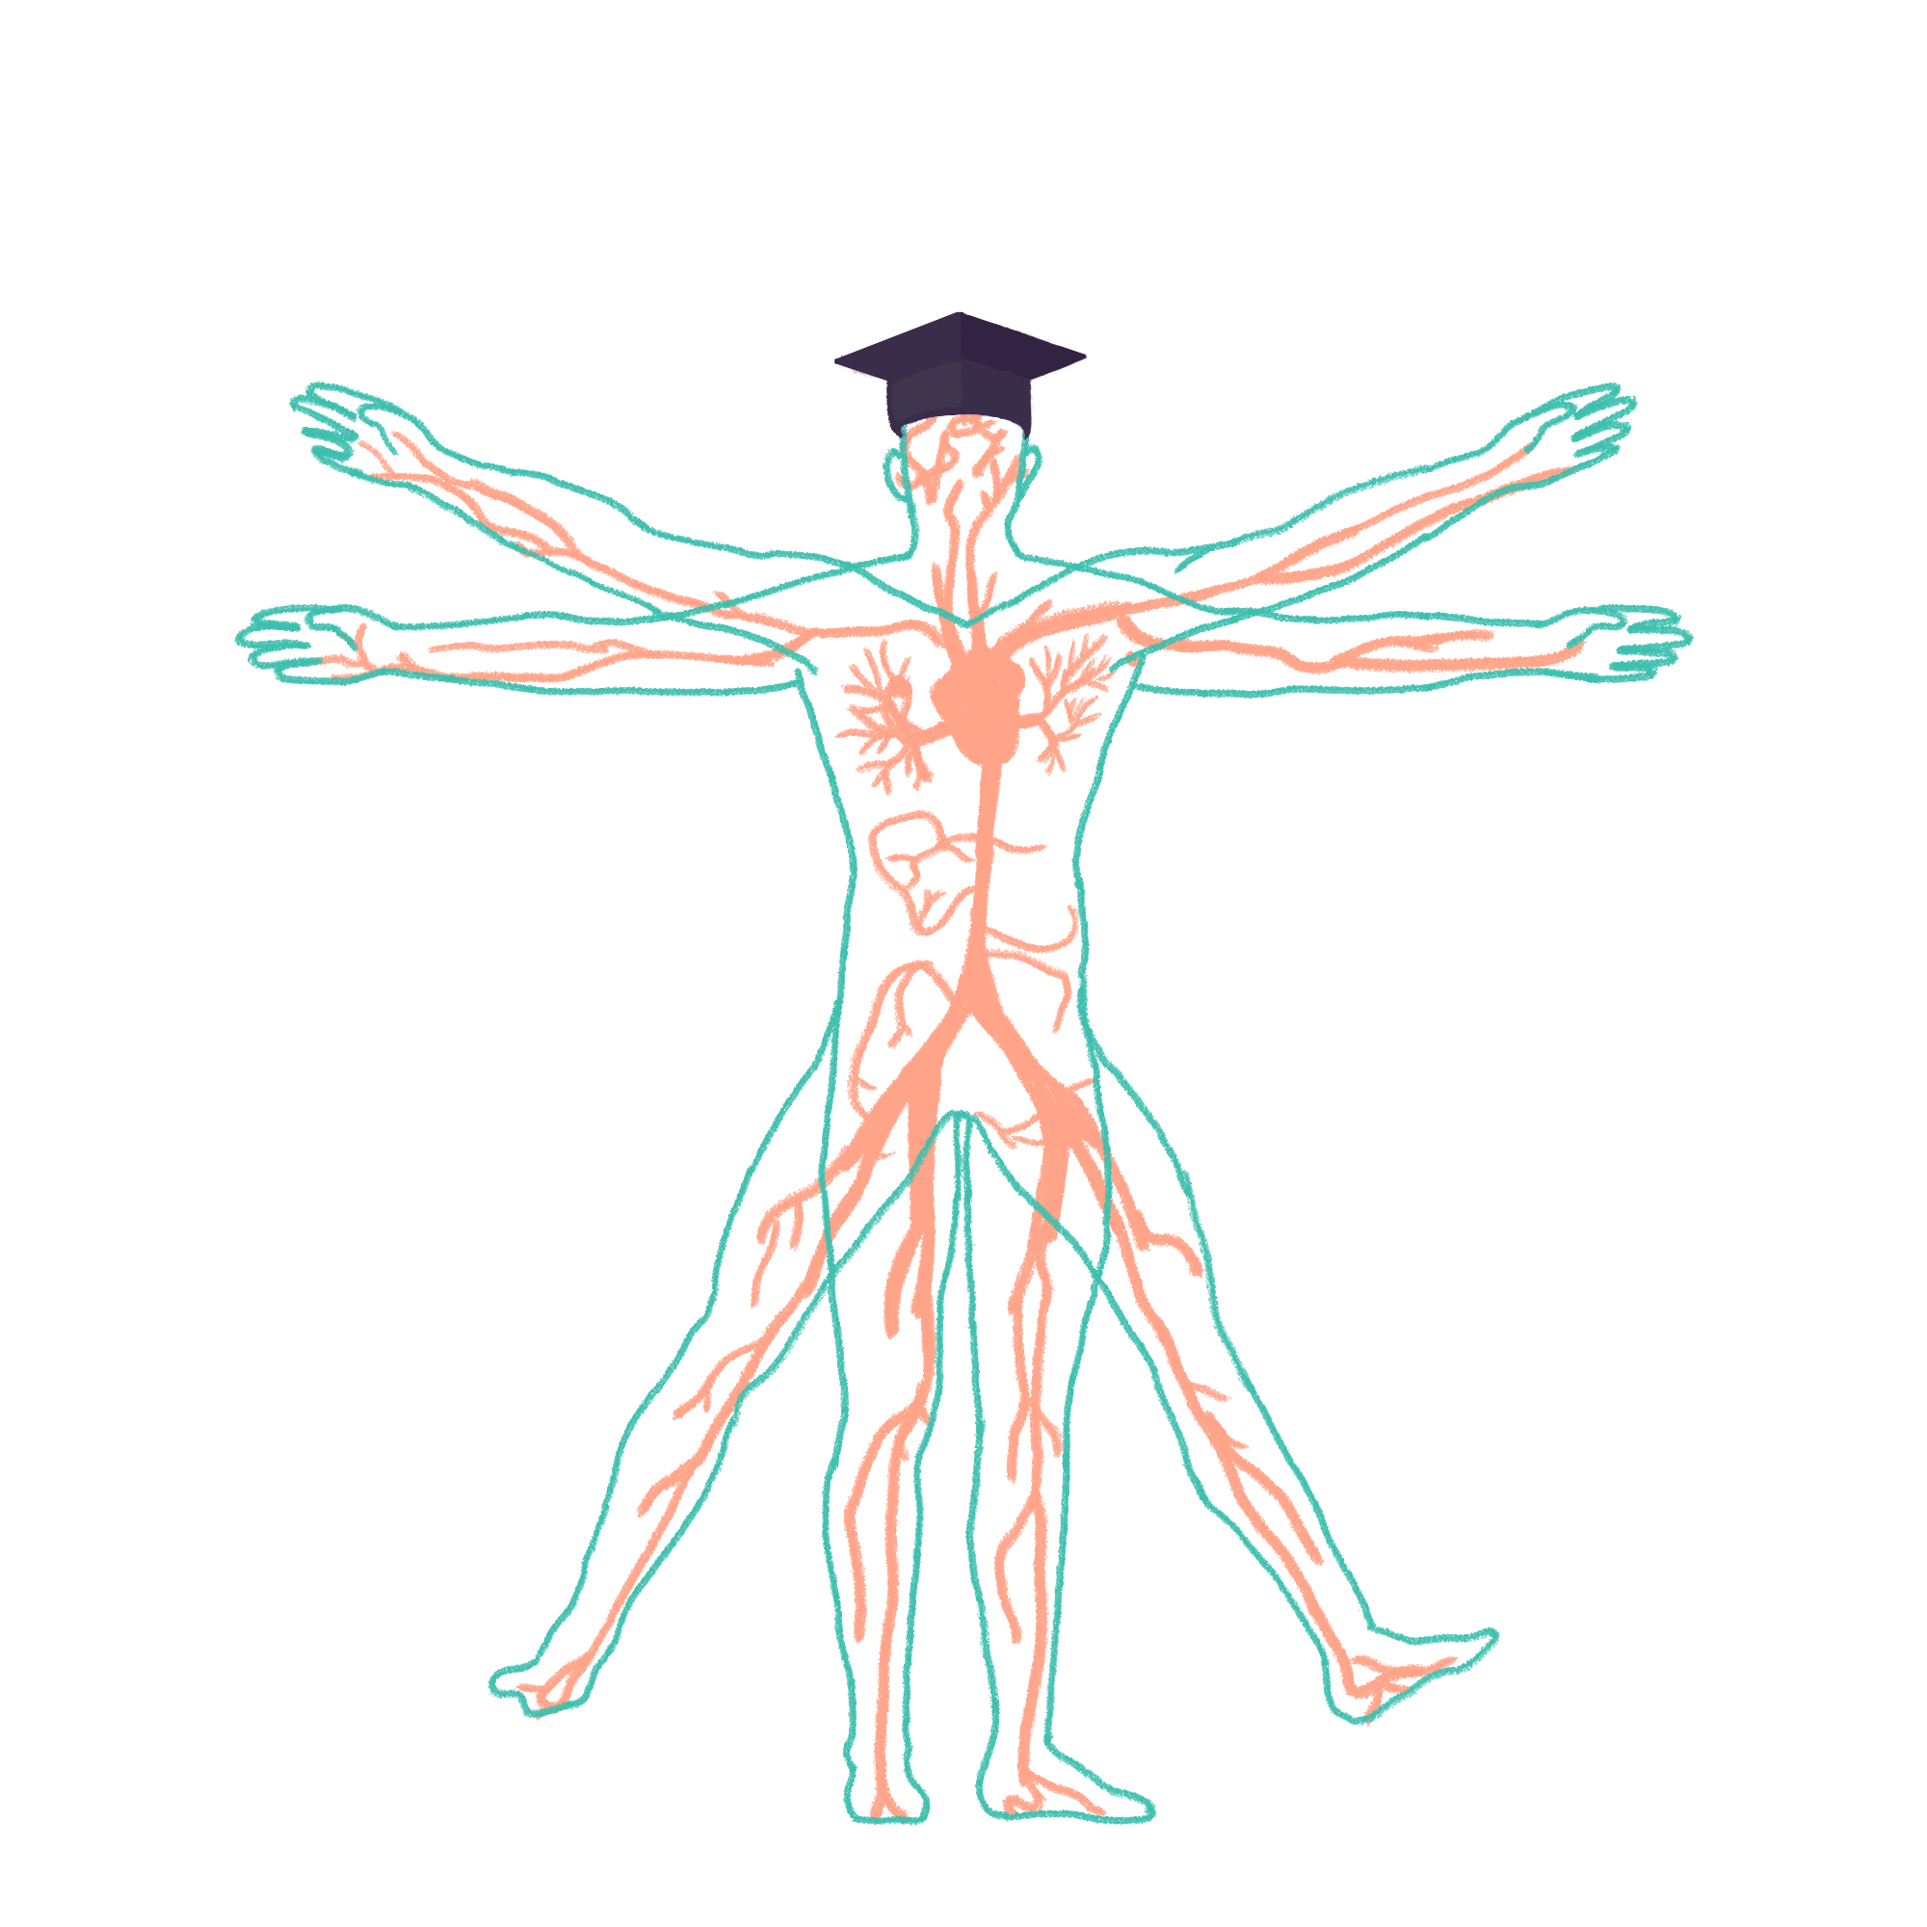
2022/2023

Slide 2
Cranial Nerves and Cerebellar
Phase 2b Revision Session
Alice Bilton and Charlotte Cartwright
28/07/2022
The Peer Teaching Society is not liable for false or misleading information…

Slide 3
Aims and Objectives
Become familiar with the structure of standard OSCE Cranial Nerves + Cerebellar examinations
Get an understanding of examination technique
Recognise clinical signs
OSCE hints and tips
The Peer Teaching Society is not liable for false or misleading information…

Slide 4
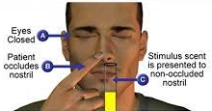
CN I - Olfactory
“Any change in sense of smell?”
If yes, use smelling bottles or well known smells e.g. coffee, lemon.
Test each nostril separately, whilst blocking the other nostril.
The Peer Teaching Society is not liable for false or misleading information…

Slide 5
CN II - Optic Nerve
AFRO
Acuity
Fields - Visual fields + Inattention
Reflexes - Pupillary and accommodation reflexes
Ophthalmoscope (Not covered in OSCE station)
The Peer Teaching Society is not liable for false or misleading information…

Slide 6
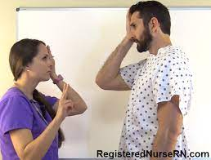
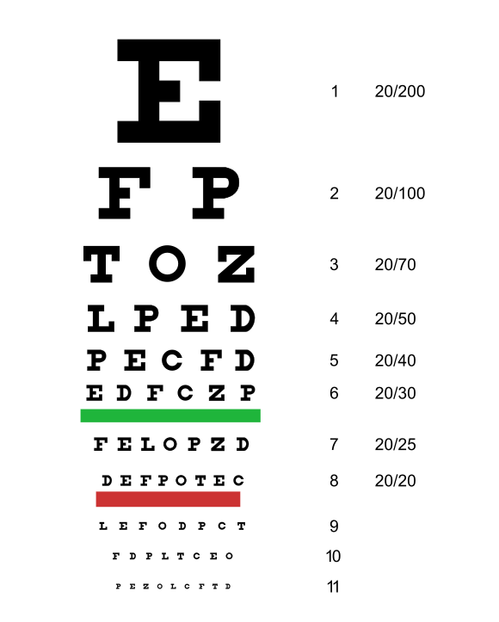
CN II - Optic Nerve
Acuity
“How many fingers” or Snellen chart (not available in OSCE)
Cover each eye to test separately
The Peer Teaching Society is not liable for false or misleading information…

Slide 7
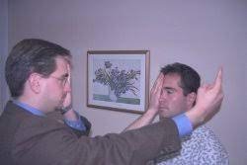
CN II - Optic Nerve
Fields - Visual fields
Sit facing patient, with knees almost touching
Ask patient to cover one eye, and cover your corresponding eye (e.g. patients right + your left)
Get them to look at you (not your hands)
Hold finger at an equal distance between you and move it from outside inwards, ask the patient when they can see your finger
Repeat for the other eye
The Peer Teaching Society is not liable for false or misleading information…

Slide 8
CN II - Optic Nerve
Fields - Inattention
Sit facing patient, with knees almost touching
Get them to look at you (not your hands)
Hold hands out to the side, and wiggle fingers
Ask the patient to tell you which side is moving
End by wiggling both hands
The Peer Teaching Society is not liable for false or misleading information…

Slide 9
CN II - Optic Nerve
Reflexes - Pupillary
Direct - Shine light in eye, observe constriction in same eye
Consensual - Shine light in eye, observe constriction in other eye
Swinging light test - State would do at the end
Accommodation - Ask patient to look at wall behind you, then switch attention to your finger (~20 cm from face)
You should see constriction of both pupils and bilateral convergence
The Peer Teaching Society is not liable for false or misleading information…

Slide 10
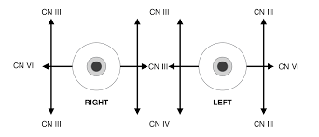
CN III + IV + VI - Oculomotor, trochlear, abducens
Keep patient in same position as CN II exam
Ask the patient to keep head still and follow your finger with their eyes
Draw a H and an I in the air
(these will cover all movements of the eye)
The Peer Teaching Society is not liable for false or misleading information…

Slide 11
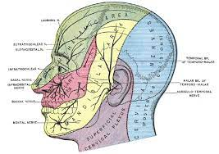
CN V - Trigeminal
Sensation - Close patients eyes, and ask if they can feel light touch (using cotton wool) on either side of the forehead, cheeks and chin
Power (3) - Clench teeth and feel for: Masseter (in front of ears) and Temporalis muscles (at temples). Then can the patient open their jaw against resistance
Reflexes - Jaw and corneal (Not covered in OSCE)
The Peer Teaching Society is not liable for false or misleading information…

Slide 12
CN VII - Facial
Motor (5)
Scrunch eyes up and ‘don’t let me open them’
Lift eyebrows
Puff cheeks out
Smile
Purse lips to whistle
Taste - Ask if any change in taste
Reflexes - Glabellar reflex (Not covered in OSCE)
The Peer Teaching Society is not liable for false or misleading information…

Slide 13
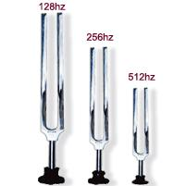
CN VIII - Vestibulocochlear
Cover opposite ear and whisper number, ask them to repeat it
Rinne’s - Put 512Hz fork on bone behind ear then hold next to ear. Ask which is loudest
Weber’s - Put fork in middle of forehead, ask if they can hear and if louder on one side
The Peer Teaching Society is not liable for false or misleading information…

Slide 14
CN IX and X - Glossopharyngeal and vagus
Open mouth and say “ah”
Check for uvula deviation
Ask about difficulty swallowing
Ask them to cough
The Peer Teaching Society is not liable for false or misleading information…

Slide 15
CN XI - Accessory
Shrug shoulders against resistance
Ask patient to turn head against resistance
The Peer Teaching Society is not liable for false or misleading information…

Slide 16
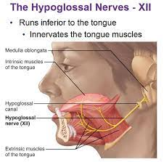
CN XII
Open mouth and look at tongue
Ask patient to stick tongue out
The Peer Teaching Society is not liable for false or misleading information…

Slide 17
Cerebellar Exam
DANISH
Dysdiodochokinesia
Ataxia
Nystagmus
Intention tremor
Speech, stance
Hypertonia
VANISHED
Vertigo
Ataxia
Nystagmus
Intention tremor
Speech
Hypertonia
Exaggerated past pointing
Dysdiodochokinesia
The Peer Teaching Society is not liable for false or misleading information…

Slide 18
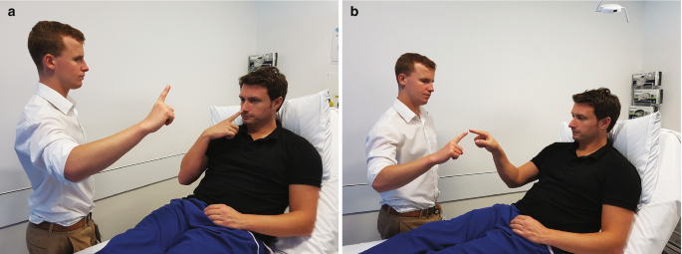
Cerebellar Exam
Vertigo - Ask re symptoms
Ataxia - Gait, Stance, Rombergs
Nystagmus - Draw H + I as before
Intention tremor - Hold hands flat/touch your finger
Speech - Baby hippopotamus, British constitution
Hypertonia
Exaggerated past pointing - finger to nose test
Dysdiodochokinesia
The Peer Teaching Society is not liable for false or misleading information…

Slide 19
Conclusion
Don’t rush
Won’t be asked to cover all cranial nerves in OSCE
Practice & get a friend to time you
The Peer Teaching Society is not liable for false or misleading information…

Slide 20
Quiz
Your patient’s tongue deviates to the left, what does this indicate?
Hypoglossal nerve lesion on right side
Glossopharyngeal nerve lesion on left side
Glossopharyngeal nerve lesion on right side
Hypoglossal nerve lesion on left side
The Peer Teaching Society is not liable for false or misleading information…

Slide 21
Quiz
When completing Weber’s test, which of the following indicates conductive hearing loss in the left ear?
Hearing equally in both ears
Hearing louder in the left ear
Hearing louder in the right ear
Hearing nothing
The Peer Teaching Society is not liable for false or misleading information…

Slide 22
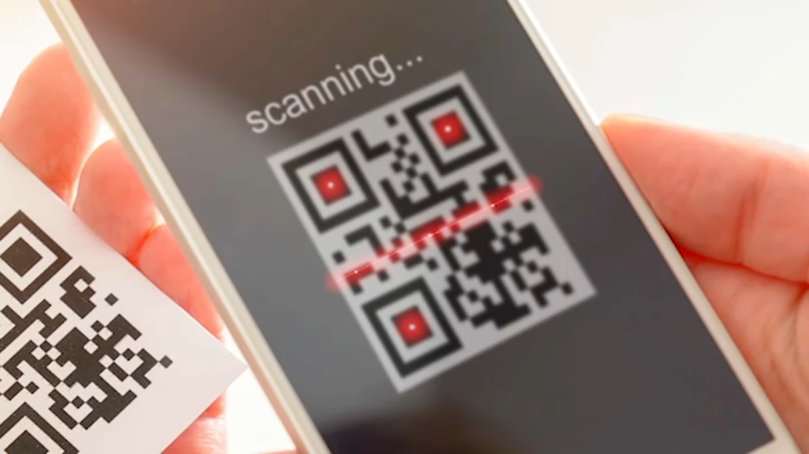
Feedback
https://forms.gle/KUNYQB6AxwogeiKq8
The Peer Teaching Society is not liable for false or misleading information…

