Slide 1
2022/2023

Slide 2
Neuro + COTE
Phase 3a Revision Session
Avesta Emami + Bilal Khaleel
23/06/22, 06:00 PM

Slide 3
Contents
Contents
Dementia
Delirium
Falls + Osteoporosis
Strokes/TIA
Incontinence
PD + HD
Epilepsy
MS + MND
Meningitis
Cerebellar syndrome
Peripheral + Mononeuropathy + CN problems
Neurosurgery (Head trauma + GCS, hydrocephalus, Emergencies [cauda equina, cord compression, Brain Abscess, Brain herniation)
Quiz
What we won’t cover
Myopathies
Plexus
headaches
Narcolepsy, Cataplexy
NF type 1 + 2
Syrinx
Myaesthenia gravis
Encephalitis
Spinal tumours
Polypharmacy

Slide 4
DEMENTIA

Slide 5
DEMENTIA
Irreversible causes:
Neuro: AD, LBD, FTD,
Infection: HIV, syphilis
Toxins: Alcohol, BZD
Vascular: VD, CVD
Trauma: Head trauma
Reversible causes:
Neuro: Hydrocephalus, tumours, SDH
Vitamin: B12, Folic, Thiamine deficiencies
Endocrine: Cushing’s, hypothyroidism
Ix: Adenbrook’s investigation, GPCOG, 6 Item CIT
non pharm Mx: personal care, social support, music therapy

Slide 6
ALZHEIMER’S
unknown cause
pathology = beta amyloid protein accumulation -> lower Ach, neuronal damage, amyloid plaques
RFs : Down’s, amyloid precursor protein gene mutation, age, 1st degree relative
Sx:
short term memory loss (progressive + persistent)
global cog impairment
irritable, mood swings, apathy
Ix: CT, MMSE
Rx:
Ach-esterase inhibitor
NMDA receptor antagonist

Slide 7
LEWY BODY
unknown cause
pathology: cerebral atrophy + lewy bodies -> alpha synuclein +ve cytoplasmic inclusions in neurones
RF: >60yo, male, FHx parkinson’s/LBD
Sx: EPSE, visual hallucx, falls, REM sleep disturbance, fluctuates but overall worse with time
Ix: SPECT - shows reduced metabolism and reduced occipital perfusion
Rx: Levodopa, DA agonists
(CI: antipsychotics)

Slide 8
FRONTOTEMPORAL
genetic causes, trauma, alcohol
Pathology: FT atrophy, Pick bodies (tau proteins), Pick’s disease
Sx: <65yo onset, impulsive, irritable, crying, overweight (pick’s increases appetite), akinesia, hallucxs, parkinsonism later
Ix: MMSE, CT/MRI head
Rx: SSRI for depression, olanzapine (antipsych) for agitation/hallucx
drugs used for AD makes FTD sx worse

Slide 9
VASCULAR
caused by: many strokes/TIA
Pathology: grey+white matter damage
RFs: HTN, DM, age, hyperlipidaemia
Sx: sudden onset, stepwise deterioration, motor disorders, behavioural changes, cog impairment
Ix: MMSE, Carotid USS, CT/MRI Head
Rx - treat RFs, antiplatelets, aspirin (secondary prevention)
cholinesterase inhibitors if AD comorbidity

Slide 10
DELIRIUM

Slide 11
DELIRIUM
Causes: HE IS NOT MAAD
Hypoxia - resp failure, MI, PE
Endocrine - cushings, thyroid, glucose
Infection - pneumonia, UTI
Stroke - ^ICP, head trauma
Nutrition - thiamine/B12 def
Others - pain, lack of sleep
Theatre - anaesthetics
Metabolic - electrolytes
Abdominal - urine retention
Alcohol - intox + withdrawal
Drugs - BZD, opioids
Sx: Disordered thinking, fear, euphoria, language impairment, inattention, delusions
Ix: brief MSE, confusion assessment method (CAM)
ABC, GCS, vitals, Bloods, urinalysis, BCx, CXR, ABG, CT head, EEG if epileptic
Rx - underlying cause, calm environment, IM haloperidol (Lorazepam if PD)

Slide 12
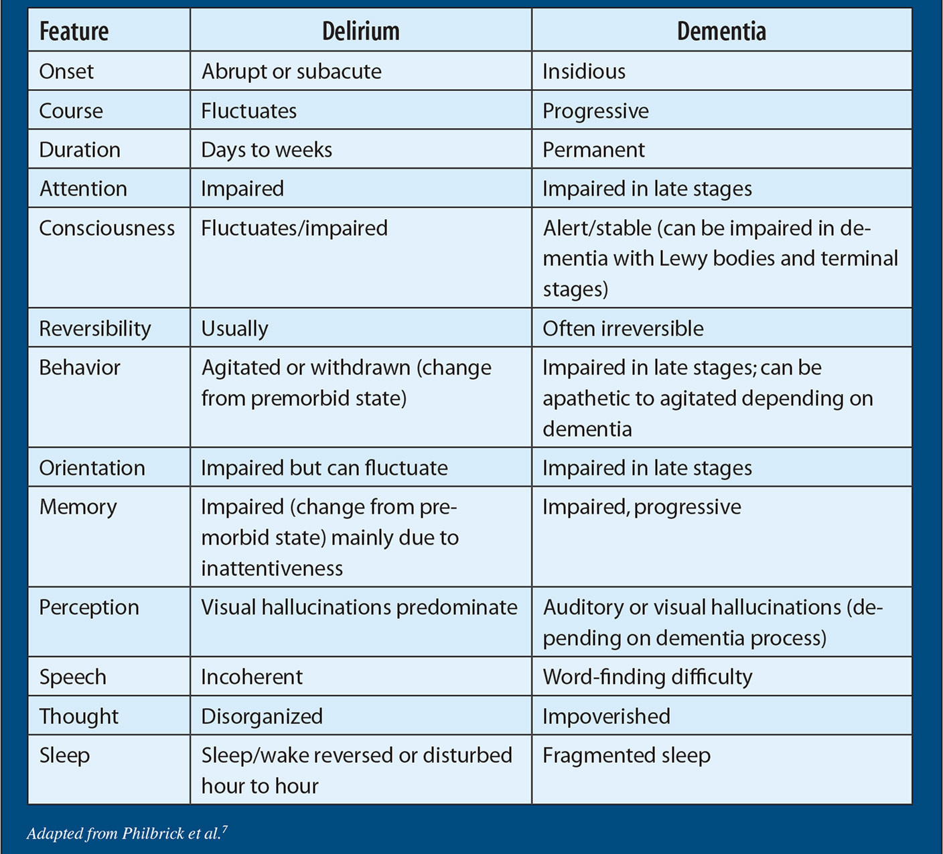
DELIRIUM V DEMENTIA

Slide 13
FALLS
main cause of injury/disability/death in elderly
Ix: Bloods (FBC, U+E, LFT, TFT, Vitamins), if head injury -> CT head, ECG, PRISMA-7 to assess frailty
Mx - treat actively, stop drugs that can cause falls
foot-wear/walking aid
fludrocortisone if postural hypotension
PT, OT, ACP, Care home
causes: I HATE FALLING
Inflammation (joints
Hypotension
Arrhythmia
Tremor
Equilibrium (balance issues, drug induced or other causes)
Foot pain
Auditory/Visual impairment
Leg length discrepancy
Lack of conditioning
Illness
Nutrition poor
Gait problems

Slide 14
OSTEOPOROSIS

Slide 15
OSTEOPOROSIS
Low BMD
due to age, female, low mobility, low BMI, RA, long term corticosteroids
Ix: FRAX - risk of # in 10 years (for female >65, male>75
DEXA scan - done at hip
T-SCORE: BMD of healthy young person
Z-score: corrected to pt age
T-score:
>-1 = normal
-1 - -2.5 = osteopaenia
<-2.5 = osteoporosis
<-2.5 + # = severe osteoporosis
Mx: Calcichew + Bisphosphonates (1st line)
-HRT, Denosumab, Raloxifene, Strontium Ranelate = alternatives

Slide 16
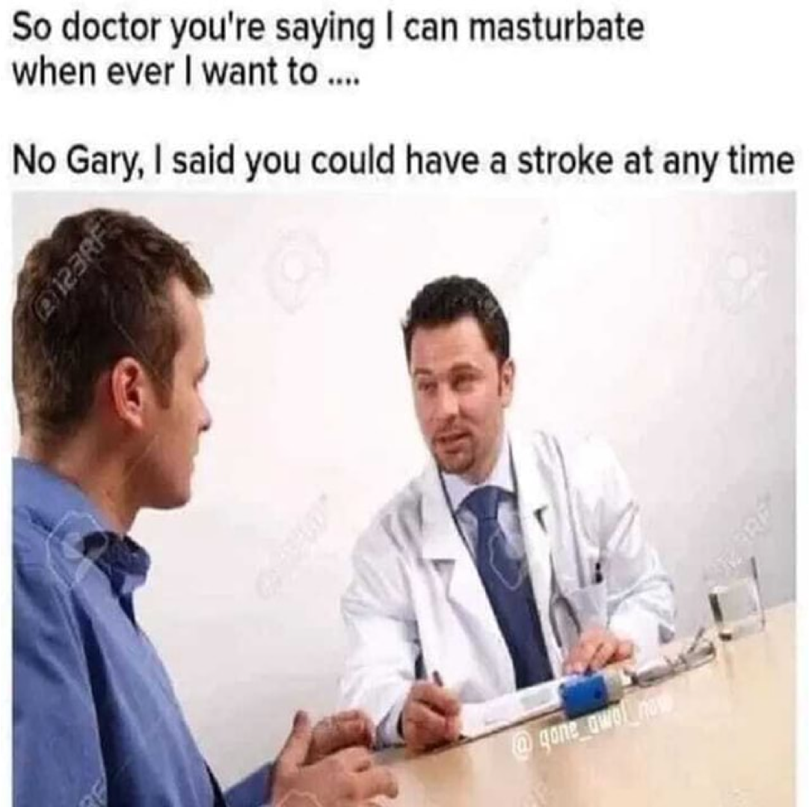
STROKES + TIA

Slide 17
STROKES + TIA
= Cerebrovascular oopsies
ischaemia/infarction of brain tissue due to thrombosis/athersclerosis
TIA= stroke that resolves in <24hrs
Crescendo TIA - 2+ in 1 week - high stroke risk
Sx - limb + facial weakness, dysphasia, visual/sensory loss (curtain loss of vision)
RFs - CVD, past hx, AF, HTN, Smoking/alcohol, COCP
Ix: FAST, ROSIER, ABCD2
-Bloods, Head CT <1hr of presentation, autoimmune + thrombophilia screen Head MRI, carotid USS
Bamford Classification of Strokes (learn this)

Slide 18
STROKES + TIA Rx
ischaemic stroke: Hydration, aspirin, clopidogrel, DOAC, warfarin, if BP >220/110 -> BB + GTN patch
<4.5 hrs of onset -> thrombolysis w/ alteplase
4.5 - 6hrs of onset -> Thrombectomy (stent/aspirate) if proximal LV occlusion, if cant do thrombectomy - give aspirin
Endarterectomy for carotid stenosis
secondary prevention - clopidogrel, atorvastatin, treat modifiable RFs
haemorrhagic stroke: anticoag + BP aim for 140/90, if hydrocephalus -> external ventricular drain
Rehab: SALT, PT, OT, nutritionist/dietician

Slide 19
INCONTINENCE

Slide 20
URINARY INCONTINENCE
age -> urethral atrophy, pelvic floor atrophy, prostatic hypertrophy
Reversible: UTI, Delirium, DMT2, diuretics
Treatable: BPH, overactive bladder, stress incontinence
Environmental: toilet too far away :( uwu
Ix: - urine dip + MSU (haematuria -> cytology + cytoscopy
FBC, U+E, LFT, glucose, TFT
Bladder diary
Mx - depends on cause

Slide 21
URINARY INCONTINENCE Mx
overactive bladder: antimuscarinics + bladder retraining
Dementia: regular toileting
Stress incontinence: pelvic floor exercise
BPH: antiandrogens, surgery
Hypotonic bladder: intermittent catheter
Nocturia: Desmopressin (not for >65 -> hypoNa+), drainage sheath
Catheters: silicone, change every 3 months, valve instead of bag
if >1yr use, suprapubic catheter ( can be blocked by stones, can leak, prone to infection)

Slide 22
FAECAL INCONTINENCE
-> constipation/ bowel obstruction
Mx - Rehydration, small+regular meals
enema 2x daily until empty o/e
colonic washout
laxatives (lactulose, senna, movicol)
Neurogenic faecal incontinence
Mx - planned evacuation (use loperamide then phosphate enema 2x/week)
regular toileting + suppository

Slide 23
PARKINSON’S DISEASE
Pathology - reduce DA production in substantia nigra
causes: idiopathic, genetic, HIV, encephalitis, Trauma (Puglists encephalopathy - Muhammad Ali)
Sx: resting tremor, flexor rigidity resisting passive extension, bradykinesia, shuffling + stooped gait
non-motor sx - anosmia, REM sleep disturbance
Ix - clinical Dx, MRI head shows SN atrophy
Mx
Levodopa + COMTi (sx relief)
DA agonists
MAO-Bi
PT, OT, SALT, Deep brain stim, comorb tx

Slide 24
HUNTINGTON’S DISEASE
autosomal dominant - 30-50yr onset
trinucleotide CAG repeat HTT gene chromosome 4
anticipation - each generation = more CAG repeats = earlier onset
pathology: degeneration of cholinergic+GABAnergic neurones
Sx: Chorea, saccadic eye movement, dysarthria, dysphagia, dystonia, personality change (irritability, apathy, depression)
Dx - genetic test + pre+post test counselling
Mx - OT,PT,SALT, genetic counselling, advanced directives, EoL care plan

Slide 25
HD Sx RELIEF
olanzapine for psych sx
SSRI for depression
diazepam
tetrabenazine (DA-depleting agent)
Prognosis: death - either by resp disease ~ 20 years later, or suicide

Slide 26
Neuro…
Nerve stuff
Brain stuff
Surgical stuff

Slide 27
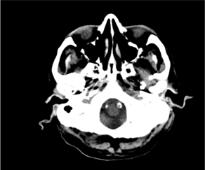
But first…
What’s wrong?
Might be multiple things…
blobs.io/head-ct-pts

Slide 28
Facial nerve palsy
Facial weakenss, altered taste (ant 2/3 tongue), can’t close eyes, hyperacusis
UMN palsy -> frontalis and orbicularis oculi preserved
LMN -> Bell’s palsy, Ramsay Hunt (herpes zoster)

Slide 29
Facial nerve palsy
Mx: Bell’s -> steroids
Ramsay Hunt -> aciclovir

Slide 30
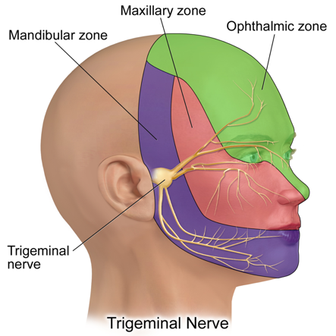
Trigeminal neuralgia
stabbing pains
unilateral
usually 1 distribution
no sx between attacks

Slide 31
Trigeminal neuralgia
compression of V nerve root
pain relief: carbamazepine, gabapentin/lamotrigine/phenytoin
surgery

Slide 32
Peripheral nerve lesions
Median nerve- LOAF
C6-T1
weakness of precision grip, sensory loss radial 3.5 fingers
splinting, steroid injection, decompression

Slide 33
Peripheral nerve lesions
Ulnar nerve
C7-T1
weakness of wrist/hand muscles
trauma at medial epicondyle, cubital tunnel syndrome

Slide 34
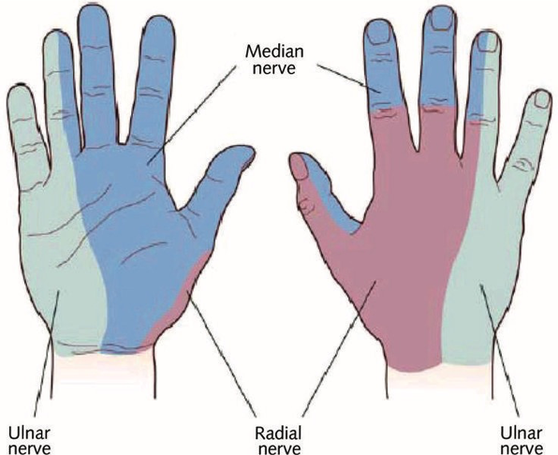
Peripheral nerve lesions

Slide 35
Peripheral nerve lesions
Lateral cutaneous nerve of the thigh
L2-L3
neuralgia paraesthetica
entrapment under inguinal ligament
anterolateral burning thigh pain

Slide 36
MND
group of neurodegenerative disorders affecting motor function
UMN (go up): hyperreflexia, hypertonia, up going plantars, spasticity
LMN: hyporeflexia, hypotonia,

Slide 37
MND
SMA - limb weakness from spinal cord anterior horn
PLS - spastic limb weakness due to UMN
PBP - involvement of bulbar motor neurons
ALS - mix of above

Slide 38
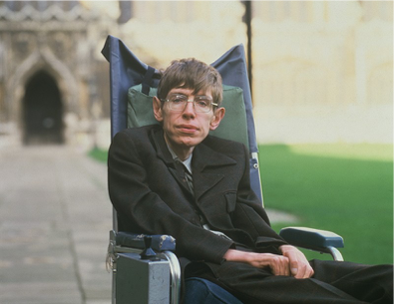
ALS
degeneration of UMN & LMN, unknown cause
5-10% AD, rest sporadic
cardiac & smooth muscle normal, ocular muscles rarely affected

Slide 39
ALS
clinically diagnosed after excluding differentials
EMG fasciculations & fibrillations
baclofen, riluzole
fatal 3-5 years

Slide 40
Epilepsy
spontaneous abnormal electrical activity in brain
2/3 idiopathic. identifiable causes include CVD, tumour, ABI

Slide 41
Epilepsy
Describing seizures
Area of onset
Awareness
Clinical features

Slide 42
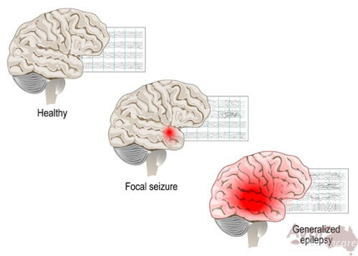
Epilepsy
Focal
Generalised
Focal to bilateral tonic-clonic

Slide 43
Epilepsy
Tonic -> generalised muscle stiffening
Clonic -> rhythmic jerking
Myoclonic -> brief jerks
Atonic -> loss of tone
Spasms -> sudden flexion/extension

Slide 44
Epilepsy
Seizure timeline
Prodromal -> Early-ictal -> Ictal -> Post-ictal

Slide 45
Epilepsy
Prodromal
Subjective feeling/sensation
confusion, irritability

Slide 46
Epilepsy
Early-ictal
Aura
sensory/cognitive/emotional/behavioural
focal epilepsy

Slide 47
Epilepsy
Ictal
depends on seizure
urinary incontinence and tongue biting

Slide 48
Epilepsy
Post-ictal
recovery period
altered consciousness
Todd’s paresis

Slide 49
Epilepsy - DVLA
Group 1: 1st seizure LOC -> no driving 6 months, reapply
epileptic seizure -> no driving 1 yr, reapply
no LOC / nocturnal seizures -> ask DVLA
Group 2: 1st seizure -> no driving 5 years, seek advice
>1 seizure -> no driving 10 years, seek advice

Slide 50
Status epilepticus
Seizure > 5 mins, or multiple seizures with incomplete recovery between
initial mx: lorazepam 4 mg IV, repeat after 10 mins if no resolution
clear environment
? IV dextrose, thiamine…

Slide 51
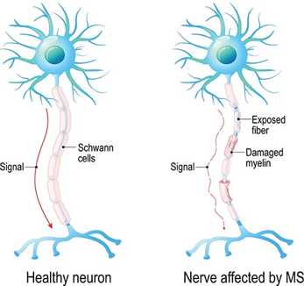
Multiple Sclerosis
chronic inflammatory condition
demylenation and axonal loss in CNS
typical onset 20-40 yrs, 3x common in women

Slide 52
Multiple Sclerosis
EYES
optic neuropathy, over few days, usually unilateral
Uthoff’s phenomenon
RAPD

Slide 53
Multiple Sclerosis
SPINAL CORD
L’hermitte sign
numbness
incontinence

Slide 54
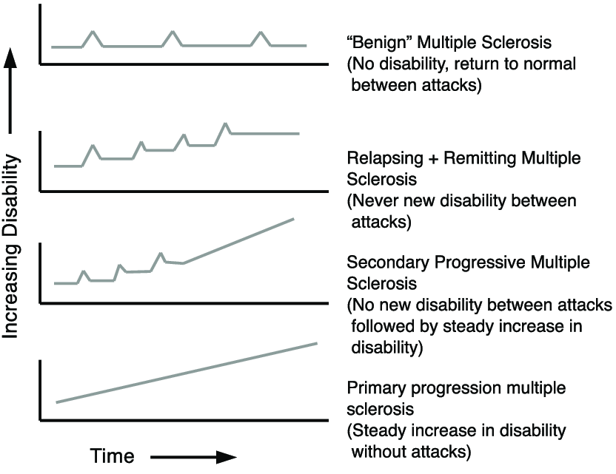
Multiple Sclerosis

Slide 55
Multiple Sclerosis
Ix: MRI, shows plaques 85%
VEP (EEG post visual stimulus)
SEP
LP -> oligoclonal bands, protein ++, Ig ++

Slide 56
Multiple Sclerosis
No cure
High dose steroids for exacerbations, interferon-B
spasm mx (baclofen), tremor mx (benzos), pain (gabapentin), urinary incontinence (anticholinergics), antidepressants
inc risk suicide

Slide 57
Cerebellar Syndrome
Vascular lesion, alcohol, demyelination, tumours, hypothyroidism, phenytoin toxicity, metallic disorders
poor balance, dysphasia

Slide 58
Cerebellar Syndrome
DANISH
Dysdiadochokinesis
Ataxia
Nystagmus
Intention tremor
Scanning speech, disarthria
Hypotonia, hyporeflexia

Slide 59
Cerebellar Syndrome
Ix: MRI
treat underlying disorder

Slide 60
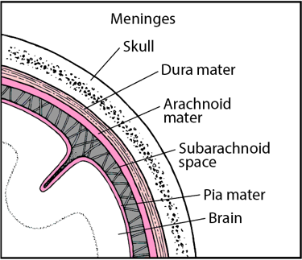
Meningitis
Infection of meninges
viral more common than bacterial

Slide 61
Meningitis
bacterial:
neonates > GBS, E coli, Strep. Pn., Listeria
+3 months + adults > Neisseria, strep pn., HIB
viral: most commonly enteroviruses
fungal, if immunodeficient

Slide 62
Meningitis
Headache, Photophobia, N&V, neck pain
fever, neck stiffness, drowsiness, petechiae
kernig’s sign, brudzinski’s sign
Ix: bloods, LP
?neuro signs/decreased GCS: Head CT ?brain abscess

Slide 63
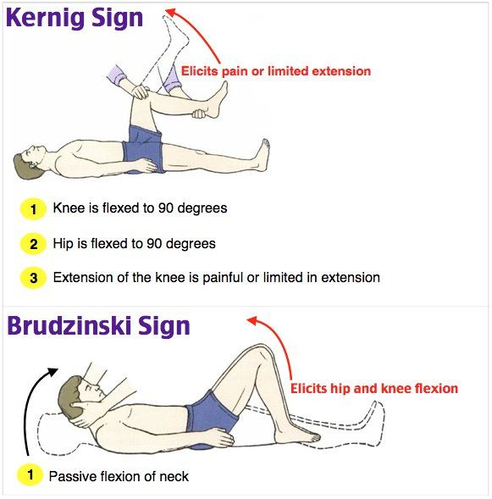
Meningitis

Slide 64
Meningitis
 | Bacterial | Viral | Fungal | TB | Malignant
OP | ++ | + | normal/+ | usually +
WCC | >500 | <1000 | 100-500 | 100-500
cells | PMNs | Monocytes | Monocytes | Monocytes | Monocytes
Glucose | Low | Normal | Low | Low | Low
Protein | ++ | normal / + | + | + | +

Slide 65
Meningitis
Primary care -> meningococcal sepsis? IM benzene (if will not delay transfer)
2ndary care:
<3 months -> IV cefotaxime + amoxicillin/ampicillin
>3 months -> IV ceftriaxone
prophylaxis to close contacts in 24 hours, cipro/rifampicin

Slide 66
Tumours
Glioma
Meningioma
Pituitary adenoma
Acoustic neuroma
Medulloblastoma

Slide 67
Tumours
Glioma (umbrella term, 50% primary brain tumours)
Meningioma (arachnoid cell cap)
Pituitary adenoma (endocrine presentations, bitemporal hemianopia)
Acoustic neuroma (unilateral sensorineural hearing loss and/or tinnitus)
Medulloblastoma (most common in children)

Slide 68
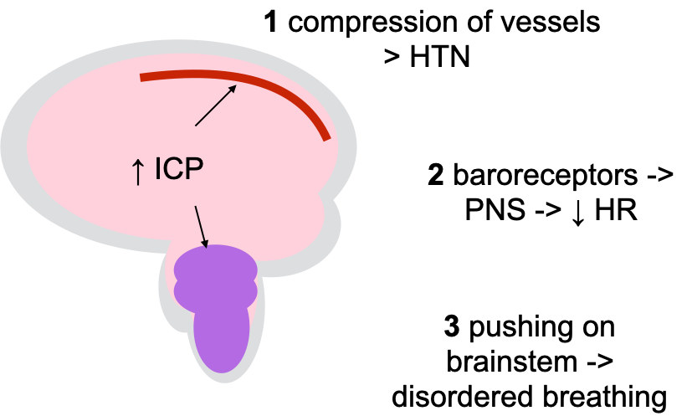
Cushing’s reflex

Slide 69
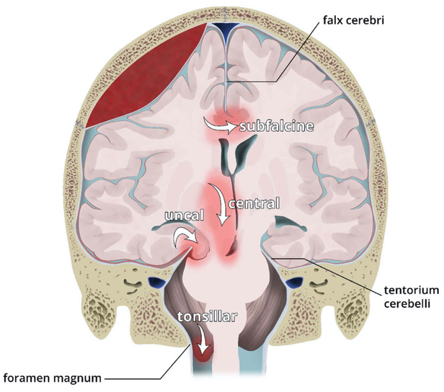
Brain herniation

Slide 70
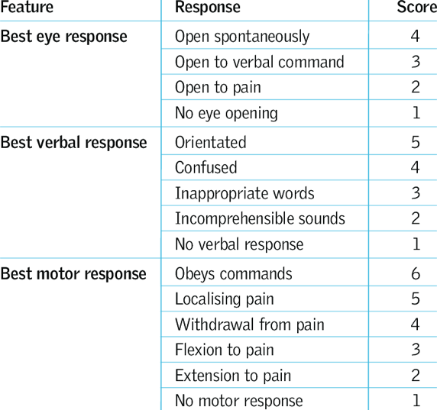
GCS

Slide 71
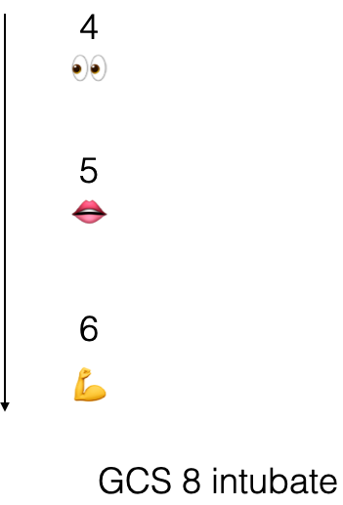
GCS

Slide 72
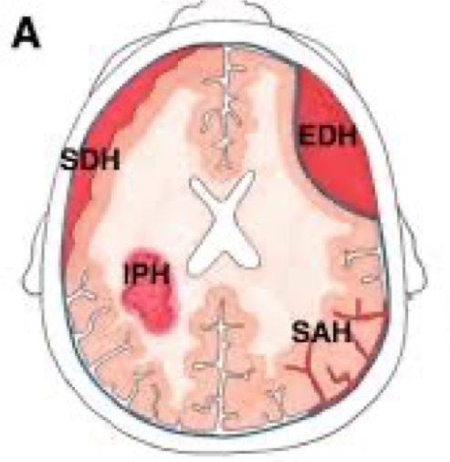
Brain bleeds

Slide 73
SAH
traumatic or secondary to aneurysm
sudden onset headache ‘worst in my life’
neck stiffness, photophobia

Slide 74
SAH
Ix: CT head, angiography
conservative, clipping or embolisation of aneurysm
EVD if CSF flow affected

Slide 75
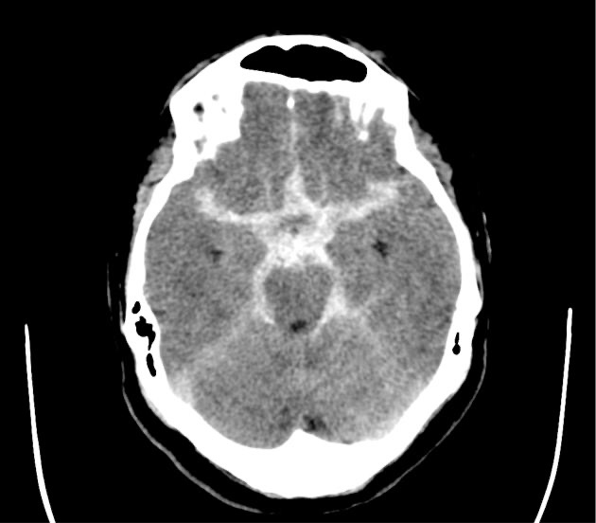
SAH
star sign

Slide 76
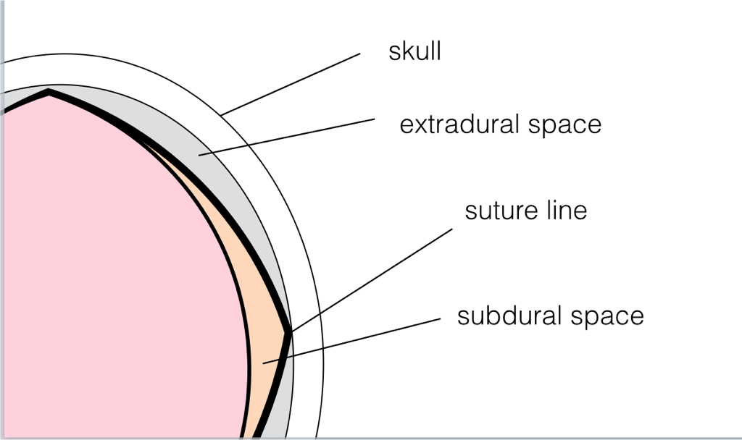
Brain bleeds

Slide 77
SDH
tear of bridging veins between cortex and dural sinuses
acute, subacute, chronic
headache, weakness, numbness, slurred speech, N&V, lethargy, seizures
Head CT
evacuation of haematoma

Slide 78
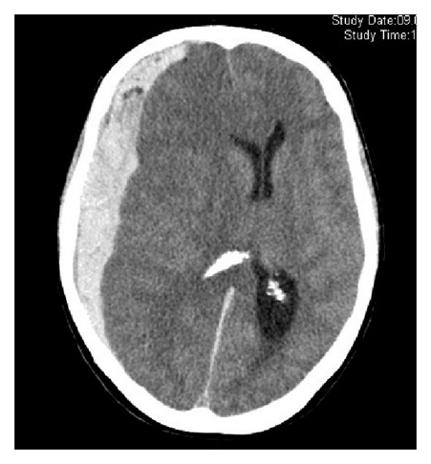
SDH
acute

Slide 79
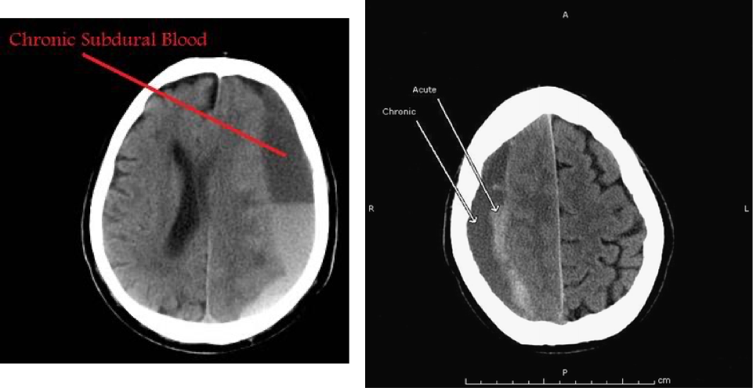
SDH

Slide 80
EDH
trauma causes damage to extradural vessel
ICP rises, GCS decreases
latent period
compression of 3rd nerve -> ipsilateral pupil dilation (false localising)
head CT
immediate surgical decompression

Slide 81
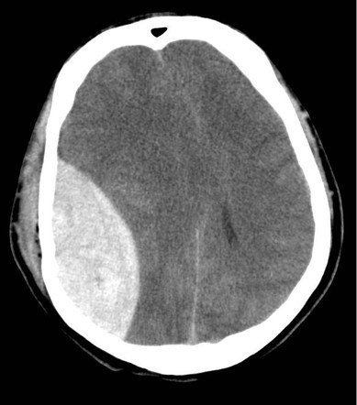
EDH

Slide 82
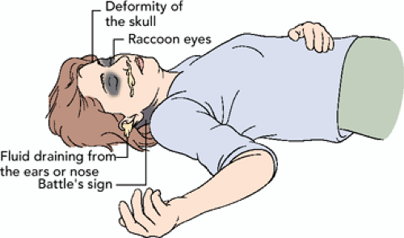
Head injury, when to CT?
within 1 hour:
GCS < 13 initially
GCS < 15 2 hours after
fracture, panda eyes, battle sign
seizure, focal neuro deficit
> 1 vomiting

Slide 83
Head injury, when to CT?
within 8 hours:
>65 yrs
bleeding / clotting disorder
dangerous mechanism of injury
> 30 mins retrograde amnesia

Slide 84
Spinal cord compression
metastatic, disc prolapse, cord tumour, trauma
sudden onset leg weakness, pain, sensory loss, painless urinary retention
motor weakness, hyperreflexia below level of compression, absent at level, normal above

Slide 85
Spinal cord compression
MRI
treat underlying cause..

Slide 86
CES
compression of cauda equina
low back pain, lower limb b/l or u/l motor and/or sensory deficit, sexual dysfunction, urinary incontinence
saddle anaesthesia, loss of anal tone
MRI, myelography sometimes used
emergency surgery

Slide 87
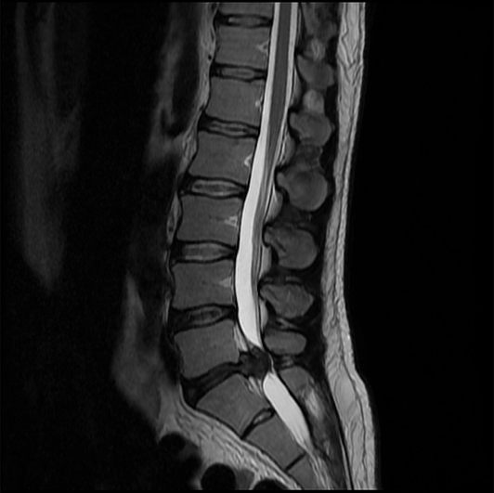
CES

Slide 88
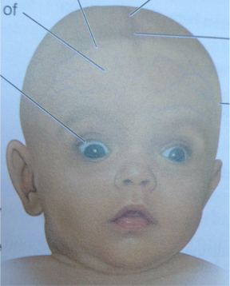
Hydrocephalus
raised ICP
headaches worse in morning, irritability, drowsiness
papilloedema, bulging fontanelle, inc OFC, sunsetting sign

Slide 89
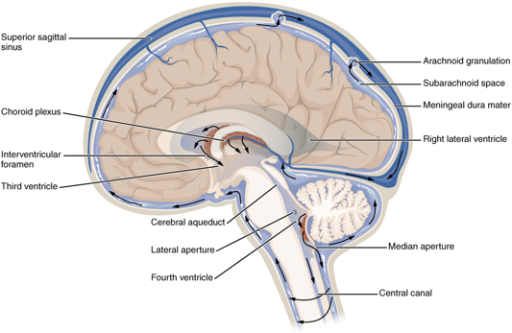
Hydrocephalus
congenital, post SAH, meningitis
non-communicating or communicating
VP shunt

Slide 90
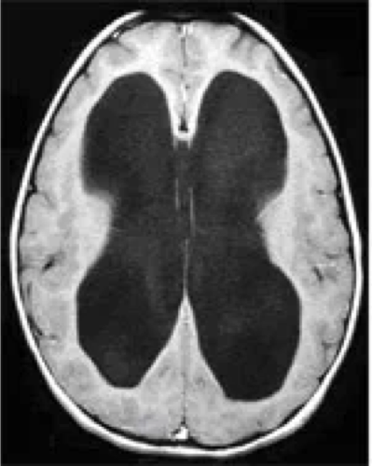
Hydrocephalus

Slide 91
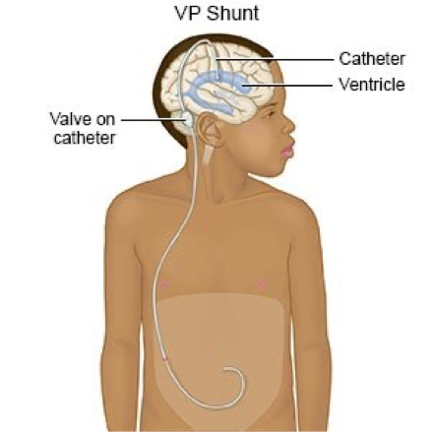
Hydrocephalus

Slide 92
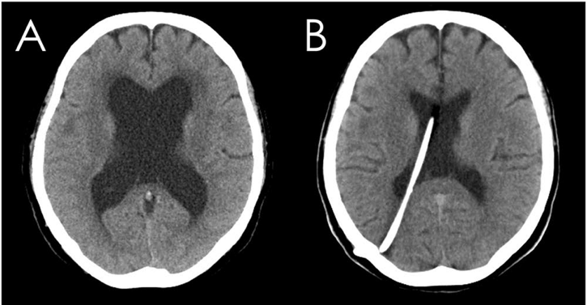
Hydrocephalus

Slide 93
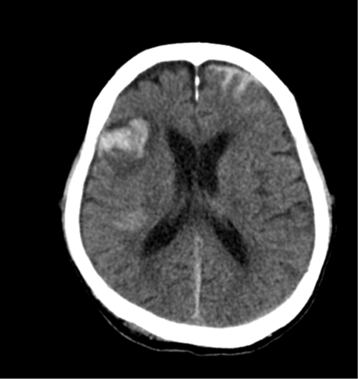
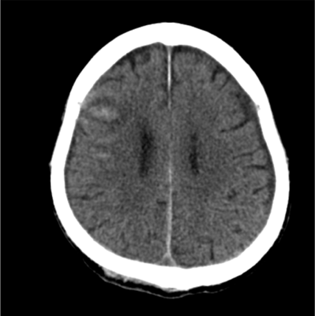
Head CT

Slide 94
Head CT

Slide 95
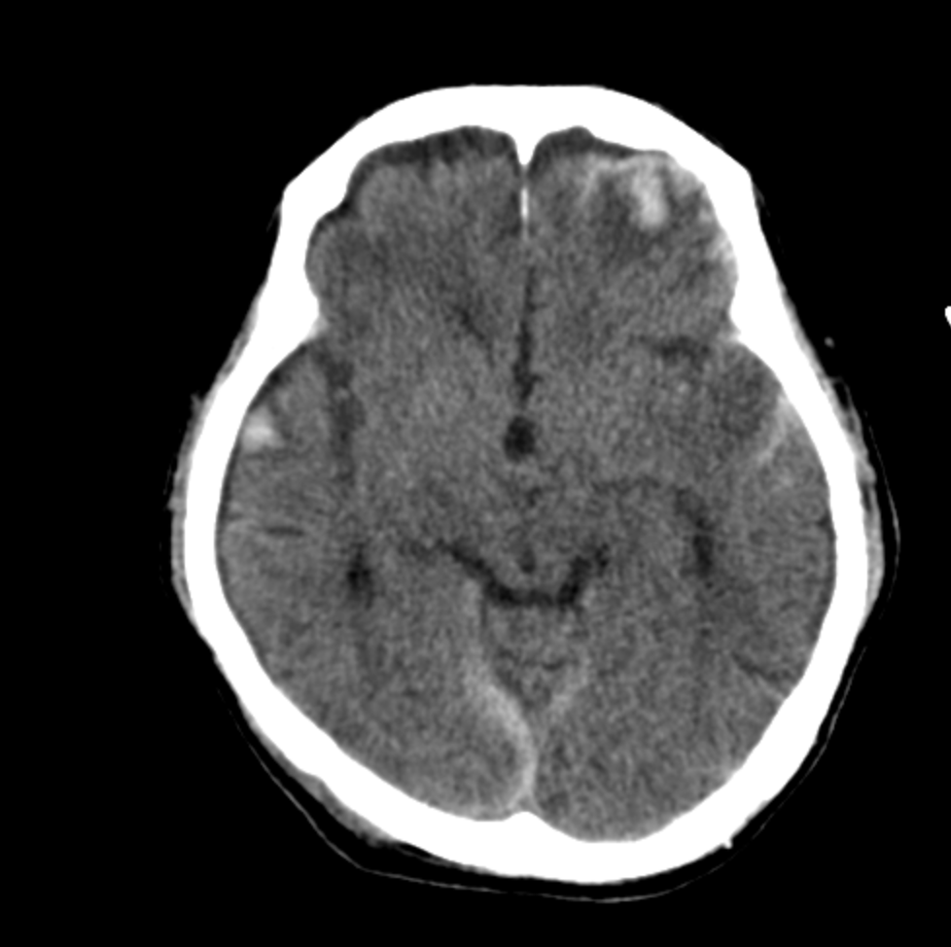
Head CT

Slide 96
Head CT

Slide 97
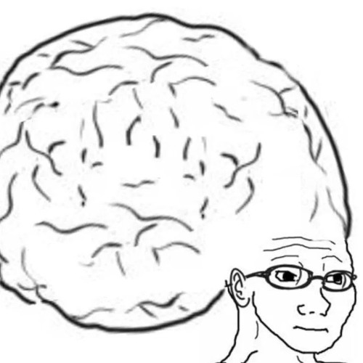
Conclusion
it is difficult but we hope we helped
feel free to email us if you have any questions
aemami1@sheffield.ac.uk
bakhaleel1@sheffield.ac.uk
The Peer Teaching Society is not liable for false or misleading information…

Slide 98
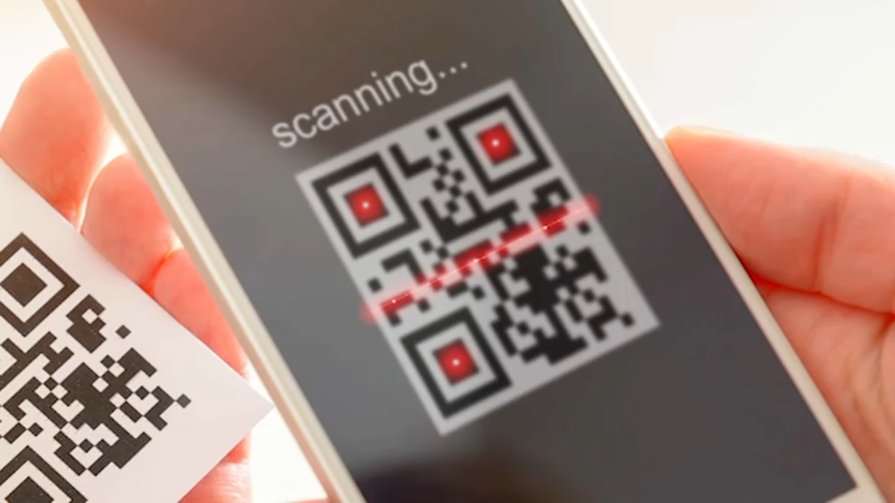
Feedback
https://forms.gle/VpoNf4ScuE8xVRLa9
The Peer Teaching Society is not liable for false or misleading information…

