Slide 1
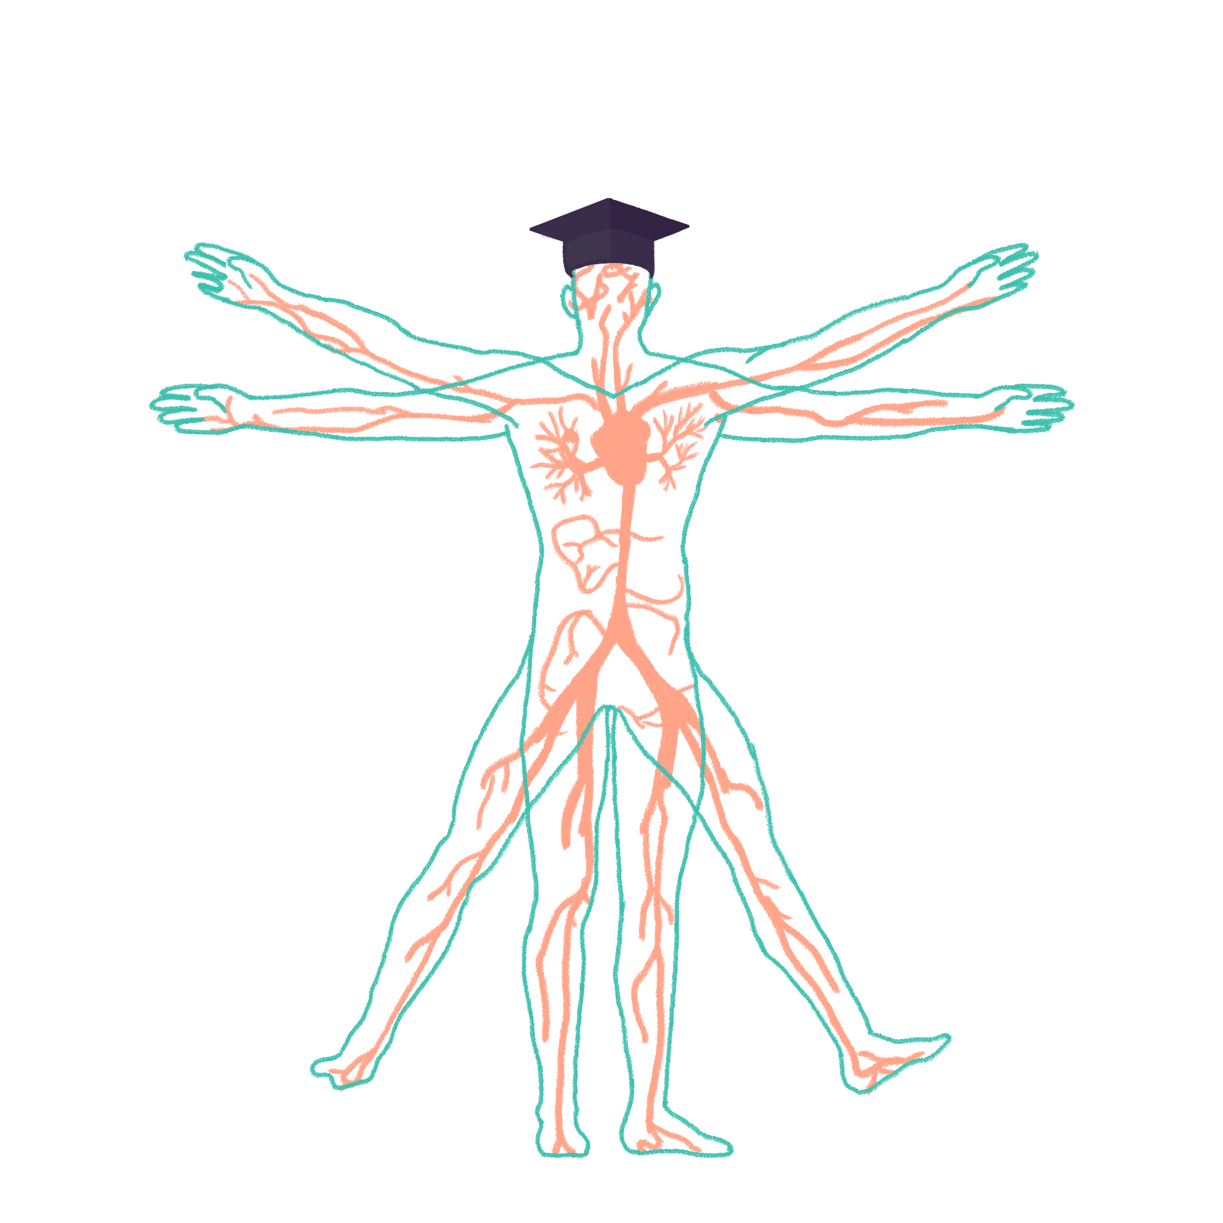
2022/2023

Slide 2
Taking a Neuro History
Phase 2b Revision Session
[Preethi and Zaynah]
[25th July 2022]
The Peer Teaching Society is not liable for false or misleading information…

Slide 3
Aims and Objectives
Revise how to take a history
Specific questions to ask in taking a neuro history
Narrowing down the diagnosis
Practise!
The Peer Teaching Society is not liable for false or misleading information…

Slide 4
Recap: General Hx Structure
Introduction + Name and DoB + Consent
PC
HPx (+ systems review!)
[summary]
PMHx
DHx
SHx
ICE
The Peer Teaching Society is not liable for false or misleading information…

Slide 5
PC
For neuro, some of the important PCs are:
Headaches
Altered consciousness
Weakness
The Peer Teaching Society is not liable for false or misleading information…

Slide 6
Headaches
Headaches = pain!
Remember the acronym for exploring pain symptoms:
Site
Onset
Character
Radiation
Associated Symptoms
Time
Exacerbating/Alleviating factors
Severity
The Peer Teaching Society is not liable for false or misleading information…

Slide 7
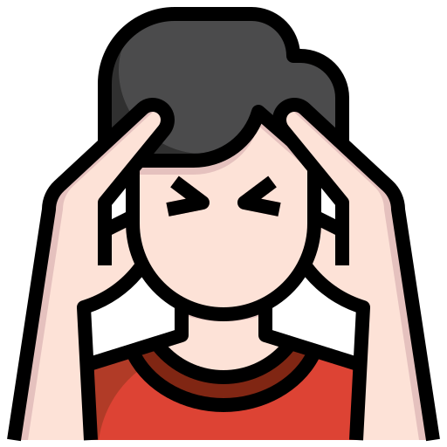
Headaches - Site
Bilateral (both sides of the head) “all around”
Unilateral (one side of the head) “one side”
“Inside the brain”
The Peer Teaching Society is not liable for false or misleading information…

Slide 8
Headaches - Onset
Comes on very suddenly
Comes on late in the day
Following head injury
Preceded by aura (flashing lights, spots in vision)
Worse in the morning (always important to ask! When in the day is it worst?)
“Does anything seem to bring it on?”
Comes on after exposure to certain things (cheese, chocolate, stress)
Has been happening for weeks, months, years
The Peer Teaching Society is not liable for false or misleading information…

Slide 9
Headaches - Character
‘Tight band around my head’
Short, painful attack around one eye
‘Throbbing’ headache in one side of head
‘stabbing/prickly’ pain in one side of face
Very severe, ‘thunderclap’ headache
The Peer Teaching Society is not liable for false or misleading information…

Slide 10
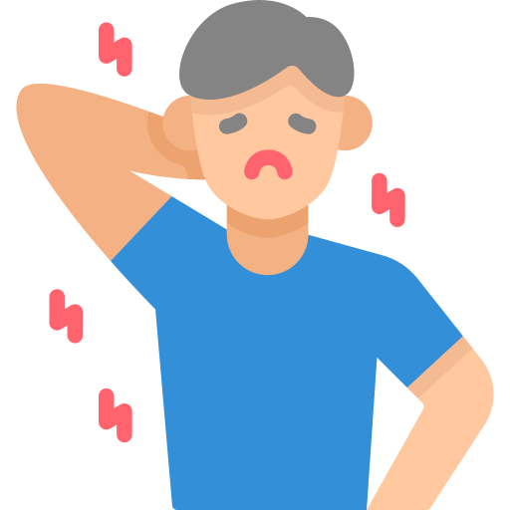
Headaches - Radiation
Throbbing pain around one eye
Pain along one side of face
Painful jaw + difficult to chew
The Peer Teaching Society is not liable for false or misleading information…

Slide 11
Headaches - Associated Symptoms
Lacrimation (tears) + flushing
Photophobia
Neck stiffness
Non-blanching rash
Scalp tenderness (painful to comb/wash hair)
Jaw claudication (painful to chew/close jaw)
Transient blindness (!!!)
Vomiting, especially after waking up in the morning (!!!)
The Peer Teaching Society is not liable for false or misleading information…

Slide 12
Headaches - Time
Can last between 30 min - 3 hours
Can last between a few hours and few days
Pain is intense and lasts for seconds
Pain has come on and is relentless
Pain came on, went away, and is now back after a few hours/days + decreasing consciousness
The Peer Teaching Society is not liable for false or misleading information…

Slide 13
Headaches - Exacerbating/Alleviating Factors
Pain is better when I lie down in a dark room
Pain is worse when I cough/lie down
“Does the pain respond to painkillers?”
The Peer Teaching Society is not liable for false or misleading information…

Slide 14
Headaches - Severity
Remember! Always ask them to rate the pain on a scale from 1 to 10
“Worst pain I’ve ever experienced in my life”
The Peer Teaching Society is not liable for false or misleading information…

Slide 15
Headaches - PMHx
Always ask about head injury! Present/past
Hospital stays?
Cardiovascular conditions/blood conditions?
Hypertension?
The Peer Teaching Society is not liable for false or misleading information…

Slide 16
Headaches - DHx
Pretty standard!
Always remember to ask for OTC medication/supplements
Always remember to ask for allergies
Any medication they take frequently?
Medication-overuse headache! A type of headache that develops and gets worse with frequent use of any medication treatment for pain, characterised by a dull, constant ache.
The Peer Teaching Society is not liable for false or misleading information…

Slide 17
Headaches - FHx
Does anyone from your family suffer from similar headaches?
Has anyone from your family had any other brain condition (including cancer!)
The Peer Teaching Society is not liable for false or misleading information…

Slide 18
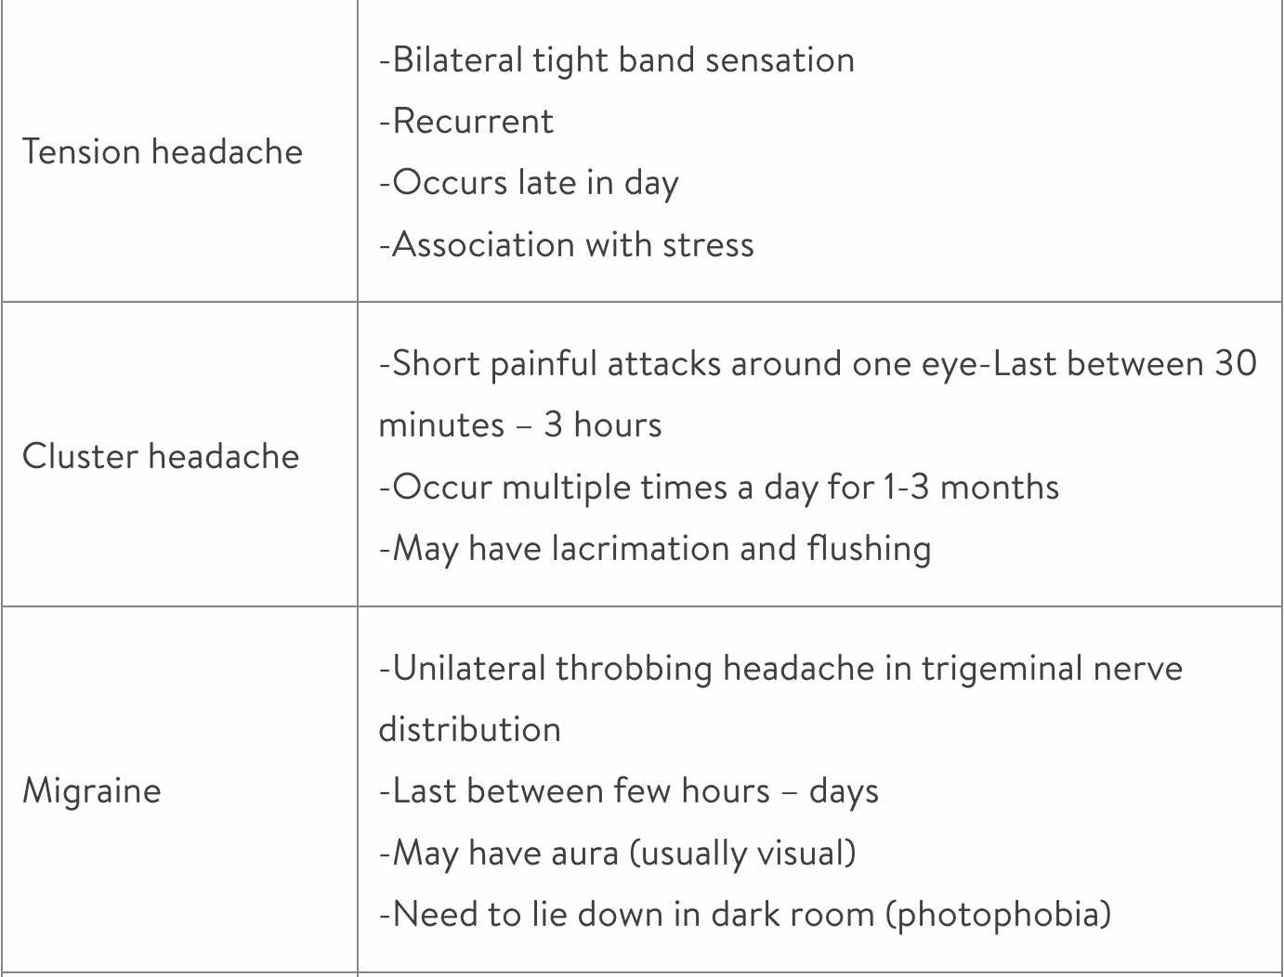
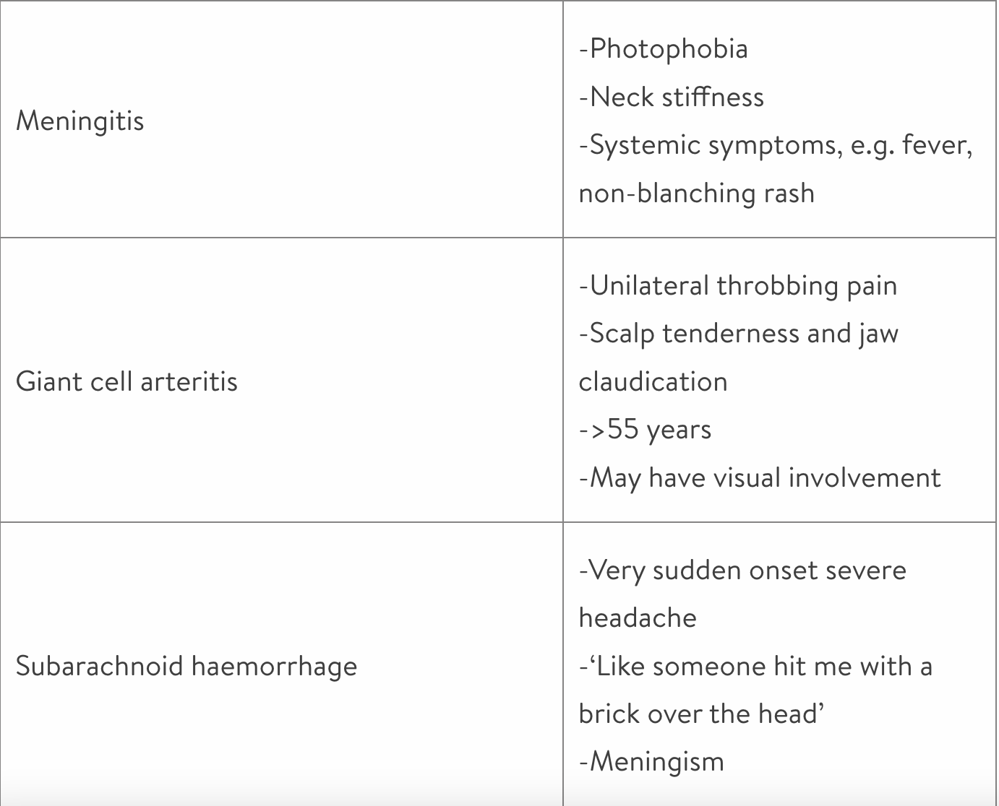
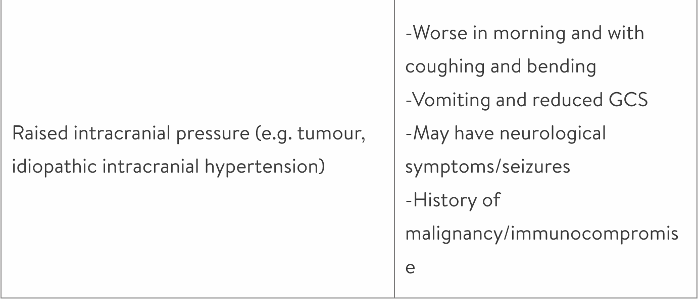
Headaches - Differentials
The Peer Teaching Society is not liable for false or misleading information…

Slide 19
Altered consciousness - PC
Differentials
Epilepsy/seizure
Vasovagal syncope
Electrolyte disturbances
Vertigo
The Peer Teaching Society is not liable for false or misleading information…

Slide 20
Altered consciousness - HPC
Always important to ask if someone was there to witness it
Before
Aura? Funny smells? hearing things?
Any trauma?
Triggers?
During
Tongue biting? eyes rolling?
Loss or bladder/bowel control?
Motor symptoms?
Duration?
After
Time to full recovery? post-ictal confusion?
Injuries?
Relieving factors?
The Peer Teaching Society is not liable for false or misleading information…

Slide 21
Rest of history
Finish off the rest of the history as normal e.g. (PMH, DH, FH, SH, ICE)
Relevant PMH/DH
Diabetes, arrhythmias/pacemakers, hypertension, previous episodes
Relevant FH
Cardiovascular disease, epilepsy, unexplained sudden deaths
Driving/work
If the patient drives and has presented with LOC it is important to advise them not to drive until they have been fully investigated and to inform the relevant driving authority (e.g. DVLA) of their current medical issues.
Also applies to use of heavy machinery at work
The Peer Teaching Society is not liable for false or misleading information…

Slide 22
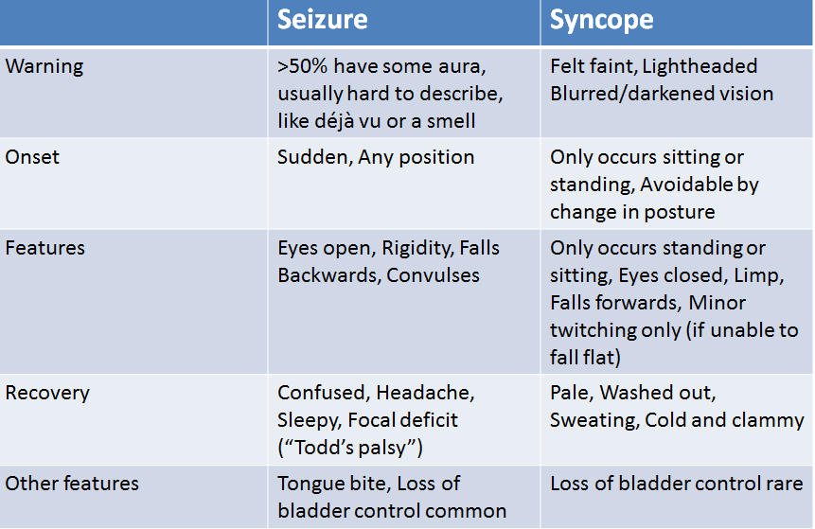
Syncope vs seizure
The Peer Teaching Society is not liable for false or misleading information…

Slide 23
Let’s Practise!
The Peer Teaching Society is not liable for false or misleading information…

Slide 24
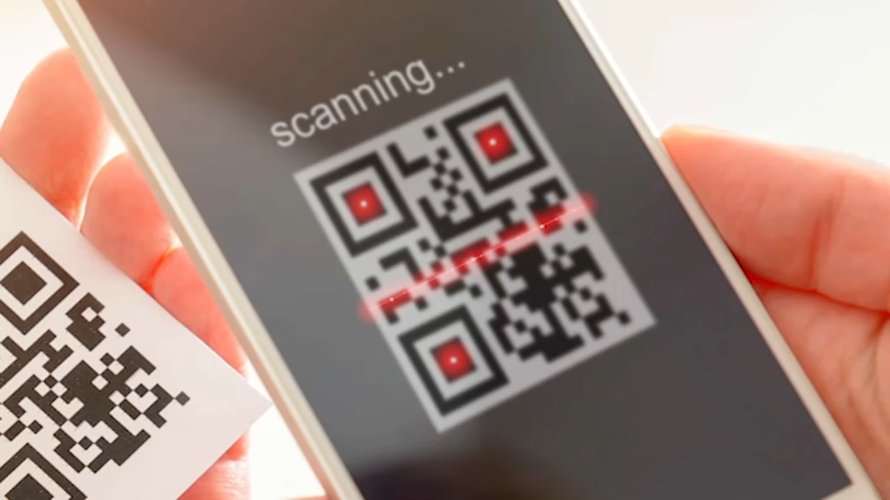
Feedback
https://forms.gle/iUDt3G29uX8yZNHv6
The Peer Teaching Society is not liable for false or misleading information…

