Slide 1
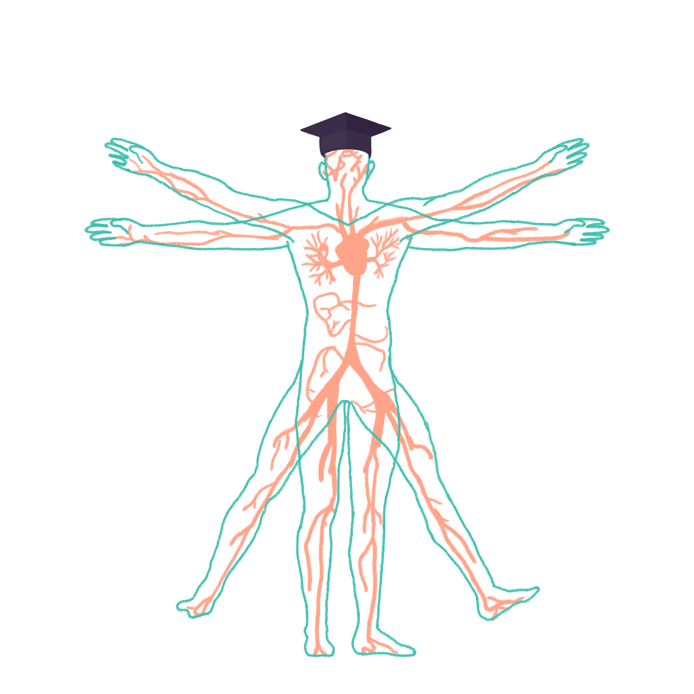
2023/2024

Slide 2
Neurology
Phase 2a Revision Session
20/03/2024
Adam Orford and Jessica To
The Peer Teaching Society is not liable for false or misleading information…

Slide 3
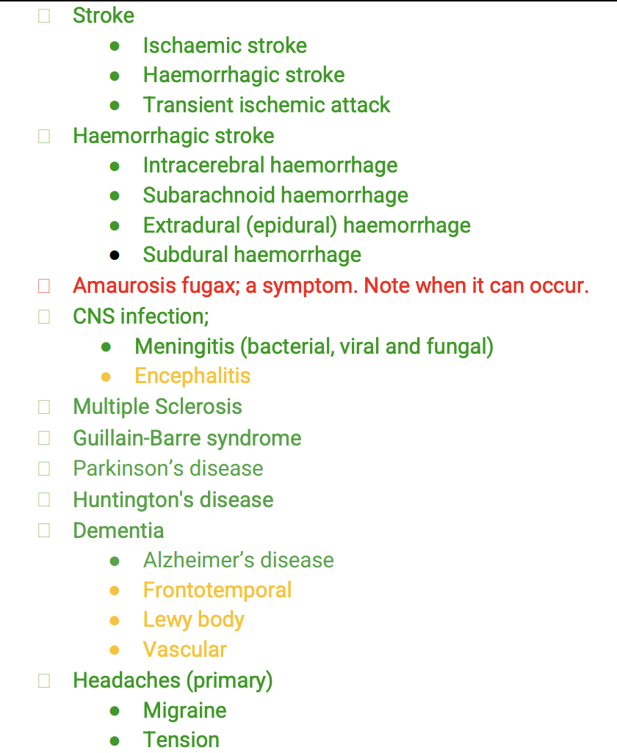
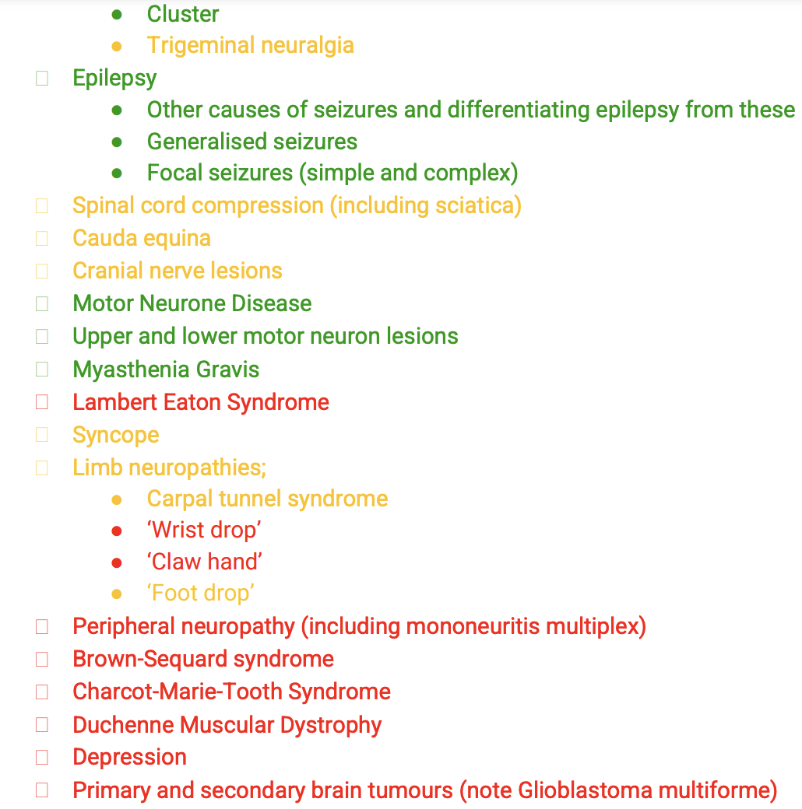
Aims and Objectives
The Peer Teaching Society is not liable for false or misleading information…

Slide 4
Transient Ischaemic Attack
DEFINITION – a transient episode of neurologic dysfunction caused by focal brain, spinal cord, or retinal ischaemia, without acute infarction.
INVESTIGATIONS:
MRI head – same day
Carotid doppler – determine whether they are a candidate for carotid endarterectomy
RISK FACTORS:
Older age
Male
Previous TIA
Smoking
Physical inactivity
Hypertension
AF
Carotid artery disease
Hyperlipidaemia
Diabetes
MANAGEMENT – REVIEW BY A SPECIALIST:
1 or more TIA 🡪 discuss with a specialist about urgent admission
Suspected TIA in the last 7 days 🡪 urgent assessment with 24 hours by a stroke specialist
Suspected TIA more than 7 days ago 🡪 assessment within 7 days
MANAGEMENT – IMMEDIATE THROMBOTIC THERAPY:
Aspirin 300 mg, unless:
Patient is bleeding or taking an anticoagulant 🡪 need immediate admission for imaging (CT Head) to exclude a bleed.
Patient is already taking aspirin 🡪 continue current dose until reviewed by a specialist.
PRESENTATION – sudden onset neurological deficit that usually resolves within an hour:
Unilateral weakness or sensory loss
Aphasia or dysarthria
Ataxia, vertigo or loss of balance
Visual problems
SECONDARY PREVENTION:
Clopidogrel
(Aspirin and dipyridamole – patients who cannot tolerate clopidogrel)
Statin e.g artorvastatin
Carotid endarectomy – carotid stenosis > 70%
Notes:
Tia
Mini-stroke
Modifiable vs non-modifiable risk factors
Driving?

Slide 5
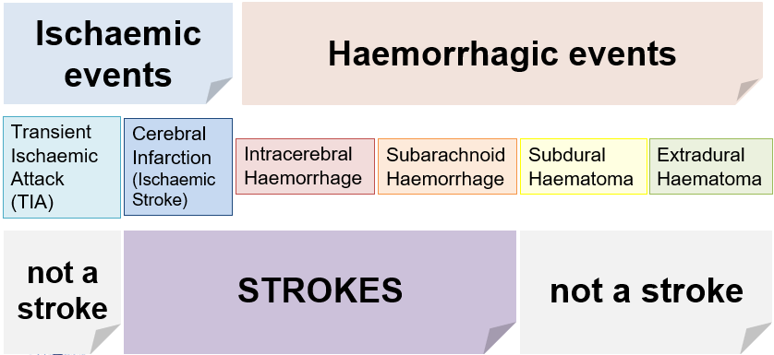
Stroke
DEFINITION – sudden onset neurological deficit due to ischaemic or haemorrhagic compromise in the blood supply to the brain that lasts more than 24 hours/with evidence of infarction
There are two main types of stroke:
Ischaemic stroke – due to vascular occlusion or stenosis causing inadequate blood flow to parts of the brain
Accounts for 85% of cases of stroke
Haemorrhagic stroke - due to vascular rupture of a vessel in the brain causing haemorrhage
Accounts for 15% of cases of stroke
Intracerebral haemorrhage
Subarachnoid haemorrhage
Subdural haeemorrhage
Extradural haemorrhage

Slide 6
Ischaemic Stroke
RISK FACTORS – same as for a TIA!
OTHER INVESTIGATIONS:
ECG/ambulatory ECG monitoring – AF 🡪 anticoagulation
Carotid imaging (US/CT/MRI angiogram) 🡪 carotid artery stenosis 🡪 carotid endarterectomy, stenting
IDENTIFICATION TOOLS:
FAST tool – used in the community
ROSIER score – used in the hospital
MANAGEMENT:
Exclude hypoglycaemia
Immediate non-contrast CT head – exclude haemorrhage
MRI head – gold-standard for identifying vascular territory affected
Aspirin 300 mg daily for 2 weeks
Blood pressure should not be lowered – do not want to reduce perfusion to brain
Admission to a specialist stroke centre
Thrombolysis with ateplase – within 4.5 hours of symptom onset
Contra-indications – active internal bleeding, recent haemorrhage, recent surgery, recent head injury, bleeding disorder/coagulation, stroke <3 months, severe hypertension
Mechanical thrombectomy – within 24 hours of symptom onset
No driving for at least 1 month following a TIA or stroke, no need to inform DVLA
SECONDARY PREVENTION:
Clopidogrel 75 mg once daily
Artorvastatin 20 – 80 mg
Blood pressure and diabetes control
Reducing modifiable risk factors
Barthel Index – used to assess degree of functional independence post-stroke:
Feeding
Bathing
Climbing stairs
Bladder/bowel control
Notes:
Symptoms on next slide

Slide 7
Bamford Classification
The most commonly used classification for ischaemic stroke – based on presenting symptoms and clinical signs:
Also known as the Oxford Stroke Classification

Slide 8
Stroke Territories
Site of the lesion | Associated effects
Anterior cerebral artery | Contralateral hemiparesis and sensory loss, lower extremity > upper
Middle cerebral artery | Contralateral hemiparesis and sensory loss, upper extremity > lower Contralateral homonymous hemianopia Aphasia
Posterior cerebral artery | Contralateral homonymous hemianopia with macular sparing Visual agnosia
Weber's syndrome (branches of the posterior cerebral artery that supply the midbrain) | Ipsilateral CN III palsy Contralateral weakness of upper and lower extremity
Posterior inferior cerebellar artery (lateral medullary syndrome, Wallenberg syndrome) | Ipsilateral: facial pain and temperature loss Contralateral: limb/torso pain and temperature loss Ataxia, nystagmus
Anterior inferior cerebellar artery (lateral pontine syndrome) | Symptoms are similar to Wallenberg's (see above), but: Ipsilateral: facial paralysis and deafness
Retinal/ophthalmic artery | Amaurosis fugax
Basilar artery | 'Locked-in' syndrome
Lacunar strokes present with either:
Isolated hemiparesis
Hemisensory loss
Hemiparesis with limb ataxia

Slide 9
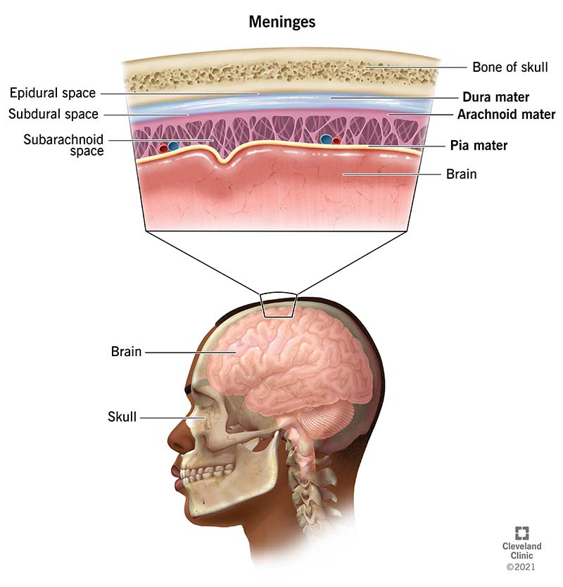
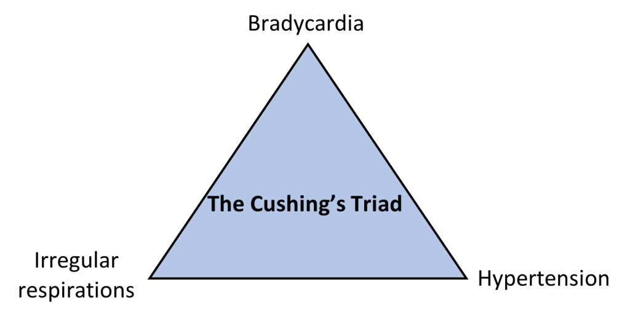
Haemorrhage
Haemorrhagic strokes can result in a raised intra-cranial pressure (ICP):
The body’s response 🡪 Cushing’s triad
A raised ICP can be treated with mannitol – osmotic diuretic

Slide 10
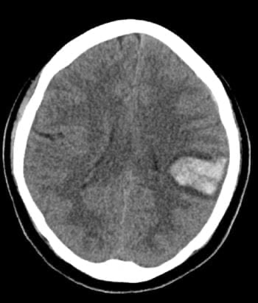
Intracerebral Haemorrhage
DEFINITION | Bleeding that occurs within the brain tissue: Most commonly occurs in the basal ganglia
RISK FACTORS AND CAUSES | Hypertension Vasculitis Vascular tumours Arteriovenous malformations Aneurysm rupture Trauma
SIGNS AND SYMPTOMS | Headache Decreased level of consciousness Nausea and vomiting Seizures
INVESTIGATIONS | Non-contrast CT head: Hyperdensity – fresh blood Midline shift if large
MANAGEMENT | ABCDE management Supportive management Burr-hole/craniotomy

Slide 11
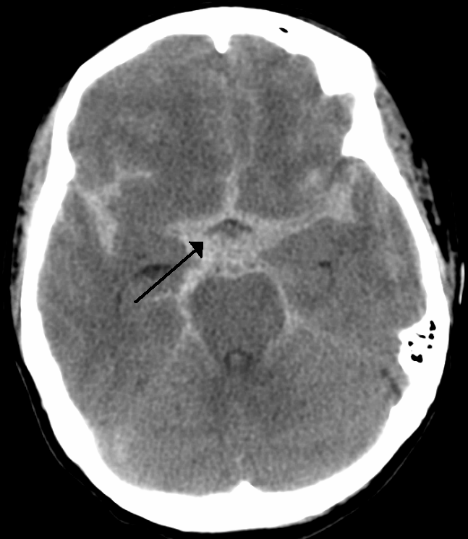
Subarachnoid Haemorrhage
DEFINITION | Bleeding that occurs within the subarachnoid space, between the pia mater and arachnoid mater
RISK FACTORS AND CAUSES | Berry aneurysms - mainly found at anterior communicating arteries of circle of Willis Arteriovenous malformations Hypertension Marfan’s syndrome Autosomal dominant polycystic kidney disease - predisposes to berry aneurysms Sickle cell anaemia
SIGNS AND SYMPTOMS | Thunderclap headache - sudden onset of a severe headache, described as worse ever Decreased level of consciousness Nausea and vomiting Seizures
INVESTIGATIONS | Non-contrast CT head – only visible on CT after 48 hours: Hyperdense - brightness shows fresh blood Star sign - blood seen in cisterns and ventricles Lumbar puncture – must be done 12 hours after headache to allow time for bilirubin to breakdown: Xanthochromia – yellow CSF due to bilirubin breakdown
MANAGEMENT | ABCDE management Nimodipine (CCB) - prevent vasospasms Surgery – coiling
COMPLICATIONS | Hydrocephalus, rebleeding, seizures, vasospasms

Slide 12
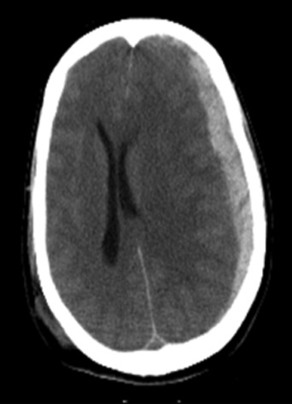
Subdural Haemorrhage
DEFINITION | Bleeding occurs between the dura mater and arachnoid mater
CAUSES | Rupture of bridging veins found in the subdural space: Brain atrophy seen in elderly Alcohol abuse - causes vein walls to become thinner Shaken baby syndrome
SIGNS AND SYMPTOMS | Slower onset of symptoms: Headache Decreased level of consciousness Confusion Nausea and vomiting Seizures
INVESTIGATIONS | Non-contrast CT head: Hypodense - old blood Crescent shape (concave) - conforms to the surface of the brain Bleeding crosses suture lines Midline shift
MANAGEMENT | ABCDE management Supportive management Burr-hole/craniotomy

Slide 13
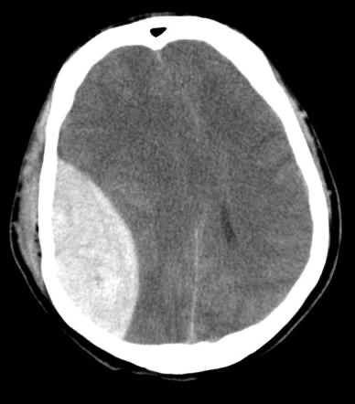
Extradural Haemorrhage
DEFINITION | Bleeding occurs outside of the dura mater
CAUSES | Bleeding from the middle meningeal artery as as result of skull fracture due to low impact trauma
SIGNS AND SYMPTOMS | Lucid interval – symptoms begin to improve, them get worse Headache Decreased level of consciousness Confusion Nausea and vomiting Seizures
INVESTIGATIONS | Non-contrast CT head: Hyperdense - brightness shows fresh blood Lemon shape (convex) - does not conform to the surface of the brain Bleeding does not cross suture lines Midline shift
MANAGEMENT | ABCDE management Supportive management Burr-hole/craniotomy

Slide 14
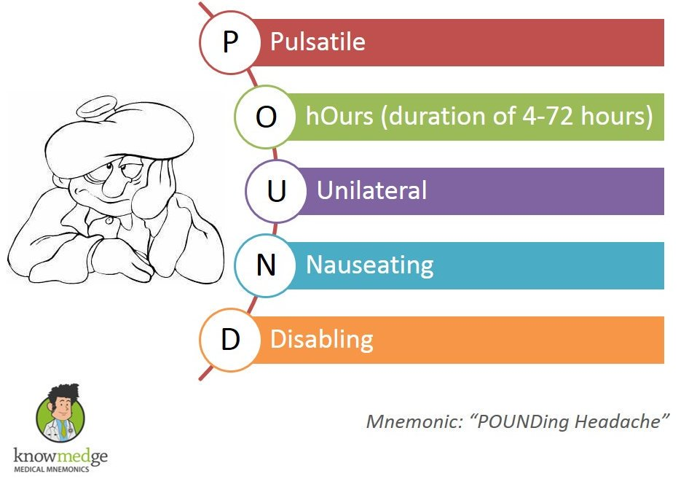
Migraine
Features | Triggers 🡪 Remember a few (stress, cheese) ( e.g., CHOCOLATE, MIGRAINED etc)
Presentation | If 3 or 4 of POUND then likely
Stages | Prodromal – yawning, craving, days before Aura – zig-zags, wavy lines paraesthesia , up to 60minutes Headache – Unilateral, Pounding, Photo/Phonophobia, N+V, 4 hours to 3 days Resolution – fading away, sleep it off Postdrome
Management | Acutely: Lying in dark, quiet room, sleeping NSAIDs, Paracetamol, Triptans, Antiemetics (Metoclopramide / Prochlorperazine) Opioids make it worse Triptans (taken on onset of headache, CI in HTN, CAD, PMHx Stroke, TIA, MI, Can worsen symptoms if taken too often) Metoclopramide (Extra-pyramidal side effects) Prophylaxis: Headache Diary 🡪 avoid triggers Propranolol – B-Blocker (CI in asthma) Amitriptyline – TCA Topiramate – Teratogenic, need contraception (but not COCP if migrainr with aura)
Notes:
Triptan binding to the vascular 5-HT1B receptors leads to vasoconstriction of the cranial arteries, which painfully dilate during a migraine attack.
https://www.grepmed.com/images/2967/primarycare-diagnosis-mnemonic-headache-migraine

Slide 15
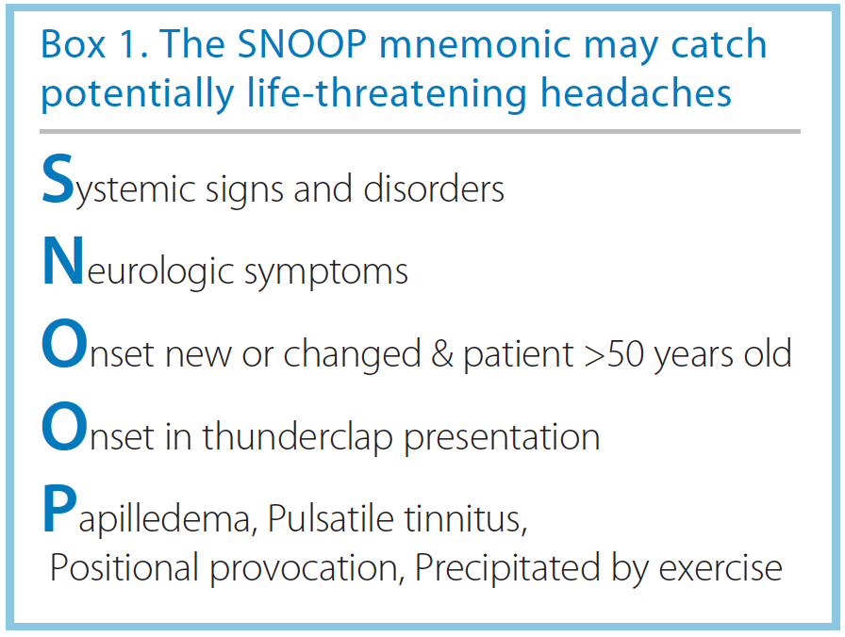
Red Flags
Fever, Photophobia, Neck Stiffness 🡪 Meningitis
New Focal Neurology 🡪 Brain Bleed / Tumour
Visual Disturbance // Papilloedema 🡪 Raised ICP / GCA / Glaucoma
When coughing/straining/standing/ bending over/ postural🡪 Raised ICP
Sudden-Onset 🡪 SAH
Vomiting 🡪 Raised ICP or CO poisoning
Trauma 🡪 Brain Bleed
PMHx of cancer 🡪 Mets
Pregnant 🡪 Pre-eclampsia
Notes:
https://practicalneurology.com/articles/2018-mar-apr/ruling-out-secondary-headache

Slide 16
Tension Headaches
Like a band around the head
No visual changes
Associated with stress, depression, alcohol, skipping meals, dehydration
Mx 🡪 Reassurance, Paracetamol, Ibuprofen
Prophylaxis 🡪 Amitriptyline
Notes:
https://healthmatters.nyp.org/whats-causing-your-headache-and-when-to-worry/

Slide 17
Cluster Headaches
Episodic (3-4 attacks between 15 mins and 3 hours) for wks/months then long pain free periods
Severe pain assoc with red, swollen eye, Lacrimation, Miosis, Ptosis
Typically 30-50yo male smoker, drinker etc
Mx 🡪
Acutely = SC Triptans, High-flow 100% O2
Prophylaxis = Verapamil (CCB), others Lithium, Prednisolone

Slide 18
Notes:
https://www.thehealthequation.co.uk/classification-of-headache-migraine/

Slide 19
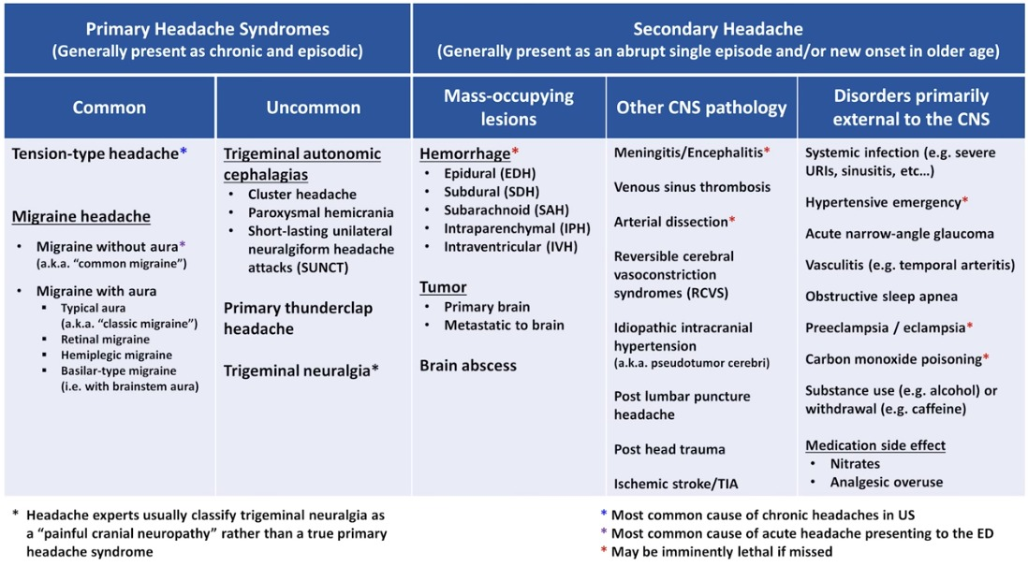
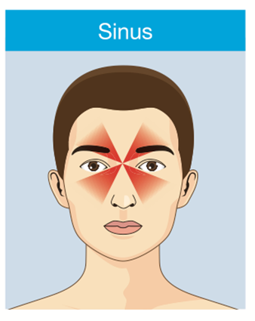
Secondary Headache 🡪 Tension Headache but with a clear cause
Sinus (pain behind browbone / cheekbones)
Med Overuse (15 days or more in a month (NSAIDs, painkillers etc) Triptans/Opioids – 10 days a month
Notes:
https://lambruneurology.com/tension-type-headache/

Slide 20
Dementia
Notes:
https://www.crosskeysvillage.org/dementia-warning-signs/

Slide 21
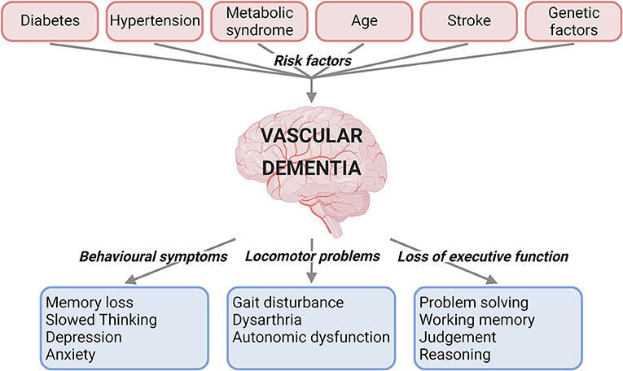
Alzheimer's
Most common cause, steadily progresses, usually older
RF 🡪 Age, FHx, Down’s Syndrome.
Histologically 🡪 Beta-Amyloid Plaques, Tau Protein Neurofibrillary Tangles
Sx:
Memory Loss, Varying changes in planning, speech, orientation
Asses in GP:
6CIT / 10CS
Grading:
MMSE 21-26 (Mild), 10-20 (moderate), Below 10 (severe)
MMSE 10-14 (moderately-severe)
Vascular Dementia
White Matter of cerebral hemispheres, grey nuclei, thalamus and the striatum affected from multiple cerebrovascular infarcts (most commonly)
RFx = HTN, Smoking, T2DM, Obesity, Hypocholesteraemia
Affects patients in a stepwise fashion (stable, acute decline, stable with reduced function)
Diagnosis 🡪 NINDS-AIREN Criteria
No Mx 🡪 Controlling BP etc
Frontotemporal Dementia
Younger patients usually
Neuron damage occurring in Frontal and Temporal Lobes, Microscopically there are Pick Bodies and Gliosis
Apathy, Disinhibition, Impulsivity, Childlike, Decline in words/Speech Apraxia
Lewy Body Dementia
Parkinson’s Plus Syndrome
Spherical Lewy body proteins (alpha-synuclein) are deposited in the brain.
Visual Hallucinations and Parkinson-like symptoms following onset of dementia
DaTscan / SPECT scan used, Normal CT scan
If Dementia after Parkinson symptoms = Parkinson's Dementia
DDX:
Creutzfeldt-Jakob Disease 🡪 Prion Protein Infection, rapidly causing death
Normal Pressure Hydrocephalus (Wet, Wobbly, Wacky = Urinary Incontinence, Gait Disturbance, Dementia
Severe Depression
Notes:
6 Item Cognition Impairment Test
10 Point Cognition Screener

Slide 22
Dementia Management
Alzheimers:
Non-Pharmacological = Wellbeing exercises, group cognition stimulation therapy (mild/moderate)
Pharmacological:
Mild / Mod 🡪 Acetylcholinesterase Inhibitors (Doneprazil/Rivastigmine). CI if bradycardia, can cause some insomnia.
NDMA Receptor Agonist (Memantine) 🡪 Moderate if CI to above/Add on if Mod/Severe, Monotherapy if severe
Lewy-Body Dementia:
Mild/Moderate/Severe 🡪 Doneprazil/Rivastigmine
Consider Memantine if not tolerated or CI to AChE Inhibitors
Don’t give antipsychotics 🡪 Precipitates severe Parkinsonism
Drugs not recommended in Vascular (manage risk factors e.g., BP) / FTD

Slide 23
Notes:
https://www.independentnurse.co.uk/content/clinical/the-role-of-the-nurse-in-screening-people-with-suspected-dementia/

Slide 24
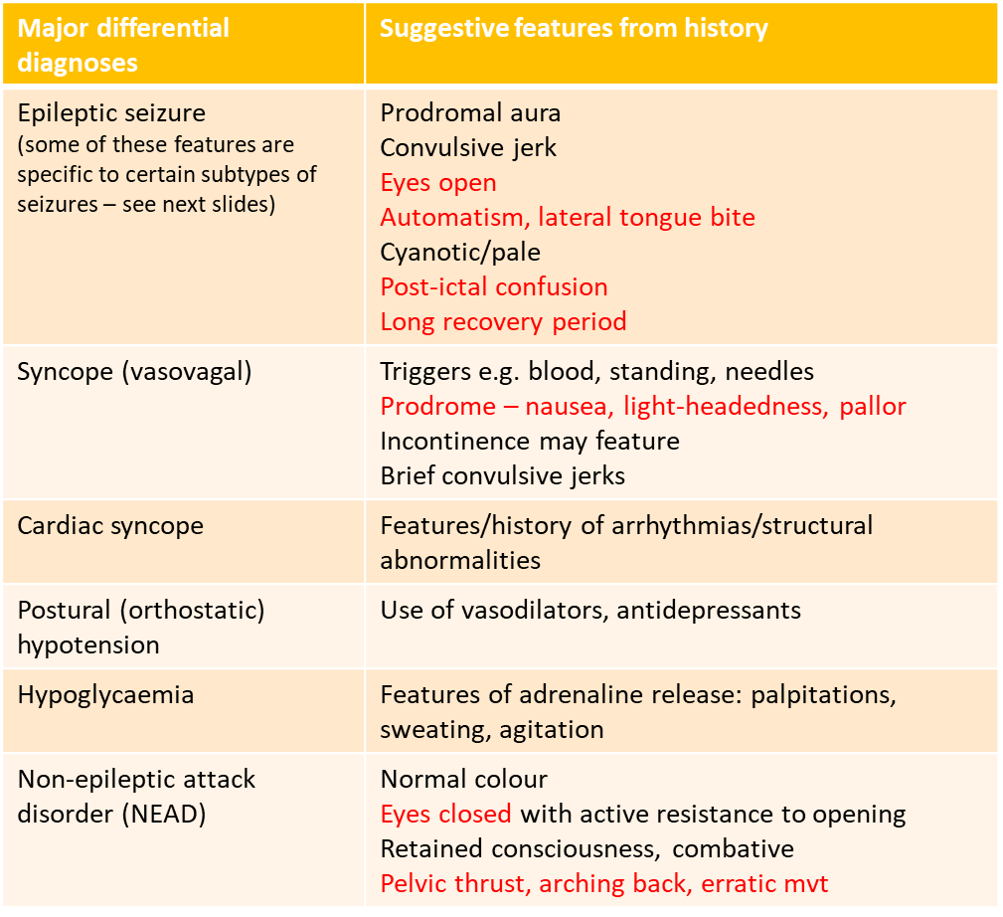
LOC DDx
From a previous PTS session but is honestly invaluable!

Slide 25
Primary Syncope
DEFINITION | Temporary loss of consciousness, characterised by fast onset, short duration and spontaneous recovery. Primary syncope (vasgo-vagal syncope) – simple fainting, no underlying pathology Secondary syncope – fainting due to an underlying pathology
PATHOPHYSIOLOGY | Due to a problem with the way the autonomic nervous system regulates blood flow to the brain: Vagus nerve receives a strong stimulus e.g an emotional event, painful sensation Parasympathetic NS is stimulated 🡪 blood vessels to the brain undergo vasodilation Blood pressure in the cerebral circulation drops 🡪 hypoperfusion of the brain Patient loses consciousness
SIGNS AND SYMPTOMS | Hot, sweaty clammy Light-headedness Dizziness Visual changes – blurriness Headache Feeling groggy after a faint – only lasts a short while, differs from post-ictal period following a epileptic seizure
CAUSES | Dehydration or missed meals Extended standing in a warm environment Vasovagal response to a stimuli – sudden surprise, pain or sight of blood
MANAGEMENT | Avoid dehydration and skipping meals Avoid prolonged standing If experiencing pre-syncope – sit or lie down to prevent injury if syncope occurs

Slide 26
Secondary Syncope
Causes of secondary syncope:
Hypoglycaemia
Anaemia
Arrhythmia
Structural heart disease – aortic valve stenosis
Infections
Investigations:
Blood-glucose
FBC and U&Es
ECGs
Echocardiogram

Slide 27
Epilepsy
Definition | Epilepsy is a disease of the brain defined by any of the following: At least two unprovoked seizures occurring more than 24 hours apart. One unprovoked seizure and a probability of further seizures similar to the general recurrence risk after two unprovoked seizures, occurring over the next 10 years. Diagnosis of an epilepsy syndrome.
Causes | Structural, Genetics, Infections, Metabolic, Immune
Stages | Prodrome 🡪 Mood changes, Anxiety, Difficulty Sleeping/focusing, Light-headedness Aura 🡪 Déjà vu, Jamais Vu, Odd smells, sounds, tastes, Numbness, Nausea, Headache, Vision Change Ictal 🡪 LOC, Memory Lapse, Confusion, Twitching, Repeated movements Post-Ictal 🡪 Confusion, Fatigue, Headache, Frustration, Anxiety, Injury, Sore Muscles
Types | Generalised Tonic-Clonic = Muscle tensing and jerking, prolonged post-ictal Focal Seizure = specific lobe, remain aware during simple partial seizures but lose awareness during complex partial seizures Myoclonic Seizure = Brief muscle contraction, ‘jolt’ Tonic Seizure = Increased muscle tone and body stiffens Atonic Seizure = Drop Attack, loss of muscle tone, Absence Seizure = Children, pt goes blank, become unaware and quickly return to normal
Ix | EEG, MRI, ECG, Serum Electrolytes, BMs, Blood cultures, Urine Cultures, Lumbar Puncture
Notes:
Serum electrolytes, including sodium, potassium, calcium and magnesium
BM for hypoglycaemia and diabetes
Blood cultures, urine cultures and lumbar puncture where sepsis, encephalitis or meningitis is suspected
https://magazine.medlineplus.gov/article/understanding-different-kinds-of-seizures

Slide 28
Focal Seizures
Frontal – ‘Movement’
Parietal – ‘Sensation’
Jackson March, Post-Ictal Todd’s Palsy
Temporal
Aura, Lip-smacking
Occipital - ‘ Vision’
Notes:
https://www.researchgate.net/figure/The-the-typical-symptoms-of-seizures-originating-in-various-areas-of-the-brain_fig3_14059973

Slide 29
Seizure Management
Generalised tonic-clonic seizures | Males – sodium valproate (teratogenic – not given to women of child-bearing age) Females – lamotrigine or levetiracetam
Focal seizures | First line – lamotrigine or levetiracetam Second line – carbamazepine
Absence seizures (Petit mal) | First line – ethosuximide Second line: Male – sodium valproate Female – lamotrigine or levetiracetam Carbamazepine may exacerbate absence seizures
Myoclonic seizures | Males – sodium valproate Females – levetiracetam
Tonic or atonic seizures | Males – sodium valproate Females – lamotrigine

Slide 30
Status Epilepticus – Medical Emergency
Defined as:
Prolonged convulsive seizure for 5 minutes or longer
Or recurrent seizures one after the other without recovery in between.
Management:
ABCDE – Secure airway, High-Conc O2, Check BMs, Get IV access
Initially IV Lorazepam repeat after 10 minutes
(Buccal Midazolam / Rectal Diazepam in community)
Second Line = IV Levetiracetam.
Other options = phenytoin or Sodium Valproate
Third Line = Alt Second Line med, GA or Phenobarbital

Slide 31
Multiple Sclerosis
DEFINITION | An inflammatory and demylinating disease characterised by the presence of neurological dysfunction in at least 2 areas of the CNS, disseminated by time and space: Type 4 hypersensitivity reaction
RISK FACTORS | Female Aged 20 to 40
CAUSES | Multiple genes involved EBV Low vitamin D Smoking Obesity
SIGNS AND SYMPTOMS | Optic neuritis Uhthoff’s phenomena – symptoms are worse with heat e.g after a hot shower Lhermitte’s sign – an electric shock sensation that travels down the spine when flexing the neck Eye movement abnormalities Numbness Paraesthesia Urinary incontinence Bowel dysfunction Sexual dysfunction
CRITERIA | McDonald Criteria – multiple CNS lesions which: Last more than 24 hours Disseminated by time – more than 1 month apart Disseminated by space – clinically on a MRI scan
Notes:
Insert graph
Uhthoff's phenomena - symptoms are worse with heat e.g after a hot shower
Lhermitte's sign - an electric shock sensation that travels down the spine when flexing the neck

Slide 32
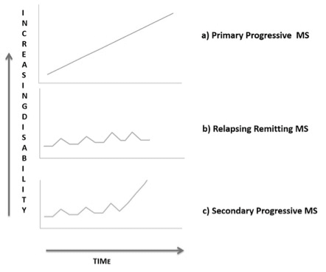
Multiple Sclerosis
DIAGNOSIS AND INVESTIGATIONS | Evidence of CNS lesions that are disseminated by time and space: MRI spine – visualise lesions Lumbar puncture – oligoclonal bands
MANAGEMENT | Acute relapse of MS – corticosteroids e.g methylprednisolone Long term management – natalizumab, interferon-beta, fingolimod Symptomatic management
Notes:
Clinically isolated syndrome

Slide 33
Guillain-Barre Syndrome
DEFINITION | An acute, autoimmune, demylinating condition that affects the PNS causing symmetrical, ascending weakness.
CAUSES | Campylobacter jejuni (gastroenteritis), EBV, CMV, Zika Virus
SIGNS AND SYMPTOMS | Back/leg pain Symmetrical and ascending muscle weakness Areflexia/hyporeflexia Facial weakness Speech impairment
DIAGNOSIS AND INVESTIGATIONS | Brighton Criteria Lumbar puncture – raised protein, but normal white cell count and glucose Nerve conduction studies Anti-ganglioside antibodies (anti-GM1)
MANAGEMENT | IV IG or plasma exchange Physiotherapy
COMPLICATIONS | Respiratory failure 🡪 monitor FVC 🡪 admit for ICU for mechanical ventilation
* MILLER FISHER SYNDROME | Variant of GBS Triad of opthalmopelgia, areflexia and ataxia Eyes are affected first, descending paralysis

Slide 34
Parkinson’s Disease
DEFINITION | A neurodegenerative disorder where there is a progressive reduction of dopamine in the basal ganglia of the brain, resulting in disorders of movement.
PATHOPHYSIOLOGY | Basal ganglia are a group of subcortical nuclei responsible for motor control Dopaminergic neurones in substantia nigra produces dopamine Dopamine is essential for the functionning of the basal ganglia In Parkinson's, there is death of dopaminergic neurones Less dopamine is produced so reduced movement initiation
KEY FEATURES | Male over 70 + TRAP BF: Tremor – resting tremor Rigidity (cogwheel rigidity) Akinesia – lack of movement Postural instability Bradykinesia – slow and small movements Festination
OTHER FEATURES | Depression Dementia Constipation Urinary urgency Insomnia Anosmia
DFIAGNOSIS AND INVESTIGATIONS | Clinical diagnosis by a specialist Dopaminergic agent shows improvement of symptoms

Slide 35
Parkinson’s Disease
MANAGEMENT | Dopamine agonists – bromocriptine, carbergoline Monoamine oxidase B-inhibitors – rasagilline, selegilline Levodopa + peripheral decarboxylase inhibitor – Levodopa + carbidopa --> co-carledopa
PARKINSON-PLUS SYNDROMES | Multiple system atrophy (MSA) Progressive supranuclear palsy Dementia with Lewy bodies Corticobasal degeneration

Slide 36
Meningitis
DEFINITION | Inflammation of the meninges, the linings of the brain and spinal cord.
CAUSES | Bacteria Fungi Viruses
RISK FACTORS | Older age Over-crowding Immunocompromised e.g HIV
SIGNS AND SYMPTOMS | Fever Headache Neck stiffness Non-blanching rash Photophobia Nausea and vomiting
DIAGNOSIS AND INVESTIGATIONS | Special tests – Kernig’s test and Brudzinski’s test Lumbar puncture (L3/4 or L4/5) – contra-indicated in meningococcal septicaeemia Blood cultures – prior to giving antibiotics but should not delay the administration of antibiotics
MANAGEMENT | NOTIFY Public Health England Community – IM benzylpenicillin (BACTERIAL) Hospital (aged under 3 months) – cefotaxime and amoxicillin (BACTERAL) Hospital (aged over 3 months) – ceftriaxone (BACTERIAL) Aciclovir (VIRAL)
Notes:
Kernig's sign: Position the patients supine with their hips flexed to 90°. This test is positive if there is pain on passive extension of the knee.
Brudzinski's sign: Position the patients supine and passively flex their neck. This test is positive if this manoeuvre causes reflex flexion of the hip and knee

Slide 37
Meningitis
PROPHYLAXIS FOR CLOSE-CONTACTS | Single dose of ciprofloxacin or rifampicin
COMPLICATIONS | Sensorineural hearing loss – most common Seizures Focal neurological deficit Waterhouse-Fridrichensen syndrome – adrenal insufficiency secondary to adrenal haemorrhage

Slide 38
Meningitis - Causes
0 – 3 Months | 3 Months – 6 Years | 6 Years – 60 Years | > 60 Years
Group B Streptococcus (most common cause in neonates) E. coli Listeria monocytogenes | Neisseria meningitidis Streptococcus pneumoniae Haemophilus influenzae | Neisseria meningitidis Streptococcus pneumoniae | Streptococcus pneumoniae Neisseria meningitidis Listeria monocytogenes
Immunosuppressed – Listeria monocytogenes
Fugal – cryptococcus neoformans
Viral – enteroviruses e.g cosackle viruses

Slide 39
Meningitis – LP Analysis

Slide 40
Encephalitis
DEFINITION | Inflammation of the brain, can be caused by either infective or non-infective (autoimmune) causes
RISK FACTORS | Aged under 1 or over 65 Immunodeficiency Viral infections
CAUSES | Viruses are the main cause – HSV-1
SIGNS AND SYMPTOMS | Fever Headache Psychiatric symptoms Focal features e,g aphasia Meningismus
DIAGNOSIS AND INVESTIGATIONS | Lumbar puncture – raised lymphocytes, raised proteins PCR – HSV CT head – medial temporal and inferior frontal lobe changes
MANAGEMENT | IV aciclovir
Notes:
Autoimmune?

Slide 41
Huntington’s Disease
DEFINITION | A slowly, progressive neurodegenerative disorder which causes degeneration of the nerve cells in the brain.
EPIDEMIOLOGY | Affects male and females equally Usually asymptomatic until aged 30 to 50
CAUSE | Autosomal dominant genetic condition – mutation on Huntington (HTT) gene on chromosome 4 Anticipation – genetic conditions which affect successive generations earlier and more severely due to expansion of unstable triplet repeat sequences Anticipation of trinucleotide CAG
SIGNS AND SYMPTOMS | Family history or unknown family history (adopted) Personality change - irritable, outbursts, impulsive Chorea - involuntary, abnormal movements Eye movement disorders Dysarthria Dysphagia
DIAGNOSIS AND INVESTIGATIONS | Clinical diagnosis confirmed by CAG repeat testing
MANAGEMENT | No treatment to slow down or stop progression of disease, management is mainly supportive Occupational therapy, physiotherapy, speech and language therapy – maintain quality of life Genetic counselling regarding relatives, pregnancy and children Advanced directives and end of life care planning Chorea – dopamine-depleting agents (tetrabenazine), benzodiazepines (diazepam), anti-psychotics (olanazapine, risperidone)

Slide 42
Cauda Equina Syndrome
DEFINITION | A condition where there is damage to the cauda equina, the bundle of nerves found at the end of the spinal cord: Medical emergency L4/5 and L5/S1 – most commonly affected areas
CAUSES | Lumbar disc herniation – most common Stenosis of the lumbar vertebrae Ankylosing spondylitis Spondylolisthesis – vertebrae become displaced Trauma Tumour
SIGNS AND SYMPTOMS | Saddle anaesthesia Sexual dysfunction Bowel and bladder dysfunction Muscle weakness in the legs Loss of knee and ankle reflexes Sciatic-like pain – bilateral
INVESTIGATIONS | Clinical diagnosis Gold standard – MRI spine
MANAGEMENT | Urgent referral to neurosurgery for cord decompression High dose dexamethasone – reduce cord compression

Slide 43
Sciatica
DEFINITION | A condition that causes irritation of the sciatic nerve and the nerves that form it
CAUSES | Herniated disc Spondylolisthesis Spinal stenosis Tumours Piriformis syndrome - muscle inflammation can cause compression of the sciatic nerve as sciatic nerve runs directly behind this muscle Pregnancy - foetal head can compress sciatic nerve when sitting
SIGNS AND SYMPTOMS | Unilateral pain from the buttocks radiating down the leg – unlike cauda equina which is more likely to be bilateral 'Electric' or 'shooting' pain Paraesthesia Numbness
DIAGNOSIS | Clinical diagnosis Sciatic stretch test
MANAGEMENT | CBT Physiotherapy Neuropathic pain medication – amitriptyline, duloxetine

Slide 44
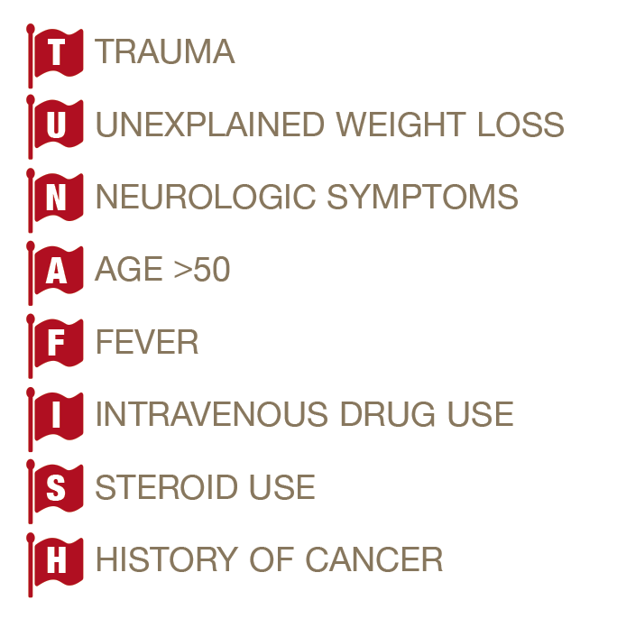
Back Pain Red Flags
Spinal fracture
Cancer
Cauda equina syndrome
Cancer
(AGE <40 – ankylosing spondylitis
Spinal infection
Cauda equina, spinal metastases

Slide 45
Motor Neuron Disease
DEFINITION | An umbrella term that encompasses a range of conditions that can cause progressive degeneration of the upper and lower motor neurons. Amyotrophic lateral sclerosis (ALS) is the most common type of MND – affects UMN and LMN
RISK FACTORS | Family history Over 40 years old
SIGNS AND SYMPTOMS | UMN and LMN signs Unsteady gait Stiffness Head and foot drop Coughing and choking on liquids and foods Slow, strained speech Does not affect the eyes
INVESTIGATIONS | Clinical diagnosis – diagnosis of exclusion Nerve conduction studies – normal, exclude neuropathy MRI spine – exclude cervical cord compression
MANAGEMENT | Riluzole Supportive care End of life care planning Non-invasive ventilation (NIV) – can support breathing at night
OTHER TYPES OF MND | Progressive bulbar palsy - affects LMN only – worse prognosis Progressive muscular atrophy – affects LMN only Primary lateral sclerosis – affects UMN only – least common

Slide 46
Upper vs Lower Motor Neuron Lesions
UMN – neuron whose cell body originates in the cerebral cortex or brainstem, and terminates in the brainstem or spinal cord
LMN – neuron whose cell body originates in the brainstem or ventral horn of the spinal cord, it extends out of the CNS and terminates at the muscle fibres which it innervates
UMN Lesions | LMN Lesions
Spastic paralysis | Flaccid paralysis
Hyperreflexia | Hyporeflexia
Hypertonia | Hypotonia
Fasciculations absent | Fasculitations present
Babinski sign positive | Babinski sign negative
Clasp-knife reflex positive | Clasp-knife reflex negative

Slide 47
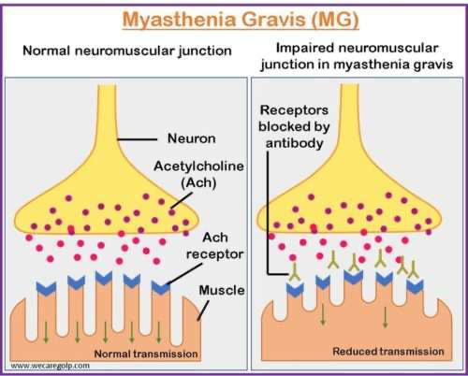
Myasthenia Gravis
DEFINITION | An autoimmune condition that causes muscle weakness that gets progressively worse with activity and improves with rest: Type 2 hypersensitivity reaction
PATHOPHYSIOLOGY | Acetylcholine receptor antibodies are produced by the immune system which bind to post-synaptic receptors of the neuromuscular junction. Antibodies block post-synaptic receptors and prevent acetylcholine from binding and triggering muscle contractions Receptors are needed more in times of activity – symptoms are worse with activity.
RISK FACTORS AND ASSOCIATIONS | Female Associated with thymomas
SIGNS AND SYMPTOMS | Fatigability – muscles become progressively weaker with activity Diplopia Ptosis Dysphagia Proximal muscle weakness – face, neck, limb girdle
INVESTIGATIONS | Single fibre electromyography Acetylcholine-receptor antibodies – sensitive Muscle specific kinase antibodies – specific CT thorax – thymoma
MANAGEMENT | 1st line - pyridostimine (long-acting acetylcholinesterase inhibitor) Immunosuppression – prednisolone, azathioprine Thymectomy

Slide 48
Myasthenia Gravis
COMPLICATION | Myathenic crisis: An illness can cause acute worsening of symptoms May result in respiratory failure if muscle of respiration become affected 🡪 monitored by ABG and FVC Treated with IV IG and plasmapheresis

Slide 49
Lambert-Eaton Syndrome
DEFINITION | An autoimmune condition that affects the neuromuscular junction and results in muscle contractions which get stronger with repeated use.
PATHOPHYSIOLOGY | Antibodies form against voltage-gated calcium channels in the presynaptic membrane of the neuromuscular junction. Voltage-gated calcium channels are involved in the release of acetylcholine into the NMJ, so when the voltage-gated calcium channels become destoryed, less acetylcholine is released into the synapse resulting in weaker muscle contractions
ASSOCIATIONS | Small-cell lung cancer
SIGNS AND SYMPTOMS | Repeated muscle contractions result in increased strength Limb-girdle weakness – difficulty climbing stairs and raising arms Hyporeflexia Autonomic features – dry mouth, dizziness, impotemce
INVESTIGATIONS | EMG – incremental response to repetitive electrical stimulation
MANAGEMENT | Treat underlying cancer Immunosuppression e.g prednisolone, azathioprine IV IG and plasma exchange

Slide 50
Primary Syncope
DEFINITION | Temporary loss of consciousness, characterised by fast onset, short duration and spontaneous recovery. Primary syncope (vasgo-vagal syncope) – simple fainting, no underlying pathology Secondary syncope – fainting due to an underlying pathology
PATHOPHYSIOLOGY | Due to a problem with the way the autonomic nervous system regulates blood flow to the brain: Vagus nerve receives a strong stimulus e.g an emotional event, painful sensation Parasympathetic NS is stimulated 🡪 blood vessels to the brain undergo vasodilation Blood pressure in the cerebral circulation drops 🡪 hypoperfusion of the brain Patient loses consciousness
SIGNS AND SYMPTOMS | Hot, sweaty clammy Light-headedness Dizziness Visual changes – blurriness Headache Feeling groggy after a faint – only lasts a short while, differs from post-ictal period following a epileptic seizure
CAUSES | Dehydration or missed meals Extended standing in a warm environment Vasovagal response to a stimuli – sudden surprise, pain or sight of blood
MANAGEMENT | Avoid dehydration and skipping meals Avoid prolonged standing If experiencing pre-syncope – sit or lie down to prevent injury if syncope occurs

Slide 51
Secondary Syncope
Causes of secondary syncope:
Hypoglycaemia
Anaemia
Arrhythmia
Structural heart disease – aortic valve stenosis
Infections
Investigations:
Blood-glucose
FBC and U&Es
ECGs
Echocardiogram

Slide 52
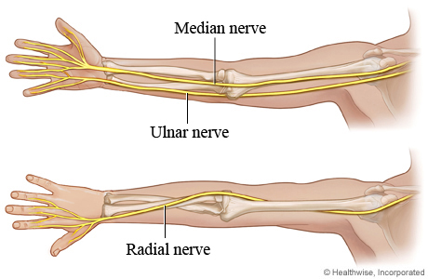
Upper Limb Neuropathies
Wrist Drop | Claw Hand
Radial nerve | Ulnar nerve
C5 – T1 | C7 – T1
Compression against the humerus | Elbow trauma Cubital tunnel syndrome

Slide 53
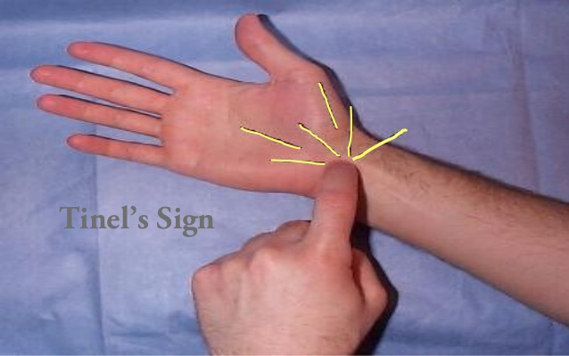
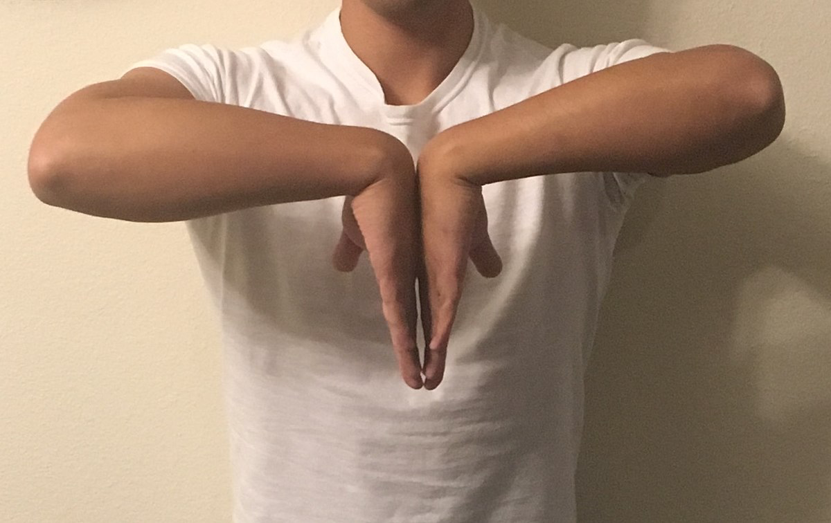
Carpal Tunnel Syndrome
DEFINITION | A condition caused by compression of the median nerve as it travels through the carpal tunnel in the wrist.
RISK FACTORS | Pregnancy Over 30 Obesity Oedema e.g heart failure Lunate fracture Rheumatoid arthritis
CAUSES | Most cases are idiopathic Swelling of the contents within the carpal tunnel Narrowing of the carpal tunnel
SIGNS AND SYMPTOMS | Pain, tingling, numbness in median nerve distribution of the hand – shaking hands for relief of symptoms Weakness of thumb abduction Wasting of thenar eminence Tinel’s sign – tapping the wrist causes paraesthesia Phalen’s sign – flexion of the wrist causes symptoms
INVESTIGATIONS | Electrodiagnostic testing – motor and sensory action potential prolongation
MANAGEMENT | Avoid activities which worsen symptoms Wrist splint in mild/moderate cases and pregnancy Steroid injections Surgical release – flexor retinaculum is cut to relieve pressure on the median nerve

Slide 54
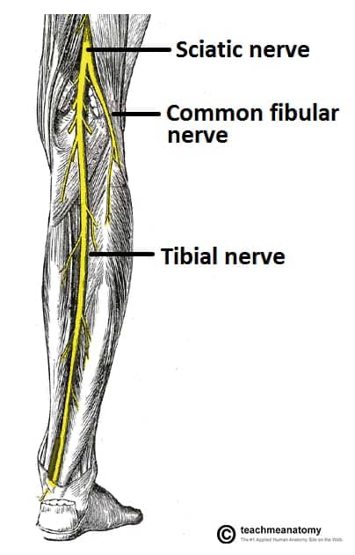
Foot Drop
DEFINITION | Difficulty with lifting the foot off the ground.
CAUSES | Damage to the common peroneal nerve – may be from knee replacement surgery Muscular dystrophy Charcot-Marie Tooth disease Motor neuron disease
SIGNS AND SYMPTOMS | Foot drags along the ground as patient walks Stepping gait Common peroneal nerve damage – weakness of eversion and dorsiflexion
INVESTIGATIONS | Physical examination – assess gait EMG
MANAGEMENT | Treat the underlying cause Braces/splints in shoes Physical therapy Nerve stimulation Surgery
Notes:
Tibial nerve?
L5?

Slide 55
Peripheral Neuropathy
The causes of peripheral neuropathy can be remembered by ABCDE:
A – Alcohol
B – B12 deficiency
C – Cancer, CKD
D – Diabetes, Drugs (Isoniazid, amiodarone, cisplatin)
E – Every vasculitis
Mononeuritis multiplex:
A type of peripheral neuropathy where there is damage to at least two different areas of the PNS.

Slide 56
Cranial Nerve Lesions
erve | Functions | Clinical | Pathway/foramen
I (Olfactory) | Smell |  | Cribriform plate
II (Optic) | Sight |  | Optic canal
III (Oculomotor) | Eye movement (MR, IO, SR, IR) Pupil constriction Accomodation Eyelid opening | Palsy results in ptosis 'down and out' eye dilated, fixed pupil | Superior orbital fissure (SOF)
IV (Trochlear) | Eye movement (SO) | Palsy results in defective downward gaze → vertical diplopia | SOF
V (Trigeminal) | Facial sensation Mastication | Lesions may cause: trigeminal neuralgia loss of corneal reflex (afferent) loss of facial sensation paralysis of mastication muscles deviation of jaw to weak side | V₁: SOF, V₂: Foramen rotundum, V₃: Foramen ovale
VI (Abducens) | Eye movement (LR) | Palsy results in defective abduction → horizontal diplopia | SOF
VII (Facial) | Facial movement Taste (anterior 2/3rds of tongue) Lacrimation Salivation | Lesions may result in: flaccid paralysis of upper + lower face loss of corneal reflex (efferent) loss of taste hyperacusis | Internal auditory meatus
VIII (Vestibulocochlear) | Hearing, balance | Hearing loss Vertigo, nystagmus Acoustic neuromas are Schwann cell tumours of the cochlear nerve | Internal auditory meatus
IX (Glossopharyngeal) | Taste (posterior 1/3rd of tongue) Salivation Swallowing Mediates input from carotid body & sinus | Lesions may result in; hypersensitive carotid sinus reflex loss of gag reflex (afferent) | Jugular foramen
X (Vagus) | Phonation Swallowing Innervates viscera | Lesions may result in; uvula deviates away from site of lesion loss of gag reflex (efferent) | Jugular foramen
XI (Accessory) | Head and shoulder movement | Lesions may result in; weakness turning head to contralateral side | Jugular foramen
XII (Hypoglossal) | Tongue movement | Tongue deviates towards side of lesion | Hypoglossal canal

Slide 57
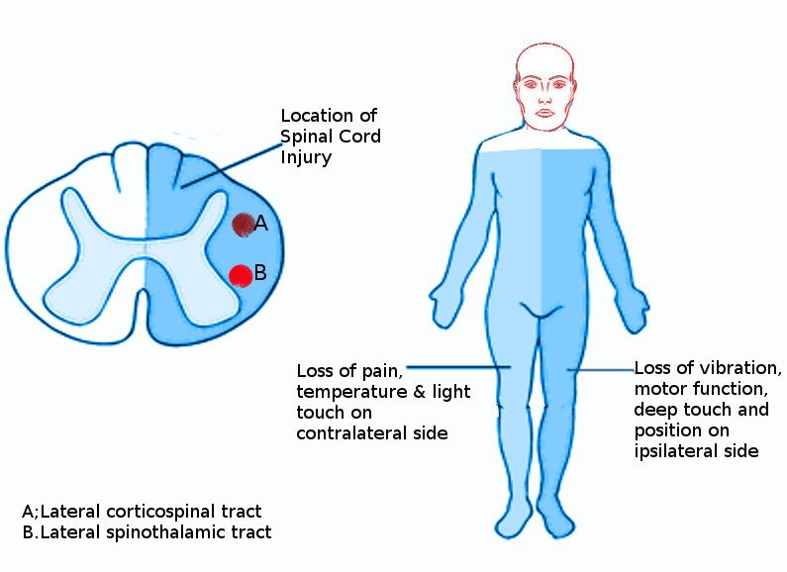
Brown-Sequard Syndrome
DEFINITION | A condition which is caused by damage to one half of the spinal cord.
CAUSES | Trauma is the most common cause – stab, gunshot wounds, fall
FEATURES | Ipsilateral weakness below the level of the lesion 🡪 corticospinal tract Ipsilateral loss of proprioception and vibration sensation 🡪 dorsal column-medial lemniscus pathway Contralateral loss of pain and temperature sensation 🡪 lateral spinothalamic tract

Slide 58
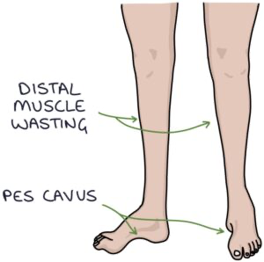
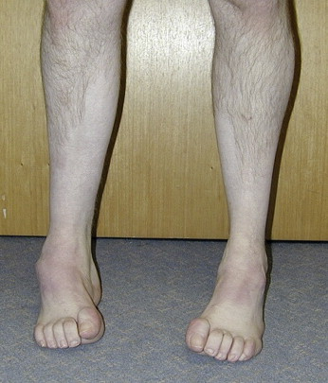
Charcot-Marie-Tooth Disease
DEFINITION | The most common hereditary peripheral neuropathy that predominantly results in motor loss.
SIGNS AND SYMPTOMS | History of frequently sprained ankles Foot drop Pes cavus – high-arched feet Champagne bottle legs Hammer toes Distal muscle weakness Hyporeflexia
MANAGEMENT | Physiotherapy – maintain muscle strength and joint range of motion Occupational therapy – assist with ADLs

Slide 59
Duchenne Muscular Dystrophy
DEFINITION | A genetic conditions that cause gradual weakening and wasting of the muscles.
RISK FACTORS | Male Family history
CAUSE | X-linked recessive genetic condition: Defective gene for dystrophin on the X chromosome 🡪 muscle is replaced by fat
SIGNS AND SYMPTOMS | Presents at around age 5, most children cannot walk by age 12 Hypotonia at birth – floppy Delayed motor milestones – walking difficulties (waddling gait) Calf pseudohypertrophy Normal sensation Diminished tendon reflexes Gower’s sign – use of hands on their legs to help them stand up due to muscle weakness in the pelvis
INVESTIGATIONS | 1st line – serum creatine kinase is raised Gold standard – muscle biopsy
COMPLICATIONS | RADS: Respiratory failure Arrhythmias Dilated cardiomyopathy Scoliosis

Slide 60
Brain Tumours
Brain tumours can cause a raised intra-cranial pressure (ICP):
Papilloedema – optic disc swelling
Headache – constant; nocturnal; worse on waking, cough, straining or bending forward; associated with vomiting
Most brain tumours in adults are supratentorial
Metastatic (secondary) brain tumours are the most common type of brain tumours
Tumours that commonly spread to the brain:
Lung – most common
Breast
Bowel
Skin (melanoma)
Kidney
Glioblastoma multiforme:
Most common primary brain tumour in adults
Associated with a poor prognosis – around 1 year
Treated surgically with post-operative chemotherapy and/or radiotherapy
Dexamethasone for oedema
Menigioma is the second most common primary brain tumour in adults

Slide 61
Conclusion
Helpful resources:
PTS
Zero to Finals
BMJ Best Practice
PassMed
Good luck :)

Slide 62
Feedback
https://forms.gle/Gc6YWfyQghBGvknj8
The Peer Teaching Society is not liable for false or misleading information…

