Slide 1
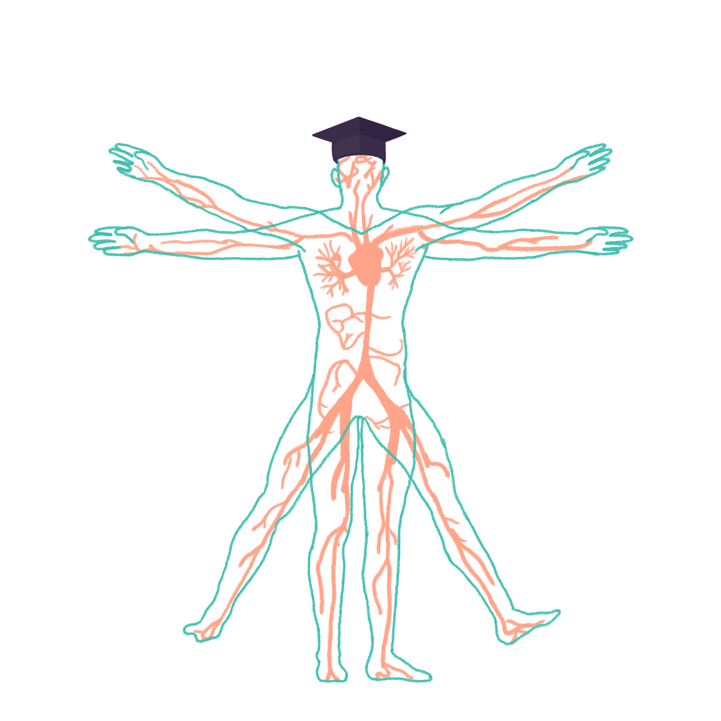
2022/2023

Slide 2
Neurological examination
Phase 2b Revision Session
Zahra Cader and Udit Gupta
[Tuesday, 26th July/6pm]
The Peer Teaching Society is not liable for false or misleading information…

Slide 3
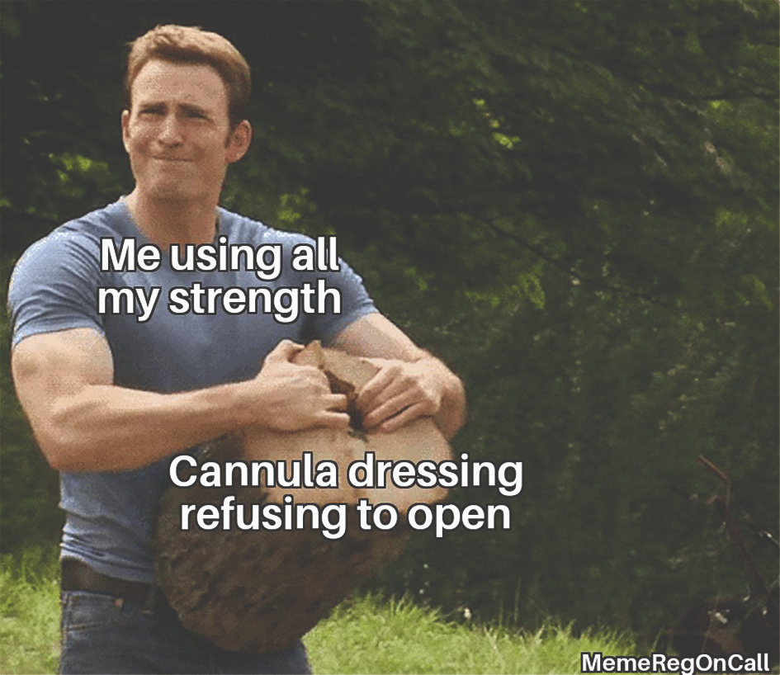
Aims and Objectives
General tips about neurological examination
Recap upper and lower limb neuro exam
Clinical application of examination findings
The Peer Teaching Society is not liable for false or misleading information…

Slide 4
Tips
Practice examining your friends and family (lots of normal examinations)
Neurological signs are not always obvious (hyper/hyporeflexia) so experience of normal examinations will help
Ask doctors to observe you whilst examining patients
Practicing will help remember the order of examination
General rule for examination → look, feel and move
Find a way that works for you!

Slide 5
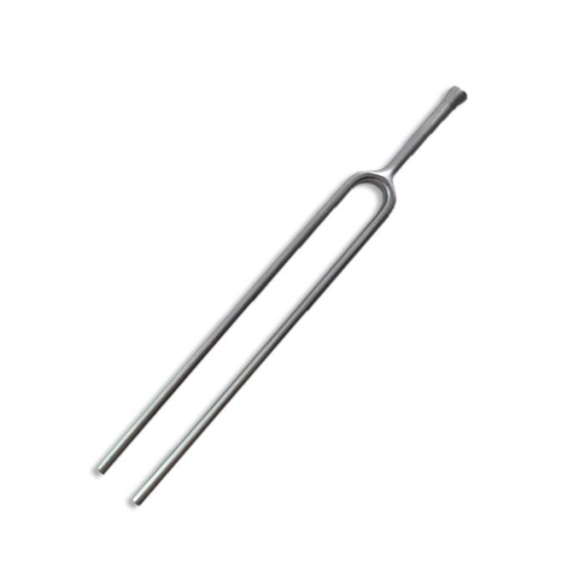
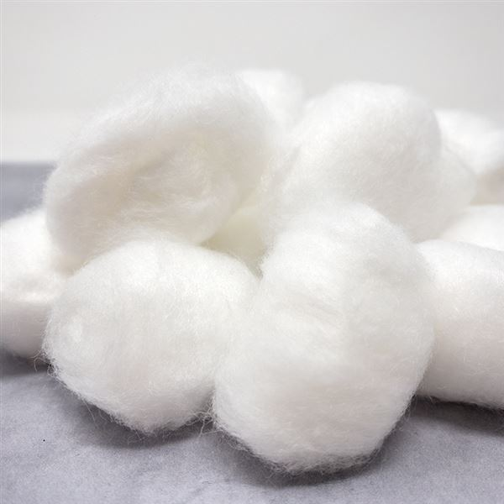
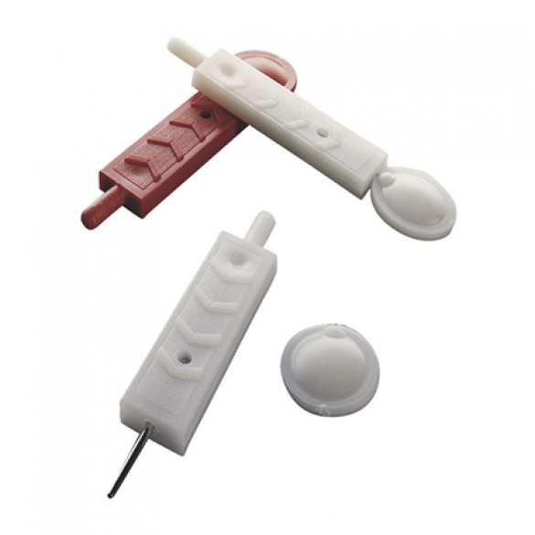
Introduction
3I’s - Introduce, Identity and Informed Consent
Explain the purpose and process of the examination in simple terms
Gather equipment (tendon hammer, neurotip, cotton wool, tuning fork (128Hz))
Ask if the patient is in any pain/weakness
Is the patient right/left handed?
Gain consent

Slide 6
General Format
Inspection
Tone
Power
Reflexes
Coordination
Sensation
Special Tests

Slide 7
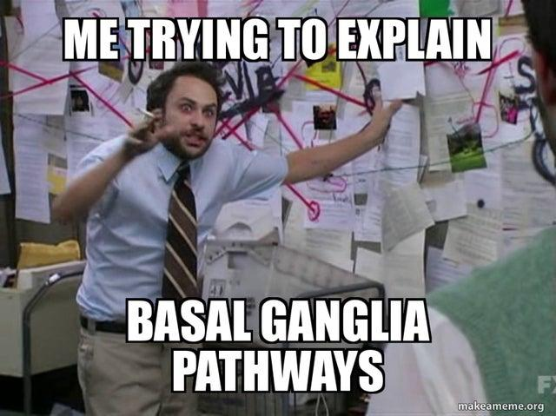
Upper limb examination

Slide 8
Inspection
Stand at the end of the bed and observe patient and surroundings
Observe posture of patient

Slide 9
Inspection
POSITIVE - Contralateral pyramidal tract (UMN) lesion

Slide 10
Extra bits to look out for!
Inspection
Chorea (Huntington's)
Myoclonus (epilepsy)
Tardive dyskinesia (protrusion of lip, lip-smacking, grimacing) - (antipsychotics, antiemetics)
Pseudoathetosis (failure of proprioception)
Hypomimia (parkinsons)
Ptosis and frontal balding (myotonic dystrophy)
Ophthalmoplegia (multiple sclerosis and myasthenia gravis)

Slide 11
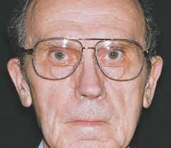
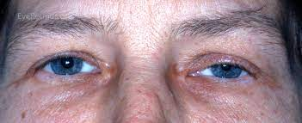
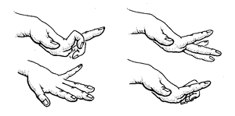
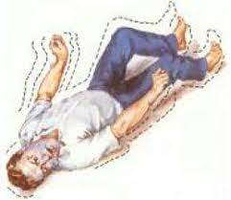
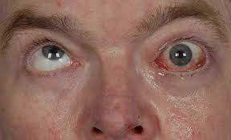
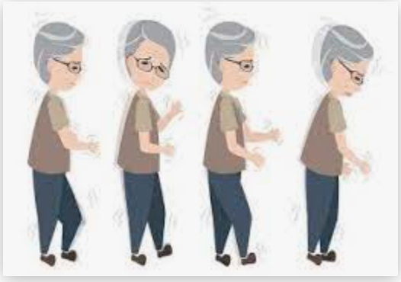
Inspection
Pseudoathetosis Hypomimia Ptosis
Myoclonus
Ophthalmoplegia
Chorea

Slide 12
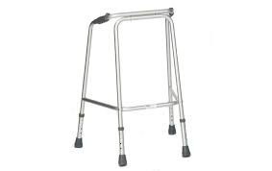
Make it obvious to look out for surroundings!

Slide 13
Question
Which of the following is NOT a sign of an upper motor lesion?
Positive babinski sign
Hyperreflexia
Tongue fasciculations
Extensor > Flexor weakness in arms

Slide 14
Answer
Which of the following is NOT a sign of an upper motor lesion?
Positive babinski sign
Hyperreflexia
Tongue fasciculations
Extensor > Flexor weakness in arms

Slide 15
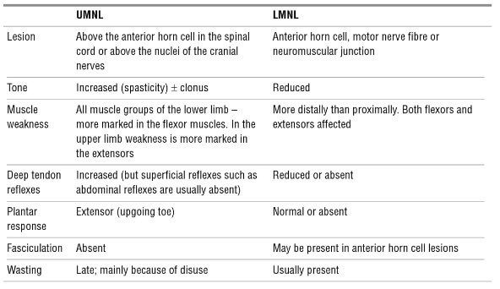
Differentiating between UMN AND LMN lesions

Slide 16
Tone
Assess muscle tone in muscle groups of upper limb
Support patient’s arm by holding their elbow and hand
Assess range of movement in shoulder (circumduction), elbow (flexion/extension) and wrist (circumduction)
Focus on signs - hyper/hypotonia, spasticity vs rigidity, cogwheeling

Slide 17
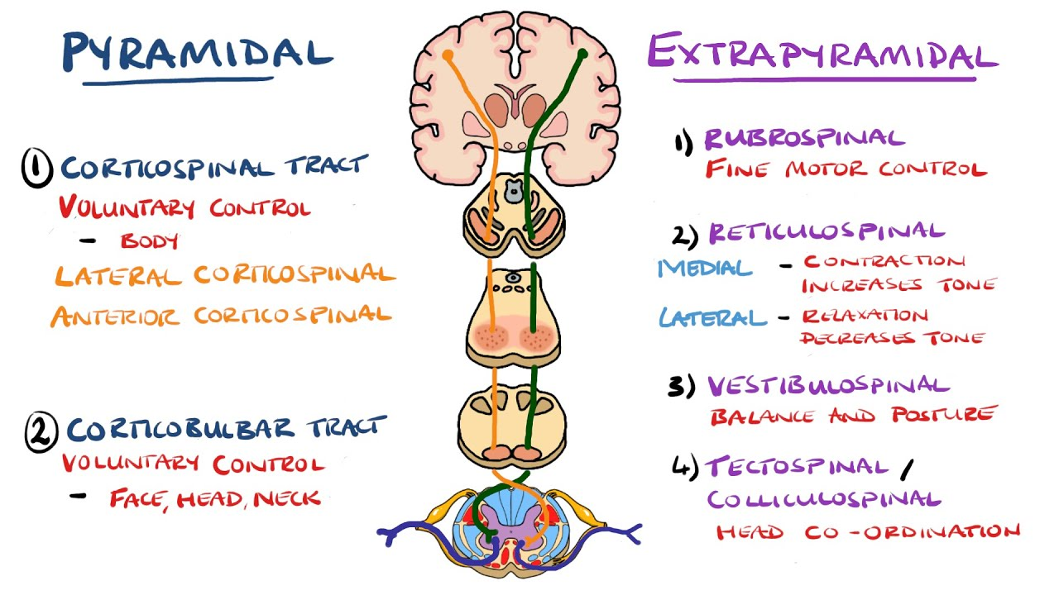
Spasticity vs Rigidity
Purpose of tone assessment - muscle movement and uneven resistance
Spasticity (pyramidal tract lesion) such as in stroke - resistance is the same in all velocities
Rigidity (extrapyramidal lesion) in Parkinson’s disease – resistance falls with increased velocity

Slide 18
Power
Assess strength of muscles against resistance
Shoulder ABduction (C5)
Shoulder ADduction (C6/7)
Shoulder flexion + extension
Elbow flexion (C5/6) + extension (C7) + pronation + supination
Wrist flexion (C6/7) + extension (C6)
Finger abduction (T1) + extension(C7) + flexion
Thumb abduction(T1)

Slide 19
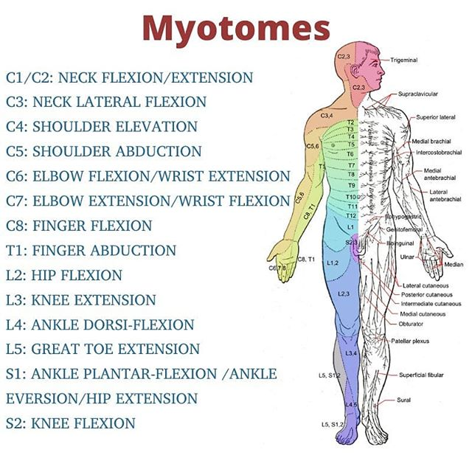
Myotomes

Slide 20
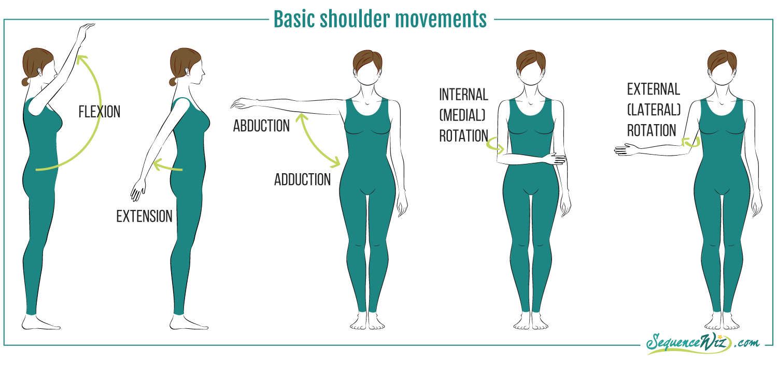
Power
Shoulder movements

Slide 21
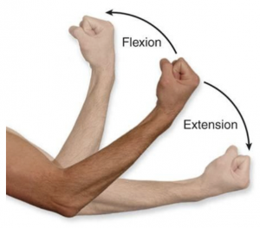
Power
Elbow movements

Slide 22
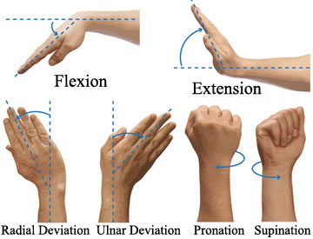
Power
Wrist movements

Slide 23
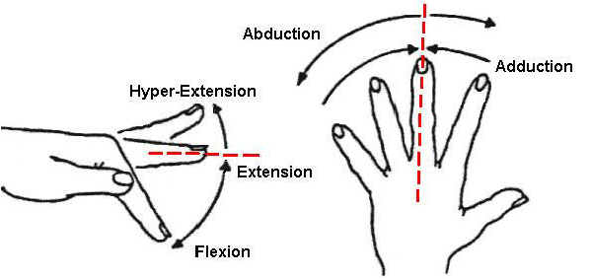
Power
Finger and Thumb movements

Slide 24
Power
MRC power scale
5/5 - movement against gravity and full power against resistance
4/5 - movement against gravity but not full resistance
3/5 - muscle contraction with active movement without resistance
2/5 - muscle contraction with active movement only when gravity is eliminated
1/5 - slight muscle contraction but no movement
0/5 - no muscle contraction

Slide 25
Question
What is the correct nerve root for the biceps reflex?
C7-C8
C4-C5
C5-C6
L3-L4

Slide 26
Answer
What is the correct nerve root for the biceps reflex?
C7-C8
C4-C5
C5-C6
L3-L4

Slide 27
Reflexes
Explain to the patient you are going to tap gently on their arm with a tendon hammer
Patients upper arm should be completely relaxed
Hold tendon hammer handle at its end to allow gravity to aid a good swing
Reinforcement manoeuvre - asking patient to clench teeth together while simultaneously tapping on tendon

Slide 28
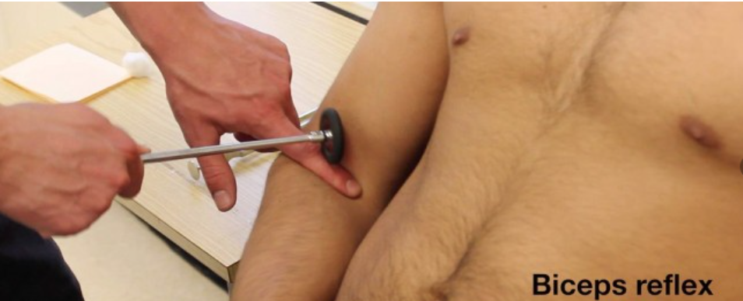
Reflexes
Biceps (C5/C6)

Slide 29
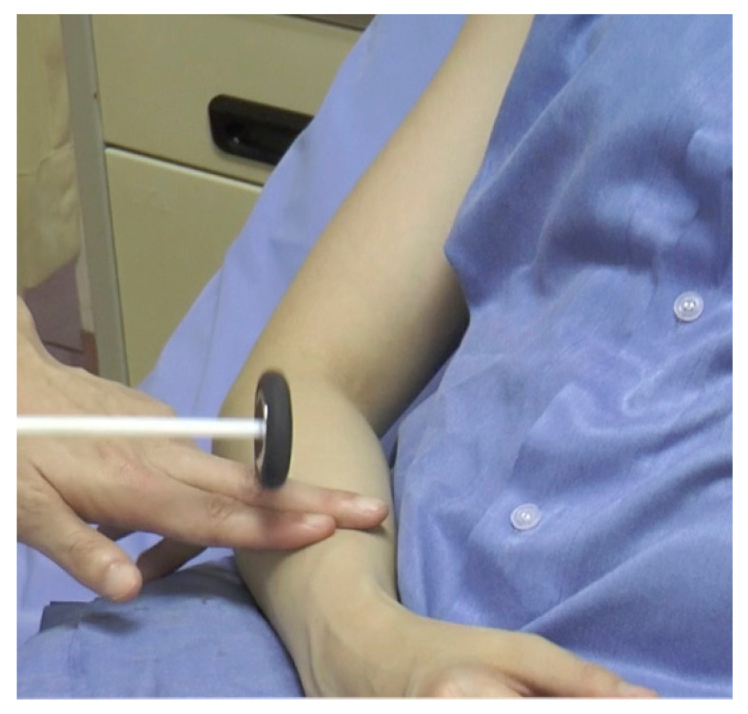
Reflexes
Supinator (C5/C6)

Slide 30
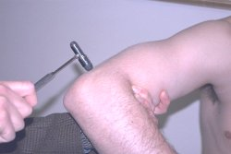
Reflexes
Triceps (C7/C8)

Slide 31
Hyperreflexia vs Hyporeflexia
Reflexes
Hyperreflexia - UMN lesions (stroke, spinal cord injury)
Hyporeflexia - LMN lesions (brachial plexus pathology or peripheral nerve injuries)
Pendular - cerebellar disease (means less brisk and slower in their rise and fall)

Slide 32
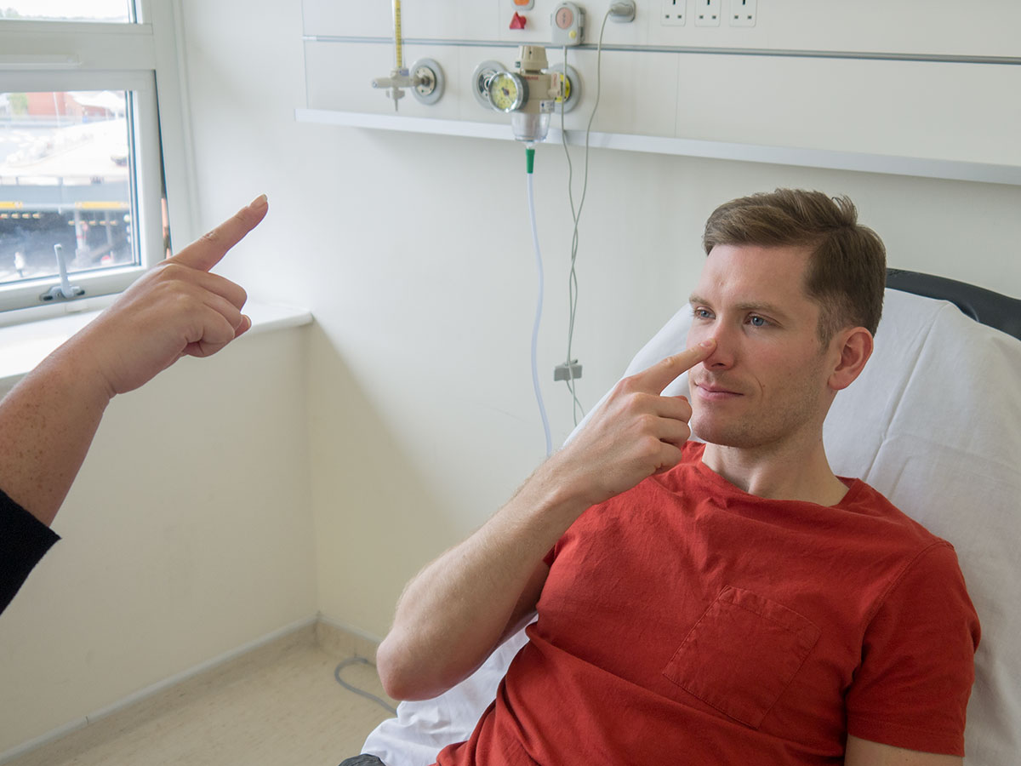
Coordination
Finger to nose test
Dysmetria - patient missing target by over/undershooting
Intention tremor - becomes apparent as patients finger approaches yours
(both are suggestive of ipsilateral cerebellar pathology)

Slide 33
Coordination
Dysdiadochokinesia

Slide 34
Sensation
Ensure patient has their eyes closed
Demonstrate normal sensation on the patient's sternum
Assess sensation across each of the upper limb dermatomes, comparing left to right at equivalent regions as you progress
Avoid assessing sensation close to dermatomal boundaries to minimise risk of misinterpretation

Slide 35
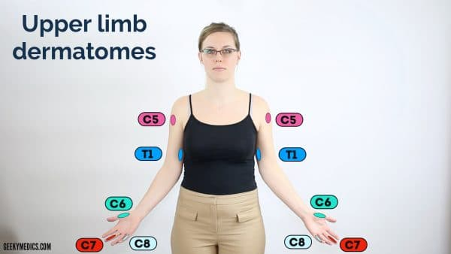
Dermatomes

Slide 36
Sensation
Light Touch (dorsal columns and spinothalamic tracts)
Pin-prick (Pain) (spinothalamic tracts) - mention in OSCE
Temperature - mention in OSCE
Proprioception (Joint sense) (dorsal columns)
Vibration (dorsal columns) with 128Hz tuning fork
Cortical localisation (stereognosis, 2-point discrimination, graphaesthesia)

Slide 37
Question
Which tract conveys sensation of proprioception and fine touch?
Spinothalamic tract
Corticospinal tract
Dorsal column-medial lemniscus
Spinocerebellar tract

Slide 38
Answer
Which tract conveys sensation of proprioception and fine touch?
Spinothalamic tract
Corticospinal tract
Dorsal column-medial lemniscus
Spinocerebellar tract

Slide 39
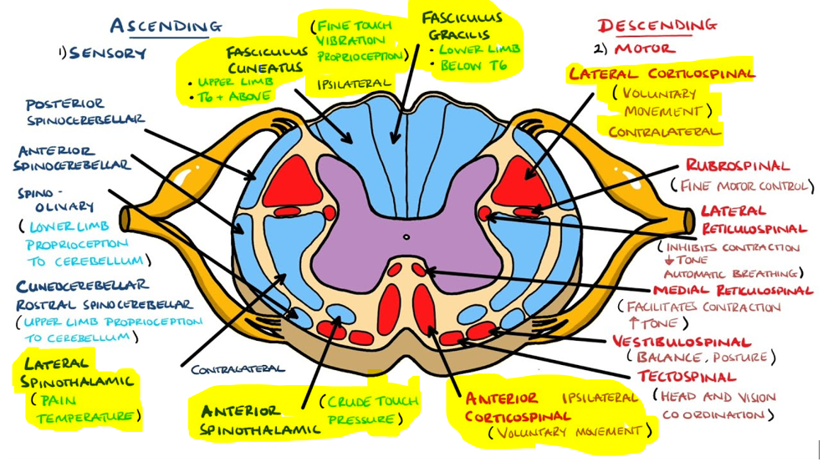
Answer Explanation

Slide 40
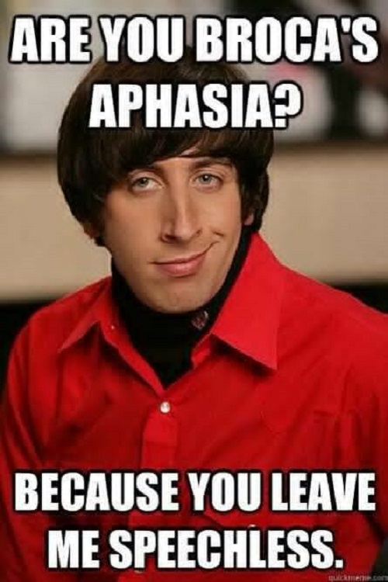
Lower Limb Neuro
Same Principle as upper limb neuro!
Inspect
Tone
Power
Reflexes
Coordination
Sensation
Special tests - Romberg’s test
Gait

Slide 41
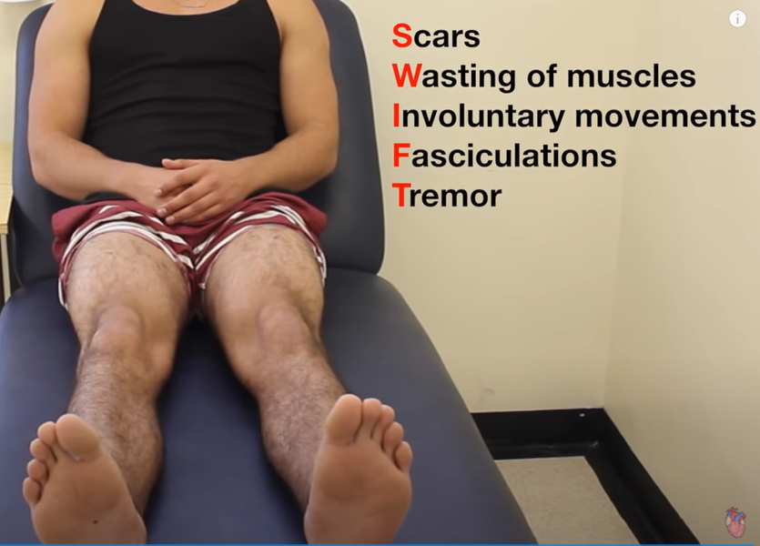
Inspection
Examine patient’s bedside
Assess for any muscle wasting, tremor, fasciculations and involuntary movements

Slide 42
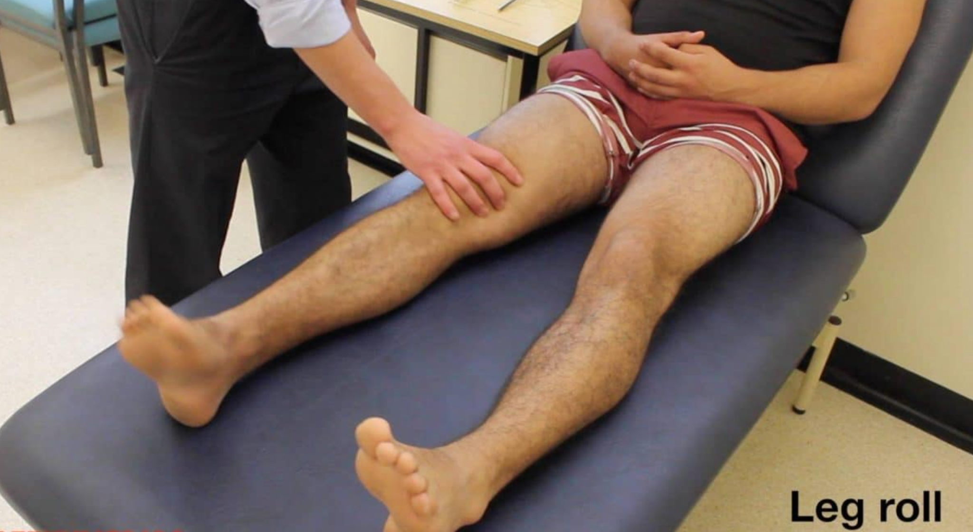
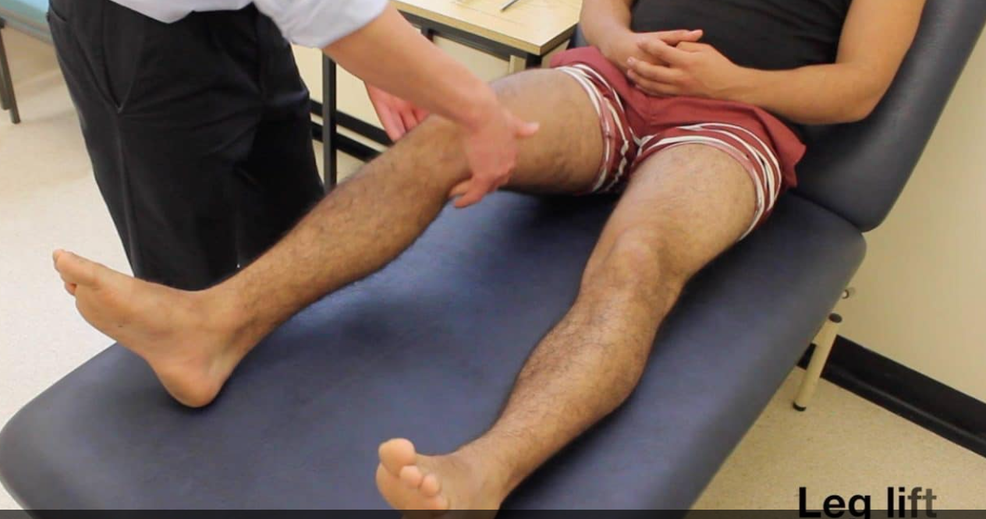
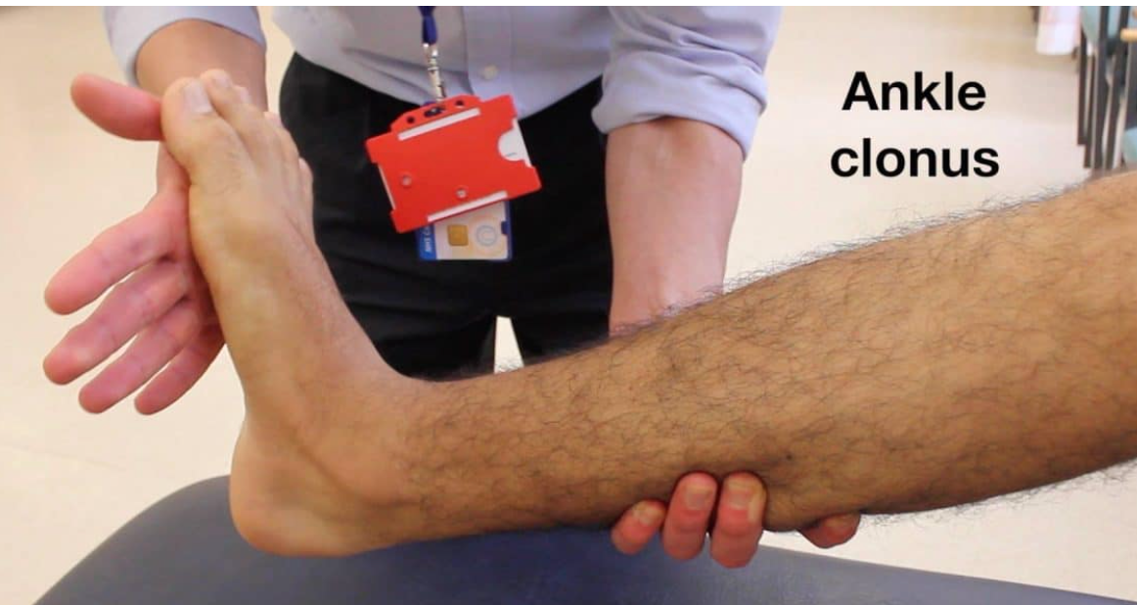
Tone
Tone
leg roll and leg lift
ankle clonus

Slide 43
Power
Power
Hip flexion (L1/2), extension (L5/S1/S2), ABduction and ADduction
Knee flexion (S1) and extension (L3/4)
Ankle dorsiflexion (L4/5) and plantarflexion (S1/2)
Big toe extension (L5)

Slide 44
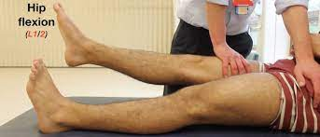
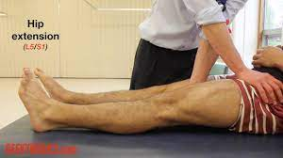
Power
Hip movements

Slide 45
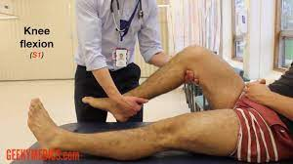
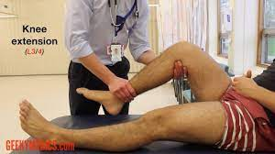
Power
Knee movements

Slide 46
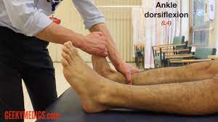
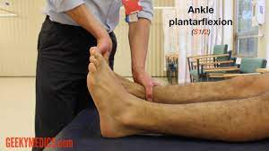
Power
Ankle and toe movements

Slide 47
Reflexes
Test 3 main reflexes
Knee reflex (L3/4)
Ankle jerk (L5/S1)
Plantar (S1)

Slide 48
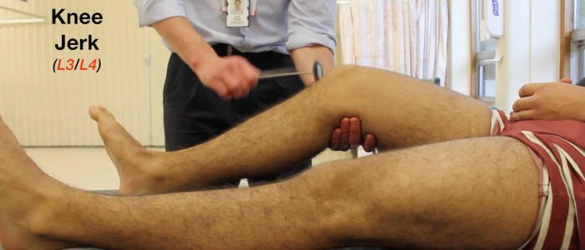
Reflexes

Slide 49
Reflexes

Slide 50
Reflexes

Slide 51
Reflexes
Difficulty eliciting reflexes
Distract the patient
Ask the patient to clench fingers
Clench jaw
SOMETIMES the patient may be hyporeflexic!

Slide 52
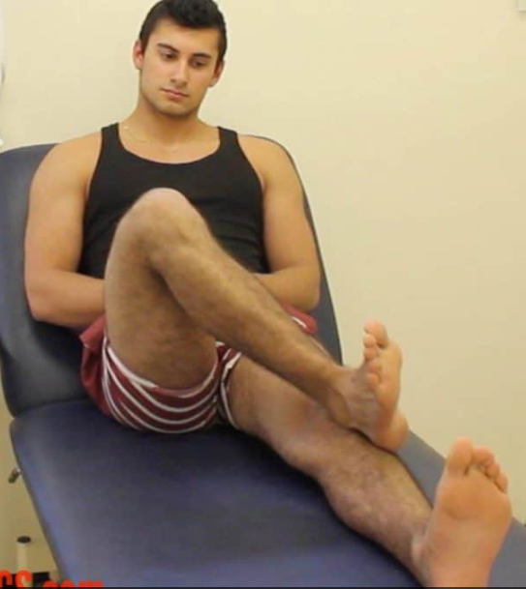
Coordination
Coordination
Heel to shin test

Slide 53
Coordination
Interpretation
Dysmetria - inability to do heel to shin test on a particular side may suggest ipsilateral cerebellar brain pathology
Patients with weakness may find it difficult to carry out movement

Slide 54
Sensation
Soft touch
Pain/pinprick - state in OSCE
Temperature - state in OSCE
Proprioception
Vibration using 128Hz tuning fork

Slide 55
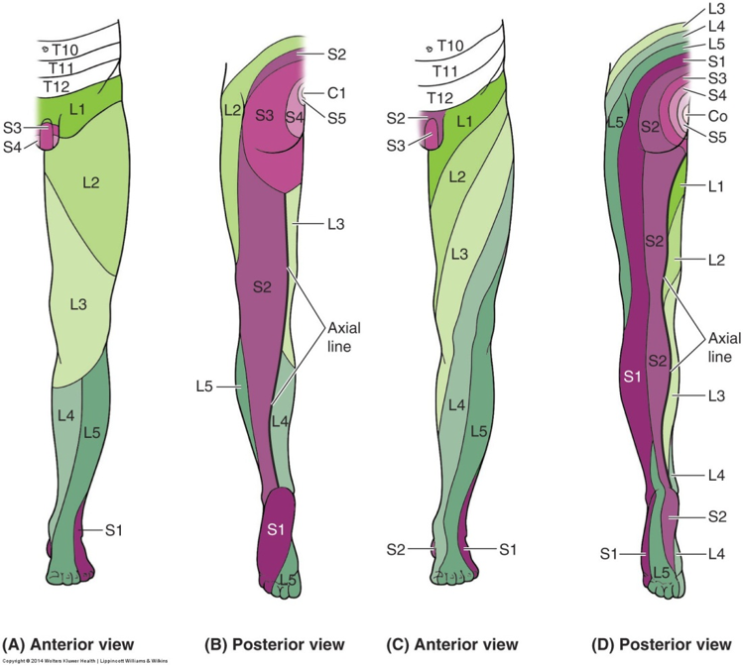
Dermatomes

Slide 56
Assessing patient’s gait
Gait
Inspection of gait
Stance
Stability
Arm swing
Posture
Turning
Specific gaits - Heel (S1) and Toe (L5) walking, Tandem (heel to toe)

Slide 57
Gait abnormalities
Gait abnormalities
Ataxic gait
Broad-based
Unsteady
Proprioceptive sensory ataxia - patients watch their feet intently to compensate for proprioceptive loss
Ipsilateral cerebellar lesion

Slide 58
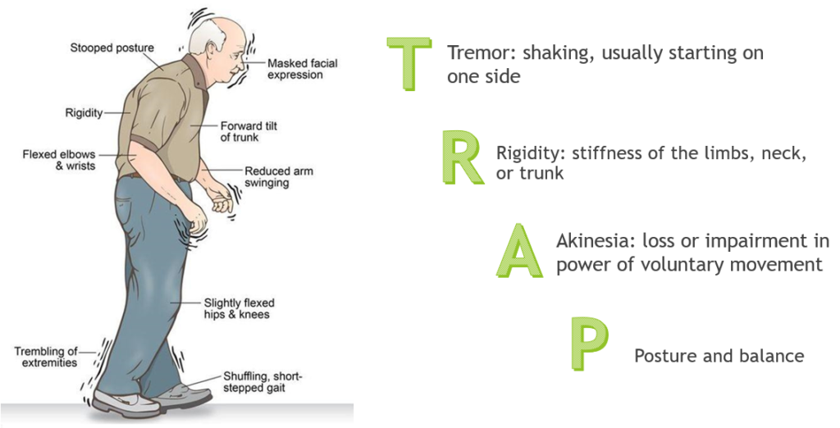
Gait abnormalities
Parkinsonian gait / Apraxic gait
Small, shuffling steps
Stooped posture
Reduced arm wing (unilateral)
Rushed (festinating)
Stuck (freeze)
Tremor

Slide 59
Gait abnormalities
High-steppage gait
Unilateral or bilateral
Foot drop (weakness of ankle dorsiflexion)
Unable to walk on heels

Slide 60
Question
Foot drop occurs due to a lesion in which nerve?
Sural Nerve
Lateral cutaneous nerve of thigh
Common peroneal nerve
Tibial nerve

Slide 61
Answer
Foot drop occurs due to a lesion in which nerve?
Sural Nerve
Lateral cutaneous nerve of thigh
Common peroneal nerve
Tibial nerve

Slide 62
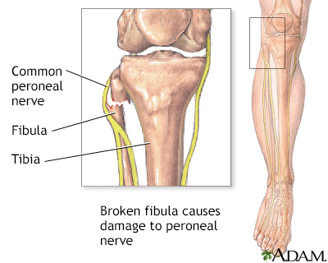
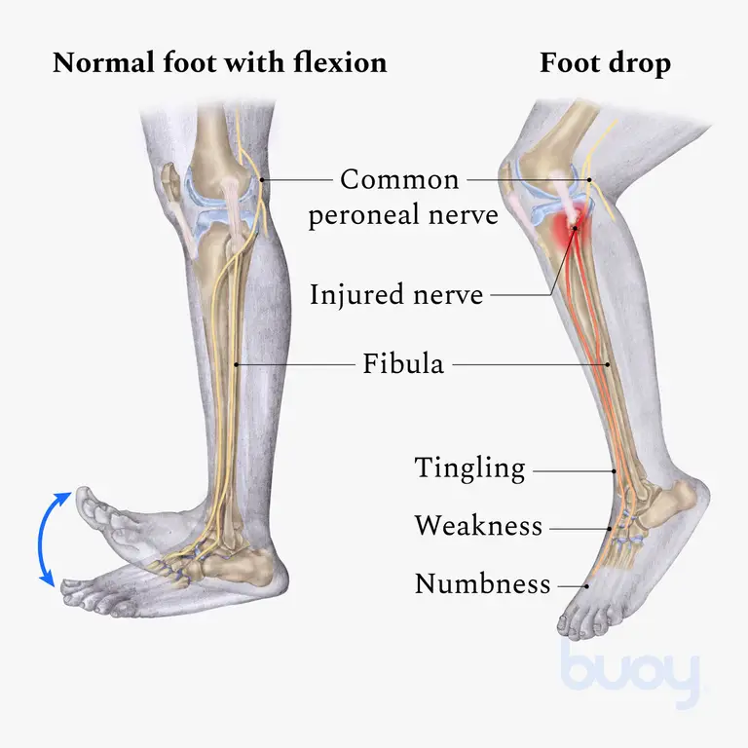
Answer Explanation
Common peroneal nerve → superficial and deep peroneal nerve
Superficial peroneal nerve → anterior compartment of leg
Deep peroneal nerve → lateral compartment of leg

Slide 63
Gait abnormalities
Waddling (myopathic) gait
Weakness in hip abductor muscles
Body sway from side to side to compensate for pelvic weakness → sway on the side of the lesion
Proximal lower limb weakness (myopathy)

Slide 64
Gait abnormalities
Hemiplegic gait
Flexion hypertonia in arms and extensor hypertonia in legs resulting in stiffness on contralateral side of lesion
Circumduction occurs due to inability to flex knee

Slide 65
Gait abnormalities

Slide 66
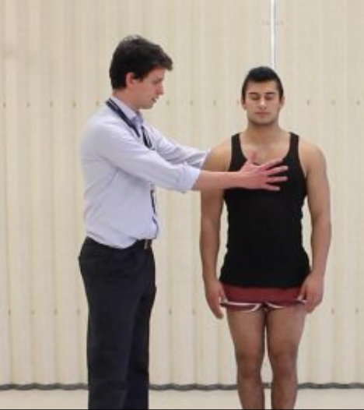
Romberg’s test
If they cannot do this with eyes open - CEREBELLAR LESION
If they cannot do this with eyes closed - LOSS OF PROPRIOCEPTION

Slide 67
Further assessments and investigations
Full neurological examination
cranial nerves
cerebellar assessment
Neuroimaging if relevant (MRI spine and head)

Slide 68
Conclusion
Have a clear structure in your head before you carry out the examination
LOOK/FEEL/MOVE always!
Practice makes perfect!
The Peer Teaching Society is not liable for false or misleading information…

Slide 69
References
Geeky medics
Oxford handbook of clinical medicine
Clinical examination handbook (given by University of Sheffield)

Slide 70
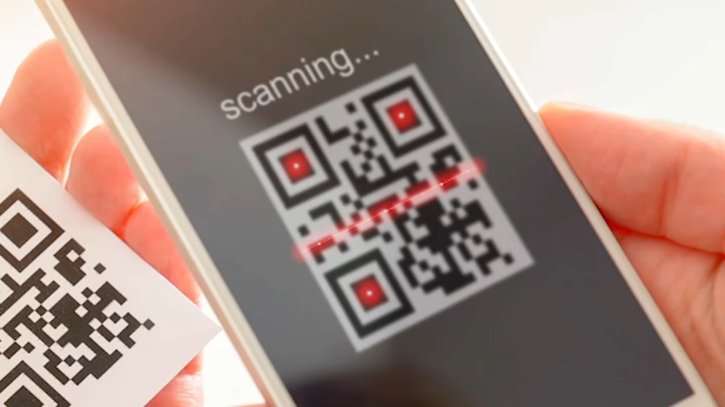
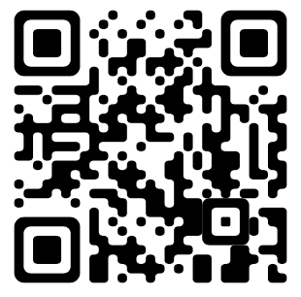
Feedback
https://forms.gle/xbnPaAbXb1tPpYcPA
The Peer Teaching Society is not liable for false or misleading information…

