Slide 1
Neurology for finals and F1
Sophie Moore
Clinical fellow
Doncaster Royal Infirmary

Slide 2
Aim
Discuss neurological presentations that are:
Important for finals
Important for F1
Fun and interesting

Slide 3
1. Weakness

Slide 4
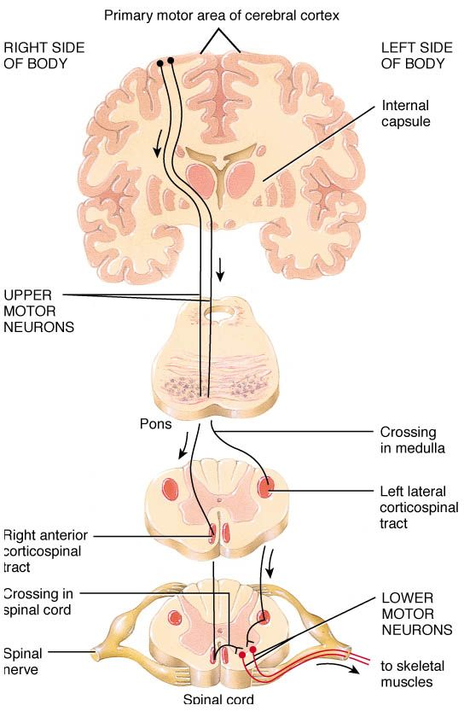

Slide 5
Weakness
Motor cortex
Corticospinal tracts
Anterior horn cells
Spinal roots
Peripheral nerves
Neuromuscular junction
Muscle fibre
Stroke
MS
Spinal cord lesion: compression, stroke, transverse myelitis
MND
Poliomyelitis
Disc prolapse
Degeneration
Trauma
Compression
Polyneuropathy
Guillain-Barré
Myasthenia gravis
Polymyositis
Dermatomyositis
Muscular dystrophy
Drugs/toxins

Slide 6
Weakness
UMN
LMN
Motor cortex
Corticospinal tracts
Anterior horn cells
Spinal roots
Peripheral nerves
Neuromuscular junction
Muscle fibre
Stroke
MS
Spinal cord lesion: compression, stroke, transverse myelitis
MND
Poliomyelitis
Disc prolapse
Degeneration
Trauma
Compression
Polyneuropathy
Guillain-Barré
Myasthenia gravis
Polymyositis
Dermatomyositis
Muscular dystrophy
Drugs/toxins

Slide 7
Upper motor neurone | Lower motor neurone

Slide 8
Upper motor neurone | Lower motor neurone
Increased tone | Decreased tone
Increased reflexes (clonus) | Decreased reflexes
Upgoing plantars | Downgoing plantars
Drift | Fasciculations
Pyramidal pattern of weakness | Wasting

Slide 9
Upper motor neurone | Lower motor neurone
Increased tone | Decreased tone
Increased reflexes (clonus) | Decreased reflexes
Upgoing plantars | Downgoing plantars
Drift | Fasciculations
Pyramidal pattern of weakness | Wasting
Neuromuscular junction:
Myasthenia gravis – fatiguable weakness of ocular, bulbar and proximal muscles
Lambert-Eaton myasthenic syndrome – improves on exertion
Myopathies:
Raised CK, usually proximal symmetrical weakness

Slide 10
Peripheral neuropathy
Diabetes mellitus
Alcohol
Drugs (isoniazid, vincristine)
Vitamin deficiency (B12, B1)
Guillain-Barré
Charcot-Marie-Tooth
Vasculitis, connective tissue disease

Slide 11
Peripheral neuropathy
Diabetes mellitus
Alcohol
Drugs (isoniazid, vincristine)
Vitamin deficiency (B12, B1)
Guillain-Barré
Charcot-Marie-Tooth
Vasculitis, connective tissue disease
sensory
motor
mononeuritis multiplex

Slide 12
Other clues
Timing
Acute – vascular, trauma
Subacute – inflammation
Insidious/chronic – degeneration, compression
Location
Brain – cranial nerves affected as well as limbs
Spine – sensory level
Peripheral – small area affected, single nerve lesion (eg median nerve)
Pattern
MS – relapsing-remitting course, lesions disseminated in space and time
MND – UMN and LMN signs, no sensory or sphincter disturbance

Slide 13
Examples
Hyperacute limb weakness and facial weakness, pronator drift and upgoing plantars
vascular problem, UMN, in the brain - stroke
Insidious onset weakness in both legs, sensory level, upgoing plantars and brisk reflexes
compression/degeneration, UMN, in the spine - spinal tumour
Insidious onset sensory change in the hand (lateral 3 fingers), wasting
compression/degeneration, LMN, peripheral nerve - carpal tunnel
Subacute onset weakness in both shoulders and thighs, raised CK
inflammatory, muscle problem - polymyositis

Slide 14
2. Fits, faints and funny turns

Slide 15
Blackout history
What happened before, during and after the event?
Before – sleep deprivation, intercurrent illness, aura
During – exact description of movements, eyes open or closed, any awareness maintained, duration
After – postictal confusion
Collateral history
Previous similar episodes – frequency, triggers
?multiple seizure/event types

Slide 16
Differential diagnosis
Epilepsy
Non-epileptic attack disorder
Vaso-vagal syncope
Other syncope/cardiogenic

Slide 17
Differential diagnosis
Epilepsy
Non-epileptic attack disorder
Vaso-vagal syncope – typical prodrome, short duration, quick recovery
Other syncope/cardiogenic – worry about exercise induced/palpitations/chest pain

Slide 18
Non-epileptic attack disorder
Often related to abuse and psychological trauma
Most reliable differentiating factors:
Long duration
Fluctuating course
Asynchronous movements
Side-to-side head or body movement
Pelvic thrusting
Closed eyes
Ictal crying
Absence of postictal confusion
History:
linguistic agency with the patient, not the seizure
focus on circumstances/consequences rather than seizure itself
NEAD: “I went into the seizure”
Epilepsy: “the seizure knocked me out”
Notes:
Tongue biting/incontinence not reliable
Does the primary literature provide support for clinical signs used to distinguish psychogenic nonepileptic seizures from epileptic seizures?
Avbersek A¹, Sisodiya S J Neurol Neurosurg Psychiatry. 2010 Jul;81(7):719-25

Slide 19
Functional problems in every specialty
Respiratory – dysfunctional breathing
Gastroenterology – IBS
Rheumatology – fibromyalgia
Cardiology – unexplained chest pain
Neurology – weakness, sensory change, visual disturbance, NEAD
Extremely common. Important to discuss without stigma

Slide 20
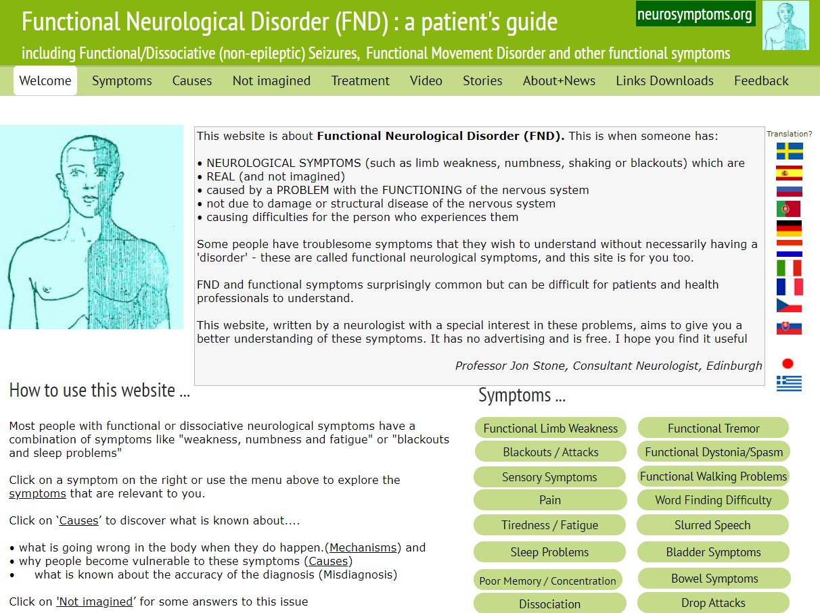

Slide 21
You are sitting at the nurses’ station reading a journal article about phenomenology and semiology of seizures, when the emergency buzzer goes off…

Slide 22
Patient is having a seizure
What do you do?
Initial approach
Investigations
Treatment

Slide 23
Seizure – initial approach
ABCDE assessment
Don’t put anything in the mouth
Oxygen via nasal cannulae or mask
Is patient known to have epilepsy/NEAD?
Consider 2222
Time

Slide 24
Seizure - investigations
Possible causes?
Hypoglycaemia
Alcohol withdrawal
Metabolic disturbance
Infection (including meningitis/encephalitis)
Stroke
Neoplasm
Drug overdose
Inadequate anticonvulsant levels, drug toxicity

Slide 25
Seizure - investigations
What investigations should you do?
FBC, U&E, LFT, Ca2+, Mg2+, glucose, clotting
ECG
?Anticonvulsant levels
?Toxicology (blood and urine)
?ABG
?CT head

Slide 26
Seizure - management
Most seizures will self terminate
<5 minutes: time, monitor, oxygen, supportive care
>5 minutes: benzodiazepines
IV lorazepam 4mg (or 2mg if elderly)
Buccal midazolam 10mg
PR diazepam 10mg
IM midazolam 10mg
Can repeat dose once
If unresponsive – load on anticonvulsant
Levetiracetam 30mg/kg
Alternatives: sodium valproate or phenytoin

Slide 27
Seizure - management
Most seizures will self terminate
<5 minutes: time, monitor, oxygen, supportive care
>5 minutes: benzodiazepines
IV lorazepam 4mg (or 2mg if elderly)
Buccal midazolam 10mg
PR diazepam 10mg
IM midazolam 10mg
Can repeat dose once
If unresponsive – load on anticonvulsant
Levetiracetam 30mg/kg
Alternatives: sodium valproate or phenytoin
2222
Anaesthetist to intubate and ventilate

Slide 28
3. Parkinson’s disease

Slide 29
You turn up at your OSCE - neurology station.
The prompt says “examine whatever you like, you’re a doctor now, we’re not holding your hand anymore”.
Help!

Slide 30
First glance – a man in his 60s with a mask-like face.
You’re saved!
What other features will you elicit?

Slide 31
Inspection
Tone
Power
Co-ordination
Sensation
Reflexes

Slide 32
Inspection – mask-like face
Tremor – asymmetrical, coarse, pill-rolling 3-5Hz resting tremor
Tone
Power
Co-ordination
Sensation
Reflexes
– increased, cogwheel rigidity
- normal
- normal
- normal
- normal

Slide 33
Inspection – mask-like face
Tremor – asymmetrical, coarse, pill-rolling 3-5Hz resting tremor
Tone – increased, cogwheel rigidity
What else are you going to test?

Slide 34
Inspection – mask-like face
Tremor – asymmetrical, coarse, pill-rolling 3-5Hz resting tremor
Tone – increased, cogwheel rigidity
Gait
Voice
Bradykinesia
(Eye movements)

Slide 35
Inspection – mask-like face
Tremor – asymmetrical, coarse, pill-rolling 3-5Hz resting tremor
Tone – increased, cogwheel rigidity
Gait
Voice
Bradykinesia
(Eye movements)
– shuffling, festinant, loss of arm swing, difficulty turning
– slow, faint, monotonous speech
– test finger-thumb opposition
– vertical gaze palsy in PSP (not in PD)

Slide 36
Congratulations, you passed your OSCE with flying colours!
You are now an F1 working in AMU on take.
A patient comes in to be clerked…

Slide 37
65 year old man
HPC
3/7 history of D&V
Not managing to drink very much
Struggling to take his medications
PMH
Parkinson’s disease, diagnosed 5 years ago
Ischaemic heart disease
COPD

Slide 38
DH
Madopar (co-beneldopa) 50/12.5 dispersible
Madopar CR 100/25 capsules
Ropinirole 1mg TDS
Atorvastatin 40mg ON
Ellipta 55/22, 1 puff OD
Co-codamol 30/500, 2 tablets QDS PRN
Senna 15mg ON
Macrogol 1 sachet PRN
Salbutamol 100mcg PRN
Aspirin 75mg OD
Lansoprazole 15mg OD

Slide 39
You diagnose him with a viral gastroenteritis and prescribe him some IV fluids. Do you need to do anything else?
A. Have a cup of tea
B. Flirt with a nurse
C. Work on your eportfolio
D. Medication review

Slide 40
DH
Madopar (co-beneldopa) 50/12.5 dispersible, 1 tablet 7am
Madopar CR 100/25 capsules, 11am, 3pm, 7pm
Ropinirole 1mg TDS
Atorvastatin 40mg ON
Ellipta 55/22, 1 puff OD
Co-codamol 30/500, 2 tablets QDS PRN
Senna 15mg ON
Macrogol 1 sachet PRN
Salbutamol 100mcg PRN
Aspirin 75mg OD
Lansoprazole 15mg OD

Slide 41
Timing of Parkinson’s medication is critical
If doses are missed or mistimed, patients can suffer from freezing, on-off switching and other side effects very quickly
Patients have their own personalised drug regimens – they do not obey drug round times
Need to make nursing staff aware so meds are given on time and can be ordered from pharmacy if necessary

Slide 42
You fill in a beautiful drug chart and go on your way, feeling proud of yourself
20 minutes later, the nurse catches you: they have tried to give the patient his medication, but he is vomiting too much.
What do you do?
Miss a dose of medication
Give an IV alternative
Give a transdermal alternative
Give an antiemetic
Insert an NG tube
This eportfolio won’t write itself, you know

Slide 43
Ideally, NG insertion means the patient can continue to have as close to their normal meds as possible
Modified release capsules may need switching to a dispersible form (ask a friendly pharmacist)
If NG is not practicable, medications can be converted to a rotigotine patch - online calculators are available, or ask a friendly pharmacist

Slide 44
You’ve converted the Madopar to a patch, but the patient is still vomiting and looks miserable. The nurse asks you for an antiemetic.
Refuse
Prochlorperazine
Domperidone
Metoclopramide
Cyclizine
Ondansetron

Slide 45
You’ve converted the Madopar to a patch, but the patient is still vomiting and looks miserable. The nurse asks you for an antiemetic.
Refuse
Prochlorperazine
Domperidone
Metoclopramide
Cyclizine
Ondansetron
Prochlorperazine and metoclopramide are contra-indicated, as they will worsen parkinsonism.
Cyclizine can also worsen symptoms. Domperidone and ondansetron are safe.

Slide 46
Also remember many drugs are contraindicated in myasthenia gravis (especially antibiotics and beta blockers), so always look it up before prescribing a new medication to a patient with myasthenia

Slide 47
4. Cord compression

Slide 48
A 75 year old man presents with decreased mobility over the last few weeks. Since yesterday he is “off legs”
Complaining of low back pain
What would you like to know?
What will you look for on examination?

Slide 49
HPC
Pain in the lower back for several weeks, wakes him up at night
2 stone weight loss in the last few months
Always has urinary hesitancy and dribbling, but hasn’t passed urine today
Hasn’t opened his bowels for a couple of days either
PMH
COPD
BPH
IHD

Slide 50
On examination
Cachectic
Chest clear
Abdomen soft, palpable bladder
Weak legs 3-4/5
PR: decreased anal tone and perianal numbness

Slide 51
What next?
Urinary catheter
Urgent MRI spine

Slide 52
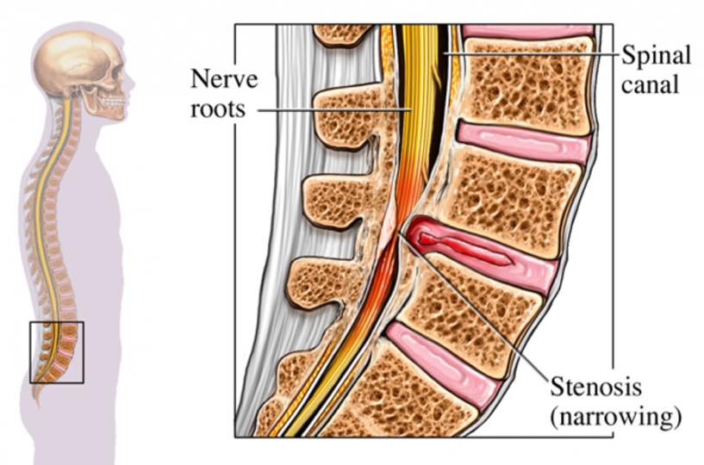

Slide 53
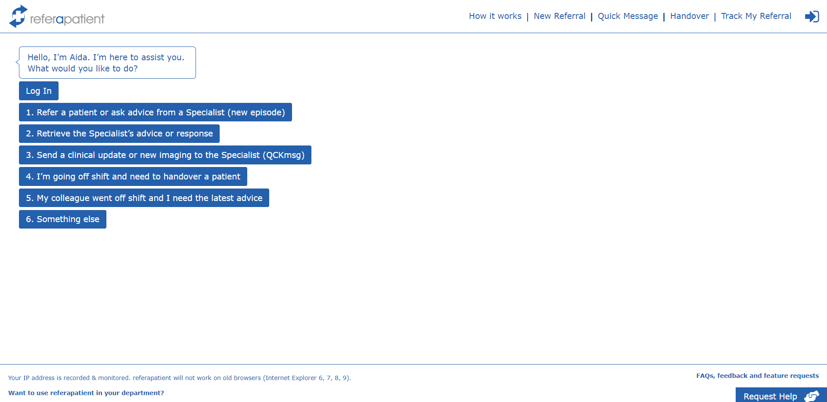
Urgently refer to neurosurgery
Dexamethasone
Consider further imaging to identify primary source of spinal mets

Slide 54
5. Dizziness/vertigo

Slide 55
Differential diagnosis of vertigo
Acute first episode of vertigo
Vestibular neuritis
Cerebellar infarct
Recurrent spontaneous vertigo
BPPV
Ménière’s
Vestibular migraine
Not vertigo – “dizziness”, lightheadedness, unsteadiness

Slide 56
Differential diagnosis of vertigo
Acute first episode of vertigo
Vestibular neuritis
Cerebellar infarct
Recurrent spontaneous vertigo
BPPV
Ménière’s
Vestibular migraine
8
Peripheral
Central

Slide 57
HiNTs
Head impulse, Nystagmus and Test of skew
For acute vestibular syndrome – vertigo, nausea/vomiting, nystagmus
When patient has continuous (not intermittent) symptoms and is currently symptomatic with nystagmus
Differentiate central from peripheral causes of vertigo

Slide 58
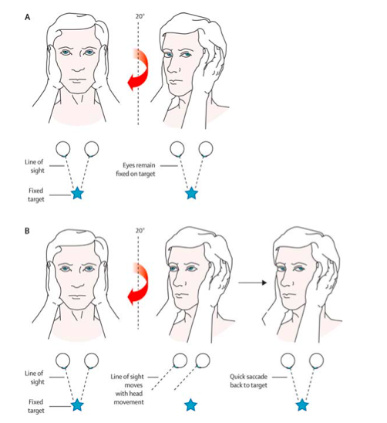
Head impulse test
Normal/negative
Central cause of vertigo
Abnormal/positive (catch up saccade)
Peripheral cause of vertigo
Notes:
Picture from West J Emerg Med. 2009 Nov; 10(4): 273–277

Slide 59
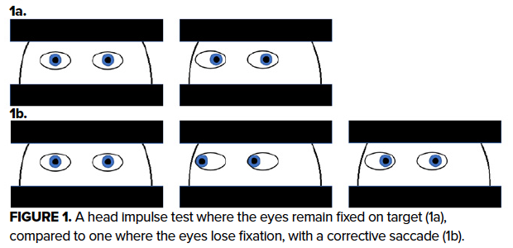

Slide 60
Nystagmus
In a peripheral disorder:
Unidirectional
Slow phase towards dysfunctional side
Suppressed by visual fixation
Improves over a few days due to brainstem plasticity

Slide 61
Skew
Vertical skew suggests a central cause

Slide 62
HiNTs summary
 | Central | Peripheral
Head impulse test | No saccade | Corrective saccade
Nystagmus | Bidirectional | Unidirectional
Test of skew | Vertical skew | No skew
INFARCT – Impulse Normal, Fast phase Alternating, Refixation on Cover Test

Slide 63
HiNTs evidence
HINTS to Diagnose Stroke in the Acute Vestibular Syndrome
Kattah JC, Talkad AV, Wang DZ, Hsieh YH, Newman-Toker DE. Stroke. 2009 Nov;40(11):3504-10
Presence of any of the three HINTS signs:
100% sensitive, 96% specific for stroke
More sensitive and specific than early MRI

Slide 64
Vestibular neuritis/neuronitis/labyrinthitis
Subacute onset over a few hours
?viral aetiology
Vestibular sedatives (betahistine) may be helpful
Will resolve in a few days due to vestibular compensatory mechanisms

Slide 65
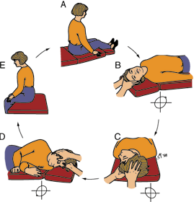
BPPV
Dix-Hallpike manoeuvre
Epley manoeuvre

Slide 66
Ménière’s disease
Vertigo, nausea and vomiting associated with hearing loss, tinnitus and sense of fullness in ear
Audiogram shows low-frequency hearing loss
Decrease sodium intake, give thiazides

Slide 67
Vestibular migraine
Recurrent vestibular symptoms
Features suggestive of migraine – headache, photophobia, phonophobia, family history, history of motion sickness
Responds to usual migraine treatment/prophylaxis
Does not respond to vestibular suppressants
Notes:
Li V, McArdle H, Anand Trip S. Vestibular migraine. BMJ 2019;366:l4213 doi: 10.1136/bmj.l4213

Slide 68
Cerebellar infarct
Hyperacute onset
Vascular risk factors
Usually not vertigo alone
Horner’s, diplopia, dysarthria, unsteady gait
HINTS

Slide 69
6. Stroke

Slide 70
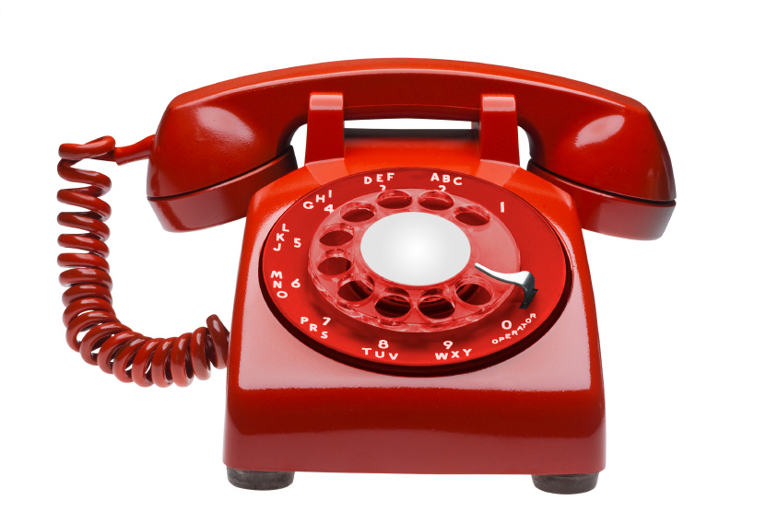
You’ve been dragged away from your AMU job to cross cover the stroke ward (classic clinical staffing)
A big red phone starts ringing ominously
The stroke registrar and stroke nurse are both sick today
– it’s all up to you

Slide 71
55 year old man
HPC
Was sitting with his wife watching TV
Sudden onset right arm and leg weakness, facial droop, speech disturbance
PMH
T2DM
Hypertension

Slide 72
DH
Metformin 1g BD
Amlodipine 5mg OD
SH
Current smoker – 30 pack years
Alcohol 20 units/week
Taxi driver

Slide 73
On examination
Clear right facial weakness – forehead spared
Struggle to test eye movements – looking more to left
Right homonymous hemianopia
Expressive dysphasia
Dense right upper and lower limb weakness
Sensory inattention to right
What’s the most likely diagnosis? What’s your initial plan?

Slide 74
CT head –important to exclude haemorrhage
Aspirin 300mg stat and OD, PO/PR
PPI – lansoprazole 15mg OD
NBM pending SLT review
Any other treatments you could give?

Slide 75
Thrombolysis
IV alteplase/tissue plasminogen activator (tPA)
As soon as possible, certainly less than 4.5 hours after stroke onset
Must have definite time of onset
Contraindications: haemorrhage, high BP, major surgery, anticoagulants, recent stroke, seizure at onset, head injury
Consider risk vs benefit – premorbid function, stroke severity
Post-thrombolysis CT at 24 hours to exclude haemorrhage before starting aspirin

Slide 76
Thrombectomy
Only available at tertiary centres (RHH) at certain times
Must have an anterior circulation large vessel occlusion (CTA)
Can give thrombolysis as well
Patients with significant stroke and good premorbid function

Slide 77
New developments – wake up stroke
MRI may show a mismatch between ischaemic and infarcted areas – the ischaemic penumbra
This is tissue with a better collateral supply which could be salvaged if the clot is removed by thrombolysis/thrombectomy
Patients who wake up with a stroke may still be treated despite no clear onset time

Slide 78
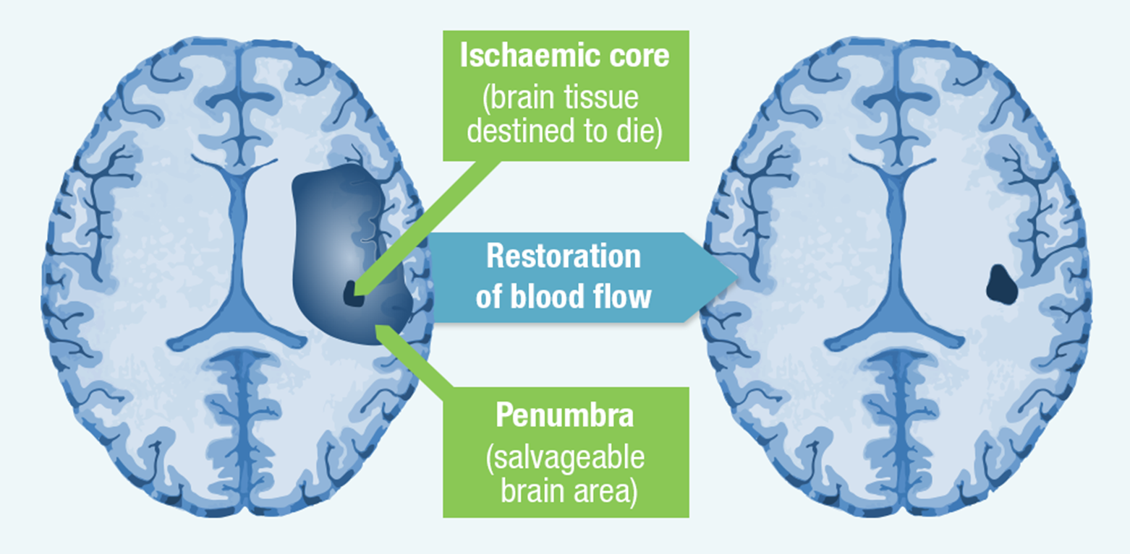

Slide 79
Further management
Carotid doppler (anterior circulation only) - identify symptomatic stenosis which could be treated with endarterectomy
ECG, 24/72 hour tape – identify AF which can be anticoagulated
Echo
Smoking cessation
Statin
Driving advice - must not drive for 1 month, may need further assessment

Slide 80
Quiz
A woman in her 50s with numbness and weakness down the left side, progressing from face to arm and leg. She also has blurring of vision on the left side and is photophobic, headachey and nauseated.
What treatment will you give?
Aspirin 300mg
IV ceftriaxone
Ibuprofen ± domperidone
Paracetamol

Slide 81
Quiz
A woman in her 50s with numbness and weakness down the left side, progressing from face to arm and leg. She also has blurring of vision on the left side and is photophobic, headachey and nauseated.
What treatment will you give?
Aspirin 300mg
IV ceftriaxone
Ibuprofen ± domperidone
Paracetamol

Slide 82
Migraine
Subacute onset/marching symptoms
Auras can cause visual or sensory symptoms, hemiplegia or vertigo
Often associated with nausea, photophobia, phonophobia
Often have family history of migraine
Prone to nausea, travel sickness etc
Can last days and be very severe
Acute – NSAID ± antiemetic, triptans
Preventative – beta-blockers, amitriptyline, topiramate…
Migraine with aura is a contraindication to the COCP

Slide 83
Quiz
A woman in her 30s with weak legs and increased tone (spastic paraparesis). Previous episode of monocular visual blurring with discomfort on eye movements.
Which set of tests will be most helpful?
MRI brain, MRI whole spine, CXR
Visual evoked potentials, nerve conduction studies, CT spine
MRI whole spine, LP, urine dip
MRI head with contrast, LP, EEG

Slide 84
Quiz
A woman in her 30s with weak legs and increased tone (spastic paraparesis). Previous episode of monocular visual blurring with discomfort on eye movements.
Which set of tests will be most helpful?
MRI brain, MRI whole spine, CXR
Visual evoked potentials, nerve conduction studies, CT spine
MRI whole spine, LP, urine dip
MRI head with contrast, LP, EEG
Notes:
More likely to have a plaque in the spine, not the brain. CSF will show oligoclonal bands. Urine dip so we can give steroids for this likely MS relapse. Yes, we will end up scanning the brain anyway.

Slide 85
Multiple sclerosis
Demyelinating plaques disseminated in space and time
This lady is likely to have plaques in the spine, but we would end up scanning the brain as well
Contrast enhancement (GAD) suggests a more acute lesion
Oligoclonal bands in CSF but not serum
Treat acute relapses with high dose steroids – need a urine dip before starting
Disease modifying treatments include interferon beta, glatiramer acetate, dimethyl fumarate, natalizumab, alemtuzumab, fingolimod

Slide 86
Quiz
A man in his 50s develops writhing movements bilaterally and becomes progressively emotionally labile and disinhibited.
What is the pattern of inheritance?
Autosomal recessive
Autosomal dominant
X-linked recessive
X-linked dominant

Slide 87
Quiz
A man in his 50s develops writhing movements bilaterally and becomes progressively emotionally labile and disinhibited.
What is the pattern of inheritance?
Autosomal recessive
Autosomal dominant
X-linked recessive
X-linked dominant
Notes:
Huntington’s disease is an autosomal dominant disease caused by mutations in the huntingtin gene (CAG triplet repeats)

Slide 88
Huntington’s disease
Autosomal dominant
Mutations in the huntingtin gene (CAG triplet repeats)
Genetic anticipation
Chorea
Emotional lability, disinhibition
Impaired executive function, dementia

Slide 89
Quiz
Which of these interventions does not make myasthenia gravis better?
Prednisolone
Methotrexate
Hydroxychloroquine
Ice on the eyelids
IV immunoglobulin

Slide 90
Quiz
Which of these interventions does not make myasthenia gravis better?
Prednisolone
Methotrexate
Hydroxychloroquine
Ice on the eyelids
IV immunoglobulin

Slide 91
Myasthenia gravis
Acetylcholine receptor antibodies or MUSK antibodies
Stops post-synaptic receptors working at the neuromuscular junction
Treat acute relapses with immunosuppression – steroids, IVIg, plasmapheresis
Acetylcholinesterase – pyridostigmine
Thymectomy
Careful with medications
Monitor FVC during an acute episode

Slide 92
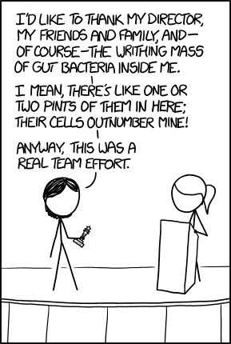
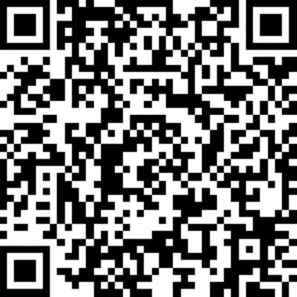
Thanks
Any questions?

Slide 93
HINTS video
https://www.youtube.com/watch?v=1q-VTKPweuk

