Slide 1

2019/2020

Slide 2
Neurophysiology
Phase 1 Revision Session
Mai Morita and Karolina Szarżanowicz
20/03/2020

Slide 3

Part 1 - Aims and Objectives
To have a good understanding of the key information from the following topics:
Axons and axonal transmission
Pain
Neuromuscular junctions, muscle spindles and tendon Golgi bodies
Vision
Auditory system
Basal ganglia
Limbic system
Cerebellum
The Peer Teaching Society is not liable for false or misleading information…

Slide 4
Vision

Slide 5
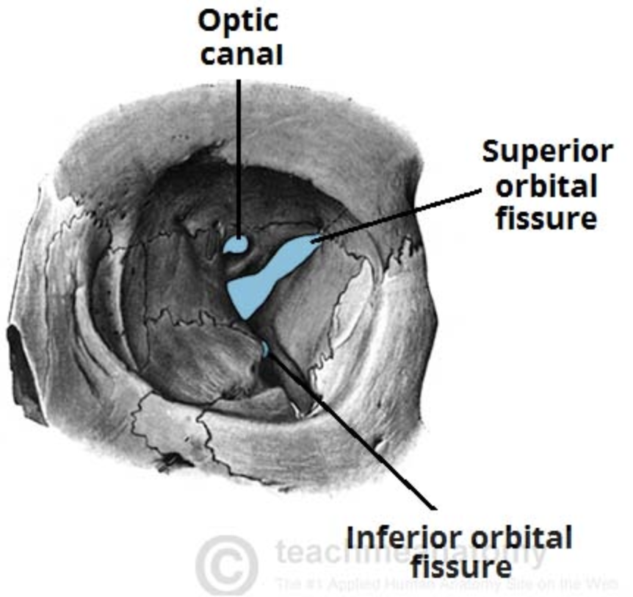
Eye anatomy
Optic nerve (CN II)
Opthalmic artery
Sympathetic nn
Oculomotor nerve (CN III)- branches
Trochlear nerve (CN IV)
Ophthalmic nerve (CN V1) –branches
Superior ophtalmic vein
Cranial nerves innervating meninges:
V1, V2, V3, IX, X
Maxillary nerve (CN V2)
Its zygomatic branch
Infraorbital artery and vein
Notes:
Quick revision from neuro 1 presentation
Skull foramina and cranial nerves
Any other structures?
Sympathetic fibres around arteries
Oculomotor- branches (sup and inf)
Ophtalmic nerve (V1) branches: lacrimal, frontal, nasociliary branches
Zygomatic branch of V2 innervates meninges
Meningeal branches of cranial nerves: V1, V2, V3, IX, X

Slide 6
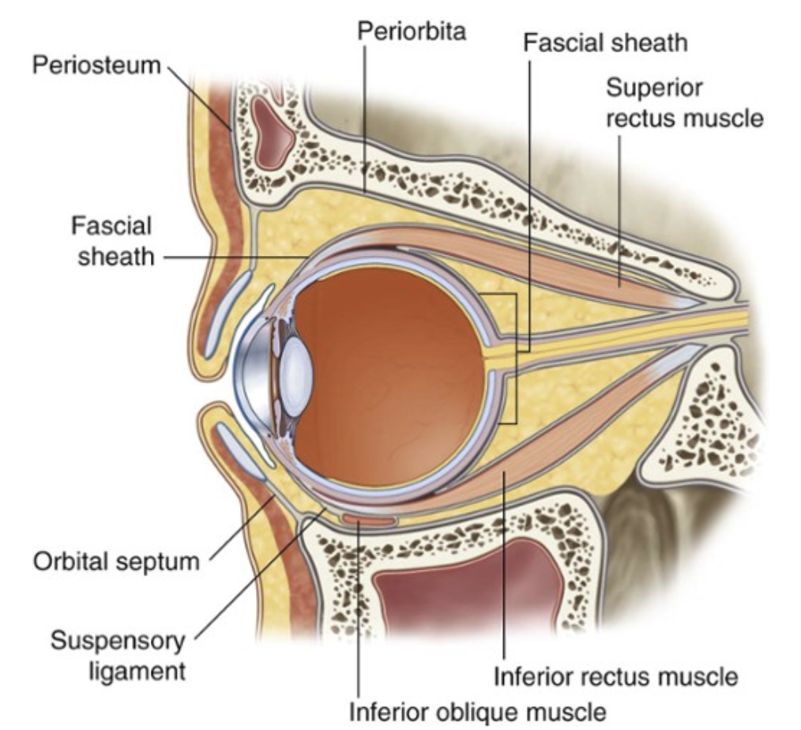
Eye anatomy
Notes:
The fat surrounding the eye
Relevant in hyperthyroidism- Graves eyes/ Graves disease

Slide 7
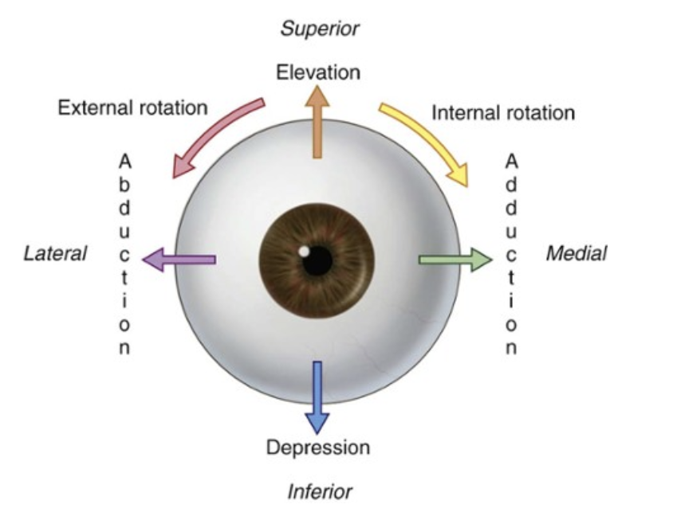
Eye movements
Individual eye movements
elevation— moving the pupil superiorly
depression— moving the pupil inferiorly
abduction— moving the pupil laterally
adduction— moving the pupil medially
internal rotation (intorsion)— rotating the upper part of the pupil medially (or toward the nose)
external rotation (extorsion)— rotating the upper part of the pupil laterally (or toward the temple).
Notes:
Intrinsic ocular muscles mentioned later- when talking aboyt eye layers

Slide 8
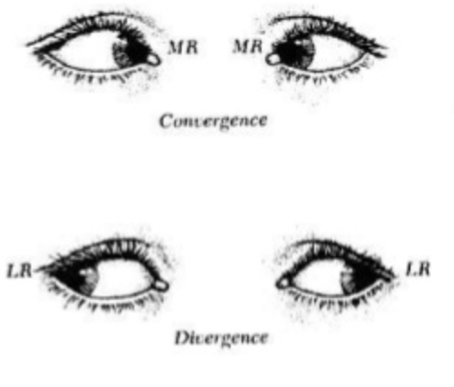
Eye movements
Both eyes movements
convergence- simultaneous inward movement of both eyes toward each other
divergence- simultaneous outward movement of both eyes away from each other
Notes:
Intrinsic ocular muscles mentioned later- when talking aboyt eye layers

Slide 9
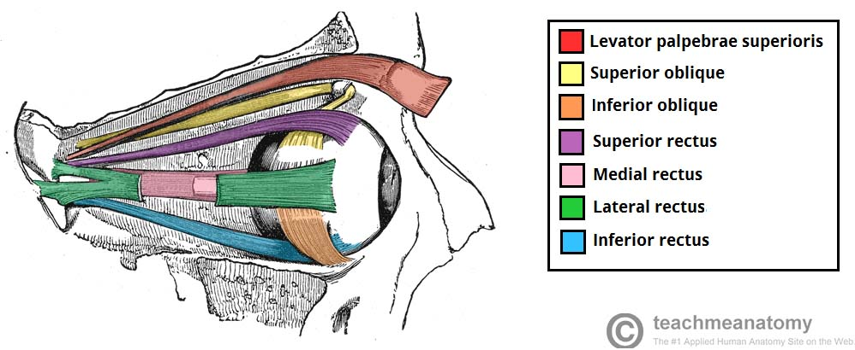
Extraocular muscles
Function: movements of the eyeball and raising the upper eyelid
Notes:
Intrinsic ocular muscles mentioned later- when talking aboyt eye layers
Tarsus- flate of connective tissue making the scaffold of an eyelid- superior tarsal muscle
Common tendinous ring (annulus of Zinn)- tendons of recti make it up
Trochla= pulley

Slide 10
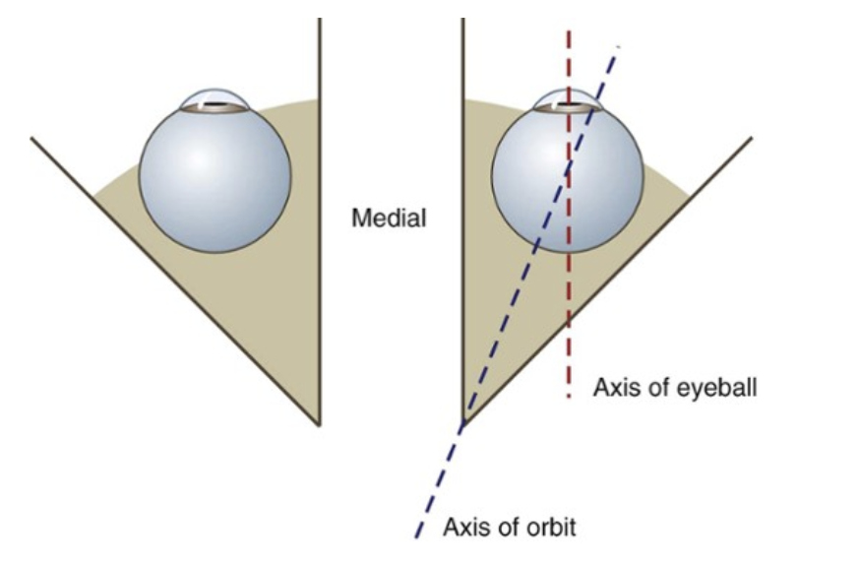
Extraocular muscles
Muscle | Nerve | Movement
Levator palpebrae superioris | Oculomotor (CN III) | Elevation of the upper eyelid
Superior rectus | Oculomotor (CN III) | Elevation, adduction, medial rotation of eyeball
Inferior rectus | Oculomotor (CN III) | Depression, adduction, lateral rotation of eyes
Lateral rectus | Abducens (VI) | Abduction of the eyeball
Medial rectus | Oculomotor (CN III) | Adduction of the eyeball
Superior oblique | Trochlear (IV) | Depression, abduction, medial rotation of the eye
Inferior oblique | Oculomotor (CN III) | Elevation, abduction, lateral rotation of the eyeball
Origin of all recti muscles: common tendinous ring (annulus of Zinn)

Slide 11
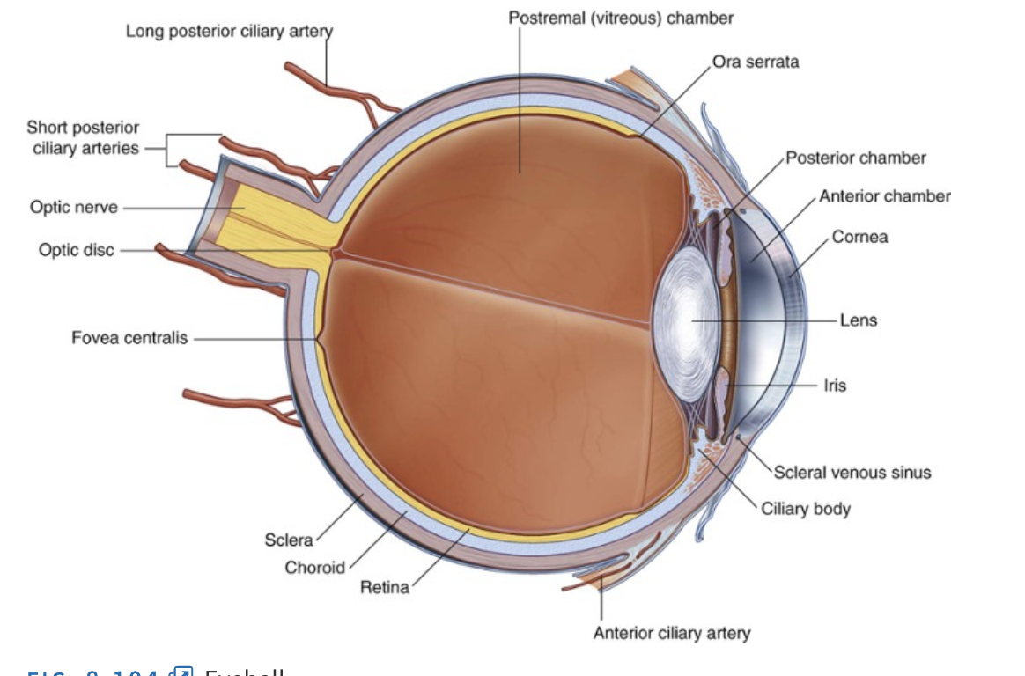
Eye anatomy
Anterior and posterior chamber- aqueous humour
Rest of the eye- vitreous humour
Notes:
Pupil
Lens
Optic nerve
Ant and post chamber
Vitreus= glass- jelly in the eye- between lens and retina
Aqueous= water

Slide 12
Eye anatomy
1.Fibrous layer
Notes:
Sclera- majority- 85% of fibrous layer
White if the eye
Goes all the way around the eyeball
becomes a part of neural sheath of the optic nerve
Cornea- part of fibrous layer over pupil and iris
Hence transparent

Slide 13
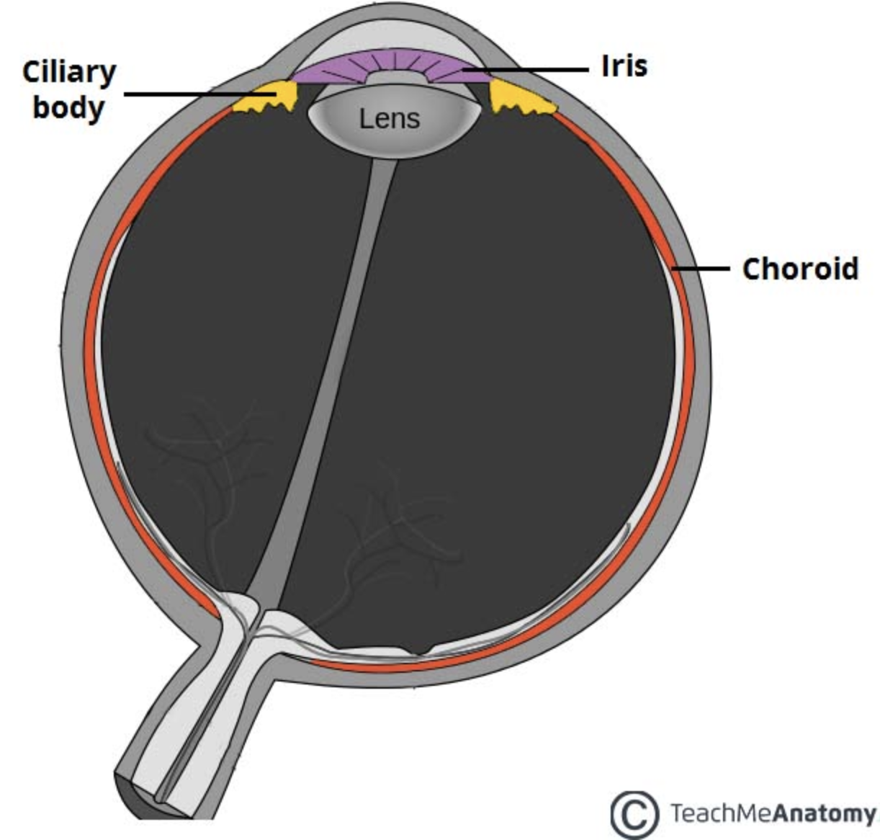
Eye anatomy
2.Vascular layer
Choroid
connective tissue and blood vessels.
nourishment to the outer layers of the retina.
      Ciliary body (ciliary muscle & ciliary processes)
      shape of lens control
      aqueous humour formation
Iris
coloured part of the eye
control of the size of pupil
Notes:
Choroid
layer of connective tissue and blood vessels.
It provides nourishment to the outer layers of the retina
pigmented layer
Cilliary body
Control of the shape of the lens- eye accommodation
Contraction of the muscle „moves the ciliary body forwards” making the hole it surrounds smaller- suspensory ligaments of lens are relaxed- lens rounded- close vision
https://www.youtube.com/watch?v=1yIpyitm6eE
Contributes to the formation of aqueous humour
Iris
Coloured part of the eye with central opening- pupil
Controlling the size of pupil- eye accommodation

Slide 14
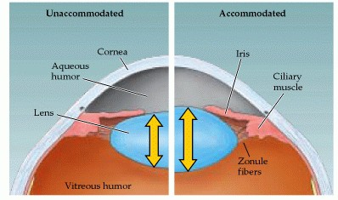
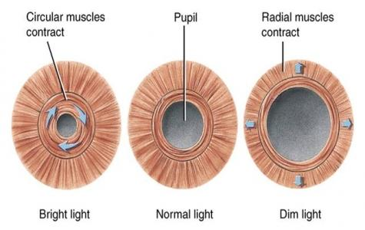
Eye anatomy
Intrinsic eye muscles
Ciliary muscle
Constricts ciliary body, relaxes tension on lens, lens becomes more rounded
Sphincter pupillae Constricts the pupil
Dilator pupillae Dilates the pupil
Parasympathetic system→ pupil constriction
Sympathetic system → pupil dilation
Pupillary light reflex
Read about cranial nerves involved
Notes:
Cilliary muscle contraction- close vivion
Parasympathetic vs sympathetic
Which cranial nerves have got parasympathetic fibres?
Pupillary light reflex

Slide 15
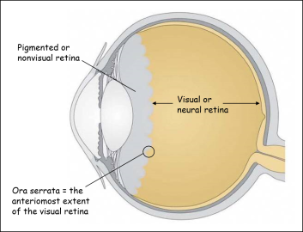
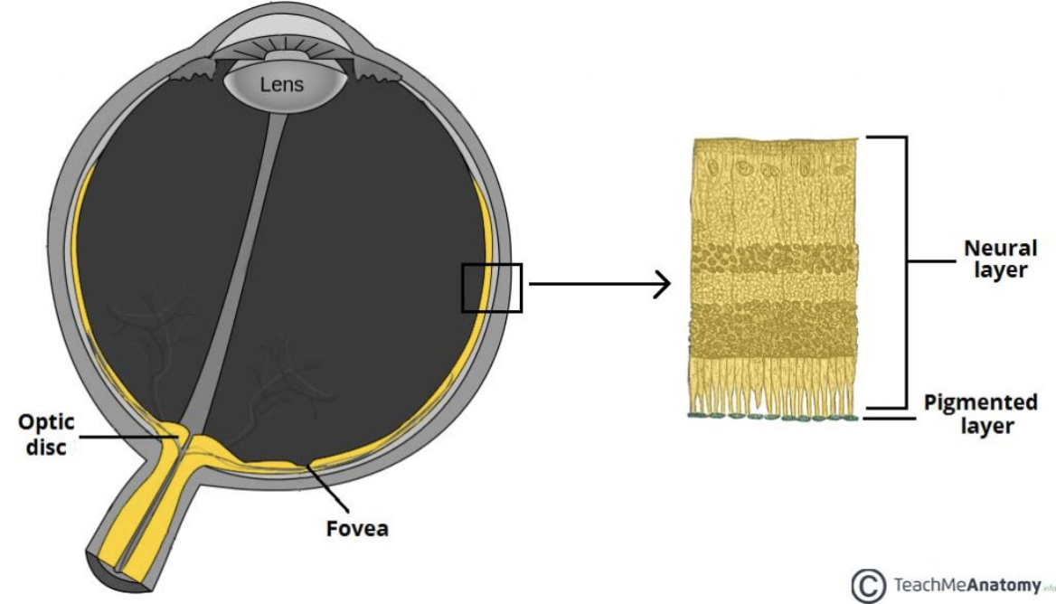
Eye anatomy
3. Retina
Optic part
Light sensitive
Nonvisual part
Covers internal surface of ciliary body and iris
Ora serrata- junction between optic and nonvisual retina
Notes:
Fovea, optic disc
Rods vs cons
Distribution of rods and cons

Slide 16
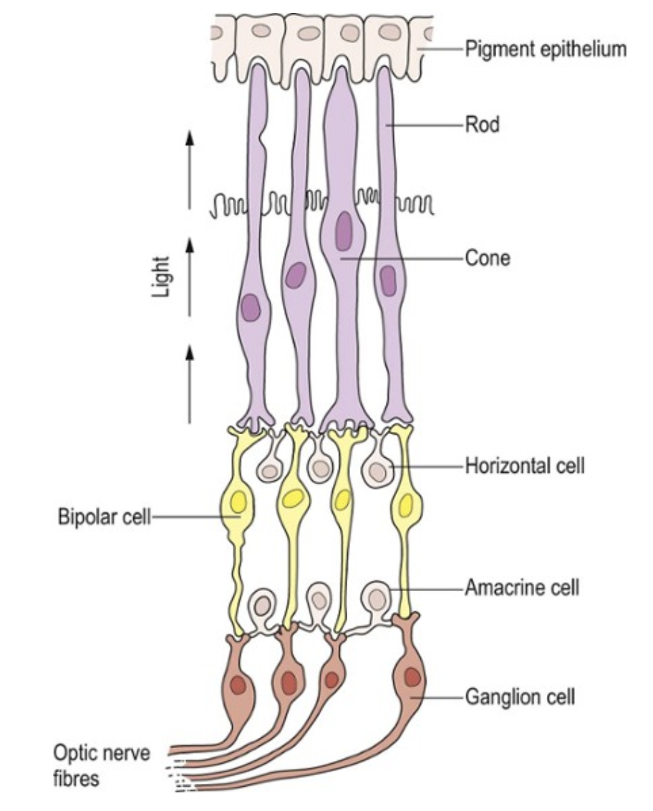
Eye anatomy
Pigmented layer
Neural layer:
Photoreceptors
  RODS- function in dim light and are insensitive to color
  CONS- respond to bright light and are sensitive to color
Bipolar cells
Ganglion cells
Synapse in the lateral geniculate body
Notes:
Pigmented and neural layer
Rods and cons and number of neurons
Number of neurons in the pathway

Slide 17
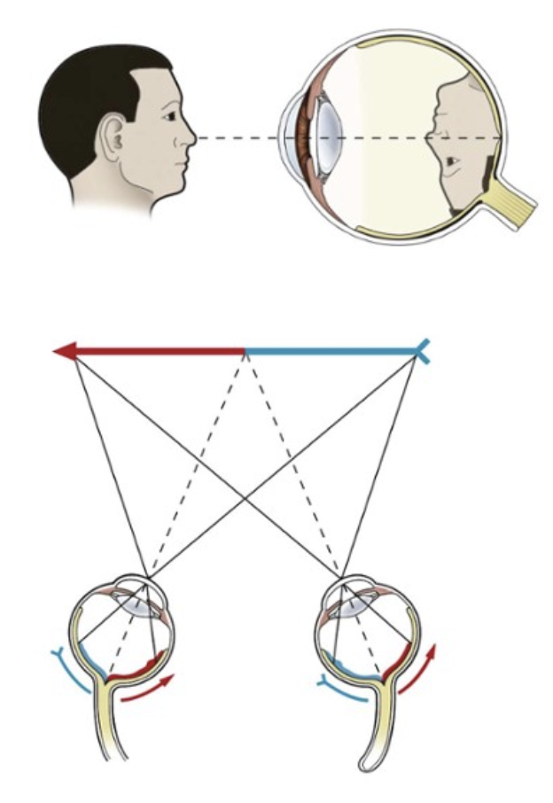
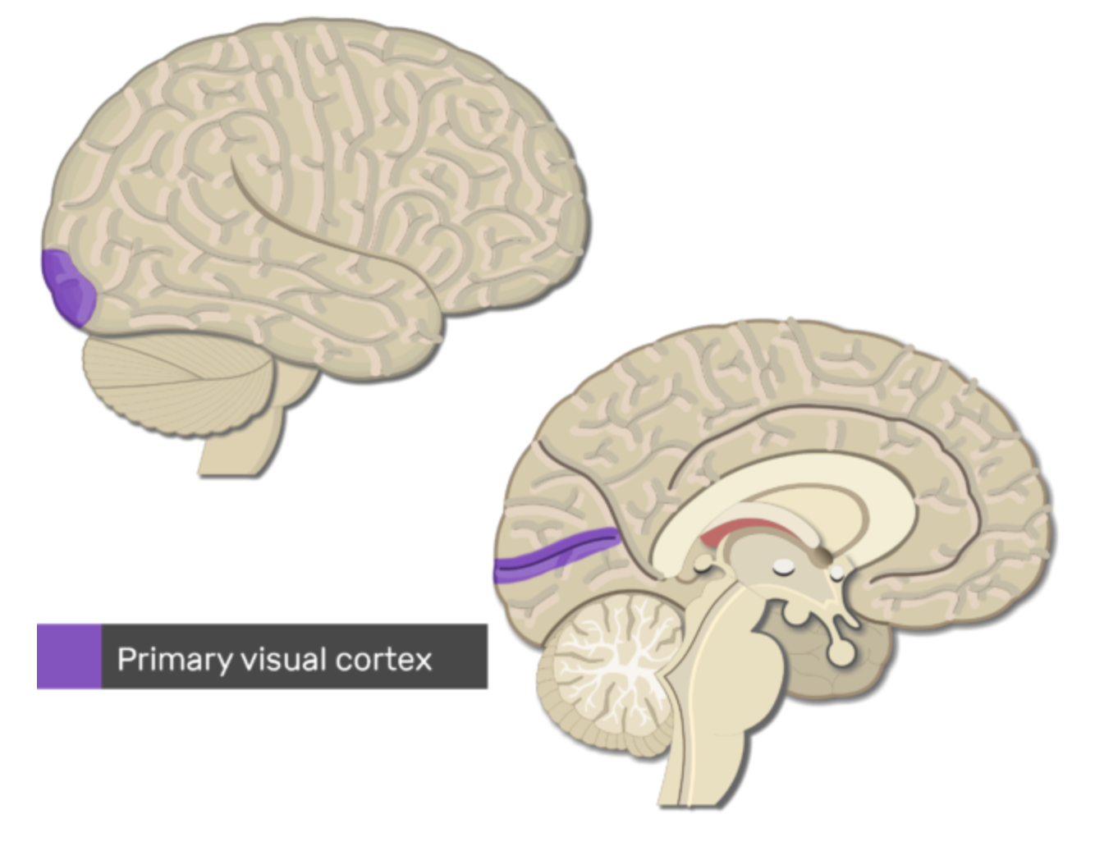
Visual pathway
Image on retina is inverted and upside down
Visual pathway consists of 3 neurons
Primary visual cortex: occipital lobe, around calcarine sulcus
Notes:
Image inverted and upside down due to spherical shape of the eye
Majority of somatosensory pathways consists of 3 neurons
Here: bipolar cells, ganglion cells and neurons from lateral geniculate nucleus

Slide 18
Visual pathway
Stria of Gennari
Notes:
Image inverted and upside down due to spherical shape of the eye
Majority of somatosensory pathways consists of 3 neurons
Here: bipolar cells, ganglion cells and neurons from lateral geniculate nucleus

Slide 19
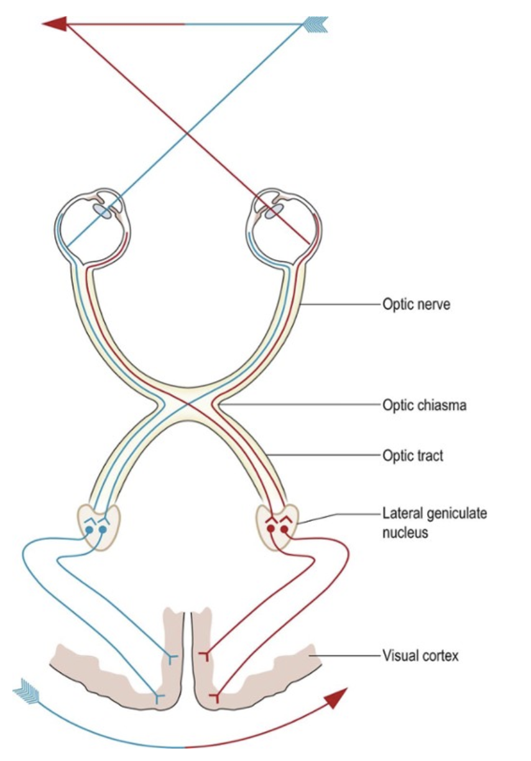
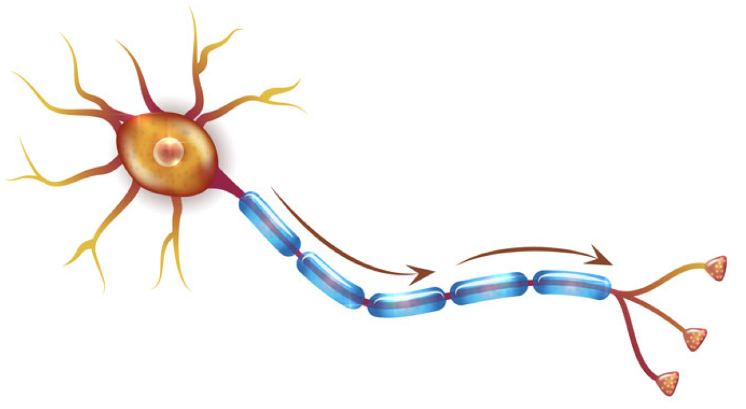
Visual pathway
Visual field
Visual field representation on the retina
Photoreceptors
Bipolar cells
Ganglion cells
Optic nerve
Optic chiasma
Optic tract
Lateral geniculate body
Meyer’s loop/ Baum’s loop
Primary visual cortex
Notes:
1= bipolar cells
2= Lateral geniculate body

Slide 20
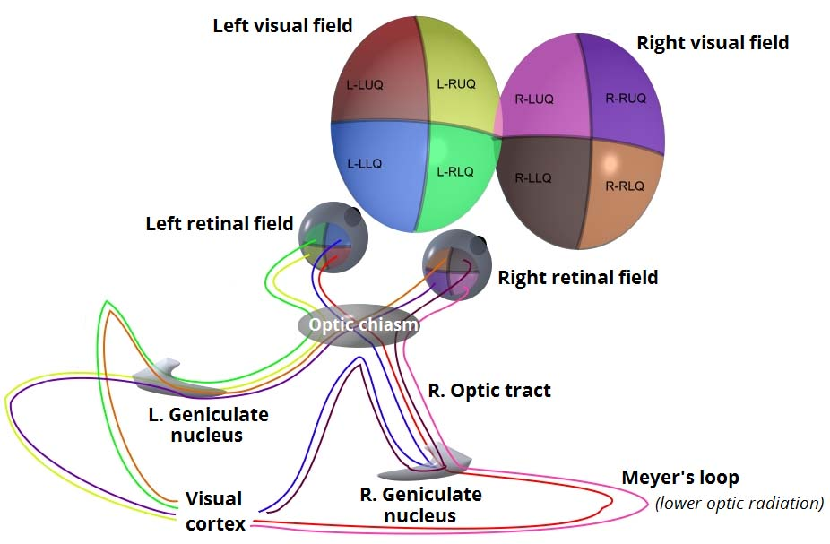
Visual pathway
Baum’s loop

Slide 21
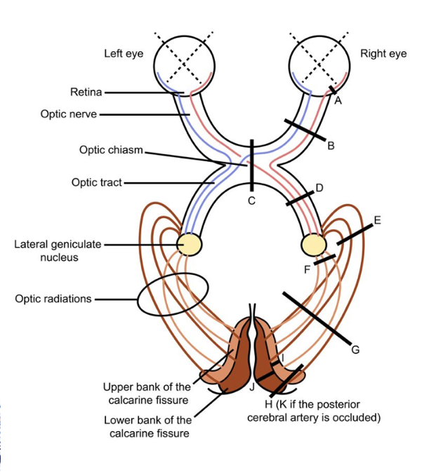


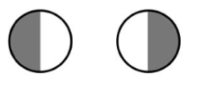


Visual pathway pathologies
A | Central scrotoma
B | Monocular vision loss
C | Bitemporal hemianopia
D G H | Contralateral homonymous hemianopia
K | Contralateral homonymous hemianopia with macular sparing
Notes:
Bitemporal hemianopia
Contralateral homonynous hemianopia

Slide 22
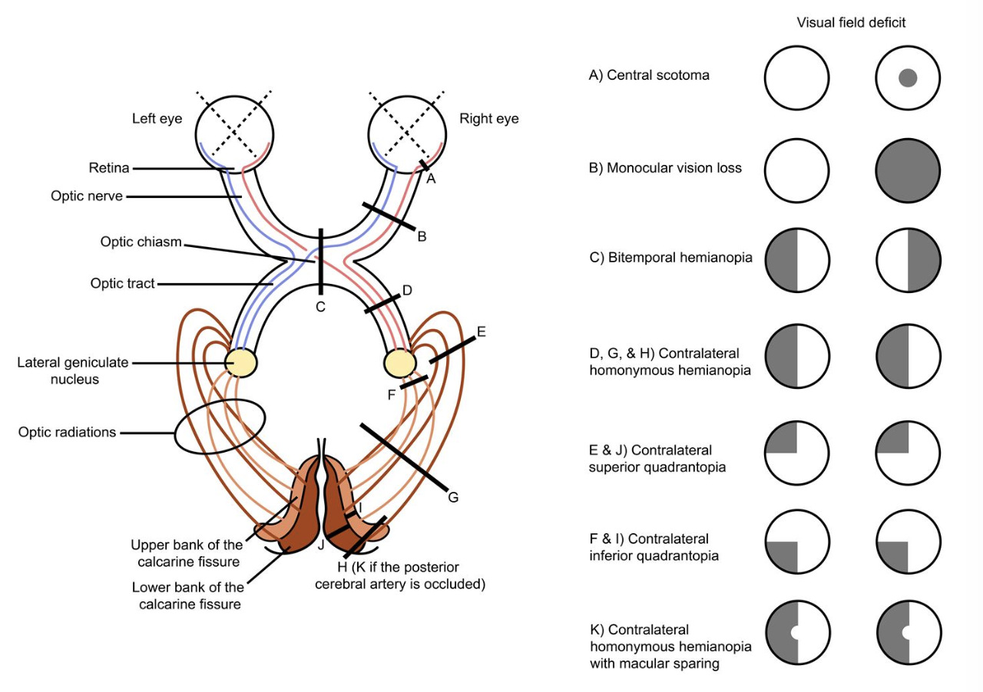
Visual pathway pathologies

Slide 23
Auditory system

Slide 24
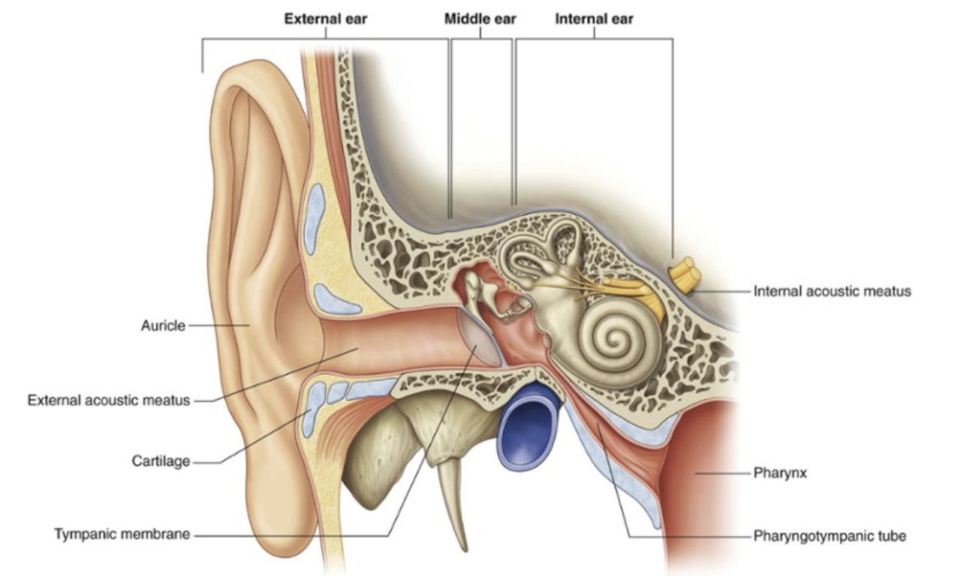
Ear anatomy
External ear:
Auricle
External acoustic meatus
Middle ear
Internal ear
Notes:
External ear consists of auricle and external acoustic meatus
Function: directing sound waves onto tympanic membrane
Parts of auricle- probably not that relevant

Slide 25
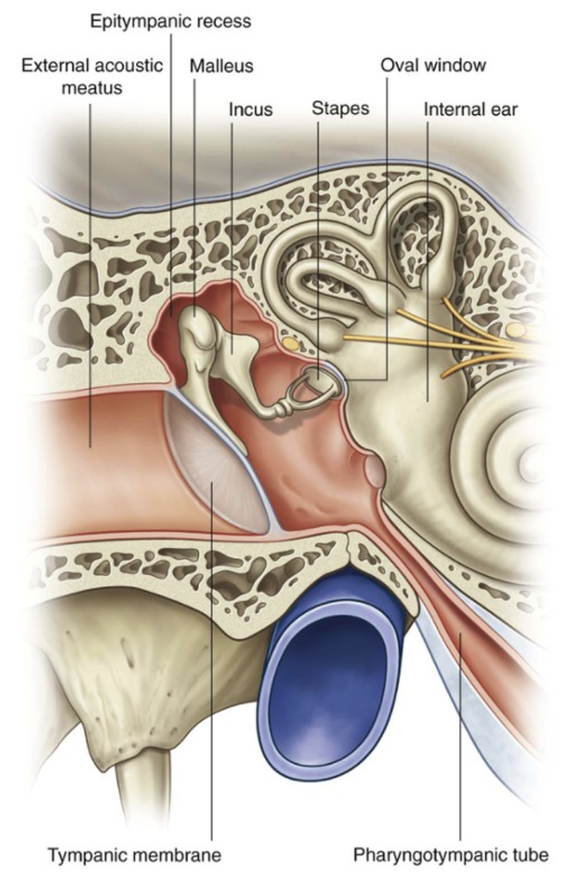
Ear anatomy
Middle ear
Ear bones
  Malleus
  Incus
  Stapes
Pharyngotympanic tube (eustachian tube/ auditory tube)
  Pressure equalisation
The oval window
The round window
Notes:
Ear bones carry vibration from the tympanic membrane
Malleus gathers sound from the tympanic membrane
Stapes directs it into the the inner ear via oval window
Pharyngotympanic tube

Slide 26
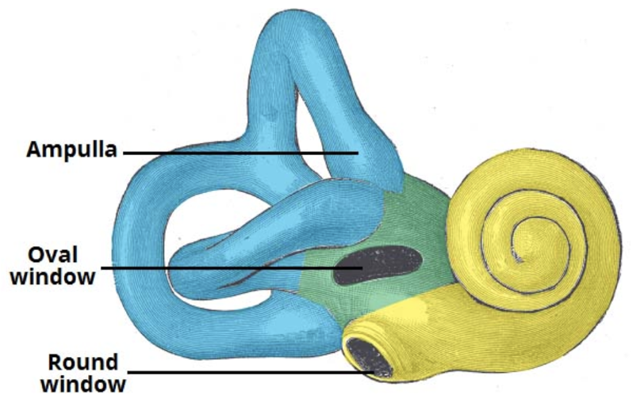
Ear anatomy
Bony labyrinth
  Lined with periosteum
  Contains perilymph
  Consists of:
  Cochlea
  Vestibule
  Semicircular canals (lateral, superior, posterior)
Internal ear
Notes:
Internal ear- vibration is translated into a neurological impulse
Bony and membranaceus labyrinths
Bony and membranaceus labyrinth- analogy of Kinder suprise

Slide 27
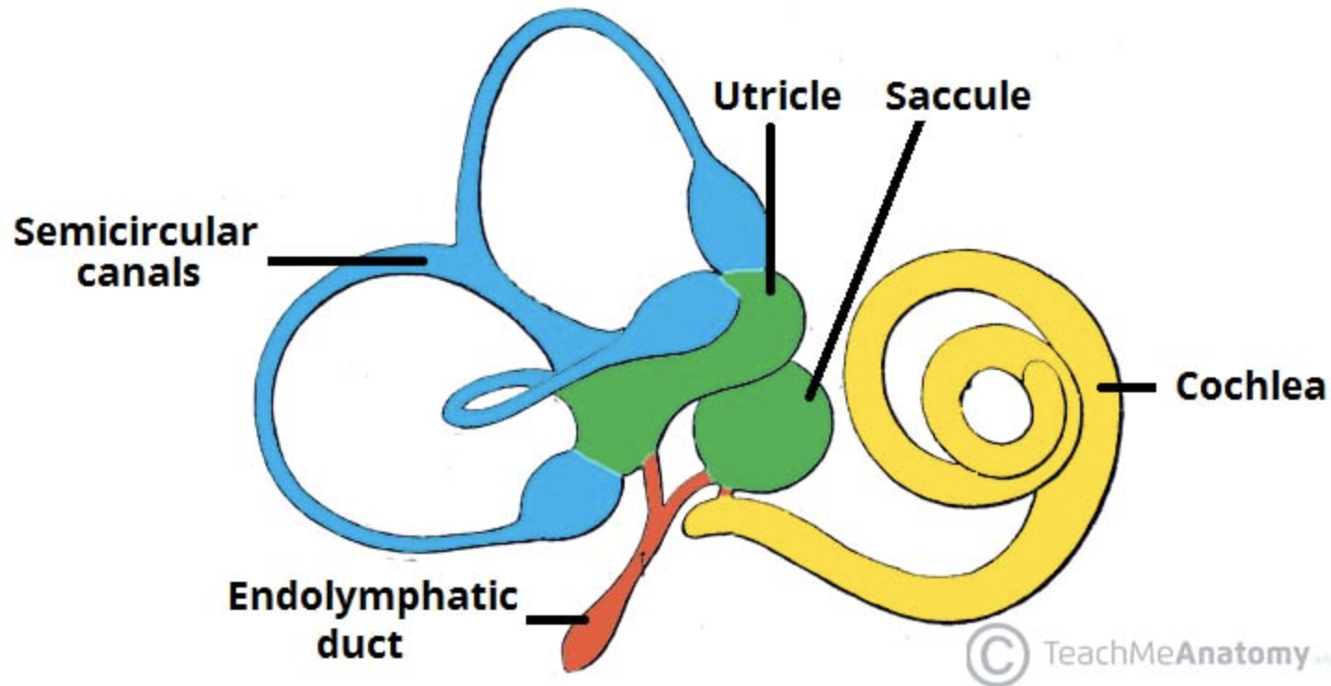
Ear anatomy
Membranaceus labyrinth
  Lies within bony labyrinth
  Contains endolymph
  Consists of:
  Cochlear duct
  Utricle
  Saccule
  Semicircular ducts (lateral,
  superior, posterior)
Internal ear
Notes:
Bony and membranaceus labyrinth- analogy of Kinder suprise

Slide 28
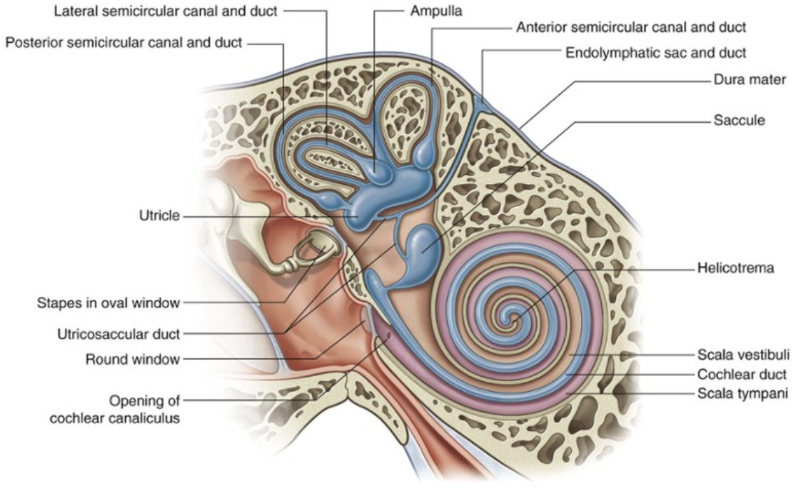
Ear anatomy
Internal ear
Notes:
Semicircular canals- balance
Cochlea- hearing
Ovale window vcovered with stapes, round window with membrane
Hence vestibulocochlear nerve- branches out to vestibular nerve- to the vestibule and cochlear nerve- to the cochlea

Slide 29
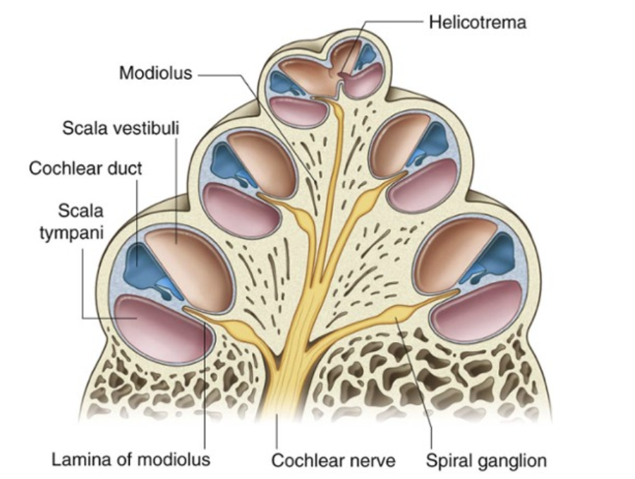
Auditory system
Cochlea
Notes:
Organ of corti
Scala tympani scala vestibuli
Connections to oval and round window
Chochlear nerve- from vestibulocochlear

Slide 30
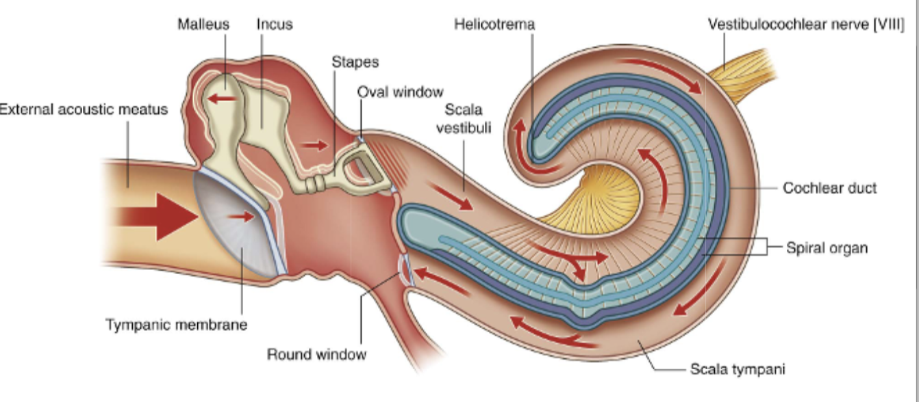
Sound transmission
Notes:
Vibration of perilymph
Hits the round window
That makes the membrane of membranaceus labyrinth move
Movement activates the organ of Corti- through HAIR CELLS

Slide 31
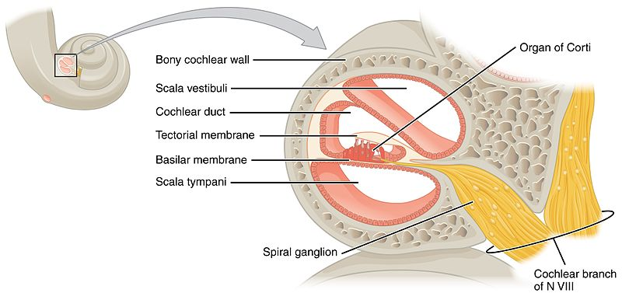
Auditory system
Organ of Corti= spiral organ
Hair cells (of the organ of Corti) translate endolymph movement into nerve impulse
Notes:
Organ of Corti-> cochlear branch-> vestibulocochlear nerve
Auditory pathway
Involves medial geniculate body
Inferior colliculus
Cortex: temporal lobe

Slide 32
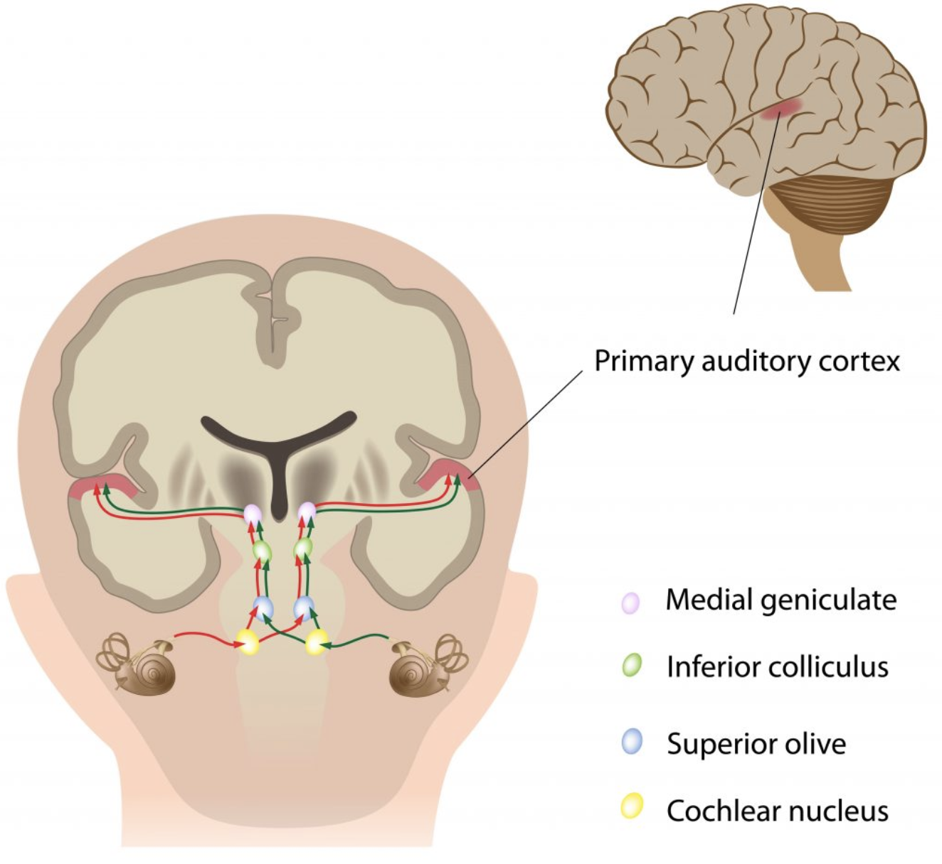
Auditory pathway
ECOLIMA
Ear receptors & Eighth CN
Cochlear nucleus
Superior Olivary nucleus
Lateral lemniscus
Inferior colliculus
Medial geniculate body
Auditory complex
Notes:
Auditory complex- temporal lobe

Slide 33
Vestibular system
Notes:
It works like a spirit level
Each organ- separate spirit level
Utricle
Saccule
Semicircular ducts

Slide 34
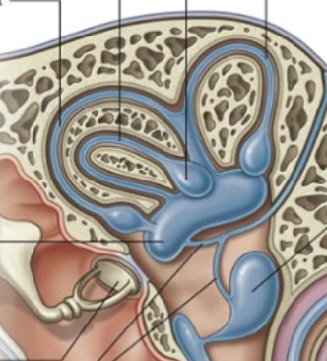
Vestibular system
Sensation of: motion, head position, spatial orientation
Utricle
horizontal movement
Saccule
vertical movement
Semi-circular ducts (Lateral, Posterior, Anterior)
head movements: nodding, shaking, tilting
Posterior semicricular canal
Anterior semicricular canal
Utricle
Saccule
Notes:
It works like a spirit level
Each organ- separate spirit level

Slide 35
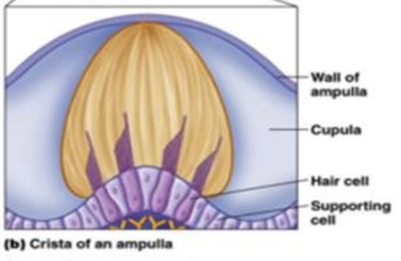
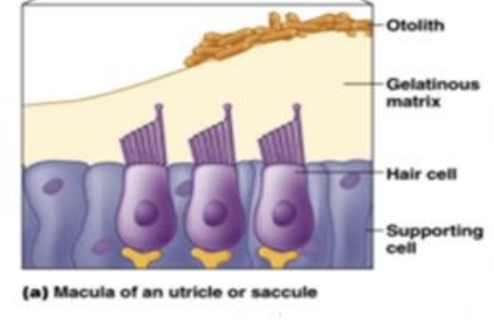
Vestibular system
Semicircular canals
Rotation
Hair cells detect endolymph movement
Signal sent via vestibular nerve
Otolith organs
Acceleration
Crystals in the endolymph move on acceleration
Hair cells detect the crystals (otoliths)
Signal sent via vestibular nerve
Notes:
Movement of endolymph in the canal

Slide 36
Basal ganglia

Slide 37
Basal ganglia
Also called basal nuclei
Spread in the forebrain
Modulate signals in descending motor pathways
∴ refine movement, control posture and muscle tone, inhibit undesired movement.
Supplied by lenticulostriate arteries
Lentiform nucleus= globus pallidus+ putamen
Striatum= putamen+ caudate nucleus
Notes:
Lentiform nucleus- anatoimically both constituents look together like one structure
Striatum- functionally putamen and caudate nucleus are more closely related

Slide 38
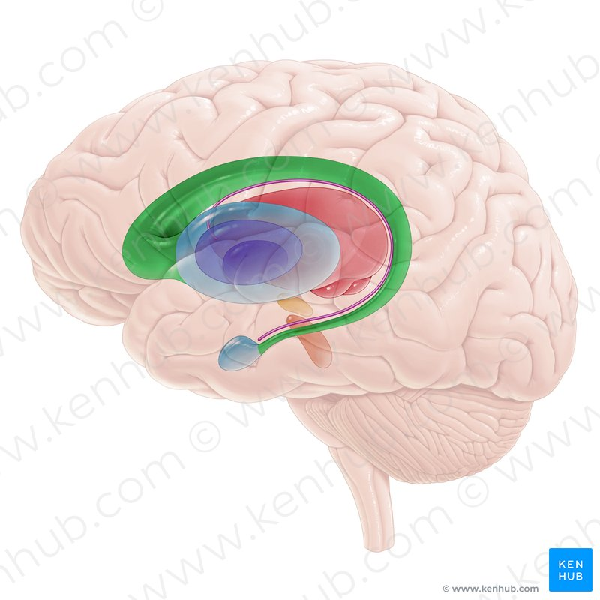
Basal ganglia anatomy
Globus pallidus
Caudate nucleus
Thalamus
Putamen
Subthalamic nucleus
Substantia niagra
Amygdala

Slide 39
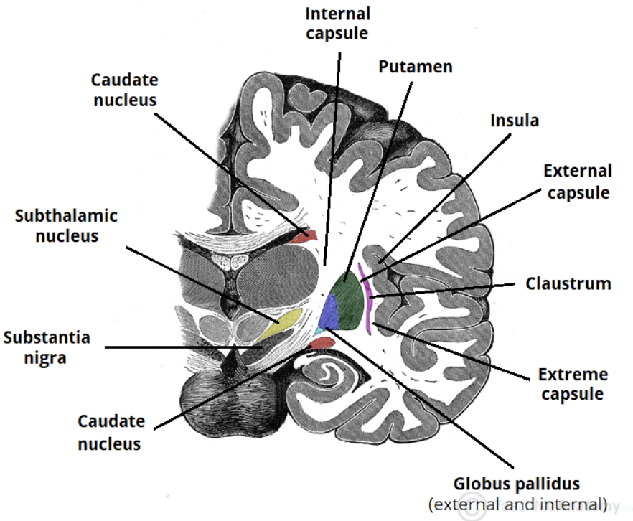
Basal ganglia anatomy
2
1
3
6
4
5
7

Slide 40
Basal ganglia anatomy
Internal capsule
Genu
Head of caudate nucleus
Insula
Internal capsule
Anterior limb
Claustrum
Putamen
Lateral medullary lamina
External segment
Globus Pallidus
Medial medullary lamina
Internal segment
Internal capsule
Posterior limb
Tail of caudate nucleus

Slide 41
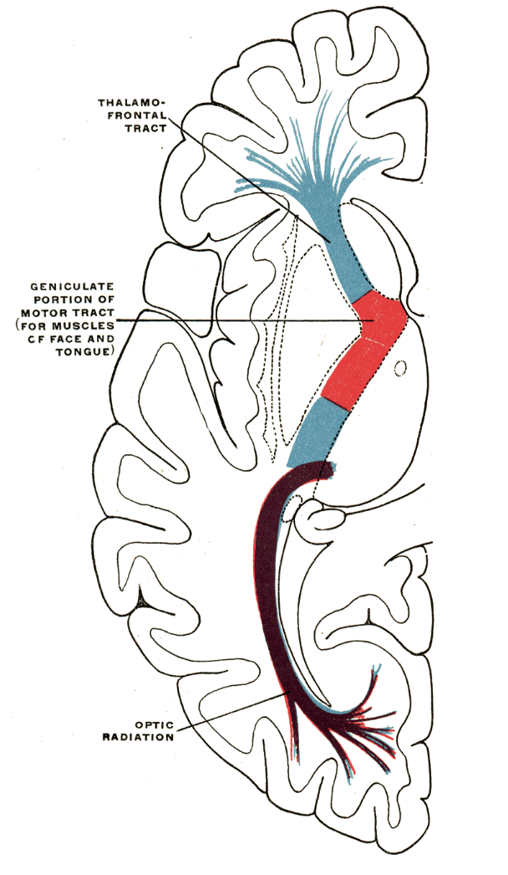
Basal ganglia anatomy
In internal capsule:
Somatosensory pathways pass through the posterior 2/3 of posterior limb
Motor (pyramidal) pathways pass through the genus and anterior 1/3 of posterior limb

Slide 42
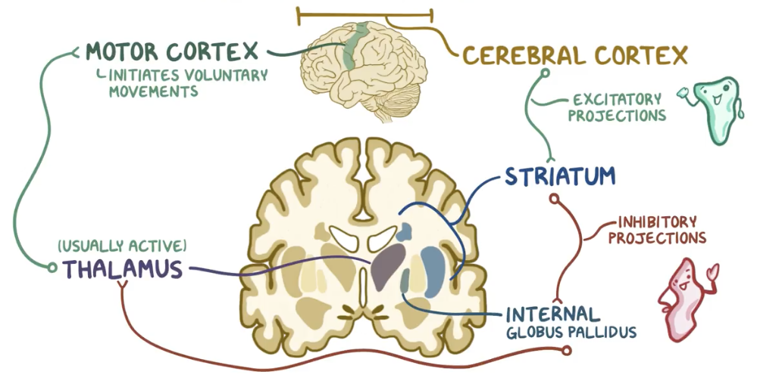
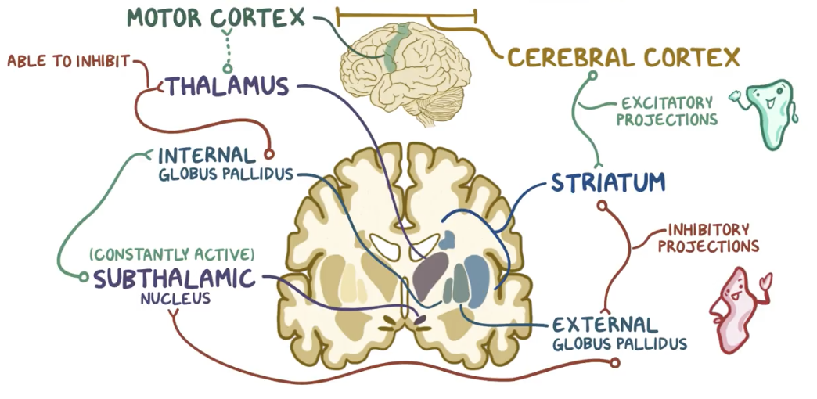
Basal ganglia function
Balance between direct and indirect pathway provides smooth movement
Direct Pathway | Indirect Pathway
Excitatory | Inhibitory
Glutamate | GABA
Notes:
Parkinson syndrome- substantia niagra- not enough dopamine to modulate movement

Slide 43
Direct Pathway
Motor cortex excites striatum
Substantia niagra initiates the direct pathway (see slide 46)
Excited striatum sends inhibitory signal to the internal globus pallidus (GPi)
Inhibited globus pallidus can’t send an inhibitory signal to the thalamus
Not inhibited, thalamus stays active and constantly sends signals to the motor cortex to initiate the movement

Slide 44
Indirect Pathway
Motor cortex excites striatum
Substantia niagra initiates the indirect pathway (see slide 46)
Excited striatum sends inhibitory signal to the external globus pallidus (GPe)
External globus pallidus cannot send an inhibitory signal to the subthalamic nucleus (STN)
Not inhibited, subthalamic nucleus constantly sends signals to internal globus pallidus (GPi)
Excited internal globus pallidus sends inhibitory signal to the motor cortex

Slide 45
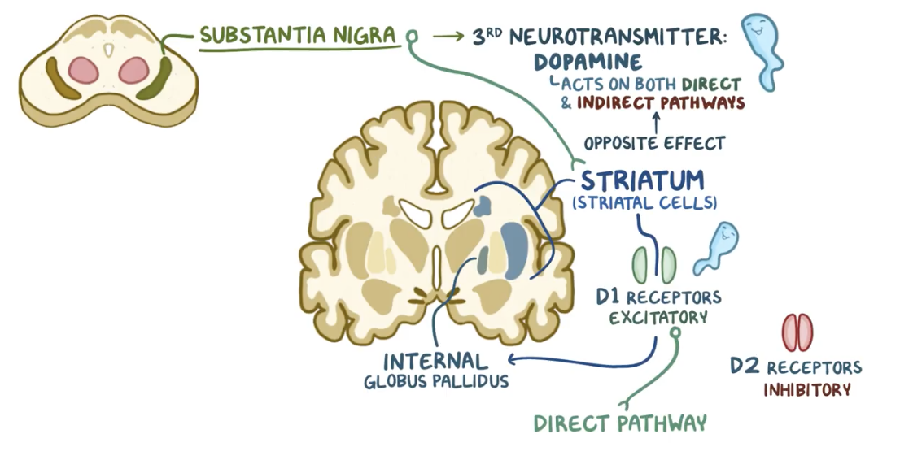
Basal ganglia function
Substantia niagra acts upon striatum, inducing either direct (via internal globus pallidus) or indirect pathway (via external globus pallidus).
Release of dopamine reinforces the desired movements and inhibits the unwanted movement
Parkinson syndrome- not enough dopamine is released, which results in tremor, bradykinesia, rigid muscles, etc
Direct pathway is excited
Indirect pathway is inhibited
Notes:
Parkinson syndrome- substantia niagra- not enough dopamine to modulate movement

Slide 46
Limbic system

Slide 47
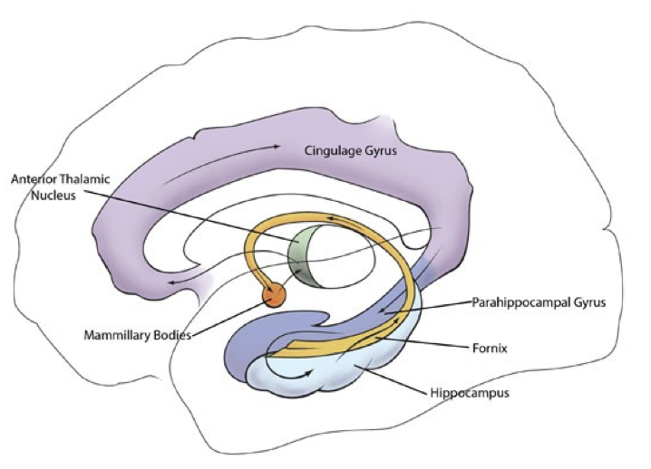
Limbic system
influences endocrine system and autonomic NS via hypothalamus
one of the oldest parts of the brain
Function: instinctive and emotional aspects of behaviour, memory
Behaviour during satiety, hunger
Short-term memory
Sexual arousal
Maternal instincts
Emotional response
Notes:
Function, elements, where in brain
Sometimes olfactory pathway counted too

Slide 48
Limbic system
Cortical structures
Hippocampus- long-term memory
Cingulate gyrus- neuropathic pain, nociception
Parahippocampal gyrus
Fornix
Subcortical structures
Amygdala- emotional, anxiety responses
Nucelus accumbens- desires, cravings, addiction
Hypothalamus- output of limbic system
Olfactory bulb- smell, its relation to memory
Notes:
Other structures sometimes counted in:
Cortical: orbital frontal cortex,
Subcortical: anterior and dorsolateral nuclei of thalamus, septal nuclei

Slide 49
Limbic system anatomy
Cingulate gyrus
Septum pellucidum
Fornix
Column of fornix
Midbrain
Mammillary body
Amygdala
Pons
Olfactory bulbs
Parahippocampal gyrus
Hippocampus
Notes:
Limbic system - structure, function and Papez circuit
Mamillary bodies belong to hypothalamus

Slide 50
Limbic system function
Papez Circuit- part of limbic system responsible for memory processing
Cingulate gyrus
Cingulum
Anterior thalamic nuclei
Fornix
Mammillothalamic tract
Hippocampus (subiculum)
Mammilary bodies
Parahippocampal
region
Notes:
Works by influencing endocrine system and the autonomic nervous system (via hypothalamus)

Slide 51
Types of memory
Sensory Memory
(fraction of a second)
Short-term Memory
(less than 1 minute)
Long-term Memory
(Lifetime)
Information
Information
Information
Explicit Memory
(conscious)
Implicit Memory
(unconscious)
DeclarativeMemory
(facts, events)
Procedural Memory
(skills, tasks)
Episodic Memory
(experiences, events)
Semantic Memory
(facts, concepts)
Notes:
Works by influencing endocrine ssystem and the autonomic nervous system (via hypothalamus)

Slide 52
Cerebellum

Slide 53
Cerebellum
Lies inferiorly to occipital and temporal lobes, under tentorium cerebelli
Blood supply:
  Superior cerebellar artery
  Anterior inferior cerebellar artery
  Posterior inferior cerebellar artery
In cerebrum: gyri and sulci
In cerebellum: folia and fissures

Slide 54
Cerebellum anatomy
Anterior lobe
Hemisphere
Vermis
Flocculonodular lobe
Posterior lobe

Slide 55
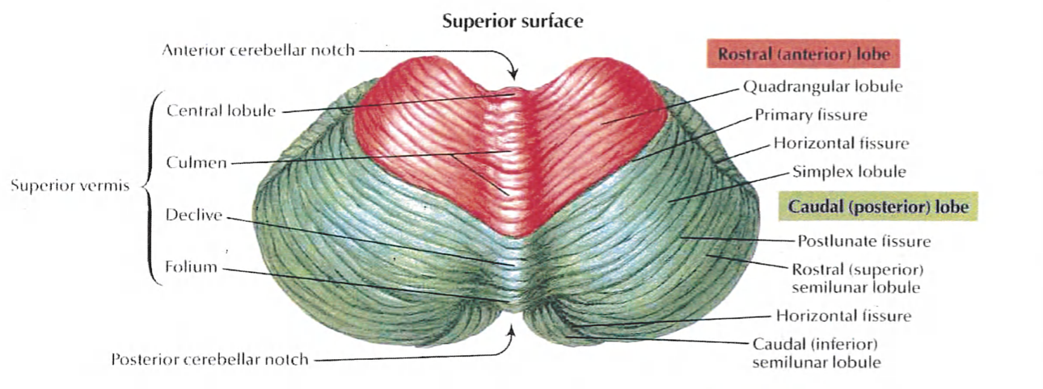
Cerebellum anatomy
Primary fissure
Horizontal fissure
Primary fissure (preclival fissure)- between anterior and posterior lobes

Slide 56
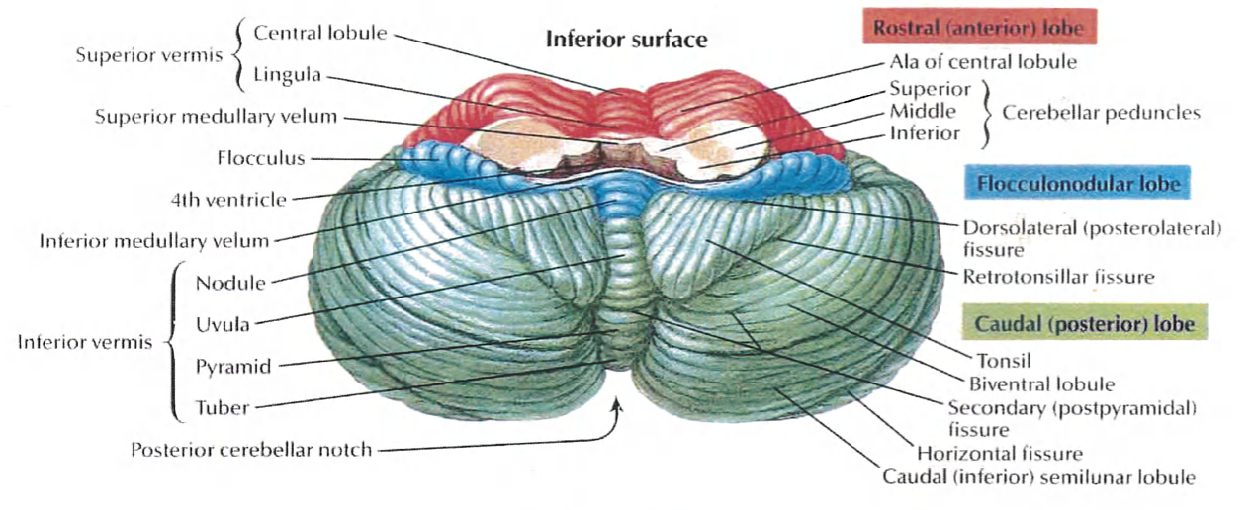
Cerebellum anatomy
Dorsolateral fissure
Tonsil
Horizontal fissure
Dorsolateral fissure (posterolateral fissure)- between posterior and flocculonodular lobes

Slide 57
Cerebellum anatomy

Slide 58
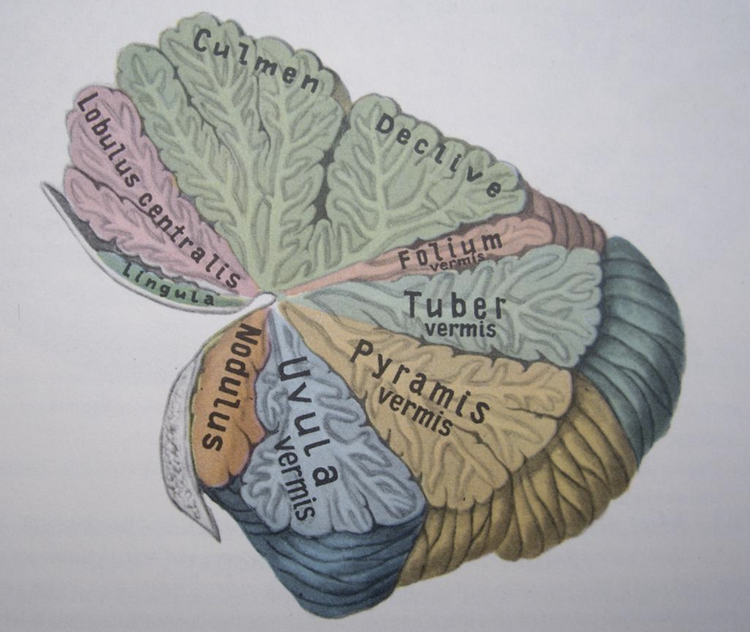
Cerebellum anatomy
Lobules of vermis
Mnemonic: Like Cats Catching Dogs For The Party Up North
Lingula
Central lobule
Culmen
Declive
Folium
Tuber
Pyramid
Uvula
Nodule
Notes:
No need to know lobules of hemispheres

Slide 59
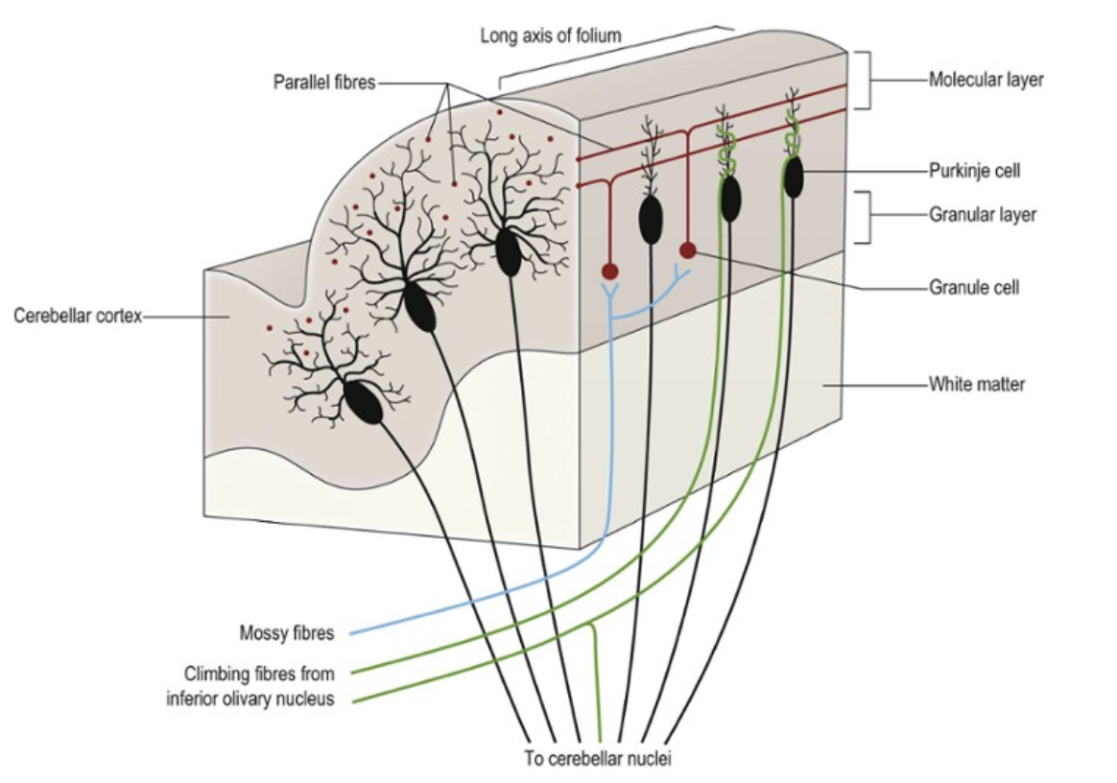
Cerebellar cortex
Cortical afferent fibres
(from outside the cerebellum to the cortex)
Climbing fibres
Origin in inferior olivary nucleus
Mossy fibres
Origin elsewhere
Cortical efferent fibres
(from cortex to the cerebellar nuclei):
Purkinje cells
Communicate through GABA neurotransmitter (inhibitory modulation)
3 layers of cortex:
Molecular layer
Purkinje cell layer
Granular layer

Slide 60
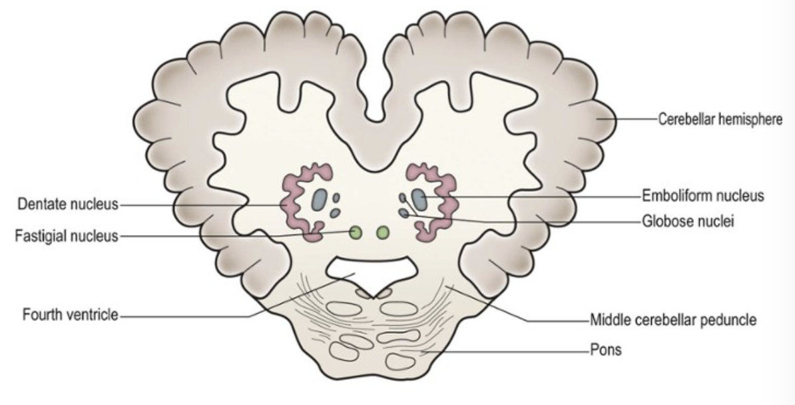
Cerebellar nuclei
Nuclei
Emboliform nucleus
Dentate nucleus
3
1
Globose nuclei
Fastigal nucleus
4
2
Notes:
Dentate nucleus is the only cerebellar nucleus visible with naked eye
Globose nuclei+ emboliform nucleus= interposed nucelus

Slide 61
Functional lobes
Spinocerebellum (paleocerebellum)
Muscle tone and posture
Corticocerebellum
(neocerebellum)
Muscular coordination (trajectory, speed, force)
Vestibulocerebellum (archicerebellum)
Maintenance of balance
Notes:
Cerebrocerebellum= lateral hemispheres
Spinocerebellum= vermis+ medial parts of hemispheres
Vestibulocerebellum= flocculonodular lobe

Slide 62
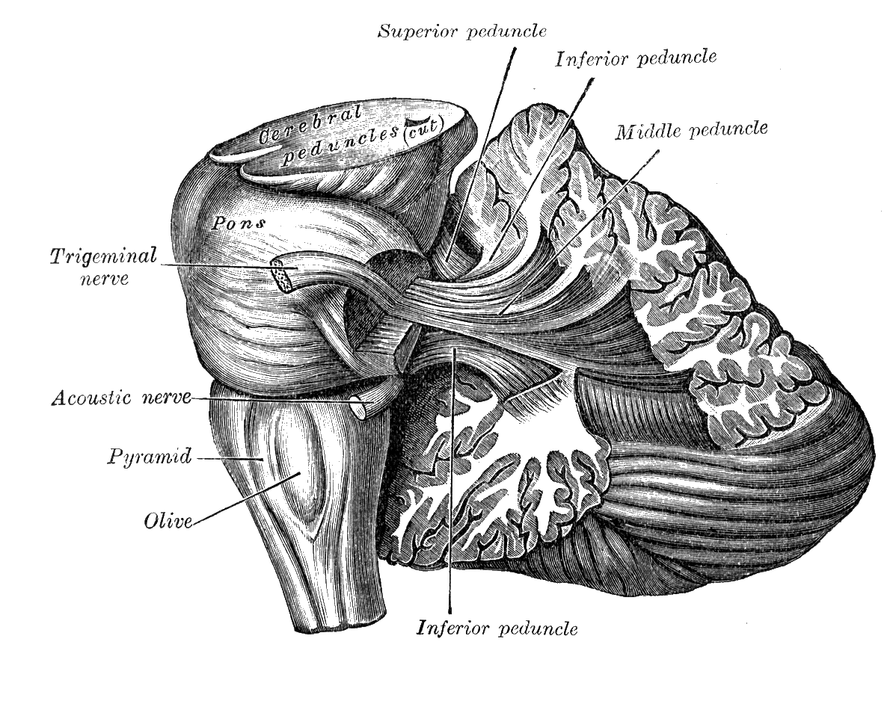
Cerebellar pathways
Tract (signal origin) | Peduncles | Cerebellar cortex | Nucleus | Tracts influenced
Corticopontocerebellar (from motor cortex through pons) | Middle cerebellar peduncles | Cerebrocerebellar | Dentate nucleus | Corticospinal and corticobulbar tracts
Spinocerebellar (position sense from muscle, joint, skin receptors) | Superior and inferior cerebellar peduncles | Spinocerebellar | Globose and emboliform nuclei | Rubrospinal tract
Vestibulocerebellar (impulses from labyrinths via brainstem) | Inferior cerebellar peduncles | Vestibulocerebellum | Fastigal nucleus | Vestibulospinal and reticulospinal tracts
Notes:
learn just the peduncles, part of cortex and the nucleus

Slide 63
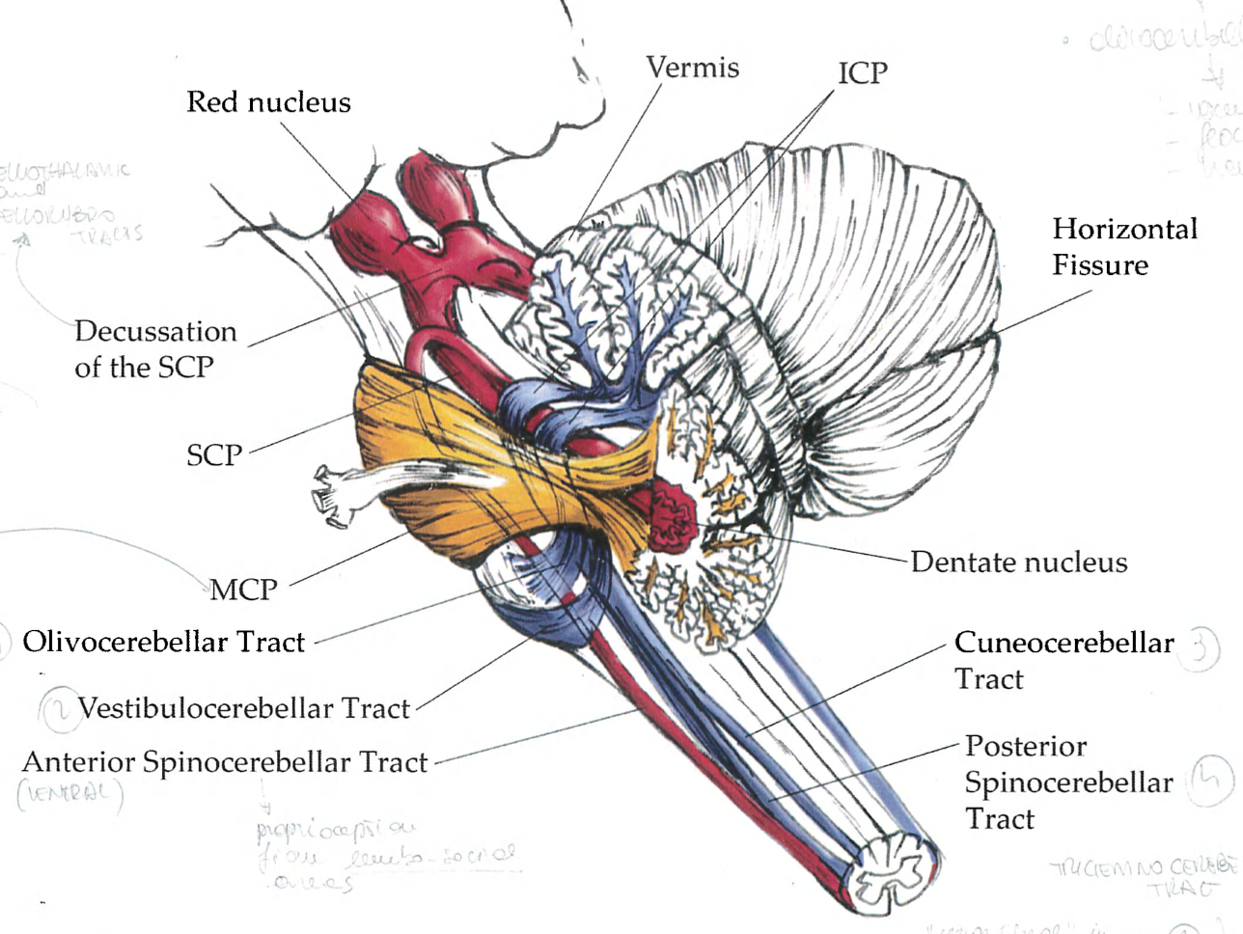
Cerebellar pathways

Slide 64
Cerebellar damage
Signs of cerebellar damage- DANISH
Dysdiadokinesia & Dysmetria - inability to perform and sustain a series of rapidly alternating muscle movements & overshooting when attempting to reach a point with a finger
Ataxia- gross incoordination of muscle movements (f.ex. unsteadiness of standing towards the side of lesion)
Nystagmus- repetitive, involuntary oscillation of the eyes
Intention tremor- wide tremor during voluntary movements
Slurred speech
Hypotonia- muscle weakness on the side of the lesion

Slide 65
Part 2 - Aims and Objectives
Understand basic structure of a neuron, how synapses work and action potential along an axon
Understand the difference between nociceptive and neuropathic pain, pain pathways and pain modulation
Understand motor units, muscle spindle and golgi tendon structures, reflexes, and UMN and LMN disorders
The Peer Teaching Society is not liable for false or misleading information…

Slide 66
Neuron Structure
Notes:
Dendrite – propagates electrochemical stimulation from other neurons to the cell body
Axon – conducts actions potential
Myelin sheath – insulating layer along axon
Node of Ranvier – gap between myelin sheaths along the axon
Schwann cells – produces myelin sheaths
Axon terminal – end of axon that connects to the next neuron’s dendrite
Synapse – the space between the axon terminal and dendrite

Slide 67
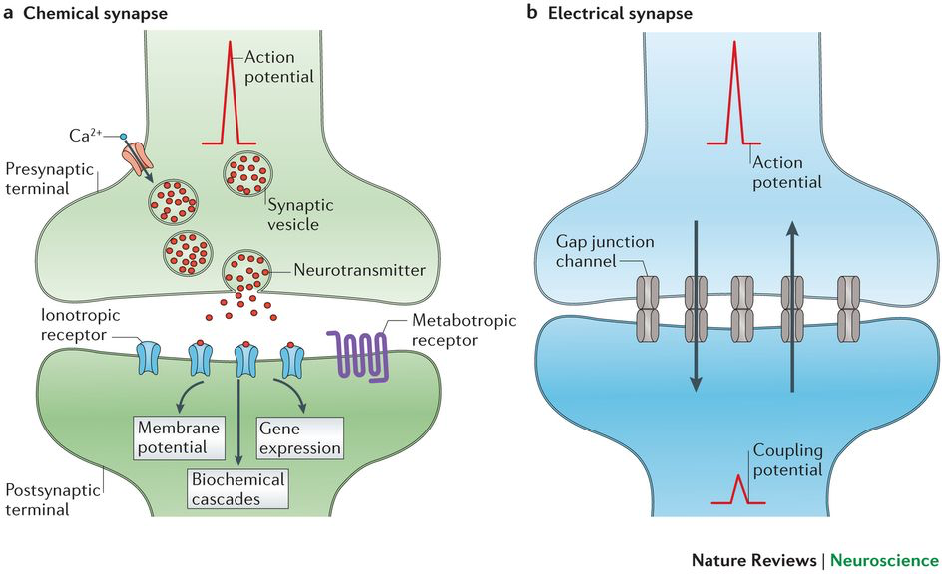
Synapses + Synaptic Transmission
TYPES
Synapses
Excitatory (e.g. Acetylcholine)
Inhibitory (e.g. GABA)
Modulatory
Synaptic Transmission
Chemical (majority)
Electrical

Slide 68
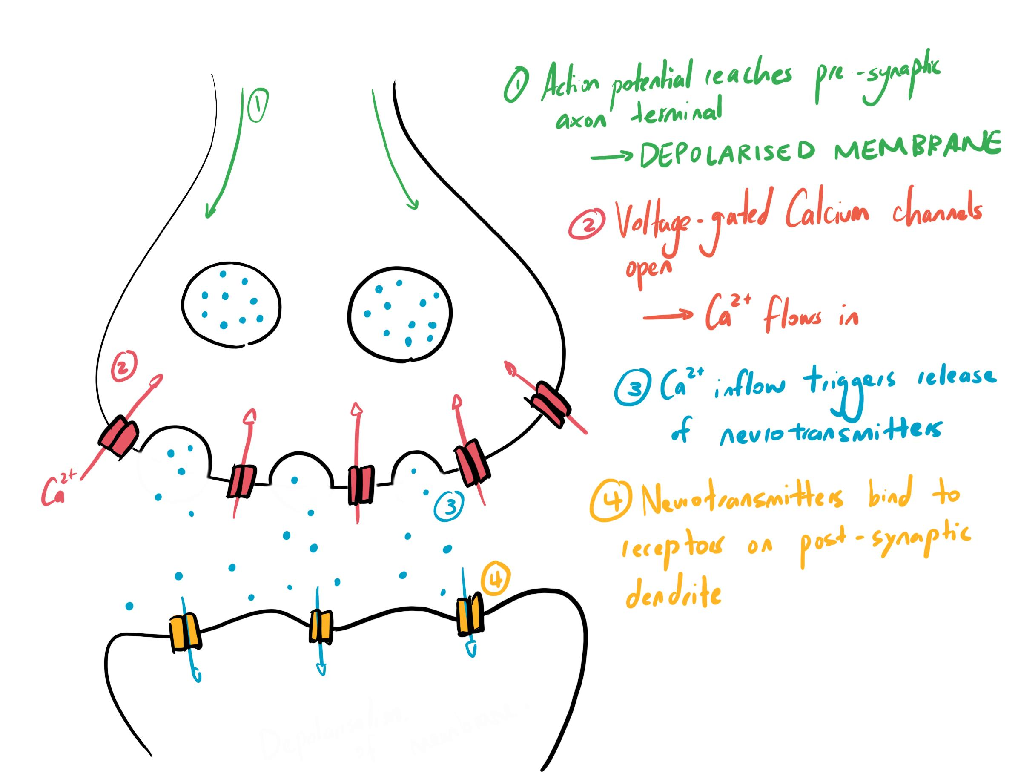
Synapse

Slide 69
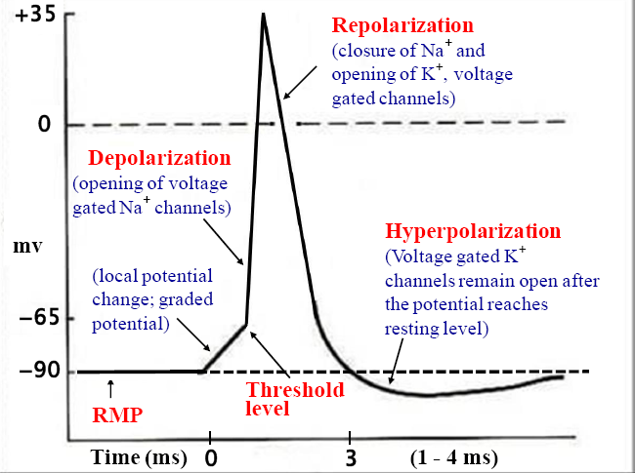
Action Potential Along Axons

Slide 70


Nociceptive vs Neuropathic Pain
Nociceptive Pain
Injury to non-neural tissue
Somatic or visceral
Activates nociceptors
Nociceptive stimuli
  Thermal
  Chemical
  Mechanical
Neuropathic Pain
Pain from primary lesion/ dysfunction of nervous system (e.g. spinal nerve root compression)

Slide 71
Alpha-Delta and C Fibres
 | Alpha-Delta Fibres | C Fibres
Characteristics | Primary Afferent Fibres (First order neuron) Large diameter Myelinated → fast conduction | Primary Afferent Fibres (First order neuron) Small diameter Unmyelinated → slow conduction
Receptor Type | Mechanical | Mechanical Chemical Thermal
Pain Quality | Well-localised Sharp/ prick/ sting ‘Fast’ pain | Diffused pain Dull/ ache/ burning ‘Slow’ pain
Substances Released | Glutamate | Glutamate and Substance P (Substance P – bound to receptors for a longer time → transmits long lasting pain)

Slide 72

Pain Modulation
Periaqueductal Grey
Grey matter structure in cerebral aqueduct
Receives info from spinothalamic tract
Inhibits Substance P → reduced pain sensation
Action of opioids
Opioids mimics this action by binding to opioid receptors in periaqueductal grey
Notes:
Periaqueductal grey activates opioid receptors
Projects to raphe nuclei magnus in brainstem
Produces serotonin → dorsal horn to bind to excitatory connections with “inhibitory interneurons”
Reduction in pre-synaptic neuronal sensitivity
Inhibits Substance P
Fewer impulse travels up pathway
Reduced pain sensation

Slide 73
Pain Modulation
Analgesia – selective suppression of pain without affecting consciousness or sensation
  Centrally acting – decreased perception
  Locally acting – decreased chemical production
Anaesthesia – uniform suppression of pain
  Sometimes consciousness is lost – general anaethesia
Melzack-Wall Pain Gate – non-painful input closes the gate to painful input → prevents pain from travelling to somatosensory cortex → pain not felt
(aka – rubbing around a painful area reduces pain)

Slide 74
Pain Pathways
First Order Neurons (Primary Afferent Neurons)
  Transmit info to dorsal root ganglion to synapse with second order neurons
Second Order Neurons
  Spinothalamic tract – carries pain, temperature and crude touch from body
    Lateral – pain and temperature
    Anterior – crude touch
  Trigemino-thalamic tract – pain, temperature and crude touch from face/head/neck
Third Order Neurons
  Ascend from thalamus to terminate in somatosensory cortex of parietal lobe → perception of pain

Slide 75
Motor Unit
An Alpha motor neuron + extrafusal skeletal muscle fibres it innervates
Different motor units innervate different number of muscle fibres
  Small motor unit → increased flexibility (e.g. fingers, eyes)
Neuromuscular Junction – space between neuron and muscle fibres
  All excitatory synapses – releases Ach
  One End Plate Potential is sufficient to initiate an action potential
Notes:
Muscles fibres in a single motor unit will be within the same muscle, but not necessarily adjacent to each other

Slide 76
Muscle Spindle
Senses STRETCH – monitors muscle length and rate of change
Intrafusal fibres – innervated by gamma motor neurons
Intrafusal fibres set a length that optimizes muscle stretch detection
Middle third – Type 1a Afferent Sensory Nerves (FAST)
Superior/ Inferior thirds – Type 2 Afferent Sensory Nerves (SLOW)

Slide 77
Golgi Tendon
Senses TENSION
  Sensory info to brain via spinal cord about amount of force on muscles
At ending of afferent fibres – Type 1b afferent fibres
Muscle stretched – Golgi tendon receptor endings distorted → ACTIVATED
Inverse Stretch (Myotatic) Reflex – afferent neurons from Golgi tendon can inhibit alpha motor neurons from contracting to protect muscle from overload

Slide 78
Reflexes
Stretch – e.g. Knee jerk reflex
  Physician taps patellar tendon – stretch receptors activated
  Burst of action potential in afferent nerves → activate excitatory synapse of motor neurons innervating these muscles
  Stimulation of motor units of thigh muscle → knee jerk reflex
Withdrawal
  Painful stimulation → ipsilateral activation of flexor + inhibits of extensor
  Opposite reaction on contralateral → activation of extensors + inhibits flexors
Inverse stretch
Clasp Knife – example of inverse stretch
  Bend patient limb – initial resistance, but resistance drastically drops at a certain point
  Characteristic of upper motor neuron lesion

Slide 79
UMN and LMN
UMN
Descending pathways + neurons in motor cortex
UMN lesions causes movement problems
Muscle wasting over time due to inactivity
Hypertonic muscles – uncontrollable movement, muscle spasms → decrease in fine-motor skills
Babinski Sign – dorsiflexed toe
Clasp-knife reflex
LMN
Motor neurons or cord + brainstem (alpha/ gamma)
Muscle severely wasted
  7 days – muscle still responds to electrical stimulation
  10 days – reaction to direct current ceases → takes time to notice muscle damage
Hypotonic muscles

Slide 80

20/03/2020 18:00-19:00
Phase 1 Neurology 2
https://www.surveymonkey.com/r/DZPTLNP
The Peer Teaching Society is not liable for false or misleading information…

Slide 81
Conclusion
Cranial nerves, Visual pathway, Basal ganglia pathways
-absolute minimum
Use the anatomy booklet to understand how much detail you need to get into
Pictures, pictures, pictures
  Neuroanatomy atlas by University of Utah
„Neuroanatomy” by A.R. Crossman and D.Neary for context and explanations
Osmosis, Armando Hasudungan, 2-minute neuroscience, Teach me Anatomy, Teach me Physiology
PTS presentations
The Peer Teaching Society is not liable for false or misleading information…

Slide 82
20/03/2020 18:00-19:00
Phase 1 Neurology 2
https://www.surveymonkey.com/r/DZPTLNP
The Peer Teaching Society is not liable for false or misleading information…

Slide 83


Slide 84
References
Images used in the presentation come from sources:
https://teachmeanatomy.info/
“Neuroanatomy” by AR Crossman and D Neary
Grays Anatomy

