Slide 1
Phase 3A Obstetrics 1
Rosie O’Donoghue

Slide 2
Antenatal care
Screening
Complications of pregnancy- miscarriages, ectopic pregnancy
Hypertension in pregnancy– pre eclampsia/ eclampsia
Obstetric shock – APH, PPH
Other things not in presentation that you should revise – Maternal infections, Rhesus disease, Molar pregnancies

Slide 3
Antenatal Care
Low risk pregnancy – Midwife led care
High risk pregnancy – Consultant led/ Shared care
Primiparous women – 10 Antenatal appointments
Multiparous women – 7 Antenatal appointments

Slide 4
Booking
Before 12 weeks gestation
Weight, BMI, BP, MSU
lifestyle advice on diet, alcohol, smoking, exercises, etc
provide information to make an informed decision about undergoing screening tests – routine blood tests and downs syndrome screening.
Arrange dating scan to take place between 10 – 13 weeks

Slide 5
Routine screening
Offer screening of mother for:
Anaemia.
Red cell allo-antibodies.
Hepatitis B virus.
HIV.
Rubella susceptibility.
Syphilis.
Asymptomatic bacteriuria (strep B)
Sickle cell and thalassaemia screening is offered to all women using the national Family Origin Questionnaire.

Slide 6
What are the principles for screening according to the World Health Organisation?

Slide 7
Principles of screening (WHO)
The condition should be an important health problem.
There should be a treatment for the condition.
Facilities for diagnosis and treatment should be available.
There should be a latent stage of the disease.
There should be a test or examination for the condition.
The test should be acceptable to the population.
The natural history of the disease should be adequately understood.
There should be an agreed policy on whom to treat.
The total cost of finding a case should be economically balanced in relation to medical expenditure as a whole.
Case-finding should be a continuous process, not just a "once and for all" project.

Slide 8
Screening for Downs syndrome (T21)
Favourite exam topic!
Also screens for Edwards (T18) and Patau’s (T13) since 2015
Maternal age main risk factor
Combined test at 10 – 14 weeks
Late presentations can have quadruple test performed at 14 – 20 weeks for Downs Syndrome

Slide 9
Combined screening test
Offered to every woman regardless of age
Combines serum testing with ultrasound scan of nuchal skin fold
Serum screen measures beta-hCG and PAPP-A
Fetal nuchal translucency screening uses ultrasound to measure the size of the nuchal pad at the nape of the fetal neck. It is performed between 11 weeks + 2 and 14 weeks + 1
Maternal factors are then taken into account before a probability is calculated
In England the national cut off is a probability of 1 in 150, at this risk level women are offered diagnostic testing

Slide 10
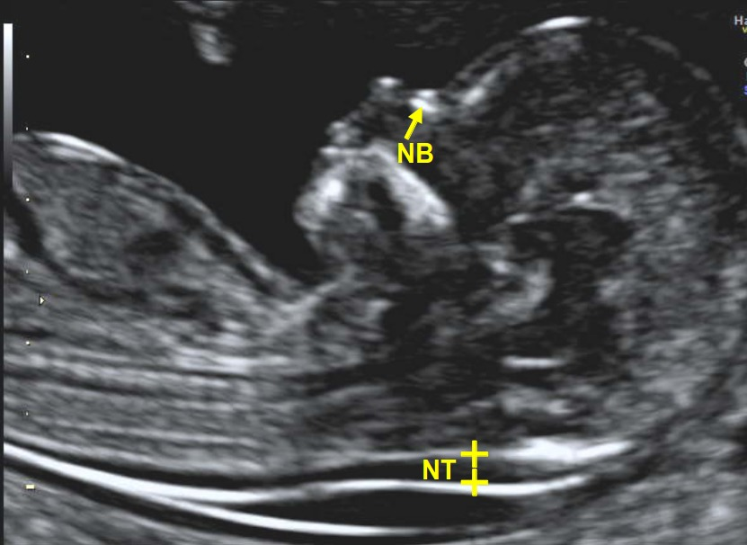

Slide 11
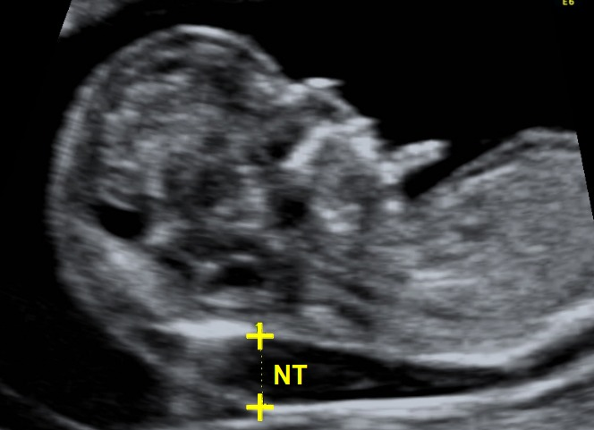

Slide 12
Quadruple test
Late bookers
nuchal translucency is not as accurate after 13 weeks
quadruple test can be taken between 14 + 2 to 20 + 0 weeks of gestation
free beta-hCG, alpha fetoprotein (AFP), inhibin-A and unconjugated estriol (uE3)
It is less accurate than the combined test with a higher FPR

Slide 13
Diagnostic testing for Downs syndrome
Chorionic villus sampling
sampling the developing placenta late in the first trimester of pregnancy – performed too soon can lead to limb deformities
fetal karyotyping
performed transabdominally, may also be performed transcervically prior to 13 weeks – transabdominal seen as safer
Miscarriage risk of around 2%

Slide 14
Amniocentesis
Taking a sample of amniotic fluid in order to examine fetal cells (karyotyping, Enzymatic activity in amniocytes and fluid biochemistry
early amniocentesis between 12 and 14 weeks
Midtrimester amniocentesis between 15 and 18 weeks. (most common, less risk associated as more amniotic fluid)
CVS safer than early amniocentesis, mid trimester amniocentesis safer than both.
0.5-1% increased risk of pregnancy loss compared with the background risk (midtrimester)

Slide 15
Complications in pregnancy
Spontaneous miscarriage
Loss of an intrauterine pregnancy before 24 weeks gestation
1 in 5 pregnancies affected
50% caused by fetal chromosomal antibodies
Maternal risk factors include DM, SLE, APS, Age, obesity, smoking, cannabis, alcohol, anatomical abnormalities.
Maternal infections such as listeria, toxoplasmosis, varicella zoster and malaria

Slide 16
Types of miscarriage
Threatened – cervical os closed, PV bleed, +/- pain, viable pregnancy on TVUS
Inevitable – Os open, POC may be seen, heavy bleeding, pain, no FHS on TVUS
Incomplete – Os open, POC may be seen, ongoing bleeding, pain, RPOC on TVUS
Complete – Os closed, bleeding and pain diminished, Uterus SFD, no RPOC
Delayed – Os closed, brown loss, minimal pain, uterus SFD, empty sac on TVUS

Slide 17
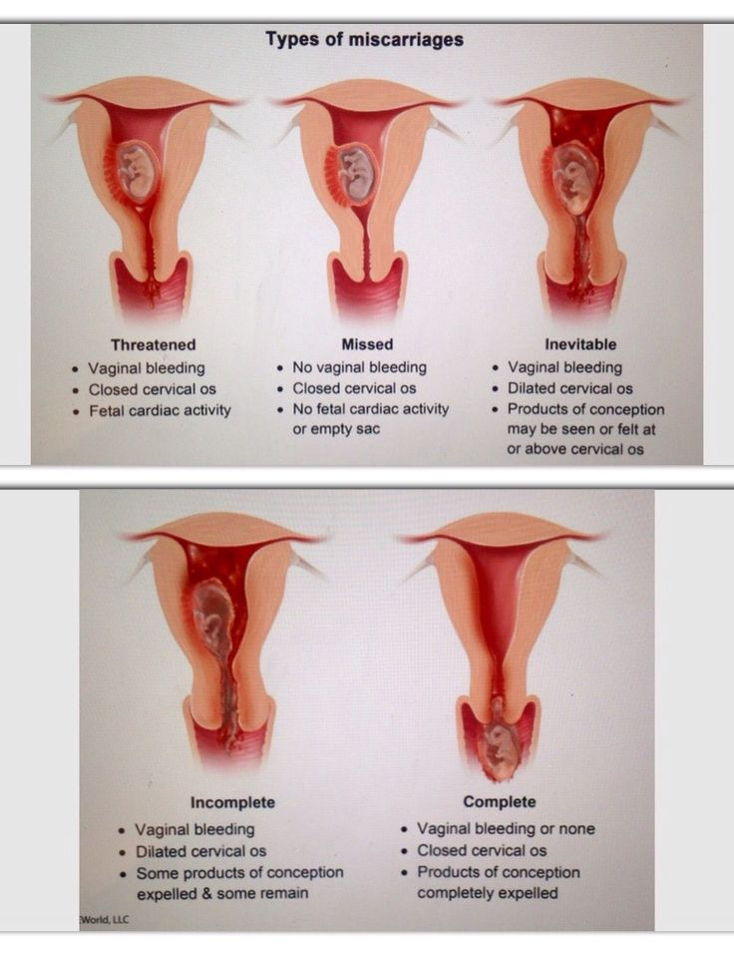

Slide 18
Managing miscarriage
ABCDE assessment of woman, treat any signs of shock
History and examination
US scanning
Serum hCG – mainly to exclude ectopic pregnancy
FBC, Group and save/cross match, Rhesus status
Expectant management for 7 – 14 days if low risk of bleeding and other complications
Medical management – vaginal misoprostal
Surgical management - ERPC

Slide 19
Ectopic pregnancy
Any pregnancy occurring outside uterus
Most commonly fallopian tubes – ampulla or isthmus
Risk factors – previous ectopic, IUD/IUS, PID, Previous pelvic or tubal surgery, assissted reproduction, endometriosis
1/3 women have no risk factors!

Slide 20
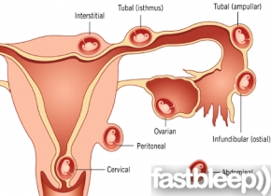

Slide 21
Symptoms
Abdominal pain
Pelvic pain
Amenorrhoea or missed period
Vaginal bleeding (with or without clots)
Dizziness, fainting or syncope
Breast tenderness
Shoulder tip pain
Urinary symptoms
Passage of tissue
Rectal pain or pressure on defecation

Slide 22
On examination
Acute abdomen or signs of peritonism
Signs of hypovolaemic shock
Pain and abdominal tenderness
Pelvic tenderness
Cervical motion tenderness
Uterus SFD

Slide 23
Management
ABCDE assessment
FBC
transvaginal ultrasound.
This can identify the location of the pregnancy and also whether there is a fetal pole and heartbeat
hCG levels are performed in women with pregnancy of unknown location who are clinically stable
hCG levels are taken 48 hours apart.
<63% rise in hCG is suboptimal and is associated with ectopics and miscarriages

Slide 24
Medical management
systemic methotrexate is offered first-line to women with:
No significant pain.
Unruptured ectopic pregnancy with an adnexal mass <35 mm and no visible heartbeat.
No intrauterine pregnancy seen on ultrasound scan.
Serum hCG <1500 IU/L.

Slide 25
Surgical management
Surgery should be offered to those women who have:
Significant pain.
Adnexal mass ≥35 mm.
Fetal heartbeat visible on scan.
Serum hCG level ≥5000 IU/L.
A laparoscopic approach is best
A salpingectomy should be performed, unless the woman has other risk factors for infertility, in which case a salpingotomy should be undertaken in order to try and conserve fertility.

Slide 26
Hypertension in pregnancy
10% pregnancies affected
>140/90 or rise of >30 systolic
Chronic hypertension – pre existing
Gestational hypertension – No proteinuria, good prognosis, resolves after delivery
Pre eclampsia – Proteinuria, serious with potential for serious complications

Slide 27
Pre eclampsia
Favourite exam topic!
Hypertension + proteinuria >300mg/24 hours
Disease of the placenta – failure of remodelling of maternal spiral arterioles leading to a high resistance, low flow placenta.
Risk factors – previous pre eclampsia, first pregnancy, twins, SLE/APS, chronic hypertension, renal disease, diabetes, smoking, obesity, family history.

Slide 28
Management
Monitor BP and urine
Bloods – FBC, U and E, LFT (think of HELLP syndrome)
Prophylaxis from 12/40 if previous gestational hypertension, chronic hypertension, CKD, SLE, APS, diabetes – Aspirin 75mg
Treat hypertension to target <150/90 until 6 wks post partum
May become multisystemic disorder
Only cure is delivery of the placenta

Slide 29
RED FLAGS OF PRE ECLAMPSIA
Headache
Visual disturbance
Epigastric/RUQ pain
SOB
Periorbital oedema
Hyperreflexia
Clonus
Seizures ( ECLAMPSIA)

Slide 30
Eclampsia
Any seizure in pregnancy is eclampsia until proven otherwise
EMERGENCY
Tonic clonic seizure before, during or after delivery
Remember BP predicts risk of stroke not risk of seizures
Manage by getting help, ABCDE assessment,turn patient on side, 02, IV MgS04,IV labetalol, general anesthetic, intubation and delivery by C section

Slide 31
HELLP
Haemolysis
Elevated liver enzymes
Low platelets
Risk of DIC, placental abrubtion, renal failure

Slide 32
Haemorrhage in pregnancy
APH - bleeding from the birth canal after the 24th week up until the second stage of labour is complete
40% no cause found
More common in multiparous women

Slide 33
Placenta Praevia
placenta is inserted wholly or in part into the lower segment of the uterus.
Classified as minor or major
Major, if the placenta covers the internal os of the cervix.
Minor or partial, if the leading edge is in the lower segment but not covering the os.

Slide 34
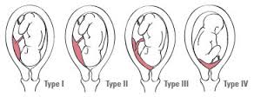

Slide 35
Minor placenta praevia
may be able to deliver vaginally.
A placental edge less than 2 cm from the os has been suggested as indicating a need for delivery by caesarean section
if the placenta is anterior, is reaching the os and the woman has previously had a caesarean section, she should be managed as if she has placenta accreta

Slide 36
Major placenta praevia
Major placenta praevia will require delivery by caesarean section.
Women should be advised not to have intercourse.
Women who have experienced a bleed, should be encouraged to stay in hospital from 34 weeks of gestation
Previous C section – think of accreta

Slide 37
PPH
Primary PPH - Loss of >500mls blood within 24 hours delivery
Secondary PPH – Loss of excessive blood between 24 hours and 6 weeks following delivery

Slide 38
Four T’s of primary PPH
Tone
Tissue
Trauma
Thrombin

Slide 39
Secondary PPH causes
Infection – endometritis
Caesarean section
prolonged rupture of membranes
severe meconium staining in liquor
long labour with multiple examinations
manual removal of placenta
mother's age at extremes of the reproductive span
low socio-economic status
Retained products of conception.

Slide 40
Questions?

