Slide 1
2023/2024

Slide 2
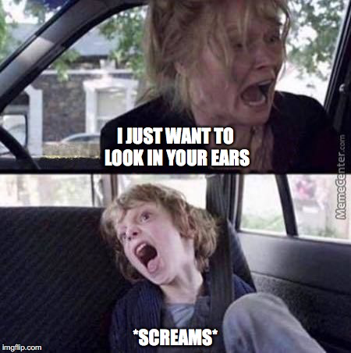
Paediatrics Part 1
Phase 3a Paediatric Revision Session
Vansh Asher, Preethi Muthukumar
[Monday 13th Nov 2023, 6pm]
The Peer Teaching Society is not liable for false or misleading information…

Slide 3
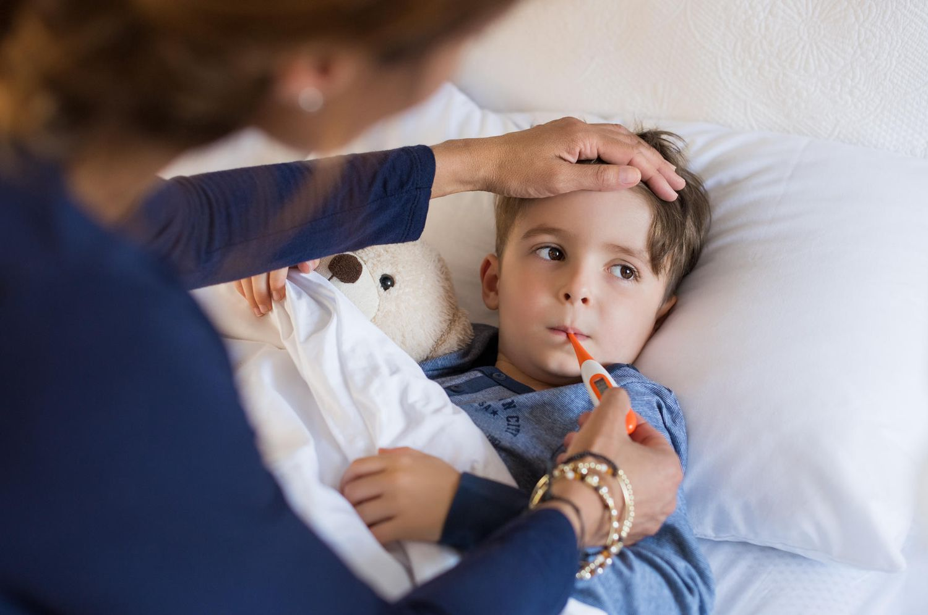
Aims and Objectives
How many conditions are there in Paeds?
155
Can we cover them all today?
Nope
So what are we going to do instead?
The Peer Teaching Society is not liable for false or misleading information…

Slide 4
Aims and Objectives
Common paediatric presentations
What are your differentials?
How will you investigate?
What’s your management?
The Peer Teaching Society is not liable for false or misleading information…

Slide 5
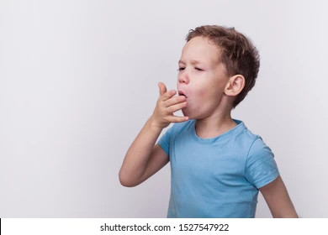
Case 1
You’re in your GP practice when Mr and Mrs Bacon bring in their 5 year old son Chris P.
Chris has been having an awful cough and is unable to sleep at night, which has prompted them to bring him in.
What do you do?
The Peer Teaching Society is not liable for false or misleading information…

Slide 6
Case 1 - Taking a History
Breathlessness
Related to activity?
Weight gain in infancy?
Cough
nature of cough - dry, productive, barking, paradoxical?
Linked to time of day/environment?
Breathing: noisy in______ _____expiration/inspiration? ex
Onset of cough/wheeze/stridor
sudden onset?
Ear/nose/throat
tugging ears?
difficulty swallowing?
offensive odour in breath?
FHx
respiratory problems
smokers/pets?
Travel
The Peer Teaching Society is not liable for false or misleading information…

Slide 7
Case 1 - Taking a History
Breathlessness
Related to activity?
Weight gain in infancy?
Cough
nature of cough - dry, productive, barking, paroxysmal?
Linked to time of day/environment?
Breathing: noisy in______ _____expiration/inspiration? ex
Onset of cough/wheeze/stridor
sudden onset?
Ear/nose/throat
tugging ears?
difficulty swallowing?
offensive odour in breath?
FHx
respiratory problems
smokers/pets?
Travel
asthma, eczema, hay fever
The Peer Teaching Society is not liable for false or misleading information…

Slide 8
Case 1
Thanks to your thorough history, Mr and Mrs Bacon tell you that Chris did have a cold and a mild temperature, but this was last week and had completely resolved before the cough. They don’t report any phlegm or ear tugging.
You examine Chris. He answers your questions in a hoarse voice. He has a harsh, barking cough. He has an audible inspiratory stridor.
What are you thinking?
The Peer Teaching Society is not liable for false or misleading information…

Slide 9
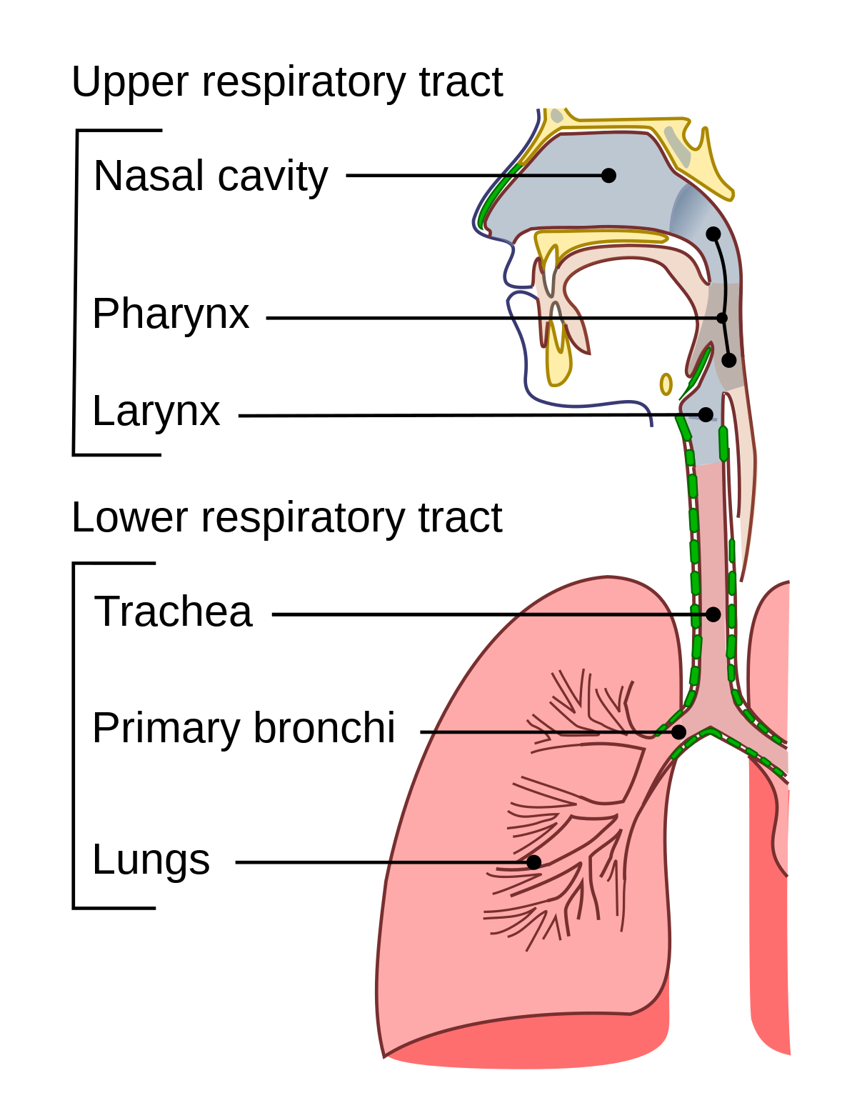
URTI
Extremely common - pre-school average of 6-8 RTIs a year!
80% of URTIs are mild and self-limiting
Sx: some combination of painful throat, fever, blocked nose, nasal discharge, earache
Always examine ears and throat!
General Mx
For fever and pain: paracetamol, ibuprofen
Abx: 10 day course of penicillin/erythromycin
When would you avoid amoxicillin?
The Peer Teaching Society is not liable for false or misleading information…

Slide 10
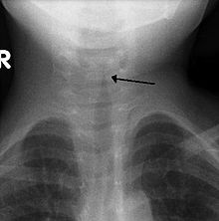
Croup
Mucosal inflammation of upper airways
6 months - 6 years (peak incidence at 2 years)
Sx: BARKING cough, harsh inspiratory stridor, worse at night, prodrome of coryza and fever
Causative organism: viral parainfluenza
Clinical Dx
X-RAY: ______________ sign
Tx: single dose of dexamethasone
If severe: high-flow oxygen, nebulised adrenaline
The Peer Teaching Society is not liable for false or misleading information…

Slide 11
Case 1
As you continue to observe Chris, you realise you can see visible suprasternal and intercostal recession, even when he’s at rest and not upset. You quickly check his pulse and realise his HR is 152 bpm.
What do you do?
The Peer Teaching Society is not liable for false or misleading information…

Slide 12
Paediatric Red Flags
The Peer Teaching Society is not liable for false or misleading information…

Slide 13
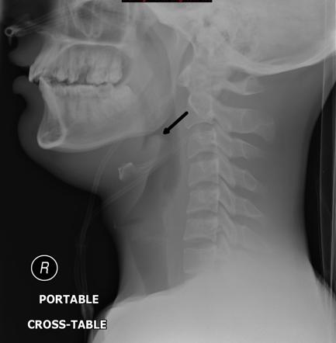
Epiglottitis
LIFE-THREATENING EMERGENCY
Severe swelling of epiglottis and surrounding tissues
4-6 years old, but can affect all ages
Sx: ACUTE onset, high fever, painful throat (drooling!), tripoding
Causative organism: H.influenzae B (immunisation!)
Ix: clinical assessment, DO NOT LIE CHILD DOWN
Compare to viral croup: fever, no cough, saliva drooling
Tx: EARLY INTUBATION, IV abx (ceftriaxone) 7-10 days
Prophylaxis?
The Peer Teaching Society is not liable for false or misleading information…

Slide 14
Other URTI
Common cold: coryza, caused by rhinovirus
Sore throat: viral cause is adenovirus, bacterial cause is GAS
FeverPAIN/CENT-OR - to determine whether to start abx
7-10 day course of phenoxymethylpenicillin or clarithromycin
Glandular fever/Mono: caused by EBV, weeks of fever, maculopapular rash, throat pain, cervical lymphadenopathy, jaundice, hepatosplenomegaly. Monospot test.
Decongestant: pseudoephedrine
Paracetamol, ibuprofen
The Peer Teaching Society is not liable for false or misleading information…

Slide 15
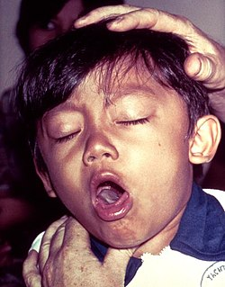
LRTI: Whooping Cough
Prolonged cough + fever for >2 weeks, infants and OC >14y.o.
HIGHLY contagious, caused by Bordatella Pertussis
3 stages:
Incubation (1-2 weeks with coryza, fever)
Paroxysmal (2-6 weeks of coughing fits with inspiratory whoop, during which child goes cyanotic, vomiting)
Convalescent (2-4 weeks of lessening symptoms)
Thankfully, primary vaccinations completed @ 4 months
Ix: perinasal swab
Tx: hospital admission, ____14 days erythromycin/7 days clarithromycin
____Prophylaxis?
The Peer Teaching Society is not liable for false or misleading information…

Slide 16
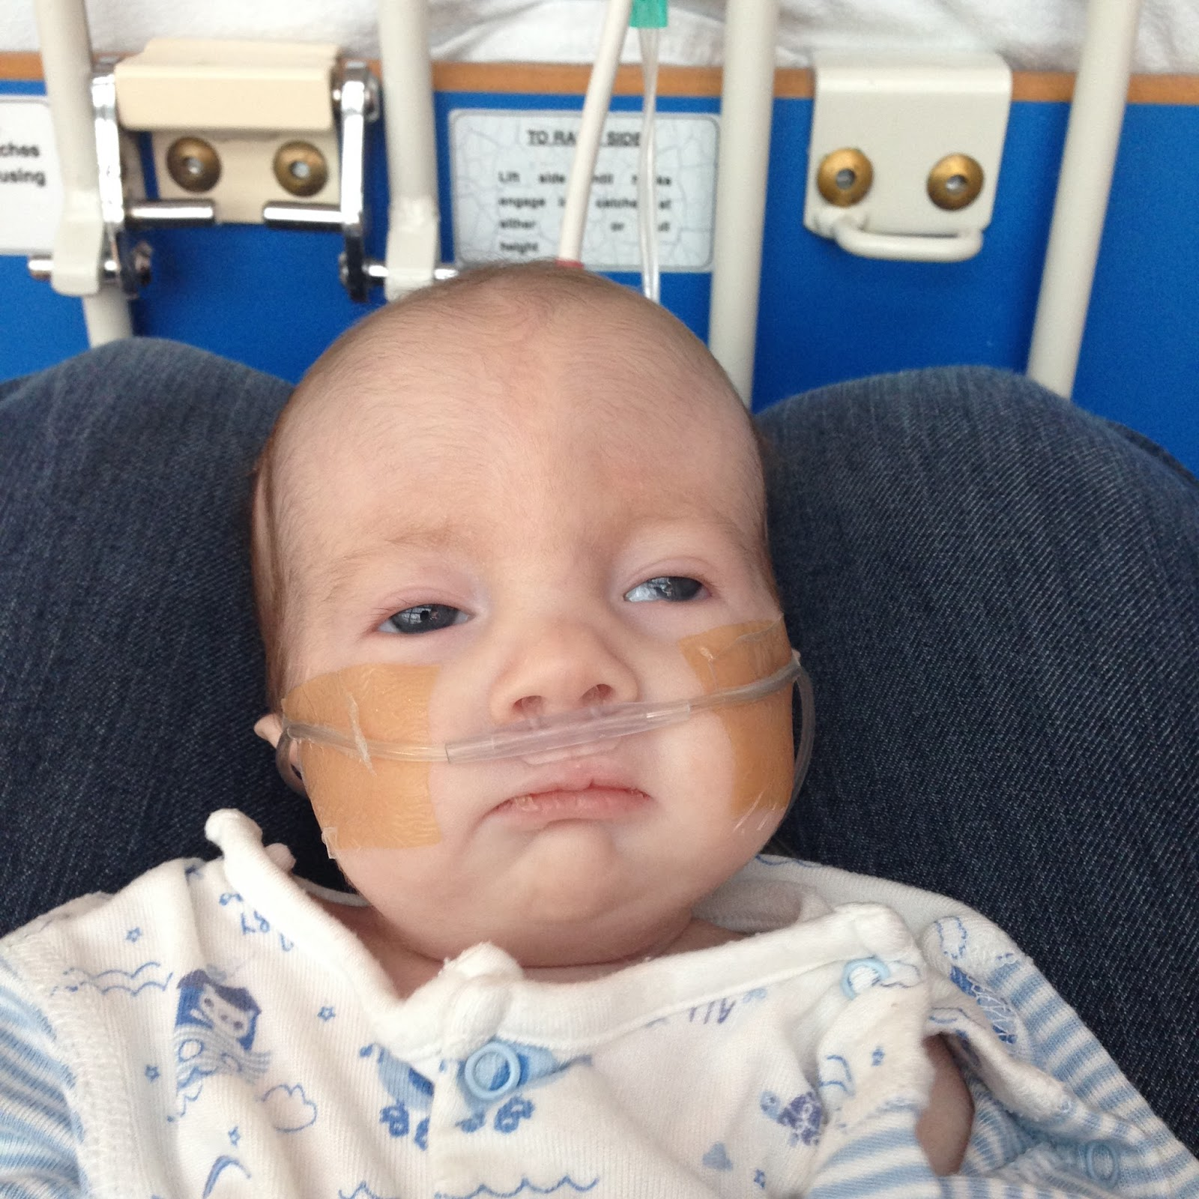
LRTI: Bronchiolitis
Infants, rare after 1 y.o.
Causative organism: RSV
RFs: prematurity, CF, immunodeficiency, CHD/CLD
RSV invades nasopharyngeal epithelium → increased mucus production → bronchial obstruction
Sx: winter months, coryza, followed by fever + dry cough, progressive dyspnoea
Ix: nasopharyngeal swab to test for RSV
Tx: O2, NGT, CPAP
Prevention?
The Peer Teaching Society is not liable for false or misleading information…

Slide 17
Asthma
Chronic inflammatory disease of airways with REVERSIBLE airway obstruction
Asthma + Eczema + Hay fever (atopy)
Sx: wheeze, dry cough, SoB, chest tightness (+diurnal variation in peak flow, have triggers)
Ix: clinical dx, PEFR and peak flow diary, reversibility test
Mx:
1. PRN Salbutamol (SABA). If using 3x a week →
2. Regular ICS (beclomethasone)
3. <5 y.o. give regular PO LTRA (montelukast), >5y.o. add LABA and __increase ICS
4. Increase ICS dosage (200 → 400 → 800mcg)
5. For >5y.o. add PO prednisolone (what do you check?)
The Peer Teaching Society is not liable for false or misleading information…

Slide 18
Acute Asthma
Severity assessment
Moderate: breathless, but NOT distressed. O2 <92%, PEFR >50% predicted
Severe: some signs of distress. Too breathless to talk/feed, tachypnoea, tachycardia, O2<92%, PEFR 33-50% predicted
Life-threatening: silent chest, confusion, normal pCO2, PEFR <33% predicted
Tx
Moderate: Inhaled SABA 10 puffs, PO prednisolone, reassess in 1h
Severe/Life-threatening:
High flow O2 if sats <92%
SABA + SAMA (10 puffs, repeat every 20-30 min)
IV hydrocortisone
Transfer to PICU if not responding → IV salbutamol, aminophylline, magnesium sulphate
Discharge: ensure PEFR>75% predicted, follow-up in clinic
The Peer Teaching Society is not liable for false or misleading information…

Slide 19
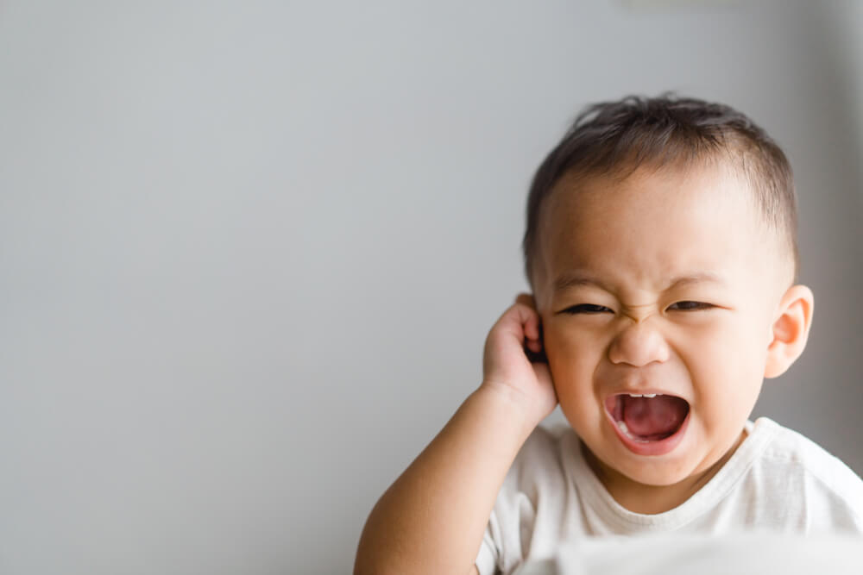
Case 2
Mr and Mrs One bring 2 year old Ella to your GP practice.
Ella had had a viral URTI a few weeks ago. Now, she was irritable, spiking a mild temperature, and tugging at her ears.
What do you do?
The Peer Teaching Society is not liable for false or misleading information…

Slide 20
Case 2
You decide to examine Ella’s ear and see this:
The Peer Teaching Society is not liable for false or misleading information…

Slide 21
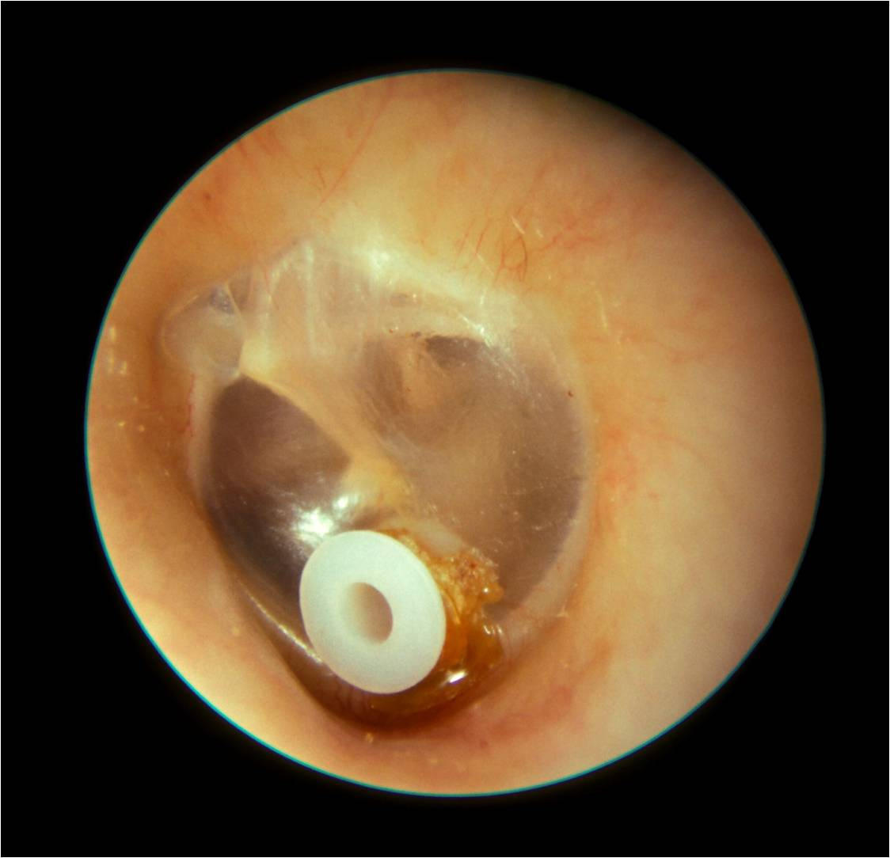
Case 2: Otitis Media
Fever, earache, hearing loss
Otoscopy: bright red, bulging membrane
Mx: paracetamol + observe, most resolve spontaneous
If Sx do not improve: give amoxicillin
Sx do not improve after 3 days
Younger than 2 years old with exudate
Perforation or discharge in canal
Recurrent OM → OM with effusion (‘glue ear’)
Px: hearing loss
Evidence of conductive hearing loss (newborn? <4y.o.? >4y.o.?)
Tx: Grommets
The Peer Teaching Society is not liable for false or misleading information…
Notes:
otoacoustic emission test, auditory brainstem response, distraction test, pure tone audiometry

Slide 22
Paeds Gastro
The Peer Teaching Society is not liable for false or misleading information…

Slide 23
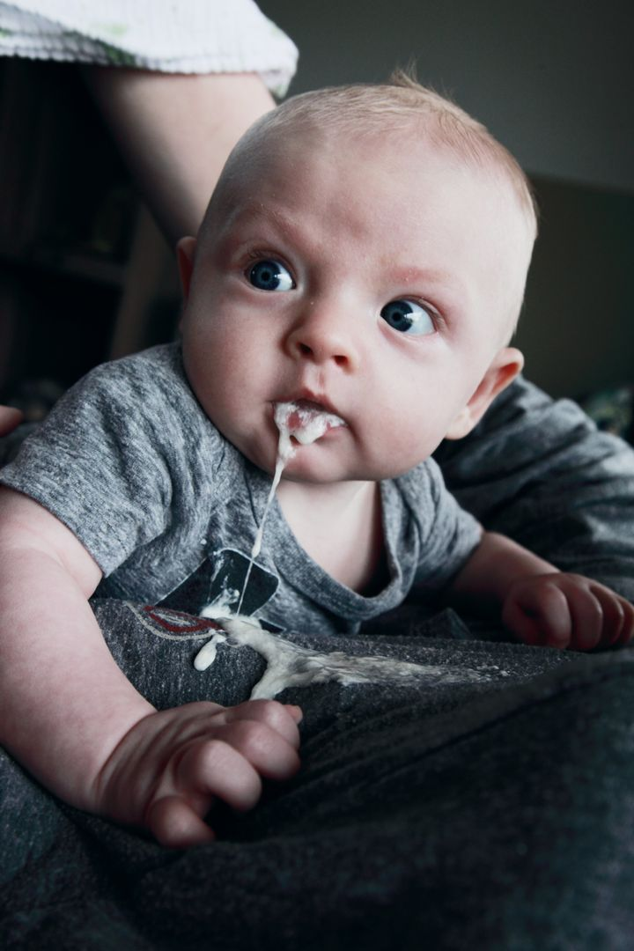
The Vomiting Child
You are the FY2 covering Paeds A&E overnight.
A very anxious mum brings in her son to you stating he has been vomiting for the last 4 hours.
What do you want to know?
The Peer Teaching Society is not liable for false or misleading information…

Slide 24
The Vomiting Child
Age of the child?
Blood in vomit?
Changes to weight?
Associated symptoms?
Pain?
Abdominal distension?
Diarrhea?
Bilious or Non-bilious?
VOMITING
Acute or Chronic?
Projectile or non-projectile?
The Peer Teaching Society is not liable for false or misleading information…

Slide 25
The Vomiting Child
You begin to take your history….
8 month old boy who has been vomiting for the last 12 hours
Mum states he looks quite paler than usual, not as active as normal and not feeding as well as normal
Mum also states that he has been coughing and had a snotty nose for the past 4 days
He has a PMH of Cystic Fibrosis
What are your immediate differentials?
The Peer Teaching Society is not liable for false or misleading information…

Slide 26
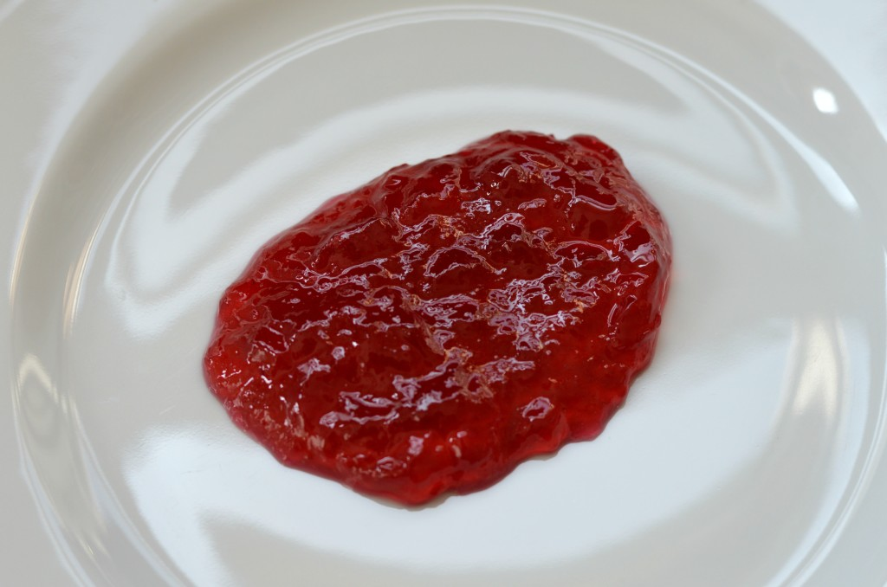
The Vomiting Child
Examination Findings
Palpable mass in the RUQ
Some generalised tenderness across the abdomen
You open his nappy and see some jelly like stools which are blood-stained
What is the most likely diagnosis?
The Peer Teaching Society is not liable for false or misleading information…

Slide 27
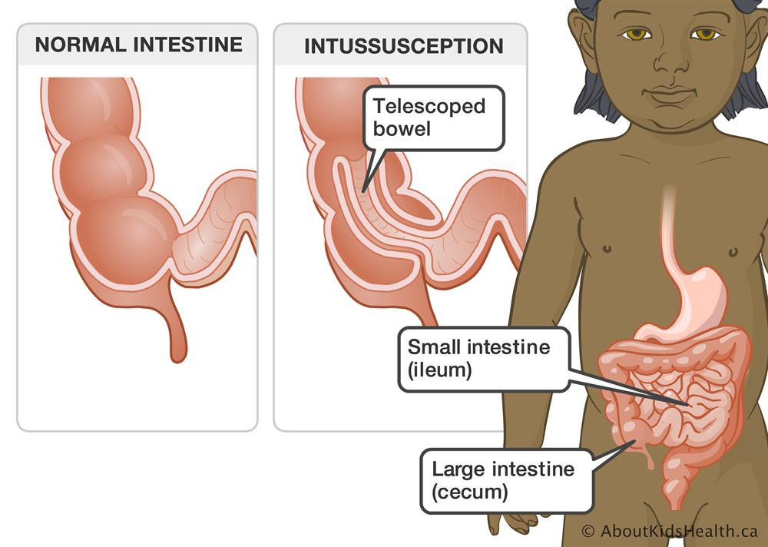
Intussusception
Definition | One piece of the bowel telescopes inside another leading to ischaemia and bowel obstruction Most common in the distal ileum at the ileocaecal junction
Epidemiology/Risk Factors | Presents around 3 months - 3 years of age, most commonly < 1 Most common cause of obstruction in neonates (mainly boys) Associated with CF and Meckel’s diverticulum
Clinical Presentation | Colic abdominal pain Pallor Abdominal distention Vomiting Sausage shaped mass palpable in the RUQ Redcurrant jelly stools, often a late presentation Signs of shock/peritonitis: Abdominal guarding, rigidity, pyrexia
investigations | Abdominal X-ray: Distended small bowel with absence of gas in the large bowel USS: Target shaped mass
Management | Medical emergency: A-E treatment Air enema using USS to stretch walls of the bowel Surgical repair if enema treatment is unsuccessful
The Peer Teaching Society is not liable for false or misleading information…
Notes:
Intussusception is a common exam question: your key exam buzzwords are telescoping bowel, sausage shaped mass, recurrent jelly stools and target shaped masses
Vomit will become bilious once you have bowel obstruction
Common presentation with the abdo pain is where the child draws their knees up to their chest

Slide 28
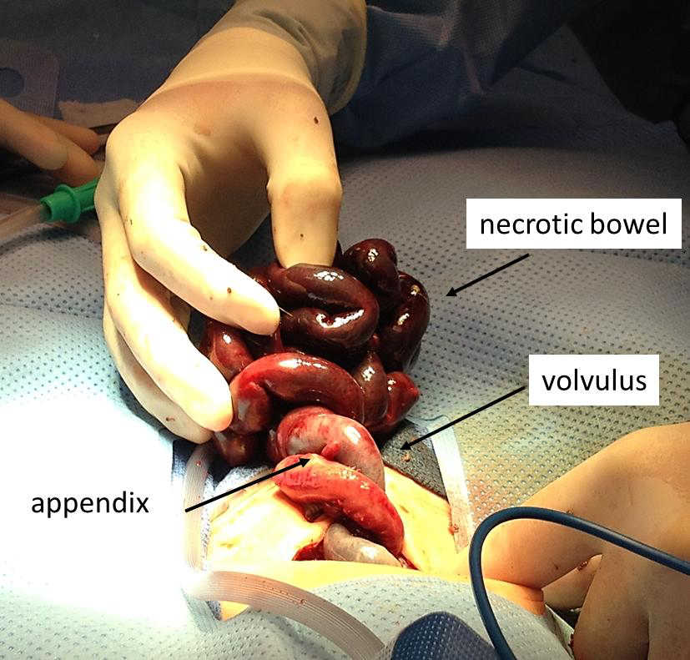
Malrotation and Volvulus
Definition | Malrotation - Bowels twists abnormally in utero Volvulus - Twisting of the bowel loops which leads to intestinal obstruction
Epidemiology/Risk Factors | Generally presents in the first month of life Often malrotation doesn’t cause any problems and will be diagnosed with volvulus Usually diagnosed before <1 years of age
Clinical Presentation | Abdominal pain Bilious vomiting Abdominal distention Tachycardia with HTN due to the severe abdominal pain
investigations | Barium enema Abdominal X-ray with contrast to look for obstruction
Management | Laparotomy if malrotation Ladd’s procedure if has progressed to volvulus
The Peer Teaching Society is not liable for false or misleading information…
Notes:
Another one of your differentials for bilious vomiting
If they develop volvulus, they are usually diagnosed before the age of 1
During the surgery, all of the necrosed bowel will be removed and then the bowel will be straightened out again, a common thing in this procedure is where

Slide 29
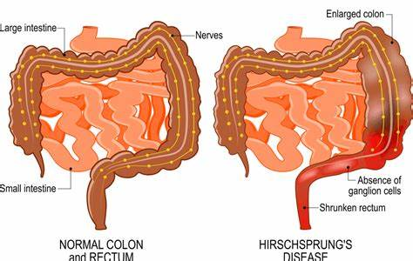
Hirschsprung's Disease
Definition | Absence of parasympathetic ganglionic cells of the myenteric plexus in the distal bowel and rectum resulting in lack of peristalsis
Epidemiology/Risk Factors | Average presentation is 2 days old More common in males Associated with Down’s Syndrome
Clinical Presentation | Failure to pass meconium within 48 hours of birth Abdominal distention Bilious vomiting Palpable faecal mass in the left lower abdomen
investigations | Contrast enema is the initial diagnostic test Rectal suction biopsy to test for ganglionic cells in anyone with delayed meconium, constipation in the first few weeks, chronic abdominal distension, positive FH, faltering growth
Management | IV Abx Bowel decompression NG tube feeding only Swenson, Soave, Duhamel pull through surgery
The Peer Teaching Society is not liable for false or misleading information…
Notes:
NICE guidelines state anyone with delayed meconium, constipation in the first few weeks, chronic abdominal distension, positive FH, faltering growth should have a rectal suction biopsy to rule out HD

Slide 30
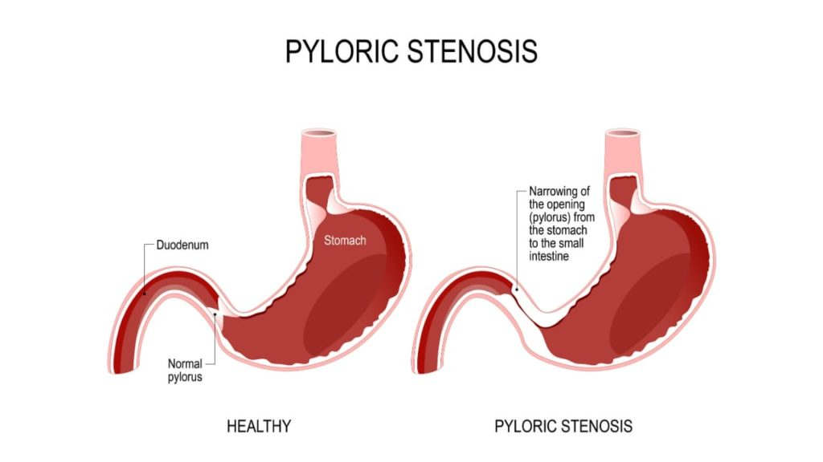
Pyloric Stenosis
Definition | Progressive hypertrophy of the pyloric sphincter causing gastric outlet obstruction
Epidemiology/Risk Factors | Much more common in boys Strong Family history link More common in first borns
Clinical Presentation | Presents 4-6 weeks of age Non-bilious, projectile vomiting after every feed (usually 30 mins after) Continue to feed despite the vomiting Weight loss Dehydration Olive sized pyloric mass
investigations | Test feeds with NG tube and empty stomach to assess peristalsis and olive shaped mass USS - To show hypertrophy of the muscle Blood gas: Hypochloremic, Hypokalemia Metabolic Alkalosis
Management | Correct metabolic imbalances and give fluid boluses Ramstedt’s Pyloromyotomy
The Peer Teaching Society is not liable for false or misleading information…
Notes:
Why do you get projectile vomiting?
After feeding, there is powerful peristalsis to try and push food into the duodenum, eventually this pressure builds causing food to be ejected into the oesopahgus and projectile across the room
It is very important to clarify what patients mean when they say projectile as this should literally be across the room

Slide 31
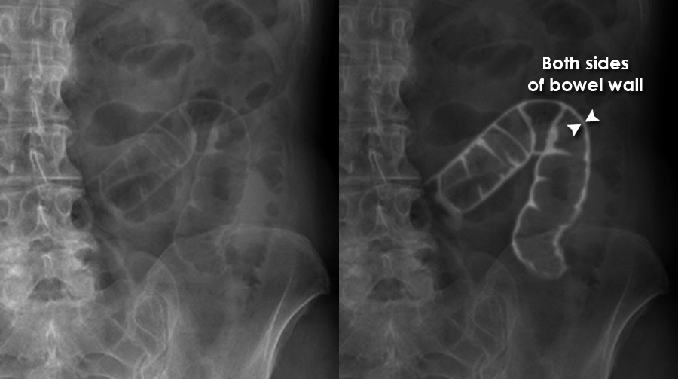
Necrotising Enterocolitis
Definition | Acute inflammatory disease affecting preterm neonates leading to bowel necrosis and multisystem organ failure
Epidemiology/Risk Factors | Low birth weight Most common surgical emergency in neonates Prematurity Abx therapy for more than 10 days
Clinical Presentation | New feed intolerance Vomiting (+ bile) Fresh blood in stools Abdominal distention Reduced bowel sounds
Investigations | Bloods: thrombocytopenia, neutropenia Blood gas: Acidotic presentation X ray: Rigler’s sign: both sides of bowel are visible due to gas in the cavity, dilated bowel loops, distended bowel
Management | Nil by mouth Bowel decompression by NG tube IV Cefotaxime Surgery to remove necrotic bowel
The Peer Teaching Society is not liable for false or misleading information…
Notes:
A very fatal condition - one of the leading causes of death in premature babies, a very common issue for infants in NICU
Prematurity is the biggest risk factor for this: any prem baby with a blood stained stools -> think about Nec Enc

Slide 32
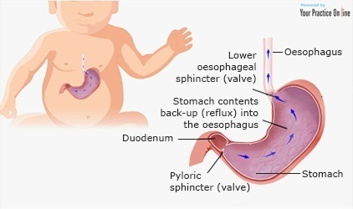
GORD
Definition | Presence of the symptoms of reflux Regurgitation - Reflux of stomach contents beyond the oesophagus
Epidemiology/Risk Factors | Regurgitation impacts 40% of infants Usually appears in the first 2 weeks of life More common in premature babies
Clinical Presentation | Symptoms should have started in the first 2 months of life Distressed behaviour Feeding difficulty Chronic crying Faltering Growth If onset is >6 months or symptoms continue over 1 year, it is unlikely to be reflux
investigations | Urinalysis to rule out UTI
Management | Usually resolves by 1 year of life Can mix alginate with feeds (Gaviscon) for breastfed babies For formula fed, encourage smaller, more regular feeds otherwise use thickened formula Consider trial to PPI for 4 weeks Referral if symptoms still persisting
The Peer Teaching Society is not liable for false or misleading information…
Notes:
Important to differentiate this as normally babies do regurgitate as the lower oeseopahgeal sphincter is still immature therefore it is easily for stomach contents to regurg however the key thing with this is that babies will be well and growing normally

Slide 33
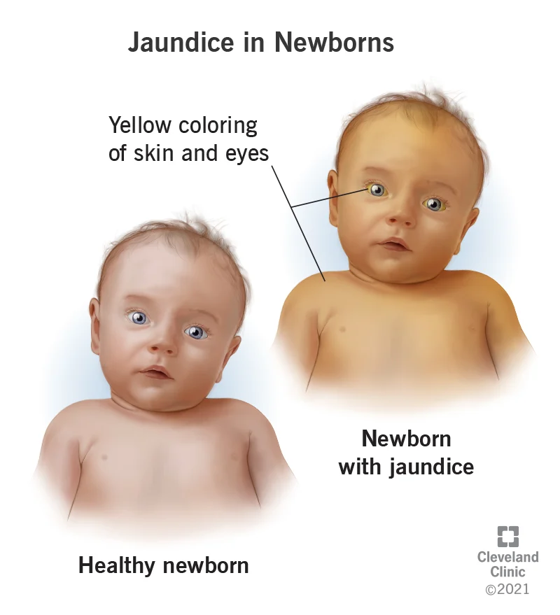
The Jaundiced Baby
You are the Paeds Reg on call and one of the nurses on the ward rings you to say she is worried about 3 babies on the ward who are looking jaundiced?
What is the most important thing you want to know about these babies?
The Peer Teaching Society is not liable for false or misleading information…

Slide 34
The Jaundiced Baby
She gives you more info on the 3 babies:
Baby 1 - Born via Cat 1 C-section 14 hours ago due to cord prolapse
Baby 2 - Born via Elective C-section 3 days ago, was just awaiting to be discharged
Baby 3 - Brought in with Mum from home as 16 days old and still jaundiced
Who are you most concerned about?
The Peer Teaching Society is not liable for false or misleading information…
Notes:
1 - pathological jaundice, usually due to blood disorders
2 - normal jaundice as 2 days - 14 days
3 - Prolonged jaundice - important to rule out biliary atresia which needs surgical intervention
Does anyone want to guess what they think the causes would be?

Slide 35
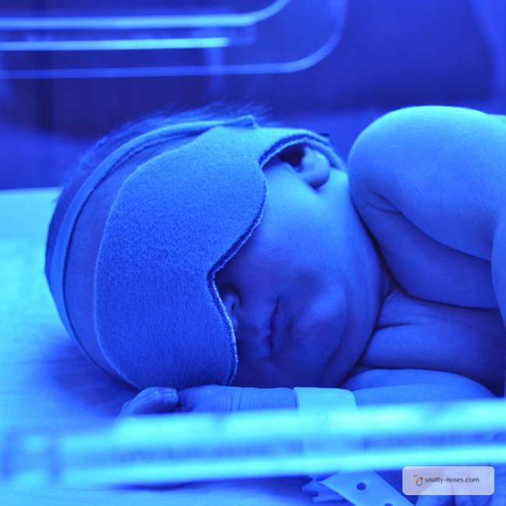
Neonatal Jaundice
Pathophysiology | Physiological Breakdown of in-utero Hb Immature liver cannot break down high concentrations of bilirubin Starts at 2-3 days of life, peaks at day 5, usually resolves by 14 days Pathological Onset less than 24 hours is pathological G6PD deficiency, Spherocytosis, Rhesus disease, Blood group incompatibility Prolonged Jaundice Jaunice > 14 days in term infants and 21 days in preterm infants Biliary atresia, Hypothyroidism, Breast milk jaundice, UTI/Infection
Clinical Presentation | Jaundiced colour Drowsiness Signs of infection
investigations | TCB should be used for gestation over 35 weeks Serum bilirubin used if cannot be used Coombs test Infection screen
Management | Treatment threshold graphs for specific gestation Phototherapy for those above threshold Repeat bilirubins 4-6 hours after commencing phototherapy Stop phototherapy 50 umol/L over the line Exchange transfusion if above that line Kernicterus: bilirubin induced encephalopathy
The Peer Teaching Society is not liable for false or misleading information…
Notes:
Kernicterus is a really important complication to know and tell parents as they may think jaundice is not actually that serious of a condition therefore you need to highlight the significant of kernicterus and the life threatening problems it can cause

Slide 36
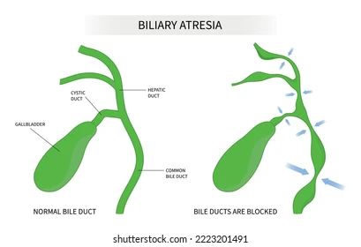
Biliary Atresia
Definition | Obstruction of the biliary tree due to sclerosis of the bile duct, reducing bile flow
Epidemiology/Risk Factors | More common in females Neonatal cholestasis at 2-8 weeks Associated with CMV infection
Clinical Presentation | Jaundice post 2 weeks Dark urine Pale stools Appetite disturbances Hepatsplenomegaly
investigations | Bloods: LFTs raised, high conjugated bilirubin Sweat test to rule of CF A1A to rule out deficiency USS to look for structural abnormalities
Management | Surgical management: Kasai procedure
The Peer Teaching Society is not liable for false or misleading information…
Notes:
Obstruction of this means bile cannot be transported from the liver to the bile therefore conjugated bilirubin builds up as there is no issues with the liver in processing bile but it just cannot be excreted

Slide 37
Biliary Atresia
The Peer Teaching Society is not liable for false or misleading information…

Slide 38
Paeds Cardio
The Peer Teaching Society is not liable for false or misleading information…

Slide 39
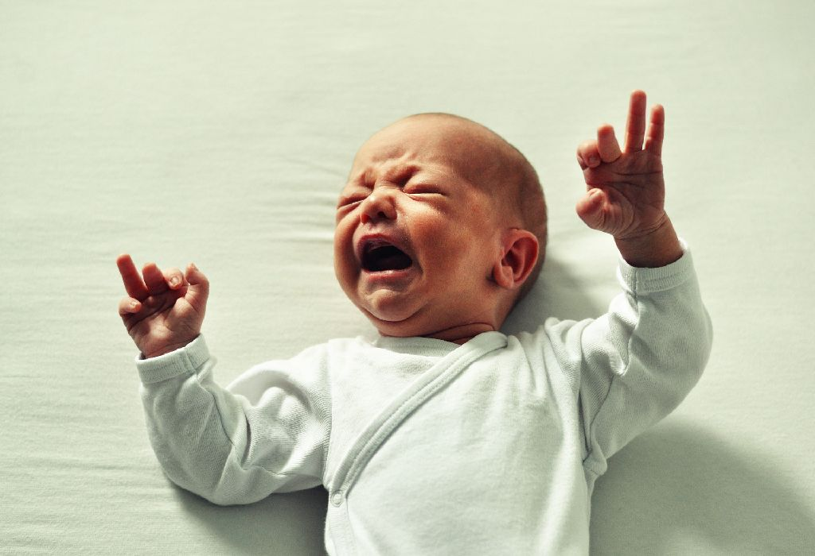
The Child failing to thrive
You are the on call SHO in the CAU and the next patient waiting to be seen is a 4 week old baby boy.
His mum states he has been very irritable the past 2 weeks and has not been growing as expected.
What are your immediate thoughts?
The Peer Teaching Society is not liable for false or misleading information…

Slide 40
The Child failing to thrive
A very non-specific presentation!
Cyanosis or acyanotic?
Associated symptoms?
Tachypnoea
Dyspnoea
Often picked up by drop in centiles when weighed
Failure to Thrive
Maternal risk factors?
Diabetes?
Rubella?
Smoking?
Any signs of infection?
The Peer Teaching Society is not liable for false or misleading information…

Slide 41
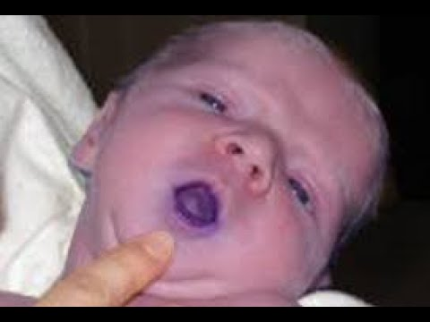
The Child failing to thrive
You take a history from Mum who states he has not been feeding weight, a lot of irritable and having these short spells where he turns blue for a few seconds and becomes short of breath before returning to normal.
What are these called?
You examine him and find a Ejection systolic murmur in the pulmonary region.
What is your top differential?
The Peer Teaching Society is not liable for false or misleading information…
Notes:
Tet spells - intermittent episodes where the right to left shunt becomes worse causing an episode of syanosis: usually when child is exerting themselves or crying
Children may squat during these as this increases vascular resistance and encourages blood to enter the pulmonary circulation hence reducing cyanosis

Slide 42
Tetralogy of Fallot
Features | Pulmonary valve stenosis Right ventricular hypertrophy Overriding aorta Ventricular Septal Defect
Pathophysiology | VSD means blood will flow between the ventricles Overriding aorta essentially means the aortic valve is placed more to the right than normal which means when the right ventricle contracts, some of the blood enters the aorta rather than all going into the pulmonary artery Pulmonary stenosis means there is greater resistance against the flow of blood which pushes it through the VSD and into the aorta i.e. shunts from right to left causing cyanosis Increased strain of the right heart causes right ventricular hypertrophy These 4 features cause a right to left shunt meaning blood bypasses the lungs and does not become oxygenated this causes cyanosis
Risk Factors | Rubella infection Increased maternal age Alcohol consumption in pregnancy Diabetic mother
The Peer Teaching Society is not liable for false or misleading information…
Notes:
What feature of TOF is most indicative of the severity of the disease? - Pulmonary stenosis which if you think about make sense: if the pulmonary is stenosed, more blood will be pushed through the VSD as well as increased strain on the heart hence causing more symptoms

Slide 43
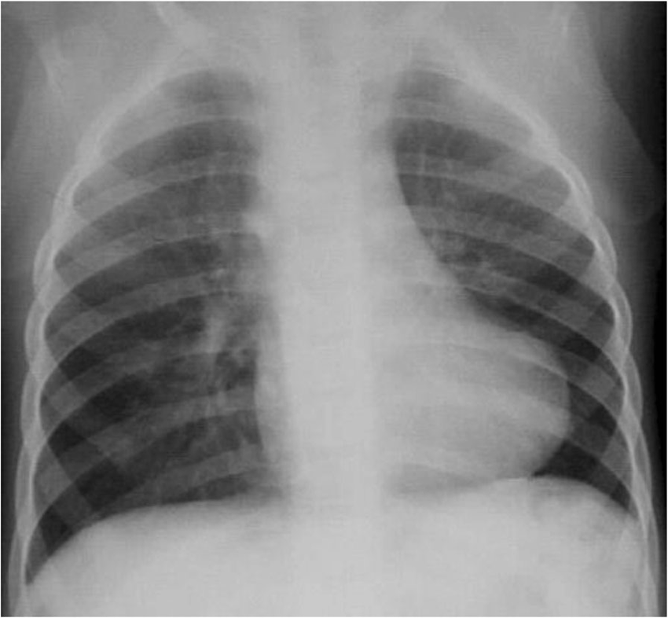
Tetralogy of Fallot
Clinical Presentation | Can be picked up on antenatal scans/NIPE exam Severe cases can present with heart failure before the age of 1 Milder cases will present with cyanosis, poor feeding, poor weight gain Tet Spells
Investigations | Echo CXR: Boot-shaped heart
Management | For neonates, a prostaglandin infusion can be used to maintain the ductus arteriosus and allow blood to flow from the aorta into the pulmonary arteries Definitive management is through open heart surgery which is only done if severe as it has a high mortality rate
The Peer Teaching Society is not liable for false or misleading information…
Notes:
What feature of TOF is most indicative of the severity of the disease? - Pulmonary stenosis

Slide 44
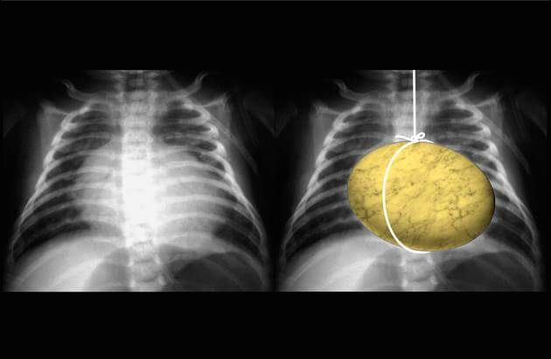
Transposition of the Great Arteries
Definition/Pathophysiology | The aorta and the pulmonary artery is essentially switched meaning right ventricle pumps blood into the aorta and left ventricle pumps blood into the pulmonary artery During pregnancy, this does not affect development however upon birth, this is life threatening as the baby will be cyanosed Survival depends on the presence of a PDA, VSD or ASD to allow blood to mix
Epidemiology/Risk Factors | More common in males Maternal rubella Increased maternal age Maternal diabetes
Clinical Presentation | Cyanosis, often in the first 24 hours of life May be asymptomatic initially if the PDA/VSD are compensating Otherwise can present with respiratory distress, poor feeding, poor weight gain
Investigations | Echo CXR: ‘Egg on a string appearance’: narrowed mediastinum and cardiomegaly
Management | Prostaglandin infusion to maintain PDA and mixing of blood Definitive management is surgical correction
The Peer Teaching Society is not liable for false or misleading information…
Notes:
This is essentially the switching of the pulmonary artery and the aorta meaning the wrong blood is sent into the wrong vessels
This is an unsurvivable condition -> if deoxygenated blood is travelling through the body, cells will die therefore you need a septal defect/PDA to survive

Slide 45
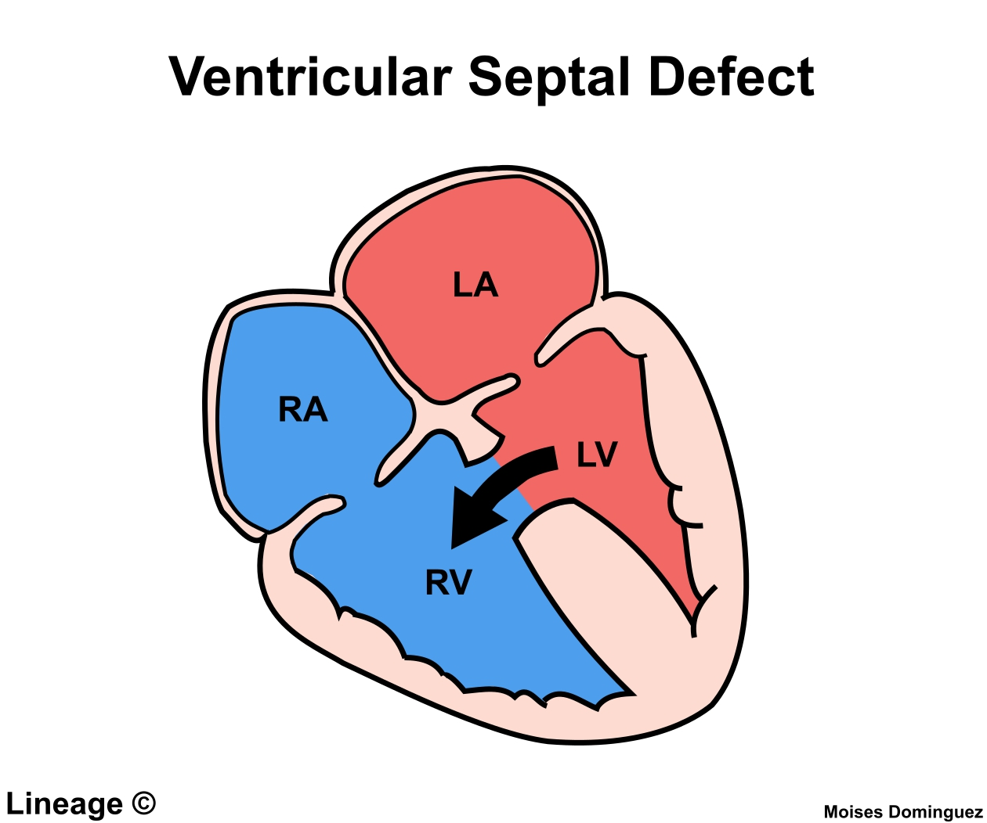
Ventricular Septal Defect
Definition/Pathophysiology | A congenital hole in the septum between the ventricles Blood typically flows from left-right through the hole as there is increased pressure in the left ventricles therefore they remain acyanotic If severe, can cause pulmonary HTN as there is extra blood flow in the pulmonary vessels If this continues, pressure in the right heart may become higher than the left causing a right to left shunt: cyanosis - this is Eisenmenger's syndrome
Epidemiology/Risk Factors | Associated with Down’s and Turner’s Syndrome
Clinical Presentation | Can be diagnosed antenatally or picked up on NIPE Poor feeding Dyspnoea/Tachypnoea Failure to thrive Pansystolic murmur at the left lower sternal border
Investigations | Echo CXR may show cardiomegaly
Management | Small VSD can be monitored over time as they may close Surgical correction Increased risk of infective endocarditis therefore Abx prophylaxis should be given
The Peer Teaching Society is not liable for false or misleading information…
Notes:
Unlikely for them to put this in a question but maybe on the end of an SAQ question, the last part could be stating a complication of VSD which would be Eisenmengers
Immediate survival depends on a shunt between the systemic circulation and pulmonary circulation that allows blood flowing through the body an opportunity to get oxygenated in the lungs
What are other causes of a pan-systolic murmur? - Mitral regurg, tricuspid regurg

Slide 46
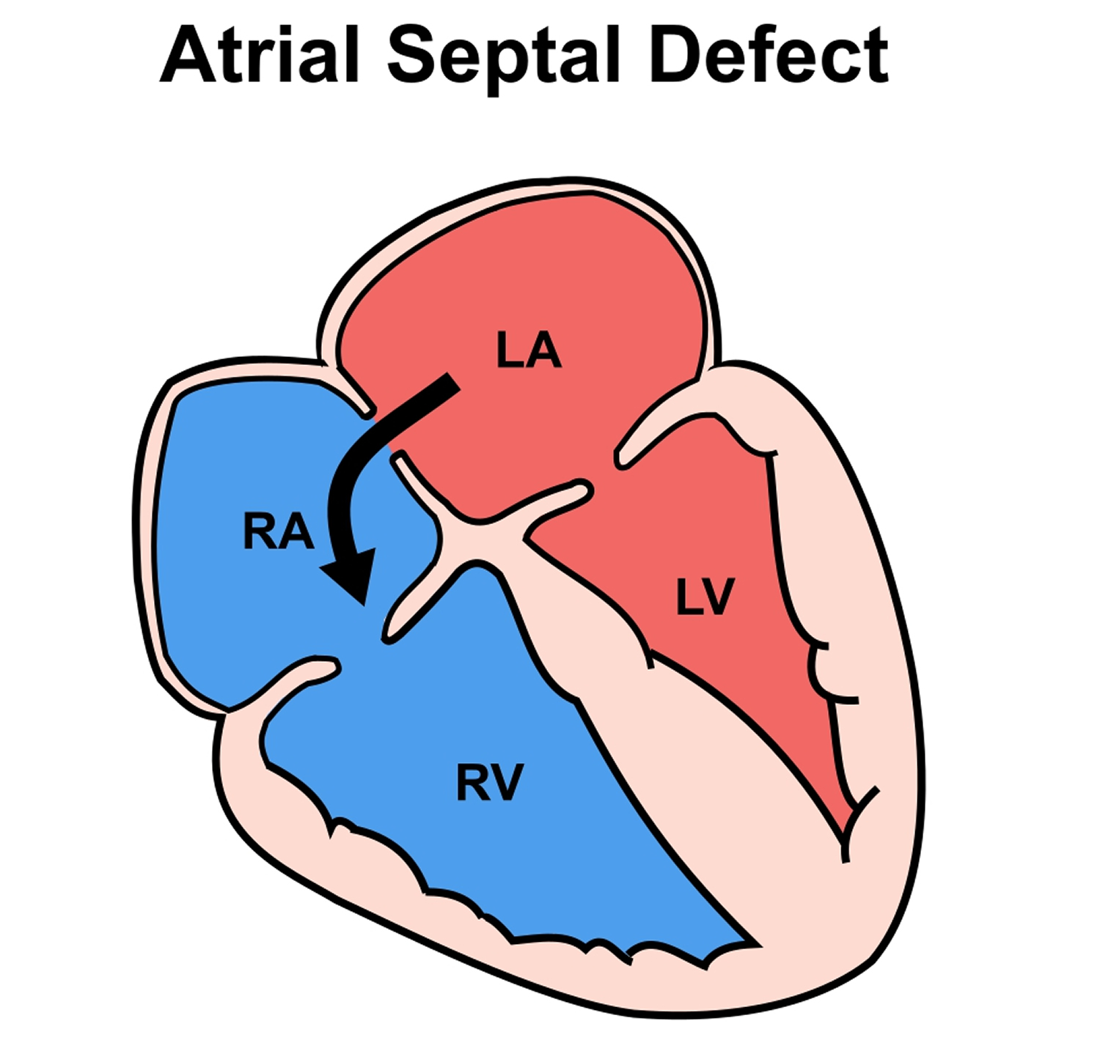
Atrial Septal Defect
Definition/Pathophysiology | A congenital hole in the septum between the atria This causes a left to right shunt due to higher pressure in the left atria compared to the right and so blood is still oxygenated and so there is no cyanosis However, over time this can cause strain on the right heart leading to right heart failure and pulmonary HTN This can again lead to Eisenmenger’s syndrome
Epidemiology/Risk Factors | Maternal smoking in the first trimester Maternal diabetes Maternal rubella
Clinical Presentation | Can be diagnosed on antenatal scan Can be asymptomatic if small Mid-systolic, crescendo-decrescendo murmur heard at the upper left sternal border Symptoms include SOB, difficulty feeding and poor weight gain
Investigations | Echo CXR may show cardiomegaly
Management | Small ASD can be monitored over time as they may close Surgical correction
Complications | Stroke due to VTE Atrial fibrillation or atrial flutter
The Peer Teaching Society is not liable for false or misleading information…
Notes:
Why would a stroke be more likely?
It is worth remembering atrial septal defects as a cause of stroke in patients with a DVT. Normally when patients have a DVT and this becomes an embolus, the clot travels to the right side of the heart, enters the lungs and becomes a pulmonary embolism. In patients with an ASD the clot is able to travel from the right atrium to the left atrium across the ASD. This means the clot can travel to the left ventricle, aorta and up to the brain, causing a large stroke.

Slide 47
The Abnormal NIPE
You are the neonatal registrar and your consultant asks you to go and examine a 2 days old baby girl who was born at 34 weeks gestation. Upon examination, you think you can hear a murmur and notice a very loud, bounding pulse.
What is the most likely diagnosis?
What is the biggest risk factor for this condition?
How would you manage this condition?
The Peer Teaching Society is not liable for false or misleading information…

Slide 48
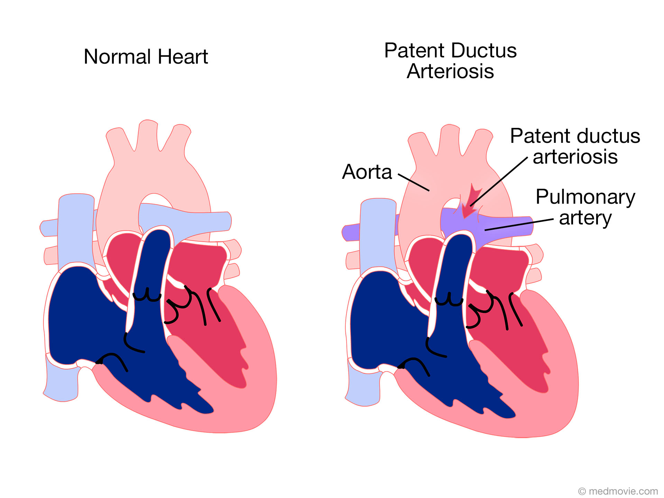
Patent Ductus Arteriosus
Definition/Pathophysiology | A persistent connection between the aorta and the pulmonary artery causing a left to right shunt Normally, this closes within the first few weeks of life however sometimes this can fail to close
Epidemiology/Risk Factors | Maternal rubella Prematurity
Clinical Presentation | Small PDA can be asymptomatic Can be picked up on NIPE when a ‘continuous machinery murmur’ is heard Symptoms can include SOB, difficulty feeding, poor weight gain
Investigations | Echo
Complications | Ibuprofen/Indomethacin can be given to inhibit prostaglandin synthesis and close the DA If this is unsuccessful/associated with another congenital heart defect, surgery is definitive management
The Peer Teaching Society is not liable for false or misleading information…
Notes:
Pressure in aorta > pressure of pulmonary vessels so blood goes from aorta into artgery causing increased pressure in pulmonary system and pulmonary HTN leading to right heart strain

Slide 49
Questions
A 7-year-old boy is brought in to the GP surgery with an exacerbation of asthma. On examination he has a bilateral expiratory wheeze but there are no signs of respiratory distress. His respiratory rate is 24 / min and PEF around 60% of normal.
What is the most appropriate action with regards to steroids therapy? [1 mark]
Name 3 signs of a life-threatening acute asthma attack? [3 marks]
In addition to steroids, what medication should be given and through what route? [3 marks]
What severity of asthma attack is the boy experiencing? [1 mark]
The Peer Teaching Society is not liable for false or misleading information…

Slide 50
Questions
What is the most appropriate action with regards to steroids therapy? [1 mark]
Oral prednisolone for 3-5 days
Name 3 signs of a life-threatening acute asthma attack? [3 marks]
3 from: SpO2 <92%, silent chest, poor respiratory effort, altered consciousness, cyanosis, elevated pCO2, PEF <33% predicted
In addition to steroids, what medication should be given and through what route? [3 marks]
Short-acting bronchodilators like salbutamol or ipratropium, given via a spacer. Give up to 10 puffs.
What severity of asthma attack is the boy experiencing? [1 mark]
He is having a moderate asthma attack, due to PEF being more than 50% predicted and RR being less than 30
The Peer Teaching Society is not liable for false or misleading information…

Slide 51
Questions
A 3-month-old girl is brought to the emergency department with a cough, poor feeding and fever. The infant is alert and responsive. She has had all routine vaccines offered. Her observations are temperature 38.1ºC, heart rate 154 bpm, respiratory rate 40/min, and oxygen saturation 91% on air. On examination, coarse crackles and a wheeze can be heard across her chest. The infant's heart sounds and ECG are normal. A lumbar puncture is performed and reported as unremarkable. An hour later, the patient has a cardiac arrest.
What is the likely diagnosis [1 mark]
What has most likely caused the cardiac arrest [1 mark]
What is the compression:ventilation ratio in paediatric BLS? [1 mark]
What is a prophylactic drug that can be offered to immunocompromised infants? [1 mark]

Slide 52
Questions
What is the most likely diagnosis?
Bronchiolitis
What has most likely caused the cardiac arrest?
Respiratory distress secondary to bronchiolitis, leading to hypoxia
What is the compression:ventilation ratio in paediatric BLS?
15:2
What is a prophylactic drug that can be offered to immunocompromised infants?
Palivizumab
The Peer Teaching Society is not liable for false or misleading information…

Slide 53
Questions
You are the F1 on nights in Grimsby and you are called to see a 3 day old baby born at 39+1 who has still not yet passed meconium and has been vomiting after feeds. On examination, you noticed the abdomen is particularly distended.
What is the most likely diagnosis? [1 mark]
What is the pathophysiology of this condition? [2 marks]
What would be your first line investigation? [1 mark]
What would be your investigation of choice to confirm your diagnosis? [1 mark]
The Peer Teaching Society is not liable for false or misleading information…

Slide 54
Questions
What is the most likely diagnosis? [1 mark]
Hirschsprung's Disease
What is the pathophysiology of this condition? [2 marks]
Loss of ganglionic cells [1 mark]
In the myenteric plexus [1 mark]
What would be your first line investigation? [1 marks]
Contrast enema
What would be your investigation of choice to confirm your diagnosis? [1 mark]
Rectal suction biopsy
The Peer Teaching Society is not liable for false or misleading information…

Slide 55
Questions
You are the Paeds Consultant and you are called in during the night by your registrar to review a 14 hour old baby boy. On examination, you notice his hands and lips have turned blue and he appears irritable.
What is the most likely diagnosis? [1 mark]
Name 2 risk factors for this condition [2 marks]
What would you expect to see on a Chest X-ray of this patient? [1 mark]
What is your gold standard investigation? [1 mark]
Who would you call to manage this patient? [1 mark]
The Peer Teaching Society is not liable for false or misleading information…

Slide 56
Questions
What is the most likely diagnosis? [1 mark]
Transposition of the Great Arteries
Name 2 risk factors for this condition [2 marks]
2 from: Increased maternal age, maternal diabetes, maternal rubella
What would you expect to see on a Chest X-ray of this patient? [1 mark]
‘Egg on a string appearance’
What is your gold standard investigation? [1 mark]
Echo
Who would you call to definitively manage this patient? [1 mark]
Paeds Cardiac Surgeons
The Peer Teaching Society is not liable for false or misleading information…

Slide 57
Feedback
The Peer Teaching Society is not liable for false or misleading information…

