Slide 1
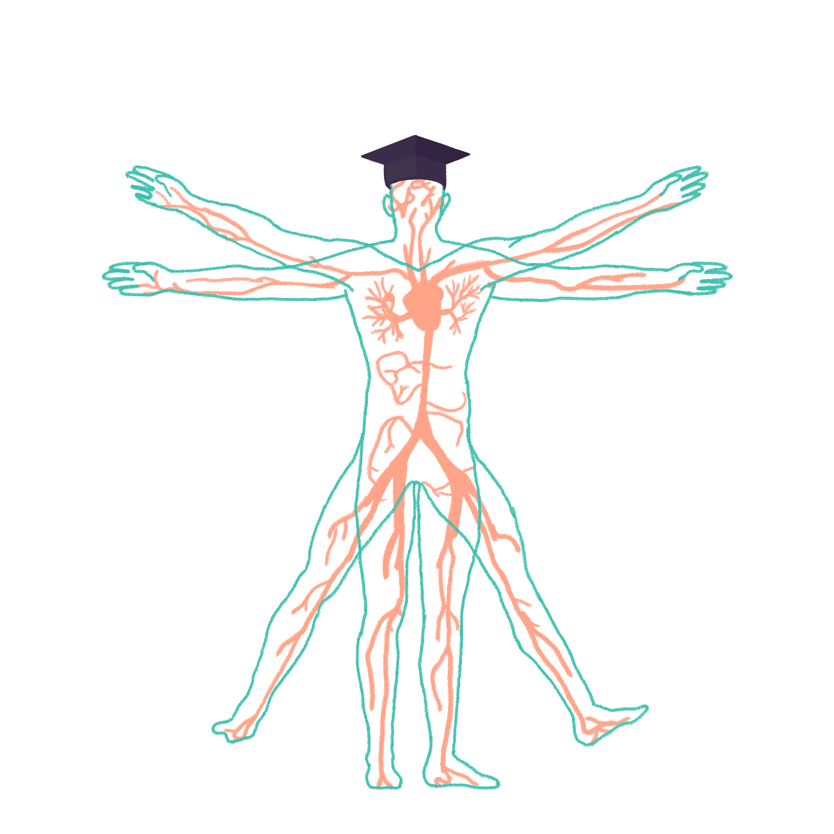
2023/2024

Slide 2
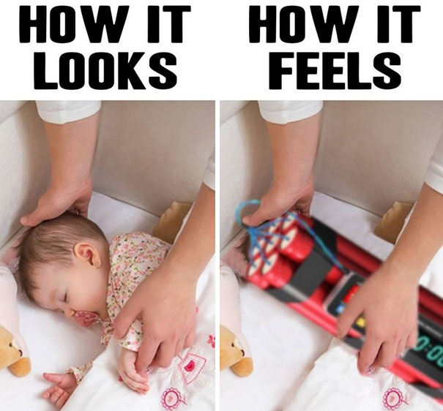
Paediatrics Part 2
Phase 3a Revision Session
Session 2
Preethi Muthukumar, Vansh Asher
Tuesday 14th November 2023
6pm
The Peer Teaching Society is not liable for false or misleading information…

Slide 3
Aims and Objectives
The Peer Teaching Society is not liable for false or misleading information…

Slide 4
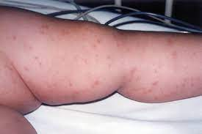
Case 1
7 y.o. boy (Andrew) presents to A&E and is feeling unwell and lethargic
Has non-blanching rash on torso, responsive to pain
Chest clear, HS normal, abdo SNT
Temp 39, RR 38, HR 142, SpO2 88% OA, CRT 5s
What are we worried about?
What could the rash be?
PS: thank you to Dr Ben Ng for this case!
The Peer Teaching Society is not liable for false or misleading information…

Slide 5
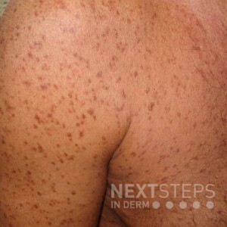
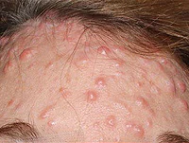
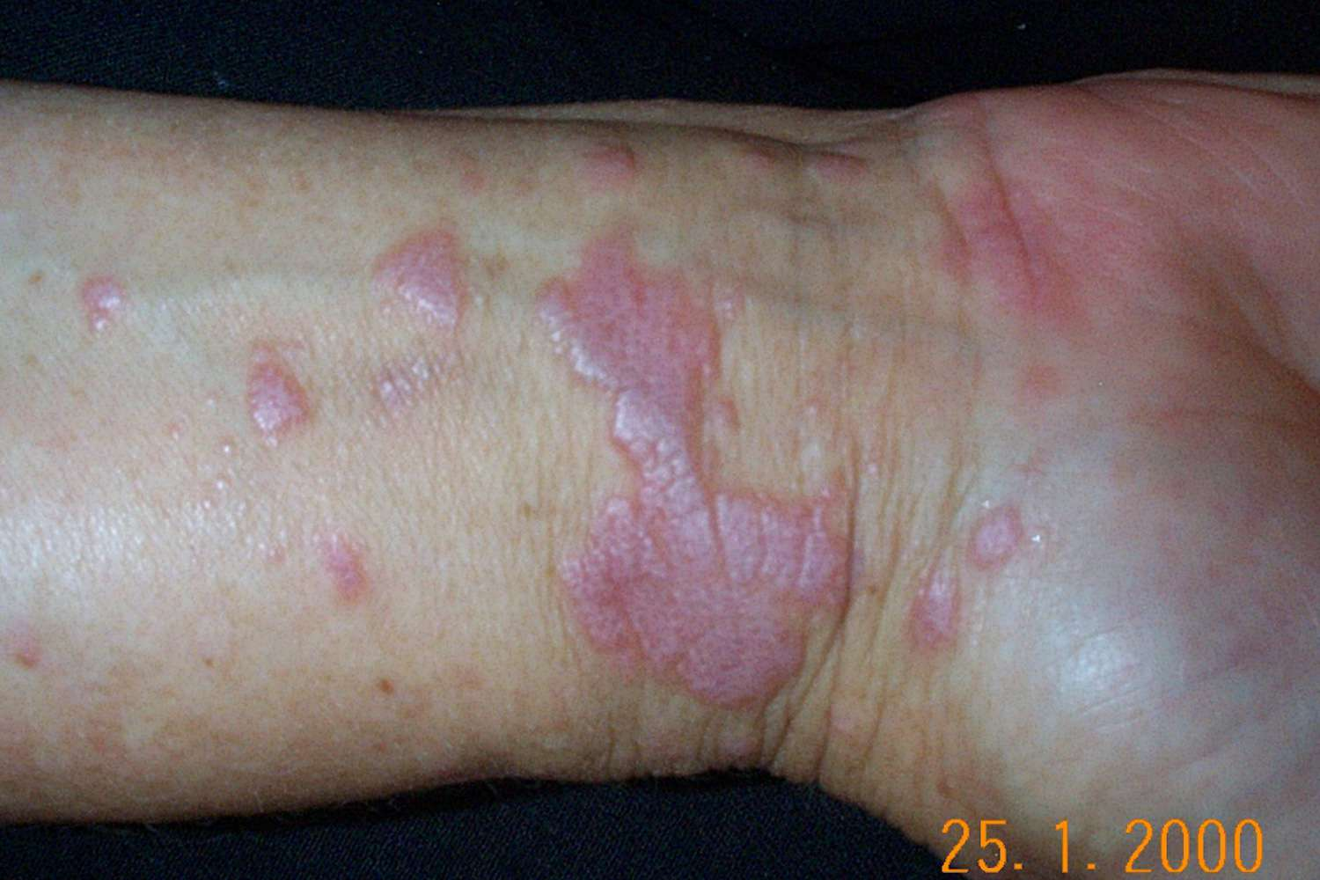
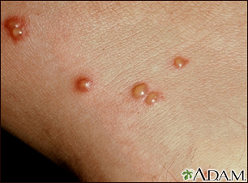
How do you describe rashes?
macules: flat, nonpalpable lesions, <10mm
papules: elevated lesions, <10mm
plaques: palpable lesions, >10mm, elevated/depressed compared to ski
vesicles: small, clear, fluid-filled blisters
The Peer Teaching Society is not liable for false or misleading information…

Slide 6
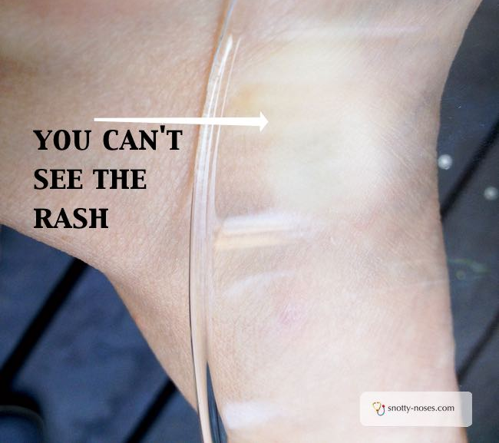
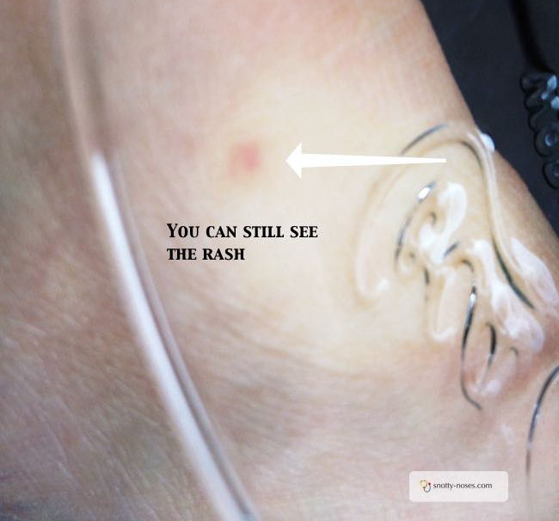
How do you describe rashes?
The Peer Teaching Society is not liable for false or misleading information…

Slide 7
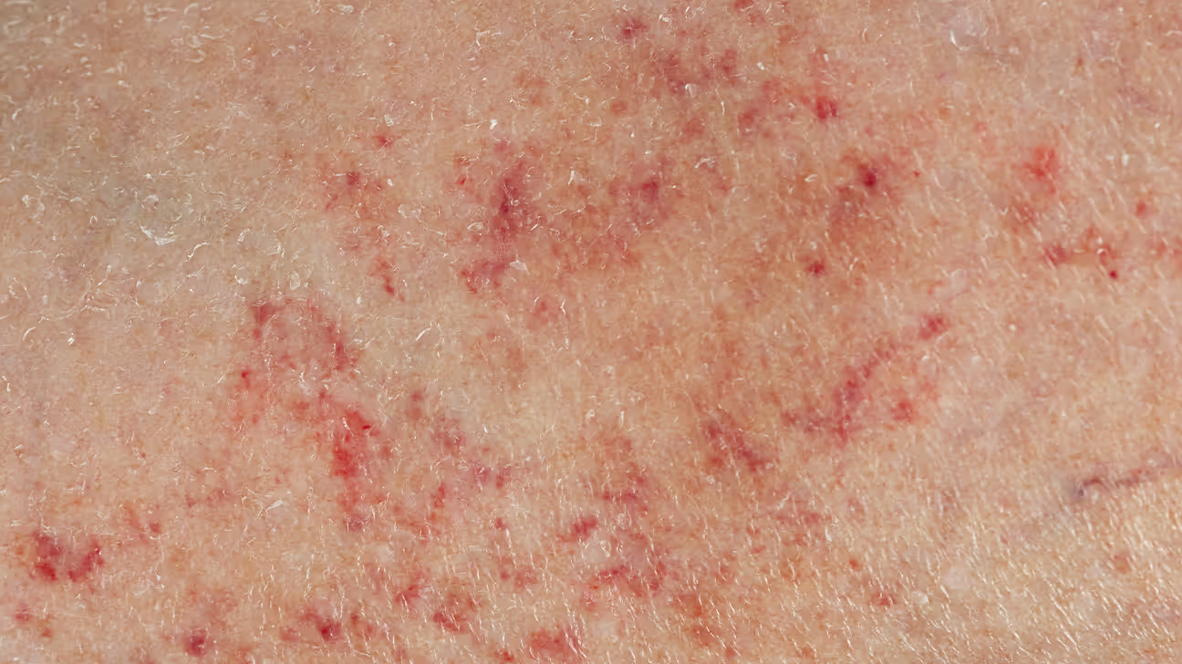
How do you describe rashes?
The Peer Teaching Society is not liable for false or misleading information…

Slide 8
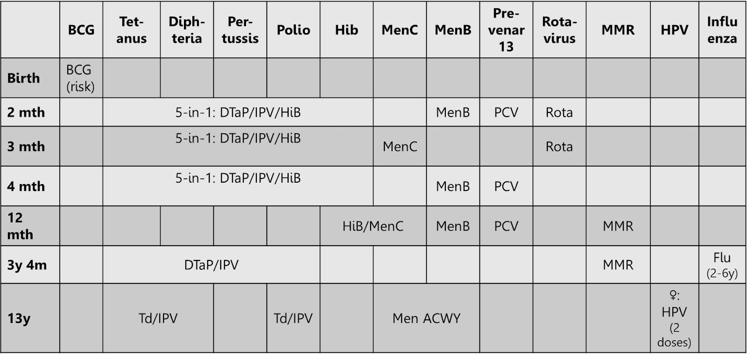
Immunisations
The Peer Teaching Society is not liable for false or misleading information…

Slide 9
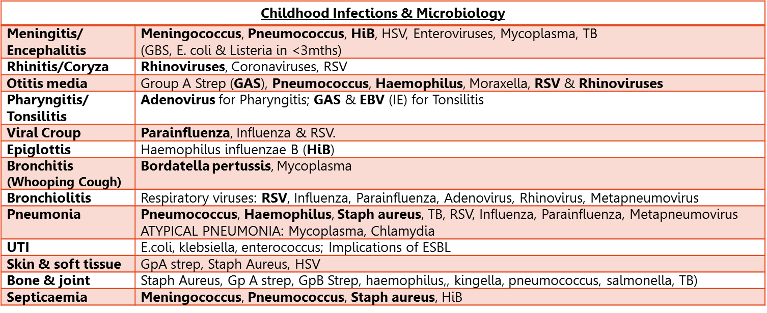
Microbiology
The Peer Teaching Society is not liable for false or misleading information…

Slide 10
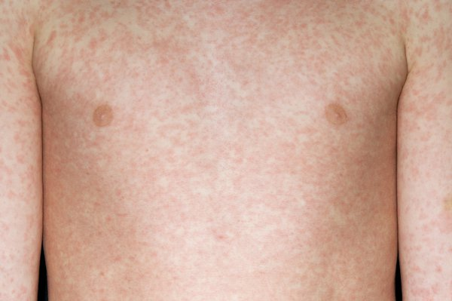
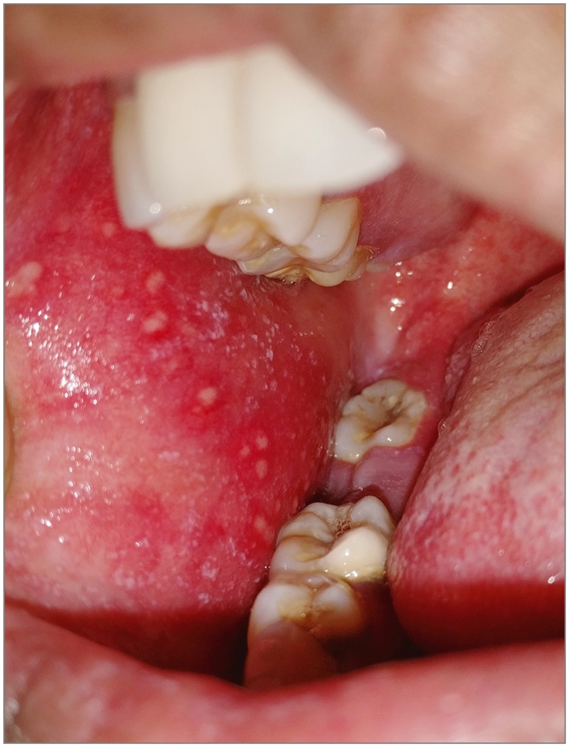
Rash 1
5 y.o. boy
Unsure about immunisations
2 weeks ago, he had cough, coryza, conjunctivitis and fever
Now he’s developed this maculopapular rash that’s started from his hairline and spread downwards
The Peer Teaching Society is not liable for false or misleading information…

Slide 11
Measles
Caused by RNA paramyxovirus
Highly infectious, aerosol transmission
Infectious from prodrome till 4 days after rash starts
Prodrome: CCCK
Ix: IgM ab, raised LFTs, measles RNA PCR on oral fluid specimen
Tx: supportive, notifiable disease
School exclusion till 5 days after rash onset
Complications: OM, pneumonia, ____encaphalitis
The Peer Teaching Society is not liable for false or misleading information…

Slide 12
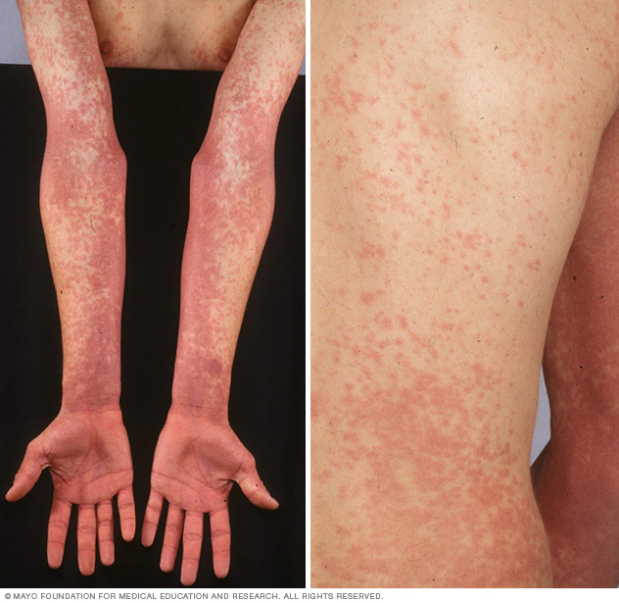
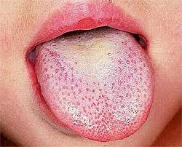
Rash 2
4 y.o. girl
Had 3 day hx of fever, vomiting, abdominal pain
Diffuse rash in neck and chest areas, with pallour around the lips
Rash has spread to flexor creases
Mum notes that it feels very rough to touch
Has exudate on tonsils
Has ‘strawberry’ tongue
The Peer Teaching Society is not liable for false or misleading information…

Slide 13
Rash 2: Scarlet fever
Occurs as body’s reaction to erythrogenic toxins produced by Strep. pyogenes
Peak incidence between 2-6 years
Spread via respiratory route (sneezing, coughing)
Distinct ‘sandpaper’ like rash, fever, vomiting, abdo pain, strawberry tongue
Tx: 10 day course of penicillin
School exclusion till 24h after commencing abx
notifiable disease
Complications: OM, rheumatic fever
The Peer Teaching Society is not liable for false or misleading information…

Slide 14
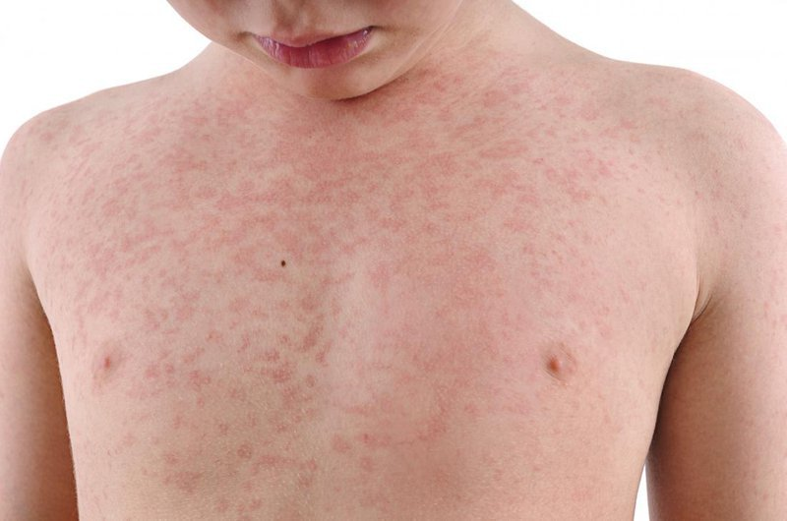
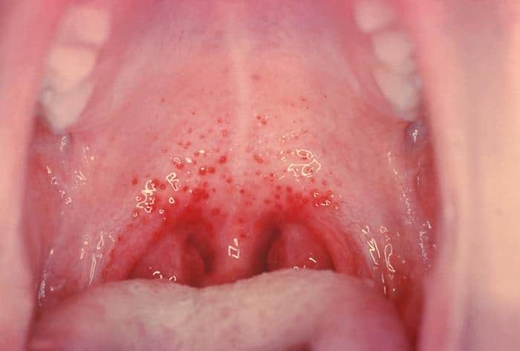
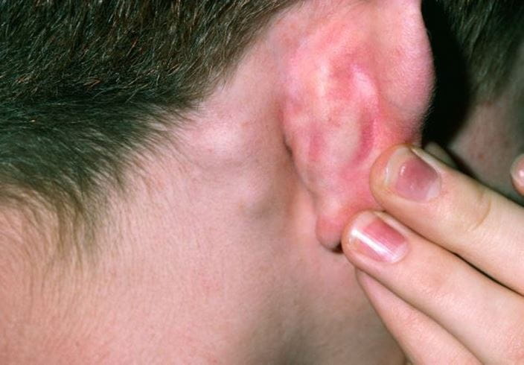
Rash 3
6 y.o. boy
Unsure about immunisation hx
Has come into paeds A&E in winter time
Had mild fever 1 week ago
Now has maculopapular rash, starting on face and spread down whole body
On examination, you spot Forchheimer spots and postauricular lymphadenopathy
What are you thinking?
The Peer Teaching Society is not liable for false or misleading information…

Slide 15
Rash 3: rubella
German measles
Caused by togavirus
Rare in UK now that MMR has been introduced
More common during winter/spring
Low-grade fever, rash beginning in face and spreading across whole body
Palatal petechiae
Suboccipital and postauricular lymphadenopathy
Tx: supportive treatment
The Peer Teaching Society is not liable for false or misleading information…

Slide 16
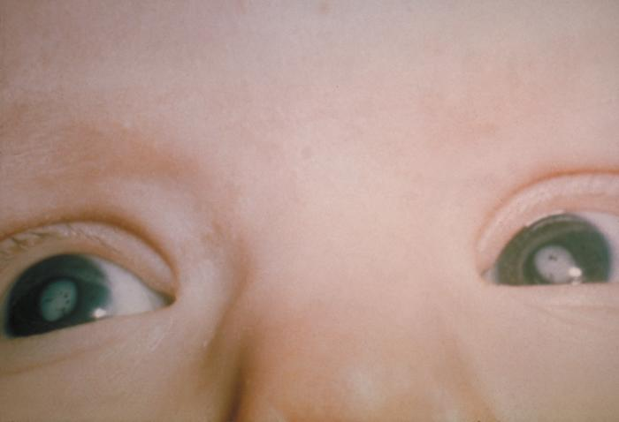
Rash 3: Congenital Rubella
Foetal rubella syndrome can occur if a non-immune mother is infected in her 1st trimester of pregnancy → teratogenic, sensorineural deafness, congenital cataracts, CHD, cerebral palsy, microcephaly
If suspected: discuss with local health protection unit
Do NOT offer MMR vaccine to pregnant woman
offer non-immune mothers MMR vaccine in post-natal phase
The Peer Teaching Society is not liable for false or misleading information…

Slide 17
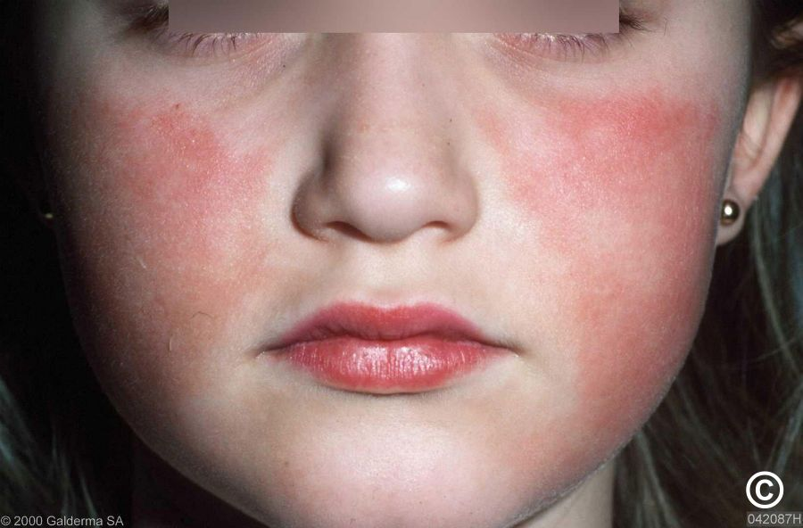
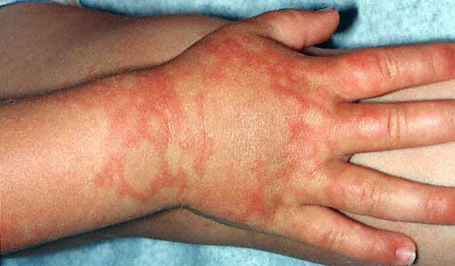
Rash 4
7 y.o. girl
Comes in during Spring
Had a headache, runny nose and fever 1 week ago
Now has bright red macules on face
Rash has spread to hands and limbs, worsens with exposure to sunlight
The Peer Teaching Society is not liable for false or misleading information…

Slide 18
Rash 4: Slapped Cheek Disease
Caused by Parovirus B19
Occurs in all ages
Fever, headache, coryza → slapped cheek rash, glove and socks rash
Ix: clinical diagnosis but can do serology
Tx: supportive, no longer infectious once rash appears
Complications: in someone who has haemolytic anaemia (eg. SCD), infection can trigger an aplastic crisis, pancytopenia
In pregnant women, infection can cause hydrops fetalis in baby
The Peer Teaching Society is not liable for false or misleading information…

Slide 19
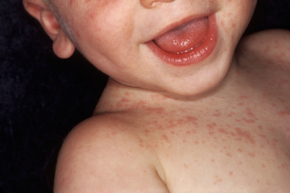
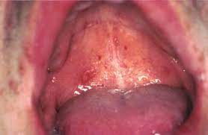
Rash 5
1 y.o. boy
Had a high fever last week of 41 degrees celsius, lasted for 3 days
Fever ended and rash began: started on trunk and spread peripherally
Had vomiting and diarrhoea before rash came on
On examination, you see spots on uvula and soft palate
The Peer Teaching Society is not liable for false or misleading information…

Slide 20
Rash 5: Roseola Infantum
Known as the ‘3 day fever’
Affects children <2y.o.
Caused by HHV-6
Rose-coloured rash starts from trunk, spreads peripherally
Nagayama spots: enanthem on uvula and soft palate
Self-resolving within 2-5 days
May have febrile convulsions prior to rash
Tx: supportive
The Peer Teaching Society is not liable for false or misleading information…

Slide 21
Rashes
The Peer Teaching Society is not liable for false or misleading information…

Slide 22
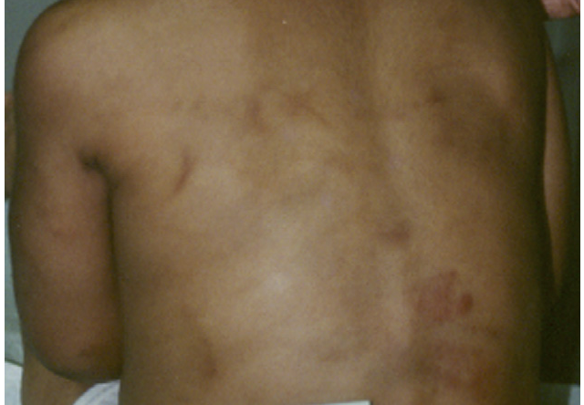
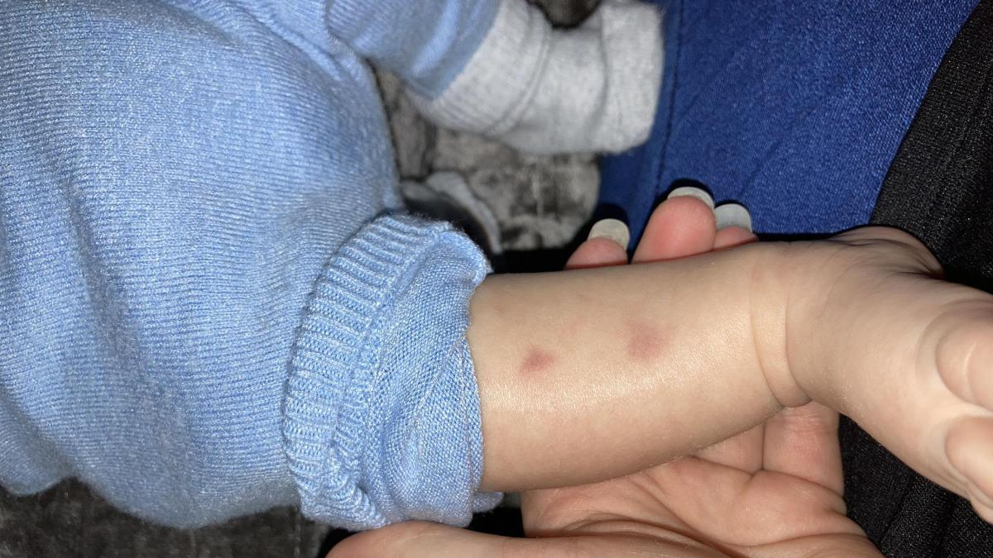
Rash 6
2 y.o. girl brought in
Parents concerned because of rash
No hx of fever, coryza
Full immunisations
On examination, you see petechiae on back. It is purple and yellow more so than red.
You also see a small cluster of rash on one arm. Mum says daughter has been itching it.
What do you think?
The Peer Teaching Society is not liable for false or misleading information…

Slide 23
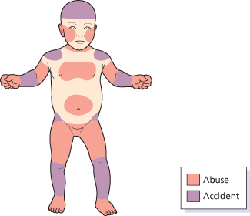
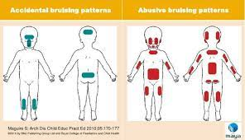
Rash 6: NAI!
bruising in non-mobile child
bruises of different ages (fresh/old)
patterns of bruising
unexplained by parents
What should you do?
Notify MASH
MASH will arrange a paediatric referral
The Peer Teaching Society is not liable for false or misleading information…

Slide 24
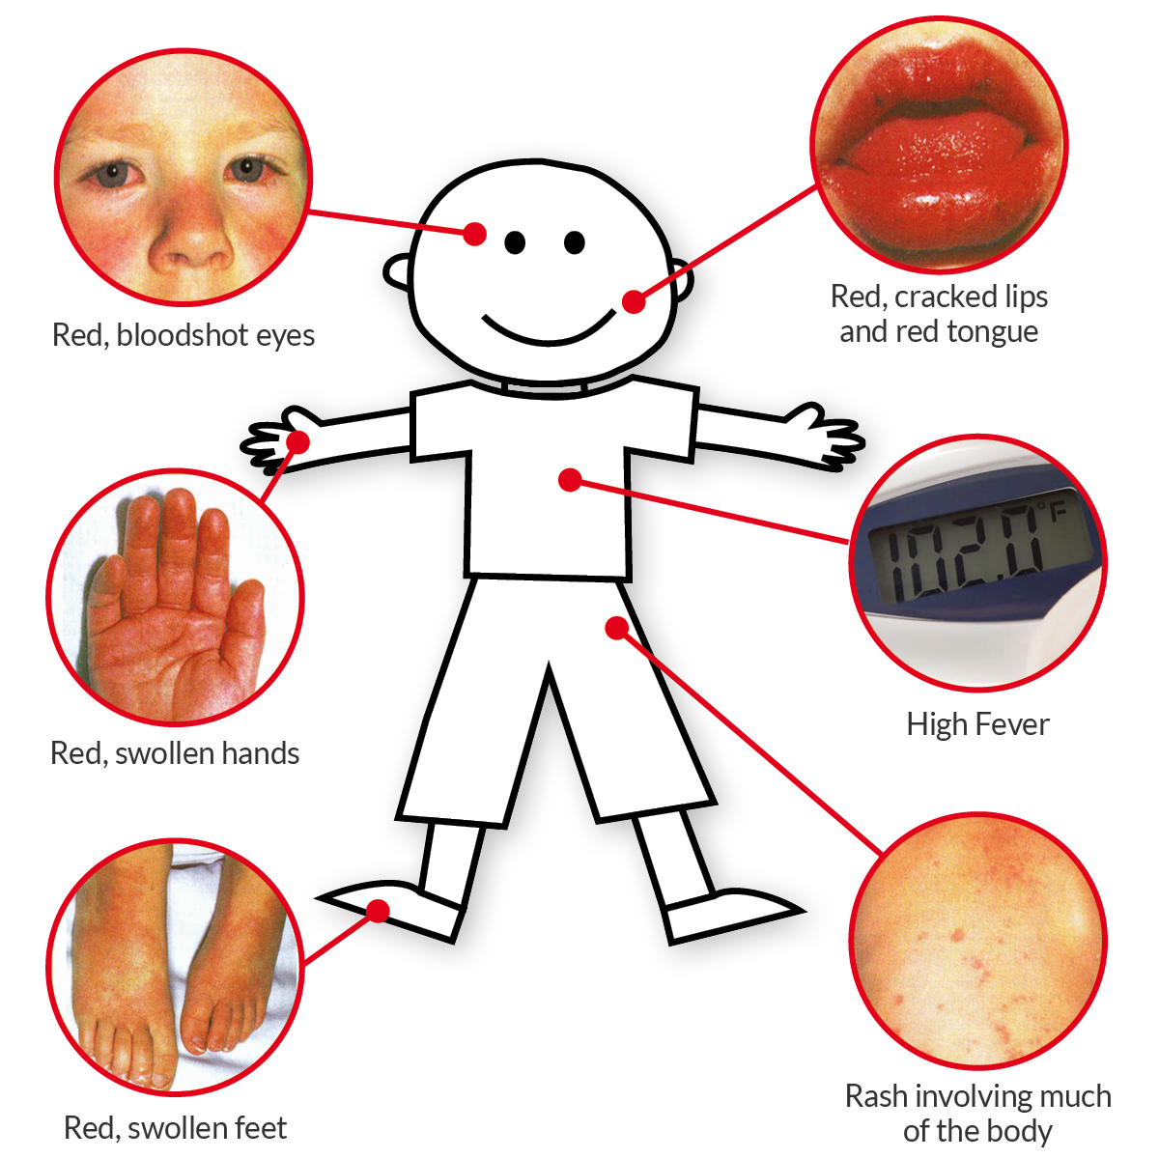
Kawasaki Disease
CRASH and BURN: conjunctivitis, rash, adenopathy, strawberry tongue, hands (palmar erythema, swelling), fever (>5 days)
more common in Japanese and Afrocarribean children, <4y.o.
Impt to dx: fatal complications
Ix: clinical dx, but what must you do!!!
Tx: high dose aspirin, IV immunoglobulins
Notifiable disease
The Peer Teaching Society is not liable for false or misleading information…

Slide 25
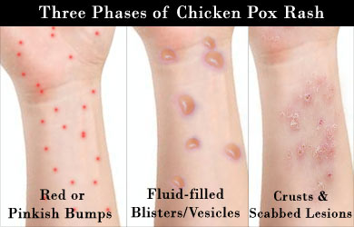
Chicken Pox
Fever, vesicular rash beginning on head and trunk
Itchy!!
Caused by varicella zoster virus (VZV)
Usually 1-6 y.o., very infectious
rash goes from vesicle → crusting
Clinical dx
Tx: school exclusion for 5 days from skin eruption
Complications: pneumonia, encephalitis, secondary bacterial infection with GAS → ______ (aciclovir?)
The Peer Teaching Society is not liable for false or misleading information…

Slide 26
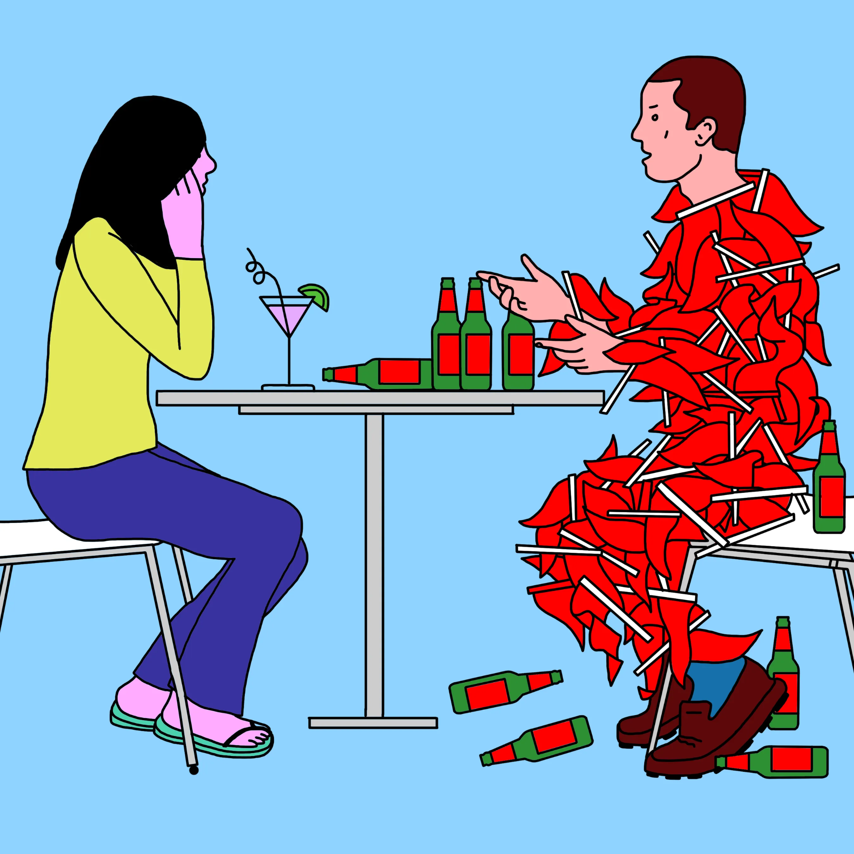
Back to the case…
Responsive to pain
Cold hands and feet
Non-blanching rash on torso
Examination: chest clear, normal HS, abdo SNT
Obs: temp 39, RR 42, HR 142, SpO2 88, CRT 5 sec, BP 70/40
The Peer Teaching Society is not liable for false or misleading information…

Slide 27
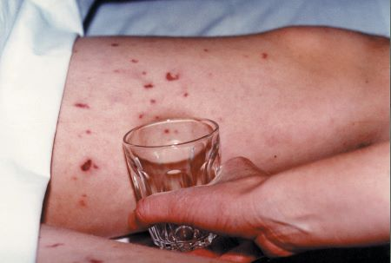
Back to the case…
Shock definition: inadequacy of circulation to meet tissue demands leading to end-organ damage
Septic shock: bacterial infection in bloodstream leading to shock
Early and late signs of shock?
In a child, a FEBRILE STATE with PURPURIC RASH = meningococcal septicaemia until proven otherwise!
The Peer Teaching Society is not liable for false or misleading information…

Slide 28
Case 1: meningococcal septicaemia
Meningitis: inflammation of meninges covering the brain
<15 y.o. children
Viral cause (by HSV-1) more common, bacterial cause (<3 months is GBS, after that meningococcus) has higher mortality
patho: colonisation of nasopharyngeal epithelium → invasion of bloodstream → invasion of meninges → host immune response → cerebral oedema, raised ICP
The Peer Teaching Society is not liable for false or misleading information…

Slide 29
Case 1: meningococcal septicaemia
Px
Infants and young children: non-specific
Older children: fever + triad: headache, neck stiffness, photophobia, focal seizures, purpuric rash
late signs: papilloedema, bulging fontanelle
Brudzinski sign, Kernig sign
If CRT <2 → suspect septicaemia
Ix: Septic screen, When to do LP?
All infants <1 month old
unwell child with elevated WCC >1 month old
when to avoid LP?
The Peer Teaching Society is not liable for false or misleading information…

Slide 30
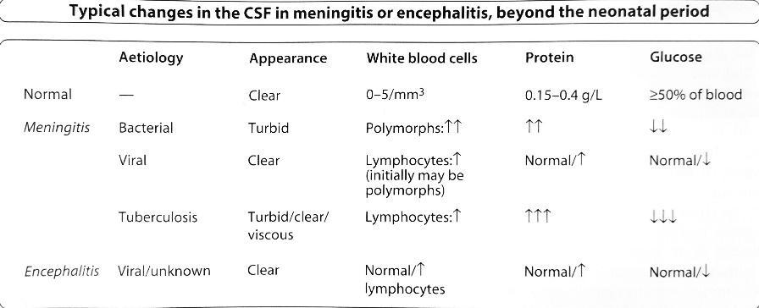
Case 1: meningococcal septicaemia
The Peer Teaching Society is not liable for false or misleading information…

Slide 31
Case 1: meningococcal septicaemia
Meningitis tx
IV benzylpenicillin + admit to hospital
IV cefotaxime
What do you add if infant <3 mths? Why?
Dexamethasone (do NOT use in meningococcal septicaemia
Contact tracing + Prophylaxis
What drugs do you use?
Notify LHPU
The Peer Teaching Society is not liable for false or misleading information…

Slide 32
Case 1: meningococcal septicaemia
Meningitis vs meningococcal septicaemia
meningitis: invasion of meningitis
septicaemia: when infection spreads to the rest of the body
In the case of Andrew, in addition to abx, what must we give straight away?
The Peer Teaching Society is not liable for false or misleading information…

Slide 33
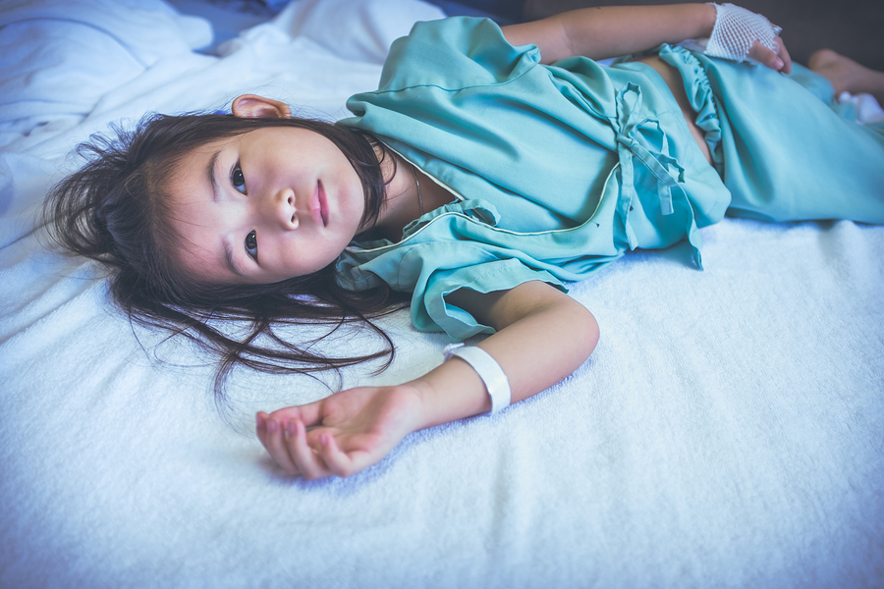
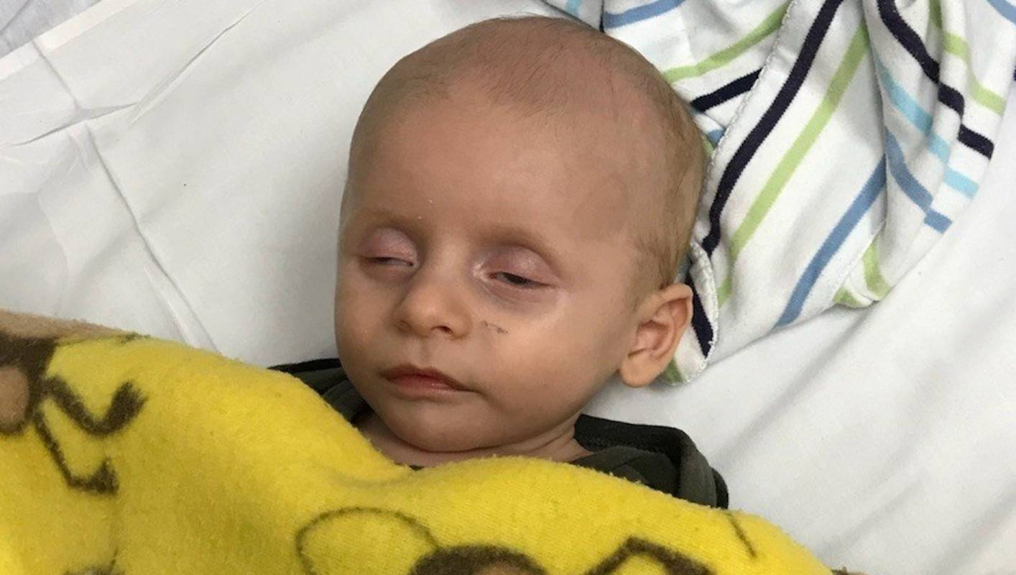
FLUIDS
In general, there are 3 situations where you’d give a child fluids:
shock
dehydrated
NBM
Resuscitation fluids
Maintenance Fluids
Replacement fluids
The Peer Teaching Society is not liable for false or misleading information…

Slide 34
Maintenance Fluids
Body weight | 24h IV Fluid Requirement
< 10kg | 100ml/kg
10kg – 20kg | 100ml/kg for the first 10kg + 50ml/kg for each 1kg over 10kg
> 20kg | 100ml/kg for the first 10kg + 50ml/kg for each 1kg between 10kg-20kg + 20ml/kg for each 1kg over 20kg
The Peer Teaching Society is not liable for false or misleading information…

Slide 35
Let’s work it out
Body weight | 24h IV Fluid Requirement
< 10kg | 100ml/kg
10kg – 20kg | 100ml/kg for the first 10kg + 50ml/kg for each 1kg over 10kg
> 20kg | 100ml/kg for the first 10kg + 50ml/kg for each 1kg between 10kg-20kg + 20ml/kg for each 1kg over 20kg
A child weighing 25kg requires IV maintenance fluids.
The Peer Teaching Society is not liable for false or misleading information…

Slide 36
Let’s work it out
Body weight | 24h IV Fluid Requirement
< 10kg | 100ml/kg
10kg – 20kg | 100ml/kg for the first 10kg + 50ml/kg for each 1kg over 10kg
> 20kg | 100ml/kg for the first 10kg + 50ml/kg for each 1kg between 10kg-20kg + 20ml/kg for each 1kg over 20kg
A child weighing 25kg requires IV maintenance fluids. What is the rate of infusion?
•10 x 100ml = 1000ml
•10 x 50ml = 500ml
•5 x 20ml = 100ml
•1600ml ÷ 24h = 67ml/hour
The Peer Teaching Society is not liable for false or misleading information…

Slide 37
Let’s work it out
Body weight | 24h IV Fluid Requirement
< 10kg | 100ml/kg
10kg – 20kg | 100ml/kg for the first 10kg + 50ml/kg for each 1kg over 10kg
> 20kg | 100ml/kg for the first 10kg + 50ml/kg for each 1kg between 10kg-20kg + 20ml/kg for each 1kg over 20kg
What if the child weighs 95kg?
What fluid will be your go-to?
The Peer Teaching Society is not liable for false or misleading information…

Slide 38
Replacement fluids
How dehydrated is the child?
Dehydrated (5%):
Unsettled
Slightly sunken eyes
Dry mouth
Tachycardia, tachypnoea
Normal:
Alert
Warm extremities
Moist membranes
Shock (10%):
Lethargic, confused
Weak pulses
Cold extremities
Mottled skin
hypotension
The Peer Teaching Society is not liable for false or misleading information…

Slide 39
Replacement Fluids
% dehydration = (well weight - ill weight) / well weight x 100
Fluid deficit (ml) = %dehydration x well weight (kg) x 10
Remember: In addition to replacing fluids, you must add maintenance!
Let’s work it out: Lucy weighs 15.2kg today (last week 16.6kg). She is slightly tachycardic and tachypnoeic, with dry lips. At what rate should her fluids be given?
maintenance
what child has
replace
resuscitation
The Peer Teaching Society is not liable for false or misleading information…

Slide 40
Replacement Fluids
Fluid deficit = 16.6- 15.2 = 1.4
1.4 / 16.6 = 0.0843
8.4% weight loss objectively
Deficit: 8.4% dehydration x 16.6kg x 10 = 1394.4mls
Maintenance: (100ml x 10) + (50ml x 6.6) = 1330mls
Total req in 24h: 2724.4 ÷ 24 = 113.5ml/hour
The Peer Teaching Society is not liable for false or misleading information…

Slide 41
Resuscitation Fluids
10ml/kg IV fluid bolus over 5-10 min
Re-assess patient
Repeat up to 40ml/kg if no sign of fluid overload
End point: CRT <2s, normal BP, normal mental state, urine output >1ml/kg/hour
Let’s work it out: A 6m old child weight 6.4kg with a non-blanching rash has weak peripheral pulses and CRT 5-6 secs. What do you give first?
The Peer Teaching Society is not liable for false or misleading information…

Slide 42
Resuscitation Fluids
10ml/kg IV fluid bolus over 5-10 min
Re-assess patient
Repeat up to 40ml/kg if no sign of fluid overload
End point: CRT <2s, normal BP, normal mental state, urine output >1ml/kg/hour
Let’s work it out: A 6m old child weight 6.4kg with a non-blanching rash has weak peripheral pulses and CRT 5-6 secs. What do you give first?
10mls x 6.4 = 64ml fluid bolus 0.9% saline
The Peer Teaching Society is not liable for false or misleading information…

Slide 43
Back to the case…
Andrew weighs 30kg. Your reg tells you to prescribe a fluid bolus and to prescribe maintenance fluids.
How much of a fluid bolus would you prescribe?
How would you calculate his maintenance fluid requirements?
The Peer Teaching Society is not liable for false or misleading information…

Slide 44
Back to the case…
Andrew weighs 30kg. Your reg tells you to prescribe a fluid bolus and to prescribe maintenance fluids.
How much of a fluid bolus would you prescribe? What will you prescribe?
10 x 30 = 300mls of normal saline
How would you calculate his maintenance fluid requirements? What is the rate of infusion?
first 10kg = 100 x 10 = 1000ml
next 10kg = 50 x 10 = 500ml
next 10kg = 20 x 10 = 200
total: 1000 + 500 + 200 = 1700ml/day
70.8ml/h
The Peer Teaching Society is not liable for false or misleading information…

Slide 45
Paeds Renal
The Peer Teaching Society is not liable for false or misleading information…

Slide 46
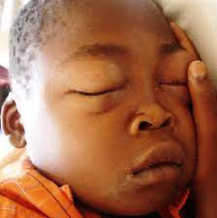
The Swollen Child
You are working in Paeds A&E when a 4 year old South-East Asian boy is brought in by his dad with swollen legs and swelling around his eyes. His dad says this has happened a couple times before but usually resolves so they didn’t think much of it.
What is your top differential?
What investigations would you want to do?
How would you manage this patient?
The Peer Teaching Society is not liable for false or misleading information…
Notes:
Nephrotic syndrome, urine dipstick, urine protein:creatinine ratio, manage with steroids

Slide 47
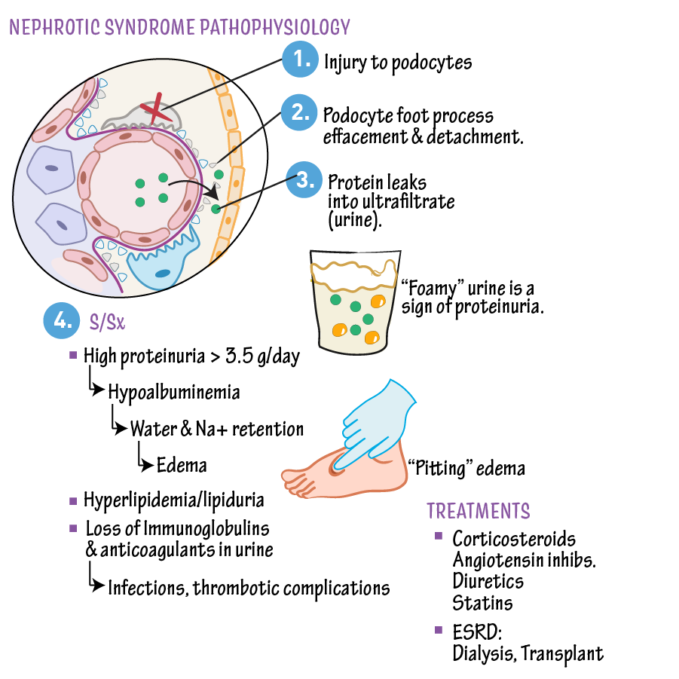
Nephrotic Syndrome
Definition | When the basement membrane in the glomerulus becomes highly permeable to protein resulting in protein leaking into the urine Low serum albumin High urinary protein Oedema
Epidemiology/Risk Factors | Most common cause is minimal change disease - idiopathic cause Other causes can be HSP, Diabetes and Intrinsic kidney disease More common in children aged 2-5
Clinical Presentation | Periorbital oedema Scrotal, vulval, leg and ankle oedema SOB due to pleural effusions Frothy urine Pallor
Investigations | Urine dipstick Urinary protein:creatinine ratio
Management | Corticosteroids usually prednisolone Diuretics can be used whilst steroids take effect Manage diet with low salt foods
Complications | Risk of relapses Hypovolaemia Thrombosis Infection Renal failure
The Peer Teaching Society is not liable for false or misleading information…
Notes:
Why does thrombosis occur? because proteins that normally prevent blood clotting are lost in the kidneys, and because the liver responds to the low albumin by producing pro-thrombotic proteins.

Slide 48
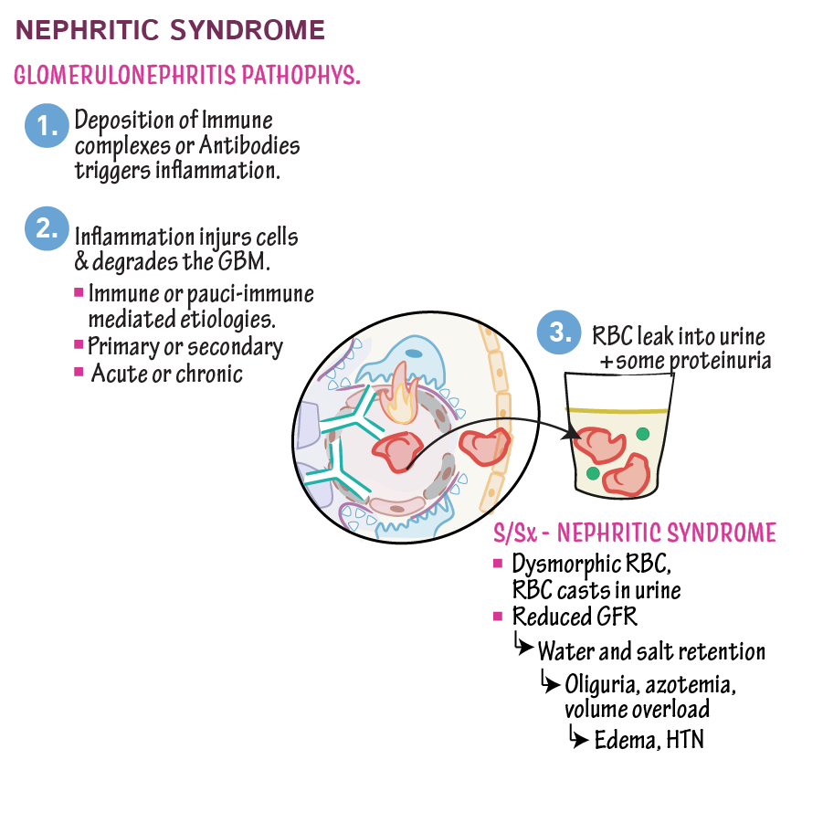
Nephritic Syndrome
Definition | Inflammation within the nephrons of the kidney causing: Reduced kidney function Haematuria Proteinuria
Aetiology | Post Strep Glomerulonephritis: Occurs 1-3 weeks after a Strep infection IgA Nephropathy: 1-2 days post infection, often related to HSP which is an IgA Vasculitis
Management | Post Strep Generally supportive treatment Treat any complications such as HTN and oedema IgA Nephropathy Supportive treatment Immunosuppressant medications to slow disease progression
The Peer Teaching Society is not liable for false or misleading information…
Notes:
Give an example of strep infection: Tonsillitis it the most common association
IgA nephropathy is actually quite nasty: many patients who suffer long term with this can end up needing renal transplants due to the significant damage

Slide 49
The Child struggling to wee
Harry is a 4 year old boy who comes to your GP practice with his dad. When you see him, he complains of pain when he is going for a wee as well as feeling hot and cold the past 2 days.
What would be your most likely suspicion at this stage?
What is important to rule out during your examination?
The Peer Teaching Society is not liable for false or misleading information…
Notes:
UTI
Signs of systemic illness e.g sepsis/pyelonephritis

Slide 50
UTI
Definition | Lower UTI: Cystitis which affects the bladder and the urethra Upper UTI: Pyelonephritis which affects the renal pelvis and kidneys Typical organisms include E coli, Klebsiella, Pseudomonas
Clinical Presentation | Infants: Fever, vomiting, lethargy, poor feeding, sepsis, smelly urine and febrile convulsions Older children: Dysuria, abdominal pain, fever, smelly/cloudy urine
Features of an atypical UTI | Seriously ill child Poor urine flow Abdominal/Bladder mass Raised creatinine Sepsis Failure to respond to treatment with suitable Abx within 48 hours
Management | If <3 months -> Refer to paeds with Abx and send sample for urgent microscopy and culture If over 3 months, perform dipstick analysis <3 months - Admit and give IV Cefotaxime >3 months with Upper UTI: Oral Cefotaxime/Co-Amoxiclav for 7-10 days >3 months with Lower UTI: Oral Trimethoprim/Nitrofurantoin Safety net advice: Bring child back if still unwell after 48 hours of Abx
The Peer Teaching Society is not liable for false or misleading information…
Notes:
What is a challenge with investigating UTI in children? It is often hard to catch a clean sample for analysis s

Slide 51
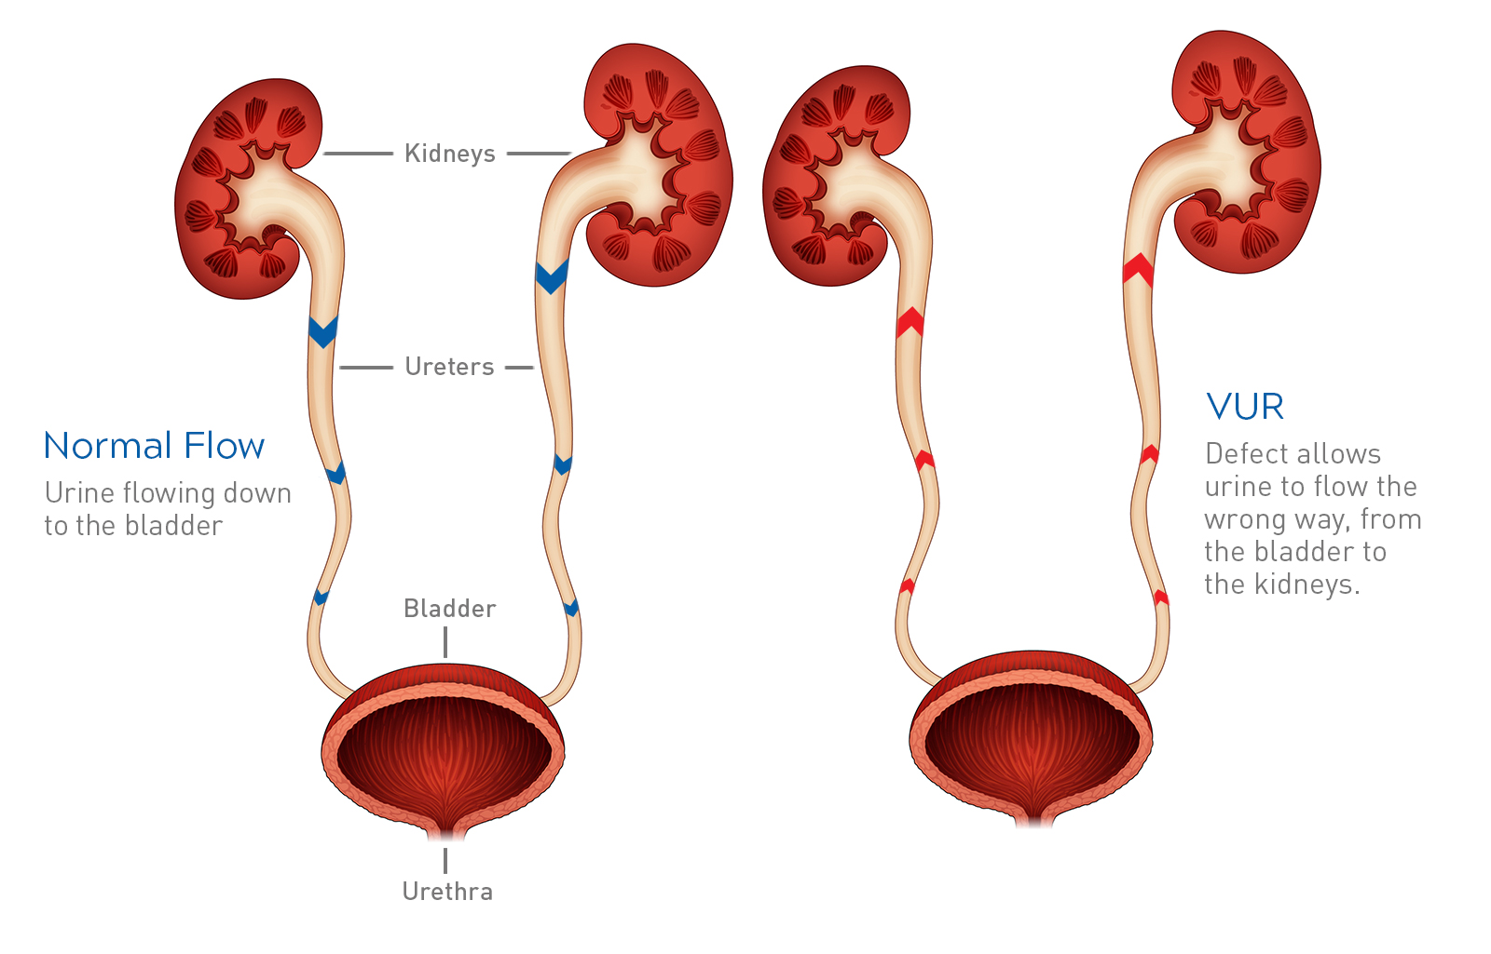
UTI
Secondary Management | Indications for Ultrasound of Urinary Tract <6 months with recurrent UTI in acute infection phase Within 6 weeks for children >6 months with recurrent UTIs Within 6 weeks for children <6 months with first-time UTI which responds to treatment Indications for DMSA Scan All children <3 years with atypical/recurrent UTI All children >3 years with recurrent UTI
Complication | Vesicoureteric Reflux Developmental abnormality where ureters are displaced and enter directly into the bladder rather than at an angle which causes reflux of urine into the kidneys causing scarring Diagnosed with MCUG scan (X-ray which looks at flow of urine)
The Peer Teaching Society is not liable for false or misleading information…
Notes:
Reflux should be suspected in those with recurrent UTIs, incontinence

Slide 52
Paeds Neuro
The Peer Teaching Society is not liable for false or misleading information…

Slide 53
The Fitting Child
Joshua is a 3 year old boy brought in to Paeds A+E by his incredibly distressed mum Lucy who states he has just had a fit. You try to take a history from her but she is incredibly anxious.
What would you want to know from her?
The Peer Teaching Society is not liable for false or misleading information…

Slide 54
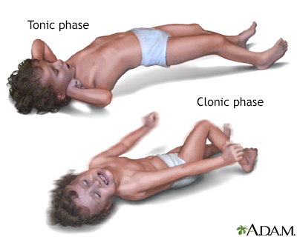
The Fitting Child
You manage to get a bit of a history where she states he was just laying on the sofa watching TV when he turned stiff for a minute and then began shaking all 4 of his limbs which lasted another minute. She states he has been a bit rundown the past few days with a cough, runny nose and sore throat.
What would your main differentials be now?
The Peer Teaching Society is not liable for false or misleading information…

Slide 55
Febrile Convulsions
Definition | Seizures associated with a high fever Simple: Generalised tonic-clonic seizures which last <15 minutes and only occur once during an illness Complex: Partial/Focal seizures/Last more that 15 minutes/Occur multiple times in the same illness
Investigations | Rule out other causes such as epilepsy, meningitis, SOLs or trauma Find the source of infection
Management | Control fever with paracetamol/ibuprofen Treat the infection Parental education Slightly higher risk of developing epilepsy
The Peer Teaching Society is not liable for false or misleading information…
Notes:
What kind of advice would you give the parents?
Stay with the child
Put the child in a safe place, for example on a carpeted floor with a pillow under their head
Place them in the recovery position and away from potential sources of injury
Don’t put anything in their mouth
Call an ambulance if the seizure lasts more than 5 minutes
If they have complex febrile convulsions, risk is slightly higher for developing epilepsy compared to the simple febrile convulsions and for ordinary people

Slide 56
Epilepsy
Type | Features | Management
Generalised Tonic-Clonic | Tonic phase with rigidity followed by clonic phase with rhythmic jerking Often has postictal period | Sodium valproate Lamotrigine
Focal | Begin in temporal lobe and can affect speech, memory and emotions Can present with hallucinations, memory flashbacks or deja vu | Lamotrigine Levetiracetam
Absence | Episodes of staring into space/becoming blank with abrupt return to normal Usually resolve with age | Ethosuximide
Myoclonic | Sudden muscle contractions where person remains awake Part of juvenile myoclonic epilepsy: associated with morning seizures/following sleep deprivation | Sodium valproate Levetiracetam
Tonic/Atonic | Sudden tension.stiffness affecting the body | Sodium Valproate Lamotrigine
The Peer Teaching Society is not liable for false or misleading information…

Slide 57
Paeds MSK
The Peer Teaching Society is not liable for false or misleading information…

Slide 58
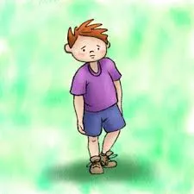
The Limping Child
Mrs Warner brings her 2 year old son Caleb to your GP practice. As he walks in, you see he has a slight limp on his left side. When you take your history, she states that he has had a cough, runny nose and has been feverish the last week and now since yesterday, he has been struggling to walk.
What is the most likely diagnosis?
What would your next steps be?
The Peer Teaching Society is not liable for false or misleading information…
Notes:
REFER - any child with <3 with a limp should be referred, even if you suspect transient synovitis

Slide 59
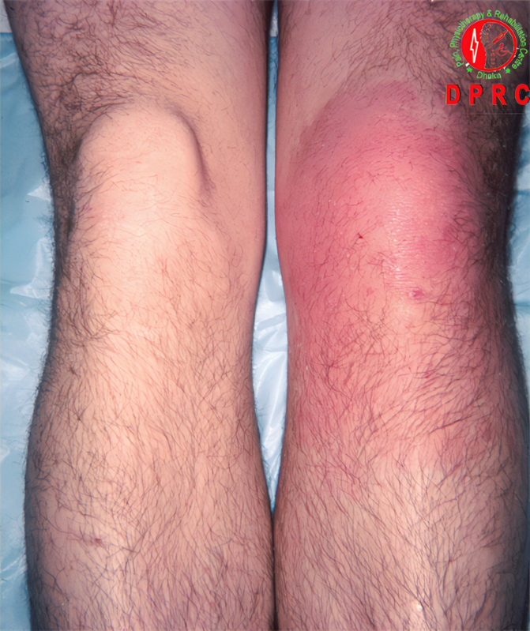
Septic Arthritis
Definition | Infection inside the joint - most common in those <4 years of age Most common aetiology is Staph Aureus Consider N.Gonorrhoeae in sexually active teenagers
Clinical Presentation | Usually affects knee or hip Hot, red, swollen, painful joint Refusal to weight bear Stiffness and reduced range of motion Signs of systemic illness: fever, lethargy
Management | Admission to hospital for urgent assessment Joint aspiration for culture and sensitivities IV Empirical Abx to start with then amend as per sensitivities Surgical drainage and washout may be needed if severe
The Peer Teaching Society is not liable for false or misleading information…
Notes:
In under 3s, septic arthritis is actually more common than transient synovitis

Slide 60
Transient Synovitis
Definition | Temporary irritation and inflammation of the synovial membrane - often associated with viral URTI Most common cause of hip pain in children aged 3-10
Clinical Presentation | Symptoms usually occur within a few days/weeks of a viral illness Limp Refusal to weight bear Low grade fever otherwise no signs of systemic illness
Features of an atypical UTI | Requires symptomatic management Exclusion of other diagnoses, especially septic arthritis Usually resolves within 1-2 weeks with no long term effects
NICE Guidelines | Referral for specialist assessment if: Pain waking the child at night Redness, swelling, or stiffness of the joint or limb Unexplained rash or bruising A palpable mass Suspicion of NAI Child < 3
The Peer Teaching Society is not liable for false or misleading information…
Notes:
Generally people with synovitis should otherwise be well with normal obs
Safety netting advice is really important with TS in a GP setting with key info to tell parents when to go to A+E

Slide 61
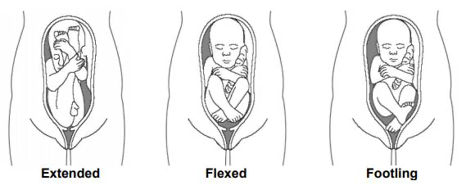
The Breech Baby
You are the F2 working on the postnatal ward. You are writing the discharge summary for Lucy, a 2 day old baby girl born via C-section for breech presentation at 39+4.
What should you arrange for Lucy?
The Peer Teaching Society is not liable for false or misleading information…
Notes:
US scan at 6 weeks for DDH as breech is a risk factor

Slide 62
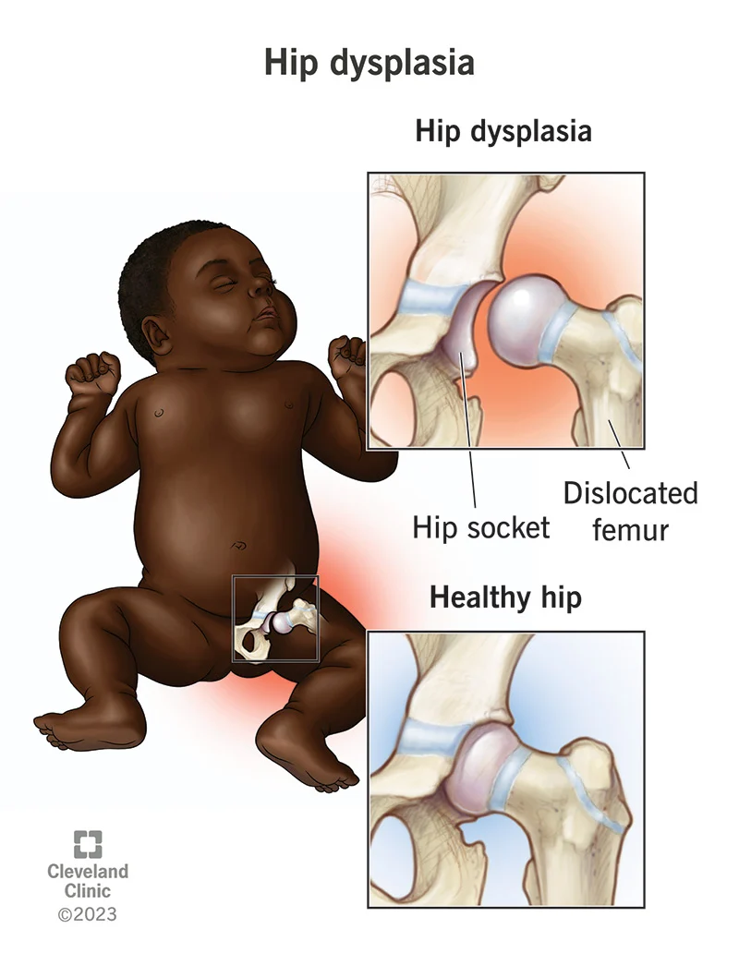
Developmental Dysplasia of the Hip
Definition | Structural abnormality in the hips caused by abnormal development of the foetal bones
Risk Factors | Family History Breech presentation from 36 weeks onwards Multiple pregnancy Female First child
Clinical Presentation | Usually picked up on NIPE Exam with Barlow (dislocate) and Ortolani (relocate) tests Can present with hip asymmetry, reduced ROM or limp
Management | Ultrasound for <4.5 months X-ray for >4.5 months Can resolve over time without intervention Pavlik harness can be used in <6 months old] Older children may need surgery
The Peer Teaching Society is not liable for false or misleading information…
Notes:
Really important thing to remember here is if they are breech at all from 36 weeks, they need the scan even if it is fixed to cephalic with ECV etc
Bold risk factors: Need US screening
B before O, dislocate then relocate

Slide 63
The Painful Hip
An 8 year old boy comes to A+E with his father complaining of pain in his hip and difficulty walking.
You take a history and find out this pain has been progressively getting worse the last 8 weeks, with no recent injuries.
What are your 2 main differentials for painful limps in boys?
The Peer Teaching Society is not liable for false or misleading information…

Slide 64
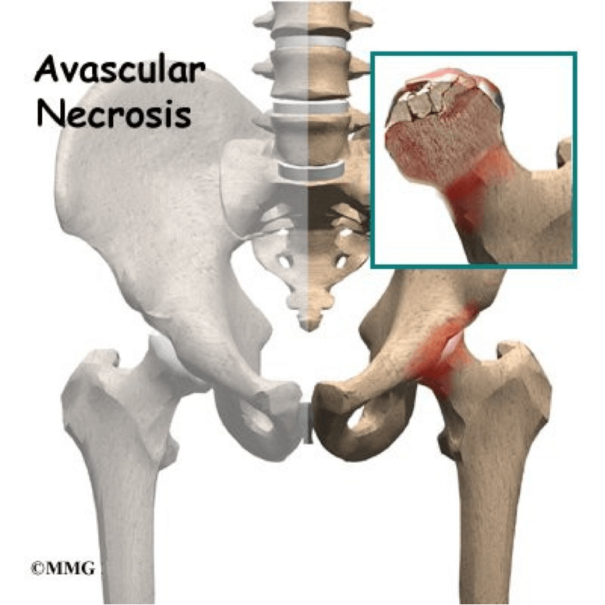
Perthes Disease
Definition | Disruption of blood flow to the femoral head causing avascular necrosis of the bone Most common in 4-8 year old boys Mainly idiopathic
Clinical Presentation | Slow onset of pain in the hip/groin Limp Restricted hip movements No trauma
Investigations | Plain X-ray: Widening of the joint space initially then decreased femoral head size Technetium bone scar/MRI if normal X-ray and symptoms persisting
Management | Initial management is conservative by maintaining position and alignment in the joint with bed rest, analgesia and casts If <6 years of age, observation is usually sufficient Older children may need surgery and physio
The Peer Teaching Society is not liable for false or misleading information…
Notes:
Main complication of this is that there is a soft and deformed femoral head meaning osteoarthritis is more likely to occur

Slide 65
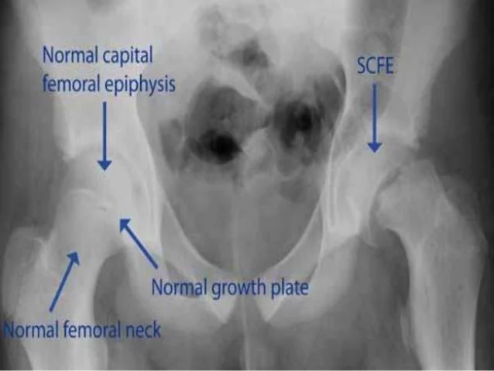
Slipped Upper Femoral Epiphysis
Definition | Rare hip condition where the femoral head epiphysis is displaced posteroinferiorly Much more common in males between the age of 8-15 More common in obese children
Clinical Presentation | Sometimes there can be a history of minor trauma which trigger symptoms Hip, groin, medial thigh or knee pain Loff of internal rotation of the leg in flexion Painful lump Want to keep the hip externally rotated
Investigations | X-ray is usually diagnostic
Management | Surgery: Internal fixation across the growth plate
The Peer Teaching Society is not liable for false or misleading information…
Notes:
Essentially the head of the femur is displaced along the growth plate, more common in obese children often when they are having a growth spurt

Slide 66
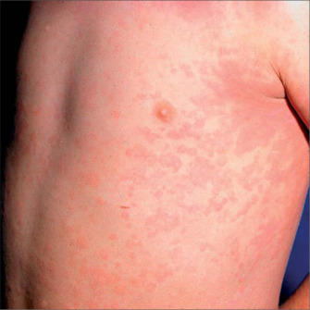
The child losing weight
You are an F2 working in GP when your supervisor asks you to review a 11 year old boy brought in as an emergency by his mum who states he has been losing weight for the past 4 weeks and complaining of some joint pain. On examination, you also note this strange rash across his skin…
What is the most likely diagnosis?
The Peer Teaching Society is not liable for false or misleading information…

Slide 67
Juvenile Idiopathic Arthritis
Autoimmune mediated inflammation which occurs within the joints
Diagnosed generally when there is arthritis without any other cause, lasting more than 6 weeks
Key Features include joint pain, swelling and stiffness
The Peer Teaching Society is not liable for false or misleading information…

Slide 68
Types of JIA
Type | Features | Investigations | Complication
Systemic JIA | Systemic illness Salmon-pink rash High fevers Lymphadenopathy | ANA and RF negative Raised CRP, ESR, platelets and ferritin | Macrophage activation syndrome: massive inflammatory response which causes DIC and low ESR
Oligoarticular JIA | Involves 4 or less joints Usually affects large joints More common in girls <6 years Classic feature is anterior uveitis | No systemic symptoms Inflammatory markers will be normal/mildly elevated ANA positive | Patients need referral to ophthalmology to manage uveitis
Polyarticular JIA | 5 or more joints affected Usually symmetrical so affects hands, feet as well as larger joints Some mild fever, anaemia and reduced growth | Can be RF negative Older children may be RF positive
The Peer Teaching Society is not liable for false or misleading information…
Notes:
Platelets go up when there is general inflammation so they are high
Macrophages cause release of a factor which increases ferritin synthesis therefore ferritin levels are high
MAS: It presents with an acutely unwell child with disseminated intravascular coagulation (DIC), anaemia, thrombocytopenia, bleeding and a non-blanching rash. It is life threatening.
Polyarticular is essentially rheumatoid arthritis in kids

Slide 69
Types of JIA
Type | Features | Investigations | Complication
Enthesitis-Related | More common in males > 6 years HLA-B27 gene Prone to anterior uveitis Tenderness of the entheses e.g. wrist, greater trochanter | HLA-B27 testing ANA and RF negative | Screening by ophthalmologist needed for uveitis
Juvenile Psoriatic Arthritis | Associated with psoriasis Can be symmetrical in smaller joints or asymmetrical and affect larger joints Plaques of psoriasis Nail pitting Dactylitis Onycholysis | RF negative ANA negative
The Peer Teaching Society is not liable for false or misleading information…
Notes:
Enthesitis is where the tendon inserts into a bone so they have inflammation here so it would be like interphalangeal joints, wrist, greater trochanter, quadriceps into anterior superior iliac spine
Enthesitis related is kind of like the seronegative spondyloarthropathies that you see in adults: examples include Ankylosing spondylitis, reactive, psoriatiic arthritis
Dactylitis - inflammation of the finer, onycholysis is separation of the nail from the nail bed

Slide 70
Juvenile Idiopathic Arthritis
Management of all JIA
Analgesics such as NSAIDs for pain
Steroids either oral, IM or intra-articular in oligoarthritis
DMARDs such as Methotrexate, Sulfasalazine
Biologics such as Infliximab
The Peer Teaching Society is not liable for false or misleading information…

Slide 71
Questions
A 2-month-old previously healthy girl is brought into the GP by her mother who reports a change in her demeanour. She suspects her child has a fever. On examination the baby is feverish with temperature of 38.5 ºC and and seems unwell and lethargic.
How should the GP manage this child? [2 marks]
What is the most likely causative organism in this case? [1 mark]
What investigation in the hospital will confirm this diagnosis [1 mark]
What are 2 contraindications to the Ix in Q3? [2 marks]
What are 2 long-term complications of this disease that can occur with delayed treatment? [2 marks]
In addition to IV cefotaxime, what other abx will the girl be given in __hospital? [1 mark]
The Peer Teaching Society is not liable for false or misleading information…

Slide 72
Questions
How should the GP manage this child? [2 marks]
IM Benpen + urgent paediatric referral
What is the most likely causative organism in this case? [1 mark]
Group B Streptococcus
What investigation in the hospital will confirm this diagnosis [1 mark]
Lumbar Puncture
What are 2 contraindications to the Ix in Q3? [2 marks]
2 from: Findings of increased intracranial pressure, bleeding diathesis, cardiopulmonary instability, soft tissue infection at the puncture site, shock, respiratory insufficiency, and suspected meningococcal
What are 2 long-term complications of this disease that can occur with delayed treatment? [2 marks]
2 from: Sensorineural hearing loss, seizures, focal neurological deficit, sepsis
In addition to IV cefotaxime, what other abx will the girl be given in __hospital? [1 mark]
Amoxicillin
The Peer Teaching Society is not liable for false or misleading information…

Slide 73
Questions
After admission, the girl experiences an abrupt and rapid deterioration. She develops petechial haemorrhages on the trunk and legs, rapidly drops oxygen saturations and becomes severely hypotensive. What complication of her condition is she experiencing? [2m]
The Peer Teaching Society is not liable for false or misleading information…

Slide 74
Questions
After admission, the girl experiences an abrupt and rapid deterioration. She develops petechial haemorrhages on the trunk and legs, rapidly drops oxygen saturations and becomes severely hypotensive. What complication of her condition is she experiencing? [2m]
Waterhouse-Friderichsen Syndrome
The Peer Teaching Society is not liable for false or misleading information…

Slide 75
Questions
Jenna is an 16-year-old girl who was initially admitted with a fever and disseminated rash. She had not been previously vaccinated and was in contact with her 2-year-old cousin who had developed a fever and disseminated blisters and vesicles containing clear fluid.
What is the causative organism for Jenna’s rash? [1 mark]
How long must Jenna be kept away from school? [1 mark]
What condition is Jenna at risk of developing later in life, due to the same organism in Q1? [1 mark]
What is the pathophysiology of the condition in Q3? [2 marks]
The Peer Teaching Society is not liable for false or misleading information…

Slide 76
Questions
What is the causative organism for Jenna’s rash? [1 mark]
Varicella zoster virus
How long must Jenna be kept away from school? [1 mark]
5 days after onset rash/until all lesions have crusted over
What condition is Jenna at risk of developing later in life, due to the same organism in Q1? [1 mark]
Shingles
What is the pathophysiology of the condition in Q3? [2 marks]
Primary infection with VZV causes varicella. After a person has varicella, the virus remains latent in the dorsal root ganglia. [1 mark] With advancing age or immunosuppression, cell-mediated immunity to VZV declines and virus reactivates to cause shingles [1 mark]
The Peer Teaching Society is not liable for false or misleading information…

Slide 77
Questions
After 3 days, she noticed that while most of her skin lesions are healing, one of the lesions on the thigh appears to be red and becoming hot to touch. An area of skin approximately 3x3cm was erythematous. The skin was marked and she was commenced on IV flucloxacillin. Over the coming 12 hours, the erythema around this lesion continued to spread. The pain around her leg increased in intensity, requiring morphine to take the edge off the pain. A blueish discolouration begins to develop around the rash.
What is the like complication that has developed? [1m]
What is the most likely organism that has caused this? [1m]
The Peer Teaching Society is not liable for false or misleading information…

Slide 78
Questions
What is the like complication that has developed? [1m]
Rapidly evolving rash + significant pain out of proportion to rash → necrotising fasciitis.
What is the most likely organism that has caused this? [1m]
B-haemolytic Group A streptococcus.
The Peer Teaching Society is not liable for false or misleading information…

Slide 79
Questions
You are a GP and a 7-week old baby is brought to you by his concerned mum who states that he has not been feeding as well as he normally does. She also states when changing his nappy, she smelt incredibly smelly urine.
How should the GP manage this child? [1 mark]
What is the most likely cause of UTI in children?
Name 2 features of an atypical UTI in children? [2 marks]
Name an appropriate antibiotic which could be used to treat this child [1 mark]
What imaging should be child undergo within 6 weeks? [2 marks]
The Peer Teaching Society is not liable for false or misleading information…

Slide 80
Questions
How should the GP manage this child? [1 mark]
Urgent same day assessment by paeds
What is the most likely cause of UTI in children?
E coli
Name 2 features of an atypical UTI in children? [2 marks]
2 from: Seriously ill child, Poor urine flow, Abdominal/Bladder mass, Raised creatinine, Sepsis, Failure to respond to treatment with suitable Abx within 48 hours
Name an appropriate antibiotic which could be used to treat this child [1 mark]
IV Cefotaxime/Ceftriaxone
What imaging should be child undergo within 6 weeks? [2 marks]
USS [1 mark]
Of the urinary tract [1 mark]
The Peer Teaching Society is not liable for false or misleading information…

Slide 81
Questions
A 5 year old boy is brought to the Paediatric Assessment Unit by his mum complaining of SOB. He tells you that his urine has been very frothy. You examine him and note some ankle and leg oedema.
What is the most likely cause of this patient’s SOB? [1 mark]
What is the most likely diagnosis? [1 mark]
Name the 3 key features of this condition? [3 marks]
What is the most common cause of this condition in children? [1 mark]
Name 1 complication that this condition can cause? [1 mark]
The Peer Teaching Society is not liable for false or misleading information…

Slide 82
Questions
What is the most likely cause of this patient’s SOB? [1 mark]
Pleural effusion
What is the most likely diagnosis? [1 mark]
Nephrotic Syndrome
Name the 3 key features of this condition? [3 marks]
Low serum albumin, high urinary protein, oedema
What is the most common cause of this condition in children? [1 mark]
Minimal change disease
Name 1 complication that this condition can cause? [1 mark]
Risk of relapses, hypovolaemia, thrombosis, infections, renal failure
The Peer Teaching Society is not liable for false or misleading information…

Slide 83
Questions
An 9 year old boy is brought to your paediatric neurology clinic after a referral from a GP for seizures. You take a history from his parents who state that he is very clumsy in the mornings and often end up spilling his cereal everywhere. They state that usually he is fine for the rest of the day and has never lost consciousness with these episodes.
What is the most likely diagnosis? [1 mark]
What would be an appropriate treatment option for this patient? [1 mark]
What would be an appropriate treatment for a 9 year old girl? [1 mark]
The Peer Teaching Society is not liable for false or misleading information…

Slide 84
Questions
What is the most likely diagnosis? [1 mark]
Juvenile myoclonic epilepsy
What would be an appropriate treatment option for this patient? [1 mark]
Sodium Valproate
What would be an appropriate treatment for a 9 year old girl? [1 mark]
Levetiracetam
The Peer Teaching Society is not liable for false or misleading information…

Slide 85
Questions
A 7 year old boy comes to your GP practice with his dad and brother complaining of pain in his left hip. He states that the hip has been tender for the last 4 weeks or so and he finds it difficult to walk sometimes. You examine his hip and notice some redness around the left hip but no swelling.
How should this patient be managed? [1 mark]
What is the most likely diagnosis? [1 mark]
What is the most likely cause of this condition? [1 mark]
What would be the most likely treatment option for this patient? [2 marks]
The Peer Teaching Society is not liable for false or misleading information…

Slide 86
Questions
How should this patient be managed? [1 mark]
Referral to hospital: redness around a joint
What is the most likely diagnosis? [1 mark]
Septic arthritis
What is the most likely cause of this condition? [1 mark]
Staph Aureus
What would be the most likely treatment option for this patient? [2 marks]
IV [1 mark], Abx [1 mark]
The Peer Teaching Society is not liable for false or misleading information…

Slide 87
Feedback
The Peer Teaching Society is not liable for false or misleading information…

Slide 88
Things we haven’t covered
Genetic syndromes
Paeds oncology: leukaemia, retinoblastoma, Wilms tumour
Neonates: learn a bit of neonatal resus
Psych: ADHD/Autism
Paeds ILAs -> go over them!!
The Peer Teaching Society is not liable for false or misleading information…

Slide 89
ALL THE BEST <3
Passmed:
do questions
revisit questions you got wrong
created ‘timed tests’ to practice doing loads of questions in one go
Run out of questions to do?
Quesmed
Pastest
PTS mocks!
Learn how to localise strokes
Do not neglect breast pathology
Do not neglect public health!!
Don’t burn out! Rest your eyes, eat well, sleep loads.
- pmuthukumar1@sheffield.ac.uk/vasher1@sheffield.ac.uk
The Peer Teaching Society is not liable for false or misleading information…

