Slide 1
2022/2023

Slide 2
Paediatrics
Phase 3A Revision Session
Suhail Raihan
20/06/22

Slide 3
Aims and Objectives
To understand how diseases affect children differently to adults
Approach to paediatrics
The Peer Teaching Society is not liable for false or misleading information…

Slide 4
Content
CVS
Respi
Infectious Diseases

Slide 5
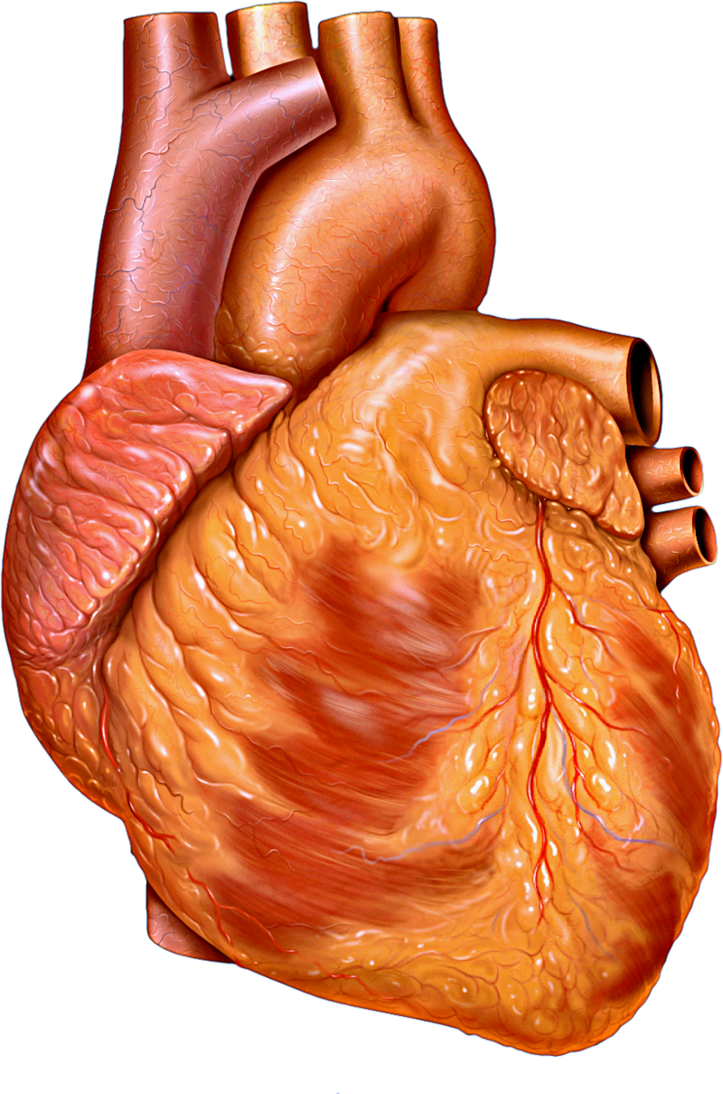

Slide 6
Question 1a
24 year old lady rushed into operating theatre as she has gone into preterm labour. The paediatrics on call team has rushed to site to receive the neonate. On assessment, the baby is blue, not crying and floppy. Where is the best location to check for the pulse of this neonate?
Radial
Carotid
Tibial
Popliteal
Brachial

Slide 7
Question
24 year old lady rushed into operating theatre as she has gone into preterm labour. The paediatrics on call team has rushed to site to receive the neonate. On assessment, the baby is blue, not crying and floppy. Where is the best location to check for the pulse of this neonate?
Radial
Carotid
Tibial
Popliteal
Brachial
Femoral and Brachial are the best to use when assessing in neonate

Slide 8
Question 1b
24 year old lady rushed into operating theatre as she has gone into preterm labour. The paediatrics on call team has rushed to site to receive the neonate. On assessment, the baby is blue, not crying and floppy. There is some flexing of all four limbs. Given the HR of 140bpm, calculate the APGAR score of this neonate.

Slide 9
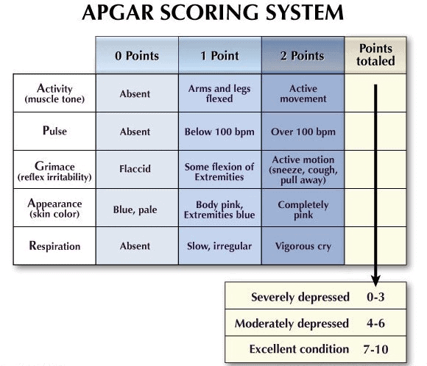
Notes:
https://www.bila.ca/2017/08/whats-an-apgar-score-and-why-is-it-important-to-my-baby/

Slide 10
Question 1b
24 year old lady rushed into operating theatre as she has gone into preterm labour. The paediatrics on call team has rushed to site to receive the neonate. On assessment, the baby is blue, not crying and floppy. There is some flexing of all four limbs. Given the HR of 140bpm, calculate the APGAR score of this neonate.
APGAR Score of 3

Slide 11
Question 2
15 year old presents to the GP complaining of amenorrhoea and headaches. She has a webbed neck and a short stature for her age. On examination, a systolic murmur is heard. Which of the following is the most likely cause?
VSD
ASD
Bicuspid Aortic Valve
Still’s Murmur
Pulmonary Stenosis

Slide 12
Question 2
15 year old presents to the GP complaining of amenorrhoea and headaches. She has a webbed neck and a short stature for her age. On examination, a systolic murmur is heard radiating to the carotids. Which of the following is the most likely cause?
VSD – pansystolic L sternal edge
ASD – fixed split S2, radiates to back
Bicuspid Aortic Valve
Still’s Murmur – innocent, comes with illness, does not radiate

Slide 13
Turner Syndrome
45X
Phenotype: Female
Webbed neck
Widely spaced nipples
Short
Primary amenorrhoea
Confirmed using karyotyping
→ Differentiate from Noonan!

Slide 14
Innocent Murmurs
ALWAYS systolic
Does not radiate
No symptoms!!
Varies w posture
Notes:
SOB
Difficulty breathing
Fatigue
Palpitation

Slide 15
Question 3
You are bleeped to NICU to assess a neonate born 3h ago. Child is visibly blue with O2 sats of 84%. There is evidence of respiratory distress. Given the presentation above, what is the most likely diagnosis?
Tetralogy of Fallot
Transposition of Great Arteries
Eisenmenger Syndrome
Bronchiolitis

Slide 16
Question 3
You are bleeped to NICU to assess a neonate born 3h ago. Child is visibly blue with O2 sats of 84%. There is evidence of respiratory distress. Given the presentation above, what is the most likely diagnosis?
Tetralogy of Fallot – heart able to compensate
Transposition of Great Arteries
Eisenmenger Syndrome – requires a long time to kick in
Bronchiolitis – coryzal

Slide 17
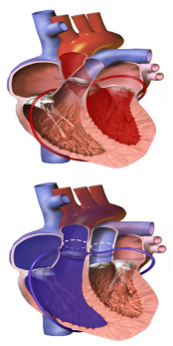
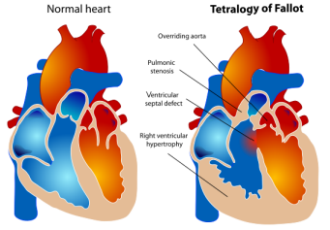
Illutsrations
Notes:
ToF - VSD / RVH / RV outflow obstruction / overriding aorta
→ symptomatic HF
TGA – aorta out from RV / PA comes out from LV
Immediate Cyanosis

Slide 18
Q4
You are bleeped to NICU to assess a neonate born 3h ago. Child is visibly blue with O2 sats of 84%. There is evidence of respiratory distress. What is the next best step in management of this patient
IV propranolol
IV Prostaglandins
IV Indomethacin
IV Paracetamol

Slide 19
Q4
You are bleeped to NICU to assess a neonate born 3h ago. Child is visibly blue with O2 sats of 84%. There is evidence of respiratory distress. What is the next best step in management of this patient
IV propranolol
IV Prostaglandins
IV Indomethacin
IV Paracetamol

Slide 20
Associations
Down Syndrome
Turner Syndrome
DiGeorge Syndrome
ASD
AVSD most common
Bicuspid Aortic Valve
Conotruncal – interrupted Aortic Arch / Truncus Arteriosus
Fixed Splitting of S2, Mid Diastolic Murmur

Slide 21
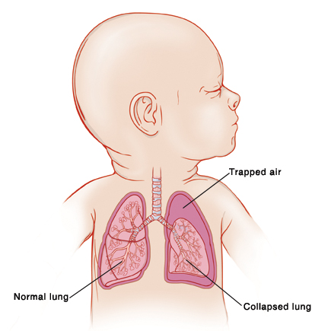

Slide 22
Q5
6 month old boy presents to ED with a 2 day history of difficulty breathing. Parent complains the child has not been feeding well, and has no wet nappies in the past 24h. On examination, the child is breathing heavy. You notice nasal flaring, tracheal tug, and use of accessory muscles to breathe.
Obs: HR 170, RR 40, O2 Sats 84%, Temp 38 degrees
What is the most appropriate next step?
Nebulised Salbutamol
IV Abx
CXR
Supplemental O2
IV Steroids

Slide 23
Q5
6 month old boy presents to ED with a 2 day history of difficulty breathing. Parent complains the child has not been feeding well, and has no wet nappies in the past 24h. On examination, the child is breathing heavy. You notice nasal flaring, tracheal tug, and use of accessory muscles to breathe.
Obs: HR 170, RR 40, O2 Sats 84%, Temp 38 degrees
What is the most appropriate next step?
Nebulised Salbutamol – Asthma Attacks
IV Abx – indicated, but not the first to do
CXR – indicated but not urgent
Supplemental O2
IV Steroids – Croup!
Notes:
A-E assessment

Slide 24
Signs of Respiratory Distress
https://www.physio-pedia.com/Signs_of_Respiratory_Distress_in_Children
Nasal flaring
Tracheal tug
Intercostal recessions
Grunting

Slide 25
Q6
8 month old brought into PAU due to concerns of turning blue. The child is tachypnoeic, tachycardic and showing signs of respiratory distress. Mom complains of rhinorrhoea and mentions her other child recently recovered from a viral flu. Given that the child is immunocompromised, which of the following could be given to prevent recurrent infections?
Pavalizumab
Acyclovir
Dexamethasone
Natalizumab
Infliximab

Slide 26
Q6
8 month old brought into PAU due to concerns of turning blue. The child is tachypnoeic, tachycardic and showing signs of respiratory distress. Mom complains of rhinorrhoea and mentions her other child recently recovered from a viral flu. Given that the child is immunocompromised, which of the following could be given to prevent recurrent infections?
Pavalizumab
Acyclovir – Viral meningitis
Dexamethasone – reduce swelling. Not indicated for Bronchiolitis
Natalizumab – MS patients
Infliximab - IBD

Slide 27
Bronchiolitis
Common cause of LRTI
Common pathogen – Respiratory Syncytial Virus
Prevalent in winter
Investigations:
Clinically diagnosed
Nasopharyngeal Aspirate Test for RSV
CXR – exclude pneumonia / pneumothorax
Supportive! A-E Assessment
No evidence for Abx / Bronchodilators / ICS
Prevention:
Vaccination – Pavalizumab

Slide 28
Q7
16 month old Sarah brought to ED for worsening SOB. She displays signs of respiratory distress and has a barking cough. She has been given one dose of Dexamethasone and Oxygen which has little effect. What is the next step in her management?
High dose steroid
Intubate & Ventilate
Nebulised Salbutamol
Nebulised Adrenaline
Supportive

Slide 29
Q7
16 month old Sarah brought to ED for worsening SOB. She displays signs of respiratory distress and has a barking cough. She has been given one dose of Dexamethasone and Oxygen which has little effect. What is the next step in her management?
High dose steroid
Intubate & Ventilate – Epiglottitis. How would it present?
Nebulised Salbutamol – asthma
Nebulised Adrenaline
Supportive - Bronchiolitis
Notes:
Tripod
Drooling
Poor vaccination hx
CALL ANAESTHESISTS – require intubation

Slide 30
Croup
Also known as acute Laryngotracheobronchitis
Most common pathogen – parainfluenza virus
Classic Fx
Seal Like / Barking Cough
Respiratory Distress
Mx: A-E Assessment!
PO Dexamethasone
O2
Nebulised adrenaline
How do you differentiate Croup from Bronchiolitis?
Notes:
Viral infection causing oedema & inflammation → Narrowing of airway. Inspiratory stridor

Slide 31
Q8
3yo boy brought into A&E following an acute exacerbation of asthma. He is confused, and exhausted. On examination, there is poor chest expansion and on auscultation his chest is silent. Obs: HR 150bpm, BP 86/52. How would classify this asthma attack?
Mild
Moderate
Severe
Life-Threatening
Near Fatal

Slide 32
Q8
3yo boy brought into A&E following an acute exacerbation of asthma. He is confused, and exhausted. On examination, there is poor chest expansion and on auscultation his chest is silent. Obs: HR 150bpm, BP 86/52. How would classify this asthma attack?
Mild
Moderate
Severe
Life-Threatening
Near Fatal
CHEST
Confused
Hypotension
Exhaustion – reduced WOB
Silent chest
Tachycardia

Slide 33
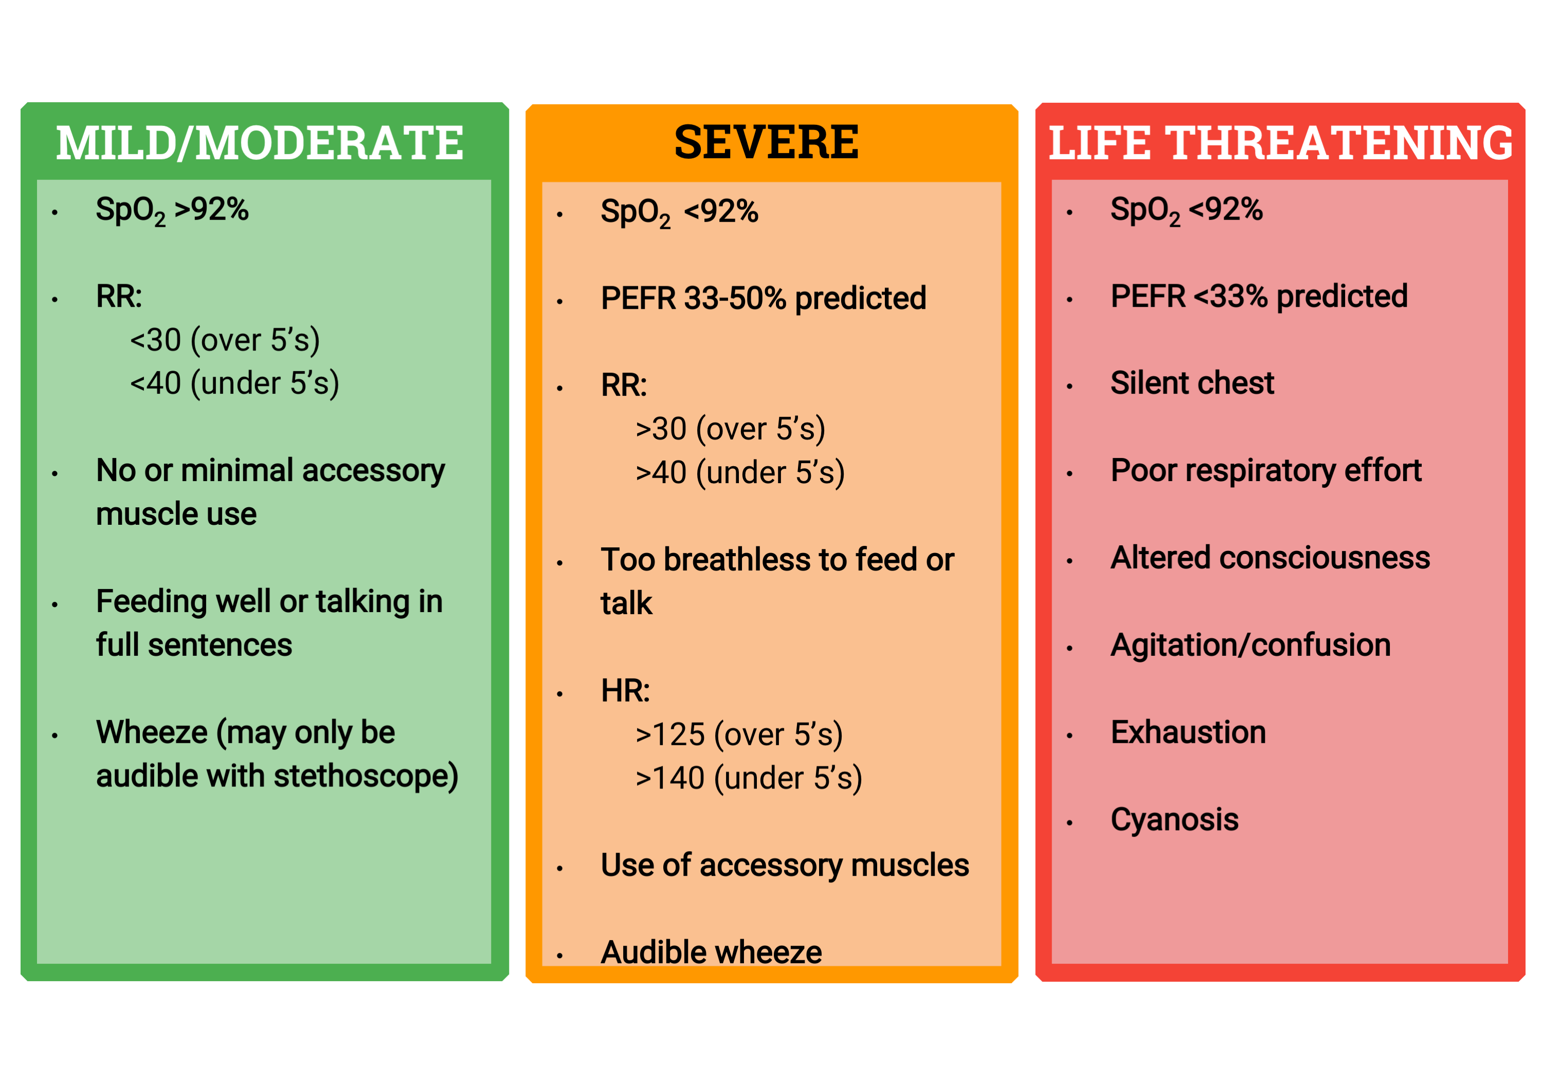
Notes:
Teachmepaediatrics
BTS Guidelines

Slide 34
Management of Asthma
Acute
OSHIT ME
Oxygen
Salbutamol
Hydrocortisone
Ipratropium Bromide
Theophylline
Mg SO4
Escalate!!
Maintenance
1st Step – SABA
< 5yo > 5 yo
ICS ICS
LTRA LABA / LTRA
Refer
Increase dose of ICS + LABA OR add LABA + LTRA

Slide 35
Q9
10 year old boy brought into clinic with concerns of poor growth. His parents complain that he has too many chest infections over the past year. He has always been the shortest in class. He mentions his bowel movement has always been difficult and the stools are foul and difficult to flush. Based on the likely diagnosis, which feature is most likely present in this patient?
Dermatitis Herpetiformis
Dextrocardia
Brushfield Spots
Ventricular Septal Defect
Absent Vas Deferens

Slide 36
Q9
10 year old boy brought into clinic with concerns of poor growth. His parents complain that he has too many chest infections over the past year. He has always been the shortest in class. He mentions his bowel movement has always been difficult and the stools are foul and difficult to flush. Based on the likely diagnosis, which feature is most likely present in this patient?
Dermatitis Herpetiformis – eczema
Dextrocardia Kartagener syndrome / PCD Syndrome
Brushfield Spots Down’s
Ventricular Septal Defect Down’s + Many Genetic conditions
Absent Vas Deferens

Slide 37
Cystic Fibrosis
CFTR Gene, Chromosome 7
Autosomal Recessive
Impaired sodium / chloride transport
MDT approach
Chest physio
Anti-mucolytics
Prophylactic Abx for chest infections
Pancreatic Enzyme
Diet – high caloric, high fat
Recurrent chest infections
Nasal polyps
Bronchiectasis – productive cough
Meconium Ileus
Malabsorption
Rectal Prolapse
Sub/Infertility
Notes:
Hypertonic saline / acetylcysteine

Slide 38
Cystic Fibrosis
Confirmed with sweat test!
Newborn Screening – Immunoreactive Trypsin Test
Genetic Test – CFTR gene
Notes:
High trypsin → Disorder og pancreas. Repeat test in few weeks. In adults, could indicate disorder of pancreas!

Slide 39
Feedback
https://forms.gle/vvQ6QLE2yZo5MUUe8
The Peer Teaching Society is not liable for false or misleading information…

Slide 40
INFECTIOUS DISEASES

Slide 41
Q10
Baby Alex is found irritable and difficult to feed. He was born 6h ago and was delivered vaginally after a prolong rupture of membrane. Obs T 38.5, HR 170bpm, RR 45. What is the most likely management of this patient?
Azithromycin
Benzylpenicillin + Gentamicin
Phenoxymethypenicillin
Cefotaxime + Amoxicillin
Cefotaxime + Dexamethasone

Slide 42
Q10
Baby Alex is found irritable and difficult to feed. He was born 6h ago and was delivered vaginally after a prolong rupture of membrane. Obs T 38.5, HR 170bpm, RR 45. What is the most likely management of this patient?
Azithromycin STI Tx chlamydia
Benzylpenicillin + Gentamicin
Phenoxymethypenicillin Scarlet Fever
Ceftriaxone + Amoxicillin Meningitis < 3 mths
Ceftriaxone + Dexamethasone Meningitis > 3 mths
Notes:
https://www.nice.org.uk/guidance/ng195/chapter/Recommendations#antibiotics-for-suspected-early-onset-infection
Ceftriaxone – use in caution in premature / jaundiced → Worsens hyperbilirubinaemia
Alternative is cefotaxime

Slide 43
Neonatal Sepsis
RFx:
Prolong ROM
Prematurity
Maternal Chorioamnionitis
Common Pathogens:
1 GBS
2 E. Coli
S. Epidermis
P Aeruginosa
Management
SEPSIS Protocol

Slide 44
Q11
7 year old Zac presents to his GP with 5 day history of high fevers. It currently reads at 38.7 degrees. On examination, you notice a widespread erythematous maculopapular rash on his hands and feet. There is some cracking of his lips and a red strawberry tongue. Which of the following investigations is indicated in his management?
CXR
Coronary Angiogram
Echocardiogram
USS
ECG

Slide 45
Q11
7 year old Zac presents to his GP with 5 day history of high fevers. It currently reads at 38.7 degrees. On examination, you notice a widespread erythematous maculopapular rash on his hands and feet. There is some cracking of his lips and a red strawberry tongue. Which of the following investigations is indicated in his management?
CXR
Coronary Angiogram Too invasive – child may be allergic to contrast / unable to tolerate
Echocardiogram
USS
ECG
Notes:
Desquamation of extremities
Prolonged fever
Treatment – high dose aspirin → Reye Syndrome
Aspirin – dmg mitochondria by increasing apopstosis via ROS → liver overwhelmed

Slide 46
Q12
4 year old Jack comes into clinic with his mom with a new rash. A purpuric rash is seen all over his legs. On examination, he is tender on palpation of his tummy. Mother complains he is usually running about and full of energy but has become more reserved since the onset of the rash. Mom recalls he recently recovered from an URTI 2 weeks ago. What is the most appropriate management for Jack?
Admit to PAU
Reassure and send home
Corticosteroids
Plasma Exchange

Slide 47
Q12
4 year old Jack comes into clinic with his mom with a new rash. A purpuric rash is seen all over his legs. On examination, he is tender on palpation of his tummy. Mother complains he is usually running about and full of energy but has become more reserved since the onset of the rash. Mom recalls he recently recovered from an URTI 2 weeks ago. What is the most appropriate management for Jack?
Admit to PAU Think abt Traffic Light
Reassure and send home HSP is self limiting
Corticosteroids poor / little evidence for this
Plasma Exchange poor / little evidence

Slide 48
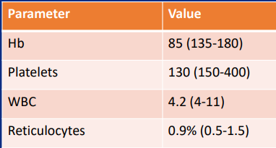
Q13
8 year old Michael is brought into PAU complaining of fatigue and reduced food intake. A blood test is carried out revealing the following:
What is the likely diagnosis?
Measles
Mumps
Rubella
Parvovirus B19
Roseola Infantum
Notes:
Other causes: SLE / RA / Chemotherapy

Slide 49
Q13
8 year old Michael is brought into PAU complaining of fatigue and reduced food intake. A blood test is carried out revealing the following:
What is the likely diagnosis?
Measles
Mumps
Rubella
Parvovirus B19
Roseola Infantum
Notes:
Aplastic Anaemia picture: Other causes: SLE / RA / Chemotherapy

Slide 50
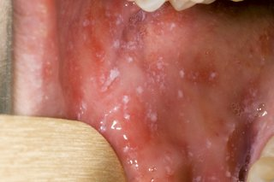
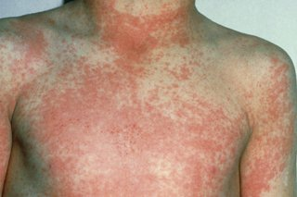
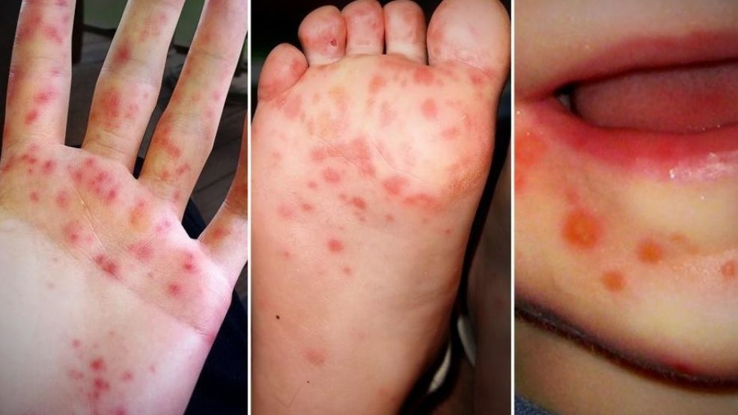
Spot Diagosis
Rash that comes on after high fevers
Congenital sensorineural deafness

Slide 51
Q15
8 year old Jim presents to ED with visible haematuria. His mom mentions he recovered from a skin infection a couple of weeks ago. ED Specialist identifies his condition as a transient, self-limiting sequlae of his infection. What is the most likely condition that could have caused this sequelae?
HFMD
Seborrhoeic Dermatitis
Scabies
Eczema Herpaticum
Impetigo

Slide 52
Q15
8 year old Jim presents to ED with visible haematuria. His mom mentions he recovered from a skin infection a couple of weeks ago. ED Specialist identifies his condition as a transient, self-limiting sequlae of his infection. What is the most likely condition that could have caused this sequelae?
HFMD
Seborrhoeic Dermatitis blocked sweat glands
Scabies –tracks visible on hands
Eczema Herpaticum a/w coeliac
Impetigo GAS related. Which other conditions!

Slide 53
Conclusion
The Peer Teaching Society is not liable for false or misleading information…

Slide 54
Feedback
https://forms.gle/vvQ6QLE2yZo5MUUe8
The Peer Teaching Society is not liable for false or misleading information…

