Slide 1
Neurology
Phase 3a
Ameena Majed & Ayesha Javed
The Peer Teaching Society is not liable for false or misleading information.

Slide 2
Aims
To cover
Headache
Epilepsy
CVA
Bleeds
PD
Alzheimer’s disease
Huntington’s disease
Myasthenia Gravis
LEMS
MS
Cord compression
Dermatomes
The Peer Teaching Society is not liable for false or misleading information.

Slide 3
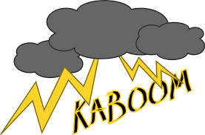
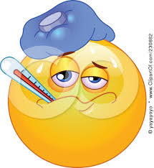
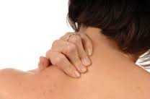
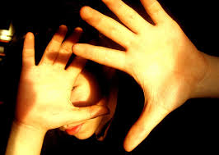
Headache red flags
The Peer Teaching Society is not liable for false or misleading information.

Slide 4
Headache red flags
Subarachnoid haemorrhage
Meningitis
The Peer Teaching Society is not liable for false or misleading information.

Slide 5
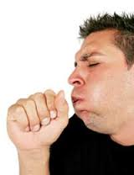
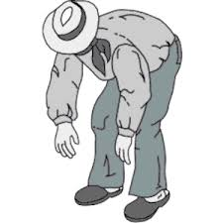
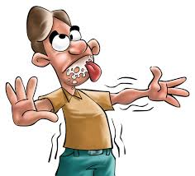
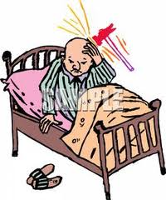
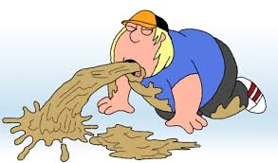
Headache red flags
The Peer Teaching Society is not liable for false or misleading information.

Slide 6
Headache red flags
Raised ICP
The Peer Teaching Society is not liable for false or misleading information.

Slide 7
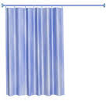
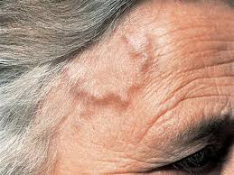
Headache red flags
The Peer Teaching Society is not liable for false or misleading information.

Slide 8
Headache red flags
Giant Cell Arteritis
Neuro Signs
The Peer Teaching Society is not liable for false or misleading information.

Slide 9
Migraine
TRIGGERS?
The Peer Teaching Society is not liable for false or misleading information.

Slide 10
Migraine
CHOCOLATE TRIGGERS
Cheese
Oral contraceptive pill (combined)
Caffeine
AlcohOL
Anxiety
Travel
Exercise
Diagnosis:
- Aura
- if no aura:
>5 headaches lasting 2-72h with either N&V or photophobia and 2 of:
Unilateral
Pulsating
Interferes with normal life
Worsened by routine activity
The Peer Teaching Society is not liable for false or misleading information.

Slide 11
Migraine
Classification:
Migraine with aura:
Visual most common (flashing lights, zigzags);
Somatosensory (paraesthesia spreading from fingers to face);
Motor (dysarthria, ataxia, opthalmoplegia, hemiparesis – may resemble stroke)
Speech (dysphasia): - 15-30min then within 1h get unilateral, throbbing headache
Isolated aura with no headache
Migraine without aura: unilateral, pulsating headache (4h-days), often premenstrual, N&V, photophobia
The Peer Teaching Society is not liable for false or misleading information.

Slide 12
Migraine management
Most common way an attack resolves is through sleep!
Acute:
NSAIDs (ketoprofen)
Triptans (sumitriptan) = 5HT agonists,
Anti-emetic – metoclopramide
Prophylaxis: if >2 ep a month
Propanolol
Amitryptiline
The Peer Teaching Society is not liable for false or misleading information.

Slide 13
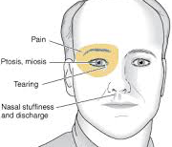
Cluster headache
M > F, peak age onset: 20-50yrs, commoner in smokers
Symptoms:
Unilateral, rapid onset severe pain around one eye,
Lacrimation + redness of eye, rhinorrhoea
Partial Horner’s, FACIAL FLUSHING,
Lasts 1-2hrs, often nocturnal.
Clusters last 4-12 wks then followed by pain-free periods
Treatment
Acute attack: 100% O2, SC/nasal triptans (Sumitriptan)
Preventatives: Verapamil, topiramate
The Peer Teaching Society is not liable for false or misleading information.

Slide 14
Giant Cell Arteritis (GCA)
Symptoms:
Headache
Scalp tenderness – worse on combing hair
Jaw claudication – pain on eating
Tender Thickened Pulseless Temporal artery
Amaurosis fugax → Blindness = EMERGENCY
Common in >50s
Associated: Polymyalgia Rheumatica^{50%}
Investigations
Temporal artery biopsy – SKIP LESIONS
↑ RAIED ESR/CRP
Treatment
Prednisolone 40-60mg 2 year course
Start before biopsy results
The Peer Teaching Society is not liable for false or misleading information.

Slide 15
Raised ICP
Vomiting, papilloedema, SEIZURES;
Headache worse on waking, lying down/bending forward/with coughing.
Pupil changes: constriction at first then dilatation
Exclude SOL by CT; LP CI until after imaging (can get coning)
Acute Treatment:
ABCDE, correct hypotension, maintain MAP >90,
Elevate head of bed to 30-40°
IV Mannitol, ± dexamethasone for reducing cerebral oedema
Definitive Rx: craniotomy, burr holes, ICP monitor bolt
The Peer Teaching Society is not liable for false or misleading information.

Slide 16
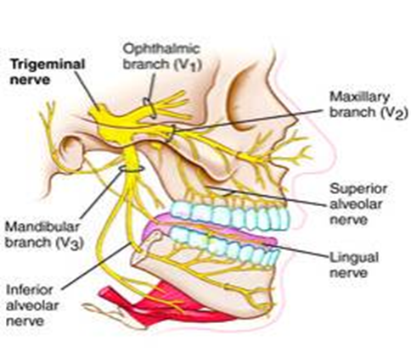
Trigeminal Neuralgia
Unknown cause, seen in old age (>50)
2⁰ causes: compression of trigeminal root, intracranial vessels/tumour, chronic meningeal inflam, MS
Test: MRI to exclude 2⁰ causes
The Peer Teaching Society is not liable for false or misleading information.

Slide 17
Trigeminal Neuralgia con…
Features:
Unilateral, severe spasms of knife-like stabbing pain in one/more sensory divisions of 5th CN (rarely ophthalmic division), lasting seconds.
Triggers: washing, shaving, talking, eating.
Treatment:
Anticonvulsant Carbamazepine 100mg/12h
Thermocoagulation of trigeminal ganglion or section of sensory division
Microvascular decompression
Differentials: similar pain in structural lesions of 5th CN, but will have physical signs like depressed corneal reflex
The Peer Teaching Society is not liable for false or misleading information.

Slide 18
Seizure = abnormal + excessive excitability of neurones of cerebral hemisphere.
Epilepsy: tendency to recurrent (≥ 2), unprovoked seizures
Epilepsy
Causes:
2/3rd idiopathic (often familial)
Structural - cortical scarring (head injury yrs before onset), SOL, stroke, hippocampal sclerosis, vascular malformation
Others: Tuberous sclerosis, sarcoid, SLE,
Non-epileptic causes:
Trauma, stroke, bleed, raised ICP, alcohol/benzo withdrawal
Metabolic: hypoxia, hypocalcaemia, hypo/hyper Na & glucose, uraemia
Liver disease, meningitis, encephalitis, HIV, pyrexia
The Peer Teaching Society is not liable for false or misleading information.

Slide 19
Epilepsy Classification
Partial: focal, Sx referable to 1 part of brain
Simple – unimpaired consciousness
Complex – impaired consciousness
AURA – mostly temporal lobe
Generalised: bilateral motor manifestation + impaired consciousness
Tonic clonic
Absence - childhood
Myoclonic
Atonic
Infantile spasms
Post-ictal: confusion, headache, sore tongue (from biting), temporary weakness
The Peer Teaching Society is not liable for false or misleading information.

Slide 20
Epilepsy con…
Management:
During seizure → ABC
Prolonged seizure: diazepam
Anti-epileptics:
Generalised: sodium valproate / lamotrigine
Partial: carbamazepine
Absence: valproate / lamotrigine
Tests:
EEG, CT/MRI (SOL), ECG
Bloods: FBC, glucose, U&E, Ca, drug screen
What advice would you give to your patient?
The Peer Teaching Society is not liable for false or misleading information.

Slide 21
Epilepsy con…
Management:
During seizure → ABC
Prolonged seizure: diazepam
Anti-epileptics:
Generalised: sodium valproate / lamotrigine
Partial: carbamazepine
Absence: valproate / lamotrigine
Tests:
EEG, CT/MRI (SOL), ECG
Bloods: FBC, glucose, U&E, Ca, drug screen
What advice would you give to your patient?
Epilepsy nurse specialist
Avoid dangers like climbing, swimming until diagnosis confirmed
DVLA – pt informs. Must be seizure free for >1yr to drive
The Peer Teaching Society is not liable for false or misleading information.

Slide 22
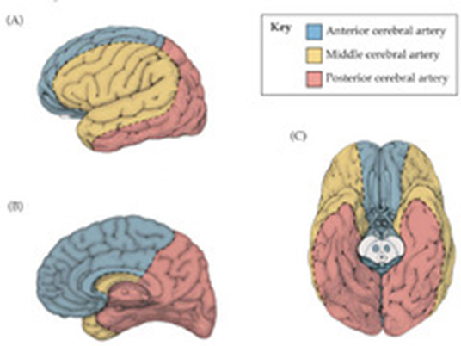
RF: hypertension, smoking, hyperlipidaemia, AF, IHD, previous TIA/Stroke, COCP, alcoholism, clotting abnormality
CVA
Ischaemic ^{85%}
Atherothromboembolism
Cardiac mural thrombi (left atrium in AF)
Haemorrhage ^{15%}
Intracranial haemorrhage
SAH (berry aneurysm rupture)
Young adults – carotid/vertebral artery dissection
ACA infarct: weakness + sensory loss - contralateral leg/foot
MCA infarct: weakness + sensory loss contralateral arm/face
+ contralateral homonymous hemianopia
PCA infarct: contralateral loss of pain + temp
+ contralateral homonymous hemianopia
The Peer Teaching Society is not liable for false or misleading information.

Slide 23
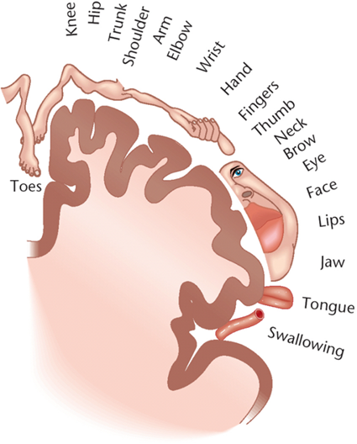
Remember: HOMUNCULUS
The Peer Teaching Society is not liable for false or misleading information.

Slide 24
Bamford/Oxford Classification
TACS: MCA +ACA.
Contralateral hemiplegia + homonymous hemianopia
Higher cortical function dysfunction
PACS: MCA or ACA.
Deficits from same hemisphere
Any 2 of Sx of TAC, but not all 3 together
POCS: Cerebellum, occipital lobes
homonymous hemianopia
DANISH cerebellar signs
LACS: Pure motor/sensory Sx
Occlusion of deep perforator arteries
The Peer Teaching Society is not liable for false or misleading information.

Slide 25
CVA management
ABCDEFG
O2, monitor blood glucose
Urgent CT/MRI for:
thrombolysis, head injury, ++ headache, on anticoag Rx, low GCS
If non haemorrhagic:
Thrombolysis: IV Altepase <4hrs
Aspirin 300mg/2wks + dipyridamole/clopidogrel (dual antiplatelet therapy)
DO NOT lower BP until 2 wks/pt stable
Carotid endarterectomy if >70% stenosis
Primary prevention: control RF: smoking, DM, HTN
2⁰ prevention: aspirin + clopidogrel, ACE-I, statin
**EQ: NBM until swallowing assessment!
The Peer Teaching Society is not liable for false or misleading information.

Slide 26
TIA
Sudden onset of focal neurological deficit due to temporary occlusion of part of cerebral circulation
Resolves < 24hrs
Usually caused by emboli
Sx same as stroke + amaurosis fugax
ABCD2
score ≥6 predicts stroke <2d
score>4 specialist assess within 24hrs
Age ≥ 60 (1)
BP ≥ 140/90 (1)
Clinical features
Unilateral weakness (2),
Speech disturbance w/o weakness (1)
Duration of Sx: ≥1h (2), 10-59mins (1)
Diabetes (1)
Treatment:
ABC
Dual antiplatelet therapy: aspirin 300mg/d + dipyridamole
Reverse RF
Change to warfarin for long term if cardiac emboli / AF
Carotid endarterectomy if >70% stenosis
Do not drive for 1 month!
The Peer Teaching Society is not liable for false or misleading information.

Slide 27
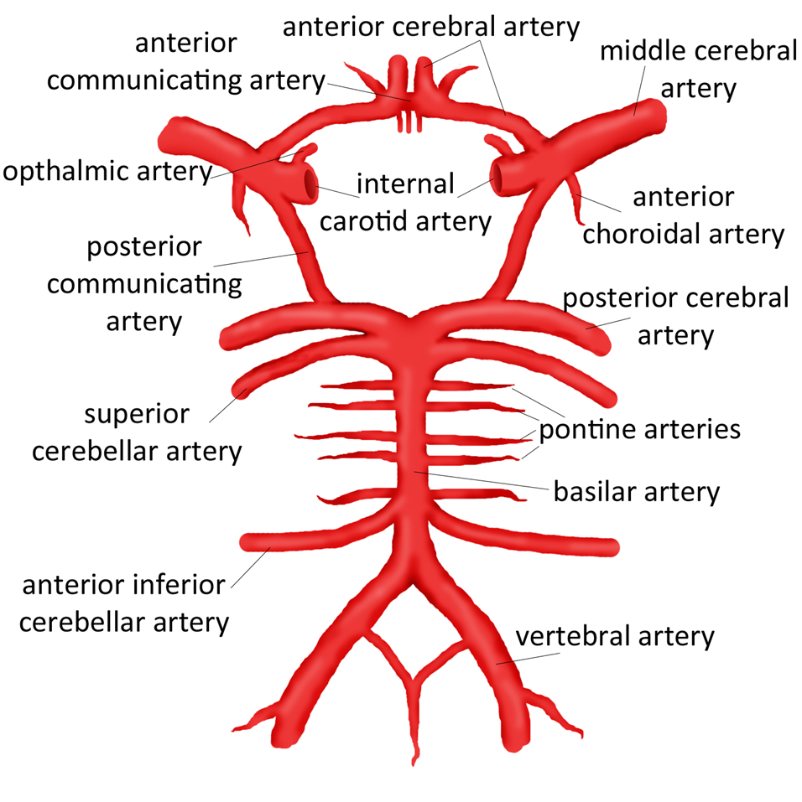
SAH
Common sites for berry aneurysms → rupture → SAH
Symptoms:
Sudden bilateral thunderclap headache at at occiput.
Feel like been kicked in back of head.
Meningism – neck stiffness, N&V, photophobia, kernig sign +ve.
3rd nerve palsy
Tests:
CT
If no raised ICP → LP after 12hrs –
Xanthochromia confirms diagnosis (12hrs-2wks)
Rx: surgically clip aneurysm
Control RF: HTN, smoking, alcohol, bleeding disorder
The Peer Teaching Society is not liable for false or misleading information.

Slide 28
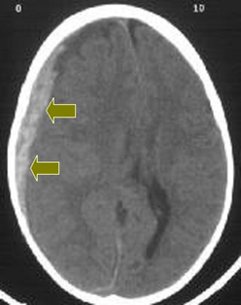
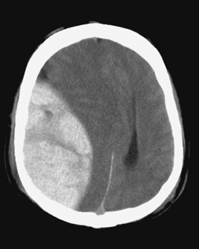
SDH and EDH
Subdural Haematoma
Minor injury causes slow bleeding to form haematoma and chronic subdural
Sx develop wks later. 50% unable to recall injury as so minor.
Atrophy of brain in elderly means more space for haematoma to expand
Treatment:
May not need if not causing mass effect.
Burr holes, craniotomy
Extradural Haematoma
Skull fracture – tearing middle meningeal artery
Traumatic head injury
Symptoms produced within mins-hours
Lucid intervals in 1/3 of cases
Symptoms
Headache
Nausea
Confusion
↓ consciousness
Speech problems
The Peer Teaching Society is not liable for false or misleading information.

Slide 29
Parkinson’s disease
Degeneration of dopaminergic neurons in the substantia nigra pars compacta, associated with lewy bodies
Causes dopamine levels
The Peer Teaching Society is not liable for false or misleading information.
Notes:
PD does not develop until striatal dopamine (DA) levels drop to 20% and substantia nigra (SN) cell loss exceeds 50%.

Slide 30
Parkinson’s disease
Epidemiology & Aetiology
1-2% of population, affecting mainly 60 years +
M:F 1.35:1
Increase risk if FH, exposed to MPTP
Reduced risk with cigarette smoking and caffeine
Progressive and incurable
The Peer Teaching Society is not liable for false or misleading information.

Slide 31
Parkinson’s – clinical features
Classical Triad
Tremor – Resting, pill-rolling
Bradykinesia – slowness of initiating voluntary movement (inc. expressionless face, monotone hypophonic speech, micrographia)
Rigidity – cogwheel, increased tone
Gait – festinant, reduced arm swing
Postural instability
Unilateral onset, persistent asymmetry
Progressive
Anosmia
Dementia
Visual hallucinations
Sleep disorder
Depression
The Peer Teaching Society is not liable for false or misleading information.
Notes:
Tremor – often the first sign

Slide 32
Parkinson’s - management
MDT – physio, OT, social worker, PD nurses
Treatment delayed till symptoms warrant
GOLD STANDARD
Levodopa (SE: N/V, anorexia)
Dopa-decarboxylase inhib (Madopar)
Efficacy reduces over time, increased dose needed
Dopamine Agonists – Ropinirole
Anticholinergics – helps tremor (SE)
The Peer Teaching Society is not liable for false or misleading information.
Notes:
Antichol – SE ie dry mouth, dizziness, confusion, urinary retention etc

Slide 33
Alzheimer’s Disease
- The leading cause of dementia
- F>M, most common in >65years
Accumulation of Beta-amyloid peptide results in progressive neuronal damage, neurofibrillary tangles (tau and ubiquitin), increase of amyloid plaques and loss of Ach
The Peer Teaching Society is not liable for false or misleading information.
Notes:
Onset is insidious and there is steady progression over the years, eventually leading to global cognitive deficit

Slide 34
Alzheimer’s disease
RF - First degree relative, downs syndrome, homozygosity for ApoE…
DM, AF, HTN-
Symptoms
Enduring, progressive and global cognitive problems
Visual spatial skills – getting lost
Memory, verbal abilities and executive function (planning)
Anosognosia – lack of insight
Irritability/mood disturbances
Behavioural change
The Peer Teaching Society is not liable for false or misleading information.

Slide 35
Alzheimer’s management
No specific investigation. Do MMSE, score? AMT
General dementia management (social services)
Refer to specialist memory services
Acetylcholinesterase inhibitors (Rivastigmine, Donepezil) – slow deterioration
Control BP
The Peer Teaching Society is not liable for false or misleading information.
Notes:
25+ is normal, 18-24 mild to mod impairment and below 17 is serious impairment

Slide 36
Huntington’s disease
RARE Autosomal dominant disorder, full penetrance
Characterised by progressive chorea and dementia
Caused by expansion of CAG repeats
Onset 35-40years
Death within 15 years
The Peer Teaching Society is not liable for false or misleading information.

Slide 37
Huntington’s disease
Signs are insidious then progressive
Chorea -> irritability -> dementia -> +/- fits ->
DEATH
Pathology
Cerebral atrophy with loss of corpus striatum GABA-nergic and cholinergic neurons
No treatment
Offer counselling to patient and family
The Peer Teaching Society is not liable for false or misleading information.
Notes:
Chorea is a continuous flow of jerky movements, fitting from one part of the body to the other – (with other causes like hyperthyroid, sle etc)

Slide 38
Myasthenia Gravis
Autoimmune disorder
Antibodies against acetylcholine receptors at NMJ (post-synaptic), interfering with transmission
Rare
1/10,000 prevalence
Peaks at 3rd and 6th decade
Associated with other autoimmune disorder (thymic hyperplasia and atrophy)
The Peer Teaching Society is not liable for false or misleading information.

Slide 39
Myasthenia Gravis
Clinical features
Weakness and fatigue of ocular, bulbar and proximal limb muscles (affects in order - extra-ocular, bulbar, face, neck, limb, girdle, trunk)
- ptosis, diplopia
-Facial weakness (myasthenia snarl)
-Bulbar – dysphagia, dysarthria, difficulty
talking, chewing, resp difficulties
The Peer Teaching Society is not liable for false or misleading information.
Notes:
Weakness and fatigue occur with repeated and sustained activity
Ocular muscles affected causes diplopia and ptosis. Often partial or unilateral and apparently gets better with an ice pack

Slide 40
Myasthenia Gravis
Investigations
TENSILON test - +ve if edrophonium improves power within a min
Antibodies: Anti AChR (anti-muSK)
Neurophysiology – reduced muscle response to repetitive nerve stimulation
TFT
Treatment
Anticholinesterase ie pyridostigmine. Provides sympotmatic relief
Corticosteroids ie prednisolone (if unresponsive)
Plasmapheresis and iv IG
Thymectomy
The Peer Teaching Society is not liable for false or misleading information.
Notes:
Tensilon test – patients given short acting anticholinesterase which preserves acetylcholine by blocking its breakdown.
Antibodies present in 90% of patients
Maybe CT

Slide 41
CRISIS!
Myasthenic crisis
LIFE THREATENING CONDITION!
Weakness of the respiratory muscles, causing respiratory failure
Monitor forced vital capacity, if low, need ventilator support
Treat with plasmapharesis or IV Ig
Cholinergic crisis
Over-treatment with anticholinesterase
Hypersalivation
Lacrimation
Increased sweating
Vomiting
Pupillary constriction
Muscle weakness and fasciculation
The Peer Teaching Society is not liable for false or misleading information.

Slide 42
Lambert-Eaton (LEMS)
Autoimmune - Failure of Ach release at the NMJ (pre-synaptic)
Neoplastic - associated with SCC of bronchus
Symptoms
Proximal muscle weakness (lower limb), aches and tenderness, reduced strength – before eye symp
Bulbar and resp muscles spared. Mild ocular symp
Autonomic symptoms (constipation ,dry mouth, impotence)
Reduced/absent reflexes
Less response to tensilon test
TREAT – IV Ig or 3,4-diaminopyridine
Regular CXR
The Peer Teaching Society is not liable for false or misleading information.

Slide 43
Multiple Sclerosis
Chronic autoimmune disorder of CNS (T cell response)
Multiple plaques of demyelination
Disseminated in time and space
Relapsing and remitting
Prolonged demyelination = axonal loss and clinically progressive symptoms
-Mean age onset – 30 yrs
-F:M 3:1
Cause? Environmental agent in a genetically susceptible host
The Peer Teaching Society is not liable for false or misleading information.
Notes:
Demylination heals incompletely causing the relapse and remit symps
Inflammation, demyelination and axonal loss are the major feature
Precise mechanism isnt known, it is thought exposure to certain viruses ie EBV
Epidemiology wise – commoner in temperate areas and not tropics with ethnic difference less common in blacks

Slide 44
Multiple Sclerosis
Clinical features
Progression
Usually monosymptomatic
Optic neuritis (rapid decline in central vision)
Numbness/tingling in limbs
Leg weakness
Brainstem/cerebella symp eg diplopia, ataxia
Worse with heat and exercise
(see table in ox handbook!)
Early on, relapses may be followed by remission and full recovery
With time, remission incomplete
The Peer Teaching Society is not liable for false or misleading information.

Slide 45
Multiple Sclerosis
Diagnosis
Clinical
History and examination
MRI sensitive, not specific
CSF – oligoclonal bands of IgG om electropherisis
Nerve conduction studies – evoked potentials
SEE MCDONALD CRITERIA!
The Peer Teaching Society is not liable for false or misleading information.

Slide 46
Multiple Sclerosis
Treatment
Methylprednisolone – short course 3d for relapse (2x yr)
Beta-Interferon – reduces relapses and lesion accumulation
Natalizumab – 2nd line
Other- Azathioprine
Physio and OT
The Peer Teaching Society is not liable for false or misleading information.

Slide 47
Cauda Equina
RED FLAGs
Incontinence
Urinary retention
Anal sphincter disturbance
Saddle anesthesia
Neurological deficit – leg weakness, numbness, pain, sciatica
Loss of reflexes
Sudden
Compression of nerves below L1
Medical emergency!!
Needs urgent management/
decompression
The Peer Teaching Society is not liable for false or misleading information.

Slide 48
Brown sequard
Cord hemisection
Ipsilateral UMN weakness below lesion (Severed corticospinal tract) causing spastic paraparesis, brisk reflexes, extensor plantars
Ipsilateral loss of proprioception and vibration (severed dorsal columns)
Contrlateral loss of pain and temperature (severed spinothalamic )
The Peer Teaching Society is not liable for false or misleading information.

Slide 49
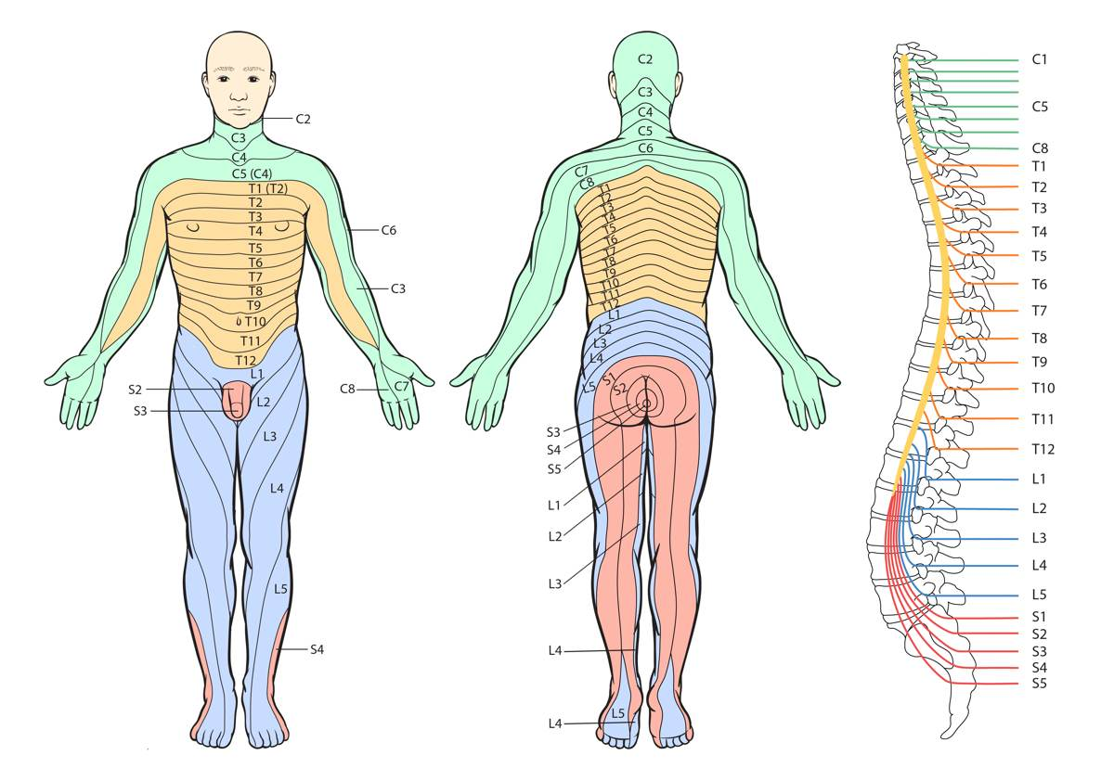

Slide 50
Thanks for listening! ☺
The Peer Teaching Society is not liable for false or misleading information.
Notes:
Check handbook for any conditions we have missed such as brain tumours, nerve palsies, degen disroders, muscular dystrophies, dermatome and myotomes, spinal cord pathology

