Slide 1
The most epic paeds talk ever
Judith and Alex

Slide 2
We will cover
Genetics
Neurology
Development
Disability
And hope to make it as interactive and fun as possible ☺

Slide 3
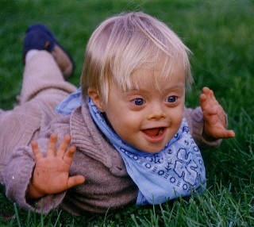
List as many features as you can of this condition

Slide 4
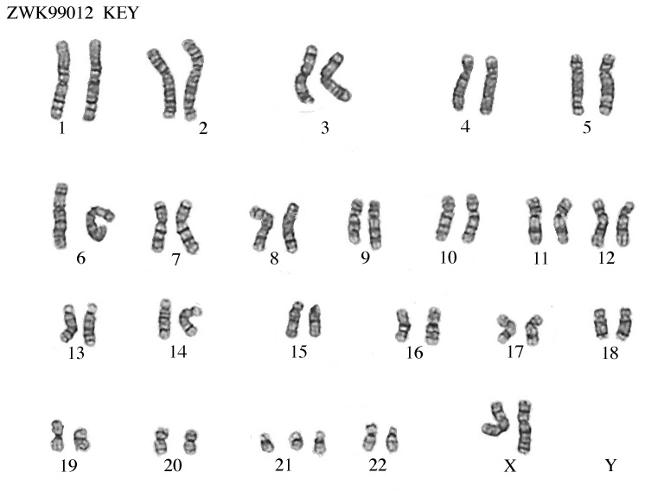
Down Syndrome
Trisomy 21
Risk increased in older women
Majority caused by meiotic non-disjunction, some by translocation and 1% by mosaicism.

Slide 5
Typical craniofacial appearance • Round face and flat nasal bridge • Upslanted palpebral fisures • Epicanthic folds • Brushfield spots in iris • Small mouth and protruding tongue • Small ears • Flat occiput and third fontanelle
Other anomalies • Short neck • Single palmar creases, incurved fifth finger and wide ‘sandal’ gap between toes • Hypotonia • Congenital heart defects (40%) • Duodenal atresia • Hirschsprung disease
Later medical problems • Delayed motor milestones • Moderate to severe learning difficulties • Small stature • Increased susceptibility to infections • Hearing impairment from secretory otitis media • Visual impairment from cataracts, squints, myopia • Increased risk of leukaemia and solid tumours • Risk of atlanto­axial instability • Increased risk of hypothyroidism and coeliac disease • Epilepsy • Alzheimer’s disease

Slide 6
Match the syndrome to their chromosomal abnormality
Edward’s Syndrome
Patau’s Syndrome
Kleinefelter
Turner Syndrome
Trisomy 18
47XXY
45X0
Trisomy 13

Slide 7
Edward’s Syndrome – trisomy 18
Patau’s Syndrome – trisomy 13
Kleinefelter – 47XXY
Turner Syndrome – 45X0

Slide 8
Deletions
Cri du chat syndrome- deletion of short arm of chr. 5 (hence 5p)
Di George -deletion of band q11 on chr.22 (CATCH-22)
Cardiac abnormality, Abnormal facies, Thymic aplasia, Cleft palate, Hypocalcaemia/hypoparathyroidism
Williams is a microdeletion of band q11 on chr.7

Slide 9
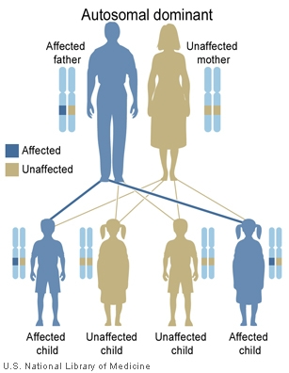
Autosomal Dominant Inheritance
Please give 3 examples of AD inheritance.

Slide 10
Autosomal Dominant Conditions
Achondroplasia
Ehlers–Danlos syndrome
Familial hypercholesterolaemia
Huntington disease
Marfan syndrome
Myotonic dystrophy
Neurofibromatosis
Noonan syndrome
Osteogenesis imperfecta
Otosclerosis
Polyposis coli
Tuberous sclerosis

Slide 11
Give 3 possible reasons as to how a child could have an AD condition with NO family history
New mutation
Parental mosaicism
Non-paternity

Slide 12
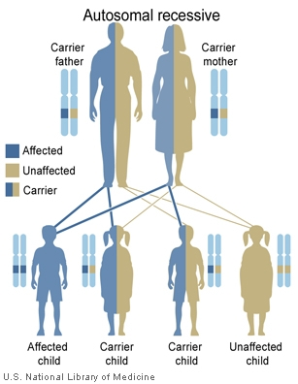
Autosomal Recessive Inheritance
Please name some Autosomal Recessive conditions.

Slide 13
Autosomal Recessive Conditions
Congenital adrenal hyperplasia
Cystic fibrosis
Friedreich ataxia
Galactosaemia
Glycogen storage diseases
Hurler syndrome
Oculocutaneous albinism
Phenylketonuria
Sickle cell disease
Tay–Sachs disease
Thalassaemia
Werdnig–Hoffmann disease (SMA I).

Slide 14
Question
Arya has cystic fibrosis. What is the probability of her healthy brother Rob being a carrier?

Slide 15
Answer
Arya has cystic fibrosis. What is the probability of her healthy brother Rob being a carrier?
Answer: 2/3

Slide 16
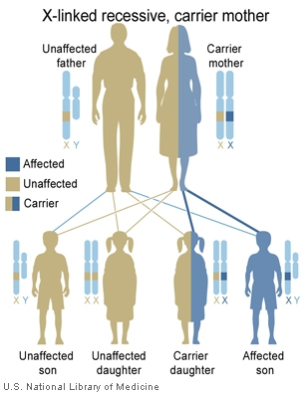
X-linked recessive
Passed from Mother to Son.
Daughters of affected males will be carriers

Slide 17
X-linked recessive
Colour blindness (red–green)
Duchenne and Becker muscular dystrophies (high Creatinine Phosphate Kinase)
Fragile X syndrome
Glucose­6­phosphate dehydrogenase (G6PD) deficiency
Haemophilia A and B
Hunter syndrome (mucopolysaccharidosis II)

Slide 18
Imprinting
Chr. 15 – q11-13
Angelman
Prader-Willi
2 mechanisms
deletion
uniparental disomy

Slide 19
Neurology
Febrile Seizures
Most commonly 6 months to 6 years
Really common
Not likely to develop epilepsy afterwards (1-2% chance)
What advice would you give parents if it happens again?

Slide 20
Febrile seizures
Remove clothing
Plenty of fluids
Antipyretics if uncomfortable
Call 999 if lasts for >5 mins

Slide 21
Which seizure type is it?
Miss Honey notices 7 year old Matilda seems to day-dream in class.
14 year old Harry is clumsy in the morning and keeps spilling his coco pops.
Sophie fell to the floor in the playground and her arms and legs started shaking. She bit her tongue and lost continence. She was sleepy afterwards.
Mum notices that 5 month old Toby, has violent flexor spasms of the head, trunk and limbs followed by extension of the arms lasting 1–2 seconds with about 20-30 occurring at a time. She thinks it’s a bit like colic.

Slide 22
Absence seizures- can be induced by hyperventilation
Juvenile myoclonic
Tonic-clonic
West syndrome (vigabatrin or corticosteroids, develop LD and lose skills)

Slide 23
Neural Tube Defects
First 28 days!
Anencephaly – failure of development of brain. Incompatible with life
Encephalocele- extrusion of brain and meninges through skull defect
Spina bifida occulta- failure of vertebral arch to fuse. Hairy patch
Meningocele- failure of vertebral arch to fuse but skin and dura protrude.
Myelomeningocele- failure of vertebral arch to fuse but skin and dura and neural tissue protrude
What should mothers take if thinking of conceiving to prevent these?

Slide 24
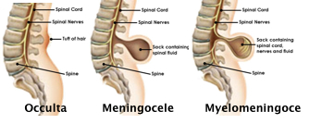
NTD
FOLIC ACID!

Slide 25
Hydrocephalus
Communicating – failure to reabsorb CSF at arachnoid villi
Non-communicating - Obstruction to flow of CSF
Usually treated with a ventriculo-peritoneal shunt
Can you name some causes of each?

Slide 26
Communicating:
Subarachnoid haemorrhage
Meningitis, e.g. pneumococcal, tuberculous
Non-communicating:
Congenital malformation • Aqueduct stenosis • Atresia of the outflow foramina of the fourth ventricle (Dandy–Walker malformation) • Chiari malformation
Posterior fossa neoplasm or vascular malformation
Intraventricular haemorrhage in preterm infant

Slide 27
Primitive Reflexes
Sudden extension of the head causes symmetrical extension, then flexion of the arms
Flexion of fingers when an object is placed in the palm
Head turns to the stimulus when touched near the mouth
Stepping movements when held vertically and dorsum of feet touch a surface
Lying supine, the infant adopts an outstretched arm to the side to which the head is turned

Slide 28
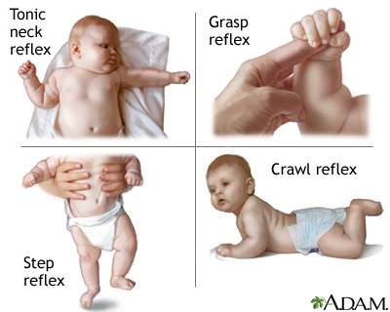
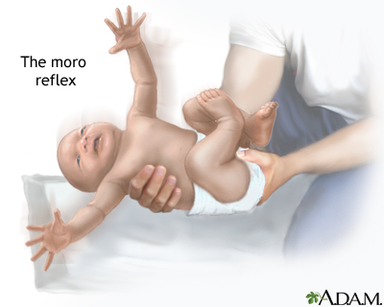
When do they disappear?
Moro
Grasp
Rooting
Stepping Response
Asymmetrical Tonic Neck Reflex

Slide 29
Moro – 4 months
Grasp – 3 months
Rooting – 6 months
Stepping Response – 6 weeks
Asymmetrical Tonic Neck Reflex – 6 months

Slide 30
Development
Gross Motor | Vision and fine motor | Hearing, speech and language | Social, emotional and behavioural
Sits with round back | Palmar grasp grip | Cooooooos and laughs | Puts food in mouth
How old is this child?
At what age would not being able to sit be classed as delayed?

Slide 31
6 months!
Delayed: 9 months

Slide 32
At 16-18 months, a child makes marks with a crayon.
What can they do aged 2?

Slide 33
And at aged 3?

Slide 34
And at 3 ½?

Slide 35
And at 4?

Slide 36
And at 5?

Slide 37
Learn the rest of the milestones ☺

Slide 38
Disability
Cerebral Palsy (CP)
Abnormality of movement and posture, causing activity limitation attributed to non-progressive disturbances that occurred within the first two years of life.
80% occur antenatally, 10% during birth and 10% post natally.
Give a cause of each

Slide 39
Cerebral Palsy
Ante: vascular occlusions, structural maldevelopment
During: Hypoxic Ischaemic Injury
Post: Meningitis, Head trauma, Encephalitis
There are different types of CP
Spastic
Dyskinetic
Ataxic
Mixed

Slide 40
Spastic Cerbral Palsy
Most common (90%)
Upper motor neurone damage → increased tone
Hemiplegia/quadriplegia/diplegia

Slide 41
Autism
What are the features of autism?
Triad:
Communication difficulties
Social interaction difficulties
Behavioural problems (rigidity and poor imagination)

Slide 42
Communication:
Limited facial expression, pedantic language, monotonous, literal interpretation, delayed speech
Social interaction:
Gaze avoidance, solitary, play alone, no appreciation of other people’s emotions, lack of appreciation of social cues
Behaviour:
Ritualistic, concrete play, lack of imagination, learn by rote, resist change

Slide 43
ADHD
What are the features of ADHD?
Triad:
Inattention
Hyperactivity
Impulsivity

Slide 44
Inattention
Easily distracted, forgetful, difficulty following instructions, make careless mistakes, lose important objects
Hyperactivity
Fidgets, always on the go, talk excessively, can’t perform activities quietly
Impulsivity
Difficulty taking turns, interrupt others

Slide 45
ADHD – associated problems
Learning difficulties
Aggression
Low self-esteem
Alcohol/drug misuse
Antisocial behaviour

Slide 46
Questions - SBA
A 9 year old girl is taking part in a school play when she says she feels sick and then suddenly collapses. She looks very pale and is seen to have a few jerking movement of her legs. An ambulance is called but by the time it arrives she is back to normal.
A – Absence seizure
B – Reflex anoxic seizure
C – Generalised tonic-clonic seizure
D – Simple faint (syncope)
E – Juvenile myoclonic epilepsy

Slide 47
Questions - SBA
A previously well 10 year old girl arrives in A+E by ambulance drowsy and confused with a temperature of 37.7ºC. Her mother reports that she has had a mild cold for the last 2 days. Today she collapsed, seemed to go stuff and then had shaking of all 4 limbs lasting around 15 minutes. She was unresponsive throughout the episode. It takes an hour to get back to normal; at that time examination is normal.
A – Febrile seizure
B – Generalised tonic-clonic seizure
C – Simple faint
D – Reflex anoxic seizure
E – Juvenile myoclonic epilepsy

Slide 48
Questions - SBA
7 month old is able to sit unsupported and roll over in both directions but is not yet mobile. She is able to reach out for toys with a palmar grasp and transfers toys between hands. She says both “mama” and “dada” but does not discriminate between her parents. She also makes other speech sounds but has no recognisable words.
A – Fine and gross motor delay
B – Normal development
C – Global delay
D – Fine motor delay
E – Gross motor delay

Slide 49
Questions - SBA
An 18 month old says “mama” and “dada” appropriately. He has some tuneful babble but has no other words. He reaches out for toys using a palmar grasp and transfers object between hands. He holds a crayon but can’t make marks with it. He is unable to stack blocks. He has been able to sit unsupported for 6 months and gets around by crawling.
A – Fine and gross motor delay
B – Normal development
C – Global delay
D – Fine motor delay
E – Gross motor delay

Slide 50
Summary
This evening, you have revised:
Genetics
Neurology
Development
Disability

Slide 51
Thanks for listening ☺
Please fill in the feedback forms and have a lovely weekend!
Good luck with your exams!

