Slide 1
Paediatrics 2
Phase 3a
Rupy Chana and Alex Cross
The Peer Teaching Society is not liable for false or misleading information…

Slide 2
Aims
Improve your understanding of paediatric:
Respiratory problems
RTI (upper and lower)
Asthma
CF
Coeliac disease
Renal disease
UTI
Vesoureteric reflux
Nephrotic syndrome
Nephritis and HSP
Cardiac problems
Congenital heart disease
Rheumatic fever
Infective endocarditis
The Peer Teaching Society is not liable for false or misleading information…

Slide 3
Respiratory infections- pathology
Viruses cause 90% infections
RSV, rhinovirus, parainfluenza, influenza, metapneumoviruus, adenovirus
Bacteria
Strep. pneumoniae (pneumococcus)
H. infleunza
Moraxella catarrhalis
Bordatella pertussis
Mycoplasma pneumoniae
The Peer Teaching Society is not liable for false or misleading information…
Notes:
RSV- Respiratory syncytial virus

Slide 4
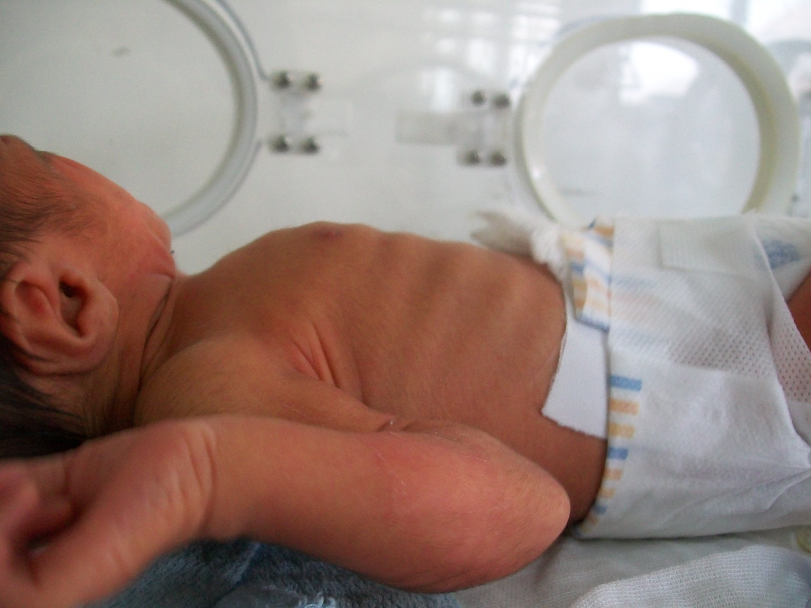
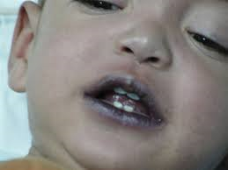
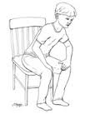
Respiratory distress
Name some signs
The Peer Teaching Society is not liable for false or misleading information…
Notes:
Tachypnoea, tachycardia, intercostal recession, subcostal recession, sternal recession, cyanosis, use of accessory muscles, nasal flaring, grunting, hyperinflation of chest, tracheal tug, stridor, wheeze, tripod position, head bobbing, tense anxious face

Slide 5
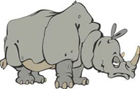
URTIs
Coryza- causes: RSV, ,
Pharyngitis- causes: , ,
strep pyogenes (Group A beta-haemolytic strep)
The Peer Teaching Society is not liable for false or misleading information…
Notes:
Coryza= common cold
Causes of coryza- RSV, rhinovirus, coronavirus,
Colds are self limiting, pre-school children have on average 6-8 per year
Pharyngitis= sore throat
Pharynx, soft palate, local lymph nodes are inflamed
Causes: adenovirus, enterovirus, rhinovirus,
In older children: Group A beta-haemolytic streptococcus (GABHS) also known as strep pyogenes

Slide 6
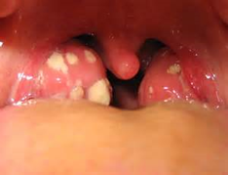
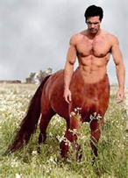
Tonsillitis
Causes: 2/3 viral, 1/3 bacterial: GABS, EBV
Ix- Centor criteria (≤1= viral, 3+= ?bacterial)
Fever
Tonsillar exudate
No cough
Tender anterior cervical lymphadenopathy
Tx- Give Abx if diabetic, immuno-deficient, marked systemic upset (headache, abdo pain, apathy) history of RF, 3 or more centor criteria
Which Abx?? 10/7 Penicillin V (or Clarithromycin if allergic)
Do NOT give Amoxicillin. WHY?
Tonsillectomy if 7+ episodes per year or 5 over 2 years
The Peer Teaching Society is not liable for false or misleading information…
Notes:
Tonsillitis
Causes: GABS, Epstein Barr virus (EBV) which also causes infectious mononucleosis
Amoxicillin can cause widespread maculopapular rash if tonsilitis due to EBV

Slide 7
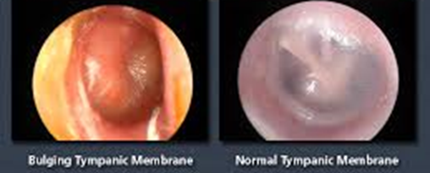
Acute otitis media
Most common age 6-12m
Causes: RSV, , pneumococcus, H. influenzae, Moraxella catarrhalis
Sx- Bulging red tympanic membrane
Most cases resolve spontaneously, but give abx if:
Sx >3d
Age <2 with bilateral AOM
Otorrhoea
High risk of complications: DM, signif organ disease, CF, prematurity
5/7 amoxicillin (erythromycin if allergic)
The Peer Teaching Society is not liable for false or misleading information…

Slide 8
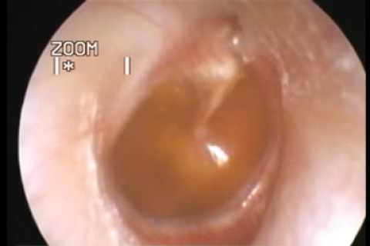
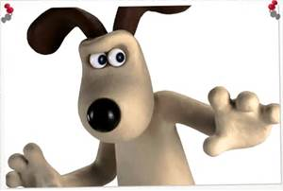
Otitis media with effusion
“Glue ear”
Peak age 2-5
Most common cause of conductive hearing loss in children, can affect speech
Sx- No pain, potentially some hearing loss
Dull, retracted eardrum with fluid level
Tx- Active observation for 3m
OR grommet insertion (ventilation tube)
Adenoidectomy if URT symptoms feature
The Peer Teaching Society is not liable for false or misleading information…
Notes:
Active observation means seeing whether the symptoms resolve themselves. Around 50% children, even with significant hearing loss, will get better by themselves

Slide 9
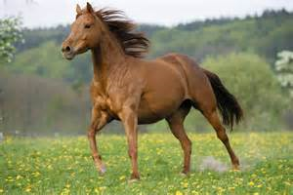
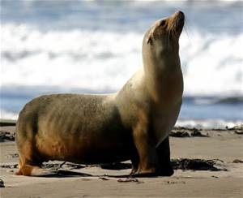
Croup
Laryngotracheobronchitis
Cause: Viral, mainly parainfluenza
Age 6m-6y. Peak age 2
Sx- Stridor, ,
Tx- Supportive, may need dexamethasone/pred/steroid nebs
May admit if child <1 or severe illness
The Peer Teaching Society is not liable for false or misleading information…
Notes:
Mucosal inflamation and increased secretions
Can lead to critical narrowing of trachea
Symptoms- stridor, barking cough like a sea lion, hoarseness. Start at night, worse at night
Chidlren <1 have smaller airway caliber

Slide 10
Epiglottitis
Life threatening emergency!!
Cause- Haemophilus influenzae type b
Age 1-6 commonly
Acute onset
Sx- Very sick looking child, intensely painful throat
Classically child is silent and very still with mouth open, dribbling
Insp stridor
The Peer Teaching Society is not liable for false or misleading information…

Slide 11
Croup vs Epiglottitis
Case
Dx?
Why?
Which other questions to ask?
How to examine?
What next?
Who to call?
Which drug to give?
Which drug to give to household contacts?
3y boy
Mum says trouble breathing and making “funny noises”
Been getting worse for last 4 hours
O/E-
Sitting bolt upright
Drooling
Inspiratory stridor
Temp 39, RR↑
The Peer Teaching Society is not liable for false or misleading information…
Notes:
Must not lie child down or examine throat as can cause total airway obstruction
If epiglottitis suspected, hospital admission required
Senior anaestetist, paediatrician and ENT surgeon summoned
Transfer to ITU
Intubate with GA
Only after this is successful should you do bloods and blood cultures
Start IV cefuroxime
Remove tracheal tube after 24 hours
Give prophylactic Rifampicin to household contacts

Slide 12
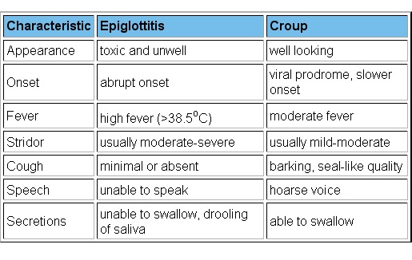
Croup vs Epiglottitis
The Peer Teaching Society is not liable for false or misleading information…

Slide 13
Pertussis
Whooping cough
Bordatella pertussis
Sx?
https://www.youtube.com/watch?v=wuvn-vp5InE
Which age of infant is susceptible?
Ix- Nasal swabs
Bloods show very high WCC
Tx- Erythromycin only helps if started early
Can give it prophylactically to household contacts
The Peer Teaching Society is not liable for false or misleading information…
Notes:
Sx-
Catarrhal phase for first week (cold)
Paroxysmal cough followed by inspiratory whoop
Worse at night
Child goes red/blue in face and mucus flows from face
May be vomiting after
Lasts 3-6weeks
Infants <4m most susceptible as may not have completed primary immunizations yet
Infants may not have characteristic cough, may have apnoea instead

Slide 14
Bronchiolitis
Most common serious resp infection of infants (2-3%/year)
Most are age 1-9
Cause- RSV (highly infectious)
Sx- Feeding difficulty, dyspnoea,
dry cough
apnoea
hyper-inflated chest, recession
Fine crackles, high pitched wheeze
Tx- Supportive. May need humidified O2
Prevention- Name, class, route, who, when??
The Peer Teaching Society is not liable for false or misleading information…
Notes:
Prognosis- most recover in 2 weeks. 50% will have recurrent cough and wheeze after/ May damage airways permanently if followed by adenovirus (bronchiolitis obliterans)
Give Pavilizumab, monoclonal antibody, IM, to high risk babies, once a month during RSV season (autumn, winter)

Slide 15
Pneumonia
Causes
Newborn- GBS
<5- RSV, Strep pneumoniae, H. influenzae b, bordatella pertussis, (what else do these cause that we’ve just discussed?)
>5- Mycoplasma pneumoniae, strep pneum, chlamydia pneum
Consider mycobacterium tuberculosis at all ages
Features
Fever and difficulty breathing, (increased RR is best sign)
Pleural irritation in bacterial infection (which Sx would patient have?)
Ix- CXR, nasal aspirate, sats, temp, blood cultures
The Peer Teaching Society is not liable for false or misleading information…
Notes:
GBS- Group B strep from mother’s genital tract
Difficult to tell between viral and bacterial causes

