Slide 1
Paediatrics 2
Cardiothoracic & renal

Slide 2
What we will cover:
Cardiac problems;
  Congenital heart disease
  Rheumatic fever
  Infective endocarditis
Respiratory problems;
  Respiratory tract infections (upper and lower)
  Cystic fibrosis
  Asthma
  Coeliac disease
(Renal disease)

Slide 3
Congenital Heart Disease
Type of lesion | L→R shunt | R→L shunt | Common mixing | Well children with obstruction | Sick neonates with obstruction
Symptoms | Breathless or asymptomatic | Blue | Breathless & blue | Asymptomatic | Collapsed with shock
Eg | ASD VSD PDA | Tetralogy Fallot TGA | AVSD Complex CHD | AS PS Adult-type CoA | CoA HLHS

Slide 4
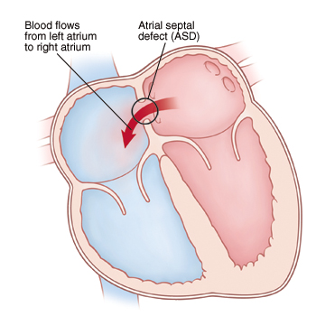
Atrial Septal Defect
Left to Right shunt
Increased pulmonary blood flow
Pulmonary hypertension
Dilatation RA & RV
RV hypertrophy
RHF

Slide 5
Atrial Septal Defect
Signs
Mid-systolic pulmonary ejection murmur upper L sternal edge
Softer if larger
Wide fixed split S2
RV heave
Elevated JVP
Primum/secundum
Often unrecognised until adulthood
Children prone to respiratory infection
Atrial arrhythmias or LV failure from 4th decade
Risk IE, paradoxical emboli
Treated at 3-5hrs to prevent RHF

Slide 6
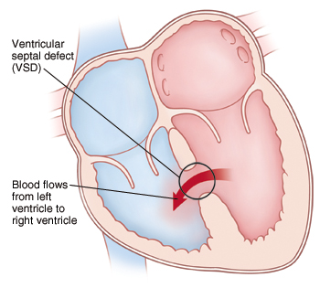
Ventricular Septal Defect
Blood shunted L to R
Pulmonary hyptertension
Once PVR>SVR then Eisenmenger’s (shunt reversal)
Small may be asymptomatic
Signs:
Systolic murmur L sternal edge
Soft if large (pansystolic)
Palpable thrill L sternal edge
Parasternal heave
Loud P2
LA & LV dilated

Slide 7
Ventricular Septal Defect
FTT, respiratory difficulties/infections
HF after 1wk if large (4-6wks mod)
HF: fatigue feeding, poor weight gain, excessive sweating, increased respiratory effort and RR
Young child: exercise limitation, fatigue, cardiomegaly, SOB, prominent apex beat
50% of small close by 3-4yrs
Surgery 3-6m if significant
Risks: arrhythmia, sudden death, IE, AV prolapse/AR, Eisenmenger’s

Slide 8
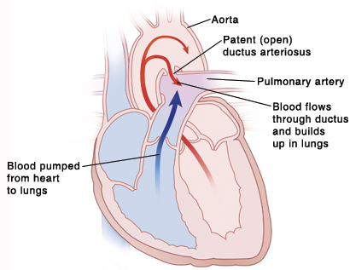
Patent Ductus Arteriosus
Causes: rubella, prematurity, prenatal hypoxia, malformations
1-2/1000 live births
Failure to close by 1 month after expected date delivery

Slide 9
PDA
Signs:
Loud continuous machinery murmur below L clavicle
Large volume collapsing, bounding peripheral pulse
LA & LV enlarged
HF, IE, pulmonary hypertension by age 40yrs
Often asymptomatic
Prostaglandin inhibitor (indomethacin): may promote closure alone (esp premature) or ibuprofen
Surgery within 5yrs

Slide 10
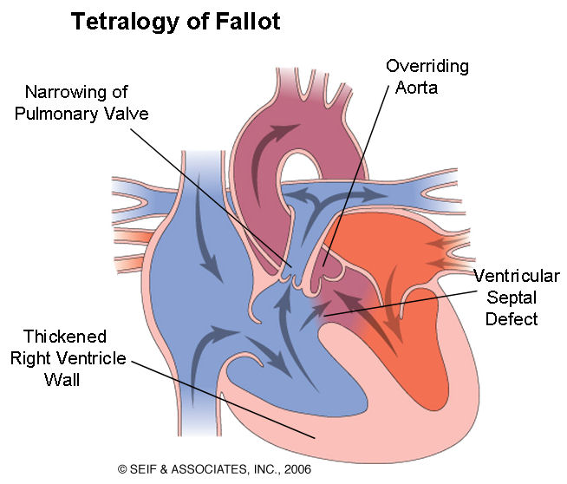
Tetralogy of Fallot
VSD
Pulmonary stenosis
Overriding aorta
RV hypertrophy
High RV pressure leads to R to L shunt
Complete mixing pulmonary/systemic bloodflow
Cyanotic

Slide 11
ToF
Most diagnosed antenatally
Central cyanosis (clubbing, polycythaemia)
Hypercyanotic spells (tet spells)
Squatting on exercise
Loud harsh ejection systolic murmur
Parasternal sustained heave
Risk cerebral thrombosis, IE, HF
XR: boot shaped heart

Slide 12
Management R to L shunts (ToF)
ABC
PG infusion (duct-dependent)
Definitive surgery (close VSD 6m, relieve PS)
Tet spells: sedation, morphine, chest-knee position, oxygen, IV propranolol, fluids

Slide 13
Coarctation of aorta
Narrowing at/just distal or proximal to insertion ductus arteriosus
Upper limb HTN
Poor perfusion below lesion
Intermittent claudication, leg fatigue, cold legs
Exercise intolerance/CP
Headaches, epistaxis
May be HF
Ejection systolic murmur upper sternal edge
Weak delayed leg pulses (radio-femoral delay)
Scapular bruit (collaterals)

Slide 14
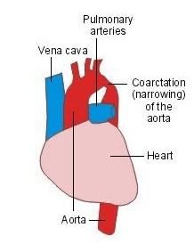
CoA
Complications: HTN, CAD, CCF, aortic aneurysm/rupture, CVA
CXR: 3 shaped aorta, collateral, rib notching
Treat if pressure gradient >30mmHg
Treat HTN
Stent insertion/surgical excision

Slide 15
Others
Transposition great arteries
Truncus arteriosus
AVSD (Down’s syndrome)
Complex e.g. tricuspid atresia
Aortic stenosis
Pulmonary stenosis
Hypoplastic left heart syndrome

Slide 16
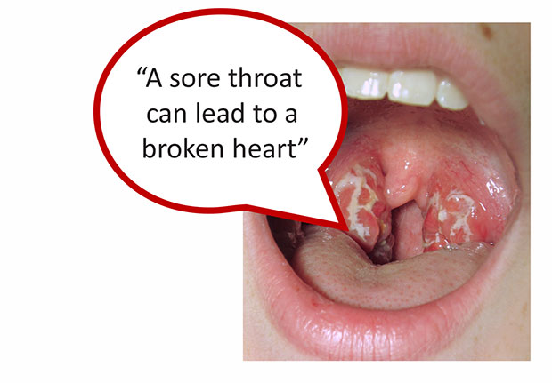
Rheumatic fever
Now rare in developed world
Abnormal immune response to preceding infection with group A β-haemolytic streptococcus (pyogenes)
2-6wks after pharyngeal infection, polyarthritis, malaise, mild fever

Slide 17
Jones Criteria
2 major or 1 major + 1 minor
AND evidence preceding group A strep infection (raised ASO titre or +ve throat culture)
Major | Minor
Pancarditis (endo, myo, peri) Polyarthritis Sydenham’s chorea Erythema marginatum Subcut nodules Emotional lability | Fever Polyarthralgia History rheumatic fever Raised ESR/CRP/leucocytes Prolonged PR Evidence strep infection (ASO)

Slide 18
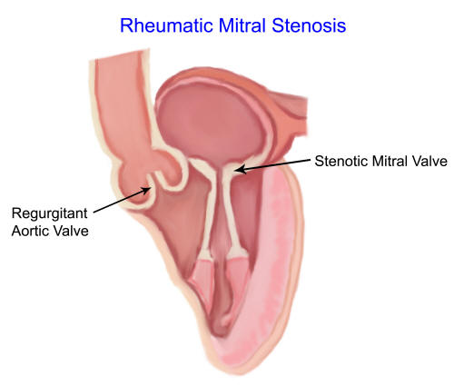
Chronic rheumatic heart disease
Scarring & fibrosis heart tissue
Symptoms early adult life
Most commonly mitral stenosis
Severity relates to number childhood episodes

Slide 19
Management
Bed rest
Anti-inflammatory e.g. high dose aspirin
Steroids if doesn’t resolve
Symptomatic HF tx (ACE-I, diuretics)
May need pericardiocentesis
Anti-strep abx if persisting infx (penicillin V or benpen)
Following resolution: monthly injection benpen to prevent recurrence (duration controversial)

Slide 20
Infective Endocarditis
Risk factors:
Congenital HD esp VSD, CoA, PDA, prosthetic material, hx rheumatic fever
Most α-haemolytic strep (viridans)-dental procedure
Staph aureus (central venous catheters)
Enterococcus (lower GI sx)

Slide 21
Symptoms & signs
Suspect if sustained fever, malaise, ↑ESR, unexplained anaemia or haematuria
(prolonged) fever
Anaemia
Headache, weight loss, night sweats, arthritis
Changing cardiac signs incl murmurs
Peripheral: splinter haemorrhages, Osler’s nodes, Janeway lesions
Retinal haemorrhages/infarcts (Roth spots)
Neuro signs

Slide 22
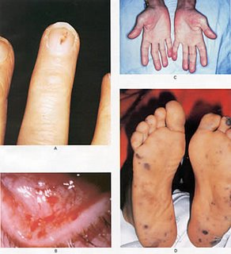
Diagnosis
LEARN DUKE CRITERIA
Multiple blood cultures
Echo: vegetations
Raised WCC & inflammatory markers

Slide 23
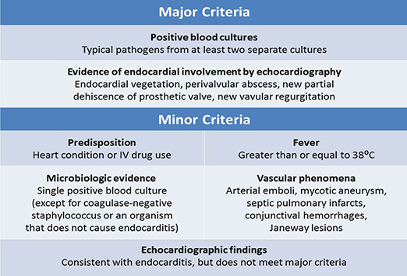

Slide 24
Management
High dose penicillin + aminoglycoside IV 6wks
May need removal infected prosthetic material
Prophylaxis not recommended but good dental hygiene
Mortality 20%
Complications: HF, brain abscesses, stroke (systemic emboli from L vegetations)

Slide 25
URTI: NICE guidelines
Offer clinical assessment to those with:
Acute otitis media 4/7
Acute sore throat 1/52
Acute rhinosinusitis 2.5/52
Acute cough/bronchitis 3/52
Antibiotics:
Bilateral acute otitis media <2yrs old
Acute otitis media with otorrhoea
Acute sore throat when ≥ 3 Centor criteria

Slide 26
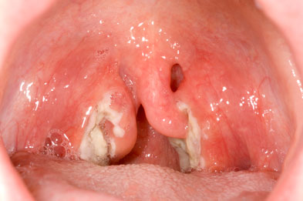
Centor Criteria
Tonsillar exudate
Tender anterior cervical adenopathy
≥38°
Absence of cough
Indicates more likely bacterial e.g. group A strep

Slide 27
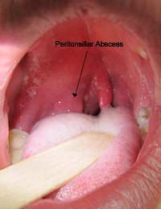
Complications tonsillitis
Quinsy (peritonsillar abscess)
Airway obstruction
Sinusitis
Otitis media
Brain abscess, meningitis
Pharyngeal/retropharyngeal abscess
Post-strep glomerulonephritis (cola urine)
Septic arthritis
Only tonsillectomy if >7 episodes in 1yr (SIGN guidelines)

Slide 28
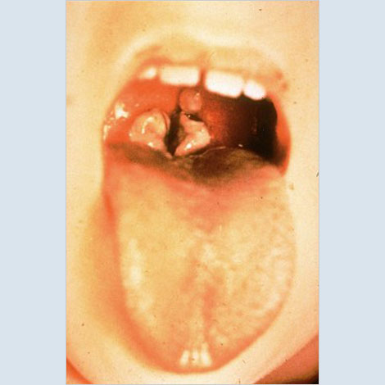
Diptheria
Corynebacterium diptheriae
Cough, SOB, fever, purulent nasal discharge
Injected pharynx, exudate 1-2d
Grey-green membrane oropharynx
Swollen neck (bull neck)
Risk airway obstruction
Give IV infusion antitoxin + penicillin G 14d (isolate)

Slide 29
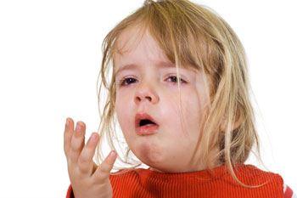
Croup (laryngotracheobronchitis)
Parainfluenza virus
Peak 2yrs
Barking cough, stridor, coarse (preceded fever, coryza), intercostal recession, 3-7d
Red flags: drowsy, cyanosis, lethargy
Home/admission (severity)
Oral dexamethasone 0.15mg/kg or pred 1mg/kg
Consider nebulised adrenaline if resp distress
Few require intubation & ITU

Slide 30
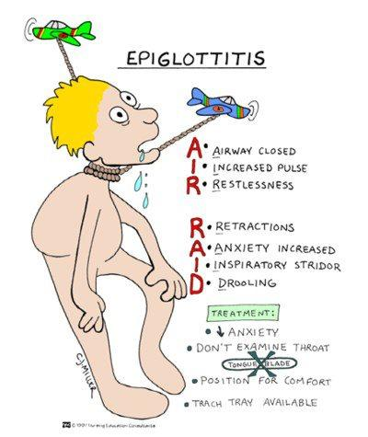
Acute epiglottitis
Haemophilus influenza B (now rare as vaccine)
High fever, very sick
Rapid onset
Intensely painful throat prevents speech/swallow
Anterior neck tenderness
Drooling, tripod sign, ear pain
Soft insp stridor, open mouth, may be no cough
DO NOT examine airway-urgent help ITU

Slide 31
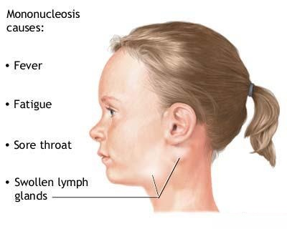
Glandular fever
EBV
Pharyngitis, fever, cervical lymphadenopathy
May be spleno/hepatomegaly, petechiae soft palate, erythematous rash, lethargy
Ix: lymphocytosis, ≥10% atypical lymphocytes, +ve serology for EBV, ±abnormal LFTs
+ve monospot/Paul-Bunnell test
Acute 1-2wks, can persist 1-3m
AVOID amoxicillin/ampicillin (rash)

Slide 32
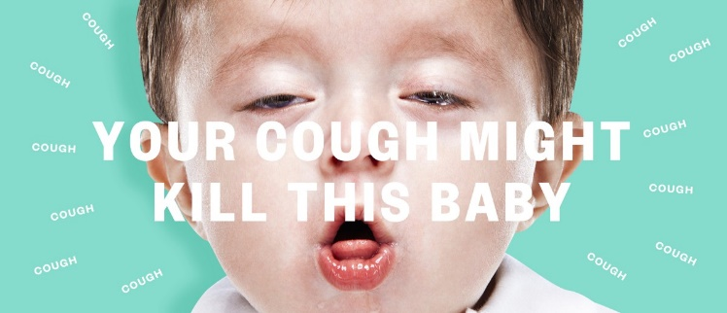
Whooping cough (pertussis)
Bordetella pertussis
Consider if prolonged cough >2/52
Paroxysmal cough + inspiratory whoop
Post-tussive vomiting
Apnoeas/cyanosis
Worse night
Epistaxis, subconjunctival haemorrhages, petechiae
Risks: pneumonia, dehydration, hypoxia, encephalopathy, cerebral haemorrhage

Slide 33
Pertussis cont.
Diagnosis: per-nasal swab or nasopharyngeal aspirate for PCR
Notifiable
If severe admit & isolate
Conflicting evidence abx but most have azithromycin if <2 months or co-trimoxazole is option in older
Vaccinate pt and contacts esp pregnant

Slide 34
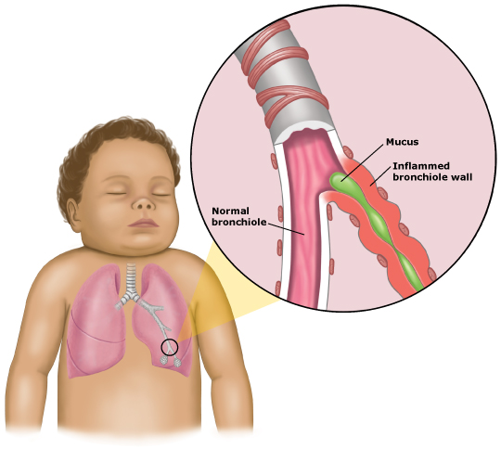
Bronchiolitis
Commonest resp infection in infancy (<1yr)
Respiratory syncytial virus
Risk: older siblings, nursery, passive smoking, overcrowding, winter, premature, LBW, chronic lung disease, congenital HD, immunocompromised, Down’s

Slide 35
Symptoms & signs
Coryza
Dry cough
Increasing SOB, apnoeas, tachypnoea, resp distress
Subcostal/intercostal recession
Hyperinflation chest
Difficulty feeding
Fine end-insp crackles, widespread creps
High pitched wheeze
Cyanosis
Fever
Tachycardia

Slide 36
Ix & management
PCR of nasopharyngeal secretions
Most at home
Fluids, temp control, nutrition
Refer if severe or at risk (significant resp distress, low SaO2, apnoeas, dehydrated)
Humidified O2 via nasal cananula
Fluid IV/NG
Bronchodilators nebs
Infection control
Palivizumab if <2yrs with chronic lung disease requiring home O2, L to R shunt, severe immunodeficiency

Slide 37
Pneumonia
Newborn | From mother’s genital tract Group B strep Gram –ve enterococci (E coli, Klebsiella) Staph aureus
Infants & young children | RSV and other resp viruses Strep pneumo Hib Bordatella pertussis Chlamydia trachomatis
Children >5yrs | Mycoplasma pneumoniae Strep pneumo Staph aureus Group A strep Bordetella pertussi Chlamydia pneumonia
All ages | Consider TB
Infection of lower resp tract & lung parenchyma that leads to infection

Slide 38
Symptoms & signs
Fever ≥38.5°C
SOB, cough, preceding URTI
Respiratory distress (↑RR, grunting, intercostal recession, nasal flaring)
Lethargy, poor feeding
Coarse crackles, dull, reduced breath sounds
Low SaO2
Mycoplasma: 5-20yrs, late summer, malaise, fever, worsening dry cough, headaches

Slide 39
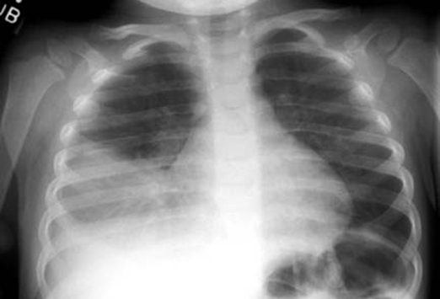
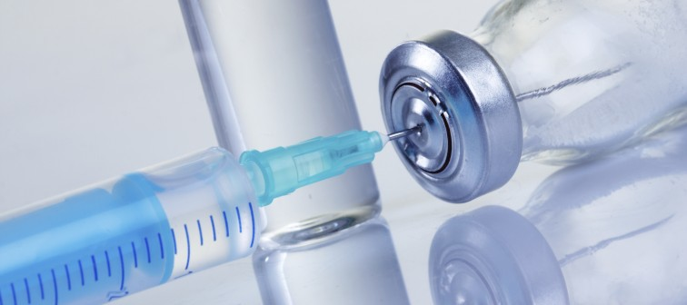
Management
Most at home
Fluids, analgesia, safety net
Admit if low SaO2, resp distress, unable to feed etc
Hospital: IV fluid, O2, monitor electrolytes
Abx: oral amoxicillin (IV or cefotaxime if complicated/severe; erythromycin if atypical)

Slide 40
Cystic Fibrosis
Genetic mutation on chromosome: ΔF508
Carrier frequency 1/22 Caucasians; 1/2000 live births
Defect in cystic fibrosis transmembrane conductance regulator (CFTR)
Failure opening Cl- channel in response to ↑cAMP in epithelial cells→↓excretion Cl- into airway lumen, increased reabsorption sodium into epithelial cells
↑ viscosity & tenacity of secretions→small airway obstruction
↑NaCl in sweat (dehydration)
90% have pancreatic exocrine insufficiency
GI: thick muconium

Slide 41
Clinical features
Frequent respiratory infections
    Neonates/infants: Staph aureus
    Infants/children: Haemophilus influenza
    Older children/adults: Pseudomonads (mucoid & non-mucoid)
    Late: Burkholderia cepacia (high mortality)
Failure to thrive, malnutrition, delayed puberty
Meconium ileus (SI obstruction)
Malabsorption, steatorrhoea
Bronchiectasis
Sterility in males
May be liver disease
Respiratory failure, cor pulmonale

Slide 42
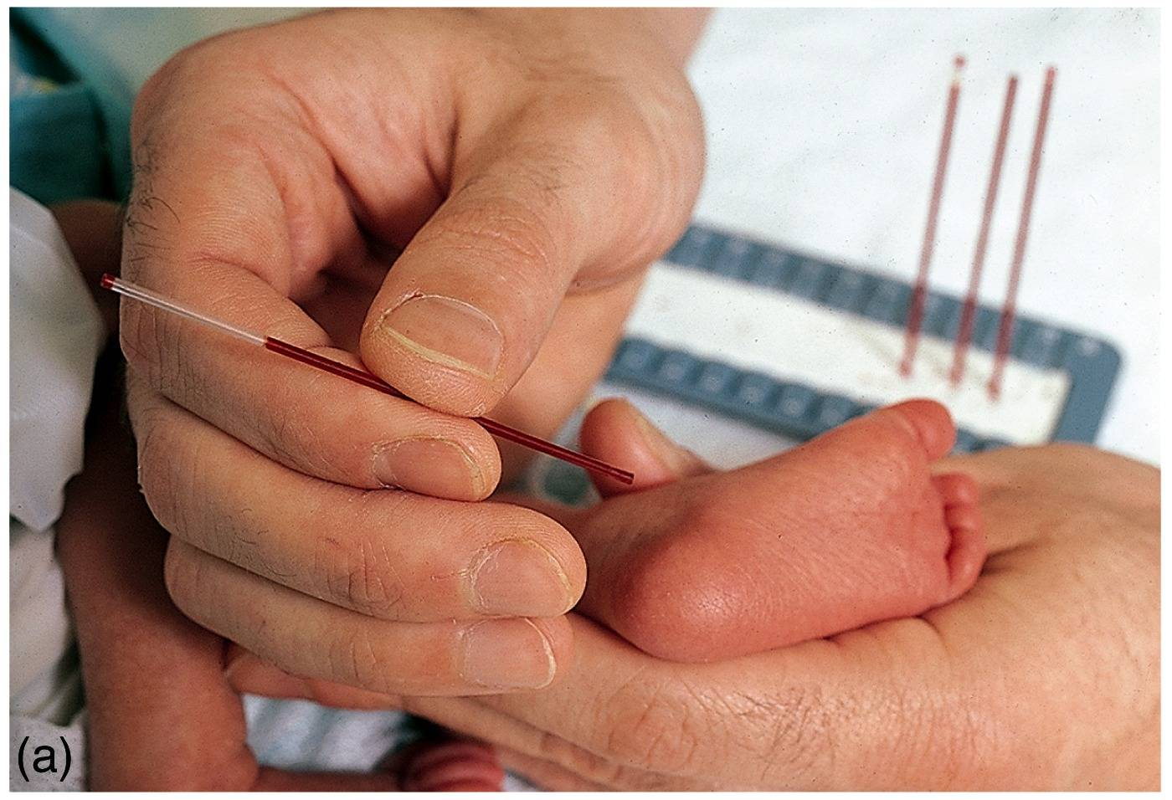
Investigation
Birth: Guthrie test (immunoreactive trypsin test)
Sweat test (high Cl)
Faecal elastase
CXR
Spirometry

Slide 43
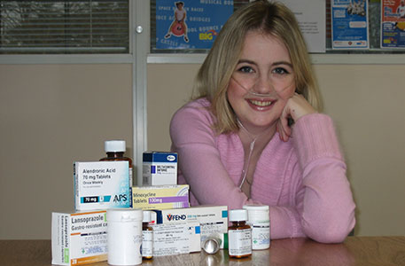
Management
Specialist MDT
Avoid smoking, flu & pneumococcal vaccines
Nutritional support
hysiotherapy, breathing exercises
Prompt abx for infections (amox 2/52 for URTI) and send sputum MC&S
Sputum: inhaled recombinant DNAase or hypertonic saline
Bronchodilators, steroids, mucolytics
Regular azithromycin
Segregation
Creon (pancreatic enzymes) + fat soluble vitamins
Heart & lung transplant
ICSI for men
Median survival >30yrs

Slide 44
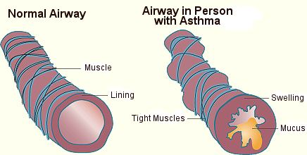
Asthma
Wheeze
Episodic SOB, tight chest
Worse night/early am, exercise, cold, pets
Interval symptoms?
Nocturnal cough (sleep disturbance)
Atopy (allergy, eczema, rhinitis)
Differentials: transient early wheeze, viral episodic wheeze, GORD, infection, CF, tracheobronchomalacia, foreign body

Slide 45
Asthma
Base diagnosis on history
Ix only if low probability asthma, poor response or possible alternative cause

Slide 46
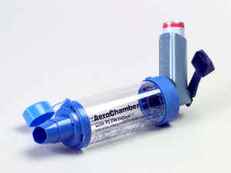
Asthma control
Have you had difficulty sleeping because of asthma?
Have you had your usual asthma symptoms during day?
Has it interfered with usual activities?

Slide 47
Management
Inhaled SABA PRN (salbutamol)
Inhaled steroid 200-400mcg/day (beclometasone)
  (<5yrs LTRA is alternative)
Add LABA (salmeterol)
  Consider LTRA (Montelukast)
Increase steroid up to 800mcg/day
Refer (oral steroids)
Annual review

Slide 48
Acute asthma attack
Mod | Severe | Life-threatening
PEFR >50-75% best/ predicted RR<25 HR<125 Speech normal No features severe | PEFR 33-50% RR≥30 (>50 if 2-5yrs) HR≥110 Accessory muscles Chest recession SaO2<92% | PEFR<33% best/predicted Silent chest Cyanosis Poor resp effort, exhaustion Reduced level consciousness Bradycardia Hypotension Normal PaCO2 (high is near fatal) PaO2<8Kpa despite O2 Low arterial pH

Slide 49
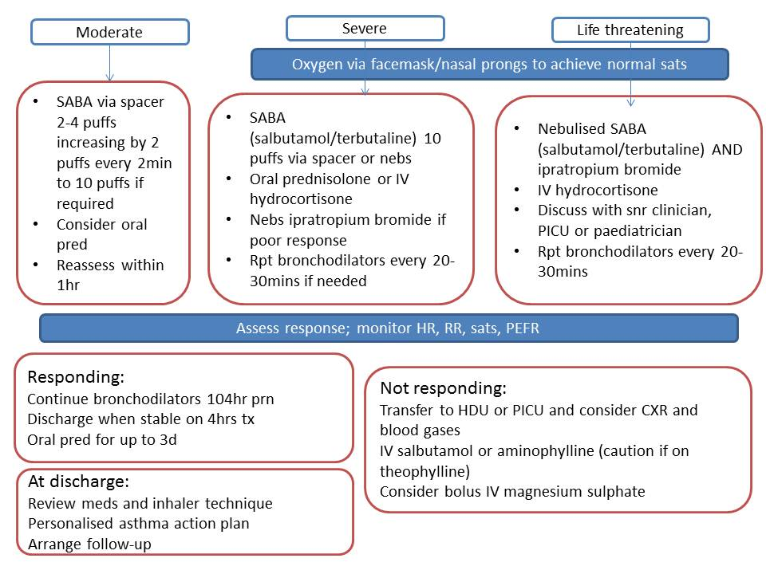

Slide 50
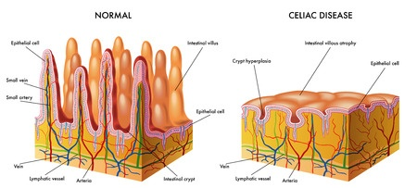
Coeliac Disease
‘Heightened immunological responsiveness to ingested gluten with abnormal proximal SI mucosa that improves morphologically on a gluten free diet’
Increased intra-epithelial lymphocytes
Villous atrophy
Crypt hyperplasia
1% adult prevalence
Autoimmune

Slide 51
Clinical features
Malabsorption
Weight loss, failure to thrive
Chronic diarrhoea, steatorrhoea
Dermatitis herpetiformis
Many asymptomatic/adult diagnosis
Complications: anaemia, OP, intestinal lymphoma, delayed puberty, growth failure
Assoc: T1DM, thyroid disease, IgA deficiency, PBC, other autoimmune
FH

Slide 52
Investigation
Serology: anti-tissue transglutaminase antibodies (alternative anti-endomysial)
Refer to GI for biopsy if +ve
If –ve check for IgA deficiency (false –ves)
Biopsy duodenum on gluten containing diet (may need gluten challenge)
FBC, B12, folate, Ca2+, vitD

Slide 53

Management
Gluten free diet (compliance!)
Annual monitoring (growth, bloods, OP risk)

Slide 54
Renal
Congenital abnormalities
  Aut dom polycystic
  Duplex, pelvic, horseshoe
  Posterior urethral valves
Renal tubular disorders
  Fanconi syndrome
  Barrter, Gitelman’s, Liddle’s
  Rickets
AKI
Haemolytic uraemic syndrome (E coli)

Slide 55
Thank you
Questions?

