Slide 1
Respiratory Conditions

Slide 2
Respiratory
Phase 2a Revision Session
Tim Sargeant and Ben Currie
8th March 2017
The Peer Teaching Society is not liable for false or misleading information…

Slide 3
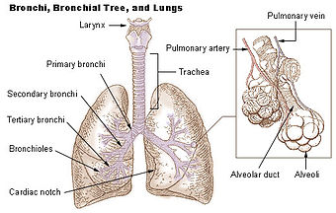
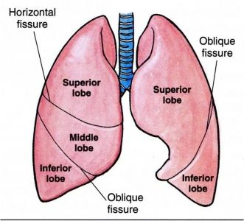
Lung Anatomy
The Peer Teaching Society is not liable for false or misleading information…

Slide 4
Ventilation
Inspiration
Contraction of intercostals
Chest cavity expansion
Contraction of diaphragm (C345 keeps diaphragm alive)
Expansion of intrapleural space
Resulting relative –ve pressure permits air entry
Expiration
Relaxation of intercostals
Chest cavity contraction
Relaxation of diaphragm
Contraction of intrapleural space
Resulting relative +ve pressure forces air out
The Peer Teaching Society is not liable for false or misleading information…

Slide 5
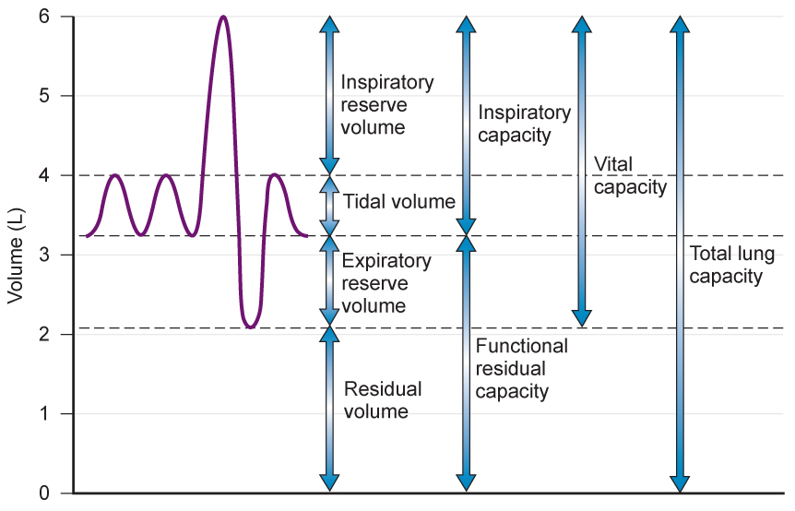
Lung Function Tests
The Peer Teaching Society is not liable for false or misleading information…

Slide 6
Lung Function Tests
FEV1 = forced expiratory volume in 1 second (peak flow)
FVC = forced vital capacity = full inspiration then expiration vol.
FEV1/FVC ratio main thing to know:
Obstructive = low FEV1 / normal FVC
… low FEV1/FVC ratio in asthma / copd
Restrictive = low FEV1 / low FVC
… normal ratio in eg pulmonary fibrosis
The Peer Teaching Society is not liable for false or misleading information…

Slide 7
Investigations
Chest X-Ray
- Airways (hilar enlargement)
- Bones (fractures, lytic lesions)
- Cardiac silhouette (cardiomegaly)
- Costophrenic angles (effusion)
- Diaphragm (abdominal perforation, free air)
- Edges (pneumothorax, fibrosis, pleural thickening)
- Fields (parenchyma, masses, consolidation)
The Peer Teaching Society is not liable for false or misleading information…

Slide 8
Investigations
Arterial Blood Gas (ABG)
- pH <7.35 adicotic / 7.35 – 7.45 neutral / >7.45 alkalotic
- paO2 <10kPA hypoxia
- paCO2 4.7-6.0kPA
- HCO3- 22-26mEq/L
- Base excess -2 - +2mmol/L
The Peer Teaching Society is not liable for false or misleading information…

Slide 9
Investigations
Arterial Blood Gas (ABG) https://abg.ninja/abg
Is it acidotic or alkalotic?
Is it metabolic or respiratory?
High CO2 = acidosis Low HCO3 = acidosis
Low CO2 = alkalosis High HCO3 = alkalosis
Is it compensated?
If respiratory picture, is HCO3 normal or altered?
If metabolic picture, is CO2 normal or altered?
The Peer Teaching Society is not liable for false or misleading information…

Slide 10
Investigations
Arterial Blood Gas (ABG)
 | pH | CO2 | HCO3
Respiratory acidosis | ↓ | ↑ | Normal
Respiratory alkalosis | ↑ | ↓ | Normal
Respiratory acidosis with metabolic compensation | ↓ / ↔ | ↑ | ↑
Respiratory alkalosis with metabolic compensation | ↑ / ↔ | ↓ | ↓
The Peer Teaching Society is not liable for false or misleading information…

Slide 11
Investigations
Arterial Blood Gas (ABG)
pH | HCO3 | CO2
Metabolic acidosis | ↓ | ↓ | Normal
Metabolic alkalosis | ↑ | ↑ | Normal
Metabolic acidosis with respiratory compensation | ↓ | ↓ | ↓
Metabolic alkalosis with respiratory compensation | ↑ | ↑ | ↑
The Peer Teaching Society is not liable for false or misleading information…

Slide 12
Asthma
Reversible, obstructive, chronic airways inflammation
Wheeze (inspiratory noise), cough, s.o.b
Triggers: cold, pets, exercise, winter, virus
Atopic asthma – type 1 hypersensitivity (IgE mediated by mast cells) – ass. with eczema / hayfever
Sensitization – re-exposure – late phase
The Peer Teaching Society is not liable for false or misleading information…

Slide 13
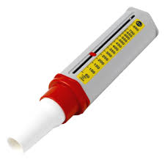
Asthma
Short acting b-agonist
Salbutamol
Inhaled steroid
Beclamethasone
Long acting b agonist
Salmeterol
Oral steroid
Prednisolone
The Peer Teaching Society is not liable for false or misleading information…

Slide 14
Acute Asthma
High flow O2
SABA inhaled / nebs
Oral steroid
Ipratropium bromide
IV Magnesium sulphate
IV aminophylline
IV salbutamol
Abx if ?infective exacerbation
The Peer Teaching Society is not liable for false or misleading information…

Slide 15
COPD
Chronic obstructive pulmonary disorder
Productive cough + s.o.b + infection risk
SMOKERS and exposure to air pollution
Obstructive FEV1/FVC ratio (low) <=70% expected
The Peer Teaching Society is not liable for false or misleading information…

Slide 16
COPD
Aim for O2 sats 88-92% - hypoxia gives respiratory drive
Smoking cessation
Bronchodilation
Pulmonary rehabilitation
Oral steroids
Severity | FEV₁ % predicted
Mild (GOLD 1) | ≥80
Moderate (GOLD 2) | 50–79
Severe (GOLD 3) | 30–49
Very severe (GOLD 4) | <30
The Peer Teaching Society is not liable for false or misleading information…

Slide 17
Bronchiectasis
Permanent dilation of bronchi / bronchioles
Results from chronic inflammation
Asthma, cystic fibrosis, infection
Chronic, productive, foul smelling cough
Clubbing, s.o.b, recurrent RT infection
The Peer Teaching Society is not liable for false or misleading information…

Slide 18
Bronchiectasis
Treat infections with empirical abx
Physio to clear respiratory secretions
Inhaled steroid therapy sometimes (beclomethasone)
The Peer Teaching Society is not liable for false or misleading information…

Slide 19
Tuberculosis
Mycobacterium tuberculosis
Cough, fever, night sweats, weight loss, haemoptysis
Risk factors
Poverty (cramped conditions) ++ droplet spread
Poor hygiene
Immunosuppression (steroids, HIV, DMARDs)
Smokers
Foreign travel
The Peer Teaching Society is not liable for false or misleading information…

Slide 20
Tuberculosis
Diagnosis
Acid-fast bacilli with Ziehl-neelsen stain on sputum sample
Consolidation on CXR
Tuberculin skin test
Mantoux test
Screens high risk patients for latent TB
Tuberculin PPD injected
Exposure = immune response
Induration at injection site measured
The Peer Teaching Society is not liable for false or misleading information…

Slide 21
Tuberculosis
Management
Antibiotics (RIPE)
Rifampicin for 6 months
Isoniazad for 6 months
Pyramidazine for the first 2 months
Ethambutol for the first 2 months
TB is a notifiable disease in the UK
Report to proper officer @ public health England
Within 3 days
The Peer Teaching Society is not liable for false or misleading information…

Slide 22
Pneumonia
Cough, s.o.b, fever, pain, tachycardia
O/E: Chest crackles, low sats, tachycardia, fever
Risk factors:
Immunosuppresion
Elderly
Cystic fibrosis
Smoking
Diabetes
The Peer Teaching Society is not liable for false or misleading information…

Slide 23
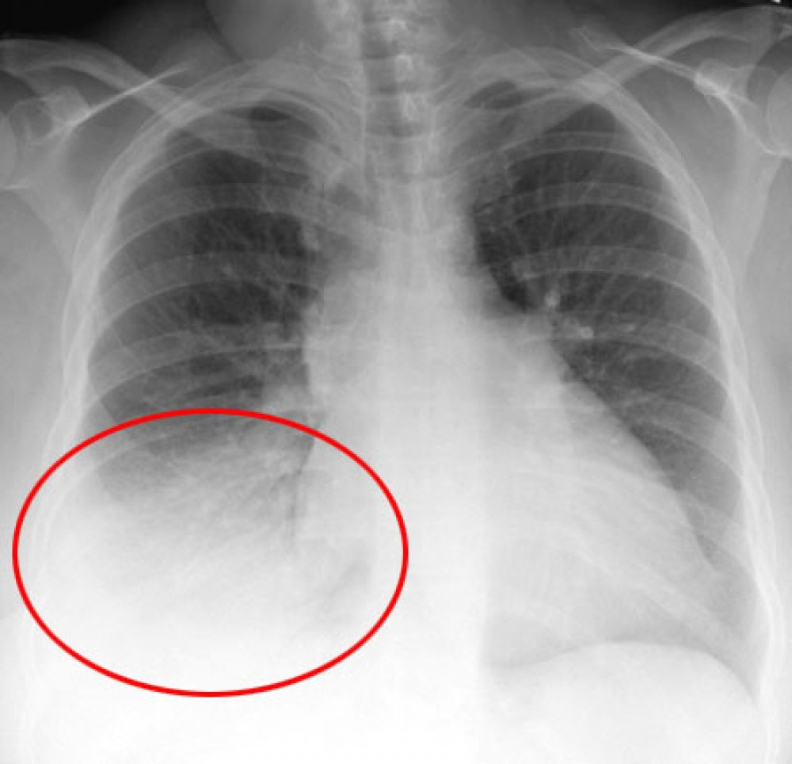
Pneumonia
Diagnosis
Clinical exam
CXR
Inf. markers / FBC / UE / cultures
CURB-65 score – pneumonia severity
Confusion new onset
Blood Urea nitrogen >7
RR >=30
BP <90systolic / 60 diastolic
Age >=65
The Peer Teaching Society is not liable for false or misleading information…

Slide 24
Pneumonia
Community vs hospital acquired pneumonia
Bacterial (2/3)
Strep.pneumoniae (50%)
H.influenza (20%)
C.pneumoniae (10%)
Viruses (1/3)
RSV
Adenovirus
Influenza virus
The Peer Teaching Society is not liable for false or misleading information…

Slide 25
Pneumonia
If the question has water cooler / air conditioner
Legionnaire’s disease
Atypical pneumonia
Legionella pneumophilia
Community acquired rx – amoxicillin
Hospital acquired rx – tazobactam / piperacillin
The Peer Teaching Society is not liable for false or misleading information…

Slide 26
Cystic Fibrosis
Autosomally recessive inherited channelopathy
Na/Cl channel dysfunction
Results in thick mucus plugs
Abnormal CFTR gene deletion
Respiratory secretions
Productive cough and mucus plugs, recurrent infection (Pseudomonas aeruginosa), s.o.b
Exocrine pancreatic insufficiency
Malabsorbtion, steatorrhoea
The Peer Teaching Society is not liable for false or misleading information…

Slide 27
Cystic Fibrosis
Diagnosis
Sweat test (>60mmol/L Cl-)
CXR – bronchiectasis, hyperinflation
Genetic testing
Management
Respiratory physio
Pancreatic enzyme supplementation
Empirical abx for infection
The Peer Teaching Society is not liable for false or misleading information…

Slide 28
Bronchial Carcinoma
3rd highest cause of death in UK, most common malignancy in the West
Smoking main risk factor
Cough with HAEMOPTYSIS, chest pain, chest infection, malaise, weight loss, SOB, signs of mets
CXR or CT should be visible tumour if
Chemotherapy, surgery and radiotherapy.
Often palliative poor prognosis (20% alive at 1 year)
The Peer Teaching Society is not liable for false or misleading information…

Slide 29
Types of Bronchial Carcinoma
Non-small cell (90%)
Squamous (40%)-obstructive lesions of bronchus leads to infection.
Adenocarcinoma (10%)-associated with asbestos.
Large cell carcinoma (25%)-metastasize early.
Small cell carcinoma (10%)
Strongly associated with smoking often spread at presentation.
The Peer Teaching Society is not liable for false or misleading information…
Notes:
Squamous-occassionally caviates, usually well differentiated, local spread common but late widespread mets
Adenocarcinoma-arise from mucous cells, common invasion of pleura and mediastinal lymph nodes, mets to brain, adrenal glands and bones.
Large cell-less differentiated forms of squamous and adeno,
Small cell-cancer of endocrine cells of APUD system-secrete polypeptides hormones which have autocrine effect so feed back to tumour and cause growth.

Slide 30
Other tumours
Mesothelioma-High grade malignancy of pleural, strongly associated with asbestos exposure.
Lymphomas-Often involve the lung. Bulk pattern of lung lymphoma described BALTOMA (bronchus associated tissue lymphoma. Is a B Cell lymphoma and responds to standard chemotherapy.
The Peer Teaching Society is not liable for false or misleading information…
Notes:
Mesothelioma- average time from diagnosis to death 8 months

Slide 31
Pulmonary fibrosis
Causes:
Secondary to infarction, TB and pneumonia
Idiopathic pulmonary fibrosis
Extrinsic allergic alveolitis
Sarcoidosis
Occupational (industrial dust diseases)
Coal workers pneumoconiosis
Silicosis
Asbestosis
The Peer Teaching Society is not liable for false or misleading information…

Slide 32
Idiopathic Pulmonary Fibrosis
Clinical features-dry cough, progressive breathlessness, malaise and cyanosis, clubbing, fine bilateral end-inspiratory crackles
Investigations-CXR/Ct, Respiratory function tests restrictive patterns-TV reduced with normal FEV1/FVC.
Treatment-prednisolone, O2, possible transplant if severe.
The Peer Teaching Society is not liable for false or misleading information…

Slide 33
Extrinsic allergic alveolitits
Inhalation of allergens provokes a hypersensitivity reaction type III. (immune complex formation)
Acute phase- alveoli infiltrated with acute inflam cells i.e. neutrophils
Chronic exposure- small granuloma formation
Clinical features
4-6 hrs post exposure- fever, rigors, dry cough, dyspnoea, crackles (no wheeze)
Chronic- weight loss, exertional dyspnoea, type 1 respiratory failure, cor pulmonale.
The Peer Teaching Society is not liable for false or misleading information…
Notes:
Gells-combe classification

Slide 34
EAA (Cont)
Most common cause is farmer’s lung (spores)
Others:
Pigeon fancier’s lung (proteins in bird droppings)
Malt worker’s lung (aspergillus clavatus)
Bagassosis/sugar worker’s lung (sugar cane fibres)
CXR- upper zone mottling/consolidation. Honeycomb lung in very advanced cases
Treat- Remove allergen, O2, oral prednisolone (steroids)
The Peer Teaching Society is not liable for false or misleading information…

Slide 35
Occupational lung disease
Coal workers pneumoconiosis-deposition of coal dust in lung.
Asbestosis-Asbestos exposure requires heavy exposure
Silicosis-Inhalation of silicon diozide/silicates abundant in stone and sand.
The Peer Teaching Society is not liable for false or misleading information…

Slide 36
Pleural effusion
Excessive fluid in pleural space
Transudates-protein content <30g/L: heart failure, hypoproteninaemia (nephrotic syndrome), hypothyroidism
Exudates-protein content >30g/L: Bacterial pneumonia, Bronchial carcinoma, TB
>300mls seen on X-ray
Treat cause and drain slowly
The Peer Teaching Society is not liable for false or misleading information…

Slide 37
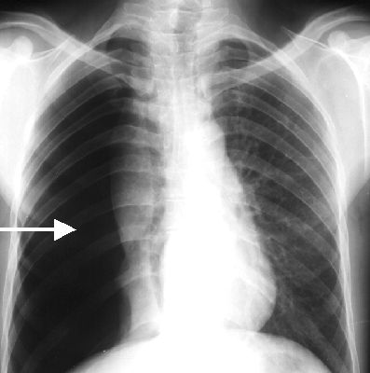
Pneumothorax
Air in pleural space
Sudden, unilateral pleurisy pain. Progressive breathlessness and tachycardia
CXR, CT, US
Small-monitor and avoid exercise
Larger-aspirate air, possibly insert
drain.
The Peer Teaching Society is not liable for false or misleading information…
Notes:
Can be spontanous or result of trauma

Slide 38
Pulmonary Embolism
Embolic blockage of pulmonary artery. Lung tissue ventilated but not perfused. Can lead to infarction and alveolar collapse
90% of emboli are from DVT.
Sudden onset unexplained dyspnea, pleuritic chest pain, cough and haemoptysis. Previous leg pain.
CXR and CT, ECG-sinus tachycardia, Bloods-raised ESR, Hypoxic ABG
O2, bed rest/analgesia, anticoagulation (low molecular wright heparin
Wells score as risk assessment, prophylaxis-anticoagulation (warfarin) and compression stockings.
The Peer Teaching Society is not liable for false or misleading information…

Slide 39
Pulmonary Hypertension
Causes: Primary, LHD, Lung disorders and hypoxia, Chronic thromboembolic PH, Systemic diseases
Clinical features: Non-specific features of RVF (SOB, fatigue, chest pain, palpitations ect), Insidious onset.
Investigations: Right heart catheter, Imaging-enlarged Pulmonary arteries and RV hypertrophy.
Treatment dependent on cause. Ca channel blockers- Primary PH. Warfarin-Chronic thromboembolic
Poor prognosis
The Peer Teaching Society is not liable for false or misleading information…

Slide 40
What hasn’t been covered
Goodpasture’s Syndrome (anti-GbM)
Sarcoidosis
Wegener’s granulomatosis
Alpha-1-antitrypsin deficiency (neutrophil elastase)
Anything else you can think of
The Peer Teaching Society is not liable for false or misleading information…

