Slide 1
Genitourinary online Formative - Results
Peer teaching society is not responsible for false or misleading information
Peer Teaching website link: https://www.peerteaching.co.uk/

Slide 2
Genitourinary online formative results (Peer Teaching Society)
Welcome to the results and feedback for the Genitourinary online formative quiz
The results to each question will be followed by a brief explanation for the questions that student struggled with most.
Questions aim to cover the core Genitourinary conditions
· Renal Colic
· Acute Kidney Injury/ Acute renal failure
· Cancer- Kidney, bladder, prostate, testicular
· Chronic Kidney disease
· Benign Prostate Hyperplasia
· Infection- pyelonephritis, cystitis, prostatitis, urethritis
· Glomerular disease- nephritic syndrome, nephrotic syndrome
· Polycystic kidney disease
· Scrotal disease- epididymal cyst, hydrocele, varicocele
Peer Teaching website link: https://www.peerteaching.co.uk/

Slide 3
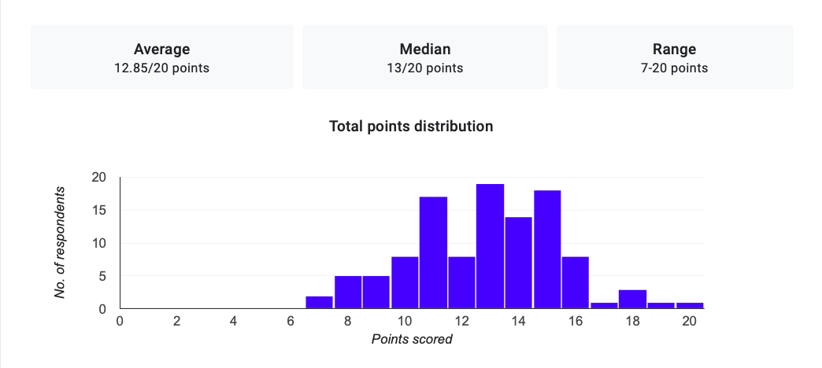
Overall Performance
110 Phase 2b students completed the quiz

Slide 6
Question 1- CKD explanation
Acute renal failure (ARF) | Chronic renal failure (CRF)
Normal sized kidneys | Small kidneys, increased echogenicity
No anaemia | Anaemia, i.e. normochromic, normocytic – check Hb
No diabetes | Diabetes
Low BP | Raised BP
Rapid change in urea/creatinine | Gradual onset of symptoms
Oliguria normally present | Oliguria only present in later stages; polyuria and nocturia often present in less advanced disease
Not often CNS symptoms | CNS symptoms in later disease
Symptoms a bit like “shock” | Symptoms more like serious extensive disease

Slide 7
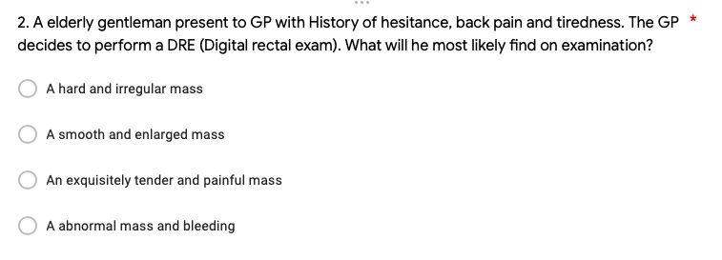

Slide 9
Question 2- Prostate cancer
Patient present to GP with Hx of hesitance , back pain and tired. GP decides to do a Digital rectal exam what will he most likely find on examination
Hard and irregular (correct) (Irregular due to location in outer layer of prostate (peripheral zone)
Smooth and enlarged (BPH) (transitional zone)
Exquisitely tender and painful (prostatitis)
Abnormal mass and bleeding (Haemorrhoids)

Slide 10
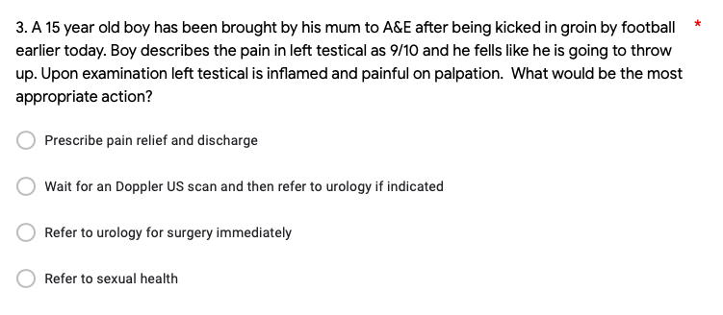

Slide 11
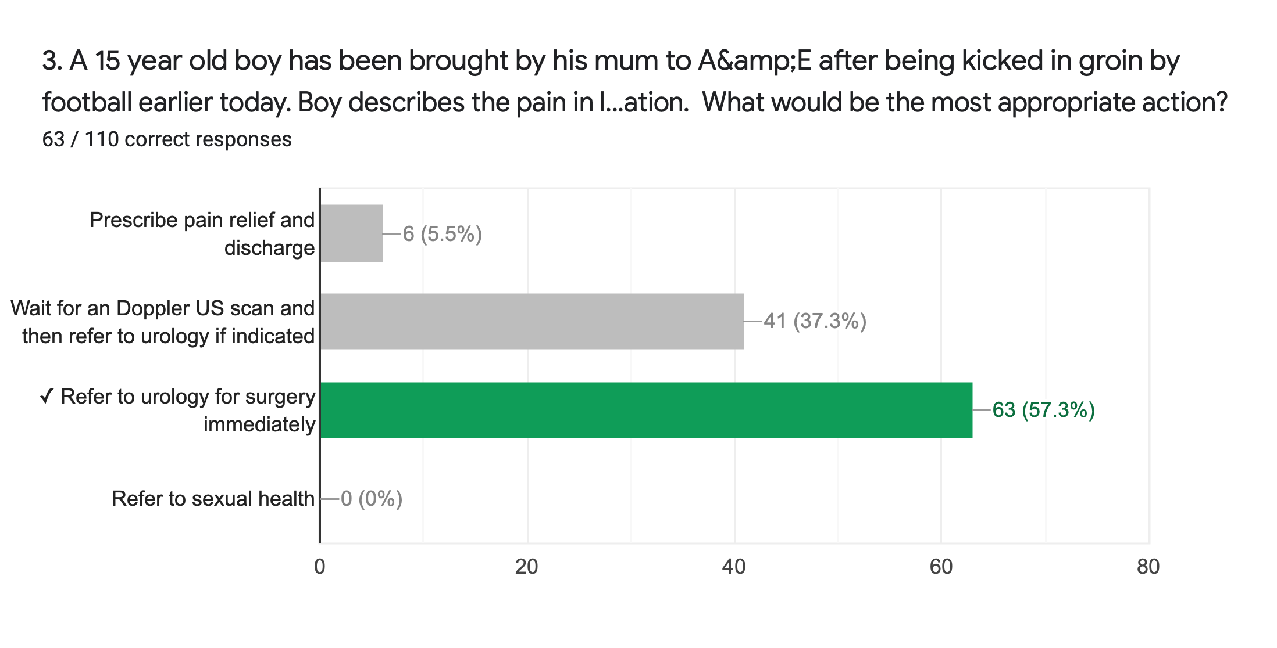

Slide 12
Question 3- Testicular torsion
Testicular torsion
15 year old boy, kicked in groin by football earlier today,mum brought him to A&E. Boy describes the pain in left testical as 8/10 and he fells like he is going to throw up. Upon examination left testical is inflamed and painfull on palpation.
Always refer suspected testicular torsion to urology immediately

Slide 15
Question 4- Cystitis
Cystitis history
A pregnant 25 year old lady presents to GP rushing to toilet more often over the last few week, recently pain in surapubic region and when urinating, urine is also a funny colour. Then which treatment.
Trimethoprim (teratogenic- so not in pregnancy)
nitrofurantoin (teratogenic- so not in pregnancy)
cephalexin (if pregnant)
Paracetamol

Slide 17
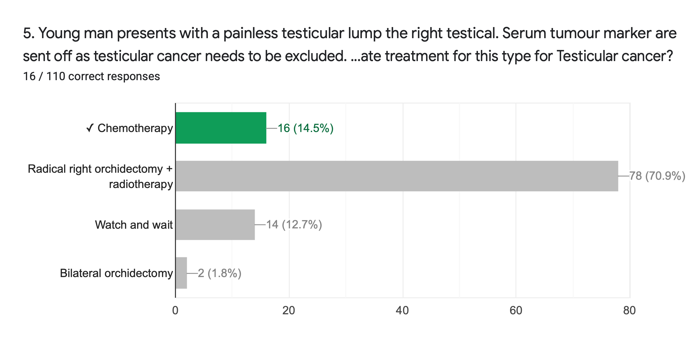

Slide 18
Question 5- Testicular cancer
Young presents with a painless testicular lump the right testical. Serum tumor marker are sent off as testicular cancer needs to be excluded. However testicular cancer in confirmed and Alpha feto protein is noted as a Serum tumor marker. What is the most appropriate treatment for this type for Testicular cancer?
Chemotherapy is the treatment for Non seminoma- Alpha fetoprotein
radical orchiectomy + radiotherapy is the treatment for seminoma -never Alpha fetoprotein

Slide 19
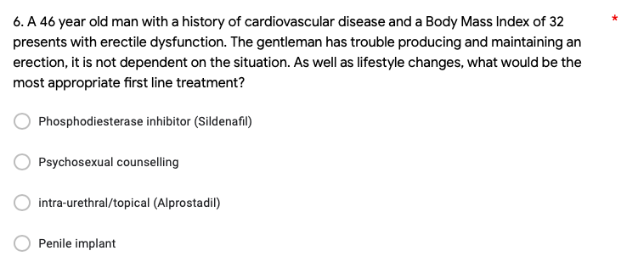

Slide 20
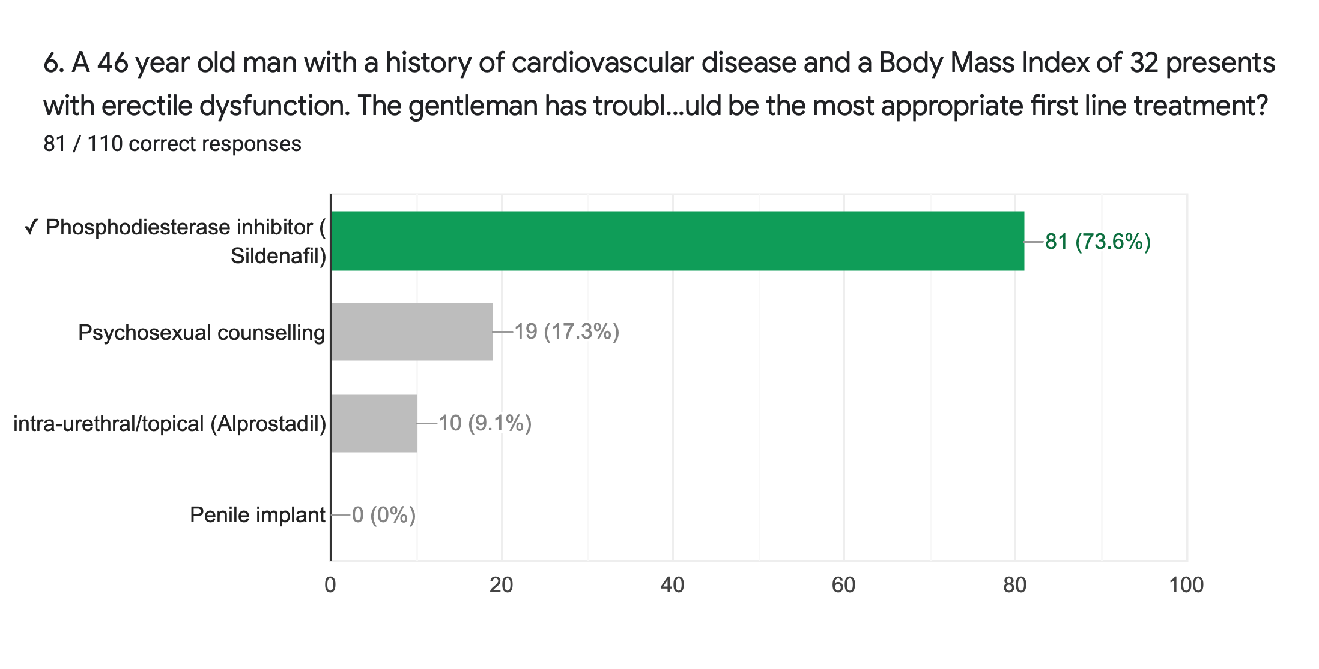

Slide 21
Question 6
Erectile dysfunction
A 46 year old man with a history of cardiovascular disease and a Body Mass Index of 25 presents with erectile dysfunction. The gentleman has trouble producing and maintaining an erection, it is not dependent on the situation. As well as lifestyle changes, what would be the most appropriate first line treatment?
Phosphodiesterase inhibitor (sildenafil)
Psycosexual councling (if young, situational ED)
intraurethral/topical alprostadil (second line)
Penile implant
Notes:
Stress lifestyle checj for diabetes

Slide 22
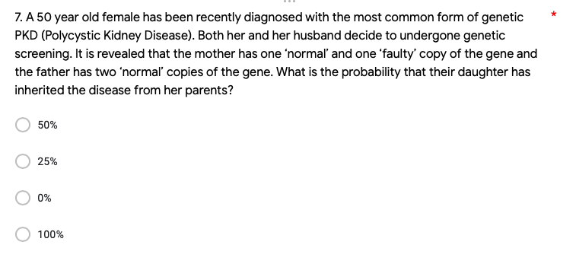

Slide 23
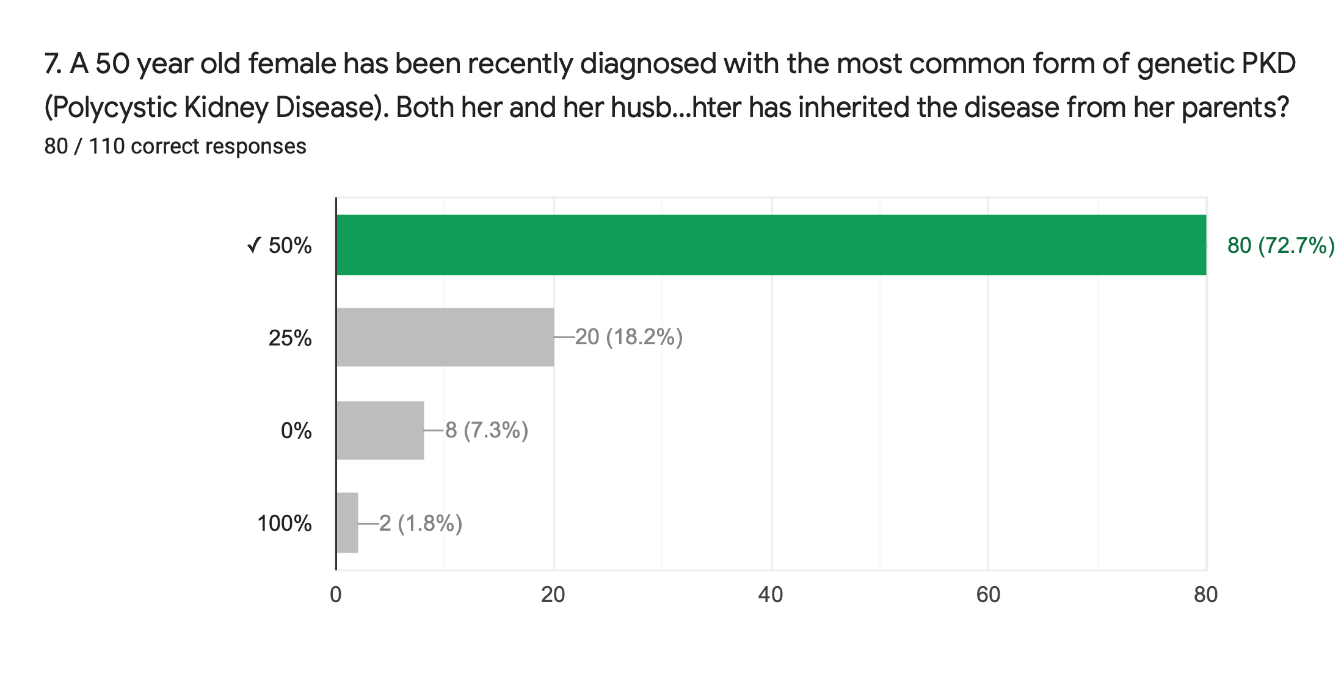

Slide 24
Question 7
A 50 year old female has been recently diagnosed with the most common form of genetic PKD (polycystic kidney disease). Both her and her husband decide to undergone genetic screening. It is revealed that the mother has one ‘normal’ and one ‘faulty’ copy of the gene and the father has two ‘normal’ copies of the gene. What is the probability that their has daughter inherited the disease from her parents?
Autosomal dominant PKD so 50%

Slide 27
Question 8-Nephritic syndrome
History show classic triad of Nephritic syndrome
post strep glomerulonephritis= weeks after URTI
minimal change disease (nephrotic syndrome)
IgA nephropathy=days after URTI)
diabetic nephropathy (nephrotic syndrome)

Slide 28
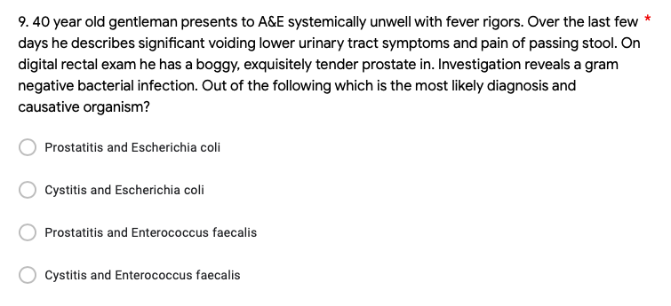

Slide 29
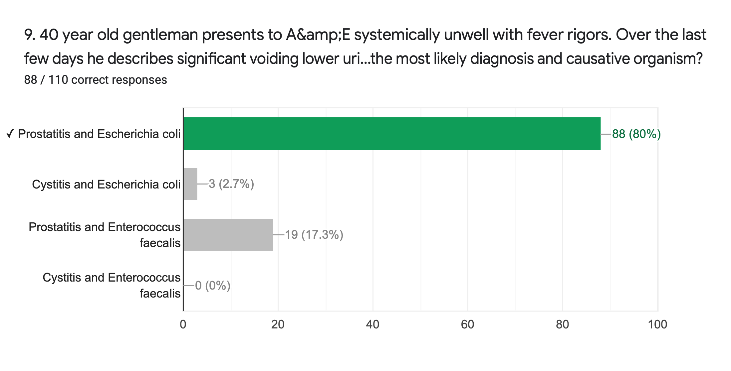

Slide 31
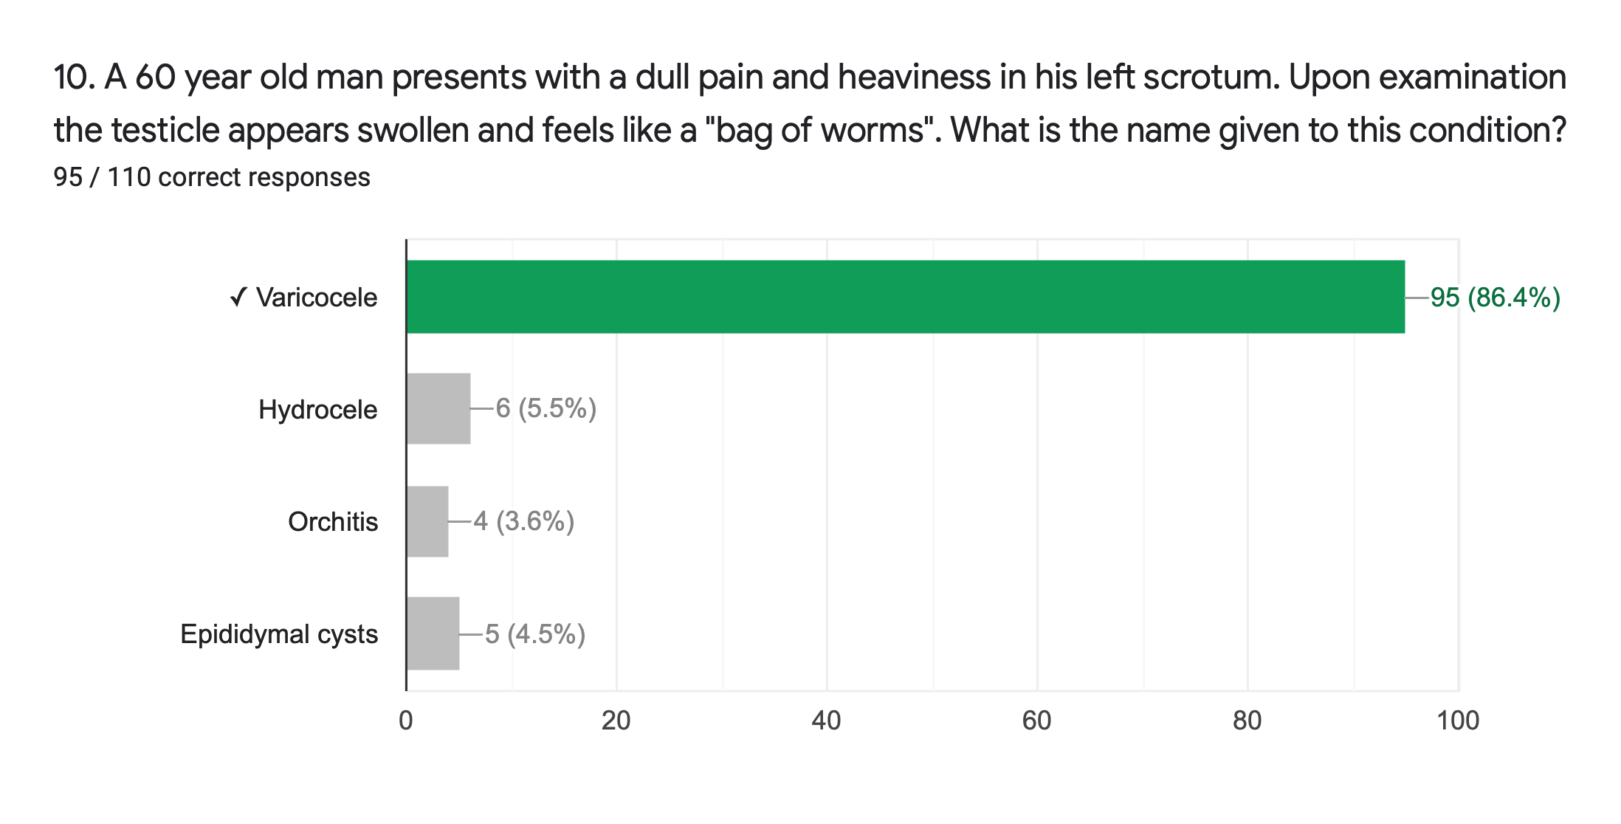

Slide 32
Question 10- Non-Malignant Scrotal Disease
A 60 year old man presents with a dull pain and heaviness in his left scrotum. Upon examination the testtical appears swolen and feels like a "bag of worms". What is the name given to this condition?
Epididymal cysts (spermatocele) | •Clear/milky fluid •Above & behind testes
Hydroceles | •Fluid in tunica vaginalis – PPV or secondary to trauma/infection/tumour •Can be transilluminated •Spontaneous recovery – if not, aspirate/surgery
Varicoceles | •Dilated pampiniform plexus – faulty valves •Left > right •‘Bag of worms’ •Ligation/embolization of gonadal veins
Haematoceles | •Blood in tunica vaginalis – trauma •Aspirate/surgery
Epididymo-orchitis | •Sudden onset testicular pain – exclude torsion! •Usually STI cause

Slide 35
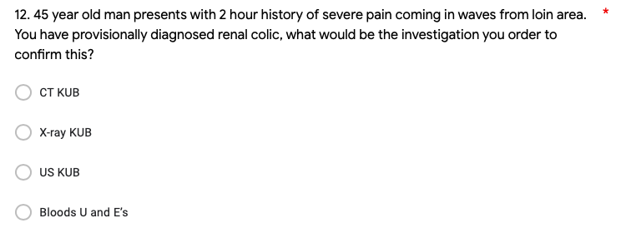

Slide 36
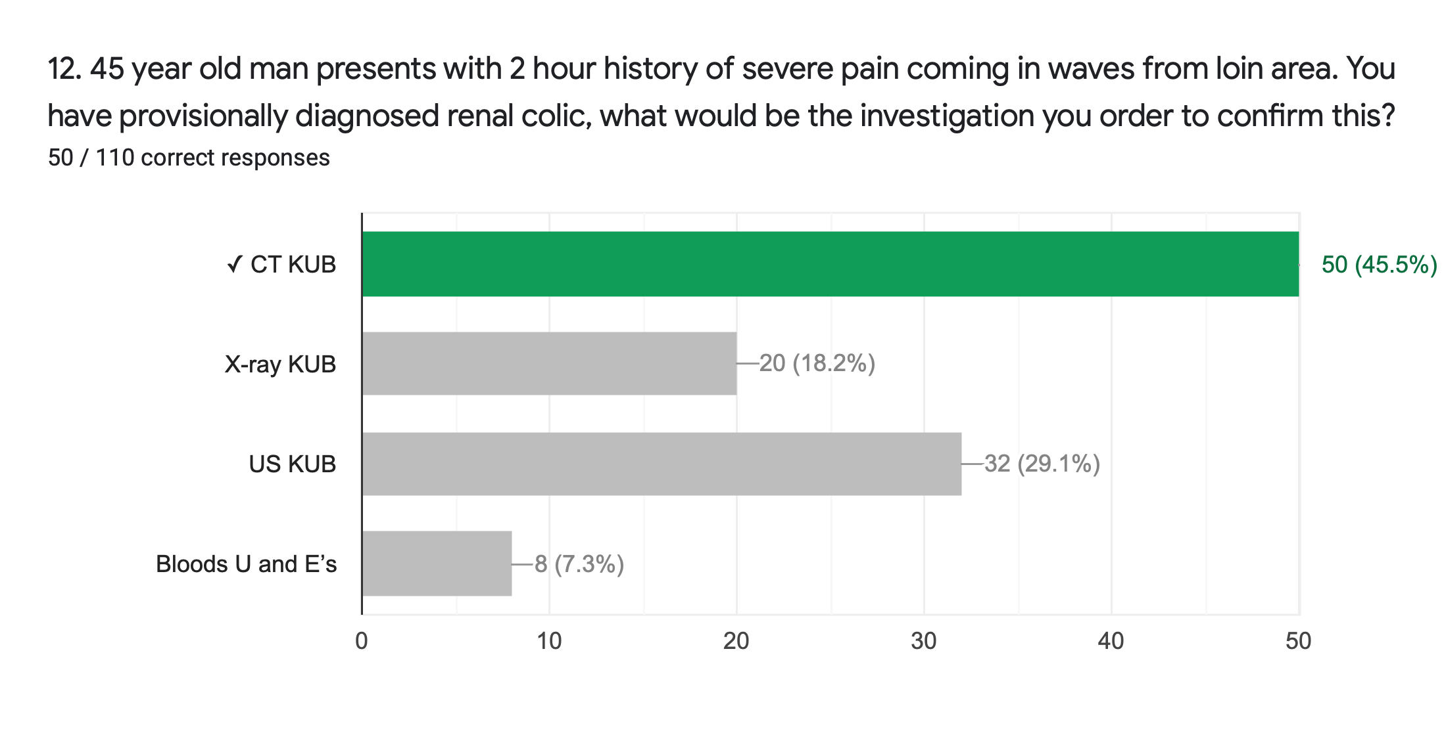

Slide 37
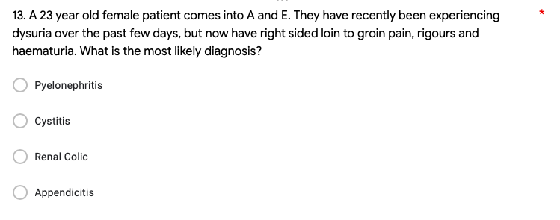

Slide 38
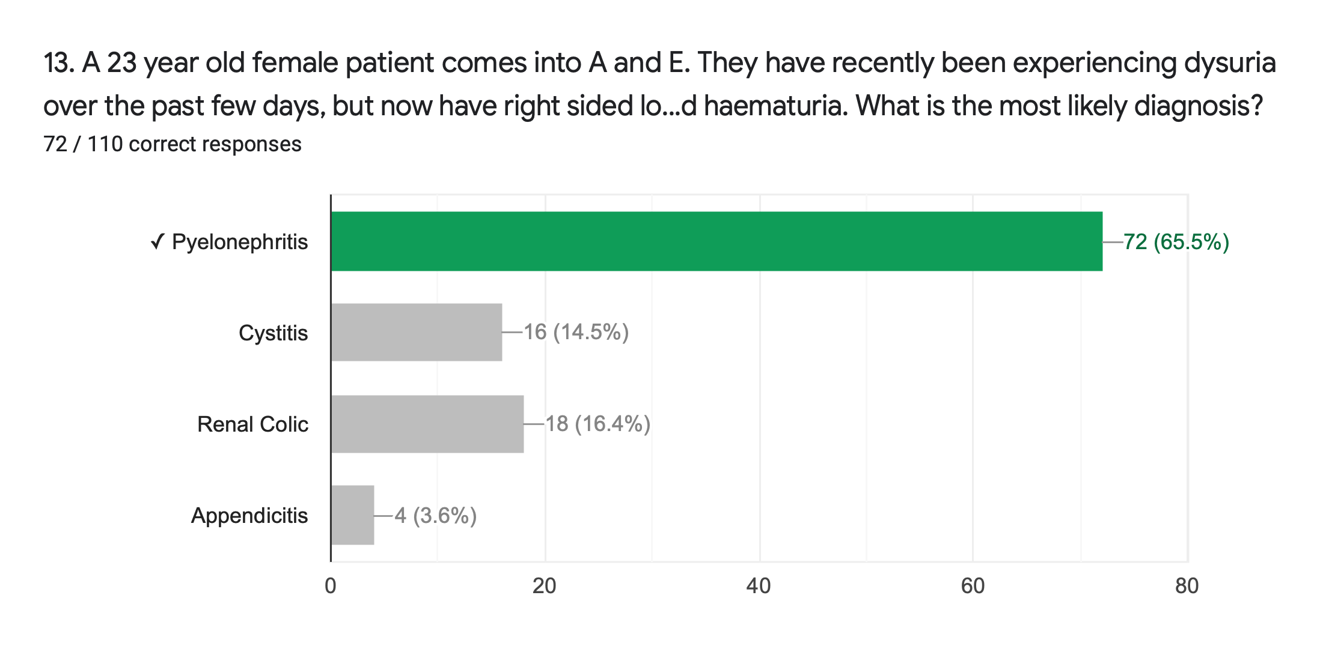

Slide 39
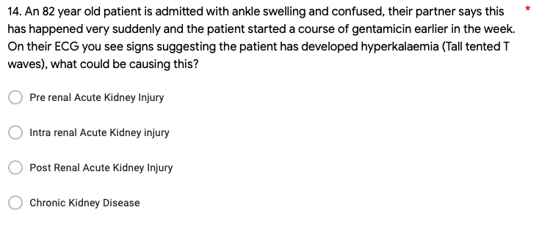

Slide 40
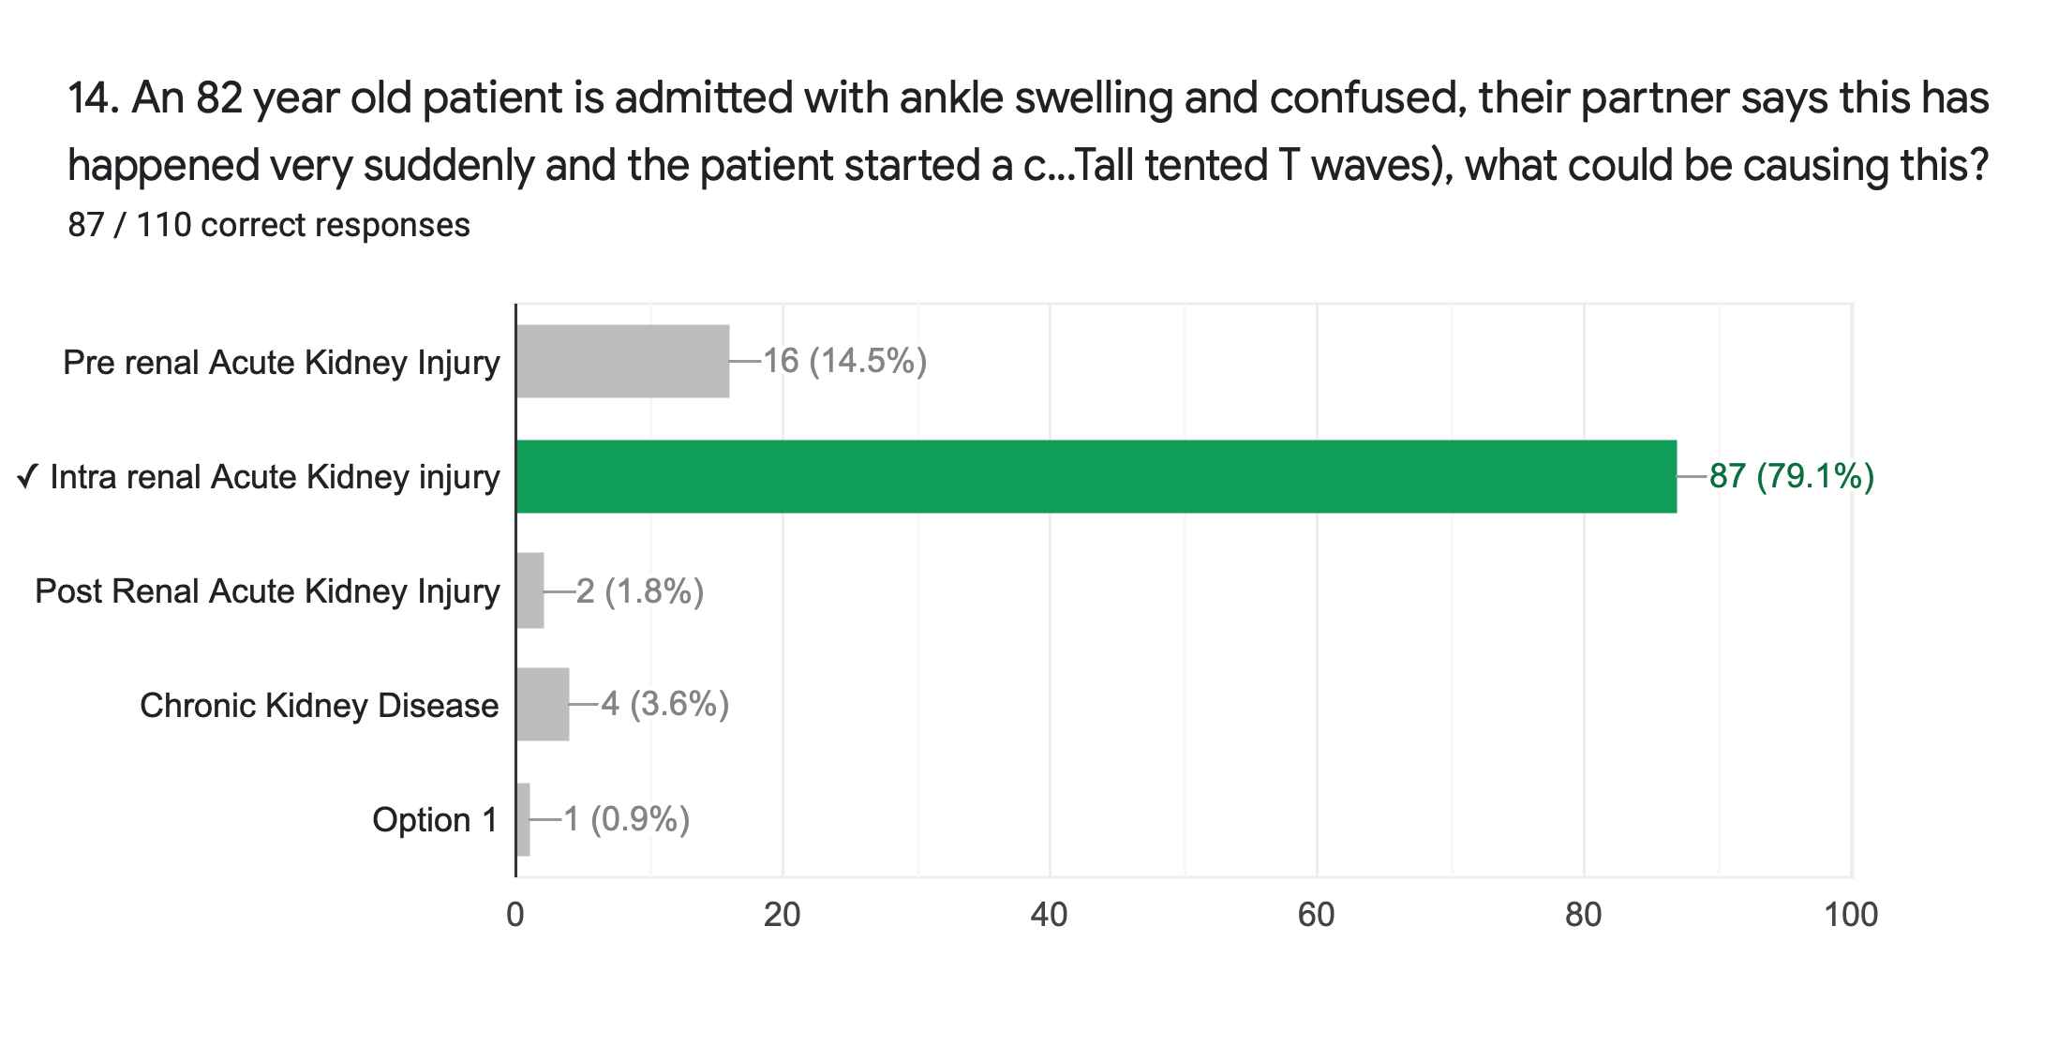

Slide 41
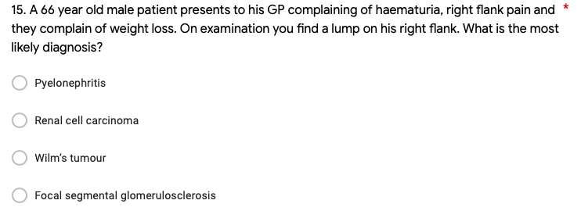

Slide 42
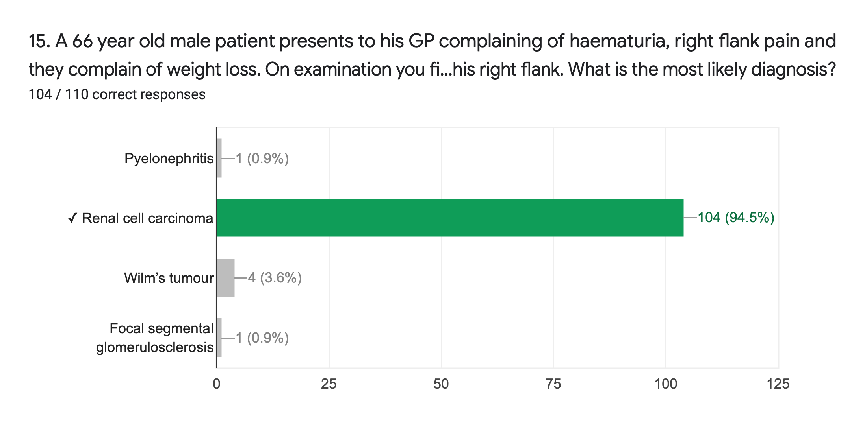

Slide 43
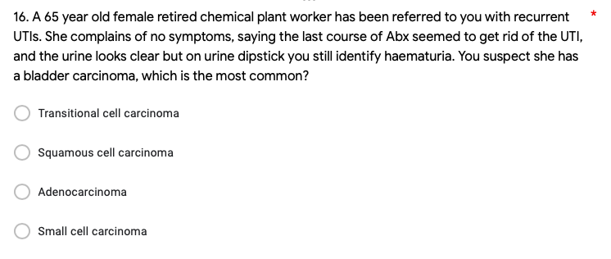

Slide 44
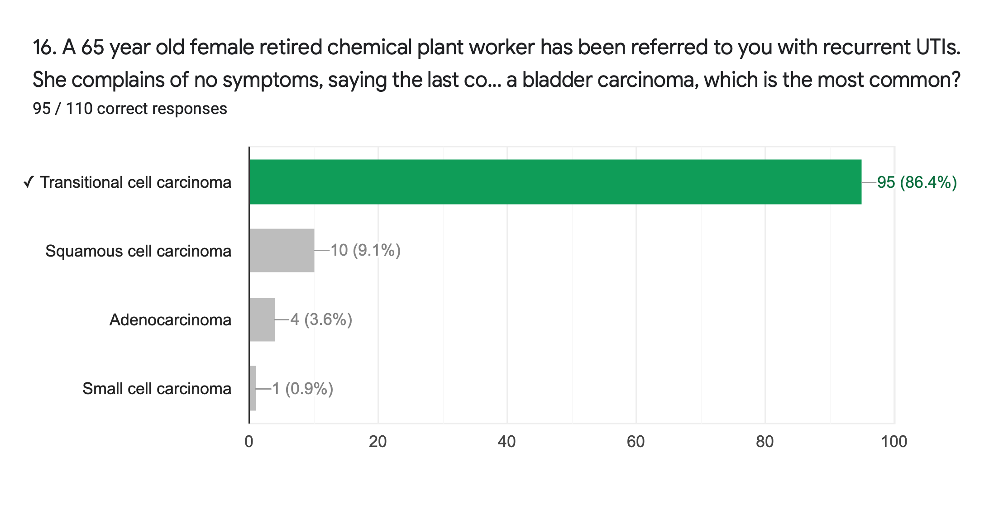

Slide 45
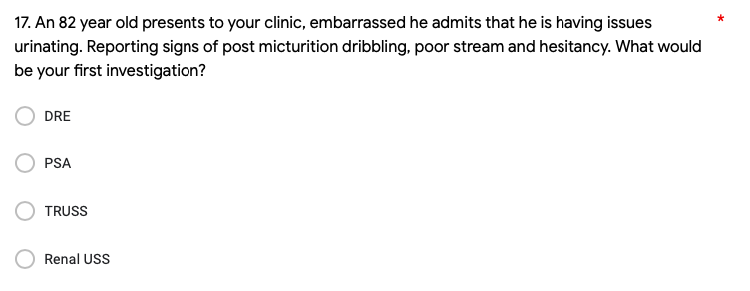

Slide 46
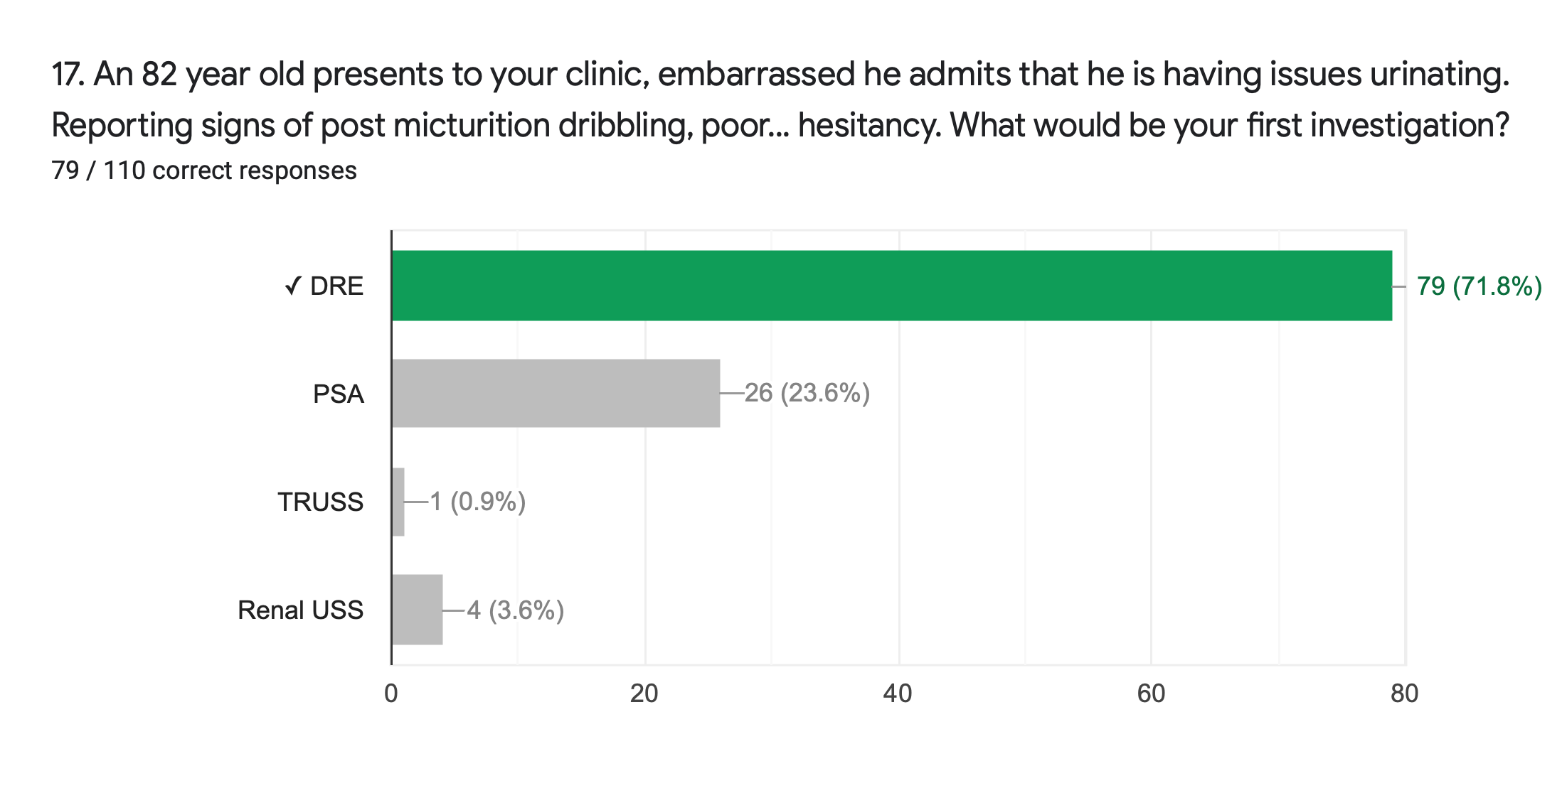

Slide 48
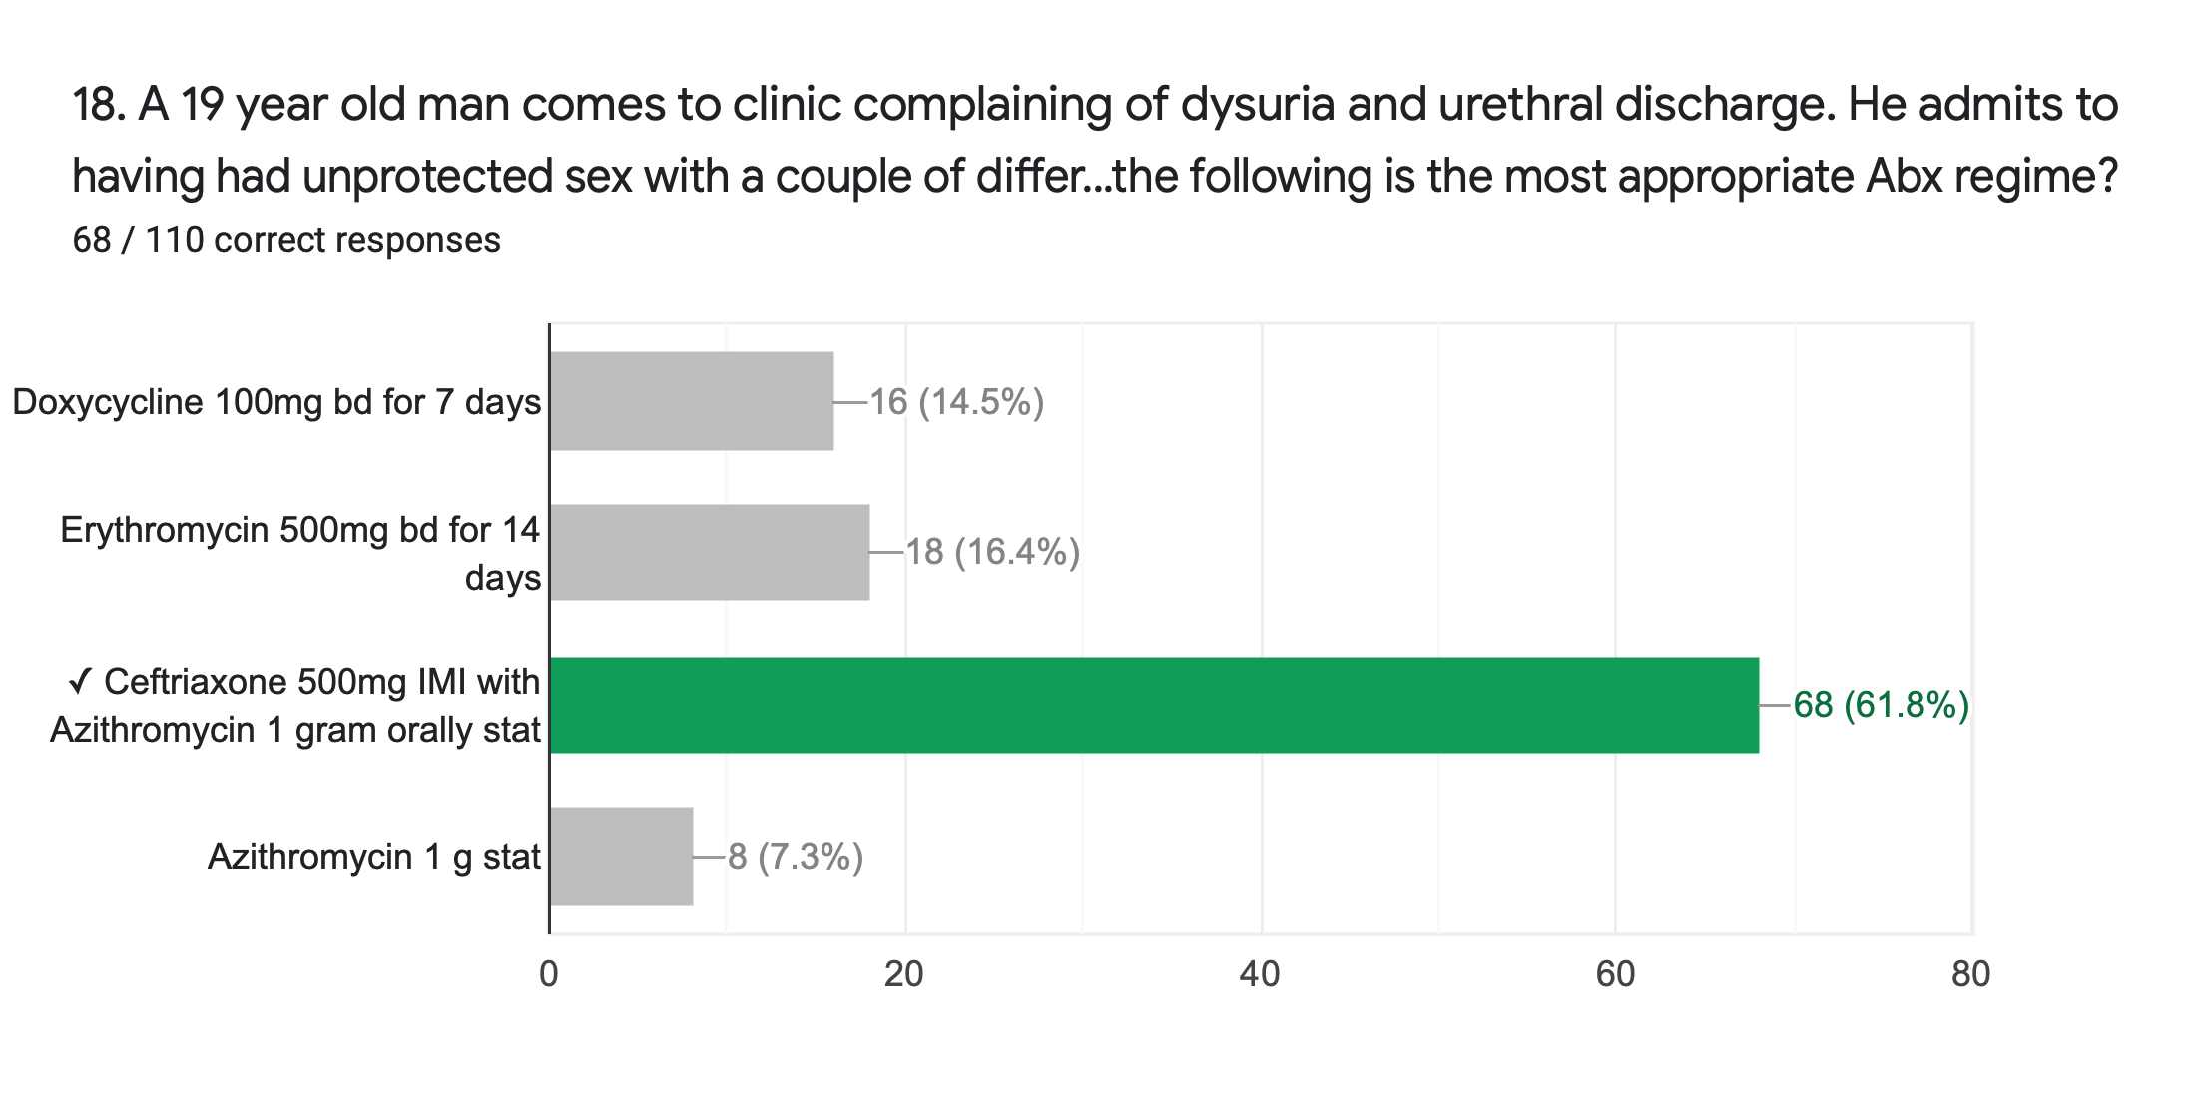

Slide 49
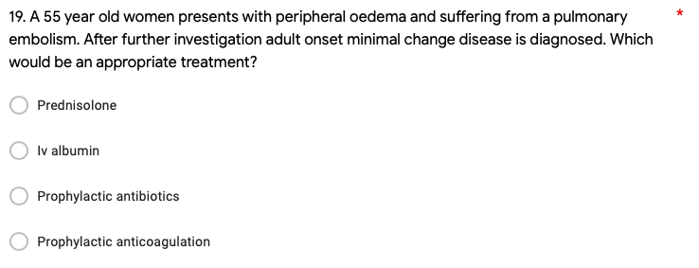

Slide 50
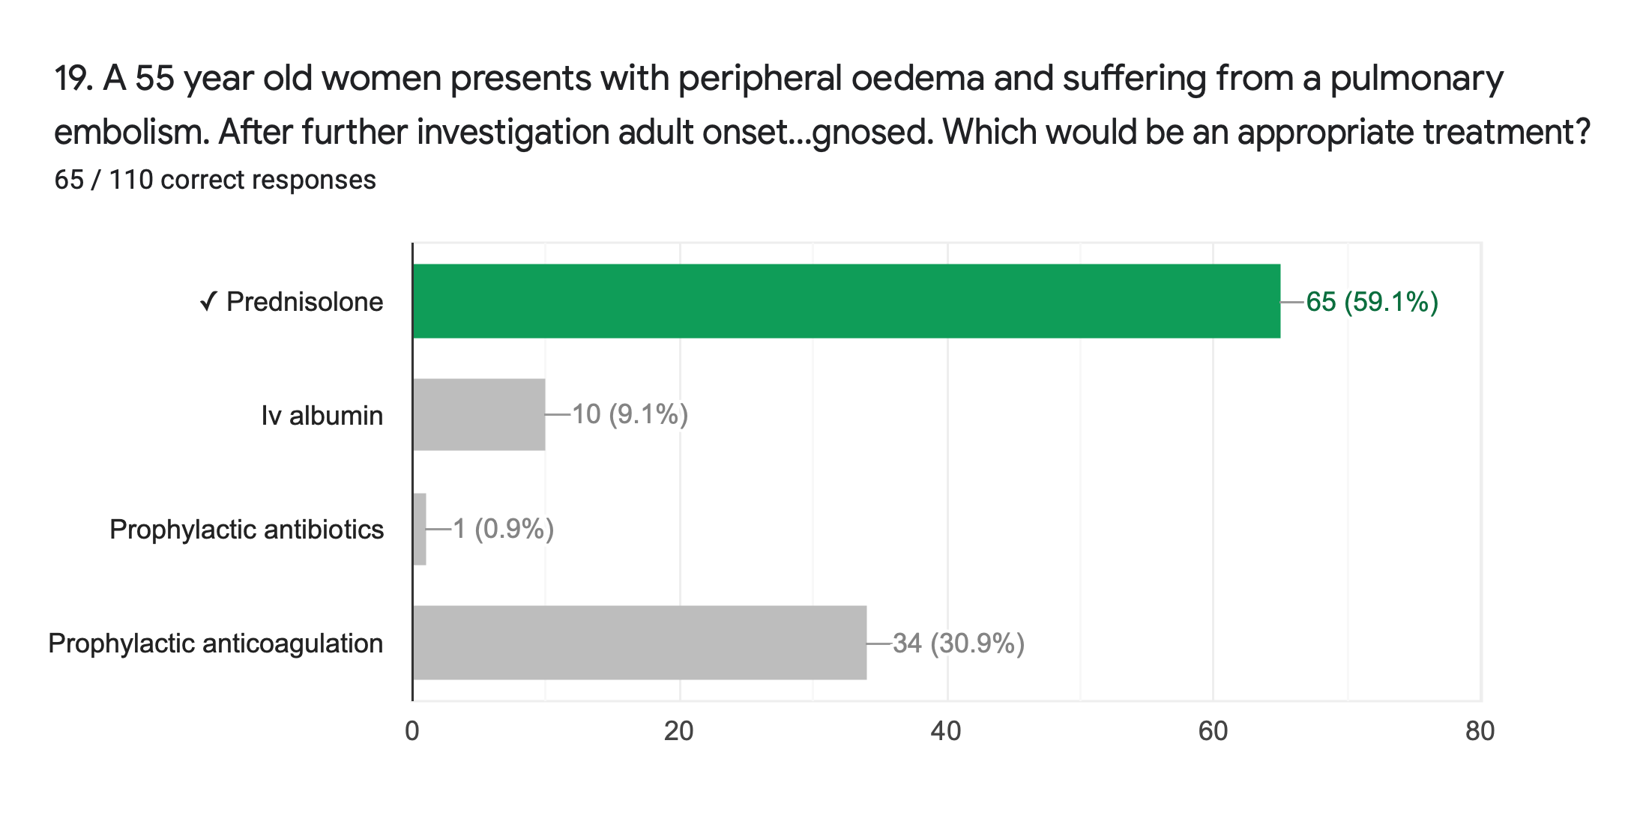

Slide 51
Question 19 - Explanation
The cause had been identified as minimal change disease and therefore the correct answer was steroids- (although the question in the exam would be clearer (without PE in the root) as a prophylactic anticoagulation course would be the correct cause if the question was on management of PE).
Management for nephrotic syndrome:
High corticosteroids e.g. Prednisolone- can reverse proteinuria in 95% cases- but the majority relapse
Frequent relapse or steroid dependent disease is treated with cyclophosphamide or ciclosporin
Steroids have been used widely for the treatment of adult-onset minimal change disease but the response rates to immunosuppressive agents in adult minimal change disease, especially steroids, are more variable than in children. Intravenous albumin, prophylactic antibiotics and prophylactic anticoagulation are currently not recommended.

Slide 52
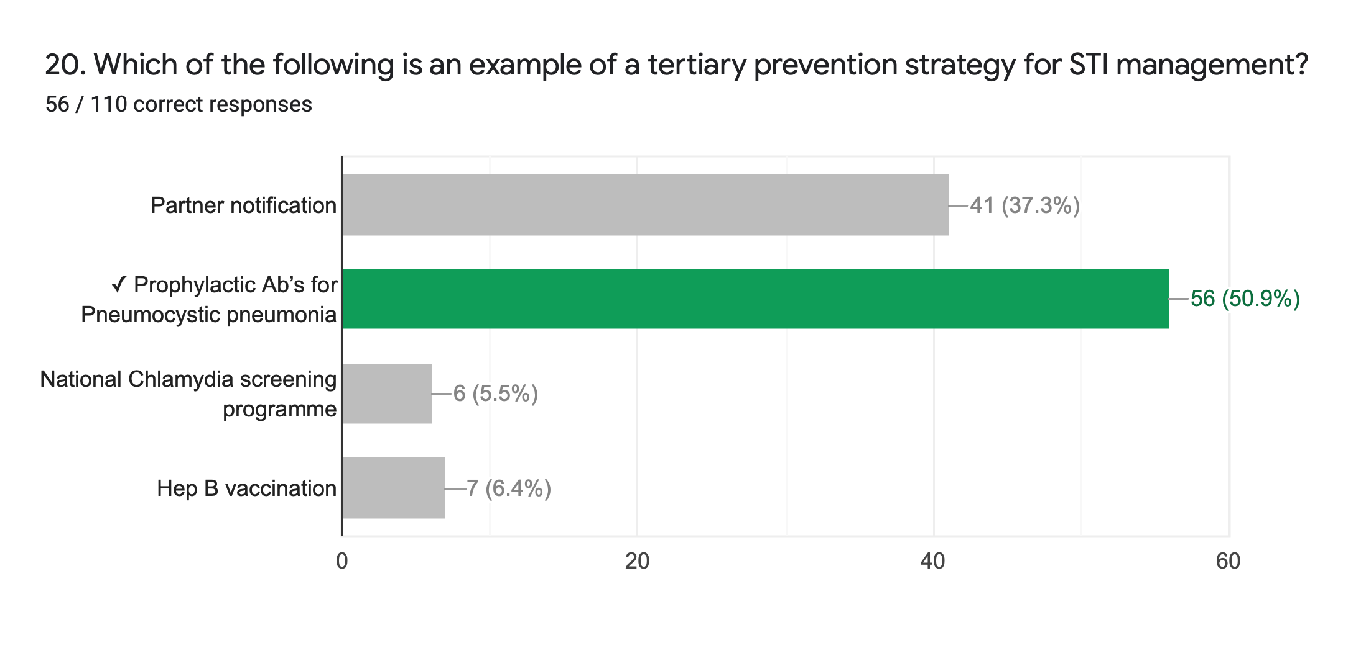

Slide 53
Question 20- Public health
Primary prevention strategies- aim to prevent injury or disease before it occurs
STI awareness campaigns to reduce personal risk behaviour (Sex. Worth talking about)- ‘Keys, Cash, Condoms’ posters
One to one risk reduction discussion- structured discussion based on the behaviour change theory
Vaccination; Hep B, HPV, pre and post exposure prophylaxis
Secondary prevention strategies- Reduce the impact of injury or disease that has occurred
Early access to STI/HIV tests/treatments
Partner notification and screening- break chain of transmission and re-infection.
Targeted screening:
Antenatal for HIV and chlamydia
National chlamydia screening programme
HIV home testing (‘it starts with me’)
Tertiary prevention strategies- soften the impact of an ongoing illness or injury with lasting effects
Anti-retrovirals for HIV
Prophylactic Ab’s for Pneumocystic pneumonia
Acyclovir for the suppression of genital herpes

Slide 54
Your Comments
Helped understand the topic better and what to expect
More formative online mini assessments through out the year for each module even when face-to-face teaching commences - allow you to think about the answers without hearing someone shouting it out or friends whispering answers before thinking about it.
very good - maybe get answers quicker after finishing
Found it really useful especially when having to pick first line managements or treatments Helped me to recap some topics in an exam style way so i'm more likely to remember Questions were really nicely written Thank you
It is really useful seeing what areas of a topic are most likely to come up/what conditions need more in depth knowledge.
Thank you very much for making these resources! Really appreciated and massively helps my learning. Puts learning conditions into an alternative perspective which I find very useful.
Great formative quiz :) Thanks for making it!

