Slide 1
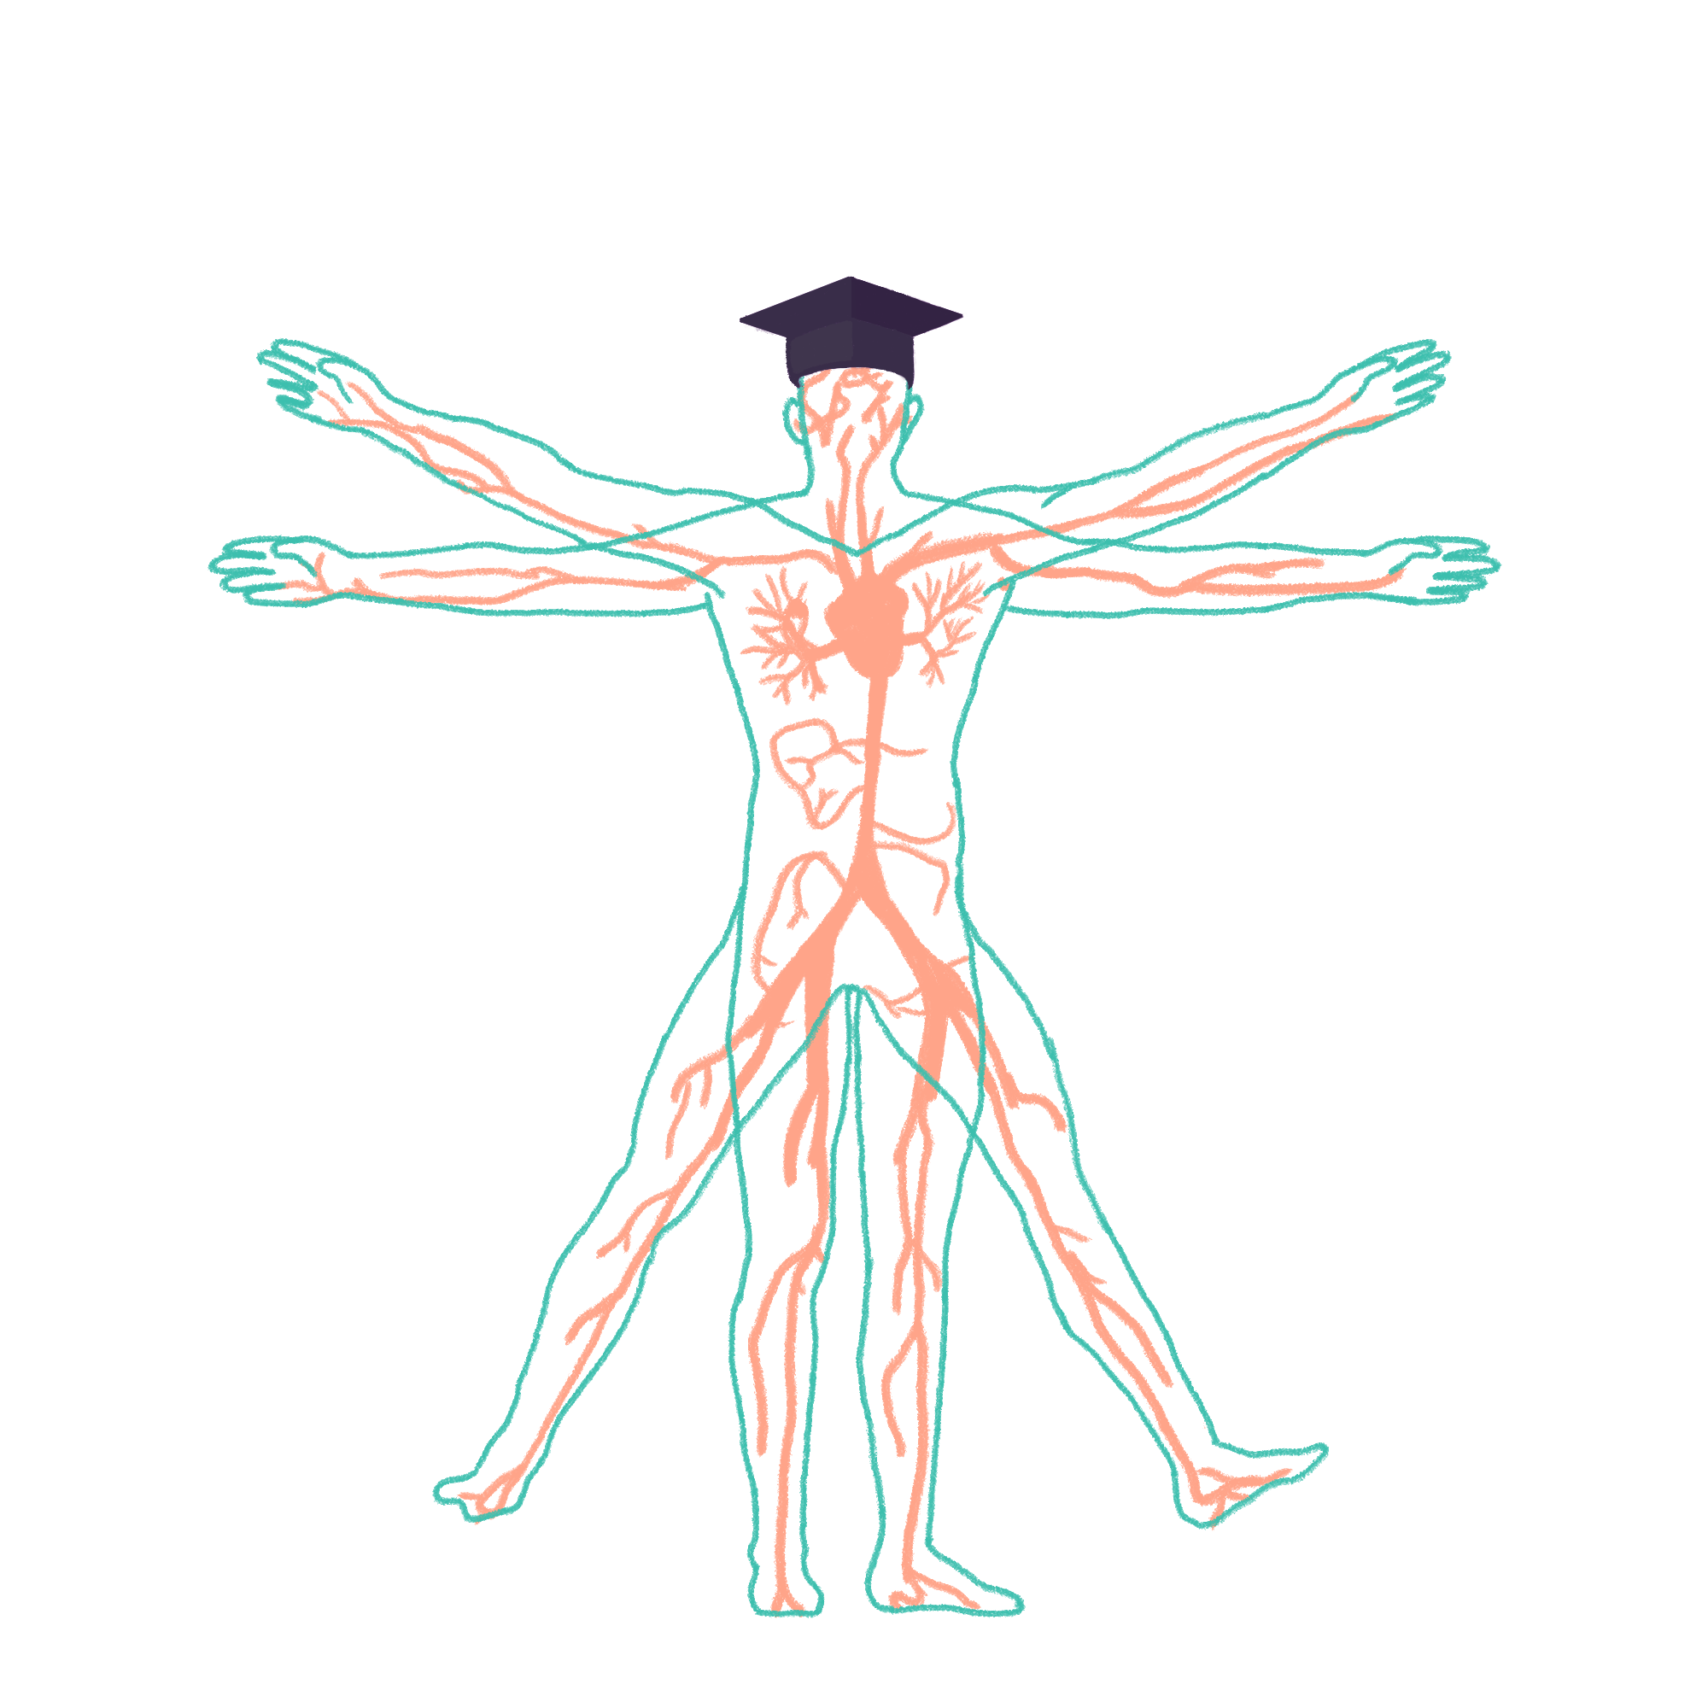
2021/2022

Slide 2
IMMS Teaching
Phase One IMMS Part 1 Wrap-Up Session
Paige Wilson
13/10/2021, 7-8pm

Slide 3

Aims and Objectives
Cells
  Organelle structure and function, membrane transport, cell junctions
Homeostasis
  Cell communication methods, water balance, feedback mechanisms
Molecular Building Blocks
  Carbs/lipids/nucleotides/proteins, enzymes,
DNA / RNA
  Structure, replication, transcription/translation,
Mitosis/Meiosis
  Cell cycle, stages, abnormalities, gonadal mosaicism
Genetic Diseases
  Phenotype vs genotype, karyotypes, pedigrees, inheritance etc.
The Peer Teaching Society is not liable for false or misleading information…

Slide 4
Cell Ultrastructure
START HERE ☺
Be aware of the presence of peroxisomes – these contain catalase, which catalyzes
2H₂O₂ → 2H₂O + O₂

Slide 5
Mitochondria
Structure | Function
Cytosol | Site of Glycolysis
Matrix | Site of Krebs cycle
Cristae | Site of electron transport chain and chemiosmosis.
Inner membrane | Has ATP synthase embedded, allowing flow of H+ from the ETC to produce ATP.
Chemiosmosis – the movement of ions across a semipermeable membrane, down their electrochemical gradient. E.g. ATP generation via the movement of H+ ions during respiration.

Slide 6
Structure & Function
Structure | Function
Mitochondria | Site of respiration and energy generation (in form of ATP)
Ribosomes | Site of protein synthesis
Rough ER | Synthesis and processing of proteins – network of branching sacs with ribosomes attached
Smooth ER | Contains enzymes for synthesis of lipids
Golgi Apparatus | Processing and packaging of proteins
Cytoskeleton | Structural support, movement of materials (i.e. vesicles)
Nucleus | Contains genetic information, assembles ribosome subunits
Lysosomes | Contains acid hydrolases for digestion and recycling
Peroxisomes | Fatty acid and ethanol oxidation, contains catalase (converts hydrogen peroxide to water + oxygen

Slide 7
Storage
Lipofuscin – yellow-brown pigment granules made from lipid-containing residues of lysosomal digestion. “Wear and tear” pigment from the peroxidation of lipids.
Lipids – can be stored in adipocytes (as triglycerides), in cell membranes, and in lipoproteins (HDL & LDL).
Glycogen – stored in liver and muscles. How excess glucose is stored (converted by glucagon-secreting alpha cells in the pancreas).

Slide 8
Cell Membrane
Phospholipid bilayer – fluid mosaic model
Contains
  Cholesterol – binds together phospholipids to support fluidity
  Proteins – act as transporters
  Glycolipids & Glycoproteins – involved in cell signaling
Functions
  Partially permeable membrane
  Site of membrane receptors
  Regulates what goes into and out of the cell
  Acts as barrier; separates intracellular cell contents from extracellular cell contents

Slide 9
Cell Membrane Transport
Phospholipid bilayer with transport and receptor proteins; selectively permeable to maintain intracellular environment
Simple diffusion
  The passive movement of particles from a region of high concentration to a region of low concentration, through a partially permeable membrane.
  Transport of small, non-polar molecules
Facilitated diffusion
  Transport of particles through a partially permeable membrane, down their concentration gradient, by means of a carrier molecule.
  Transport of large and polar molecules
Active transport
  Transport of particles against their concentration gradient, requiring ATP.
  Transport of molecules such as nutrients and waste (proteins, ions, complex sugars)

Slide 10
Cell Junctions
Junction | Function
Tight Junction | Seals neighboring cells together in an epithelial sheet, to prevent leakage of molecules between them
Adherens Junction | Joins an actin bundle in one cell to a similar bundle in a neighbouring cell
Desmosome | Joins the intermediate filaments in one cell to those in a neighboring cell
Hemidesmosome | Anchors intermediate filaments in a cell to the basal lamina
Gap Junction | Allows the passage of small water-soluble ions and molecules

Slide 11
Cell Junctions

Slide 12
Homeostasis
The maintenance of a constant internal environment – like a dynamic equilibrium.
Cells must communicate to achieve homeostasis
  Major communication systems = endocrine (hormones), nervous (neurotransmitters), and immune (antibodies, and immune chemical messengers i.e. cytokines)
Maintained by feedback loops
  Positive feedback = amplification of signal (i.e. oxytocin release during childbirth, clotting cascade)
  Negative feedback = bearing towards an equilibrium (i.e. thermoregulation, blood glucose concentration)

Slide 13
Cell Communication
Autocrine
  Chemical released from cell into ECF and acts upon itself
Paracrine
  Local cellular communication; travels short distances i.e. ACh at NMJ. Paracrine chemical messengers travel in ECF.
Endocrine
  Secretion into blood NOT via duct. Long distance communication i.e. HPA axis
Exocrine
  Secretion via ducts into organ (i.e. salivary and sweat glands)

Slide 14
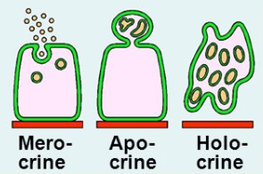
Cell Communication
Modes of secretion
Merocrine – no part of the cell is lost with the secretion i.e. salivary glands
Apocrine – top of the cell is lost with the secretion i.e. mammary gland
Holocrine – the whole cell is lost with the secretion i.e. sebaceous glands

Slide 15
Water Distribution
LEARN THIS!!!
Based on average 70kg male, total water = 42L (~60%)
ICF
=28L
Total Body Water
= 42L
Interstitial Fluid
= 11L
ECF
= 14L
Plasma (Intravascular)
= 3L

Slide 16
Water Balance - Definitions
Osmosis
  The net diffusion of water across a partially permeable membrane from a region of high water potential to a region of low water potential
Osmolality
  Total solute concentration of a solution: number of solute particles per 1kg of solvent (higher osmolarity = lower water potential).
Osmolarity
  Total solute concentration of a solution: number of solute particles per 1L of solvent (higher osmolarity = lower water potential).
Osmotic Pressure
  The pressure that must be applied to a solution on one side of a membrane to prevent osmotic flow of water across the membrane from a compartment of pure water.
Oncotic Pressure
  A form of osmotic pressure exerted by proteins (notably albumin)

Slide 17
Carbs & Glycosidic Bond
C_{n}H_{2n}O_{n} - General Formula
Monosaccharides (1), Disaccharides (2), Oligosaccharides (3-12), Polysaccharides (13+)
Glucose + galactose = lactose
Glucose + fructose = sucrose
Glucose + glucose = maltose

Slide 18
Lipids
Triglyceride
  3 fatty acids + glycerol
  Melting point decreases with degree of unsaturation
Phospholipids
  Hydrophilic phosphate head, hydrophobic hydrocarbon tail
  Glycerol, 2 fatty acids, phosphate group
Lipoproteins
  HDL = GOOD = transports cholesterol to the liver to be metabolized
  LDL = BAD = transports cholesterol to the cells
Lipid metabolism – you will cover in GI module

Slide 19
Nucleotides & Nucleic Acids
A=T (2x H-bonds), C=G (3x H-bonds)
Building Blocks of DNA
3 bases = codon = 1 amino acid (of 20)

Slide 20
Amino Acids & Peptide Bonds
Amino acids are the building blocks of proteins
20 total
General structure:
Carboxyl = -ve
Amino = +ve
Joined by peptide bonds, via condensation reaction between carboxyl and amino groups
  Very stable bonds
  Cleaved by proteolytic enzymes i.e. proteases

Slide 21
Proteins
Primary
  Sequence of amino acids
Secondary
  Local folding: alpha-helix or beta-pleated sheet
Supersecondary
  Intermediate between 20 and 30. Zinc finger, helix-turn-helix, beta-alpha-beta, beta-hairpin. Just know an example!
Tertiary
  3D folding pattern due to chain interactions
Quaternary
  Protein consisting of more than one amino acid chain, addition of prosthetic groups etc.

Slide 22
Enzymes & Coenzymes
Enzymes
Biological catalysts – reduce the activation energy of a reaction
Large, globular proteins
Do not change their structure during the reaction
Lock and Key model
Induced fit model
Very specific to the reaction they are catalysing
Coenzymes
Non-protein compound necessary for the normal functioning of an enzyme
Small, organic molecules
Bind to the active site of an enzyme, activating it
Change in structure during the reaction; bind to functional groups released from the reaction
Less specific

Slide 23
Forces

Slide 24
DNA / RNA - Structure

Slide 25
DNA Replication
Semi-conservative, non-continuous, universal
Topoisomerase
  Relieves supercoils, unwinding the double helix
DNA Helicase
  Breaks hydrogen bonds between the two strands, exposing nucleotides
DNA Polymerase
  Reads 3’ to 5’. Prints 5’ to 3’. Works in pairs to make 2 strands of new DNA. Semi-conservative as one strand is preserved. Starts at primer
Primer – short strand of DNA – acts as a starting point for DNA synthesis as DNA polymerase can only add nucleotides to an existing strand
Single strand binding protein (SSB) – keeps the two DNA strands apart during the synthesis of new DNA – prevents annealing

Slide 26
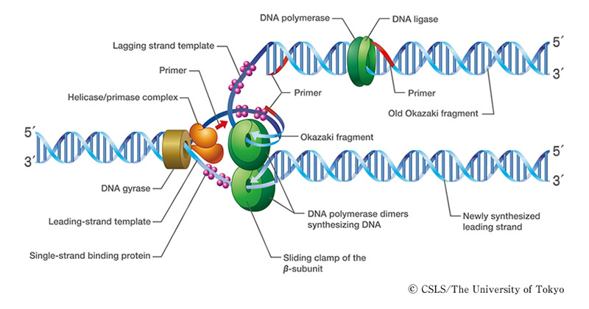
DNA Replication

Slide 27
Protein Synthesis - Transcription
Topoisomerase unwinds the DNA double helix (relieves supercoils).
SSBs coat the DNA strands to prevent annealing
Free mRNA nucleotides line up next to their complementary bases on the template (antisense) strand (U-T, T-A, C-G, G-C). Begins at promotor region.
This forms antiparallel mRNA strand 5’ to 3’
mRNA leaves the nucleus and attaches to 80S ribosome

Slide 28
Protein Synthesis - Translation
mRNA attached to 80S ribosome
tRNA molecules have anticodons complementary to the codons on the mRNA strand on one end, and the amino acid corresponding to the codon on the other
Once two tRNA molecules are adjacent, a peptide bond is formed between the two amino acids.
This process repeats until stop codon reached
No tRNA binds to the stop codon, so the polypeptide is released into the cytoplasm

Slide 29
Protein Synthesis

Slide 30
Mutations
Missense
  DNA nucleotide is switched out for another, causing a different amino acid to be coded for
Nonsense
  When a stop codon is coded for prematurely
Silent
  A change in the sequence of DNA nucleotides without a resulting change in the corresponding amino acid that is coded for

Slide 31
Cell Cycle

Slide 32
Identifying Stages - Mitosis
Interphase
Prophase – nuclear envelope breaks down, chromosomes condense and become visible – CROSSING OVER OCCURS
Prometaphase – spindle fibres begin to form
Metaphase – chromosomes line up along the metaphase plate, each sister chromatid attached to spindle fibres from opposite poles
Anaphase – centromeres split in two, sister chromatids pulled towards opposite poles
Telophase – nuclear envelope begins to reform, cleavage begins to form, spindle breaks down
Cytokinesis

Slide 33
Mitosis/Meiosis – Light Microscopy

Slide 34
Meiosis
Production of sex cells by reducing their chromosome number by half
2n → 4n → 2n → n
Creates genetic variability in the gametes

Slide 35
Meiosis

Slide 36
Abnormalities
Non-disjunction
  Caused by the failure of homologous chromosomes to separate properly during cell division
Numerical
  A type of chromosomal defect; different number of chromosomes i.e. 47XXY (Klinefelter Syndrome)
Structural
  When parts of an individual chromosome is missing, duplicated, transferred to another chromosome, or turned upside down. (Insertion, translocation).

Slide 37
Gametogenesis
Gametogenesis – don’t worry too much as you’ll cover this in SUGER

Slide 38
Gonadal Mosaicism
A type of genetic mosaicism where more than one set of genetic information is present – specifically within gamete cells
All or part of parental germline is affected by a disease mutation, but the parental somatic cells are not affected
May or may not affect offspring
E.g. osteogenesis imperfecta

Slide 39
Genetics
Phenotype – the observable characteristics of an individual, resulting from the interaction of the genotype with the environment
Genotype – the genetic constitution of an individual organism
Karyotype – the number and visual appearance of the chromosomes in the nuclei of an organism or species.

Slide 40
Spectrum of Genetic Disease
Mendelian or Multifactorial?
  Mendelian inheritance = pattern of inheritance following the laws of segregation and independent assortment
  Multifactorial inheritance = where both genetic and environmental factors produce a trait or condition

Slide 41
Patterns of Inheritance
Autosomal dominant / recessive
Sex linked (x-linked)
  Gene causing the trait / disorder is located on the X chromosome
  Males only have one, so will definitely inherit
Pedigrees – know how to read them!
Lyonization – also known as X-inactivation
  Process by which one of the X chromosome can be inactivated in females

Slide 42
Pedigrees

Slide 43
Multifactorial Diseases
Genetic | Multifactorial | Environmental
Downs Syndrome (Trisomy 21) | Spina Bifida | Poor diet - Kwashiorkor
Cystic Fibrosis | Cleft lip / palate | Infection
Huntington’s Disease | Diabetes | Drug related illness
Haemophilia | Schizophrenia | Trauma related illness
Edwards Syndrome (Trisomy 18)
Patau Syndrome (Trisomy 13)
Main cause of disease in developed countries
Main cause of disease in less developed countries

Slide 44
Genetics: Concepts
Penetrance
  The proportion of individuals carrying a particular variant allele of a gene (genotype), that also express an associated trait (phenotype)
Variable expression
  When one genotype can produce a range of different phenotypes; one individual may be more severely affected than another.
Sex limitation
  Genes present in both sexes but only expressed in one, and remains turned off in the other

Slide 45
Question 1
What bases form a stop codon?
ATC
AUG
GTC
AUC
Notes:
AUG

Slide 46
Question 2
During which phase of meiosis does crossing over occur?
Prophase
Metaphase
Anaphase
Telophase
Notes:
Prophase

Slide 47
Question 3
How much fluid would you typically find in the intracellular compartment of 70kg male?
14L
28L
11L
42L
Notes:
28L

Slide 48


