Slide 1
2021/2022

Slide 2
IMMS Teaching
Phase One IMMS Wrap-Up Session 2
Asha Chaudhry & Sophie Allan
26/10/2021 , 6-7pm

Slide 3
What this session will cover
ATP – Glycolysis, Krebs’ cycle (+link reaction), oxidative phosphorylation
Fatty acid oxidation/ketones – ketogenesis
Movement across membranes
Membrane structure
Water and sodium homeostasis
Basic embryology

Slide 4
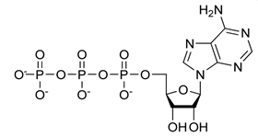
ATP/ADP Cycle
ADP-ATP cycle
ATP is made of:
Adenine
Ribose
3 Phosphate
ATP
Krebs cycle, oxidative phosphorylation, substrate level phosphorylation, beta oxidation, glycolysis
Biosynthesis of macromolecules, muscle contraction, active ion transport, thermogenesis.
PO₄²⁻
ADP
PO₄²⁻
Notes:
Where im starting

Slide 5
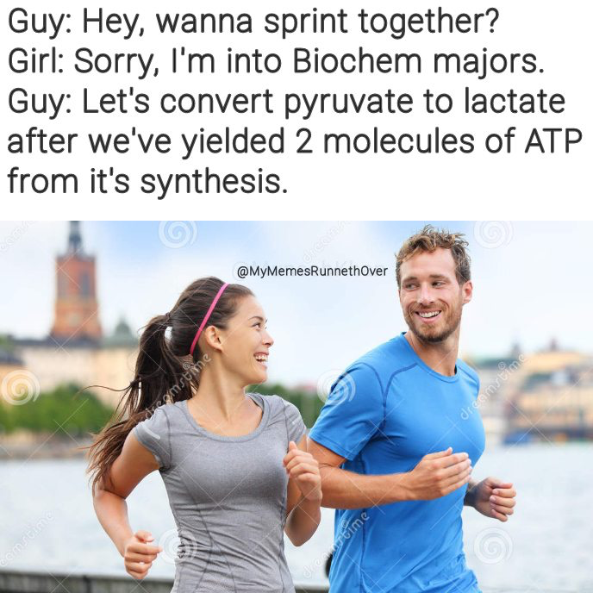
Glycolysis
cytosol of mitochondria (cytoplasm)
Aerobic or anaerobic conditions
Regulated by conc of ATP, AMP, insulin, glucagon
Produces: 2xNADH, (net) x2 ATP, x2 pyruvate
Glucose
ATP
Glucose-6-phosphate
Fructose-6-phosphate
ATP
Fructose-1,6-bisphosphate
Dihydroxyacetone phosphate
Glyceraldehyde-3-phosphate
NADH
1,3-bisphosphoglycerate
ATP
3-phosphoglycerate
2-phosphoglycerate
H₂O
Phosphoenolpyruvate
Pyruvate
Notes:
Where im starting

Slide 6
Glycolysis enzymes
Glucose
PFK is main regulatory enzyme - efficiency is controlled by allosteric activators/inhibitors
RATE LIMITING STEP !!
Fructose-2,6-bisphosphate activates via insulin
Hexokinase
Glucose-6-phosphate
Phosphohexose isomerase
Fructose-6-phosphate
Phosphofructokinase-1
Fructose-1,6-bisphosphate
Dihydroxyacetone phosphate
Fructose Bisphosphate Aldolase
Glyceraldehyde-3-phosphate
Triose phosphate isomerase
Gylceraldehyde-3-phosphate dehydrogenase
1,3-bisphosphoglycerate
Phosphoglycerate kinase
3-phosphoglycerate
Phosphoglycerate mutase
2-phosphoglycerate
Enolase
Phosphoenolpyruvate
Pyruvate kinase
Pyruvate
Notes:
Where im starting

Slide 7
Link reaction
*** Anaerobic respiration
Lactate
Pyruvate
CoA
NAD⁺
Aerobic conditions Pyruvate => Krebs cycle via Links
Anaerobic conditions Pyruvate => Lactate (fermentation)
Pyruvate to acetyl-CoA is irreversible
Enzyme = pyruvate DH
1 carbon atom is removed
NADH + H⁺
Acetyl CoA
“Krebs cycle”
Notes:
It goes to lactate to accept 2 hydrogen ions from NADH to form lactic acid. This would usually be done by the electron transport chain but requires oxygen.
This regenerates NAD+ allowing glycolysis to continue.

Slide 8
Kreb’s cycle
Mnemonic:
Can
I
Keep
Selling
Socks
For
Money
Officer
Acetyl CoA
H₂O
CoA
Oxaloacetate
Citrate
NADH + H⁺
Malate
Isocitrate
NADH + H⁺
H₂O
CO₂
Fumarate
α-ketoglutarate
NADH + H⁺
Occurs in the mitochondrial matrix
1 pyruvate= 1xATP, 3xNADH, 1FADH2
Releases: 2xCO2
FADH₂
Succinate
Succinyl Co-A
GTP
GDP
ADP
ATP

Slide 9
Kreb’s cycle
Acetyl CoA
Citrate synthase
Isocitrate DH is the rate limiting enzyme!!!
Generally most enzymes are
inhibited by ↑: ATP, NADH, products
Activated by ↑: ADP
Acetyl-CoA + 3 NAD⁺ + FAD + GDP + P_{i} + 2 H₂O =>
2 CO₂ + 3 NADH + FADH₂ + GTP + 3 H⁺ + CoA
Oxaloacetate
Citrate
Malate dehydrogenase
Aconitase
Malate
Isocitrate
Fumarate Hydratase
Isocitrate Dehydrogenase
Fumarate
α-ketoglutarate
Succinate dehydrogenase
Α-ketoglutarate dehydrogenase
Succinate
Succinyl Co-A
Succinyl Coenzyme A synthetase

Slide 10
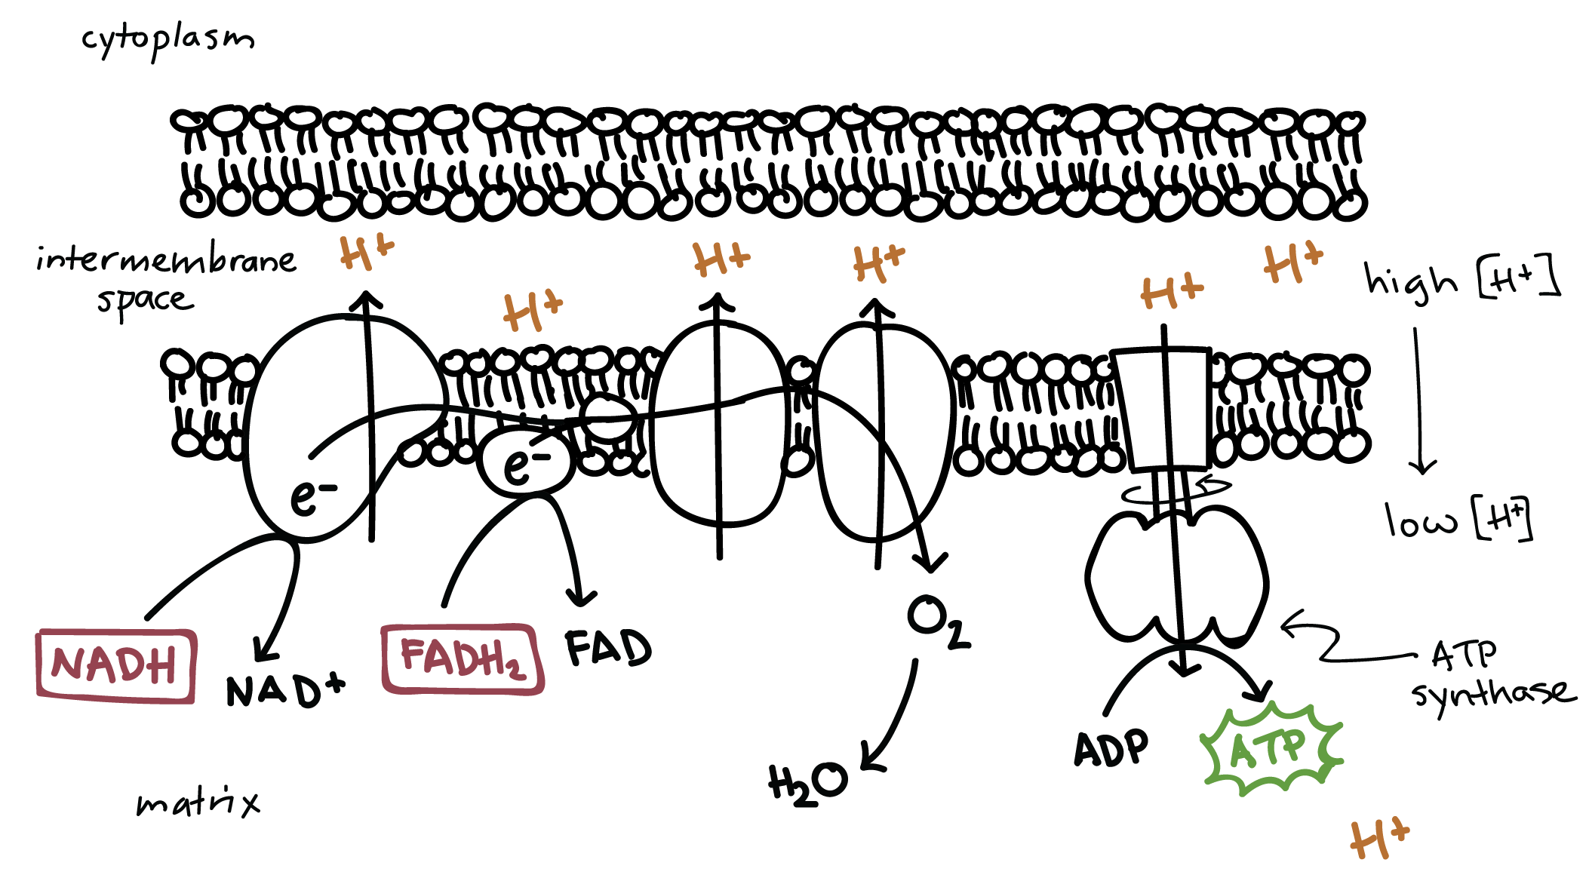
Oxidative phosphorylation
Electron transport chain
Occurs in the mitochondrial membrane
NADH + FADH oxidise to deliver power to proton pumps
Via electrochemical gradient
(H+ pumped into the intermembrane space, then flow down the gradient via ATP synthase to form ATP)
Final electron acceptor (electrons transferred to CO2
Khan Academy

Slide 11
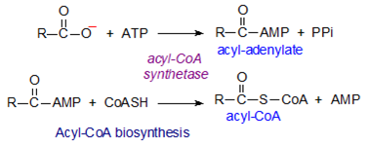
Fatty Acid Beta-Oxidation
The breakdown of fatty acids => ATP
Fatty acids must be activated to Acyl CoA (cytoplasm)
Oxidation of fatty acids occurs in mitochondria
Acyl CoA cannot cross membrane
Requires carnitine shuttle.
Notes:
Acyl CoA into Acyl carnitine, the Coenzyme A is removed and recycled (carnitine is added). Acyl Carnitine can be transported through the membrane
On the other side, acyl carnitine is converted into Acyl CoA, carnitine removed, Coenzyme A added.

Slide 12
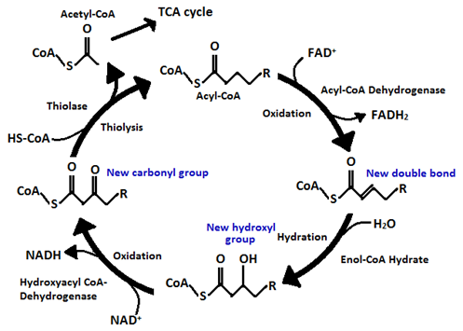
Fatty Acid Beta-Oxidation 2
Acyl CoA – 2 Carbons = 1 mol (NADH + FADH₂ + Acetyl CoA)
At the β position
Examples of fatty acids: Linoleic acid, Oleic acid, Palmitic acid, and arachidonic acid

Slide 13
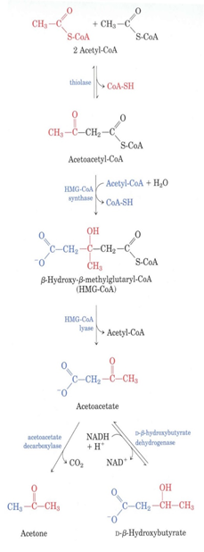
Ketones
Liver mainly makes ketones from 2 Acetyl CoAs
Main physiological ketones:
Acetone
Acetoacetate
B-hydroxybutyrate
Ketones are relatively strong acids = pH3.5

Slide 14
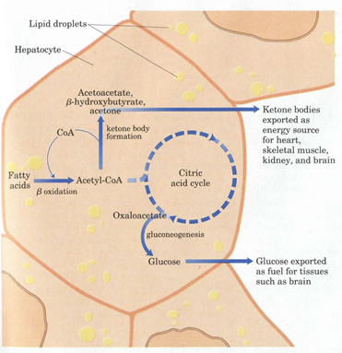
Ketogenesis
Liver mainly makes ketones from 2 Acetyl CoAs, doesn’t have enzyme to reverse this, ensures extrahepatic tissue use.
Ketogenesis occurs little normally, high during:
Starvation - ketones used by heart, muscle, saves glucose for brain
Excessive exercise
Some diabetic patients - if you overwhelm TCA cycle
Diabetic ketoacidosis:
Low insulin = high glucose
Increase FFA oxidation as high glucagon
Exceeds TCA cycle
↑ Ketones = Acidaemia
Notes:
Brain preferentially has glucose, but can adapt to using ketones like the rest of the body.

Slide 15
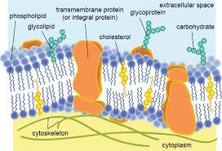
Cell Membrane Structure
Phospholipid bilayer: hydrophilic head and hydrophobic tail
- consists of a glycerol molecule, two fatty acids and a phosphate group
Fluid mosaic model: due to intrinsic/extrinsic proteins
Contains: cholesterol (supports fluidity), proteins (transporters), glycolipids and glycoproteins (cell signalling)
Functions: semi permeable membrane, hosts cell membrane receptors, regulates what goes in and out of the cell, separate intracellular cell contents from extracellular cell contents

Slide 16
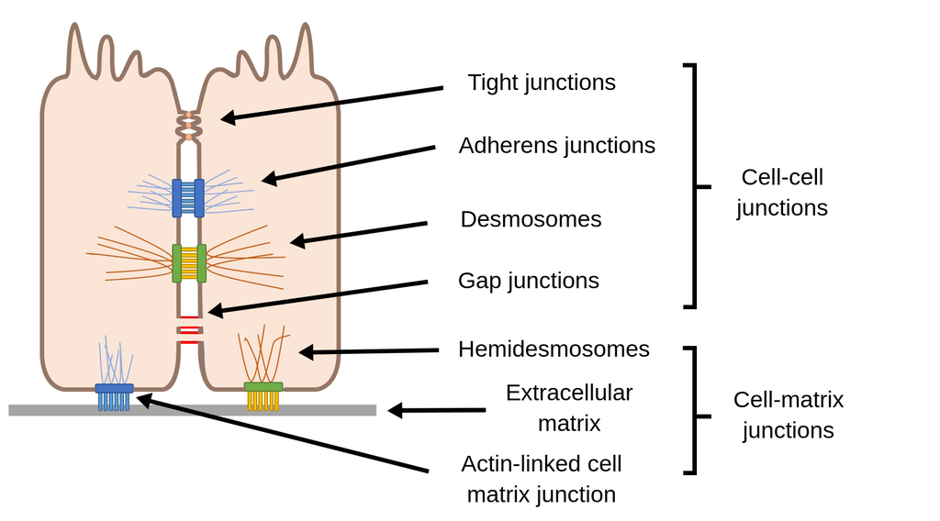
Cell Junction
Def: Intracellular connections between plasma membranes of adjacent cells
Tight: impermeable junctioms that prevent molecules from passing through (digestive tract)
Desmosomes: anchoring junctions, tension-reducing (like velcro) (heart muscle/skin)
Gap junctions: intracellular communication allowing ions/small molecules (smooth muscle tissue)
Hemidesmosomes: anchor intermediate filaments to basal lamina (epithelial cells)
Adherens junction: joins actin bundle to a similar bundle in a neighbouring cell (epithelial cells)

Slide 17
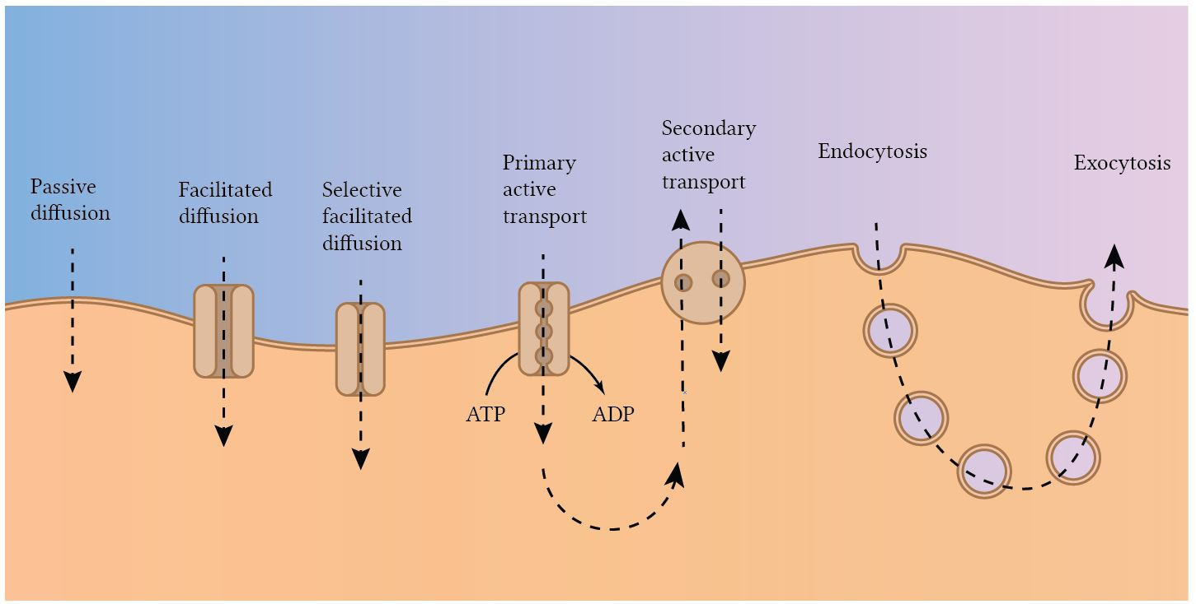
Movement across cell membranes

Slide 18
Homeostasis
‘The maintenance of a constant internal environment’
> There is a set point at which the normal range fluctuates
> maintained via feedback loops.
> hypothalamus primarily controls

Slide 19
Water distribution
Water distribution in the body:
> 2/3 intracellular: 28L
> 1/3 extracellular: 14L --> 3L (plasma), 1L (transcellular), 10L (interstitial)
ECF: contains glucose, urea, Cl- and HCO3-. Main cation is Na+
ICF: main cation is K+
Fluid losses can be sensible (measured, eg: urine) or insensible (cannot be measured, eg: evaporation)

Slide 20
Water and sodium homeostasis
Sodium homeostasis across membranes significantly influences osmotic pressure and, thus, water distribution. It influences extracellular fluids.
Water follows higher Sodium concentrations (osmotic pressure gradient)
Sodium is regulated to maintain appropriate extracellular fluid volume
Sodium is regulated via renin-angiotensin system and the nephrons
Notes:
Increased Sodium concentrations results in greater extracellular water retention
Results in Fluid Overload (Edematous State) with increased ECFV
Decreased Sodium concentration results in extracellular water loss
Results in volume depletion with decreased ECFV
Sodium homeostasis balances Sodium intake with Sodium excretion
Fluid Overload and Hypovolemia are defects in Sodium regulation (even when Serum Sodium is normal)
Hyponatremia is a water excess state (water regulation abnormality)
May be associated with low, normal or high ECFV (or total body Sodium)

Slide 21
Basic Embryology 1
Embryology is not as important as physiology, anatomy or histology
Worth understanding as can help understand congenital defects
IMMS gives basic overview of embryology, specifics are covered in each module.

Slide 22
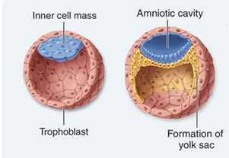
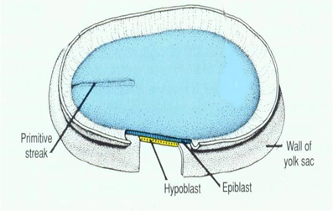
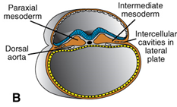
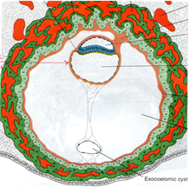
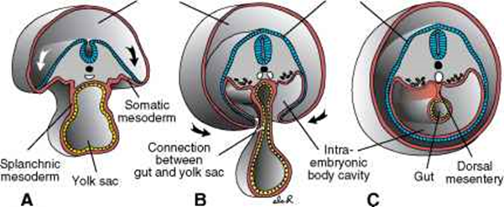
Basic Embryology 2
Embryonic period - week 1-8 (after is foetal period - to partum)
First week - Fertilisation/blastocyst formation
Second week - Bilaminar disc + Implantation
Third week - Trilaminar disc (Gastrulation)
Fourth week - Folding of embryo
Fifth to Eight week - most organs develop, becomes foetus

Slide 23
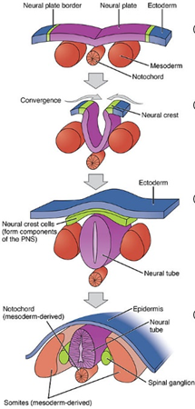
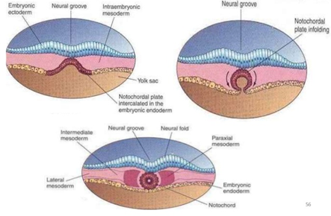
Basic Embryology 3
Gastrulation is the formation of the trilaminar disc.
Ectoderm - epidermis of skin, CNS, PNS, hair, nails, eyes
Endoderm - GI tract, thyroid, parathyroid, liver, respiratory tract
Mesoderm - Connective tissue in-between: muscle, bones, cartilage, urogenital system, blood/vessels
Neurulation:
Notochord derived from mesoderm
Release chemical messengers to affect overlying ectoderm
Causes in-folding to form neural tube (brain+spinal cord) and central canal

Slide 24
Practice questions
On content of all of IMMS, not just this session
Do not worry if you don’t know the answers - these are just practice questions
Type answers in chat
Answers will be on next slide

Slide 25
Question 1
Which of these phases of glycolysis generates ATP from ADP?
Glucose → Glucose-6-phosphate
2-phosphoglycerate → phosphoenolpyruvate
Glyceraldehyde-3-phosphate → 1,3-bisphosphoglycerate
Fructose-6-phosphate → Fructose-1,6-bisphosphate
Phosphoenolpyruvate → Pyruvate
Notes:
E - as phosphoenolpyruvate is dephosphorylated

Slide 26
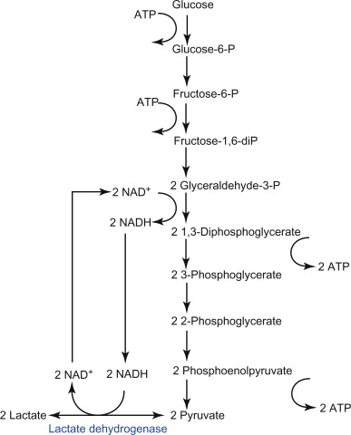
Question 1 - Answer
Which of these phases of glycolysis generates ATP from ADP?
Phosphoenolpyruvate → Pyruvate
Notes:
E - as phosphoenolpyruvate is dephosphorylated

Slide 27
Question 2
Where in the cell does the Krebs cycle occur?
Cytoplasm
Mitochondrial matrix
Mitochondrial Intramembranous space
Mitochondrial Inner membrane
Mitochondrial Outer membrane
Notes:
B - correct
A is wrong, but is where glycolysis occurs
C - where there is hydrogen Ions are pumped
D - where electron transport chain takes place to produce ATP
E - for lipid synthesis and fatty acid metabolism

Slide 28
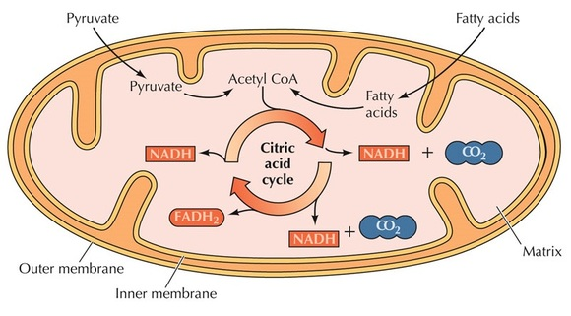
Question 2 - Answer
Where in the cell does the Krebs cycle occur?
Mitochondrial matrix
Notes:
B - correct
A is wrong, but is where glycolysis occurs
C - where there is hydrogen Ions are pumped
D - where electron transport chain takes place to produce ATP
E - for lipid synthesis and fatty acid metabolism

Slide 29
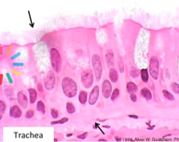
Question 3
What type of epithelium is this?

Slide 30
Question 3 - Answer
What type of epithelium is this?
Respiratory epithelium, giveaways:
Ciliated
Goblet cells
Pseudostratified

Slide 31
Question 4
Which cell junction best describes desmosomes?
Allows for the flow of ions between cells
Attaches cells to the extracellular matrix
Connects intermediate filaments of adjacent cells
Form a complete barrier, preventing movement of substances between cells
Connects microtubules of adjacent cells
Notes:
C -they do this to increase mechanical stability of cells.
A is gap junction
B is hemidesmosome
C is desmosome
D is occluding/tight junction
E is not real, microtubules are used to move chromosomes in cell replication

Slide 32
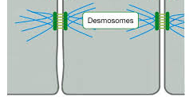
Question 4 - Answer
Which cell junction best describes desmosomes?
Connects intermediate filaments of adjacent cells
Notes:
C -they do this to increase mechanical stability of cells.
A is gap junction
B is hemidesmosome
C is desmosome
D is occluding/tight junction
E is not real, microtubules are used to move chromosomes in cell replication

Slide 33
Question 5
In what week of embryonic life does the embryo undergo gastrulation?
Week 1
Week 2
Week 3
Week 4
Week 5

Slide 34
Question 5 - Answer
In what week of embryonic life does the embryo undergo gastrulation?
Week 3
Remember week 3, the embryo becomes a trilaminar disc.

Slide 35
Question 6
Which of the following molecules is NOT a ketone?
Acyl-CoA
Acetoacetate
Beta-hydroxybutyrate
Acetone
Notes:
A - this is fed into beta oxidation

Slide 36
Question 6 - Answer
Which of the following molecules is NOT a ketone?
Acyl-CoA
Notes:
A - this is fed into beta oxidation. Watch for wording of the question, they like to try and through you off.

Slide 37
Question 7
During cell division, which phrase best describes anaphase?
Nuclear membranes break down
Chromatids separate and are pulled to opposite poles of the cell
Chromosomes align on the metaphase plate
Nuclear membrane reforms
Chromatids attach to microtubules
Notes:
Topoisomerase

Slide 38
Question 7 - Answer
During cell division, which phrase best describes anaphase?
Chromatids separate and are pulled to opposite poles of the cell
Notes:
Topoisomerase

Slide 39
Question 8
Edwards Syndrome is best described as:
Nondisjunction
Nonsense mutation
Multifactorial
Mosaicism
Autosomal dominant
Notes:
Topoisomerase

Slide 40
Question 8 - Answer
Edwards Syndrome is best described as:
Nondisjunction
Notes:
It is failure of the chromosome pairs to separate in meiosis 1, or sister chromatids to separate properly in meiosis 2. Likelihood of this happening increases with age of both men and females.

Slide 41
Question 9 -
Which of the following might contain type 2 collagen?
Bone
Cartilage
Spleen
Basement membranes
Placenta
Notes:
Autosomal dominant

Slide 42
Question 9 - Answer
Which of the following might contain type 2 collagen?
Cartilage
Notes:
Autosomal dominant

Slide 43
Question 10
A patient's blood pH is 7.49, they appear to be breathing normally but have been vomiting excessively, what statement best describes this condition?
Respiratory acidosis
Respiratory alkalosis
Metabolic acidosis
Metabolic alkalosis
Mixed respiratory and metabolic acidosis

Slide 44
Question 10 - Answer
A patient's blood pH is 7.49, they appear to be breathing normally but have been vomiting excessively, what statement best describes this condition?
Metabolic alkalosis
Notes:
First off, blood pH should be between 7.35-7.45, so we immediately know it is alkalosis.
They are breathing normally so it must be purely metabolic alkalosis - due to the body losing lots of H+ via vomitting stomach acid.

Slide 45
Conclusion
Don’t stress if you don’t know all of this!
Most of IMMS is covered later in the year ☺
Good Luck!

Slide 46
29/10/2019 6-7pm
IMMS Wrap-Up Session
https://www.surveymonkey.com/r/DZPTLNP

