Slide 1
2021/2022

Slide 2
Gastrointestinal SAQ/SBAs
Phase 2a Revision Session
Beth Richards & Paige Wilson
13.04.22
6-7pm
The Peer Teaching Society is not liable for false or misleading information…

Slide 3
Hello!
This session is designed to run through a series of different types of questions, to:
Revise GI content
Work on exam technique
Consolidate knowledge
Please feel free to ask questions throughout if you are unsure of anything!
Beth and Paige x
The Peer Teaching Society is not liable for false or misleading information…

Slide 4
Before we start
Reminder of your surgical sieve for thinking of causes and differentials! → VITAMIN CDEF
V: Vascular
I: Infective / Inflammatory C: Congenital
T: Trauma D: Degenerative
A: Autoimmune E: Endocrine / Environment
M: Metabolic F: Functional
I: Iatrogenic
N: Neoplastic
The Peer Teaching Society is not liable for false or misleading information…

Slide 5
Question 1: SBA
A 22-year-old man presents to your GP surgery with recurrent episodes of abdominal pain and non-bloody diarrhoea around 6-times a day. You investigate and his faecal calprotectin is raised at 312. Which of the following would indicate a diagnosis of Crohn’s disease?
Non-granulomatous inflammation
Continuous inflammation with no skip lesions
Inflammation affects mucosa only
Inflammation beyond the ileocecal valve
Goblet cell depletion
The Peer Teaching Society is not liable for false or misleading information…

Slide 6
Question 1: SBA
A 22-year-old man presents to your GP surgery with recurrent episodes of abdominal pain and non-bloody diarrhoea around 6-times a day. You investigate and his faecal calprotectin is raised at 312. Which of the following would indicate a diagnosis of Crohn’s disease?
Non-granulomatous inflammation
Continuous inflammation with no skip lesions
Inflammation affects mucosa only
Inflammation beyond the ileocecal valve
Goblet cell depletion
The Peer Teaching Society is not liable for false or misleading information…

Slide 7
Question 1: Answer
A 22-year-old man presents to your GP surgery with recurrent episodes of abdominal pain and non-bloody diarrhoea around 6-times a day. You investigate and his faecal calprotectin is raised at 312. Which of the following other would indicate a diagnosis of Crohn’s disease?
Non-granulomatous inflammation
Continuous inflammation with no skip lesions
Inflammation affects mucosa only
Inflammation beyond the ileocecal valve
Goblet cell depletion
The Peer Teaching Society is not liable for false or misleading information…

Slide 8
Question 1: Explanation
Non-granulomatous inflammation
Continuous inflammation with no skip lesions
Inflammation affects mucosa only
Inflammation beyond the ileocecal valve
Goblet cell depletion
Crohn’s disease is characterised by transmural (full-thickness) inflammation of anywhere within the GI tract, there are skip lesions and no goblet cell depletion.
Answers A, B, C and E are characteristic of Ulcerative Colitis.
The Peer Teaching Society is not liable for false or misleading information…

Slide 9
Question 1: Explanation
Feature | Crohn's Disease | Ulcerative Colitis
Location | Any part of GI tract | Colon only
Inflammation Pattern | Skip Lesions | Continuous Inflammation
Layers affected | Transmural | Mucosal
Granulomas | Granulomas | No granulomas
Crypt Abscesses? | Crypt Abscesses | Crypt Abscesses
Goblet cell depletion | No | Yes
Cobblestone appearance? | Yes | No
The Peer Teaching Society is not liable for false or misleading information…

Slide 10
Question 2: Case Discussion
(A hard one to work on exam technique…sorry!)
2. A 30 year old man presents with difficulty swallowing. He struggles with tough foods like steak and bread, but is generally ok with liquids and soups. He gets lots of regurgitation and heartburn with it.
What do you want to highlight from this case?
The Peer Teaching Society is not liable for false or misleading information…

Slide 11
Question 2: Case Discussion
2. A 30 year old man presents with difficulty swallowing. He struggles with tough solid foods like steak and bread, but is generally ok with liquids and soups. He gets lots of regurgitation and heartburn with it.
What else do you want to know?
Any investigations?
Do you have any differentials?
The Peer Teaching Society is not liable for false or misleading information…

Slide 12
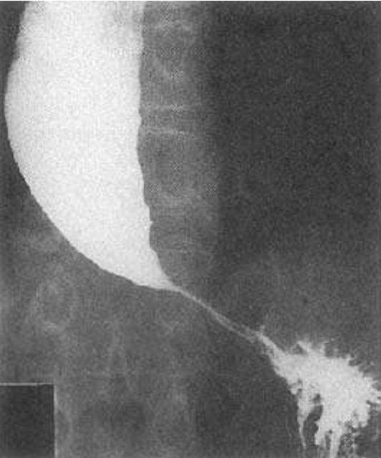
Question 2: Case discussion
More info:
Trialled PPIs - didn’t help
No fevers, weight loss, night sweats etc
Does cough at night
CXR shows very dilated oesophagus
Small/absent gastric bubble
Barium swallow: slow movement within oesophagus
As this progresses, the patient may be at risk of aspiration pneumonia
The Peer Teaching Society is not liable for false or misleading information…
Notes:
This is a dysphagic picture rather than an acid-reflux picture.
Source: https://patient.info/doctor/achalasia-pro

Slide 13
Question 2: Case discussion
This patient has achalasia
Dysphagia affecting solids more than liquids
No apparent underlying cause
Regurgitation rather than reflux
The Peer Teaching Society is not liable for false or misleading information…
Notes:
This is a dysphagic picture rather than an acid-reflux picture.

Slide 14
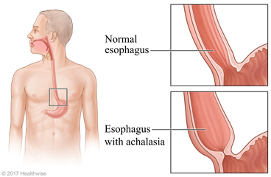
Question 2: Case discussion
The Peer Teaching Society is not liable for false or misleading information…
Notes:
Image Source: https://content.ca.healthwise.net/resources/12.9/en-ca/media/medical/hw/h9991408_005_pi.jpg

Slide 15
Question 2: Case discussion
The goal here is to ask the right questions and rule out malignancy - this isn’t high yield content so please don’t be stressed if you struggled on this one!
There is usually no underlying cause of achalasia, but a small proportion of patients may have i.e. oesophageal cancer.
Go through systematically and ensure you are always thinking about your red flags!
The Peer Teaching Society is not liable for false or misleading information…
Notes:
This is a dysphagic picture rather than an acid-reflux picture.

Slide 16
Question 3: SAQ
4. A 60-year-old lady presents to your GP surgery with episodes of abdominal pain and bloating. This is triggered by certain foods. She has lost a little bit of weight, but has no fevers or night sweats. On asking, you find that her stools are smelly and hard to flush. She has a history of Sjogren’s syndrome and type 1 Diabetes.
The Peer Teaching Society is not liable for false or misleading information…

Slide 17
Question 3: SAQ
4. A 60-year-old lady presents to your GP surgery with episodes of abdominal pain and bloating. This is triggered by certain foods. She has lost a little bit of weight, but has no fevers or night sweats. On asking, you find that her stools are smelly and hard to flush. She has a history of Sjogren’s syndrome and type 1 Diabetes.
What is your differential diagnosis?
What foods might trigger this?
Which initial investigation would be most appropriate, and what should the patient do in the 6-weeks leading to this?
What might you see on biopsy?
What is the management for this condition?
The Peer Teaching Society is not liable for false or misleading information…

Slide 18
Question 3: Answer
What is your differential diagnosis?
Coeliac disease
What foods might trigger this?
Bread, pasta - anything containing wheat, barley, rye or oats.
Which initial investigation would be most appropriate, and what should the patient do in the 6-weeks leading to this?
Anti-tTg antibody. Patient must keep gluten in diet for 6 weeks leading to this.
The Peer Teaching Society is not liable for false or misleading information…

Slide 19
Question 3: Answer
What might you see on biopsy?
Villous atrophy, crypt hyperplasia.
What is the management for this condition?
Lifelong gluten free diet
BONUS:
What complications may this lady develop in the future?
The Peer Teaching Society is not liable for false or misleading information…

Slide 20
Question 3: Explanation
This lady has Coeliac Disease - the hints to differentiate this from IBS in the stem are:
Autoimmune medical history
Steatorrhoea
Coeliac disease has multiple extraintestinal manifestations, such as
Oral aphthous ulcers - Dermatitis herpetiformis
Angular stomatitis - Delayed puberty
Osteoporosis - Enamel hypoplasia
Short stature - Liver / biliary disease
The Peer Teaching Society is not liable for false or misleading information…

Slide 21
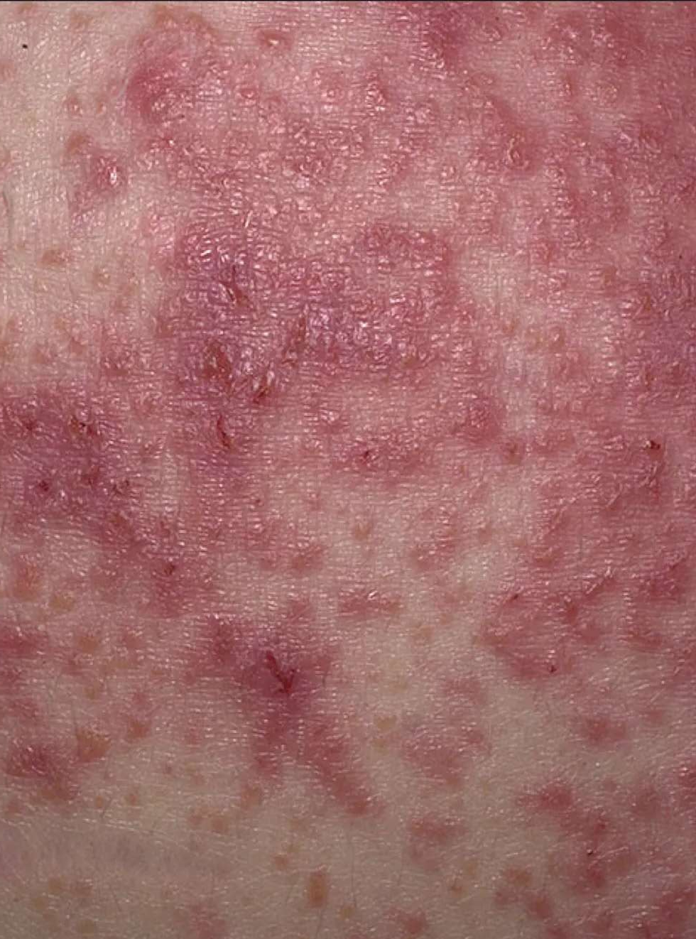
Question 3: Explanation
Dermatitis herpetiformis:
Itchy blisters
Raised, red skin lesions
Commonly on knees, elbows, buttocks, lower back & scalp
The Peer Teaching Society is not liable for false or misleading information…
Notes:
Image Source: https://www.verywellhealth.com/dermatitis-herpetiformis-photos-562325

Slide 22
Question 4: SBA
5. A 48-year-old man presents to A&E with severe epigastric pain and haematoschezia. He feels faint and appears pale. He has had this pain on and off before, but has never coughed up blood before. The pain is relieved by eating. He has a PMH of GORD. What is your differential diagnosis and which artery is likely the source of the bleed?
Gastric ulcer, gastroduodenal artery
Barrett’s Oesophagus, oesophageal arteries
Duodenal ulcer, gastroepiploic artery
Duodenal ulcer, gastroduodenal artery
Mallory Weiss Tear, oesophageal arteries
The Peer Teaching Society is not liable for false or misleading information…

Slide 23
Question 4: SBA
5. A 48-year-old man presents to A&E with severe epigastric pain and haematoschezia. He feels faint and appears pale. He has had this pain on and off before, but has never coughed up blood before. The pain is relieved by eating. He has a PMH of GORD. What is your differential diagnosis and which artery is likely the source of the bleed?
Gastric ulcer, gastroduodenal artery
Barrett’s Oesophagus, oesophageal arteries
Duodenal ulcer, gastroepiploic artery
Duodenal ulcer, gastroduodenal artery
Mallory Weiss Tear, oesophageal arteries
The Peer Teaching Society is not liable for false or misleading information…

Slide 24
Question 4: Answer
5. A 48-year-old man presents to A&E with severe epigastric pain and haematoschezia. He feels faint and appears pale. He has had this pain on and off before, but has never coughed up blood before. The pain is relieved by eating. He has a PMH of GORD. What is your differential diagnosis and which artery is likely the source of the bleed?
Gastric ulcer, gastroduodenal artery
Barrett’s Oesophagus, oesophageal arteries
Duodenal ulcer, gastroepiploic artery
Duodenal ulcer, gastroduodenal artery
Mallory Weiss Tear, oesophageal arteries
The Peer Teaching Society is not liable for false or misleading information…

Slide 25
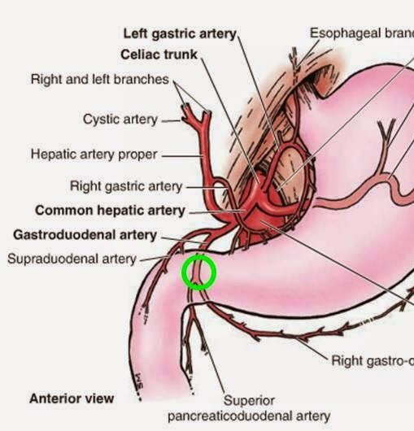
Question 4: Explanation
This man has a duodenal ulcer with an acute bleed: a posterior duodenal wall ulcer may erode into the gastroduodenal artery!
You can differentiate between a gastric and duodenal ulcer by how it relates to eating: pain relieved with meals suggests duodenal; worse with meals suggests gastric.
The Peer Teaching Society is not liable for false or misleading information…
Notes:
Image Source: http://www.stepwards.com/wp-content/uploads/2016/05/1-gastroduodenal-artery.jpg

Slide 26
Question 4: Explanation
Feature | Gastric Ulcer | Duodenal Ulcer
Location | Stomach | Duodenum
Eating? | Pain worse | Pain improves
Signs | Haematemesis, melaena, vomiting | Melaena, haematoschezia
H.Pylori | ~70% | Almost 100%
Weight | Weight loss | Weight gain
Heartburn? | Common | Less common
The Peer Teaching Society is not liable for false or misleading information…

Slide 27
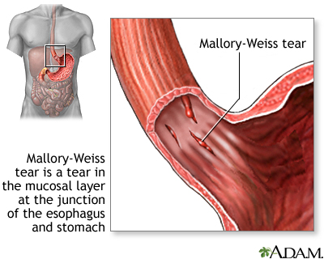
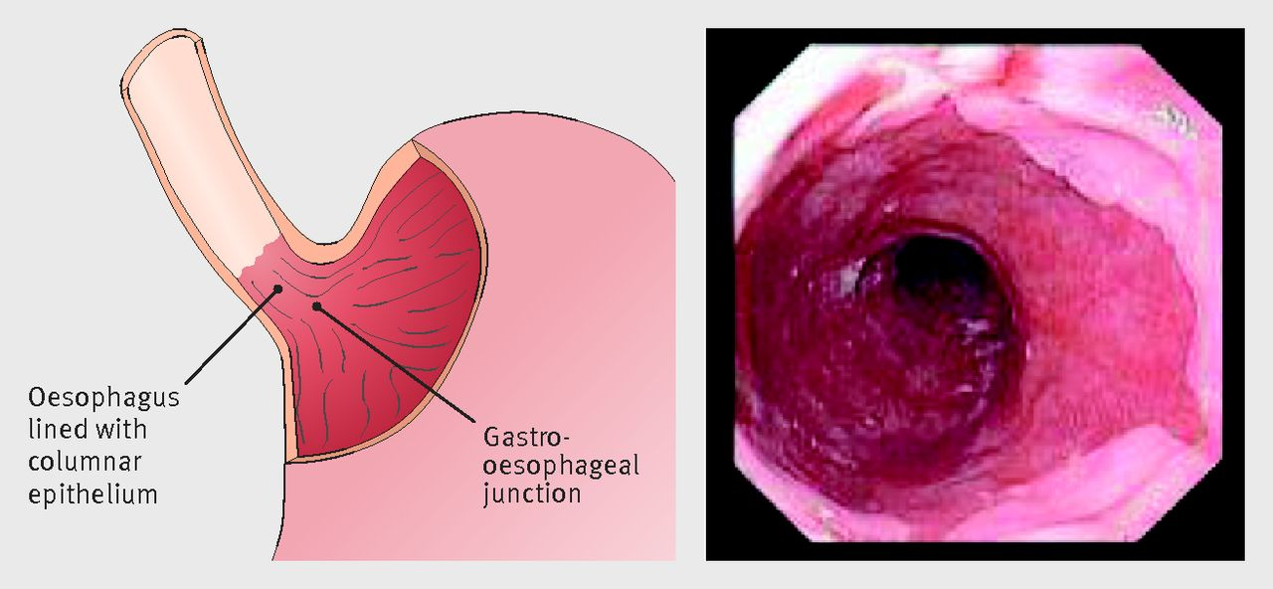
Question 4: Explanation
Despite the history of GORD, this presentation is too acute to be Barrett’s oesophagus.
A Mallory-Weiss tear is a tear of the mucosa in the lower oesophagus and is preceded by a history of forceful coughing or vomiting.
The Peer Teaching Society is not liable for false or misleading information…
Notes:
L Image Source: https://www.bmj.com/content/bmj/353/bmj.i2373/F1.large.jpg
R Image Source: https://medlineplus.gov/ency/images/ency/fullsize/18145.jpg

Slide 28
Question 5: SBA
A 62 year old male patient arrives to your GP clinic complaining of a relapse of heartburn. Because of the pandemic they didn’t want to visit the doctors however their daughter brought them in due to noticing they were having trouble eating, but had lost significant weight.
PMHx: diverticulitis, angina, depression, hiatus hernia, GORD
SHx: Smoker, 20 units of alcohol per week
The Peer Teaching Society is not liable for false or misleading information…

Slide 29
Question 5: SBA
A 62 year old male patient arrives to your GP clinic complaining of a relapse of heartburn. Because of the pandemic they didn’t want to visit the doctors however their daughter brought them in due to noticing they were having trouble eating, but had lost significant weight.
PMHx: diverticulitis, angina, depression, hiatus hernia, GORD
SHx: Smoker, 20 units of alcohol per week
The Peer Teaching Society is not liable for false or misleading information…

Slide 30
Question 5: SBA
A 62 year old male patient arrives to your GP clinic complaining of a relapse of heartburn. They were having trouble eating, but had lost significant weight.
PMHx: diverticulitis, angina, depression, hiatus hernia, GORD
SHx: Smoker, 20 units of alcohol per week
Which of the following is not a risk factor for oesophageal cancer?
Barret oesophagus
Achalasia
Diverticulitis
Hiatal hernia
Angina
The Peer Teaching Society is not liable for false or misleading information…

Slide 31
Question 5: Answer
A 62 year old male patient arrives to your GP clinic complaining of a relapse of heartburn. They were having trouble eating, but had lost significant weight.
PMHx: diverticulitis, angina, depression, hiatus hernia, GORD
SHx: Smoker, 20 units of alcohol per week
Which of the following is not a risk factor for oesophageal cancer?
Barret oesophagus
Achalasia
Diverticulitis
Hiatal hernia
Angina
The Peer Teaching Society is not liable for false or misleading information…

Slide 32
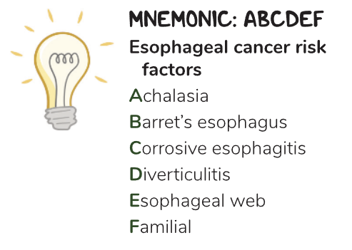
Question 5: Explanation
OESOPHAGEAL CANCER
Other risk factors:
Increasing with age
Biologically male
GORD, reflux oesophagitis
Smoking
Alcohol (combined with smoking)
Hiatal hernia
The Peer Teaching Society is not liable for false or misleading information…

Slide 33
Question 6: SBA
8. Chloe is an 8-year-old girl who presents to A&E with severe abdominal pain. Her mum tells you she first started getting a tummy ache 4 hours ago, but began crying with the pain around half and hour ago. It started in the middle but now it is worst in the right lower quadrant. She feels sick but hasn’t been sick. What is the gold standard for management of Chloe’s condition?
Laparoscopic cholecystectomy
Fluids and antibiotics
Laparoscopic appendicectomy
Ultrasound scan abdomen
Antiemetics for the nausea
The Peer Teaching Society is not liable for false or misleading information…

Slide 34
Question 6: SBA
8. Chloe is an 8-year-old girl who presents to A&E with severe abdominal pain. Her mum tells you she first started getting a tummy ache 4 hours ago, but began crying with the pain around half an hour ago. It started in the middle but now it is worst in the right lower quadrant. She feels sick but hasn’t been sick. What is the gold standard for management of Chloe’s condition?
Laparoscopic cholecystectomy
Fluids and antibiotics
Laparoscopic appendicectomy
Ultrasound scan abdomen
Antiemetics for the nausea
The Peer Teaching Society is not liable for false or misleading information…

Slide 35
Question 6: Answer
8. Chloe is an 8-year-old girl who presents to A&E with severe abdominal pain. Her mum tells you she first started getting a tummy ache 4 hours ago, but began crying with the pain around half an hour ago. It started in the middle but now it is worst in the right lower quadrant. She feels sick but hasn’t been sick. What is the gold standard for management of Chloe’s condition?
Laparoscopic cholecystectomy
Fluids and antibiotics
Laparoscopic appendicectomy
Ultrasound scan abdomen
Antiemetics for the nausea
The Peer Teaching Society is not liable for false or misleading information…

Slide 36
Question 6: Explanation
Chloe has appendicitis: Generalised abdominal pain localising to McBurney’s Point in the RIF. The Gold Standard for management is a laparoscopic appendicectomy.
Laparoscopic cholecystectomy is the Gold Standard for management of cholecystitis, which would present similarly but localise to RUQ, not RLQ.
Ultrasound scan abdomen would be an investigation, not management, and the other options are forms of symptomatic / conservative management.
The Peer Teaching Society is not liable for false or misleading information…

Slide 37
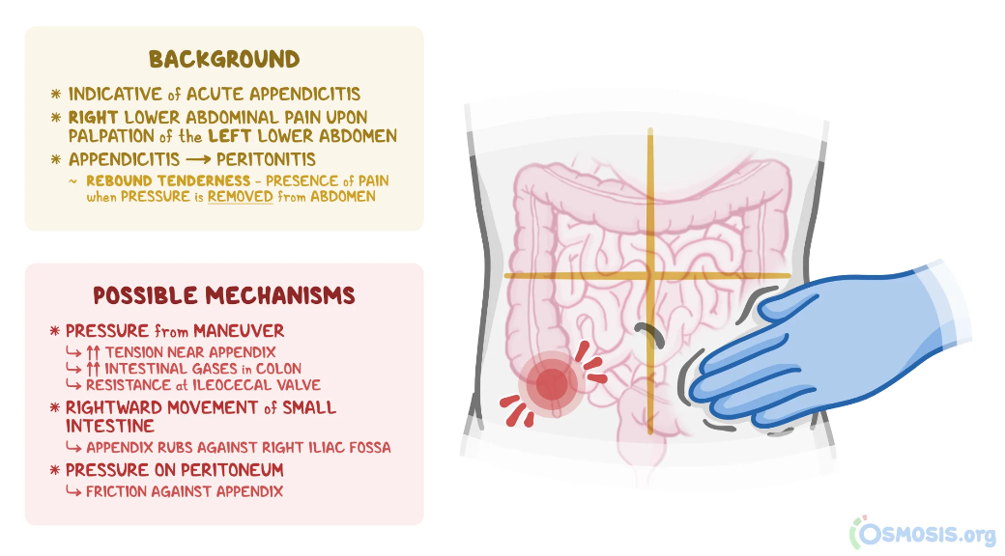
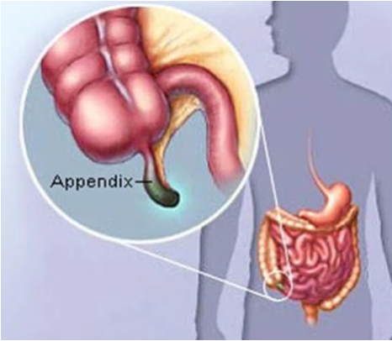
Question 6: Explanation
The Peer Teaching Society is not liable for false or misleading information…
Notes:
L Image Source: https://www.osmosis.org/answers/Rovsing-sign
R Image Source: https://insimu.com/rovsings-sign-what-is-it-and-how-it-helps-your-clinical-diagnosis/

Slide 38
Question 7 SBA
A young person presents to your GP clinic complaining of a 4 day history of diarrhoea, a fever and abdominal pain.
Name 1 pathogenic causes of diarrhoea
Name 1 non-infectious diseases which may present with diarrhoea
Name 1 other causes of diarrhoea which are not related to disease or infection.
The Peer Teaching Society is not liable for false or misleading information…

Slide 39
Question 7: Answer
Name 1 pathogenic cause of diarrhoea
Examples:
Viral: norovirus, rota virus
Bacterial: staph aurius, bacillus cereus, (food poisoning),
Protazoa: E. Coli
Parasites
The Peer Teaching Society is not liable for false or misleading information…

Slide 40
Question 7: Answer
B. Name 1 non-infectious diseases which may present with diarrhoea
IBS
IBD: Crohn’s disease, Ulcerative Collitis
Bowel cancer
The Peer Teaching Society is not liable for false or misleading information…

Slide 41
Question 7: Answer
Name 1 other causes of diarrhoea which are not related to disease or infection.
Stress
Medication related
Toxin ingestion
The Peer Teaching Society is not liable for false or misleading information…

Slide 42
Question 8: SBA
10. Which of the following statements is most applicable to coeliac disease?
Characterised by enhanced gastric acid production
Two peaks of incidence at ~2months and ~40 years of age
Transmural areas of inflammation on biopsy
Associated with HLA-DQ2/DQ8
SBR may be raised on bloods
The Peer Teaching Society is not liable for false or misleading information…

Slide 43
Question 8: Answer
10. Which of the following statements is most applicable to coeliac disease?
Characterised by enhanced gastric acid production
Two peaks of incidence at ~2months and ~40 years of age
Transmural areas of inflammation on biopsy
Associated with HLA-DQ2/DQ8
SBR may be raised on bloods
The Peer Teaching Society is not liable for false or misleading information…

Slide 44
Question 8: Explanation
This question is not necessarily about knowing the HLA associations (but fab if you do!) but about ruling out other answers:
Characterised by enhanced gastric acid production
Two peaks of incidence at ~2 months and ~40 years of age
Transmural areas of inflammation on biopsy
Associated with HLA-DQ2/DQ8
SBR may be raised on bloods
A = GORD, C = Crohn’s, E = Jaundice.
2 month old babies don’t eat gluten - so it must be D!
The Peer Teaching Society is not liable for false or misleading information…

Slide 45
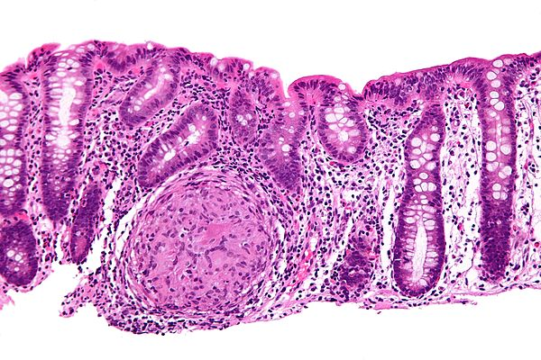
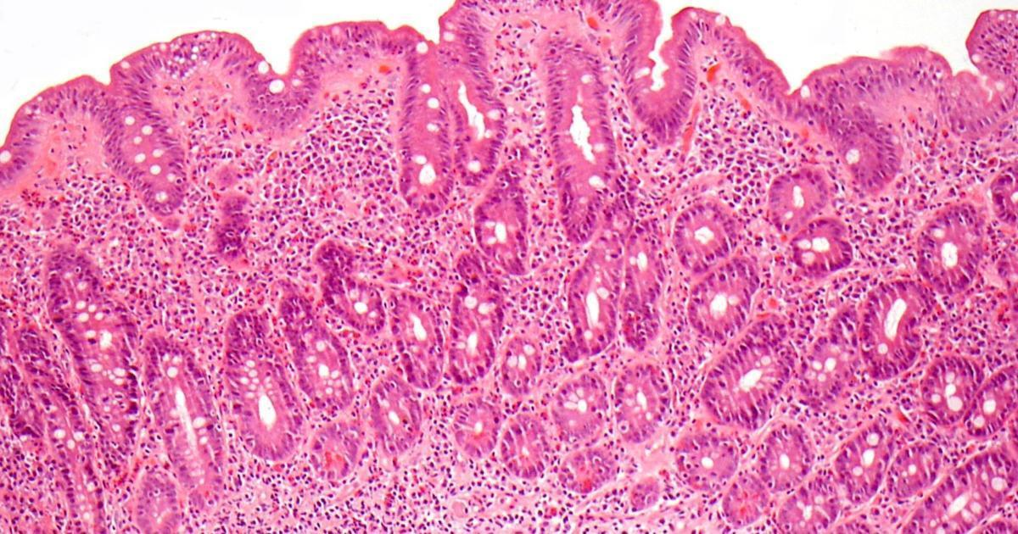
Question 8: Explanation
BONUS: Can you identify which is coeliac disease and which is Crohn’s disease? Why?
The Peer Teaching Society is not liable for false or misleading information…
Notes:
Left image → Crohn’s. Source: https://librepathology.org/wiki/Crohn%27s_disease
Right image → Coeliac. Source: https://www.findatopdoc.com/Healthy-Living/biopsy-for-celiac-disease

Slide 46
Question 9
Trevor is a 28 year old man who has recently had an endoscopy for inflammatory markers present in his bloodwork, and diarrhoea. On endoscopy skip lesions were found, and transmural inflammation.
What is the first line treatment for this patient?
Oral prednisolone
Methotrexate
Infliximab
Mercaptopurine
azathioprine
The Peer Teaching Society is not liable for false or misleading information…

Slide 47
Question 9
Trevor is a 28 year old man who has recently had an endoscopy for inflammatory markers present in his bloodwork, and diarrhoea. On endoscopy skip lesions were found, and transmural inflammation.
What is the first line treatment for this patient?
Oral prednisolone
Methotrexate
Infliximab
Mercaptopurine
azathioprine
The Peer Teaching Society is not liable for false or misleading information…

Slide 48
Question 9: Answer
Trevor is a 28 year old man who has recently had an endoscopy for inflammatory markers present in his bloodwork, and diarrhoea. On endoscopy skip lesions were found, and transmural inflammation.
What is the first line treatment for this patient?
Prednisolone
Methotrexate
Infliximab
Mercaptopurine
Azathioprine
The Peer Teaching Society is not liable for false or misleading information…

Slide 49
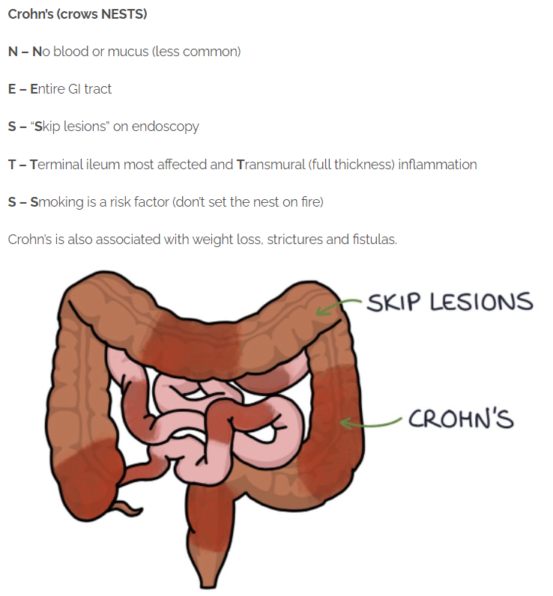
Question 9: Explanation
John’s symptoms and investigations lead to a diagnosis of Crohn’s disease.
The Peer Teaching Society is not liable for false or misleading information…

Slide 50
Question 10
13. Haemorrhoids are swollen veins in the anus and lower rectum. They are similar to varicose veins, and are very common. Which of the following features would indicate that the haemorrhoids are internal, rather than external?
Painless bleeding with bowel movements
Itching and irritation in anal region
Pain and discomfort
Swelling around your anus
Bleeding
The Peer Teaching Society is not liable for false or misleading information…

Slide 51
Question 10: Answer
13. Haemorrhoids are swollen veins in the anus and lower rectum. They are similar to varicose veins, and are very common. Which of the following features would indicate that the haemorrhoids are internal, rather than external?
Painless bleeding with bowel movements
Itching and irritation in anal region
Pain and discomfort
Swelling around your anus
Bleeding
The Peer Teaching Society is not liable for false or misleading information…

Slide 52
Question 10: Explanation
Painless bleeding with bowel movements
Itching and irritation in anal region
Pain and discomfort
Swelling around your anus
Bleeding
A = Applies to internal haemorrhoids only: external = painful. A is the single best answer as it is the differentiating feature.
EXAM TIP:
A and C both involve pain and are mutually exclusive (i.e., both cannot be true) - therefore the answer must be A or C by default.
The Peer Teaching Society is not liable for false or misleading information…

Slide 53
Question 11: SBA
15. Julie is a 59-year-old lady who presents with left lower quadrant abdominal pain associated with nausea. It started a few days ago, and is constant and persistent. She last opened her bowels 5 days ago, and her LLQ is soft and tender on examination. Julie has a high BMI, a low fibre diet, and an 18-pack-year smoking history. What might you see on a CT scan?
Ascites
Inflamed and infected pouches of the sigmoid
Appendiceal inflammation
Haemoperitoneum
Free gas within peritoneal cavity
The Peer Teaching Society is not liable for false or misleading information…

Slide 54
Question 11: SBA
15. Julie is a 59-year-old lady who presents with left lower quadrant abdominal pain associated with nausea. It started a few days ago, and is constant and persistent. She last opened her bowels 5 days ago, and her LLQ is soft and tender on examination. Julie has a high BMI, a low fibre diet, and an 18-pack-year smoking history. What might you see on a CT scan?
Ascites
Inflamed and infected pouches of the sigmoid
Appendiceal inflammation
Haemoperitoneum
Free gas within peritoneal cavity
The Peer Teaching Society is not liable for false or misleading information…

Slide 55
Question 11: Answer
15. Julie is a 59-year-old lady who presents with left lower quadrant abdominal pain associated with nausea. It started a few days ago, and is constant and persistent. She last opened her bowels 5 days ago, and her LLQ is soft and tender on examination. Julie has a high BMI, a low fibre diet, and an 18-pack-year smoking history. What might you see on a CT scan?
Ascites
Inflamed and infected pouches of the sigmoid
Appendiceal inflammation
Haemoperitoneum
Free gas within peritoneal cavity
The Peer Teaching Society is not liable for false or misleading information…

Slide 56
Question 11: Explanation
Julie has diverticulitis.
Ascites → generally caused by liver disease, malignancy, fluid retention or hypoalbuminaemia → does not fit clinical picture.
Inflamed and infected pouches of the sigmoid
Appendiceal inflammation → appendicitis pain = RLQ
Haemoperitoneum → history does not suggest blood loss
Free gas within peritoneal cavity → abdomen is soft; free gas within the peritoneal cavity would suggest a perforated peritonitis → abdomen would be hard.
The Peer Teaching Society is not liable for false or misleading information…

Slide 57
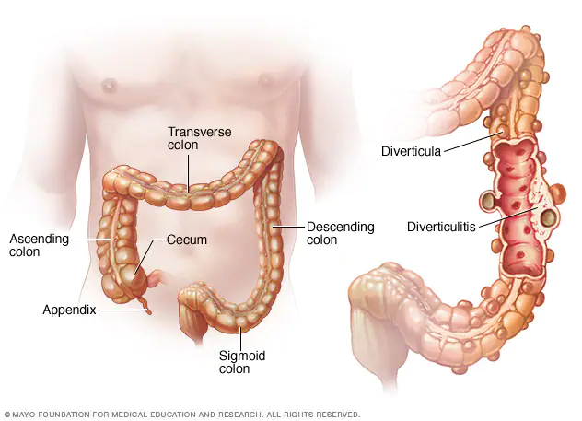
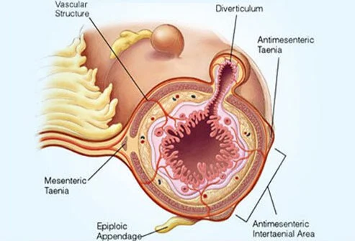
Question 11: Explanation
Diverticulitis
The Peer Teaching Society is not liable for false or misleading information…
Notes:
Left Image Source: https://www.mayoclinic.org/diseases-conditions/diverticulitis/symptoms-causes/syc-20371758
Right Image Source: https://www.onhealth.com/content/1/diverticulitis_diverticulosis

Slide 58
Question 11: Explanation
Diverticula = small pouches in GI tract, most commonly in colon. Most common after age of 40.
Diverticulosis = presence of diverticula.
Diverticulitis = inflammation of one or more diverticula.
Sx: LLQ pain (RLQ more common in Asian descent), N+V, fever, abdominal tenderness, change in bowel habit (usually constipation).
Associated with ageing, low fibre diet, obesity, smoking, sedentary lifestyle
The Peer Teaching Society is not liable for false or misleading information…

Slide 59
Question 11: Explanation
Prevention:
Regular exercise, avoid smoking, high-fibre diet, drink plenty of water
Investigations:
Bloods & urinalysis → exclude infection
Pregnancy test in women of childbearing age
LFTs → exclude hepatic causes
Stool culture → exclude GI infection
CT scan → identify the inflamed diverticula
The Peer Teaching Society is not liable for false or misleading information…

Slide 60
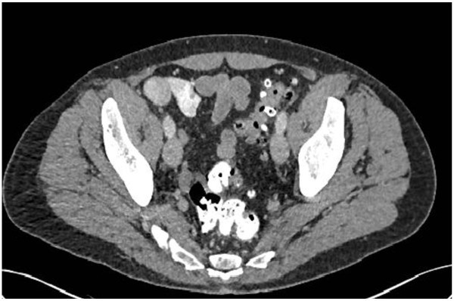
Question 11: Explanation
CT Abdomen
The Peer Teaching Society is not liable for false or misleading information…
Notes:
Image Source: https://wjes.biomedcentral.com/articles/10.1186/1749-7922-10-3

Slide 61
Question 11: Explanation
Management:
If uncomplicated / mild infection: PO antibiotics & liquid diet
If complicated: IV antibiotics, drain any abscesses
Surgery may be indicated if:
Complicated, recurrent, immunocompromised
Primary bowel resection with anastomosis
Bowel resection with colostomy
The Peer Teaching Society is not liable for false or misleading information…

Slide 62
BREAK
Take 5 mins to refresh your brain & grab a cuppa
Happy to answer any questions!
The Peer Teaching Society is not liable for false or misleading information…

Slide 63
Question 12: SBA
You are on F1 on the geriatric ward. You have been asked by a nurse to review a patient who has become acutely unwell. The patient was in the ward for treatment of cellulitis. They have watery diarrhea that contains blood and intense abdominal pain and a temperature of 39.2 degrees. The nurse reports that a few other patients have been complaining of malaise and abdominal cramping.
What is the first line treatment for this patient?
500mg Metronidazole IV TD 10 days
250mg Clarithromycin BD 5 days
200mg Fidaxomicin PO BD 10 days
125mg Vancomycin QD PO 10 days
500mg Amoxicillin TD PO 5 days
The Peer Teaching Society is not liable for false or misleading information…

Slide 64
Question 12
You are on F1 on the geriatric ward. You have been asked by a nurse to review a patient who has become acutely unwell. The patient was in the ward for treatment of cellulitis. They have watery diarrhea that contains blood and intense abdominal pain and a temperature of 39.2 degrees. The nurse reports that a few other patients have been complaining of malaise and abdominal cramping.
What is the first line treatment for this patient?
500mg Metronidazole IV TD 10 days
250mg Clarithromycin BD 5 days
200mg Fidaxomicin PO BD 10 days
125mg Vancomycin QD PO 10 days
500mg Amoxicillin TD PO 5 days
The Peer Teaching Society is not liable for false or misleading information…

Slide 65
Question 12: Answer
You are on F1 on the geriatric ward. You have been asked by a nurse to review a patient who has become acutely unwell. The patient was in the ward for treatment of cellulitis. They have watery diarrhea that contains blood and intense abdominal pain and a temperature of 39.2 degrees. The nurse reports that a few other patients have been complaining of malaise and abdominal cramping.
What is the first line treatment for this patient?
500mg Metronidazole IV TD 10 days
250mg Clarithromycin BD 5 days
200mg Fidaxomicin PO BD 10 days
125mg Vancomycin QD PO 10 days
500mg Amoxicillin TD PO 5 days
The Peer Teaching Society is not liable for false or misleading information…

Slide 66
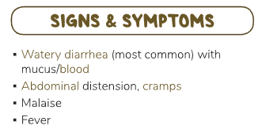
Question 12: Explanation
Clostridium Difficile Infection
C. Diff is common within
patients who are having
antibiotic treatment for other infections due to disturbance of the gut biome.
It also spreads like wildfire throughout hospital wards.
The Peer Teaching Society is not liable for false or misleading information…

Slide 67
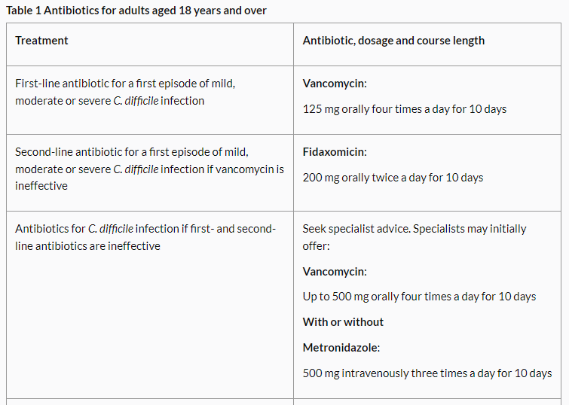
Question 12: Explanation
NICE Guidelines for treatment of C. Diff
The Peer Teaching Society is not liable for false or misleading information…

Slide 68
Question 13 SBA
17. Which of the following is the least appropriate with regards to irritable bowel syndrome?
Group of abdominal symptoms with no apparent organic cause
Abdominal pain relieved by defecation
Loperamide is an appropriate treatment for IBS-related constipation
Low-FODMAP diet is advisable
Patient may have mucus in stools
The Peer Teaching Society is not liable for false or misleading information…

Slide 69
Question 13: Answer
17. Which of the following is the least appropriate with regards to irritable bowel syndrome?
Group of abdominal symptoms with no apparent organic cause
Abdominal pain relieved by defecation
Loperamide is an appropriate treatment for IBS-related constipation
Low-FODMAP diet is advisable
Patient may have mucus in stools
The Peer Teaching Society is not liable for false or misleading information…

Slide 70
Question 13: Explanation
Answers A, B, D and E are all correct.
Loperamide, whilst used in the management of
IBS, is an anti-motility drug - you don’t want to
give this to a constipated patient!
It is used to treat diarrhoea.
Senna and Movicol are appropriate for IBS-related constipation.
Buscopan is an antispasmodic used to treat pain.
The Peer Teaching Society is not liable for false or misleading information…

Slide 71
Question 14: SBA
19. Perianal disorders are those that affect the area around the anus. Which of the following best describes a pilonidal sinus?
Rectal mucosa protrusion through the anus causing a dragging sensation
Tear in the squamous lining of the anal canal causing pain
A track communicating between skin and rectum or anal canal causing discharge
Abnormal pocket in the skin near the tailbone containing hair and skin debris
Swollen veins that protrude inside the rectum
The Peer Teaching Society is not liable for false or misleading information…

Slide 72
Question 14: Answer
19. Perianal disorders are those that affect the area around the anus. Which of the following best describes a pilonidal sinus?
Rectal mucosa protrusion through the anus causing a dragging sensation
Tear in the squamous lining of the anal canal causing pain
A track communicating between skin and rectum or anal canal causing discharge
Abnormal pocket in the skin near the tailbone containing hair and skin debris
Swollen veins that protrude inside the rectum
The Peer Teaching Society is not liable for false or misleading information…

Slide 73
Question 14: Explanation
Rectal mucosa protrusion through the anus causing a dragging sensation
→ Rectal prolapse
Tear in the squamous lining of the anal canal causing pain
→ Anal fissure
A track communicating between skin and rectum or anal canal causing discharge
→ Fistula
Abnormal pocket in the skin near the tailbone containing hair and skin debris
→ Pilonidal sinus
Swollen veins that protrude inside the rectum
→ Internal haemorrhoids
The Peer Teaching Society is not liable for false or misleading information…

Slide 74
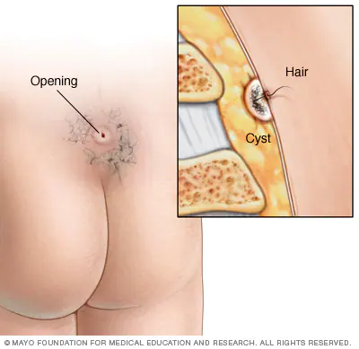
Question 15: Explanation
Abnormal pocket in the skin containing hair and skin debris - at the top of the cleft of the buttocks.
Occur when hair punctures the skin and becomes embedded in the skin. Can become infected → requires surgical drainage.
The Peer Teaching Society is not liable for false or misleading information…
Notes:
Image Source: https://www.mayoclinic.org/diseases-conditions/pilonidal-cyst/symptoms-causes/syc-20376329

Slide 75
Question 16
22. Gastritis is inflammation of the lining of the stomach. Which of the following would be the least appropriate management option?
Clarithromycin, Amoxicillin, and Metronidazole
Omeprazole
Ranitidine
Ibuprofen
Gaviscon
The Peer Teaching Society is not liable for false or misleading information…

Slide 76
Question 16: Answer
22. Gastritis is inflammation of the lining of the stomach. Which of the following would be the least appropriate management option?
Clarithromycin, Amoxicillin, and Metronidazole
Omeprazole
Ranitidine
Ibuprofen
Gaviscon
The Peer Teaching Society is not liable for false or misleading information…

Slide 77
Question 16: Explanation
Clarithromycin, Amoxicillin, and Metronidazole
→ Appropriate treatment for H.Pylori infection, which is a cause of gastritis.
Omeprazole
→ PPI - blocks acid production and promotes healing
Ranitidine
→ H2 Receptor Antagonist - reduces acid production
Ibuprofen
→ NSAIDs - can damage the gastric mucosa by suppressing prostaglandin synthesis, impair barrier properties of mucosa and reduce mucosal blood flow
Gaviscon
→ Antacid - neutralise acid, appropriate symptom relief.
The Peer Teaching Society is not liable for false or misleading information…

Slide 78
Question 17
24. Barry is a 57 year old man with a 15 year history of Gastro-oesophageal Reflux Disease. On endoscopy you notice his oesophageus is red, so you decide to biopsy. What cells are likely to be present?
Stratified squamous non-keratinising epithelium
Simple columnar epithelium with goblet cells
Simple squamous epithelium
Stratified squamous keratinising epithelium
Pseudostratified ciliated columnar epithelium
The Peer Teaching Society is not liable for false or misleading information…

Slide 79
Question 17
24. Barry is a 57 year old man with a 15 year history of Gastro-oesophageal Reflux Disease. On endoscopy you notice his oesophagus is red, so you decide to biopsy. What cells are likely to be present?
Stratified squamous non-keratinising epithelium
Simple columnar epithelium with goblet cells
Simple squamous epithelium
Stratified squamous keratinising epithelium
Pseudostratified ciliated columnar epithelium
The Peer Teaching Society is not liable for false or misleading information…

Slide 80
Question 17: Answer
24. Barry is a 57 year old man with a 15 year history of Gastro-oesophageal Reflux Disease. On endoscopy you notice his oesophagus is red, so you decide to biopsy. What cells are likely to be present?
Stratified squamous non-keratinising epithelium
Simple columnar epithelium with goblet cells
Simple squamous epithelium
Stratified squamous keratinising epithelium
Pseudostratified ciliated columnar epithelium
The Peer Teaching Society is not liable for false or misleading information…

Slide 81
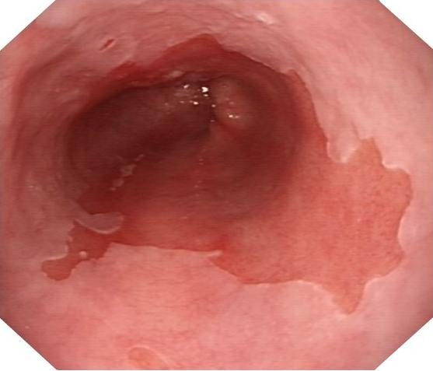
Question 17: Explanation
Barrett’s Oesophagus
Metaplasia of stratified squamous to simple columnar epithelium
The Peer Teaching Society is not liable for false or misleading information…
Notes:
Source: https://www.google.com/url?sa=i&url=https%3A%2F%2Fwww.gastrolondon.co.uk%2Fbarretts-oesophagus%2F&psig=AOvVaw1OYktLRYBb_wuWpajpT4kr&ust=1649955459760000&source=images&cd=vfe&ved=0CAcQjRxqFwoTCIjVwZzBkfcCFQAAAAAdAAAAABAD

Slide 82
Question 18: SAQ
3. A 22 month old child is brought into A+E by their parents. The parents report that the child suddenly started screaming, pulling their knees to their stomach. They appear to be in great abdominal pain. On examination of the abdomen you hear high-pitched tinkling sounds and their stool contains blood and mucus. The x-ray shows large dilated loops of bowels.
The Peer Teaching Society is not liable for false or misleading information…

Slide 83
Question 18: SAQ
3. A 22 month old child is brought into A+E by their parents. The parents report that the child suddenly started screaming, pulling their knees to their stomach. They appear to be in great abdominal pain. On examination their stool contains blood and mucus. The x-ray shows large dilated loops of bowels.
What is the diagnosis of this child?
What is the most likely cause of this diagnosis?
How would you manage this?
The Peer Teaching Society is not liable for false or misleading information…

Slide 84
Question 18: Answer
What is the diagnosis of this child?
Bowel Obstruction
What is the most likely cause of this diagnosis?
Intersusseption
How would you manage this?
Conservative management - treat the symptoms
IV fluids, nasogastric suction
Surgery if persists
The Peer Teaching Society is not liable for false or misleading information…

Slide 85
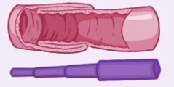
Question 18: Explanation
INTESTINAL OBSTRUCTION
 | Mechanical Obstruction | Functional Obstruction
 | A blockage | Paralysis of the muscles
Causes | Post-op adhesions Hernia Volvulus Intussusception | Post-op ileus Appendicitis Peritonitis Hypothyroidism Hypokalemia Hypercalcemia
The Peer Teaching Society is not liable for false or misleading information…

Slide 86
Question 18: Explanation
Symptoms
Small Bowel | Large bowel
Vomiting more common Periumbilical Cramping and intermittent pain Lasts for a few minutes at a time | Lower abdominal pain Less frequent pain Episodes last longer
The Peer Teaching Society is not liable for false or misleading information…

Slide 87
Question 19: SAQ
26. Mesenteric ischaemia and ischaemic colitis are two conditions affecting blood flow within the gastrointestinal tract.
What is the main difference between these conditions?
List some risk factors for ischaemic colitis
What are some potential complications of mesenteric ischaemia?
How might you investigate if you suspected ischaemic colitis? How does this differ from mesenteric ischaemia?
For which of these conditions may you treat surgically with a stent?
The Peer Teaching Society is not liable for false or misleading information…

Slide 88
Question 19: Answer
26. Mesenteric ischaemia and ischaemic colitis are two conditions affecting blood flow within the gastrointestinal tract.
What is the main difference between these conditions?
Mesenteric ischaemia → narrowed / blocked arteries restrict blood flow to small intestine
Ischaemic colitis → temporary restriction of blood supply to the large intestine due to vasoconstriction or low pressure flow.
The Peer Teaching Society is not liable for false or misleading information…

Slide 89
Question 19: Answer
26. Mesenteric ischaemia and ischaemic colitis are two conditions affecting blood flow within the gastrointestinal tract.
List some risk factors for ischaemic colitis
Demographic: Age (>60), Sex (F>M)
Clotting Abnormalities: i.e., Factor V Leiden
High Cholesterol → Atherosclerosis → Vessel narrowing
Reduction of blood flow → HF, Low BP, Shock, DM, RA
Prev abdo surgery → scar tissue
Heavy exercise → may lead to reduced colonic blood flow
Surgery involving the aorta
The Peer Teaching Society is not liable for false or misleading information…

Slide 90
Question 19: Answer
26. Mesenteric ischaemia and ischaemic colitis are two conditions affecting blood flow within the gastrointestinal tract.
What are some potential complications of mesenteric ischaemia?
Sepsis, bowel necrosis (→ short bowel syndrome), death,
fear of eating, unintentional weight loss
How might you investigate if you suspected ischaemic colitis?
CT Abdomen (rule out other things such as IBD), Colonoscopy, Stool culture (rule out infection)
How does this differ from mesenteric ischaemia?
Investigate with angiography, doppler ultrasound
The Peer Teaching Society is not liable for false or misleading information…

Slide 91
Question 19: Answer
26. Mesenteric ischaemia and ischaemic colitis are two conditions affecting blood flow within the gastrointestinal tract.
For which of these conditions may you treat surgically with a stent?
Mesenteric ischaemia
(Surgical management of ischaemic colitis may involve bowel resection due to necrosis or blockage, or repairing a hole in the colon).
The Peer Teaching Society is not liable for false or misleading information…

Slide 92
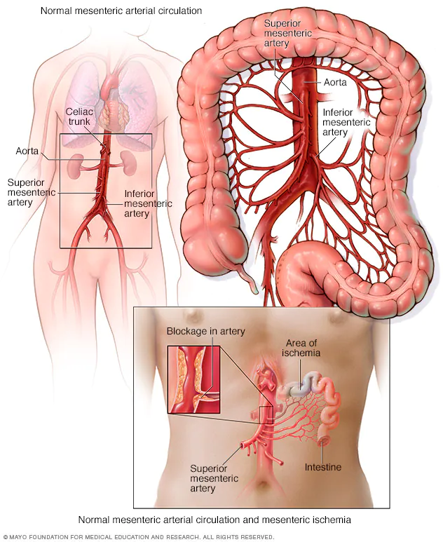
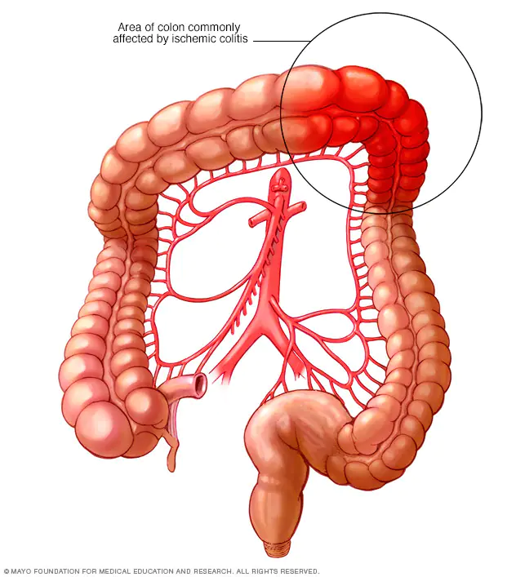
Question 19: Explanation
The Peer Teaching Society is not liable for false or misleading information…
Notes:
Left image source: https://www.mayoclinic.org/diseases-conditions/mesenteric-ischemia/symptoms-causes/syc-20374989
Right image source: https://www.mayoclinic.org/diseases-conditions/ischemic-colitis/symptoms-causes/syc-20374001

Slide 93
Question 20: SAQ
28. Jerry is a 54-year-old man who is blue-lighted into A&E with haematemesis. His son tells you that his stools have been darker in colour, and he lost consciousness before the ambulance arrived. His skin has a yellow tinge. His son confides in you that Jerry has had a drinking problem for some years now. You suspect a rupture of oesophageal varices.
What are oesophageal varices?
What is causing Jerry’s stools to be dark?
What is the likely cause in Jerry’s case?
What else could cause oesophageal varices?
The Peer Teaching Society is not liable for false or misleading information…

Slide 94
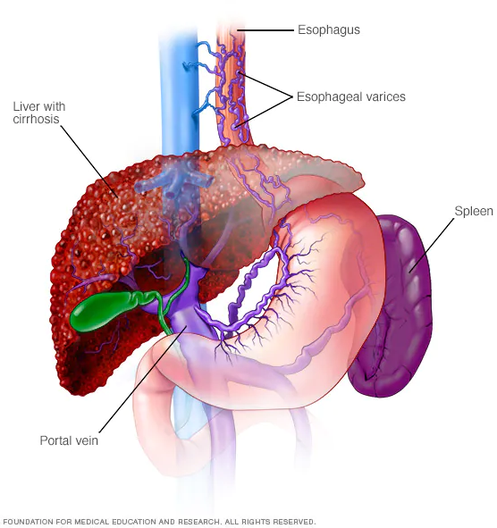
Question 20: Answer & Explanation
What are oesophageal varices?
Abnormal, enlarged veins in the oesophagus, that develop when normal blood flow to the liver is blocked by a clot / scar tissue
What is causing Jerry’s stools to be dark?
The bleeding varices can result in swallowing large amounts of blood, which causes black, tarry stools
The Peer Teaching Society is not liable for false or misleading information…
Notes:
Image Source: https://www.mayoclinic.org/diseases-conditions/esophageal-varices/symptoms-causes/syc-20351538#:~:text=Esophageal%20varices%20are%20enlarged%20veins,throat%20and%20stomach%20(esophagus).

Slide 95
Question 20: Answer & Explanation
What is the likely cause in Jerry’s case?
Jerry has a history of alcohol abuse for some years now, which has likely caused cirrhosis of his liver. This results in increased pressure on the IVC → pulmonary hypertension → blood seeks other pathways → oesophageal vein swelling → rupture and bleed
What else could cause oesophageal varices?
Hepatitis
Primary biliary cholangitis
Parasitic infections i.e., schistosomiasis
Blood clot (thrombosis) of portal vein / splenic veins
The Peer Teaching Society is not liable for false or misleading information…

Slide 96
Question 21: SBA
30. Millie is a 19-year-old girl with a past medical history of Bulimia Nervosa. She presents to A&E with upper abdominal pain and significant haemoptysis. What is the likely cause of the haemoptysis in Millie’s case, and what other symptom might she have?
Lung cancer, ipsilateral anhidrosis
Mallory-Weiss tear, bloody stools
Gastric ulcer, left upper quadrant pain
Oesophageal varices, chest pain
Hiatus hernia, reflux
The Peer Teaching Society is not liable for false or misleading information…

Slide 97
Question 21: SBA
30. Millie is a 19-year-old girl with a past medical history of Bulimia Nervosa. She presents to A&E with upper abdominal pain and significant haemoptysis. What is the likely cause of the haemoptysis in Millie’s case, and what other symptom might she have?
Lung cancer, ipsilateral anhidrosis
Mallory-Weiss tear, bloody stools
Gastric ulcer, left upper quadrant pain
Oesophageal varices, chest pain
Hiatus hernia, reflux
The Peer Teaching Society is not liable for false or misleading information…

Slide 98
Question 21: Answer
30. Millie is a 19-year-old girl with a past medical history of Bulimia Nervosa. She presents to A&E with upper abdominal pain and significant haemoptysis. What is the likely cause of the haemoptysis in Millie’s case, and what other symptom might she have?
Lung cancer, ipsilateral anhidrosis
Mallory-Weiss tear, bloody stools
Gastric ulcer, left upper quadrant pain
Oesophageal varices, chest pain
Hiatus hernia, reflux
The Peer Teaching Society is not liable for false or misleading information…

Slide 99
Question 21: Explanation
Lung cancer, ipsilateral anhidrosis
→ No symptoms of cancer or Horner’s syndrome
Mallory-Weiss tear, bloody stools
→ Correct answer - fits clinical picture and history
Gastric ulcer, left upper quadrant pain
→ May occur as complication but no history of reflux
Oesophageal varices, chest pain
→ Would be a more acute picture
Hiatus hernia, reflux
→ No symptoms of heartburn, reflux or feeling of fullness
The Peer Teaching Society is not liable for false or misleading information…

Slide 100
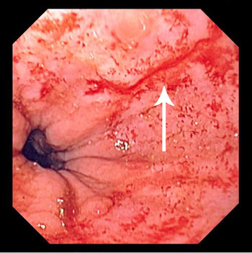
Question 21: Explanation
The significant factor in this patient’s case is the history of Bulimia.
Mallory-Weiss tear: tear in the oesophagus most commonly caused by severe / prolonged vomiting; stomach illness, chronic alcohol use and bulimia.
Other causes include trauma to the chest and abdomen, severe / prolonged hiccups, intense coughing, gastritis and hiatal hernias.
The Peer Teaching Society is not liable for false or misleading information…
Notes:
Image Source: https://www.msdmanuals.com/professional/gastrointestinal-disorders/esophageal-and-swallowing-disorders/mallory-weiss-syndrome

Slide 101
Question 21: Explanation
Mallory-Weiss Tear: Management
Most cases will self-resolve within a few days
If the bleeding does not stop:
→ Endoscopic therapy (steroid injections, coagulation therapy)
→ Transfusions if low Hb
→ Surgery (suture the tear)
→ Medications → lansoprazole
The Peer Teaching Society is not liable for false or misleading information…

Slide 102
Thank you!
Thank you for coming to the session!
We hope it was helpful and that you feel more confident for your upcoming exams. We’ll stick around a bit for any questions!
We’d appreciate if you could fill out the feedback form:
Beth and Paige x
The Peer Teaching Society is not liable for false or misleading information…

Slide 103
Feedback
https://docs.google.com/forms/d/e/1FAIpQLSftgWzVzgt7imEK6BKAJvjNJUZ22BGTdshQI86AJQoETVaoBg/viewform?usp=sf_link
The Peer Teaching Society is not liable for false or misleading information…

