Slide 1
GASTROINTESTINAL
Phase 2a Revision Session
1st February 2024
Areesha Aziz & Basma Khan

Slide 2
Contents
NOT COVERED: Perianal disorders & Pseudomembranous colitis

Slide 3
Chronic diarrhoea differentials
Acute diarrhoea < 2 weeks
Chronic diarrhoea > 4 weeks
List differential diagnoses for a patient presenting with 2-month Hx of diarrhoea?

Slide 4
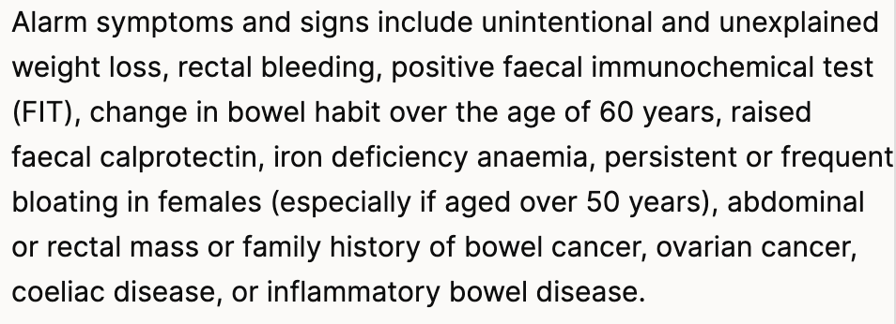
Chronic diarrhoea
Differential | Suggestive features
IBD – Crohn’s & Ulcerative colitis | Raised fecal calprotectin, raised ESR
IBS | Coleliac serology, fecal calprotectin, stool cultures –ve, CRP & ESR normal
Coeliac disease | Steatorrhoea (pale foul-smelling fatty stools that float in toilet pan), raised IGA anti-ttG
Colorectal cancer | Change in bowel habit 60+, anaemia, +ve FIT test
Hyperthyroidism | Insomnia, anxiety, resting tremor, palpitations, heat intolerance, increased sweating, oligomenorrhoea
When to consider alternative diagnoses to IBS [NICE]:
Notes:
From NICE: https://cks.nice.org.uk/topics/irritable-bowel-syndrome/diagnosis/diagnosis/

Slide 5
* List 3 things to ask in a diarrhoea Hx (mock exam q)
Colour & consistency {watery, loose, show Bristol stool chart}
Duration – acute or chronic
Pale, smelly stools that float in toilet pan
Associated Sx: abdominal pain, bloating, blood or mucus in stools, skin rashes
Sx of hyperthyroidism
Wt loss
Recent antibiotics – Co-amoxiclav, cephalosporins, clindamycin, Ciprofloxacin
Recent travel abroad – tropical sprue
Social Hx - caffeine & laxative intake
Family Hx – IBD, coeliac disease, colorectal cancer

Slide 6
Inflammatory Bowel Disease
Definition
Epidemiology
Group of chronic autoimmune inflammatory diseases of the GI system with extraintestinal effects. Relapsing & remitting course
Ashkenazi Jewish
Starts in early teens (15-20) & elderly (55+) = BIMODAL INCIDENCE
Pathophysiology
Defective GI epithelium allows leakage of gut bacteria into bloodstream triggering an autoimmune response in genetically susceptible individuals.
Crohn’s 🡪NOD2/CARD15 mutation , ASCA antibodies +ve
UC 🡪 pANCA antibodies +ve
 | Crohn’s | Ulcerative colitis
Location | Anywhere in GI tract - mouth 🡪 anus | Starts @ rectum (proctitis), extends proximally but LIMITED to colon
Colonoscopy (macroscopic) | Cobblestone mucosa with skip lesions (patchy inflammation) | Continuous circumferential inflammation
Histology (microscopic) | Transmural inflammation with non-caseating granulomas | Mucosal inflammation w/ crypt abscesses & crypt hyperplasia
Risk factors | Smoking | Non-smoking
Notes:
2 main types of IBD to know about are Ulcerative colitis & Crohn’s disease, though others include microscopic colitis
Granuloma = aggregate of epithilioid histiocytes. Caseating granulomas look like cheese & are characteristic of TB
IN UC, patients often report that flares or relapses start after smoking cessation.

Slide 7
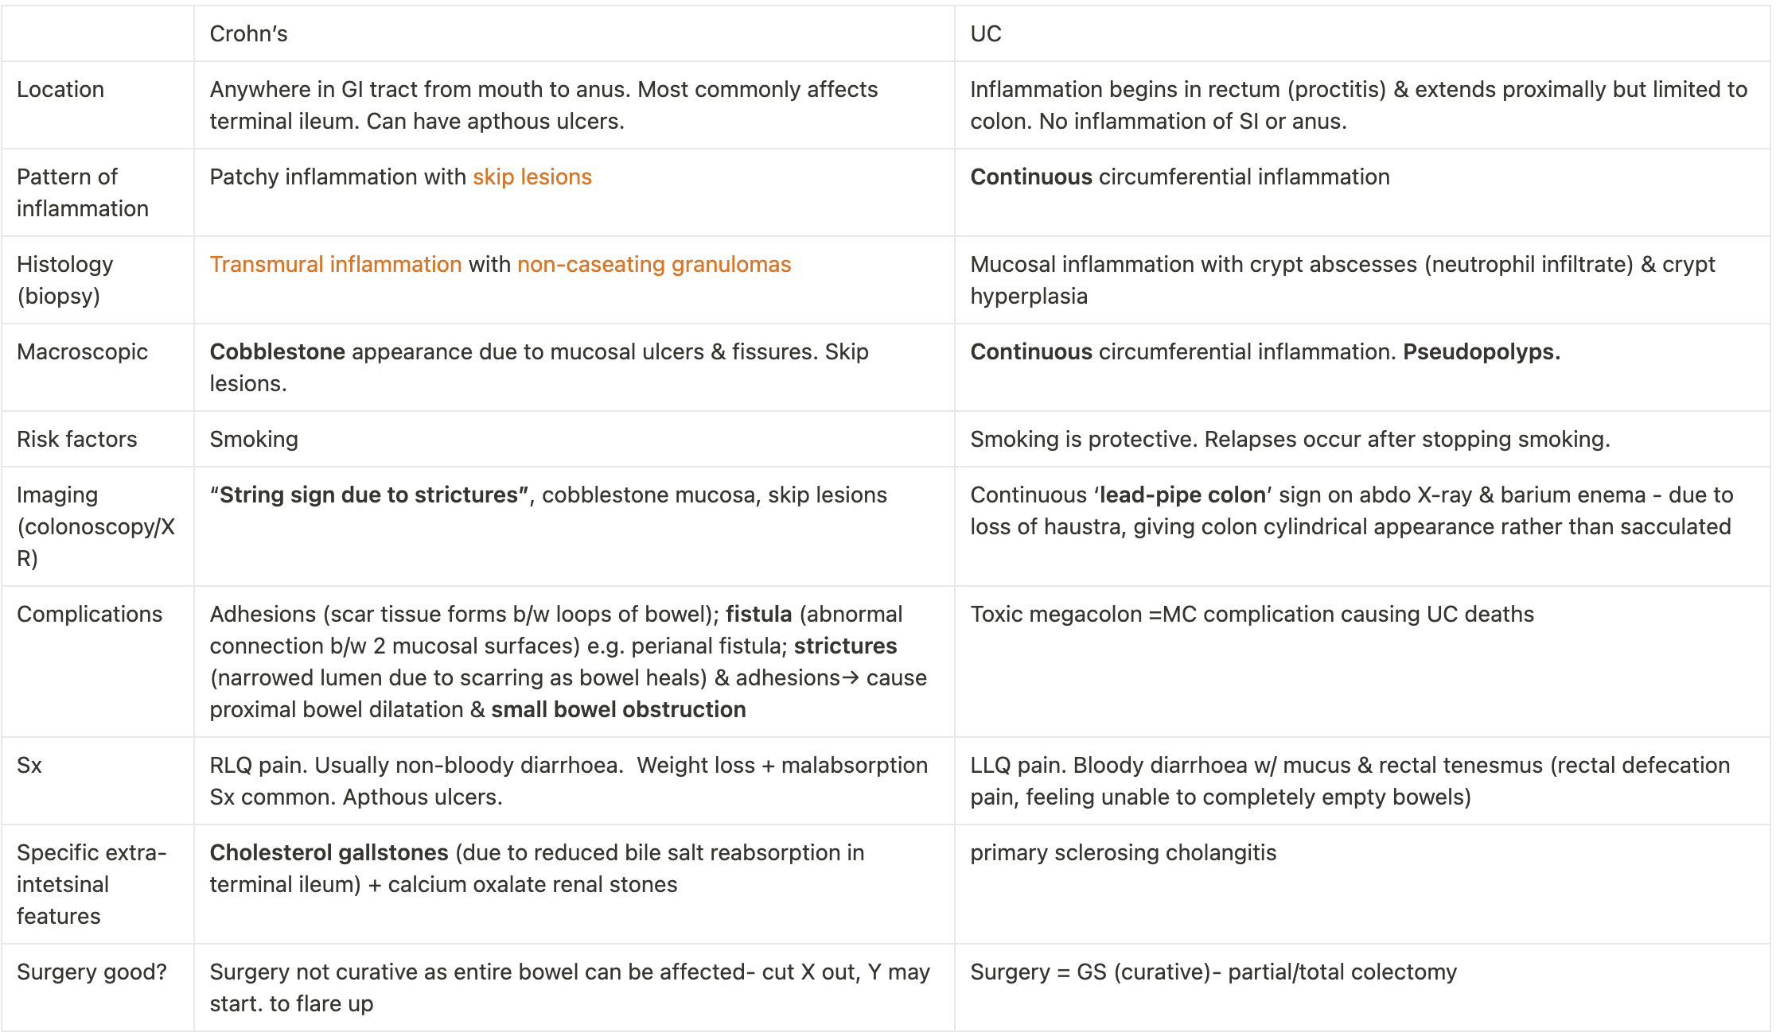
Crohn’s vs UC differences– SAQ Q
70% of PSC patients have UC.
Notes:
Apthous ulcers are more exclusive in Crohn’s. Cholesterol gallstones are more exclusive to UC.

Slide 8
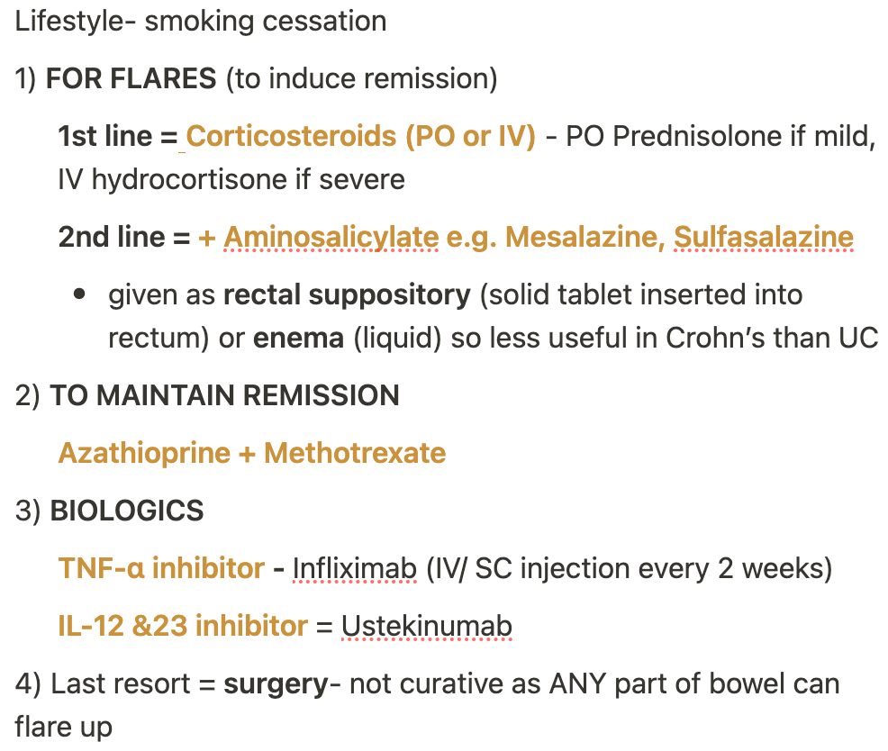
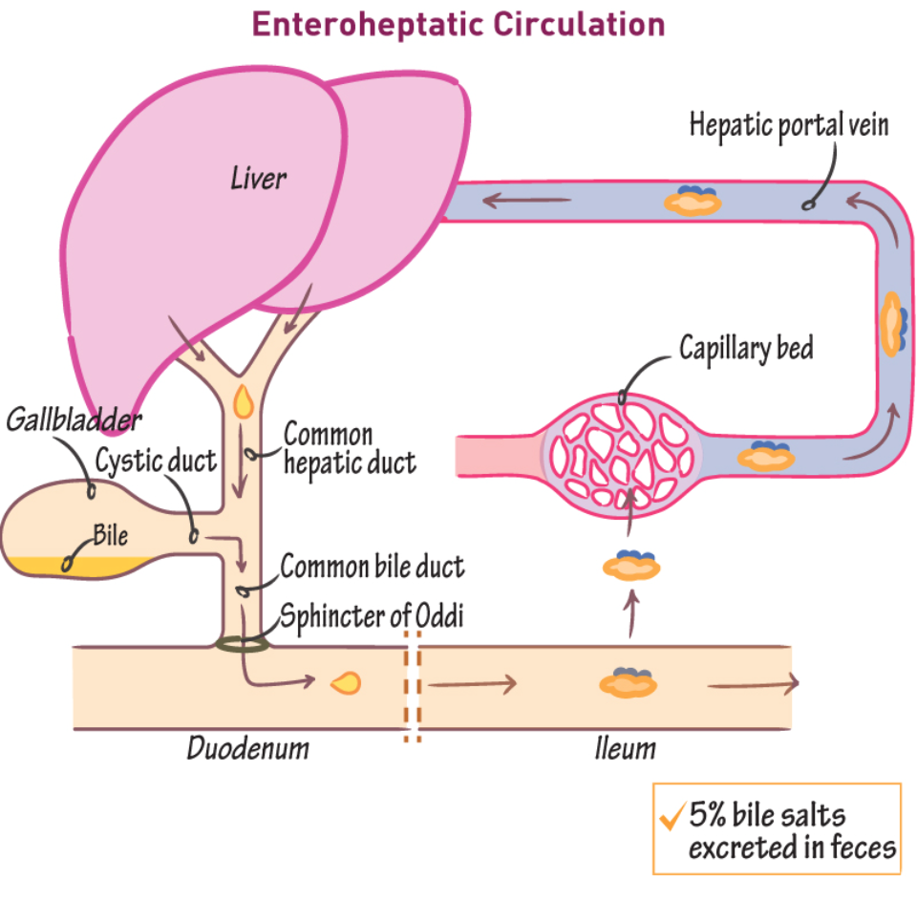
Crohn’s disease
= type of IBD characterised by patchy transmural granulomatous inflammation with skip of any part of GI tract (mouth→ anus). MC affects in terminal ileum & proximal colon
Pathophysiology
STRONG GENETIC COMPONENT: Frameshift mutation in NOD2/CARD15 gene 🡪 autoimmune response 🡪 ASCA antibodies develop and cause transmural patchy inflammation
Symptoms
Tx
Abdo (RLQ) pain
Non-bloody diarrhoea
MC affects terminal ileum hence malabsorption
Weight loss & fatigue
Haematinic deficiencies
Fe deficiency anaemia: angular stomatitis, glossitis, koilonychia
B12 deficiency: paresthesia, lemon-yellow skin
Steatorrhoea & fat-soluble vitamin deficiencies
Cholesterol gallstones (reduced bile salt reabsorption in terminal ileum via enterohepatic circulation)
Apthous ulcers
Notes:
Transmural = all 4 layers of GI wall from mucosa to serosa are affected
Frameshift mutation = addition or deletion of 1 base which alters the reading frame of DNA base triplets resulting in altered protein being encoded
95% of bile salts are recycled via the enterohepatic circulation – reabsorbed in terminal ileum, travel via hepatic portal vein in liver to be resynthesized into bile. This process is reduced in UC hence cholesterol proportion in bile increases, causing precipitation of cholesterol-supersaturated bile as gallstones 🡪 gallstones can cause RUQ pain (biliary colic) & other complications e.g. choledocholithiasis.
Blood in stools is more common in UC than Crohn’s disease, though not impossible,

Slide 9
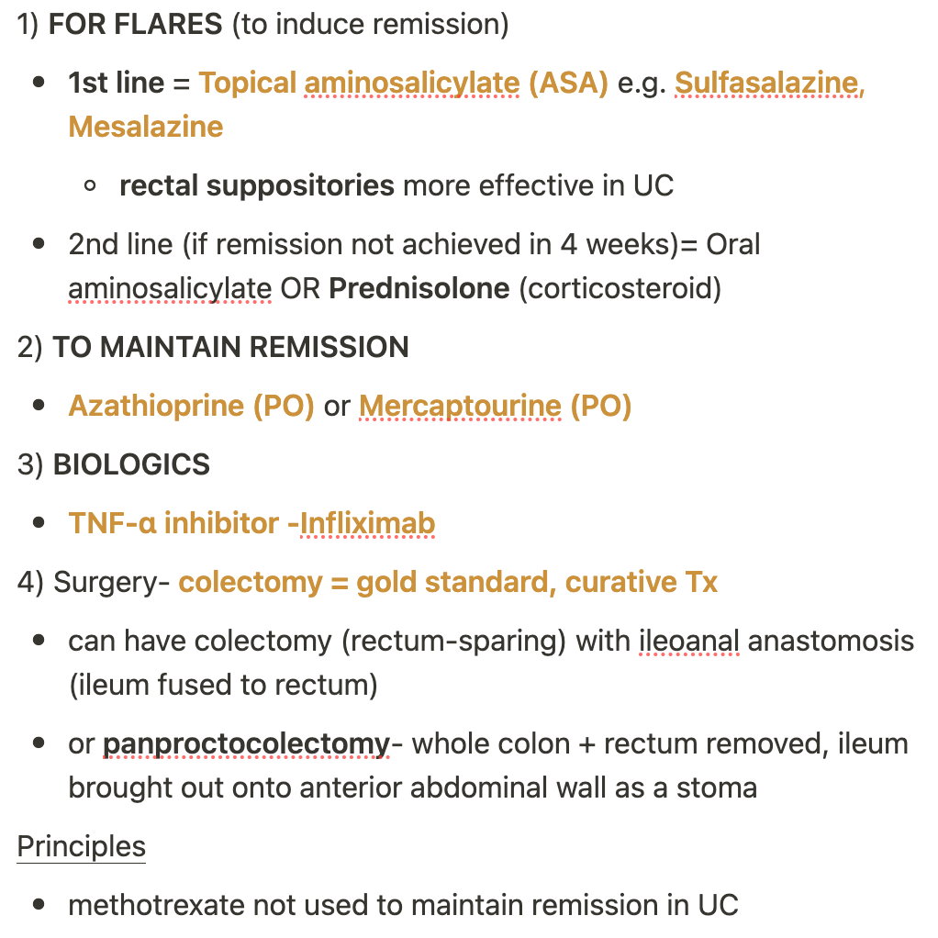
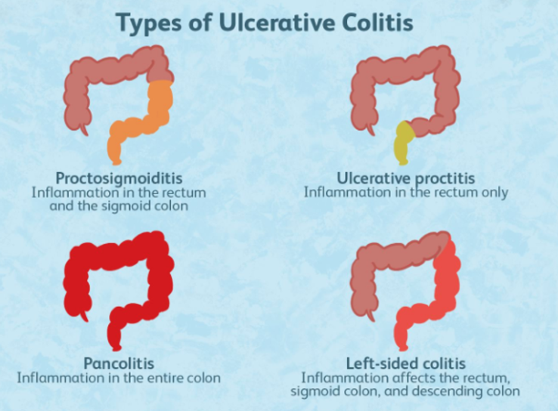
Ulcerative colitis
= autoimmune colitis beginning @ rectum (proctitis) & extending proximally into colon (NEVER beyond ileocaecal valve) associated with p-ANCA antibodies & HLA B27 gene
Affects colon only, never SI or anus
Pathophysiology
p-ANCA antibodies formed against gut bacteria cross-react with neutrophils due to molecular mimicry (gut bacteria possess similar antigens to neutrophils).
Cytotoxic T cells in epithelium of colon cause destruction of mucosa & submucosa→ mucosal & submucosal ulceration
Symptoms
Tx
LLQ abdo pain
bloody diarrhoea w/ mucus
rectal tenesmus
weight loss (Crohn’s >>)
Complications
- Toxic megacolon = MC cause of death in UC patients
- ↑ risk of cholangiocarcinoma
Notes:
pANCA = perinuclear antineutrophil cytoplasmic antibodies
Rectal tenesmus = feeling of incomplete bowel emptying +/- rectal defecation pain
Toxic megacolon = acute form of colonic distension, colon can perforate & cause sepsis.
Management = Mesalazine is preferred over Sulfasalazine as it has fewer side effects. The aminosalicylates are given as rectal suppositories if only rectum only inflamed, or foam enema is inflammation spreads more proximally, or orally if inflammation is more proximal still.

Slide 10
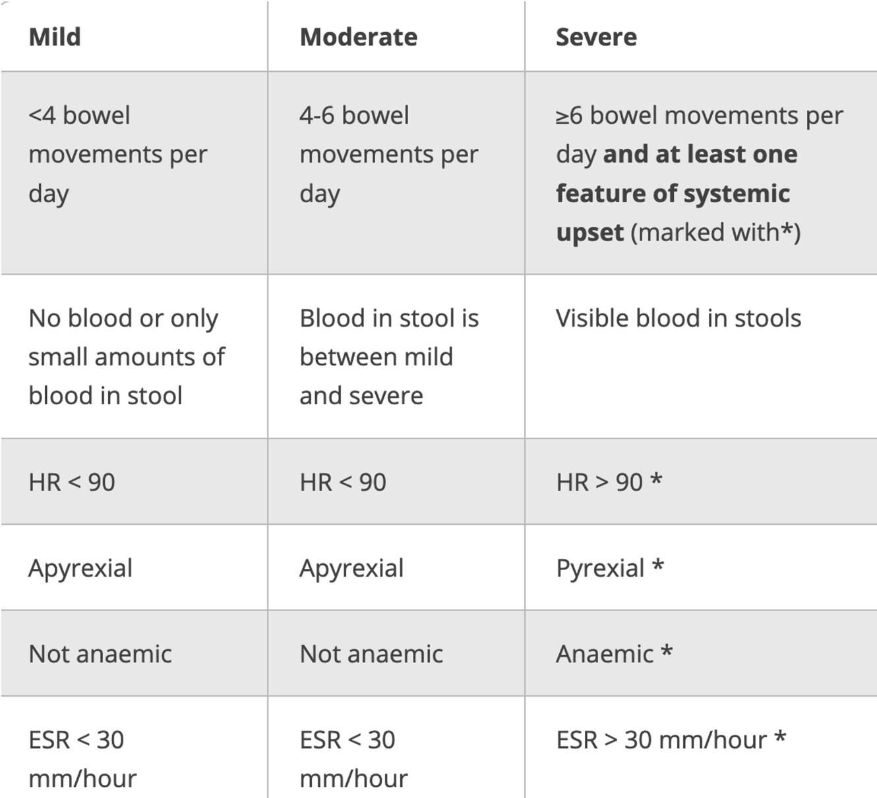
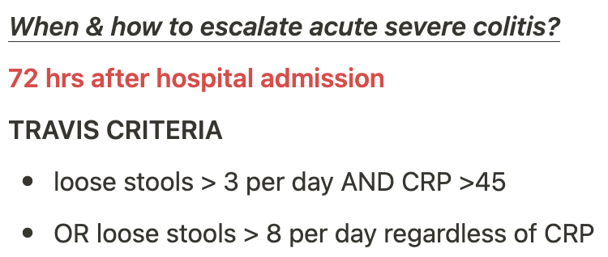
UC flare (acute severe colitis)
TrueLove & Witts’ scoring determines severity of UC flare (mild/moderate/severe). Px with severe UC require hospital admission.
Parameters = HR >90, anaemia (due to blood loss), frequency of bowel movements, blood in stools, ESR & pyrexia.
Acute Tx for flare = 5-ASA ( PR Mesalazine) & corticosteroids. 72hrs after hospital admission reassess patient to determine whether treatment escalation is needed using Travis criteria.
Tx for escalation = BIOLOGICS or COLECTOMY (curative). Consider patient choice e.g. impact of stoma etc.
Notes:
Options for escalating treatment of UC flare -=
1) BIOLOGICS - usually Infliximab [ TNF-alpha inhibitor, most reliable and used for long time, given by IV infusion for inpatients or SC injection for outpatients. Vendelizumb is less immunogenic but takes longer to work. Small molecule inhibitors e.g. JAK inhibitors – Upadicitinib are also now being used for IBD.
2)COLECTOMY - curative.
Ask patient about their wishes - would they mind a stoma? Some stomas allow unscrewing distally so you can empty the poo rather than untying each time.
NB: Don’t need to learn Travis criteria for 2a exams. Be aware of Truelove & Witt’s index & try to learn its parameters if you have time.

Slide 11
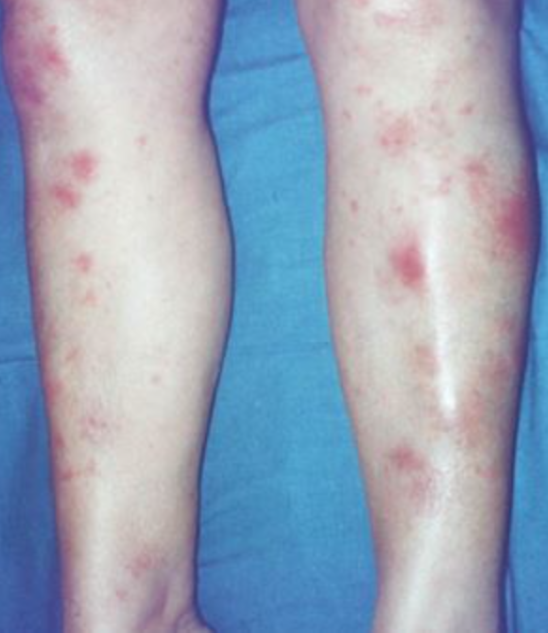
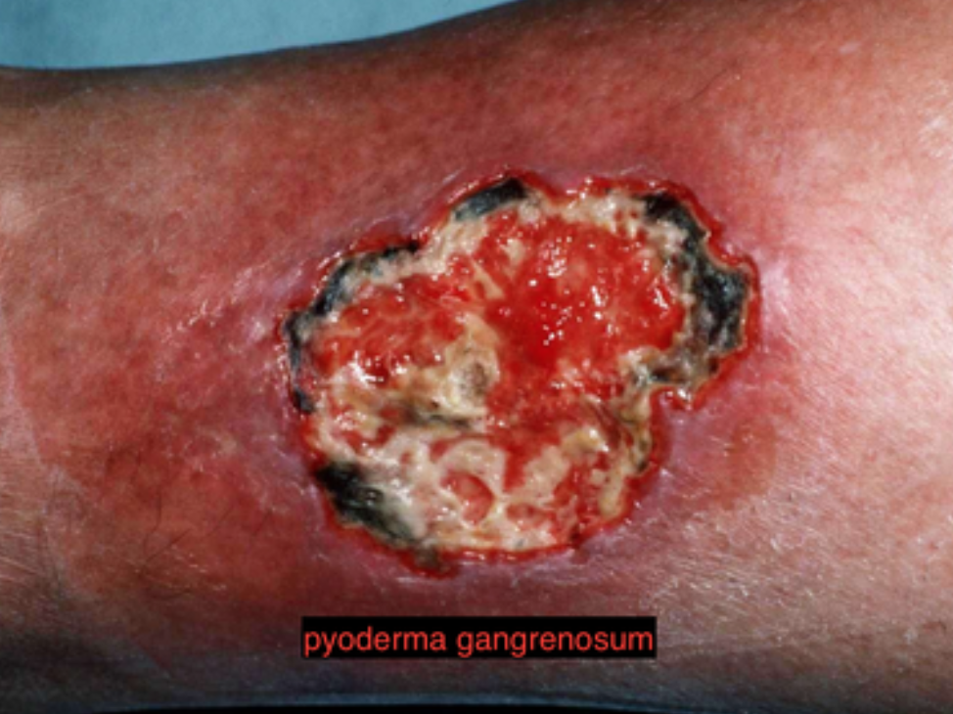
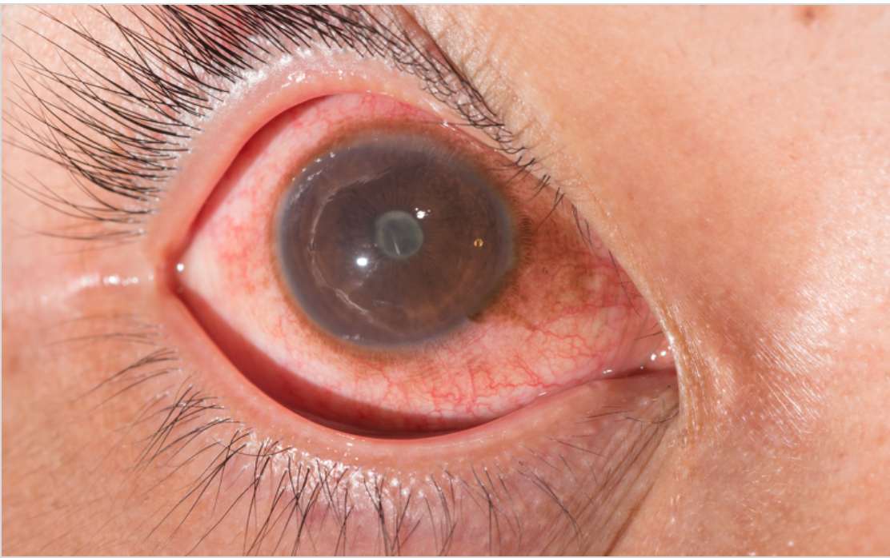
Extraintestinal manifestations of IBD
Skin 🡪 erythema nodosum (tender nodules on anterior shins) + pyoderma gangrenosum
Eyes 🡪 uveitis + episcleritis
Joints 🡪 seronegative spondyloarthropathies (WILL LEARN THIS IN MSK & RHEUM!) - seronegative refers to absence of rheumatoid factor.
70% of primary sclerosing cholangitis patient develop UC!
Pyoderma gangrenosum
Erythema nodosum
Notes:
Common features of seronegative spondyloarthropathies can be remembered with SPINEACHE.
Erythema nodosum. = tender red nodules on anterior shins due to inflammation of subcutaneous tissue Symptoms of uveitis include: Pain, Blurred/cloudy vision, Loss of peripheral vision, Sensitivity to light, Redness of the eye, Headaches, Floating spots in field of vision

Slide 12
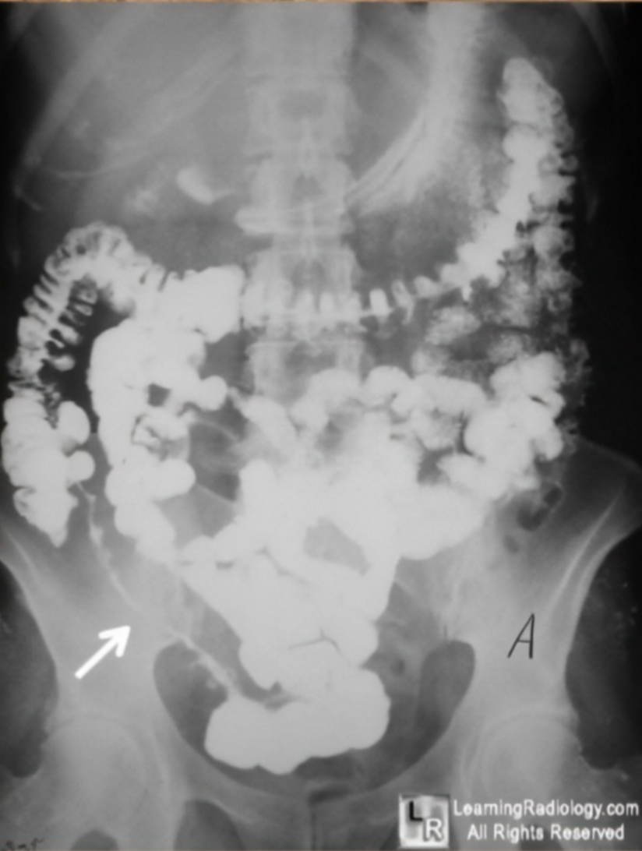
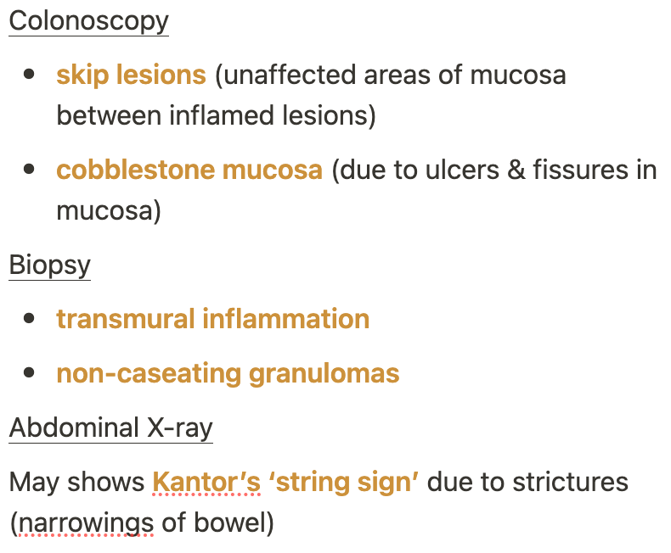
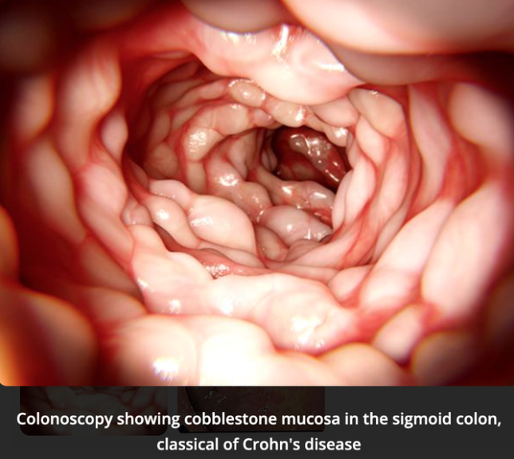
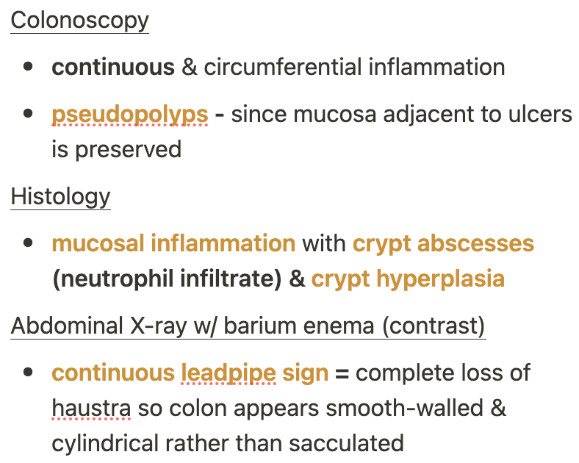
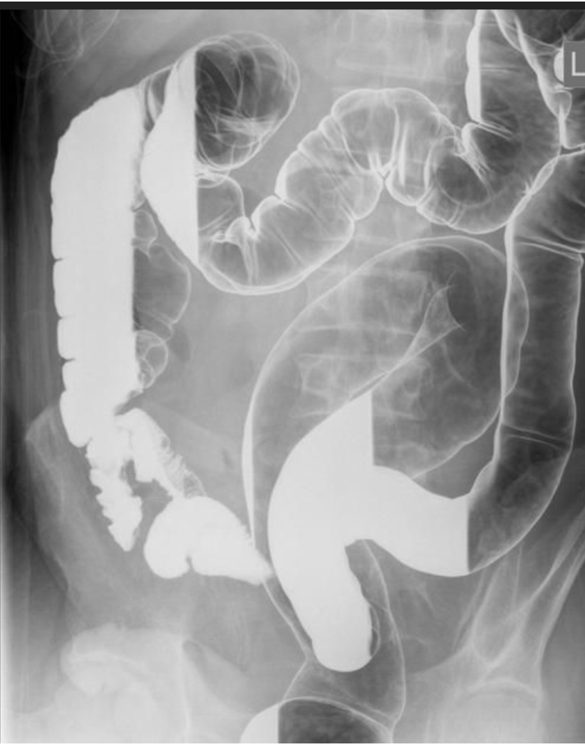
IBD investigations
Crohn’s disease
DIFFERENTIAL DX:
IBD
IBS
Coeliac disease
Gastroenteritis
Ix
Faecal calprotectin 🡪 ↑ in IBD not IBS
CRP & ESR – ↑
Stool MC & S – rule out C. difficile infection
Coeliac serology- IgA tissue transglutaminase with total IgA
ASCA & pANCA antibodies 🡪 ASCA often +ve in Crohn’s, pANCA +ve in UC
Ulcerative colitis
GS = colonoscopy with mucosal biospy
Notes:
In acute severe colitis (UC flare), abdominal X-rays are used to check for toxic megacolon.

Slide 13
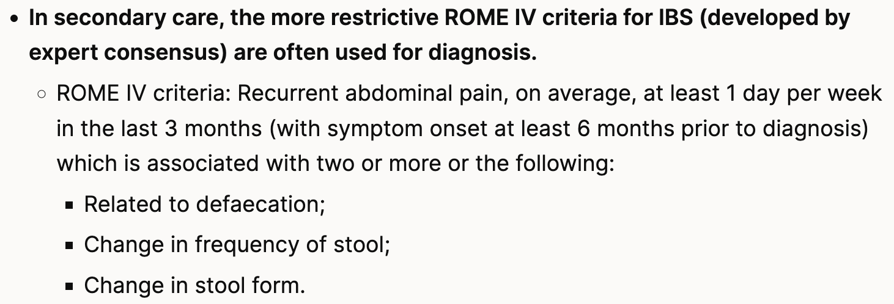
IBS
Aetiology
Unknown, several hypotheses:
Altered gut microbiome
Gut-brain axis
Visceral hypersensitivity (sensory neurons in Aucherbach’s & Meissner’s plexi are overstretched by gas-producing foods
Definition
Functional bowel disorder characterized by abdominal pain (relieved by defecation), bloating & change in bowel habits.
Diagnosis & symptoms
Diagnosed based on Rome IV criteria
Types
IBS-D
IBS-C
IBS-M
If ALARMS Sx present think of differentials:
Ovarian cancer – frequent bloating in 50+ female
Bowel cancer – 60+ w/ change in bowel habit , +ve FIT test, anaemia
IBD – raised fecal calprotectin
WHO 🡪 20-30 y/o females
RF = stress, anxiety, depression, previous gastroenteritis
In the absence of ALARM symptoms, suspect IBS!
Notes:
Functional bowel disorder means there is no structural or biochemical abnormality detected on imaging. Other functional bowel disorders are dyspepsia.
If IBS symptoms present in a 50+ female esp frequent bloating first step is to rule out ovarian cancer.

Slide 14
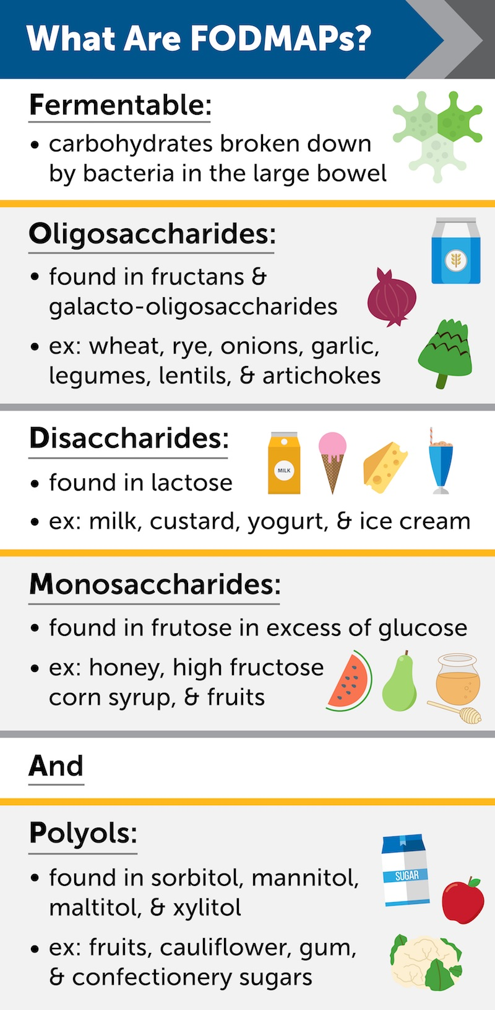
IBS
AVOID
Treatment
 | IBS-D | IBS-C
Conservative – 1st line | Low FODMAP diet & avoid trigger foods (fatty, oily, spicy foods), reduce fibre | ↑ fibre intake (>= 30g/day)
Pharmacological – 2nd line | Antimotility agent = Loperamide/Imodium | 1st line = bulk-forming laxative - Isphagula husk 2nd line = stimulant laxative - Senna
For abdo pain give ANTISPASMODICs e.g. Mebevarine, Buscopan (anticholinergics)
3rd line 🡪 consider CBT & tricyclic antidepressants - Amitryptiline
Notes:
Fermentable Oligosaccharides, Disaccharides, Monosaccharides, and Polyols (FODMAPS) are short-chain carbohydrates that are poorly absorbed in the GIT
CBT – cognitive behavioural therapy
Lactulose (osmotic laxative) is another treatment for constipation but not recommended for IBS-C.

Slide 15
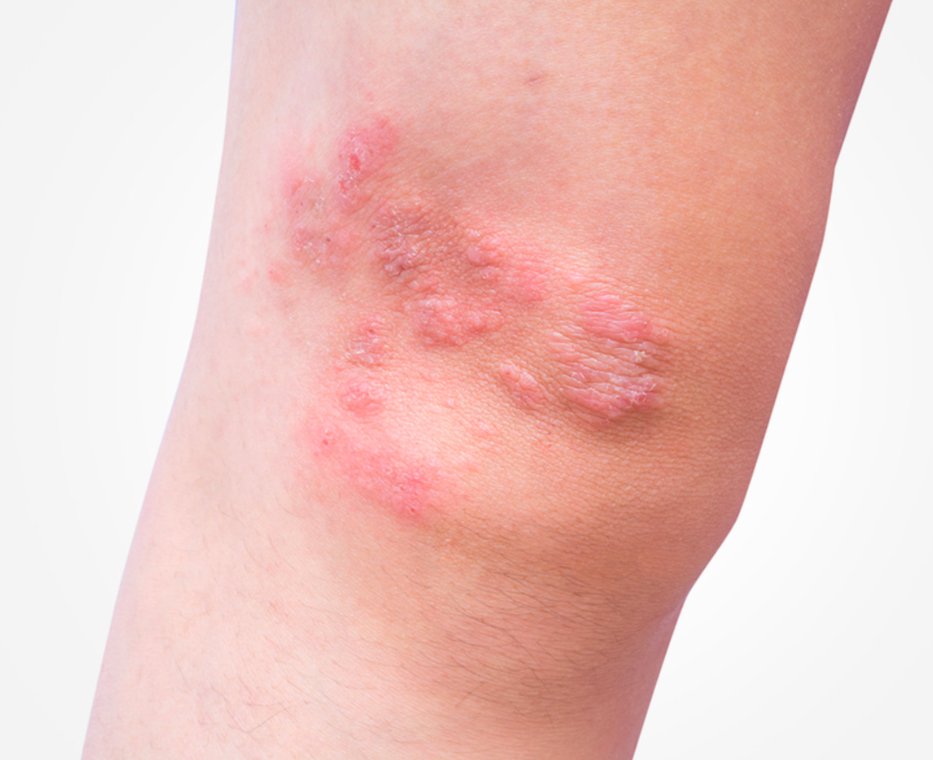
Coeliac disease
Pathophysiology
Definition
Type 4 hypersensitivity reaction mediated by T cells:
Gluten breaks down to gliadin → gliadin binds to IgA in gut lumen forming IgA-gliadin complex that crosses enterocytes into lamina propria
Gliadin is deamidated by tissue transglutaminase (enzyme). Deamidated gliadin is taken up by macrophages & presented via HLA DQ2 or DQ8 (MHC II molecules) to CD4+ T helper cells.
CD4+ T helper cells are activated & release pro-inflammatory cytokines (IFN- gamma & TNF-alpha).
T helper cells launch an immune response & activate B cells: resulting in production of IgA anti-tTG (tissue transglutaminase) autoantibodies & endomysial (EMA) antibodies
CD8+ cytotoxic T cells are activated & destroy epithelial cells of villi (enterocytes).
This results in:
villous atrophy → causes malabsoprtion
crypt hyperplasia
intraepithelial lymphocyte infiltration
Autoimmune disease where ingestion of gluten in genetically susceptible individuals (HLA DQ2 or HLA DQ8) causes mucosal inflammation of upper small bowel & malabsorption.
Risk factors
HLA DQ2 or HLA DQ8
IgA deficiency
FHx
Other autoimmune diseases – T1DM, autoimmune thyroid disease
Dermatitis herpetiformis
Notes:
Gluten is present on wheat, barley & rye
HLA (human leukocyte antigen) are a tissue type of MHC class II.
Gliadin is the most immunogenic component of gluten.
Show histology slide of crypts of Lieberkuhn 🡪 normally have enterocytes & goblet cells & stem cells in crypts to replenish gut lining

Slide 16
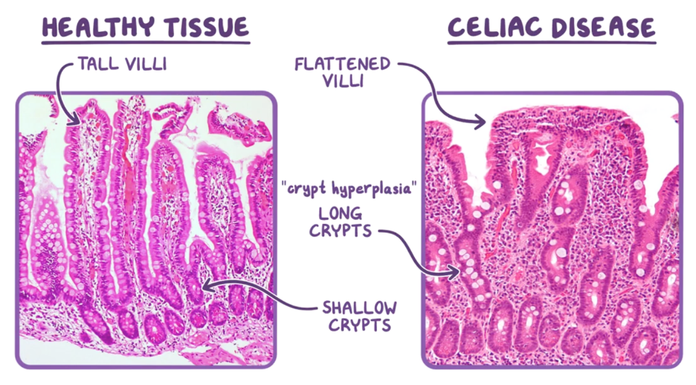
Coeliac disease
Complications
OSTEOMALACIA (soft bones with ↑ fracture risk due to impaired bone mineralisation due to decreased intestinal Ca2+ absorption)
Symptoms
ABDO Sx:
diarrhoea (more common) or constipation
bloating & abdo pain
N & V
Indigestion
DERMATOLOGICAL: dermatitis herpetiformis (itchy vesicular blistering rash)- MC on buttocks, scalp & extensor surfaces of elbows, knees)
due to anti-tTG Abs cross-reacting with epidermal transglutaminase in skin
MALABSORPTION due to villous atrophy resulting in:
weight loss or failure to thrive (children)
steatorrhoea (fatty stools which float on water)
haematinic deficiency (Fe/B12/folate)- anaemia Sx e.g. fatigue, pallor, dyspnoea + angular stomatitis (ulcers at corner of mouth) + glossitis
Diagnosis
Serology
1st line = IgA anti-tTG raised
+ total serum IgA- some Px are IgA deficient which produces false -ve anti-tTTG result
2nd line (if anti-tTG is not v. high, less sensitive) = IgA endomysial antibodies (EMA)
GS = endoscopy with duodenal biopsy
shows villous atrophy, crypt hyperplasia & intraepithelial lymphocytes

Slide 17
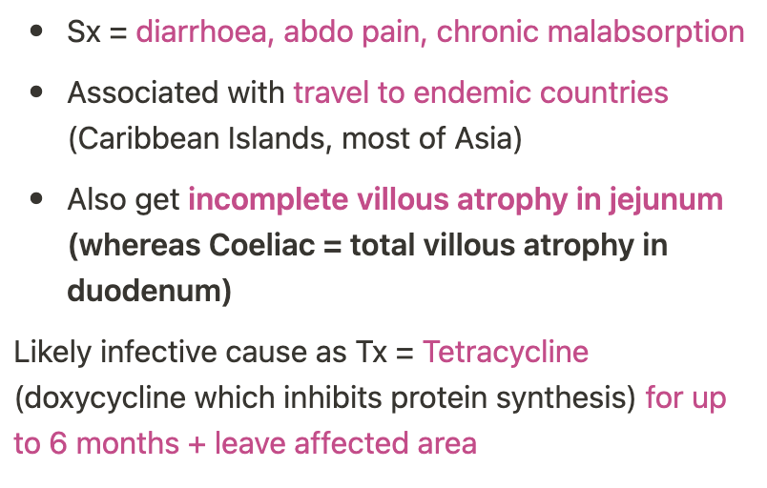
Coeliac disease
Tropical sprue
Treatment
Life-long gluten free diet {avoid wheat, barley, rye}
+ DEXA scans to monitor bone density (at risk of osteoporosis)
Complications
MALIGNANCY- ↑ risk of small bowel adenocarcinoma and T-cell lymphoma (as increased T cells in GI wall). Risk appears to normalise after a few years of gluten restriction.
Notes:
Hallmark of coeliac disease is malabsorption.
Differential for coeliac disease is tropical sprue.

Slide 18
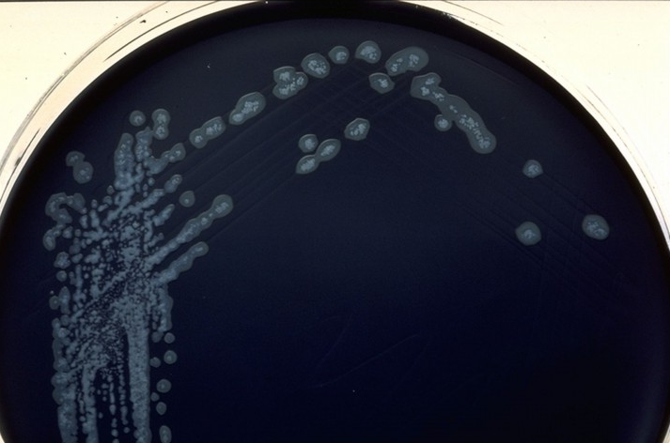
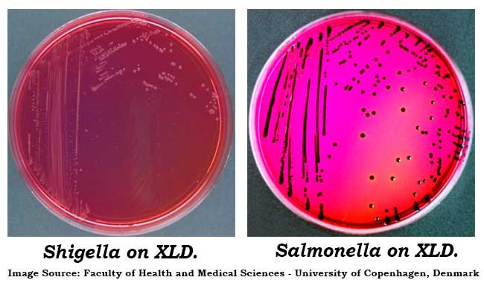
Diarrhoea
Definition
Viral
Parasitic
The abnormal passage of 3 or more loose or liquid stools per day (between levels 5-7 on the Bristol stool chart)
Rotavirus – leading cause in children <3y
Norovirus – most common in adults
cruise ships, hospital, restaurants
Giardia lamblia – most common
Treat: metronidazole
Cryptosporidium (helminth parasite)
Bacterial
Causes
Traveller's diarrhoea (TD) – E.coli usually
🡪 fever, n+v, cramps, tenesmus, or bloody stools during a trip abroad
🡪 Self-limiting illness lasting 3 to 5 days
Infective
Viral –most common
Bacterial
Parasitic
IBD (Crohn’s/ UC)
Coeliac disease
Hyperthyroidism
Inflammation/Malignancy
Campylobacter jejuni –MC Bacterial
CCDA agar or PCR
Undercooked chicken (after BBQs!)
Usually self limiting = no treatment
E. coli (Escherichia coli)
Salmonella enterica (pink w/ black centre on XLD)
Shigella (pink on XLD)- causes bloody diarrhoea
CCDA

Slide 19
Diarrhoea
Antibiotics as a cause of Clostridium difficile infection
Some antibiotics can interfere with the balance of bacteria in the bowel, which can cause the C. diff bacteria to multiply and produce toxins → Watery diarrhoea
Investigate: Stool antigen test or PCR, if positive, isolate for 48 hours diarrhoea free (C.diff is highly infective)
Treat: Metronidazole, vancomycin, stop ‘C’ antibiotics
Quick Identification:
Under 3y= Rotavirus
Adult, recently in hospital/restaurant/cruise ship = Norovirus
Travel History= Traveller’s Diarrhoea
Watery Diarrhoea, on ‘C’ Antibiotics = C. diff
Bloody Diarrhoea= bacterial, Shigella
Recently at a BBQ= Campylobacter
Signs of neurological problems= Campylobacter (Guillain Barre)
Oily diarrhoea, floats= Coeliacs (steatorrhoea)
5 C’s Antibiotics
Cefalexin
Clarythromycin
Co-Amoxiclav
Clindamycin
Ciprofloxacin

Slide 20
Diarrhoea
Investigations
Treatment
Treat Underlying cause
Viral infections + Travellers Diarrhoea self limiting
Oral rehydration and avoid high-sugar drinks
For symptoms
Antiemetics – metoclopramide
Antimotility – loperamide
Broad spectrum antibiotics – ciprofloxacin, ceftriaxone
Giardia lamblia – metronidazole
Bloods
Increased ESR/CRP = infection
Increased eosinophils = parasite
Increased ESR/CRP + anaemia = Crohn’s, UC, cancer
Stool culture: bacteria, parasites
PCR: viruses, C. diff or campylobacter

Slide 21
GI Red Flags – ALARMS Sx
Important to know when managing peptic ulcer disease, IBS -like symptoms and swallowing difficulties as differentials can be benign or cancerous!
Anaemia (Fe deficiency)
Loss of Weight (unintentional)
Anorexia (loss of appetite)
Recent onset of worsening Sx
Melaena/haematemesis 🡪 UGIB
Swallowing issues (dysphagia) 🡪 exclude oesophageal cancer> achalasia

Slide 22
What is false regarding Irritable Bowel syndrome?
It is associated with passage of mucus per rectum
Abdominal pain is typically relieved by defecation
Abdominal pain is usually triggered by eating high FODMAP foods.
It is diagnosed by the Rome IV criteria in secondary care.
It is sometimes triggered by a previous STI.

Slide 23
What is false regarding Irritable Bowel syndrome?
It is associated with passage of mucus per rectum
Abdominal pain is typically relieved by defecation
Abdominal pain is usually triggered by eating high FODMAP foods.
It is diagnosed by the Rome IV criteria in secondary care.
It is sometimes triggered by a previous STI.
Notes:
It is sometimes triggered by a previous gastroenteritis.

Slide 24
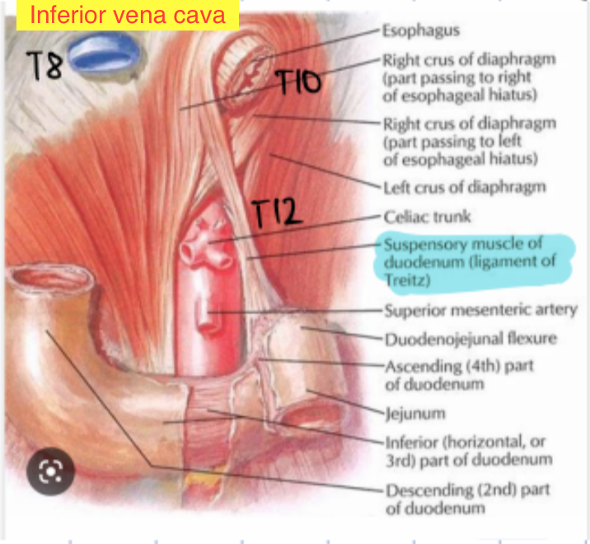
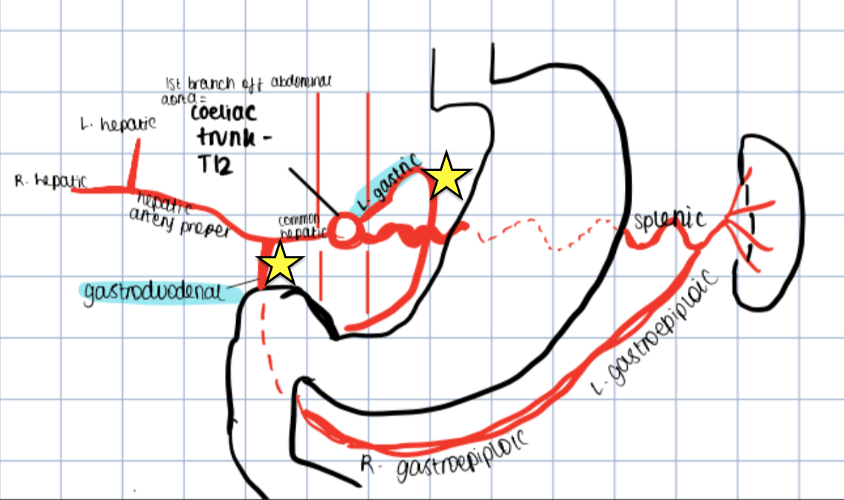
UGIB vs LGIB
Ligament of Treitz anchors duodenojejunal flexure to retroperitoneum.
Anything before = UGIB
Anything after = LGIB
UGIB | LGIB
Sx = haematemesis (coffee-ground vomit), melaena (black tarry stool) | Hamatochezia: Fresh red blood
Cause 🡪 Mallory Weiss tear Ruptured oesophageal varices Bleeding peptic ulcers | Bowel cancer Anorectal disease {haemorrhoids, anal fissure} Diverticular disease
Notes:
Ligament of Treitz anatomically distinguishes b/w UGIB & LGIB. Any bleed before = UGIB, any bleed after = LGIB.
Stools turn black & tarry (melaena) due to oxidisation.

Slide 25
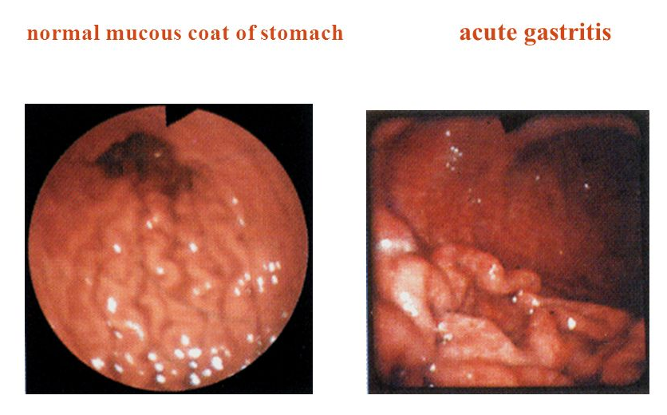
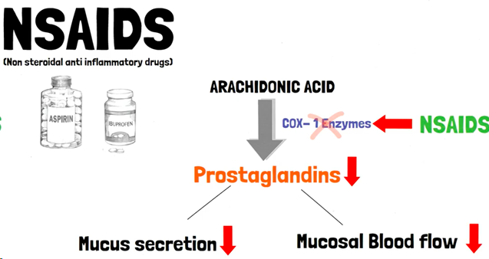
Gastritis- CAP
Definition
H.pylori is gram-negative, spiral bacterium. Oral-oral or faecal-oral transmission
Inflammation of the stomach mucosal lining
Causes
ACUTE | CHRONIC
Helicobacter pylori infection Alcohol abuse Stress (critically ill, major surgery) NSAIDs (COX inhibitor → inhibits prostaglandin synthesis→ less mucus secretion) MCC 🡪CAMPYLOBACTER pylori- GUILLAN BARRE Viral - CMV | Helicobacter pylori infection Autoimmune gastritis (affects fundic portion of stomach) Parietal cell antibodies and intrinsic factor antibodies → reduce vit B12 absorption in terminal ileum → pernicious anaemia
Notes:
Ask whats the difference between Vit b-12 deficiency and pernicious anemia
While vitamin B12 deficiency anemia may be caused by a lack of vitamin B12 in the diet, pernicious anemia is caused by an inability to absorb vitamin B12.

Slide 26
Gastritis
Signs+ Symptoms
Investigations
Management
H.pylori eradication
CAP Triple therapy (PPI + 2 antibiotics). Twice a day for 7 days (NICE guidelines)
1st line: Clarithromycin 500mg + Amoxicillin 1g + PPI (omeprazole)
If penicillin allergy: Metronidazole 400mg instead of Amoxicillin
Stop NSAIDs
Stop alcohol
Autoimmune Gastritis - IM vitamin B12 (hydroxocobalamin)
Dyspepsia (indigestion)
Epigastric pain WITH DIARRHOEA
Anorexia
Nausea & vomiting
Helicobacter pylori infection
Urea breath test
Stool antigen test
Before testing, stop PPI for at least 2 weeks/stop antibiotics for 4 weeks
Ensures test results are only due to H.pylori
Endoscopy (gastric mucosal inflammation/atrophy)
Autoimmune gastritis
B12 Testing (low)
Parietal cell antibodies, intrinsic factor antibodies)
Differentials
Peptic ulcer disease (PUD)
GORD
Gastric carcinoma
Complication
Peptic ulcers
Bleeding and anaemia
MALT lymphoma (mucosa-associated lymphoid tissue)
Gastric cancer
Notes:
Gastritis endoscopy - rugae more prominent
biopsy for histological assessment and testing for H pylori infection
Triple therapy: Omeprazole, amoxicillin and clarithromycin. If penicillin allergy: Omeprazole, clarithromycin and metronidazole

Slide 27
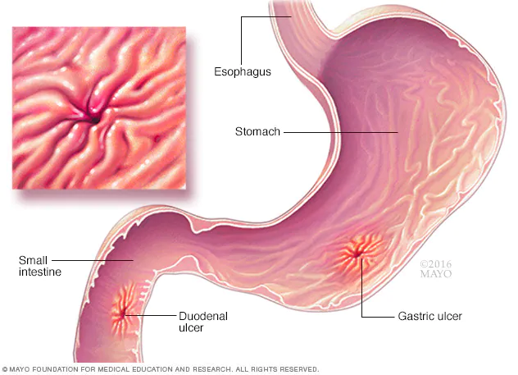
Peptic ulcer disease
2 Types of Peptic Ulcers:
Gastric
Duodenal (more common)
Symptoms+ Signs
Dyspepsia (indigestion)
Epigastric pain
Duodenal: gets better after eating
Gastric: gets worse after eating
Perforation of artery: haematemesis / melena
Causes + Pathophysiology
Anything that decreases mucosal production/increases acid
Gastritis
H. pylori infection
secretes urease → urea converted to ammonium (is toxic to gastric mucosa) → decreased mucus + increased inflammation → increased acid production
NSAIDs
Investigations
Treatment
H. pylori tests (Urea breath test, stool
Endoscopy = GOLD
Treat underlying cause
stop NSAIDs
triple therapy!
Reduce smoking, alcohol, stress
Complication
Gastritis 🡪 Peptic Ulcers 🡪 Gastric Cancer
Notes:
Pyloric sphincter closed

Slide 28
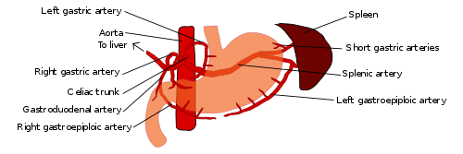
Gastric vs Duodenal ulcers
 | Gastric Ulcer | Duodenal Ulcer (more common)
Timing of pain | Worsen after eating | Better 1-2hrs after eating Worsens 2hrs after eating
Perforation of artery | Gastroduodenal artery | Left gastric artery
Signs after perforation | haematemesis + melena | melena + haematochezia
Notes:
Duodenal ulcers are less painful after eating bc the pyloric sphincter closes during digestion, preventing acid from going into duodenum

Slide 29
Mallory Weiss Tear
WHAT = Tear in lower oeosphageal mucosa due to sudden increase in intra- abdo pressure causing haematemesis. Typically preceded by retching/vomiting.
RF = hyperemesis gravidarum, bulimia, alcoholism
WHO 🡪 young ppl vomiting after night out drinking; no PMHx of liver disease or portal HTN
Sx = low volume hametemesis
Tx = none, self-resolves
Risk stratify using Glasgow-Batchford score
Notes:
Melaena is less common in MW tear, more common in rupture oeosphageal varices.

Slide 30
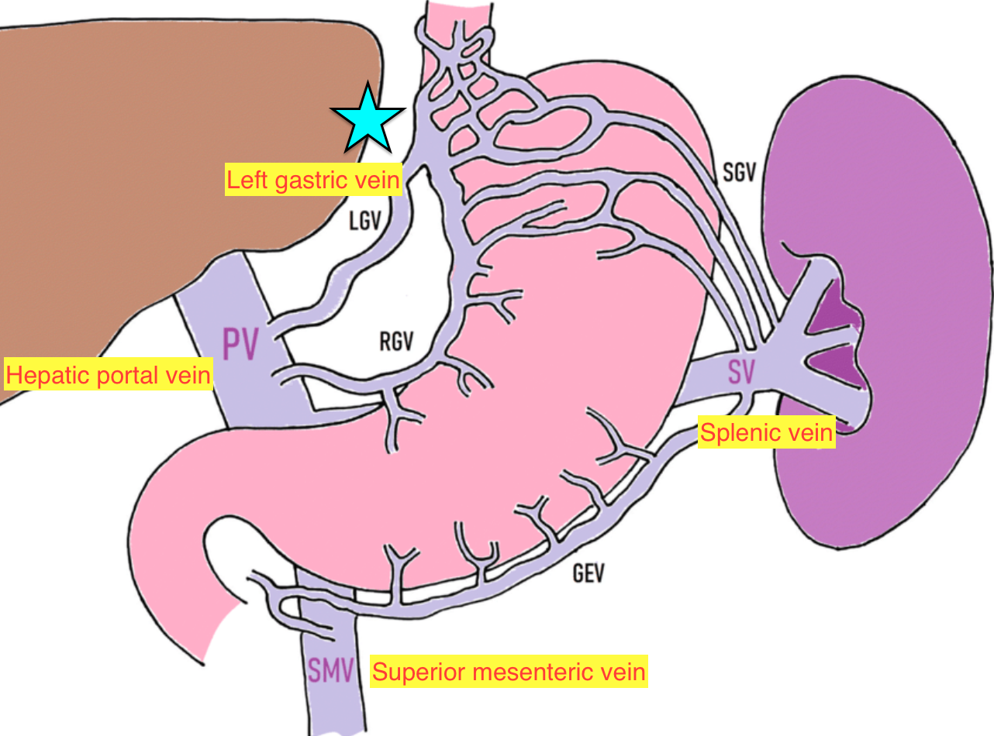
Oesophageal varices
Definition + pathophys
RF/Aetiology
Dilation of oesophageal veins @ gastro-oesphageal junction, cardia & inferior oeosophagus due to ↑ shunting to postosystemic anastomoses as a complication of portal HTN, usually in the context of liver cirrhosis. Veins are thin & not designed to accommodate large volumes of blood therefore rupture.
Complication of portal HTN:
MC cause = liver cirrhosis
Other causes = liver cirrhosis, alcoholism, schistosomiasis
Symptoms
haematemesis, melaena
can be haemodynamically unstable - hypotension, tachycardia
Investigations (bleeding varices)
If haem. unstable 🡪 IV fluid resuscitation & blood transfusion if Hb <70g/L (<80/L & cardiac comorbidity)
THEN urgent upper GI endoscopy within 24hrs
(& risk stratify using Glasgow Batchford score)
SIGNS OF HIGH-RISK UPPER GI BLEED = melaena, low BP, tachycardia, syncope, Hx of liver disease or heart failure, low Hb or high urea

Slide 31
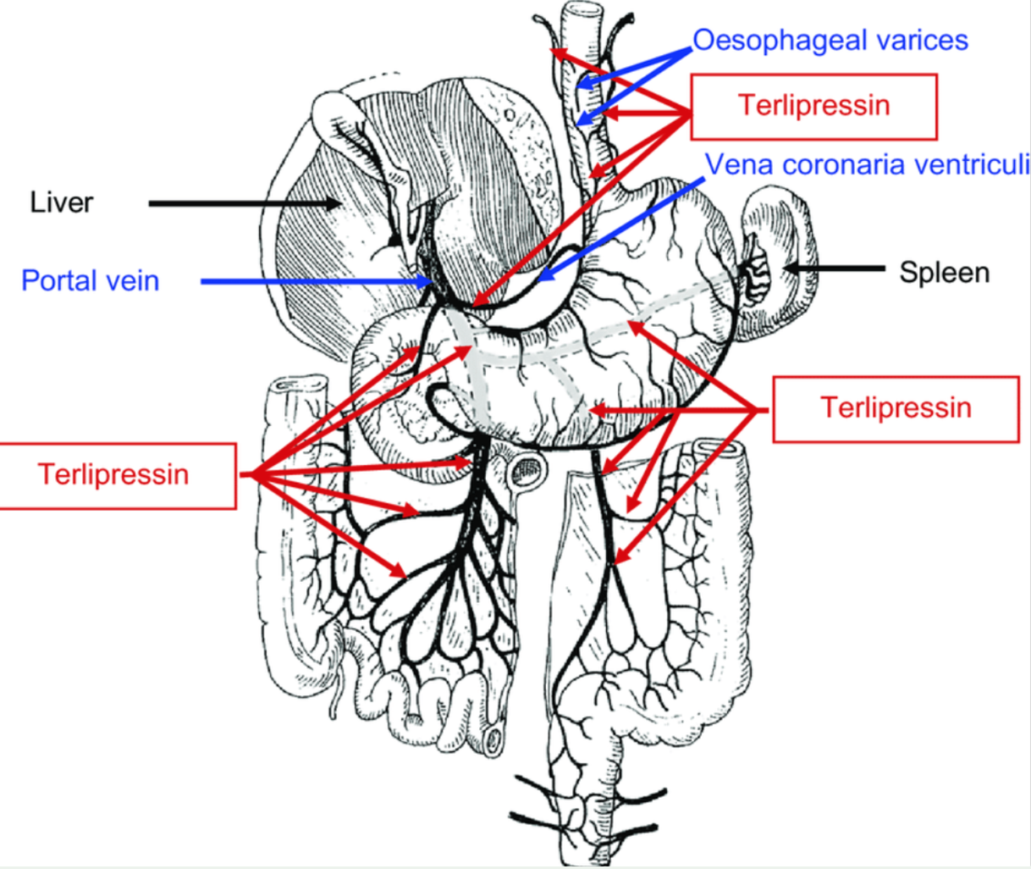
Oesophageal varices
Treatment
ACUTE (if haem unstable) = IV fluid resuscitation & blood transfusion if Hb <70g/L (or Hb <80g/L & cardiac comorbidity)
STOP BLEEDING
1st IV Terlipressin. If contraindicated give somatostatin analogue e.g. Ocreotide.
1st Endoscopic variceal band ligation
2nd line = TIPPS - transjugular intrahepatic portosystemic shunt - a shunt created between systemic & portal venous system to decreases portal venous pressure.
PREVENT FURTHER BLEEDING
Non-selective beta blockers- Propanolol- ↓ HR & CO rate thus ↓ portal venous pressure. Nitrates.
Repeat endoscopic variceal banding - band is placed around the varices; after a few days the varices degenerates & falls off leaving a scar
Last resort = liver transplant (if cause = portal HTN secondary to liver cirrhosis)
Terlipressin mechanism = Vasopressin analogue. Causes splanchnic vasoconstriction thus ↓ portal venous pressure (as less blood flow to portal vein through splenic & superior mesenteric vein) & ↓ bleeding from varices.
Shown to reduce mortality
CI in ischemic heart disease, PVD, heart failure
Notes:
Terlipressin is an ADH (vasopressin) analogue.
Splanchnic vessels = the entire blood vessels of the gut. The splenic vein & superior mesenteric vein anastomose to form the hepatic portal vein.
Contraindications of Terlipressin = ischaemic heart disease & peripheral vascular disease & heart failure because it is a potent vasoconstrictor and increases systemic vascular resistance→ decreases perfusion to organs.

Slide 32
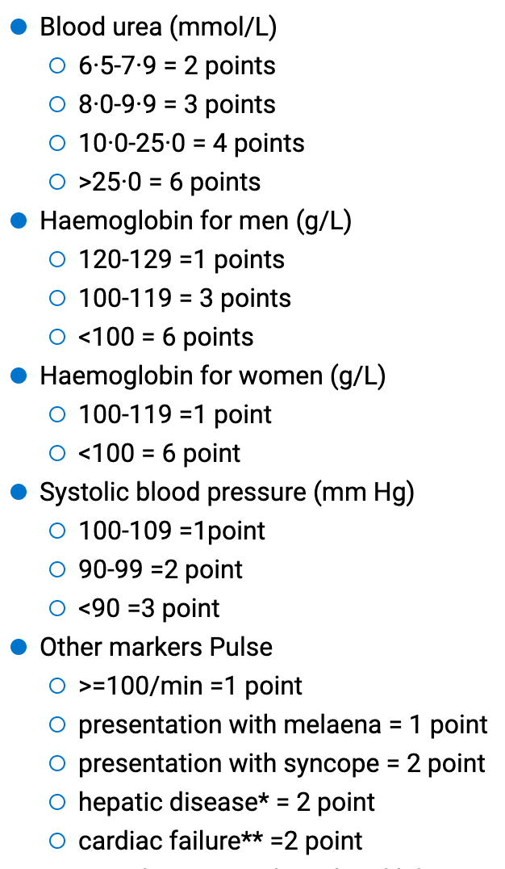
Glasgow-Batchford score
Risk stratifies patients with UGIB to identify those suitable for outpatient endoscopy vs those needing urgent upper GI endoscopy. Score 0 means patient is low risk & can be managed with outpatient endoscopy.
= HIGH-risk

Slide 33
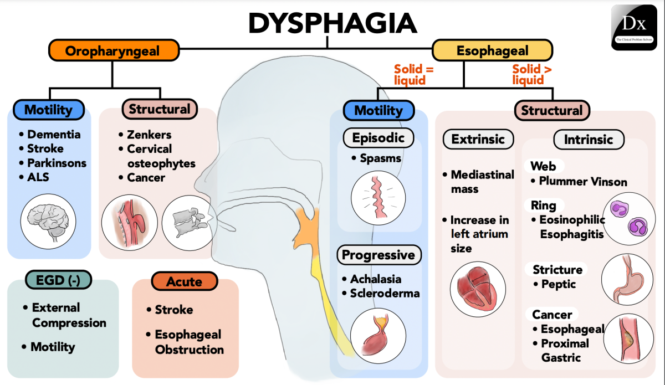

Slide 34
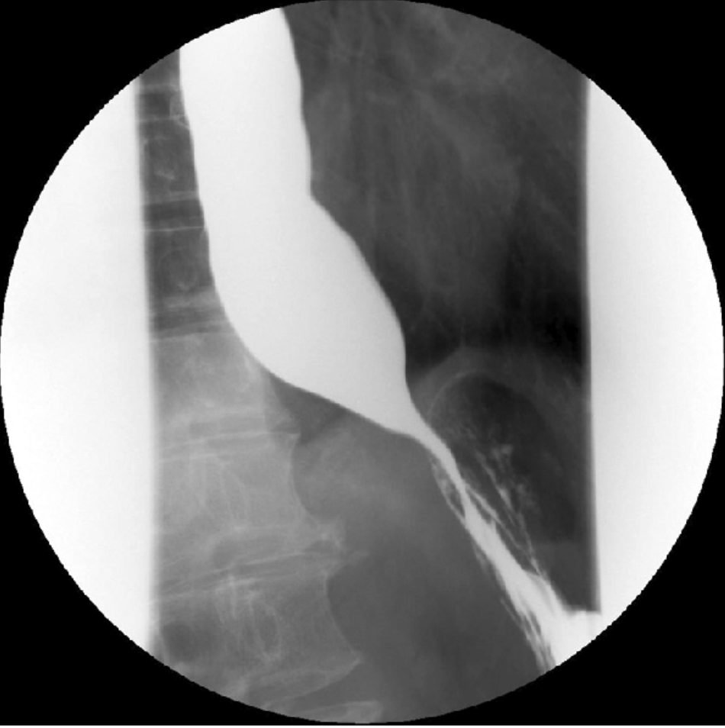
Achalasia
Treatment
SURGERY is curative:
Endoscopic balloon dilatation – to stretch LOS. Less effective
Laparoscopic cardiomyotomy/Heller’s procedure – LOS muscle is removed. This often causes iatrogenic GORD as LOS becomes incompetent so Nissen’s fundoplication can be performed silmutaneously.
Before surgery:
DRUGS to relax LOS – {nitrates} or CCB e.g. Nifedipine/Verapamil
Definition + Pathophysiology
Oesophageal motility disorder due to:
Degeneration of neurones in Auberach’s & Meissner’s plexi causes autonomic dysfunction of the smooth muscle of LES 🡪 impaired peristalsis & LES fails to relax 🡪 non progressive dysphagia
Symptoms
non-progressive dysphagia (can’t swallow solids & liquids)
REFLUX: Retrosternal burning chest pain
Food regurgitation 🡪 comp = aspiration pneumonia
Diagnosis
Bird’s beak sign on barium swallow
1st line:
OGD – exclude oesophageal cancer
Barium swallow 🡪 dilated distal oesophagus & bird’s beak sign
GS = oeosphageal manometry (measures pressure across LOS)
Notes:
OGD = oesophagogastroduodenoscopy

Slide 35
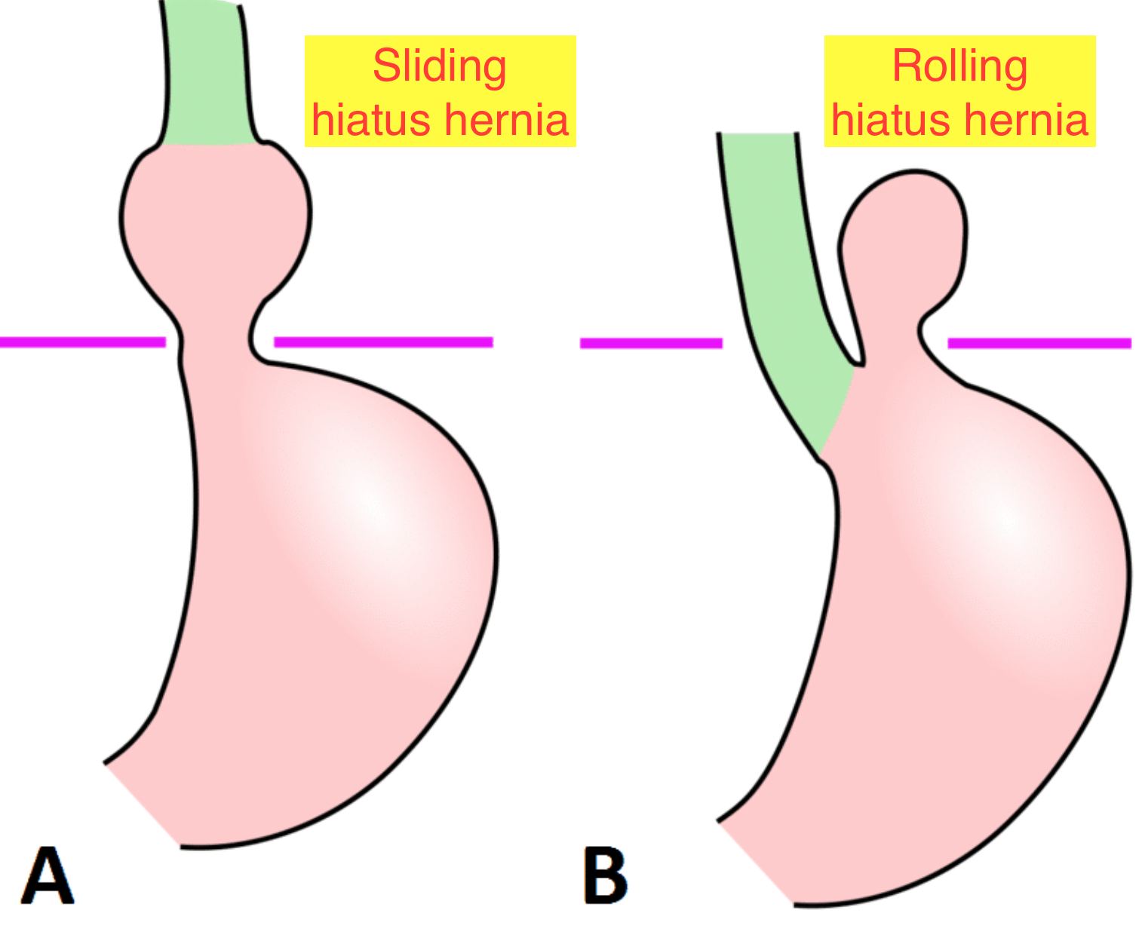
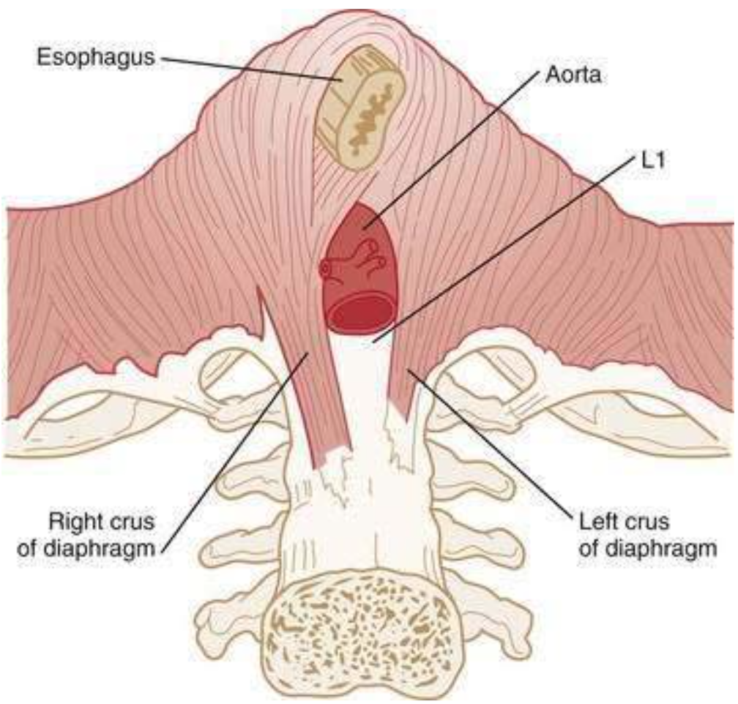
GORD
Definition
Complications:
- Oesophagitis
- Barrett’s oesophagus 🡪 Oesophageal adenocarcinoma
= reflux of acidic gastric contents into oesophagus due to incompetent LES or high intra-abdo pressure overcoming sphincter mechanisms.
Risk factors
Increased intra-abdo pressure: pregnancy, obesity
Incompetent LES :
Drugs ↓ LES tone: Ca2+ channel blockers, nitrates, anticholinergics
Systemic sclerosis
Diaphragmatic sphincter (formed from R crus of diagram)
Hiatus hernia – sliding (80%) & rolling (20%)
Diagnosis
If no 🚩 🡪 clinically Dx & treat
If 🚩 {haematemesis, melaena, wt loss} 🡪
1st line = OGD 🡪 oesophagitis or Barrett’s oeosophagus
2nd line (if OGD normal) = Oesophageal manometry & 24hr gastric pH monitoring
Symptoms
Retrosternal burning chest pain, worse lying flat (heartburn)
Dysphagia, odynophagia
Chronic cough
Nocturnal asthma
Dental erosions, acid taste in mouth
Notes:
Oeosophageal manometry – measures pressure across & functionality of LOS
24hr pH monitoring – catheters monitor pH at gastro-esophageal junction

Slide 36
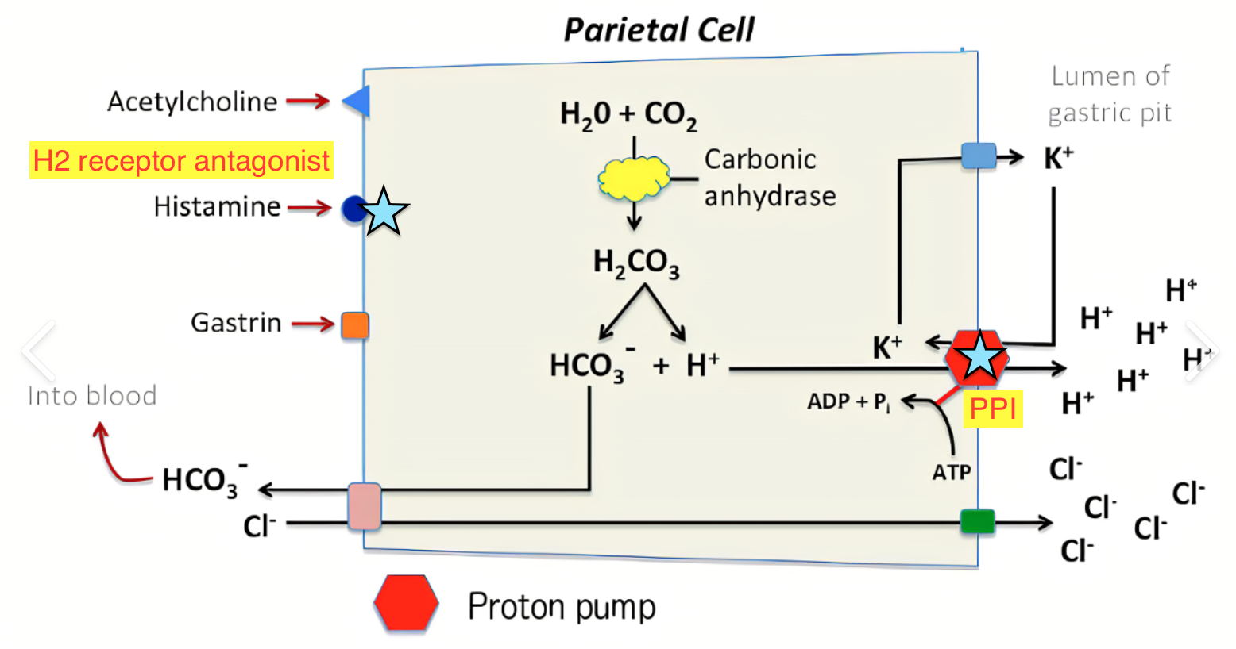
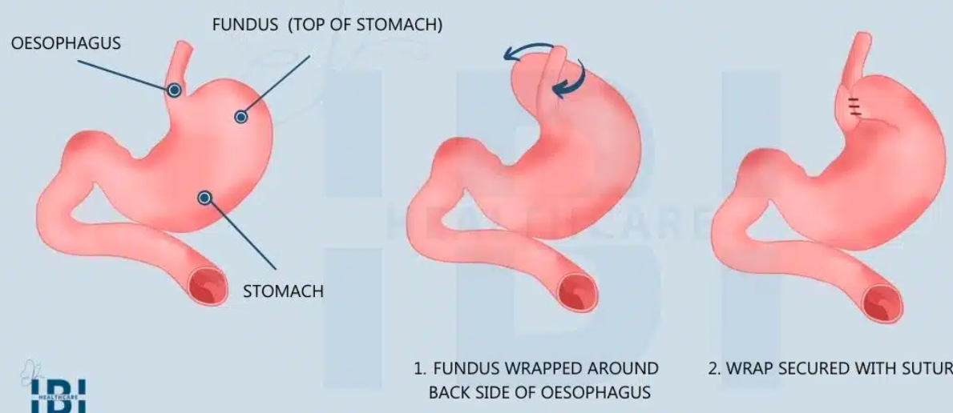
GORD Tx
Tx
Conservative | Weight loss, smaller meals , avoid eating <3hrs before sleeping ↑ no of pillows
Pharmacological | OTC self-management – Alginates (Gaviscon) &/or antacids 1st line = PPI 4 or 8 weeks e.g. Omeprazole, Lansaprazole 2nd line = H2 receptor antagonist e.g. Cimetidine, Ranitidine
Surgical = GS | GS = Laparoscopic Nissen’s fundoplication (fundus wrapped around lower oeosophagus to mimic sphincter)
Notes:
PPI inhibit H+/K+ ATPase pumps in apical membrane of parietal cells🡪 less H+ pumped into gastric lumen so less HCl produced.
Alginates form a floating raft on top of gastric contents to prevent reflux

Slide 37
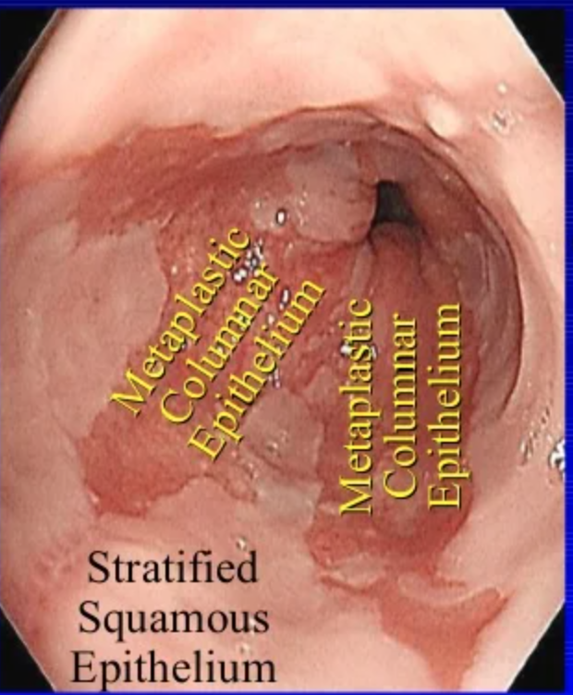
Barrett’s oesophagus
GORD 🡪 Barrett’s oeosphagus 🡪 oesophageal adenocarcinoma
= Metaplasia of distal oesophagus from SSNKE epithelium 🡪 simple columnar epithelium resembling gastric mucosa that predisposes to development of oeosophageal carcinoma
GORD complication, often involves sliding hiatus hernia.
WHO 🡪 50+ Caucasian males
INVESTIGATIONS
OGD with biopsy 🡪 Z-line ≥ 1 cm above gastro-esophageal junction
TREATMENT
Treat underlying acid reflux w/ PPI
If non-dysplastic 🡪 Surveillance endoscopy
If dysplastic histological Δ 🡪 Endoscopic mucosal resection or radiofrequency ablation
Notes:
Dysplasia = change from one cell type into less well differentiated cell type

Slide 38
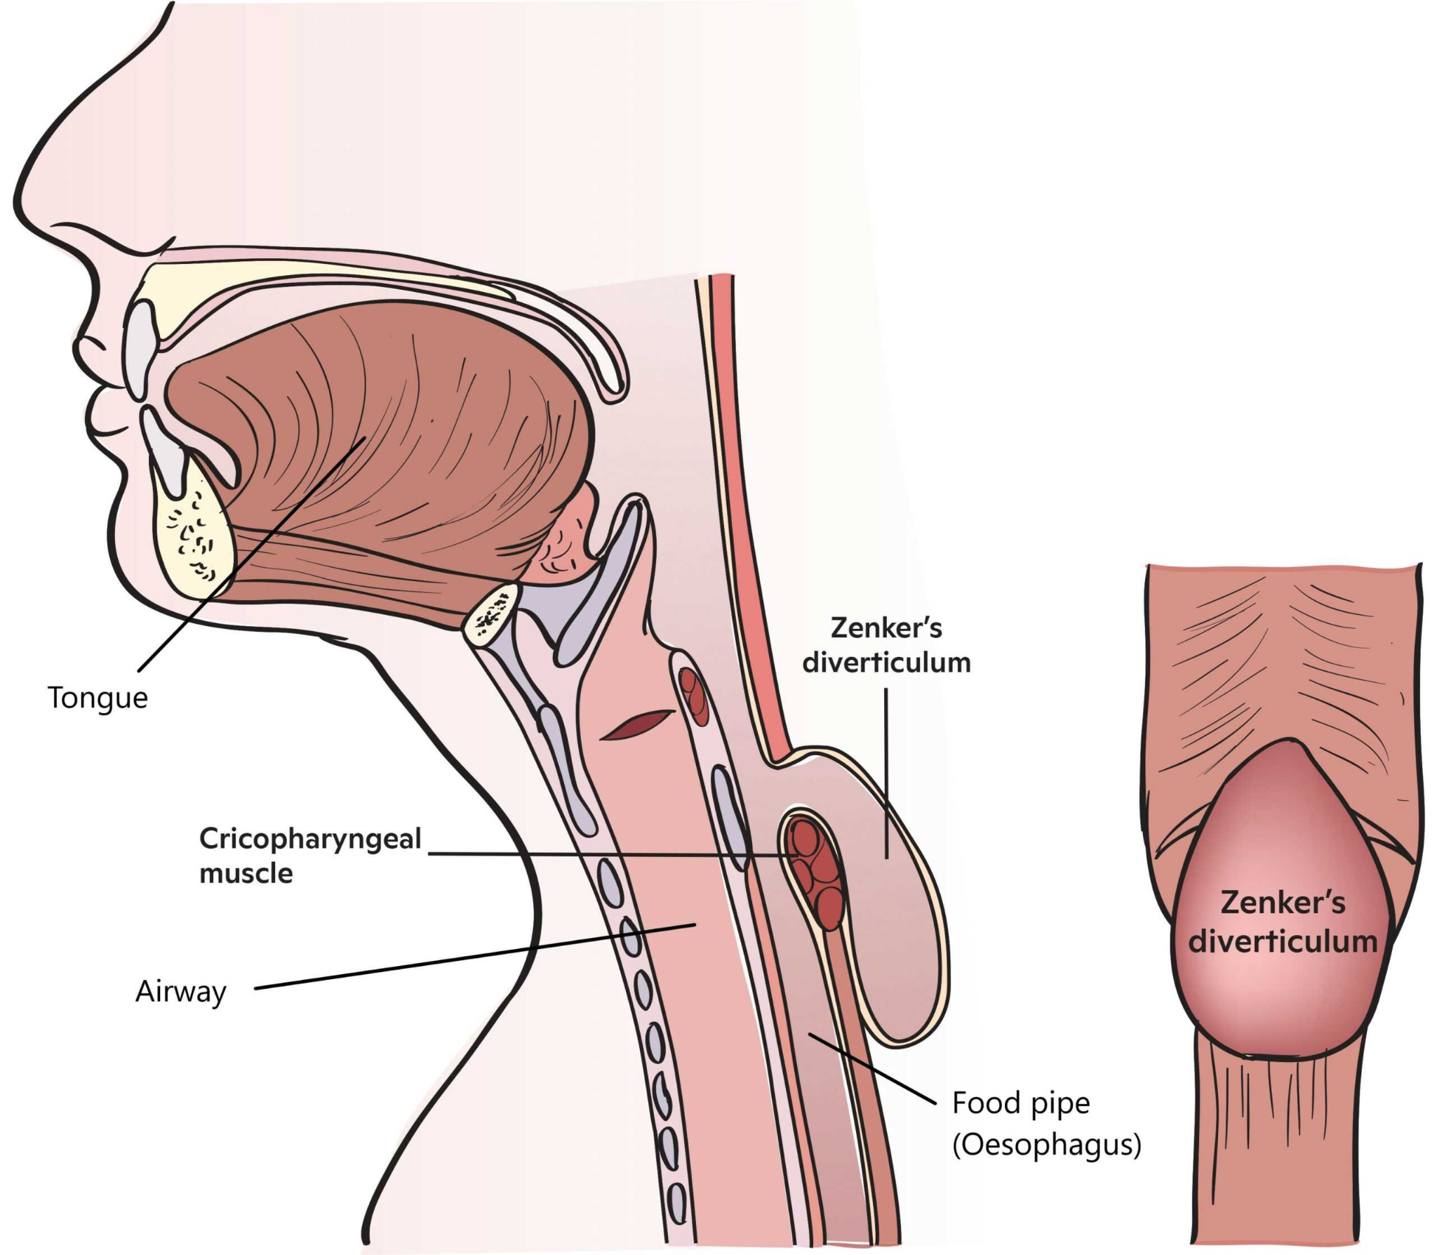
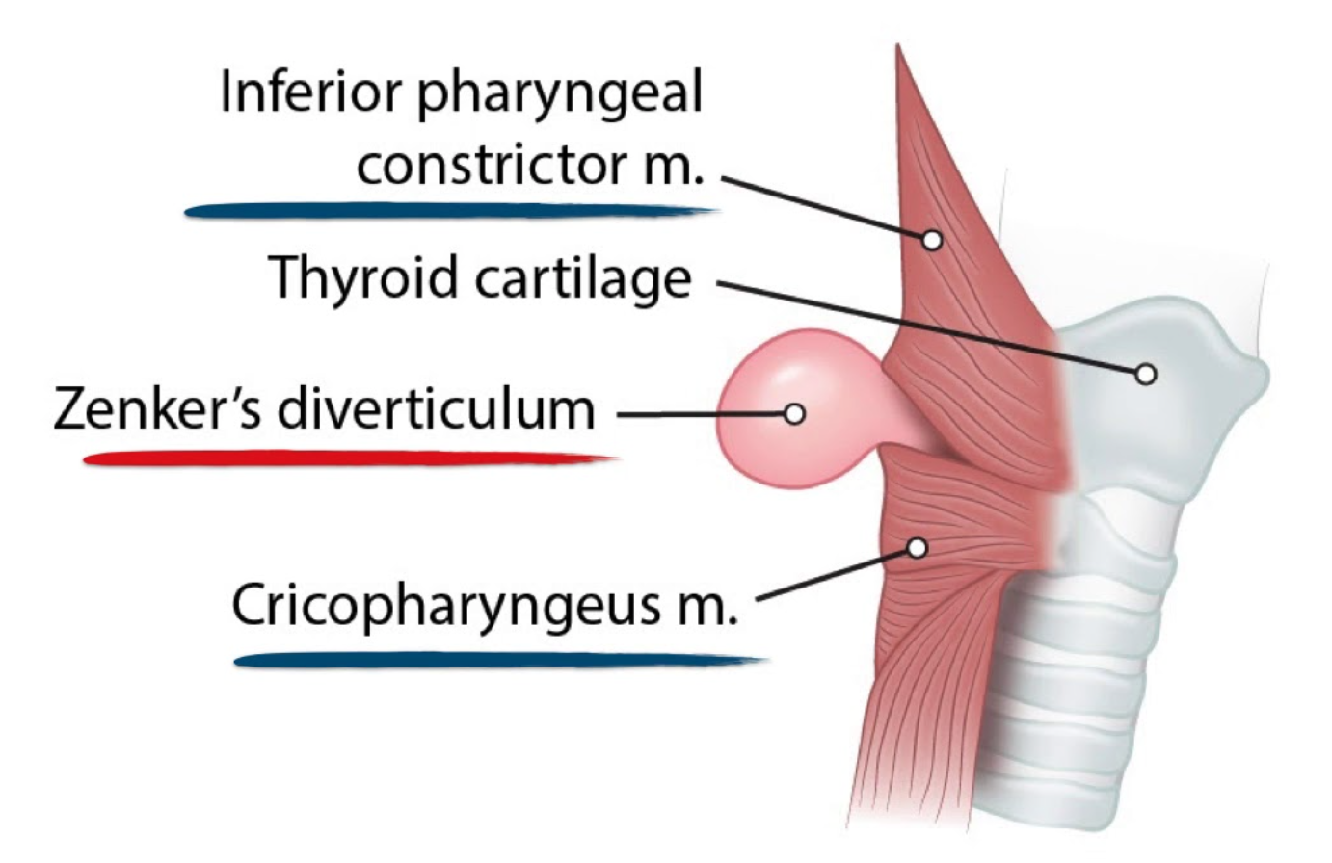
Zenker’s diverticulum AKA pharyngeal pouch
= herniation through weakness in posterior pharyngeal wall (Killian’s dehiscence) bounded superiorly by the oblique fibres of thyropharyngeus & inferiorly by transverse fibres of cricopharyngeus
Sx = dysphagia, halitosis (smelly breath), regurgitation, neck lump/sensation of food being stuck in pharyngeal pouch

Slide 39
GI cancers- oesophagus, stomach, bowel
Red Flag Symptoms
ALARMS
Anemia
Loss of Weight
Anorexia- Loss of appetite
Recent onset of progressive symptoms ie. tiredness
Masses/ Melaena/ Haematemesis
Swallowing Difficulties
Age + 55 and unintentional weight loss + any of the following: upper abdo pain/ reflux/ dyspepsia
OR Age 50+ with unexplained rectal bleeding ==endoscopy within 2 wks

Slide 40
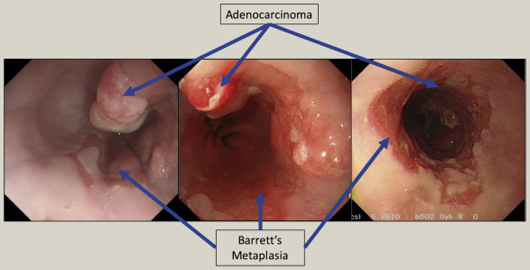
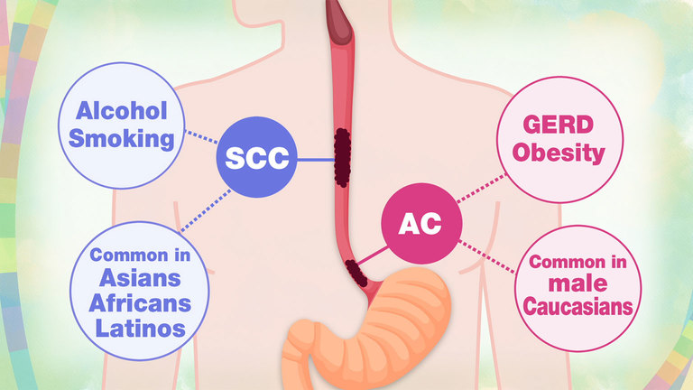
Oesophageal cancer
 | Squamous cell carcinoma (SCC) | Adenocarcinoma (AC)
Epidemiology | Common in developing world | Common in developed world
Location | Upper ⅔ of the oesophagus | Lower ⅓ of the oesophagus
Risk factors Males Older age | Smoking Alcohol Achalasia Plummer-Vinson syndrome Hot food and beverage BAME Older age Males | Barrett’s oesophagus metaplasia (premalignant) GORD Obesity Smoking Hernias Caucasian Older age Males
Differentials
Achalasia
Strictures (due to GORD)
Barrett’s oesophagus
Sudden NON-PROGRESSIVE Dysphagia suggests achalasia. Progressive dysphagia suggests cancer (difficulty swallowing solids then liquids)
Notes:
Ask how to differentiate achalasia from oes cancer ie. First cant eat mashed potatoes, then can’t swallow water)
Metaplasia can progress to neoplasia
Plummer-Vinson syndrome causes oesophageal webs. presents as a classic triad of dysphagia, iron-deficiency anaemia and oesophageal webs

Slide 41
Oesophageal cancer
Signs + Symptoms
Investigations
2-week endoscopy (OGD) referral in people with:
Dysphagia (only) or
Age ≥ 55yo with weight loss and 1 of the following
Upper abdo pain
Reflux
Dyspepsia
1st line🡪 Upper GI endoscopy (OGD) and biopsy
Staging
CT Chest Abdo Pelvis (CAP)
PET – to detect metastases
ALARMS symptoms
(Anemia, Weight Loss, Anorexia, Worsening symptoms, Tiredness)
Progressive dysphagia (solids followed by liquid) if sudden, non pregressive= ACHALASIA
Odynophagia (painful swallowing)
Hoarse voice (mass is pressing on the recurrent laryngeal nerve)
Management
Surgical resection (only if no metastases) with adjuvant radiotherapy/chemotherapy
+/- Trastuzumab (Herceptin) : for HER2+ve metastatic oesophageal cancer
Palliative care if advanced (5-year prognosis is 15%)
Notes:
strictures- scarring mcc gord
Medically fit= CHEMO/RADIO therapy + SURGERY
Unfit= PALLIATIVE

Slide 42
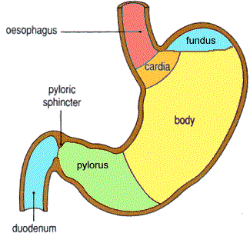
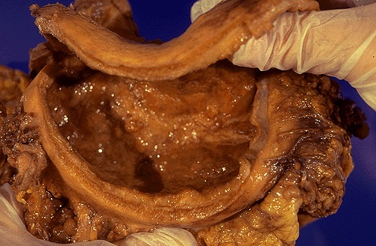
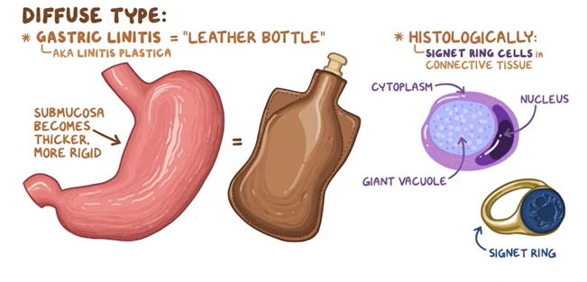
Gastric cancer
 | Type 1 (intestinal type) ↑MC | Type 2 (diffuse type)
Prevalence | 80% | 20%
Pathophysiology | End-result of an inflammatory process (chronic gastritis → atrophic gastritis → intestinal metaplasia and dysplasia) | Development of linitis plastica (leather bottle stomach)= thickening+ increased rigidity of stomach wall
Prognosis | Better | Worse (5-year survival of 3-10%)
Location | Antrum + lesser curvature | Anywhere in the stomach (especially cardia) Diffuse
Risk factors | Male, older age, H.pylori infection, chronic/atrophic gastritis | Female, younger age (<50yo), Blood type A, Family history, H.pylori infection
Histology | Well-differentiated Tubular | Poorly differentiated Signet ring cells
Notes:
Causes
H.pylori
Smoking
CDH-1 mutation (mutated E-cadherin gene, helps cells stick together, controls cell cycle)=80% risk
FHx (autoimmune chronic gastritis)
Type 1 (intestinal) has better prognosis 1st is the best
Type 2 is highly metastatic, has rapid progression and therefore worse prognosis (3-10%). Linitis plastica (leather bottle stomach) is the thickening and rigidity of the stomach wall

Slide 43
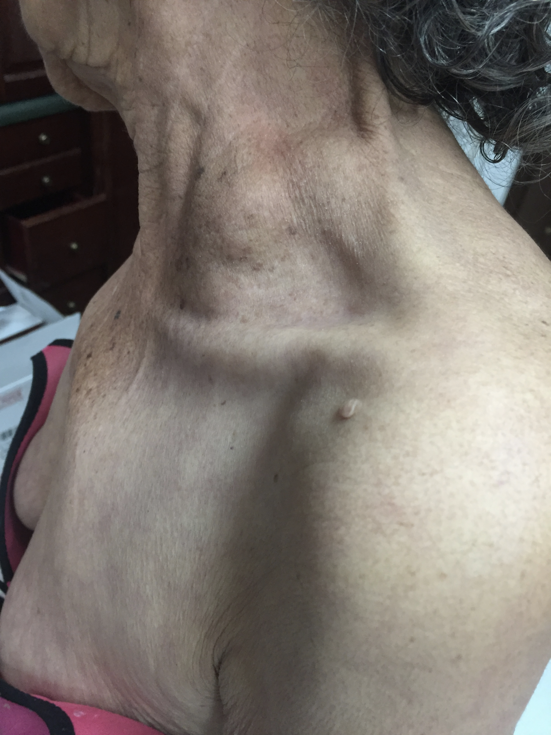
Gastric cancer
Signs + Symptoms
Management
Red flag Symptoms (ALARMS)
Anaemia, Loss of Weight, Tiredness, Swallowing Difficulties (Dysphagia) Melaena/ Haematemesis
Nausea + Vomiting
Epigastric Pain
Troisier’s sign- enlarged Virchow’s node (left supraclavicular Lymph node)
Sister Mary Joseph Sign (enlarged belly button lymph nodes)
Surgical resection (subtotal or total gastrectomy) + adjuvant radiotherapy/ chemotherapy
Palliative/ Supportive care
Low overall survival as diagnosis is made at a late stage
Virchow’s node
Investigations
Upper GI endoscopy (OGD) + biopsy
Endoscopic ultrasound (assesses how deeply tumour has invaded, check for metastases)
CT/MRI/PET of the chest and abdomen (staging and metastases)
Ovarian metastasis is called Krukenberg tumour
2-week endoscopy referral in people with: Dysphagia or Age ≥ 55yo with weight loss and 1 of Upper abdo pain/ Reflux/ Dyspepsia
Notes:
endoscopic USS assess depth of tumor invasion and detecting nodal involvement prior to surgery.
Lymph node spread
Virchow’s node= SUPRACLAVICULAR
Sister Mary Joseph sign =mass around BELLY BUTTON, enlarged bb lymph nodes
Metastatic signs
Ovaries🡪 KRUKENBERG TUMOR
Jaundice🡪 LIVER METASTASES

Slide 44
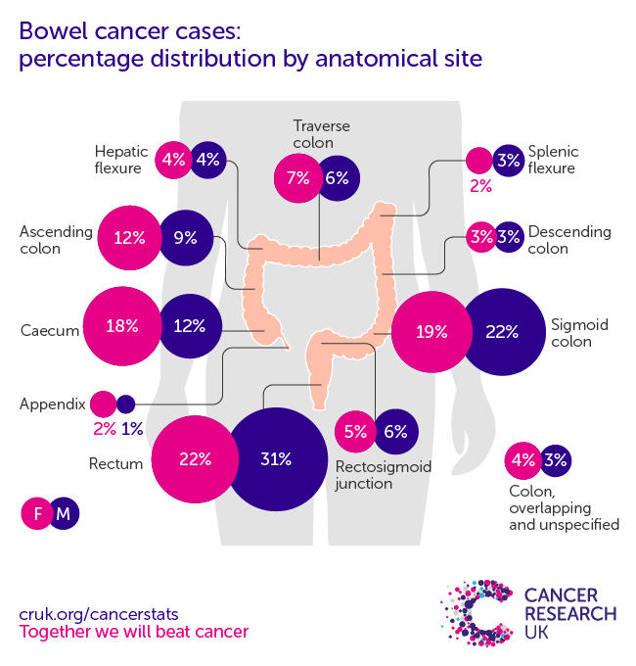
Bowel cancer
Epidemiology
Risk Factors
1. FHx of bowel cancer
2. Hereditary (autosomal dominant)
Familial Adenomatous Polyposis (FAP) 🡪 AD
Mutation in APC (tumour suppressor gene).
Polyp formation
Lynch syndrome/ Hereditary NonPolyposis Colorectal Cancer (HNPCC) 🡪 AD
Mutation in MSH-1/MSH-2 gene
DNA mismatch repair
3. IBD
4. Obesity
5. DM
6. Smoking
7. Alcohol
4th most common cancer (most common in sigmoid colon and rectum)
peaks at 85-89 y.o
Small intestine carcinomas make up just 1% of all GI tumours, associated with Crohn’s +Coeliacs Disease
Notes:
Common mets to LIVER + LUNGS
FAP and HNPCC are TYPES OF COLON/BOWEL CANCERS
FAP= AD mutation in APC gene which is a tumour suppressor gene= 1000s of duodenal polyps
Will inevitably get Colorectal cancer (93% risk by age 50)
HNPCC= is an AD MSH-1/ MSH-2 gene mutation= DNA mismatch repair
rapidly ↑ ↑ increases progression adenoma🡪 adenocarcinoma

Slide 45
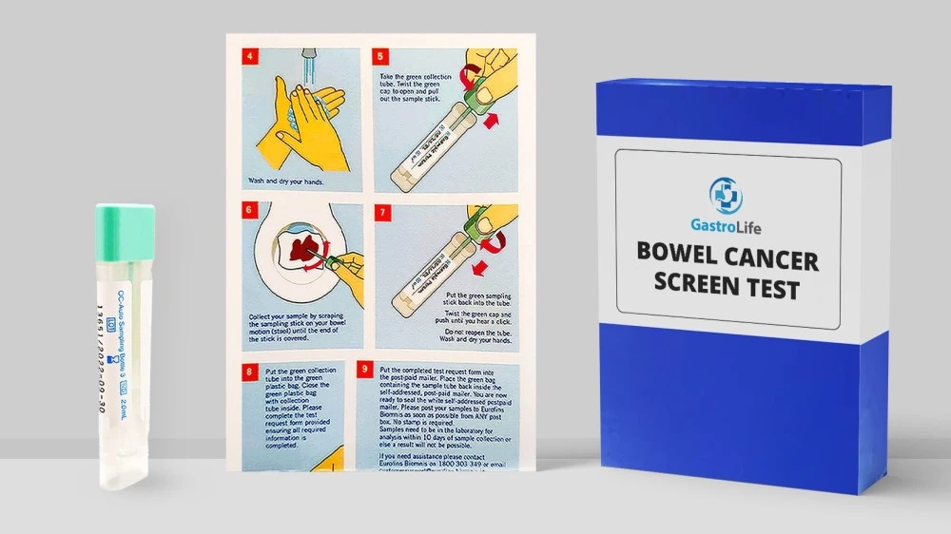
Bowel cancer
Signs +Symptoms
Investigations
Screening
Red flags (ALARMS)
Change in bowel habit
Weight loss
Anaemia (iron deficiency)
Tenesmus (feeling of having to keep emptying your bowels)
Abdominal pain, LLQ
Bloody/mucusy stools, mixed
Gold standard: Colonoscopy + biopsy
Sigmoidoscopy (rectum and sigmoid colon)
CT colonography (if unfit for colonoscopy)
CT TAP (thorax, abdomen and pelvis) for staging (Duke’s classification, TNM classification)
Bowel cancer screening
60-74yo, every 2 years
Faecal Immunochemical test (FIT) screening for microscopic blood particles in faeces
For all those who are 60+ with Iron deficiency anaemia and have had a change in bowel habit
2 week wait referral for colonoscopy+ biopsy for suspected cancer
Over 40 with abdominal pain and unexplained weight loss
Over 50 with unexplained rectal bleeding
Over 60 with a change in bowel habit or iron deficiency anaemia
Management
Surgical resection-only curative option
Neoadjuvant Radiotherapy/ Chemotherapy
Test for carcinoembryonic antigen (CEA) tumour marker to see how well treatment is working
Notes:
FIT Test (fecal occult)
Screening test for micro blood particles in poop. Done in all 60+ w. Fe def anaemia + bowel habit Δ
Suspected cancer pathway referral= 2 week wait
+ve FIT test+ suspected colorectal cancer referred for colonoscopy/biopsy within 2 weeks
Other screening programmes- breast + cervical cancer not PSA- not reliable

Slide 46
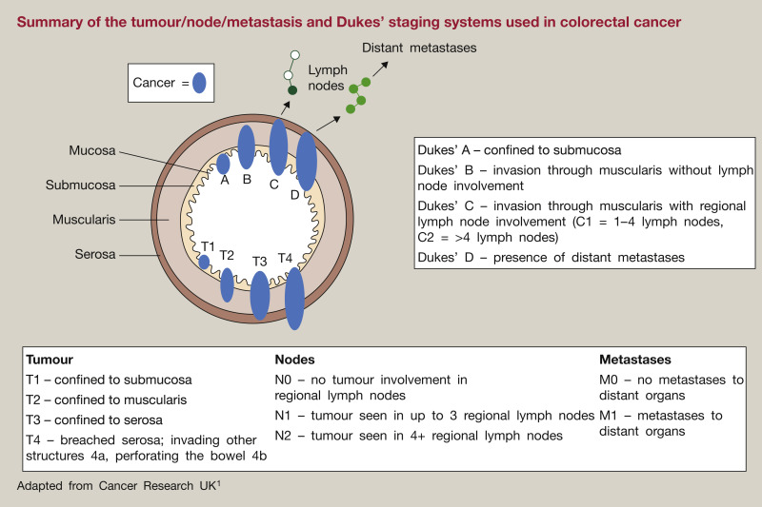
Duke’s classification, TNM classification
Be careful not to get mixed up with the Duke’s classification for infective endocarditis!
Notes:
DIFFERENT DUKE’S CRITERIA TO CARDIAC AND INFECTIVE ENDOCARDITIS

Slide 47
Question
87-year old hypertensive, diabetic patient presents with bright red blood in stools and severe LLQ abdominal pain which started 12 hrs ago. Her normal BP of 140/ 100mmHg has dropped to 120/70mmHg and abdominal exam reveals a soft abdomen with tenderness & localised guarding in LLQ.
Drug Hx: Ramipril, Amlodipine, Spironolactone, Metformin, Apixaban
PMHx: atrial fibrillation, T2DM, hypertension
What is the most likely diagnosis?
Ulcerative colitis
Crohn’s disease
Diverticular disease
Ischaemic colitis
Acute mesenteric ischaemia

Slide 48
Question
87-year old hypertensive, diabetic patient presents with bright red blood in stools and severe LLQ abdominal pain which started 12 hrs ago. Her normal BP of 140/ 100mmHg has dropped to 120/70mmHg and abdominal exam reveals a soft abdomen with tenderness & localised guarding in LLQ.
Drug Hx: Ramipril, Amlodipine, Spironolactone, Metformin, Apixaban
PMHx: atrial fibrillation, T2DM, hypertension
What is the most likely diagnosis?
Ulcerative colitis
Crohn’s disease
Diverticular disease
Ischaemic colitis
Acute mesenteric ischaemia
Patient risk factors = multiple antihypertensives which have caused a drop in BP leading to bowel hypoperfusion. She also has A. Fib which may have caused the thromboembolism in the superior mesenteric artery (more likely than IMA as it is more proximal) resulting in ischemic colitis.
In both types of bowel ischemia, pain is out of proportion to clinical findings.
Notes:
Not UC or Crohn’s as these have a chronic course.
Not acute mesenteric ischemia as wouldn’t have bloody diarrhoea.

Slide 49
Mesenteric ischaemia
= ischemia of small intestine due to narrowing/blockage of superior mesenteric artery (branch of abdominal aorta @ L1)
Types
ACUTE = medical emergency, analogous to ”intestinal MI”. Complete blockage of SMA due to atherothrombosis or thromboembolism. Comp = necrosis, bowel perforation 🡪 sepsis
CHRONIC = analogous to “intestinal angina”. Insidious onset over many months due to atherosclerosis slowly narrowing SMA.
Causes
THROMBOSIS – due to atherosclerosis
EMBOLISM – often due to A Fib
Investigations
1st line = FBC, ABGS 🡪 metabolic acidosis & ↑ lactate
GS = CT angiogram
Presentation
Treatment
Chronic | Intestinal
Central/R iliac fossa colicky post-prandial pain (blood flow to bowel ↑ after meals) Weight loss due to “food fear” SIGN = abdominal bruits on ausucltation | 10/10 central/ R iliac fossa pain OUT OF PROPORTION WITH CLINICAL FINDINGS (no rebound tenderness or guarding) Rapid hypovolemic shock: confusion, oliguria, hypotension, tachycardia
Medical ( acute mesenteric ischaemia)
IV fluids – aid bowel perfusion
IV broad spectrum Abx for SBP prophylaxis- Ceftriaxone & Metronidazole
IV heparin – anticoagulation
Surgical
IF bowel is necrotic (acute) 🡪 surgical resection of necrotic bowel
GS (chronic) = elective surgical revascularization w/ embolectomy & angioplasty (balloon stenting)
Notes:
Atherothrombosis = thrombus formation when atherosclerotic plaque ruptures
Lactose is a marker of anaerobic respiration
Ceftraixone = effective against gut coliforms. Metronidazole = effective against anaerobes

Slide 50
Ischaemic colitis- medical emergency
= ischemia of large intestine due to narrowing/blockage of superior & inferior mesenteric artery. Leads to colonic injury (ulceration, inflammation, haemorrhage) due to either ischemia OR reperfusion. MC @ watershed areas – splenic flexure & rectosigmoidal junction.
Causes
Investigations
MC = THROMBOSIS – due to atherosclerosis
EMBOLISM e.g. A Fib (acute mesenteric ischemia is more probable complication of AF as SMA is more proximal than IMA)
Arrythmias
cOCP + HRT, malignancy, thrombophilias
Faecal calprotectin – rule out IBD (more chronic course)
GS = CT angiogram. Then colonoscopy within 48hrs to exclude stricture formation & confirm mucosal healing {AFTER bleeding stops}
Treatment
Symptoms
IV fluids & prophylactic Abx to prevent SBP
If gangrenous 🡪 surgical resection
Sudden colicky LLQ abdo pain
Bright red bloody diarrhoea
+/- signs of hypovolemic shock: hypotension, tachycardia, oliguria, confusion
Signs
Complications
Strictures 🡪 large bowel obstruction
Bowel perforation 🡪 SBP
Soft abdomen w/ localized guarding
If bowel perforation 🡪 rebound tenderness & localized guarding
Notes:
https://www.bmj.com/content/355/bmj.i6600.full.
Watershed areas are most vulnerable to ischemia when blood flow decreases, as they lie between the territory of SMA & IMA. Rectum is resistant to ischemia because it has dual blood supply from internal iliac artery & inferior mesenteric artery. Ischemic colitis is most common at splenic flexure.
Symptoms are triad of rectal bleeding, diarrhoea + colicky LLQ abdominal pain.

Slide 51
Diverticular disease
Diverticula = outpouchings of colonic mucosa, MC @ sigmoid colon
Diverticulosis = asymptomatic outpouchings, often incidental findings
Diverticular disease = symptomatic outpouchings
Diverticulitis = infection 7 inflammation of diverticula
Pathophysiology
High pressures in sigmoid colon push mucosa & submucosa through muscularis propria at sites where arteries traverse the muscularis propria. Blood vessels here rupture causing haemtochezia.
In diverticulitis, the colonic outpouchings accumulate faeces resulting in infection.
Risk factors
Risk factors
Either ↑ colonic pressure or ↓ wall strength:
Constipation & low fibre diet
Obesity
Connective tissure disorders – Marfan’s, Ehlers Danlos syndrome
Age 50+
1st line =
FBC shows leukocytosis & ↑ CRP
Colonoscopy if acute bleeding – CI if profuse bleeding to avoid puncturing bowels even more
GS = CT abdomen & pelvis
Symptoms
Treatment
Diverticular disease
LLQ pain
Constipation
Haematochezia
Diverticulitis
TRIAD ↑ & pyrexia & LLQ guarding & rebound tenderness
Diverticular disease: bulk forming laxative e.g. Isphagola husk. GS = surgery
Diverticulitis:
PO antibiotics: Co-amoxiclav. If penicillin allergic, give Cefalexin & Metronidazole
IV fluids & liquid diet

Slide 52
Bowel Obstruction
Definition
Investigations
The interruption of passage through the bowel.
1. Small bowel obstruction (most common -75% of all cases)
2. Large bowel obstruction
3. Pseudo-obstruction
🡪Can be a surgical emergency if it
progress to bowel ischemia/ perforation
1st line: Abdo X-Ray
(rule of 3/6/9)
🡪Dilation of small bowel >3cm
🡪Dilation of large bowel >6cm
🡪Dilation of caecum >9cm
TRANSLUMINAL FLUID GAS SHADOWS (gas-fluid level) DIAGNOSTIC
Gold standard: CT of the abdomen and pelvis with contrast (identify transition zone) more accurate
Other: FBC, U&Es,
Signs + Symptoms
Abdo pain, Abdo distention, vomiting
absolute constipation, no flatus
Notes:
SURGICAL EMERGENCY IF BOWEL ISCHEMIA/ PERFORATION
Radiographic transition zones (RTZs) on CT, which are areas of abrupt change from dilated to collapsed bowel, as pathognomonic for SBO diagnosis and location

Slide 53
 | SBO (MC bc smaller diameter) | LBO
Aetiology | Adhesions –scar tissue from previous abdominal operations ie. Hysterectomy/ C-section (75%) Hernias (10%) Crohn’s –forms strictures Malignancy Children- appendicitis, volvulus, intussusception | Malignancy (90%) Sigmoid volvulus (5%) (can be cecum) Diverticulitis Intussusception –children, soft bowels
Abdominal pain | Colicky (localized pain, comes and goes) located higher up than LBO | Continuous
Vomiting | Early onset (bilious) | Late onset (bilious followed by faecal)
Constipation | Late onset (Vom then Constipation) | Early onset (Constipation then Vom)
Abdominal distention | MILD DISTENSION Less severe | GROSS DISTENSION Significant
Bowel Sounds | ‘Tinkling’ bowel sounds Hyperresonant on percussion for both | HYPERACTIVE then NORMAL then ABSENT
X-ray | 🡪 Dilation of the small bowel >3cm 🡪 Coiled-spring appearance | 🡪 Dilation of the large bowel >6cm or the caecum >9cm 🡪 Coffee bean appearance
Abdominal XRay (LBO)
Fetal/Embryo sign Caecal Volvulus RLQ
Coiled-spring appearance / Stack of Coins
Coffee Bean Sign Sigmoid Volvulus LLQ
Notes:
Explain adhesions, intussception, bowel telescopes in on itself
Why stack of coins? Valvula coniventes/ mucosal folds accentuates

Slide 54
Bowel Obstruction Management- same for SBO/LBO
Conservative Management
stable patients
‘Drip and suck management’
DRIP🡪 Insert IV cannula → Resuscitate with IV fluids, maintain nutrition
SUCK🡪 Insert nasogastric tube to decompress stomach and suck out contents
Nil-by-mouth
Catheter (monitor urine output)
Analgesia, antiemetics, antibiotics
unstable patients if ischemia or perforation
Treat according to cause
Laparotomy = open up abdomen, do surgical exploration
Adhesiolysis for adhesions
Hernia repair
Tumour resections
Bowel resection (if bowel is no longer viable due to advanced ischemia)
Surgical Management
Notes:
IV Fluid Resus= DRIP
NG Tube= SUCK OUT CONTENTS OF STOMACH
Anti-emetics// Analgesia// Abx (Stasis is the basis) ↑ ↑ INFECTION RISK🦠
Drip fluid resuscitation is to maintain organ perfusion (hemodynamics) and substrate (oxygen, electrolytes)

Slide 55
Pseudo-obstruction/Ogilvie Syndrome
Definition
Causes
Investigations
Post-operative (paralytic ileus)
Recent trauma/surgery
Medications (opioid, CCBs, antidepressants)
Neurological (Parkinson’s, MS multiple sclerosis, Hirschsprung’s)
Electrolyte imbalance
Reduced motility of the GI tract, due to failure of peristalsis leads to a functional bowel obstruction
no mechanical obstruction
1st line: Abdo X-Ray (megacolon → dilation >10cm )
Gold standard: CT Abdo + pelvis with contrast (no transition zone)
Pathophysiology
Management
Parasympathetic nerve dysfunction results in absence of smooth muscle movement🡪 no peristalsis
🡪 Bowel ischemia and perforation
Rest and Hydration + treat underlying cause
‘Drip and suck’ management (IV fluids + NG tube)
IV neostigmine to stimulate motility
Surgical decompression for unstable patients (caecostomy, ileostomy)
Symptoms
Nausea, vomiting, absent bowel movements, absence of flatus, diminished bowel sounds
Notes:
Can resolve spontaneously, keep under obs 2-3 days post-surgery, around the time that kicks in, can last up to 6 wks if not more, fluids only, want to vomit whatever else.
🡪Often a distinct transition point can be seen where bowel calibre changes from normal to abnormal
🡪Dilated bowel loops proximal to the transition point (small bowel >3.0 cm, large bowel >5 cm)
🡪Hirschsprung disease is a congenital condition in which nerve cells are missing in the large intestine (myenteric plexus) resulting in pseudobstruction
🡪Neostigmine has been reported to effectively relieve acute colonic pseudo-obstruction. cholinesterase inhibitor used to treat myasthenia gravis

Slide 56
Acute Appendicitis – surgical emergency
Definition
Causes
Pathophysiology
Inflammation of the appendix
Located at the McBurney’s point (right side of abdomen 1/3 from the ASIS to the Umbilicus)
Faecolith (stone made of faeces) = most common
Foreign bodies
Intestinal worms /pinworm
Lymphoid hyperplasia of Peyer’s patches
Luminal Obstruction→ stasis → bacterial overgrowth → inflammation =appendicitis
Complications
🡪reduced vascular supply, ischemia, tissue death
🡪high pressure buildup of mucus, periappendiceal abscess🡪 rupture 🡪 SBP, sepsis, death
Epidemiology
Highest incident between 10-30 year olds
Most common abdominal surgical emergency
Notes:
Calcified faecal deposits block the appendix lumen= STASIS IS THE BASIS for bacterial overgrowth🡪 inflammation
Mucus build up, high pressure, appendix enlargement
Blind ending pouch

Slide 57
Symptoms
Investigations
Differential Diagnosis
GI: IBD, diverticulitis, Meckel’s diverticulum
GU: Kidney stones, UTI, testicular torsion
Gynae: Ectopic pregnancy,
ovarian torsion, ruptured ovarian cyst
Pain
Periumbilical pain (non-localized)
migrates to the Right Iliac Fossa (localized)
Nausea & vomiting
Anorexia (can’t eat)
Pyrexia (fever) dt infection
Blood test – inflammation +infection (WCC, ESR, CRP)
Abdominal US (in children and pregnant women)
Abdominal CT with contrast
Urinalysis (exclude UTI)
Pregnancy test – exclude ectopic pregnancy (1 of MC DDx)
Signs
Management
Rovsing's sign (palpation on the LIF causes pain in the RIF)
Psoas sign (RIF pain on right hip extension)
Obturator sign (RIF pain on right hip flexion and internal rotation
Guarding + Rebound tenderness
Initial🡪 fluids, analgesia, antiemetics, preoperative IV antibiotics
Definitive🡪 Appendicectomy, Typically laparoscopically but open surgery may be required in severe cases
Notes:
Guarding - when abdominal muscles tense up
Rebound tenderness - pain when releasing pressure on palpation
Chronic appendicitis presents with milder symptoms
Peritonism (not peritonitis) refers to the localised inflammation of the peritoneum, usually due to inflammation of a viscus that then irritates the visceral (and subsequently parietal) peritoneum
GUARDING= touch abdomen and muscles flinch because its painful, feels really hard when you touch it

Slide 58
Acute Appendicitis
Alvarado Score- used to predict likelihood of appendicitis
A score of ≥7 is predictive of acute appendicitis. A score of 5 or 6 may warrant an ultrasound or CT but this should be considered on a case-by-case basis.

Slide 59
https://forms.gle/LP8Bu4tSXdoumQAM8
Feedback Form

Slide 60
Top tips (GI)
Study GI by symptoms & associated differentials, not disease .e.g dysphagia
Only learn enough pathophysiology to understand the disease, (Osmosis videos go into detailed immunology of IBD etc which can be overwhelming)
Know more pathophysiology for: coeliac disease
Remember 4C antibiotics causing C difficile infection
Don’t need to be an expert in IBS biologics for 2a, just know the step-up algorithm

Slide 61
Resources
Bitemedicine
Quesmed
Osmosis videos
Zero to finals
Haroon Tariq’s notes

Slide 62
Feedback please!
Any questions regarding this PPT please email aaziz4@sheffield.ac.uk or brkhan1@Sheffield.ac.uk. We are happy to help!

