Slide 1
Peer teaching PowerPoint brief
Thank you for signing up to deliver a Peer Teaching Society teaching session. We appreciate you taking the time to teach our members. As part of the process we now offer the opportunity to collate feedback on your teaching session. The Peer Teaching Society feedback form is linked at the end of the template. The process of collating this feedback is as follows:
All field marked with [Square Brackets] should be filled in by yourself.
Specifically, the date and time at the end should be in the format of [DD/MM/YYYY] and [HH:MM AM/PM]. This allows us to filter responses to the specific session and give you your specific feedback.
Get students to utilize the QR code or the link to fill out the feedback form at the end of the session.
Peer Teaching Society will collate the responses for you and send them to you as soon as possible utilizing the email you provided on the sign up form.
Finally, delete this slide when you have completed the above.
Good luck with your teaching session and thank you again for engaging with Peer Teaching Society. We hope to see you again soon!

Slide 2
2021/2022

Slide 3
Haematology SBA/SAQ practice questions
Phase 2a Revision Session
Ella Reeve and Jack Emmerson
08/04/2022/18:00-19:00

Slide 4
Aims and Objectives
We will cover 10 SAQ/SBA-style questions on haematology.
Answer via poll on blackboard.
Answers will be shown after each question with an explanation.
The Peer Teaching Society is not liable for false or misleading information…

Slide 5
Haematology topics
These are the index conditions in your handbook

Slide 6
Question 1
Shane is 34yr old male with Down’s syndrome. He has recently been complaining of increasing breathlessness and fatigue over the last 3 or 4 weeks. Upon looking at his medical record, you also notice he has been getting infections much more commonly than normal.
On examination you note bruising on his legs but otherwise normal.
The Peer Teaching Society is not liable for false or misleading information…

Slide 7
Question 1
Shane is 34yr old male with Down’s syndrome. He has recently been complaining of increasing breathlessness and fatigue over the last 3 or 4 weeks. Upon looking at his medical record, you also notice he has been getting infections much more commonly than normal.
On examination you note bruising on his legs but otherwise normal.
Which of the following are you most likely to see on a peripheral blood film?
Bite cells
Smudge cells
Auer rods
Spherocytes
Tear drop cells
The Peer Teaching Society is not liable for false or misleading information…

Slide 8
Question 1 - Answer
Shane is 34yr old male with Down’s syndrome. He has recently been complaining of increasing breathlessness and fatigue over the last 3 or 4 weeks. Upon looking at his medical record, you also notice he has been getting infections much more commonly than normal.
On examination you note bruising on his legs but otherwise normal.
Which of the following are you most likely to see on a peripheral blood film?
Bite cells
Smudge cells
Auer rods
Spherocytes
Tear drop cells
The Peer Teaching Society is not liable for false or misleading information…

Slide 9
Question 1 (AML) - Explanation
Bone marrow infiltration and failure will lead to:
Bruising / bleeding - thrombocytopenia
Infections - leukopenia
Breathless, fatigue, pale - Anaemia
(pancytopenia if all 3 are present)
The Peer Teaching Society is not liable for false or misleading information…

Slide 10
Question 1 (AML) - Explanation
Bone marrow infiltration and failure will lead to:
Bruising / bleeding - thrombocytopenia
Infections - leukopenia
Breathless, fatigue, pale - Anaemia
(pancytopenia if all 3 are present)
Findings on blood smear:
Bite cells Seen in G6PD
Smudge cells Seen in CLL
Auer rods Seen in AML
Spherocytes Seen in HS (hereditary spherocytosis)
Tear drop cells Seen in myelofibrosis
The Peer Teaching Society is not liable for false or misleading information…

Slide 11
Question 1 (AML) - Explanation
Shane is 34yr old male with Down’s syndrome. He has recently been complaining of increasing breathlessness and fatigue over the last 3 or 4 weeks. Upon looking at his medical record, you also notice he has been getting infections much more commonly than normal.
On examination you note bruising on his legs but otherwise normal.
Bite cells Seen in G6PD
Smudge cells Seen in ALL
Auer rods Seen in AML
Spherocytes Seen in HS (hereditary spherocytosis)
Tear drop cells Seen in myelofibrosis
DS is most commonly associated with AML, however there is also a higher prevalence of ALL in patients with DS.
Age points more to AML.
The Peer Teaching Society is not liable for false or misleading information…

Slide 12
Question 2
Katie, a 25-year old student has been struggling with tiredness for a few months. She presented to the GP having developed weakness and pins and needles in her hands and feet, and difficulty with balance and walking. She has been following a vegan diet for the past 7 years.
What blood tests would you carry out and what would you expect the results to be? (3 marks)
The Peer Teaching Society is not liable for false or misleading information…

Slide 13
Question 2 - Answer (Anaemia)
Katie, a 25-year old student had been struggling with tiredness for a few months. She presented to the GP having developed weakness and pins and needles in her hands and feet, and difficulty with balance and walking. She has been following a vegan diet for the past 7 years.
What blood tests would you like to carry out and what would the likely results be? (3 marks)
FBC
↓Hb
↑MCV (macrocytic anaemia)
Blood film
Hypersegmented neutrophils (>5 lobes) and presence of oval macrocytes
Serum cobalamin ↓
The Peer Teaching Society is not liable for false or misleading information…

Slide 14
Question 2
Katie is found to have anaemia caused by vitamin B12 deficiency.
What is the most common cause of this?
What features in a history would point towards it?
What tests are required to identify it?

Slide 15
Question 2
Most common cause of B12 deficiency anaemia is pernicious anaemia. Vitamin B12 binds to intrinsic factor
It is an autoimmune disease- personal or family history of T1DM, autoimmune thyroid disease, Addison’s, vitiligo
Test for antibodies: parietal cell and intrinsic factor (specific) antibodies
Learn the difference between specific and sensitive
N.B. If someone had folate and B12 deficiency, correct B12 first.
Notes:
Learn the difference between specific and sensitive. Important in conditions such as pernicious anaemia/rheumatoid arthritis.

Slide 16
Question 2 - Explanation
Vitamin B12 deficiency can result in subacute combined degeneration of the spinal cord. Can present with sensory deficits, paraesthesia, weakness, ataxia and gait disturbance.
Stores of B12 are sufficient to last 2-5 years (so very short history of dietary deficiency would not cause significant B12 deficiency)
Serum MMA and homocysteine levels are also raised in B12 deficiency
The Peer Teaching Society is not liable for false or misleading information…

Slide 17
Question 3
A 56-year-old female presents with a painless right neck lump that has been slowly enlarging for the last 2 years. She denies fevers but states she has been waking up sweaty at night more often. On direct questioning she believes she may have lost some weight.
Physical examination reveals bilateral cervical and axillary adenopathy and a palpable spleen.
The Peer Teaching Society is not liable for false or misleading information…

Slide 18
Question 3
A 56-year-old female presents with a painless right neck lump that has been slowly enlarging for the last 2 years. She denies fevers but states she has been waking up sweaty at night more often. On direct questioning she believes she may have lost some weight.
Physical examination reveals bilateral cervical and axillary adenopathy and a palpable spleen.
What are some differential diagnoses?
The Peer Teaching Society is not liable for false or misleading information…

Slide 19
Question 3
A 56-year-old female presents with a painless right neck lump that has been slowly enlarging for the last 2 years. She denies fevers but states she has been waking up sweaty at night more often. On direct questioning she believes she may have lost some weight.
Physical examination reveals bilateral cervical and axillary adenopathy and a palpable spleen.
Subsequent node biopsy is negative for Reed-Sternberg cells but a diagnosis of non-hodgkin’s lymphoma is made.
What is the most common cell of origin for this malignancy?
T lymphocytes
B lymphocytes
Neutrophils
Th lymphocytes
Myeloblast
The Peer Teaching Society is not liable for false or misleading information…

Slide 20
Question 3 - Answer
A 56-year-old female presents with a painless right neck lump that has been slowly enlarging for the last 2 years. She denies fevers but states she has been waking up sweaty at night more often. On direct questioning she believes she may have lost some weight.
Physical examination reveals bilateral cervical and axillary adenopathy and a palpable spleen.
Subsequent node biopsy is negative for Reed-Sternberg cells but a diagnosis of non-hodgkin’s lymphoma is made.
What is the most common cell of origin for this malignancy?
T lymphocytes
B lymphocytes
Neutrophils
Th lymphocytes
Myeloblast
The Peer Teaching Society is not liable for false or misleading information…

Slide 21
Question 3 (Lymphoma) - Explanation
Around 80% of NHL is of B cell origin, the remaining 20% are of T cells.
Normal B cells mature in bone marrow. It is upon subsequent differentiation in secondary lymphoid tissues (lymph nodes and spleen). Thought during subsequent differentiation they undergo malignant transformation.
Large B cell lymphoma is the most common.
Hodgkin’s lymphoma is also a B-cell malignancy. It is the type of lymphoma where you see Reed-Sternberg cells.
The Peer Teaching Society is not liable for false or misleading information…

Slide 22
Question 4
William is an 80 year old gentleman who takes warfarin for his metallic heart valve. His daughter called an ambulance after he had a nosebleed which would not stop. A&E blood tests showed his INR was 8.0 (target 2.5)
What should the F2 give to help stop this?
Vitamin A
Vitamin B
Vitamin K
Vitamin D
Vitamin E

Slide 23
Question 4 Answer
What medication will help to stop this?
Vitamin A
Vitamin B
Vitamin K
Vitamin D
Vitamin E
What clotting factors are vitamin K dependent?

Slide 24
Explanation
X, IX, VII, II → 1972 are vitamin K dependent clotting factors
Warfarin is a competitive inhibitor of vitamin K epoxide reductase complex 1 which is required for activating vitamin K.
Giving vitamin K is the reversal agent for warfarin.
Normal INR range is 2.0-3.0, if it is too high, the blood doesn’t clot properly and you get bleeding e.g. epistaxis (nose bleeds), gums bleeding, bruising for no reason, coffee ground vomit. If INR is too low you get clotting.
Notes:
Know both the roman numerals and numbers for this

Slide 25
Question 5
Janet, (77F) attends A&E after a fall at home. An X-ray shows a fractured femur in the mid-shaft. You note this is a strange fracture to sustain considering her latest DEXA scan did not show osteoporosis.
During her admission Janet notes that she has also been suffering with a few other symptoms that she wonders whether you would be able to help her with. This include:
A strange tingling/numb sensation around her mouth and on her fingers and toes.
A worsening back pain for 2-3 months
She has recently become quite constipated
You take U&E’s as part of routine bloods which shows a high serum urea and creatinine.
What is your top differential?
The Peer Teaching Society is not liable for false or misleading information…

Slide 26
Question 5
Janet, (77F) attends A&E after a fall at home. An X-ray shows a fractured femur in the mid-shaft. You note this is a strange fracture to sustain considering her latest DEXA scan did not show osteoporosis.
During her admission Janet notes that she has also been suffering with a few other symptoms that she wonders whether you would be able to help her with. This include:
A strange tingling/numb sensation around her mouth and on her fingers and toes.
A worsening back pain for 2-3 months
She has recently become quite constipated
You take U&E’s as part of routine bloods which shows a high serum urea and creatinine..
Which of the following symptoms/signs points AWAY from a diagnosis of myeloma?
Back pain
Numbness around the mouth
Pathological fracture
Constipation
High serum urea
The Peer Teaching Society is not liable for false or misleading information…

Slide 27
Question 5 - Answer
Janet, (77F) attends A&E after a fall at home. An X-ray shows a fractured femur in the mid-shaft. You note this is a strange fracture to sustain considering her latest DEXA scan did not show osteoporosis.
During her admission Janet notes that she has also been suffering with a few other symptoms that she wonders whether you would be able to help her with. This include:
A strange tingling/numb sensation around her mouth and on her fingers and toes.
A worsening back pain for 2-3 months
She has recently become quite constipated
You take U&E’s as part of routine bloods which shows a high serum urea and creatinine.
Which of the following symptoms/signs points AWAY from a diagnosis of myeloma?
Back pain
Numbness around the mouth
Pathological fracture
Constipation
High serum urea
The Peer Teaching Society is not liable for false or misleading information…

Slide 28
Question 5 (myeloma) - Explanation
Myeloma = Old CRAB
Hypercalcaemia - Groans (constipation), stones, bones, moans (psychic)
Renal injury - AKI (high creatinine, high urea, low eGFR)
Anaemia - breathless, fatigue (not reported here).
Bone destruction - pathological fractures (vertebral most common).
Symptoms of hypocalcaemia = CATs go numb
Convulsions, arrhythmias, tetany and numbness.
Also Chvostek’s and Trousseau’s signs
The Peer Teaching Society is not liable for false or misleading information…

Slide 29
Question 6
George presents with jaundice, fatigue, dizziness and palpitations. Blood tests show an autoimmune haemolytic anaemia.
Which of these statements regarding haemolytic anaemias is false?
The direct antiglobulin test (Coombs’) is used to distinguish autoimmune between non-immune aetiologies
Warm AIHA involves the IgG autoantibody
Bite cells and Heinz bodies are features of a PBS in G6PD deficiency
Signs of sickle cell usually manifest within 1-2 weeks of birth
Decreased haptoglobin is a feature of haemolytic anaemia
Notes:
Might get questions where they write a whole spiel about a presentation and then give you the answer/ask you an entirely different question.

Slide 30
Question 6
George presents with jaundice, fatigue, dizziness and palpitations. Blood tests show an autoimmune haemolytic anaemia.
Which of these statements regarding haemolytic anaemias is false?
The direct antiglobulin test (Coombs’) is used to distinguish autoimmune between non-immune aetiologies
Warm AIHA involves the IgG autoantibody
Bite cells and Heinz bodies are features of a PBS in G6PD deficiency
Signs of sickle cell usually manifest within 1-2 weeks of birth
Decreased haptoglobin is a feature of haemolytic anaemia
Notes:
Might get questions where they write a whole spiel about a presentation and then give you the answer/ask you an entirely different question.

Slide 31
Question 6
Blood test findings in haemolytic anaemia: normocytic, ↑LDH, ↑unconjugated bilirubin, ↓haptoglobin (particularly with intravascular haemolysis), ↑reticulocyte count.
HbA affected in sickle cell: β-globin chain misshapen. Normally glutamic acid but in sickle cell it is valine.
Results in HbS- when deoxygenated it sickles- aggregates with other HbS and the RBC sickles.
Fetal Hb (2α + 2γ globin chains) → primary Hb at birth so no symptoms until a few months old.

Slide 32
Question 7
Mike, a 55M goes for his routine blood tests. His FBC shows a haemoglobin of 195g/L (normal 130-180g/L). This has been gradually increasing. On further questioning, he reports worsening symptoms of facial flushing that are associated with headaches. He also gets intermittent itching all over his body that gets worse when taking a hot bath.
Which of the following is not known to cause polycythaemia on a full blood count?
Alcohol
Living at high altitude
Obstructive sleep apnoea
JAK2 mutation
G6PD
The Peer Teaching Society is not liable for false or misleading information…

Slide 33
Question 7 - Answer
Mike, a 55M goes for his routine blood tests. His FBC shows a haemoglobin of 195g/L (normal 130-180g/L). This has been gradually increasing. On further questioning, he reports worsening symptoms of facial flushing that are associated with headaches. He also gets intermittent itching all over his body that gets worse when taking a hot bath.
Which of the following is not known to cause polycythaemia on a full blood count?
Alcohol
Living at high altitude
Obstructive sleep apnoea
JAK2 mutation
G6PD
The Peer Teaching Society is not liable for false or misleading information…

Slide 34
Question 7 (polycythaemia)- Explanation
Polycythaemia, or an increased number of red blood cells can occur via two mechanisms:
Primary: JAK2 mutation = polycythaemia vera
Secondary:
Alcohol
Chronic hypoxia
Obstructive sleep apnoea
Living at altitude
Lung disease affecting oxygen transfer
Smoking
EPO secreting tumours
G6PD is a hereditary enzyme defect. As far as i can tell there is no association with polycythaemia (more likely causes anaemia).
The Peer Teaching Society is not liable for false or misleading information…

Slide 35
Question 8
Sam, a 3-year old has had bloody diarrhoea for the past 5 days after eating some dodgy cottage pie at nursery. Their parents are now getting worried as they have a purpuric rash, are very fatigued and are not producing much urine (oliguria).
What is the most likely diagnosis?
Immune thrombocytopenic purpura
Haemolytic uraemic syndrome
Von Willebrands disease
Thrombotic thrombocytopenic purpura
Kawasaki disease

Slide 36
Question 8
Sam, a 3-year old has had bloody diarrhoea for the past 5 days after eating some cottage pie at nursery. Their parents are now getting worried as they have a purpuric rash, are very fatigued and oliguria.
What is the most likely diagnosis?
Immune thrombocytopenic purpura
Haemolytic uraemic syndrome
Von Willebrands disease
Thrombotic thrombocytopenic purpura
Kawasaki disease

Slide 37
Question 8 Explanation
Haemolytic uraemic syndrome→ triad of microangiopathic haemolytic anaemia, thrombocytopenia and renal impairment.
Most are diarrhoea-associated (caused by Shiga-toxin producing E.coli) in children
Blood test results show:
FBC: anaemia and thrombocytopenia
Haemolysis: LDH, bilirubin
Peripheral blood smear: schistocytes
U&E: raised creatinine and electrolyte abnormalities
Management is mainly supportive

Slide 38
Question 9
Adi, a 28M presents with a 5 day history of fever, chills and diarrhoea. He had been volunteering in Sub-Saharan Africa for 3 months, returning 8 weeks ago, and had been bitten by mosquitoes on multiple occasions. He recounts forgetting to take any prophylaxis medications.
On examination, temperature of 38.8C and a mild jaundice can be noted in the sclera. The rest of the examination is normal.
Which of the following is the most appropriate treatment option?
IV artesunate
Oral amoxicillin
IV Co-amoxiclav
Oral hydroxychloroquine
Oral Benzylpenicillin
The Peer Teaching Society is not liable for false or misleading information…

Slide 39
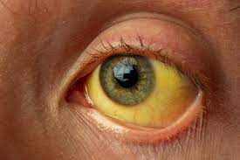
Question 9 - Answer
Adi, a 28M presents with a 5 day history of fever, chills and diarrhoea. He had been volunteering in Sub-Saharan Africa for 3 months, returning 8 weeks ago, and had been bitten by mosquitoes on multiple occasions. He recounts forgetting to take any prophylaxis medications.
On examination, temperature of 38.8C and a mild jaundice can be noted in the sclera. The rest of the examination is normal.
Which of the following is the most appropriate treatment option?
IV artesunate
Oral amoxicillin
IV Co-amoxiclav
Oral hydroxychloroquine
Oral Benzylpenicillin
The Peer Teaching Society is not liable for false or misleading information…

Slide 40
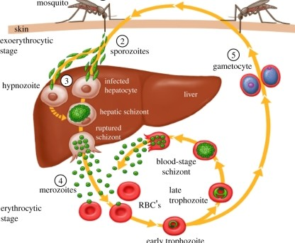
Question 9 (malaria) - Explanation
He’s got quite mild malaria. Think of this when you have a traveller presenting with fevery illness and signs of haemolytic anaemia (jaundice, dark urine).
The Peer Teaching Society is not liable for false or misleading information…
Notes:
It is often called black water fever.

Slide 41
Question 9 (malaria) - Explanation
He’s got quite mild malaria. Think of this when you have a traveller presenting with fevery illness and signs of haemolytic anaemia (jaundice, dark urine).
Diagnosed on Giemsa stained thin/thick blood films
Mild is treated with oral (hydroxy)chloroquine
Severe is treated with IV artesunate.
+ Primaquine, notify to PHE.
The Peer Teaching Society is not liable for false or misleading information…
Notes:
It is often called black water fever.

Slide 42
Question 9 (malaria) - Explanation
He’s got quite mild malaria. Think of this when you have a traveller presenting with fevery illness and signs of haemolytic anaemia (jaundice, dark urine).
Diagnosed on Giemsa stained thin/thick blood films
Mild is treated with oral (hydroxy)chloroquine
Severe is treated with IV artesunate.
+ Primaquine, notify to PHE.
What other MSK condition is treated
with antimalarials?
The Peer Teaching Society is not liable for false or misleading information…
Notes:
It is often called black water fever.

Slide 43
Question 10
A 17 year old presents to her GP with a 3-month history of tiredness. Further conversation reveals a history of heavy periods and a vegetarian diet. Blood tests show a decreased Hb of 95g/L (>120g/L), decreased MCV of 70 (80-100) and decreased ferritin of 20mcg/L (>30mcg/L). This suggests an iron deficiency anaemia.
What changes would you expect to see on a blood film?
Name 3 other causes of microcytic anaemia
What are 3 signs of iron deficiency anaemia?

Slide 44
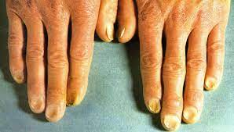
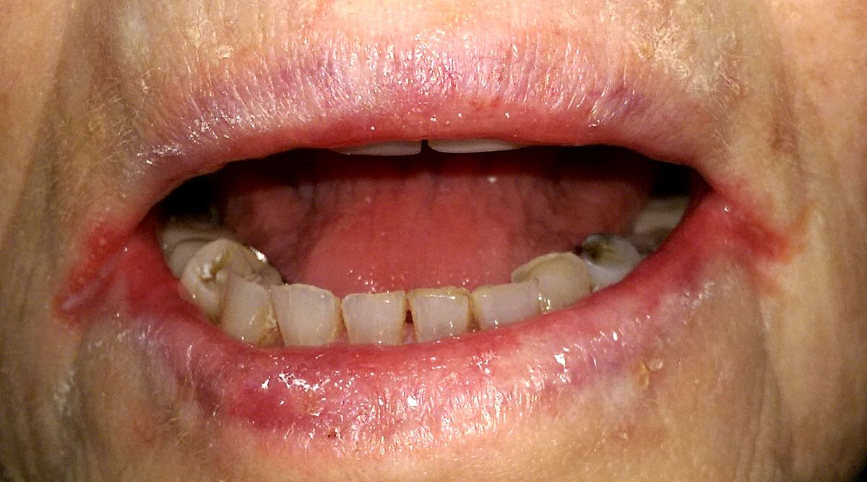
Question 10 Answer
Microcytic hypochromic RBCs, anisocytosis (variation in size of RBCs), poikilocytosis (irregular shaped RBCs)
Sideroblastic anaemia, anaemia of chronic disease, thalassaemia
Koilonychia (spoon shaped nails), angular stomatitis, atrophic glossitis, pallor

Slide 45
Conclusion
Learn the key features for each condition e.g. Auer rods (they really do come up in exams!)
Common conditions are common is still true for haem- focus on the malignancies and anaemias
Good luck for your exams!
The Peer Teaching Society is not liable for false or misleading information…

Slide 46
Feedback
https://docs.google.com/forms/d/e/1FAIpQLScpdBWBdqGddb3AXdcv-A4gbcbBv_4xn2I-sFFSOZC_q6Dm_Q/viewform?usp=sf_link
The Peer Teaching Society is not liable for false or misleading information…

