Slide 1
2019/2020

Slide 2
Immunology
Phase 2a Revision Session
Jonathan Sheridan
JSheridan1@Sheffield.ac.uk
The Peer Teaching Society is not liable for false or misleading information…

Slide 3
Lecture outline
Organs and Cells of the Immune system
Innate and Adaptive Response
Antibodies
Autoimmunity
Immunodeficiency
Hypersensitivity
*Slide notes contain detailed notes on slide content. Index slides are also included for things not covered during the lecture or for extra background.
The Peer Teaching Society is not liable for false or misleading information…

Slide 4
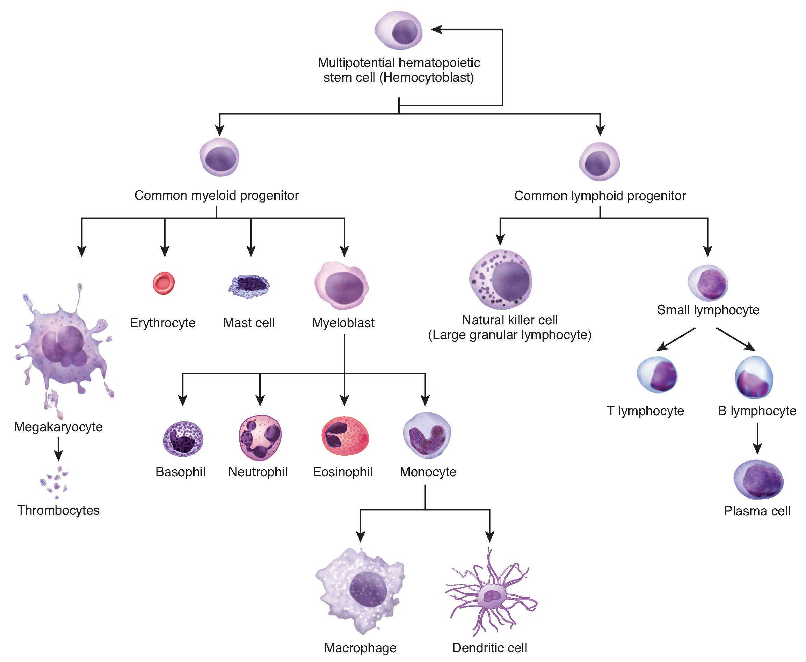
Haematopoesis
The Peer Teaching Society is not liable for false or misleading information…
Notes:
In haematopoesis differentiation is determined the presence of specific cytokines and chemokines and the induction of specific transcription factors.
The innate immune system is the initial rapid and non-specific response to antigenic material with no immunological memory.
Common myeloid progenitor decedents can be considered as the innate branch of the immune system. On the other side decedents of the common lymphoid progenitor can be considered cells of the adaptive immune response. The only notable exception are natural killer cells that are considered innate cells.

Slide 5
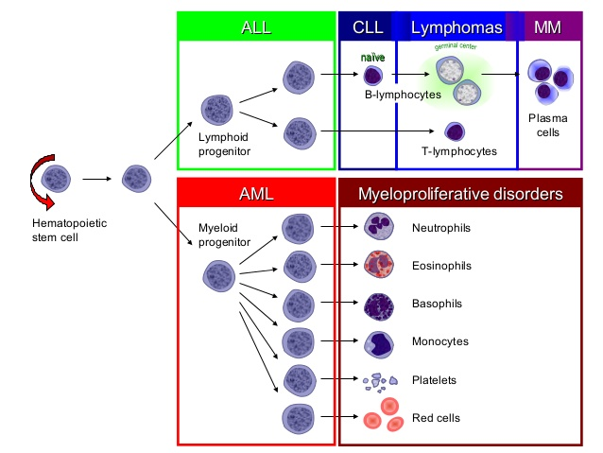
Haematopoesis
The Peer Teaching Society is not liable for false or misleading information…
Notes:
ALL comes from Lymphoid progenitors causing increased amounts of immature lymphocytes
CLL affects naïve (not exposed to antigen) mature B cells.
Lymphomas affect Mature naïve T cells and B cells in germinal centres
Multiple myeloma is a cancer of plasma cells.
AML is the cancer of myeloid progenitors causing a decrease in their downstream cells.
Myeloproliferative Disorders include chronic myeloid leukaemia includes proliferation of granulocytes

Slide 6
Organs of the Immune System
Primary Lymphoid organs
Bone marrow; All Immune cell origin. B cell maturation site.
Thymus; T-Cell maturation site.
Secondary Lymphoid organs
Lymph nodes; Site of DC, B, and T-cell interactions.
Spleen; Site of removal of RBCs and Ab-coated bacteria
Tertiary Lymphoid organs
Transient formation of germinal centres, usually pathology related.
The Peer Teaching Society is not liable for false or misleading information…
Notes:
Secondary lymphoid tissues provide the stage to allow foreign antigen to interact with lymphocytes.
Tertiary lymphoid organs (TLOs) are lymph node like ectopic structures that form during chronic inflammation such as in chronic infection, transplant graft rejection, and autoimmunity. For example in multiple sclerosis focal TLOs form in the brain which produces anti-myelin antibody leading to the demyelinating pathology.

Slide 7
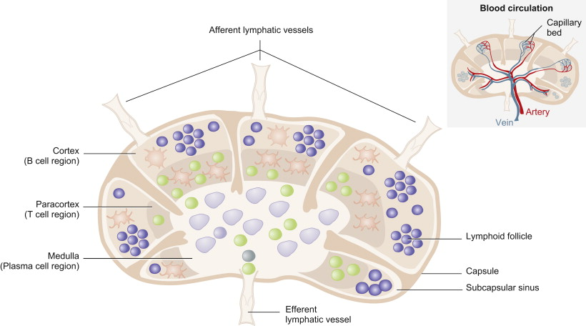
Lymph Nodes
The Peer Teaching Society is not liable for false or misleading information…
Notes:
LNs are the site of B cell and T cell interaction. They also interact with dendritic cells that are delivering antigen to the LN. Think of it as a site where the innate and adaptive immune systems interact.
DC enter with Ag in afferent lymphatics and interact with naïve CD4+ cells to activate them in the paracortex. T cell either become effector cells or memory cells.
Lymphoid follicles = Germinal centres which are the site of somatic hypermutation (this achieves a higher affinity Fab and class switching.

Slide 8
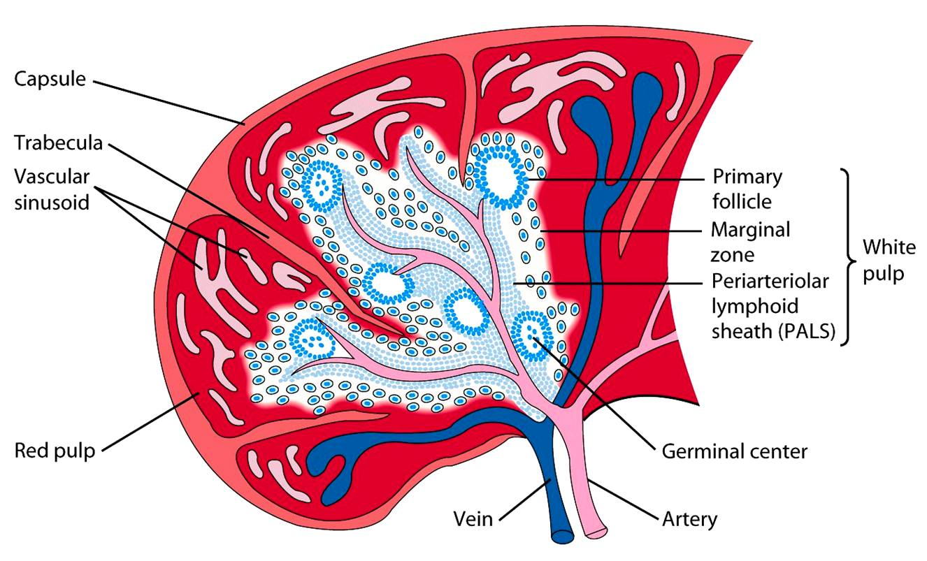
Spleen
The Peer Teaching Society is not liable for false or misleading information…
Notes:
Red pulp; Mechanical filtration of RBCs, reserve for monocytes in mice.
White Pulp; Active immune responses through humoral and cell-mediated immunity. PALS is rich in T cells. Lymphoid follicles are rich in B cells.
Other functions;
Production of RBCs; up to the 5th month of gestation. In thalassaemia (decreased Hb) resulting in haemolytic anaemia haematopoesis occurs in the context of pathology and the spleen produced RBCs once more.
Storage of RBCs, lymphocytes, and other elements. ~25% of lymphocytes are stored. ~30% of RBCs are stored that can be released in hypovolaemia and hypoxia. It can also store platelets and clears old platelets from circulation.

Slide 9
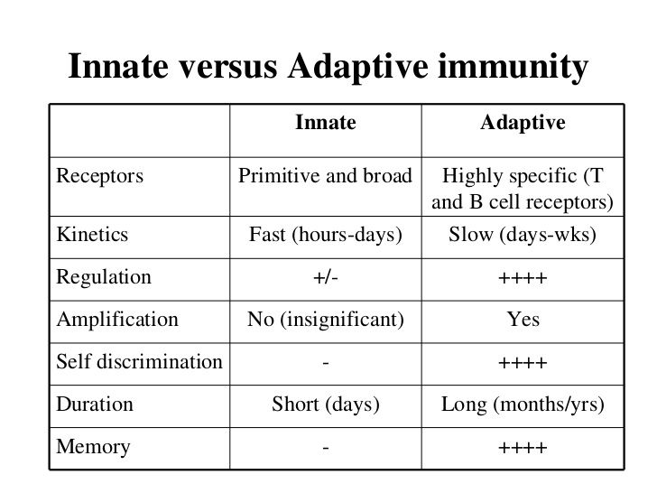
Innate vs Adaptive Immunity
The Peer Teaching Society is not liable for false or misleading information…
Notes:
Not much to say other than learn this table.

Slide 10
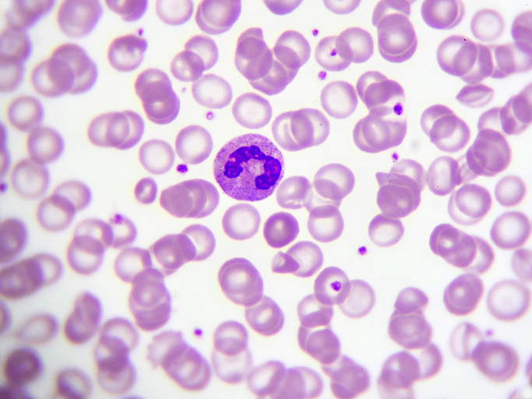
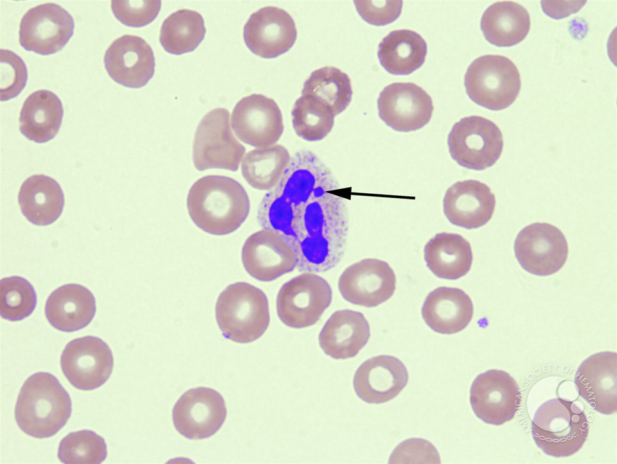
Innate Cells; Neutrophils
Most abundant (70%) WBC in the blood
Short lived
Rapidly egress into tissues during acute infection
Phagocytic and bactericidal.
Polymorphonuclear cells
Barr Body (inactivated X chromosome in women)
The Peer Teaching Society is not liable for false or misleading information…
Notes:
In phagocytosis pathogens are detected by pattern recognition receptors of innate phagocytic cells.
Neutrophils are the principal cell of acute inflammation. They kill by releasing internalising bacteria and degranulating their contents into a phagolysosome. Major components include alpha-defensins and lactoferrin.
Their other killing mechanism is the respiratory burst. Here electrons are pumped into the phagolysosome by NADPH Oxidase. The electrons combine with molecular oxygen to produce superoxide ions. These ions combine with protons present in the granules to produce peroxide which is bactericidal in itself. Myeloperoxidase can then chlorinate the peroxide to produce a hypohalous acid which is also bactericidal.
Movement of neutrophils out of capillaries in acute inflammation:
1. E-selectin (an adhesion molecule on the capillary endothelium), is activated by IL-1 and TNF-α from damaged cells, and binds to the glycoprotein CD15 on neutrophils in blood.
2. This causes neutrophils in the blood to slow down and roll along the endothelium lining.
3. ICAM-1 on endothelium (induced by LPS, IL-1, TNF-α) binds to integrin on neutrophil; the neutrophil stops.
4. Diapedesis: neutrophil squeezes through endothelium (holes caused by C3a, C5a, chemokines, histamines, prostaglandins, leukotrienes (causing smooth muscle contractions in the bronchioles))

Slide 11
Innate Cells; Macrophages
Phagocytosis, antigen presentation, and cytokine secreting
TNF-α, IL-1, IL-12
Round single nuclei often with a small indentation.
CD14+ and CD40+
Either derived from blood monocytes or as tissue resident macrophages.
Detect pathogens and damage markers by pattern recognition receptors
One of the principle cells in chronic inflammation.
The Peer Teaching Society is not liable for false or misleading information…
Notes:
Tissue resident macrophages are derived from the yolk sac and foetal liver during development and persist in tissues via self renewal.
Can be derived from circulating monocytes under the correct conditions.
Two phenotypes M1 is considered pro-inflammatory due to its ability to metabolise arginine to nitric oxide. M2 are considered anti-inflammatory due to their ability to metabolise arginine to the repair molecule ornithine. However this dichotomy is dictated in the literature as greater complexities are being discovered.
Remember PRRs detects PAMPs and DAMPs. Little point in learning all of them, but the most important one is TLR4 which detects LPS on G-ve bacteria.
Antibody bind pathogens by their Fab regions. Macrophages have Fc receptors that bind antibody and in turn phagocytoses the bacteria the antibody has bound.
Antibody binds pathogens. Complement then binds antibody Fc regions forming a complex. Macrophages have complement receptors that recognise this complex.

Slide 12
Innate Cells; Other Granulocytes
Basophil
Can be thought of as circulating mast cells that release histamine upon IgE crosslinking Fcε receptors.
They also secrete serotonin and heparin
Important in asthma, anaphylaxis, atopic dermatitis, and hay fever.
Key point; They do not egress into tissues and become mast cells .
Eosinophil
Important cells in dealing with parasitic infections.
Release cationic granules such as major basic protein.
Release ROS, eicosanoids, leukotrienes, elastase among other molecules.
The Peer Teaching Society is not liable for false or misleading information…
Notes:
You can remember the granulocytes (polymorphonuclear cells) as BEN; Basophil, Eosinophil, and Neutrophil.

Slide 13
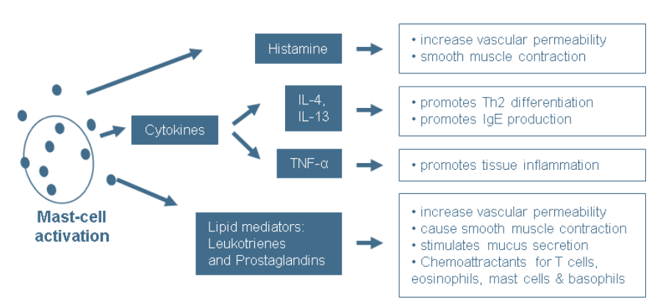
Innate Cells; Mast cells
Important in parasitic infection and allergic reactions.
At mucosal surfaces.
Stem cell factor is essential for development.
Main source of histamine.
Activated by immune complex IgE crosslinking FcεR1
The Peer Teaching Society is not liable for false or misleading information…
Notes:
Literally no point knowing more than this.
IgE binds allergen -> Activated mast cells via Fc Receptor.

Slide 14
Innate Cells; NK Cells
In blood and tissues
CD16+
Not phagocytic
Antibody-dependent cellular cytotoxicity (ADCC)
Release lytic granules that kill virus infected cells.
Recognise self and non-self by the presence of MHC-I on cell surfaces
The Peer Teaching Society is not liable for false or misleading information…
Notes:
ADCC is an independent mechanism that does not require complement and uses only one cell type. It is classically NK cells that do this. Typically IgG will bind surface antigens on the pathogen-infected cell. NK have Fc receptors (CD16) that recognise the antibody Fc region. This cross-linking triggers degranulation and cell apoptosis. Viral proteins are expressed on the surface of cells during viral replication and become antibody targets.
Granules contain perforin and granzymes that induce apoptosis and cell lysis.
Cancers tend to down regulate MHC-I mediated antigen presentation. NK cell inhibitory receptors detect levels of MHC I on cell surfaces, if cells lack enough MHC I, NK cells will activate and try to kill the cell. Cell that have MHC I activate the inhibitory receptor and therefore does not elicit a response. Cytotoxic T cells only act on tumour cells in response to NK cell cytokine production.

Slide 15
Antigen Presenting Cells
The professional antigen presenting cells
Macrophages
B-Cells
Dendritic Cells
They all present exogenous Ag in the context of MHC-II
Dendritic cells are the most potent antigen presenting cell. They egress to secondary organs to aid the adaptive response
All nucleated cells are capable of MHC-I presentation.
The Peer Teaching Society is not liable for false or misleading information…
Notes:
MHC molecules are coded on chromosome 6
Exogenous antigen is processed in the ER and presented on cell surface in the context of MHC II. Endogenous proteins present in the cytosol such as viral proteins or cancer-related proteins are processed in endosomes and presented in the context of MHC-I
Dendritic cells are also capable of cross-presentation; They can present exogenous Ag in the context of MHC-I in order to activate Tc cells.
Technically thrombocytes are anucleate and still have MHC-I molecules but distinctly RBCs do not present MHC-I

Slide 16
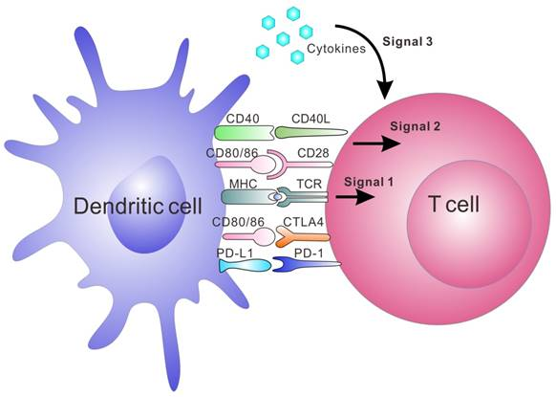
Antigen Presenting Cells
Title
The Peer Teaching Society is not liable for false or misleading information…
Notes:
Dendritic cells can be thought of as the bridge between the innate and adaptive immune responses in secondary lymphoid organs.
When immune cells come together they form what is know as an immune synapse. For a response to occur 3 things are essential 1. Binding of primary receptors e.g. TCR to MHC II. 2. Binding of co-stimulatory molecules e.g. CD28/CTLA4 to CD80/CD86. 3. A robust release of the appropriate cytokines. MHC binding without other stimulation leads to anergy.
During initial encounter with a novel antigen T cells will differentiate into either memory or effector T cells.

Slide 17
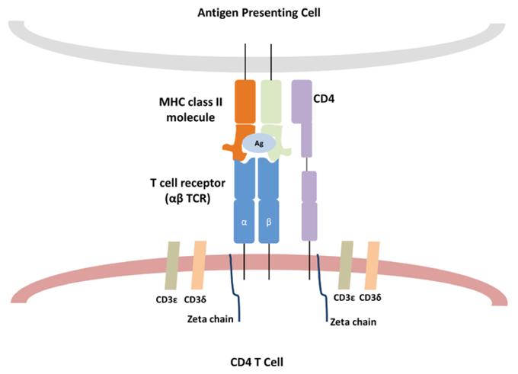
T cells
CD3 is the common T cell marker
Can express CD4 or CD8
T cell receptor
Can be naïve, effector, or memory
CD25 is the marker of activation.
The Peer Teaching Society is not liable for false or misleading information…
Notes:
CD3 is the identifying co-stimulating molecule for all T cells. Its main function is intracellular signalling that activates the T cell. It is a protein complex comprised of one gamma, one theta, and two epsilon polypeptide chains.
T-cells begin their lives in the bone marrow as HSCs and differentiate through the lymphoid pathway into immature T cells. They initially start as naïve (naïve meaning has not encountered antigen yet) CD4+CD8+ double positive cells. During maturation in the thymus they undergo thymic education to retain either CD4 or CD8, and they undergo VDJ recombination in the thymus to determine the antigen epitope that their TCR will recognise.
Naïve = not encountered antigen.
T-cells must recognise antigen in the context of MHC molecules using their T-cell receptors. The only exception to this is superantigens. Superantigens bind the beta chain of TCR regardless of TCR. Since there are only around 50 variants of the chain superantigens activate ~20% of the whole T cell population.
Naïve T cells are identified by being CD45RA+ whereas memory T cells are identified by being CD45RO+. The general marker for T cell activation is CD25 expression.

Slide 18
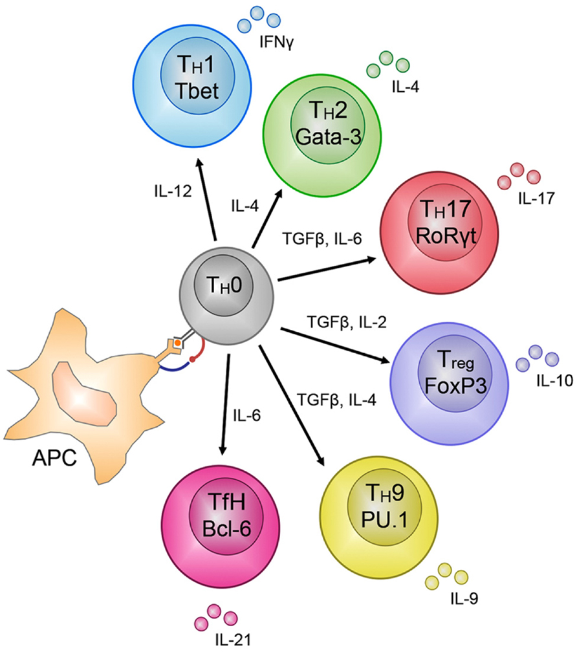
T cells
The Peer Teaching Society is not liable for false or misleading information…
Notes:
Upon antigen presentation by APCs naïve T cells can become a wide variety of effector T cells depending on transcription factors, and cytokine stimulation

Slide 19
Cytotoxic T cells (CD8)
Cytotoxic T Cells (Tc)
CD8+
Cytotoxic. Release perforins and granzymes.
Recognise Ag in the context of MHC I
Become effector or memory cells
The Peer Teaching Society is not liable for false or misleading information…
Notes:
Tc kills cells via two mechanisms; 1. Perforin and Granzymes; Perforin is pore forming cytolytic protein that allows salt and water to enter cells and causing them to lyse. Granzymes are a group of serine proteases. They cleave a caspase protein (CPP-32) which will activate a nuclease (CAD) which initiations DNA degradation and apoptosis. 2. CD8 T cells also express the Fas ligand, this binds Fas on target cells which activates the caspase cascade and therefore apoptosis.

Slide 20
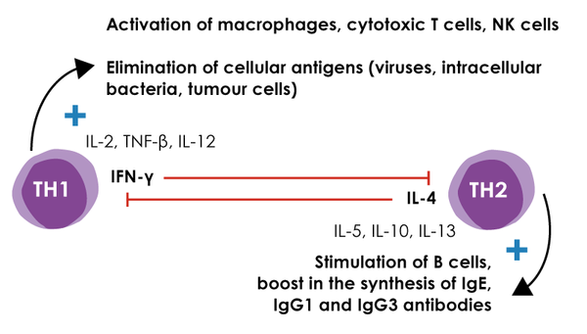
T helper cells (CD4)
Th1
Cell-mediated immunity
Regulate monocytes and macrophages.
Th2
Humoral immunity .
Regulators of eosinophils, basophils, and mast cells.
The Peer Teaching Society is not liable for false or misleading information…

Slide 21
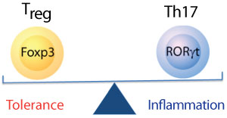
T helper cells (CD4)
Treg
The principle cell in peripheral immune tolerance.
IL-10 is their key cytokine that has a mass anti-inflammatory action
Th17
Important cells at mucosal membranes.
Principle cytokine is IL-17
IL-17 affects innate immune cells to produce IL-8.
The Peer Teaching Society is not liable for false or misleading information…
Notes:
Th17 and Treg cells are antagonistic. Transcription factors and cytokines produced by Th17 cells suppressive T reg cells and vice versa.
IL-8 is the most important cytokine in neutrophil production and recruitment.
IL-23 maintains Th17 populations and is a target for biologics.

Slide 22
B-Cells
The BCR
CD19 is the co-stimulatory molecule of mature cells
CD20 is the mature B cell marker.
B-cell activation in secondary lymphoid organs.
Somatic hypermutation and affinity selection aided by dendritic and T cells
Activated B cells either become short lived plasma cells (IgM+) or long-lived plasma cells (IgG, E, or A+)
The Peer Teaching Society is not liable for false or misleading information…
Notes:
B-cells can either be activated directly by antigen in the absence of T cell help for a rapid but short lived response. These tend to have less affinity and IgM releasing.
B cells are activated when they internalise antigen and present it to T cells in the context of MHC II. They do this in lymph nodes. After activation they migrate to newly formed germinal centres to undergo somatic hypermutation. This is when RAG enzymes introduce random mutations in the variable region of the antibody gene. Dendritic cells in germinal centres will present the same antigen to the B cell to test if the avidity of its antibodies has increased. B cells with less avidity will be negatively selected and those with greater avidity will be positively selected and undergo class switching and clonal proliferation.
Fun fact germinal centre dendritic cells are not classical immune cells. Instead of a haematopoietic origin they are of mesenchymal origin.
In Hodgkin lymphoma there is the appearance of Reed–Sternberg cell. These are B-cell derived giant cells that are distinctive of this lymphoma. CD15 is a distinctive marker. They have prominent eosinophilic inclusion-like nucleoli (thus resembling an "owl's eye" appearance) under microscopy.
CD20 is the target of Rituximab which.

Slide 23
B-Cells Activation
The Peer Teaching Society is not liable for false or misleading information…

Slide 24
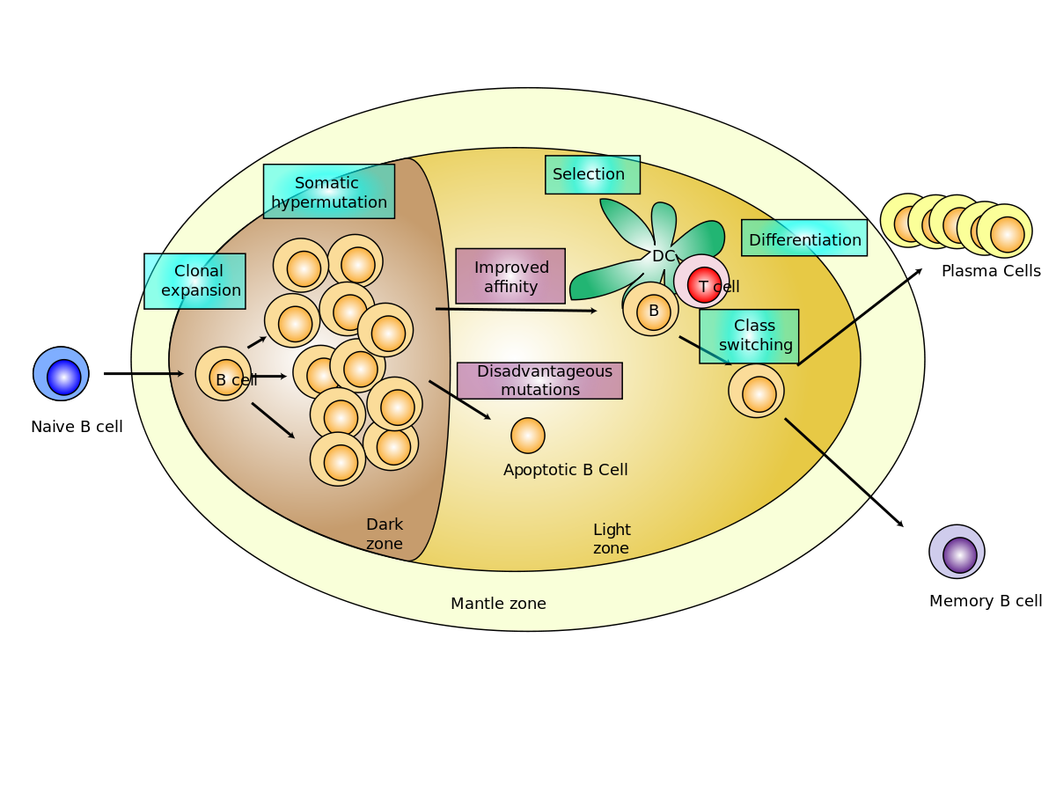
B-Cells Activation
The Peer Teaching Society is not liable for false or misleading information…
Notes:
B-cells can be activated directly by antigen in the absence of T cell help for a rapid but short lived response. These tend to have less affinity and IgM releasing.
B cells that are activated when they internalise antigen and present it to T cells in the context of MHC II. They do this in lymph nodes. After activation they migrate to newly formed germinal centres to undergo somatic hypermutation. This is when activation-induced cysteine deaminase (AID) introduces random mutations in the variable region of the antibody gene. Dendritic cells in germinal centres will present the same antigen to the B cell to test if the avidity of its antibodies has increased. B cells with less avidity will be negatively selected and those with greater avidity will be positively selected and undergo class switching and clonal proliferation.
When memory cells encounter their specific antigen they become activated and undergo clonal proliferation and begin secreting IgG.

Slide 25
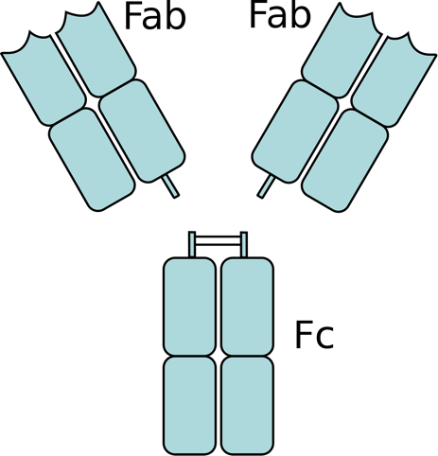
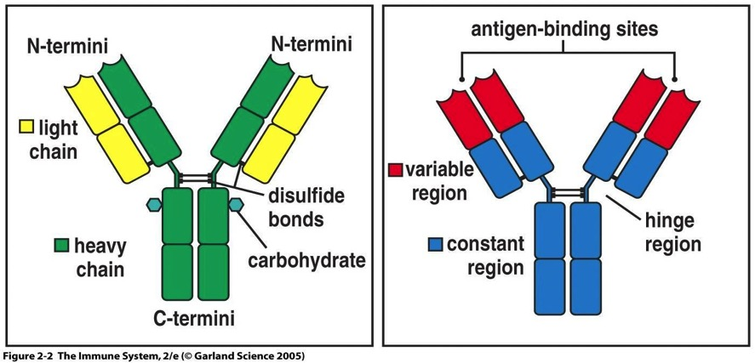
Antibodies
The Peer Teaching Society is not liable for false or misleading information…
Notes:
Constant region determines Antibody type and therefore effector function.
Fab region (antigen-binding fragment) bind epitopes of antigen. Fab regions are initially determined by a process called VDJ recombination during maturation in the bone marrow.
Avidity for antigen is increased during infection through somatic hypermutation in the germinal centres of secondary organs.
Fc region (fragment crystallizable region) is the area that binds Fc receptors on immune cell surfaces.
Fc region also binds complement to aid in opsonisation of pathogens for phagocytosis.
Functions of Antibodies; Neutralisation of toxins, opsonisation of pathogens, complement activation via the classical pathway

Slide 26
Antibodies
Antibody | Function and Features
IgA | The mucosal Ab as a dimer. Present in colostrum and coats neonate gut.
IgM | Pentameric and not entirely specific to antigen. Highest capacity to activate complement.
IgG | Most abundant in the blood. Highly specific. Important during secondary responses. 4 subclasses. Can cross the placenta.
IgE | Bound to Mast cells and basophils by FcεR. Important in allergy and helminth infection. Least abundant in the blood.
IgD | Not that important. Function is debated in the literature.
The Peer Teaching Society is not liable for false or misleading information…
Notes:
IL-5 Promotes IgA class switching
IL-4 promotes IgE class switching
Colostrum contains IgA, IgM, and IgG where IgA is the principle antibody.

Slide 27
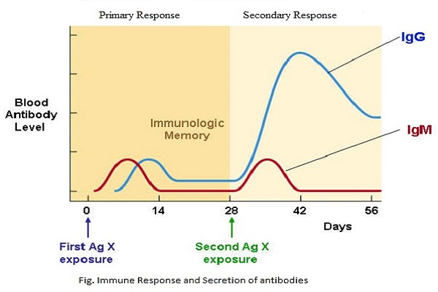
Antibodies
The Peer Teaching Society is not liable for false or misleading information…

Slide 28
Hypersensitivity
Type | Mechanism | Examples
Type I – Anaphylactic | Antigen reacts with IgE bound to mast cells | • Anaphylaxis • Atopy (e.g. asthma, eczema and hayfever)
Type II - Cell bound | IgG or IgM binds to antigen on cell surface | • Autoimmune haemolytic anaemia • Goodpasture's syndrome • Pernicious anaemia • Rheumatic fever
Type III - Immune complex | Free antigen and antibody (IgG, IgA) combine | Systemic lupus erythematosus Post-streptococcal glomerulonephritis
Type IV - Delayed hypersensitivity | T-cell mediated | • Tuberculosis / tuberculin skin reaction • Graft versus host disease • Multiple sclerosis • Guillain-Barre syndrome
The Peer Teaching Society is not liable for false or misleading information…
Notes:
Type 1 is a fast reaction occurring in minutes. Cross-linking of antigen to IgE on mast cells and basophils causes massive degranulation and therefore massive release of histamine.
Type 2 IgM or IgG binds to self antigen leading to cell destruction by the membrane attack complex and cellular mechanisms.
Type 3 IgG binds soluble antigen forming a circulating immune complex. These deposit in vessel walls especially in the kidneys. Here they kick off an inflammatory response causing complement deposition, opsonisation, phagocytosis etc. RBCs carrying the complement receptor 1 bind complement coated immune complexes and transport them to the liver and spleen for phagocytosis.
Type 4; This is helper T cell mediated. Specifically Th1. Th1 are activated by antigen presenting cells. Memory T cells are formed. When the memory T cells encounter the antigen again they will activate macrophages leading to tissue damage.
Type 5 are an increasing recognised hypersensitivity. IgM or IgG bind cell surface receptors and either stimulating or blocks endogenous ligand binding. Grave’s disease and myasthenia gravis are among the only recognised pathologies of this type.

Slide 29
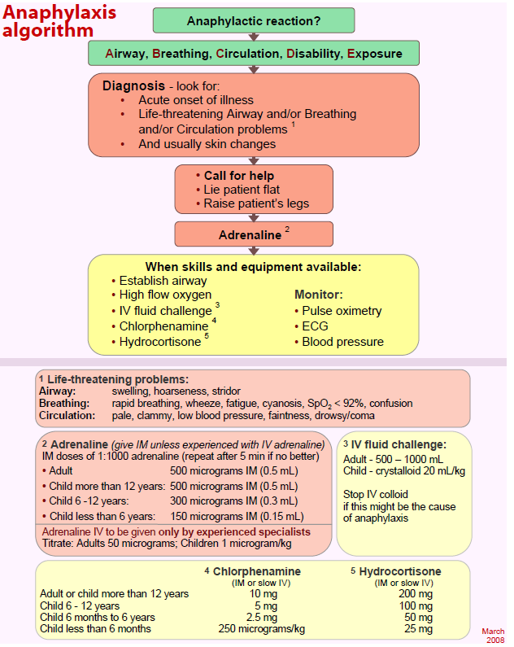
Hypersensitivity
Anaphylaxis
IgE binds antigen which then cross-links FcεRI on mast cells and basophils leading to massive degranulation and histamine release.
Medical emergency that can be fatal.
IM Adrenaline is 1st line
Chlorphenamine (antihistamine) and hydrocortisone (cortisol) can be used after this.
The Peer Teaching Society is not liable for false or misleading information…

Slide 30
Autoimmunity
Immune tolerance vs Autoimmunity
How autoimmunity develops: Many ways!
Thymic education
Tregs
CD4 activation against autoantigen
Features of autoimmunity
Often relapsing-remitting
Organ-specific vs Systemic
Damage to or destruction of tissues
Altered organ growth/function
The Peer Teaching Society is not liable for false or misleading information…
Notes:
Central tolerance is when TCRs and BCRs are tested against self antigen. B cells are tested in the bone marrow, BCRs that recognise self antigen either leads to clonal deletion (apoptosis), receptor editing, or anergy. T-cells undergo positive and negative selection in the thymus. Positive selection; T-cells that recognise MHC molecules. If they cannot they do not receive survival signals. This also determines CD4 or CD8 lineage. Negative selection; This test their affinity to self. If they bind self antigen they receive signals to apoptose. T cells that pass both stages move to secondary organs as mature naïve T cells.
Peripheral tolerance; Low affinity self reactive T cells can escape the thymus to the periphery. In secondary lymphoid organs T cells are presented self antigen again by dendritic cells and if they recognise they either are clonally deleted or converted to Treg. Tregs can also deplete IL-2 from the environment and secrete the tolerogenic cytokine IL-10. Induced anergy can also occur if there is no co-stimulatory (and therefore pro-inflammatory cytokine presence).
Tx involve reducing inflammation and suppressing the immune system. This usually relieves symptoms but do not typically cure.

Slide 31
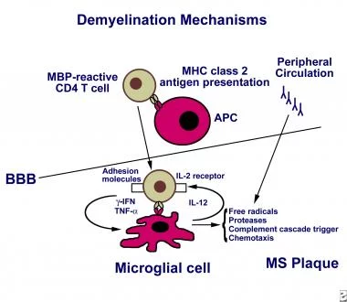
Autoimmunity – MS
The Peer Teaching Society is not liable for false or misleading information…
Notes:
Multiple sclerosis is the most common CNS immune mediated condition. It is a demyelinating condition. Caused by a failure of central and peripheral tolerance to eliminate self reactive T cells. These T cells are reactive to myelin proteins such myelin basic protein.
Tertiary Lymphoid organs form in the brain of MS allowing T and B cell interactions and the generation of autoantibodies.
(Current research hasn’t made a definite link to MBP but several studies show a role of the autoantibody into the pathogenesis of MS. Another proposed mechanism is molecular mimicry where T cells in essence confuse MBP with herpes virus 6. Similar to a current theory of Guillain-Barre)
Researchers often say diseases like MS “develop from interactions of an individuals genetics and with unidentified environmental causes” which is fancy science speak for we don’t know yet.
MS can be either;
Relapsing remitting (RRMS); Where there are preriods of disease activity and no activity. Often incomplete recovery will occur → disability. Some will progress to secondary progressive.
Primary progressive (PPMS); Worsening neurological function from onset of symptoms with no early relapses or remissions.
Secondary progressive (SPMS); Progressive worsening of neurological function over time. There will be periods of active disease with progression of the disease as well as periods of non-active disease where it still progresses.
Diagnosis
Spinal tap; demonstrating MS associated autoantibodies
MRI; Highlights brain lesions.
Evoked potential tests, which record the electrical signals produced by your nervous system in response to stimuli
Management
Acute attacks are managed with IV methylprednisolone
RRMS; Immunomodulators → Interferon beta 1a, or 1b, or peginterferon beta 1a
SPMS; Siponimod or methylprednisolone.
PPMS; Ocrelizumab and anti CD20 MAb similar to rituximab.

Slide 32
Immunodeficiency
Primary Immunodeficiency
Those born with intrinsic defects in their immune system.
Rare and mostly genetic disorders
E.g. SCID
Secondary Immunodeficiency
These are acquired and are referred to generally as immunosuppression
Drug induced e.g. Steroids, azathioprine, chemotherapy.
Cancers of the bone marrow and blood cells
AIDS.
The Peer Teaching Society is not liable for false or misleading information…
Notes:
SCID = severe combined immunodeficiency. Also known as bubble boy disease where both B and T cells lose functionality. The most severe primary immunodeficiency with various genetic causes and subtypes. SCID mice are, however, amazing to use in research and help isolated areas of the immune system.
Profound immunodeficiency is a hallmark of AIDS.
There also are a number of other secondary immunodeficiencies such as hypothyroidism, diabetes and hypoglycaemia.
Steroids, specifically glucocorticoids, are anti-inflammatory by blocking eicosanoid production. They also suppress cell-mediated immunity by inhibiting NF-κB transcription factor which supresses IL-2 production which in turn reduced T cell proliferation.
Azathioprine is an immunosuppressive drug that is a purine analogue that inhibits fast proliferating cells such as T cells.
Cancers; Leukaemia, Lymphoma, and Myeloma.
HIV has a cell tropism for CD4+ T cells. In uncontrolled infection there is increasing destruction of CD4 cells. Once it drops below 200 cells/uL there is profound immunodeficiency and is defining aspect of the development of AIDS.

Slide 34
INDEX SLIDES
The Peer Teaching Society is not liable for false or misleading information…

Slide 35
Vaccines
Active immunity | Passive immunity
Produced by the host immune system. | Passive with no host participation
Induced by infection or vaccines. | Usually pooled antibodies transferred into the host
Durable effective protection | Transient and less effective
Effective after initial lag period | No lag period, effective immediately.
Immunological memory is present | No memory present
Boosted effect on subsequent dose | Subsequent doses do not boost immunity due to elimination.
Negative phase | No negative phase
The Peer Teaching Society is not liable for false or misleading information…
Notes:
The principle of vaccination; Controlled and safe exposure to part of a pathogen that is immunogenic and will induce immunological memory with little to no harm to the host. A lot of vaccines have an initial “prime” dose followed by a “boost dose”. An ideal vaccine will induce both T and B memory cells. Adjuvants help boost the immune response. Viral vectors are often used to boost the immune response. Vectors and Prime-boost regimes can be used to direct memory to specific tissues.
Natural active immunity is after exposure to antigen from pathogens in the environment. Unnatural active immunity is with vaccines. Natural passive immunity is maternal antibodies in colostrum. Active passive immunity is the transfer of antibodies from one organism to another e.g. IVIG.
The negative phase is a period after initial antigen exposure where ones immunity is actually lower than before encountering the antigen.

Slide 36
Macrophage names
Cell Name* | Location
Monocytes | Bone marrow/Blood
Kupffer cells | Liver
Sinus histiocytes | Lymph nodes
Alveolar macrophages | Alveoli
Tissue macrophages leading to giant cells | Connective tissue
Microglia* | CNS
Hofbauer cells | Placenta
Intraglomerular mesangial cells | Kidney
Osteoclasts | Bone
Epithelioid cells | Granulomas
Sinusoidal lining cells | Red pulp of the spleen
Langerhans cells* | Skin
Notes:
Microglia and Langerhans cells are unique in that they arise in the yolk sac only during the early stages of pregnancy. They seed themselves into their respective tissues were they undergo local proliferation if needed. Other Tissue resident macrophages can be derived from bone marrow as well as the yolk sac and foetal liver.

Slide 37
Cytokine | Main sources | Functions | Inflammation
IL-1 | Macrophages | Acute inflammation Induces fever | Pro-inflammatory
IL-2 | Th1 cells | Stimulates growth and differentiation of T cell response | Pro-inflammatory
IL-3 | Activated T helper cells | Stimulates differentiation and proliferation of myeloid progenitor cells | Pro-inflammatory
IL-4 | Th2 cells | Stimulates proliferation and differentiation of B cells | Anti-inflammatory
IL-5 | Th2 cells | Stimulate production of eosinophils | Pro-inflammatory
IL-6 | Macrophages, Th2 cells | Stimulates differentiation of B cells Induces fever | Pro-inflammatory
IL-8 | Macrophages | Neutrophil chemotaxis | Pro-inflammatory
IL-10 | Th2 cells | Inhibits Th1 cytokine production | Anti-inflammatory
IL-12 | Dendritic cells, macrophages, B cells | Activates NK cells and stimulates differentiation of naive T cells into Th1 cells | Pro-inflammatory
Tumour necrosis factor-α (TNF-α ) | Macrophages | Induces fever, Neutrophil chemotaxis. | Pro-inflammatory
Interferon-γ | Th1 cells | Activates macrophages + NK cells. | Pro-inflammatory
Notes:
IL-4 promotes class switching to IgE in B cells as well as clonal proliferation. Also promotes M2 phenotype macrophages and therefore aids in wound healing. Positive feedback loop when released from T cells so Th2 is favoured and Th1 is suppressed.
IL-8 is also known as CXCL9. Can actually be released by any TLR bearing cell. Promotes phagocytosis. Can actually attract all granulocytes but attracts neutrophils most potently. Also a known angiogenesis promoter.
Interferons are cytokines released by the body in response to viral infections and neoplasia. They are classified according to cellular origin and the type of receptor they bind to. IFN-alpha (all WBC) and IFN-beta (Fibroblasts) bind to type 1 receptors whilst IFN-gamma (from NK and Th) binds only to type 2 receptors.

Slide 38
Immune Based Therapies
Therapy | Mechanisms and examples
Monoclonal Antibodies (mAbs) | Very targeted. Do not carry antigenic segments. Designed to either deplete certain cell populations or functionally downregulate a population.
Immunosuppressive drugs | Glucocorticoids. Ciclosporin, tacrolimus and rapamycin Purine analogues. Alkylating agents.
Cytokines and Anticytokines | Either activate or block cytokine receptors to achieve immunomodulatory effects. E.g. Pegylated interferon.
Intravenous Immunoglobulin | Replacing IgG in patients with immunodeficiencies. Can also be used in certain inflammatory conditions.
The Peer Teaching Society is not liable for false or misleading information…
Notes:
An example of mAbs are anti-TNF therapy. These mAbs are often used in autoinflammatory conditions such as Crohn’s Disease (CD). Infliximab is a chimeric mAb used in CD often in acute infusions. Adalimumab is a humanised mAb that is a subcut injection that is patient administered and can be preferred when encouraging patient autonomy.
Glucocorticoids; E.g. Hydrocortisone, prednisone. They downregulate the monocyte production of IL-1 and TNF-alpha. They block the T-cell production of IL-2 and IFN-gamma and therefore humoral immunity. They also reduce the activation and migration of innate and adaptive cells in general.
Ciclosporin, tacrolimus and rapamycin; Are all calcineurin inhibits and inhibit Ca2+ dependent second messenger signals in T cells following TCR activation. This makes them potent T cell inhibitors.
Purine analogues; The most important is azathioprine. Used in IBD and organ rejection. They incorporate into DNA resulting in chain termination. They are a potent antiproliferative in dividing adaptive immune cells.
Alkylating agents; e.g. Cyclophosphamide. Interfere with DNA synthesis and induce immunosuppression.
Cytokines and anticytokines; Cytokines are pleotropic and regulate the immune system so are attractive targets for therapy. Anakinra is a IL-1 receptor antagonist which is beneficial in type 2 DM. Pegylated interferon is used in chronic hepatitis C infection.
IV Ig; Is a preparation of poly specific IgG pooled from a large number of healthy donors (>20k). It is used in patients with primary or secondary immunodeficiencies e.g. Selective IgA deficiency. Recommended for a small number of other diseases such as immune-mediated thrombocytopenia, and Kawasaki’s. Possible mechanisms include Fc receptor blockade to prevent phagocytosis, inhibition of autoantibody synthesis, inhibition of complement activation, induction of T cell regulation.

Slide 39
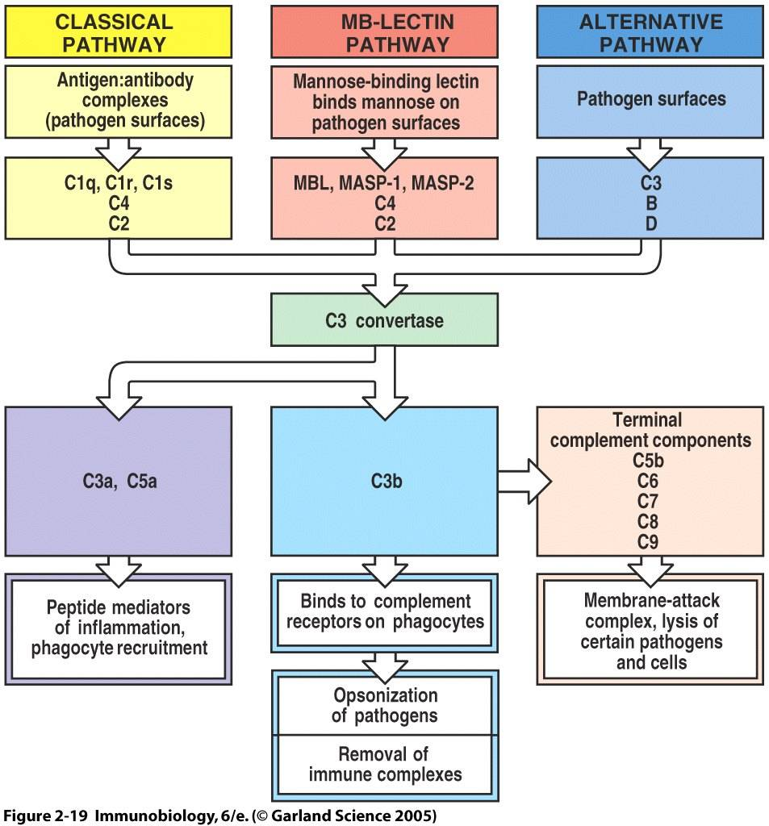
Complement
The Peer Teaching Society is not liable for false or misleading information…
Notes:
Complement is an acute phase protein that are synthesised by the liver and circulate in an inactive form.
Complement proteins are cleaved by convertases into two components e.g. C3 becomes C3a and C3b. Those ending with a are involved with inflammation and chemotaxis. C3b opsonises pathogens. The membrane attack complex inserts itself into pathogen membranes and causes lysis.
All pathways converge to active C3 convertase.
The classical pathway is initiated by antigen-antibody complexes (IgM/IgG) which bind complement and activate the cascade.
The alternative pathway is activated when C3b (which is free and abundant in plasma) binds pathogens surfaces directly e.g. in G-ve bacteria. C3 has the ability to auto hydrolyse into C3a and C3b where C3b then goes on to activate the cascade.
Mannose binding lectin (MBL) pathway; MBL binds mannose on pathogens’ surface. Mannose is not present on human cells. This activates MASP proteins (serine proteases) and cleave C2 and C4.

Slide 40
HLA Associations
HLA Type | Associations
HLA-A3 | Haemochromatosis
HLA-B51 | Behcet's disease
HLA-B27 | Ankylosing spondylitis Reiter's syndrome Acute anterior uveitis
HLA-DQ2/DQ8 | Coeliac disease
HLA-DR2 | Narcolepsy Goodpasture's
HLA-DR3 | Dermatitis herpetiformis Sjogren's syndrome Primary biliary cirrhosis
HLA-DR4 | Type 1 diabetes mellitus Rheumatoid arthritis
The Peer Teaching Society is not liable for false or misleading information…
Notes:
Just for interest. Might be useful later on the course.

Slide 41
Cells and their markers
Type of cell | Cell surface markers
Haematopoietic stem cells | CD34
Helper T cell | CD4, TCR, CD3, CD28
Cytotoxic T cell | CD8, TCR, CD3, CD28
Regulatory T cell | CD4, CD25, TCR, CD3, CD28
B cell | CD19, CD20, CD40, MHC II, B7
Macrophage | CD14, CD40, MHC II, B7
Natural killer cell | CD16, CD56
The Peer Teaching Society is not liable for false or misleading information…
Notes:
CD1 MHC molecule that presents lipid molecules
CD2Found on thymocytes, T cells, and some natural killer cells that acts as a ligand for CD58 and CD59 and is involved in signal transduction and cell adhesion
CD3The signalling component of the T cell receptor (TCR) complex
CD4Found on helper T cells. Co-receptor for MHC class II Used by HIV to enter T cells.
CD5 Found in the majority of mantle cell lymphomas
CD8Found on cytotoxic T cells. Co-receptor for MHC class I Found on a subset of myeloid dendritic cells
CD14 Cell surface marker for macrophages
CD15Expressed on Reed-Sternberg cells (along with CD30)
CD16 Bind to the Fc portion of IgG antibodies
CD21Receptor for Epstein-Barr virus
CD28Interacts with B7 on antigen presenting cell as costimulation signal
CD45Protein tyrosine phosphatase present on all leucocytes
CD56 Unique marker for natural killer cells
CD95Acts as the FAS receptor, involved in apoptosis

Slide 42
SBAs
The following are a series of SBAs for you to try. The answers to each question with explanations are written in the presenter notes. Good luck!
The Peer Teaching Society is not liable for false or misleading information…

Slide 43
SBAs
A 34-year-old male comes into the GP complaining of haemoptysis. He notes that he wakes up at night due to waking up in a pool of sweat and mentions he recently returned from a holiday in Pakistan. The GP suspects tuberculosis. Which of the following cytokines is primarily responsible for activating macrophages?
IL-2
IL-4
TNFα
IL-1β
IFN-γ
The Peer Teaching Society is not liable for false or misleading information…
Notes:
ANSWERS BELOW HERE
E. INF gamma is the main activator of macrophages. IL-2 is secreted by macrophages. IL-4 is involved in B-cell differentiation. IL-1β is a pyrogen

Slide 44
SBAs
A 5-year-old girl is brought to the GP after repeated episodes of allergic rhinitis and eczema. Which cytokine is involved in atopy and, amongst other things, causes class switching of immunoglobulins to IgE?
IL-4
IL-17
IL-5
IL-1β
IFN-γ
The Peer Teaching Society is not liable for false or misleading information…
Notes:
ANSWERS BELOW HERE
IL-4 is the key cytokine for allergic inflammation and has multiple roles in allergy and asthma including; IgE class switching, Th2 polerisation, Increases VCAM-1 expression, promotes eosinophils to enter tissues, and mucous secretions.

Slide 45
SBAs
An infant presents to hospital with a fever, shortness of breath and a cough producing yellow sputum. She has had many previous admissions due to similar infections and has been diagnosed with a deficiency in mannose binding lectin (MBL). Which substance is failing to trigger a complement cascade reaction in this patient?
IgE
IgM
C3 Convertase
Pathogen surface carbohydrates.
Membrane attack complex
The Peer Teaching Society is not liable for false or misleading information…
Notes:
ANSWERS BELOW HERE
d) Mannose is a carbohydrate found on bacterial cell walls but not human cells. The lectin pathway of the complement system is triggered when MBL binds to mannose on bacteria. a and b are incorrect as antibodies activate the classical complement pathway. C3 convertase and the membrane attack complex are downstream components of the complement system and therefore do not trigger the cascade.

Slide 46
SBAs
A 13-year-old boy has been brought to the GP by his dad after having a sore throat and a cough for the last week. After an examination, the GP concludes that he likely has a viral infection that will resolve without other treatment. Which immune cells are responsible for directly combating this type of infection through apoptosis?
Basophils
Plasma Cells
T helper cells (CD4)
Neutrophils
Cytotoxic T-cells (CD8)
The Peer Teaching Society is not liable for false or misleading information…
Notes:
ANSWERS BELOW HERE
e) CD8 T cells are responsible for inducing apoptosis in virally infected cells. Cytotoxic T cells are responsible for inducing apoptosis. T helper cells produce cytokines for promoting the immune response. Basophils are a sign of chronic inflammation and produce histamine. Neutrophils (macrophages) kill extracellular microbes through phagocytosis and not apoptosis. T helper cells release cytokines to alter the immune response.

Slide 47
SBAs
A 10-year-old boy presents with an itchy rash on his elbows. The rash is red and there are excoriation marks. He has a past history of hay fever and has generally dry skin. The GP diagnoses him with eczema and he is prescribed hydrocortisone. Which antibody is responsible for mediating type 1 hypersensitivity?
IgG
IgA
IgM
IgE
IgD
The Peer Teaching Society is not liable for false or misleading information…
Notes:
ANSWERS BELOW HERE
d) IgE is the antibody responsible for type I hypersensitivity.

Slide 48
SBAs
A 38-year-old male attends the human immunodeficiency virus (HIV) clinic for routine blood tests for monitoring of his condition. The number of which of the following cells is used to measure the progression of disease in HIV positive patients?
Neutrophils
B Cells
NK cells
CD4 T cells
CD8 T cells
The Peer Teaching Society is not liable for false or misleading information…
Notes:
ANSWERS BELOW HERE
d) CD4+ T cells are the specific cell tropism for HIV are is correlated to disease progression. HIV uses CD4 to enter CD4+ cells. Other immunological changes are seen but are not correlated clinically with progression. The following immunological changes are seen in progressive HIV:
Reduction in CD4 count
Increase B2-macroglobulin
Decreased IL-2 production
Polyclonal B-cell activation
Decrease NK cell function
Reduced delayed hypersensitivity responses

Slide 49
SBAs
A 34-year-old man is referred to the gastroenterologist due to persistent epigastric pain and nausea. He returned travelling from south-east Asia ten weeks ago. Blood tests reveal iron deficiency anaemia, and faecal microscopy reveals the presence of hookworm eggs. Which immune cell is responsible for the defense against helminths?
Basophils
Eosinophils
Neutrophils
Macrophages
Dendritic Cells
The Peer Teaching Society is not liable for false or misleading information…
Notes:
ANSWERS BELOW HERE
b) Eosinophils are the innate response to helminth infection. Basophils could be thought of as circulating mast cells that secrete histamine. Neutrophils are the principle cell in acute inflammation and are particularly good at combating pyogenic (pus forming) bacteria. Macrophages serve a similar role to neutrophils but also antigen present and are present in chronic inflammation. Dendritic cells are antigen presenting cells that serve as a joining of the adaptive and innate immunity.

Slide 50
SBAs
A 14-year-old boy complains of a 3-day history of fatigue, aches and pains, and fever. Upon examination his temperature is 38ºC and his tonsils are inflamed. He is suspected to have a bacterial infection which will be fought by his adaptive immune system. Which of the following cell-surface proteins are found on cytotoxic T-cells?
CD4
CRP
MHC I
CD 8
MHC II
The Peer Teaching Society is not liable for false or misleading information…
Notes:
ANSWERS BELOW HERE
d) CD8 is the identifying surface marker for cytotoxic T cells. CD4 is the marker for T helper cells. CRP is an acute phase protein raised during infection and inflammatory responses. MHC I and MHC I are antigen presenting molecules.

Slide 51
SBAs
A 24-year-old lady collapses after being stung by a wasp. You run to her aid and find marked facial oedema and a loud wheeze. You suspect anaphylaxis. Which type of immunoglobulin (Ig) is associated with this kind of reaction?
IgG
IgA
IgM
IgE
IgD
The Peer Teaching Society is not liable for false or misleading information…
Notes:
ANSWERS BELOW HERE
d) IgE is the principle antibody involved in type 1 hypersensitivity.

