Slide 1
2021/2022

Slide 2
Genitourinary
Phase 2a Revision Session
Hasnain Khan, Phase 3b
Andrew Macdonald, Phase 3a
Friday 25th February 2022

Slide 3
Outline
Epidemiology, Pathophysiology, S/S, Investigations, Management
Kidney
Cancer
Prostate
Infection
Scrotal Disease
Nephrotic and Nephritic Syndrome
STIs
Kahoot Quiz
The Peer Teaching Society is not liable for false or misleading information…

Slide 4
Resources
The Peer Teaching Society is not liable for false or misleading information…

Slide 5
CKD and AKI
Reduced kidney function (acute or chronic)
Function
Water/Hormone homeostasis
Removal of waste/toxins
RBC production
Activate Vit D
Risk Factors
Emergency surgery, ie, risk of sepsis or hypovolaemia
CVD risk
CKD- eGFR < 60
DM
HF
Age >65 years
Liver disease
Use of nephrotoxic drugs

Slide 6
CKD vs AKI
CKD stage | GFR range
1 | > 90 ml/min
2 | 60-90 ml/min with some sign of kidney damage
3a | 45-59 ml/min, a moderate reduction in kidney function
3b | 30-44 ml/min, a moderate reduction in kidney function
4 | 15-29 ml/min, a severe reduction in kidney function
5 | Less than 15 ml/min, established kidney failure - dialysis or a kidney transplant may be needed
NICE Diagnostic criteria (any one)
Rise in creatinine of >= 26µmol/L in 48 hours
>= 50% rise in creatinine over 7 days
Fall in urine output to less than 0.5ml/kg/hour for more than 6 hours in adults (8 hours in children
1 | Increase in creatinine to 1.5-1.9 times baseline, or Reduction in urine output to <0.5 mL/kg/hour for ≥ 6 hours
2 | Increase in creatinine to 2.0 to 2.9 times baseline, or Reduction in urine output to <0.5 mL/kg/hour for ≥12 hours
3 | Increase in creatinine to ≥ 3.0 times baseline, or Increase in creatinine to ≥353.6 µmol/L or Reduction in urine output to <0.3 mL/kg/hour for ≥24 hours

Slide 7
Pre-renal, Intrinsic or Post-renal?
1. T2DM and HTN, low urine osmolality, high urine Na+, High blood K+
Intrinsic
2. Normal Na+, raised Urea and Creatine. Responds well to fluid therapy
Pre-renal
3. Loin->groin acute colicky pain, microscopic haematuria
Post-renal

Slide 8
Aetiology
Pre-renal
hypovolaemia secondary to diarrhoea/vomiting
renal artery stenosis
Intrinsic
glomerulonephritis
acute tubular necrosis (ATN)
acute interstitial nephritis (AIN), respectively
rhabdomyolysis
tumour lysis syndrome
Post-renal
kidney stone in ureter or bladder
benign prostatic hyperplasia
external compression of the ureter

Slide 9
AKI Management
Fluid balance
Nephrotoxic Drugs
NSAIDS
Aminoglycides
ACE-i
ARB
Loop diuretics
?Metformin
?Digoxin
?Lithium
Treat hyperkalemia-> risk for arrythmia
Treat underlying cause
RRT- if not responding to medical treatment

Slide 10
CKD Management
Slow progression of disease
DM treatment
HTN treatment
Glumeronephritis treatment
Reduce risk of CVD
Atorvastatin- 20mg
Manage complications
Mineral bone disease- low Vit D
HTN
Proteinuria
Anaemia-> ESA
RRT- haemodialysis, peritoneal dialysis, transplant

Slide 11
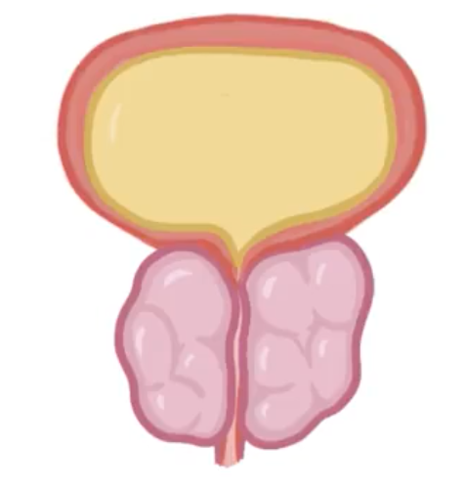
Prostate Pathology
Physiology
Produces testosterone and dihydrotestosterone
Production of PSA- liquefies semen
Benign Prostatic Hyperplasia
Benign enlargement of the prostate gland
LUTS- storage and voiding
Examination: DRE and PSA
Management: (1) Tamsulosin (2) Finasteride
Prostate Cancer
Adenocarcinoma
LUTS symptoms
Metastasis- haematuria, back pain
Localised: radical prostatectomy
Advanced: zoladex (GnRH agonist)

Slide 12
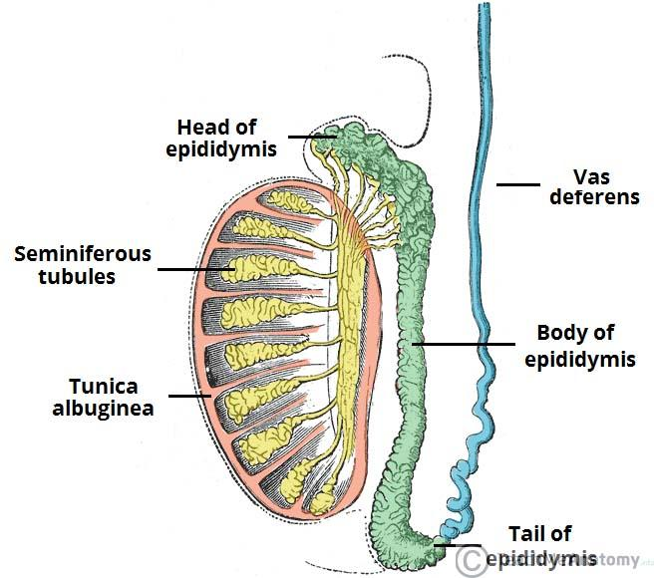
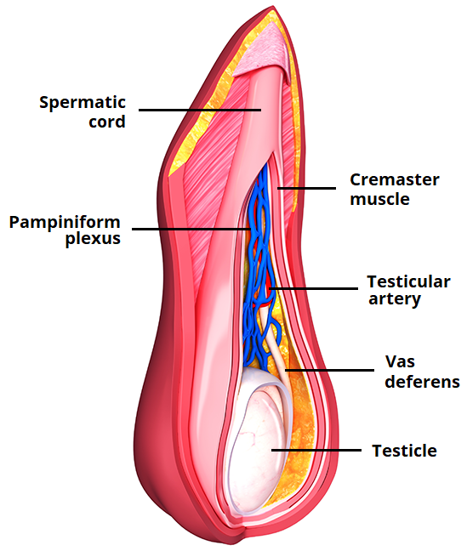
Male Reproductive System

Slide 13
Scrotal Pathology
Varicocele
Abnormal enlargement of the testicular veins
‘Bag of worms’
US and Doppler
Management: Conservative
Hydrocele
Fluid in tunica vaginalis
Soft, non-tender, transluminous swelling
Conservative

Slide 14
Acute Testicular Pain
Testicular Torsion
Medical emergency
Acute, severe pain
Unilateral, swollen, tender, retracted upwards
Prehn’s sign negative
De-torsion
Epididymitis
Acute pain
Unilateral
?Previous infection
Prehn’s sign positive
Stat IM Ceftriaxone (if organism unknown) plus doxycycline

Slide 15
Testicular pathology
Epididymal Cyst
Most common cause of scrotal swelling
Lump found in posterior aspect of testicle
US
Dissolve in 10 days
Testicular Cancer
Painless lump
Hydrocele
Gynacomastia
US
Chemo/Radio
Orchidectomy

Slide 16
Nephritic syndrome
Investigations
The diagnostic test for the cause of nephritic syndrome is kidney biopsy
Urinalysis- shows haematuria in nephritic syndrome
Bloods- elevated ESR and CRP in inflammation. May be anaemia reflecting systemic disease.
Definition
This is a syndrome fitting a clinical picture of inflammation within the kidney. There are several features that define nephritic syndrome.
Haematuria- reflects inflammation of the kidney
Oliguria- due to reduced GFR
Proteinuria- less than 3g/24 hours
Hypertension –due to fluid overload
Management
Treat underlying cause
Blood pressure control- ACE-I/ARB. This reduces proteinuria and preserves renal function
Corticosteroids- this is to reduce the inflammation causing damage to the kidney
Aetiology
Inflammatory disease affecting the kidney can arise from both systemic disease and renal limited disease.
Systemic causes
SLE
Post strep GN
Small vessel vasculitis
Goodpasture's/anti-GMB disease
Renal causes
IgA nephropathy

Slide 17
Causes of glomerulonephritis
IgA nephropathy
This is where there is deposition of IgA into the mesangium of the kidney. This results in inflammation and damage
Presents asymptomatically with microscopic haematuria
Diagnose by biopsy
Manage as previous slide. Give fish oil and steroids if persistent proteinuria after 3-6 months
Most common cause of nephritic syndrome in high income countries
Goodpasture's disease
Caused by autoantibodies to Type IV collagen in glomerular and alveolar membrane
Presents with SOB and oliguria due to resp and renal damage
Diagnose with anti-GBM antibodies in bloods and biopsy
Manage with plasma exchange, steroids, and cyclophosphamide (for immune suppression)
This is rare HOWEVER it is a cause for rapidly progressing glomerulonephritis leading to renal failure in days/weeks so worth knowing

Slide 18
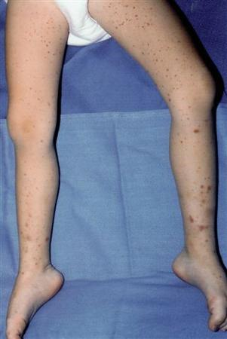
Causes of glomerulonephritis
Henoch Schoenlein purpura
This is a small vessel vasculitis that affects the kidney and joints due to IgA deposition
Presents with a purpuric rash on legs, nephritic symptoms, and joint pain due to IgA deposition
Diagnosed clinically, confirmed with renal biopsy.
Managed with corticosteroids and ACE-I/ARB
Post streptococcal glomerulonephritis
This is nephritic syndrome following an infection, 3-6 weeks prior. This is due to deposition of strep antigens in the glomeruli leading to inflammation and damage.
Presents with haematuria. Can present with acute nephritis
Diagnosed by evidence of strep infection
Treated with antibiotics to clear the strep, and supportive care.

Slide 19
A few questions….
Nephritic syndrome is characterised by inflammation of the kidney and is diagnosed by renal biopsy
A child presenting with haematuria 4 weeks after a skin infection has post streptococcal nephritis
IgA nephritis is the most common cause of nephritic syndrome in the UK

Slide 20
A few questions….
Nephritic syndrome is characterised by inflammation of the kidney and is diagnosed by renal biopsy
A child presenting with haematuria 4 weeks after a skin infection has post streptococcal nephritis
IgA nephritis is the most common cause of nephritic syndrome in the UK

Slide 21
Nephrotic syndrome
Presentation
Oedema
Frothy urine- reflects proteinuria
Definition
In nephrotic syndrome there is an issue with the filtration barrier, with the podocytes being primarily implicated, which results in leaking of protein into the urine. This results in the triad characterising nephrotic syndrome:
Proteinuria- >3g/24 hours
Hypalbuminaemia- due to loss of albumin in urine
Oedema- loss of oncotic pressure. This can be rapid and severe
Investigations
Urinalysis
Urine Protein: creatinine ratio- to quantify the degree of proteinuria
Blood tests- renal function, elevated lipids
Renal biopsy- gives cause
Management
Fluid and salt restriction
Loop diuretics- to manage oedema
Treat cause
ACE-I/ARB to reduce protein loss
Manage complications
Aetiology
The triad of symptoms all occur due to renal disease disrupting kidney function
Minimal change disease
Focal segmental glomerulosclerosis
Membranous nephropathy
Complications
Hyperlipidaemia- loss of albumin increases cholesterol formation. Manage with statins
VTE- due to increased clotted factors. Give heparin
Secondary causes- DDANI
Diabetes, drugs, autoimmune, neoplasia, infection

Slide 22
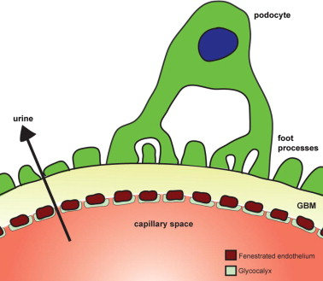
Causes of nephrotic syndrome
Minimal change disease
This makes up 25% of adult cases of nephrotic syndrome
Normal appearance upon microscopy but there is abnormal function
Diagnosis is by biopsy, presentation is nephrotic
Treat with high dose steroids: prednisolone
Membranous nephropathy
This makes up 25% of adult nephrotic syndrome and is immunologically mediated
Diagnosed by renal biopsy showing thickened glomerular basement membrane. Anti phospholipase A2 receptor antibody found in 70-80% of patients.
Managed with ACE-I/ARB in all. In patients with high risk of progression, prednisolone and cyclopshosphamide.
Focal segmental glomerulosclerosis
Commonest cause on renal biopsy
Can be idiopathic or secondary to HIV, heroin, lithium
Diagnosed by presence of scarring of the glomeruli- i.e. focal sclerosis
Give steroids idiopathic disease
All patients should receive ACE-I/ARB blood pressure control

Slide 23
Nephritic vs Nephrotic
Nephritic | Nephrotic
Proteinuria ++ Hypertension Haematuria visible/ non visible Oedema + GFR↓↓ Rash? N&V? Abdo pain | Proteinuria ++++++ Hypoalbuminaemia Oedema +++ GFR↓/↔ Hyperlipidaemia

Slide 24
A few questions…
A patient with nephrotic syndrome presents with (oedema) and (frothy urine)
(ACE-I/ARB) are used to reduce protein loss and slow progression of renal disease
25% of cases of nephrotic syndrome have (no visible changes on biopsy)

Slide 25
A few questions…
A patient with nephrotic syndrome presents with oedema and frothy urine
ACE-I/ARB are used to reduce protein loss and slow progression of renal disease
25% of cases of nephrotic syndrome have no visible changes on biopsy

Slide 26
Bladder cancer
Presentation
Painless haematuria- this is the most common presenting symptom for bladder cancer, assume pt has urothelial tumour till proven otherwise
Ask about RF in history
UTI symptoms without bacteriuria
This is the most common GU tract malignancy affecting men more than women
3% of all cancer deaths and 10th most common cancer
90% are urothelial carcinoma, and spreads to the iliac and para-aortic nodes, and to the liver and lungs
Investigations
Urinalysis- sterile pyuria
Cystoscopy and biopsy- diagnostic
CTT urogram- allows staging
Aetiology and risk factors
Smoking increases risk 2-4 times, accounts for half of male cases of bladder cancer
Age over 55
Pelvic radiation
Exposure to occupational carcinogens
Bladder stone- due to chronic inflammation
Management
T1: transurethral resection or local diathermy
T2-3: radical cystectomy
T4: palliative chemotherapy and radiotherapy

Slide 27
Renal cancer
Presentation
Classic triad of symptoms: haematuria, flank pain, palpable abdominal mass
90% of cancers are found to be arising from the proximal tubular epithelium and are classes as carcinomas
Mean age of diagnosis is 55, with a 2:1 male:female diagnosis ratio
505 are picked up incidentally, with 30% having mets on diagnosis
Spreads to the bone, liver and lungs
Risk factors
Haemodialysis
Smoking
Hypertension
Investigations
Bloods: polycythaemia from erythropoietin secretion
Raised BP: due to renin secretion
Ultrasound
CT/MRI
CXR- shows cannon ball mets
Mayo prognostic risk score used to predict survival
Stage I: partial or radical nephrectomy
Stage II: radical nephrectomy
Stage III: radical nephrectomy and adrenalectomy
Stage IV: systemic treatment

Slide 28
Urinary tract infections (UTI)
Definition
Defined as the presence of microorganisms in the urinary tract which produces clinical features. It can affect the lower tract causing cystitis (bladder), urethritis and prostatitis, and the upper causing pyelonephritis. It can also occur from untreated urolithiasis
Aetiology
The 5 most common pathogens can remembered with KEEPS:
Klebsiella
E coli- most common causing >50% of cases
Enterococci
Proteus
Staphylococcus coagulase negative
Presentation
Voiding symptoms- FUNDS: frequency, urgency, nocturia, dysuria
Pyelonephritis
This is infection and inflammation of the kidney, most often due to ascending UTI
Presentation
Classic triad of symptoms
Loin pain, fever and pyuria
Costovertebral joint pain and tenderness
Septic shock in advanced disease
Investigations
Urinalysis- white cells and microscopic haematuria
Mid stream urine and culture: this is the gold standard for Dx of the causative agent
Bloods- elevated inflammatory markers
Renal USS- to rule out urinary tract obstruction or stones
Treatment
Antibiotics: cefalexin for 7-10 days. Trimethoprim or amoxicillin if sensitive.
Analgesia- paracetamol

Slide 29
Cystitis
This is infection of the urinary bladder and is most common in young sexually active women.
Risk factors
History of UTI
Diabetes
Frequent sexual intercourse
Pregnancy
Presentation
Dysuria- discomfort, pain, burning on urination
Frequency
Urgency
Cloudy smell urine
Suprapubic tenderness/discomfort
Investigations
Urine dipstick- if positive for nitrites or WBCs and RBCs then UTI likely
This is unreliable in women over 65 so don’t bother
Urine culture and sensitivity- this is the gold standard diagnosis
Management
Antibiotics: 3 days of trimethoprim, or nitrofurantoin.
avoid nitrofurantoin at term in pregnancy. Avoid trimethoprim full stop in pregnancy.
Prostatitis
inflammation and swelling of the prostate gland, most commonly caused by E coli
Presentation
Very tender prostate: on DRE intensely tender prostate gland
Systemic Sx: fever, chills, malaise
Voiding Sx
Investigations
Urinalysis and culture- shows blood and WBCs, and bacteria
Blood cultures- in patients who are febrile
Management
Antibiotics: ciprofloxacin or levofloxacin for 14 days
Antibiotics and pregnancy
Avoid trimethoprim in pregnancy due to teratogenic effects
Nitrofurantoin is generally safe

Slide 30
A few questions…
Bladder cancer classically presents with (painless haematuria)
Kidney cancer presents with a triad of (haematuria, flank pain, palpable abdominal mass)
FUNDS stands for (frequency, urgency, nocturia, and discharge)
Cystitis should be treated with (cefalexin and analgesia)

Slide 31
A few questions…
Bladder cancer classically presents with painless haematuria
Kidney cancer presents with a triad of haematuria, flank pain, palpable abdominal mass
FUNDS stands for frequency, urgency, nocturia, and discharge
Cystitis should be treated with cefalexin and analgesia

Slide 32
STI’s
Chlamydia
This is the most common bacterial STI, caused by the chlamydia trachomatis pathogen
Presentation
Men- testicular pain
voiding symptoms, dysuria
50% are ASX
Women- vaginal discharge and dysuria
white, yellow or green discharge
70% are ASX
Diagnosis
Nucleic acid amplification testing
Management
Avoid sex until treatment finished and contact tracing
Single 1g dose of azithromycin+7 days of doxycycline
Gonorrhoea
Second most common STI in UK and caused by Neisseria gonorrhoea
Presentation
more likely to be ASX
Men: dysuria, frequency, discharge
Female: vaginal discharge dysuria, pelvic pain
Investigations
NAAT
Microscopy: shows gram-negative diplococci
Culture: all infected areas with a swab
Treatment
Single Ceftriaxone IM dose

Slide 33
Urolithiasis
Presentation
Most are asymptomatic
Causes severe colicky unilateral pain from loin to groin
Associated with nausea and vomiting
Haematuria- 85% of cases
Assume ruptured AAA until proven otherwise!
This is the presence of crystalline stones in the urinary tract
The three places to find them are the pelvicoureteric junction, the pelvic brim, and the vesicoureteral junction.
Stones form from crystals in supersaturated urine. They are most often composed of calcium oxalate (80% of cases)
Blockage of the urinary tract can cause hydronephrosis if untreated
Risk factors
Dehydration
High salt intake
Obesity- lowers pH
Congenital horseshoe kidney
Oxalate rich diet
Gout- uric acids stones
Investigations
KUBXR- first line and diagnostic for 80% of stones
Non contrast CTKUB- gold standard
Urine dip stick- for haematuria
Blood tests- raised calcium and phosphate
Management
Strong analgesia- diclofenac
Antibiotics
Tamsulosin/nifedipine- relaxes smooth muscle and helps expulsion
Percutaneous nephrolithotomy- used to expulse stones over 10mm
Prevention
thiazide diuretics- this helps with recurrent stones by reducing calcium levels
Hydration, reduce salt and oxalate intake

Slide 34
A few questions….
Kidney stones are commonly found at the (pelvic ureteric junction,) the (pelvic brim,) and the vesicoureteral junction
The diagnostic test for STI’s is (Nucleic acid amplification testi)ng
85% of patients with kidney stones present with (haematuria)

Slide 35
A few questions….
Kidney stones are commonly found at the pelvic ureteric junction, the pelvic brim, and the vesicoureteral junction
The diagnostic test for STI’s is Nucleic acid amplification testing
85% of patients with kidney stones present with haematuria

Slide 36
Feedback
https://docs.google.com/forms/d/e/1FAIpQLSfqh20D5niF2UtbDQIDicIy7ubf3yk7PK1ebOFBDSTR_olo3w/viewform?usp=sf_link
The Peer Teaching Society is not liable for false or misleading information…

Slide 37
Quiz
The Peer Teaching Society is not liable for false or misleading information…

Slide 38
Hasnain Khan- hqrkhan1@sheffield.ac.uk
Andrew Macdonald- amacdonald3@sheffield.ac.uk

