Slide 1
2021/2022

Slide 2
Haematology
Phase 2a Revision Session
Cameron Clark & Emily Sams
07/02/22 7pm

Slide 3
Session Outline
Blood counts & anemia
Clotting
Sickle cell
Thrombocytopenia (TTP, ITP)
DIC
Hemophilia
Von Willebrand’s
(5 minute break)
Leukemia:
Acute lymphoid
Acute myeloid
Chronic lymphoid
Chronic myeloid
Lymphoma:
Hodgkin’s / Non-Hodgkin’s
Myeloma
Polycythemia
Questions
Low yield conditions - G6DPP, Thalassemia, HIT, HUS, Tumor lysis, inherited thrombophilia, myelodysplasia, essential thrombocythemia
The Peer Teaching Society is not liable for false or misleading information…

Slide 4
Anaemia
Anaemia is a lower than normal concentration of haemoglobin or red blood cells (Hb <130 in men, <120 women)
Haemolytic: increased breakdown of RBC’s
Aplastic: decreased RBC, WC, platelets
Microcytic: reduced MCV
Macrocytic: raised MCV
Normocytic: normal MCV

Slide 5
Anaemia (2)
General Presentation:
Symptoms: fatigue, headache, dizziness, dyspnoea (especially on exertion)
Signs: tachycardia, skin pallor, conjunctiva pallor, intermittent claudication
Koilonychia (spoon-shaped nails) – iron deficiency
Angular stomatitis – iron deficiency, B12 deficiency
Lemon-yellow skin – B12 deficiency
Jaundice / dark urine – haemolytic anaemia

Slide 6
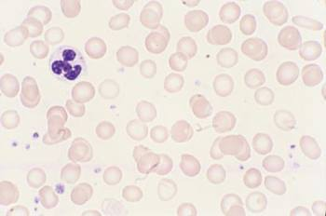
Microcytic Anaemia
Iron deficiency:
FBC: low Hb, Low MCV <95fl
Iron studies:
Low ferratin (unless active inflammation)
Low serum iron
Low transferrin saturation
Raised transferrin
Blood film: small, hypochromic cells
Cause:
Reduced absorption (low intake / malabsorption at small intestine / drugs like PPI’s and tetracyclines)
Increased utilization (pregnancy)
Blood loss (stools / urine / trauma / surgery / menorrhagia)
Notes:
Ferratin = main protein that stores iron intracellularly. Predominantly in the liver. Ferratin is an acute phase reactant so will rise in acute inflammation.
Transferrin = protein mediating iron transport in the blood. Raised because the body tries to compensate for reduced iron levels, by producing more transferrin. The saturation still remains low.

Slide 7
Microcytic Anaemia (2)
Chronic Disease:
FBC: low Hb, Low or normal MCV, high ESR
Iron studies:
Normal / raised ferratin
Low serum iron
Low transferrin saturation / transferrin
Cause:
Chronic infection
Chronic inflammation (connective tissue diseases)
Neoplasia
Notes:
Ferratin is raised because in ACD, iron is kept stored in reticuloendothelial system. As ferratin is the main intracellular store of iron, it is therefore raised.
It is not key to understand all the iron studies for phase 2a. Have an awareness of them. Most important is being able to list causes of anaemia.

Slide 8
Microcytic Anaemia (3)
Other causes:
Sickle cell
Thalassemia:
Inherited (AR) alpha or beta globin mutations, varied presentation
Generally microcytic, hypochromic cells.
Sideroblastic anaemia:
Iron levels normal, the body can’t insert the iron into Hb
Microcytic
Increased iron, transferrin, ferratin. Ringed ‘sideroblasts’ on blood film
Notes:
Sickle cell will be covered later
Thalassemia will be covered later. It is a quite low yield condition for phase 2a. Alpha / Beta thalassemia relate to haemoglobin chain abnormalities causing a normocytic / microcytic anaemia.

Slide 9
Normocytic Anaemia
Acute blood loss
Bone marrow failure
Pregnancy
Haemolytic anaemia:
Presentation: jaundice, dark urine
Investigations: raised reticulocytes (chronic), raised bilirubin, raised urobilinogen, schistocytes on blood film
Causes:
Autoimmune
Sepsis / disseminated intravascular coagulopathy (DIC)
Sickle cell
Thalassemia
Notes:
Microangiopathic haemolytic anaemia leads to schistocyte formation. These are fragmented RBC’s, they cause endothelial damage and dysfunction. Seen in Sepsis / DIC / haemolytic uraemic syndrome, TTP. (Not key for phase 2a)

Slide 10
Macrocytic Anaemia
B12 Deficiency:
Causes:
Pernicious anaemia – lack of intrinsic factor, usually produced by parietal cells in the stomach. Allows B12 absorption in the terminal ileum
Malabsorption (coeliac / IBD / bowel resection / ileostomy)
Decreased dietary intake (found in meat, fish, eggs, milk)
Chronic nitrous oxide use
Presentation:
Bloods: raised MCV, Low Hb, low B12
‘Megaloblastic’ anaemia – defined by cell changes on blood smear
S&S: general anaemia presentation + a range of neurological S&S
Notes:
Megaloblastic anaemia characterized by oval shaped RCB’s, hyper segmented neutrophils (Not key for phase 2a)
Severe B12 deficiency causes demyelination of the spinal cord. Generally neurological symptoms start distal. This is called subacute combined degeneration (Not key for phase 2a)

Slide 11
Macrocytic Anaemia (2)
Other causes:
Diseases of the liver and spleen
Haematological malignancy
Alcohol – chronic consumption affects bone marrow
Notes:
Diseases of the liver and spleen generally lead to formation of codocytes, ‘target cells’ on the blood film. Alcohol induced macrocytic anaemia is no associated with codocytes (Not key for phase 2a)

Slide 12
Abnormal Cell Count
Result | Potential Cause
Neutrophilia | Infection / Inflammation / CML
Neutropenia | Antibiotics / Chemotherapy / Marrow failure / Liver disease
Thrombocytosis | Infection / Inflammation / Tissue injury / Splenectomy / Essential thrombocythemia
Thrombocytopenia | Production failure: Marrow failure / congenital / leptospirosis Increased removal: ITP / TTP / DIC / HIT / HUS / SLE
Lymphocytosis | EBV / CMV / Hepatitis / Malignancy (CLL / ALL / Lymphoma) / Stress
Lymphocytopenia | Steroids / HIV / Post-viral / Marrow failure / Chemotherapy

Slide 13
Clotting (1)
Primary haemostasis: initiation and formation of the platelet plug
Platelet activation
Secondary haemostasis: formation of the fibrin clot
Intrinsic and extrinsic coagulation cascade

Slide 14
Clotting (2)
Platelet activation:
Initial activation:
Collagen binding to GPVI / GPIIbIIIa via vWF
Amplification:
Thromboxane – binds to TPa receptors
ADP binds to P2Y12 / P2Y1 receptors
Other platelets form GPIIb/IIa crossbridges
Thrombin – binds to PAR1 / PAR4 receptors
Effects:
Platelet shape change (pseudopodia, projections increase interlinking with other platelets)
Dense granule release (Contains more ADP for further P2Y12 activation)
Alpha granule release (Inflammatory mediators and clotting factors)

Slide 15
Clotting (2)
Platelet activation:
Initial activation:
Collagen binding to GPVI / GPIIbIIIa via vWF
Amplification:
Thromboxane – binds to TPa receptors – NSAIDS inhibit thromboxane formation
ADP binds to P2Y12 / P2Y1 receptors – Clopidogrel / ticagrelor inhibit P2Y12 binding
Other platelets form GPIIb/IIa crossbridges
Thrombin – binds to PAR1 / PAR4 receptors – Dabigatran inhibits thrombin
Effects:
Platelet shape change (pseudopodia, projections increase interlinking with other platelets)
Dense granule release (Contains more ADP for further P2Y12 activation)
Alpha granule release (Inflammatory mediators and clotting factors)

Slide 16
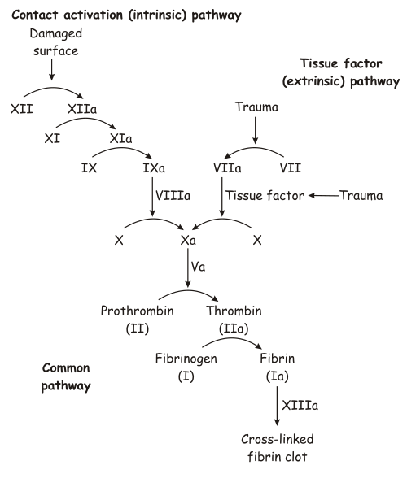
Clotting (3)
Clotting Cascade
Intrinsic (initiated by endothelial collagen)
12 → 11 → 9 → 8 → 10 → 10a
Extrinsic (initiated by Tissue Factor. This is expressed by immune cells and endothelium)
7 → 10 → 10a
Common
10a → Prothrombin (II) → Thrombin (IIa) → Fibrinogen → Fibrin (factor 13 reinforces fibrin)

Slide 17
Clotting (3)
Clotting Cascade
Intrinsic (initiated by endothelial collagen)
12 → 11 → 9 → 8 → 10 → 10a
Extrinsic (initiated by Tissue Factor. This is expressed by immune cells and endothelium)
7 → 10 → 10a
Common
10a → Prothrombin (II) → Thrombin (IIa) → Fibrinogen → Fibrin (factor 13 reinforces fibrin)
Warfarin (blocks Vit K)
APTT
PT
APTT
Heparin (via Antithrombin III)
Rivaroxaban (directly)
Notes:
Vitamin K facilitates proper functioning of II, VII, IX, X. Warfarin inhibits Vit K. – Easily reversed, give Vit K
NOAC’s like rivaroxaban / apixaban are very selective, but cannot be reversed
Heparin is unselective antithrombin III inhibitor
APTT = activated partial thromboplastin time (measure of intrinsic and common pathway)
PT = prothrombin time (measure of extrinsic pathway)

Slide 18
Sickle Cell
Autosomal recessive (heterozygote = ‘trait’, homozygote = disease)
Gene on Cr11 → Glutamic acid substitution with valine → B-Globin polymerization
Sickled cells. Endothelial damage. Reduced O₂ carrying capacity
Acute Presentation (crisis):
MSK: Bone pain, joint pain
Infection
Resp: dyspnoea, cough, hypoxia
CNS: stroke
GI: sequestration crisis
Notes:
Sequestration crisis = blood outflow from the spleen is blocked. Blood accumulates - splenomegaly

Slide 19
Sickle Cell (2)
Risk factors for sickle crisis:
Low O₂
Cold weather
Parvovirus B19
Exertion
Chronic complication:
Avascular necrosis of joints, silent CNS infarcts, retinopathy, nephropathy, ED

Slide 20
Sickle Cell (3)
Workup:
FBC – Low MCV, Low Hb
Blood smear – sickled erythrocytes
Sickle solubility test
Hb electrophoresis
Management:
Acute: morphine / O₂ / IV fluids / Transfusion exchange
Chronic: hydroxycarbamide
Notes:
Sickle solubility is a quick test to detect HbS. Will not distinguish trait from disease.
Hb electrophoresis will show a band of HbS
Hydroxycarbamide inhibits ribonucleotide reductase, decreases DNA synthesis, raises HbF levels in sickle cell.

Slide 21
TTP (Thrombotic thrombocytopenic purpura)
ADAM TS13 protein deficiency (vWF cleaving protease)
Can’t break clumps of vWF into useful monomers – causes microvascular clots to form
Problem with primary haemostasis
Risks: adults, female
Presentation: Fatigue, fever, jaundice, petechiae, purpura, neurological deficit
Workup:
FBC: raised WCC, low Hb, low platelets
Other: raised bilirubin, raised creatinine
Blood smear: schistocytes
Clotting: PT and APTT normal
Treatment:
Plasma exchange, IV methylprednisolone, monoclonal Ab’s (Platelet transfusion contraindicated)
Notes:
Schistocytes are the jagged, deformed RBC’s also found in haemolytic anaemias and DIC.
Bilirubin raised because haemolytic anaemia
Creatinine raised due to renal damage from the microvascular clots
PT and APTT normal as this is a problem with primary haemostasis

Slide 22
ITP (Immune thrombocytopenic purpura)
Autoimmune, IgG destruction of Gpiib/iiia → platelets can’t activate → problem with primary haemostasis
Risks: paediatric, post-viral
Presentation: see TTP, this is a diagnosis of exclusion in reality..
Workup:
FBC: raised WCC, low Hb, low platelets
Clotting: PT and APTT normal
Blood smear: normal
Treatment:
Steroids / IV IgG
Notes:
This is quite low-yield. Doesn’t come up often. Just have an awareness of it.

Slide 23
DIC (Disseminated Intravascular Coagulation)
Widespread activation of coagulation cascade & platelet activation.
Microvascular thrombosis. Consumption of clotting factors
Caused by systemic inflammation / infection
Risks: sepsis, crush injury, malignancy
Presentation: bleeding (epistaxis, bruising, rash, GI bleed), ARDS
Workup:
Bloods: low platelets, low fibrinogen, high d-dimer, long PT, long APTT
Blood smear: schistocytes
Treatment:
Treat underlying cause (eg sepsis)
Low fibrinogen = cryoprecipitate
Low platelets = platelet transfusion
Notes:
Disorder of primary & secondary haemostasis

Slide 24
Haemophilia
A = Factor VIII deficiency (intrinsic) – secondary haemostasis
X-linked, recessive (male > female)
B = Factor IX deficiency (intrinsic) - rare
Presentation:
Soft tissue bleeding pattern – into muscles, joints, haematoma formation
Workup:
APTT long, PT may be normal
Genetic testing + Factor VIII testing
Treatment:
Recombinant factor VIII or IX

Slide 25
Von Willebrand’s Disease
Many sub-types, defect in quantity or quality of vWF
Varied inheritance, Type 1 (most common) is autosomal dominant. This is a quantitative disease.
Primarily a primary haemostasis disorder
vWF protects FVIII from liver protein C destruction. FVIII deficiency can therefore occur
Presentation: mucocutaneous bleeding (epistaxis, GI bleeds, menorrhagia, easy bruising)
Workup:
Plasma vWF measurement
APTT can be prolonged if FVIII low
Treatment:
Type 1 disease responds to desmopressin
Tranexamic acid can reduce acute bleeding

Slide 26
5 Minute Break

Slide 27
Leukaemia
Leukaemia is a cancer of the bone marrow
Immature blast cells uncontrollably proliferate, taking up space within the bone marrow, and then infiltrating into other tissues
The lack of space within the bone marrow means fewer healthy cells can mature and be released into the blood
4 types
Acute lymphoblastic leukaemia (ALL)
Acute myeloid leukaemia (AML)
Chronic lymphoblastic leukaemia (CLL)
Chronic myeloid leukaemia (CML)

Slide 28
Acute lymphoblastic leukaemia
Features
The most common leukaemia in children (often 0-4 years old)
Proliferation of immature lymphoblasts
Presentation
General anaemia symptoms
Bleeding/bruising
Infections
Hepatosplenomegaly
Lymphadenopathy
CNS infiltration -> headaches, CN palsies
Diagnosis
FBC -> anaemia, thrombocytopenia, neutropenia
Blood film
Bone marrow biopsy
Imaging (CXR/CT) -> lymphadenopathy
Management
Blood and platelet transfusions
Chemotherapy (methotrexate)
Steroids
Stem cell/bone marrow transplant
Antibiotics
Notes:
Anaemia presentation - fatigue, dizziness, palpitations, pallor, shortness of breath, etc
Can also do a lumbar puncture in cases of CNS involvement

Slide 29
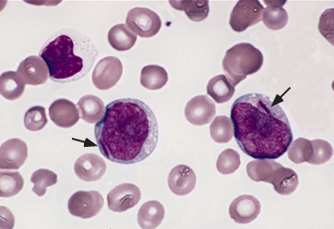
Acute myeloid leukaemia
Features
Proliferation of immature myeloblasts
Present mostly in the elderly
Only 15% 5-year survival
Presentation
General anaemia symptoms
Bleeding/bruising
Infections
Hepatosplenomegaly
Gum hypertrophy
Diagnosis
FBC -> anaemia, thrombocytopenia
Blood film
Bone marrow biopsy -> auer rods
Management
Blood & platelet transfusions
Chemotherapy
Stem cell/bone marrow transplant
Antibiotics

Slide 30
Chronic lymphoblastic leukaemia
Features
Proliferation of B lymphocytes
Mostly affects those 60+
Most common type of leukaemia in adults
Presentation
Often asymptomatic
Lymphadenopathy
May have night sweats and weight loss
Diagnosis
FBC -> anaemia, thrombocytopenia, leukocytosis
Blood film -> smudge cells
Bone marrow biopsy
Management
Watch and wait in early stages
Chemotherapy (rituximab)
Stem cell/bone marrow transplant

Slide 31
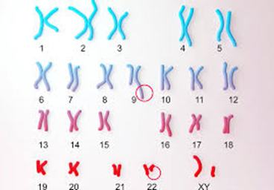
Chronic myeloid leukaemia
Features
Proliferation of myeloid blood cells
Most common in adults over 40
The vast majority of cases are associated with the philadelphia chromosome
Presentation
General anaemia symptoms
Bleeding/bruising
Infections
Hepatosplenomegaly
Weight loss and night sweats
Gout
Diagnosis
FBC -> anaemia, thrombocytopenia, leukocytosis
Bone marrow biopsy
Blood film
Genetic testing
Management
Chemotherapy
Stem cell/bone marrow transplant
Tyrosine kinase inhibitors (Imatinib)

Slide 32
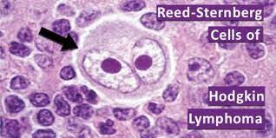
Hodgkin lymphoma
Features
Proliferation of lymphocytes in the lymph nodes
Associated with EBV and immunosuppression
Incidence has a bimodal distribution - peaks in early 20s and then in 70s
Presentation
Lymphadenopathy - painful upon drinking alcohol
B-symptoms -> fever, night sweats, weight loss
Diagnosis
ESR -> raised
Imaging (CXR/CT) for staging
Lymph node biopsy -> Reed Sternberg cells
Management
ABVD chemotherapy
Doxorubicin (brand name adriamycin), bleomycin, vinblastine, dacarbazine
Radiotherapy
Steroids
Stem cell/bone marrow transplant

Slide 33
Non-Hodgkin lymphoma
Features
Associated with EBV and immunosuppression
Predominantly affects adults over the age of 40
Presentation
Painless lymphadenopathy
B symptoms -> weight loss, night sweats, fever
Can get hepatosplenomegaly
Diagnosis
Imaging (CXR/CT) for staging
Lymph node biopsy -> no Reed Sternberg cells
Management
RCHOP chemotherapy
Rituximab
Cyclophosphamide
Hydroxy-daunorubicin
Vincristine (brand name Oncovin)
Prednisolone
Radiotherapy

Slide 34
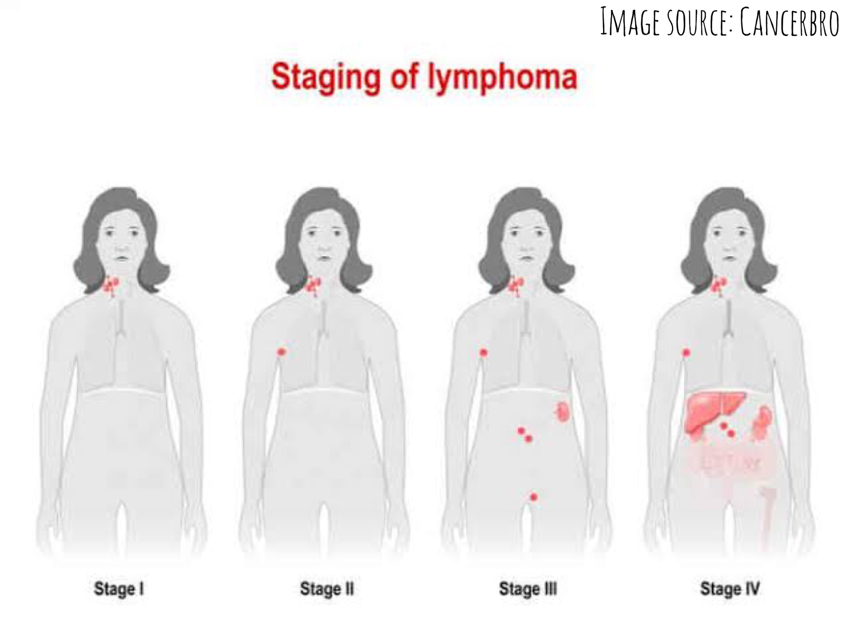
Lymphoma staging
The Ann Arbor staging is used for lymphoma staging
Stage 1 -> the disease is in one area only
Stage 2 - the disease is in 2 or more areas on the same side of the diaphragm
Stage 3 -> the disease is in 2 or more areas on both sides of the diaphragm
Stage 4 - the disease has spread beyond the lymph nodes

Slide 35
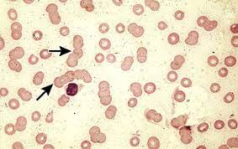
Multiple myeloma (1)
Features
Predominantly occurs in those over the age of 40
There is a close link to a condition called monoclonal gammopathy of undetermined significance (MGUS)
There is too much of an immunoglobulin released by abnormal plasma cells
1% of cases develop into myeloma
Presentation (CRAB)
Hypercalcaemia -> polydipsia, polyuria, constipation, abdo pain
Renal impairment
Anaemia -> fatigue, dizziness, etc
Bone lesions -> bone pain
Diagnosis
FBC -> anaemia
ESR -> raised
Blood film -> Rouleaux formation
Serum and urine electrophoresis -> Bence Jones protein in urine
Bone marrow biopsy
Imaging (x-ray/CT) -> bone lesions

Slide 36
Multiple myeloma (2)
Management
Chemotherapy
Stem cell transplant
Analgesia
Bisphosphonates (zoledronic acid)
Blood transfusions
Common chemotherapy combinations
VCD (bortezomib, cyclophosphamide, dexamethasone)
VTD (bortezomib, thalidomide, dexamethasone)
MTP (melphalan, thalidomide, prednisolone)
Don’t worry about learning the specific drugs!

Slide 37
Polycythaemia
Definition -> a high concentration of erythrocytes in the blood
Types
Absolute -> split into primary and secondary
Relative
Relative polycythaemia
There are a normal number of erythrocytes, but there is a reduction in plasma
Causes include obesity, dehydration, and excessive alcohol consumption
Absolute polycythaemia
There is an increased number of erythrocytes
Primary polycythaemia
Abnormality in the bone marrow
Called polycythaemia vera
Secondary polycythaemia
A disease outside the bone marrow causing overstimulation of the bone marrow
Causes include COPD, sleep apnoea, PKD, renal artery stenosis, kidney cancer
Notes:
PKD -> polycystic kidney disease

Slide 38
Polycythaemia vera
Presentation (these indicate polycythaemia vera as the cause)
Itching, especially after contact with warm water
Hepatosplenomegaly
Diagnosis
FBC -> raised haemoglobin, haematocrit, white cell count, and platelet count
Genetic testing
Serum erythropoietin -> decreased (can be normal or increased in other types of polycythaemia)
Management
Venesection
Low dose aspirin daily
Hydroxycarbamide for those at high risk of thrombus
Features
Myeloproliferative neoplasm
Most people with polycythaemia vera have the JAK2 mutation
The affected bone marrow can also produce excessive numbers of platelets and white blood cells
Presentation
Headaches
Dizziness
Fatigue
Blurred vision
Red skin (hands, face, and feet)
Hypertension

Slide 39
Question time
The Peer Teaching Society is not liable for false or misleading information…

Slide 40
Question 1
You are a junior doctor working in haematology. A 62-year-old woman complains of severe fatigue and dizziness that came on over the past few weeks. On examination, you notice lots of bruises and gum hypertrophy. Her FBC shows anaemia and thrombocytopenia, and a bone marrow biopsy showed auer rods. What is the diagnosis?
ALL
AML
CLL
CML
Myeloma
The Peer Teaching Society is not liable for false or misleading information…

Slide 41
Question 1 - answer
B - AML
Gum hypertrophy and auer rods are hallmarks of AML
The Peer Teaching Society is not liable for false or misleading information…

Slide 42
Question 2
You are a doctor working in paediatrics. A 3-year-old boy comes in with his parents who are worried about him as he has become very pale, he wants to sleep more often, and they have noticed bruises on his arms and legs. On examination, he has splenomegaly. His FBC shows anaemia, thrombocytopenia, and neutropenia. What is the most likely diagnosis?
ALL
AML
CLL
CML
Hodgkin lymphoma
The Peer Teaching Society is not liable for false or misleading information…

Slide 43
Question 2 - answer
A - ALL
ALL is the most common type of leukaemia in children
The Peer Teaching Society is not liable for false or misleading information…

Slide 44
Question 3
A 75-year-old man presents with fatigue, bone pain, and excessive thirst. His FBC shows anaemia and his ESR is raised
What is the most likely diagnosis?
What characteristic protein would you find in his urine?
The Peer Teaching Society is not liable for false or misleading information…

Slide 45
Question 3 - answer
Myeloma
CRAB - Excessive thirst is a symptom of hypercalcaemia, bone pain is caused by bone lesions, and anaemia presents with symptoms such as fatigue.
Bence Jones protein
The Peer Teaching Society is not liable for false or misleading information…

Slide 46
Question 4
A 19-year-old man presents to you after noticing a small lump in his neck. He says it became painful after a night out where he drank alcohol. He has also noticed some weight loss. A biopsy was done which showed Reed Sternberg cells.
What is the most likely diagnosis?
Upon imaging, there were enlarged lymph nodes in his neck and axilla region.
b. What stage is his disease?
The Peer Teaching Society is not liable for false or misleading information…

Slide 47
Question 4 - answers
Hodgkin lymphoma
Pain upon drinking alcohol and Reed Sternberg cells confirm the diagnosis of Hodgkin lymphoma
Stage 2
The disease in 2 or more areas on the same side of the diaphragm
The Peer Teaching Society is not liable for false or misleading information…

Slide 48
Question 5
You are a medical student on placement in haematology. You are asked to assess a 66 year-old man who has come in to receive routine treatment for Haemophilia A
Which of the following drugs is the man most likely to be receiving?
Recombinant FIX
Cryoprecipitate
Desmopressin
Recombinant FVIII
The Peer Teaching Society is not liable for false or misleading information…

Slide 49
Question 5 - answer
You are a medical student on placement in haematology. You are asked to assess a 66 year-old man who has come in to receive routine treatment for Haemophilia A
Which of the following drugs is the man most likely to be receiving?
Recombinant FIX – Haemophilia B
Cryoprecipitate - maybe, but no
Desmopressin – von Willebrand’s
Recombinant FVIII – Haemophilia A is FVIII deficiency.
The Peer Teaching Society is not liable for false or misleading information…
Notes:
Cryoprecipitate is a mix of clotting factors extracted from plasma. It contains a lot of factor VIII, however it is unlikely to be given as routine haemophilia therapy.

Slide 50
Question 6
A 17 year-old boy presents to your A&E department with a 2-day history of severe, deep pain in both knees and his upper legs with increasing fatigue and weakness.
He appears pale and clammy on examination, an abdominal exam notes massive splenomegaly.
Vitals: HR 115, RR 19, BP 110/63, SpO2 94% on air, Temp 36.9
FBC: MCV low, Hb low, reticulocytes mildly raised, haematocrit low
Given the likely diagnosis, what would be the most appropriate therapy?
O2 + IV methylprednisolone
O2 + IV fluids
O2 + IV morphine + IV fluids
NSAID’s
The Peer Teaching Society is not liable for false or misleading information…

Slide 51
Question 6 - answer
A 17 year-old boy presents to your A&E department with a 2-day history of severe, deep pain in both knees and his upper legs with increasing fatigue and weakness.
He appears pale and clammy on examination, an abdominal exam notes massive splenomegaly.
Vitals: HR 115, RR 19, BP 110/63, SpO2 94% on air, Temp 36.9
FBC: MCV low, Hb low, reticulocytes mildly raised, haematocrit low
Given the likely diagnosis, what would be the most appropriate therapy?
O2 + IV methylprednisolone
O2 + IV fluids
O2 + IV morphine + IV fluids – Acute sickle crisis with ?splenic sequestration
NSAID’s
The Peer Teaching Society is not liable for false or misleading information…

Slide 52
Question 7
An 75 year old women presents to A&E with severe community acquired pneumonia. She is displaying markers of red-flag sepsis, and develops a petechial rash over her entire body.
Blood tests show thrombocytopenia, long PT and APTT, low fibrinogen and a raised D-dimer
What is the name for the complication this patient has developed:
Thrombotic thrombocytopenia purpura
Disseminated intravascular coagulation
Haemolytic uraemic syndrome
Tumour lysis syndrome
The Peer Teaching Society is not liable for false or misleading information…

Slide 53
Question 7
An 75 year old women presents to A&E with severe community acquired pneumonia. She is displaying markers of red-flag sepsis, and develops a petechial rash over her entire body.
Blood tests show thrombocytopenia, long PT and APTT, low fibrinogen and a raised D-dimer
What is the name for the complication this patient has developed:
Thrombotic thrombocytopenia purpura
Disseminated intravascular coagulation
Haemolytic uraemic syndrome
Tumour lysis syndrome
The Peer Teaching Society is not liable for false or misleading information…

Slide 54
Low-Yield Conditions
The following are often mentioned in lectures, so may appear in exams, however, it is quite unlikely.
They may appear as incorrect options in an MCQ, so having a basic awareness of them can help you rule-out other answers
The Peer Teaching Society is not liable for false or misleading information…

Slide 55
Glucose-6-phosphate dehydrogenase deficiency
G6P has a role in pentose sugar metabolism, also protects RBC’s from damage.
In G6PD, RBC’s are exposed to more oxidative stress = haemolysis
Risks: X-linked (men), W.Africa, Middle-east, Asia
Presentation: haemolytic anaemia S&S + splenomegaly
Workup:
Bloods: anaemia, increased LDH, increased reticulocytes,
Blood smear: Heinz bodies (requires special prep)
Notes:
Increased LDH and increased reticulocytes are both markers of haemolysis

Slide 56
Inherited thrombophilia
Protein C/S Deficiency:
Less inhibition of factor VIII and V
Autosomal dominant
Factor V Leiden:
Factor V is resistant to liver protein C
Most common inherited thrombophilia (autosomal dominant)
Antithrombin III deficiency:
II, IX, X are no longer inhibited
Antiphospholipid syndrome (Hughes Syndrome) – probably most likely to be seen in an exam
AP antibodies bind to cell surfaces
Risks: SLE, female, diabetes, HTN, obesity
Presentation: unexplained thrombosis (DVT / PE), recurrent miscarriage, Livedo reticularis (look up, it’s a skin thing)

Slide 57
Thalassemia
Alpha thalassemia = alpha globin = chromosome 16 (2 genes) – autosomal recessive
Beta thalassemia = beta globin = chromosome 11 (1 gene) – autosomal recessive
Alpha (silent) [aa/a-]
Alpha (trait) [-a/-a or --/aa] → asymptomatic or mild anaemia
Alpha (Hb H disease) [-a/--] → mild microcytic anaemia, haemolytic anaemia
Alpha (Hydrops foetalis) [--/--] → incompatible with life
Beta
Minor (heterozygous) → asymptomatic, hypochromic RBC’s
Intermedia → anaemia, frequent infections
Major → failure to thrive, transfusion dependant (signs: bossing of skull, overgrowth of maxilla)
Workup = genetic test / Hb electrophoresis showing increased abnormal Hb, sometimes increased HbF
Treatment = depends on severity. Transfusions, supportive therapy

Slide 58
Heparin-induced thrombocytopenia
Following heparin administration, rarely (5%), antibodies bind to the drug → prothrombotic state
Problem with primary haemostasis
Presentation:
Onset of emboli (PE / DVT / CSVT) following heparin administration
Suspect in any patient on heparin who’s platelets fall >50%
Bloods: platelets low, D-dimer high
Treatment:
Stop heparin
Anticoagulate

Slide 59
Haemolytic Uraemic Syndrome
Paediatric condition, following infection with shiga-toxin producing bacteria like E.Coli / Shigella (typically 5d after gastroenteritis)
Microvascular clot formation, deposition of platelets and fibrin in small vessels
Presentation:
Classic triad – haemolytic anaemia, AKI (oliguria, haematuria, hypertension), thrombocytopenia
Workup:
Bloods: thrombocytopenia, anaemia, high reticulocytes, high LDH, high bilirubin
Blood smear: schistocytes
Differentiate from TTP with ADAMTS13 testing

Slide 60
Tumour Lysis Syndrome
Collection of metabolic disturbances occurring with rapid destruction of neoplastic cells
Following chemotherapy, the characteristic syndrome is rapid development of:
Hyperuricaemia, hyperkalaemia, hyperphosphatemia
Hypocalcaemia
AKI
Occurs more frequently with aggressive treatment of haem malignancies like non-Hodgkin lymphoma, acute leukaemia
Notes:
Important as it is the reason Allopurinol is given alongside some leukaemia treatments. Not asked about very often in exams.

Slide 61
Myelodysplasia
Heterogenous group of conditions, defined by cell dysplasia
Often manifests as anaemia and bone marrow failure
Haemopoietic tissue is displaced by the dysplastic cells
Presentation:
General S&S of anaemia
Neutropenia (frequent infections)
Workup:
Histological diagnosis. 10% of 500 cells must show dysplasia
Wide variety of abnormalities

Slide 62
Essential Thrombocythemia
Elevated platelet count
50% have JAK-2 mutation, meaning TPO is constantly stimulating platelet production
In bone marrow biopsy, ++ megakaryocytes are seen
Presentation: increased thrombus risk (PE, DVT, CSVT)
Workup:
FBC – thrombocytosis
Genetic testing for JAK mutation
Bone marrow biopsy

Slide 63
07/02/22 7pm
Phase 2a Haematology revision
https://docs.google.com/forms/d/e/1FAIpQLSfHC1EROkvUL3n26hF_XbI80Z-Dv5Q7UjiXKkdGkxrXyMYgyA/viewform?usp=sf_link
The Peer Teaching Society is not liable for false or misleading information…

