Slide 1
2021/2022

Slide 2
MSK
MSK Revision Session
Tan Hao Wei & Suhail Raihan
16/2/2022

Slide 3
Aims and Objectives
Osteoarthritis
Rheumatoid arthritis
Osteoporosis
Autoimmune rheumatological disorders (e.g. Systemic Lupus Erythematosus (SLE), antiphospholipid syndrome, Sjögrens syndrome, systemic sclerosis, CREST syndrome, polymyositis/dermatomyositis)
Raynaud’s phenomenon
Seronegative spondyloarthropathies (e.g. Ankylosing spondylitis, psoriatic arthritis, reactive arthritis)
Vasculitis (e.g. polymyalgia rheumatica, polyarteritis nodosa)
Crystal arthropathies (e.g. gout, pseudogout)
Paget’s disease of bone
Osteomalacia
Vertebral disc degeneration
Primary and secondary bone tumours, myeloma
Fibromyalgia
Mechanical lower back pain
Infection (e.g. septic arthritis, osteomyelitis)
The Peer Teaching Society is not liable for false or misleading information…

Slide 4
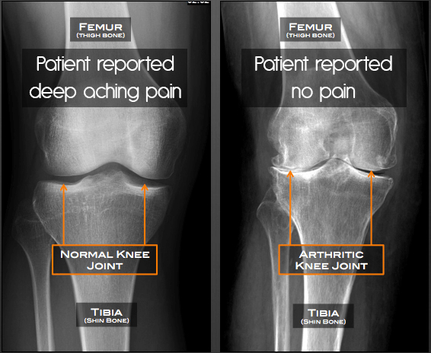
Osteoarthritis
Loss of cartilage + Disordered bone repair
Classical X-ray findings (LOSS)
L-loss of joint space
O-Osteophytes formation
S-Subchondral sclerosis
S-subchondral cysts

Slide 5
OA-presentation
Most common arthritis
F>M
Obesity
Mainly in large weight bearing joints (knees, Hips)
Joint pain, worse with movement
Stiffness on rest
Limited joint movement
Bone swelling in fingers (HD Blue picture)
Heberden
Bouchard

Slide 6
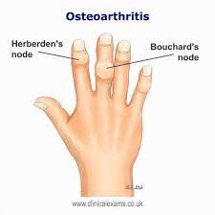
OA-presentation

Slide 7
Treatment
Biological
Paracetamol (work up the analgesics ladder)
Cortisol injections
Joint replacement
Social
Weight loss (needed before surgery)
Lifestyle advice

Slide 8
Rheumatoid arthritis
Autoimmune disease
Symmetrical, deforming, peripheral polyarthris
F 3X>M
X-ray findings (LOES)
Loss of joint space
Osteopenia
Erosion of bone
Swelling of soft tissues

Slide 9
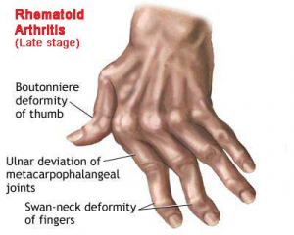
RA-presentation
Pain in affected joints
Deformities of hand
ulnar deviation
Swan neck
Boutenniere deformity
Morning stiffness >30mins
Systemic presentations
scleritis, pleural effusions, pericarditis

Slide 10
RA
Diagnostic criteria (RF RISES)
- Rheumatoid factor positive
- Finger/hand/wrist involvement
- Rheumatoid nodules present
- Involvement of ≥ 3 joints
- Stiffness in the morning for > 1 hour
- Erosions seen on X-Ray
- Symmetrical involvement
More than 6 weeks, More than 4 of the above
X-ray
Bloods
RF (highly sensitive)
Anti-ccp (more specific)
ESR

Slide 11
Treatment
Methotrexate (to be given with folate)
DMARDs
Steroids
Biologics (TNF a blockers: Infliximab, B cell inhibitors: Rituximab)
NSAIDS, Opioids for pain management
Felty syndrome
rheumatoid arthritis, splenomegaly, granulocytopenia

Slide 12
Osteoporosis
↓ bone mass/density and micro-architectural deterioration
↑ in bone fragility and susceptibility in fracture
Causes
Endocrine (Cushing’s, Parathyroid)
Haematology (Myeloma)
GI (Malabsorption)
Iatrogenic (use of steroids)

Slide 13
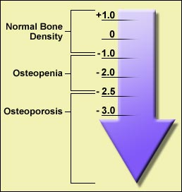
Presentation/Diagnosis
Not clinically apparent until a fracture occurs
DEXA scan (T-score)
Risk assessment
FRAX
Qfracture

Slide 14
Treatment
Medical
bisphosphonates (oral alendronate/ IV zolendronate)
Monoclonal anitbody (denosumab)
HRT
Social
Lifestyle advice (quit smoking and alcohol)
Calcium and Vit D

Slide 15
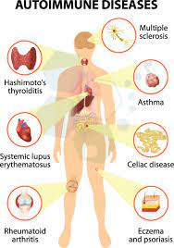
Lupus (SLE)
Inflammatory, multisystem autoimmune disorder with arthralgia and rashes
Female 9X >M
Peak 20-40 y.o.
Type III hypersensitivity

Slide 16
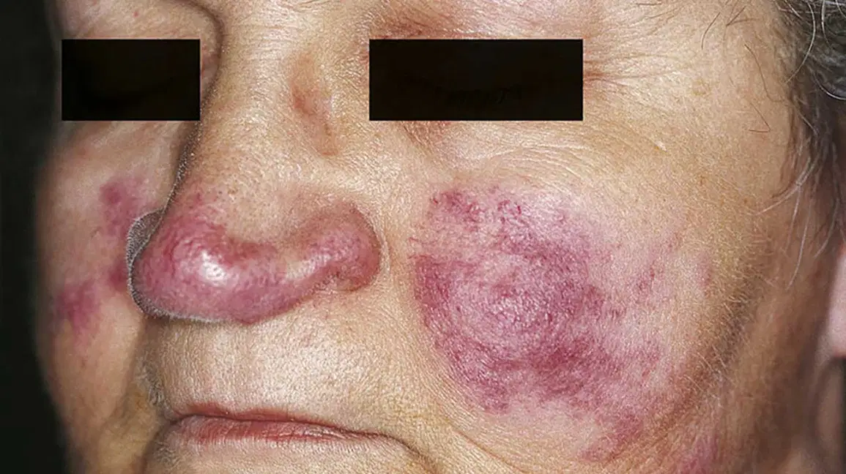
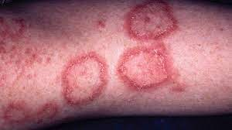
Presentation
Joint pain
Skin - malar rash, discoid rash, photosensitive rash
Serositis - Scleritis, Pericarditis, Pleuritis, Oral ulcers
Kidneys - Glomerulonephritis with proteinuria
CNS - depressions ,psychosis

Slide 17
Diagnosis/Treatment
Bloods - ESR/CRP
ANA, Anti-dsDNA, Serum C3 and C4
Steroids
Hydroxychloroquine
Methotrexate

Slide 18
Antiphospholipid
Antibody-mediated acquired thrombophilia characterised by thrombosis (arterial or venous) and/or recurrent miscarriages
Associated with SLE in 20-30%
Signs & Symptoms
Coagulation defects
Livedo reticularis
Obstetric issues
Thrombocytopenia

Slide 19
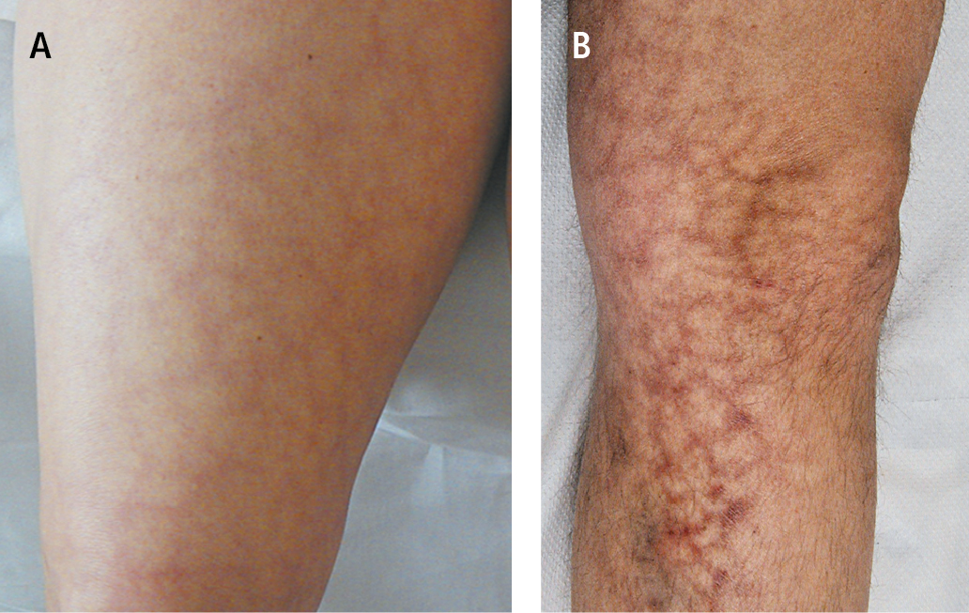

Slide 20
Diagnosis/Treatment
Diagnostic criteria (≥ 1 clinical + ≥ 1 lab)
Clinical criteria: Vascular thrombosis, Pregnancy morbidity
Lab Criteria: anticardiolipin antibody, Lupus anticoagulant, Anti-Beta 2 Glycoprotein 1 antibody
Lifestyle
aim to prevent CVS issues (avoid smoking, more exercise, healthy diet)
Blood clots (anticoagulate with heparin)
Chronix (Warfarin)
Pregnancy (heparin and aspirin)

Slide 21
Sjogren's
Chronic inflammatory autoimmune disorder
- immunologically mediated destruction of epithelial exocrine glands, especially the lacrimal and salivary glands
Signs & symptoms
Dry eyes, mouth, Parotid gland enlargement
Joint pain
Raynauds
Systemic features
Associated with RA, SLE, PBC, Scleroderma

Slide 22
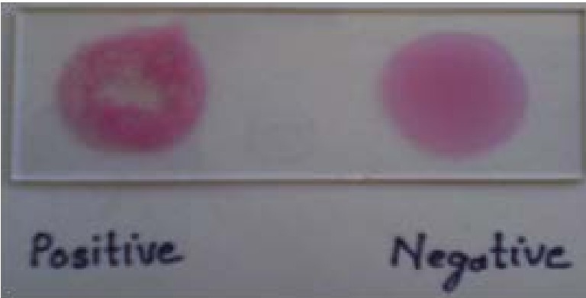
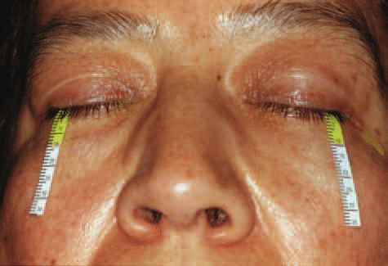
Diagnosis/Treatment
Schirmer tear test
Rose Bengal staining and slit lamp exam
Rheumatoid factors, ANA, Anti-Ro, Anti-La
Lifestyle - Humidifier, Eye drops, Mouth wash
Medications - NSAID, Hydroxychloroquine
M3 agonist - pilocarpine

Slide 23
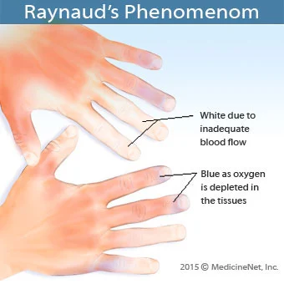
Raynauds phenomenon
Intermittent spasm in the arteries supplying the fingers and toes usually precipitated by cold and relieved by heat
Associated with SLE, Systemic sclerosis, RA, dermatomyositis
Can also be caused by vibrational tools, smoking, use of Beta blockers

Slide 24
Treatment
Lifestyle - protect the hands, stop smoking
Medications - CCB

Slide 25
Systemic sclerosis
Multisystem autoimmune disease in which there is increased fibroblast activity (↑ collagen deposition), resulting in abnormal growth of connective tissue.
Highest case specific mortality of any autoimmune rheumatic diseases

Slide 26
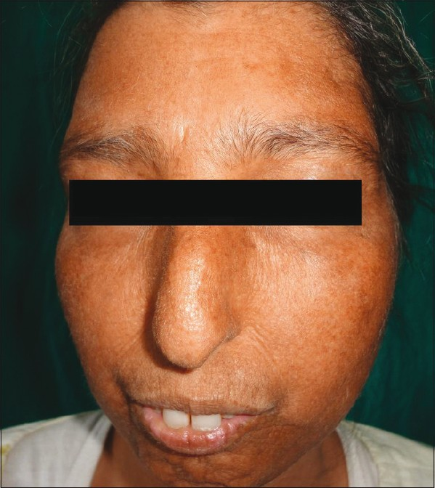
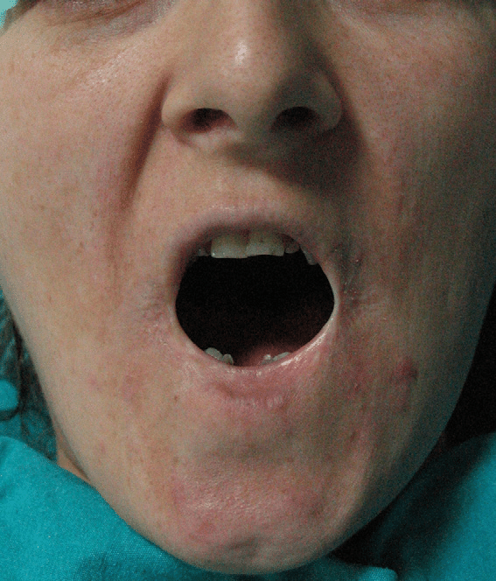
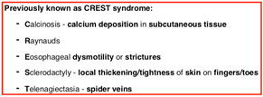
Signs and Symptoms
Limited
skin involvement limited to hands, face, feet and forearms
characteristic ‘beak’-like nose and small mouth
Microstomia

Slide 27
Sign and symptoms
Diffuse
skin changes develop more rapidly and are more widespread
Raynaud’s phenomenon coincident with skin involvement
GI, Renal, Lung involvement

Slide 28
Diagnosis/Treatment
Limited - ACAs
Diffuse - Anti-topoisomerase, Anti scl-70
ANAs
ESR (normal)
If renal involvement, there may be anemia
Lifestyle - avoid smoking, handwarmers
Medications -
GI - PPIs, Antibiotics
Renal - ACEi
Pulmonary fibrosis - cyclophosphamide

Slide 29
Poly/dermato myositis
Polymyositis is a RARE muscle disorder of unknown aetiology in which there is inflammation and necrosis of skeletal muscle fibres
Dermatomyositis is poly + skin involvement

Slide 30
Signs and Symptoms
Polymyositis
symmetrical progressive muscle weakness and wasting affecting the proximal muscles of the shoulder and pelvic girdle
- pain and tenderness are uncommon
- can lead to respiratory failure if respiratory muscles involved
Dermatomyositis
heliotrope (purple) discoloration of eyelids
Scaly erythematous plaques over the knuckles
arthralgia, dysphagia resulting from oesophageal muscle involvement and Raynaud’s phenomenon

Slide 31
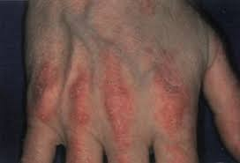
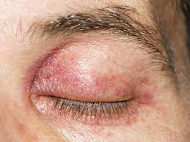

Slide 32
Diagnosis/Treatment
Muscle Biopsy
Bloods
serum creatine kinase, aminotransferases, lactate dehydrogenase and aldolase all ↑
Immunology
ANA, Anti jo1, anti mi2
Oral prednisolone
Stronger Immunosuppresssants
Symptomatic treatment of skin disease

Slide 33
Paget’s
localized disorder of bone remodelling
↑ osteoclastic bone resorption followed by ↑ formation of weaker bone
Leads to structurally disorganized mosaic of bone (woven bone)
incidence ↑ with age, rare under 40 y.o
- affects up to 10% of individuals by the age of 90

Slide 34
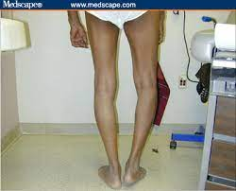
Signs and symptoms
60-80% are asymptomatic, minority will have various symptoms;
- bone pain
- joint pain
- deformities, in particular bowed tibia and skull changes
- neurological complications
- nerve compression of 8th cranial nerve causing deafness
-blockage of aqeuduct of sylvius causing hydrocephalus

Slide 35
Diagnosis/Treatment
Bloods - Increased ALP, normal calcium and phosphate
Urinary hydroxyproline increase
X-rays - Findings of osteoarthritis
Bisphosphonates, NSAIDS

Slide 36
Osteomalacia
Defective mineralization of newly formed bone matrix or osteoid in adults, due to inadequate phosphate or calcium, or due to ↑ bone resorption (hyperPTH)
Rickets - defective mineralization at epiphyseal growth plate aka osteomalacia in children
Causes
malnutrition (most common)
drug induced
defective 1-alpha hydroxylation
Liver disease

Slide 37
Signs and Symptoms
Osteomalacia
widespread bone pain and tenderness
gradual onset and persistent fatigue
muscle weakness, parasthesia, waddling gait
fractures
Rickets
leg-bowing and knock knees
- tender swollen joints
- growth retardation
- bone and joint pain
dental deformities – delayed formation of teeth, enamel hypoplasia
- enlargement of end of ribs (‘rachitic rosary’)

Slide 38
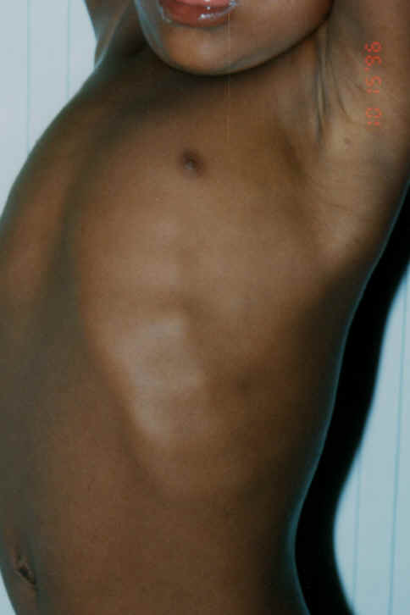

Slide 39
Diagnosis/treatment
Bloods - U&Es, Serum ALP, Vit D
X-rays - defective mineralisation, rachitic rosary
Lifestyle - nutrition, sunlight
Medications - Vit D replacement
Malabsorption/Renal disease - IM calcitriol

Slide 40
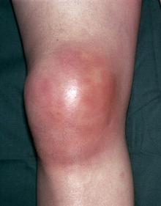
RED HOT SWOLLEN JOINTS
Notes:
what are the differentials?
how to differentiate septic arthritis and gout clinically ?

Slide 41
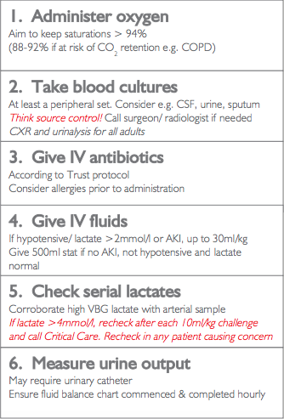
Septic Arthritis
LIFE THREATENING
40 year old man rushed into A&E with a juicy red hot swollen joint. He has cold peripheries and is confused with the following readings
T: 40 degrees
HR: 140 bpm
RR: 30
What would you like to do?
Notes:
For hot joints - add on a joint aspiration
Give 3 take 3
Treatment - Abx specific to bacteria & supportive

Slide 42
Causes & Risks
IVDU
Immunocompromised
Intra-articular injections
Common Bugs:
S. Aureus
Neisseria Gonorrhoea
Gram -ve Bacteria - E. Coli
Haemophilus Influenza (specific for kids)

Slide 43
Treatment

Slide 44
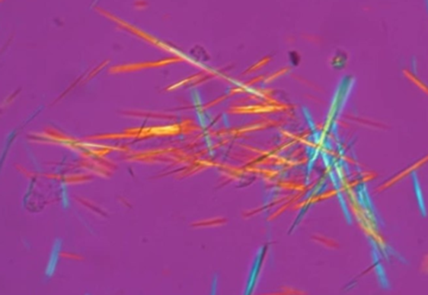
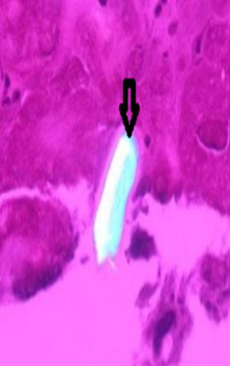
Hyperuricaemia
Pseudogout = Positive Birefringent
Ca Pyrophosphate
Gout = Negatively Birefringent
Monosodium Urate

Slide 45
How it works
Notes:
Uric Acid formation ⇒ Production > Excretion - renals

Slide 46
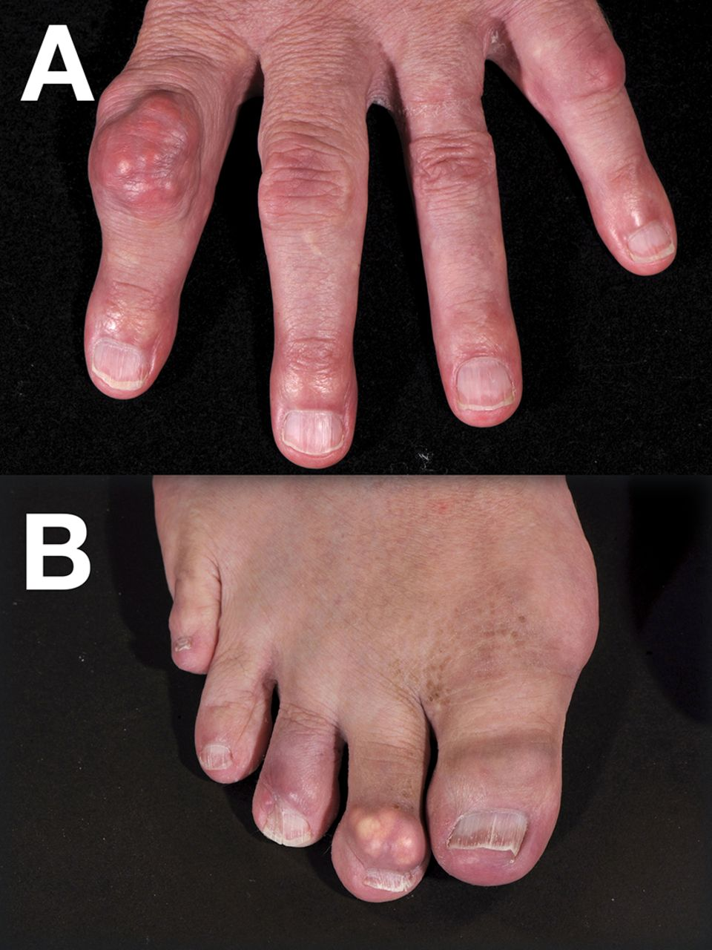
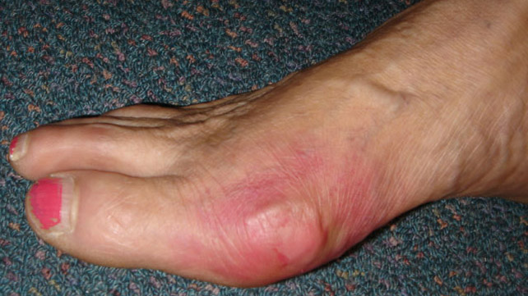
How it works
Build up of uric acid → ppt as uric acid crystals (MU)
→ deposits in joint spaces
causing inflammation!

Slide 47
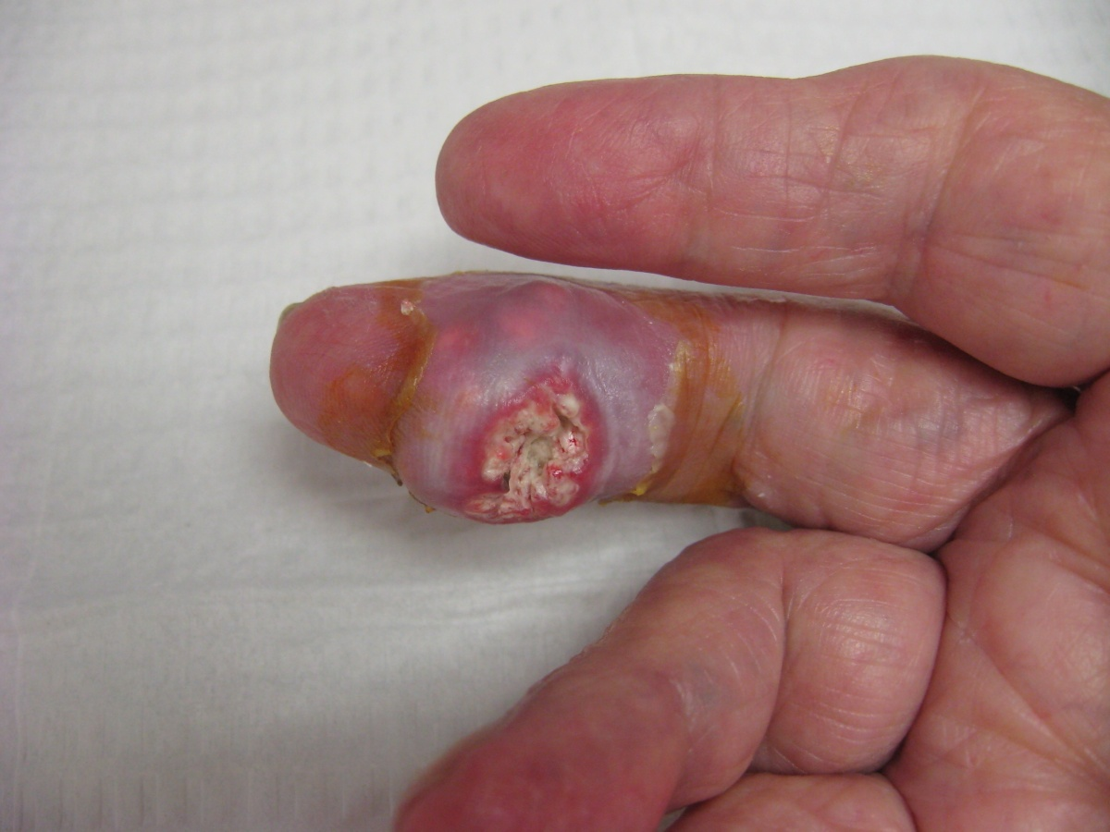
Tophi Gout
Notes:
Takes 10 years from the first attack for tophi to develop

Slide 49
Hyperuricaemia
Definition: > 420 µmol/L (M)/ 360 µmol/L (F)
How would they present?
Asymptomatic
1 in 5 will develop gout
Notes:
asymptomatic

Slide 50
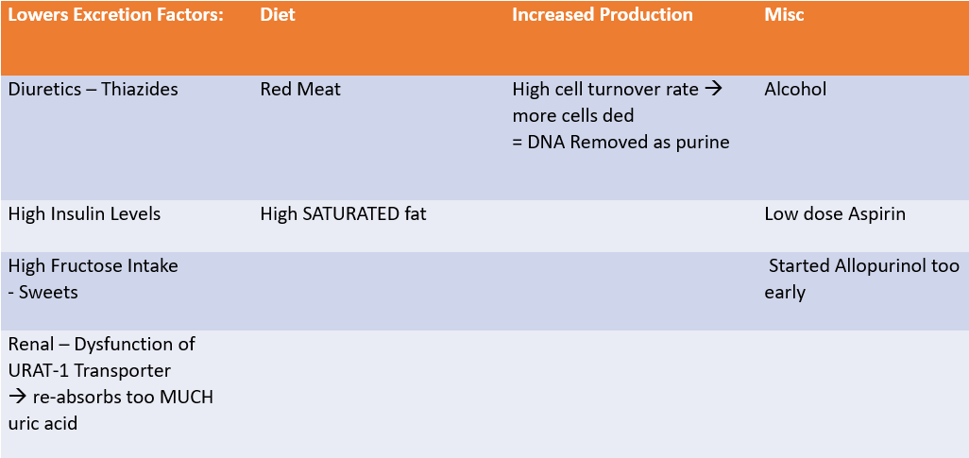
Causes & Risks
Notes:
Structure:
Congenital / Genetics
Infection
Inflammatory
Trauma
Iatrogenic
Miscellaneous - Lifestyle / DIet / Alcohol / Smoking

Slide 51
Sx
Ix
Red, Hot joint
Painful
Swollen
Acute onset
Most common joint:
Big Toe
Midfoot, ankle, knee, wrist
1st Line:
Bloods
Gold standard: Joint aspiration
U&E + eGFR - Renal Fx
Uric Acid Levels & 4-6 weeks after to confirm HyperUricaemia
Notes:
However, testing for urate crystals in joint fluid or tophi is often not practical.

Slide 52
Management Plan
ACUTE
1st Line:
NSAIDs or Colchicine
2nd Line: Intra-articular Steroid Injection
Lifestyle Advice
CHRONIC
1st Line:
Allopurinol - inhibit Xanthine Oxidase
2nd Line: Febuxostat
Notes:
First line is dependent on other co-morbidities / drug interactions
Lifestyle - weight loss, exercise, diet, alcohol consumption, and fluid intake.
Consider co-prescribing colchicine w allopurinol - for 6 mths

Slide 53
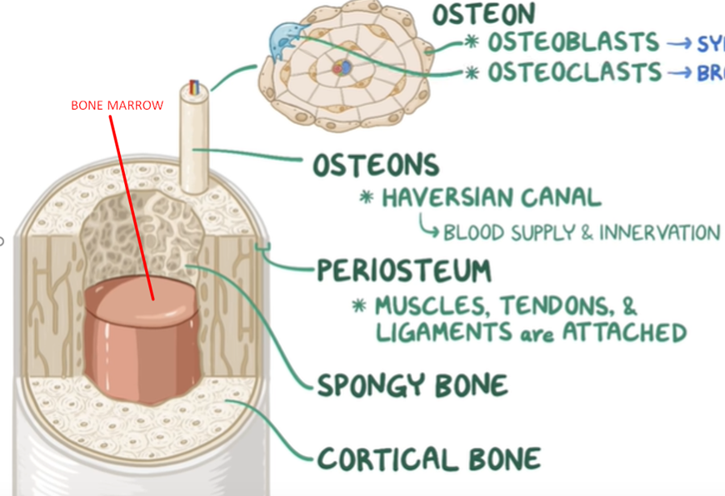
Osteomyelitis
Infection of bone marrow
3 main ways of entry
haematogenously
open wound
contiguously: Skin into blood
Notes:
Can be bacterial / viral

Slide 54
Case
24 year old came in with high fevers, malaise and pale peripheries. He has a record of being an IVDU. He mentioned using a needle he found on the streets for his last drug abuse. You suspect sepsis.
What would you like to do?
Sepsis 6
Bone Biopsy
Joint X Ray - determine severity of dmg
Notes:
sepsis 6

Slide 55
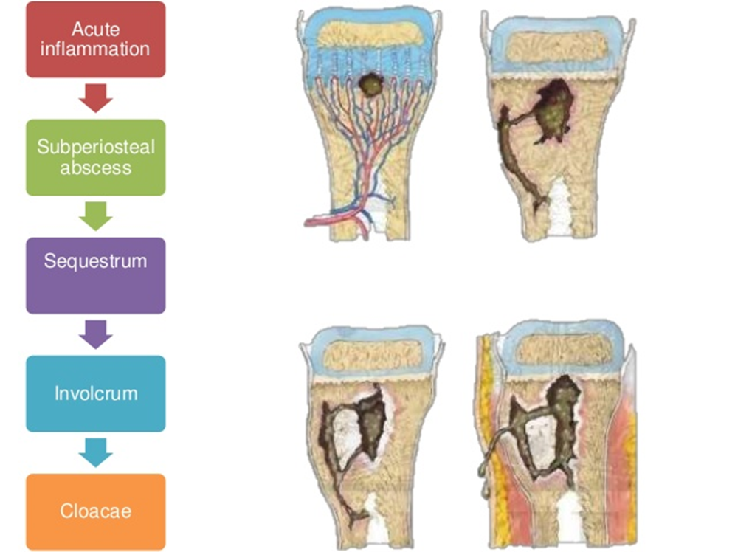
Notes:
sequestrum - necrotic bone within the pus
Involcrum – new bone surrounding sequestrum
Cloacae - opening to allow dead bone and pus to come out

Slide 57
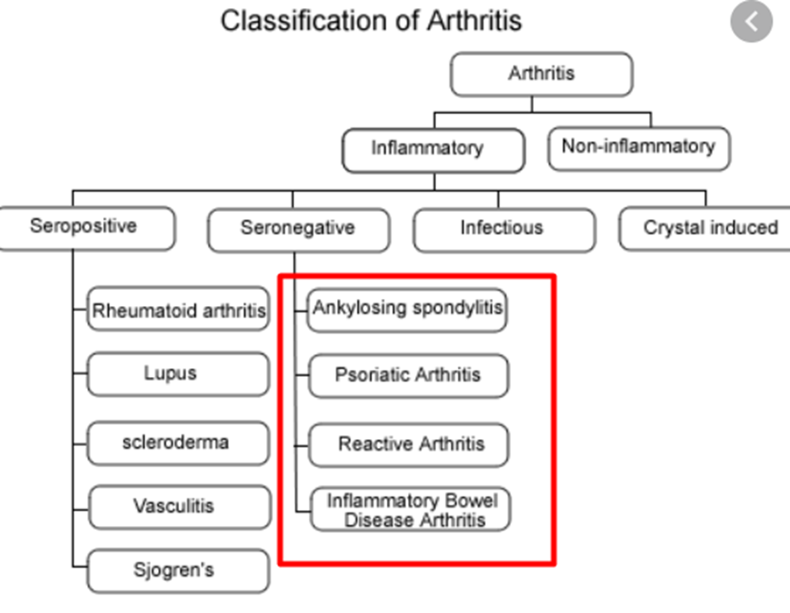
Seronegative Spondyloarthropathies
Umbrella Term for conditions w these similar features
1 Axial Inflammation
2 Asymmetrical Peripheral Arthritis
3 Seronegative = NO RHEUM FACTOR
4 HLA B27 association

Slide 58
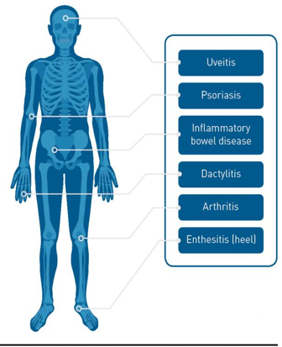
Presentation - SPINACHEE
Sausage DIgits
Psoriasis
Inflammatory Back Pain
NSAIDs - good response
Arthritis
Crohn’s Disease
HLA B27
Eye - Uveitis
Enthesitis

Slide 59
Ankylosing Spondylitis
Inflammation of sacroiliac joints
Loss of spinal movements
Ix
Bloods - HLA B27
X Ray - Bamboo Spine
X Ray
Sacroiliac Joints – eroded & sclerotic
Unclear margin btw rims
Bone spurs aka syndesmophytes
Bamboo Spine due to fusion

Slide 60
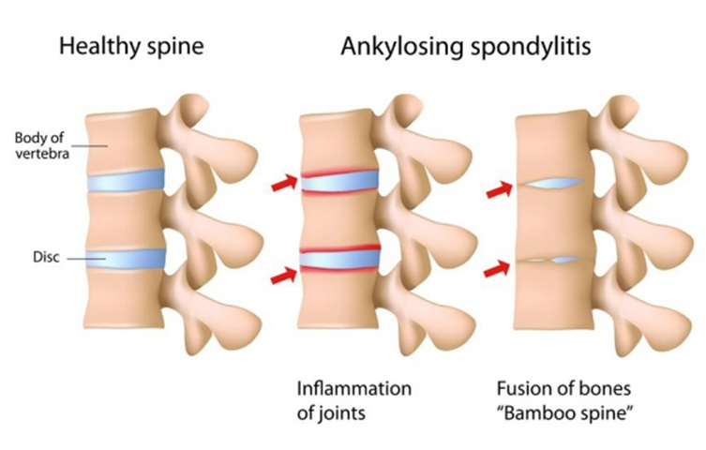
AS

Slide 61
b) Reactive Arthritis
Mainly due to infection
think about RA when someone has an active sexual hx
S&S
Can’t see - Uveitis
Can’t pee - Urethritis
Can’t climb a tree - Enthesitis

Slide 62
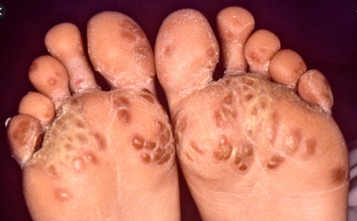
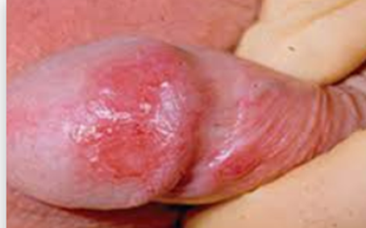
Other niche Sx
Keratoma Blennorhagica
Circinate Balanitis

Slide 63
Ix
Bloods - inflammatory markers
erythrocyte sedimentation rate (ESR)
C-reactive protein (CRP)
antinuclear antibody (ANA)
rheumatoid factor
Imaging - determine extent of damage from enthesitis

Slide 64
c) Psoriatic Arthritis
Occurs in 10-40% of people w psoriasis
S&S
Painful, swollen, stiff joints
psoriatic plaques
Dactylitis
Telescopic Fingers
What would you see on X Ray?

Slide 65
Tx for HLA B27
Supportive
Pain Management - NSAIDs or Corticosteroids
Biological Therapy - Infliximab

Slide 66
Back Pain
Hx Taking - SOCRATES
Differentials - Congenital / Trauma / Infection / Inflammation / Iatrogenic / Miscellaneous
most common:
Mechanical

Slide 67
Differentials
Congenital
Infection - osteomyelitis
Inflammation - HLA B27 / osteoporosis / Osteoarthritis / Pyelonephritis
Trauma - Fracture
Iatrogenic
Malignant - MM / Metastases
Lifestyle - posture / overuse
Notes:
PKD, Aortic ANeurysm
Prostatitis

Slide 68
Red flags for LBP
Cauda equina syndrome.
Cancer of the spine.
Spinal fracture due to trauma or osteoporotic collapse.
Spinal infection.

Slide 69
Based on differentials & red flags, Ix?
Bloods
Inflammatory markers
FBC - anaemia / WBC
ALP levels
Imaging
DEXA Scan
MRI - better at imaging bone pathology

Slide 70
Tx for mechanical back pain
Analgesia Ladder
Paracetamol
NSAIDs
Weak Opiates
Strong Opiates
Neuropathic Pain Tx - Gabapentin / Tricyclic
Other Mx Plans
Lifestyle advice
Physiotherapy

Slide 71
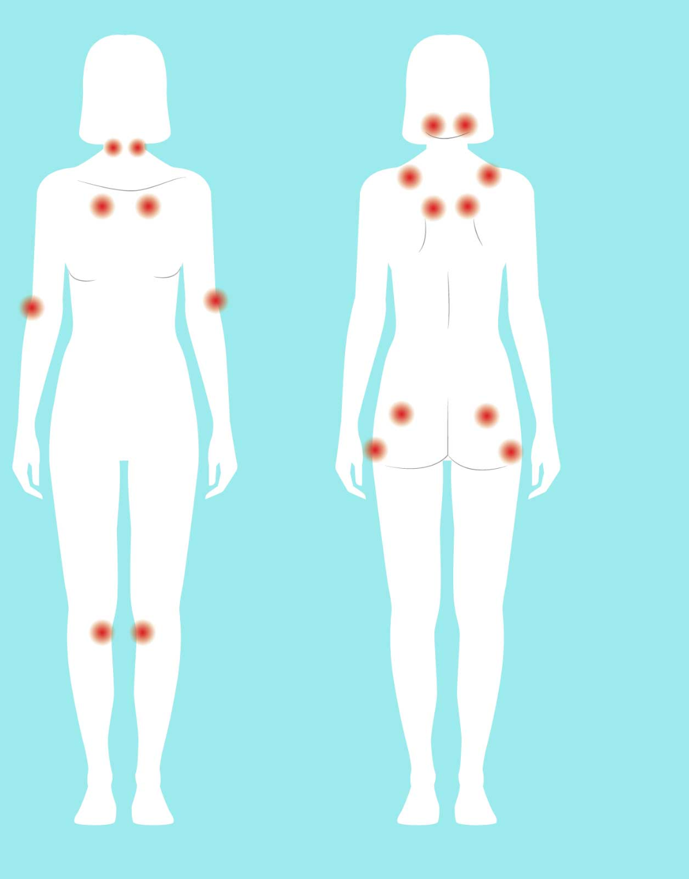
Fibromyalgia
Chronic Pain Syndrome
Widespread over body
11 out of 18 points
Female
> 3 months
No organic cause
Non-Nociceptive Pain
Notes:
nociceptive = dmg to tissue

Slide 72
Ix
Tx
Exclude all other differentials with bloods & imaging
Neuropathic Pain relief
TCA
Gabapentin
Pregabalin
Opiates

Slide 73
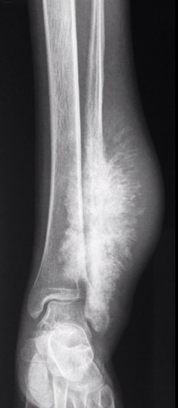
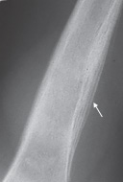
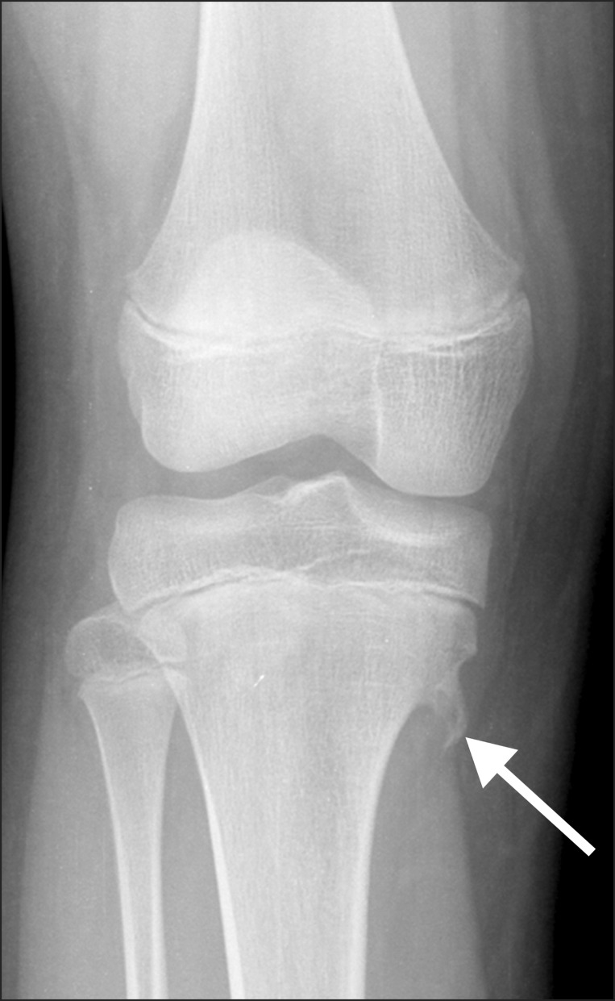
Bone Tumours
Notes:
L to R
Sunburst appearance - osteosarcoma
Onion skin changes - Ewing
Exostosis - Osteochondroma

Slide 74
Osteosarcoma
Primary bone malignancy
KIDS
metaphysis of long bones
a/w Paget’s Disease
Notes:
Tibia, fibular, femur / humerus, radius, ulna

Slide 75
Ewing Sarcoma
super rare
From mesenchymal cells
Originating from long bones as well

Slide 76
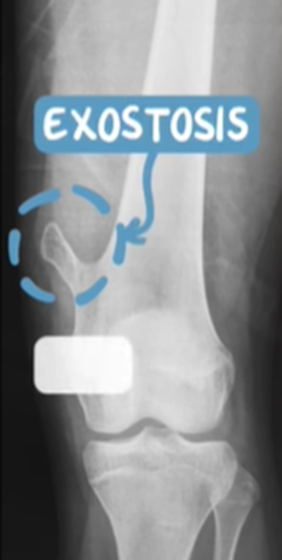
Osteochondroma
Benign
v common in M < 25yo
overproduction of bone which deposits on metaphysis

Slide 77
Secondary Bone Tumours
Prostate
Breast
Kidneys
Thyroid
Lungs
PBKTL = Lead Kettle
Brostate
Breast
Bidneys
Byroid
Bronchus
5 B’s

Slide 78
Investigations
Bloods
FBC
U&E
ALP
PSA
Imaging
X Ray - Lytic Lesions
CT Scans - metastases

Slide 79
Management
Pain Management
Bisphosphonates
Radiotherapy
Chemotherapy

Slide 80
Conclusion
Questions feel free to email -
hwtan1@sheffield.ac.uk
Rsuhailnuruddin1@sheffield.ac.uk
The Peer Teaching Society is not liable for false or misleading information…

Slide 81
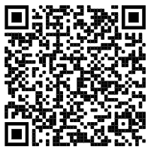
Feedback
https://docs.google.com/forms/d/e/1FAIpQLSf64bHCmikSnTlA6fz27T9dwn8x0_8Zzs3JSPXjDY5OZK1lAg/viewform?usp=sf_link
The Peer Teaching Society is not liable for false or misleading information…

