Slide 1
2021/2022

Slide 2
OSCE Cardiovascular
Phase 3a Revision Session
Hasnain Khan and Tara Iyadurai
26/07/21

Slide 3
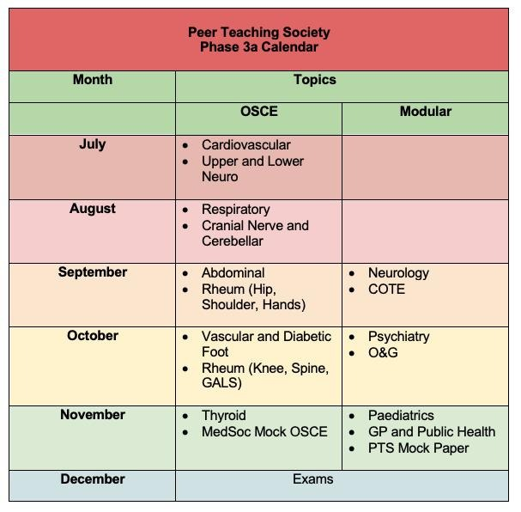

Slide 4
July and August Timetable
Only OSCE, all 6:30-8pm;
Today- Cardiovascular
29/07/21- Upper and Lower Neuro
26/08/21- Cranial Nerve and Cerebellar
01/09/21- Respiratory

Slide 5
Content
Steps to perform a Cardiovascular Examination
History-taking
Chest pain
Breathlessness
Syncope
Communication Skills
Q-Risk
CHAD2VASC
Quiz
The Peer Teaching Society is not liable for false or misleading information…

Slide 6
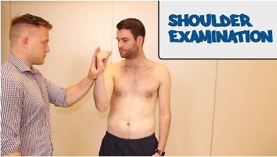
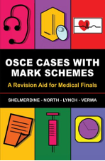
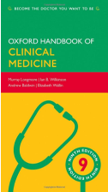
Revision Tips
•Past exams and mark schemes
•GEEKY MEDICS
•Go to as many mock OSCE’s as you can
•Get the books = Majeeds, OSCE cases with mark schemes (multi-coloured one), Macleod’s, Oxford Handbook (only core conditions)
•Get a revision group going
•Briefly go over the core conditions
•Make a list of common questions for each of the categories of conditions (e.g. cardio = chest pain, breathlessness, etc)

Slide 7
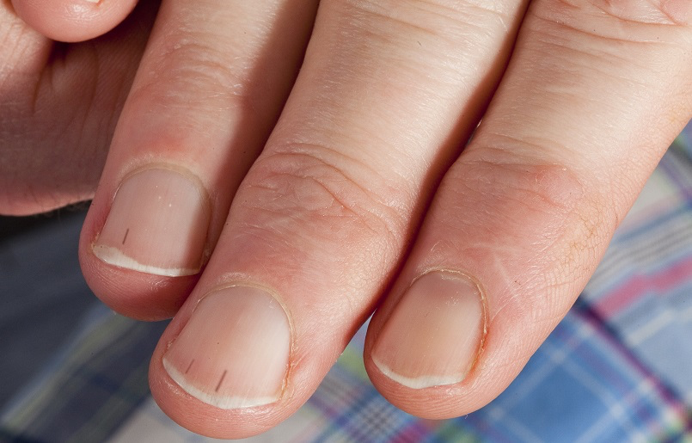
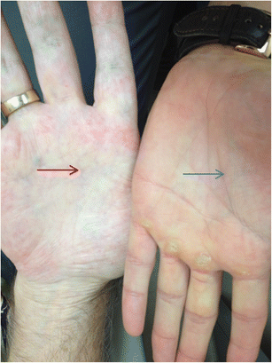
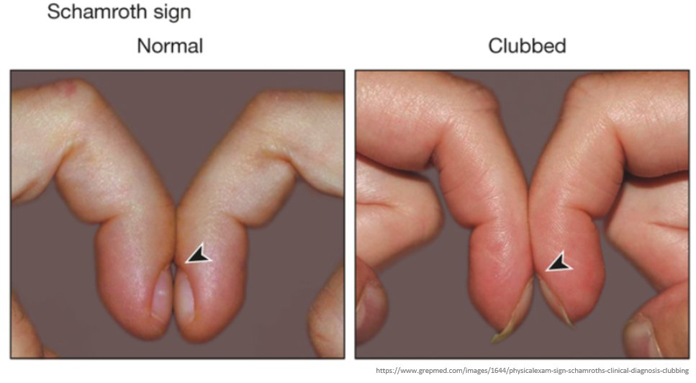
Cardio Exam - Tara
Introduce yourself
Identify the patient
Informed consent - offer chaperone
General inspection - bedside, wheelchairs, o2 cylinder
Look at patient
LOOK, FEEL, LISTEN!!!!!!

Slide 8
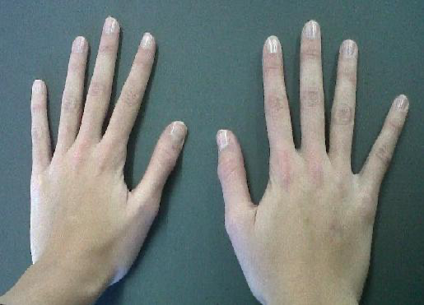
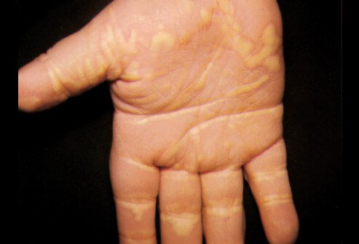
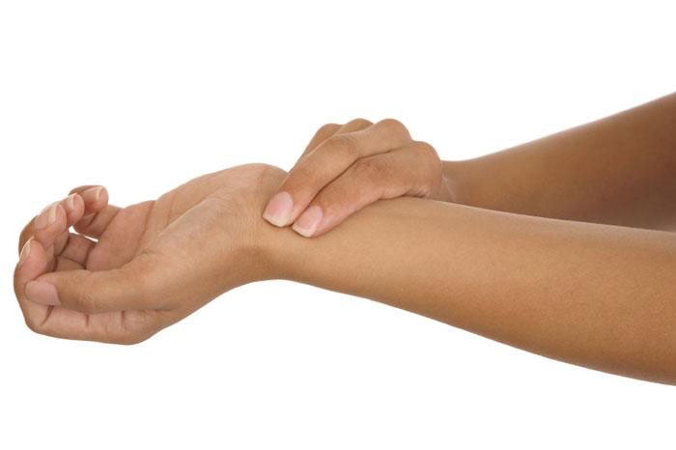
More hands...

Slide 9
Moving up....

Slide 10
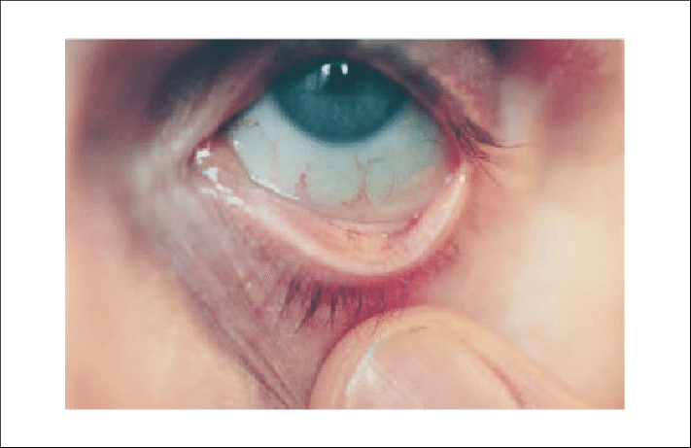
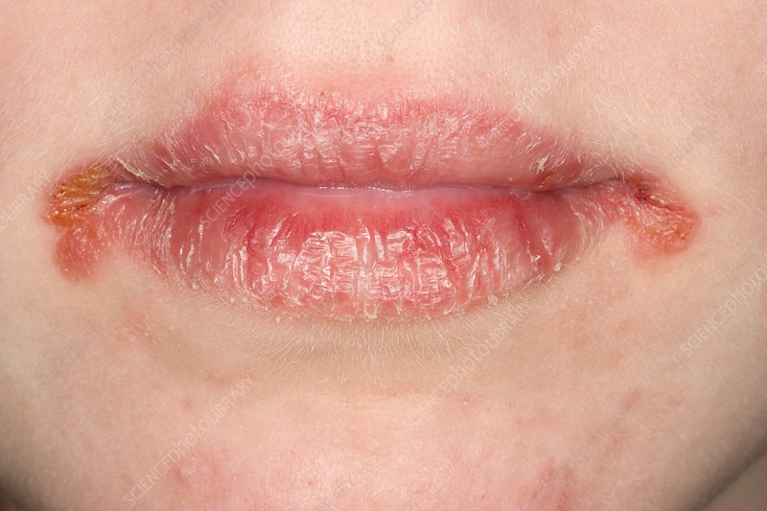
Up to the face...

Slide 11
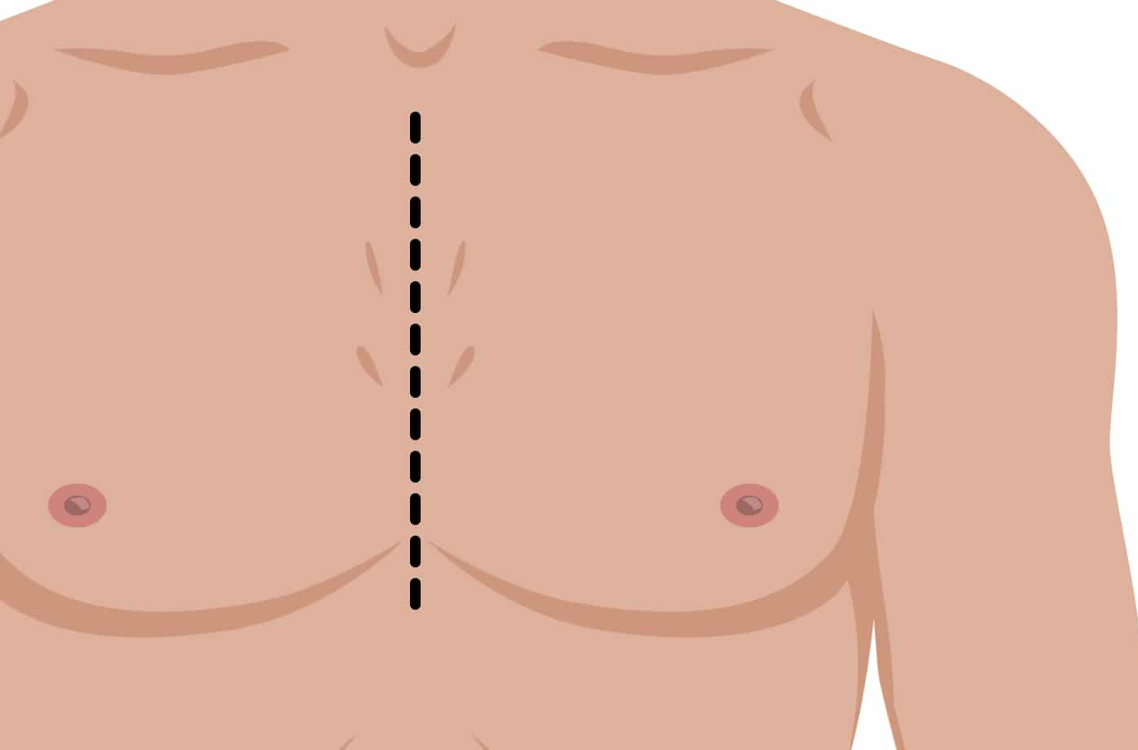
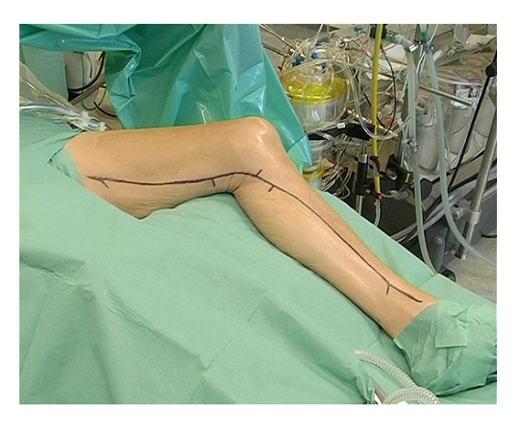
Onto the chest...
Remember to check for harvest sites!

Slide 12
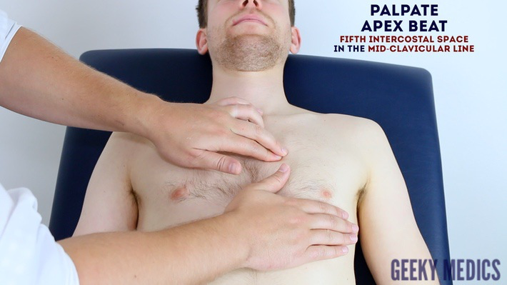
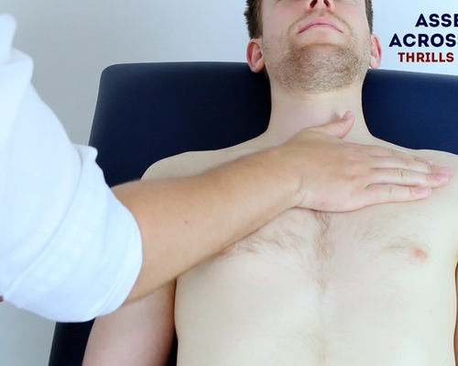
Feel and listen

Slide 13
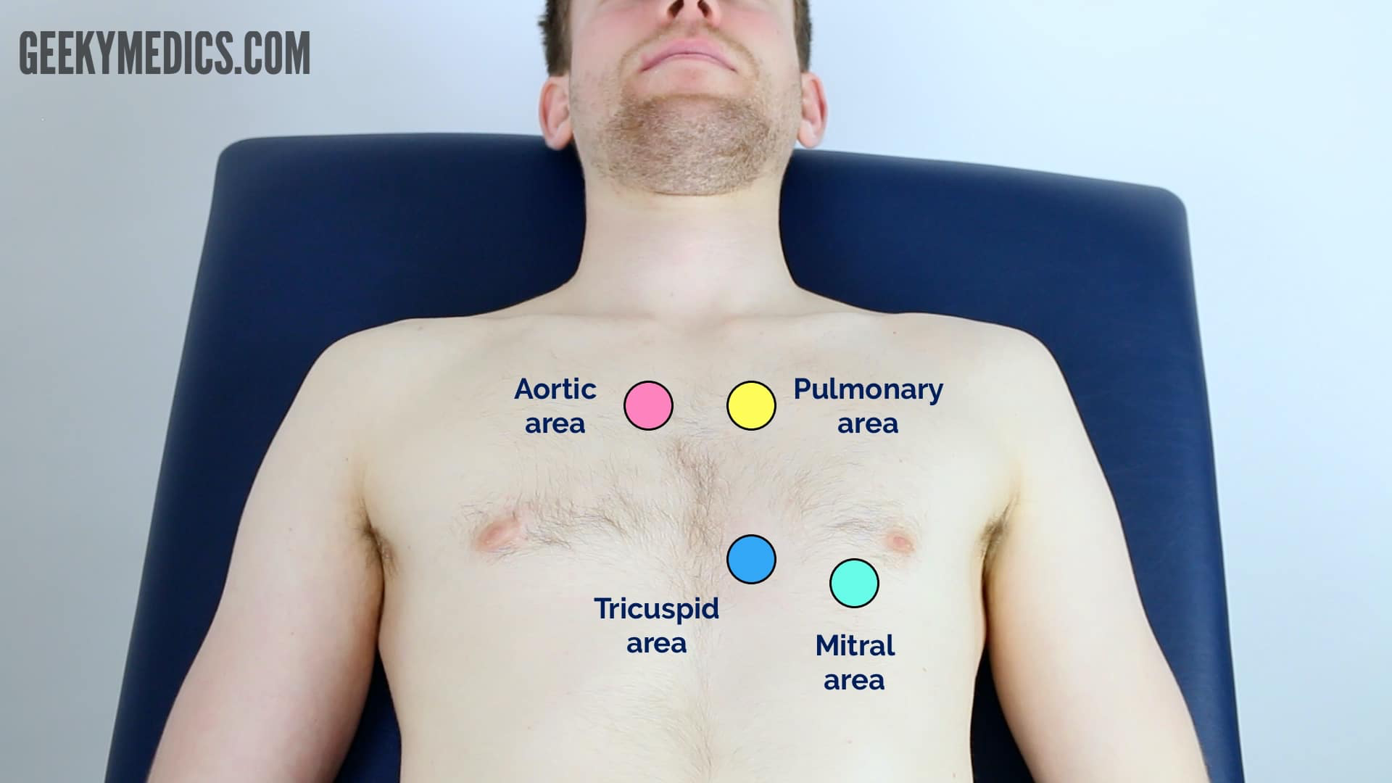
Time to get that Littman out...

Slide 14
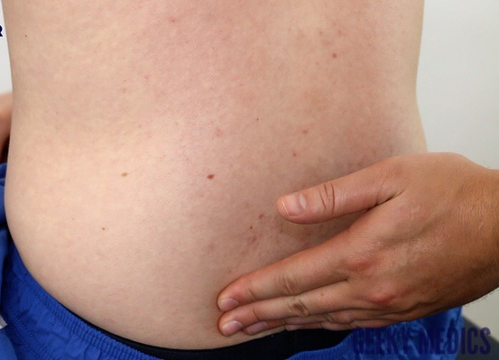
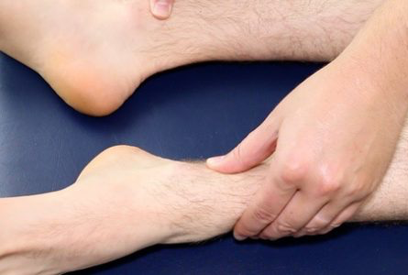
And finally onto the last things...

Slide 15
Let’s summarise
Say it’s the end of the examination
Thank the patient
Now summarise to the examiner

Slide 16
Summarising con’t
Today I examined Mrs Smith, a 64-year-old female. On general inspection, the patient appeared comfortable at rest and there were no objects or medical equipment around the bed of relevance.”
“The hands had no peripheral stigmata of cardiovascular disease and were symmetrically warm, with a normal capillary refill time.”
“The pulse was regular and there was no radio-radial delay. On auscultation of the carotid arteries, there was no evidence of carotid bruits and on palpation, the carotid pulse had normal volume and character.”
“On inspection of the face, there were no stigmata of cardiovascular disease noted in the eyes or mouth and dentition was normal.”
“Assessment of the JVP did not reveal any abnormalities and the hepatojugular reflux test was negative.”
“Closer inspection of the chest did not reveal any scars or chest wall abnormalities. The apex beat was palpable in the 5th intercostal space, in the mid-clavicular line. No heaves or thrills were noted.”
“Auscultation of the precordium revealed normal heart sounds, with no added sounds.”
“There was no evidence of peripheral oedema and lung fields were clear on auscultation.”
“In summary, these findings are consistent with a normal cardiovascular examination.”
“For completeness, I would like to perform the following further assessments and investigations.”

Slide 17
Further investigations
Suggest further assessments and investigations to the examiner:
Measure blood pressure: to identify hypotension, hypertension or significant discrepancies between the two arms suggestive of aortic dissection.
Peripheral vascular examination: to identify peripheral vascular disease, which is common in patients with central cardiovascular pathology.
Record a 12-lead ECG: to look for evidence of arrhythmias or myocardial ischaemia.
Dipstick urine: to identify proteinuria or haematuria which can be associated with hypertension.
Bedside capillary blood glucose: to look for evidence of underlying diabetes mellitus, a significant risk factor for cardiovascular disease.
Perform fundoscopy: if there were concerns about malignant hypertension, fundoscopy would be performed to look for papilloedema.

Slide 18
History Taking
•Out of 25
•3 marks come from patient
•2 marks for a coherent history
•1 mark for introducing yourself (and asking the patient name and DOB)
•1 mark for washing / fake washing your hands!
•1 mark for family history
•1 mark for the social history usually (smoking, alcohol intake, etc)
•1 mark for drugs and allergies
And then marks for various relevant questions in relation to the presenting complaint and history of presenting complaint. In some histories there are really specific questions which you will just never get / even think of – literally don’t worry about these, as long as you get the main ones!

Slide 19
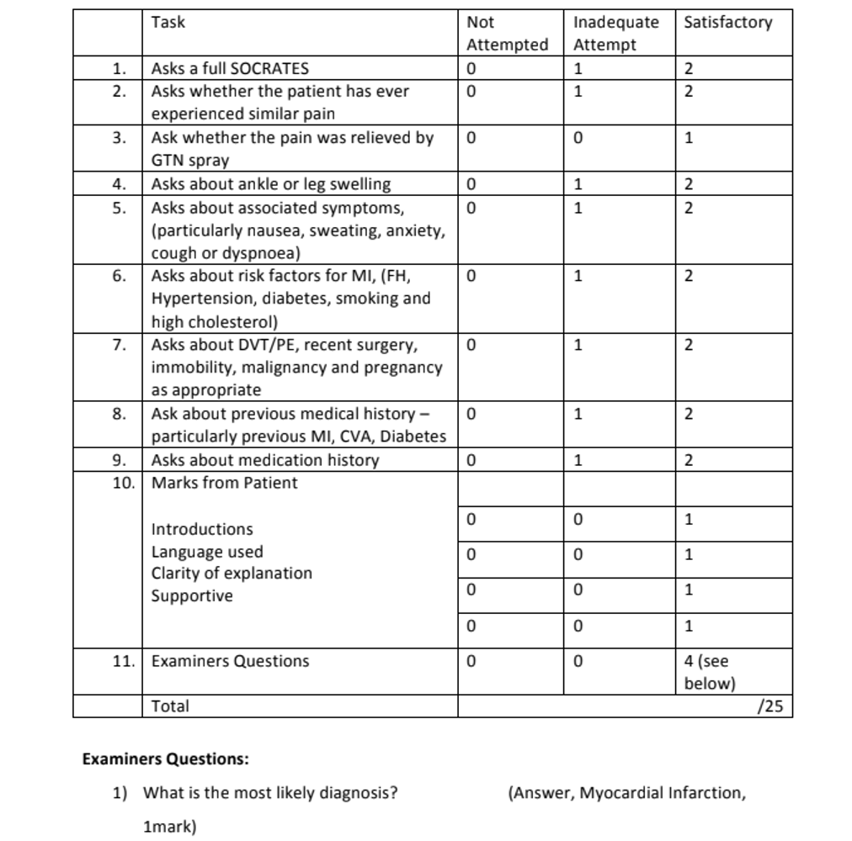
Example of Mock OSCE Mark Scheme

Slide 20
Chest Pain
SOCRATES
Site
Where is it?
Can you point to it?
Onset
How and when the symptoms developed
Gradual or sudden?
When did it start? How long have you had it for?

Slide 21
Chest Pain cont
Character
Describe the pain (dull ache, throbbing, sharp)
Constant or come and go?
Radiate
Spread? Arm, back or neck?
Associated symptoms
Cardio- falls/faint
Resp- breathlessness, dyspnoea, cough
GI- dyspepsia, N+V
Systemic- fever, weight gain, fatigue, trauma
Time course
How has it changed over time?
Exacerbating Factors
Anything make it better or worse (exertion, lying flat/leaning forward)

Slide 22
Chest Pain cont.
PMHx: CVD Risk Factors
HTN
Hyperlipidaemia
DM
Social Hx
Exercise, weight
Family Hx
Cardiovascular diseases
Drug Hx
Smoking, Alcohol, Illicit substances
ICE

Slide 23
Differentials for Chest Pain
Cardiovascular
ACS: MI and Angina
Aortic Dissection
Arrhythmia
Pericarditis
Resp
COPD
Pneumothorax
PE
Pneumonia
GI
GORD
Peptic Ulcer
MSK
Mechanical
Trauma/Injury
Other
Anxiety

Slide 24
Dyspnoea
Onset
How long?
Constant or comes and goes?
Character
Unable to do things
Associated Symptoms
Cardio: chest pain, palpitations
Resp: wheeze, cough
Other: oedema, fever
Time course
How has it progressed?
Exacerbating Factors
Exertion
Sleeping arrangements

Slide 25
Dyspnoea cont.
PMHx: Risk Factors
Cardio: HTN, Hyperlipidaemia, DM, HF
Resp: Asthma, COPD
Social Hx
Exercise, weight
Family Hx
Cardiovascular or Respiratory diseases
Drug Hx
Smoking, Alcohol, Illicit substances
ICE

Slide 26
Differentials Syncope
 | Seizure | Syncope | NEAD
Trigger | Flashing Lights, Hyperventilation | Anxiety, Pain | Stress, Hx Mental Health Generally not occur when alone
Prodrome |  | Slow, flaccid, faint Nausea and sweating
Onset | Sudden | Gradual | Gradual
Duration | 1-30s | 1-3mins
Ictal |  | Read notes | Pelvic Thrusting Sudden stop Isolated clonic movement
Incontinence | Uncommon | Common | None
Tongue Bite | Rare | Common | None
Colour | Pale, blue | Pale, flushed, Cold skin
Post-ictal | Prolonged | Prolonged | Quick Crying

Slide 27
Syncope
Onset
Gradual or sudden
Character
Prodrome/Aura, Ictal and Post-ictal, Video?
Associated symptoms
Incontinence, Tongue-biting, Colour of skin
Time course
How long was each phase
Exacerbating Factors
Triggers

Slide 28
Communication Skills
Assessment of Chronic Condition | Risk Assessment
INR | Q-Risk**
HbA1c | CHA2DS2-VAS**
Peak Flow | FRAX
Spirometry | ABCD2
CRP | Wells Score
ESR | Diabetes Risk
LFT

Slide 29
Tips for Communication Skills
Treat them as a normal history
HPC, PMHx, FHx, SHx, DHx, ICE
Try and integrate the questions into your history

Slide 30
Risk Assessment History
Do the 3 I’s (Introduce, Identify and Informed Consent)
‘I have been told that you have experienced … and have been asked to check your risk of getting … This is a routine procedure we do to help reduce your risk. I’m going to ask some questions about yourself to have an idea about what’s going on and possibly give some changes to your life to help reduce your risk’

Slide 31
Assessment of Chronic Disease History
Do the 3 I’s (Introduce, Identify and Informed Consent)
‘I am aware you have a diagnosis of … and you have had some blood samples taken.’
‘Are you aware of … and how we use it.’
If they are not aware, explain in simple terms and why it is important to monitor
‘From looking at your results they are higher/lower than expected. I’m going to ask you a few questions to understand the reason for this and discuss changes to your lifestyle to help improve your results’

Slide 32
Q-Risk
Risk of having a heart attack or stroke over the next 10 years
Personal History | Past Medical History | Other
Age Sex Ethnicity BMI Postcode | CKD (stage 4 or 5) Atrial fibrillation Rheumatoid arthritis Diabetic status | Existing hypertension treatment Angina or MI in 1st degree relative <60 Smoking status Cholesterol Systolic BP

Slide 33
History Taking
Personal History
•Age
•Sex
•Ethnicity
•BMI- height (cm) and weight (kg)
•Postcode
•HDL/Cholesterol Ratio
•BP
HPC
•Symptoms of MI and Stroke
PMHx
•CKD- what stage
•AF
•RA
•Diabetes Mellitus
Drug Hx
•HTN Medication
•Family Hx
•Angina/MI/Stroke in family relatives <60
Social Hx
•Smoking

Slide 34
CHA₂DS₂- VASc score
Risk of stroke in patients with AF
C | Congestive HF | 1 point
H | Hypertension | 1 point
A₂ | Age >75 | 2 points
D | Diabetes | 1 point
S₂ | Stroke/TIA history | 2 points
V | Vascular disease | 1 point
A | Age 65-74 | 1 point
S | Sex (female) | 1 point

Slide 35
History Taking
Personal Information
•Age
•Sex
HPC
•Leg swelling- when is it better or worse
•Chest pain
•Pink frothy sputum
PMHx
•Congestive Heart Failure- but they will say no
•Hypertension
•Diabetes
Vascular Disease
•Stroke/TIA Hx

Slide 36
Feedback
Once you have filled the feedback form, download Kahoot to do our quiz!
Notes:
https://forms.gle/MaAXxBmK5Kxobwxh6

Slide 37
Quiz
Download the Kahoot App!
The Peer Teaching Society is not liable for false or misleading information…

Slide 38
Conclusion
The Peer Teaching Society is not liable for false or misleading information…

Slide 39
Hasnain Khan- hqrkhan1@sheffield.ac.uk
Tara Iyadurai- tiyadurai1@sheffield.ac.uk

