Slide 1
2021/2022

Slide 2
OSCE Cranial Nerve and Cerebellar
Phase 3a Revision Session
Hasnain Khan and Alex Kumra
27th August 2021

Slide 3
Content
Examination- Alex
Cranial Nerve
Cerebellar
History Taking- Hasnain
General Tips
Headache
Ophthalmic History
Vision Loss
ABCD2
The Peer Teaching Society is not liable for false or misleading information…

Slide 4
Examination
Start with the basics
Wash hands
Introduce
Identify
Inform
General inspection
Check the environment for cues
CNI (olfactory)
Ask for sense of smell (scratch and sniff)

Slide 5
CNII
Optic Nerve
Assess with Snellen chart
Check colour perception
Visual fields
Pupillary responses (consensual and direct)
Fundoscopy (not needed to be performed)

Slide 6
CNIII, IV, VI
Oculomotor, Trochlear, Abducens
H and I
Check for nystagmus (allowed at the extremities)
Ask about double vision
Top to bottom- check for drooping (ptosis)

Slide 7
CNV
Trigeminal- it’s both sensory and motor
Sensory
3 branches (ophthalmic, maxillary, mandibular)
Corneal reflex (won’t be required)
Motor
Masseter (clench teeth)
Open mouth against resistance
Jaw deviates to affected side

Slide 8
CNVII
Facial nerve
Scrunch eyes
Puff cheeks
Toothy grin
Taste on anterior ⅔ of tongue (won’t be required)
Hyperacusis (weak stapedius)

Slide 9
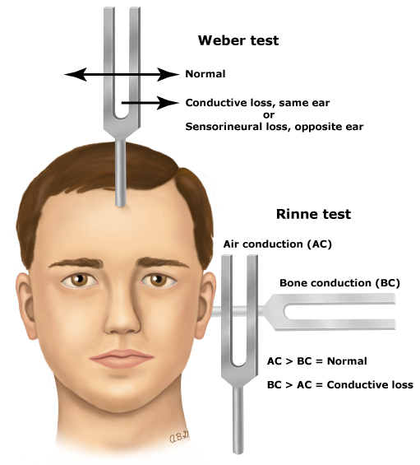
CNVIII
Vestibulocochlear
Whisper (cover opposite ear)
Rinne and Weber
Check vestibular function by checking nystagmus and asking about vertigo

Slide 10
CNIX and X
Glossopharyngeal and vagus
Check uvula when saying ‘ahh’ (deviated to side of lesion)
Gag reflex (not required)
Cough (bovine would suggest lesion)
Hoarse voice (recurrent laryngeal branch of CNX)

Slide 11
CNXI
Spinal Accessory
Sternocleidomastoid (turn head against resistance)
Trapezius (shrug shoulders)

Slide 12
CNXII
Hypoglossal
Extend tongue
Fasciculations
Atrophy
Deviation (towards lesion)

Slide 13
Cerebellar
DANISH
Dysdiadochokinesia
Ataxia (gait and posture)
Nystagmus
Intention tremor
Slurred, staccato speech
Hypotonia/heel-shin test

Slide 14
Cerebellar
Gait (walking and heel-toe)
Romberg (stand straight- fall wo correction)
Speech (British Constitution, Baby Hippo)
Eyes (Nystagmus, saccades)
Arms (finger-nose, rebound, tone, dysdiadokinesia)
Legs (Tone, reflexes, heel-shin)

Slide 15
History Taking
•Out of 25
•3 marks come from patient
•2 marks for a coherent history
•1 mark for introducing yourself (and asking the patient name and DOB)
•1 mark for washing / fake washing your hands!
•1 mark for family history
•1 mark for the social history usually (smoking, alcohol intake, etc)
•1 mark for drugs and allergies
And then marks for various relevant questions in relation to the presenting complaint and history of presenting complaint. In some histories there are really specific questions which you will just never get / even think of – literally don’t worry about these, as long as you get the main ones!

Slide 16
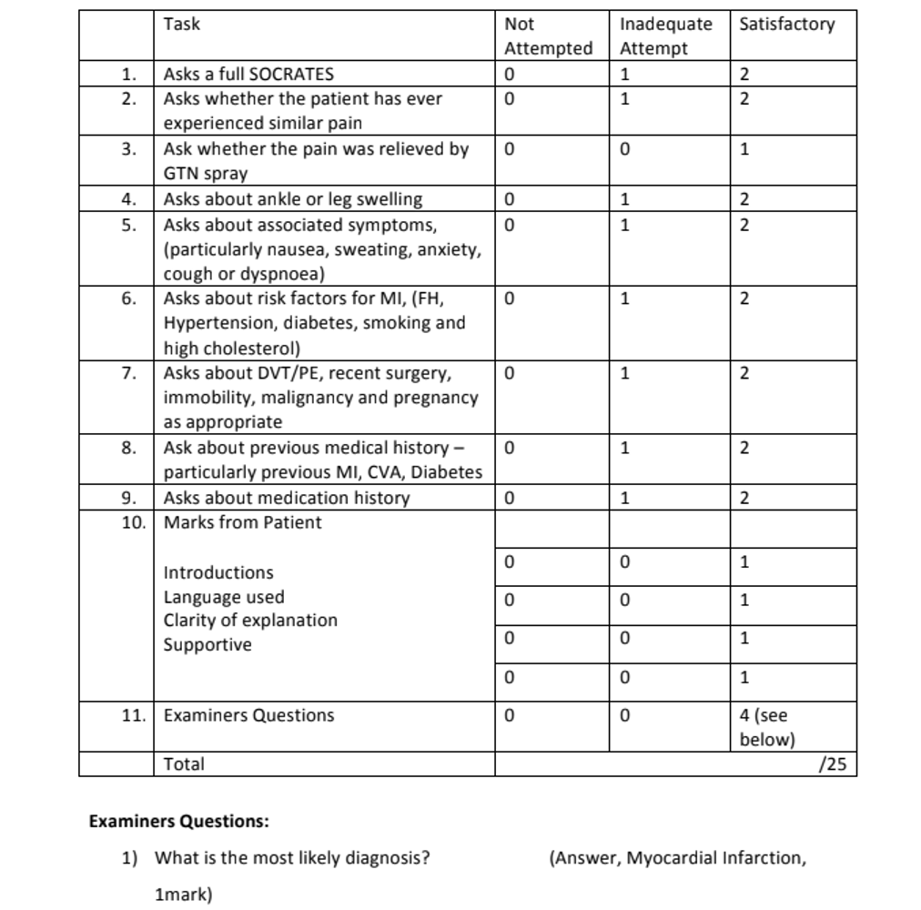
Example of Mock OSCE Mark Scheme

Slide 17
Headache
SOCRATES
Site
Where is it?
Can you point to it?
Onset
How and when the symptoms developed
Gradual or sudden?
When did it start? How long have you had it for?

Slide 18
Headache cont.
Character
Describe the pain (aching, throbbing, pounding, pulsating, pressure, thunderclap)
Constant or intermittent?
Radiate
Spread? Neck, face or eye?
Associated symptoms
Neuro- neck stiffness, weakness, sensory disturbances, visual disturbances, neuro deficits
Systemic- fever, weight gain, fatigue, trauma
Mental Health- stressors, sleep
Time course
How has it changed over time?
Exacerbating Factors
Anything make it better or worse (exertion, lying flat/leaning forward)
Better/worse any particular time of the day
Red Flag
Sudden high intensity
Association with fever
New onset focal neuro deficit
Reduced consciousness

Slide 19
Headache cont.
PMHx
Recent head trauma
Hx of primary or secondary headaches
Blood disorders
Cancer
Social Hx
Smoking, Alcohol, Recreational drugs
Family Hx
Same as PMHx but at ages
Drug Hx (Medication-overuse headaches)
Opiates, Triptans, NSAIDs, Paracetamol
Have you tried anything?
ICE

Slide 20
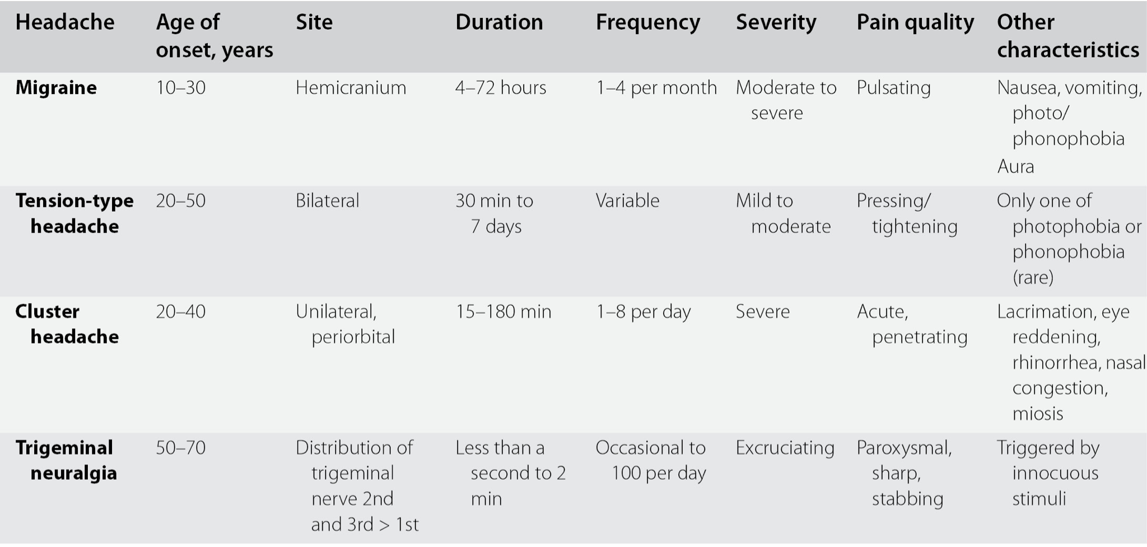
Primary Headache

Slide 21
Differentials for Headache
Primary
Tension-type
Cluster
Migrane
Trigeminal Neuralgia
Sinusitis
Secondary
Intracranial Hypertension
Intracranial haemorrhage
Acute angle-closure glaucoma
Bleeding Disorder
Infection
Psychological

Slide 22
Ophthalmic History Taking
Visual disturbances
Any changes to your vision recently
Red eyes
Have you or others noticed?
All over or only on the white part?
Eye Discharge/Watering
Any discharge
Watery and clear or sticky and yellow
Does your eyes water
Grittiness/Dryness
Something stuck in your eye?
Itchiness
Do you feel the need to rub your eyes?
Photophobia
Issues with bright light?
Do you prefer darkened rooms?
Swelling/Tenderness
Swelling around the eye
Does it hurt when you touch it?

Slide 23
Differentials for Vision Loss
Transient Loss (<24hrs)
Migraine- marching, sparkling, shimmering lights
Amaurosis Fugax- ‘curtains closing’ lasting minutes-hours
Papilloedema- ‘obscurations’
Persistent Visual Loss
Sudden and Painless
Retinal vein/artery occlusion
Stroke
Vitreous haemorrhage
Gradual and Painless
Cataract
Macular degeneration
Tumour
Painful Loss
Acute closed-angle glaucoma
Optic neuritis
Keratitis

Slide 24
Tips for Communication Skills
Treat them as a normal history
HPC, PMHx, FHx, SHx, DHx, ICE
Try and integrate the questions into your history

Slide 25
Risk Assessment History
Do the 3 I’s (Introduce, Identify and Informed Consent)
‘I have been told that you have experienced … and have been asked to check your risk of getting … This is a routine procedure we do to help reduce your risk. I’m going to ask some questions about yourself to have an idea about what’s going on and possibly give some changes to your life to help reduce your risk’

Slide 26
ABCD2
Risk of stroke after a TIA
*also ask about AF (any funny heart beats), any previous TIAs.
Age >60 |  | 1
Blood pressure >140/90 |  | 1
Clinical features | Unilateral weakness | 2
 | Speech difficulty without weakness
 |  | 1
Duration | >60 min | 2
 | 10-59 min | 1
 | <10 min | 0
Diabetes |  | 1

Slide 27
Assessment of Chronic Disease History
Do the 3 I’s (Introduce, Identify and Informed Consent)
‘I am aware you have a diagnosis of … and you have had some blood samples taken.’
‘Are you aware of … and how we use it.’
If they are not aware, explain in simple terms and why it is important to monitor
‘From looking at your results they are higher/lower than expected. I’m going to ask you a few questions to understand the reason for this and discuss changes to your lifestyle to help improve your results’

Slide 28
Feedback
Once you have filled the feedback form, download Kahoot to do our quiz!
Notes:
https://forms.gle/VEsGuP7w2fZDm2Ks5

Slide 29
Quiz
The Peer Teaching Society is not liable for false or misleading information…

