Slide 1
Psychiatry 2
Phase 3A
Katie Pearson
Emma Morganti
The Peer Teaching Society is not liable for false or misleading information.

Slide 2
Introduction
Mood disorders
Depression
Mania
Bipolar disorder
Anxiety
Addiction
Alcohol
Difference between dementia and delirium
The Peer Teaching Society is not liable for false or misleading information.

Slide 3
Depression Persistent symptoms for at least 2 weeks:
Behavioural
Psychomotor retardation or agitation
Altered facial expression
Self neglect
Social withdrawal
Emotional
Low mood >2 weeks
Tearfulness
Loss of interest, anhedonia, lack of motivation
Irritability
Anxiety
Suicidal thinking/behaviour
Cognitive
Slow thinking, slow speech, quite speech, monotone, difficulty concentrating
Negative, pessimistic thoughts, hopelessness, worthlessness
Biological
Diurnal variation in mood (worse in morning)
sleep disturbance (early morning waking)
loss of appetite
loss of libido
fatigue, anergia
constipation, amenorrhoea
Severe
Psychosis
Catatonia – stupor, posturing, waxy flexibility
Notes:
The NICE guidelines encourage a case-finding approach with at-risk groups (individuals with a past history of depression or a chronic health problem with associated functional impairment) using a two question approach:
During the past month, have you:
Felt low, depressed or hopeless?
Had little interest or pleasure in doing things?

Slide 4
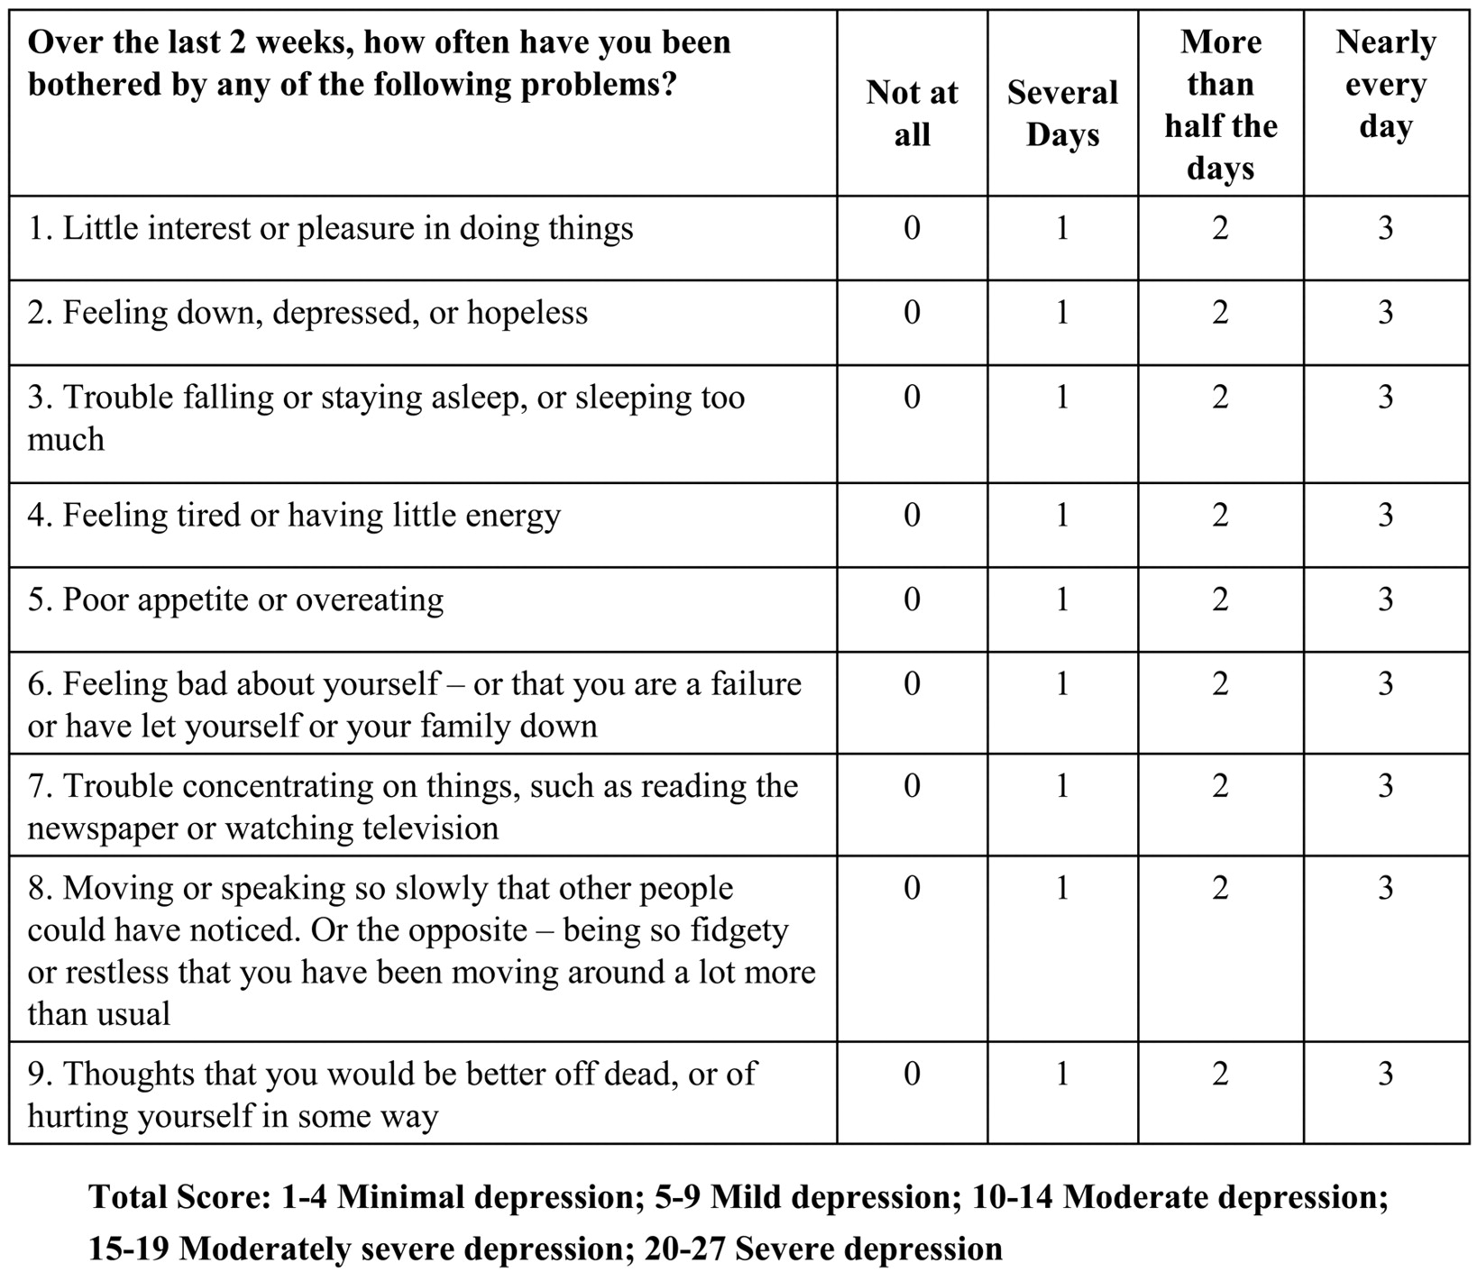
PHQ 9
The Peer Teaching Society is not liable for false or misleading information.

Slide 5
Treatment
Non-pharmacological eg CBT
Pharmacological
SSRIs first line
citalopram, fluoxetine (young people), sertraline
SEs: agitation, anxiety, nausea, suicidal thoughts (more likely first 2 weeks)
Tricyclics
eg amitriptyline
Anticholinergic side effects, cardiotoxic in overdose
SNRIs
Eg venlafaxine, duloxetine
Can increase BP
MAOIs
Eg phenelzine, isocarboxazid
Rarely used
Interacts with mature cheese, bovirl, marmite (tyramine, hypertensive crisis)
ECT if severe
The Peer Teaching Society is not liable for false or misleading information.
Notes:
Antidepressants are not addictive
Most common time for suicide is when starting to take antidepressants

Slide 6
Suicide risk assessment after self harm
Planned or impulsive?
Avoided discovery?
Dangerous methods?
Final acts?
Suicidal intent?
Regret survival?
Previous attempt?
Protective factors?
The Peer Teaching Society is not liable for false or misleading information.

Slide 7
Mania
Mood
Irritability
Euphoria
Cognitive
Grandiosity, self importance
Flight of ideas
Distractibility, confusion
Behavioural
Hyperactivity
Decreased sleep
Pressure of speech
Hypersexuality, disinhibition
Extravagance
Psychotic
Delusions
Hallucinations (tend to be auditory, positive, 2nd person)
The Peer Teaching Society is not liable for false or misleading information.

Slide 8
Bipolar disorder
Minimum 2 episodes of mood disorder
At least 1 must be mania/hypomania
The Peer Teaching Society is not liable for false or misleading information.

Slide 9
Treatment
Bipolar disorder management
Patient awareness and information on condition
Plan for relapse management, coping strategies, lifestyle advice
Lithium is first line for long term management - monitor, narrow therapeutic window, risk of toxicity
If lithium inappropriate: valproate
Bipolar depression
Suicide risk assessment
If moderate – severe: antidepressant combined with antipsychotic eg fluoxetine + olanzapine or quetiapine alone
Acute mania
Section
Stop antidepressant
Antipsychotic
Haloperidol, olanzapine, quetiapine or risperidone
If 2 different antipsychotics don’t work: lithium
If not lithium: valproate
ECT if prolonged and severe
The Peer Teaching Society is not liable for false or misleading information.
Notes:
Not everyone needs lifelong prophylaxis, at least 1-3years

Slide 10
Anxiety/Neuroses
Anxiety
Generalised Anxiety Disorder
Panic disorder
Phobias
Post Traumatic Stress Disorder
Obsessive Compulsive Disorder
The Peer Teaching Society is not liable for false or misleading information.

Slide 11
Generalised Anxiety Disorder
Excessive and inappropriate worry and feelings of fear and dread
>6 months
Feelings of worry not due to a specific reason, triggered by a range of things or sometimes by no apparent stimulus
Psychological and somatic symptoms
The Peer Teaching Society is not liable for false or misleading information.

Slide 12
Psychological symptoms
Apprehension and fear
Irritability
Difficulty concentrating
Distractibility
Restlessness
Sensitivity to noise
Depersonalisation-Derealisation
The Peer Teaching Society is not liable for false or misleading information.

Slide 13
Somatic symptoms
Autonomic arousal
Palpitations, fast heart rate, sweating, shaking, dry mouth
Respiratory
Chest tightness, hyperventilation
GI
Dysphagia, epigastric discomfort, diarrhoea
Neuro
Fatigue, blurred vision, dizziness, headaches, sleep disturbance
General
Muscle tightness, numbness/tingling, restlessness, hot flushes/cold chills
The Peer Teaching Society is not liable for false or misleading information.

Slide 14
Panic disorder
Recurrent panic attacks
Out of the blue, often no specific trigger
Fear, terror, impending doom
Hyperventilation (hypocapnia)
Dyspnoea, Palpitation, Chest pain / discomfort, Choking sensation, Dizziness, Parasthesia, Sweating
Reassure, relaxation techniques, slow breathing, paper bag
The Peer Teaching Society is not liable for false or misleading information.

Slide 15
Phobias
Intense fear triggered by a single stimulus/set of stimuli
Predictable
Stimulus normally no concern to others
Leads to avoidance of stimulus
Patient knows the fear is irrational
The Peer Teaching Society is not liable for false or misleading information.
Notes:
Classical conditioning – previously benign stimulus (e.g. a lift), initiating shock (getting stuck).
AGORAPHOBIA – away from home. Disabling. Often assoc with Claustrophobia
SOCIAL PHOBIA – avoidance and fear of social situations
SIMPLE PHOBIAS – e.g. spiders Arachnophobia

Slide 16
Treatment
Relaxation techniques
Meditation, yoga, exercise, slow breathing, talking
CBT
Pharmacological therapy
Benzodiazepines
?sedative antihistamines
SSRIs
Symptom treatment – beta blockers
The Peer Teaching Society is not liable for false or misleading information.

Slide 17
PTSD
Caused by a traumatic event
Persistent reliving of the event eg flashbacks, nightmares
Avoidance
Hyperarousal
Sleep disturbance, hyper-vigilance, irritability, exaggerated startle response
Inability to remember parts of the event
CBT
EMDR
SSRIs
The Peer Teaching Society is not liable for false or misleading information.

Slide 18
OCD
OBSESSIONAL RUMINATIONS
Persistent and obtrusive
Impede functioning
Cause distress
Minor degrees of obsessional symptoms common in lots of people
COMPULSIVE RITUALS
E.g. constant need to check that things have been done correctly
Some rituals derived from superstitions e.g. repeating actions a set number of times
Can be associated with depression, tourette’s
The Peer Teaching Society is not liable for false or misleading information.

Slide 19
Treatment
Psychological:
CBT
Modelling therapy – demonstration
Thought stopping techniques
Pharmacological:
Anxiolytics
SSRIs
The Peer Teaching Society is not liable for false or misleading information.

Slide 20
Dependence syndrome
Primacy of substance seeking behaviour
Narrowing of drug taking repertoire
Increased tolerance to effects of drugs
Loss of control of consumption
Signs of withdrawal on attempted abstinence
Drug taking to avoid withdrawal symptoms
Continued use despite negative consequences
Rapid reinstatement of previous pattern of use after abstinence
The Peer Teaching Society is not liable for false or misleading information.

Slide 21
Screening for alcohol problems
C: have you ever thought you should cut down?
A: have you ever felt annoyed when someone criticised your drinking?
G: have you ever felt guilty about your drinking?
E: have you ever had a drink first thing in the morning to steady your nerves or get rid of a hangover? (eyeopener)
2+ yes answers consider using AUDIT (Alcohol Use Disorders Identification Test)
The Peer Teaching Society is not liable for false or misleading information.

Slide 22
Alcohol withdrawal
4-12 hours after last drink
Coarse tremor, sweating, insomnia, tachycardia, N+V, anxiety, craving for alcohol, occasional hallucinations
Peak at 48hours and last 2-5 days
Alcohol withdrawal seizures in 5-15% within 48hrs last drink
The Peer Teaching Society is not liable for false or misleading information.
Notes:
Give quick acting benzo (lorazepam) to patient with seizures to reduce likelihood of further

Slide 23
Delirium Tremens
Medical emergency requiring inpatient care
Acute confusional state secondary to alcohol withdrawal
Clouding of consciousness, disorientation, amnesia for recent events, marked psychomotor agitation, hallucinations (Lilliputian), worse at night, fluctuations in severity
Treatment: oral lorazepam
The Peer Teaching Society is not liable for false or misleading information.
Notes:
Persist or oral decline – parenteral lorazepam, haloperidol, olanzapine

Slide 24
Alcohol withdrawal management
Inpatient or outpatient?
Admit if PH of complicated withdrawals, current delirium, comorbid mental or physical illness, polydrug misuse, suicide risk, Wernicke-Korsakoff syndrome, severe N+V, severe malnutrition, lack of stable environment
The Peer Teaching Society is not liable for false or misleading information.
Notes:
1.1.1.1For people in acute alcohol withdrawal with, or who are assessed to be at high risk of developing, alcohol withdrawal seizures or delirium tremens, offer admission to hospital for medically assisted alcohol withdrawal.
1.1.1.2For young people under 16 years who are in acute alcohol withdrawal, offer admission to hospital for physical and psychosocial assessment, in addition to medically assisted alcohol withdrawal.
1.1.1.3For certain vulnerable people who are in acute alcohol withdrawal (for example, those who are frail, have cognitive impairment or multiple comorbidities, lack social support, have learning difficulties or are 16 or 17 years), consider a lower threshold for admission to hospital for medically assisted alcohol withdrawal.
1.1.1.4For people who are alcohol dependent but not admitted to hospital, offer advice to avoid a sudden reduction in alcohol intake^{[6]} and information about how to contact local alcohol support services.

Slide 25
Alcohol withdrawal management
Reducing regime of benzodiazepine – chlordiazepoxide, diazepam
Given to improve withdrawal symptoms and reduce the risk of seizures
Clinical symptoms of withdrawal, hx of alcohol dependence syndrome, consumption greater than 10 units/day for previous ten days
B vitamins
Admit for IV pabrinex or oral thiamine if outpatient
The Peer Teaching Society is not liable for false or misleading information.

Slide 26
Wernicke-Korsakoff
Due to thiamine deficiency – poor intake, reduced absorption, impaired hepatic storage
Wernicke encephalopathy is acute and Korsakoff syndrome is chronic phase of same disease process
The Peer Teaching Society is not liable for false or misleading information.

Slide 27
Wernicke’s encephalopathy
Acute onset of
Acute confusional state
Occular signs (nystagmus, opthalmoplegia)
Ataxic gait
Triad only seen in 10%, confusion in 80%
Associated: peripheral neuropathy, resting tachycardia, evidence of malnourishment
The Peer Teaching Society is not liable for false or misleading information.

Slide 28
Wernicke’s Encephalopathy
Treat with IV Pabrinex
Treat immediately diagnosed
Consider all those at high risk for IV pabrinex
If treated opthalmoplegia and confusion resolve, but ataxia, neuropathy and nystagmus may be permanent
The Peer Teaching Society is not liable for false or misleading information.

Slide 29
Korsakoff syndrome
80% untreated Wernicke’s develop to Korsakoff psychosis
Lose ability to lay down new memories
Variable retrograde amnesia
Other parts of memory unimpaired e.g. working memory
Confabulation for episodes of amnesia
The Peer Teaching Society is not liable for false or misleading information.

Slide 30
Dementia or delirium?
Feature | Dementia | Delirium
Onset | Chronic/ insidious | Acute/subacute
Course | Stable, progressive | Fluctuating
Attention | Normal, reduced | Markedly reduced
Arousal | Usually normal | Increased/decreased
Delusions | Systematised | Fleeting
Hallucinations | Less common | Common
Psychomotor activity | Usually normal | Usually abnormal
Autonomic features | Normal | Abnormal
The Peer Teaching Society is not liable for false or misleading information.
Notes:
Delirium – most commonly caused by infections eg UTIs, prescribed drugs eg benzos, steroids, substance withdrawal
Psychomotor: eg sleepiness, retardation, lethargy or agitated, hyperactive

Slide 31
Question time!
State 3 questions you could ask to assess someone’s suicide risk after a previous attempt
The Peer Teaching Society is not liable for false or misleading information.
Notes:
SSRI (citalopram, fluoxetine)
Agitation, anxiety, nausea, suicidal thoughts

Slide 32
Question time!
Name three features of mania.
The Peer Teaching Society is not liable for false or misleading information.
Notes:
Irritablility, euphoria, grandiosity, self importance, flight of ideas, distractability,
Hyperactivity

Slide 33
Question time!
A 25 year old woman has been suffering from episodes of dizziness, sweating, palpitations and a feeling of impending doom….. The episodes are unpredictable and don’t appear to be triggered by anything. What is she suffering from and how would you manage it?
The Peer Teaching Society is not liable for false or misleading information.
Notes:
Panic disorder – CBT, relaxation technqies

Slide 34
Question time!
Give 4 features of the dependency syndrome.
The Peer Teaching Society is not liable for false or misleading information.
Notes:
Primacy of substance seeking behaviour
Narrowing of drug taking repertoire
Increased tolerance to effects of drugs
Loss of control of consumption
Signs of withdrawal on attempted abstinence
Drug taking to avoid withdrawal symptoms
Continued use despite negative consequences
Rapid reinstatement of previous pattern of use after abstinence

Slide 35
Thank you!
Any questions?

