Slide 1
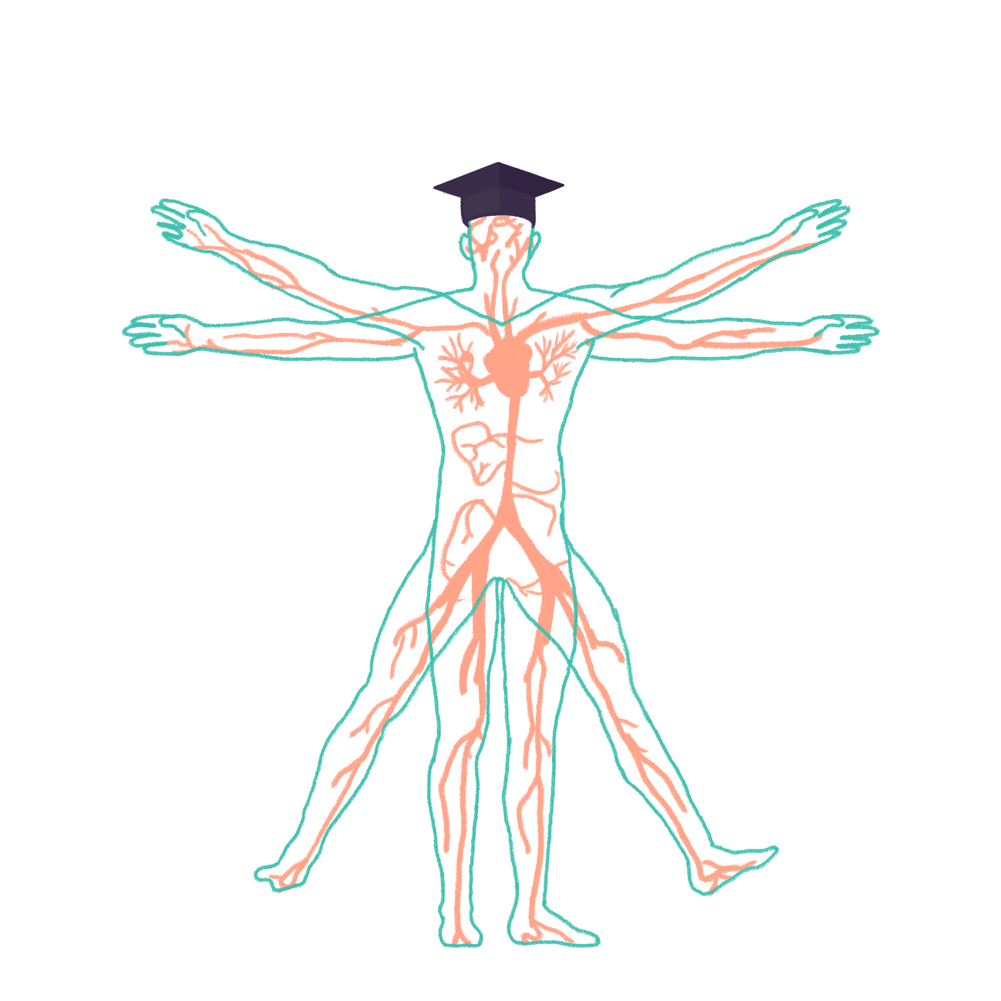
2022/2023

Slide 2
CARDIOVASCULAR
Phase 2a Revision Session
Thursday 19th January 2023
Raneem Alhalabi
The Peer Teaching Society is not liable for false or misleading information…

Slide 3
What we’ll cover today:
Hypertension
IHD:
Angina
Acute coronary syndrome (unstable angina and myocardial infarction)
Cardiac failure
Valvular Heart Diseases:
Aortic stenosis
Mitral regurgitation
Aortic regurgitation
Mitral stenosis
Infections:
Infective endocarditis
Pericarditis
Pericardial effusion and cardiac tamponade
Arrythmias:
Atrial fibrillation
Atrial flutter
Heart block
Bundle branch block
Types of shock

Slide 4
What we won’t be covering today:
Congenital Heart defects
AAA
PE
Cardiomyopathies

Slide 5
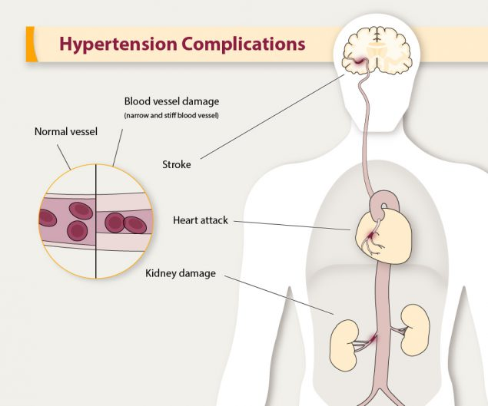
Hypertension:
Above or equal to 140/90 mmHg
90% primary HTN and 10% secondary HTN
Diagnosed with ambulatory blood pressure monitoring or home blood pressure monitoring
Assessment of cardiovascular risk and investigation for secondary HTN should be offered
Stages according to severity
First line management:
Lifestyle changes

Slide 6
Case study:
A 35 year old female presents with palpitation, headaches, sweating and anxiety.
Blood pressure measurement: 180/100mmHg
What is the most likely diagnosis? (Hint: endocrine condition)

Slide 7
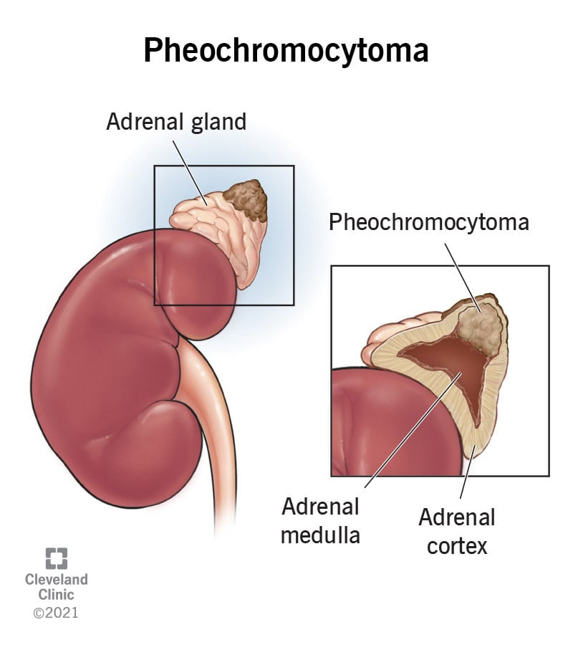
Case study:
A 35 year old female presents with palpitation, headaches, sweating and anxiety.
Blood pressure measurement: 180/100mmHg
What is the most likely diagnosis?
Phaeochromocytoma
One of the less common causes of secondary hypertension but it comes up every now and then!

Slide 8
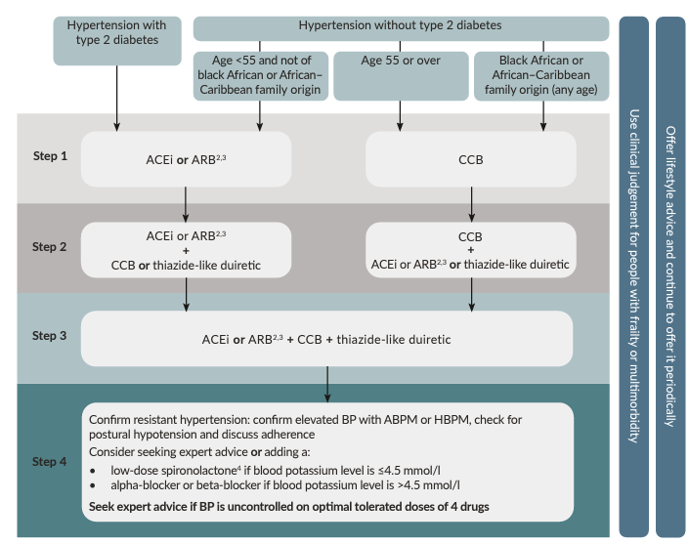
Hypertension Treatment:

Slide 9
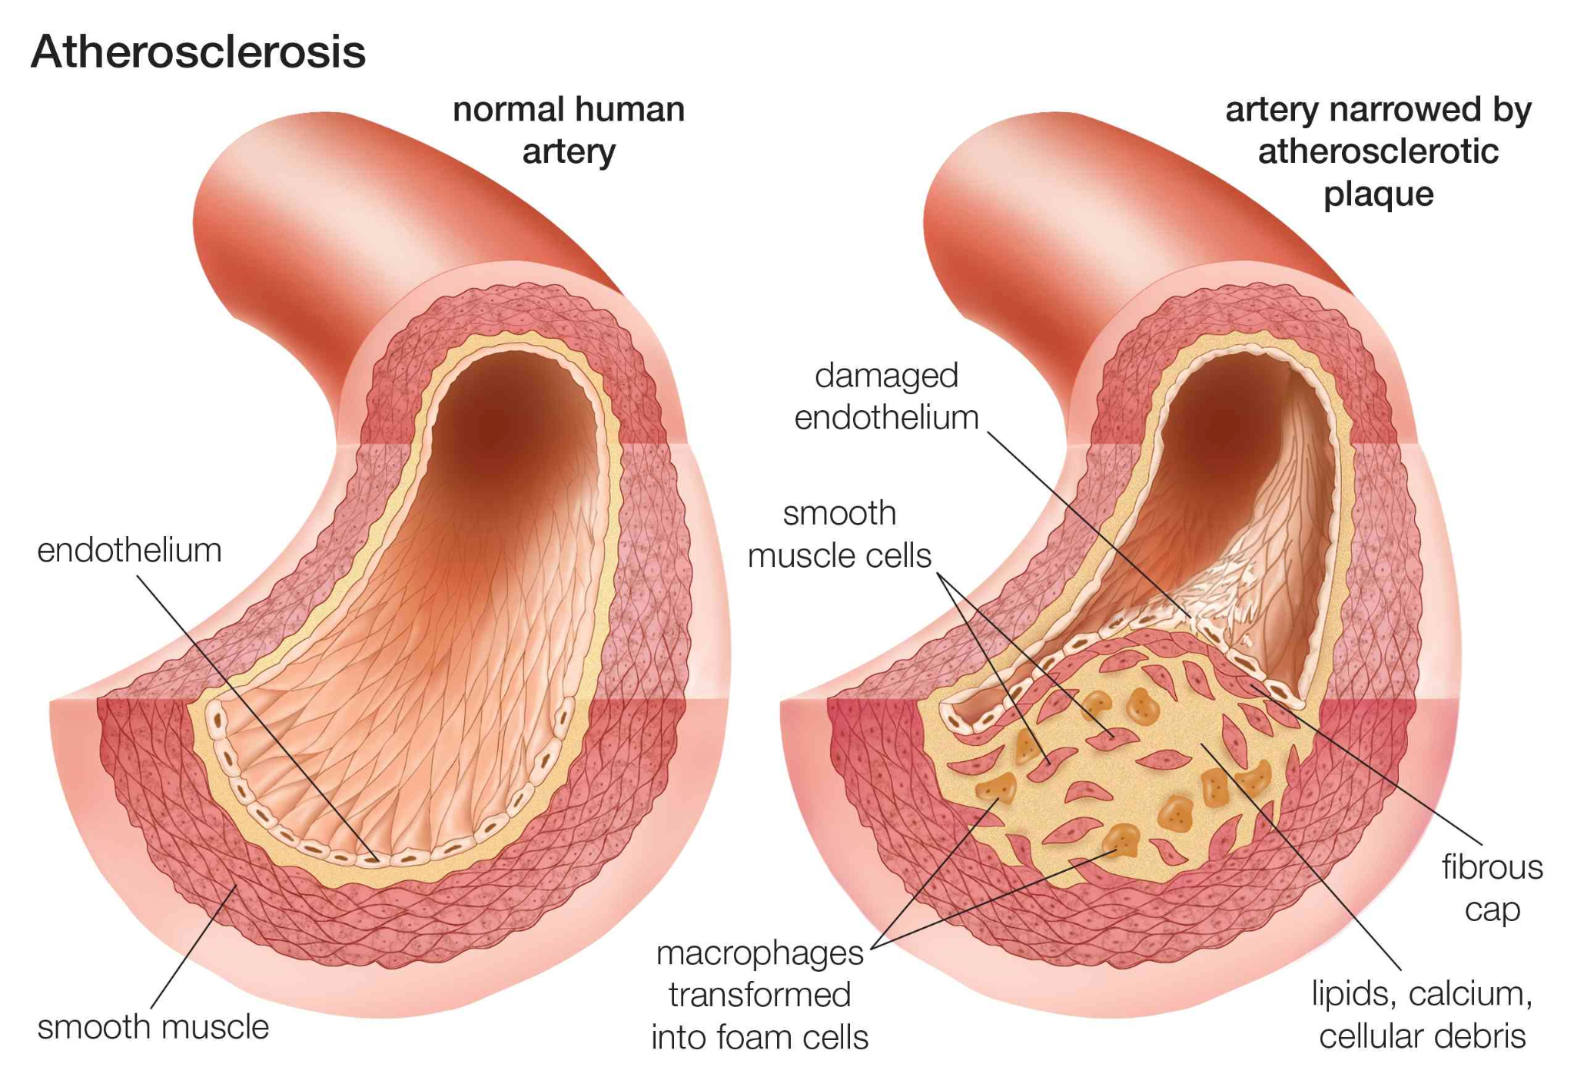
IHD
Cardiac myocyte damage due to insufficient oxygenated blood supply
In order of severity: Stable angina → unstable angina → NSTEMI → STEMI

Slide 10
Stable angina:
DEFINITION, CAUSE/S & RISK FACTORS | Chest pain caused by an insufficient blood supply to the myocardium and induced by physical exertion or emotional stress. It must be relieved with rest or with a dose of sublingual GTN
PATHOPHYSIOLOGY | Atherosclerosis leads to narrowing of coronary arteries that results in ischaemia
SIGNS & SYMPTOMS | Central chest tightness provoked by exertion Pain may radiate to one or both arms, neck or jaw Dyspnoea, sweating and nausea
DIAGNOSIS & INVESTIGATIONS (Ix) | 12 lead ECG: normal or ST depression Do NOT perform exercise ECG for people with known CAD
TREATMENT (Tx) | Modify risk factors: smoking cessation, exercise, weight loss GTN spray (to be used during episodes of chest pain) Beta blocker or Calcium channel blocker Revascularization (PCI or CABG)
Differentials: | Pericarditis PE Chest infection GORD

Slide 11
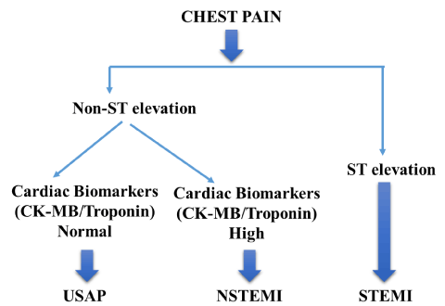
Acute Coronary Syndrome (ACS):
Umbrella term that includes:
ST-elevation myocardial infarction
Unstable angina
Non-ST-elevation myocardia infarction

Slide 12
Unstable Angina:
A new onset of angina or deterioration in previously diagnosed stable angina. Chest pain that occurs at rest, is not relieved by GTN and occurs more frequently and lasts for longer.
Unstable angina usually requires immediate admission or referral to hospital,

Slide 13
STEMI vs NSTEMI
STEMI:
Complete occlusion of a MAJOR coronary artery
This leads to full thickness damage of heart muscle
Diagnosed on ECG at presentation
NSTEMI:
Partial occlusion of a MAJOR coronary artery or complete occlusion of a MINOR coronary artery
Causes partial thickness damage of the heart
Diagnosis made on troponin results
ECG may show ST-depression and/or T wave inversion

Slide 14
Myocardial infarction
DEFINITION, CAUSE/S & RISK FACTORS | Occlusion of a coronary artery preciously affected by atherosclerosis
PATHOPHYSIOLOGY (IF APPLICABLE) | Atherosclerosis leads to narrowing of coronary arteries that results in ischaemia (go back to ICS for atherosclerotic formation)
RISK FACTORS | Age, male, FHx of IHD, ethnicity, smoking, HTN, DM, obesity and sedentary lifestyle
SIGNS & SYMPTOMS | Acute central chest pain, nausea, sweating, dyspnoea, SOB, palpitations, pallor. (Be aware of the atypical presentations)
DIAGNOSIS & INVESTIGATIONS (Ix) | STEMI: ST elevation, pathological Q waves after a few days NSTEMI: ST depression and/or T wave inversion Increased troponin in both
TREATMENT (Tx) | Offer 300mg loading dose of aspirin and then decide on management using guidelines (Next slide)
Differentials: | Pericarditis PE Myocarditis GORD Aortic dissection

Slide 15
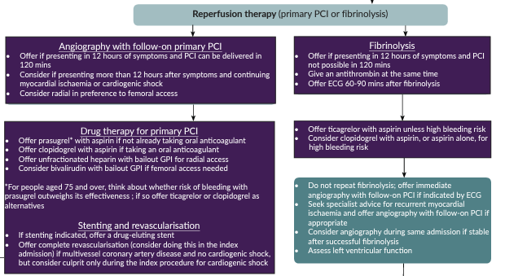
MI Treatment Guidelines

Slide 16
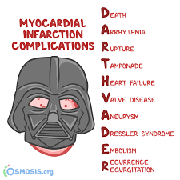
Complication of myocardial infarction:

Slide 17
Cardiac Failure
DEFINITION, CAUSE/S & RISK FACTORS | The inability of the heart to deliver blood and thus O2 at a rate that is commensurate with the requirement at metabolising tissue of the body
RISK FACTORS | 65 and older, African descent, Men, obesity, history of MI
SIGNS & SYMPTOMS | Dyspnoea, orthopnoea and paroxysmal nocturnal dyspnoea Fatigue, cyanosis, murmurs, displaced apex beat, bi-basal crackles Cough with pink sputum, sacral and pitting oedema
DIAGNOSIS & INVESTIGATIONS (Ix) | Brain natriuretic peptide (BNP): increases when there is myocardial stress. Correlates with the severity of heart failure CXR: ABCDE Echocardiogram (gold)
TREATMENT (Tx) | Diuretics (furosemide) ACEi / ARB BB Digoxin
What is the most common cause of cardiac failure?

Slide 18
VALVULAR DISEASES

Slide 19
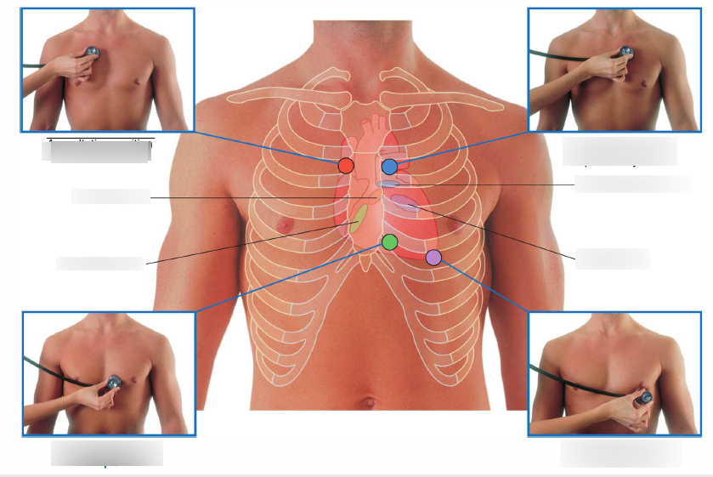
But first, let’s talk about murmurs!
An extra, unusual sound in your heartbeat. It sounds like a vibration or whooshing sound. Sometimes they’re very obvious but most of the time they’re subtle and you have to listen for a while to catch it!
Murmurs can be systolic or diastolic
A systolic murmur occurs after S1
A diastolic murmur occurs after S2
Most murmurs are systolic. If you’re not sure and say it’s systolic, 95% of the time you’ll be right!!

Slide 20
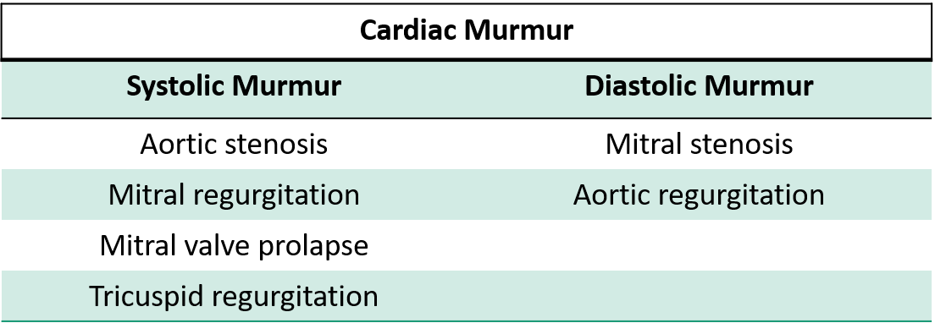
Murmurs of valvular diseases:
SYSTOLIC – ASMR
AS: aortic stenosis
MR: Mitral regurgitation
DIASTOLIC – ARMS
AR: aortic regurgitation
MS: mitral stenosis

Slide 21
Aortic Stenosis:
DEFINITION, CAUSE/S & RISK FACTORS | Narrowing of the aortic valve resulting in obstruction to the left ventricular stroke volume Causes and risk factors: calcified aortic valve disease, congenital bicuspid aortic valve and rheumatic heart disease (very rare now)
PATHOPHYSIOLOGY (IF APPLICABLE) | Narrowing of aortic valve → decreased stroke volume → increased afterload → increased left ventricular pressure → compensatory LVH → increased oxygen demand → ischaemia
SIGNS & SYMPTOMS | Chest pain Exertional Dyspnoea Syncope Angina Ejection systolic murmur crescendo-decrescendo character Loudness does not matter
DIAGNOSIS & INVESTIGATIONS (Ix) | Echocardiogram: left ventricular size and function, doppler derived gradient and valve area ECG: LVH CXR: LVH, calcified aortic valve
TREATMENT (Tx) | Surgical aortic valve replacement or TAVI (Transcutaneous Aortic Valve Implantation) less invasive
Differentials: | Mitral regurg

Slide 22
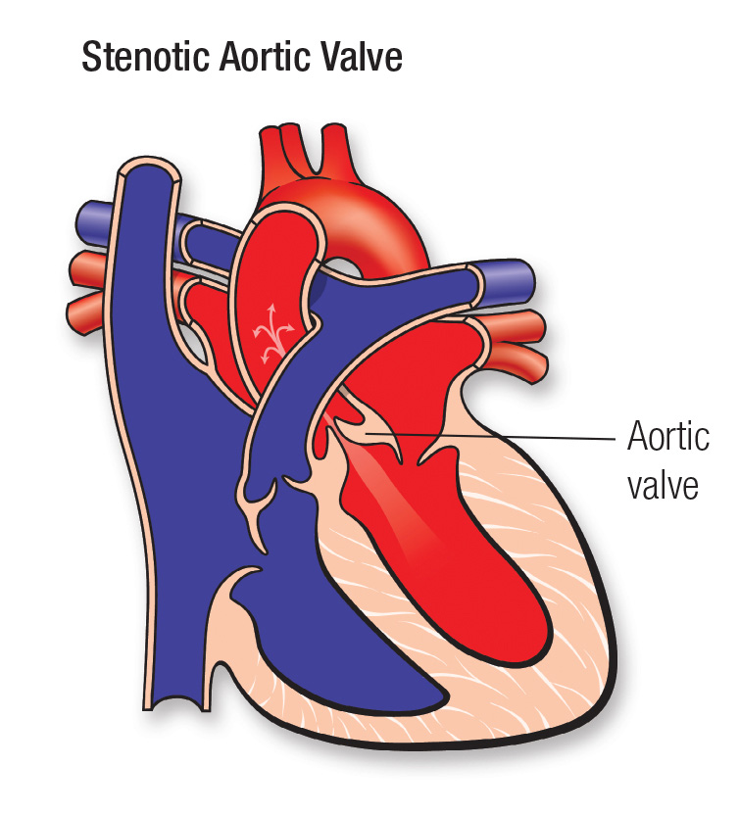
Aortic Stenosis:
DEFINITION, CAUSE/S & RISK FACTORS | Narrowing of the aortic valve resulting in obstruction to the left ventricular stroke volume Causes and risk factors: calcified aortic valve disease, congenital bicuspid aortic valve and rheumatic heart disease (very rare now)
PATHOPHYSIOLOGY (IF APPLICABLE) | Narrowing of aortic valve → decreased stroke volume → increased afterload → increased left ventricular pressure → compensatory LVH → increased oxygen demand → ischaemia
SIGNS & SYMPTOMS | Chest pain Exertional Dyspnoea Syncope Angina Ejection systolic murmur crescendo-decrescendo character Loudness does not matter
DIAGNOSIS & INVESTIGATIONS (Ix) | Echocardiogram: left ventricular size and function, doppler derived gradient and valve area ECG: LVH CXR: LVH, calcified aortic valve
TREATMENT (Tx) | Surgical aortic valve replacement or TAVI (Transcutaneous Aortic Valve Implantation) less invasive
Differentials: | Mitral regurg

Slide 23
Aortic Stenosis:
DEFINITION, CAUSE/S & RISK FACTORS | Narrowing of the aortic valve resulting in obstruction to the left ventricular stroke volume Causes and risk factors: calcified aortic valve disease, congenital bicuspid aortic valve and rheumatic heart disease (very rare now)
PATHOPHYSIOLOGY (IF APPLICABLE) | Narrowing of aortic valve → decreased stroke volume → increased afterload → increased left ventricular pressure → compensatory LVH → increased oxygen demand → ischaemia
SIGNS & SYMPTOMS | Chest pain Exertional Dyspnoea Syncope Angina Ejection systolic murmur crescendo-decrescendo character Loudness does not matter
DIAGNOSIS & INVESTIGATIONS (Ix) | Echocardiogram: left ventricular size and function, doppler derived gradient and valve area ECG: LVH CXR: LVH, calcified aortic valve
TREATMENT (Tx) | Surgical aortic valve replacement or TAVI (Transcutaneous Aortic Valve Implantation) less invasive
Differentials: | Mitral regurg

Slide 24
Mitral Regurgitation:
DEFINITION, CAUSE/S & RISK FACTORS | Backflow of blood from the left ventricle to the left atrium during systole Causes: Ischaemic mitral valve, Rheumatic heart disease, IE, papillary muscle dysfunction
PATHOPHYSIOLOGY (IF APPLICABLE) | Regurgitation into the left atrium → left atrial dilatation → left atrial enlargement → LVH (since ventricle needs to put in more effort to pump less blood) → pulmonary hypertension → right ventricular dysfunction
SIGNS & SYMPTOMS | Exertion dyspnoea, fatigue, lethargy, palpitations, symptoms of heart failure. Pansystolic murmur at the apex radiating to the axilla Intensity does not correlate with severity
DIAGNOSIS & INVESTIGATIONS (Ix) | Echocardiogram: TOE is very helpful ECG: may show LAH, AF, LVH (not diagnostic) CXR: LAH
TREATMENT (Tx) | Vasodilators: ACEi Rate control: BB Diuretics: Furosemide Serial echocardiograms Surgery is indicated if ejection fraction <60% or new onset AF

Slide 25
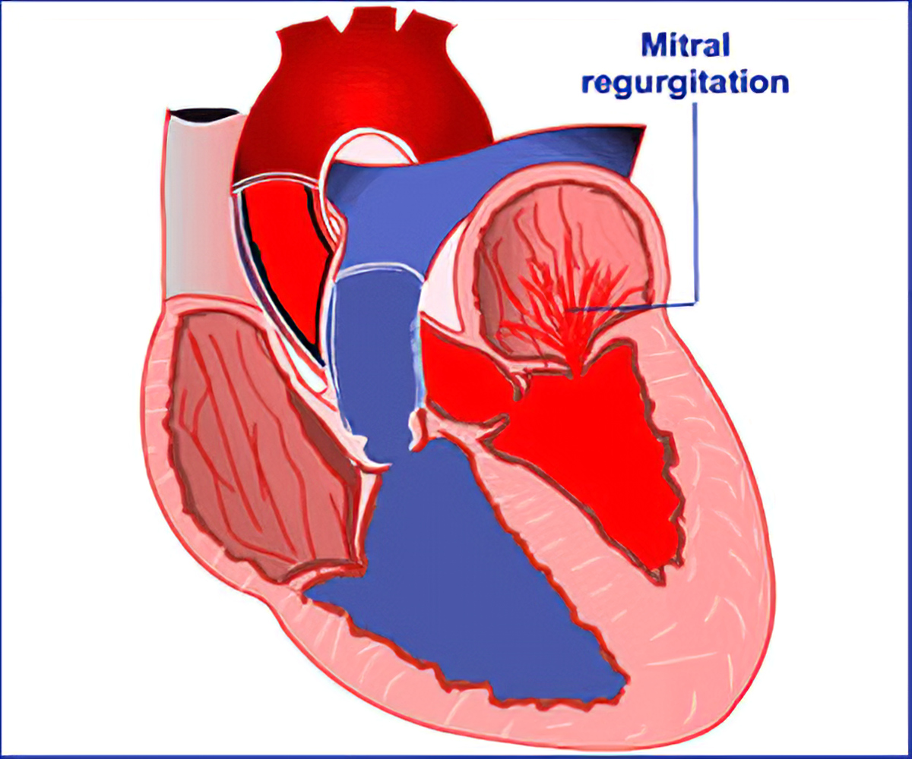
Mitral Regurgitation:
DEFINITION, CAUSE/S & RISK FACTORS | Backflow of blood from the left ventricle to the left atrium during systole Causes: Ischaemic mitral valve, Rheumatic heart disease, IE, papillary muscle dysfunction
PATHOPHYSIOLOGY (IF APPLICABLE) | Regurgitation into the left atrium → left atrial dilatation → left atrial enlargement → LVH (since ventricle needs to put in more effort to pump less blood) → pulmonary hypertension → right ventricular dysfunction
SIGNS & SYMPTOMS | Exertion dyspnoea, fatigue, lethargy, palpitations, symptoms of heart failure. Pansystolic murmur at the apex radiating to the axilla Intensity does not correlate with severity
DIAGNOSIS & INVESTIGATIONS (Ix) | Echocardiogram: TOE is very helpful ECG: may show LAH, AF, LVH (not diagnostic) CXR: LAH
TREATMENT (Tx) | Vasodilators: ACEi Rate control: BB Diuretics: Furosemide Serial echocardiograms Surgery is indicated if ejection fraction <60% or new onset AF

Slide 26
Mitral Regurgitation:
DEFINITION, CAUSE/S & RISK FACTORS | Backflow of blood from the left ventricle to the left atrium during systole Causes: Ischaemic mitral valve, Rheumatic heart disease, IE, papillary muscle dysfunction
PATHOPHYSIOLOGY (IF APPLICABLE) | Regurgitation into the left atrium → left atrial dilatation → left atrial enlargement → LVH (since ventricle needs to put in more effort to pump less blood) → pulmonary hypertension → right ventricular dysfunction
SIGNS & SYMPTOMS | Exertion dyspnoea, fatigue, lethargy, palpitations, symptoms of heart failure. Pansystolic murmur at the apex radiating to the axilla Intensity does not correlate with severity
DIAGNOSIS & INVESTIGATIONS (Ix) | Echocardiogram: TOE is very helpful ECG: may show LAH, AF, LVH (not diagnostic) CXR: LAH
TREATMENT (Tx) | Vasodilators: ACEi Rate control: BB Diuretics: Furosemide Serial echocardiograms Surgery is indicated if ejection fraction <60% or new onset AF

Slide 27
Mitral Stenosis:
DEFINITION, CAUSE/S & RISK FACTORS | Obstruction of left ventricle inflow that prevents proper filling RFx: Rheumatic fever, untreated strep infections
PATHOPHYSIOLOGY (IF APPLICABLE) | Thickening and immobility of valve → obstruction of blood flow from right atrium to right ventricle → left atrial pressure increases → LAH → pulmonary venous, arterial and right heart pressures increase → pulmonary oedema → pulmonary HTN → RVH → tricuspid regurgitation
SIGNS & SYMPTOMS | Symptoms appear years later Dyspnoea, Haemoptysis, Oedema, Malar flush Diastolic murmur When patient lying on the left side in held expiration Longer murmur = more severe
DIAGNOSIS & INVESTIGATIONS (Ix) | Echocardiogram: GOLD ECG: Left atrial enlargement and AF CXR: Pulmonary oedema
TREATMENT (Tx) | Rate control: BB Diuretics: furosemide Surgical mitral valve replacement or Percutaneous mitral balloon valvotomy (less invasive)

Slide 28
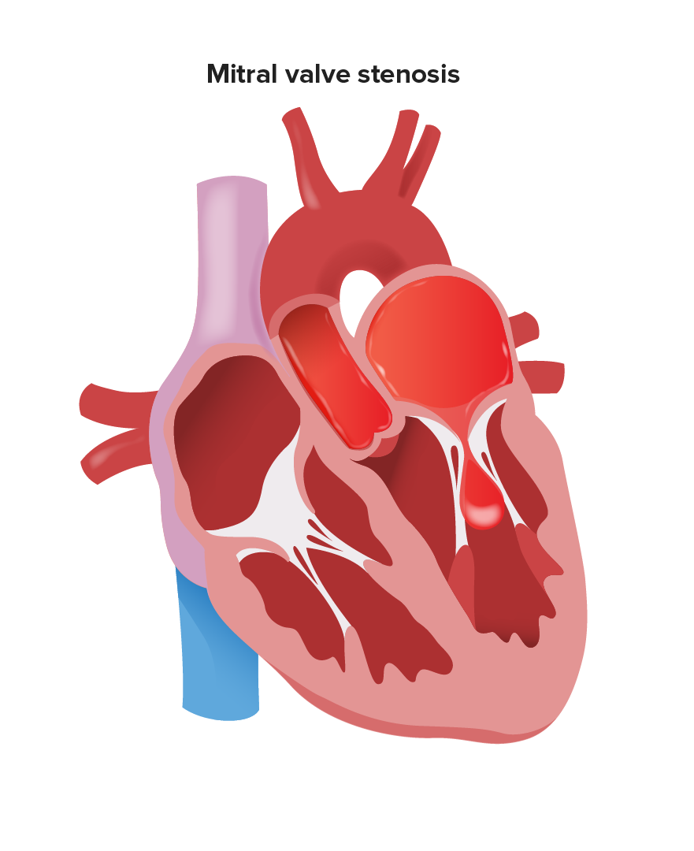
Mitral Stenosis:
DEFINITION, CAUSE/S & RISK FACTORS | Obstruction of left ventricle inflow that prevents proper filling RFx: Rheumatic fever, untreated strep infections
PATHOPHYSIOLOGY (IF APPLICABLE) | Thickening and immobility of valve → obstruction of blood flow from right atrium to right ventricle → left atrial pressure increases → LAH → pulmonary venous, arterial and right heart pressures increase → pulmonary oedema → pulmonary HTN → RVH → tricuspid regurgitation
SIGNS & SYMPTOMS | Symptoms appear years later Dyspnoea, Haemoptysis, Oedema, Malar flush Diastolic murmur When patient lying on the left side in held expiration Longer murmur = more severe
DIAGNOSIS & INVESTIGATIONS (Ix) | Echocardiogram: GOLD ECG: Left atrial enlargement and AF CXR: Pulmonary oedema
TREATMENT (Tx) | Rate control: BB Diuretics: furosemide Surgical mitral valve replacement or Percutaneous mitral balloon valvotomy (less invasive)

Slide 29
Mitral Stenosis:
DEFINITION, CAUSE/S & RISK FACTORS | Obstruction of left ventricle inflow that prevents proper filling RFx: Rheumatic fever, untreated strep infections
PATHOPHYSIOLOGY (IF APPLICABLE) | Thickening and immobility of valve → obstruction of blood flow from right atrium to right ventricle → left atrial pressure increases → LAH → pulmonary venous, arterial and right heart pressures increase → pulmonary oedema → pulmonary HTN → RVH → tricuspid regurgitation
SIGNS & SYMPTOMS | Symptoms appear years later Dyspnoea, Haemoptysis, Oedema, Malar flush Diastolic murmur When patient lying on the left side in held expiration Longer murmur = more severe
DIAGNOSIS & INVESTIGATIONS (Ix) | Echocardiogram: GOLD ECG: Left atrial enlargement and AF CXR: Pulmonary oedema
TREATMENT (Tx) | Rate control: BB Diuretics: furosemide Surgical mitral valve replacement or Percutaneous mitral balloon valvotomy (less invasive)

Slide 30
Aortic Regurgitation:
DEFINITION, CAUSE/S & RISK FACTORS | Leakage of blood into left ventricle from the aorta during diastole due to ineffective coaptation of the aortic cusps Causes: Congenital bicuspid aortic valve, rhematic fever, IE
PATHOPHYSIOLOGY (IF APPLICABLE) | To maintain cardiac output more blood needs to be pumped out of the left ventricle to compensate for the backflow → LVH → heart failure Decreased coronary artery supply
SIGNS & SYMPTOMS | Exertional dyspnoea, palpitations, angina, syncope, displaced apex beat Diastolic murmur at the left sternal border 4th intercostal space Collapsing water hammer pulse
DIAGNOSIS & INVESTIGATIONS (Ix) | Echocardiogram: GOLD ECG: LVH CXR: aortic root enlargement
TREATMENT (Tx) | IE prophylaxis Vasodilators: ACEi Monitor progression Surgery if symptoms are increasing

Slide 31
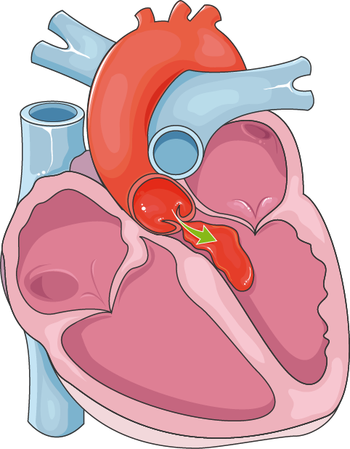
Aortic Regurgitation:
DEFINITION, CAUSE/S & RISK FACTORS | Leakage of blood into left ventricle from the aorta during diastole due to ineffective coaptation of the aortic cusps Causes: Congenital bicuspid aortic valve, rhematic fever, IE
PATHOPHYSIOLOGY (IF APPLICABLE) | To maintain cardiac output more blood needs to be pumped out of the left ventricle to compensate for the backflow → LVH → heart failure Decreased coronary artery supply
SIGNS & SYMPTOMS | Exertional dyspnoea, palpitations, angina, syncope, displaced apex beat Diastolic murmur at the left sternal border 4th intercostal space Collapsing water hammer pulse
DIAGNOSIS & INVESTIGATIONS (Ix) | Echocardiogram: GOLD ECG: LVH CXR: aortic root enlargement
TREATMENT (Tx) | IE prophylaxis Vasodilators: ACEi Monitor progression Surgery if symptoms are increasing

Slide 32
Aortic Regurgitation:
DEFINITION, CAUSE/S & RISK FACTORS | Leakage of blood into left ventricle from the aorta during diastole due to ineffective coaptation of the aortic cusps Causes: Congenital bicuspid aortic valve, rhematic fever, IE
PATHOPHYSIOLOGY (IF APPLICABLE) | To maintain cardiac output more blood needs to be pumped out of the left ventricle to compensate for the backflow → LVH → heart failure Decreased coronary artery supply
SIGNS & SYMPTOMS | Exertional dyspnoea, palpitations, angina, syncope, displaced apex beat Diastolic murmur at the left sternal border 4th intercostal space Collapsing water hammer pulse
DIAGNOSIS & INVESTIGATIONS (Ix) | Echocardiogram: GOLD ECG: LVH CXR: aortic root enlargement
TREATMENT (Tx) | IE prophylaxis Vasodilators: ACEi Monitor progression Surgery if symptoms are increasing

Slide 33
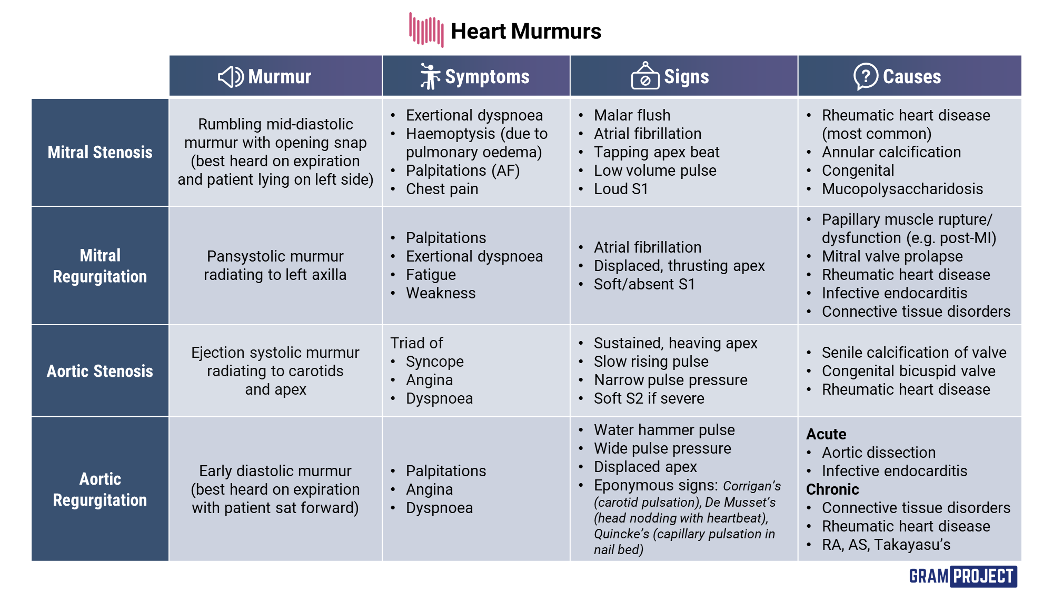

Slide 34
Infections

Slide 35
Infective Endocarditis:
DEFINITION, CAUSE/S & RISK FACTORS | An infection of the endocardium or vascular endothelium of the heart RFx: IVDU, poor dental hygiene, prosthetic valve
Causes: | Most common- Staph aureus: IVDU Strep viridians: poor dental hygiene (most common in developing countries) Staphylococcus epidermis: prosthetic valve surgery
SIGNS & SYMPTOMS | Fever, headache, malaise, confusion and night sweats Finger clubbing, splinter haemorrhages, Janeway lesions, osler nodes, roth spots
DIAGNOSIS & INVESTIGATIONS (Ix) | Duke's criteria to decide whether it is definite or possible IE Blood cultures: 3 sets from different sites over 24 hours (BEFORE ANTIBIOTICS) High CRP and ESR CXR: cardiomegaly ECG: long PR interval Echo (gold) TTE is less discomfort but TOE is much more sensitive and diagnostic
TREATMENT (Tx) | Prolonged course of antibiotics (6 weeks) 2weeks IV and then switch to oral
Differentials: | SLE Antiphospholipid syndrome Reactive arthritis Meningitis

Slide 36
Pericarditis:
DEFINITION, CAUSE/S & RISK FACTORS | Acute inflammation of the pericardium with or without effusion Causes: majority are idiopathic and most commonly seen in young healthy patients Viral is the most common infectious cause Bacterial and fungal are more rare
Pathophysiology | Acute inflammation of the pericardium → fibrinous reaction → exudate and adhesions within pericardial sac → serous or haemorrhagic effusion may occur
SIGNS & SYMPTOMS | Sharp, pleuritic, crushing chest pain worse on inspiration and lying down and relieved by sitting forwards Dyspnoea Cough Hiccups Fever and tachycardia
DIAGNOSIS & INVESTIGATIONS (Ix) | CXR: cardiomegaly in case of effusion ECG: Saddle shaped ST elevation (diagnostic) Increased inflammatory markers
TREATMENT (Tx) | NSAIDs Colchicine for 3 weeks
Differentials: | Angina MI Pulmonary infarction PE

Slide 37
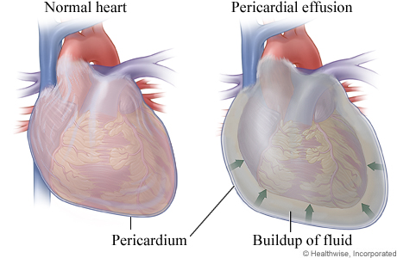
Pericardial Effusion:
DEFINITION, CAUSE/S & RISK FACTORS | A collection of fluid within the potential space of the serous pericardial sac Commonly occurs with an episode of acute pericarditis When this leads to ventricular filling compromise it becomes cardiac tamponade (EMERGENCY)
SIGNS & SYMPTOMS | Soft and distant heart sounds Muffled apex beat Raised JVP Dyspnoea
DIAGNOSIS & INVESTIGATIONS (Ix) | CXR: Large globular heart ECG: Low voltage QRS complexes Echo: GOLD
TREATMENT (Tx) | Treat the underlying cause (i.e pericarditis) Most resolve spontaneously

Slide 38
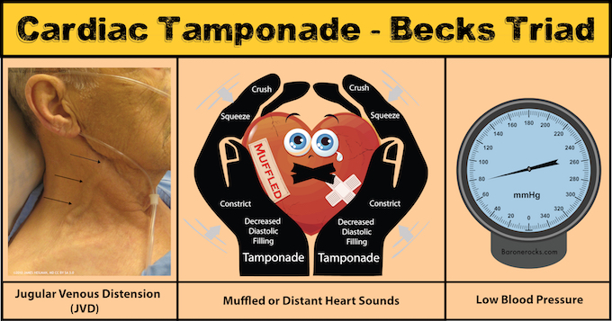
Cardiac Tamponade:
DEFINITION, CAUSE/S & RISK FACTORS | Compromised ventricular filling due to pericardial effusion
SIGNS & SYMPTOMS | Beck’s triad: Muffled heart sounds Raised JVP Low blood pressure
DIAGNOSIS & INVESTIGATIONS (Ix) | CXR: Large globular heart ECG: Low voltage QRS complexes Echo: (GOLD) late diastolic collapse of the right atrium
TREATMENT (Tx) | Call the experts!! Urgent drainage: Pericardiocentesis

Slide 39
Arrythmias

Slide 40
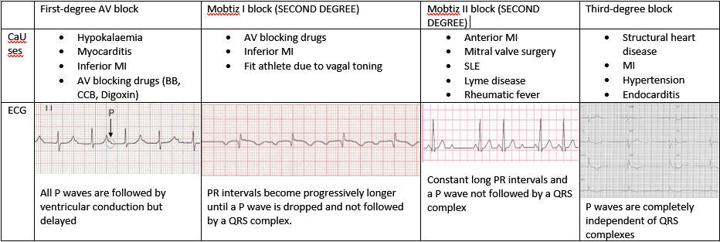
Heart Block
Notes:
First degree heart block does not need treatment
Second degree heart block may need a pacemaker depending on the symptoms
Third degree heart block needs pacemaker ASAP
Atropine 500 mg is given in symptomatic bradycardia as it increased thee heart rate

Slide 41
Atrial Fibrillation
The Peer Teaching Society is not liable for false or misleading information…

Slide 42
Atrial Flutter:
The Peer Teaching Society is not liable for false or misleading information…

Slide 43
Bundle Branch Block:
RBBB:
Causes: PE, IHD, ASD, VSD
Right bundle no longer conducts → ventricles don’t contract at the same time → left ventricle contracts first and then activates the right ventricle to contract
LBBB:
Causes: IHD and aortic valve disease
Left bundle no longer conducts → ventricles don’t contract at the same time → right ventricle contracts first and then activates the left ventricle to contract
The Peer Teaching Society is not liable for false or misleading information…
Notes:
Widening of the QRS complex >0.12 seconds
Rarely symptomatic

Slide 44
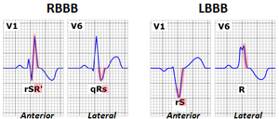
Bundle Branch Block:
The Peer Teaching Society is not liable for false or misleading information…
Notes:
Widening of the QRS complex >0.12 seconds
Rarely symptomatic

Slide 45
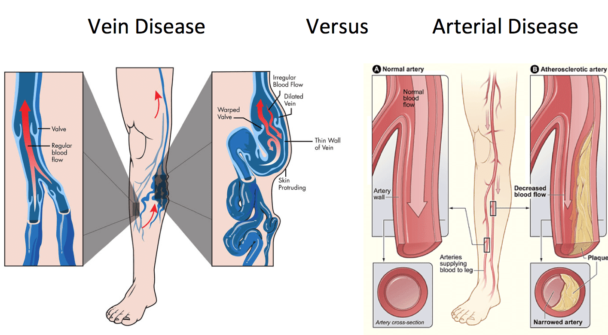
PAV vs PVD (DVT):
 | Peripheral Arterial Disease | Peripheral Venous Disease
Signs | Pain, pulseless, pallor, perishingly cold, paraesthesia, paralysis | Red, swollen, warm
Symptoms | Intermittent claudication | Dull achy constant pain
Investigations | ABPI | D-dimer and doppler ultrasound
Management | Anti-coagulants | Anti-coagulant
Complications | Acute limb ischaemia → loss of limb | PE
The Peer Teaching Society is not liable for false or misleading information…
Notes:
Widening of the QRS complex >0.12 seconds
Rarely symptomatic

Slide 46
SBA Questions

Slide 47
An ECG of a patient on the cardiology ward shows increasing PR intervals which enetually culminates in an absent QRS complex after the P wave. What is the most likely diagnosis?
Normal sinus rhythm
First-degree AV block
Mobitz type I block
Mobitz type II block
Complete heart block

Slide 48
An ECG of a patient on the cardiology ward shows increasing PR intervals which enetually culminates in an absent QRS complex after the P wave. What is the most likely diagnosis?
Normal sinus rhythm
First-degree AV block
Mobitz type I block
Mobitz type II block
Complete heart block

Slide 49
74-year-old man presented to A&E lightheaded, dizzy, sweaty and clammy. She looks very pale. She has a history of HF and MI. Her obs are HR 125, RR 26, BP 92/66, and she is afebrile. No history of recent trauma. What is the most likely diagnosis?
Septic shock
Hypovolemic shock
Cardiogenic shock
Neurogenic shock
Anaphylactic shock

Slide 50
74-year-old man presented to A&E lightheaded, dizzy, sweaty and clammy. She looks very pale. She has a history of HF and MI. Her obs are HR 125, RR 26, BP 92/66, and she is afebrile. No history of recent trauma. What is the most likely diagnosis?
Septic shock
Hypovolemic shock
Cardiogenic shock
Neurogenic shock
Anaphylactic shock

Slide 51
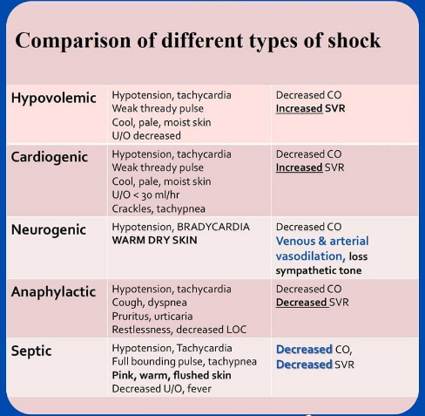

Slide 52
59-year-old man with BP of 168/92 has been diagnosed with essential HTN. He does not like the first medication you prescribed 5 years ago for his HTN as it makes him cough. What would be your next line of treatment?
Losartan
Furosemide
Lisinopril
Spironolactone
Amlodipine

Slide 53
59-year-old man with BP of 168/92 has been diagnosed with essential HTN. He does not like the first medication you prescribed 5 years ago for his HTN as it makes him cough. What would be your next line of treatment?
Bonus questions:
What is the first medication you prescribed him?
What could be the side effect of this new medication?
Losartan
Furosemide
Lisinopril
Spironolactone
Amlodipine

Slide 54
Paula is a 34-year-old woman of Caucasian heritage. She is 25 weeks pregnant and has been diagnosed with hypertension. Which of the following drugs should you NOT give her no matter what?
Losartan
Ramipril
Spironolactone
Amlodipine
Thiazides
1 and 2
1 and 4
2
2, 3, 4, and 5
1, 2, and 3

Slide 55
Paula is a 34-year-old woman of Caucasian heritage. She is 25 weeks pregnant and has been diagnosed with hypertension. Which of the following drugs should you NOT give her no matter what?
Losartan
Ramipril
Spironolactone
Amlodipine
Thiazides
ACEi and ARB should always be discontinued in pregnancy as they cause fetotoxicity
1 and 2
1 and 4
2
2, 3, 4, and 5
1, 2, and 3

Slide 56
A 74-year-old man presents to A&E with dizziness, fatigue and SOB. He feels especially lightheaded when he stands up. He has recently noticed a clear productive cough. On auscultation you notice a systolic murmur. What is the most likely cause of his diagnosis?
Calcified aortic valve
Congenital bicuspid aortic valve
Myxomatous degeneration
Endocarditis
Rheumatic fever

Slide 57
A 74-year-old man presents to A&E with dizziness, fatigue and SOB. He feels especially lightheaded when he stands up. He has recently noticed a clear productive cough. On auscultation you notice a systolic murmur. What is the most likely cause of his diagnosis?
Calcified aortic valve
Congenital bicuspid aortic valve
Myxomatous degeneration
Endocarditis
Rheumatic fever
The diagnosis is Aortic Stenosis

Slide 58
Conclusion
We’ve covered a good range of topics that are more likely to come up
Resources used to make this session:
Passmed textbook
NICE guidelines
Oxford Handbook of Clinical Medicine
Geeky Medics notes
KP notes
The Peer Teaching Society is not liable for false or misleading information…

Slide 59
Feedback
If you want my arrhythmia tables fill out the feedback form and add your email at the end and I will send it to you!!!
https://forms.gle/dp8rLL5rzxfN9r1t8
The Peer Teaching Society is not liable for false or misleading information…

