Slide 1
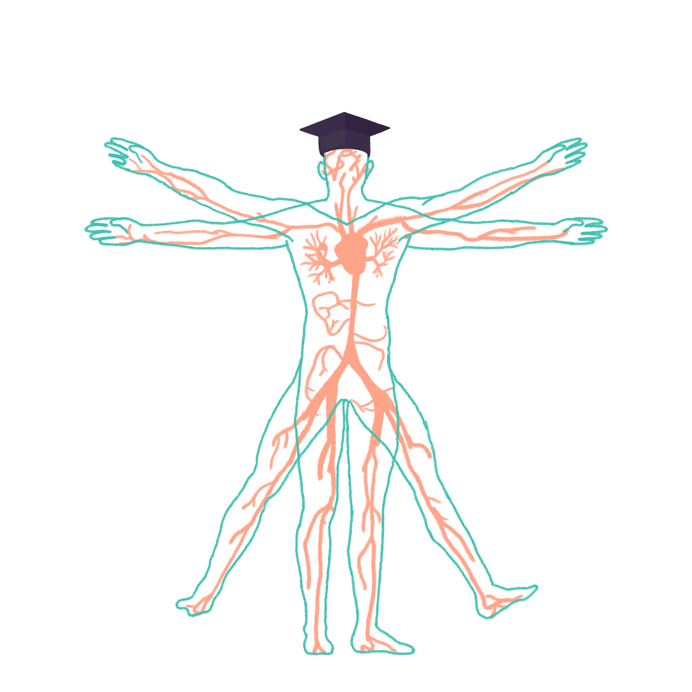
2023/2024

Slide 2
GI Wrap Up
Phase 1 Revision Session
Liv Slaney and Emma Johnson
15/04/24
The Peer Teaching Society is not liable for false or misleading information…

Slide 3
Aims and Objectives
x8 SBAs
Break
x2 (10 mark) SAQs
Surface markings
Anterior abdominal wall muscles
Rectus sheath
Bowel nerve supply
Retroperitoneal organs
Factors affecting BMR
Stages of swallowing
Salivary glands
Stomach histology
Carbohydrate and starch digestion
Proteins – digestion and absorption
The Peer Teaching Society is not liable for false or misleading information…

Slide 4
SBA
Which of these structures are found in the right hypochondrium?
Liver, Gallbladder, Small Intestine, Ascending Colon, Transverse Colon, Left Kidney
﻿Liver, Gallbladder, Small Intestine, Ascending Colon, ﻿﻿Transverse Colon, Right Kidney
Stomach, Liver, Pancreas, Left and Right Kidney
Stomach, Pancreas, Small Intestine, Transverse Colon
Liver, Gallbladder, Small Intestine, Spleen, Left Kidney
The Peer Teaching Society is not liable for false or misleading information…

Slide 5
SBA
Which of these structures are found in the right hypochondrium?
Liver, Gallbladder, Small Intestine, Ascending Colon, Transverse Colon, Left Kidney
﻿Liver, Gallbladder, Small Intestine, Ascending Colon, ﻿﻿Transverse Colon, Right Kidney
Oesophagus, Stomach, Liver, Pancreas, Left and Right Kidney - Epigastric
Stomach, Pancreas, Small Intestine, Transverse Colon - Umbilical
Liver, Gallbladder, Small Intestine, Spleen, Left Kidney
The Peer Teaching Society is not liable for false or misleading information…
Notes:
Left hypochondriac region: Part of stomach, top of left lobe of liver, left kidney, spleen, tail of pancreas, part of small intestine, part of transverse colon, part of descending colon.
Right hypochondriac region: Liver, gallbladder, part of small intestine, part of ascending colon, part of transverse colon, right kidney

Slide 6
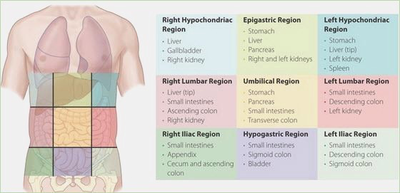
SBA - Surface Markings
The Peer Teaching Society is not liable for false or misleading information…
Notes:
subcostal plane
corresponds to a line drawn joining the lower most bony point of the rib cage, usually 10thcostal cartilage
body of the L3 vertebra; the origin of the inferior mesenteric artery and 3rd part of the duodenum lie on this plane
transtubercular plane
corresponds to a line uniting the two tubercles of the iliac crests
upper border of the L5 vertebra and the confluence of the common iliac veins (i.e. IVCorigin) lie on this plane

Slide 7
SBA
Which of these structures is not found on the Transpyloric plane?
Pylorus of stomach
Neck of pancreas
Hepatic portal vein
Kidney hilum
Neck of gallbladder
The Peer Teaching Society is not liable for false or misleading information…

Slide 8
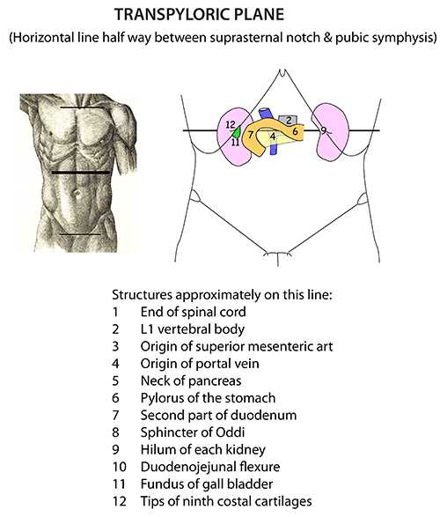
SBA
Which of these structures is NOT found on the Transpyloric plane?
Pylorus of stomach
Neck of pancreas
Hepatic portal vein
Kidney hilum
Neck of gallbladder X
The Peer Teaching Society is not liable for false or misleading information…
Notes:
Imaginary horizontal line at L1 vertebral level

Slide 9
SBA
Which of the following aponeuroses make up the anterior wall of the rectus sheath above the arcuate line?
External oblique, internal oblique and transversus abdominis
External oblique and ½ internal oblique
½ Internal oblique and transversus abdominis
Transversalis fascia
External oblique, internal oblique and transversalis fascia
The Peer Teaching Society is not liable for false or misleading information…

Slide 10
SBA
Which of the following aponeuroses make up the anterior wall of the rectus sheath above the arcuate line?
External oblique, internal oblique and transversus abdominis - anterior wall below arcuate
External oblique and ½ internal oblique
½ Internal oblique and transversus abdominis - posterior wall above arcuate
Transversalis fascia - posterior wall below arcuate
External oblique, internal oblique and transversalis fascia
The Peer Teaching Society is not liable for false or misleading information…

Slide 11
SBA
The Peer Teaching Society is not liable for false or misleading information…
Notes:
https://www.youtube.com/watch?v=u1rDfeXyQc8
Significance - linea alba and arcuate line are useful landmarks in surgery, risk of herniation/bleeding below arcuate line due to absent posterior aponeuroses.
•External Oblique:
Fibres run inferiomedially (putting your hand in your pocket)
•Internal oblique:
Fibres run superomedially

Slide 12
SBA
Which of the following provides sympathetic innervation to the foregut?
Vagus nerve
Lumbar splanchnic nerve
Greater splanchnic nerve
Lesser and least splanchnic nerve
Pelvic splanchnic nerve
The Peer Teaching Society is not liable for false or misleading information…

Slide 13
SBA
Which of the following provides sympathetic innervation to the foregut?
Vagus nerve - foregut and midgut parasympathetic
Lumbar splanchnic nerve - hindgut Sympathetic
Greater splanchnic nerve
Lesser and least splanchnic nerves - midgut Sympathetic
Pelvic splanchnic nerve - hindgut parasympathetic
The Peer Teaching Society is not liable for false or misleading information…
Notes:
https://www.youtube.com/watch?v=WXO_nyFY9oM
Good to learn nerve roots:
Greater splanchnic - T5 - T9
Lesser splanchnic - T10 - T11
Least splanchnic - T12
Lumbar splanchnic - L1-L2
Pelvic splanchnic - L2-L4

Slide 14
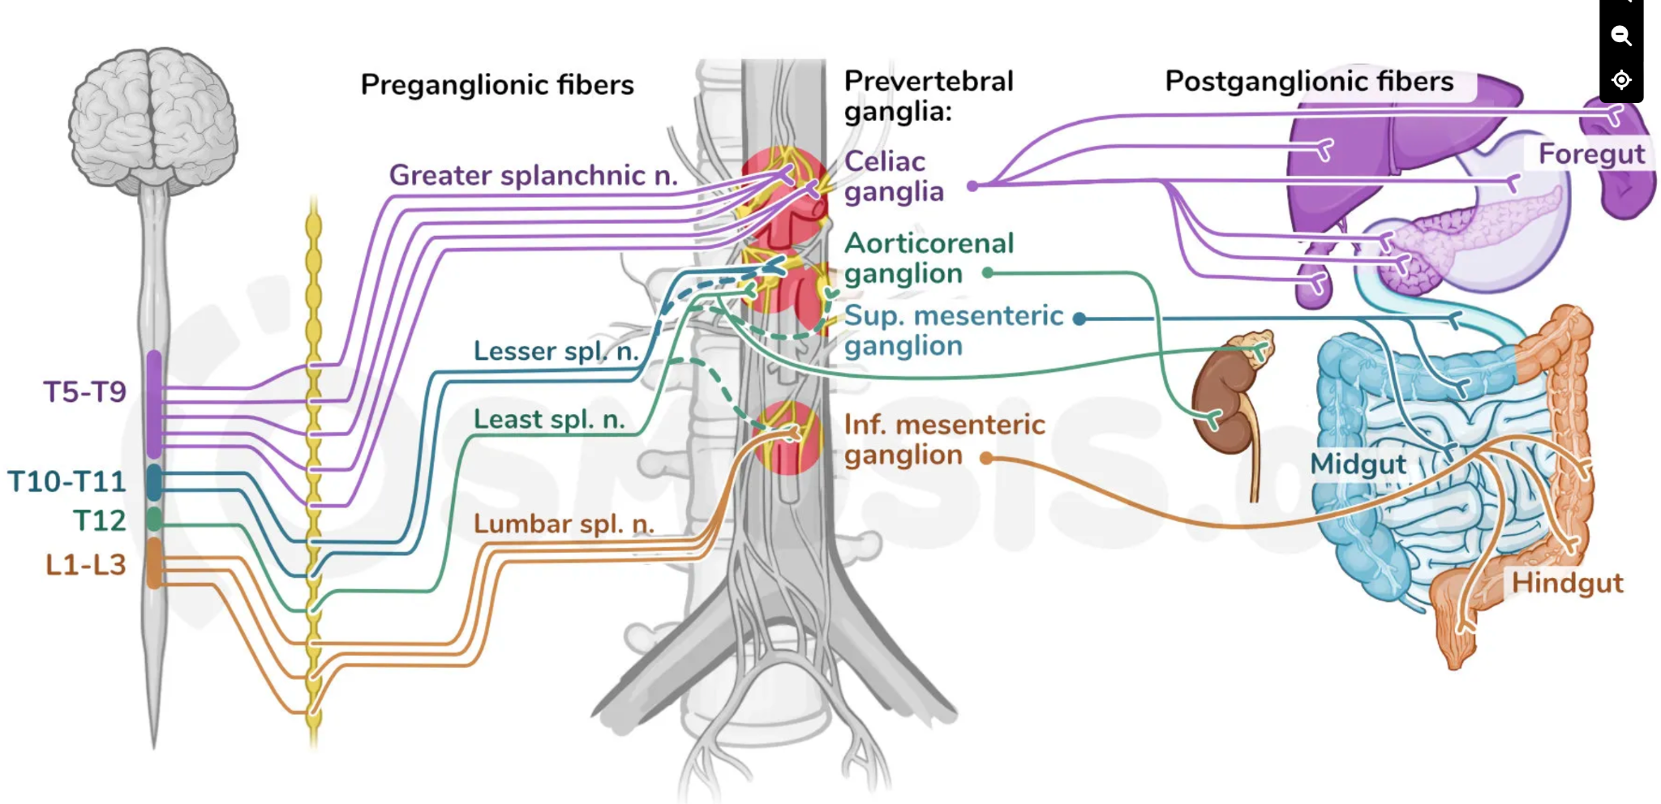
SBA
The Peer Teaching Society is not liable for false or misleading information…
Notes:
https://www.youtube.com/watch?v=WXO_nyFY9oM
Splanchnic nerves mean “nerves for the internal organs,” so they innervate the abdominal viscera. Abdominopelvic splanchnic nerves contain sympathetic fibers, which arise from cell bodies in the lateral horn of the gray matter of the spinal cord, from T5 to L2/3 spinal segments.
The vagus nerves in the abdomen supply parasympathetic innervation to the lower esophagus, stomach, small intestine, ascending colon and most of the transverse colon.
The pelvic splanchnic nerves carry parasympathetic innervation to the final part of the gut, from the descending colon to the anus.

Slide 15
SBA
Which of the following structures is not retroperitoneal?
Adrenal glands
Duodenum (D2 and D3)
Ureters
Oesophagus
Transverse colon
The Peer Teaching Society is not liable for false or misleading information…

Slide 16
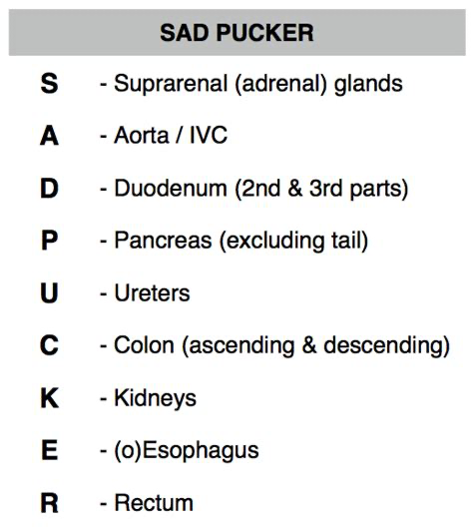
SBA
Which of the following structures is not retroperitoneal?
Adrenal glands
Duodenum (D2 and D3)
Ureters
Oesophagus
Transverse colon
The Peer Teaching Society is not liable for false or misleading information…

Slide 17
SBA
Which phase of swallowing is voluntary?
Oral phase
Acute phase
Pharyngeal phase
Salivary phase
Oesophageal phase
The Peer Teaching Society is not liable for false or misleading information…

Slide 18
SBA
Which phase of swallowing is voluntary?
Oral phase
Acute phase
Pharyngeal phase - involuntary
Salivary phase
Oesophageal phase - involuntary
The Peer Teaching Society is not liable for false or misleading information…

Slide 19
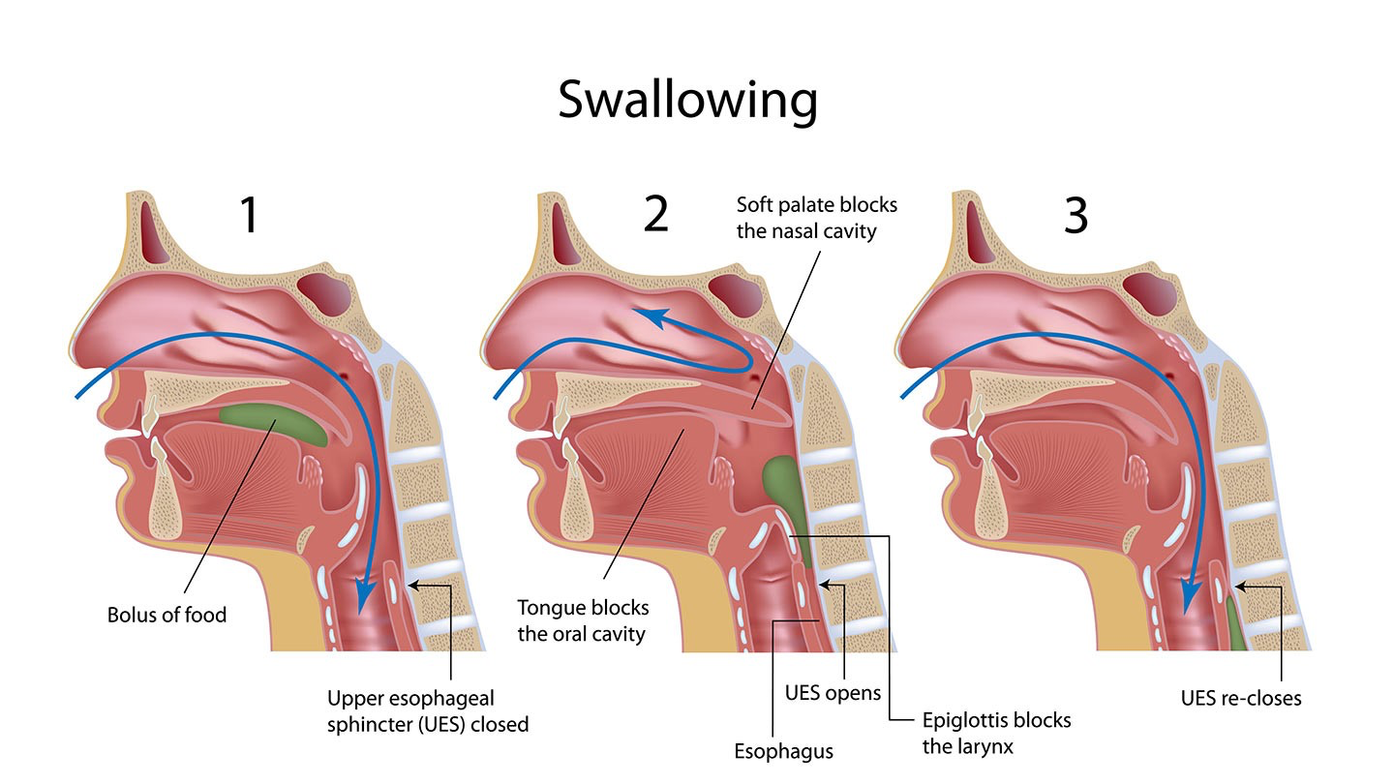
SBA
The Peer Teaching Society is not liable for false or misleading information…
Notes:
https://www.youtube.com/watch?v=YQm5RCz9Pxc

Slide 20
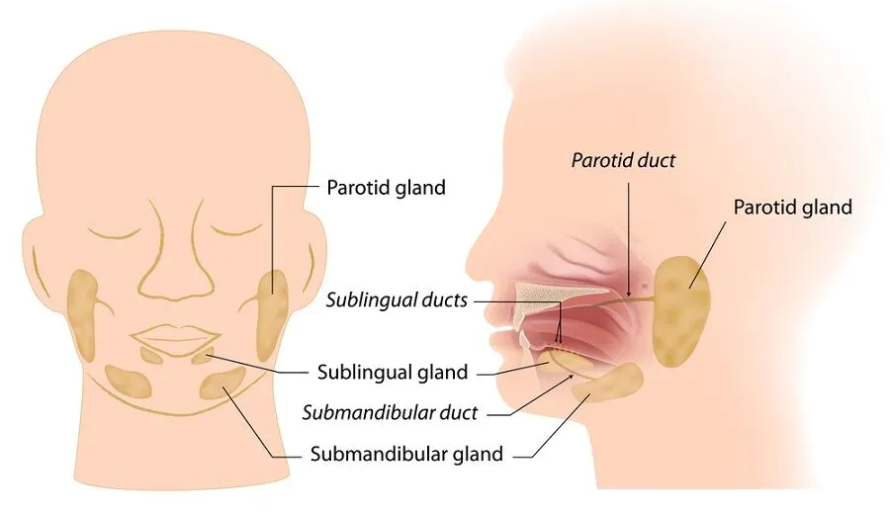
SBA
Which of the following salivary glands is mostly serous with some mucous acini?
Buccal
Sublingual
Parotid
Submandibular
None of the above
The Peer Teaching Society is not liable for false or misleading information…

Slide 21
SBA
Which of the following salivary glands is mostly serous with some mucous acini?
Buccal
Sublingual - mostly mucous
Parotid - serous only
Submandibular
None of the above
The Peer Teaching Society is not liable for false or misleading information…
Notes:
The submandibular gland is mostly serous with some mucous acini. This means that it primarily secretes a watery fluid containing enzymes (serous) but also produces some mucus. Serous cells are responsible for producing a watery secretion that contains enzymes, electrolytes, and other proteins. This type of secretion helps in the digestion and breakdown of food.
The sublingual gland is predominantly composed of mucous cells. This means that it secretes a thick, viscous fluid rich in glycoproteins called mucins. Mucous cells play a role in lubricating and protecting the oral cavity, as well as aiding in the initial stages of digestion by moistening food particles.
The parotid gland is a major salivary gland located near the ear. It is "purely serous" = produce a watery secretion that contains enzymes, electrolytes, and antibodies.

Slide 22
SBA
Which of the following factors decreases BMR?
Being male
Increased age
Pregnancy
Exercise
Low BMI (thin)
The Peer Teaching Society is not liable for false or misleading information…

Slide 23
SBA
Which of the following factors decreases BMR?
Being male
Increased age - in adults, BMR decreases at a rate of 2% per decade
Pregnancy
Exercise
Low BMI (thin)
The Peer Teaching Society is not liable for false or misleading information…
Notes:
BMR = Basal metabolic rate (BMR) estimates the minimum number of calories a person needs to burn to sustain their basic life functions during a 24-hour period of rest. Examples of such functions include:
breathing
circulation
digestion and absorption of nutrients
cellular processes
Decrease w age ﻿due in part to the natural loss of lean muscle and decrease in energy expenditure that occurs as people age. As you get older, you’ll need to compensate for your slowing metabolism by eating healthier and working out harder.
Males have more muscle mass and lower body fat. Thus, they have higher BMR than females, regardless of age.
Leaner ppl burn calories more effectively hence higher BMR
Pregnancy increases BMR by 20%

Slide 24
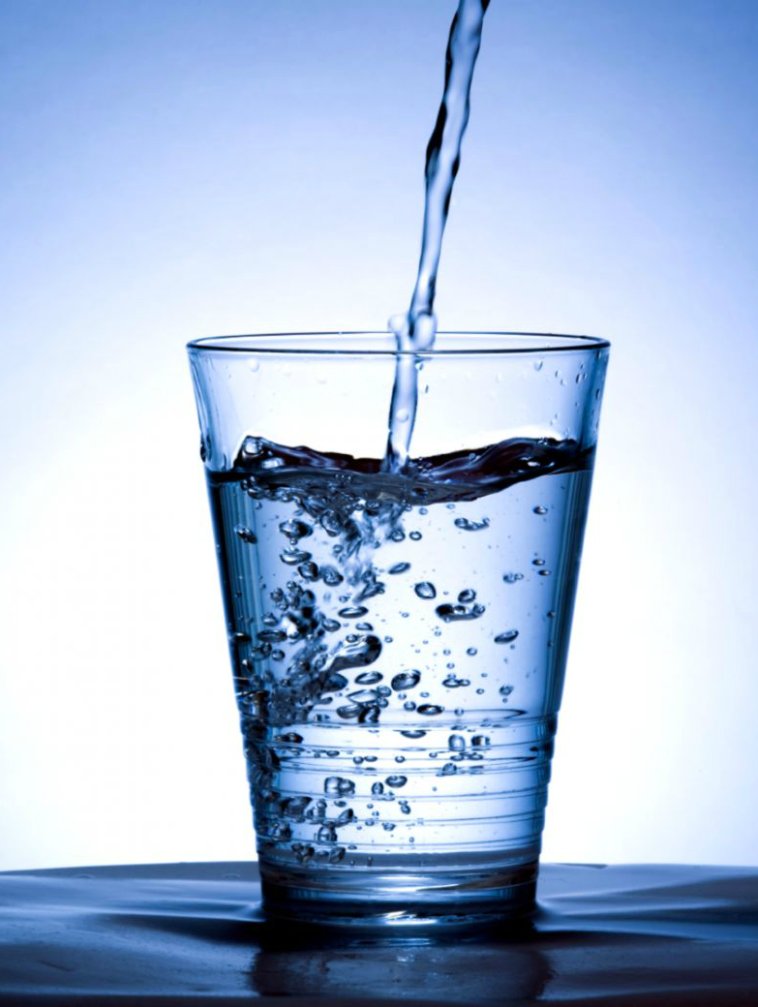
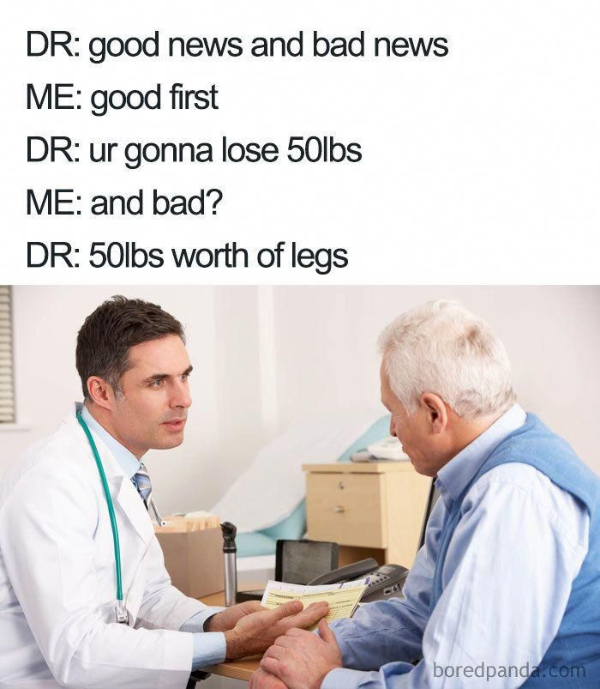
Break !
The Peer Teaching Society is not liable for false or misleading information…

Slide 25
SAQ
A 45 year-old man attends the GP with a 6 month history of abdominal pain. After investigations, he was diagnosed with peptic ulcer disease. (10 marks).
What is the surface epithelium of the stomach? (1 mark)
Identify 4 gastric cells and describe their secretions. (4 marks)
Name 2 causes of peptic ulcers. (2 marks)
Zollinger Ellison syndrome is a condition that can lead to recurrent peptic ulcers. What hormone does it release? (1 mark)
Name 2 protective mechanisms of the gastric mucosa. (2 marks)
The Peer Teaching Society is not liable for false or misleading information…

Slide 26
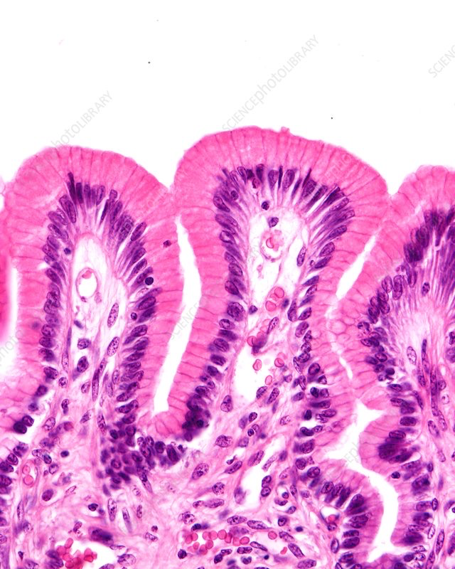
SAQ
What is the surface epithelium of the stomach? (1 mark)
Simple columnar epithelium.
Accept foveolar epithelium.
The Peer Teaching Society is not liable for false or misleading information…
Notes:
It lines the inside of the stomach as surface mucous cells and had many gastric pits - this forms as holes throughout the stomach lining.

Slide 27
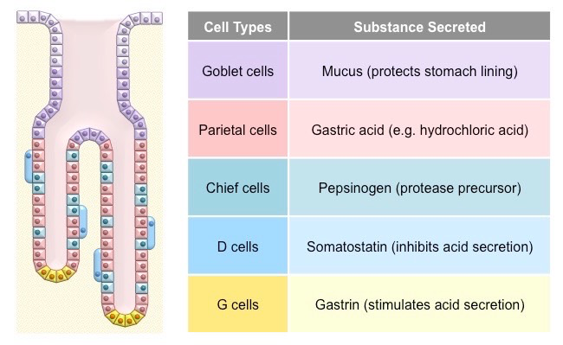
SAQ
Identify 4 gastric cells and describe their secretions. (4 marks)
Goblet cells secrete mucus.
Parietal cells secrete HCL and/or intrinsic factor.
Chief cells secrete pepsinogen.
Enterochromaffin-like cells secrete histamine.
G cells secrete Gastrin
D cells secrete Somatostatin.
The Peer Teaching Society is not liable for false or misleading information…
Notes:
https://old-ib.bioninja.com.au/options/option-d-human-physiology/d2-digestion/gastric-pits.html

Slide 28
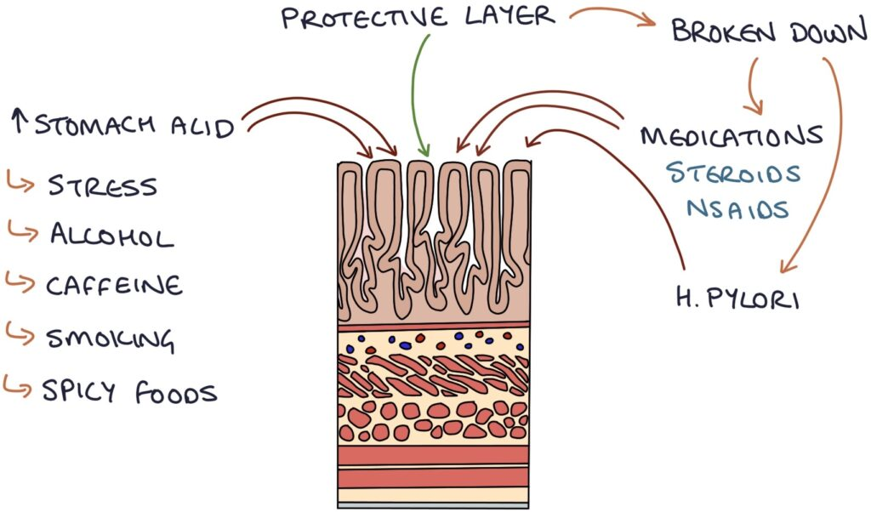
SAQ
Name 2 causes of peptic ulcers. (2 marks)
Helicobacter pylori.
Non-steroidal anti-inflammatory drugs (NSAIDs e.g. ibuprofen).
Gastric ischemia.
Gastrinoma.
Psychological stress.
Chemical irritants.
The Peer Teaching Society is not liable for false or misleading information…
Notes:
Zero to finals

Slide 29
SAQ
Zollinger Ellison syndrome is a condition that can lead to recurrent peptic ulcers. What hormone does it release? (1 mark)
Gastrin
The Peer Teaching Society is not liable for false or misleading information…
Notes:
Osmosis

Slide 30
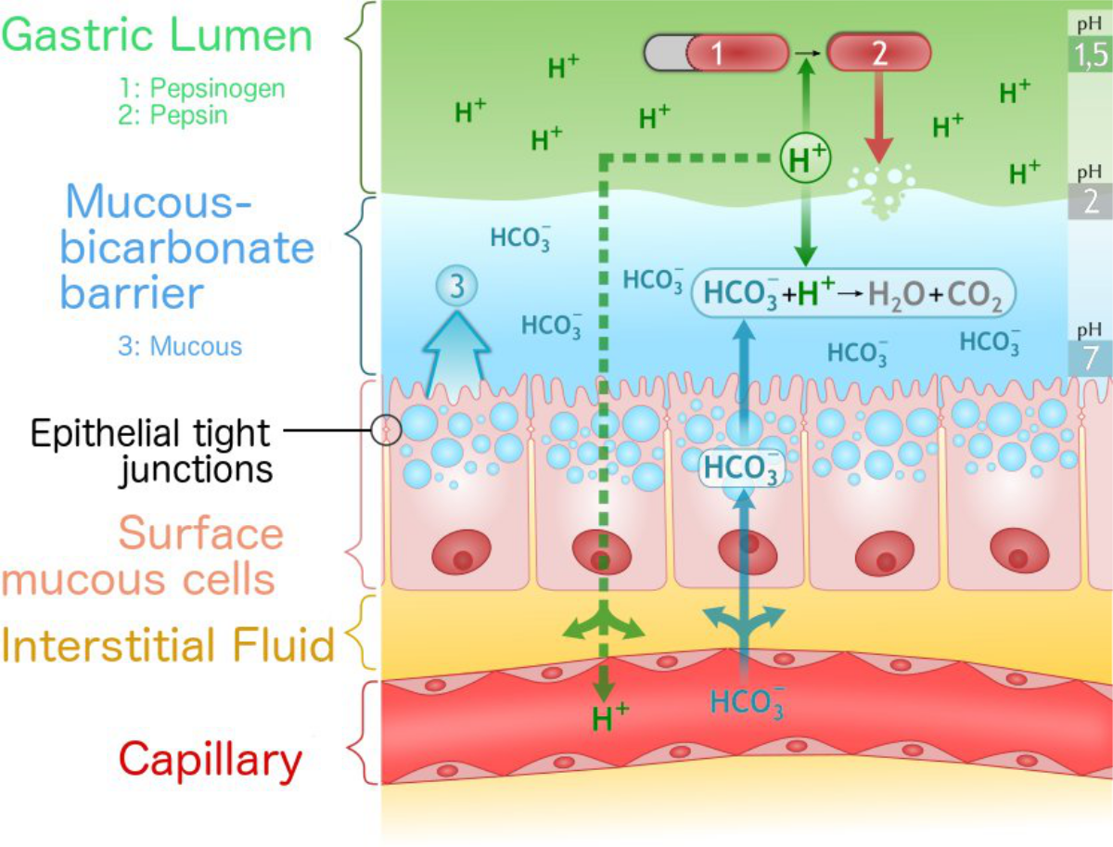
SAQ
Name 2 protective mechanisms of the gastric mucosa. (2 marks)
Alkaline mucus on luminal surface
Tight junctions between epithelial cells.
Rapid cell replacement of damaged cells by stem cells.
Feedback loops for regulation of gastric acid secretion.
The Peer Teaching Society is not liable for false or misleading information…
Notes:
Teach Me Physiology

Slide 31
SAQ
A 30-year-old woman has started a new diet following a diagnosis of hypertension. She is 165 cm and weighs 95 kg. (10 marks)
What is her BMI? (1 mark)
Out of the 5 classifications of BMI, what class would she be? (1 mark).
Name two hormones that decrease appetite and stimulates satiety. (2 marks)
How are carbohydrates digested? (3 marks)
How are proteins digested? (3 marks).
The Peer Teaching Society is not liable for false or misleading information…

Slide 32
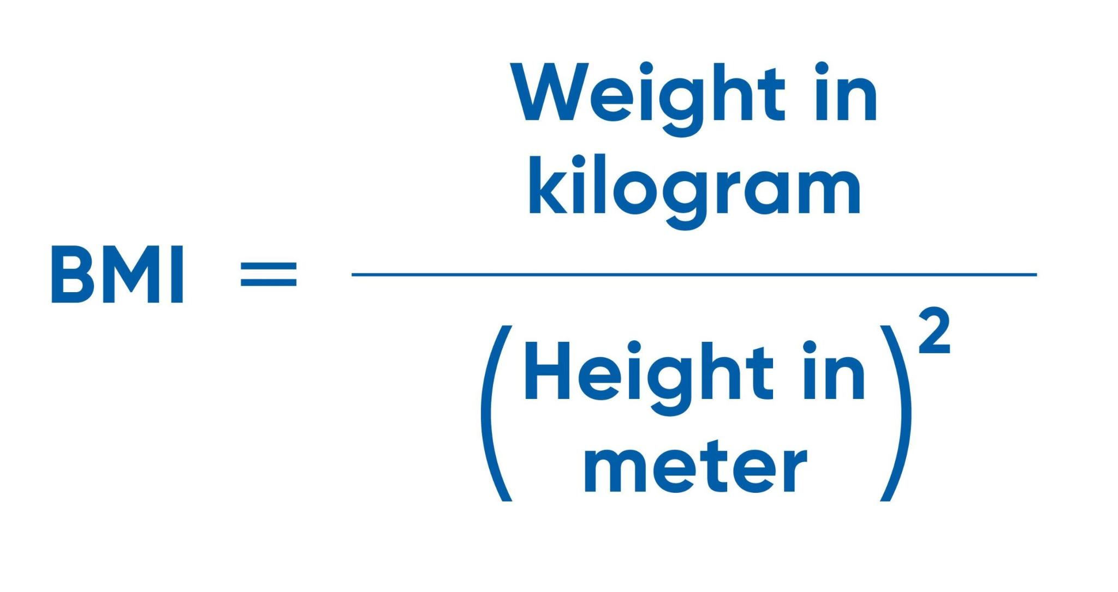
SAQ
A 30-year-old woman has started a new diet following a diagnosis of hypertension. She is 165 cm and weighs 95 kg. (10 marks)
What is her BMI? (1 mark)
34.9
Accept 34.8
The Peer Teaching Society is not liable for false or misleading information…

Slide 33
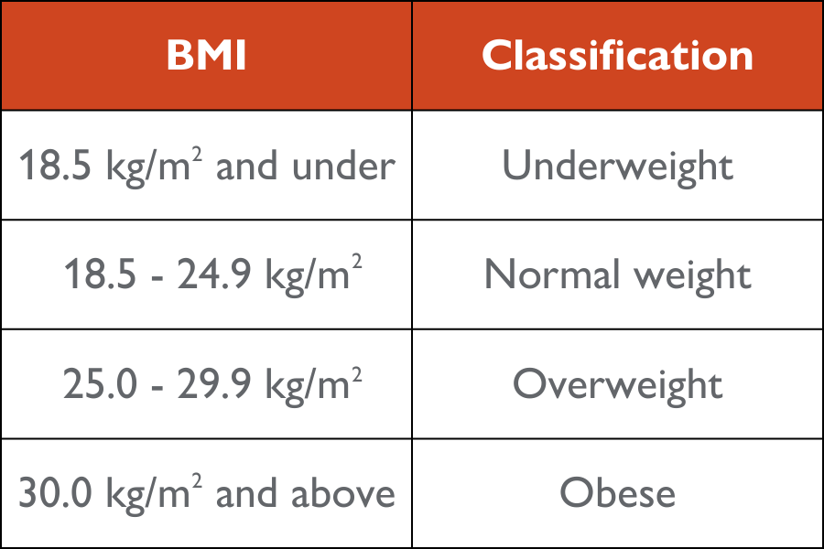
SAQ
A 30-year-old woman has started a new diet following a diagnosis of hypertension. She is 165 cm and weighs 95 kg. (10 marks)
Out of the 5 classifications of BMI, what class would she be? (1 mark).
Obese
The Peer Teaching Society is not liable for false or misleading information…

Slide 34
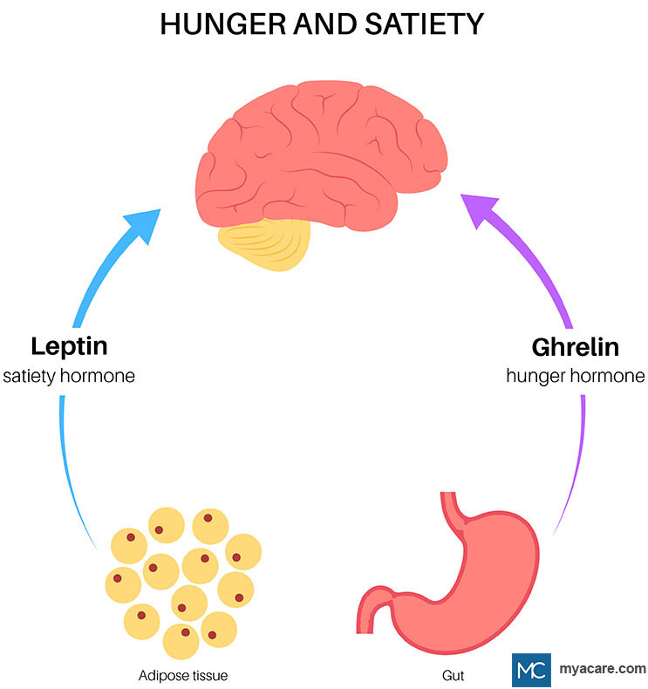
SAQ
Name two hormones that decrease appetite and stimulates satiety. (2 marks)
PYY (peptide tyrosine tyrosine)
Leptin
Insulin
CCK (cholecystokinin)
The Peer Teaching Society is not liable for false or misleading information…
Notes:
teachmephysiology

Slide 35
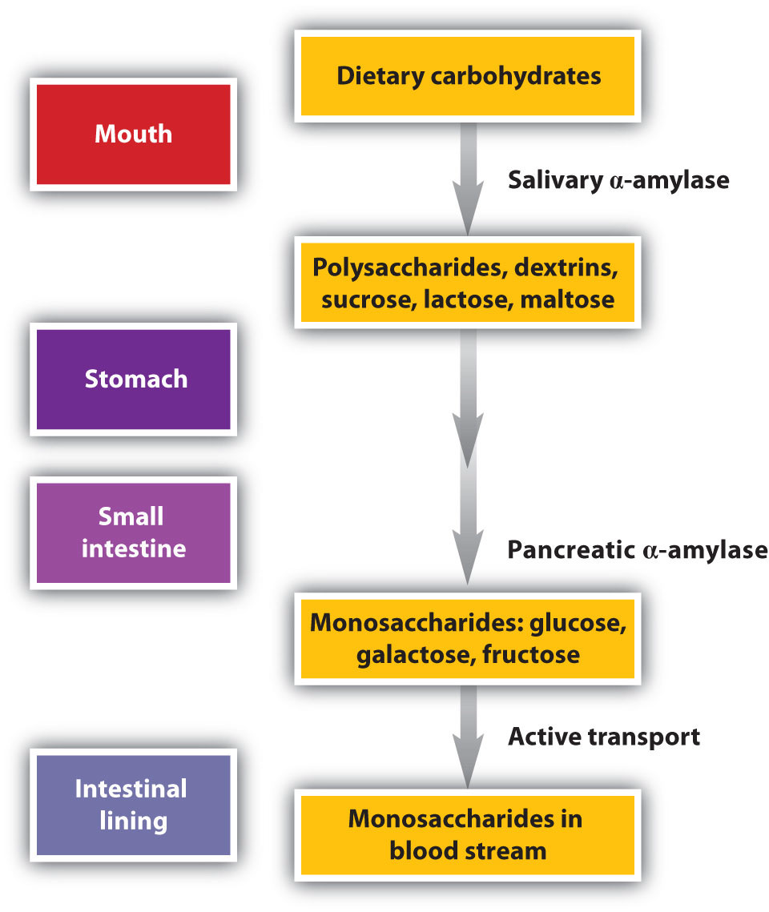
SAQ
How are carbohydrates digested? (3 marks)
Begins in the mouth, with salivary amylase.
Pancreatic alpha amylase is the main enzyme and occurs in the SI. This produces disaccharides.
Brush border enzymes hydrolyse disaccharides into monosaccharides of glucose, galactose and fructose.
Monosaccharides are absorbed into the bloodstream.
The Peer Teaching Society is not liable for false or misleading information…
Notes:
https://www.google.com/search?sca_esv=924f3957077d70b1&q=how+are+carbohydrates+digested&tbm=isch&source=lnms&prmd=ivnbmtz&sa=X&ved=2ahUKEwif8tbP6KGFAxUNW0EAHZqcAqkQ0pQJegQIEBAB&biw=718&bih=779&dpr=2#imgrc=apj4I0FOM2DhlM
teachmephysiology

Slide 36
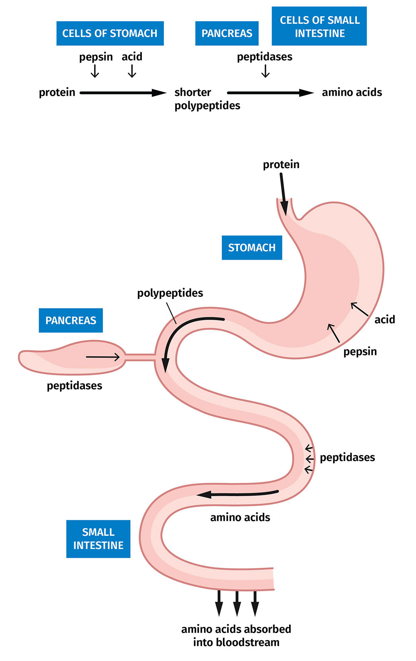
SAQ
How are proteins digested? (3 marks).
Protein digestion begins in the stomach with the action of pepsin, breaking protein into amino acids and oligopeptides.
Digestion is completed in the small intestine proteolytic pancreatic enzymes (trypsin and chymotrypsin).
These peptide fragments are absorbed or digested to free amino acids. The final digestion is by exopeptidases.
By carboxypeptidases, aminopeptidases and intracellular peptidases.
The Peer Teaching Society is not liable for false or misleading information…
Notes:
Teachmephysiology

Slide 37
We would appreciate any feedback! Scan for the slides
The Peer Teaching Society is not liable for false or misleading information…
Notes:
https://docs.google.com/forms/d/e/1FAIpQLScXWOGGxwVsg2O3CloFgzFkI5WAMfFQHhEVDyELNbB3Is0G3Q/viewform

