Slide 1
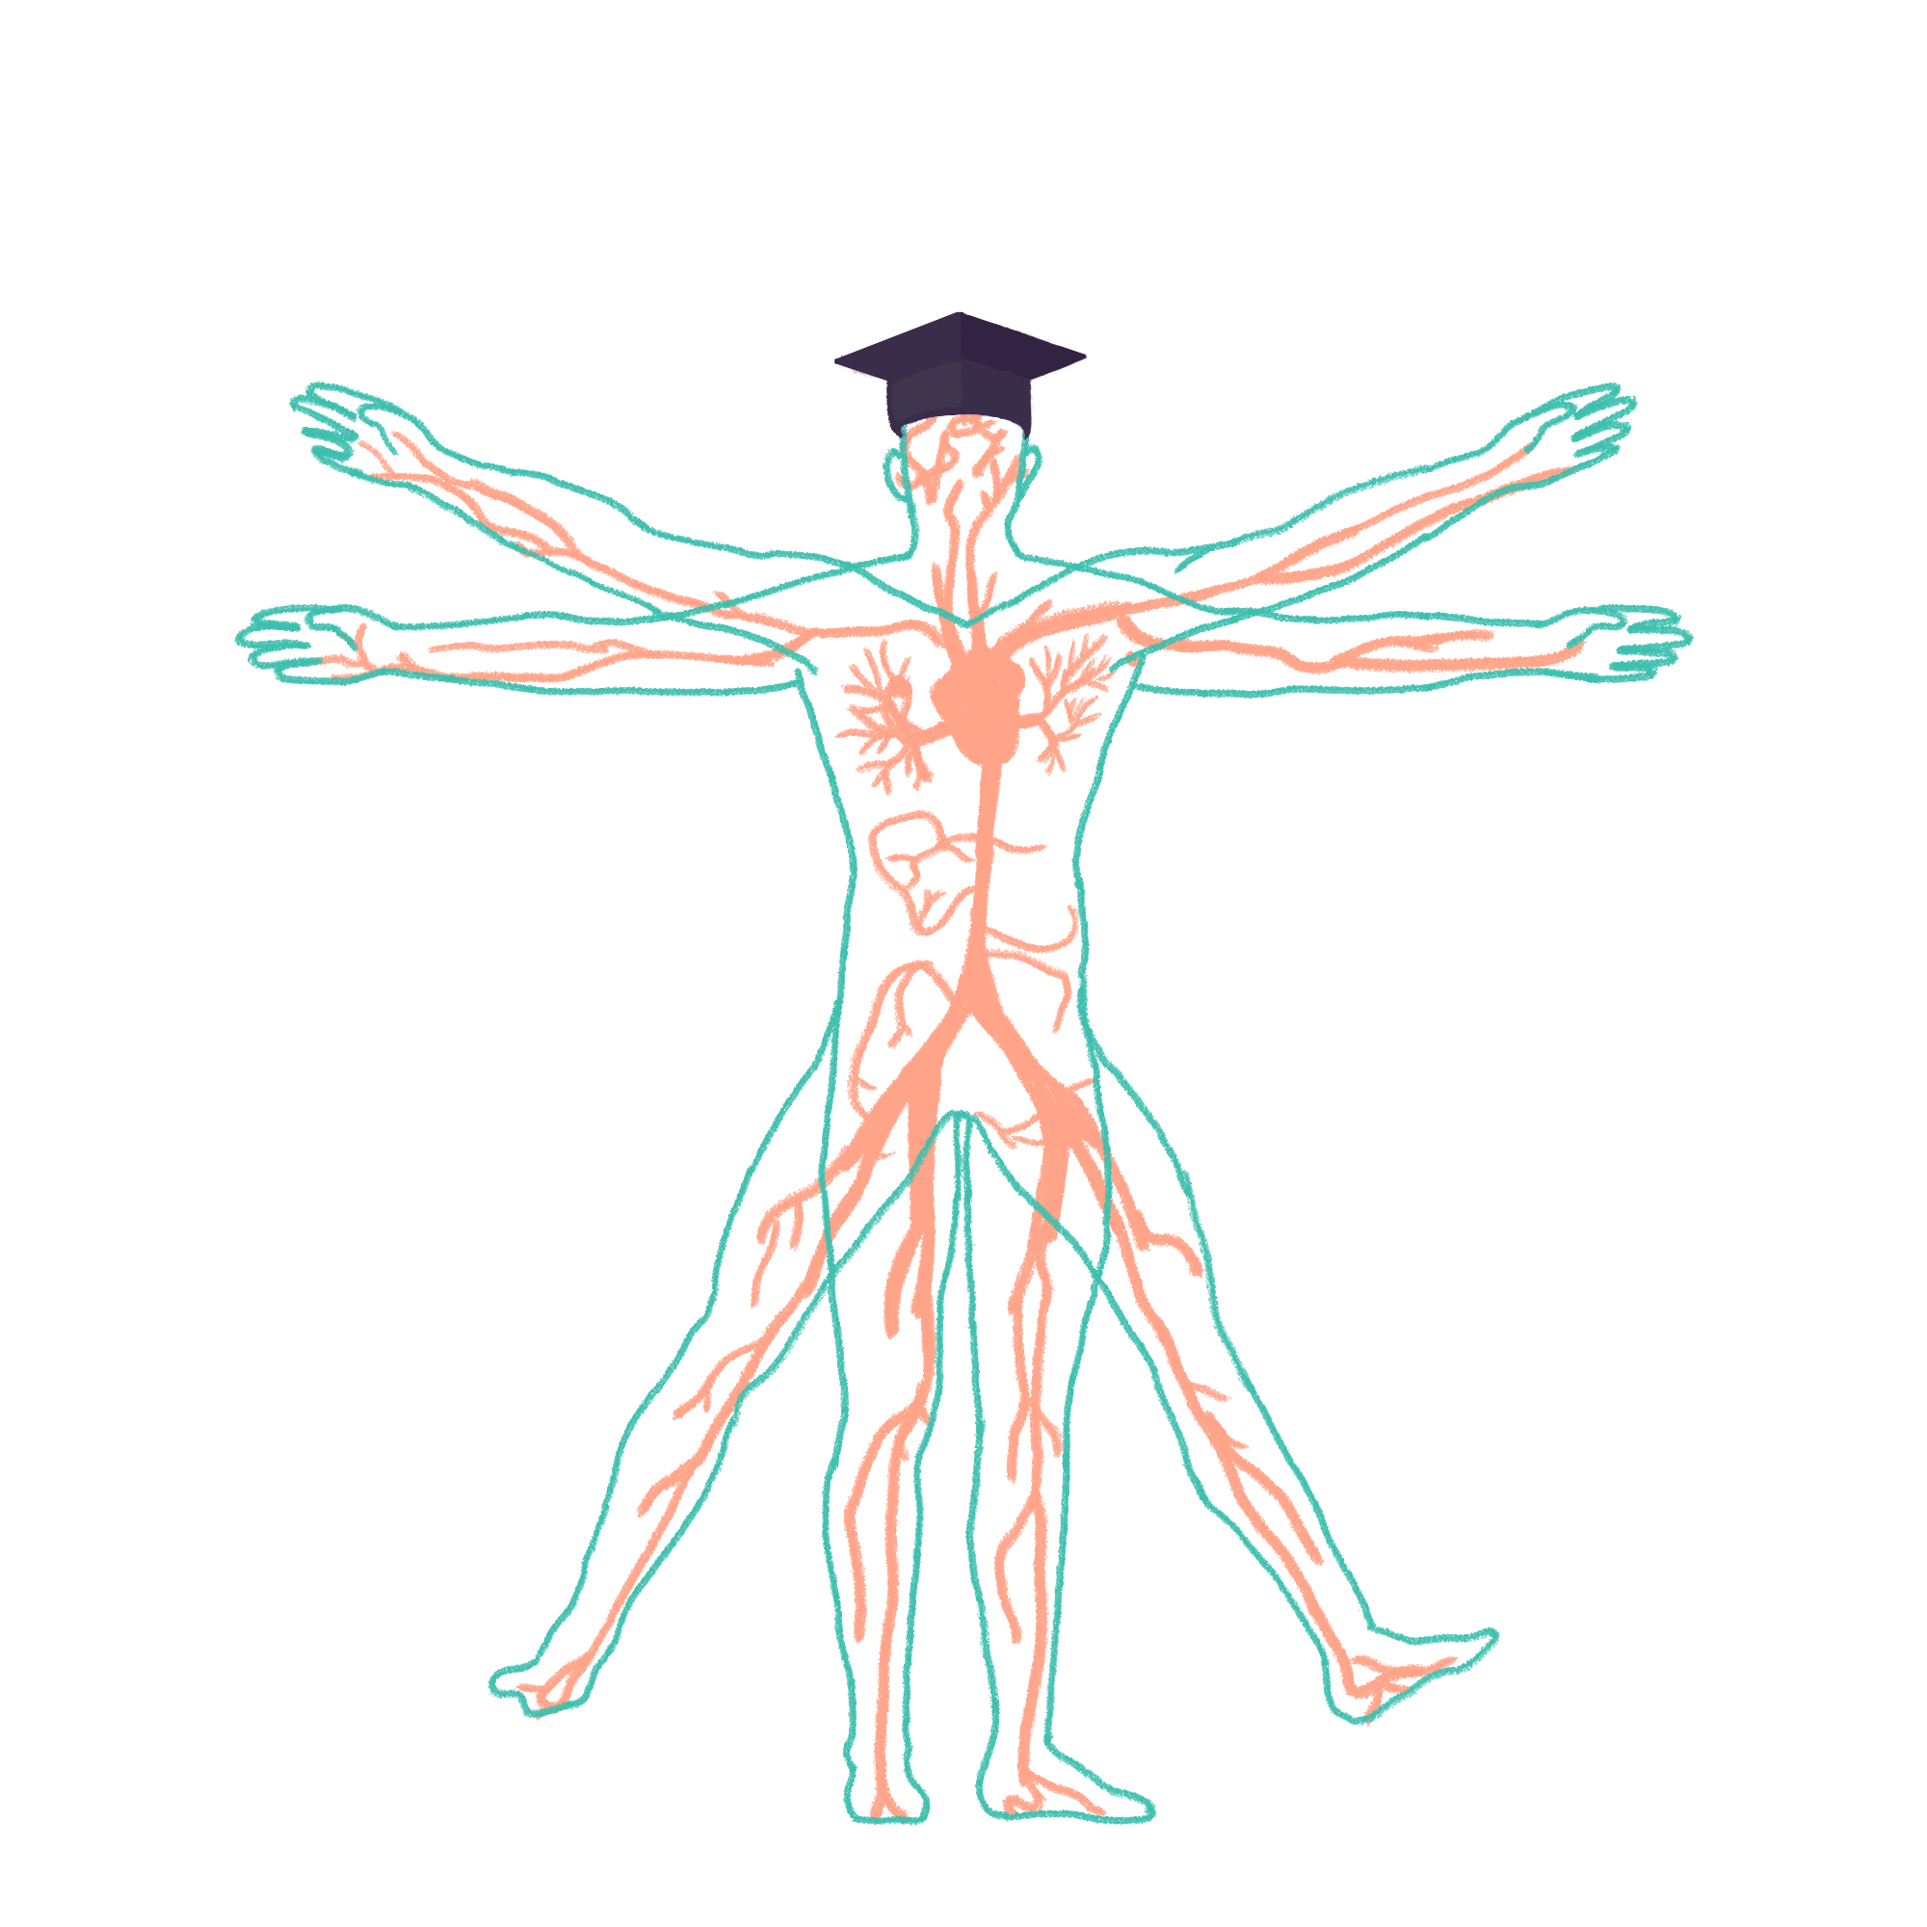
2023/2024

Slide 2
Liver and Friends
Phase 1 Revision Session
Omar Al-Rubaie
14/12/2023 18:30-19:30
The Peer Teaching Society is not liable for false or misleading information…

Slide 3
Aims and Objectives
- Anatomy of the Hepatobiliary System.
- Liver Physiology:
- Detoxification.
- Vitamin and Iron Storage.
- Fat Metabolism.
- Protein Production.
- Nitrogen Balance.
- Gallbladder and Pancreas Physiology.
- Embryology.
- Histology.
The Peer Teaching Society is not liable for false or misleading information…

Slide 4
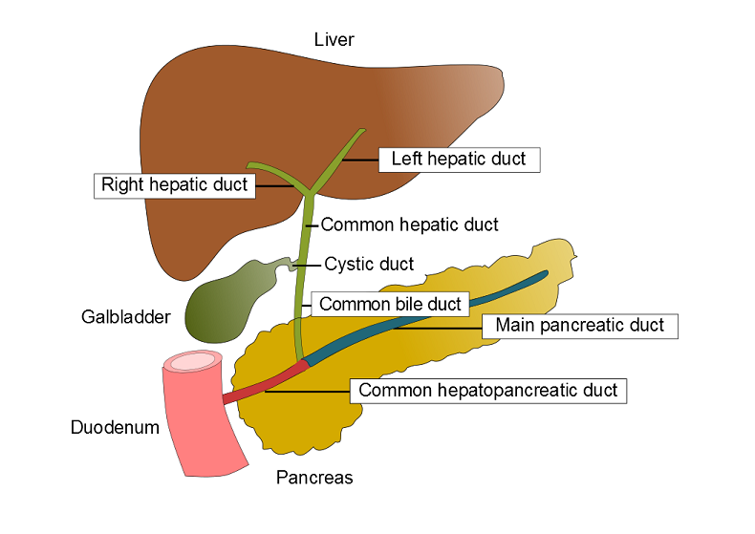
Overview of Anatomy
The Hepatobiliary system is comprised of:
- the liver
- intrahepatic bile ducts
- extrahepatic bile ducts
- (gallbladder)
- pancreas.
The Peer Teaching Society is not liable for false or misleading information…
Notes:
The Liver - The liver is predominantly located in the right hypochondrium and epigastric areas and extends into the left hypochondrium. The liver detoxifies various metabolites, synthesises proteins and produces biochemicals necessary for digestion and growth, it also synthesises bile (Swiss army knife of organs).
Intrahepatic Bile Ducts – Bile ducts within the liver connect each lobule forming the right and left hepatic ducts which leave the liver forming the common hepatic duct.
Extrahepatic Bile Ducts – All of the bile ducts outside of the liver and includes the gallbladder. This is the common hepatic duct, gallbladder, cystic duct and common bile duct, this then merges with main pancreatic duct to form common hepatopancreatic duct.
Gallbladder - The gallbladder is a gastrointestinal organ located within the right hypochondrial region of the abdomen. It lies within a fossa formed between the inferior aspects of the right and quadrate lobes of the liver (will go over lobes in next slide. The primary function of the gallbladder is to concentrate and store bile which is produced by the liver.
Pancreas - The pancreas is an abdominal glandular organ with both digestive exocrine (lipase, amylase and protease) and hormonal endocrine (insulin and glucagon) functions. It is both a intraperitoneal and retroperitoneal organ.

Slide 5
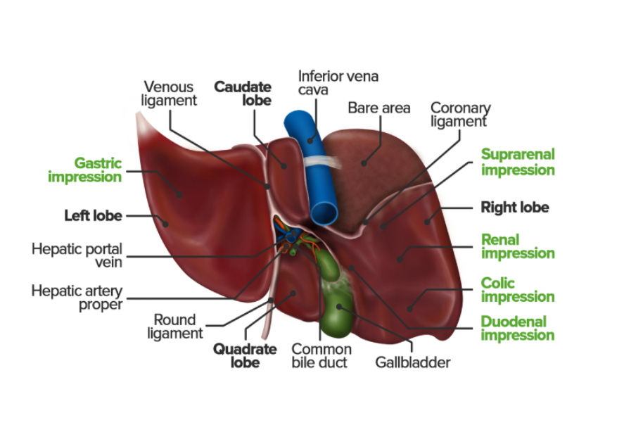
The Liver
Liver Lobes – left, right, caudate, and quadrate.
Impressions – gastric, suprarenal, renal, colic, duodenal, and oesophageal.
Blood – hepatic artery proper, hepatic portal vein, hepatic veins.
Nerves – hepatic plexus.
The Peer Teaching Society is not liable for false or misleading information…
Notes:
Looking at bottom of liver (inferior aspect).
Lobes – The liver contains a large right lobe and smaller left lobe. There are then two further accessory lobes which are the caudate lobe and the quadrate lobe. The caudate and quadrate lobes are separated by the porta hepatis which is a deep transverse fissure containing all the vessels, nerves, and ducts entering or leaving the liver with the exception of the hepatic veins.
Impressions – They are made and named by the surrounding organs, oesophageal is posterior to the gastric.
Blood - The liver has a dual blood supply with 25% coming from the hepatic artery proper (or proper or common hepatic artery) (non-parenchymal structures such as Kupffer cells and endothelial cells), and 75% from the hepatic portal vein which is partially deoxygenated blood containing nutrients absorbed in the small intestines. Venous draining is via the hepatic veins which open up into the inferior vena cava.
Nerves - The Liver has both sympathetic (coeliac plexus) and non-sympathetic (vagus nerve) nervous supply via the hepatic plexus.

Slide 6
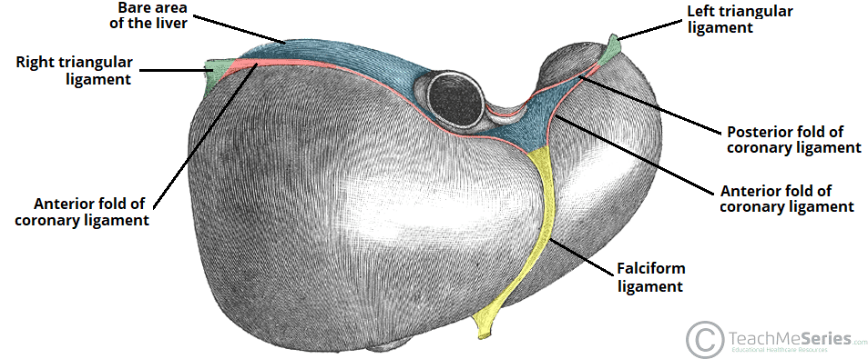
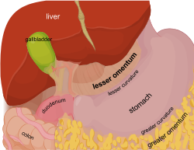
Ligaments of the Liver
Falciform ligament (ligamentum teres).
Coronary ligament (anterior and posterior folds).
Triangular ligaments (left and right).
Lesser omentum
The Peer Teaching Society is not liable for false or misleading information…
Notes:
Now looking at top of liver (superior aspect).
Falciform ligament – Embryological remnant of the umbilical vein which would return blood from the placenta to the foetus. It attaches to the anterior surface of the liver and connect to the anterior abdominal wall with its free edge containing the ligamentum teres.
Coronary ligament – Attaches the superior surface of the liver to the diaphragm and lines the bare area of the ligament, thin red line. Triangular ligament formed on the left and right by the coronary ligaments fold.
Triangular ligament – The right is formed by the anterior fold of the coronary ligament and connects the right lobe to the diaphragm. The left is formed by the anterior and posterior folds of the coronary ligament meeting, connecting the left lobe to the diaphragm.
Lesser omentum – consists of the hepatoduodenal ligament and the hepatotactic ligament, connecting the inferior aspect of the liver to the relevant structures
These ligaments provide structural support to the liver. Support is also provided by the inferior vena cava (big hole in middle) where the hepatic veins and fibrous tissue bind to it.

Slide 7
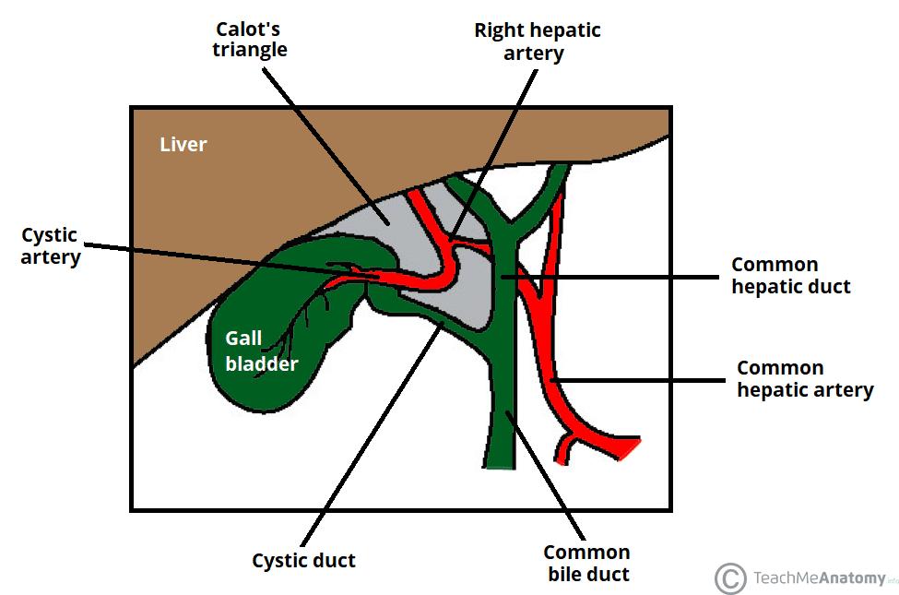
Calots Triangle
Borders – medial, inferior, superior.
Contents – right hepatic artery, cystic artery, lymphatic structures.
The definition has historically changed, be careful.
The Peer Teaching Society is not liable for false or misleading information…
Notes:
Looking at the liver’s front (anterior) aspect.
Borders - medial border is common hepatic duct, inferior border is the cystic duct, superior border is the inferior surface of the liver (used to be the cystic artery, changed due to normal anatomical variation of said artery).
Contents – the right hepatic artery (after the bifurcation of the proper hepatic artery), the cystic artery (typically arising from the right hepatic artery and supplies the gallbladder), and lymphatics along with the lymph node of Lund (first lymph node of the gallbladder).

Slide 8
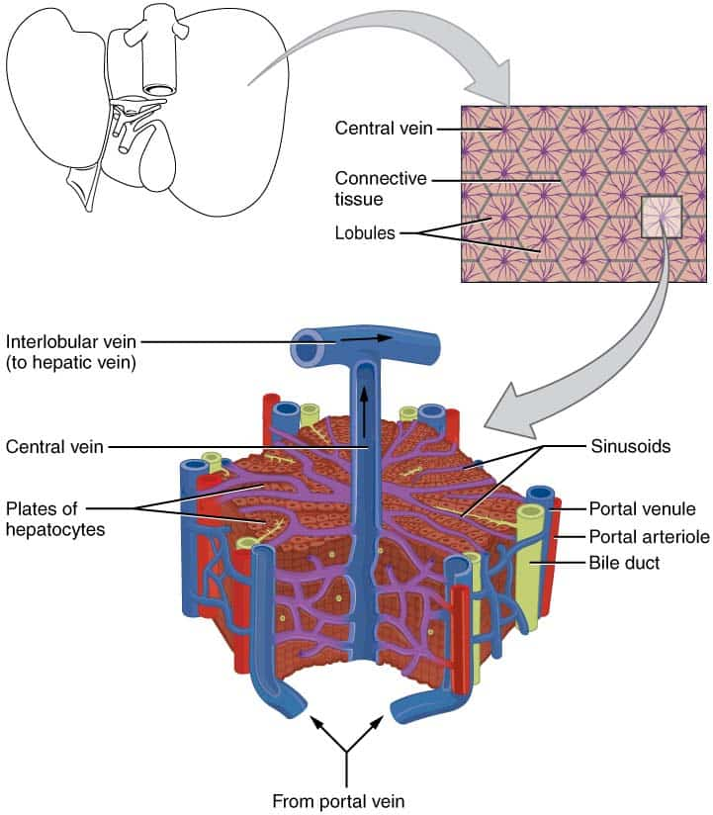
Liver Lobules
Portal triad – arteriole, venule, bile duct.
Drains into the central vein.
Function unit of the Liver (acinus).
The Peer Teaching Society is not liable for false or misleading information…
Notes:
We are now inside the liver.
Portal triad – it is composed of the arteriole (branch of hepatic artery supplying non-parenchymal cells with oxygenated blood), the venule (branch of the hepatic protein vein supplying partially deoxygenated blood and supplies from the small intestines), and the bile duct (carrying bile away from the liver to the right and left hepatic bile ducts). As each merges the hepatoduodenal ligament eventually surrounds the portal triad.
Central vein – is in the centre of each lobule and is where the blood and products drain before travelling to the interlobular vein, followed by the hepatic vein, then finally the inferior vena cava.
Acini (from the latin for grape) – the hepatic acini (acinus singular) is the true functional unit of the liver (there is also pancreatic acini) but is harder to visualise than a lobule (see and describe red circle, overlap between two lobules). It is the cells surrounded the portal triad and is more useful when considering liver function as it is around the afferent vascular system and the bile duct, rather than the central vein. It is comprised of three zones. Zone 1 (orange circle) is closest to blood supply so have most oxygen and exposure to toxins, so pathology is most often seen in zone 1 hepatocytes.

Slide 9
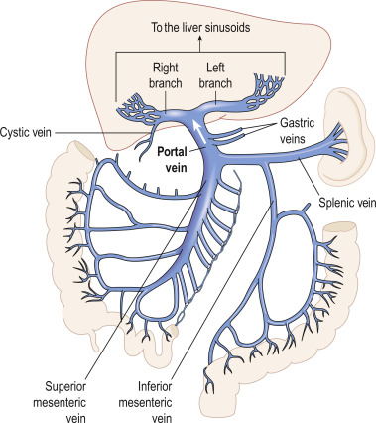
Portal System
The Peer Teaching Society is not liable for false or misleading information…
Notes:
Describe what is seen. Not much more to say. Some FYI pathology, e.g. ascites.

Slide 10
Gallbladder and Biliary Tree
Gallbladder – structure, blood supply, and innervation.
Pancreas – structure, blood supply, and ducts.
Biliary tree - structure
The Peer Teaching Society is not liable for false or misleading information…
Notes:
Gallbladder – it is a gastrointestinal organ located within the right hypochondrial region of the abdomen. This intraperitoneal, pear-shaped sac lies within a fossa formed between the inferior aspects of the right and quadrate lobes of the liver. It concentrates and stores bile which is produced by the liver. It is formed of the fundus which is the rounded distal portion, the body which is the centre and largest part and is closest to the duodenum, and the neck which narrows into the cystic duct. It is supplied with blood from the cystic artery and drained by the cystic vein with drains into the portal vein. It has sympathetic innervation from the coeliac plexus, and parasympathetic from the vagus. Parasympathetic stimulation causes it to contract and secrete bile, majority of contraction is caused by gustatory response (fat causing cholecystokinin hormone produced in small intestine and food on tongue). Lymphatic drainage is into the node of Lund in calots triangle.
Pancreas – it is a retroperitoneal organ with its tail being intraperitoneal (near the spleen). It is composed of the head which is the widest part and is connected to the duodenum by connective tissue, the uncinate process which is a projection from the lower head, then the neck, body, and tail moving down the left of the pancreas. It is supplied by the pancreatic branches of the splenic artery, with the head also being supplied by the superior and inferior pancreaticoduodenal arteries which come from the gastroduodenal (coeliac trunk) and superior mesenteric arteries. Venous drainage is into the superior mesenteric branches of the hepatic portal veinous system. The exocrine serous gland produces digestive enzyme precursors which drain into short intercalated ducts, followed by intralobular collecting ducts, followed by the main pancreatic duct which travels the length of the pancreas and unites with the common bile duct into the common hepatopancreatic duct.
Describe biliary tree ass seen, drains into duodenum through sphincter of Oddi via the ampulla of Vater. At the ampullas end is the papilla of Vater or the major duodenal papilla which is the orifice opening into the duodenum.

Slide 11
Anatomy Quiz (i)
What structure sits on the free edge of the falciform ligament?
a) Coronary Ligament.
b) Ligamentum Teres.
c) Lesser Omentum
d) Falciform Anterior Fold
The Peer Teaching Society is not liable for false or misleading information…

Slide 12
Anatomy Quiz (i)
What structure sits on the free edge of the falciform ligament?
a) Coronary Ligament.
b) Ligamentum Teres.
c) Lesser Omentum
d) Falciform Anterior Fold
The Peer Teaching Society is not liable for false or misleading information…

Slide 13
Anatomy Quiz (ii)
What supplies the majority of blood to non-parenchymal cells in the Liver?
a) Hepatic Portal Vein
b) Hepatic Plexus
c) Proper Hepatic Artery
d) Superior Mesenteric Artery
The Peer Teaching Society is not liable for false or misleading information…

Slide 14
Anatomy Quiz (ii)
What supplies the majority of blood to non-parenchymal cells in the Liver?
a) Hepatic Portal Vein
b) Hepatic Plexus
c) Proper Hepatic Artery
d) Superior Mesenteric Artery
The Peer Teaching Society is not liable for false or misleading information…

Slide 15
Anatomy Quiz (iii)
What sphincter surrounds the Ampulla of Vater?
a) Sphincter of Oddi
b) Sphincter of Vater
c) Pyloric Sphincter
d) Ileocecal Sphincter
The Peer Teaching Society is not liable for false or misleading information…

Slide 16
Anatomy Quiz (iii)
What sphincter surrounds the Ampulla of Vater?
a) Sphincter of Oddi
b) Sphincter of Vater
c) Pyloric Sphincter
d) Ileocecal Sphincter
The Peer Teaching Society is not liable for false or misleading information…

Slide 17
Overview of Liver Physiology
There are a number of key areas of Liver physiology, today we will discuss:
- Liver Detoxification
- Liver Storage
- Fat Metabolism
- Nitrogen Balance
- The Gallbladder and Pancreas
The Peer Teaching Society is not liable for false or misleading information…

Slide 18
Liver Detoxification (i)
Xenobiotics:
Chemicals that are not produced by our own bodies.
The Liver is the principle site of xenobiotics metabolism.
Phase 1 Reactions:
Oxidation
Reduction
Hydroxylation
Hydrolysis
The Peer Teaching Society is not liable for false or misleading information…
Notes:
Xenobiotics – read above, for example water pollutants such as DBPs, things we have every day like caffeine, and medications.
Phase 1 reactions – most commonly oxidation which is catalysed by cytochrome P450 (will cover on next slide) and results in the drug losing electrons. Drugs are often still chemically active after phase 1 reactions. Oxidation is removing electrons, reduction is adding electrons, hydroxylation is adding an OH group, hydrolysis is a decomposition reaction using water.

Slide 19
Liver Detoxification (ii)
Phase 2 Reactions:
Conjugation
Sulfation
Glucuronidation
Methylation
Cytochrome P450:
A major xenobiotic metaboliser.
An oxidiser.
First pass effect in pharmacokinetics.
The Peer Teaching Society is not liable for false or misleading information…
Notes:
Phase 2 reactions – most commonly conjugation where an ionised group is attached to the drug. This often is glutathione, methyl, or acetyl groups. This usually occurs in the cytoplasm of hepatocytes. This reaction makes the metabolite more water soluble which decreases its effect and makes it easier to excrete. Other examples are sulfation which is adding an SO3 group, glucuronidation is metabolise by UGTs and is the reaction between a metabolite and uridine 5’-diphosphoglucuronic acid to render it harmless and more water soluble, and methylation which is simply adding methyl groups.
Cytochrome P450 – read what is above. First pass effect is when a drug (often when taken orally) undergoes metabolism prior to entering circulation, reducing its concentration and bioavailability. It occurs during hepatic circulation (from hepatic portal system). 90% of drugs are metabolised by one of the cytochrome P450 enzymes.

Slide 20
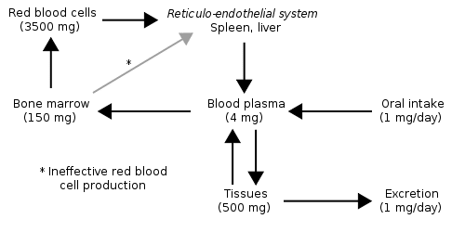
Storage in the Liver
Fat Soluble Vitamins:
Vitamin A
Vitamin D
Vitamin E
Vitamin K
Vitamin B12*
Iron:
Most iron is stored as ferritin.
The Peer Teaching Society is not liable for false or misleading information…
Notes:
Fat soluble vitamins – vitamin D is stored within stellate cells in the liver as retinyl ester made from retinol (the active form). It can be moved back and forth between the two forms multiple times a day to regulate the amount in circulation. It is used rhodopsin, a photoreceptor in rod cells, in gene transcription, the mobilisation of iron stores, and normal immune system function. Vitamin D can either be produced in our body as cholecalciferol or found in food as ergocalciferol, both must be metabolised in the liver to become its active form. It is used to regulate serum calcium and phosphate, increase the absorption of calcium in the kidneys and intestines, and activate osteoclasts to release more calcium. Vitamin E is an important anti-oxidant and is storied in the liver and adipose tissue. It prevents free radicals and protects vitamin A. Vitamin K is important for the synthesis of clotting factors which we will discuss a bit later and is a co-factor for enzymes. Finally, vitamin B12 is not fat soluble (water soluble) but around 50% of it is stored in the Liver as cobalamin. It is needed to produce DNA and RNA, produce red blood cells, and maintain healthy neurones.
Iron – levels in the body need to be tightly regulated so excess iron is stored in areas such as the liver. Most iron is stored in the form of ferritin which is a protein produced by the liver. All liver cells can store iron, but most is stored in hepatocytes. If too much iron is present excess iron is stored in haemosiderin which is large and insoluble so is difficult to mobilise.

Slide 21
Fat Metabolism
White vs Brown Fat:
White fat – 1 fat droplet, few organelles, most abundant type of fat cell (adipocyte).
Brown fat – many droplets and mitochondria, generates heat.
Lipolysis:
How fat is turned into energy when needed.
Beta-oxidation occurs in mitochondria and forms acetyl-coA.
The Peer Teaching Society is not liable for false or misleading information…
Notes:
Types of fat – there are three types of fat, white, beige and brown adipocytes. Beige is similar to white adipocytes and are scattered among them so we will focus on white and brown. White adipocytes have 1 fat droplet, few organelles but are the most abundant type of adipocyte. They store most of the fat around the body and can be found under the skin, around organs, and inside of bones (increase in bone with age). As well as energy storage it acts as an insulator and cushions organs. Also secretes hormones such as leptin (makes you feel full). Beige adipocytes are similar but sometimes generate heat. Brown adipocytes have many fat droplets, many mitochondria and function to produce heat. They are more common in foetuses and infants and are located in the upper back, above the clavicles, and around the vertebrae.
Lipolysis – the process by which fat is prepared to be used to produce energy. Firstly, triglycerides are hydrolysed into fatty acids and glycerol by the enzyme triglyceride lipase. This is stimulated by adrenaline and glucagon. (IMMS knowledge needed) The fatty acids enter the blood stream and bind to albumin making them soluble in blood so they can be transported to the Liver. In the hepatocytes glycerol is converted into glycerol-3-phosphate which enters the glycolysis pathway. Fatty acids are transported to mitochondria to undergo beta-oxidation. The fatty acids repeatedly have two carbon segments removed from their chain, producing NADH and FADH2 each cycle. Finally, acetyl-coA will be produced which binds with oxalacetate to form citrate and enter the citric acid cycle (krebs cycle) to release ATP).

Slide 22
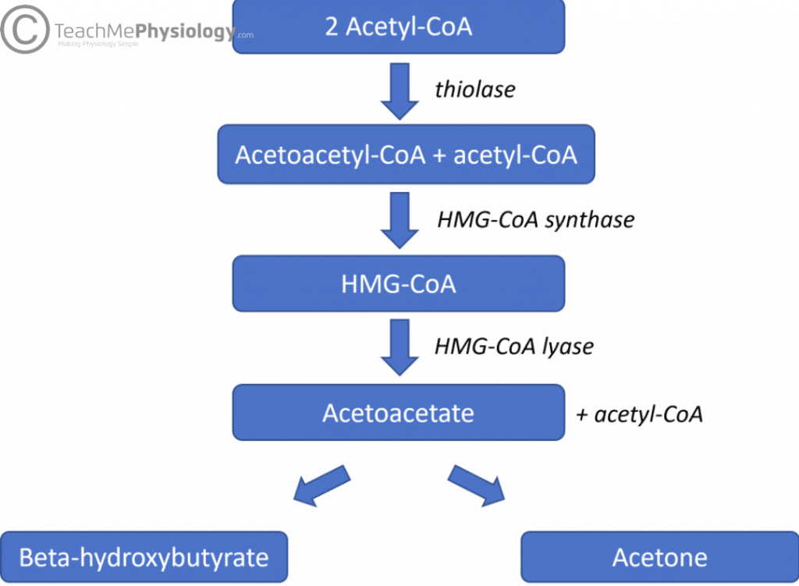
Fat Metabolism
Ketogenesis:
Lipogenesis:
Fatty acids are synthesised in hepatocytes.
The Peer Teaching Society is not liable for false or misleading information…
Notes:
Ketogenesis – excess acetyl-coA from beta-oxidation is used for ketogenesis. Describe chain above (HMG- CoA is an intermediate). Acetoacetate or acetoacetic acid is partially converted into beta-hydroxybutyrate and a small amount of acetone. All three ketones travel around the blood where they can be used as an energy source. Stimulated by lack of glucose in tissues (and glucagon). (Diabetic ketoacidosis).
Lipogenesis – fat is a much more energy dense alternative to glycogen which can be quickly depleted so is much better for long term energy storage. To start the process glucose is turned into pyruvate through glycolysis and converted into acetyl-coA in the mitochondria. Describe what is above (this occurs in the cytoplasm). Fatty acid chains are then combined with glycerol to form triglycerides. These can be synthesised into very low density lipoproteins which can be transported around the body. This process is stimulated by insulin and inhibited by glucagon, adrenalin, and the presence of lipoprotein in the blood.

Slide 23
Protein Production
Albumin:
Most abundant circulating plasma protein and is secreted by Hepatocytes.
Vital for intravascular oncotic pressure.
Clotting Factors:
Almost all factor are synthesised by the Liver.
Fat soluble vitamin K is absorbed via Bile.
Complement Factors:
Form a part of the innate immune system.
Acts to opsonise pathogens and trigger inflammation.
The Peer Teaching Society is not liable for false or misleading information…
Notes:
Albumin – makes up half of the total protein content in plasma. It is synthesised by hepatocytes in the Liver and is secreted into the blood, some is stored in the Liver. When secreted 30%-40% remains in the blood with the rest entering the interstitial space. Its most important function is maintaining intravascular oncotic pressure and preventing fluid leakage into the extravascular space.. Production is decreased in liver disease.
Clotting factors – most clotting factors are produced by the Livers hepatocytes., for example fibrinogen, prothrombin, Factor V, VII, IX, X, XI, XII. Liver sinusoidal endothelial cells produce factor VIII and von Willebrand factor. Factor II, VII, IX, and X are vitamin K dependent so rely on Bile for their absorption. Liver disease or biliary obstruction can often result increased bleeding as a result.
Complement factors – produced by the Liver and circulate in the blood until needed in an inactive form. There are three main pathways, but all serve to form C3 convertase to activate further proteins (C5, then C6, C7, C8, and C9). This has various effects such as the lysis of pathogens, inflammation, and opsonisation (marked by the immune system for phagocytosis).

Slide 24
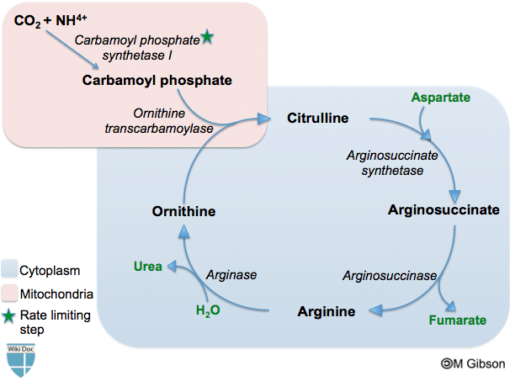
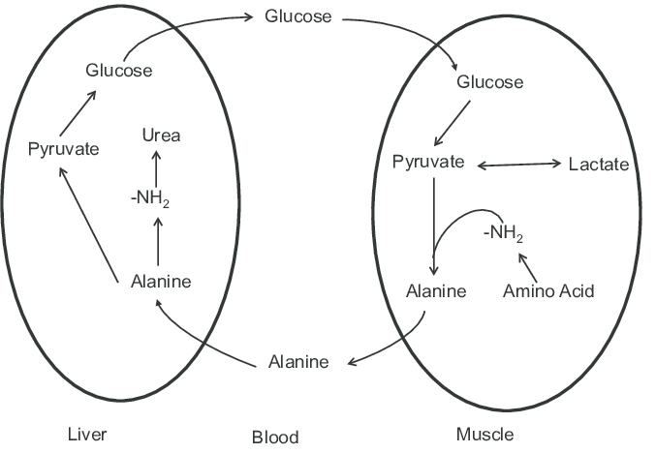
Nitrogen Balance
Urea Cycle:
Glucose-Alanine Cycle:
The Peer Teaching Society is not liable for false or misleading information…
Notes:
Urea Cycle – occurs in the mitochondria and cytoplasm of hepatocytes. In the mitochondrion ammonia (ammonium NH4+ cation) reacts with ATP (energy) and CO2 to form citrulline from ornithine (amino acids). The citrulline undergoes reactions in the cytoplasm to reform ornithine which re-enters the mitochondrion closing the cycle. This turns ammonia (harmful) into urea (less harmful and can be excreted).
Glucose-Alanine Cycle – Similar to but not to be confused with the cori cycle (which is only in Liver and Kidneys). This helps muscles get rid of toxic ammonium ions (anion) and provide glucose through gluconeogenesis. Describe what is seen above.

Slide 25
Gallbladder Physiology
Bile Production and Contraction:
Bile acid-dependent vs bile acid-independent.
Transport through the biliary tree.
Bilirubin and Bile Salts:
Cholic acid and chenodeoxycholic acid.
Amino acid conjugation.
Bilirubin is a bile pigment.
The Peer Teaching Society is not liable for false or misleading information…
Notes:
Bile – bile is made up of bile acids, cholesterol, phospholipids, bile pigments, electrolytes, and water. It is split into two main groups, bile acid-dependent and bile acid-independent. The bile acid-dependent part is produced by hepatocytes which secrete bile acids, bile pigments, and cholesterol into small channels that transport it towards the bile duct. The bile acid-independent component is made by cells lining the biliary duct, called ductal cells. They secrete an alkaline solution, stimulated by secretin. The two components mix and enter the intrahepatic bile ducts which rain into the biliary tree. Bile is constantly being produced but is only needed during or after meals, so it is stored in the gallbladder and concentrated there with the water and ions being removed. The hormone cholecystokinin is released by the duodenum after eating, this stimulates the gallbladder the contract and the sphincter of Oddi to relax, allowing bile to flow.
Bilirubin and bile salts – there are two primary bile acids, cholic acid and chenodeoxycholic acid. There are conjugated with the amino acids glycine and taurine to form bile salts. There are more soluble than the acids and act as detergents, emulsifying lipids in the digestive tract. The salts have a lipid-soluble hydrophobic end, and a water-soluble hydrophilic end which allows them to break fats up into smaller droplets, increasing surface area and therefore the efficiency of lipase. Bile also contains pigments, these are mostly biliverdin and bilirubin. Bilirubin is a byproduct of haemolysis and is conjugated in the liver to be secreted in bile. (Talk about jaundice, post-hepatic).

Slide 26
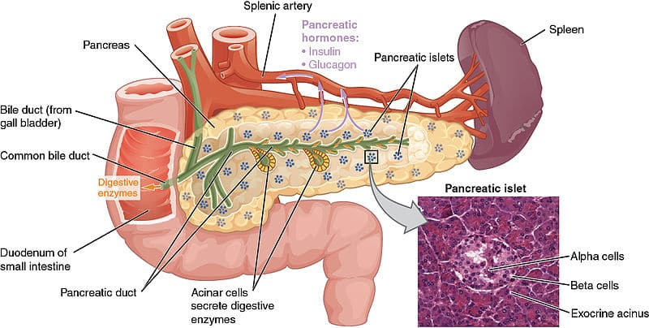
Pancreas Physiology
Pancreatic Secretion:
Proteases, lipase, amylase
Produced by acinar cells.
Secretion of bicarbonate:
Carbonic anhydrase.
H₂O + CO₂ -> H₂CO₃
H₂CO₃ ⇌ H⁺ + HCO₃–
Secretion.
The Peer Teaching Society is not liable for false or misleading information…
Notes:
Enzymes – produced by acinar cells via their rough endoplasmic reticulum. They are condensed into vacuoles by the Golgi apparatus, which are then concentrated into inactive zymogen granules which are stored until needed for secretion. When needed they are secreted into the main pancreatic duct which merges with the bile duct. The enzymes produced are proteases such as chymotrypsinogen and trypsinogen which break down proteins and peptides into single amino acids. Pancreatic lipase which digests triglycerides, monoglycerides, and fatty acids. And amylase which breaks down starch and maltose. Secretion is triggered by vagal innervation and cholecystokinin. Secretin causes the pancreas just to secrete tits alkaline parts, speaking of which:
Bicarbonate – water and carbon dioxide are reacted together to form carbon acid; this is catalysed by the enzyme carbonic anhydrase. Carbonic acid then dissociates into hydrogen ions and bicarbonate ions, this is a reversible reaction. Hydrogen ions are pumped out of the pancreatic ductal cells (where this occurs) and into the blood in exchange for sodium ions. The carbonate produced by the dissociation of carbonic acid then secreted into the intercalated ducts of the pancreas (small branches), being exchanged for Chloride ions. Chloride channels allow the ion to return to the intercalated ducts. The bicarbonate ions and sodium ions then flow to the main pancreatic duct to be secreted into the duodenum.

Slide 27
Physiology Quiz (i)
The Glucose-Alanine Cycle occurs in two main sites, what are they?
a) Liver and Kidney
b) Kidney and White Adipose
c) Liver and White Adipose
d) Liver and Muscles
The Peer Teaching Society is not liable for false or misleading information…

Slide 28
Physiology Quiz (i)
The Glucose-Alanine Cycle occurs in two main sites, what are they?
a) Liver and Kidney
b) Kidney and White Adipose
c) Liver and White Adipose
d) Liver and Muscles
The Peer Teaching Society is not liable for false or misleading information…

Slide 29
Physiology Quiz (ii)
Where in a cell does beta-oxidation occur?
a) In the cytoplasm
b) The rough endoplasmic reticulum
c) The mitochondria
d) The smooth endoplasmic reticulum
The Peer Teaching Society is not liable for false or misleading information…

Slide 30
Physiology Quiz (ii)
Where in a cell does beta-oxidation occur?
a) In the cytoplasm
b) The rough endoplasmic reticulum
c) The mitochondria
d) The smooth endoplasmic reticulum
The Peer Teaching Society is not liable for false or misleading information…

Slide 31
Physiology Quiz (iii)
What water soluble vitamin is often stored in the Liver?
a) Vitamin K
b) Vitamin B9
c) Vitamin A
d) Vitamin B12
The Peer Teaching Society is not liable for false or misleading information…

Slide 32
Physiology Quiz (iii)
What water soluble vitamin is often stored in the Liver?
a) Vitamin K
b) Vitamin B9
c) Vitamin A
d) Vitamin B12
The Peer Teaching Society is not liable for false or misleading information…

Slide 33
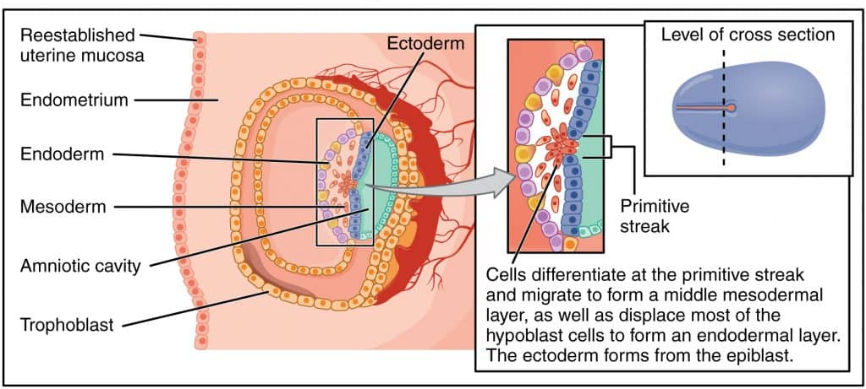
Overview of Embryology
The bilaminar disk undergoes gastrulation.
Endoderm layer is formed.
Hepatic diverticulum.
Formed hepatobiliary system.
The Peer Teaching Society is not liable for false or misleading information…
Notes:
Gastrulation – it is the migration, invagination, and differentiation of the epiblast layer, controlled by the primitive streak (the groove in the midline of the epiblast). Cells migrate from the epiblast layer and migrate towards the primitive pit forming three new layers. The endoderm, mesoderm, and ectoderm. The endoderm are the cells that will eventually form the liver along with the respiratory, digestive, and genitourinary tracts. It is formed by epiblast cells that migrate through the primitive put and displace hypoblast cells. This all occurs on the third week of gestation.
Hepatic diverticulum – liver specification occurs in the posteroventral foregut where the duodenum eventually will form. Endodermal proliferation occurs forming the hepatic diverticulum. This then continues, describe the image.

Slide 34
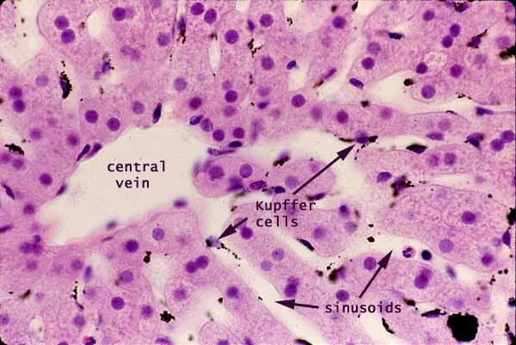
Histology (i)
Sinusoids and sinusoidal macrophages:
The Peer Teaching Society is not liable for false or misleading information…
Notes:
Potential for Perls stain (macrophages go blue/black).

Slide 35
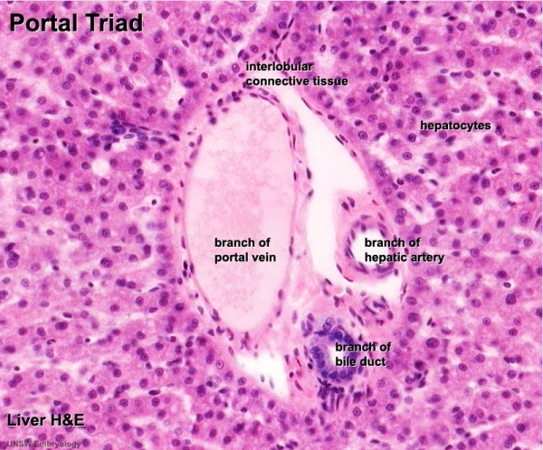
Histology (ii)
Portal triad:
The Peer Teaching Society is not liable for false or misleading information…

Slide 36
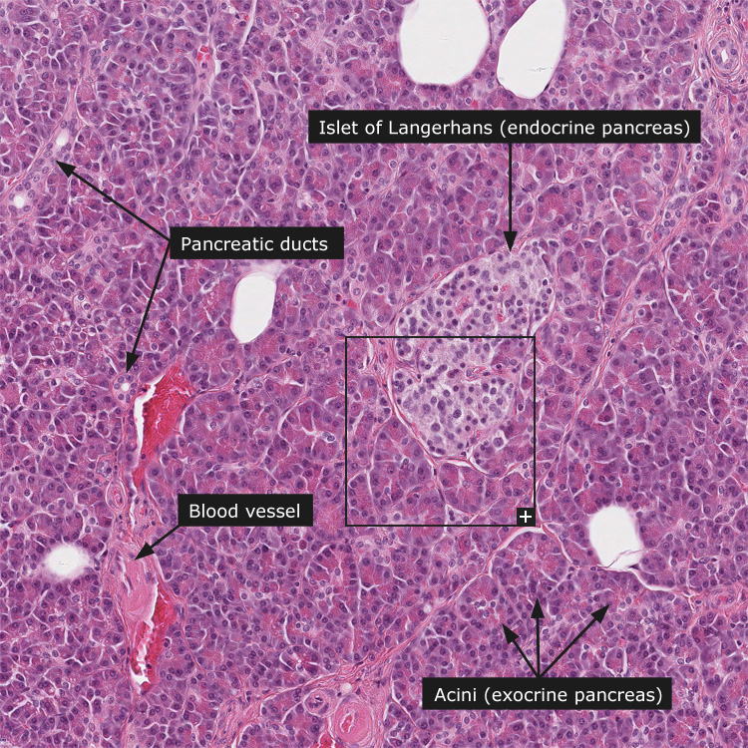
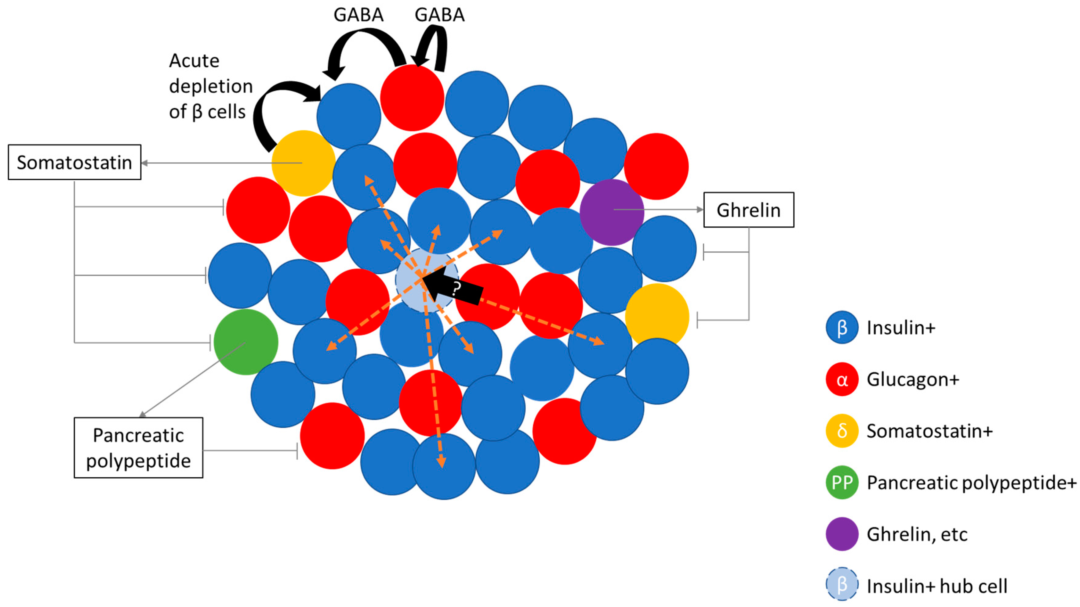
Histology (iii)
Exocrine vs endocrine pancreas:
The Peer Teaching Society is not liable for false or misleading information…

Slide 37
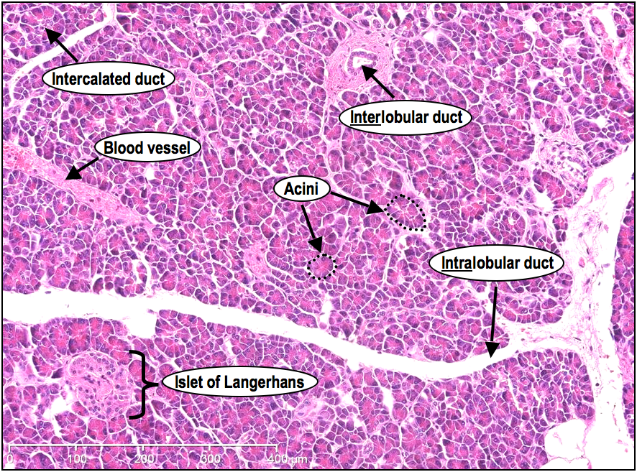
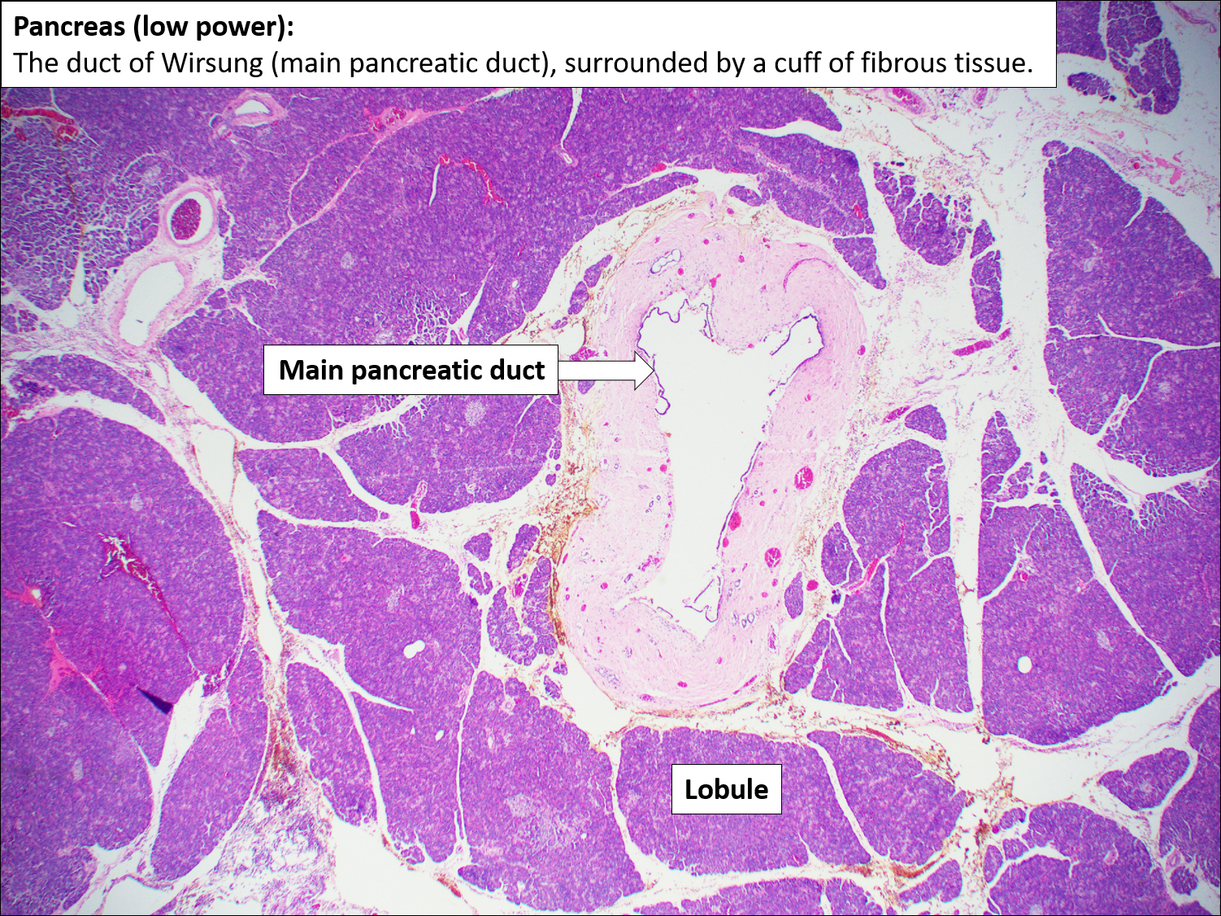
Histology (iv)
Pancreatic ducts:
The Peer Teaching Society is not liable for false or misleading information…

Slide 38
Conclusion
Hepatobiliary:
- Anatomy.
- Physiology.
- Embryology.
- Histology.
The Peer Teaching Society is not liable for false or misleading information…

Slide 39
References
The Gallbladder and Biliary System (histocutup.co.uk)
Hepatobiliary System - an overview | ScienceDirect Topics
The Accessory Organs of the Abdomen – TeachMeAnatomy
Gastrointestinal – TeachMePhysiology
Liver: Anatomy | Concise Medical Knowledge (lecturio.com)
Learning Medicine Made Simple - Powerful learning platform (osmosis.org)
Geeky Medics | free medical student revision notes, OSCE guides & MCQs
The Peer Teaching Society is not liable for false or misleading information…

Slide 40
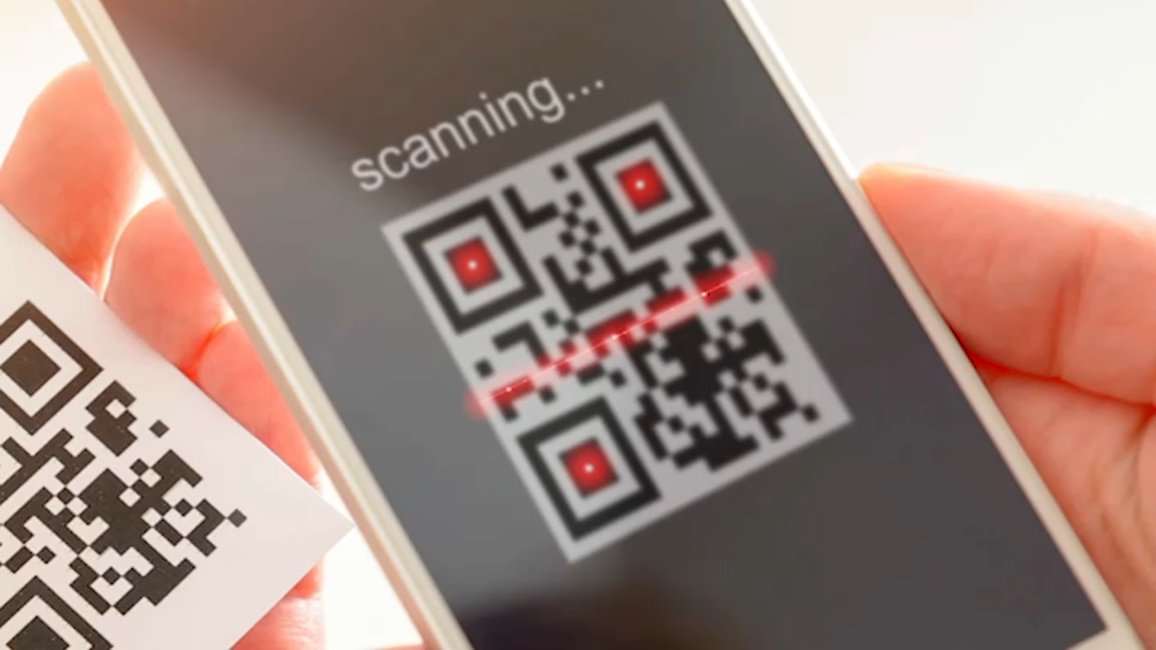
Feedback
phase reps add QR code here - QR Code Generator (the-qrcode-generator.com)
phase reps add feedback link here
The Peer Teaching Society is not liable for false or misleading information…

Slide 41
