Slide 1
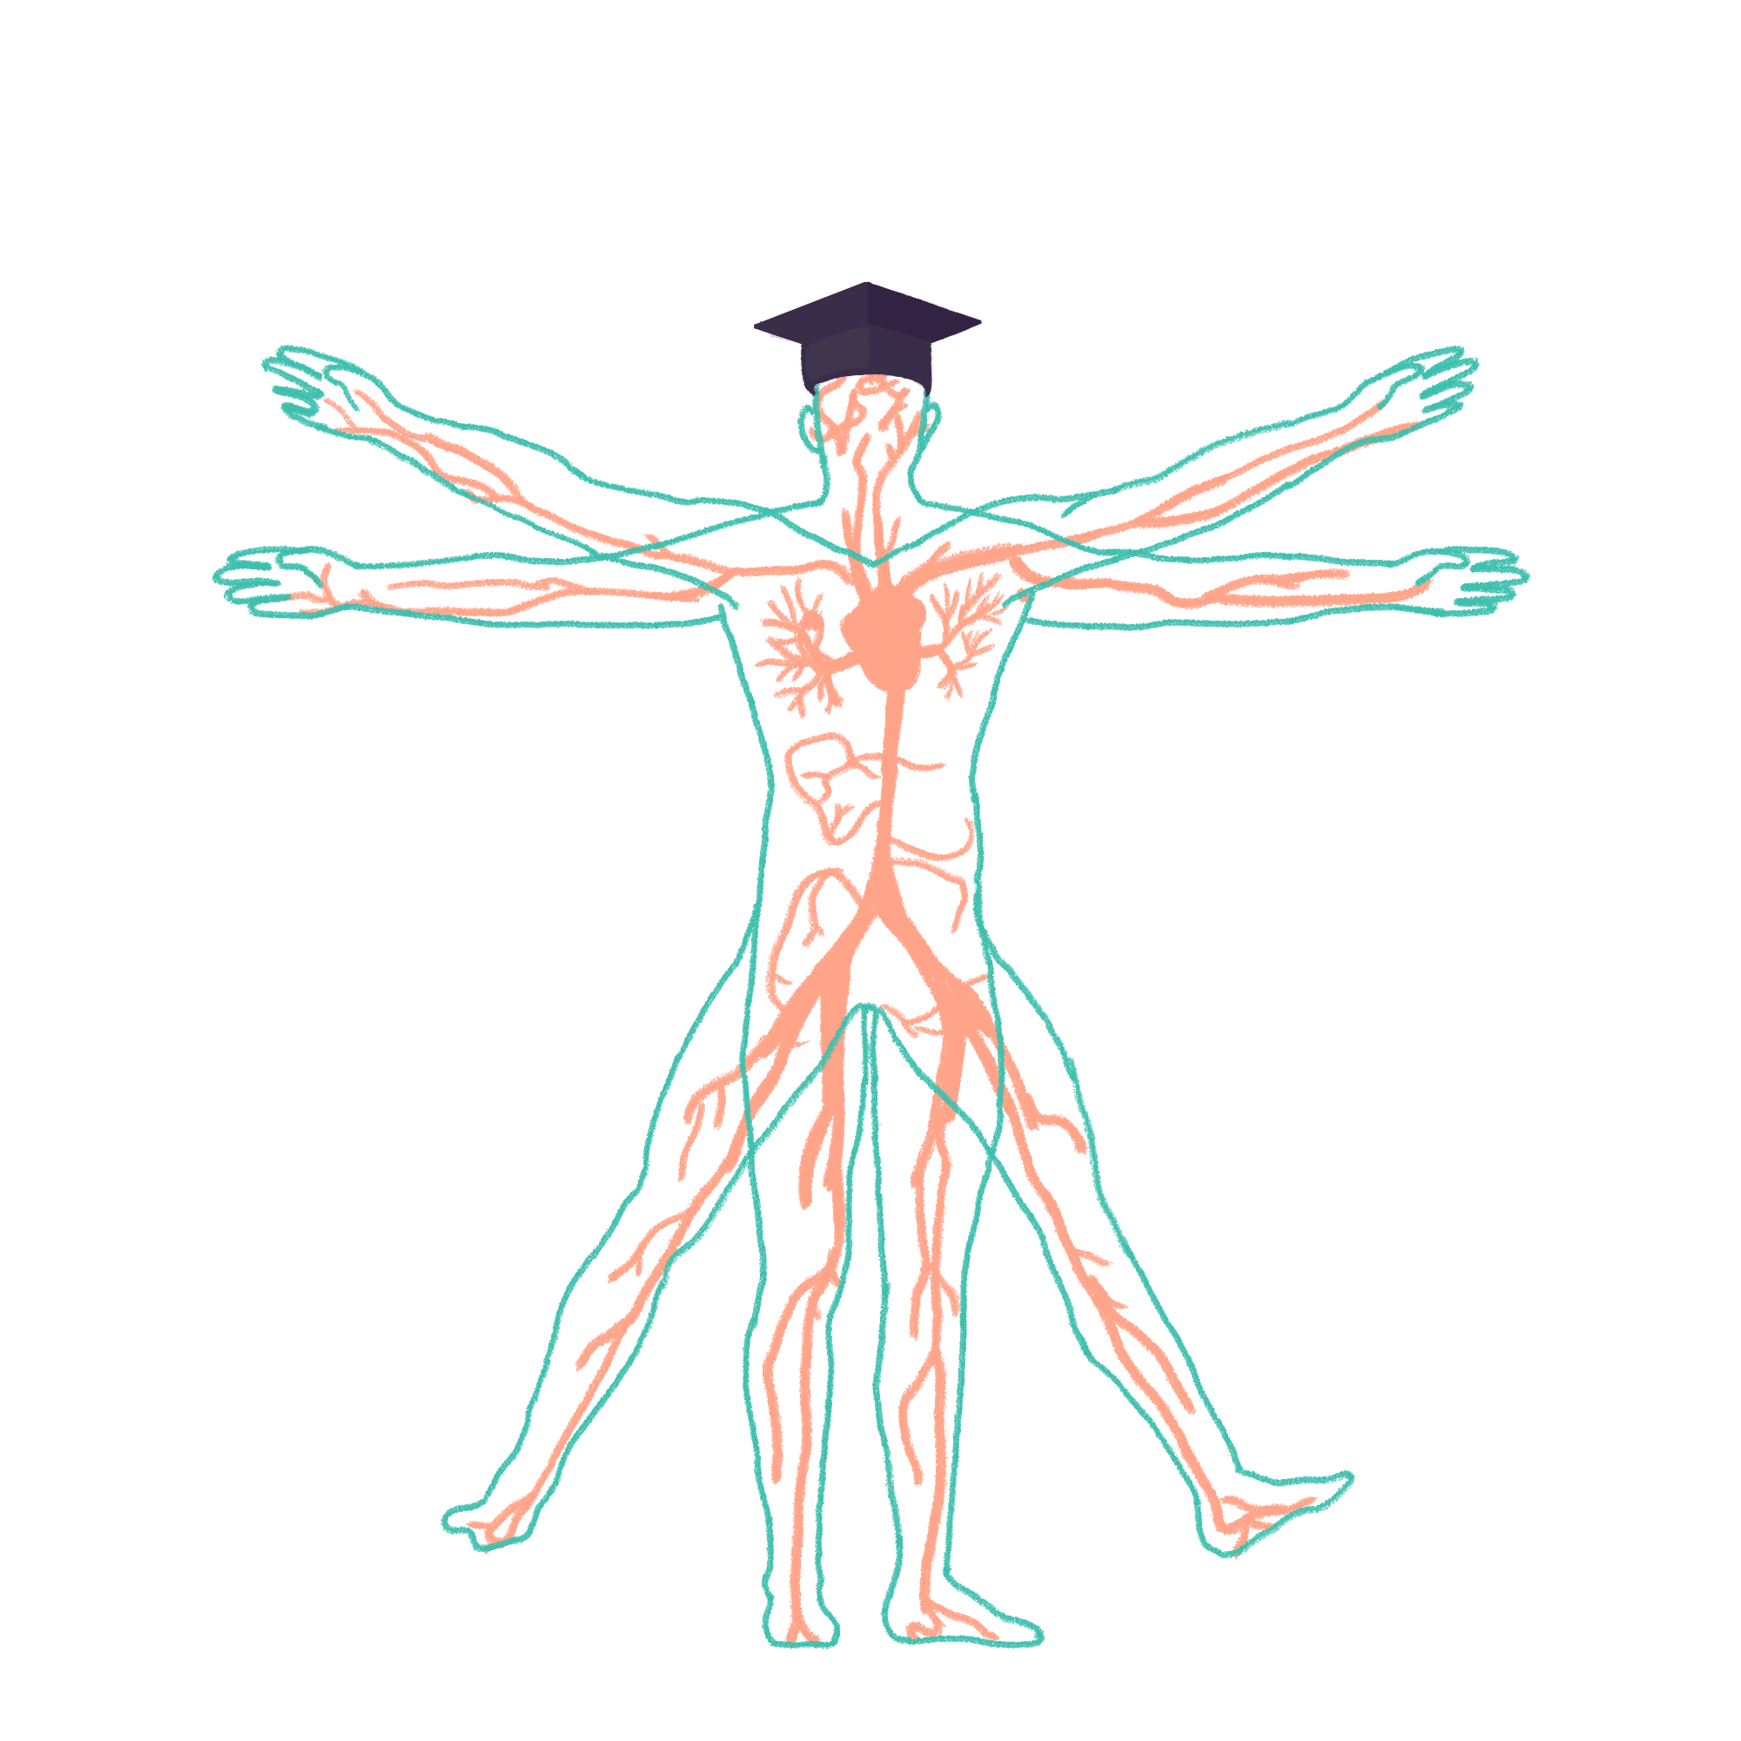
2023/2024

Slide 2
3A – Neuro Quiz
Phase 3a Revision Session
Ali Alhashimi
27/11/23, 6pm
The Peer Teaching Society is not liable for false or misleading information…

Slide 3
Condition List
The Peer Teaching Society is not liable for false or misleading information…

Slide 4
Question 1
A 35Y F presents to A&E complaining of progressive leg weakness, and swallowing difficulties. Maximal expiratory pressure was 68% of normal. PMHx reveals previous admission for treatment of gastroenteritis caused by Campylobacter jejuni two weeks ago. On examination she has hyporeflexia, bilateral facial drooping and is in urinary retention.
What is your immediate management for this patient?
Administer IV Immunoglobulins
Admit to ITU for mechanical ventilation
40mg Prednisolone
Keep a watchful eye and wait
Give Dalteparin for thromboprophylaxis
The Peer Teaching Society is not liable for false or misleading information…
Notes:
ischaemic stroke (most common) as an episode of neurological dysfunction caused by focal cerebral, spinal or retinal infarction
RFs=Smoking Diabetes mellitus Hypertension Hypercholesterolaemia Obesity Atrial fibrillation Carotid artery disease Age Thrombophilic disorders (e.g. antiphospholipid syndrome) Sickle cell disease

Slide 5
Question 1
A 35Y F presents to A&E complaining of progressive leg weakness, and swallowing difficulties. Maximal expiratory pressure was 68% of normal. PMHx reveals previous admission for treatment of gastroenteritis caused by Campylobacter jejuni two weeks ago. On examination she has hyporeflexia, bilateral facial drooping and is in urinary retention.
What is your immediate management for this patient?
Administer IV Immunoglobulins
Admit to ITU for mechanical ventilation
40mg Prednisolone
Keep a watchful eye and wait
Give Dalteparin for thromboprophylaxis
The Peer Teaching Society is not liable for false or misleading information…
Notes:
ischaemic stroke (most common) as an episode of neurological dysfunction caused by focal cerebral, spinal or retinal infarction
RFs=Smoking Diabetes mellitus Hypertension Hypercholesterolaemia Obesity Atrial fibrillation Carotid artery disease Age Thrombophilic disorders (e.g. antiphospholipid syndrome) Sickle cell disease

Slide 6
Guillain-Barre Syndrome
GBS is an immune-mediated polyneuropathy that causes rapid demyelination of the peripheral nervous system. It is associated with a recent infection usually by Campylobacter jejuni. It is usually ascending, meaning it affects the legs first and moves upwards.
Symptoms/ Signs:
Progressive, symmetrical ascending weakness
Hyporeflexia/Areflexia
Mild sensory symptoms
Cranial nerve involvement
Respiratory depression due to muscle weakness
Investigations:
LP: rise in protein but normal WCC
Nerve conduction studies: decreased velocity (due to demyelination)
Management:
IVIG is first line. However, admit to ITU if signs of bulbar dysfunction i.e if cranial nerves 9-12 are affected. Patients will require mechanical ventilation in the ITU. Also admit to ITU if respiration is poor, especially if maximal expiratory pressure is reduced by 30% or more. IVIG is then administered after.
Miller Fisher Syndrome (GBS variant)
Triad:
Ophthalmoplegia
Ataxia
Areflexia
The Peer Teaching Society is not liable for false or misleading information…
Notes:
ischaemic stroke (most common) as an episode of neurological dysfunction caused by focal cerebral, spinal or retinal infarction
RFs=Smoking Diabetes mellitus Hypertension Hypercholesterolaemia Obesity Atrial fibrillation Carotid artery disease Age Thrombophilic disorders (e.g. antiphospholipid syndrome) Sickle cell disease

Slide 7
A 21F presents complaining of recurring headaches which she describes to be throbbing in nature and only on one side. She complains that the headache gets worse when she is using her phone to watch videos. She also complains of seeing floating shapes before her headache presents. Her PMHx includes bipolar disorder, asthma, eczema, allergic rhinitis and PCOS. She is taking lithium, the oral contraceptive pill, loratadine and has a salbutamol inhaler. Which medication(s) should be stopped?
Question 2
Salbutamol inhaler
Loratadine
The oral contraceptive pill
Lithium and loratadine
Lithium and salbutamol inhaler
The Peer Teaching Society is not liable for false or misleading information…
Notes:
ischaemic stroke (most common) as an episode of neurological dysfunction caused by focal cerebral, spinal or retinal infarction
RFs=Smoking Diabetes mellitus Hypertension Hypercholesterolaemia Obesity Atrial fibrillation Carotid artery disease Age Thrombophilic disorders (e.g. antiphospholipid syndrome) Sickle cell disease

Slide 8
A 21F presents complaining of recurring headaches which she describes to be throbbing in nature and only on one side. She complains that the headache gets worse when she is using her phone to watch videos. She also complains of seeing floating shapes before her headache presents. Her PMHx includes bipolar disorder, asthma, eczema, allergic rhinitis and PCOS. She is taking lithium, the oral contraceptive pill, loratadine and has a salbutamol inhaler. Which medication(s) should be stopped?
Question 2
Salbutamol inhaler
Loratadine
The oral contraceptive pill
Lithium and loratadine
Lithium and salbutamol inhaler
The Peer Teaching Society is not liable for false or misleading information…
Notes:
ischaemic stroke (most common) as an episode of neurological dysfunction caused by focal cerebral, spinal or retinal infarction
RFs=Smoking Diabetes mellitus Hypertension Hypercholesterolaemia Obesity Atrial fibrillation Carotid artery disease Age Thrombophilic disorders (e.g. antiphospholipid syndrome) Sickle cell disease

Slide 9
Migraines
Patient presents with classical symptoms of migraine with aura. She is experiencing unilateral, throbbing pain with preceding aura. She should be prescribed triptans for the migraine itself and beta-blockers for a prophylactic effect. Migraines sometimes present with N&V as well as photophobia and phonophobia (can easily come up in exams)
The OCP is contraindicated in patients with migraines, and this should be stopped. Significant increased risk of stroke.
Learn how to differentiate between tension headaches, migraines and cluster headaches (i.e., how severe, distribution, how long they last, causes…)
The Peer Teaching Society is not liable for false or misleading information…
Notes:
ischaemic stroke (most common) as an episode of neurological dysfunction caused by focal cerebral, spinal or retinal infarction
RFs=Smoking Diabetes mellitus Hypertension Hypercholesterolaemia Obesity Atrial fibrillation Carotid artery disease Age Thrombophilic disorders (e.g. antiphospholipid syndrome) Sickle cell disease

Slide 10
Migraine Management
Acute Mx:
Triptans, NSAIDS and/or paracetamol
Consider metoclopramide or prochlorperazine (if N+V is a prominent symptom or the above medication is not tolerated/contraindicated)
Prophylaxis Mx:
Propranolol
Amitriptyline
Topiramate
Triptans:
5-HT agonists
Routes: oral , nasal, subcut
Side effects: flushing, tingling, chest and throat tightness (may mimic angina- can be distressing)
Contraindicated in patients with IHD or cerebrovascular disease
The Peer Teaching Society is not liable for false or misleading information…
Notes:
ischaemic stroke (most common) as an episode of neurological dysfunction caused by focal cerebral, spinal or retinal infarction
RFs=Smoking Diabetes mellitus Hypertension Hypercholesterolaemia Obesity Atrial fibrillation Carotid artery disease Age Thrombophilic disorders (e.g. antiphospholipid syndrome) Sickle cell disease

Slide 11
A 13-month baby presents to A&E with a distressed mother complaining that her baby just doesn’t seem himself. He seems drowsy and has fluctuating levels of alertness. On examination you notice the baby has multiple unexplained bruises on his body and is very small for his age. You then order a CT head. What signs will you see on the CT head?
Question 3
Crescent shaped haematoma indicating extradural haemorrhage
Crescent shaped haematoma indicating subdural haemorrhage
Star shaped haematoma indicating extradural haemorrhage
Lens shaped haematoma indicating a subdural haemorrhage
Lens shaped haematoma indicating a subarachnoid haemorrhage
The Peer Teaching Society is not liable for false or misleading information…
Notes:
ischaemic stroke (most common) as an episode of neurological dysfunction caused by focal cerebral, spinal or retinal infarction
RFs=Smoking Diabetes mellitus Hypertension Hypercholesterolaemia Obesity Atrial fibrillation Carotid artery disease Age Thrombophilic disorders (e.g. antiphospholipid syndrome) Sickle cell disease

Slide 12
A 13-month baby presents to A&E with a distressed mother complaining that her baby just doesn’t seem himself. He seems drowsy and has fluctuating levels of alertness. On examination you notice the baby has multiple unexplained bruises on his body and is very small for his age. You then order a CT head. What signs will you see on the CT head?
Question 3
Crescent shaped haematoma indicating extradural haemorrhage
Crescent shaped haematoma indicating subdural haemorrhage
Star shaped haematoma indicating extradural haemorrhage
Lens shaped haematoma indicating a subdural haemorrhage
Lens shaped haematoma indicating a subarachnoid haemorrhage
The Peer Teaching Society is not liable for false or misleading information…
Notes:
ischaemic stroke (most common) as an episode of neurological dysfunction caused by focal cerebral, spinal or retinal infarction
RFs=Smoking Diabetes mellitus Hypertension Hypercholesterolaemia Obesity Atrial fibrillation Carotid artery disease Age Thrombophilic disorders (e.g. antiphospholipid syndrome) Sickle cell disease

Slide 13
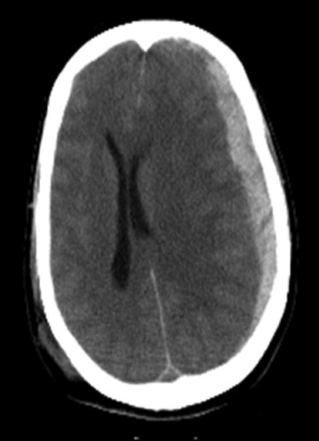
Subdural Haemorrhage
Suspected shaken baby syndrome – baby is shaken vigorously which causes a bleed in the subdural space. Can happen if parents are abusive and neglectful. This presents with fluctuating levels of consciousness, drowsiness, headache, signs of raised ICP – nausea and vomiting, confusion etc.
Subdural haematomas are usually seen in elderly patients, alcoholics and babies due to small brain sizes. This means bridging veins are vulnerable and prone to rupture.
CT would show a bleed in the subdural space that looks like a crescent/banana.
Midline shift (Can be normal if bilateral as pressure of haematoma from both sides prevents midline shift)
Usually unilateral (approx 85%), Bilateral (15%)
Crosses suture lines
The Peer Teaching Society is not liable for false or misleading information…
Notes:
ischaemic stroke (most common) as an episode of neurological dysfunction caused by focal cerebral, spinal or retinal infarction
RFs=Smoking Diabetes mellitus Hypertension Hypercholesterolaemia Obesity Atrial fibrillation Carotid artery disease Age Thrombophilic disorders (e.g. antiphospholipid syndrome) Sickle cell disease

Slide 14
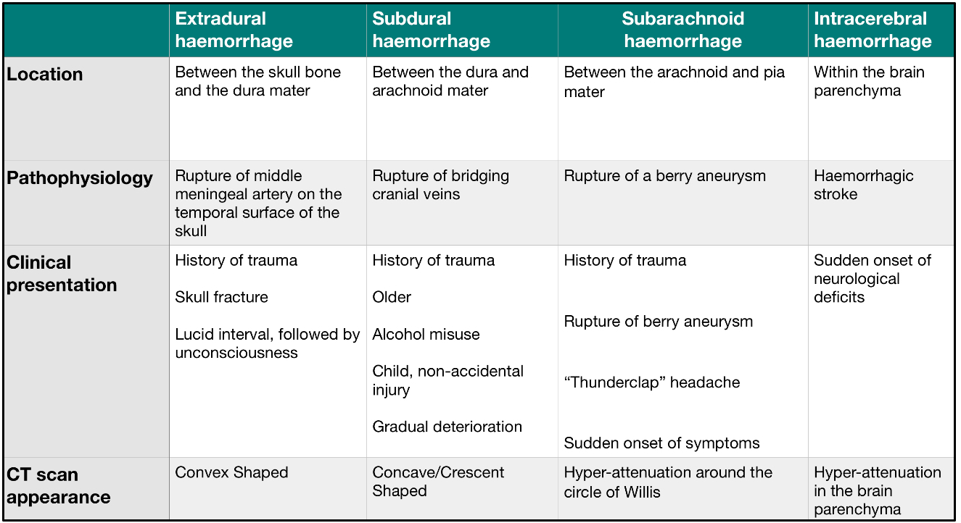
Haemorrhages
Question 1
Pterion
ADPKD
Meningism
The Peer Teaching Society is not liable for false or misleading information…
Within suture lines
Beyond suture lines
Notes:
ischaemic stroke (most common) as an episode of neurological dysfunction caused by focal cerebral, spinal or retinal infarction
RFs=Smoking Diabetes mellitus Hypertension Hypercholesterolaemia Obesity Atrial fibrillation Carotid artery disease Age Thrombophilic disorders (e.g. antiphospholipid syndrome) Sickle cell disease

Slide 15
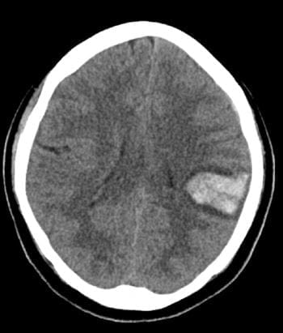
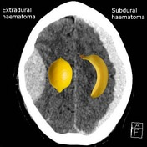
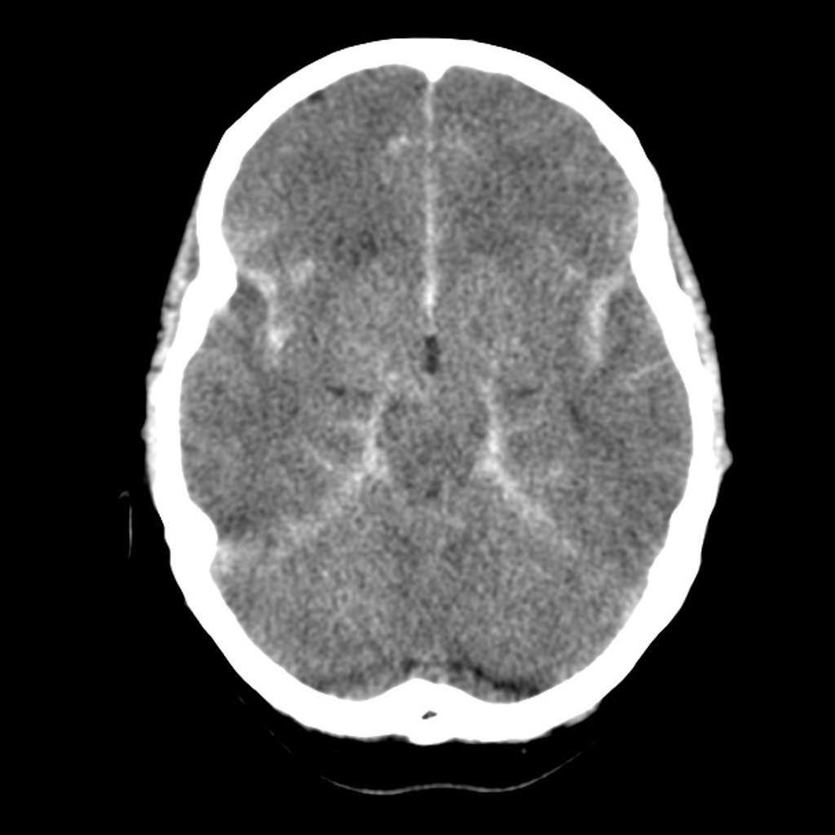
Haemorrhages
Question 1
Subarachnoid
Intracerebral
The Peer Teaching Society is not liable for false or misleading information…
Notes:
ischaemic stroke (most common) as an episode of neurological dysfunction caused by focal cerebral, spinal or retinal infarction
RFs=Smoking Diabetes mellitus Hypertension Hypercholesterolaemia Obesity Atrial fibrillation Carotid artery disease Age Thrombophilic disorders (e.g. antiphospholipid syndrome) Sickle cell disease

Slide 16
An 85M presents to A&E with unilateral hemiparesis and hemiplegia. He has trouble speaking and is unable to understand you. His wife explains that this has been going on for the last 5 hours and his first symptom was slurring of speech. You request an urgent CT which shows areas of infarction and administer 300mg Aspirin. What treatment would then be offered?
Question 4
IV Alteplase
Perform Thrombectomy
Clopidogrel
Atorvastatin
Request MRI
The Peer Teaching Society is not liable for false or misleading information…
Notes:
ischaemic stroke (most common) as an episode of neurological dysfunction caused by focal cerebral, spinal or retinal infarction
RFs=Smoking Diabetes mellitus Hypertension Hypercholesterolaemia Obesity Atrial fibrillation Carotid artery disease Age Thrombophilic disorders (e.g. antiphospholipid syndrome) Sickle cell disease

Slide 17
An 85M presents to A&E with unilateral hemiparesis and hemiplegia. He has trouble speaking and is unable to understand you. His wife explains that this has been going on for the last 5 hours and his first symptom was slurring of speech. You request an urgent CT which shows areas of infarction and administer 300mg Aspirin. What treatment would then be offered?
Question 4
IV Alteplase
Perform Thrombectomy
Clopidogrel
Atorvastatin
Request MRI
The Peer Teaching Society is not liable for false or misleading information…
Notes:
ischaemic stroke (most common) as an episode of neurological dysfunction caused by focal cerebral, spinal or retinal infarction
RFs=Smoking Diabetes mellitus Hypertension Hypercholesterolaemia Obesity Atrial fibrillation Carotid artery disease Age Thrombophilic disorders (e.g. antiphospholipid syndrome) Sickle cell disease

Slide 18
Stroke Management
Pt is presenting with symptoms of an acute ischemic stroke which is confirmed by a CT scan. As the patient has been experiencing symptoms for longer than 4.5 hours, they are no longer eligible for thrombolysis treatment (IV alteplase) as evidence shows that the risks outweigh the benefits.
They should be offered a thrombectomy if they present with a stroke within 6 hours once the stroke has been confirmed with a CT. The thrombectomy could also be done within 24 hours if the imaging shows salvageable tissue.
The Peer Teaching Society is not liable for false or misleading information…
Notes:
aspirin 300mg orally or rectally should be given as soon as possible if a haemorrhagic stroke has been excluded
anticoagulants should not be started until brain imaging has excluded haemorrhage, and usually not until 14 days have passed from the onset of an ischaemic stroke'
RF=Smoking Diabetes mellitus Hypertension Hypercholesterolaemia Obesity Atrial fibrillation Carotid artery disease Age Thrombophilic disorders (e.g. antiphospholipid syndrome) Sickle cell disease

Slide 19
A 26M presents with headache, neck pain, fever and a non-blanching purpuric rash covering his trunk and arms. You suspect bacterial meningitis and perform a lumbar puncture to confirm your diagnosis. What findings do you expect to see on the results?
Question 5
Clear fluid, low protein, elevated glucose
Turbid fluid, raised WCC, low glucose
Turbid fluid, normal WCC, low glucose
Clear fluid, raised WCC, normal glucose
Clear fluid, low WCC, normal glucose
The Peer Teaching Society is not liable for false or misleading information…

Slide 20
A 26M presents with headache, neck pain, fever and a non-blanching purpuric rash covering his trunk and arms. You suspect bacterial meningitis and perform a lumbar puncture to confirm your diagnosis. What findings do you expect to see on the results?
Question 5
Clear fluid, low protein, elevated glucose
Turbid fluid, raised WCC, low glucose
Turbid fluid, normal WCC, low glucose
Clear fluid, raised WCC, normal glucose
Clear fluid, low WCC, normal glucose
The Peer Teaching Society is not liable for false or misleading information…

Slide 21
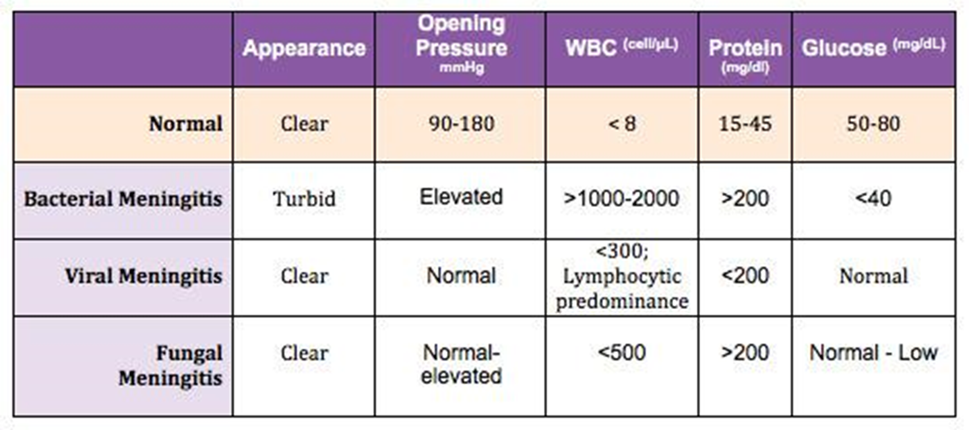
Meningitis LP findings
The Peer Teaching Society is not liable for false or misleading information…

Slide 22
Question 6
A 26 year old woman presents to you with cloudy vision (blurry and difficulty seeing the colour red) in one eye and pain upon movement of that eye. She smokes a pack a day and has done this for the past 10 years. She states that she has had similar episodes previously but they usually self resolve. However, this time it has lasted a few days and she also has some leg weakness which she noticed after taking a shower.What is your diagnosis?
Multiple sclerosis
Guillain-barre
Myasthenia gravis
Glioblastoma multiforme
Stroke
The Peer Teaching Society is not liable for false or misleading information…

Slide 23
Question 1
A 26 year old woman presents to you with cloudy vision (blurry and difficulty seeing the colour red) in one eye and pain upon movement of that eye. She smokes a pack a day and has done this for the past 10 years. She states that she has had similar episodes previously but they usually self resolve. However, this time it has lasted a few days and she also has some leg weakness which she noticed after taking a shower.What is your diagnosis?
Multiple sclerosis
Guillain-barre
Myasthenia gravis
Glioblastoma multiforme
Stroke
The Peer Teaching Society is not liable for false or misleading information…

Slide 24
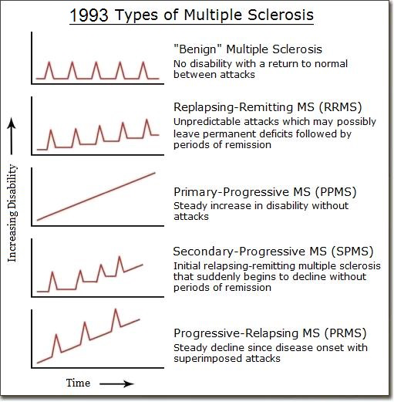
Multiple Sclerosis
autoimmune condition causing destruction of oligodendrocytes.
Epi: 20-40, female. Learn types primary progressive, secondary, relapsing remitting.
Presentation:
Optic neuritis- Graying or blurring of vision in one eye (can be described as looking through petroleum jelly). May have pain in moving that eye and describe loss of color discrimination, particularly reds.
Symptoms worsen with heat uhthoff's phenomenon
Lhermitte’s phenomenon.
Urinary incontinence
Spasticity and increased deep tendon reflex
Investigations: 2 CNS lesions disseminated in time and space ie cannot diagnose MS after one potential relapse).
MRI of brain to visualise lesions
CSF: oligoclonal bands
Treatment:
Acute: IV methylprednisolone
Frequent relapse:
Relapsing-remitting : Immunomodulators interferon beta 1b or monoclonal antibodies such as IV amletuzumab
Symptomatic: baclofen for spasticity, alpha blockers for incontinence etc.
The Peer Teaching Society is not liable for false or misleading information…

Slide 25
Question 6
An 18-year-old girl presents with several episodes of confusion over the past several months. These episodes start with a rising sensation within her abdomen that travels upward through her chest. She is usually unaware for a few minutes, but others have told her that during these episodes she smacks her lips, picks at her clothing, and is unable to speak.
After the event, she feels tired, has a headache, and prefers to lie down.
Her medical history is notable for several febrile seizures as a young child, although she was not treated for seizures at that time. She takes the oral contraceptive pill.
What would be the most appropriate treatment?
Sodium valproate
Diazepam
Lamotrigine
Carbamazepine
Reassure and educate patient
The Peer Teaching Society is not liable for false or misleading information…

Slide 26
Question 6
An 18-year-old girl presents with several episodes of confusion over the past several months. These episodes start with a rising sensation within her abdomen that travels upward through her chest. She is usually unaware for a few minutes, but others have told her that during these episodes she smacks her lips, picks at her clothing, and is unable to speak.
After the event, she feels tired, has a headache, and prefers to lie down.
Her medical history is notable for several febrile seizures as a young child, although she was not treated for seizures at that time. She takes the oral contraceptive pill.
What would be the most appropriate treatment?
Sodium valproate
Diazepam
Lamotrigine
Carbamazepine
Reassure and educate patient
The Peer Teaching Society is not liable for false or misleading information…

Slide 27
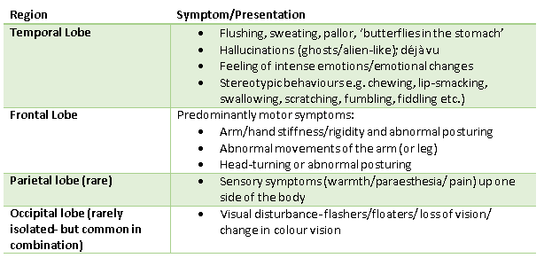
Focal Seizures
The Peer Teaching Society is not liable for false or misleading information…

Slide 28
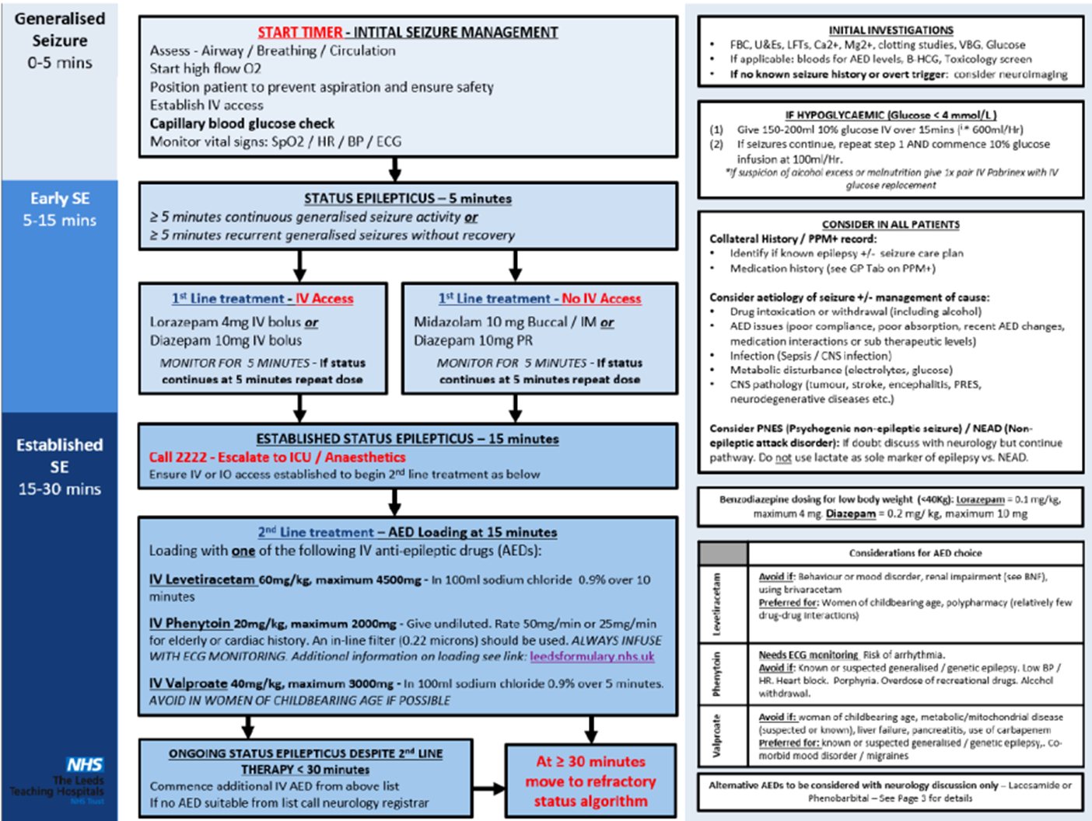
Status Epilepticus
The Peer Teaching Society is not liable for false or misleading information…

Slide 29
Question 7
A 63-year-old caucasian woman presents with partial vision loss in the right eye.
She reports bitemporal headache for several weeks which is made worse by chewing, accompanied by pain and stiffness in the neck and shoulders.
Review of systems is positive for low-grade fever, fatigue, and weight loss. She states that sometimes she loses complete vision in an eye for a brief moment and describes it like a curtain drawing over her eyes.
What would be the most appropriate immediate management?
Prednisone
Oxygen
Paracetamol
Aspirin
Methylprednisolone IV
The Peer Teaching Society is not liable for false or misleading information…

Slide 30
Question 7
A 63-year-old caucasian woman presents with partial vision loss in the right eye.
She reports bitemporal headache for several weeks which is made worse by chewing, accompanied by pain and stiffness in the neck and shoulders.
Review of systems is positive for low-grade fever, fatigue, and weight loss. She states that sometimes she loses complete vision in an eye for a brief moment and describes it like a curtain drawing over her eyes.
What would be the most appropriate immediate management?
Prednisone
Oxygen
Paracetamol
Aspirin
Methylprednisolone IV
The Peer Teaching Society is not liable for false or misleading information…

Slide 31
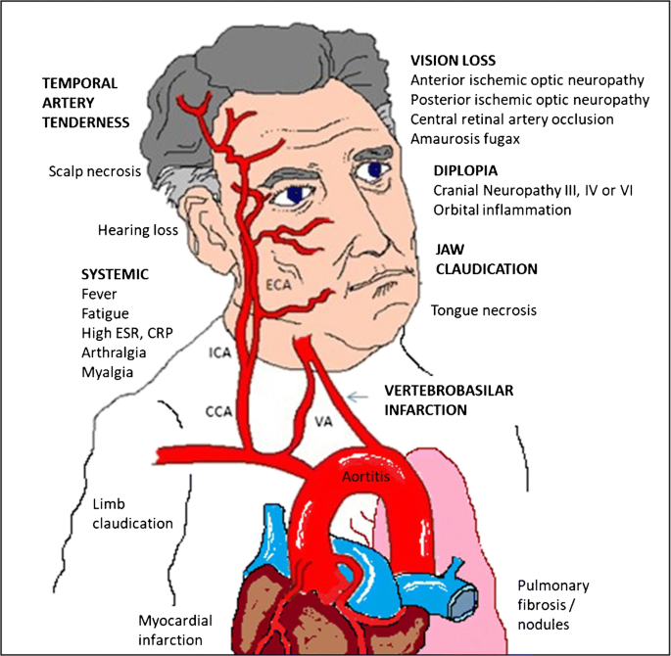
Temporal Arteritis
Features:
Headache
Jaw claudication's
Loss of vision – can be permenant
Tender temporal region
Associated with polymyalgia rheumatica
proximal muscle stiffness, arthralgia, responds well to steroids
Investigations
Temporal artery biopsy – can be negative due to skip lesions
Management
High dose Steroids
Oral prednisolone if no visual symptoms
IV methylprednisolone if visual symptoms occur
The Peer Teaching Society is not liable for false or misleading information…

Slide 32
Question 8
A 60-year-old man presents with right foot drop, which has developed gradually over the last year and progressed to involve more proximal areas in the last 2 months. The patient reports associated muscle twitching and painful muscle cramps involving the same areas. The neurologic examination reveals bilateral lower-extremity weakness, more severe on the right, with associated spasticity, atrophy of the right foot intrinsic muscles, diffuse fasciculations, and hyperreflexia, with deep tendon reflexes being brisker on the right lower extremity, and a positive right Babinski sign. Sensation is preserved throughout. Several other family members have been diagnosed (some have died) with a pattern suggesting autosomal dominant disease.
What would you give for management?
Riluzole
Oral pyridostigmine
IV immunoglobulin
L-dopa
IV alemtuzumab
The Peer Teaching Society is not liable for false or misleading information…

Slide 33
Question 8
A 60-year-old man presents with right foot drop, which has developed gradually over the last year and progressed to involve more proximal areas in the last 2 months. The patient also complains of muscle twitching and painful cramps involving the same areas. A neuro examination reveals bilateral lower-extremity weakness, more severe on the right, with associated spasticity, diffuse fasciculations, and hyperreflexia, with deep tendon reflexes being brisker on the right lower extremity, and a positive right Babinski sign. Sensation is preserved throughout. Several other family members have been diagnosed (some have died) with a pattern suggesting autosomal dominant disease.
What would you give for management?
Riluzole
Oral pyridostigmine
IV immunoglobulin
L-dopa
IV alemtuzumab
The Peer Teaching Society is not liable for false or misleading information…

Slide 34
ALS
Presentation:
Amyotrophic Lateral Sclerosis (ALS) - UMN + LMN- Most common type
muscle atrophy
Unsteady gait and foot drop
UMN- babinski's , hyperreflexia, spasticity
LMN- wasting and fasciculations
Ocular sparing
Investigations: based on clinical finding
-LMN+UMN Definite: LMN + UMN signs in 3 regions
-Probable: LMN + UMN signs in 2 regions
Treatment :
Ant glutamatergic drugs - Oral riluzole - an Na+ channel blocker that inhibits glutamate release. Prolongs life by 3 months
Symptomatic treatment of drooling, dysphagia and spasms.
The Peer Teaching Society is not liable for false or misleading information…

Slide 35
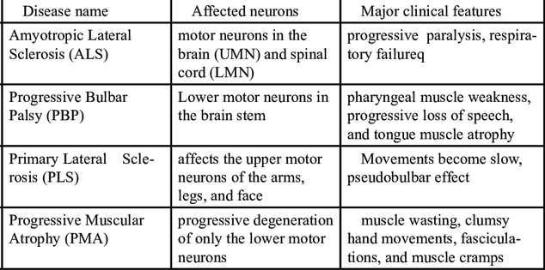
MND Classifications
The Peer Teaching Society is not liable for false or misleading information…

Slide 36
Question 9
A 22 woman presents with recurrent slurring of speech that worsens when she continues to talk. She has trouble swallowing which also gets worse. She reports that during work her eyelid start to feel heavy after staring at the screen and her double vision gets worse. Her symptoms have deteriorated over the past few months. She has intermittent weakness in her legs and arm. She reports a feeling of generalized fatigue and is short of breath. She finds that she usually feels slightly better after waking up.
What antibody is linked with this condition?
Anti-EMA
Anti-CCP
Antinuclear antibody
Anti-musk / anti-AChR
Anti peritoneal antibody
The Peer Teaching Society is not liable for false or misleading information…

Slide 37
Question 9
A 22 woman presents with recurrent slurring of speech that worsens when she continues to talk. She has trouble swallowing which also gets worse. She reports that during work her eyelid start to feel heavy after staring at the screen and her double vision gets worse. Her symptoms have deteriorated over the past few months. She has intermittent weakness in her legs and arm. She reports a feeling of generalized fatigue and is short of breath. She finds that she usually feels slightly better after waking up.
What antibody is linked with this condition?
Anti-EMA
Anti-CCP
Antinuclear antibody
Anti-musk / anti-AChR
Anti peritoneal antibody
The Peer Teaching Society is not liable for false or misleading information…

Slide 38
Myasthenia Gravis
Autoimmune disease against acetylcholine receptors of the neuromuscular junction
Presentation :
muscle fatigability
Ptosis and diplopia
Dysphagia and Dysarthria
facial paresis
Proximal limb weakness
Myasthenic crisis: weakness of respiratory will require intubation or noninvasive ventilation
Investigations:
anti-AChR
EMG
CT of chest
Tensilon test , ICE pack test
Management:
Acute: Pyridostigmine
Long-term: steroids, azathioprine, rituximab, thymectomy
Crisis – Plasma exchange +/- IVIG
The Peer Teaching Society is not liable for false or misleading information…

Slide 39
Question 10
A 64 year old white male presents to emergency services unconscious. You ask his wife and she describes him having an excruciating headache while reading his evening news. Upon further questioning she states it was preceded by him having a painful headache in the morning. She states he has a past medical history of hypertension, polycystic kidney disease. He has a 15 year pack history and drinks every weekend. A CT is done and it confirms a Subarachnoid haemorrhage.
What would be your initial management ?
Mannitol
IV alteplase
Nimodipine
Burrhole surgery
Endovascular coiling
The Peer Teaching Society is not liable for false or misleading information…

Slide 40
Question 10
A 64-year-old white male presents to emergency services unconscious. You ask his wife, and she describes him having an excruciating headache while reading his evening news. Upon further questioning she states it was preceded by him having a painful headache in the morning. She states he has a past medical history of hypertension, polycystic kidney disease. He has a 15-year pack history and drinks every weekend. A CT is done, and it confirms a subarachnoid haemorrhage.
What would be your initial management ?
Mannitol
IV alteplase
Nimodipine
Burrhole surgery
Endovascular coiling
The Peer Teaching Society is not liable for false or misleading information…

Slide 41
Subarachnoid haemorrhage
Presentation: THUNDERCLAP headache, loss of consciousness, sentinel headache (preceding headache due to leakage of the offending aneurysm is sudden and intense), signs of raised ICP
Investigations:
CT head to differentiate from stroke will see hyper dense areas,
lumbar puncture - xanthochromia (yellowish) due to bilirubin breakdown
Treatment:
Cardiopulmonary support and discontinue any antiplatelet + anticoagulant
Nimodipine: prevents further vasospasms and therefore reduces ischemia
Surgical management: endovascular coiling and potentially neurosurgical clipping
Polycystic kidney disease is a huge risk factor for aneurysms
The Peer Teaching Society is not liable for false or misleading information…

Slide 42
A 20 y/o boy presents to clinic complaining of a ‘dead foot’. He tells you his right foot has been like this since he woke up after an adventurous night out at Tank and falling asleep on the floor cross-legged.
On further examination, you discover that his right foot also has weak ankle eversion and sensory loss over the dorsum of the foot.
Given the likely diagnosis, which of the following structures do you think has been affected?
Uncommon fibular nerve
Sciatic nerve
Common peroneal nerve
Sural nerve
Lateral sural nerve
Question 11
The Peer Teaching Society is not liable for false or misleading information…

Slide 43
A 20 y/o boy presents to clinic complaining of a ‘dead foot’. He tells you his right foot has been like this since he woke up after an adventurous night out at Tank and falling asleep on the floor cross-legged.
On further examination, you discover that his right foot also has weak ankle eversion and sensory loss over the dorsum of the foot.
Given the likely diagnosis, which of the following structures do you think has been affected?
Uncommon fibular nerve
Sciatic nerve
Common peroneal nerve
Sural nerve
Lateral sural nerve
Question 11
The Peer Teaching Society is not liable for false or misleading information…

Slide 44
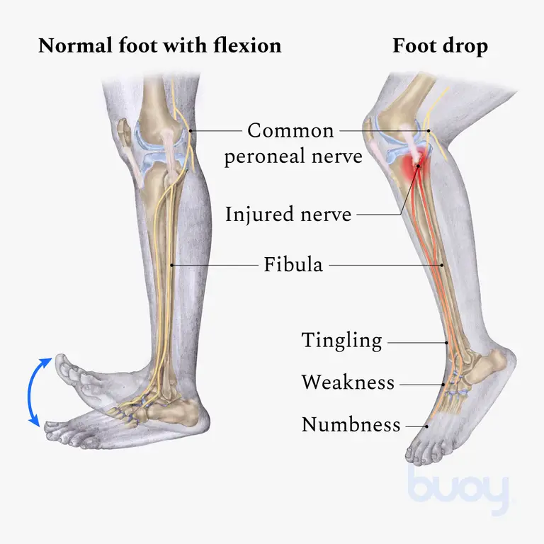
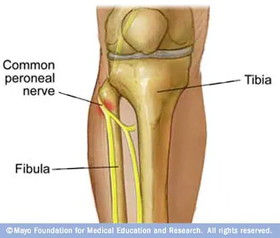
So this is a classic presentation of foot-drop
This is also suggested by the history. The patient fell asleep cross-legged which can cause damage to the common peroneal nerve which wraps around the fibular head
Uncommon fibular nerve doesn’t exist. It sounds a bit like common fibular nerve which is another name for common peroneal nerve
Sciatic nerve - damage to this nerve can also cause foot drop but given the history it’s not the most likely answer
Sural nerve and lateral sural nerve are incorrect
Foot drop
The Peer Teaching Society is not liable for false or misleading information…

Slide 45
A 57 year old female patient comes into clinic complaining of numbness in his left hand, especially at night. She often has to shake it off to relieve it. Alongside this, she often feels tingling and numbness in her hands. The doctor then asks the patient to flex their wrists to 90 degrees and to hold it in that position for at least 30 seconds. The patient complains of numbness and tingling throughout. What was the test performed?
Question 12
Tinel's test
Chvostek's test
Mcmurray’s test
Brudzinski's test
Phalen’s test
The Peer Teaching Society is not liable for false or misleading information…

Slide 46
A 57 year old female patient comes into clinic complaining of numbness in his left hand, especially at night. She often has to shake it off to relieve it. Alongside this, she often feels tingling and numbness in her hands. The doctor then asks the patient to flex their wrists to 90 degrees and to hold it in that position for at least 30 seconds. The patient complains of numbness and tingling throughout. What was the test performed?
Question 12
Tinel's test
Chvostek's test
Mcmurray’s test
Brudzinski's test
Phalen’s test
The Peer Teaching Society is not liable for false or misleading information…

Slide 47
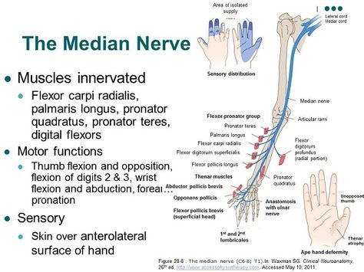
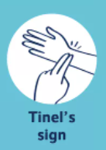
Carpal Tunnel Syndrome
Carpal tunnel syndrome is the most common entrapment mononeuropathy. Females between the ages of 40 and 60 are at the highest risk.
Symptoms: numbness and/or tingling of the thumb and radial fingers, aching wrist, weakness, nighttime worsening.
Risk factors: Smoking, over 30 y/o, high BMI, smoking, acromegaly, hypothyroidism, RA, diabetes, pregnancy, occupation
Investigations and tests:
1st line: electromyogram.
Phalen's test +/- Tinel's test
Treatment:
Wrist splint
Corticosteroid injection
Surgical release
The Peer Teaching Society is not liable for false or misleading information…

Slide 48
A 52 year old male patient goes to his GP complaining of a headache, nausea and vomiting. The headache has been going on for a couple of months and seems to be getting worse over time. The GP orders an MRI scan, and finds a mass in the patient’s brain. What is the most likely cause?
Question 13
Metastasis from lung cancer
Glioblastoma multiforme
Meningioma
Metastasis from breast cancer
Pilocytic astrocytoma
The Peer Teaching Society is not liable for false or misleading information…

Slide 49
A 52 year old male patient goes to his GP complaining of a headache, nausea and vomiting. The headache has been going on for a couple of months and seems to be getting worse over time. The GP orders an MRI scan, and finds a mass in the patient’s brain. What is the most likely cause?
Question 13
Metastasis from lung cancer
Glioblastoma multiforme
Meningioma
Metastasis from breast cancer
Pilocytic astrocytoma
The Peer Teaching Society is not liable for false or misleading information…

Slide 50
Brain Tumours
Brain tumours are most commonly a result of metastatic spread, rather than being a primary lesion. With regards to tumours that spread to the brain, the following malignancies are the most likely causes (in descending order): Lung cancer, Breast cancer, Bowel cancer, Skin cancer (mainly melanoma) and kidney cancer. Hence A was the most likely cause.
Glioblastoma is the most common primary brain tumour (but still less common than metastatic spread). It has a very poor prognosis (roughly 1 year). Main treatment is surgical with post operative chemo and radiotherapy. Dexamethasone can be used to treat oedema.
Meningioma are usually benign lesions that arise from the arachnoid cap cells. Compression is the main cause of symptoms rather than invasion. Treatment includes either surgical resection with or without radiotherapy
Answer explained in A
Pilocytic astrocytoma. If this was a young child, then this answer would have been more appropriate. It is the most common primary brain tumour in children. It shows Rosenthal fibres (corkscrew eosinophilic bundles) on histology. Usually benign and surgically excised
Fun fact: The majority of adult tumours are supratentorial, where as the majority of childhood tumours are infratentorial.
The Peer Teaching Society is not liable for false or misleading information…

Slide 51
A 23-year-old university student presents to the emergency department with fever and confusion. The previous night he felt unwell and had complained of a headache. This morning he seemed confused, and felt warm to touch. On physical examination he is acutely unwell with fever, tachycardia, and mild hypotension. Neck stiffness and a few truncal petechiae are present. A diagnosis of meningococcal disease was made.
SAQ 1
A. Describe Brudzinski's and Kernig's sign (3)
B. What is the first line antibiotic for meningococcal meningitis? (1)
C. Which antibiotic is used as prophylaxis for close contacts? (1)
The Peer Teaching Society is not liable for false or misleading information…

Slide 52
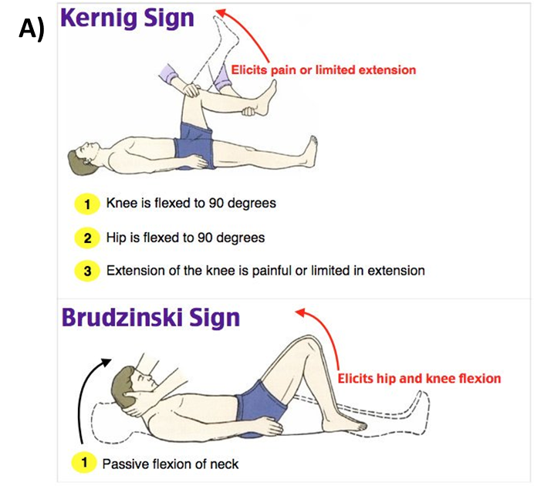
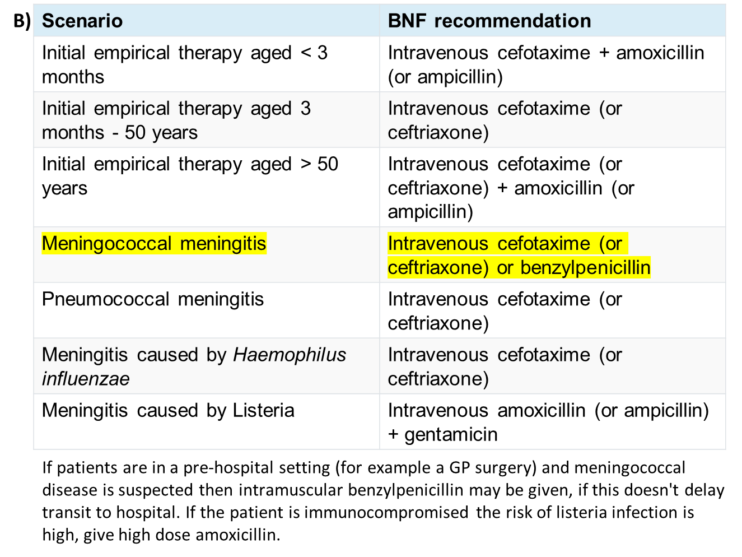
SAQ 1 Answers
C) people who have been exposed to a patient with confirmed bacterial meningitis should be given prophylactic antibiotics if they have close contact within the 7 days before onset. Oral ciprofloxacin or rifampicin may be used
The Peer Teaching Society is not liable for false or misleading information…

Slide 53
A 58-year-old man presents to the emergency department with headache, fever, blurred vision, and drowsiness. For the last 2 weeks he had been feeling ill and had decreased appetite. Three days prior to presentation he experienced intermittent confusion, severe headache, and fever. Examination was limited by a generalised tonic-clonic seizure, for which he received IM lorazepam. A lumbar puncture shows increased lymphocytes with normal glucose and mildly raised protein, viral PCR was positive.
SAQ 2
A) What is the most likely diagnosis? (1)
B) What is the most common causative pathogen? (1)
C) What is the first line treatment for this patient? (1)
The Peer Teaching Society is not liable for false or misleading information…

Slide 54
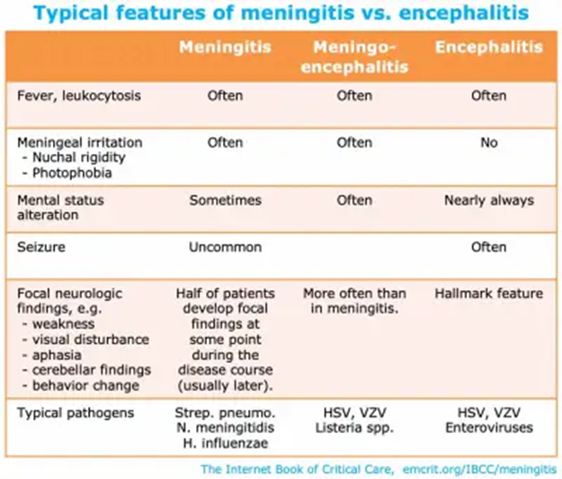
SAQ 2 Answers
Encephalitis
Features
fever, headache, psychiatric symptoms, seizures, vomiting focal features e.g. aphasia
Pathophysiology
HSV-1 (Herpes Simplex virus) responsible for 95% of cases in adults
Investigation
CSF: lymphocytosis, elevated protein
PCR for HSV
neuroimaging
medial temporal and inferior frontal changes (e.g. petechial haemorrhages)
normal in one-third of patients
MRI is better
EEG pattern: lateralized periodic discharges at 2 Hz
Management
intravenous acyclovir should be started in all cases of suspected encephalitis
The Peer Teaching Society is not liable for false or misleading information…

Slide 55
A 44 y/o male patient presents to A&E with bilateral lower-limb weakness. On further examination you discover the patient’s lower-limbs are areflexic and there is a loss of anal sphincter movement. You order an MRI scan and the patient is subsequently diagnosed with cauda equina.
Where would you expect to see a lesion on the MRI scan? (1)
Give three other signs/ symptoms of cauda equina (3)
What is the initial management? (2)
SAQ 3
The Peer Teaching Society is not liable for false or misleading information…

Slide 56
SAQ 3 Answers
Cauda equina is compression of the nerve roots at or caudal to L1
Classic clinical presentations include:
‘Saddle anaesthesia’ - Genital, anus, buttock region
Bilateral or unilateral sciatica - see diagram
Urinary retention
Erectile dysfunction
Lower-limb leg weakness that is flaccid and areflexic (LMN signs). This is in contrast to spinal lesions further up the cord which would cause UMN lesion signs in the lower-limbs, not LMN signs
On imaging:
We would expect to find a lesion in the lumbosacral region
The most likely cause is a herniated disc
Management:
Urgent referral to neurosurgery for cord decompression
The Peer Teaching Society is not liable for false or misleading information…

Slide 57
A 70 year-old man presents to your clinic with a 1-year history of rigidity and loss of dexterity. His handwriting has become smaller and his wife feels his wife feels his face is less expressive and his voice softer. His symptoms developed insidiously but have mildly progressed. You suspect a diagnosis of Parkinson’s disease.
What are the three cardinal signs parkinsonism? (3)
Name three differences between benign essential tremor and parkinsonian tremor. (3)
Name the first-line management of parkinson’s disease.
SAQ 4
The Peer Teaching Society is not liable for false or misleading information…

Slide 58
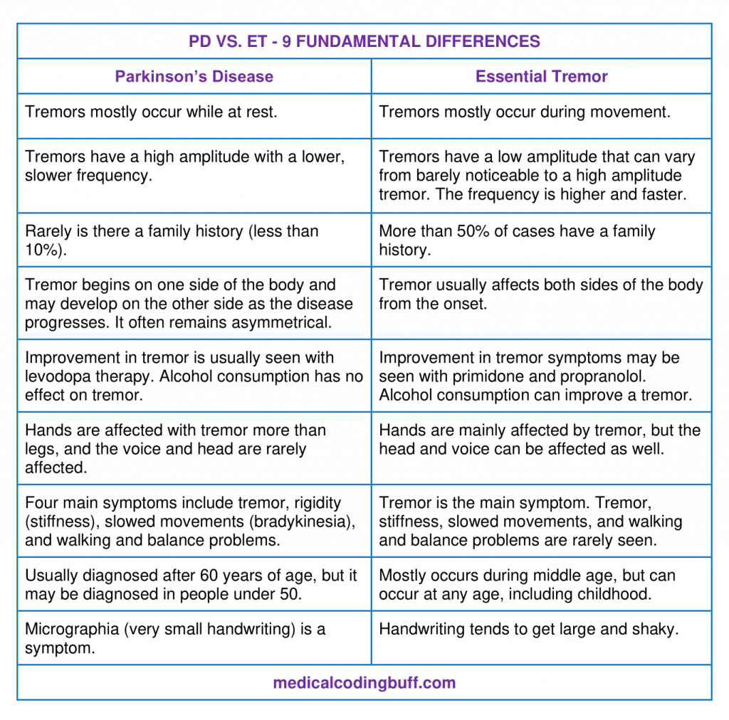
Parkinson’s disease is a neurodegenerative disease with selective loss of nigrostriatal dopaminergic neurons in the substantia nigra
Parkinsonism triad:
Rigidity
Bradykinesia
Resting tremor
Parkinson’s vs benign essential tremor:
See table
Management:
1st Line - Levodopa (usually given alongside a decarboxylase inhibitor e.g., co-careldopa to prevent peripheral conversion of levodopa and maximise dose that crosses blood brain barrier), pramipexole, MAO-I, ropinirole
SAQ 4 Answers
The Peer Teaching Society is not liable for false or misleading information…

Slide 59
Conclusion
mononeuropathies and radiculopathies can be confusing
Common things are common (stroke, epilepsy, dementia, headaches)
Don’t forget public health
Good Luck!!
The Peer Teaching Society is not liable for false or misleading information…

Slide 60
Feedback
The Peer Teaching Society is not liable for false or misleading information…

