Slide 1
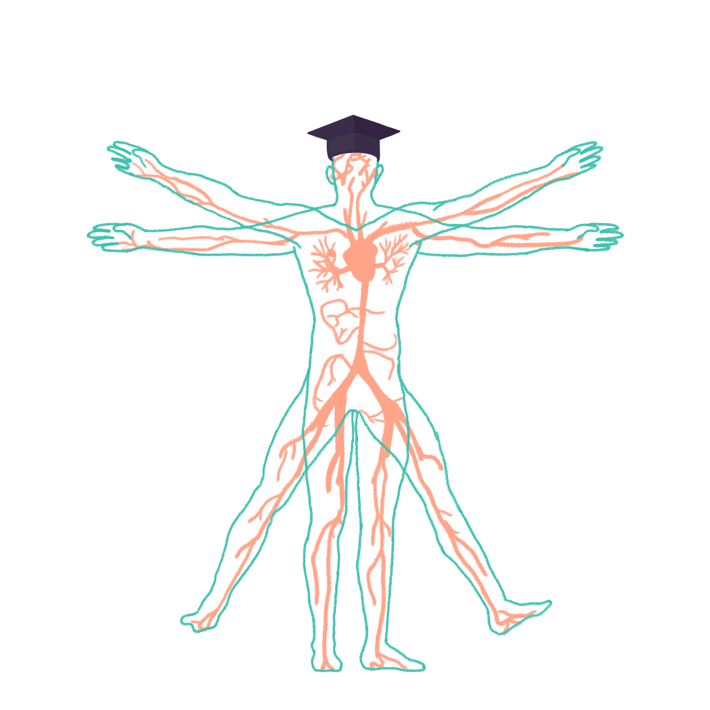
2023/2024

Slide 2
Reproduction
Phase 1 Revision Session
Asha Chaudhry and Molly Warren
The Peer Teaching Society is not liable for false or misleading information…

Slide 3
What we will cover…
SRY gene
Oogenesis, spermatogenesis, spermiogenesis
Hypothalamic pituitary gonadal axis
Menopausal changes
Puberty changes
Menstrual cycle
Fertilization and implantation
Follicular development
Layer of the uterus
Cervical ripening
Maternal adaptations during pregnancy
Stages of labour
Placenta (hormones, function and structure)
The Peer Teaching Society is not liable for false or misleading information…

Slide 4
SRY Gene
The Peer Teaching Society is not liable for false or misleading information…
Notes:
This is the sex-determining region of the Y chromosome, in a male embryo the XY sex chromosomes are present and in a female it is XX.
In the first stage of gonadal development, the male/female are indifferent - they begin as genital ridges (derived from intermediate mesoderm and overlying epithelium)
In the fourth week germ cells migrate from endoderm lining of the yolk sac to the genital ridges and reach the ridges in the sixth week
The epithelium of the genital ridges proliferates and penetrates the int mesoderm to form primitive sex cords forming the indifferent gonad

Slide 5
SRY Gene
The Peer Teaching Society is not liable for false or misleading information…
Notes:
The Y chromosome in the male embryo contains the SRY gene => development of primitive sex cords to form testis cords (tunica albuginea forms around the cords)
In the female embryo there is no Y chromosome hence no SRY gene => primitive sex cords degenerate and do not form the testes cords.
The epithelium of gonad continues to proliferate producing cortical cords and in the third month this forms the primordial follicle

Slide 6
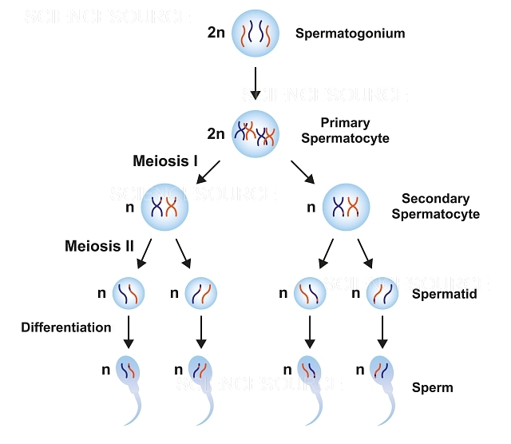
Spermatogenesis and spermiogenesis
The Peer Teaching Society is not liable for false or misleading information…
Notes:
Males start producing sperm when they reach puberty.
Biological males continually produce sperm in large quantities (~200 million a day) to maximises likelihood of sperm reaching egg
Sperm production occurs in the testes in the seminiferous tubules
Blood testes barrier
Sertoli cells form the blood testis barrier - prevents substances found in blood from affecting the developing sperm e.g hormones/waste products and immune system (sperm are genetically different from the male -> different surface antigens)
Spermatogonia are diploid cells that divide by mitosis to give two identical cells
One of these cells will be used to replenish the pool of spermatogonia – these cells are A1 spermatogonia. This replenishment of spermatogonia means that males are fertile throughout their adult life.
The other cell – type B spermatogonium – will eventually form mature sperm. They replicate by mitosis several times to form identical diploid cells known as primary spermatocytes.
Primary spermatocytes then undergo meiosis:
Meiosis I produces two haploid cells -> secondary spermatocytes.
Meiosis II produces four haploid cells -> spermatids.
Maturation
The cytoplasmic bridges break down and the spermatids are released into the lumen of the seminiferous tubule (spermiation)
The spermatids undergo spermiogenesis (remodelling and differentiation into mature spermatozoa) as they travel along the seminiferous tubules until they reach the epididymis.
From the seminiferous tubule, cells will travel to the rete testis. This acts to “concentrate” the sperm by removing excess fluid. Then, cells move to the epididymis where the sperm is stored and undergoes the final stages of maturation.
Spermatogenesis takes approximately 70 days, therefore for sperm production to be continuous and not intermittent, multiple spermatogenic processes are occurring simultaneously within the same seminiferous tubule, with new groups of spermatogonia arising every 16 days (spermatogenic cycle). Each of these populations of spermatogenic cells will be at different stages of spermatogenesis.

Slide 7
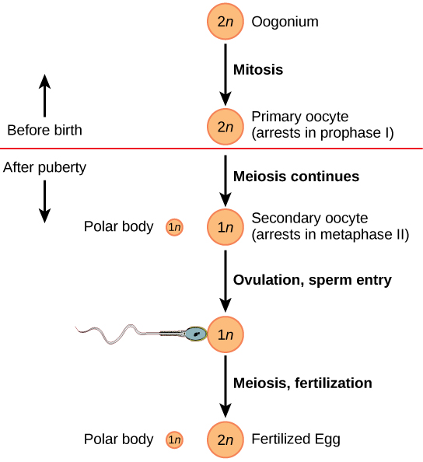
Oogenesis
The Peer Teaching Society is not liable for false or misleading information…
Notes:
Oogenesis differs from spermatogenesis in that it begins in the foetus before birth
Primordial germ cells (originate in the yolk sac of the embryo) move to colonise the cortex of the primordial gonad
Meiosis I begins before birth and forms primary oocytes. There is therefore a finite supply of ova.
Primary oocytes are arranged in the gonads as clusters. They have flattened epithelial cells surrounding them, and this is called the primary follicle.
Once puberty begins, several primary oocytes (15-20) begin to mature each month, although only one of these reaches full maturation to become an oocyte.

Slide 8
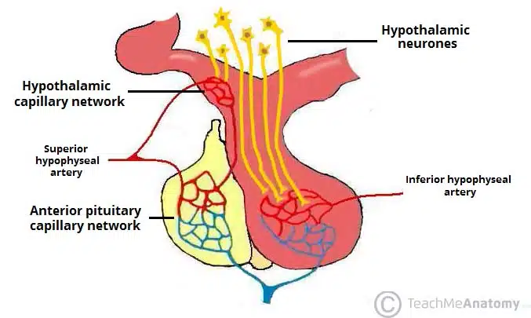
HPG axis: posterior vs anterior pituitary gland
ANTERIOR:
Endocrine tissue
Hormone stimulus
Stimulates the release of: TSH, prolactin, FSH/LH, ACTH, GH into bloodstream
POSTERIOR:
Neural tissue and direct extension of hypothalamus
Releases: ADH and oxytocin
The Peer Teaching Society is not liable for false or misleading information…
Notes:
To understand the HPG axis it’s important to recap some anatomy! The pituitary gland is an extensions of the hypothalamus which can be divided into the anterior and posterior pituitary.
The posterior pituitary is neural tissue and the conversation between the hypothalamus and post pituitary is via nerves. Therefore, does not make/store it’s own hormones and get these from the hypothalamus itself: oxytocin and ADH
Oxytocin is involved in parturition and milk secretion
ADH is involved in blood osmolarity control.
What is the stalk called that connects the hypothalamus to the posterior pituitary? It is the infundibulum
The anterior pituitary is NOT an extension of the hypothalamus and is pure endocrine tissue, the conversation between hypothalamus and ant pituitary gland is via the bloodstream (aka hypophyseal portal system). It becomes a hormonal stimulus to produce AND release TRH, PRH, GnRH, CRH, GHRH this stimulates the release of TSH, prolactin, FSH/LH, ACTH, GH respectively into the bloodstream.
Where does the ant pituitary gland receive blood from?

Slide 9
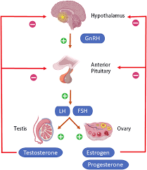
HPG Axis
Which cells does LH stimulate in the testes?
Which cells does FSH stimulate in the testes?
The Peer Teaching Society is not liable for false or misleading information…
Notes:
Gonadotrophins are the hormones produced to control the reproductive system: LH and FSH. They are essential for controlling the reproductive system and regulation production of gametes and sex steroids.
1. GnRH is released in pulsatile fashion from neurons in hypothalamus
2. This acts on GnRH receptors found in gonadotroph cells of anterior pituitary
3. This stimulates the production of LH and FSH which are released into the bloodstream in an episodic fashion
4. LH and FSH act on the gonads to stimulate testosterone release from testes, oestrogen/progesterone release in ovaries
Which cells does LH stimulate in the testes? Leydig cells
Which cells does FSH stimulate in the testes? Sertoli cells

Slide 10
Menopausal changes
Hormonal
Vasomotor
Urogenital changes
Bone density
Ischaemic heart disease
The Peer Teaching Society is not liable for false or misleading information…
Notes:
Hormonal Changes
Reduction of circulating oestrogen – due to reduced sensitivity of the ovary to circulating gonadotropins (FSH and LH) as a result of decreasing available binding sites (due to the reduction in follicle numbers)
This reduced sensitivity -> reduction in oestrogen secretion -> increase in anovulatory cycles.
Levels of FSH and LH increase significantly during the menopause due to low levels of circulating oestrogen (and therefore no negative feedback on the hypothalamus and the pituitary) The decrease in developing follicles also reduces the amount of inhibin released – causing an enhanced rise of FSH.
Perimenopause symptoms: hot flushes, urinary incontinence and increased UTIs as well as irregular vaginal bleeding from both ovulatory and anovulatory cycles.
Progesterone is required to support the endometrium so when ovulation does not occur the endometrial lining breaks down. This is termed oestrogen breakthrough bleeding and can happen as frequently as every fortnight in perimenopausal women.
As levels of oestrogen decrease both of these types of bleeding gradually cease.
Vasomotor Changes
Hot flushes: red flush starting on the face and spreading down the neck and chest.
Associated with peripheral vasodilation and a transient rise in body temperature.
Exact mechanism is unknown
Urogenital Changes
Circulating oestrogen maintains tissue of uterus and vagina -> atrophy of the vagina and thinning of the myometrium and vaginal walls. Also vaginal dryness -> dyspareunia
Bladder and urethra share embryological derivation with the uterus and vagina and so these tissues also atrophy -> symptoms of urinary incontinence and an increase in UTIs
Bone Density
Oestrogen protects bone mass and density through reducing the activity of oesteoclasts. With the drop in oestrogen this balance is tipped and there is an increase in bone reabsorption = acceleration of age related loss of bone density = increased freq in fractures, especially of the wrist and hip.
Ischaemic Heart Disease
Oestrogen offers a protective effect against heart disease. It is thought that oestrogen reduces levels of LDL cholesterol whilst raising HDL cholesterol. After the menopause women experience the same frequency of cardiovascular disease as men.

Slide 11
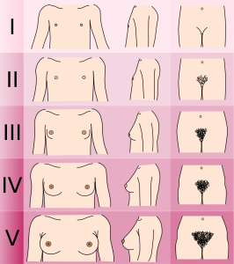
Puberty changes - female
Breast formation
1.5-3 years later 1st period – 12.8 y/o (Caucasian)
Pubic hair growth (2 years after start of puberty)
Tanner Staging system →
The Peer Teaching Society is not liable for false or misleading information…

Slide 12
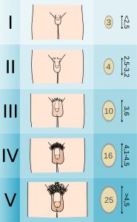
Puberty changes - male
Increase in testicular size – 11.6 y/o (UK average)
1 year later first ejaculation
Pubic hair growth (2 years after start of puberty)
Tanner Staging system →
The Peer Teaching Society is not liable for false or misleading information…

Slide 13
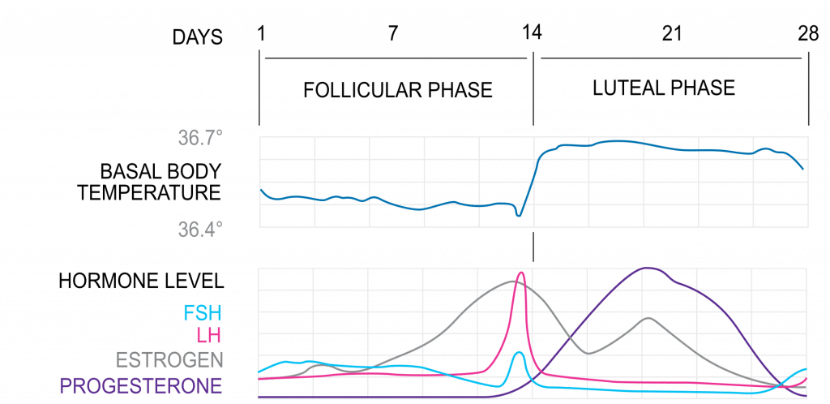
Menstrual cycle – Ovarian cycle
The Peer Teaching Society is not liable for false or misleading information…
Notes:
Follicular Phase
The follicular phase marks the beginning of a new cycle as follicles (oocytes surrounded by stromal cells) begin to mature and prepare to release an oocyte.
At the start of a new cycle (menses), there is little ovarian hormone production and the follicle begins to develop independently of gonadotropins or ovarian steroids. Due to the low steroid and inhibin levels, there is little negative feedback at the HPG axis, resulting in an increase in FSH and LH levels. These stimulate follicle growth and oestrogen production.
Only one dominant follicle can continue to maturity and complete each menstrual cycle. As oestrogen levels rise, negative feedback reduces FSH levels, and only one follicle can survive, with the other follicles forming polar bodies.
Follicular oestrogen eventually becomes high enough to initiate positive feedback at the HPG axis, increasing levels of GnRH and gonadotropins. However, the effect is only reflected in LH levels (the LH surge) due to the increased follicular inhibin, selectively inhibiting FSH production at the anterior pituitary. Granulosa cells become luteinised and express receptors for LH.
Ovulation
In response to the LH surge, the follicle ruptures and the mature oocyte is assisted to the fallopian tube by fimbria. Here it remains viable for fertilisation for around 24 hours.
Following ovulation, the follicle remains luteinised, secreting oestrogen and now also progesterone, reverting back to negative feedback on the HPG axis. This, together with inhibin (inhibits FSH) stalls the cycle in anticipation of fertilisation.
Luteal Phase
The corpus luteum is the tissue in the ovary that forms at the site of a ruptured follicle following ovulation. It produces oestrogens, progesterone and inhibin to maintain conditions for fertilisation and implantation.
At the end of the cycle, in the absence of fertilisation, the corpus luteum spontaneously regresses after 14 days. There is a significant fall in hormones, relieving negative feedback, and resetting the HPG axis ready to begin the cycle again.
If fertilisation occurs, the syncytiotrophoblast of the embryo produces human chorionic gonadotropin (HCG), exerting a luteinising effect, and maintaining the corpus luteum. It is supported by placental HCG and it produces hormones to support the pregnancy. At around 4 months of gestation, the placenta is capable of producing sufficient steroid hormone to control the HPG axis.

Slide 14
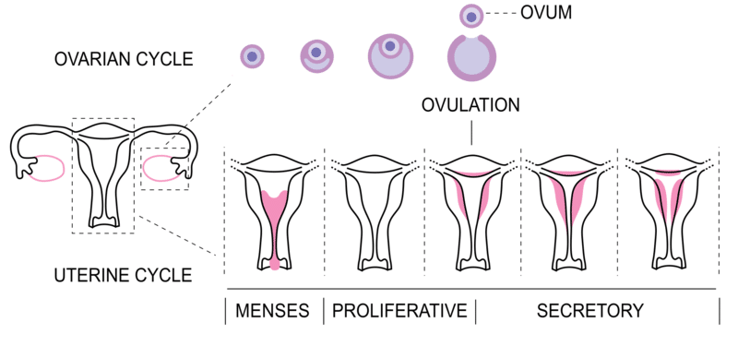
Menstrual cycle – Uterine cycle
The Peer Teaching Society is not liable for false or misleading information…
Notes:
Proliferative Phase
Following menses, the proliferative phase runs alongside the follicular phase, preparing the reproductive tract for fertilisation and implantation.
Oestrogen initiates fallopian tube formation, thickening of the endometrium, increased growth and motility of the myometrium and production of a thin alkaline cervical mucus (to facilitate sperm transport).
Secretory Phase
The secretory phase runs alongside the luteal phase.
Progesterone stimulates further thickening of the endometrium into a glandular secretory form, thickening of the myometrium, reduction of motility of the myometrium, thick acidic cervical mucus, changes in mammary tissue and other metabolic changes.
Menses
Marks the beginning of a new menstrual cycle.
It occurs in the absence of fertilisation once the corpus luteum has broken down and the internal lining of the uterus is shed. Menstrual bleeding usually lasts between 2-7 days with 10-80ml blood loss.

Slide 15
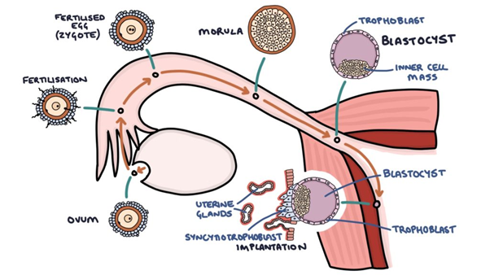
Fertilization
The Peer Teaching Society is not liable for false or misleading information…
Notes:
Fertilization occurs when a sperm and an oocyte combine and their nuclei fuse. Because each of these reproductive cells is a haploid cell containing half of the genetic material needed to form a human being, their combination forms a diploid cell – zygote
Transit of Sperm
Fertilization is a numbers game. During ejaculation, hundreds of millions of spermatozoa are released into the vagina
Almost immediately, millions of these sperm are overcome by the acidity of the vagina (approximately pH 3.8)
More may be blocked from entering the uterus by thick cervical mucus
Of those that do enter, thousands are destroyed by phagocytic uterine leukocytes.
During the journey, fluids in the female reproductive tract prepare the sperm for fertilization through a process called capacitation, or priming.
The fluids improve the motility of the spermatozoa
Alsothe fluids deplete cholesterol molecules embedded in the membrane of the head of the sperm, thinning the membrane in such a way that will help facilitate the release of the lysosomal enzymes needed for the sperm to penetrate the oocyte’s exterior once contact is made.
Contact Between Sperm and Oocyte
Upon ovulation, the oocyte released by the ovary is swept into—and along—the fallopian tube. Fertilization must occur in the distal fallopian tube because an unfertilized oocyte cannot survive the 72-hour journey to the uterus
As it is swept along the distal uterine tube, the oocyte encounters the surviving capacitated sperm.
To reach the oocyte itself, the sperm must penetrate the two protective layers. The sperm first burrow through the cells of the corona radiata. Then, upon contact with the zona pellucida, the sperm bind to receptors in the zona pellucida. This initiates a process called the acrosomal reaction in which the enzyme-filled “cap” of the sperm, called the acrosome, releases its stored digestive enzymes. These enzymes clear a path through the zona pellucida that allows sperm to reach the oocyte
Finally, a single sperm makes contact with sperm-binding receptors on the oocyte’s plasma membrane
The plasma membrane of that sperm then fuses with the oocyte’s plasma membrane, and the head and mid-piece of the “winning” sperm enter the oocyte interior.
The first sperm to reach the oocyte is never the one to fertilize it. Rather, hundreds of sperm cells must undergo the acrosomal reaction, each helping to degrade the corona radiata and zona pellucida until a path is created to allow one sperm to contact and fuse with the plasma membrane of the oocyte.
When the first sperm fuses with the oocyte, the oocyte deploys two mechanisms to prevent polyspermy. This is critical because if more than one sperm were to fertilize the oocyte, the resulting zygote would be a triploid organism - incompatible with life.
The fast block: a near instantaneous change in sodium ion permeability upon binding of the first sperm, depolarizing the oocyte plasma membrane and preventing the fusion of additional sperm cells.
The slow block (the cortical reaction): special proteins are released and cause the release of any other attached sperm and destroy the oocyte’s sperm receptors, thus preventing any more sperm from binding.

Slide 16
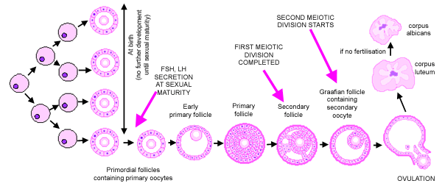
Follicular development
The Peer Teaching Society is not liable for false or misleading information…
Notes:
Folliculogenesis is the process in which a recruited primordial follicle grows and develops into a specialized graafian follicle with the potential to either ovulate its egg into the oviduct at mid-cycle to be fertilized or to die by atresia.

Slide 17
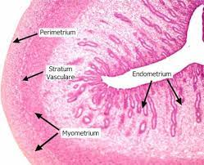
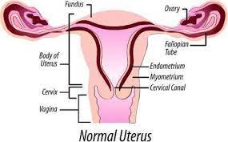
Layers of the uterus
The Peer Teaching Society is not liable for false or misleading information…
Notes:
What is a “normal uterus” commonly described as? Anteverted and anteflexed.
The uterus is made up of three sections: fundus, body and cervix
The fundus and the body of the uterus are made up of 3 tissue layers: peritoneum, myometrium and the endometrium
Peritoneum- double layered membrane continuous with abdominal peritoneum (aka perimetrium)
Myometrium - thick SMOOTH MUSCLE layer (undergo hyperplasia/trophy during pregnancy to expel fetus at birth)
Endometrium- inner mucous membrane split into deep stratum basalis and superficial stratum functionalis (this sheds in menstruation and regenerates from cells in stratum basalis layer and is the upper 2/3).
*endometriosis- when these cells appear outside the uterus*
HISTOLOGY:
Endometrium- simple columnar epithelium

Slide 18
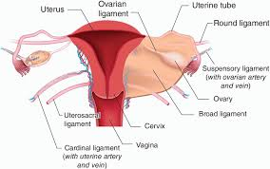
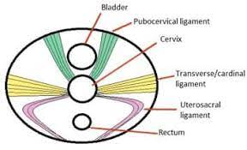
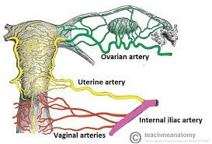
Ligaments/vasculature/innervation
The Peer Teaching Society is not liable for false or misleading information…
Notes:
These ligaments help secure the uterus in place: broad, round, ovarian, cardinal and uterosacral
Broad- acts as a mesentary and maintains uterus in position
Round- maintains anteverted position
Ovaries - joins ovaries to uterus
Cardinal- contains uterine artery/vein and provides support
Uterosacral- provides support extending from cervix to sacrum
Blood supply is via uterine artery, venous drainage via plexus in broad ligament into uterine veins. Lymphatic drainage via iliac, sacral, aortic, inguinal nodes
Innervation:
Sympathetic- arises from uterovaginal plexus, comprises of ant and int parts of inf hypogastric plexus
Parasympathetic fibres derive from pelvic sphlanchic nerve (S2-S4)

Slide 19
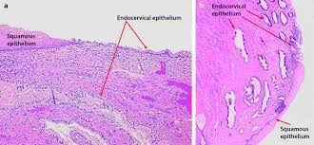
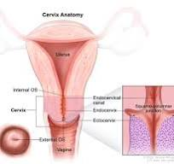
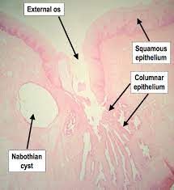
A bit about the cervix
The Peer Teaching Society is not liable for false or misleading information…
Notes:
The cervix is the lower aspect of the uterus connecting the vagina to the main body of the uterus. It facilitates passage of sperm into uterine cavity and maintains sterility of the reproductive tract.
It is made up of the ectocervix (stratified squamous non-keratinised epithelium) and endocervix (mucus-secreting simple columnar epithelium)
The ectocervix projects into the vagina at the external os and the endocervix is more proximal and ends in the internal os
It is supplied by the uterine artery and venous drainage via a plexus in the broad ligament draining into the uterine veins

Slide 20
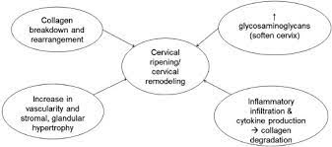
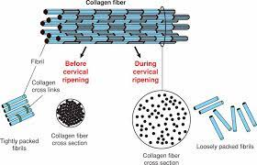
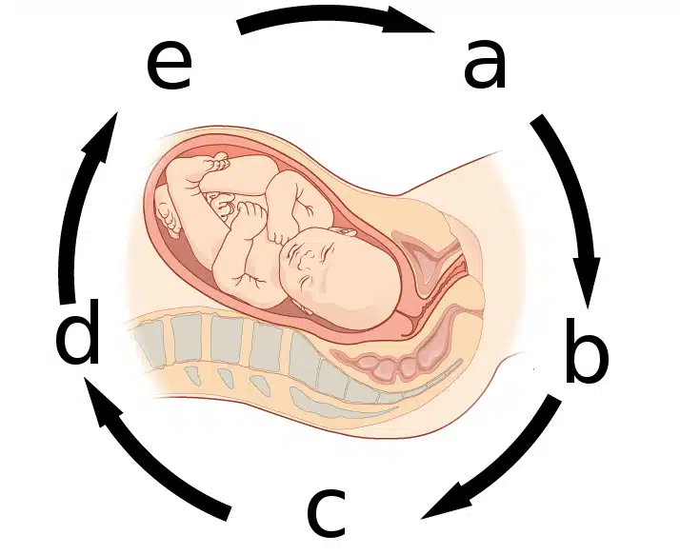
Cervical ripening/effacement
The Peer Teaching Society is not liable for false or misleading information…
Notes:
Cervical ripening is the softening of the cervix that occurs before labour to ensure the cervix dilates. Occurring in labour/late pregnancy.
In the third trimester prostaglandin synthesis increases by the placenta, uterine decidua, myometrium and membranes - increasing the oestrogen:progesterone ratio
The cervix offers less resistance (softens/dilates) as there is a: reduction in collagen/aggregation of collagen fibres and an increase in glycosaminoglycans and hyaluronic acid
Oxytocin is inhibited by relaxin and progesterone during the majority of pregnancy, but due to the increased oest:prog the uterus begins to contract due to pulsatile release of oxytocin from post pituitary gland
These contractions result in pos feedback loop = more oxytocin= stronger contractions (Feguson reflex)
The image shows the structural changes that occur in the collagen (main protein in the cervix) that alter the tissue strength and flexibility via reduction in cross-links
These are then altered again closer to labour to ripening - the collagen fibril diameter increases - loss of tissue integrity and increased tissue compliance

Slide 21
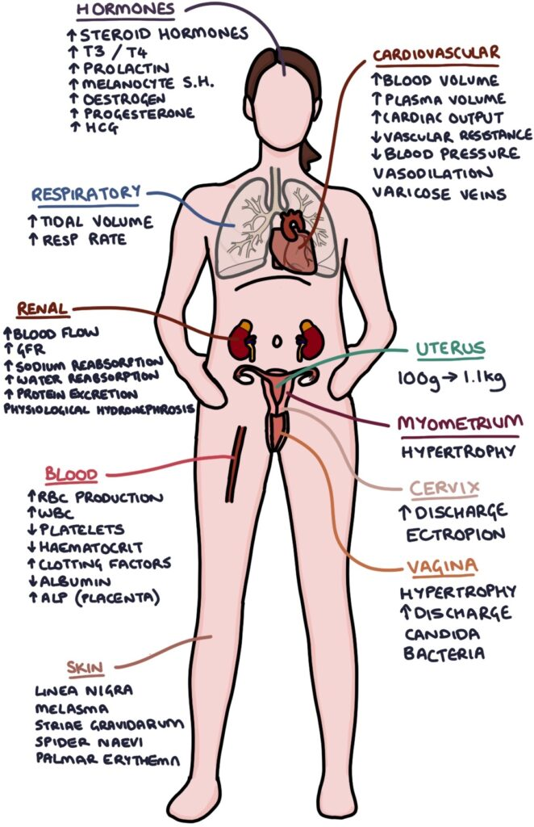
Maternal adaptations in pregnancy
- Endocrine
- Cardiovascular
- Respiratory
- GI
- Urinary
- Haematological
The Peer Teaching Society is not liable for false or misleading information…
Notes:
Endocrine System
Throughout pregnancy levels of progesterone (from corpus luteum and later placenta) and oestrogen (from placenta) increase
Increase in oestrogen levels increases hepatic production of thyroid-binding globulin (TBG) = more free T3 and T4 bind to the TBG = more TSH released from anterior pituitary
Therefore, the free T3 and T4 levels remain unchanged – but total T3 and T4 levels rise.
Thyroxin is essential for the foetus’ neural development, but the foetal thyroid gland is not functional until the second trimester of gestation. Hence, increasing T3 and T4 levels in the mother ensures that there is a constant supply of thyroxin to the foetus early in pregnancy.
During pregnancy (mainly during the second trimester) there is also an increase in human placental lactogen, prolactin and cortisol levels. These are anti-insulin hormones therefore, they increase insulin resistance in the mother and reduce peripheral uptake of glucose. This ensures that there is a continuous supply of glucose for the foetus.
The mother switches to an alternative source of energy which is provided by lipids. The increase in lipolysis means that there is an increase in free fatty acids in the plasma which provide substrate for maternal metabolism. The breakdown of lipids can result in ketogenesis thus, pregnancy is associated with an increased risk of ketoacidosis.
Cardiovascular System
As discussed above, during pregnancy progesterone levels increase. Progesterone acts to decrease systemic vascular resistance in pregnancy which leads to a decrease in diastolic BP during 1st and 2nd trimesters
In response to this the cardiac output increases by about 30-50%. An increase in blood pressure during pregnancy could be an indication of pre-eclampsia.
Pregnancy results in the activation of the RAAS, leading to an increase in sodium levels and water retention. This means that the total blood volume increases.
Respiratory System
Anatomically, the growth of the foetus during pregnancy causes upward displacement of the diaphragm. However, this does not decrease the total lung capacity significantly as there is also an increase in the transverse and anterior-posterior diameters of the thorax.
In pregnancy, there is also an increase in metabolic rate, which leads to an increased demand for oxygen. The tidal volume and the minute ventilation rate increase to help the mother meet these oxygen demands.
Many women experience hyperventilation during pregnancy, it is thought that the reason for this is the increased carbon dioxide production and the increased respiratory drive caused by progesterone. This hyperventilation results in respiratory alkalosis with a compensated increase in renal bicarbonate excretion.
Gastrointestinal System
The growth of the uterus causes several anatomical changes related to the gastrointestinal tract. One of these is the upward displacement of the stomach as the uterus grows, this leads to an increase in intra-gastric pressure which would predispose the mother to reflux along with symptoms such as nausea and vomiting.
The appendix may also move to the RUQ
The increase in progesterone during pregnancy results in smooth muscle relaxation, which decreases gut motility. Although this allows for more time for nutrient absorption, it can lead to constipation.
Increased progesterone also causes relaxation of the gallbladder so biliary tract stasis may occur. This predisposes the mother to gallstones
Urinary System
Increased cardiac output during pregnancy causes an increase in renal plasma flow, which increases the GFR by about 50-60%. This would mean that there is an increase in renal excretion, so in pregnancy, the levels of urea and creatinine will be lower.
Progesterone affects the urinary collecting system causing relaxation of the ureter (resulting in hydroureter) and relaxation of the muscles of the bladder. Both of these changes cause urinary stasis which predisposes a woman to UTIs and pyselonephritis
Haematological Changes
In pregnancy there is an increase in fibrinogen and clotting factors the blood and a decrease in fibrinolysis.
All of these factors increase the risk of thromboembolic disease in pregnancy
During pregnancy, the plasma volume increases significantly, however, the red cell mass does not increase by as much -> physiological dilutional anaemia

Slide 22
Stages of labour
1
Stage 1: Beginning of labour until cervix fully dilated
Stage 2: Full dilation of cervix until foetus expelled
Stage 3: Placenta delivered
2
The Peer Teaching Society is not liable for false or misleading information…
3
Notes:
First Stage
The first stage of labour results in the creation of the birth canal and lasts from the beginning of labour until the cervix is fully dilated (~10cm). The maximum size of the birth canal is determined by the pelvis – the pelvic inlet is typically around 11cm, but this may increase slightly during pregnancy as ligaments soften under the influence of hormones.
Throughout the first stage contractions will occur every 2-3 minutes. If foetal membranes have not already ruptured, they do during this stage. It consists of two phases:
The latent phase – slow cervical dilatation over several hours which lasts until the cervix has reached 4cm dilatation.
The active phase – faster rate of cervical dilatation until 10cm dilatation reached.
Once the cervix is dilated the foetal head is able to descend, remaining flexed to maintain the smallest diameter possible.
Second Stage
Lasts from full dilatation of the cervix until foetus has been expelled. Uterine contractions become expulsive and this pushes the foetus through the birth canal. There are two stages of this:
The passive stage – this lasts until the head of the foetus reaches the pelvic floor, at which point the woman experiences the desire to push. Rotation and flexion of the head are also completed in this stage. It typically only lasts a few minutes.
The active stage – the pressure of the foetal head on the pelvic floor results in an urge to “bear down”. During this stage the woman pushes in conjunction with her contractions in order to expel the foetus.
Contractions are made more forceful and frequent by the actions of two hormones:
Prostaglandins
Oxytocin
Delivery
Once the head of the foetus reaches the perineum, it extends in order to come up and out of the pelvis. Following delivery of the head, it rotates by 90 degrees to assist with delivery of the shoulders.
The anterior shoulder delivers first, coming under the symphysis pubis while the body flexes laterally and posteriorly to aid passage. Following this the body flexes laterally and anteriorly to help deliver the posterior shoulder.
Once the shoulders have been delivered the rest of the body follows.
Third Stage
Follows delivery and lasts until the placenta has been delivered.
Uterine muscle fibres contract to compress the blood vessels supplying the placenta, which then shears away from the uterine wall.
Contractions continue until the placenta and membranes have been delivered.

Slide 23
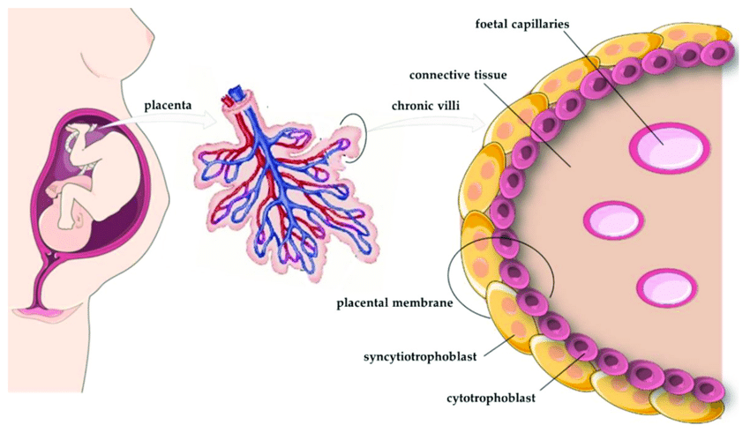
Placenta (hormones, function and structure)
The Peer Teaching Society is not liable for false or misleading information…
Notes:
The placenta produces several metabolic proteins (leptin, adiponectin), peptide hormones (hCG, hPL, PGH) and steroid hormones (progesterone, estrogens) which have significant influence on maternal glucose metabolism and its adaptation throughout pregnancy
Its principal function is to supply the fetus with oxygen and nutrients. Is is structurally adapted, possessing a large surface area for exchange and a thin membrane separating the maternal and fetal circulations.

Slide 24
SBA QUESTIONS!!
Which mechanism explains hot flushes experienced during menopause, influencing temperature control?
A – continuous FSH release
B - Pulsatile FSH release
C – continuous LH release
D – pulsatile LH release
The Peer Teaching Society is not liable for false or misleading information…
Notes:
D – pulsatile LH release
Hot flushes are associated with transient rise of body temperature and peripheral vasodilation – the exact mechanism is unknown

Slide 25
What age does puberty typically begin in girls?
A – 7-12
B – 8-14
C – 10-15
D – 12-16
What age does puberty begin in boys?
The Peer Teaching Society is not liable for false or misleading information…
Notes:
B- between ages of 8-14
Boys: 10-16 years

Slide 26
What is the name for the positive feedback loop oxytocin exerts on the posterior pituitary gland?
A – Ferguson reflex
B – Braxton hicks reflex
C – cervical ripening
D – active stage of labour
The Peer Teaching Society is not liable for false or misleading information…
Notes:
A- Ferguson Reflex

Slide 27
What is the name for the involuntary contractions that occur during the third trimester of pregnancy?
A – Braxton Hicks contractions
B – Myometrial excitability
C – Positive feedback contractions
D – Latent phase contractions
The Peer Teaching Society is not liable for false or misleading information…
Notes:
A- Braxton Hicks contractions
Thought to be “practice contractions” and not part of labour

Slide 28
What is the effect of follicular inhibin in the follicular stage?
A – Stimulates LH release
B – inhibits LH release
C – Stimulates FSH release
D – inhibits FSH release
The Peer Teaching Society is not liable for false or misleading information…
Notes:
E- inhibits FSH release
Inhibin released from follicles acts at the anterior pituitary to selectively inhibit FSH release

Slide 29
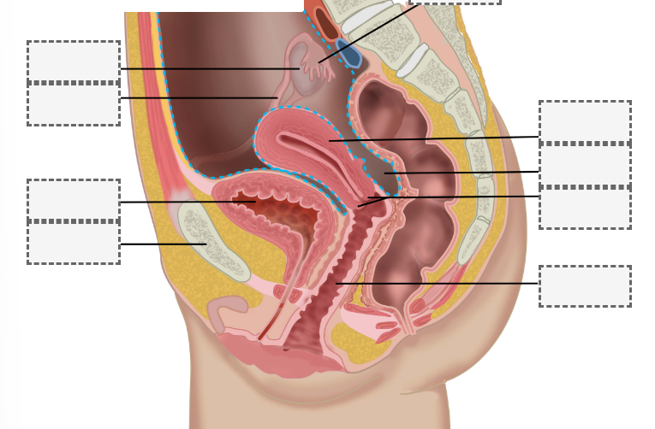
Notes:
1- Fimbriae
2 - uterus
3- pouch of Douglas
4 - cervix
5 - vagina
6 – pubis
7 – bladder
8 – uterine tube
9- ovary

Slide 30
Conclusion
Teach me Anatomy
Teach me Physiology !!!
Histology booklet
Any questions???
The Peer Teaching Society is not liable for false or misleading information…

Slide 31
Feedback
https://forms.gle/ZSMrqfZgtSWmzde8A
The Peer Teaching Society is not liable for false or misleading information…

Slide 32
