Slide 1
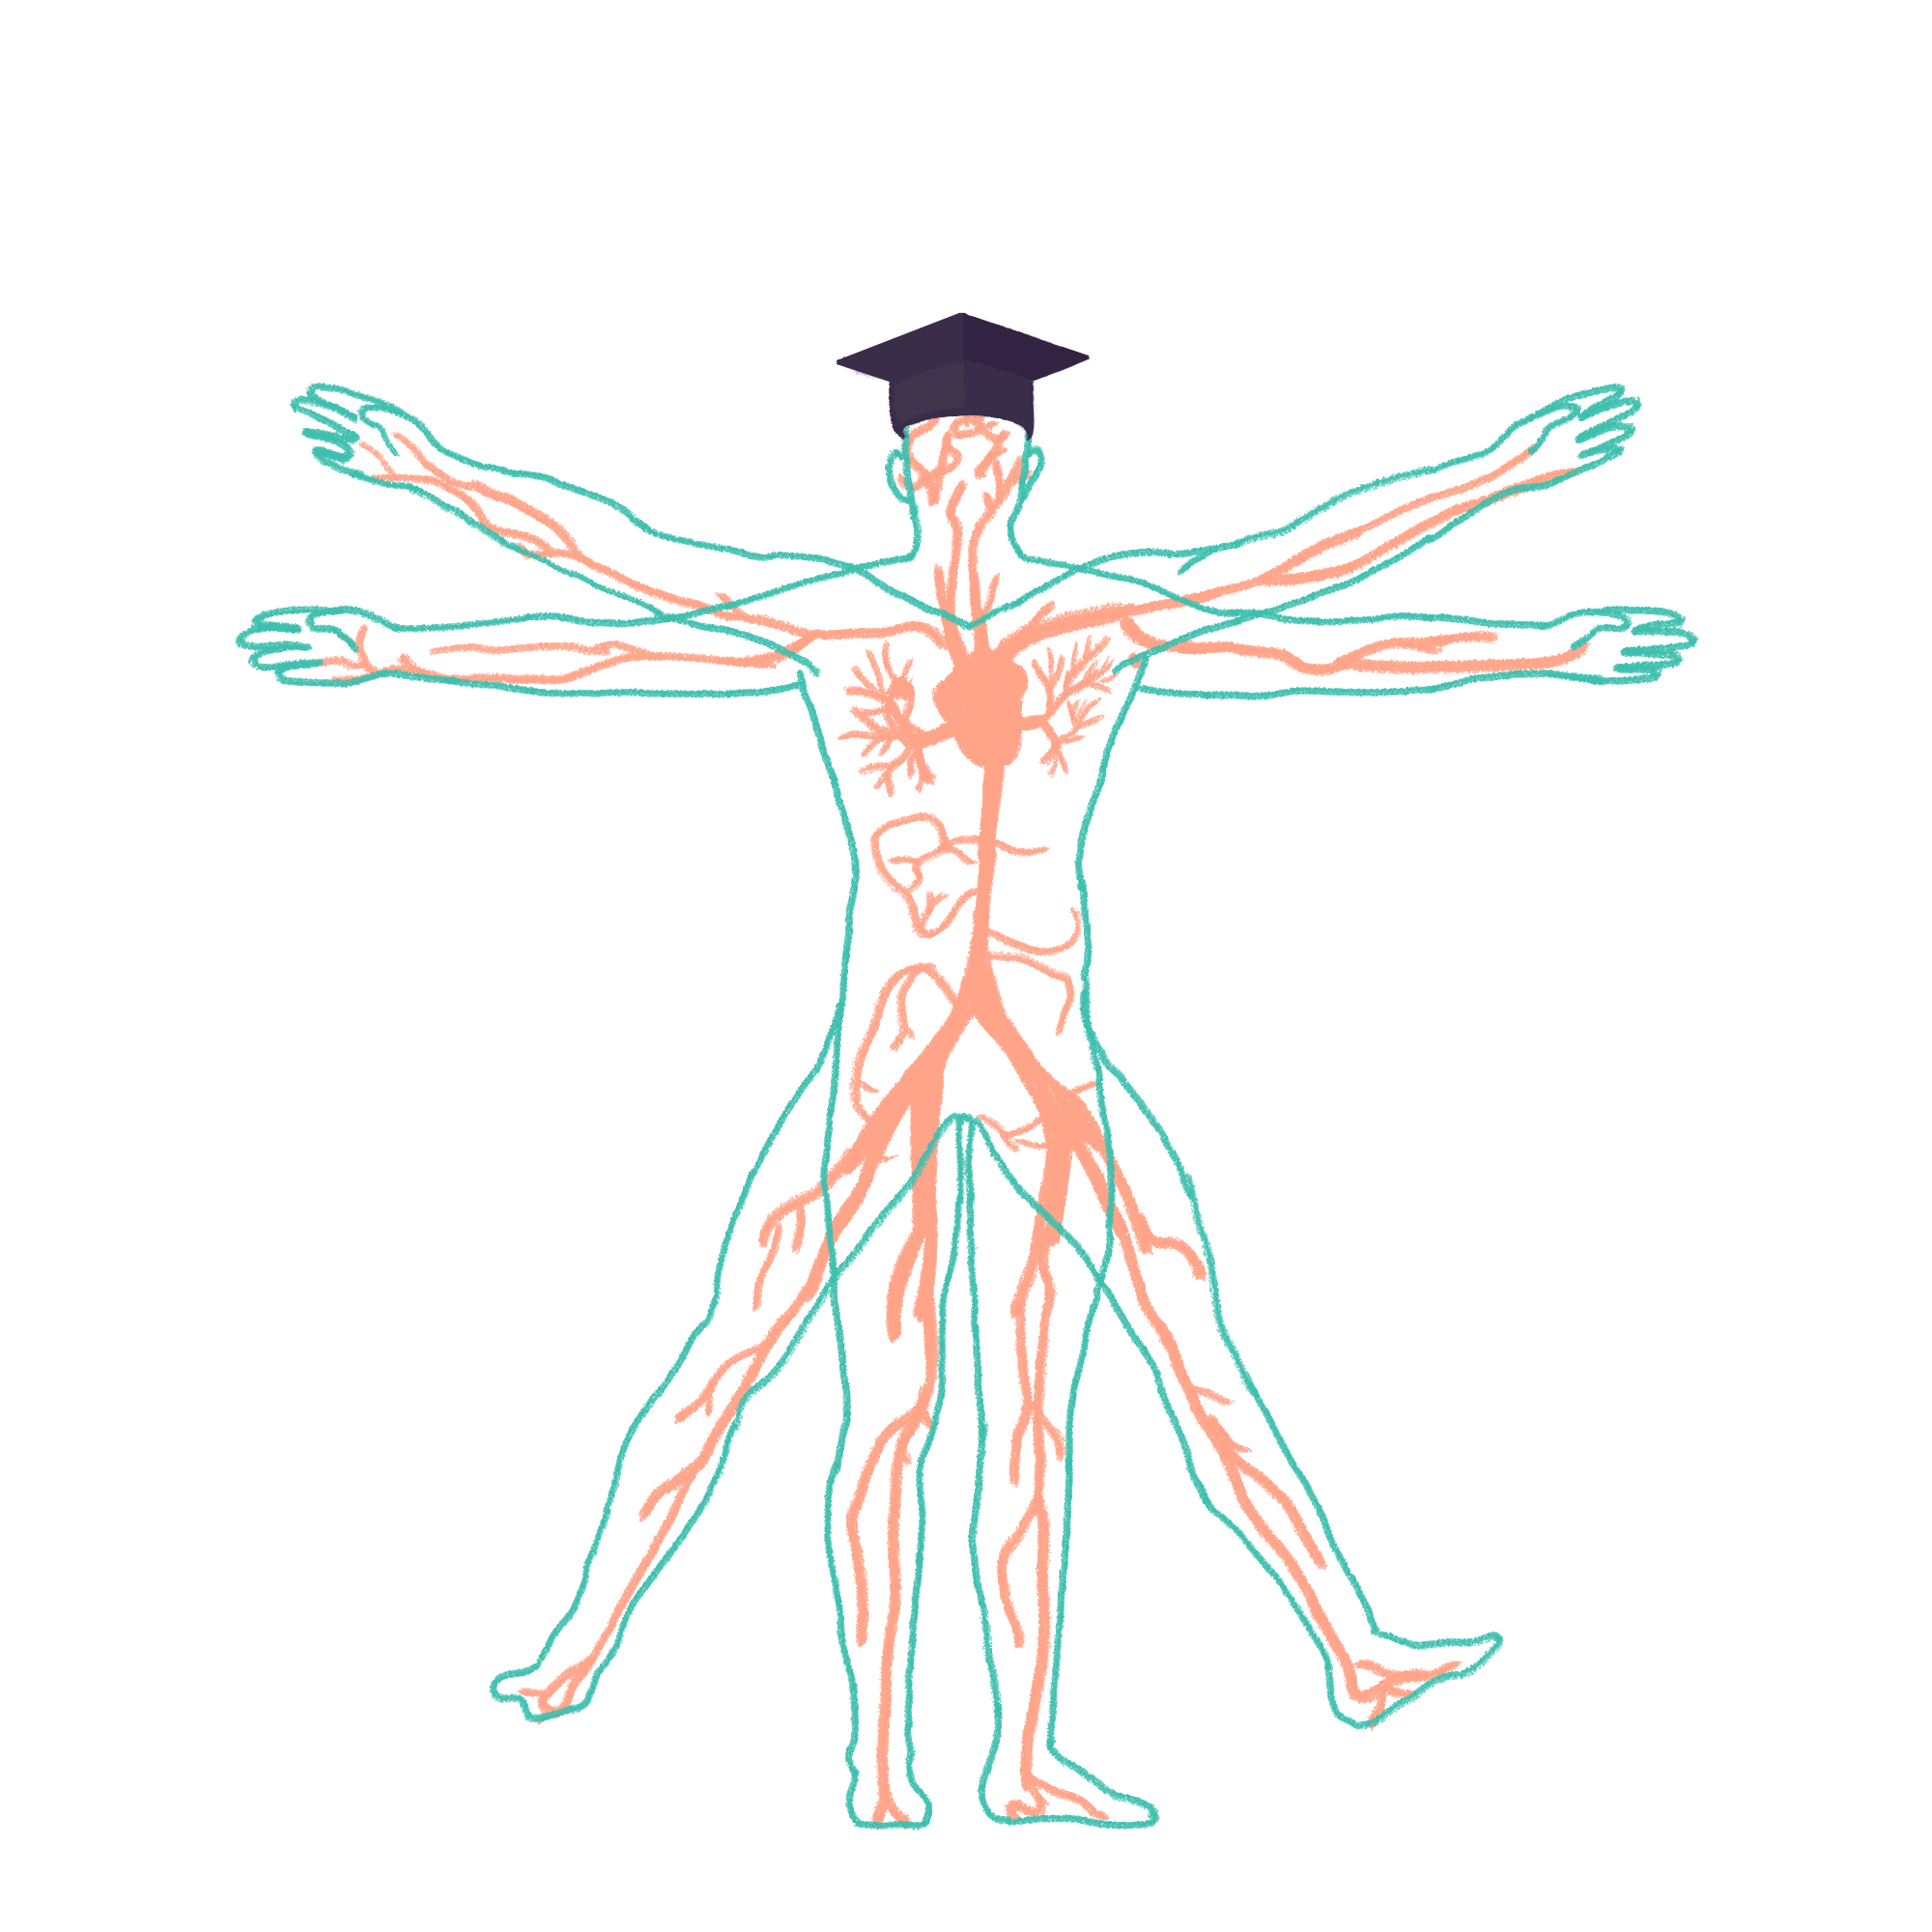
2023/2024

Slide 2
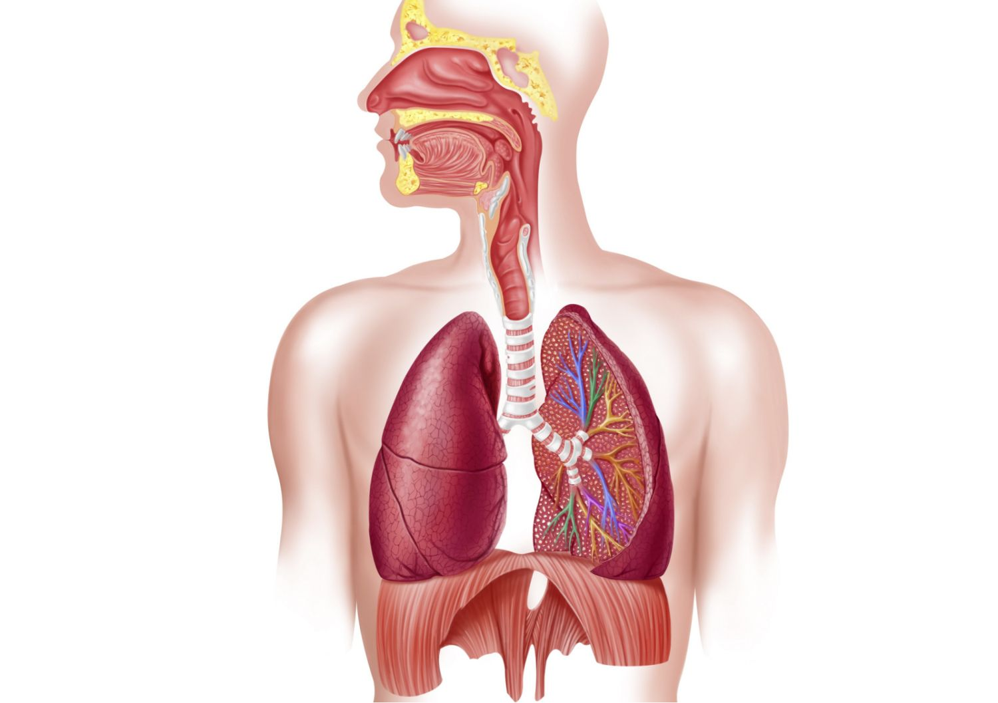
Respiratory 1
Phase 1 Revision Session
[S Klyde Alistar and Yap Yuan Zher]
[14/11/23- 6:30pm]
The Peer Teaching Society is not liable for false or misleading information…

Slide 3
Aims and Objectives (broadly)
Physiology
Inspiration and expiration
Pontine and medullary respiratory sensory
Central vs peripheral chemoreceptors
Anatomy
Muscles of the chest
Lungs
Bronchial tree
Larynx
Diaphragm
Nerves
The Peer Teaching Society is not liable for false or misleading information…

Slide 4
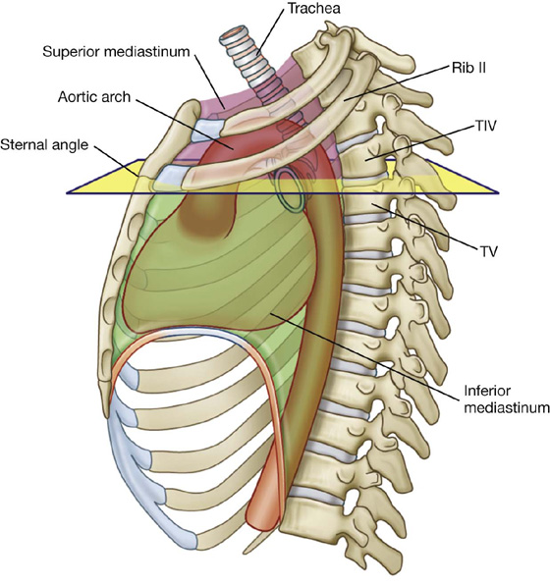
Sternal Angle
It is located at the level of T2. True or false?
False. It is located at T4/5 (rib 2)
The Peer Teaching Society is not liable for false or misleading information…
Notes:
False. Sternal angle is located at the level of Rib 2, not T2. It is located at T4/5. This demonstrates the fact that the ribs curve upwards from the sternum to the vertebra.
image: https://clinicalgate.com/thorax-6/

Slide 5
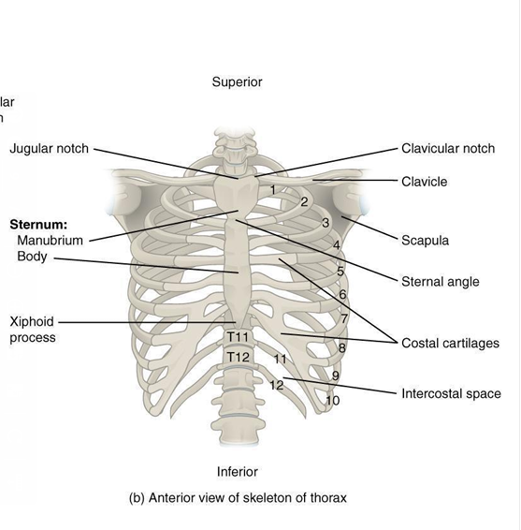
Anatomy:
1
2
4
3
5
The Peer Teaching Society is not liable for false or misleading information…

Slide 6
Anatomy:
2
4
3
5
The Peer Teaching Society is not liable for false or misleading information…

Slide 7
Anatomy:
4
3
5
The Peer Teaching Society is not liable for false or misleading information…

Slide 8
Anatomy:
4
5
The Peer Teaching Society is not liable for false or misleading information…

Slide 9
Anatomy:
5
The Peer Teaching Society is not liable for false or misleading information…

Slide 10
Anatomy:
The Peer Teaching Society is not liable for false or misleading information…

Slide 11
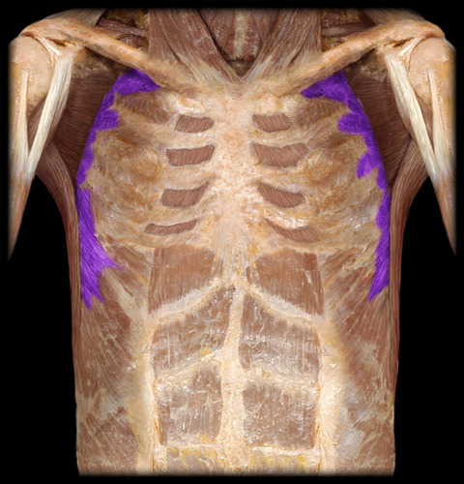
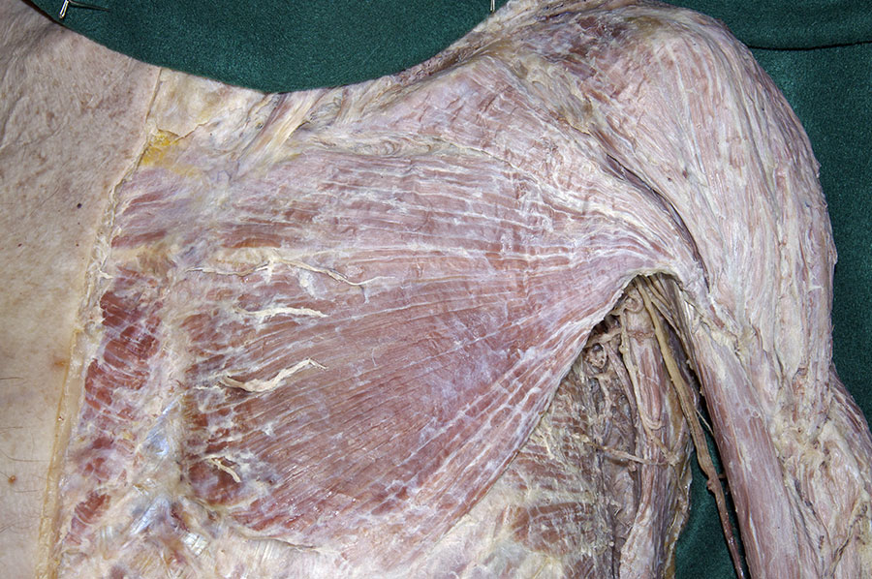
What muscle is this? Action?
Pectoralis major. Adducts the humerus
Serratus anterior. Protracts the scapula
The Peer Teaching Society is not liable for false or misleading information…
Notes:
image: https://clinicalgate.com/thorax-6/

Slide 12
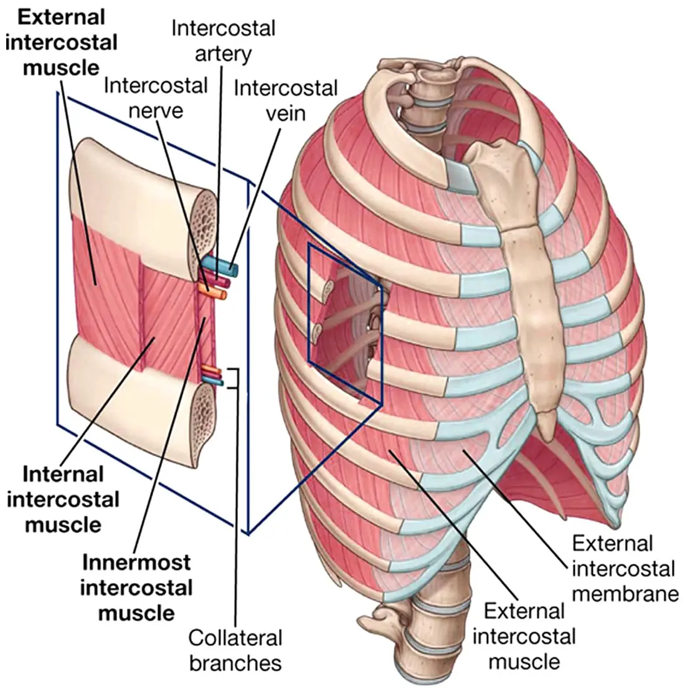
Which intercostal muscles are involved in inspiration vs expiration?
External intercostals: inspiration
Internal and innermost intercostals: expiration
Know the orientations of the fibres
External: antero-inferior
Internal & innermost: postero-inferior
The Peer Teaching Society is not liable for false or misleading information…
Notes:
image: https://clinicalgate.com/thorax-6/

Slide 13
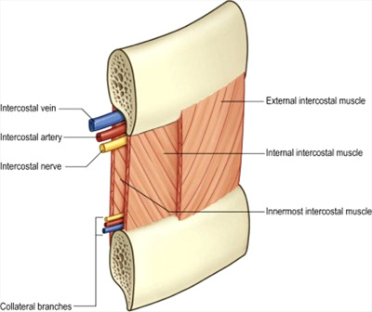
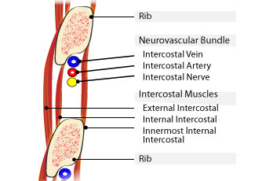
When a chest drain is done, incisions are made in the lower part of the intercostal space. Why?
To avoid the neurovascular bundle (it lies in the costal groove of the rib above)
The Peer Teaching Society is not liable for false or misleading information…
Notes:
image: https://clinicalgate.com/thorax-6/

Slide 14
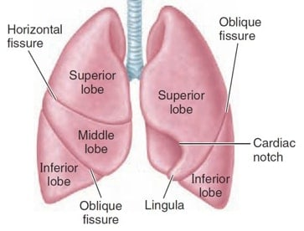
Fissures
The Peer Teaching Society is not liable for false or misleading information…

Slide 15
Name the fissures
The Peer Teaching Society is not liable for false or misleading information…

Slide 16
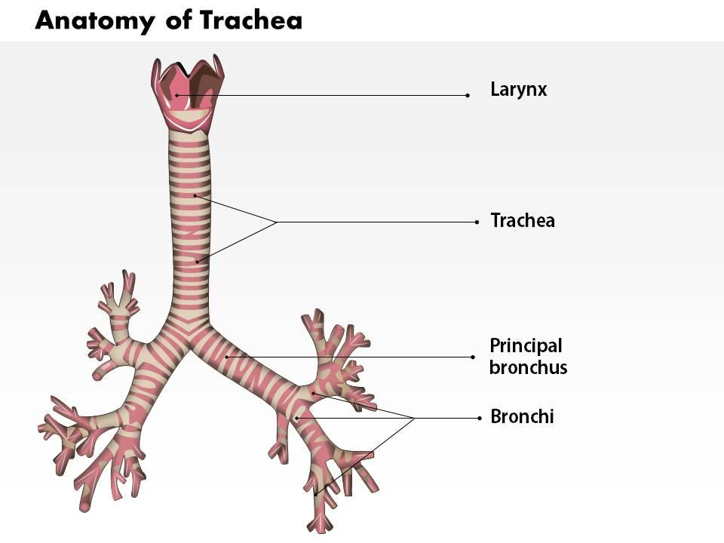
If someones chokes on food, it is more likely to lodge in which lung? Why?
Right lung. The right bronchus is shorter, wider, and more vertical.
Easy way to remember:
The left bronchus is more angled and longer due to the presence of the heart
The Peer Teaching Society is not liable for false or misleading information…

Slide 17
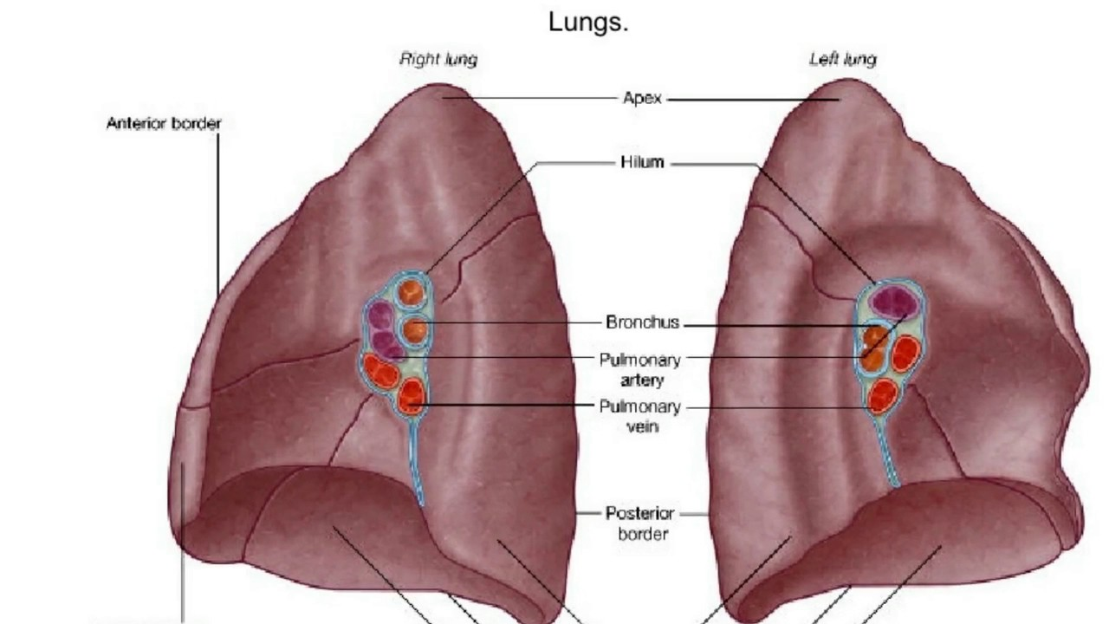
Hilum of the Lung
The Peer Teaching Society is not liable for false or misleading information…

Slide 18
Position of Pulmonary Artery in relation to the bronchus
RALS
Right Anterior
Left Superior
The Peer Teaching Society is not liable for false or misleading information…

Slide 19
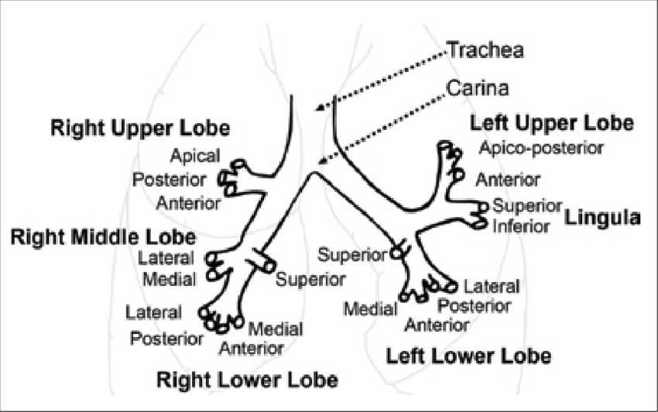
Bronchial tree
Lobar bronchi -
one for each lobe (right3,left2)
Segmental bronchi -
10 for each lung
Many bronchioles
The Peer Teaching Society is not liable for false or misleading information…

Slide 20
What is the bifurcation of trachea called? At which level is it located?
Carina. At sternal angle (T4/5)
The Peer Teaching Society is not liable for false or misleading information…

Slide 21
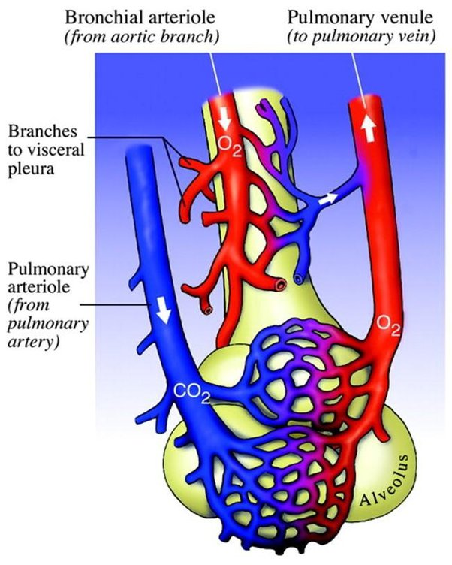
Pulmonary vs Bronchial blood supply
Pulmonary arteries and veins are mainly involved in GAS EXCHANGE
Pulmonary arteries carry deoxygenated blood from heart to lungs
Pulmonary veins carry oxygenated blood from lungs to heart
Bronchial arteries and veins supply OXYGEN and NUTRIENTS to the lung tissue themselves
Bronchial arteries branch from descending aorta
Bronchial veins drain into azygos veins

Slide 22
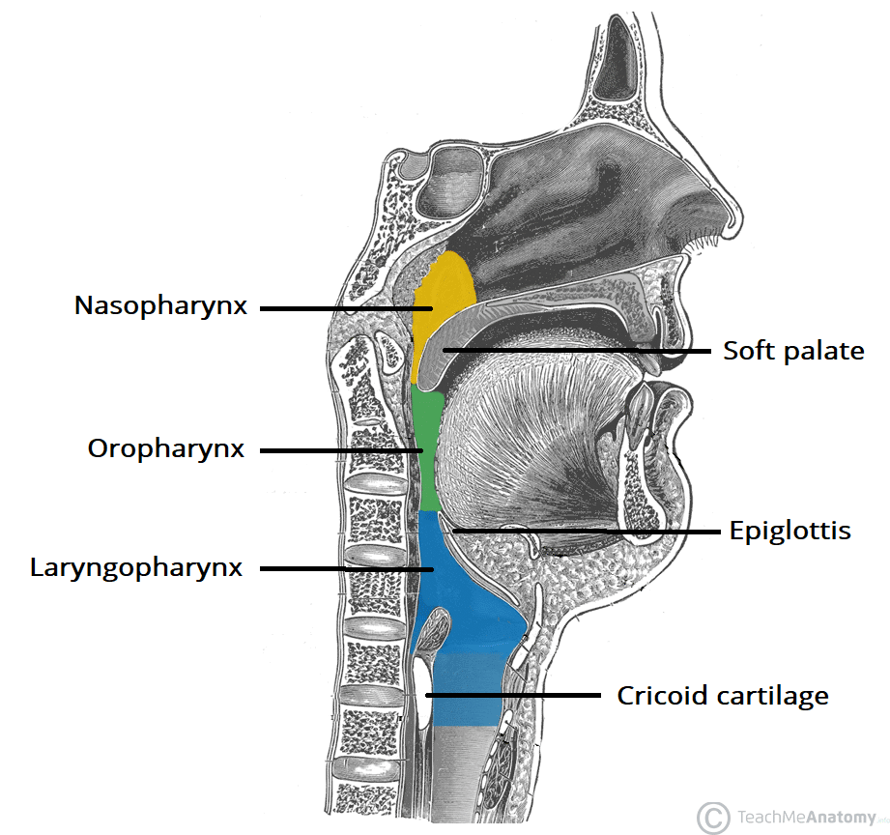
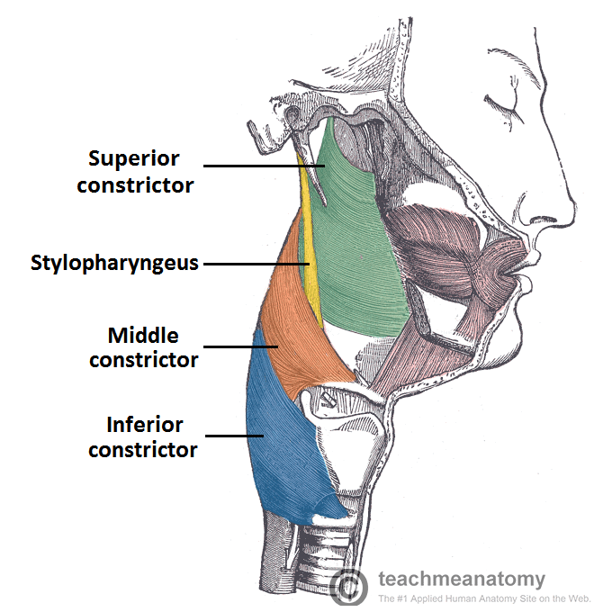
Pharynx and its muscles
3 parts:
Nasopharynx (nasal)
Oropharynx (oral)
Laryngopharynx (larynx)
External circular muscles
Superior, middle and inferior constrictors
Contracts superior to inferior, pushing food down
Internal longitudinal muscles

Slide 23
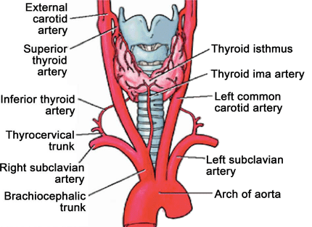
Thyroid
Consists of 2 lobes
joined by an isthmus, anterior to trachea
Blood supply:
L and R superior thyroid arteries (branch from external carotid)
L and R inferior thyroid arteries (branch from thyrocervical trunk, which is from subclavian artery)
The Peer Teaching Society is not liable for false or misleading information…

Slide 24
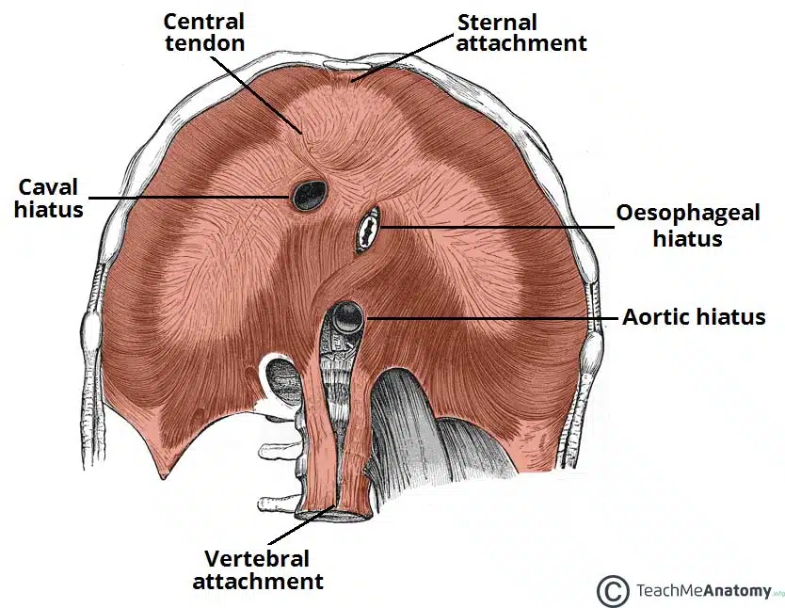
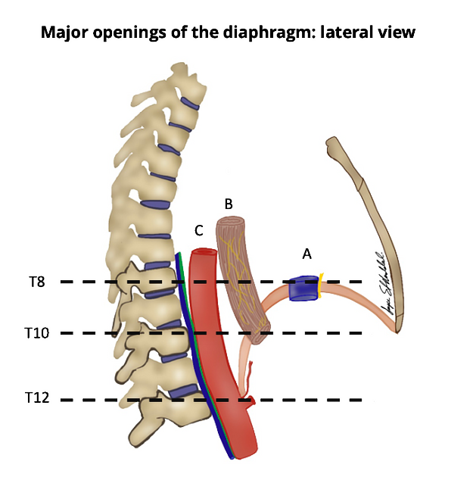
Diaphragm openings (Hiatuses)
T8 | T10 | T12
IVC (Inferior vena cava) | Oesophagus R and L vagus nerves | Aorta Azygous vein Thoracic duct
To remember:
I ate 10 eggs at 12.
I(IVC)
8(T8)
10(T10)
Eggs (Esophagus)
At (Aorta, thoracic duct)
12(T12)

Slide 25
Summary: Right lung vs Left lung: differences?
 | Right lung | Left lung
Lobes | 3 | 2
Hilum | RA (right anterior: PA anterior to bronchus) | LS (left superior: PA superior to bronchus)
Length, angle, diameter | Shorter, wider, more vertical | Longer, narrower, more horizontal
Presence of lingula | No | Yes

Slide 26
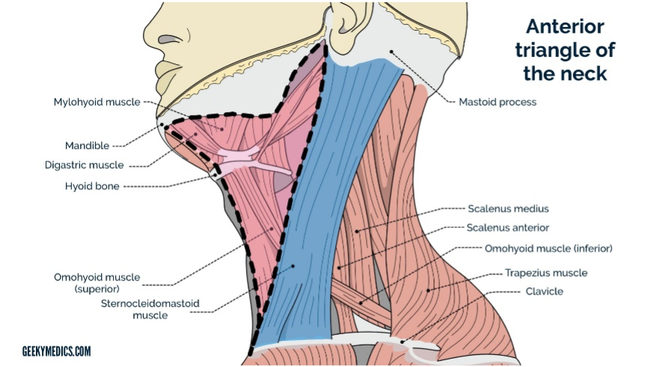
Anterior triangle of the neck
Important things to know that exist in the anterior triangle of the neck:
Trachea and larynx
Extrinsic muscles of the larynx (suprahyoid and infrahyoid)
Common carotid artery
Internal jugular vein
Nerves (covered in next slide)
The Peer Teaching Society is not liable for false or misleading information…
Notes:
Suprahyoid - connects hyoid to skull
Infrahyoid - connects hyoid to the sternum and scapula
Common carotid artery and internal jugular vein are main blood vessels of the head and neck region

Slide 27
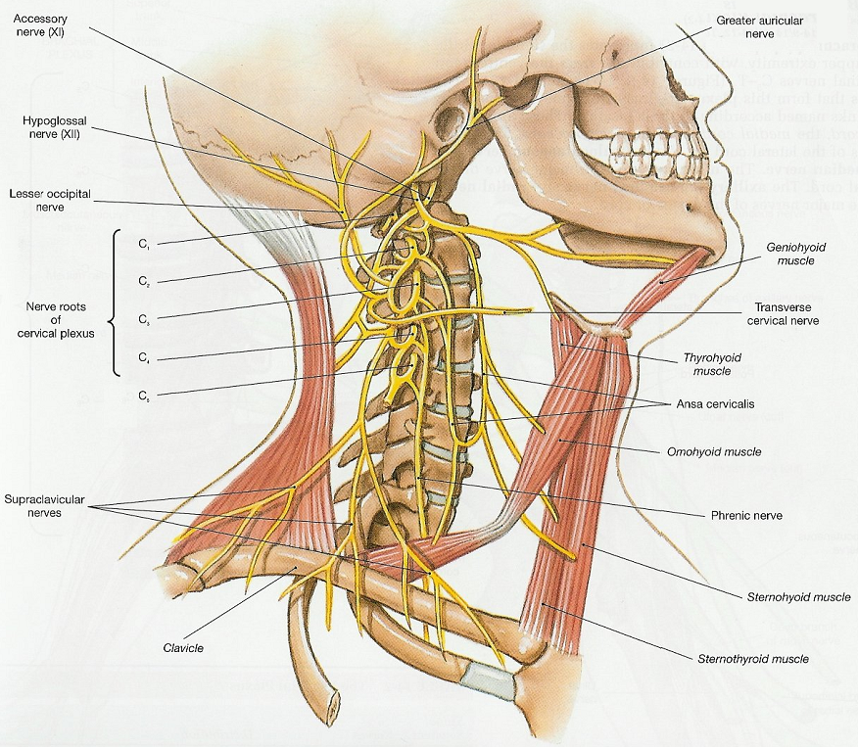
Nerves in the neck
Facial nerve (CN7) - Platysma
Glossopharyngeal nerve (CN 9) - Pharynx and carotid sinus
Vagus nerve (CN10)
Muscles of the pharynx and larynx
The Peer Teaching Society is not liable for false or misleading information…
Notes:
I will not talk deeply about what each of the nerves supply, only the main ones involving the neck. You will learn more in neuro.
Facial nerve - supplies platysma in the neck (sheet of muscle from collarbone to the angle of your neck) - it also supplies some salivary glands and the taste buds in the anterior ⅔ of your tongue
Glossopharyngeal nerve - supplies your pharynx and carotid sinus. Carotid sinus is a dilation near the carotid arteries bifurcation (contains baroreceptors - i will address more later)
Vagus nerve - muscles of the pharynx and both motor and sensory of the larynx (allows for swallowing)

Slide 28
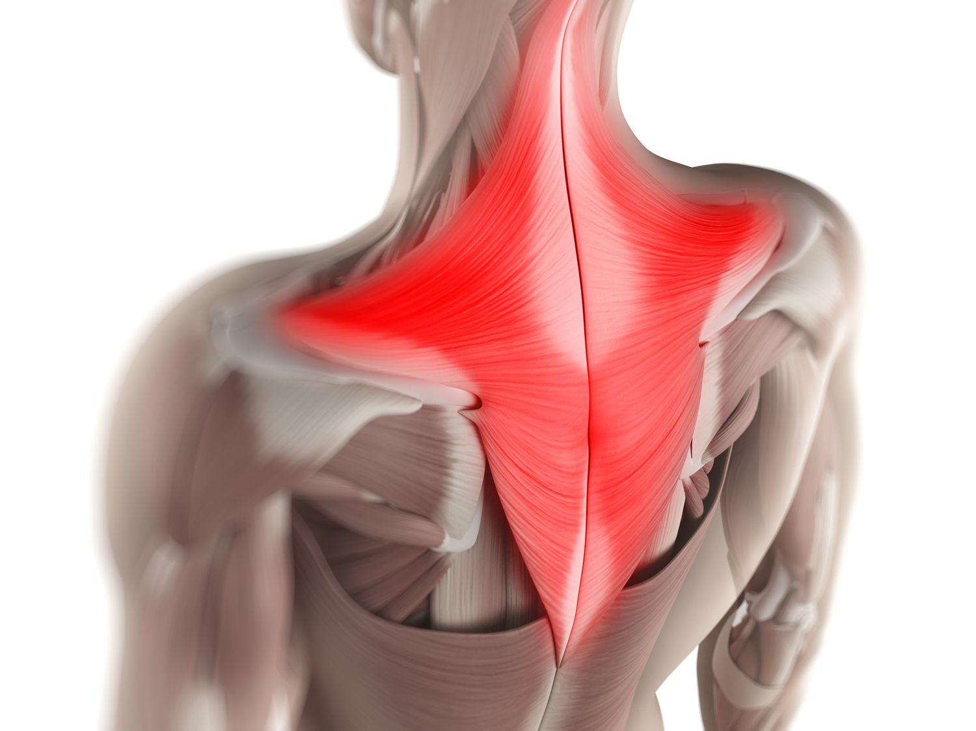
Nerves in the neck (2)
Accessory nerve (CN XI) - supplies sternocleidomastoid and trapezius muscles
Hypoglossal nerve (CN XII) - supplies muscles of the tongue
Phrenic nerve (C3,4,5) - supplies the diaphragm
The Peer Teaching Society is not liable for false or misleading information…
Notes:
The accessory nerve supplies sternocleidomastoid and trapezius muscles. Key that you know for exam as they tend to ask which nerve supplies which muscles for example.
Hypoglossal nerve - main function is that it supplies muscles of the tongue.
The phrenic nerve which originates from C3, C4, C5 nerve fibres descends through the neck, enters the thorax and innervates the diaphragm
Take note while most of the nerves are in the anterior triangle of the neck, the phrenic nerve is in the posterior triangle.

Slide 29
Larynx
The Peer Teaching Society is not liable for false or misleading information…

Slide 30
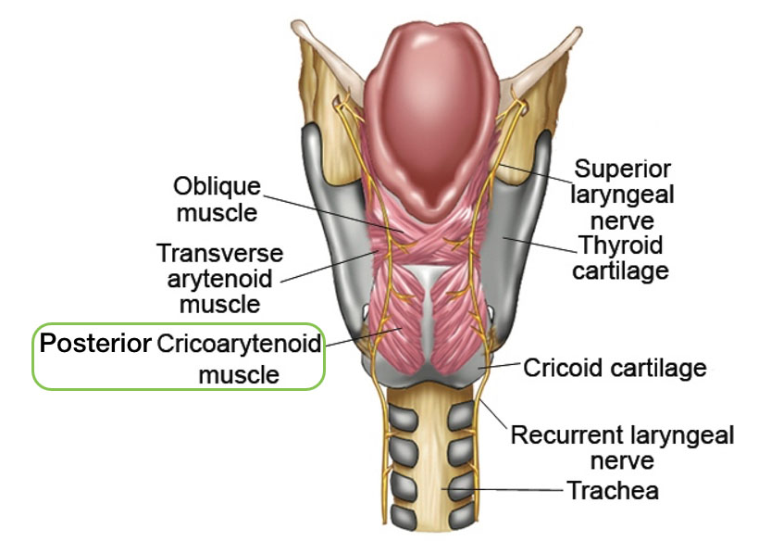
Intrinsic muscles of the larynx
Cricothyroid
Posterior cricoarytenoids
Transverse arytenoids
The Peer Teaching Society is not liable for false or misleading information…
Notes:
A lot of information on this page, I will focus mainly on the internal larynx. There are 2 pairs of folds in the cavity of the larynx, you have your vestibular folds (slightly higher-false vocal cords) than your vocal folds (lower - true vocal cords). In order to move your vocal cords, a few pairs of intrinsic muscles need to move the laryngeal cartilages. These include your cricothyroid muscle - between your thyroid and cricoid cartilage (when it contracts, it tips the thyroid cartilage anteriorly and inferiorly), posterior cricoarytenoids - when they contract, they abduct the vocal cords and open the rima glottidis. (have a look at the models in the anatomy lab). Transverse arytenoids adduct the vocal cords and close the rima glottidis.
Cricothyroid membrane used for emergency airway

Slide 31
Which nerve innervates the intrinsic muscles?
Cricothyroid — Superior laryngeal nerve
All other intrinsic muscles of the larynx - Recurrent laryngeal nerve
The Peer Teaching Society is not liable for false or misleading information…

Slide 32
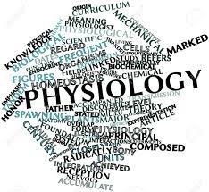
PHYSIOLOGY

Slide 33
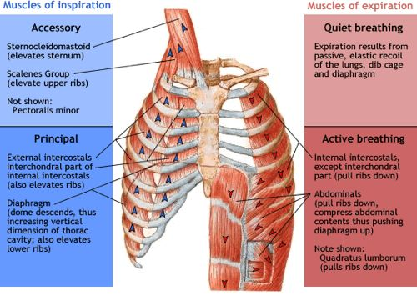
Respiratory pump- System of muscles and structures involved in breathing
Passive Inspiration
Diaphragm and external intercostal muscles contract
Lungs expand
Air is drawn in (passive inspiration)
Active inspiration
Above with accessory muscles (sternocleidomastoid, pectoralis major, pectoralis minot, serratus anterior)
The Peer Teaching Society is not liable for false or misleading information…
Notes:
Diaphragm and external intercostal muscles contract - increases intrathoracic volume (external intercostals pull ribs superiorly and laterally, ribs pull sternum superiorly and anteriorly
Lungs expand with thoracic wall due to surface tension
Pressure in lungs lower than atmospheric pressure, drawing air in

Slide 34
Respiratory pump
Passive expiration
Lungs recoil
Active expiration
Diaphragm and external intercostal muscles relax
Internal intercostals contract
Lungs recoil
Air is expelled
The Peer Teaching Society is not liable for false or misleading information…

Slide 35
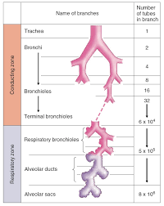
Physiology of the airways
Conducting zone
No gas exchange, just transport of air
Respiratory zone
Where most of the gas exchange takes place
Dead space- Refers to the volume of air that does not participate in gas exchange/ventilation. (it includes the air in the nose, pharynx, trachea and bronchioles)
The Peer Teaching Society is not liable for false or misleading information…

Slide 36
What is the volume of dead space in the lungs?
150ml
75ml
180ml
175ml
The Peer Teaching Society is not liable for false or misleading information…

Slide 37
What is the volume of dead space in the lungs?
150ml
75ml
180ml
175ml
The Peer Teaching Society is not liable for false or misleading information…
Notes:
Anatomic dead space - 150ml
Alveolar dead space - 25ml
Total - 175ml

Slide 38
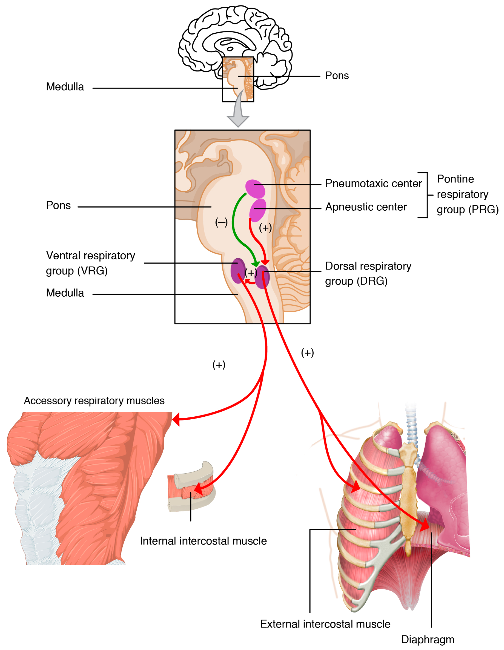
Pontine and medullary respiratory sensory
Pneumotaxic center - sends inhibitory impulses to inspiratory centers
Apneustic center - sends signal for inspiration for long and deep breaths.
Both located in the pons
The Peer Teaching Society is not liable for false or misleading information…
Notes:
The pnemotaxic center sends out inhibitory impulses to the inspiratory centers to inhibit inspiration and transition to expiration
The apneustic center helps start and maintain deeper breaths when needed to ensure you have the right amount of oxygen for different activities.

Slide 39
Pontine and medullary respiratory sensory
Dorsal respiratory group – primarily triggers inspiratory movement
Ventral respiratory group - primarily triggers expiratory movement
Both located in medulla
The Peer Teaching Society is not liable for false or misleading information…

Slide 40
Where are central chemoreceptors located?
In the carotid arteries
In the aorta
In the brainstem
In the lungs
The Peer Teaching Society is not liable for false or misleading information…
Notes:
C

Slide 41
Where are peripheral chemoreceptors located?
Carotid and aortic bodies
Heart
Brainstem
Lungs
The Peer Teaching Society is not liable for false or misleading information…
Notes:
A
Carotid body - bifurcation of the common carotid artery
Aortic body - in the walls of the aortic arch

Slide 42
What am I?
Responds to changes in pH of the cerebral spinal fluid (CSF)
If CO2 levels increase → pH of CSF decreases → receptor is inhibited
Central chemoreceptor
The Peer Teaching Society is not liable for false or misleading information…

Slide 43
Differences between central and peripheral chemoreceptors
 | Central | Peripheral
Strongest stimulus
Location
Innervation
Small changes in PaCO2
Large reductions in O2
Brainstem
Aortic and carotid bodies
No particular innervation
Carotid bodies - glossopharyngeal nerve
Aortic bodies - Vagus nerve
The Peer Teaching Society is not liable for false or misleading information…

Slide 44
Why are some patients with COPD not given supplemental oxygen for long periods of time?
COPD - Obstructs airflow, difficulty breathing
Patients have chronically high CO2 levels and thus don’t respond to central chemoreceptor stimulation.
Respiratory drive becomes hypoxic —> dependent on peripheral chemoreceptor stimulation (Oxygen driven)
If patients with a hypoxic drive were given oxygen → decreased signals by peripheral chemoreceptors → frequency of breathing decreases possibly to point of respiratory arrest
The Peer Teaching Society is not liable for false or misleading information…
Notes:
Suppress a patient’s natural drive to breathe

Slide 45
Conclusion
Questions?
The Peer Teaching Society is not liable for false or misleading information…

Slide 46
Feedback
phase reps add QR code here - QR Code Generator (the-qrcode-generator.com)
phase reps add feedback link here
The Peer Teaching Society is not liable for false or misleading information…

