Slide 1
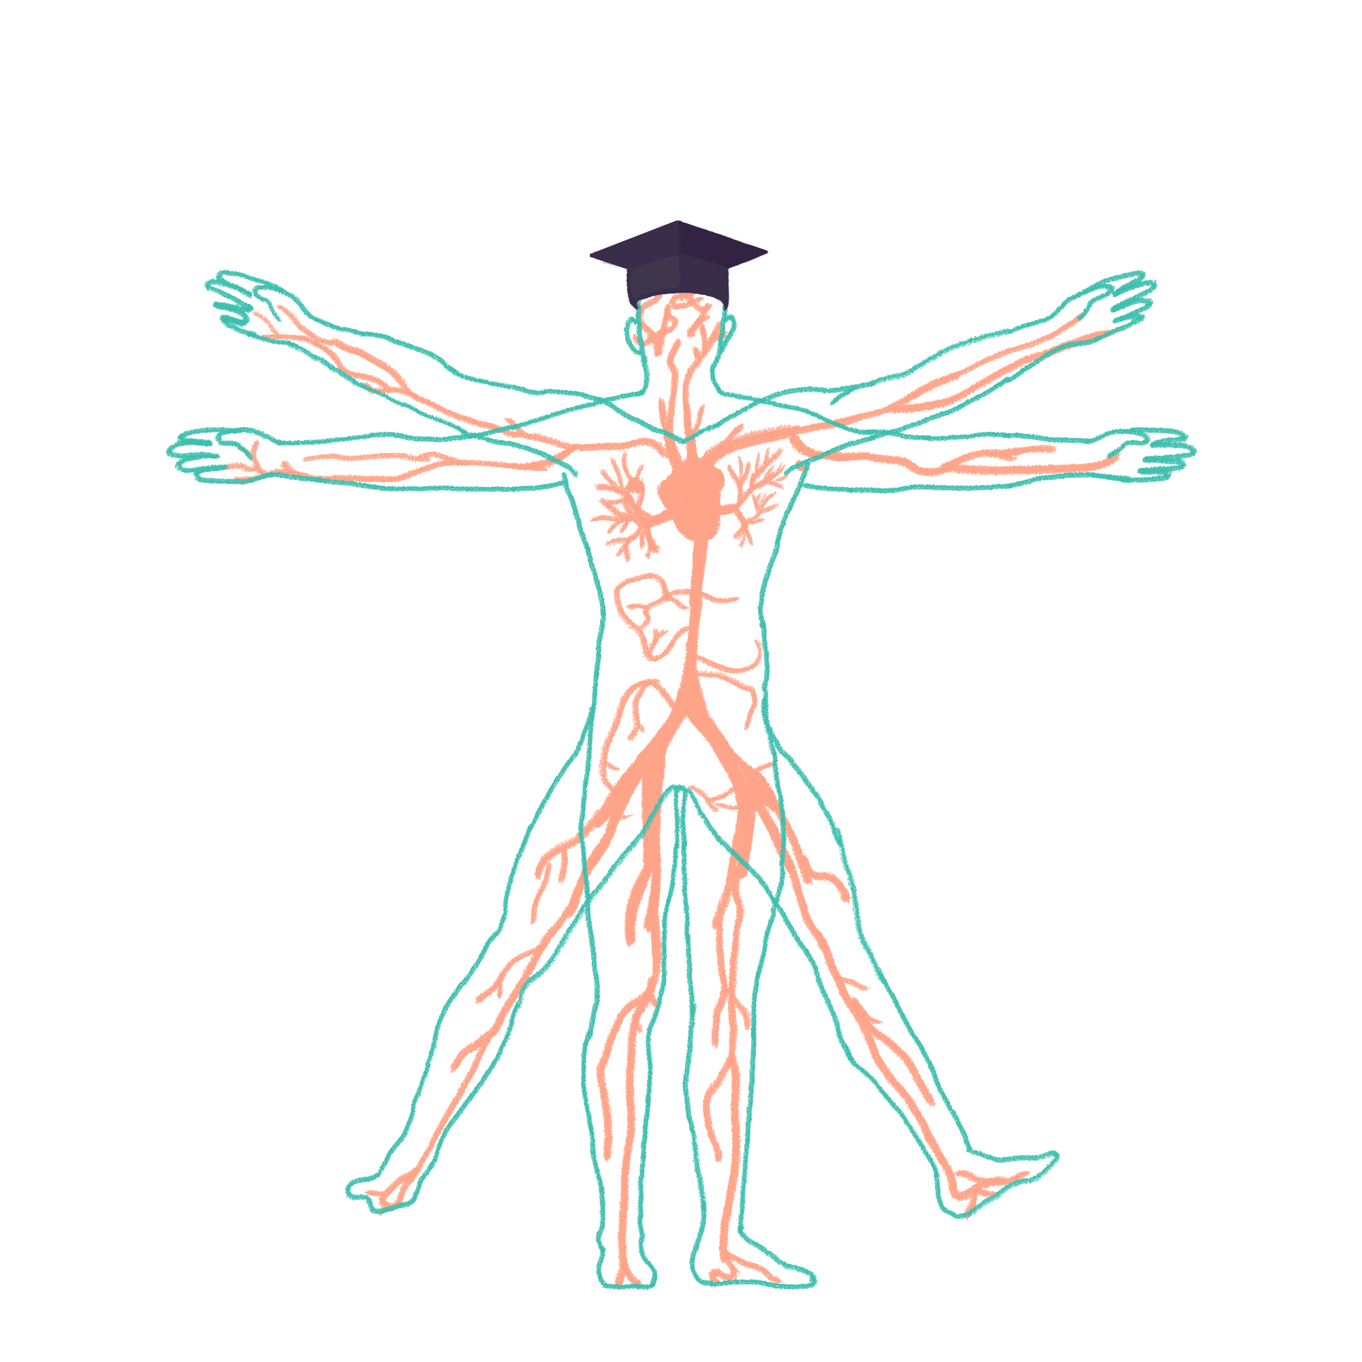
2023/2024

Slide 2
SUGAR 2
Phase 1 Revision Session
Alice Wilkinson
24/04/24 6:30pm
The Peer Teaching Society is not liable for false or misleading information…

Slide 3
Aims and Objectives
Renal:
Basic Renal Processes
Ion and water regulation
Hormone regulation
Pituitary:
Hormones
Feedback loops
Thyroid
Pancreas:
Endocrine
The Peer Teaching Society is not liable for false or misleading information…

Slide 4
Renal Processes
Functions of the kidneys:
Water, ion, and acid-base regulation
Removal of metabolic waste products (blood → urine)
Removal of foreign chemicals (blood → urine)
Gluconeogenesis
Hormone/enzyme production
The Peer Teaching Society is not liable for false or misleading information…

Slide 5
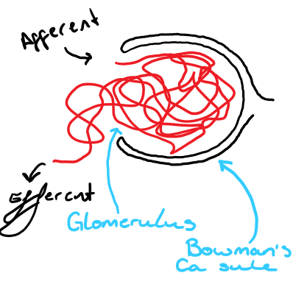
GFR
Glomerular filtration = filter plasma from the glomerular capillaries → Bowman's space/capsule
Glomerular filtrate (Plasma like fluid in bowman’s capsule) - Cells, Proteins. Substances move by bulk flow
Glomerular filtration rate = total filter volume / unit time
The Peer Teaching Society is not liable for false or misleading information…

Slide 6
Bulk flow
Small, lipid insoluble proteins/large molecules are transported across a capillary membrane from high to low pressure.
Bi-directional depending on what direction the net pressure gradient is going. In glomerulus, its being filtered rather than reabsorbed.
The Peer Teaching Society is not liable for false or misleading information…

Slide 7
GFR
Glomerular filtration rate = total filter volume / unit time
GFR (volume) determined by:
net filtration pressure* - afferent/efferent arteriole
Capillary permeability* - renal = fenestrated
Filtration surface area - long capillary length of glomerulus
At a given Net filtration Pa, GFR ∝ permeability and SA
The Peer Teaching Society is not liable for false or misleading information…
Notes:
All affect filtrate volume

Slide 8
Calculating GFR
Because GFR is measuring the rate of filtration by the glomerulus, it can be calculated fairly accurately by the rate of renal clearance of certain molecules.
What are the necessary conditions for this molecule to be used to calculate the FV? [3]
The Peer Teaching Society is not liable for false or misleading information…
Notes:
All affect filtrate volume

Slide 9
Calculating GFR
Use a filtered molecule as a measurable control for filtration volume.
Conditions:
Freely filtered
Not secreted or absorbed in tubules
Not metabolised
What Molecule fits these criteria and is used?
The Peer Teaching Society is not liable for false or misleading information…
Notes:
All affect filtrate volume

Slide 10
Calculating GFR
Use a filtered molecule as a measurable control for filtration volume.
Conditions:
Freely filtered
Not secreted or absorbed in tubules
Not metabolised
What Molecule fits these criteria and is used? Creatinine (insulin ideal)
The Peer Teaching Society is not liable for false or misleading information…
Notes:
All affect filtrate volume

Slide 11
Calculating GFR - Creatinine clearance
GFR = UrineC x urine flow rate
—--------------------------------
PlasmaC
GFR (70kg healthy person) = >125ml/min
Creatinine = >90
The Peer Teaching Society is not liable for false or misleading information…
Notes:
All affect filtrate volume

Slide 12
Questions
What process related to glucose do the kidneys undergo in the post-absorptive state? [2]
The Peer Teaching Society is not liable for false or misleading information…
Notes:
All affect filtrate volume

Slide 13
Questions
What process related to glucose do the kidneys undergo in the post-absorptive state? [2]
Gluconeogenesis mainly in the PCT. Synthesizing glucose from non-hexose precursors (in this case lactate specifically)
The Peer Teaching Society is not liable for false or misleading information…
Notes:
All affect filtrate volume

Slide 14
Questions
Name 2 functions of the kidney
What is a normal GFR
What molecule is used to measure GFR
By what process are substances filtered into the BC?
Bulk flow
Active transport
Exocytosis
Osmosis
The Peer Teaching Society is not liable for false or misleading information…

Slide 15
Questions
5. Which of the following is not a reason that creatinine clearance is used to measure GFR
Freely filtered
Not secreted or absorbed in tubules
Small molecular weight
Not metabolised
6. Which of the following is true about renal clearance? (urineC x flow rate)/plasmaC
The best approximation of GFR is with creatinine clearance
A substance with clearance > GFR must be filtered and secreted
A substance with clearance > GFR must be filtered and absorbed
It can be calculated using only urine flow rate and urine concentration
The Peer Teaching Society is not liable for false or misleading information…

Slide 16
Questions
Name 2 functions of the kidney
water, ion, acid/base regulation
Waste product removal (metabolic/chemical)
Gluconeogenesis
Hormone/enzyme production
What is a normal GFR 125ml/min
What molecule is used to measure GFR Creatinine
By what process are substances filtered into the BC?
Bulk flow
Active transport
Exocytosis
Osmosis
The Peer Teaching Society is not liable for false or misleading information…

Slide 17
Questions
5. Which of the following is not a reason that creatinine clearance is used to measure GFR
Freely filtered
Not secreted or absorbed in tubules
Small molecular weight
Not metabolised
6. Which of the following is true about renal clearance? (urineC x flow rate)/plasmaC
The best approximation of GFR is with creatinine clearance
A substance with clearance > GFR must be filtered and secreted
A substance with clearance > GFR must be filtered and absorbed
It can be calculated using only urine flow rate and urine concentration
The Peer Teaching Society is not liable for false or misleading information…

Slide 18
Filtration Pressure
Starling forces
→ Hydrostatic pressure (Pa caused by flow resistance in the glomerular capillaries or Bowman’s capsule.)
→ Oncotic pressure (Pa caused by osmotic movement as a result of protein concentration differences.)
Hydrostatic Pa in glomerulus (Pgc) is impacted by the lumen radius of afferent and efferent arterioles
Oncotic Pa in Bowman’s capsule (πbs) is zero because in a healthy kidney, no proteins can cross into the Bowman’s capsule so there is nothing to produce osmotic movement
The Peer Teaching Society is not liable for false or misleading information…

Slide 19
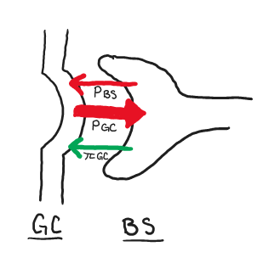
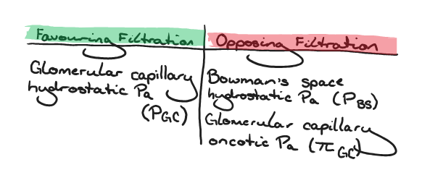
Filtration Pressure
Starling forces: Net Glomerular Filtration Pa = Pgc - Pbs - πgc
The Peer Teaching Society is not liable for false or misleading information…

Slide 20
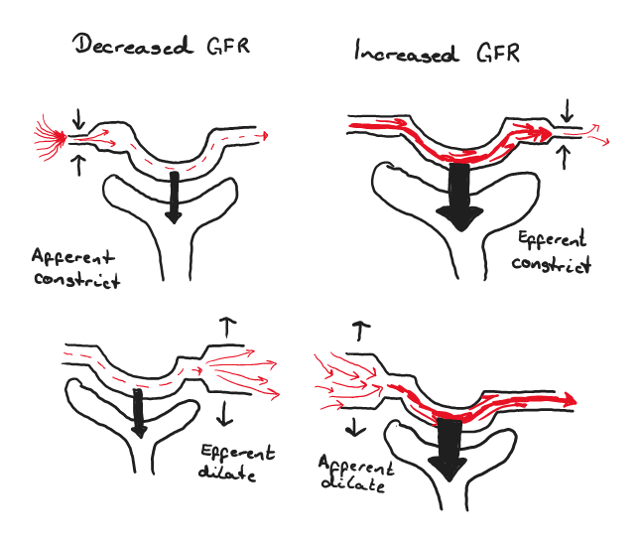
Hydrostatic Pressure
AUTOREGULATION (afferent):
Intrinsic property of arteriole smooth muscle in nephron
Myogenic: raised Pa in arteriole detected so afferent constricts to lower Pa and GFR
Tubuloglomerular: RAAS*. Change in NaCl detected (macula densa) so afferent lumen adjusts
The Peer Teaching Society is not liable for false or misleading information…

Slide 21
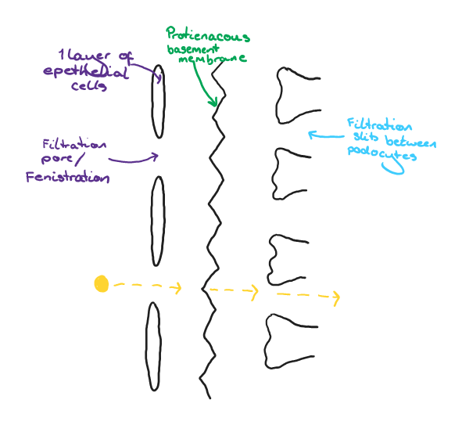
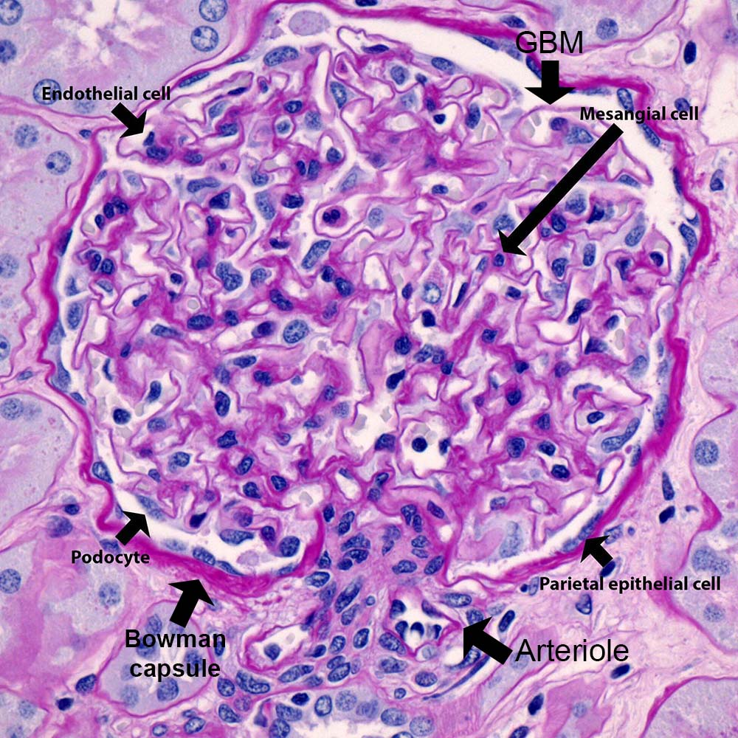
Capillary permeability
Significantly higher filtration rates of capillaries in the nephron compared systematically.
Physical histology (Highly fenestrated capillaries, podocytes with filtration slits. Allow lots of bulk transport, not high molecular weight molecules (blood cells, proteins/protein-bound minerals)
Filtration pathway -vely charged as are most proteins
The Peer Teaching Society is not liable for false or misleading information…

Slide 22
Questions
Which of the following will lead to increased glomerular fluid filtration?
An increase in plasma protein concentration
An increase in fluid pressure in the bowman’s space
An increase in glomerular capillary blood pressure
Afferent arteriole constriction
2. True or false: Oncotic pressure of bowman’s capsule is 0 because there is no significant protein concentration to drive osmosis
3. Which of the following stimulates the myogenic response in hydrostatic autoregulation?
RAAS
Macula densa detention of NaCl change
Cardiac baroreceptors detecting a change in systemic blood pressure
Intrinsic property of nephron arteriole smooth muscle
The Peer Teaching Society is not liable for false or misleading information…

Slide 23
Questions
Which of the following will lead to increased glomerular fluid filtration?
An increase in plasma protein concentration
An increase in fluid pressure in the bowman’s space
An increase in glomerular capillary blood pressure
Afferent arteriole constriction
2. True or false: Oncotic pressure of bowman’s capsule is 0 because there is no significant protein concentration to drive osmosis True
3. Which of the following stimulates the myogenic response in hydrostatic autoregulation?
RAAS
Macula densa detention of NaCl change
Cardiac baroreceptors detecting a change in systemic blood pressure
Intrinsic property of nephron arteriole smooth muscle
The Peer Teaching Society is not liable for false or misleading information…

Slide 24
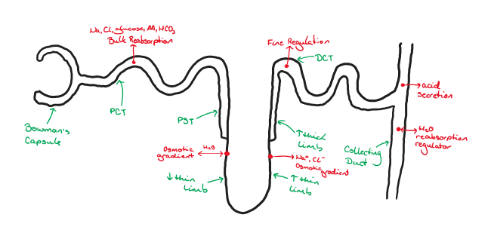
Ion and water Regulation
The Peer Teaching Society is not liable for false or misleading information…

Slide 25
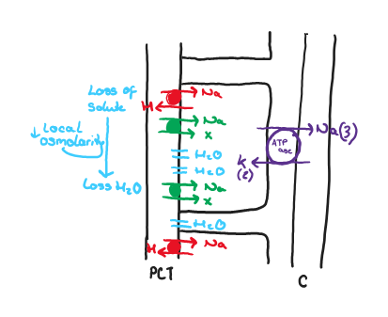
Proximal Convoluted Tubule (PCT)
Primary active Na+ reabsorption
(BC → tubular cell)
Na+/H+ countertransport
Na co- transports MANY molecules (glucose, phosphates, aa, lactates)
(tubular cell → GC)
NaKATPase: 3Na out/2K in
Water freely flows due to leaky (many aquaporins) PCT
The Peer Teaching Society is not liable for false or misleading information…

Slide 26
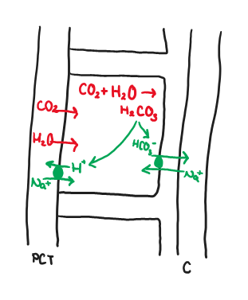
Proximal Convoluted Tubule (PCT)
Proximal bicarb reabsorption
In tubular cell: CO2 + H20 → H2CO3 (carbonic anhydrase)
Co-transported out of cell into capillaries with Na+
The Peer Teaching Society is not liable for false or misleading information…

Slide 27
Proximal Convoluted Tubule (PCT)
Amino acid reabsorption
Co-transported with Na+ (different co-transported for each different AA)
Cl- absorption
Week tight junctions between tubular cells means Na+ and Cl- can diffuse freely out of the lumen into capillaries
The Peer Teaching Society is not liable for false or misleading information…

Slide 28
Proximal Convoluted Tubule (PCT)
What is the transport maximum?
What is Glucosuria?
The Peer Teaching Society is not liable for false or misleading information…

Slide 29
Proximal Convoluted Tubule (PCT)
What is the transport maximum?
The limit to the amount of material the tubule can reabsorb per unit time due to binding site saturation
What is Glucosuria?
The Peer Teaching Society is not liable for false or misleading information…

Slide 30
Proximal Convoluted Tubule (PCT)
What is the transport maximum?
The limit to the amount of material the tubule can reabsorb per unit time due to binding site saturation
What is Glucosuria?
glucose in a non-diabetic person’s urine due to plasma glucose exceeding TM
The Peer Teaching Society is not liable for false or misleading information…

Slide 31
Loop of Henle
Descending Limb
Water permeable and doesn’t exchange Na/Cl
Water moves between limb + interstitial fluid until osmolarity is the same between them.
More hyperosmotic (less water lost, more solute in IF) further into medulla
Ascending limb
Reabsorbs (pumps out) Na + Cl but is impermeable to water
Descending limb + IF have a higher osmolarity, distal tubule is more diluted and IF is hyperosmotic ready for bulk H2O reabsorption at collecting duct
The Peer Teaching Society is not liable for false or misleading information…

Slide 32
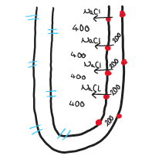
Loop of Henle
For now, pretend the filtrate in the tubules is stationary! Easier to explain
The Peer Teaching Society is not liable for false or misleading information…

Slide 33
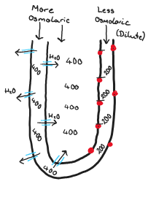
Loop of Henle
This is achieving:
Reabsorbed H2O into the blood
Hyperosmotic IF so there can be massive H2O reabsorption at the collecting duct + conc urine
Hypoosmotic fluid in distal tube
Loop countercurrent multiplier - difference in osmolarities between the ascending and descending so IF hyperosmolarity can be maintained
The Peer Teaching Society is not liable for false or misleading information…

Slide 34
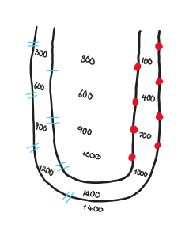
Loop of Henle
Now add back in the idea of flow!
Ascending limb is more diluted and has generally less stuff in it so flow is slower than descending
Na + Cl transport = NKCC2 proton pump (Na, Cl, and K)
K back into Loop lumen by ROMK
The Peer Teaching Society is not liable for false or misleading information…

Slide 35
Loop of Henle
What drug inhibits NKCC2 in order to dilute the blood and concentrate urine? [1]
The Peer Teaching Society is not liable for false or misleading information…

Slide 36
Loop of Henle
What drug inhibits NKCC2 in order to dilute the blood and concentrate urine? [1]
Frusemide
The Peer Teaching Society is not liable for false or misleading information…

Slide 37
Loop of Henle
How is mass diffusion from hyperosmotic IF into blood vessels prevented? [2 marks]
The Peer Teaching Society is not liable for false or misleading information…

Slide 38
Loop of Henle
How is mass diffusion from hyperosmotic IF into blood vessels prevented? [2 marks]
Specialised blood vessels in the medulla called vasa recta have a hairpin loop structure.
The effect of solutes in/water out as it descended deeper, is reversed after the loop bends and ascends. Solutes out/water in again.
The Peer Teaching Society is not liable for false or misleading information…

Slide 39
Distal convoluted tube (DCT)
Fine tune reabsorption of solutes (Na, K, Pi, Ca)
Co-transporter for Na and Cl reabsorption: NCC → further dilutes filtrate
What drug inhibits NCC? [1]
The Peer Teaching Society is not liable for false or misleading information…

Slide 40
Distal convoluted tube (DCT)
Fine tune reabsorption of solutes (Na, K, Pi, Ca)
Co-transporter for Na and Cl reabsorption: NCC → further dilutes filtrate
What drug inhibits NCC? [1]
Thiazide
The Peer Teaching Society is not liable for false or misleading information…

Slide 41
Collecting duct
H2O reabsorption regulator
Principal cells -> Majority, Na+ reabsorption and K excretion
Intercalated cells -> assist in acid/base control
The Peer Teaching Society is not liable for false or misleading information…

Slide 42
Collecting duct
Aldosterone action
Na enters the parietal cell via ENaC (epithelial sodium channel) and from parietal cell into capillaries via NaKATPase channels
Aldosterone increases the transcription rate of both of these = apical Na influx into parietal cells. K efflux.
The Peer Teaching Society is not liable for false or misleading information…

Slide 43
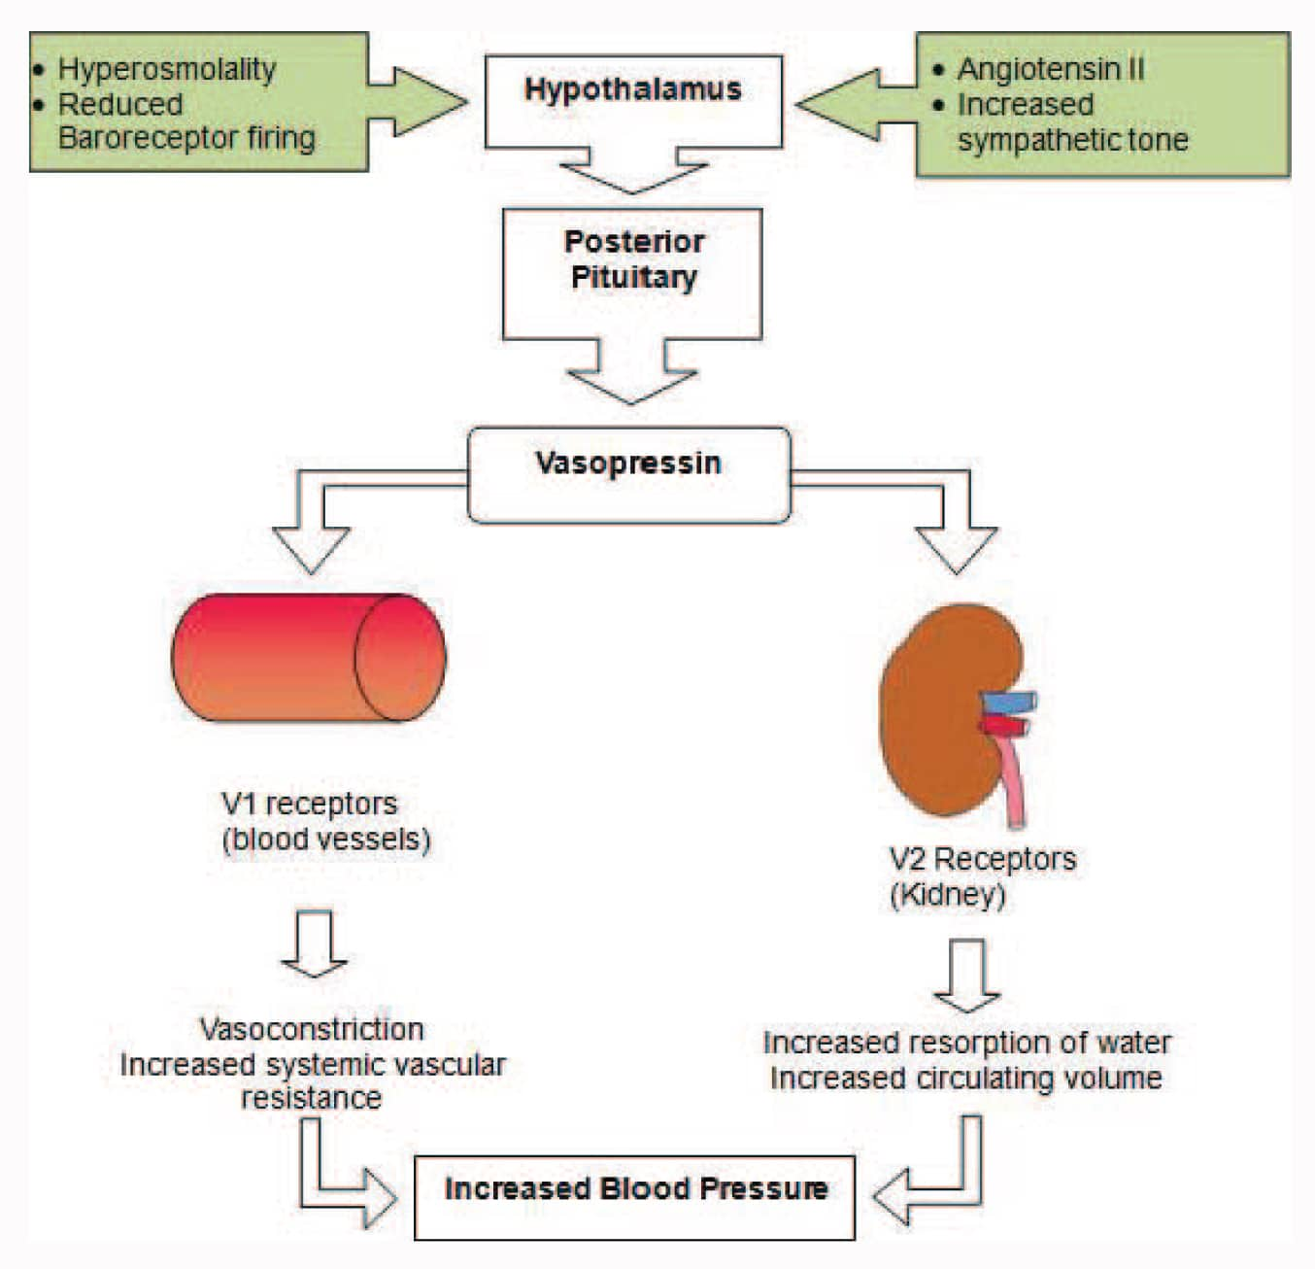
Collecting duct
Vasopressin (ADH) action
Binds to V2 receptors of collecting duct and increase aquaporin insertion.
Increases permeability to H2O so more can be reabsorbed and the urine is more concentrated.
Signalled by osmoreceptors in the hypothalamus detecting change of plasma osmolarity
https://resources.wfsahq.org/atotw/vasopressin-2/
The Peer Teaching Society is not liable for false or misleading information…

Slide 44
Questions
True or false: Medullary hyperosmotic state is maintained by the exchange of water in the ascending limb of the loh.
An increase in renin production is caused by:
Increased renal artery blood pressure
Decreased sodium perfusion of macula densa
Elevated levels of angiotensin II
Decreased systemic blood pressure
When sodium is being reabsorbed from the tubular cells to the blood in the PCT, what transport protein is being used?
NaKATPase
Na+/H+ counter transport
NKCC2 proton pump
ENaC
Liddle’s syndrome is a genetic disorder causing overexpression of ENaC channels. Where in the nephron are ENaC channels found? And what physiological outcome does this overactivity have? [3]
The Peer Teaching Society is not liable for false or misleading information…

Slide 45
Questions
True or false: Medullary hyperosmotic state is maintained by the exchange of water in the ascending limb of the loh. False
An increase in renin production is caused by:
Increased renal artery blood pressure
Decreased sodium perfusion of macula densa
Elevated levels of angiotensin II
Decreased systemic blood pressure
When sodium is being reabsorbed from the tubular cells to the blood in the PCT, what transport protein is being used?
NaKATPase
Na+/H+ counter transport
NKCC2 proton pump
ENaC
The Peer Teaching Society is not liable for false or misleading information…

Slide 46
Questions
Liddle’s syndrome is a genetic disorder causing overexpression of ENaC channels. Where in the nephron are ENaC channels found? And what physiological outcome does this overactivity have? [3]
Tubular facing wall of parietal cells in the collecting duct
Elevated sodium reabsorption/sodium plasma concentration causing hypertension OR hyporeninemia OR suppressed aldosterone secretion.
The Peer Teaching Society is not liable for false or misleading information…

Slide 47
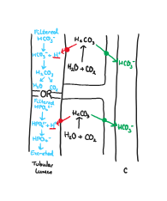
Acid/base regulation
HCO3 reabsorbed at PCT (Na counter-transport after CO2+H2O)
H+ filtered at PCT (Na counter-transport)
Intercalated cells
Alpha cells → H/KATPase to secrete H+ back into lumen
Beta cells → Reabsorption of HCO3-
The Peer Teaching Society is not liable for false or misleading information…

Slide 48
Acid/base regulation
Relationship between CO2 and H+:
CO2 + H2O ←→ H2CO3 ←→ HCO3 + H+
(carbonic anhydrase)
Kidneys regulate reabsorption/filtration rates of H+ depending on arteriole H+ concentrations
H+ buffers: CO3/HCO3- system and external phosphates/proteins (Ammonium is the most significant, also HPO42-)
Metabolic alkalosis Vs acidosis - requires coordination of kidney & respiratory system. Resp (Minutes) Kidney (hours/days)
The Peer Teaching Society is not liable for false or misleading information…

Slide 49
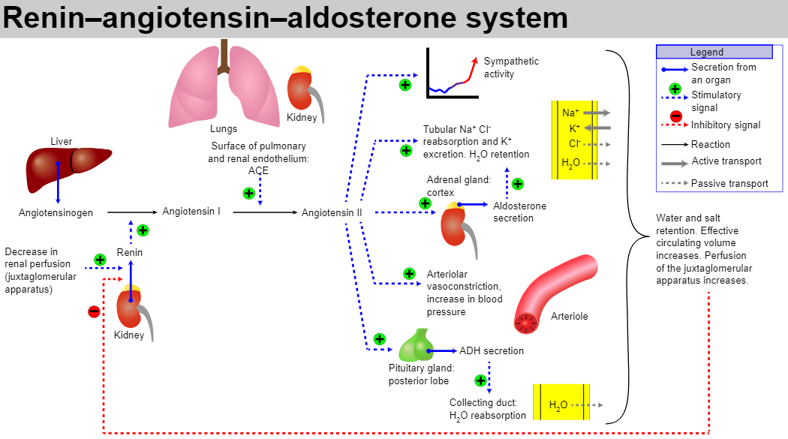
RAAS
Macula densa detects change in Na. Releases prostaglandins to stimulate granular cells. Granular cells (juxtaglomerular) release renin which has +ve feedback on kidney.
Renin stimulates angiotensinogen →
angiotensin 1
https://www.google.com/url?sa=i&url=https%3A%2F%2Fteachmephysiology.com%2Furinary-system%2Fregulation%2Fthe-renin-angiotensin-aldosterone-system%2F&psig=AOvVaw2yNVqRS_QBrvngeYqlSuzN&ust=1713762121540000&source=images&cd=vfe&opi=89978449&ved=0CAQQjB1qFwoTCMjdnc3D0oUDFQAAAAAdAAAAABAD
The Peer Teaching Society is not liable for false or misleading information…

Slide 50
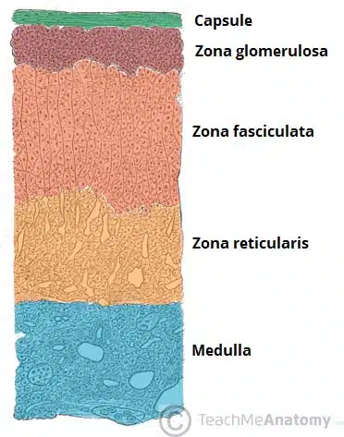
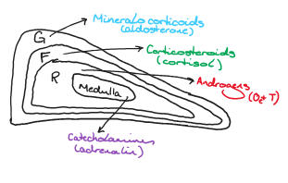
Adrenal Gland
https://teachmeanatomy.info/abdomen/viscera/adrenal-glands/
https://www.google.com/url?sa=i&url=https%3A%2F%2Fteachmephysiology.com%2Furinary-system%2Fregulation%2Fthe-renin-angiotensin-aldosterone-system%2F&psig=AOvVaw2yNVqRS_QBrvngeYqlSuzN&ust=1713762121540000&source=images&cd=vfe&opi=89978449&ved=0CAQQjB1qFwoTCMjdnc3D0oUDFQAAAAAdAAAAABAD
The Peer Teaching Society is not liable for false or misleading information…

Slide 51
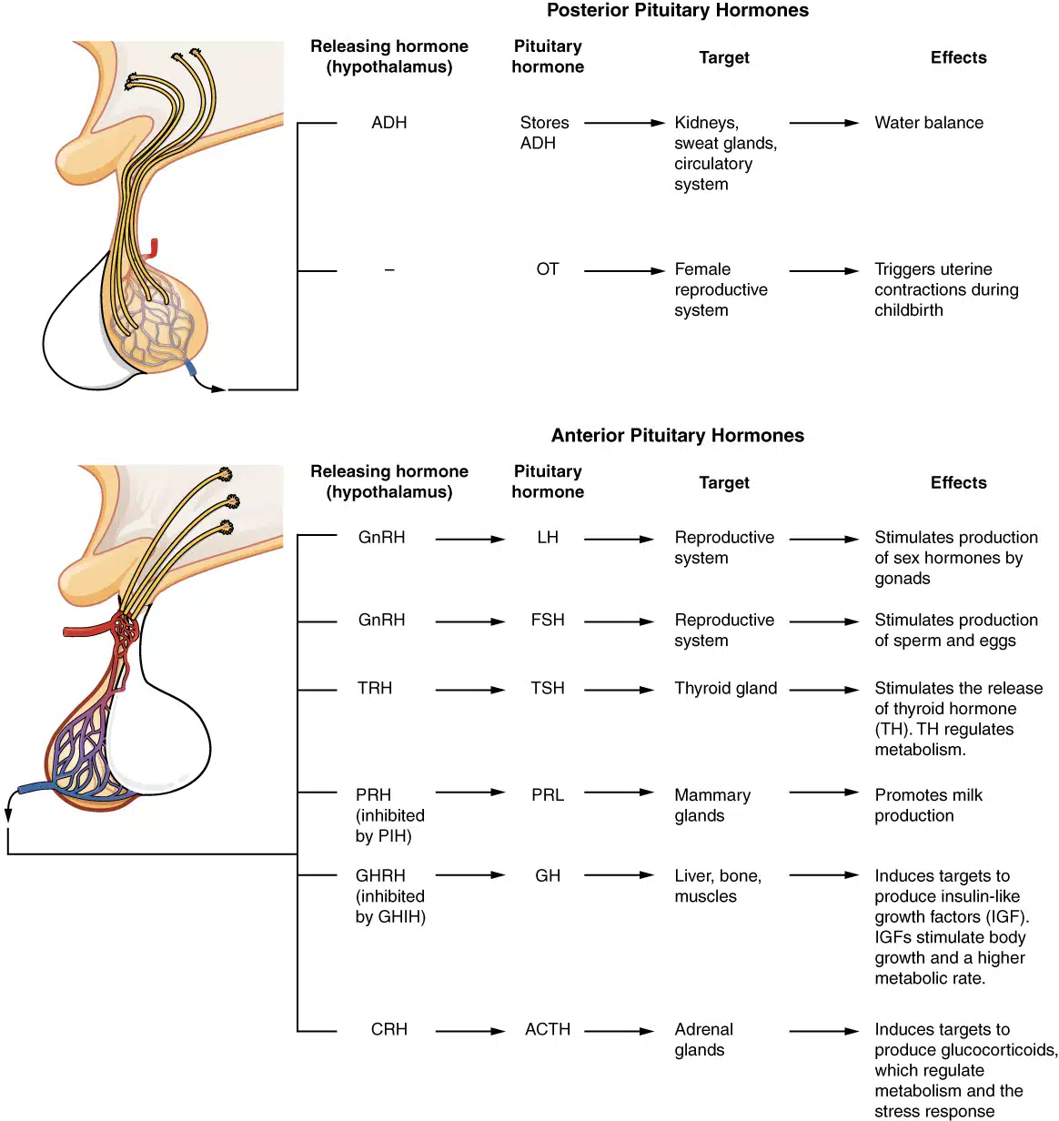
Pituitary Gland
Posterior: ADH, oxytocin
Anterior: GH, FSH, TSH, LH, ACTH, prolactin, melanocyte stimulating hormone
The Peer Teaching Society is not liable for false or misleading information…

Slide 52
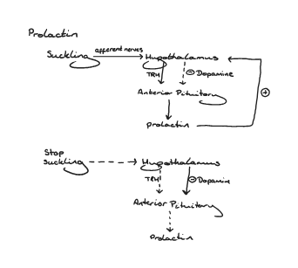
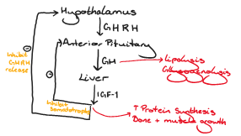
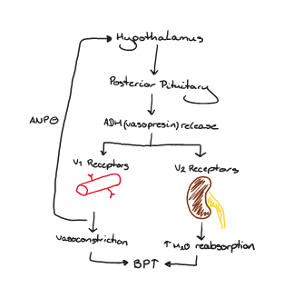
Pituitary Gland
GH
ADH
The Peer Teaching Society is not liable for false or misleading information…

Slide 53
Questions
Which of the following is part of the renal response to metabolic acidosis
H+ reabsorption
HCO3- secretion into tubular lumen
Increased production of carbonic anhydrase mediated HPO42- buffer
Increased ammonium secretion into tubular lumen
Where does renin act in the RAAS?
Angiotensinogen and kidney (+ve feedback)
Just angiotensin I
Just Angiotensin II
Angiotensin II and aldosterone
Where is cortisol secreted?
Anterior pituitary gland
Zona fascicularis of adrenal
Adrenal medulla
Posterior pituitary
The Peer Teaching Society is not liable for false or misleading information…

Slide 54
Questions
4. Which of the following is true about ADH?
It’s produced in the anterior pituitary gland
Secretion is stimulated by hypothalamus osmoreceptors detecting plasma osmolarity change
At high concentrations it produces an negative feedback response on itself
It acts on the collecting duct parietal cells to increase expression of sodium channel pumps.
The Peer Teaching Society is not liable for false or misleading information…

Slide 55
Questions
Which of the following is part of the renal response to metabolic acidosis
H+ reabsorption
HCO3- secretion into tubular lumen
Increased production of carbonic anhydrase mediated HPO42- buffer
Increased ammonium secretion into tubular lumen
Where does renin act in the RAAS?
Angiotensinogen and kidney (+ve feedback)
Just angiotensin I
Just Angiotensin II
Angiotensin II and aldosterone
Where is cortisol secreted?
Anterior pituitary gland
Zona fascicularis of adrenal
Adrenal medulla
Posterior pituitary
The Peer Teaching Society is not liable for false or misleading information…

Slide 56
Questions
4. Which of the following is true about ADH?
It’s produced in the anterior pituitary gland
Secretion is stimulated by hypothalamus osmoreceptors detecting plasma osmolarity change
At high concentrations it produces an negative feedback response on itself
It acts on the collecting duct parietal cells to increase expression of sodium channel pumps.
The Peer Teaching Society is not liable for false or misleading information…

Slide 57
Thyroid + Pancreas
The Peer Teaching Society is not liable for false or misleading information…

Slide 58
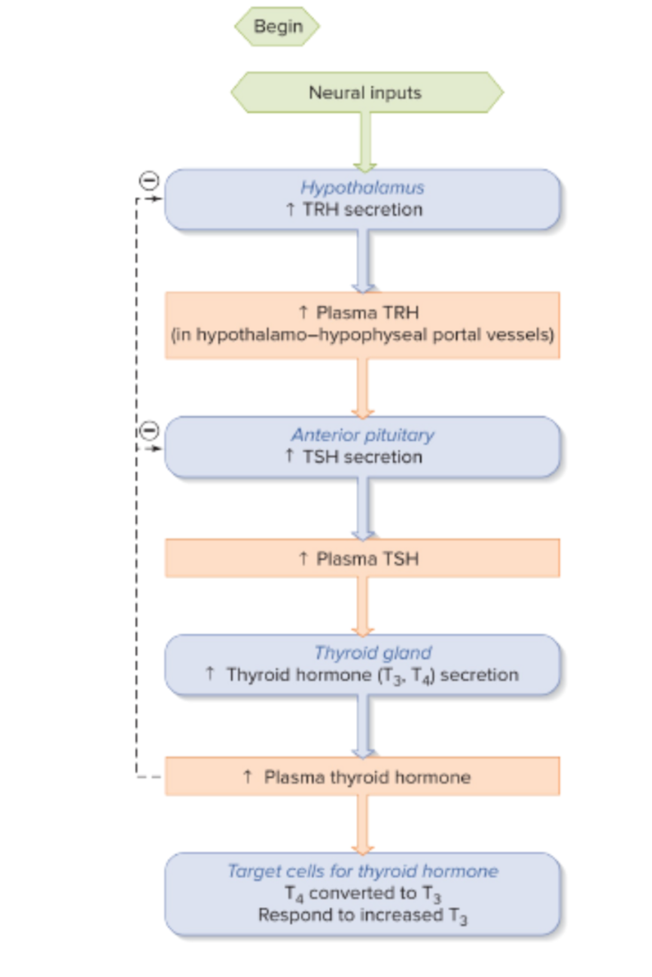
Thyroid Gland
T3 and T4: T3 is the active form of the hormone cleaved from T4 (thyroxine - more abundant in cells as a hormone store)
The Peer Teaching Society is not liable for false or misleading information…

Slide 59
Thyroid gland - Thyroxine synthesis
Iodine trapping (co-transported into follicle with Na+, into the colloid by Cl-/I- membrane protein pendrin
Organification of iodine (in the colloid, iodine is added onto thyroglobulin protein using enzyme thyroid peroxidase → T3)
Hormone secreted by endocytosis into the blood
The Peer Teaching Society is not liable for false or misleading information…

Slide 60
Thyroid Gland - Thyroxine function
→ Regulates metabolism
Increases beta-receptor expression in the heart: HR, CO, SV all increases
Simulates respiratory centre to increase oxygenation
Increase development of skeletal fast-twitch muscles (type II)
Increases metabolic rate (glucose reabsorption, gluconeogenesis, lipolysis, body temp, carbs)
Neonate growth (brain + body)
Fertility + menstruation
Mood
The Peer Teaching Society is not liable for false or misleading information…

Slide 61
Endocrine pancreas
2 cell types: Islets of Langerhans alpha or beta cells
Beta cells: Insulin production
→ Hormone that increases the expression of specific glucose transporters (e.g. GLUT-4 in muscle + adipose) on the plasma membrane thereby increasing the uptake of glucose (and AA) by cells.
The Peer Teaching Society is not liable for false or misleading information…

Slide 62
Endocrine pancreas
Increased Plasma insulin:
Muscle | Adipose | Liver
Increased glucose uptake and utilisation | Increased glucose uptake and utilisation | Decreased gluconeogenesis
Glycogen synthesis, AA uptake, and protein synthesis | Triglyceride synthesis | No ketone synthesis
 |  | Glycogen + triglyceride synthesis
The Peer Teaching Society is not liable for false or misleading information…

Slide 63
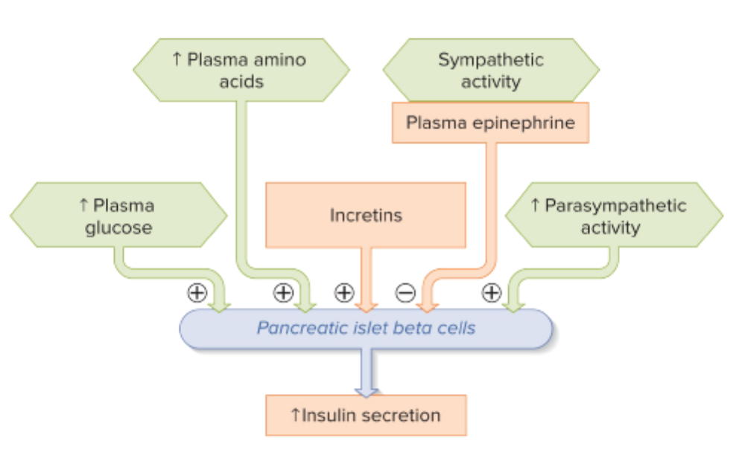
Endocrine pancreas
The Peer Teaching Society is not liable for false or misleading information…

Slide 64
Questions
If someone has had decreased thyroxine levels since teen-age, what feature would you NOT expect to see?
Low mood
Weight gain
Amenorrhea
Short stature
True or false: thyroid hormones have a negative feedback cycle on the anterior pituitary and hypothalamus
Name a specific glucose transporter that insulin acts on
If there is a high insulin concentration in the blood, what response would you expect to happen in muscle cells?
Decreased ketone production
Decreased glycogen synthesis
Increased plasma glucose levels
Increased amino acid uptake by cells
The Peer Teaching Society is not liable for false or misleading information…

Slide 65
Questions
If someone has had decreased thyroxine levels since teen-age, what feature would you NOT expect to see?
Low mood
Weight gain
Amenorrhea
Short stature
True or false: thyroid hormones have a negative feedback cycle on the anterior pituitary and hypothalamus True
Name a specific glucose transporter that insulin acts on GLUT-4
If there is a high insulin concentration in the blood, what response would you expect to happen in muscle cells?
Decreased ketone production
Decreased glycogen synthesis
Increased plasma glucose levels
Increased amino acid uptake by cells
The Peer Teaching Society is not liable for false or misleading information…

Slide 66
Thank you for listening!
We have covered:
Renal processes and nephron physiology
Acid/base balance
RAAS
Adrenal gland
Pituitary gland
Thyroid gland
Endocrine pancreas
The Peer Teaching Society is not liable for false or misleading information…

Slide 67
Feedback
https://forms.gle/PxQg4yFBHK2aA1xj7
The Peer Teaching Society is not liable for false or misleading information…

