Slide 1
GEM SBA-Style Revision Series
2022/23

Slide 2
GEM - Phase 1 Respiratory SBAs
Phase 1 Respiratory GEM SBA Revision Session
Arthur and Beth
27/09/2022 18:30-19:30

Slide 3
Aims and Objectives
Basic overview of respiratory in Phase 1, introducing some concepts from Phase 2a
13 questions with explanations

Slide 4
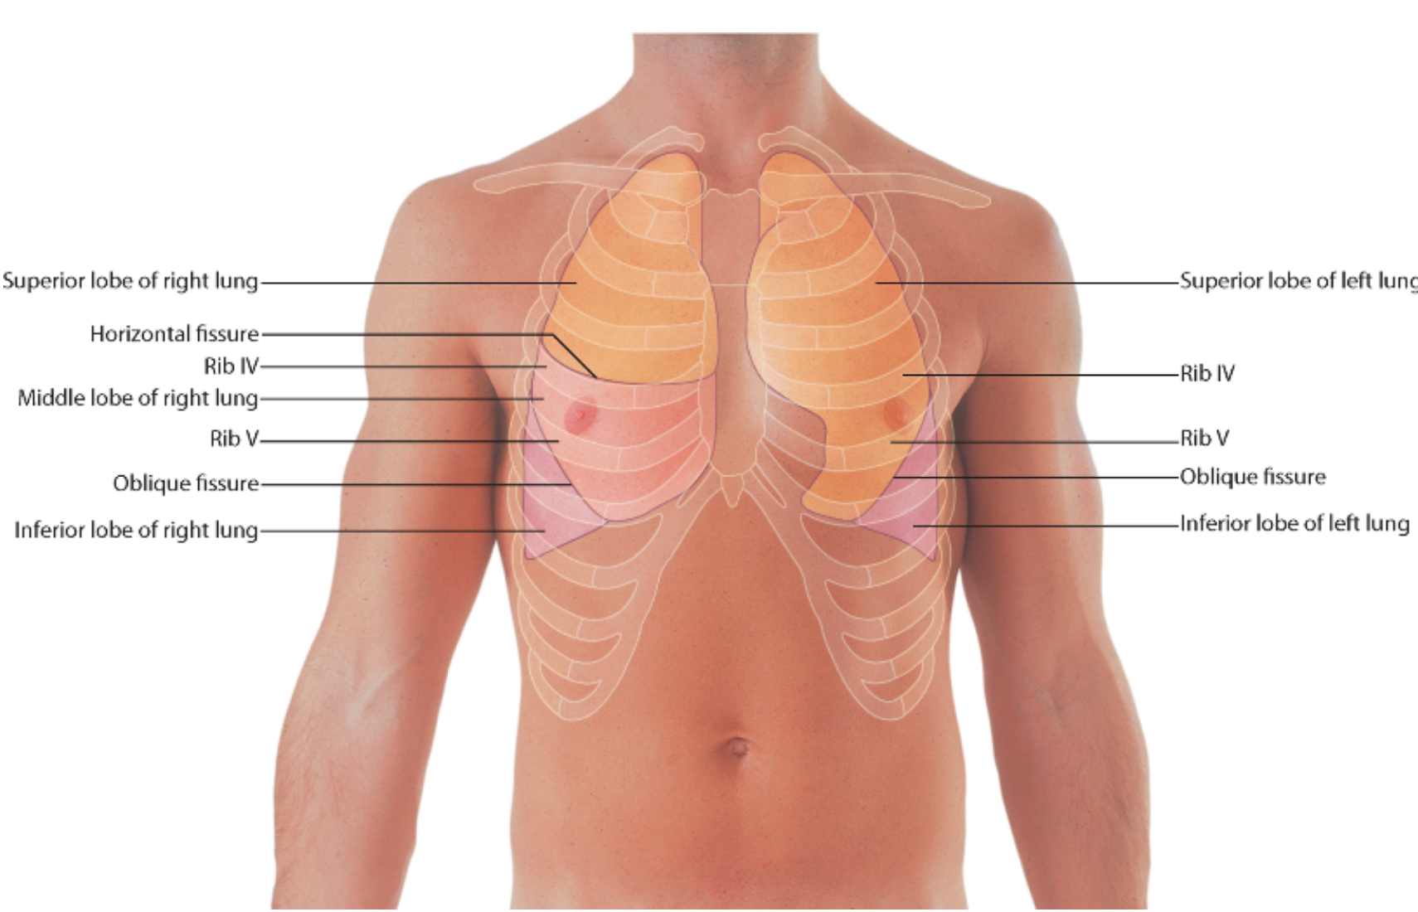
Q1. You are on a respiratory ward listening to the chest of a patient with your stethoscope, as you suspect he might have pneumonia. How many lobes are there in the right lung?
3
2
1
4
5

Slide 5
Q1. You are on a respiratory ward listening to the chest of a patient with your stethoscope, as you suspect he might have pneumonia. How many lobes are there in the right lung?
3
2
1
4
5

Slide 6
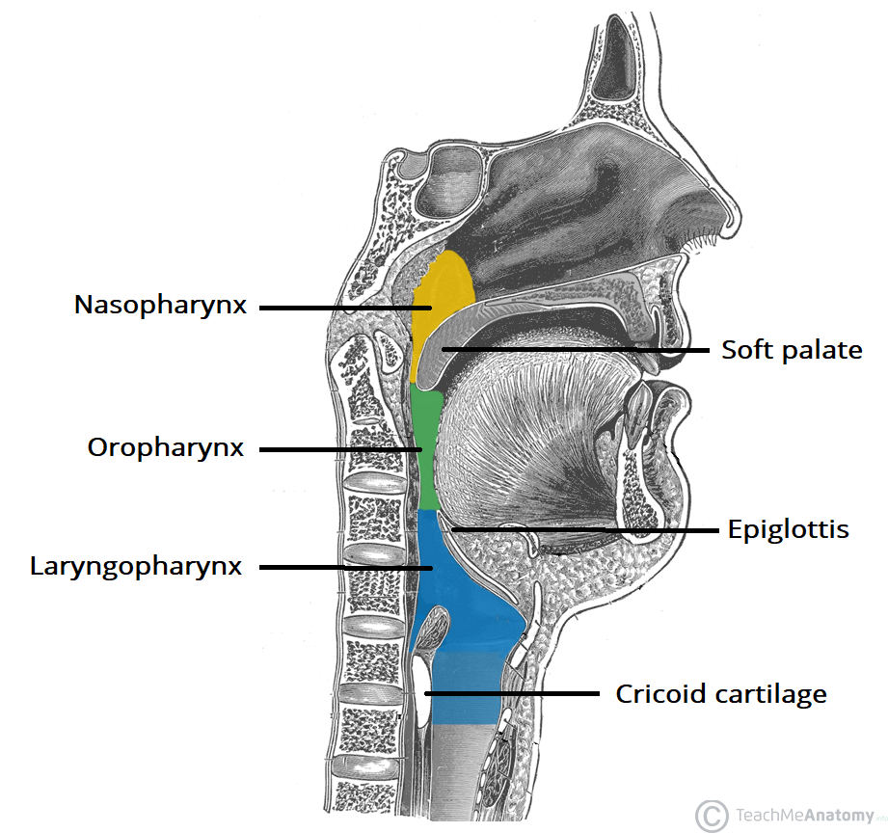
Anatomy – Upper and Lower Respiratory Tract
Upper = nasopharynx, oropharynx, laryngopharynx
Lower = trachea -> alveoli
Notes:
ECG basics Osmosis video - https://www.youtube.com/watch?v=xIZQRjkwV9Q

Slide 7
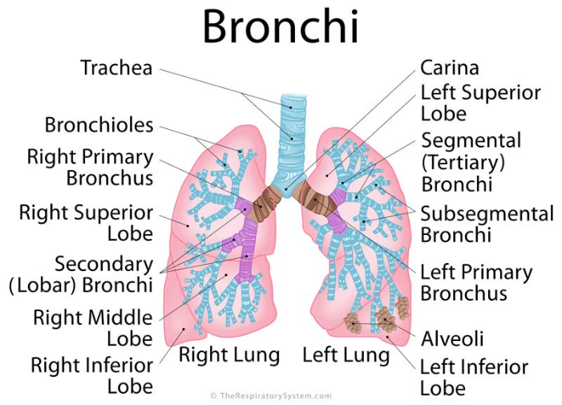
Anatomy – Upper and Lower Respiratory Tract
Upper = nasopharynx, oropharynx, laryngopharynx
Lower = trachea -> alveoli
N.B. if someone aspirates, it is more likely to end up in the right lung
Notes:
ECG basics Osmosis video - https://www.youtube.com/watch?v=xIZQRjkwV9Q

Slide 8
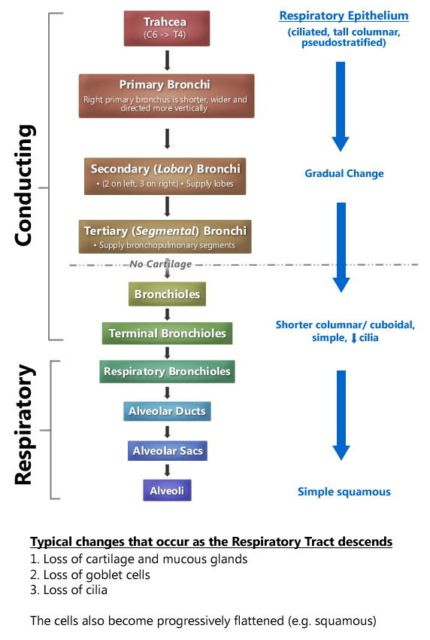
Anatomy – Upper and Lower Respiratory Tract
Notes:
ECG basics Osmosis video - https://www.youtube.com/watch?v=xIZQRjkwV9Q

Slide 9
Q2. How could respiratory epithelium best be described?
Simple columnar epithelium
Ciliated pseudostratified columnar epithelium
Stratified cuboidal epithelium
Transitional epithelium
Smooth muscle

Slide 10
Q2. How could respiratory epithelium best be described?
Simple columnar epithelium
Ciliated pseudostratified columnar epithelium
Stratified cuboidal epithelium
Transitional epithelium
Smooth muscle

Slide 11
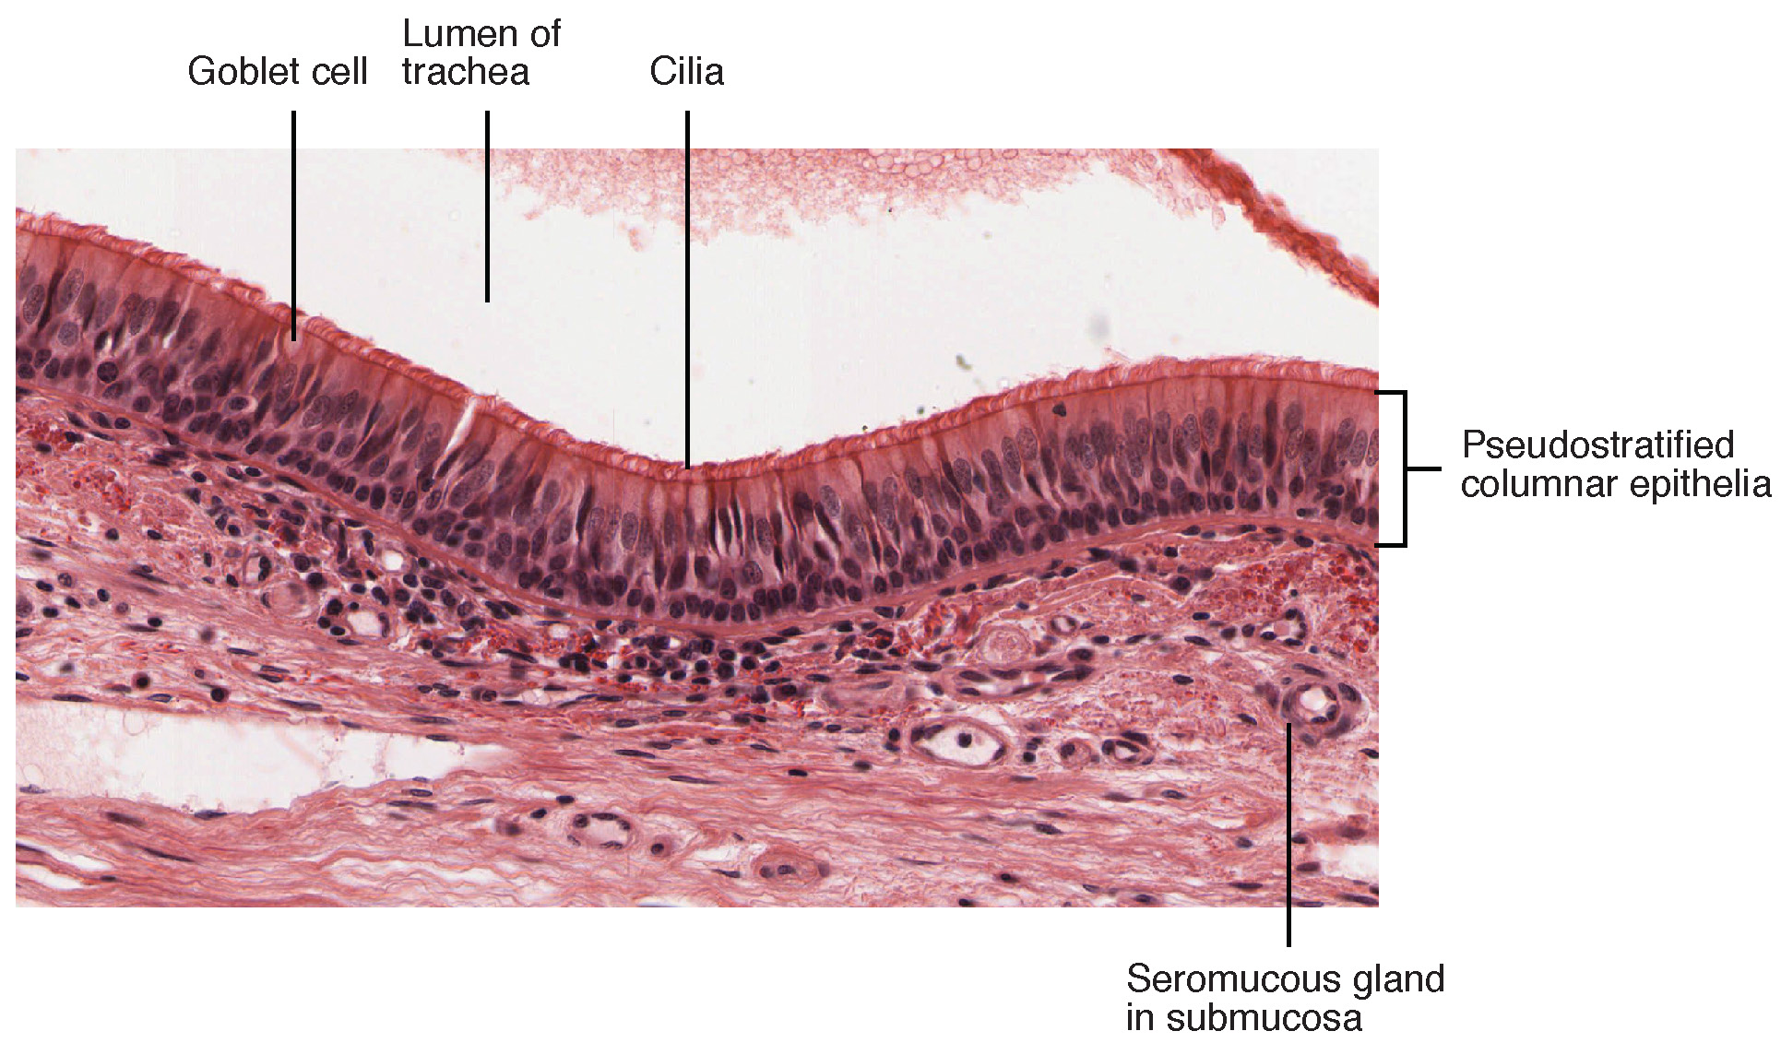
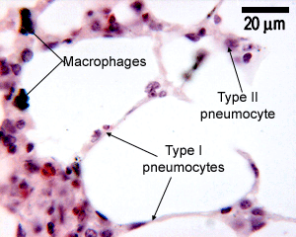
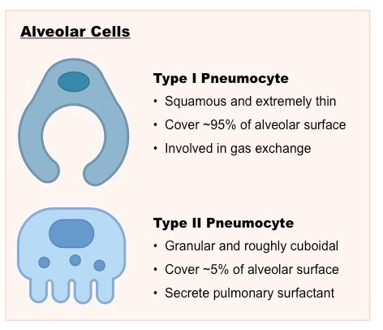
Histology

Slide 12
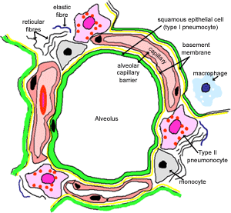
Histology - Barriers to Diffusion
Fluid lining alveolus (surfactant)
2. Layer of epithelial cells – type I pneumocytes
3. Basement membrane of type I cells
4. Interstitial space
5. Basement membrane
6. Endothelia
7. Erythrocyte
The Peer Teaching and MedSoc are not liable for false or misleading information. This session was created by students, for students, as a revision resource, therefore any resemblance to university questions is purely coincidental. Content has not been reviewed by and is therefore unaffiliated with Sheffield Medical School.

Slide 13
Q3. During inspiration, which of the following statements is true?
External intercostal muscles = contract, Diaphragm = relaxes, Volume = increases, Pressure = increases
External intercostal muscles = relax, Diaphragm = relaxes, Volume = decreases, Pressure = Increases
External intercostal muscles = relax, Diaphragm = relaxes, Volume = decreases, Pressure = decreases
External intercostal muscles = contract, Diaphragm = contracts, Volume = increases, Pressure = decreases
External intercostal muscles = relaxes, Diaphragm = contracts, Volume = increases, Pressure = decreases

Slide 14
Q3. During inspiration, which of the following statements is true?
External intercostal muscles = contract, Diaphragm = relaxes, Volume = increases, Pressure = increases
External intercostal muscles = relax, Diaphragm = relaxes, Volume = decreases, Pressure = Increases
External intercostal muscles = relax, Diaphragm = relaxes, Volume = decreases, Pressure = decreases
External intercostal muscles = contract, Diaphragm = contracts, Volume = increases, Pressure = decreases
External intercostal muscles = relaxes, Diaphragm = contracts, Volume = increases, Pressure = decreases

Slide 15
Respiratory Pump
Passive Inspiration/Expiration
Inspiration
Expiration
Diaphragm contracts (Flattens)
Sternocleidomastoid
Scalenes
Internal intercostals
2. External intercostal muscle contract (ribs lifted up and out)
Serratus Anterior
Transversus thoracis
3. Air is drawn in – passive inspiration
4. Diaphragm and external intercostal muscles relax
External intercostals
5. Air leaves the lungs – passive expiration
Nerves involved:
C3,4,5 – phrenic nerve – diaphragm
Intercostal nerve – intercostal muscles
External Obliques
Diaphragm
Rectus abdominis
Internal Obliques
*Accessory muscles – only used in active inspiration/expiration

Slide 16
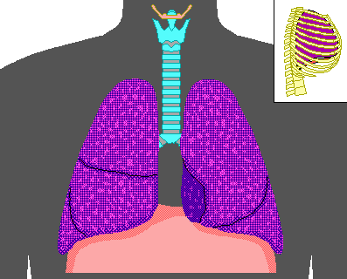
Respiratory Pump

Slide 17
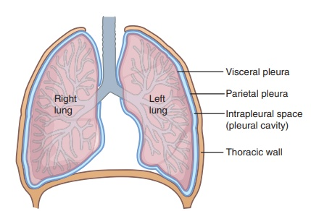
Respiratory Pump - Pressures

Slide 18
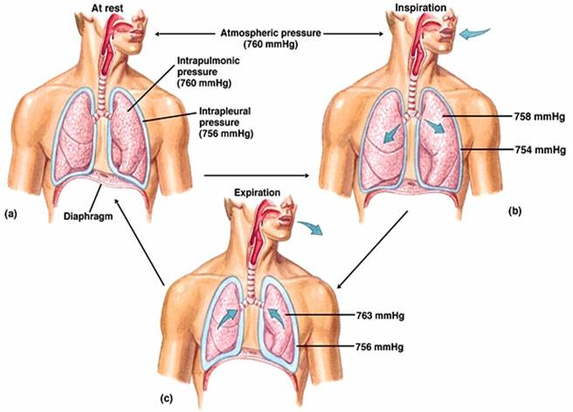
Respiratory Pump - Pressures
Alveolar pressure (Palv) aka intrapulmonary pressure is the pressure within the alveoli
Alveolar Pressure 760 mmHg
Intrapleural pressure (Ppl) is the pressure difference across the pleura
Transpulmonary pressure (TPP) = Palv – Ppl
A positive TPP allows inspiration
Palv > Ppl stops the lung collapsing

Slide 19
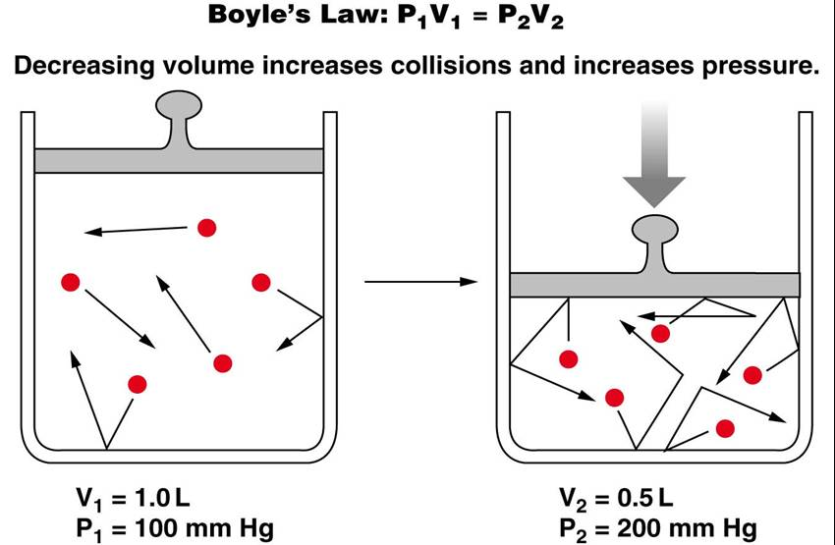
Respiratory Pump - Pressures
Boyles Law
P₁V₁ = P₂V₂
Describes how the pressure of a gas is inversely proportional to its volume

Slide 20
Q4. Mr Jones is a 22-year old male complaining of sharp chest pain that is worse when he is breathing in. After a number tests, it is determined he has a pneumothorax, meaning that air is leaking from his lungs and into his pleural space. How will this affect his Palv (pressure in alveoli) and Ppl (intrapleural pressure)?
Palv = Ppl
Palv > Ppl
Palv < Ppl

Slide 21
Q4. Mr Jones is a 22-year old male complaining of sharp chest pain that is worse when he is breathing in. After a number tests, it is determined he has a pneumothorax, meaning that air is leaking from his lungs and into his pleural space. How will this affect his Palv (pressure in alveoli) and Ppl (intrapleural pressure)?
Palv = Ppl
Palv > Ppl
Palv < Ppl
N.B. This is the case for a spontaneous pneumothorax as there is a 2-way valve, allowing the pressure to equalise. In tension pneumothorax, a 1-way valve is created, therefore the intrapleural pressure or Ppl continues to rise above the Palv, making a tension pneumothorax an emergency requiring immediate treatment.

Slide 22
Control of Breathing
Ventilation describes a breath in and out
Respiration describes the process of gas exchange
**these are often used interchangeably ☹**

Slide 23
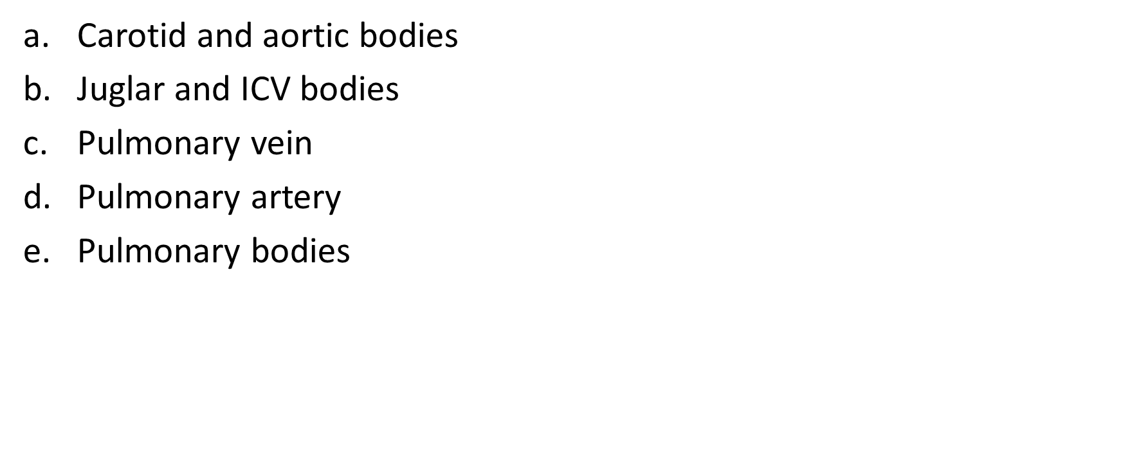
Q5. Ventilation is controlled by peripheral and central (neural) chemoreceptors. Where are the peripheral chemoreceptors located?

Slide 24
Q5. Ventilation is controlled by peripheral and central (neural) chemoreceptors. Where are the peripheral chemoreceptors located?
Carotid and aortic bodies
Juglar and ICV bodies
Pulmonary vein
Pulmonary artery
Pulmonary bodies

Slide 25
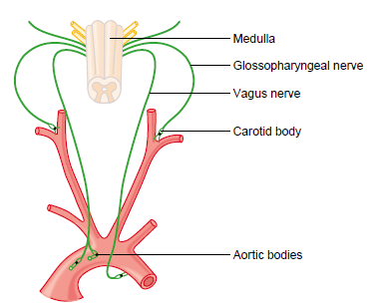
Peripheral chemoreceptors

Slide 26
Peripheral chemoreceptors involved in respiration
Detect ↓ in PaO2 (also detect pH / CO2)
Afferent impulses conducted along the vagus and glossopharyngeal nerve
Impulses transmitted to pons and medulla
↑ RR, tidal volume, blood flow to kidneys + brain and CO

Slide 27
Q6. Ventilator drive is controlled by peripheral and central (neural) chemoreceptors. Where are the central chemoreceptors located?
Medulla
Pons
Medulla and pons
Cerebellum
Tentorium cerebelli

Slide 28
Q6. Ventilator drive is controlled by peripheral and central (neural) chemoreceptors. Where are the central chemoreceptors located?
Medulla
Pons
Medulla and pons
Cerebellum
Tentorium cerebelli

Slide 29
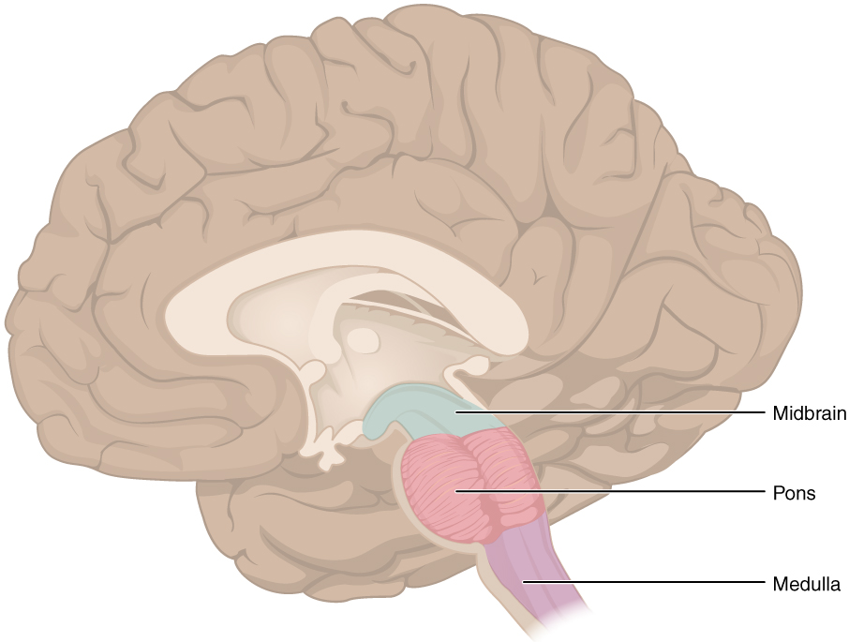
Peripheral chemoreceptors

Slide 30
Central chemoreceptors involved in respiration
Located in medulla
Detect changes in CO2
Send impulses to respiratory centre in medulla to initiate change in ventilation to restore normal CO2
↑ CO2 = ↑ ventilation
↓ CO2 = ↓ ventilation

Slide 31
How do central chemoreceptors detect changes in CO2
They actually detect changes in pH of the CSF!
CO2
H+
↓ pH
Blood brain barrier
CO2
Carbonic acid
CO2
HCO3-
CSF

Slide 32
Q7. Which nerve innervates the diaphragm?
Phrenic nerve
Intercostal nerve
Sympathetic chain
Vagus nerve
Glossopharyngeal nerve

Slide 33
Q7. Which nerve innervates the diaphragm?
Phrenic nerve
Intercostal nerve
Sympathetic chain
Vagus nerve
Glossopharyngeal nerve
N.B. C3, 4, 5 keep the diaphragm alive!

Slide 34
Q8. How many type of respiratory failure are there?
1
2
3
4
5

Slide 35
Q8. How many type of respiratory failure are there?
1
2
3
4
5

Slide 36
Respiratory failure
Respiratory failure is when the respiratory system is unable to get enough oxygen leading to hypoxaemia
Hypoxaemia may also occur alongside hypercapnia
There are two type of respiratory failure. You can tell which type by using an ABG
Type 1 respiratory failure and type 2 respiratory failure

Slide 37
Type of respiratory failure
Type 1 respiratory failure is hypoxaemia with normal CO2
Type 2 respiratory failure is hypoxaemia with ↑ CO2
Type 1 respiratory failure is caused by V/Q mismatch
Type 2 respiratory failure is caused by alveolar hypoventilation

Slide 38
Can anyone think of things that might cause T1RF?
Remember T1RF is caused by V/Q mismatch
Common examples;
Pulmonary oedema (fluid on the lungs) - ↓ V, normal Q
Pulmonary embolism – Normal V, ↓ Q

Slide 39
Can anyone think of things that might cause T2RF?
Remember T2RF is caused by alveolar hypoventilation
Common examples
COPD
Neuromuscular disease
Opiates

Slide 40
Q9. A 20-year-old is admitted with sudden onset right sided chest pain and SOB. An ABG shows the following;
PaCO2 - 7 (normal 4 – 6) PaO2 - 8 (normal 10 - 14) What type of respiratory failure is this?

Slide 41
Q9. A 20-year-old is admitted with sudden onset right sided chest pain and SOB. An ABG shows the following;
PaCO2 - 7 (normal 4 – 6) PaO2 - 8 (normal 10 - 14) What type of respiratory failure is this?
T2RF
Low O2 and raised CO2

Slide 42
Q10. ~70 % of CO2 is transported in the blood in the form of….
Bicarbonate (HCO3-)
Within RBCs
Glycated haemoglobin
Tricarbonate (HCO4-)
Dissolved in the blood

Slide 43
Q10. ~70 % of CO2 is transported in the blood in the form of….
Bicarbonate (HCO3-)
Within RBCs
Glycated haemoglobin
Tricarbonate (HCO4-)
Dissolved in the blood

Slide 44
CO2 transport in the blood
Normal pH 7.35 – 7.45

Slide 45
Q11. You observe a patient in a COPD clinic undergoing spirometry. COPD is described as having an obstructive disease pattern on spirometry. What does this mean?
a. FEV1:FVC ratio is maintained
b. FEV1:FVC ratio is reduced
c. FEV1:FVC ratio is reduced, overall lung capacity is normal/reduced
d. FEV1:FVC ratio is maintained, overall lung capacity is maintained
e. FEV1:FVC ratio is maintained, overall lung capacity is reduced
Spirometry

Slide 46
Q11. You observe a patient in a COPD clinic undergoing spirometry. COPD is described as having an obstructive disease pattern on spirometry. What does this mean?
a. FEV1:FVC ratio is maintained
b. FEV1:FVC ratio is reduced
c. FEV1:FVC ratio is reduced, overall lung capacity is normal/reduced
d. FEV1:FVC ratio is maintained, overall lung capacity is maintained
e. FEV1:FVC ratio is maintained, overall lung capacity is reduced
Spirometry

Slide 47
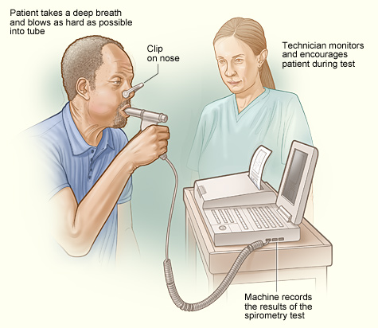
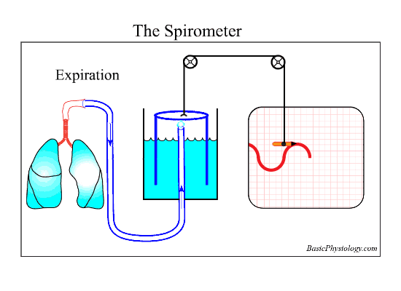
Spirometry

Slide 48
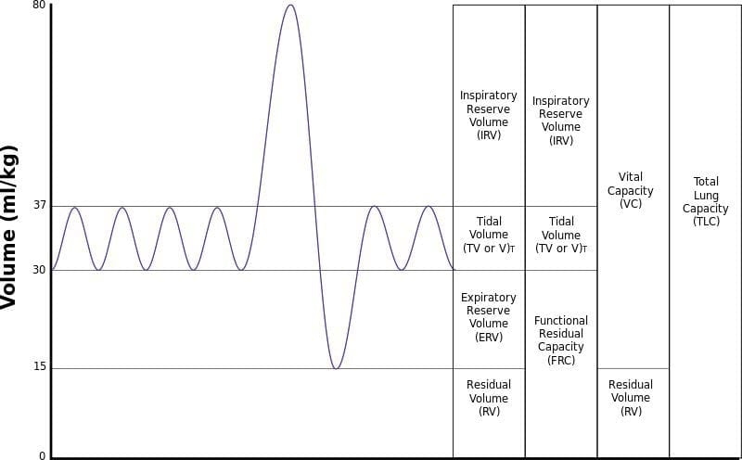
Spirometry - Definitions
Tidal volume (TV) – volume of air moved in and out of the lungs during quiet breathing
Inspiratory Reserve Volume (IRV) – the maximal volume that can be inhaled above tidal volume – back up capacity that is not typically used
Expiratory Reserve Volume (ERV) – volume of air that can be maximally exhaled below tidal volume
Residual Volume (RV) – volume of air remaining in lungs after maximal exhalation
Functional Residual Capacity (FRC) – Expiratory reserve volume + residual volume
Vital Capacity (VC) – Inspiratory capacity + Tidal volume + Expiratory reserve – max volume that can be exhaled after maximal inhalation
Total lung capacity (TLC) – total volume of air the lungs can hold

Slide 49
Forced Spirometry
FEV1 – Forced Expiratory Volume in 1 Second
FVC – Forced Vital Capacity

Slide 50
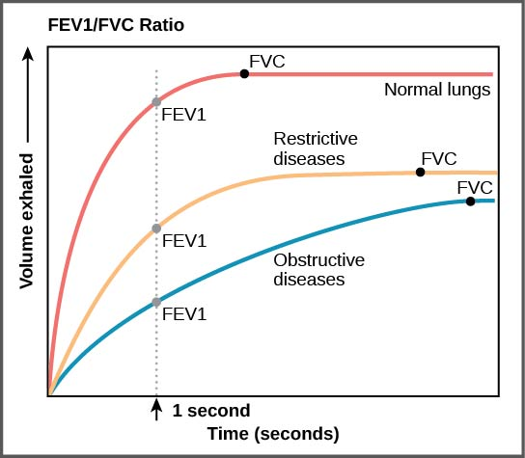
Spirometry – Obstructive vs. Restrictive Disease
In Restrictive lung diseases e.g. pulmonary fibrosis, asbestosis:
FEV1/FVC ratio maintained, overall lung capacity reduced
Why?
Harder for air to get into the lungs due to increased fibrosis making the lungs less compliant
In Obstructive lung diseases e.g. asthma, COPD:
FEV1/FVC ratio is reduced and overall capacity is reduced
Why?
Harder for air to escape the lungs due e.g. to reduced elasticity in COPD

Slide 51
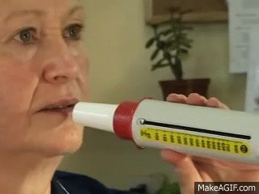
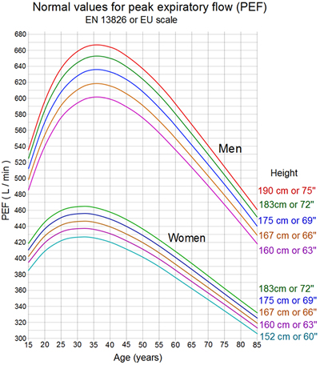
Peak Expiratory Flow

Slide 52
Q12. Which of the following is true about airway tone control?
Bronchoconstriction is stimulated by the SNS
Bronchodilation is stimulated by the vagus nerve (PNS)
Bronchoconstriction is stimulated by the respiratory nerve
Bronchodilation is stimulated by the SNS via β2 adrenergic receptors
Bronchodilation is stimulated by the respiratory nerve

Slide 53
Q12. Which of the following is true about airway tone control?
Bronchoconstriction is stimulated by the SNS
Bronchodilation is stimulated by the vagus nerve (PNS)
Bronchoconstriction is stimulated by the respiratory nerve
Bronchodilation is stimulated by the SNS via β2 adrenergic receptors
Bronchodilation is stimulated by the respiratory nerve

Slide 54
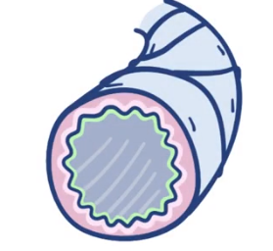
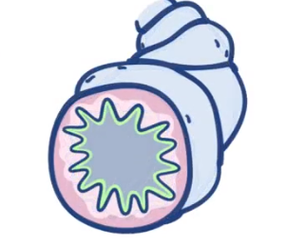
Airway Tone
Smooth muscle in the bronchioles can contract or relax and change the airflow to a certain part of the lung.
Parasympathetic (rest and digest) control via Vagus nerve
Acetylcholine
M3 muscarinic receptor on bronchial smooth muscle
Bronchoconstriction (as less oxygen is needed)

Slide 55
Airway Tone
Smooth muscle in the bronchioles can contract or relax and change the airflow to a certain part of the lung.
Sympathetic (fight or flight) nervous system
Release adrenaline/noradrenaline
β2 adrenergic receptor on bronchial smooth muscle
Bronchodilation (as more oxygen is needed)

Slide 56
Asthma
In asthma, the bronchial smooth muscle goes into spasm and there is increased mucus secretion
This is due to a hypersensitive immune response from an environmental trigger e.g. dust
This narrows the airways, and leads to shortness of breath, chest tightness and wheeze.

Slide 57
Q13. You are talking to a patient in an asthma clinic who shows you a list of her medications. She has been prescribed a salbutamol inhaler. What class of drug is salbutamol?
β2 adrenergic receptor antagonists
Muscarinic receptor agonists
β2 adrenergic receptor agonists
β1 adrenergic receptor antagonists

Slide 58
Q13. You are talking to a patient in an asthma clinic who shows you a list of her medications. She has been prescribed a salbutamol inhaler. What class of drug is salbutamol?
β2 adrenergic receptor antagonists
Muscarinic receptor agonists
β2 adrenergic receptor agonists
β1 adrenergic receptor antagonists

Slide 59
Ventilation (V) / perfusion (Q) coupling
V = ventilation (air into / out of alveoli)
Q = perfusion (blood to alveoli)
Alveoli
100 O2
https://www.youtube.com/watch?v=dDBX-z07n9I
100 O2 carriers

Slide 60
V : Q ratio simplified
Watch this video - https://www.youtube.com/watch?v=-mL_NQ3pKnA
1
↓ Q
V:Q = 3.3
V & Q fairly ballanced
2
V:Q = 1
3
↑ Q
V:Q = 0.63

Slide 61
V:Q Mismatch
Blood directed to better ventilated areas of the lung
What happens to VQ ratio? Are V and Q matched?
V&Q no longer match - ↓ V but no change to Q

Slide 62
V : Q Mismatch
Bronchoconstriction
What happens to V Q ratios mismatch now?
V and Q are not matched = ↓ Q but no change in V
Air and blood directed to better ventilated areas of the lung
Vasoconstriction

Slide 63
V : Q Mismatch = hypoxia
Bronchoconstriction
Blood directed to an already fully saturated with O2 area
Hypoxia
Vasoconstriction

Slide 64
Chronically elevated CO2 levels and ventilatory drive
Normally, ventilatory drive is primarily driven by central chemoreceptors
Peripheral chemoreceptors respond when O2 is low (~< 92 %). Normal sats ≥95 %.
Central chemoreceptors get used to chronically elevated CO2
Peripheral chemoreceptors take over control of ventilatory drive
Peripheral chemoreceptors respond to ↓ paO2
Oxygen saturations chronically low

Slide 65
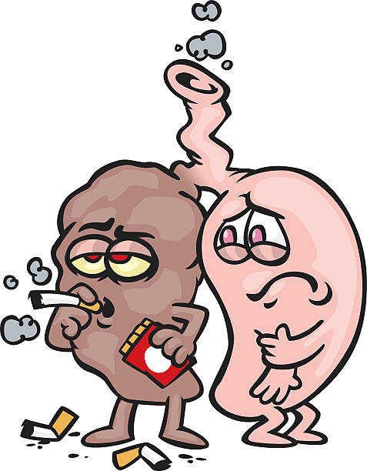
Chronically elevated CO2 levels and ventilatory drive
Pop them on O2. There sats now 98 %
O2 levels exceed threshold for peripheral chemoreceptors
Peripheral receptors stop sending impulses
COPD
Chronic CO2 retention
New O2 requirement
Ventilatory drive decreases exacerbating their hypercapnia
Leads to acidosis

Slide 66
Conclusion
Do not worry about the Phase 1 exam!
Use this 6 weeks as a time to:
Get to know what areas you are lacking in from these sessions
Find out what you would like to use to take notes/revise e.g. Anki, Notion etc.
Find out which resources you would like to use to learn e.g. YouTube videos, Osmosis, Zero To Finals, Oxford Clinical Handbook, BMJ Best Practice etc.

Slide 67
Good resources
Phase 1 drive is useful with previous years revision session presentations and mock SBA papers
Osmosis.com – good notes and easy to follow videos (great for Phase 2a also)
Ninja nerds on YouTube – long videos on physiology but really good if you’re struggling with a concept and want in depth explanations

Slide 68
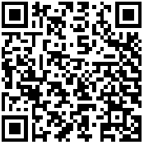
Feedback
Please scan the QR code to fill out the feedback form!!

