Slide 1
2022/2023

Slide 2
Respiratory
Phase 1 Revision Session
Areesha Aziz
24/11/22
The Peer Teaching Society is not liable for false or misleading information…

Slide 3
Aims and Objectives
Measures of lung function (FEV, FVC...) in spirometry
Airway tone
Equations
Host defense
Hypersensitivity
Hypoxia, hypercapnia and respiratory failure
The Peer Teaching Society is not liable for false or misleading information…

Slide 4
Spirometry: measures of lung function
Volumes | Capacities
Tidal volume- volume of air inhaled/exhaled in 1 breath cycle (500ml) | VC- volume of air that can be exhaled with maximum effort after maximum inspiration
IRV- volume of air in excess of tidal inspiration that can be inhaled with maximum effort | IC- volume of air that can be inhaled with maximum effort after tidal expiration
ERV- volume of air in excess of tidal expiration that can be exhaled with maximum effort | FRC- volume of air remaining in lungs at end of tidal expiration
RV- volume of air remaining in lungs at end of forced expiration | TLC- maximum volume of air lungs can contain after maximum inspiration (5000ml)
The Peer Teaching Society is not liable for false or misleading information…
Notes:
Image source: https://www.bing.com/images/search?view=detailV2&ccid=dT0nOs2X&id=6E210E25ABB2007E310DFE087A67D9F4CE3146F6&thid=OIP.dT0nOs2XouoITRhaM04qyAHaEl&mediaurl=https%3a%2f%2fschematron.org%2fimage%2fspirometry-diagram-2.jpg&cdnurl=https%3a%2f%2fth.bing.com%2fth%2fid%2fR.753d273acd97a2ea084d185a334e2ac8%3frik%3d9kYxzvTZZ3oI%252fg%26pid%3dImgRaw%26r%3d0%26sres%3d1%26sresct%3d1%26srh%3d799%26srw%3d1293&exph=366&expw=592&q=spirometry+grpaph&simid=608017097334682657&FORM=IRPRST&ck=4FC555106E7CAF2DCB0AC0D64ACA41A7&selectedIndex=4&ajaxhist=0&ajaxserp=0

Slide 5
Spirometry (2)
Capacity equations
TLC = IRV + TV + ERV + RV
TLC = IC + FRC/ RV + VC
VC = IRV + TV + ERV
IC = IRV + TV
The Peer Teaching Society is not liable for false or misleading information…

Slide 6
How can we measure lung volume?
Why measure FRC? → FRC is altered in disease states e.g. in emphysema, FRC ↑
Gas dilution
Ate end of tidal expiration, connect mouth to mouthpiece. Volume of air initially in lungs = FRC
Inhale known volume & conc of inert tracer gas e.g. helium
Exhaled helium is diluted according to unknown volume of air in lungs. Exhaled [helium] is measured.
Patient breathes
tidally- allows helium to mix with air in lungs
The Peer Teaching Society is not liable for false or misleading information…
Notes:
A known concentration and volume of inert tracer gas e.g. helium/nitrogen is inhaled. The patient then breathes in tidally. The final exhaled helium is diluted proportional to the unknown volume of air in the lungs (functional residual capacity).
When the patient puts their mouth on the mouthpiece and breathes tidally, the helium reservoir + patient’s lungs are a closed system i.e. initial amount of helium = final amount of helium
Source: https://www.youtube.com/watch?v=4nQApZ8Q0XM

Slide 7
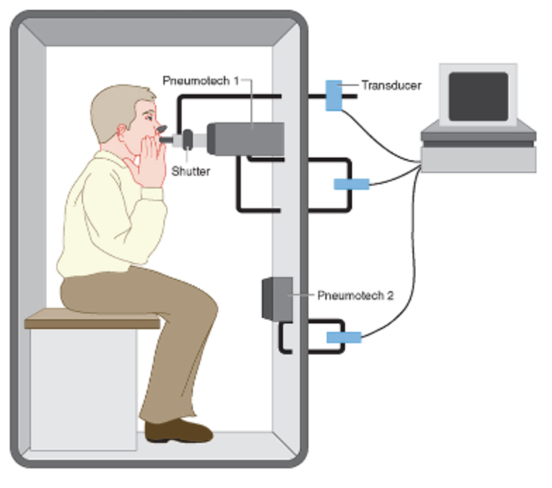
How can we measure lung volume?
Total body box plethysmography
From the FRC, the patient pants with an open glottis against a closed shutter to produce changes in box pressure proportional to the volume of the air in the chest
Based on Boyle’s law
The Peer Teaching Society is not liable for false or misleading information…
Notes:
To get to FRC: end of tidal expiration
Boyle’s law- pressure and volume are inversely proportional when mass and temperature of a gas are constant. So when comparing the same substance under 2 sets of conditions, the law can be expressed as P1V1 = P2V2. pressure multiplied by volume is a constant value.

Slide 8
How can we measure lung volume?
Gas dilution | Total body plethysmography
Only measures air in lung areas that communicate with trachea. Does not measure air in non-communicating bullae (air pockets, COPD) | Measures volume of ALL air in thorax including air trapped in bullae
Q) What does a low TLC indicate?
A) restriction- since lungs are less compliant and have decreased expansion ability e.g. pulmonary fibrosis
The Peer Teaching Society is not liable for false or misleading information…
Notes:
Bullae- thin walled, air-filled spaces in lungs larger than 1cm in diameter. Bullae are not ventilated (air does not pass in and out of them) and are associated with COPD.

Slide 9
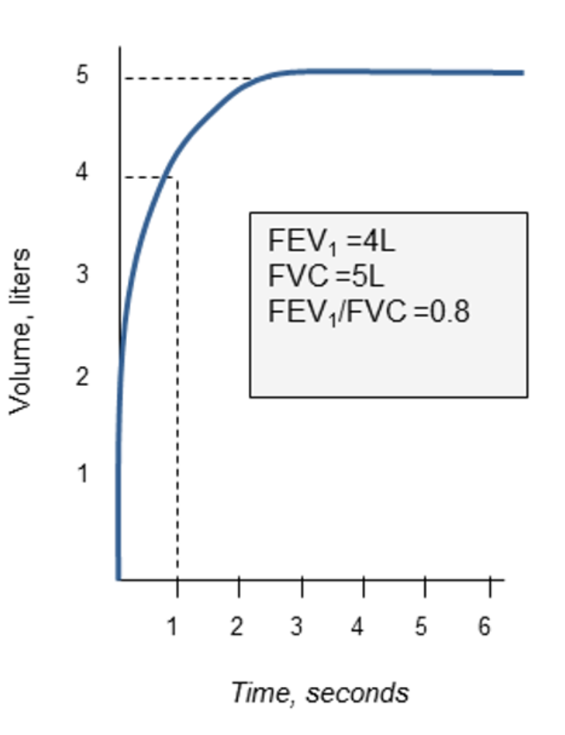
Spirometry: volume-time curve
Procedure for volume-time plot
Breathe in to total lung capacity (TLC)
Exhale with maximum effort as fast as possible to residual volume (RV)
Volume produced is the vital capacity (FVC)- the volume of air that can be exhaled with maximum effort after maximal inspiration
The Peer Teaching Society is not liable for false or misleading information…

Slide 10
Spirometry: volume-time curve
FVC = amount of air that can be exhaled with maximum effort after maximum inspiration
FEV1 = amount of air that can be exhaled with maximum effort after maximum inspiration in 1 second
FEV1/ FVC >= 80% is normal i.e. healthy individuals can expire 80% of FVC in 1s
The Peer Teaching Society is not liable for false or misleading information…

Slide 11
Spirometry (2)
Q) How would you diagnose obstruction and restriction using spirometry parameters?
The Peer Teaching Society is not liable for false or misleading information…

Slide 12
Spirometry: obstruction and restriction
FVC = amount of air that can be exhaled with maximum effort after maximum inspiration
FEV1 = amount of air that can be exhaled with maximum effort after maximum inspiration in 1 second
FEV1 is a good marker of lung health, normal values are FEV1 >= 80% of expected for sex, age etc.
Obstruction | Restriction
FEV1/ FVC < 0.7 Difficult to expel air from lungs due to airway blockage Obstruction = flow problem e.g. COPD, asthma | FEV1/FVC is normal ( 80% therefore 80% of air can be forcefully exhaled after maximum inhalation in 1s) FVC < 80% of predicted Restriction = volume problem (TLC is low) Decreased compliance of the lungs e.g. pulmonary fibrosis
The Peer Teaching Society is not liable for false or misleading information…
Notes:
Asthma- characterised by reversible bronchoconstriction (narrowing of airways)
COPD- irreversible (fixed) bronchoconstriction causing airflow limitation

Slide 13
Spirometry: normal peak flow curve
PEF= peak expiratory flow, the maximal flow as air is being exhaled with maximum effort after maximum inspiration
What does the graph show?
Flow is greatest at the start of expiration and decreases linearly as lung volume is being emptied.
FEF75 lies behind FEV1 because 80% of the FVC is exhaled in the 1st second- hence in healthy people the FEV1/FVC ratio is 0.8
The Peer Teaching Society is not liable for false or misleading information…
Notes:
Procedure is the same as for volume-time plot. Instead we plot flow per unit time as a function of volume.

Slide 14
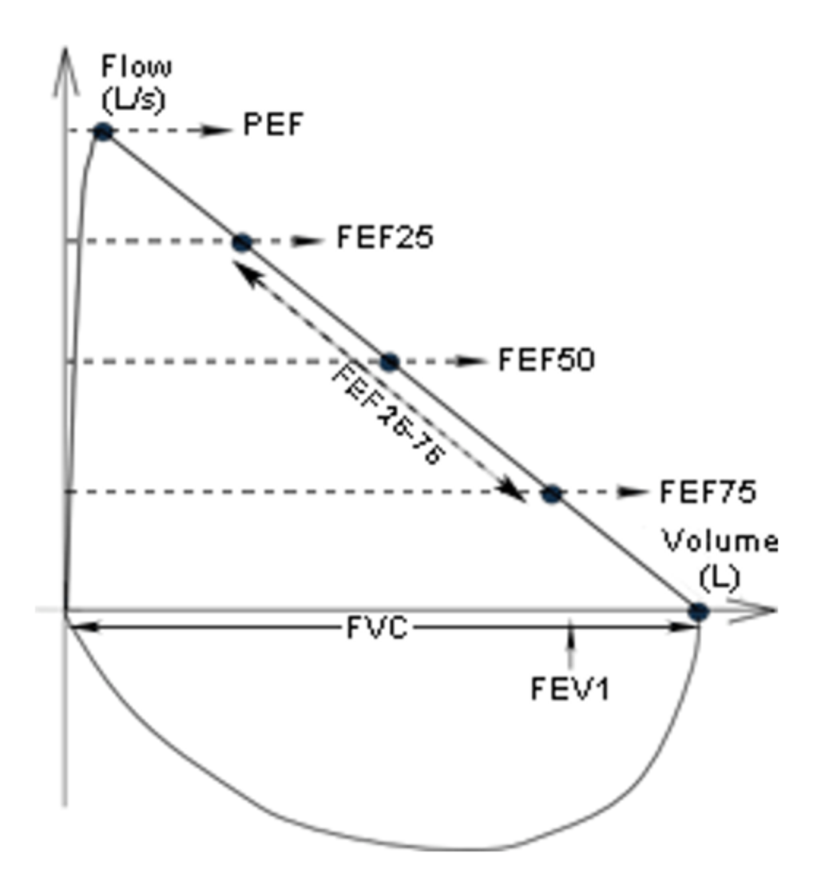
Spirometry: abnormal peak-flow curve
Obstruction= flow abnormality
Restriction = volume problem
Peak expiratory flow
The Peer Teaching Society is not liable for false or misleading information…
Notes:
Normally when patients blow into a peak flow meter, flow decreases linearly with volume remaining in the lungs.
Obstruction- flow problem characterised by scalloped curve; lungs can expand and are compliant but due to bronchoconstriction (airway narrowing) it takes a long time to expel air from the lungs during expiration.
Restriction- decreased expansion ability of lungs; volume problem; FVC is low and < 80% of predicted.

Slide 15
Airway tone
Which cranial nerve, when stimulated, results in the release of Acetylcholine in the lungs causing bronchoconstriction?
A) Oculomotor nerve- CN 3
B) Vagus nerve- CN 10
C) Glossopharyngeal nerve- CN 9
D) Phrenic nerve - C3, C4, C5
The Peer Teaching Society is not liable for false or misleading information…

Slide 16
Airway tone
Which cranial nerve, when stimulated, results in the
release of Acetylcholine in the lungs causing bronchoconstriction?
B) Vagus nerve- CN 10
The Peer Teaching Society is not liable for false or misleading information…

Slide 17
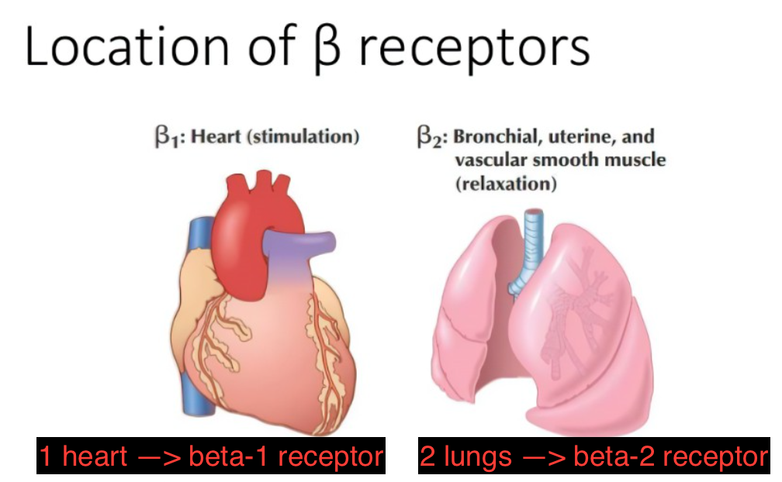
Airway tone
Sympathetic stimulation causes bronchodilation
Lung receives innervation from T2-T4 ganglia of sympathetic chain
Ach released at preganglionic synapse binds to N1 receptors
NAd released from postganglionic neurone acts indirectly by stimulating release of adrenaline from adrenal medulla
Adrenaline binds to beta-2 receptors on airway smooth muscle → bronchodilation
The Peer Teaching Society is not liable for false or misleading information…
Notes:
Image source: https://www.bing.com/images/search?view=detailV2&ccid=VkR8x7s5&id=8A0398CFDD5A873CCE2BF2BAC914A68B8CF2A9EE&thid=OIP.VkR8x7s5QiHojI2NeVBlEwHaFj&mediaurl=https%3a%2f%2fimage.slidesharecdn.com%2fbetaadrenergicblockers-150412052808-conversion-gate01-170824180220%2f95%2fbetaadrenergicblockers-150412052808conversiongate01-6-638.jpg%3fcb%3d1503597778&cdnurl=https%3a%2f%2fth.bing.com%2fth%2fid%2fR.56447cc7bb394221e88c8d8d79506513%3frik%3d7qnyjIumFMm68g%26pid%3dImgRaw%26r%3d0%26sres%3d1%26sresct%3d1%26srh%3d799%26srw%3d1065&exph=479&expw=638&q=beta+2+receptors+in+lungs+diagram&simid=608051774903443140&FORM=IRPRST&ck=E0BDB381EF5385CD86B4CC2246519A5E&selectedIndex=1&ajaxhist=0&ajaxserp=0

Slide 18
Airway tone
Parasympathetic stimulation causes bronchoconstriction
Lung receives bilateral innervation from vagus nerves (NB: vagus nerve provides parasympathetic innervation to all organs of thorax and abdomen)
ACh released at preganglionic synapse binds to N1 receptors
ACh released from postganglionic neurone binds to M3 receptors on airway smooth muscle → bronchoconstriction (↑ airways smooth muscle tone)
Hint: PNS puts you to sleep (‘rest& digest’) and bronchoconstriction reduces the effort needed to breathe during sleeping.
The Peer Teaching Society is not liable for false or misleading information…

Slide 19
Airway tone- drugs
Bronchodilators reduce effort needed to breathe, prescribed for asthma & COPD patients.
Beta-2 agonists e.g. salbutamol (short-acting) & salmeterol (long-acting)
Muscarinic antagonists (M3 antagonists)/ antimuscarinics e.g. ipratropium (short acting) & tiotropium (long acting)
The Peer Teaching Society is not liable for false or misleading information…

Slide 20
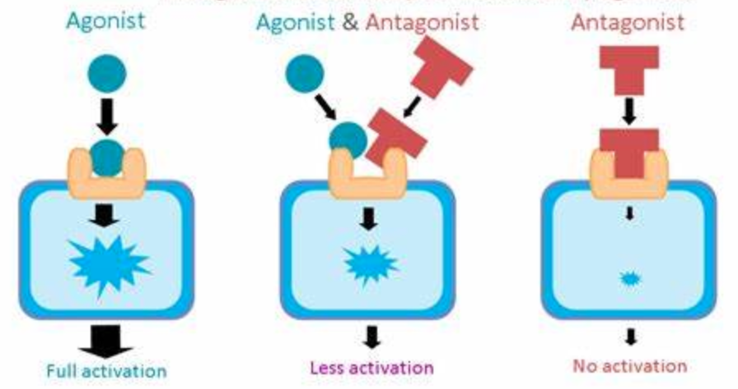
Airway tone- agonists and antagonists
Ligands= compounds that can bind to receptors can be agonists or antagonists. Can be agonists or antagonists.
Agonists have affinity (can bind to receptor) and efficacy (can activate receptor).
Antagonists have affinity (can bind to receptors) but 0 efficacy (can’t activate receptor). Antagonists block receptor activation by agonists.
The Peer Teaching Society is not liable for false or misleading information…
Notes:
Image source: https://www.bing.com/images/search?view=detailV2&ccid=oKz5iD0g&id=9C7342FBD7B848FC2396B54EDE96B08AEF640ECC&thid=OIP.oKz5iD0gJNccceXs7FfwcwAAAA&mediaurl=https%3a%2f%2fpsychonautwiki.org%2fw%2fimages%2f4%2f40%2fAgonists_and_antagonists.png&cdnurl=https%3a%2f%2fth.bing.com%2fth%2fid%2fR.a0acf9883d2024d71c71e5ecec57f073%3frik%3dzA5k74qwlt5OtQ%26pid%3dImgRaw%26r%3d0%26sres%3d1%26sresct%3d1%26srh%3d800%26srw%3d1059&exph=358&expw=474&q=Agonist+vs+Antagonist+Drugs&simid=608051903743332857&FORM=IRPRST&ck=C5BF9FB267B982F04AE84D6474462815&selectedIndex=4&ajaxhist=0&ajaxserp=0

Slide 21
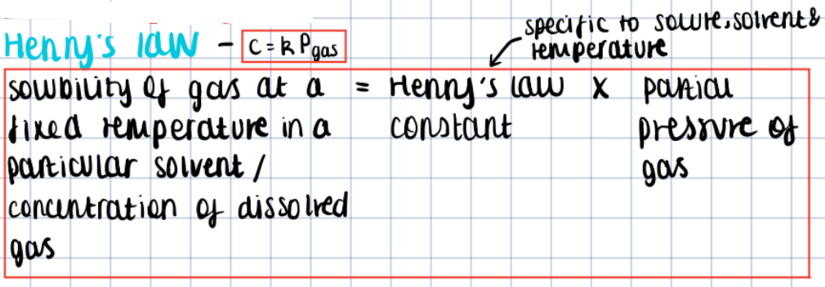
Lung equations (1)
The Peer Teaching Society is not liable for false or misleading information…

Slide 22
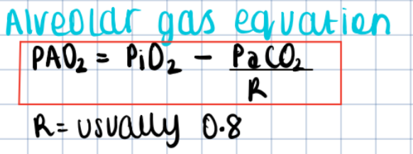
Lung equations (2)
R = respiratory quotient (CO2 produced/ O2 consumed)
R= 1 for carbohydrate diet
R= close to 0.7 for fat diet
PAO2 = partial pressure of oxygen in alveoli
PaCO2 = partial pressure of CO2 in arterial blood
PiO2 = pressure of inspired oxygen (always 21kPa at sea level)
FiO2= fraction of inspired oxygen. Always 0.21
Patm – atmospheric pressure, 100kPa
The Peer Teaching Society is not liable for false or misleading information…

Slide 23
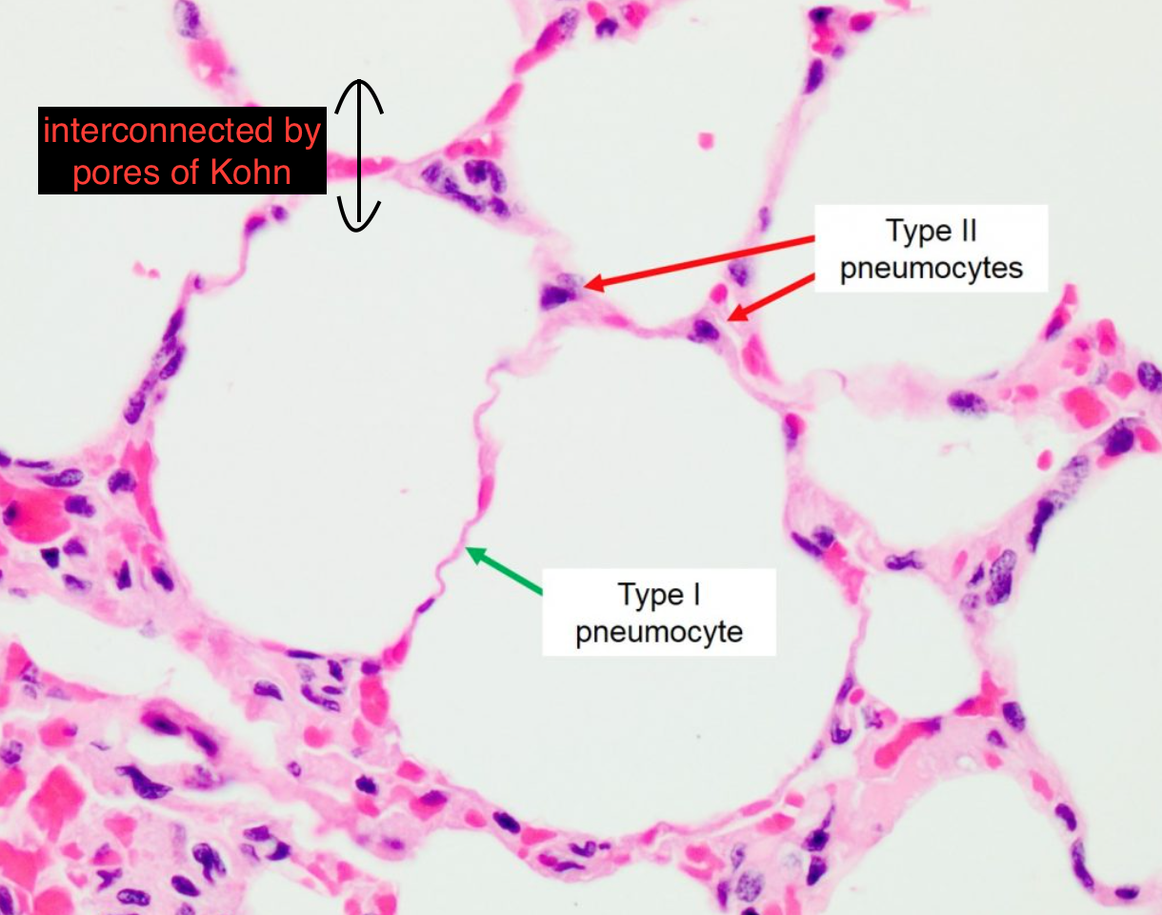
Surfactant (1)
= mixture of phospholipids (phosphatidyl choline, phosphatidyl inositol, phosphatidyl glycerol) + surfactant proteins A,B,C & D
Produces by neonates from 34 weeks gestation with DRAMATIC increase 2 weeks prior to birth
Clinical relevance → surfactant deficiency in preterm neonates causes Respiratory Distress Syndrome of Neonate
Functions of surfactant
Abolishes surface tension therefore prevents alveolar collapse
Allows even inflation of alveoli (connected via pores of Kohn)
Allows maintenance of FRC (since it prevents alveolar collapse, it ensures there is air left in alveoli at end of tidal expiration to keep them inflated)
Type 1 pneumocytes→ simple squamous epithelial cells for gas exchange
Type 2 pneumocytes → secrete surfactant
The Peer Teaching Society is not liable for false or misleading information…
Notes:
Surface tension- cohesive force acting at the liquid air interface which acts to pull water molecules closer together and reduce surface area. If surface tension is too strong, it will result in alveolar collapse.
https://www.bing.com/images/search?view=detailV2&ccid=gK8gc4HX&id=E325C6CDF4EB39FA687FB001FF363B16EBC97D15&thid=OIP.gK8gc4HX1qafnOa8410RQgHaF3&mediaurl=https%3a%2f%2fohiostate.pressbooks.pub%2fapp%2fuploads%2fsites%2f36%2f2017%2f05%2fAlveoli-with-labels-1024x811.jpg&cdnurl=https%3a%2f%2fth.bing.com%2fth%2fid%2fR.80af207381d7d6a69f9ce6bce35d1142%3frik%3dFX3J6xY7Nv8BsA%26pid%3dImgRaw%26r%3d0&exph=811&expw=1024&q=alvaoeli+histolgy+diagram&simid=608017900494398684&FORM=IRPRST&ck=F0D06185D30BF8EFF09A20415C4411B1&selectedIndex=1&ajaxhist=0&ajaxserp=0

Slide 24
Surfactant (2)
Preterm babies have surfactant deficiency ∵ there is LARGE increase in surfactant production 2 weeks prior to birth.
Higher surface tension in alveoli → larger transpulmonary pressures are required to prevent alveolar collapse and inflate the lungs
Loss of lung volume (difficult to maintain FRC) and non-compliant lungs
Uneven inflation of alveoli
Clinical features: central & peripheral cyanosis (bluish lips, fingers & toes), flaring nostrils, rapid shallow breathing
The Peer Teaching Society is not liable for false or misleading information…
Notes:
Surface tension- cohesive force acting at the liquid air interface which acts to pull water molecules closer together and reduce surface area. If surface tension is too strong, it will result in alveolar collapse.

Slide 25
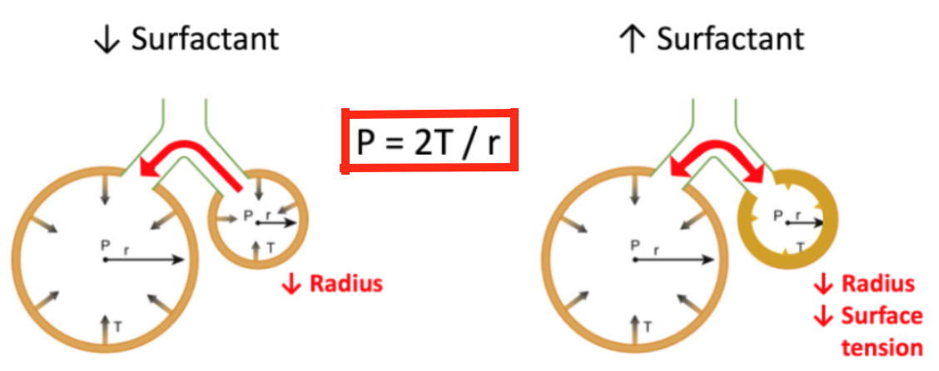
Surfactant & Laplace’s law
If the surface tension (T) increases or radius (R) of a sphere decreases, the pressure (P) required to prevent collapse of the sphere- the collapsing pressure- increases.
The smaller the radius, the higher the transpulmonary pressure needed to prevent alveolar collapse for a given surface tension.
Thus smaller alveoli require greater transpulmonary pressures to prevent alveolar collapse, for a given surface tension → Smaller alveoli have a greater tendency to collapse.
P = transpulmonary pressure required to prevent alveolar collapse/collapsing pressure
T = surface tension
R = radius of alveoli
The Peer Teaching Society is not liable for false or misleading information…
Notes:
https://www.bing.com/images/search?view=detailV2&ccid=dYm7684a&id=1D590E19A53F26D273D180E00AC3B1C6ACA7C969&thid=OIP.dYm7684ao5thk_ekNvd6BwHaCq&mediaurl=https%3a%2f%2f66.media.tumblr.com%2f6430554ffb52f91882b2192ebb123e78%2ftumblr_pgxm5u0Pqf1uybg0co1_1280.png&cdnurl=https%3a%2f%2fth.bing.com%2fth%2fid%2fR.7589bbebce1aa39b6193f7a436f77a07%3frik%3dacmnrMaxwwrggA%26pid%3dImgRaw%26r%3d0&exph=374&expw=1038&q=laplace%27s+law&simid=608047089078599671&FORM=IRPRST&ck=BC795F00A85653F7861839CEC7B2CE96&selectedIndex=8&ajaxhist=0&ajaxserp=0
Surface tension – the force acting at liquid-air interface acting to pull water molecules closer together and reduce the surface area

Slide 26
Surfactant & Laplace’s law
Small alveoli | Large alveoli
Larger collapsing pressure (tendency to collapse) More surfactant = lower surface tension → prevents alveolar collapse | Smaller collapsing pressure Less surfactant = higher surface tension → equally likely to collapse as small alveoli
Surface tension can be lowered by surfactant, this decreases the transpulmonary pressure in the smaller alveoli needed to prevent alveolar collapse and allows homogenous aeration.
As alveoli increase in size, the surfactant becomes more spread out over the surface of the liquid, so surface tension is lower. In smaller alveoli, there is a thicker layer of surfactant that reduces surface tension to a greater degree than in larger alveoli. This difference in surface tension between the smaller and larger alveoli prevents collapse of smaller alveoli.
P = transpulmonary pressure required to prevent alveolar collapse/collapsing pressure
T = surface tension
R = radius of alveoli
The Peer Teaching Society is not liable for false or misleading information…
Notes:
https://www.bing.com/images/search?view=detailV2&ccid=dYm7684a&id=1D590E19A53F26D273D180E00AC3B1C6ACA7C969&thid=OIP.dYm7684ao5thk_ekNvd6BwHaCq&mediaurl=https%3a%2f%2f66.media.tumblr.com%2f6430554ffb52f91882b2192ebb123e78%2ftumblr_pgxm5u0Pqf1uybg0co1_1280.png&cdnurl=https%3a%2f%2fth.bing.com%2fth%2fid%2fR.7589bbebce1aa39b6193f7a436f77a07%3frik%3dacmnrMaxwwrggA%26pid%3dImgRaw%26r%3d0&exph=374&expw=1038&q=laplace%27s+law&simid=608047089078599671&FORM=IRPRST&ck=BC795F00A85653F7861839CEC7B2CE96&selectedIndex=8&ajaxhist=0&ajaxserp=0
Surface tension – the force acting at liquid-air interface acting to pull water molecules closer together and reduce the surface area

Slide 27
Innate vs adaptive immunity
Innate | Adaptive
Present from birth Rapid, non-specific response to antigen No immunological memory Does not depend on lymphocytes | Induced by infection Slower, antigen- specific response Generates memory B and T cells which provoke faster secondary immune response on reinfection Requires lymphocytes
T cells cannot respond to naïve antigens; antigens must be presented by APCs on MHC class II for T-cells to respond
Interface b/w innate and adaptive immunity = antigen-presenting cells
Dendritic cells
Macrophages
B cells
The Peer Teaching Society is not liable for false or misleading information…

Slide 28
Lung defense: non-immune barriers
Respiratory epithelium = pseudostratified ciliated columnar epithelium with interspersed goblet cells (3 marks)
Physical barrier to pathogens (lungs must be sterile)
Mucociliary escalator prevents infection: submucosal glands and goblet cells secrete mucus which traps inhaled particulates and pathogens, mucus is wafted unidirectionally by cilia up into the oropharynx where it can be coughed up or swallowed (killed by HCl in gastric acid).
Chemical secretions: antimicrobial peptides, antiproteinases (block pathogenic proteases), surfactant proteins A&D act as opsonin
Mucus
Viscoelastic gel containing water, carbohydrates, fats and proteins
Cough
= explosive expiration that clears tracheobronchial tree of foreign material & secretions, voluntary or reflexive.
How?
- Epiglottis closes over laryngeal inlet & vocal folds close→ abdominal muscles contract, diaphragm pushed upwards → INCREASE in intrathoracic pressure causes tracheal narrowing → vocal cords open & epiglottis unfolds → pressure gradient b/w atmosphere & trachea causes air to be expelled at high flow rates
The Peer Teaching Society is not liable for false or misleading information…

Slide 29
Lung defense: Innate immunity
INNATE= Always present or rapidly recruited; non-specific to antigen
Neutrophils
Most abundant blood-borne leukocyte (comprises 40-75% of leukocytes)
Granulocyte/polmorphonuclear leukocyte- cytoplasmic granules & lobed nuclei
Phagocytic cells
Highly mobile- migrate down chemotactic gradient to areas of tissue injury, must extravasate to do this
Alveolar macrophages
Comprise 93% of pulmonary macrophages
Monocyte-derived
3 functions:
Phagocytose pathogens w/o inducing large immune response
Present antigens on MHC Class II to T helper cells to enable them to respond
- Clear apoptotic cells (e.g. neutrophils)
Neutrophil granule | Contents
Primary | Myeloperoxidase, elastase, cathepsins & defensins
Secondary | Lysozyme, collagenase
Tertiary | Gelatinases, adhesion molecules
The Peer Teaching Society is not liable for false or misleading information…
Notes:
Primary granules = myeloperoxidase (produces reactive oxygen species for bacterial killing), elastase (hydrolyses elastin in connective tissue to enable migration of leukocyte to site of pathogen), cathepsins & defensins (anti-bacterial proteins)

Slide 30
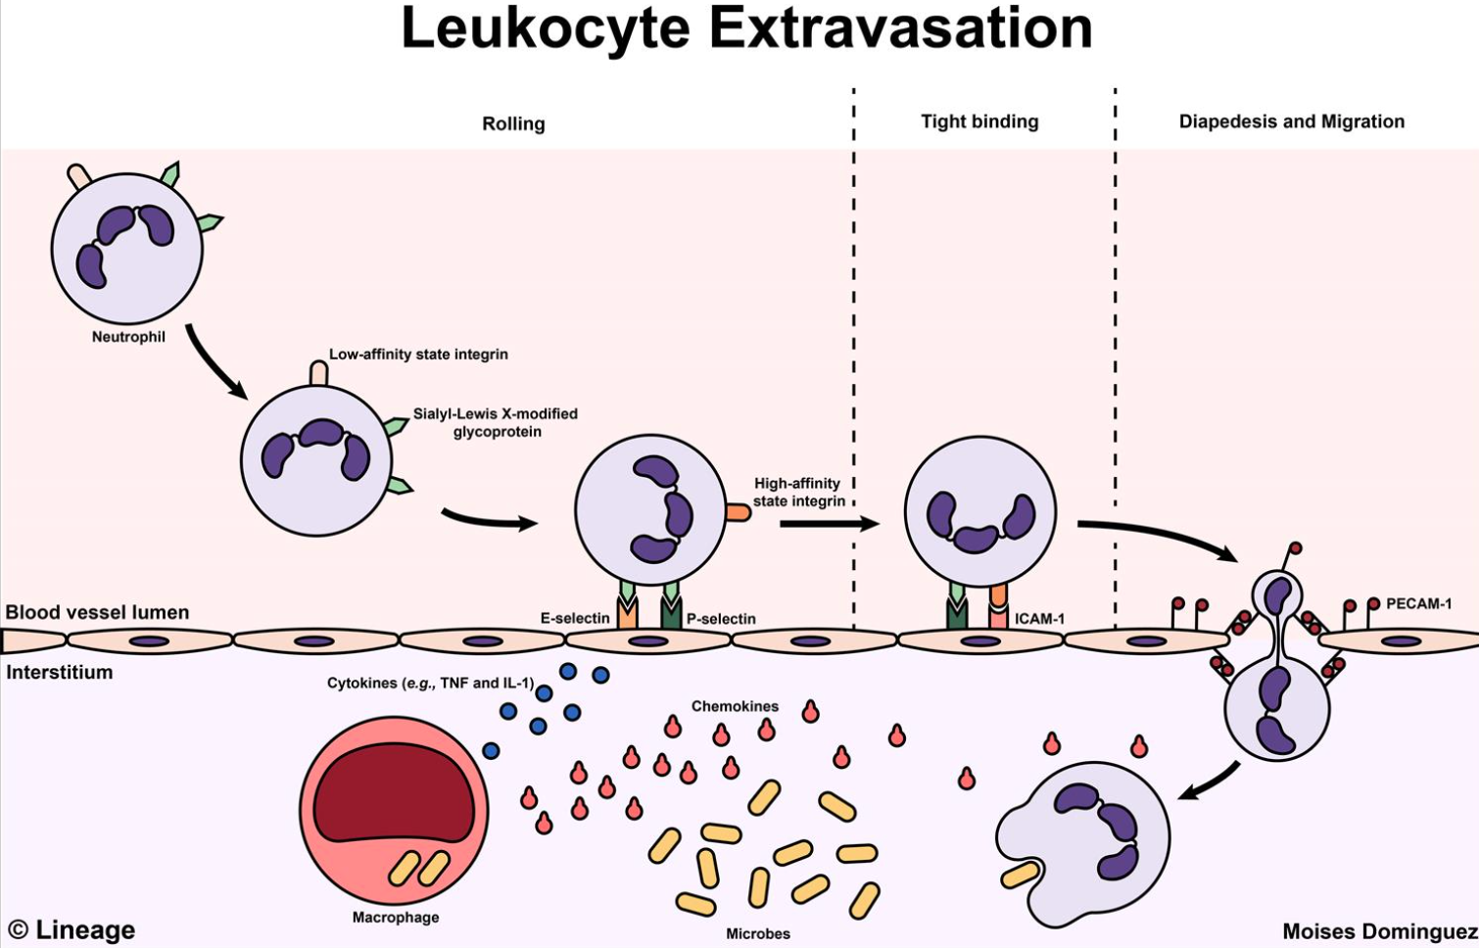
Lung defense: Innate immunity (2)
How do neutrophils carry out effector function?
1. Identify threat through pattern recognition receptors e.g. TLR4 is a PRR that identifies LPS in bacterial cell wall
2. Activation
3. Adhesion- neutrophils are loosely tethered to endothelium by selectins which allows rolling → expression of integrins allows stable adhesion
4. Migration- neutrophils protrude through gaps b/w endothelium (diapedesis) & migrate down a chemotactic gradient to site of injury/ pathogen.
5. Phagocytosis – formation of pseudopodia; pathogen engulfed in phagosome; phagolysosome
6. Bacterial killing- myeloperoxidase is needed for the respiratory burst. Large increase in production of ROS using NADPH oxidase kills bacteria.
7. Apoptosis- neutrophils splits into fragments; alveolar macrophages phagocytose neutrophils.
The Peer Teaching Society is not liable for false or misleading information…
Notes:
Pattern recognition receptors are part of innate immunity- they enable us to respond to pathogens we have not encountered before so don’t have immunological memory against but have encountered in our evolutionary history.
Toll like receptors are a type of pattern recognition receptor.
Image source: https://www.bing.com/images/search?view=detailV2&ccid=klujfxCf&id=B9584AC973D751C2B2672355B7074488F1DF8BD3&thid=OIP.klujfxCf6EEREpdKJbdkxQHaEw&mediaurl=https%3a%2f%2fupload.medbullets.com%2ftopic%2f106005%2fimages%2f032917mdstep1pathologyleukocyteextravasation.jpg&cdnurl=https%3a%2f%2fth.bing.com%2fth%2fid%2fR.925ba37f109fe8411112974a25b764c5%3frik%3d04vf8YhEB7dVIw%26pid%3dImgRaw%26r%3d0&exph=964&expw=1500&q=neutrophil+migration+diagram&simid=608043958054450600&FORM=IRPRST&ck=2B4CD791573A5588D29615E8E5754905&selectedIndex=12&ajaxhist=0&ajaxserp=0

Slide 31
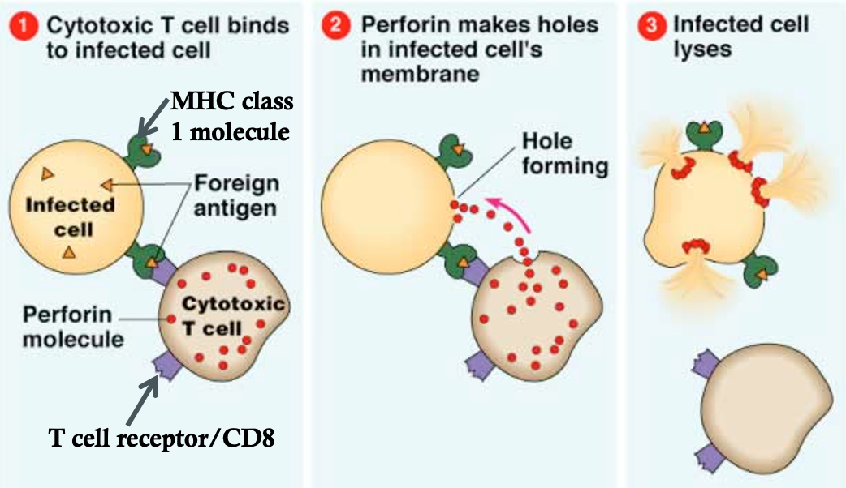
Lung defense: adaptive immunity
Cells of adaptive immunity
B cells- produced in bone marrow but are activated in secondary lymphoid organs e.g. lymph nodes. When activated, they differentiate into plasma cells which secrete antibodies. B cells can recognize naïve antigens and present them on MHC class II for recognition by Th cells.
T cells- produced in bone marrow but mature in thymus
Cytotoxic T (CD8+) cells express CD8 receptors on their surface. They bind to the MHC class I- antigen complex on the host cells surface. They mediate killing of tumour & virus-infected cells though perforin which creates holes in CSM.
T helper (Th) (CD4+) cells express CD4 surface receptors. They must bind to antigens presented on MHC class II on APCs. Some Th cells release cytokines which stimulate clonal expansion of B cells.
APCs = dendritic cells, macrophages, B cells
→ Present antigens on MHC class II for recognition by Th cells.
The Peer Teaching Society is not liable for false or misleading information…

Slide 32
Adaptive immunity- antibodies
All antibodies are produced by B cells; the isotypes differ in their Fc portions (constant region).
IgG- can cross the placenta and confer immunity to fetus. Important in secondary immune response.
IgA- can form dimers, found in mucosal secretions e.g. breast milk
IgM- pentamer produced at beginning of infection. Important in primary immune response.
IgE- monomer, often binds to Fc receptors on mast cells, basophils and eosinophils. Implicated in allergy and parasitic infections.
IgD- expressed by naïve B cells alongside IgM but is lost once B cells are activated into plasma cells.
TIP: remember GAMED
The Peer Teaching Society is not liable for false or misleading information…
Notes:
IgE receptors are on mast cells in tissues, basophils which circulate in blood and eosinophils (also circulate in blood).
Eosinophils restrict the inflammatory response by neutralising histamine therefore are antagonistic in action to mast cells and basophils which secrete histamine.
Image source: \https://pathologia.ed.ac.uk/topic/class-switching/

Slide 33
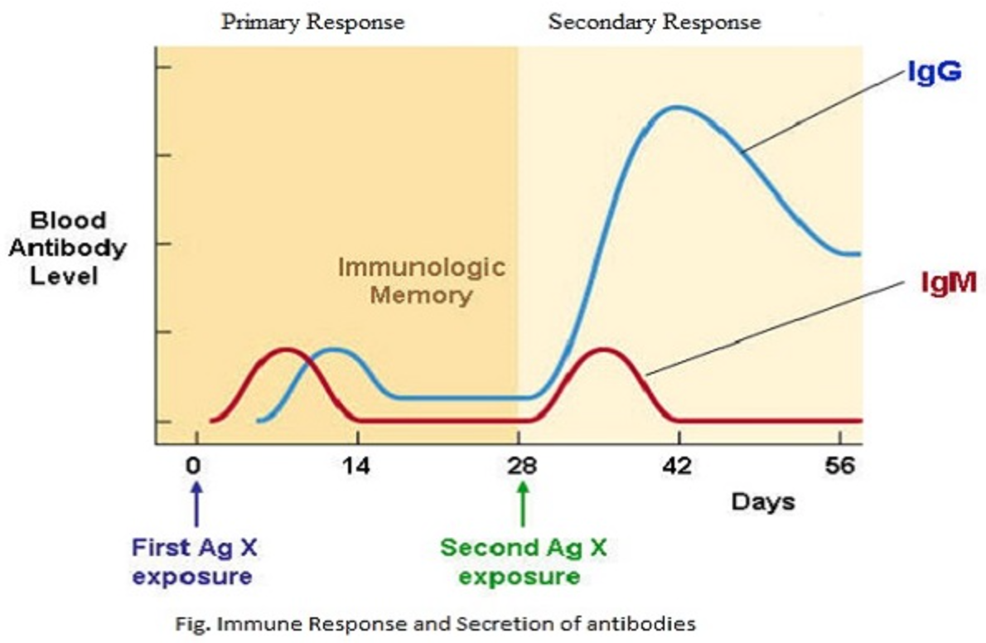
Adaptive immunity- antibodies
IgG levels are higher during secondary immune response even though IgM is also produced→ IgG important for secondary immune response
IgM levels peak first → IgM is made at the beginning of infection & is important in primary immune response
The Peer Teaching Society is not liable for false or misleading information…
Notes:
IgE receptors are on mast cells in tissues, basophils which circulate in blood and eosinophils (also circulate in blood).
Eosinophils restrict the inflammatory response by neutralising histamine therefore are antagonistic in action to mast cells and basophils which secrete histamine.
Image source: \https://pathologia.ed.ac.uk/topic/class-switching/

Slide 34
Type 1 hypersensitivity
Immediate hypersensitivity response- onset <1 hr
Anaphylaxis; hayfever
Ig E mediated
The Peer Teaching Society is not liable for false or misleading information…

Slide 35
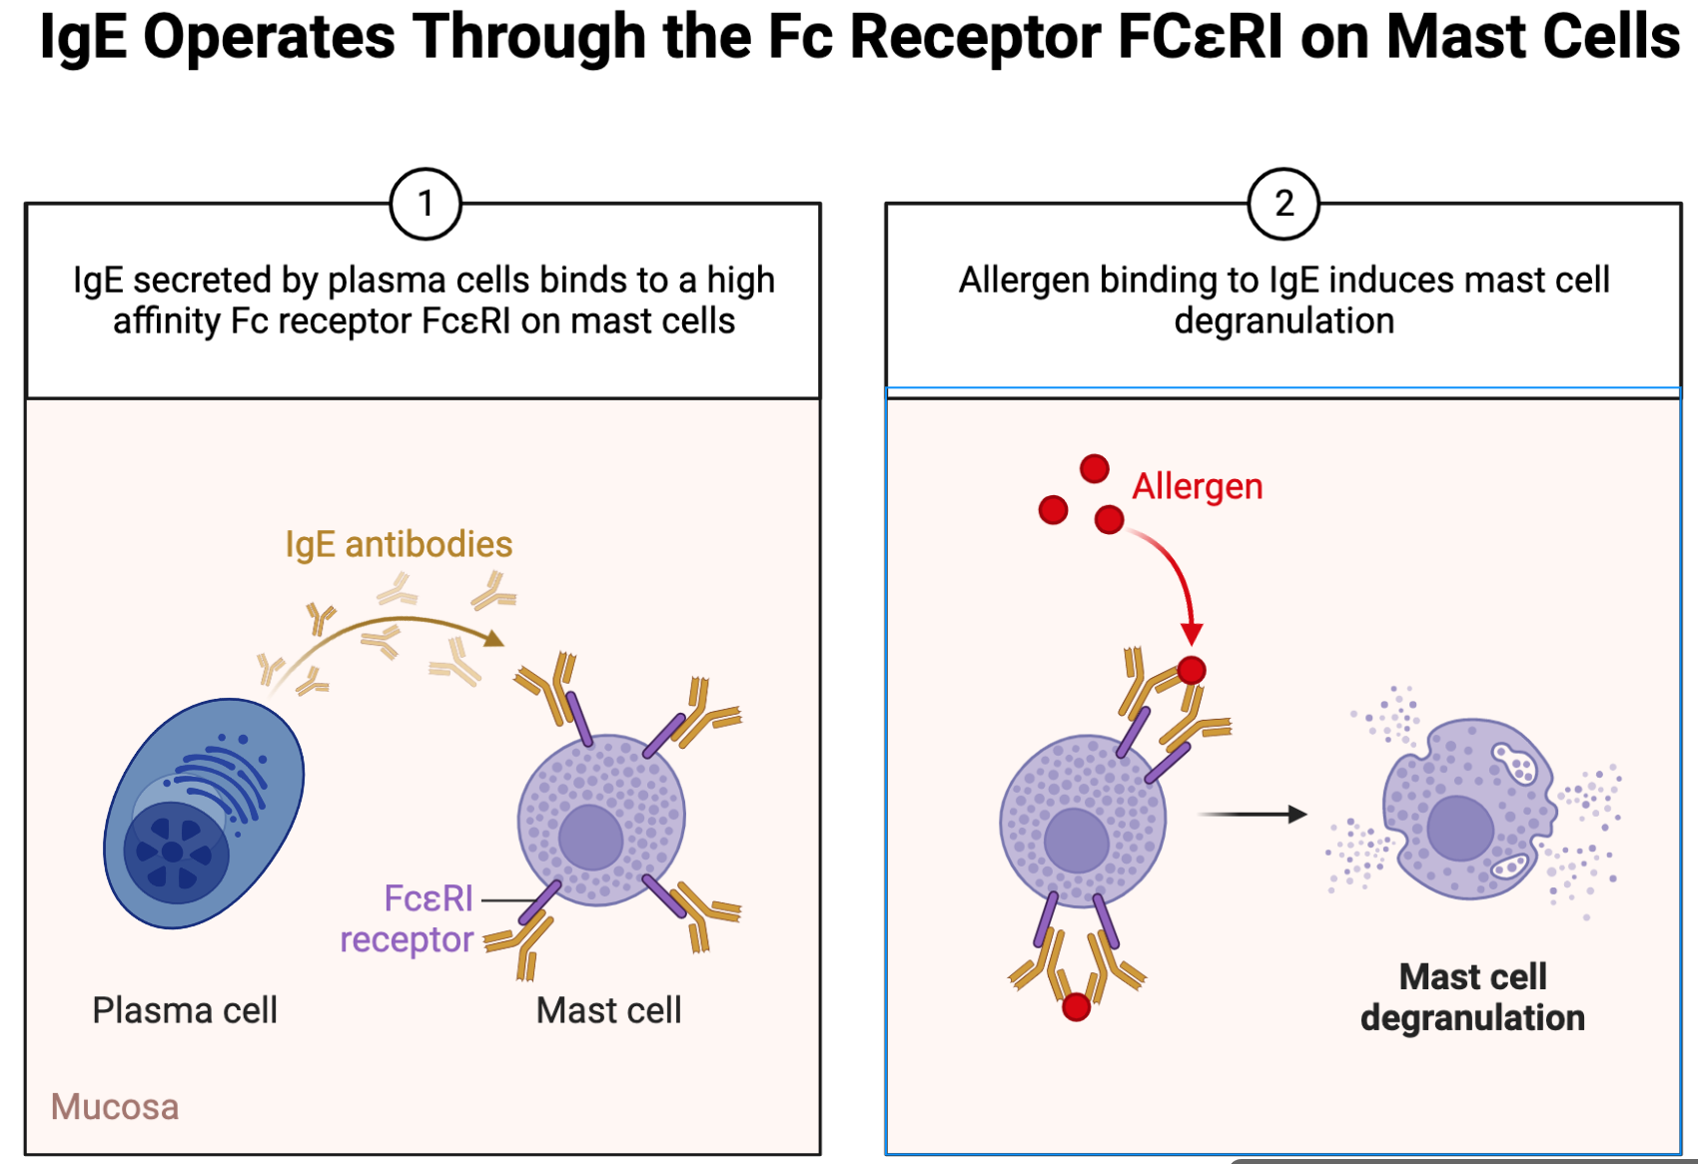
Mechanism of anaphylaxis
T1 Hypersensitivity reaction
Initial exposure to antigen→ priming of Th2 cells which release IL-4 to stimulate clonal selection of B cells. B cells produce IgM antibodies that ‘cross switch’ to IgE antibodies
IgE antibodies bind to FcεRI on mast cells using their Fc (constant region) = mast cell sensitization
Upon allergen re-exposure → IgE released from plasma cells cross-links IgE bound to mast cells → mast cell degranulation, releasing preformed inflammatory mediators
The Peer Teaching Society is not liable for false or misleading information…
Notes:
Image source: Biorender
Cross-switching is where B cells change their production of antibodies from IgM to IgA, IgG or IgE. The Fc (constant) region is changed but Fab (variable region) stays the same so antigen specificity stays the same but the effector functions of the antibody change, since it can bind to Fc receptors on different immune cells.
FcεRI is a high affinity Fc receptor present on mast cells capable of binding the Fc portion of IgE. Fc receptors are present on certain immune cells, including B lymphocytes, natural killer cells, macrophages, neutrophils, and mast cells.
Binding of antigens to mast cell-bound IgE causes cross-linking of mast cells which triggers degranulation (exocytosis of inflammatory mediators).
Inflammatory mediators = histamine, prostaglandins, leukotrienes, Kallikrein generating factor
Many of these mediators are preformed and stored in the granules, whereas others are produced de novo on activation of mast cells and basophils. The preformed mediators cause an immediate response and newly synthesised inflammatory mediators may cause a late-phase response 8-12 hours later which is why monitoring anaphylaxis patients is crucial after initial response.

Slide 36
Mechanism of anaphylaxis
Why do anaphylaxis patients require monitoring after the initial response?
The Peer Teaching Society is not liable for false or misleading information…

Slide 37
Mechanism of anaphylaxis
Why do anaphylaxis patients require monitoring after the initial response?
1-20% of patients have a biphasic response consisting of an immediate and delayed stage.
Immediate response- occurs within minutes, lasts 1-2 hours
Delayed response- 8-12 hours later
The Peer Teaching Society is not liable for false or misleading information…

Slide 38
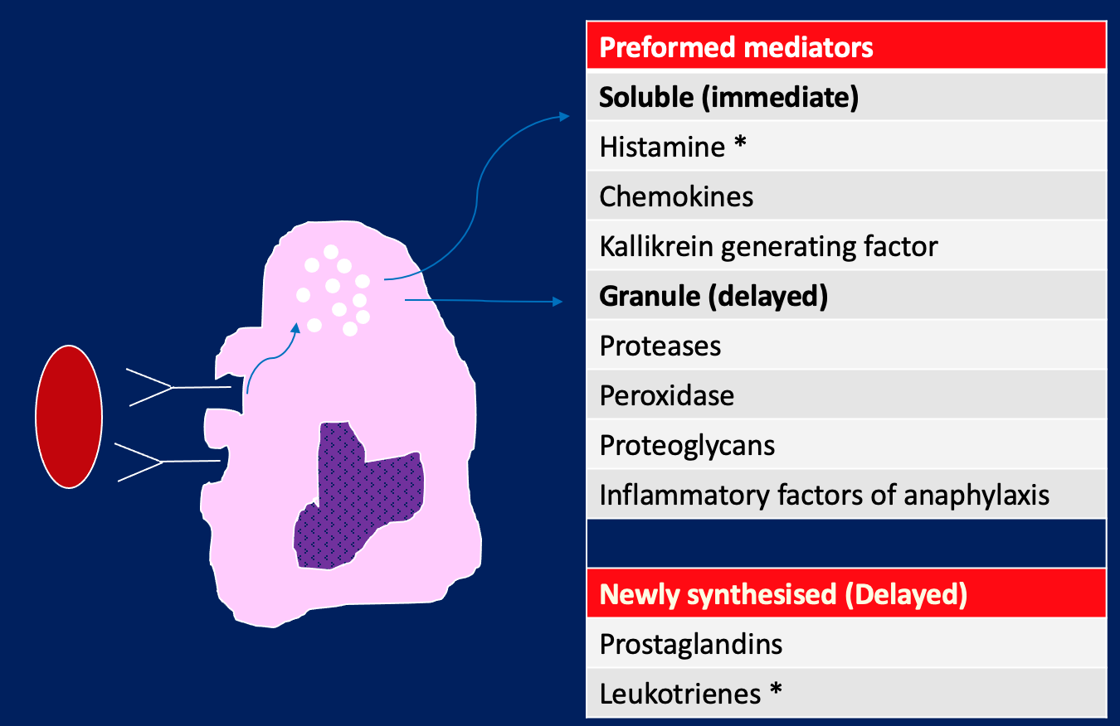
Mechanism of anaphylaxis
Biphasic response
Immediate→ pre-formed mediators causes the immune response e.g.
late-phase response (8-12 hours later) → cytokines released in the immediate stage activate basophils, eosinophils, and neutrophils even though the antigen is no longer present. Release of newly synthesised mediators from mast cells.
Systemic effects
Bronchoconstriction/bronchospasm
Vasodilation→ hypotension
Angioedema
Urticaria
Mast cell
The Peer Teaching Society is not liable for false or misleading information…
Notes:
Image from Nick Weatherly’s Phase 1 lecture slides
Adapted from Underwood’s pathology
Because the inflammatory mediators are preformed, anaphylaxis is an example of an immediate hypersensitivity reaction. Clinically, the effects begin within 5-10 minutes and peak at 30 minutes. ‘Skin prick’ testing demonstrates how injection with an antigen causes a wheal to appear rapidly- example of T1 hypersensitivity.
Common allergens for anaphylaxis = bee and wasp venom, antibiotics, latex, peanuts

Slide 39
Type 2 hypersensitivity
Mediated by antibodies (IgM/ IgG) binding to antigens on host cell membrane → cytotoxicity
Outcome depends on whether complement system is activated or cell metabolism is affected
E.g. blood transfusions, haemolytic disease of fetus and newborn (HDFN) , Goodpasture’s syndrome
Onset = hours- days
NB: In type 2, antibodies bind to cell-bound antigens resulting in an immune response against host cells (cytotoxicity). In type 3, antibodies bind to soluble antibodies and the immune complexes formed are then deposited in the tissues.
Goodpasture’s syndrome
α3 subunit of type IV collagen in glomerular basement membrane becomes antigenic → anti-GBM antibodies produced
There is alveolar and kidney involvement
Haemoptysis and haematuria
The Peer Teaching Society is not liable for false or misleading information…
Notes:
Hameoptysis- coughing up blood
Hameaturia- blood in urine

Slide 40
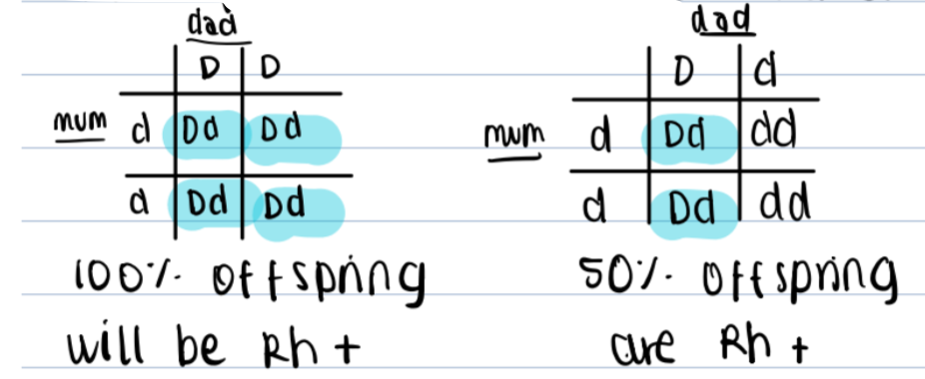
Type 2 hypersensitivity- HDFN
Occurs when Rh –ve (genotype dd) mother and Rh +ve (genotype dd or Dd) father have Rh +ve baby
During 1st pregnancy, Rh D sensitization occurs: fetal Rh +ve erythrocytes come into contact with maternal blood→ mother starts to produce anti-D antibodies
No problems with 1st pregnancy as maternal anti-D antibodies are IgM and can’t cross placenta to attack fetal erythrocytes
In future pregnancies, maternal blood contains anti-D antibodies which are IgG and can cross placenta & attack Rh D antigens on fetal erythrocytes → haemolysis of fetal erythrocytes & severe fetal anaemia
The Peer Teaching Society is not liable for false or misleading information…
Notes:
Rhesus D antigens are present on RBC surfaces and are the most immunogenic. Rhesus alleles are codominant.
A rhesus +ve person will have rhesus D antigens present on erythrocytes and can have the genotype DD or Dd. A rhesus –ve person will not have Rhesus D antigens on erythrocytes and will have genotype dd. When a Rhesus –ve person is exposed to Rh D antigens, they will begin to make anti-D antibodies. Unlike the ABO blood system, anti-D antibodies are not naturally occurring and require initial exposure to be made,

Slide 41
Type 3 hypersensitivity
Type 3 hypersensitivity
Mediated by immune complexes deposited in tissues, causing tissue damage
Onset = typically 7-21 days
E.g. rheumatoid arthritis (immune complexes in synovial joints), hypersensitivity pneumonitis (immune complexes in acinar airways) → Farmer’s lung, Pigeon fancier’s lung, maltworker’s lung, Hot tub lung
The Peer Teaching Society is not liable for false or misleading information…

Slide 42
Type 4 hypersensitivity
Type 4 hypersensitivity
delayed-type/ T-cell mediated (onset = days-weeks-months)
T cells secrete cytokines that attract macrophages
Seen in granulomatous diseases e.g. Tuberculosis, sarcoidosis
The Peer Teaching Society is not liable for false or misleading information…

Slide 43
Respiratory failure
Hypoxia- PaO2< 8kPa (oxygen deficiency in tissues)
Hypercapnia- PaCO2> 6.5 kPa
Respiratory failure = inability to maintain normal blood gases
Always characterised by hypoxaemia
PaCO2 may or may not be present
Acute (e.g. trauma → pneumothorax, opiate overdose, pulmonary embolism) or chronic (e.g. COPD)
COPD patients have ‘hypoxic drive’ – since central chemoreceptors become tolerant to persistently elevated PaCO2, their drive to breathe is their hypoxia.
Clinical: when treating COPD patients for respiratory failure, aim to maintain oxygen saturations of 88-92% NOT 94-98%.
Type 1 respiratory failure | Type 2 respiratory failure
Hypoxia Low (hypocapnia) or normal PaCO2 | Hypoxia Hypercapnia
The Peer Teaching Society is not liable for false or misleading information…

Slide 44
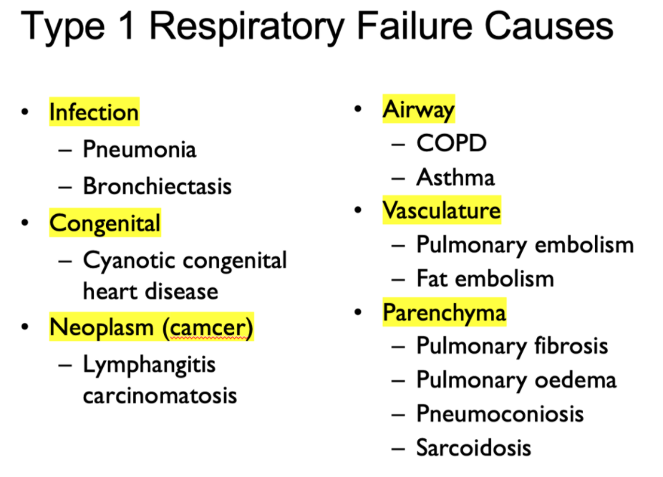
Type 1 respiratory failure
Causes = hypoxia causes
V/Q mismatch
Shunt
Diffusion impairment
Alveolar hypoventilation
The Peer Teaching Society is not liable for false or misleading information…
Notes:
Image source: David Fishwick lecture slides

Slide 45
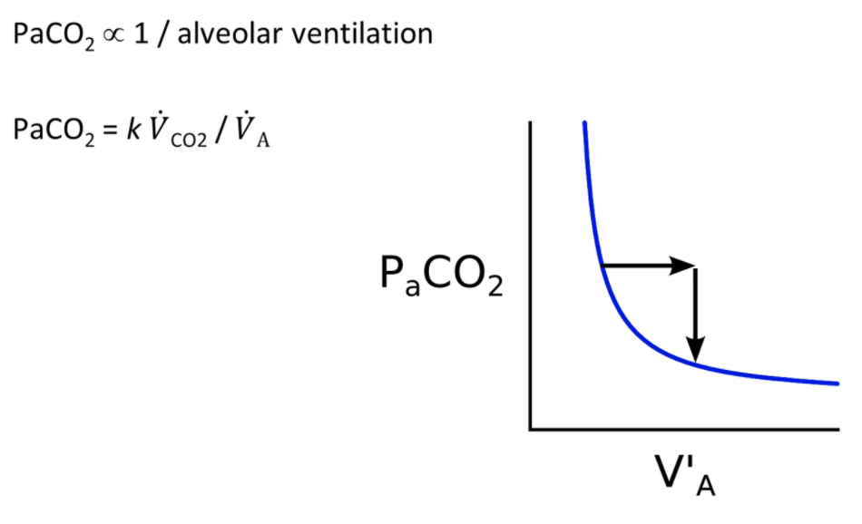
Type 2 respiratory failure
Causes:
Hypoventilation- the MAIN cause
Respiratory pump failure
Specific causes:
Neurological: Cervical spine injury (phrenic nerve originates from C3, C4, C5 and innervates diaphragm responsible for changing intrathoracic pressure)
Muscle: myasthenia gravis, Duchenne’s muscular dystrophy
Drugs: suxamethonium
Airway: COPD and asthma
Obesity- at night obese patients hypoventilate
The Peer Teaching Society is not liable for false or misleading information…
Notes:
Source: David Fishwick lecture slides
NB: COPD patients can have type 1 and 2 respiratory failure. Initially there is type 1 respiratory failure. Over time COPD patients become barrel-chested due to air trapping in the thorax (e.g. inside bullae) which stretches the intercostal muscles → ventilatory pump failure → type 2 respiratory failure.

Slide 46
Before we move on to the questions
Feedback please!!!
The Peer Teaching Society is not liable for false or misleading information…
Notes:
https://docs.google.com/forms/d/e/1FAIpQLScM8SI9I9NukBozVrPhFJAWzfyBAuiyeT2tVudqY2eO8P5Q7g/viewform?usp=sf_link

Slide 47
Question 1
Which of these gives the equation for VC?
A) VC = IRV + TV + ERV + RV
B) VC = RV + VC
C) VC = IRV + TV + ERV
D) VC = IRV + TV
The Peer Teaching Society is not liable for false or misleading information…

Slide 48
Question 1
Which of these gives the equation for VC?
A) VC = IRV + TV + ERV + RV
B) VC = RV + VC
C) VC = IRV + TV + ERV
D) VC = IRV + TV
The Peer Teaching Society is not liable for false or misleading information…

Slide 49
Question 2
Which spirometry parameter would indicate obstructive lung disease?
A) FEVC < 0.8
B) FEV1/ FVC < 0.7
C) FEV1 < 0.8
D) Low TLC
The Peer Teaching Society is not liable for false or misleading information…

Slide 50
Question 2
Which spirometry parameter would indicate obstructive lung disease?
A) FEV1 < 0.8 – FEV1 is a good marker of lung health and this result would be abnormal but not specific for obstruction.
B) FEV1/ FVC < 0.7
C) FVC < 0.8 – indicates restriction due to decreased expansion ability of lungs
D) Low TLC- indicates restriction which is a problem with lung volume.
The Peer Teaching Society is not liable for false or misleading information…

Slide 51
Question 3
An asthma patient is given an inhaler to stimulate bronchodilation. Which of the following is a therapeutic bronchodilator used and what is its drug class?
A) Salbutamol- Muscarinic (M3) antagonist
B) Tiotropium – Muscarinic (M3) antagonist
C) Ipratropium- short acting beta-2 agonist
D) Hydrocortisone – steroid
The Peer Teaching Society is not liable for false or misleading information…

Slide 52
Question 3
An asthma patient is given an inhaler to stimulate bronchodilation. Which of the following is a therapeutic bronchodilator used and what is its drug class?
A) Salbutamol- Muscarinic (M3) antagonist. This is a short-acting beta-2 agonist.
B) Tiotropium – Muscarinic (M3) antagonist. Long-acting.
C) Ipratropium- short acting beta-2 agonist. This is a long-acting M3 antagonist.
D) Hydrocortisone – steroid which dampens inflammation. No effect on airway smooth muscle tone.
The Peer Teaching Society is not liable for false or misleading information…

Slide 53
Question 4
Which of the following is an example of type 3 hypersensitivity reaction?
Sarcoidosis
Goodpasture’s syndrome
Anaphylaxis
Farmer’s lung
The Peer Teaching Society is not liable for false or misleading information…

Slide 54
Question 4
Which of the following is an example of type 3 hypersensitivity reaction?
Sarcoidosis- type 4 (delayed)
Goodpasture’s syndrome – type 2
Anaphylaxis- type 1
Farmer’s lung- this is a type of hypersensitivity pneumonitis. On exposure to mouldy hay, antibody-antigen complexes form and are deposited in airways
The Peer Teaching Society is not liable for false or misleading information…

Slide 55
Question 5
Which cell type lines the conducting airways?
Simple squamous epithelium
Stratified squamous keratinising epithelium
Pseudostratified ciliated columnar epithelium with interspersed goblet cells
Simple cuboidal cells
Hint: Conducting airways = part of airway responsible for allowing bulk flow of air to sites of gas exchange. Trachea → main bronchi→ lobar bronchi → segmental bronchi→ terminal bronchioles
The Peer Teaching Society is not liable for false or misleading information…

Slide 56
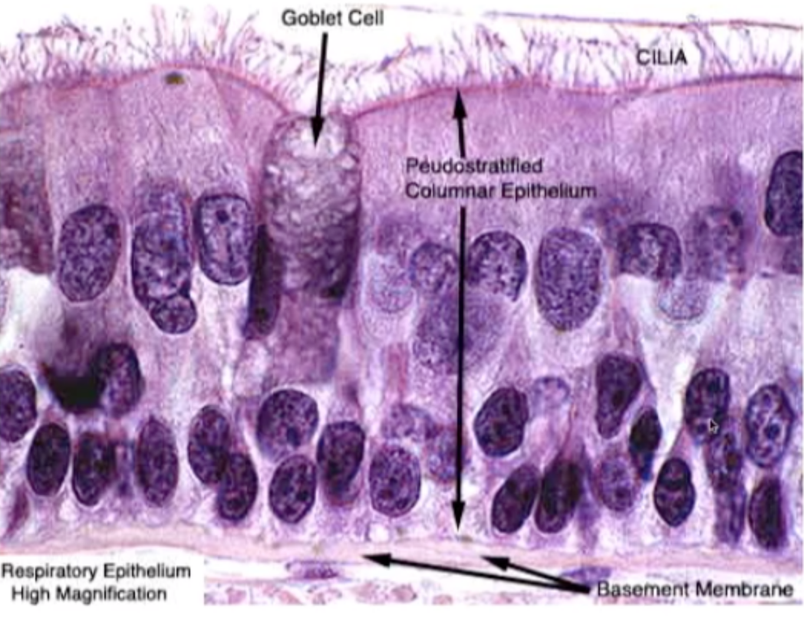
Question 5
Which cell type lines the conducting airways?
Simple squamous epithelium
Stratified squamous keratinising epithelium
Pseudostratified ciliated columnar epithelium with interspersed goblet cells
Simple cuboidal cells
Pseudostratified- all cell in contact with basement membrane but looks like multiple layers of cells. Nuclei are at variable heights!
Goblet cells- secrete mucus
The Peer Teaching Society is not liable for false or misleading information…
Notes:
Image source: Julian Burton histology screencast

Slide 57
Conclusion
Resources used:
KP notes
HT notes
Lecture slides
Teachmephysiology
Armando Hasudugan
If you have any questions regarding phase 1, feel free to email me: aaziz4@sheffield.ac.uk.
The Peer Teaching Society is not liable for false or misleading information…

