Slide 1
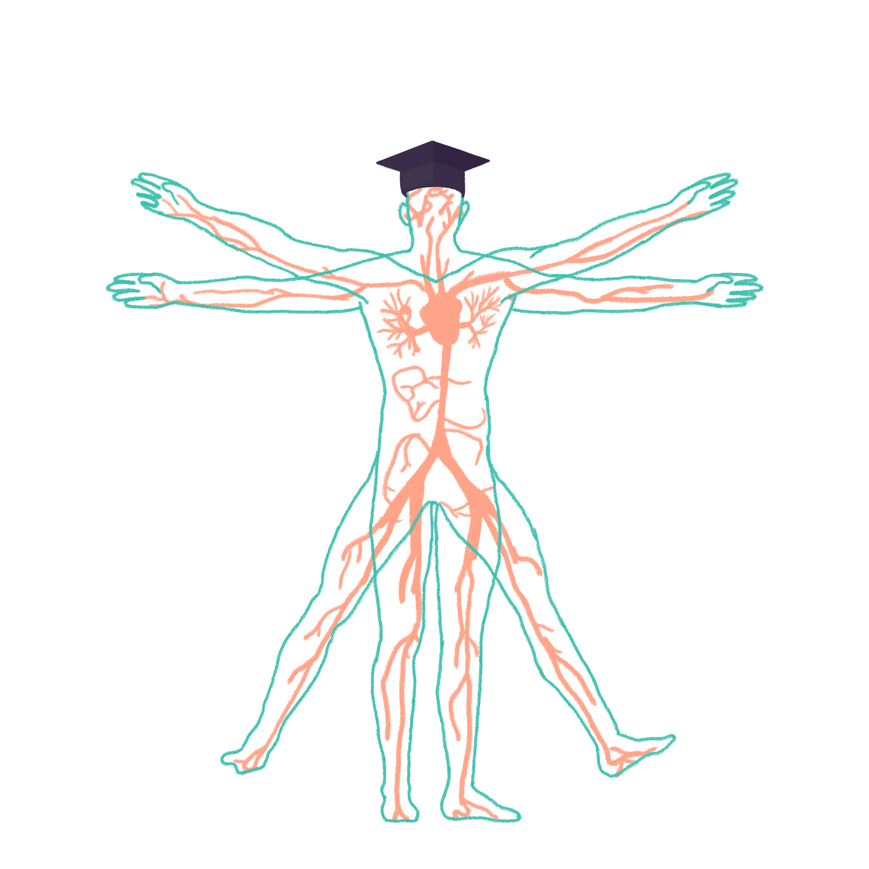
2022/2023

Slide 2
Session title
Phase 1 Respiratory Revision Session
[Raneem Alhalabi]
[22/11/22]
The Peer Teaching Society is not liable for false or misleading information…

Slide 3
Content
Anatomy
Histology
Embryology
Foetal circulation and first breath
Gas exchange
Control of respiration
The Peer Teaching Society is not liable for false or misleading information…

Slide 4
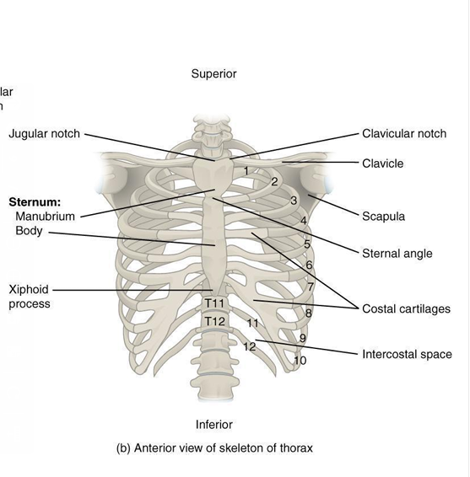
Anatomy:
1
2
4
3
5
The Peer Teaching Society is not liable for false or misleading information…

Slide 5
Anatomy:
2
4
3
5
The Peer Teaching Society is not liable for false or misleading information…

Slide 6
Anatomy:
4
3
5
The Peer Teaching Society is not liable for false or misleading information…

Slide 7
Anatomy:
4
5
The Peer Teaching Society is not liable for false or misleading information…

Slide 8
Anatomy:
5
The Peer Teaching Society is not liable for false or misleading information…

Slide 9
Anatomy:
The Peer Teaching Society is not liable for false or misleading information…

Slide 10
Anatomy:
Type in the chat the muscle of the thoracic wall that matches the following statements:
15 seconds for each statement!!
The Peer Teaching Society is not liable for false or misleading information…

Slide 11
The most superficial muscle of the anterior chest wall and it attaches to the upper humerus, the clavicle and the upper six ribs?
The Peer Teaching Society is not liable for false or misleading information…

Slide 12
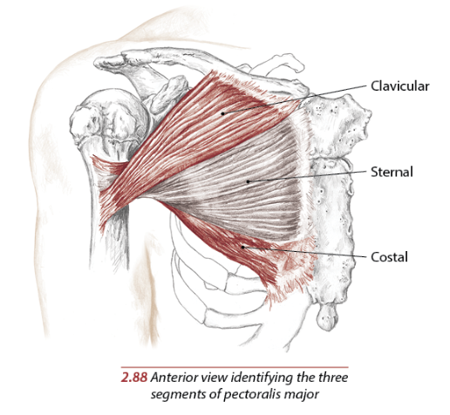
The most superficial muscle of the anterior chest wall and it attaches to the upper humerus, the clavicle and the upper six ribs?
Pectoralis major
The Peer Teaching Society is not liable for false or misleading information…

Slide 13
The smallest muscle that attaches to the scapula and ribs 3-5?
The Peer Teaching Society is not liable for false or misleading information…

Slide 14
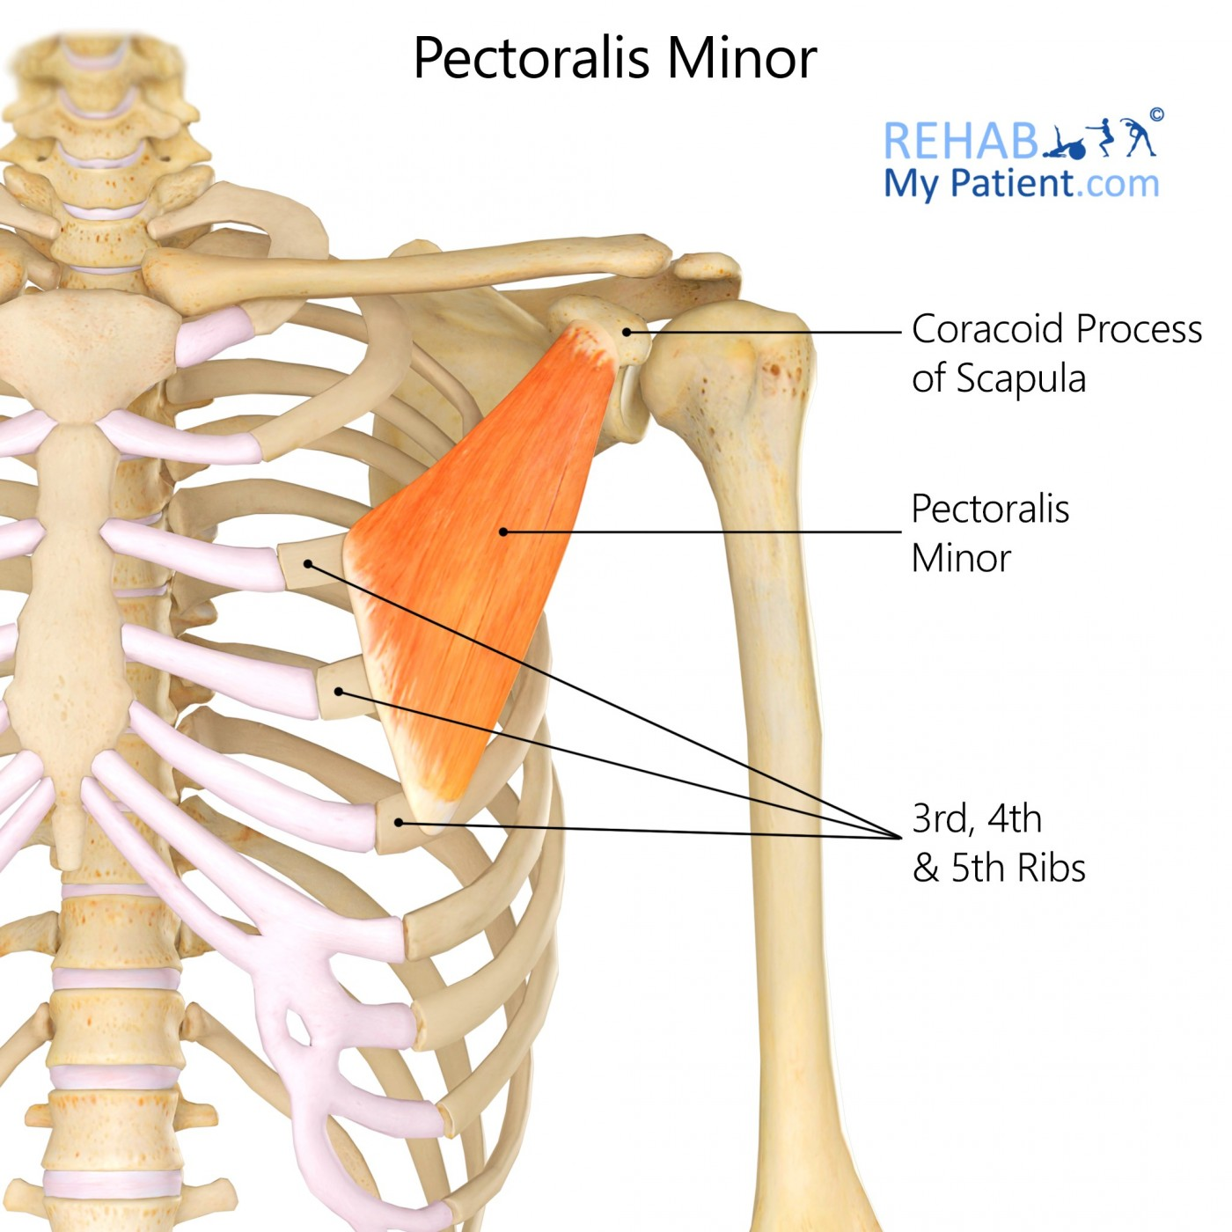
The smallest muscle that attaches to the scapula and ribs 3-5?
Pectorals minor
The Peer Teaching Society is not liable for false or misleading information…

Slide 15
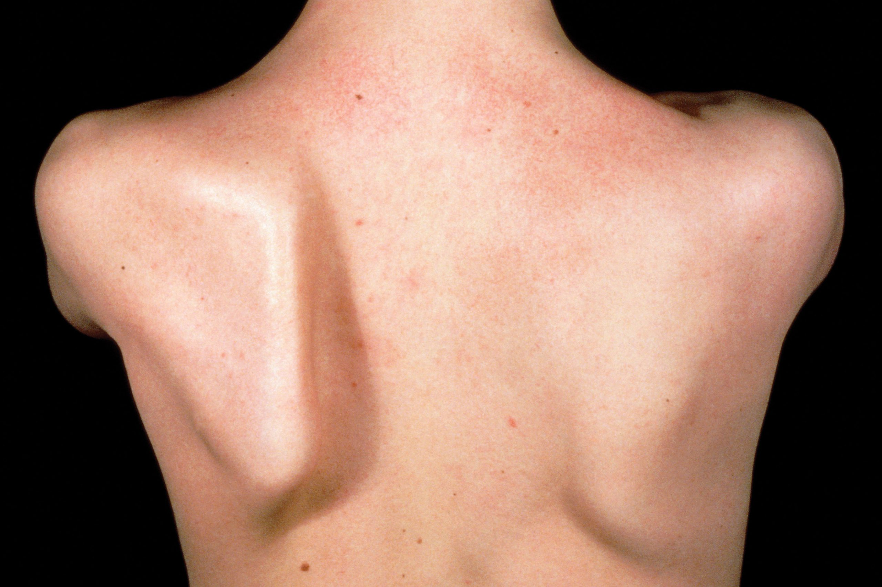
Dysfunction in this muscle causes a winged scapula?
The Peer Teaching Society is not liable for false or misleading information…

Slide 16
Dysfunction in this muscle causes a winged scapula?
Serratus anterior
Bonus question: what nerve innervates this muscle?
The Peer Teaching Society is not liable for false or misleading information…

Slide 17
Dysfunction in this muscle causes a winged scapula?
Serratus anterior
Bonus question: what nerve innervates this muscle?
Long thoracic nerve
The Peer Teaching Society is not liable for false or misleading information…

Slide 18
The fibres of these muscles are orientated antero-inferiorly and they are most active in inspiration?
The Peer Teaching Society is not liable for false or misleading information…

Slide 19
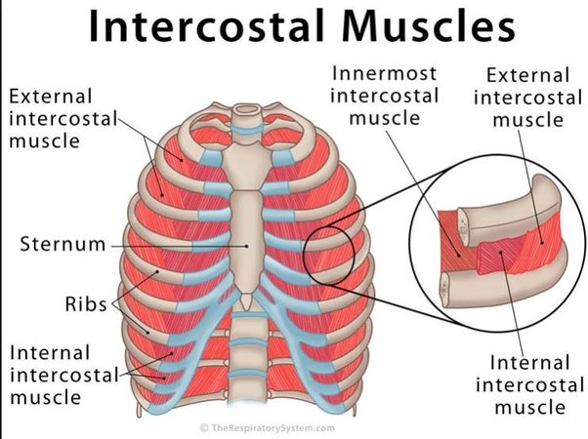
The fibres of these muscles are orientated antero-inferiorly and they are most active in inspiration?
External intercostal muscles
The Peer Teaching Society is not liable for false or misleading information…

Slide 20
In medical procedures that involve piercing the intercostal space the incision is always made in the middle to lower part of the intercostal space. Why is that?
The Peer Teaching Society is not liable for false or misleading information…

Slide 21
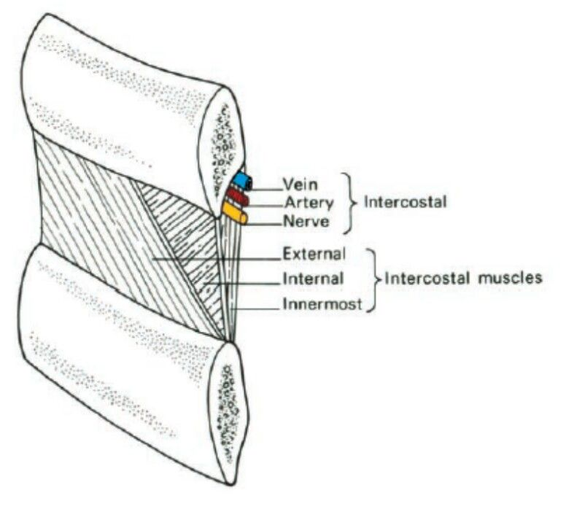
In medical procedures that involve piercing the intercostal space the incision is always made in the middle to lower part of the intercostal space. Why is that?
To avoid the neurovascular bundle!!
The Peer Teaching Society is not liable for false or misleading information…

Slide 22
The neurovascular bundle:
Anterior intercostal artery: branch of the internal thoracic
Posterior intercostal artery: branch of the descending aorta
Anterior intercostal veins drain into the internal thoracic vein
Posterior intercostal veins drain into the azygous system
Intercostal nerves
The Peer Teaching Society is not liable for false or misleading information…

Slide 23
The pleura:
2 layers of pleura:
Parietal pleura: innervated by the intercostal nerves. It’s somatic innervation so injury is very painful!!
Visceral pleura: innervated by the autonomic nervous system and therefore does not reach conscious perception.
The Peer Teaching Society is not liable for false or misleading information…

Slide 24
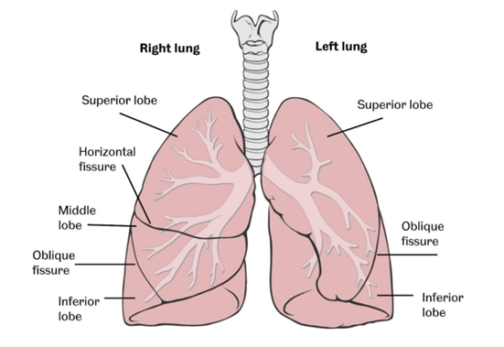
Anatomy of the lungs:
The Peer Teaching Society is not liable for false or misleading information…

Slide 25
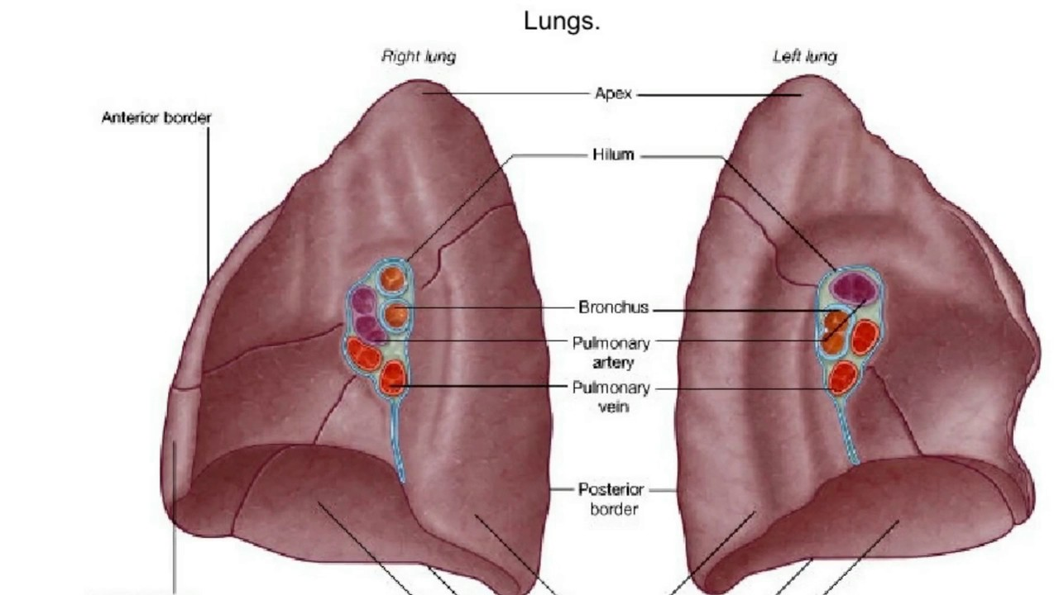
The Peer Teaching Society is not liable for false or misleading information…

Slide 26
RALS:
Right Anterior Left Superior
Position of the pulmonary artery in relation to the main bronchus
The Peer Teaching Society is not liable for false or misleading information…

Slide 27
The Peer Teaching Society is not liable for false or misleading information…

Slide 28
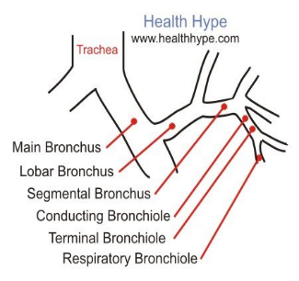
Respiratory tree
Respiratory tree
Trachea
R & L main bronchi
R & L lobar bronchi
Segmental branches
Terminal bronchioles
Respiratory bronchiole
Alveolar duct
Alveolar sac
Alveoli
Notes:
trachea= cricoid (C6) to carina (T5)
R & L main bronchi: divide at carina
R main= shorter & more vertical- objects more likely to get lodged here!
lobar bronchi 10
segmental/terminal bronchi 40 million
respiratory bronchi (each supply 8-10 alv)
acini: resp bronchioles, alveolar duct, sac, alveoli

Slide 29
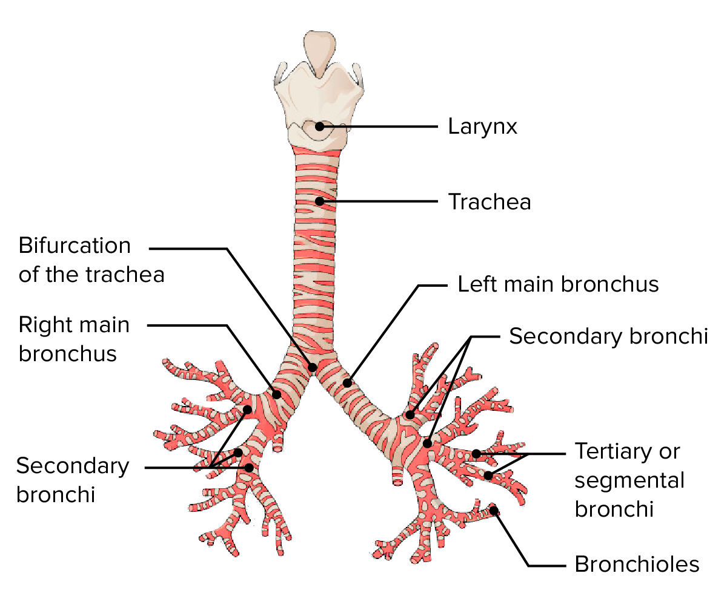
What is the ridge of the tracheal bifurcation called?
The Peer Teaching Society is not liable for false or misleading information…

Slide 30
What is the ridge of the tracheal bifurcation called?
Carina
The Peer Teaching Society is not liable for false or misleading information…

Slide 31
You come back from anatomy feeling super hungry and while your food is heating in the microwave you snack on a couple of peanuts but uh oh suddenly you choke on one!!!!
Where is it most likely to be stuck and why?
The Peer Teaching Society is not liable for false or misleading information…

Slide 32
You come back from anatomy feeling super hungry and while your food is heating in the microwave you snack on a couple of peanuts but uh oh suddenly you choke on one!!!!
Where is it most likely to be stuck and why?
The right main bronchus because it is wider, shorter and more vertical
The Peer Teaching Society is not liable for false or misleading information…

Slide 33
Anatomy of the neck:
For such a small area the neck has so many structures so I suggest taking the time to learn about each of them.
My method was to learn it layer by layer going from superficial to deep.
The Peer Teaching Society is not liable for false or misleading information…

Slide 34
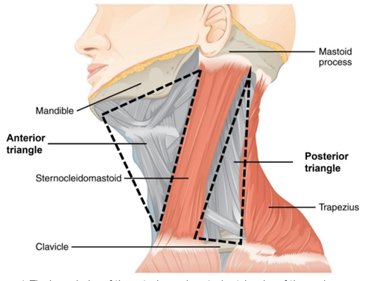
Anterior triangle bounded by:
Midline of the neck
Anterior border of the sternocleidomastoid
Mandible
Posterior triangle of the neck:
Posterior border of sternocleidomastoid
Trapezius
Clavicle
The Peer Teaching Society is not liable for false or misleading information…

Slide 35
Contents of the neck triangles:
Anterior:
Trachea
Larynx
Thyroid and parathyroid
Suprahyoid and infrahyoid muscles
Common carotid artery
Internal jugular vein
Facial, vagus, glossopharyngeal, accessory and hypoglossal nerves
Posterior:
Subclavian arteries
External jugular vein
Brachial plexus roots
Phrenic nerve
Cervical plexus
Don’t worry too much about the posterior triangle it’s not as important and all the good stuff are in the anterior one!
The Peer Teaching Society is not liable for false or misleading information…

Slide 36
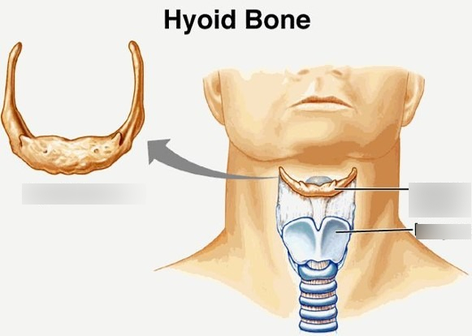
Muscles of the neck:
Divided into suprahyoid and infrahyoid separated by the hyoid bone and they’re all named after their attachments!
The Peer Teaching Society is not liable for false or misleading information…

Slide 37
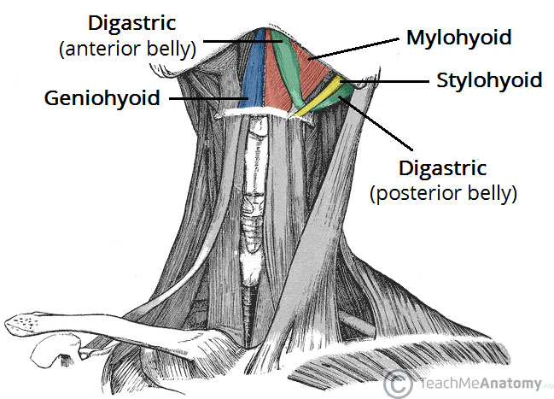
Suprahyoid muscles:
When these muscles contract they raise the hyoid bone and larynx during speech and swallowing
The Peer Teaching Society is not liable for false or misleading information…

Slide 38
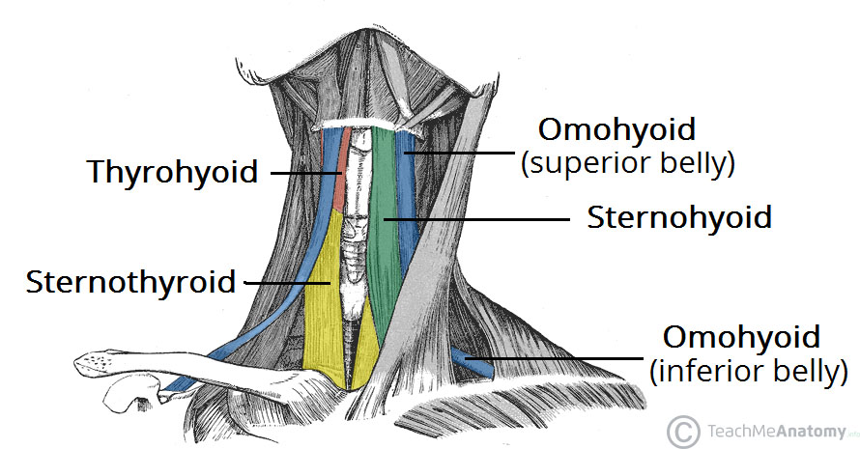
Infrahyoid muscles:
When these muscles contract they draw the hyoid bone and larynx inferiorly during speech and swallowing.
All these muscles are paired!
The Peer Teaching Society is not liable for false or misleading information…

Slide 39
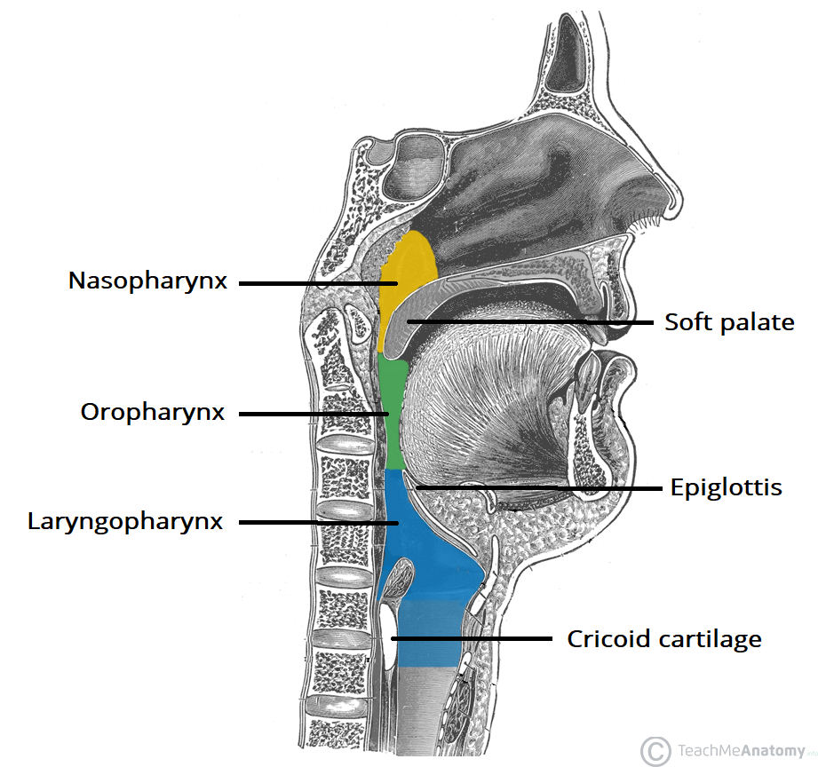
Pharynx
base of the skull >> C6 (inf border of cricoid)
nasopharynx
oropharynx
laryngopharynx

Slide 40
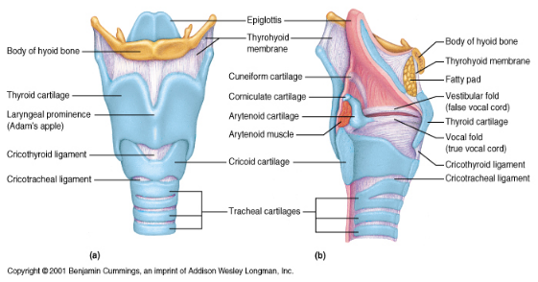
Larynx
9 cartilages
Single: epiglottis, cricoid, thyroid
Paired: cuneiform, corniculate, arytenoid
Elastic= epiglottis
Hyaline= thyroid, cricoid, arytenoid

Slide 41
ESSENTIAL HISTOLOGY
What type of epithelium is this?

Slide 42
ESSENTIAL HISTOLOGY
What type of epithelium is this?
Ciliated pseudostratified
columnar epithelium

Slide 43
ESSENTIAL HISTOLOGY
Other features to remember:
Vocal cords: Reike’s space
Trachea: C-shaped cartilaginous rings
Bronchioles: few goblet cells, ciliated columnar > ciliated cuboidal, clara cells (terminal)
Alveoli:
t1 pneumocytes: squamous epithelial cells- thin barrier for diffusion, tight junctions
t2 pneumocytes: produce surfactant > dec surface tension
pores of Kohn (equal aeration betw alveoli) & alveolar macrophages (phagocytose)
Notes:
V/Q mismatch: when blood is going to poorly ventilated parts of lung

Slide 44
Foetal Circulation:
Lungs are of no use
Blood is shunted away from the lungs
Foetal circulation:
Blood enters foetus through umbilical vein
Blood shunted away from the liver by the ductus venousus to the IVC
Right atrium
Shunted through the foramen ovale to the left atrium
Shunted through the ductus arteriousus from the pulmonary artery to the aorta
Deoxygenated blood back to the placenta through umbilical arteries
The Peer Teaching Society is not liable for false or misleading information…

Slide 45
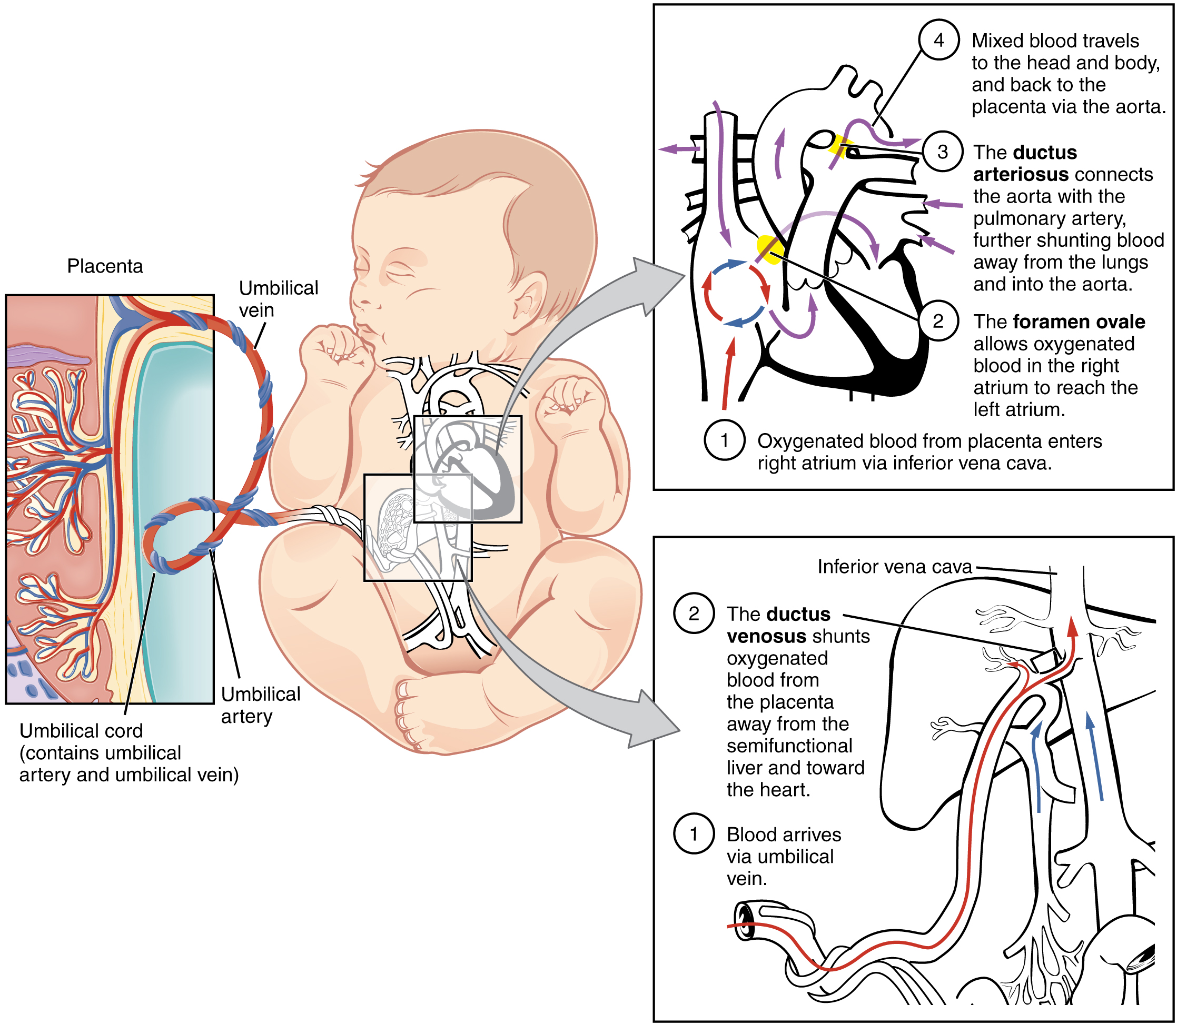
The Peer Teaching Society is not liable for false or misleading information…

Slide 46
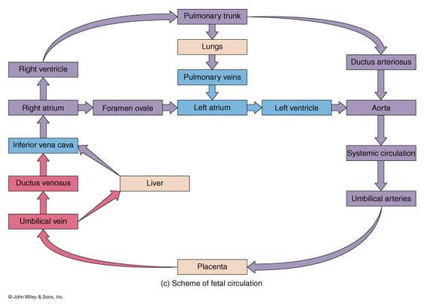
The Peer Teaching Society is not liable for false or misleading information…

Slide 47
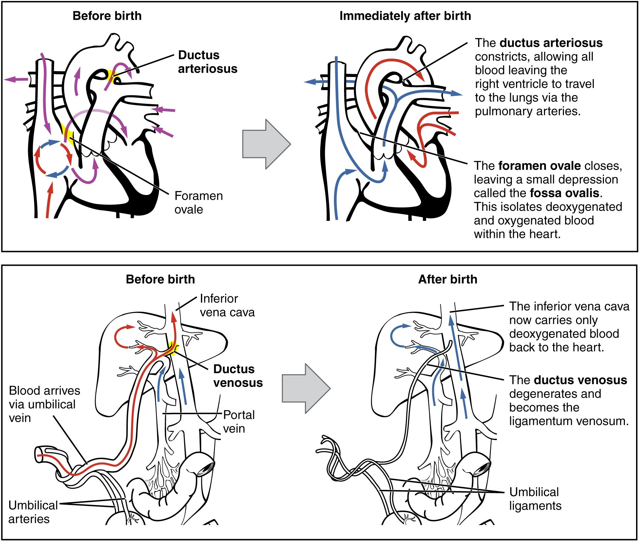
First breath effects:
Umbilical cord is ligated = no more blood supply from placenta
Pulmonary vascular resistance decreases as oxygen is filling the lungs
The pressure in the left atrium increases so the foramen ovale is closed shut
Ductus venousus, ductus arteriousus and umbilical vein later become remnants and ligaments.
The Peer Teaching Society is not liable for false or misleading information…

Slide 48
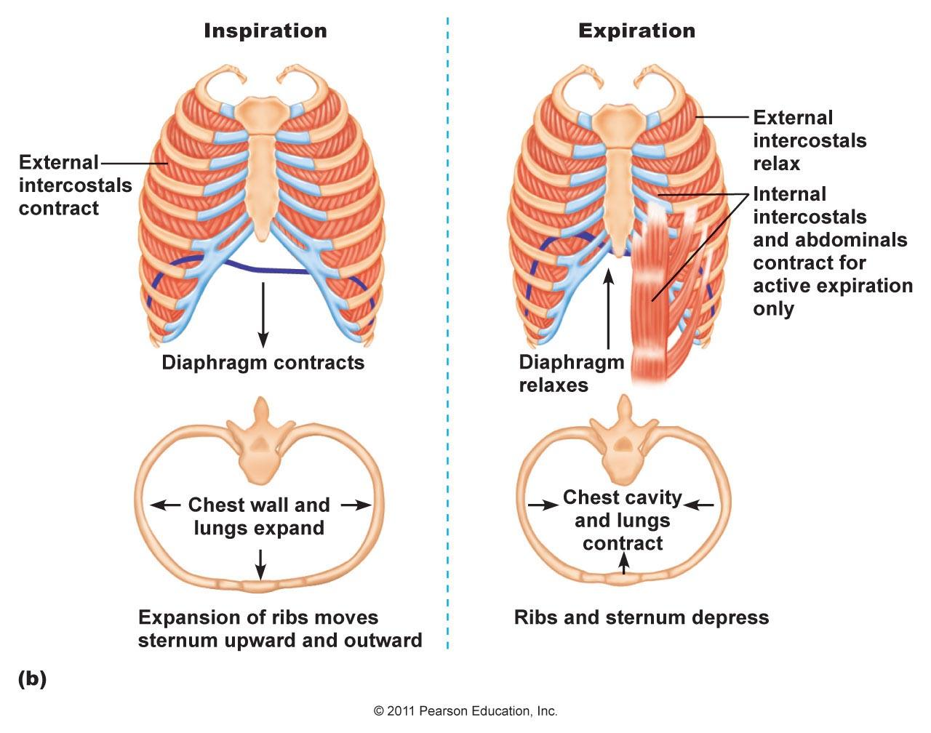
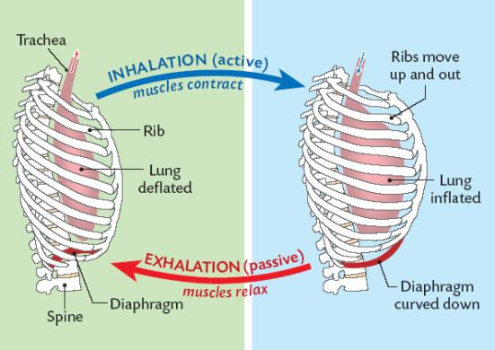
RESPIRATORY PUMP
Notes:
Inspiration:
largely quiet
due to diaphragm and ext intercostal muscles contracting
phrenic nerve stimulated >
diaphragm contracts > flattens as dome moves downwards >
enlarging thorax inc volume >
activation of motor neurons to external intercostal muscles > contract >
upward and outward movement of ribs and further inc in thoracic vol >
intrapleural pressure dec and transpulmonary pressure more positive >
lung expansion (greater transpulm force expanding lungs than lung elastic recoil) >
negative alveolar pressure >
inward airflow >
end of inspiration: alveolar pressure= atmospheric pressure: elastic recoil and transpulmonary pressure balanced > no airflow
Expiration:
passive during quiet breathing
diaphragm and ext intercostal muscles relax & elastic recoil of lungs
end of inspiration >
motor neurons to diaphragm & ext intercostal muscles dec firing > muscles relax >
thoracic vol dec >
lungs and chest walls collapse passively due to elastic recoil >
intrapleural pressure inc while transpulmonary pressure dec &
air in alveoli compressed > inc in alv pressure > exceeds atmospheric pressure> airflow outwards
Forced expiration:
during exercise for larger air volumes needed
internal intercostal muscles & abdominal muscles also contract >
ribs move down and in > actively dec thoracic volume &
abdominal muscle contraction > inc in intra-abdominal pressure > forces relaxed diaphragm even further up into thorax > further dec thoracic vol
greater than normal vol of air expired!
Airway resistance determined by tube length, tube radius and flow type
So site of greatest total resistance to airflow= trachea

Slide 49
How many layers of Gas exchange are there? (from the alveolus to the red blood cell)
The Peer Teaching Society is not liable for false or misleading information…

Slide 50
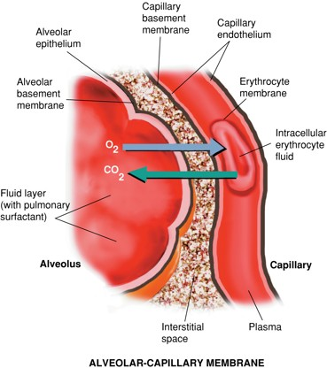
How many layers of Gas exchange are there?
Fluid lining alveoli
Layer of epithelial cells (type I pneumocytes)
Basement membrane of ^ cells
Interstitial space between alveoli epithelium and capillary endothelial cells
Basement membrane of capillary endothelium
Capillary endothelial cells
Red blood cell
The Peer Teaching Society is not liable for false or misleading information…

Slide 51
Control of Respiration:
Where are peripheral chemoreceptors found?
The Peer Teaching Society is not liable for false or misleading information…

Slide 52
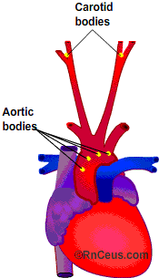
Control of Respiration:
Where are peripheral chemoreceptors found?
Aortic arch and carotid bodies (at the bifurcation)
The Peer Teaching Society is not liable for false or misleading information…

Slide 53
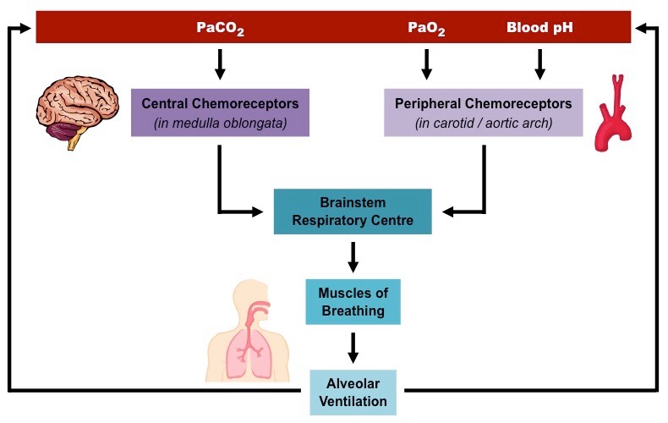
Centrall vs peripheral chemoreceptors:
The Peer Teaching Society is not liable for false or misleading information…

Slide 54
Central vs peripheral chemoreceptors:
Central chemoreceptors:
Respond to very small increases in the pCO2
Stimulated by an increase in H+ concentration in the CSF
Main respiratory drive in healthy people is CO2
Peripheral Chemoreceptors:
Respond to large reductions in pO2
Respond to increase in H+
Clinical importance:
COPD patients with chronically high CO2 don’t respond to central chemoreceptor stimulation anymore so their respiratory drive is hypoxic which means they mainly respond to peripheral chemoreceptor stimulation
The Peer Teaching Society is not liable for false or misleading information…

Slide 55
FEEDBACK:
The Peer Teaching Society is not liable for false or misleading information…
Notes:
https://docs.google.com/forms/d/e/1FAIpQLSfcgK6F3custKyCCGJHXtT7q52BnrJCUOL48yio-Ht8GVkTQg/viewform?usp=sf_link

Slide 56
QUESTION TIME:
The Peer Teaching Society is not liable for false or misleading information…

Slide 57
SAQ:
Which cells secrete surfactant?
When is it released?
Why is it released?
What happens in surfactant deficiency?
The Peer Teaching Society is not liable for false or misleading information…

Slide 58
SAQ:
Which cells secrete surfactant?
Type 2 pneumocytes
When is it released?
34 weeks gestation with a significant increase in the 2 weeks prior to birth
Why is it released?
Decreases surface tension of alveoli so they can expand easily
What happens in surfactant deficiency?
Respiratory distress syndrome
The Peer Teaching Society is not liable for false or misleading information…

Slide 59
SBA:
Which of the following gives the greatest stimulus to increase breathing rate?
High concentration of arterial CO2
Low concentration of arterial O2
Desaturation of haemoglobin
Low arterial pH

Slide 60
SBA:
Which of the following gives the greatest stimulus to increase breathing rate?
High concentration of arterial CO2
Low concentration of arterial O2
Desaturation of haemoglobin
Low arterial pH

Slide 61
SBA:
Respiratory acidosis will have which of the following?
High CO2, low pH, low bicarbonate
High CO2, high pH, high bicarbonate
Low CO2, low pH, high bicarbonate
High CO2, low pH, high bicarbonate

Slide 62
SBA:
Respiratory acidosis will have which of the following?
High CO2, low pH, low bicarbonate
High CO2, high pH, high bicarbonate
Low CO2, low pH, high bicarbonate
High CO2, low pH, high bicarbonate

Slide 63
SBA:
Which of the following structures are not part of the upper respiratory tract?
Paranasal sinuses
Nose and nasal passages
Pharynx
Larynx (below vocal cords)

Slide 64
SBA:
Which of the following structures are not part of the upper respiratory tract?
Paranasal sinuses
Nose and nasal passages
Pharynx
Larynx (below vocal cords)
The true vocal cords mark the division between the upper and lower respiratory tract.

Slide 65
SBA:
Which of the following statements is true?
During inspiration, the diaphragm contracts upwards to create positive pressure in the chest, which allows the body to inhale oxygen
During expiration, the diaphragm relaxes downwards to create negative pressure in the thorax, allowing the body to exhale carbon dioxide
During inspiration, the diaphragm contracts downward to create negative pressure in the thorax, allowing the body to inhale oxygen
During expiration, the diaphragm contracts upwards to create negative pressure, allowing for the expiration of oxygen

Slide 66
SBA:
Which of the following statements is true?
During inspiration, the diaphragm contracts upwards to create positive pressure in the chest, which allows the body to inhale oxygen
During expiration, the diaphragm relaxes downwards to create negative pressure in the thorax, allowing the body to exhale carbon dioxide
During inspiration, the diaphragm contracts downward to create negative pressure in the thorax, allowing the body to inhale oxygen
During expiration, the diaphragm contracts upwards to create negative pressure, allowing for the expiration of oxygen

Slide 67
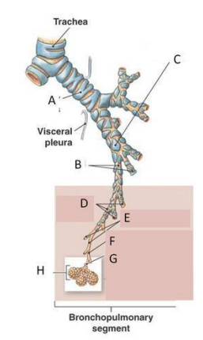
What are structures?
A=
F=
G=
The Peer Teaching Society is not liable for false or misleading information…

Slide 68
What are structures?
A= primary bronchus
F=Terminal bronchioles
G= Respiratory bronchioles
The Peer Teaching Society is not liable for false or misleading information…

Slide 69
Conclusion:
Resources used: TeachMeAnatomy, phase 1 drive (KP notes), Anatomy handbook
Hope you found this useful!!
Any questions: ralhalabi1@sheffield.ac.uk

