Slide 1
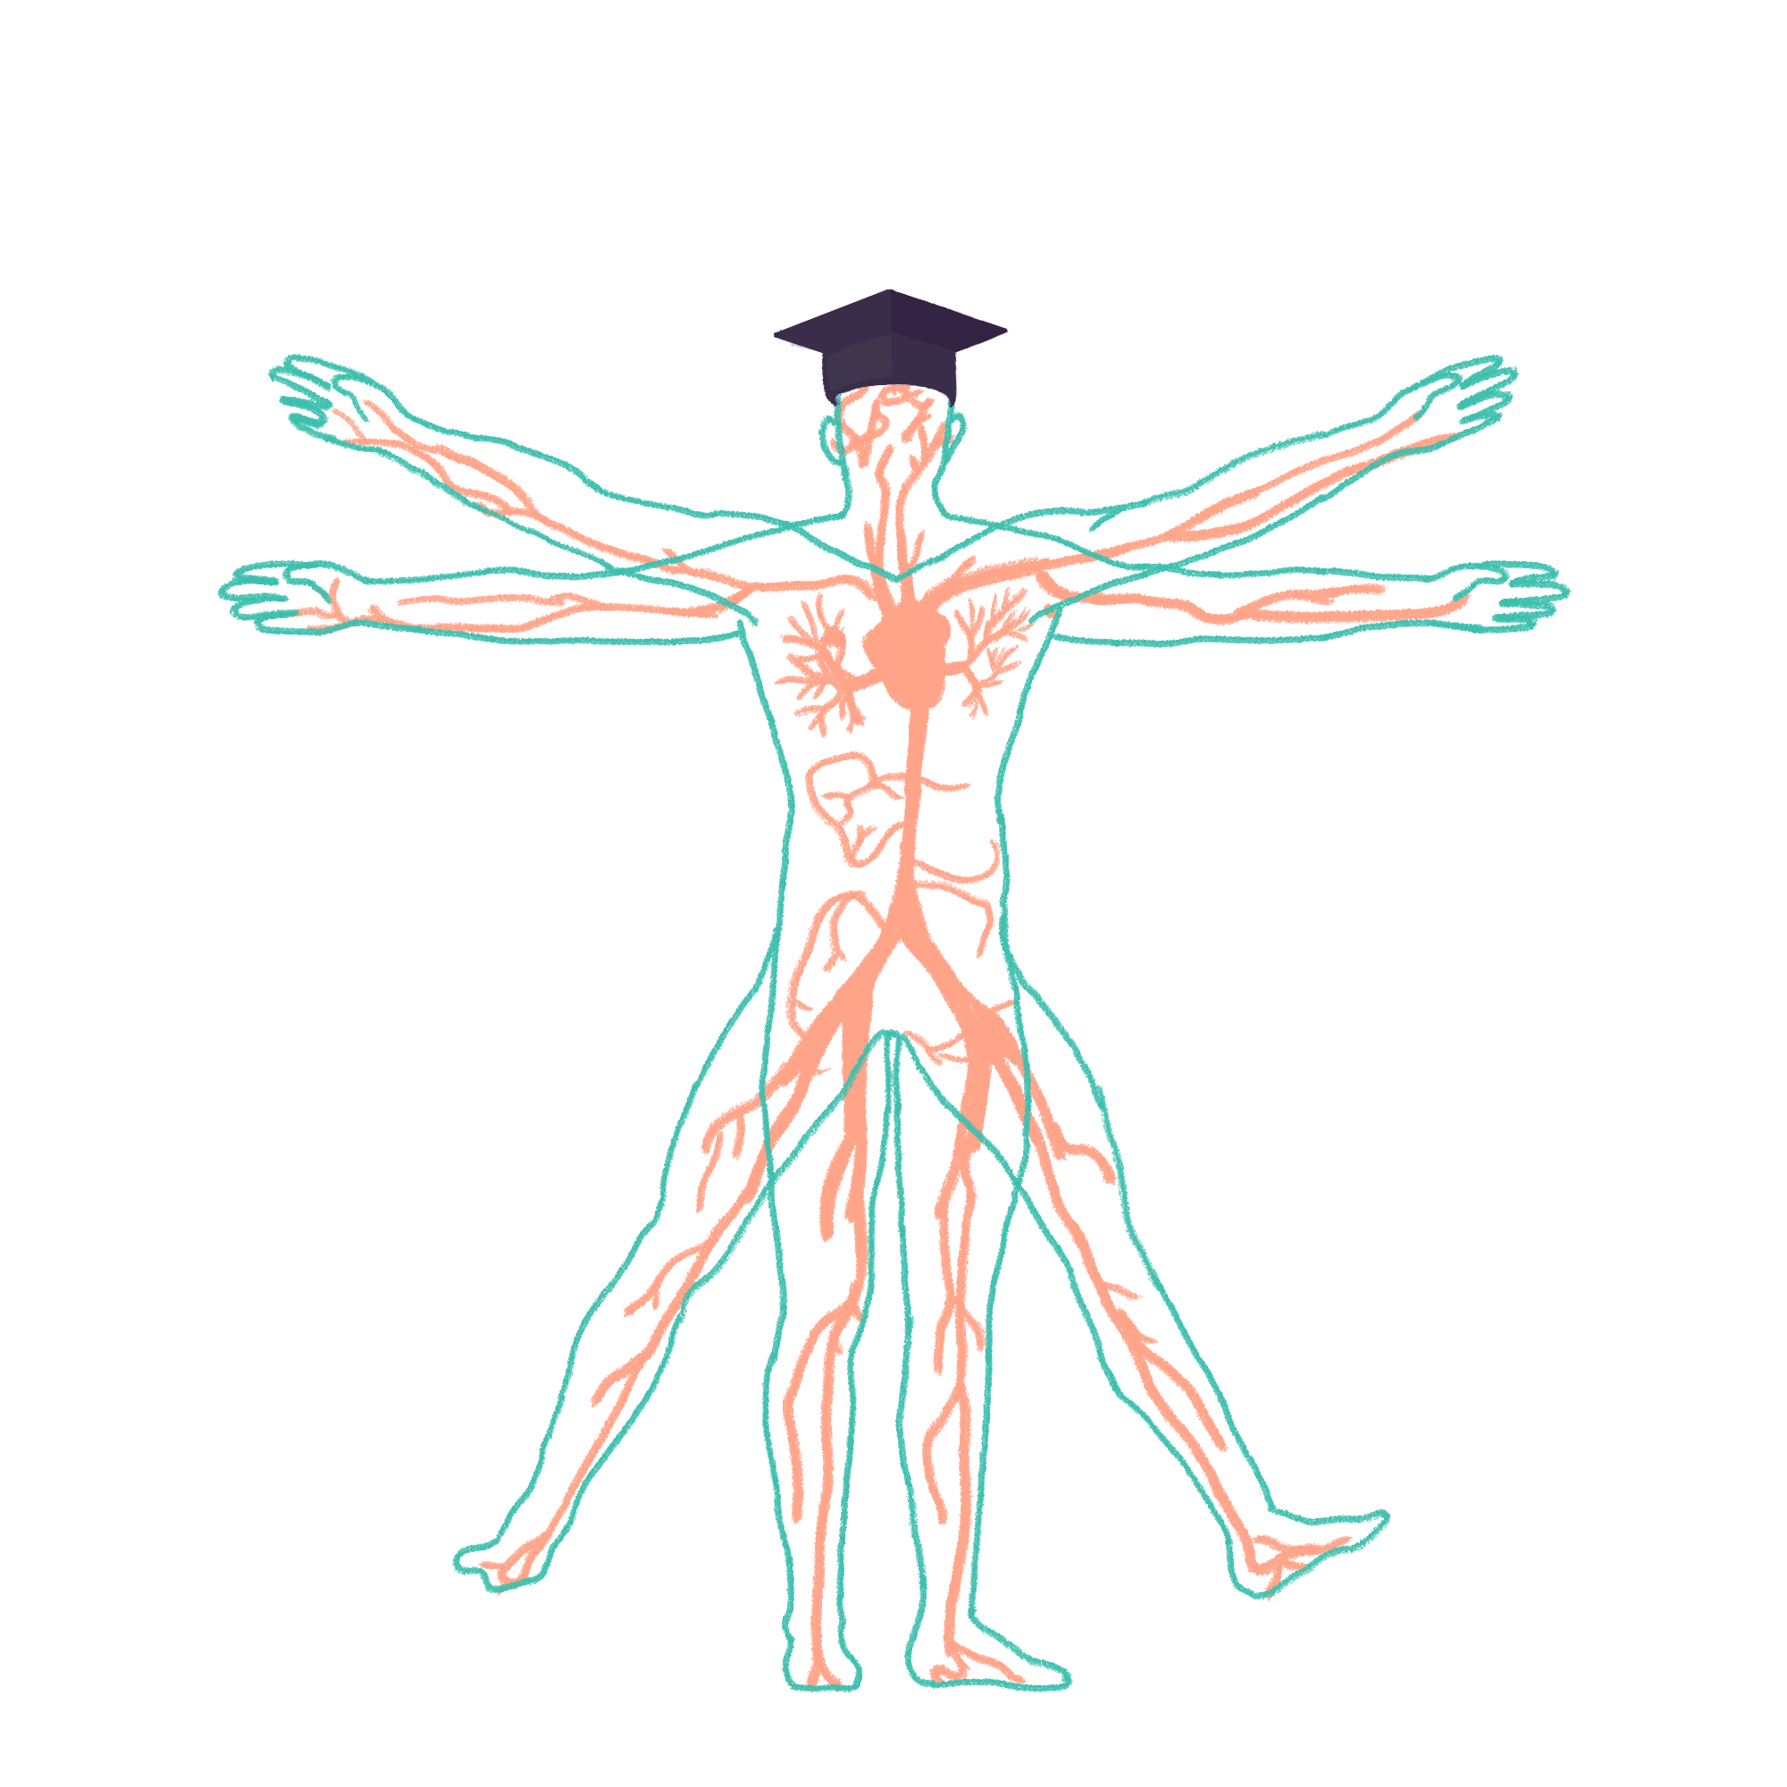
2022/2023

Slide 2
Respiratory History
Phase 2b Revision Session
Vansh Asher
Thursday 14th July 6pm
The Peer Teaching Society is not liable for false or misleading information…

Slide 3
Aims and Objectives
Learn the basic points for taking a respiratory history
Think about differential diagnosis and how to tailor your history for these
The Peer Teaching Society is not liable for false or misleading information…

Slide 4
Communication Skills
Patients contribute 3 marks for the OSCE Stations so…
Maintain good eye contact
Be friendly and smile (even behind the mask)
Have open body language
Try and remember their name!
Be an active listener
Show empathy (appropriately!)
The Peer Teaching Society is not liable for false or misleading information…
Notes:
People do not get 3 marks normally, on average most people get 2

Slide 5
Basic History Taking Structure
Wash your hands
3 I’s - Introduce, Identify and Informed consent
Presenting Complaint
History of Presenting Complaint
Past Medical/Surgical History
Drug History
Social History
Family History
Summarise
ICE
Thank patient
Wash your hands
The Peer Teaching Society is not liable for false or misleading information…
Notes:
Introduce - Name, Role
Identify - Name, DOB
Informed Consent - Explain what you are doing and then ask if okay

Slide 6
Presenting Complaint
OPEN QUESTION!
‘Could you tell me what’s brought you into hospital today?
‘How can we help you today?’
‘Can you explain to me what’s brought you to come and see me today?’
The Peer Teaching Society is not liable for false or misleading information…
Notes:
In the OSCE station, you’ll be given a small description of what the problem might be e.g cough but you should still use an open question

Slide 7
History of Presenting Complaint
Detailed investigation into their symptom
3 main symptoms:
Chest pain
SOB
Cough
The Peer Teaching Society is not liable for false or misleading information…

Slide 8
History of Presenting Complaint
Chest pain
Like any pain:
Site - Whereabouts is the pain?
Onset - How did the pain start?
Character - Can you describe the pain for me?
Radiation - Did the pain stay in one place or did it move around anywhere?
Associated symptoms - Cough, SOB etc
Timing - How long did the pain last? Was it constant or episodic?
Exacerbating/Relieving Factors - Did anything make the pain better/worse?
Severity - Could you rate the pain on a scale of 1-10?
The Peer Teaching Society is not liable for false or misleading information…
Notes:
Site - Can you show me where the pain was?
Onset - Good to ask what were you doing when the pain started?
Radiation - Show me where the pain moved to
Severity - Make sure you explain what is 0 and what is 10 - picky but helps you gain those patient marks

Slide 9
Basic History Taking Structure
Shortness of Breath
Onset - How did this start? What were you doing when this started?
Associated symptoms: Cough, Pain, Night sweats
Timing - When did it start? How long did it last? How long did it take for you to return to normal?
Exacerbating/Relieving Factors - Did anything make it better/worse?
Severity - Compare this to baseline function!! Limiting ADLs?
The Peer Teaching Society is not liable for false or misleading information…
Notes:
Severity is really important - How long could you walk before and how long can you walk now? How many flights of stairs could you climb before getting breathless and how many now etc? - Comparison is key

Slide 10
Basic History Taking Structure
Cough
Onset - When did it start?
Character - Can you describe the cough? Is it productive? What colour is it? How much cough are you producing?
Timing - How often?
Exacerbating/Relieving Factors - Does anything make the cough better/worse?
Colour - Blood -> Fresh blood or dark? How much blood i.e. was it mixed in with sputum or only blood?
The Peer Teaching Society is not liable for false or misleading information…
Notes:
Timing - Does the cough wake you up at night? - Nice to gain patient marks and can link to heart failure
Frothy pink sputum -? pulmonary oedema
Rusty sputum -> pneumonia

Slide 11
Basic History Taking Structure
Other Respiratory Complaints
Wheeze
Leg swelling
Systemic symptoms: Weight loss, fever, night sweats
The Peer Teaching Society is not liable for false or misleading information…
Notes:
For every single history, you MUST ask about these 3 systemic symptoms
It would be on the harder side but you could get a history with non-specific symptoms such as weight loss

Slide 12
Past Medical/Surgical History
Previous Medical conditions including resp/cardiac problems
Previous Surgeries?
If yes, explore more…
E.g. PMH of DVT
Are you currently taking any medication for this?
The Peer Teaching Society is not liable for false or misleading information…
Notes:
As much as you need a good structure, don’t be afraid to jump between sections if this is how the conversation flows - builds good rapport.

Slide 13
Drug History
Prescribed Medications?
Over the counter medications?
Recreational drugs? - MUST ASK!
Important drugs; Inhalers, Steroids, Antibiotics, Anti-HTN
If yes to these, ask when did they start taking them? Any side effects?
Allergies?
If yes, what happens when you have this?
The Peer Teaching Society is not liable for false or misleading information…
Notes:
Recreational drugs - This is a question we ask everyone but do you take any recreational drugs?
Does anyone know which Anti-HTN may be of note? ACE inhibitors - dry cough

Slide 14
Social History
Smoking? - How much? How long for?
Ex smoker -> Same questions + When did you stop?
Occupation - Exposure to irritants like asbestos, coal, dust etc
Home - Who do they live with?
Pets
Hobbies
Recent Foreign Travel
If suspecting infection, is anyone else at home affected?
The Peer Teaching Society is not liable for false or misleading information…
Notes:
How have these symptoms been affecting you around the house? Have you been managing okay?

Slide 15
Family History
Is there any conditions that seem to run in the family?
Be aware, they may say NO but you need to dive deeper
‘For example, lung cancer, cystic fibrosis etc’
The Peer Teaching Society is not liable for false or misleading information…
Notes:
The actors may have in their mark scheme: Do not mention FH of lung cancer unless specifically asked so you need to ask about specific conditions that may be of relevance in the scenario.

Slide 16
Summarising
Gets you patient marks as it shows you’ve been listening
Helps to buy you time if you need to think of what more to ask
Patients will often help you out in OSCE settings
‘Is there anything else you think I have missed’
The Peer Teaching Society is not liable for false or misleading information…

Slide 17
ICE
Ideas - ‘Have you got any idea what might be going on’
Concerns - ‘Is there anything in particular you are worried about’
Expectations - ‘What were you hoping for from todays consultation?’
The Peer Teaching Society is not liable for false or misleading information…
Notes:
You MUST do this!

Slide 18
Differentials
https://almostadoctor.co.uk/differentials
The Peer Teaching Society is not liable for false or misleading information…
Notes:
How have these symptoms been affecting you around the house? Have you been managing okay?

Slide 19
Example Time
Station 5 - Shortness of Breath
You are GP and a 23 year old girl has come in complaining of shortness of breath. You have 7 minutes to speak to the patient and take a history.
The Peer Teaching Society is not liable for false or misleading information…

Slide 20
Questions
What do you think is the most likely diagnosis?
Name 1 investigation you might order to help you confirm the diagnosis?
The Peer Teaching Society is not liable for false or misleading information…

Slide 21
Conclusion
Know the framework inside out
Don’t stress too much about getting the diagnosis - this only counts for 1 mark in the OSCE
Don’t ever panic taking a history, if you forget what else to ask for HoPC, do the other sections and come back to it
Don’t be afraid to take a pause in the history: I’m just going to think if I have forgotten anything, give me a minute…
Practice again and again to start with then closer to the exam start practising against the clock
The Peer Teaching Society is not liable for false or misleading information…

Slide 22
Top Tips
If you have nothing to do on placement, find a room with other students and practice histories/examinations on each other
Don’t worry too much about revising 2a content for diagnoses, you’ve already passed 2a, focus on the steps of histories/examinations
Summarising is your best friend at buying you time when you go blank in a station
Just being friendly can get you easy patient marks
The Peer Teaching Society is not liable for false or misleading information…
Notes:
Don’t

Slide 23
Resources
Geeky Medics is great for watching videos and having the checklists BUT the mark scheme is based on the Clinical Examination Handbook on Minerva so use this as your guide
OSCE Stop
Almostadoctor
The Peer Teaching Society is not liable for false or misleading information…

Slide 24
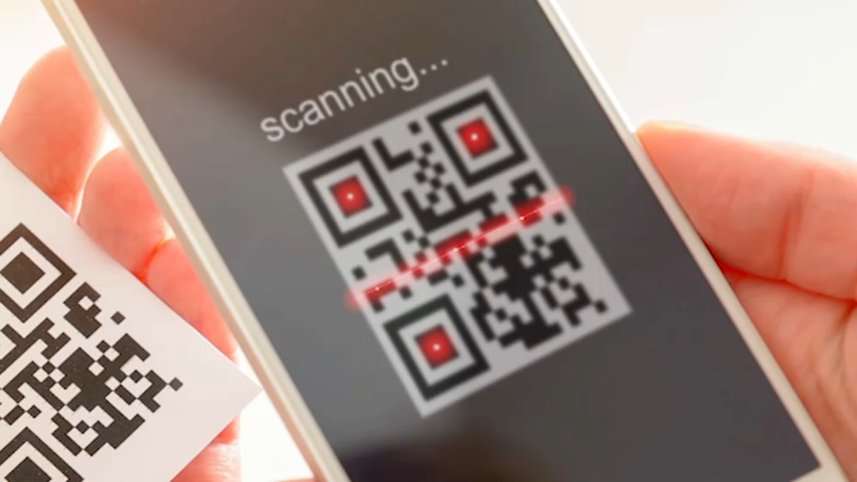
Feedback
https://forms.gle/vsm6zsUo3iFsu7be6
The Peer Teaching Society is not liable for false or misleading information…

