Slide 1
Phase 1 Respiratory Wrap-Up
Part 2

Slide 2
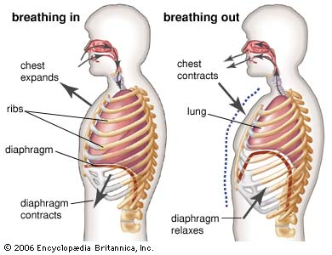
The Respiratory Pump
Inspiration
Intercostal muscles = contract
Diaphragm = contracts
Volume = Increases
Pressure = decreases
Expiration
Intercostal muscles = Relaxes
Diaphragm = Relaxes
Volume = Decreases
Pressure = Increases
The Peer Teaching Society is not liable for false or misleading information…
Notes:
Nerve inputs control the muscles which pull on the ribs
This creates a change in volume within the lung cavity which reduces the pressure
Once the pressure is decreased atmospheric air is forced into the lungs = inhalation
The opposite happens in expiration, the muscles reduce the size of the cavity which increases the pressure above atmospheric thus air is pushed out
Muscles involved
Passive/quiescent breathing – diaphragm and external intercostals
Expiration – relaxation of muscles
Inhalation = sternocleidomastoid, serratus anterior, external intercostals
Expiration = internal intercostals, transverse thoracis, external oblique, internal oblique

Slide 3
Intrapleural Pressure
The Peer Teaching Society is not liable for false or misleading information…
Notes:
Intrapleural pressure is the pressure within the pleural cavity
Is due to the visceral pleura adhering to the parietal pleura
Is always negative with respect to atmospheric pressure and intrapulmonary pressure
Opposes the elastic recoil of the lungs
Keeps the lungs attached to the thoracic wall and diaphragm and keeps the lungs partially inflated at all times
This prevents collapsing
If pressure is allowed equalise…. i.e. knife wound then the lung collapses

Slide 4
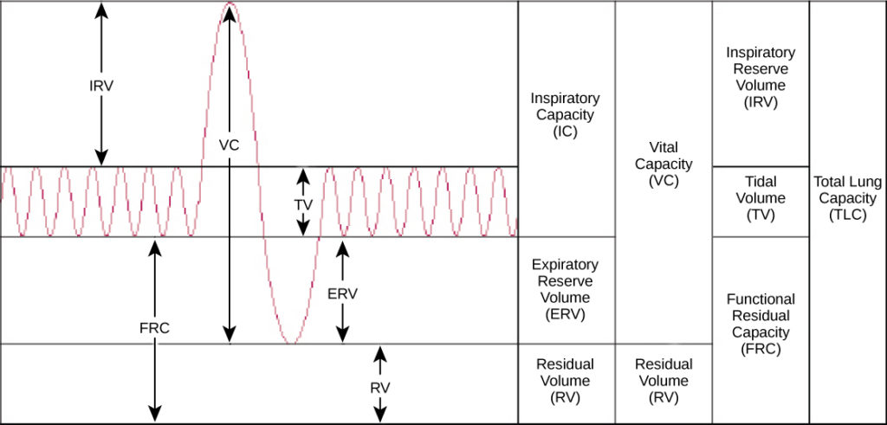
Spirometry
The Peer Teaching Society is not liable for false or misleading information…
Notes:
Tidal volume – volume inhaled/exhaled in a normal breath, ~500ml
Inspiratory reserve – max air that can be inhaled minus tidal volume, ~3L
Expiratory reserve – max air that can be exhaled minus tidal volume, ~1.2L
Residual volume – air remaining in lungs after max expiration to prevent collapse, ~1.2L
Vital capacity – max air expired after max inspiration, ~4.7L (ERV +TV + IRV)
Insp. capacity – max inhalation after normal tidal expiration, ~3.5L (IRV + TV)
Functional residual capacity – air in lungs after tidal expiration, ~2.4L (RV + VC)
Total lung capacity – 5.9L (RV +VC)

Slide 5
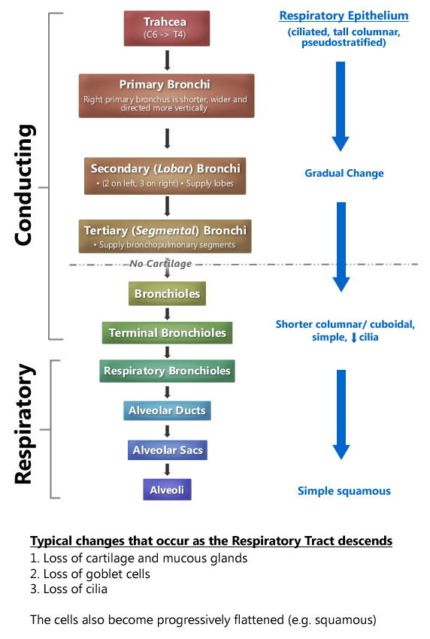
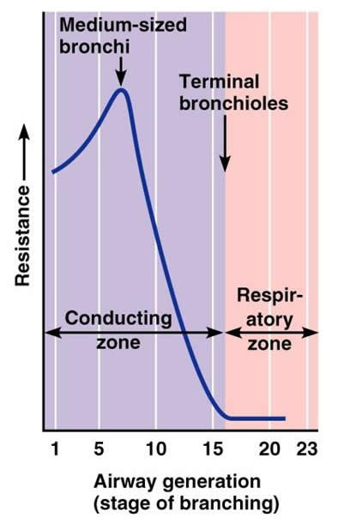
Airways
The Peer Teaching Society is not liable for false or misleading information…
Notes:
Trachea:
From larynx (C6) to carina (T5)
Semicircular cartilaginous rings, incomplete posteriorly
Pseudostratified ciliated columnar epithelia with interspersed goblet cells – mucociliary clearance
Bronchi:
Feed in to lungs at hilum with pul. arteries (bronchovascular bundle) & veins
R. main bronchus more vertical, left accommodates aortic arch beneath
RMB further divides into lobar bronchi to form 3 lobes – lower, middle & upper
LMB – 2 lobes, upper lingular & lower
Segmental bronchi arising from lobar divisions
Bronchioles:
Terminal
Respiratory – highest restriction to airflow. Gas exchange in premature neonates
Pulmonary lobules containing smaller bronchioles & alveoli
Alveoli:
Type I (gas exchange) & II (surfactant production) pneumocytes
Adjacent alveoli connected through pores of Kohn – allows movement of macrophages, 1 per 3 alveoli
Fused basement membrane with endothelia of capillaries – 1um thick
Each supplied by 1000 capillaries, but each cap. supplies multiple alveoli
1x10^6cm cross sectional area
In total, 24 divisions from trachea to alveoli

Slide 6
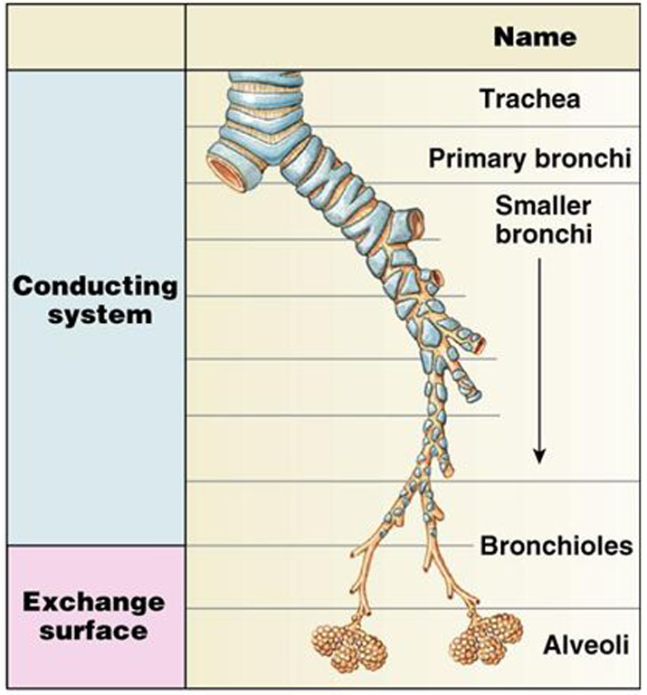
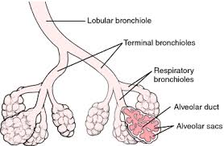
Airways
Conducting = trachea to respiratory bronchioles
no gas exchange
Respiratory = respiratory bronchioles to alveoli
gas exchange
Dead space = anatomical + alveolar
175 mL = 150 mL + 25 mL
The Peer Teaching Society is not liable for false or misleading information…
Notes:
Anatomical dead space is in the conducting airway
Alveolar dead space is the volume in the alveolar where no perfusion occurs

Slide 7
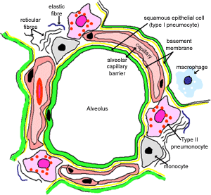
Barriers to Diffusion
Fluid lining alveolus (surfactant)
2. Layer of epithelial cells – type I pneumocytes
3. Basement membrane of type I cells
4. Interstitial space
5. Basement membrane
6. Endothelia
7. Erythrocyte
The Peer Teaching Society is not liable for false or misleading information…
Notes:
Can be a question, just need to remember unfortunately.
Don't worry about a set number of layers – sometimes people don't include the RBC, or use the basement membrane in the same layer as the epithelial cell

Slide 8
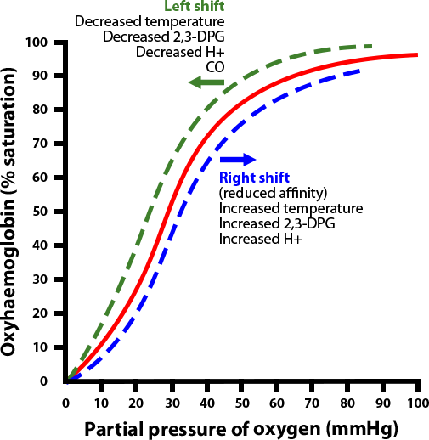
O2 Dissociation Curve
The Peer Teaching Society is not liable for false or misleading information…
Notes:
Plots the proportion of haemoglobin in its saturated form and the prevailing oxygen tension
Blood temperature – increased blood temperature reduces affinity for O2, hence more O2 is delivered to warm tissue
pH – lower pH (more acidic blood) caused by increased H+ from lactic acid or carbonic acid, reduces affinity of Hb for O2, more O2 is delivered to acidic sites which are working harder
2-3 diphosphoglycerate is created in erythrocytes during glycolysis, high levels shift the curve to the right.
What is going to happen during exercise?
Curve shifts to the right, O2 has a reduced affinity for Hb meaning that more O2 can be supplied to tissues. Increased temperature, increased acidity, increased 23DPG

Slide 9
Hypoxia
Definition of ‘Hypoxia’ = deficiency of O2 at tissue level (low PO2)
4 Types
Hypoxaemia (hypoxic hypoxia) – most common
Anaemia or CO hypoxia
Ischaemia hypoxia
Histotoxic hypoxia
The Peer Teaching Society is not liable for false or misleading information…
Notes:
Hypoxia = deficiency of O2 at tissue level (low PO2)
4 types;
Hypoxaemia/hypoxic hypoxia – most common
Causes
Hypoventilation – results in increased arterial PCO2; failure to ventilate alveoli properly, caused by respiratory muscle weakness (seen in MND) or loss of respiratory drive (morphine)
Diffusion impairment – thickening of alveolar membranes or decrease in there surface area – blood and air failure to equilibrate
Shunting – Abnormality whereby blood bypasses the lungs, moves from right side of heart to left – Eisenmenger’s Syndrome
Ventilation perfusion mismatch – most common, discrepencies in the amount of air reaching the alveoli vs amount of blood arriving in capillaries, occurs in COPD
Anaemia or CO hypoxia
Ischaemia hypoxia
Histotoxic Hypoxia
Hypercpania = An increase in CO2 at tissue level (high PCO2)

Slide 10
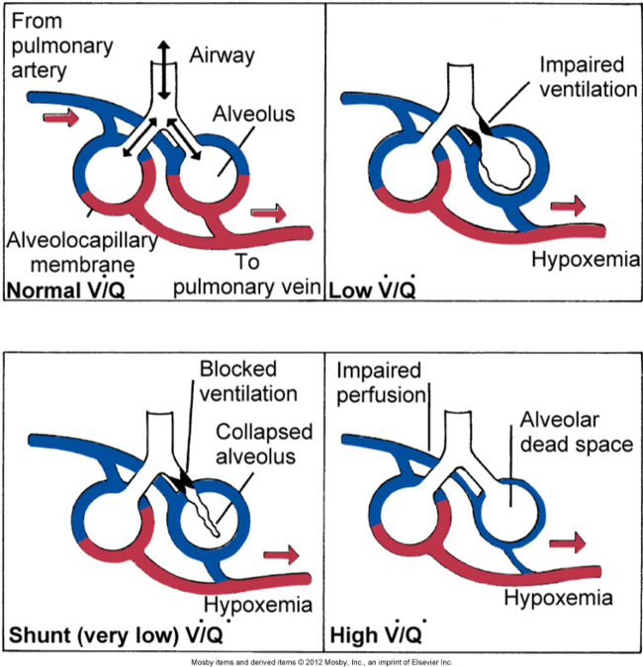
Hypoxaemia
Causes
Hypoventilation
Diffusion impairment
Shunting
V/Q mismatch
The Peer Teaching Society is not liable for false or misleading information…
Notes:
Causes
Hypoventilation – results in increased arterial PCO2; failure to ventilate alveoli properly, caused by respiratory muscle weakness (seen in MND) or loss of respiratory drive (morphine)
Diffusion impairment – thickening of alveolar membranes or decrease in there surface area – blood and air failure to equilibriate
Shunting – Abnormality whereby blood bypasses the lungs, moves from right side of heart to left – Eisenmenger’s Syndrome
Ventilation perfusion mismatch – most common, discrepencies in the amount of air reaching the alveoli vs amount of blood arriving in capillaries, occurs in COPD
Question: What does the V/Q stand for? Ventilation/Perfusion

Slide 11
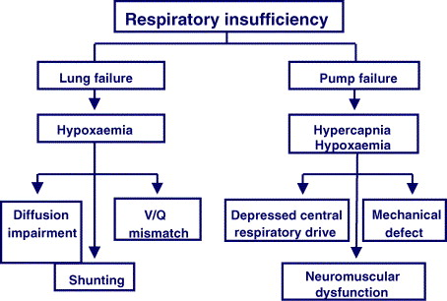
Respiratory Failure
Type 1 = Lung Failure
PO2 is low
PCO2 is low or normal
Type 2 = Pump Failure
PO2 is low
PCO2 is high
What is the name for increased CO2 in the blood?
The Peer Teaching Society is not liable for false or misleading information…
Notes:
Type 1 respiratory failure is the lungs being unable to meet the demands of the body this can occur by;
Diffusion impairment – O2 not being able to diffuse into the blood
Shunting – blood missing out the pulmonary system (hole in the heart)
Ventilation perfusion mismatch – the level of ventilation not keeping up with the perfusion of blood that’s arriving in the capillaries
In type 1 failure there is only 1 factor that changes
An common example is pulmonary embolism which causes a V/Q mismatch
Type 2 respiratory failure is caused by pump failure i.e. muscular control. This means that either/both CO2 cannot be removed quick enough or O2 cannot arrive at tissues quick enough. This can be caused by;
Depressed central respiratory drive – the control centres in the brain have failed and CV control is lost
Neuromuscular dysfunction – the muscles controlling the lungs are not working properly
Mechanical defect
COPD is a common type 2 failure. Heroin overdose can cause type 2.
Bonus question: HYPERCAPNIA
Detected by chemoreceptors and alters HR and BR
Can cause respiratory acidosis (more later)

Slide 12
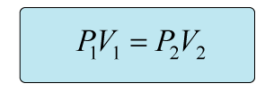
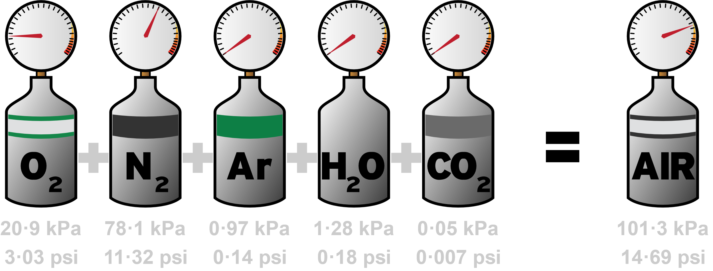
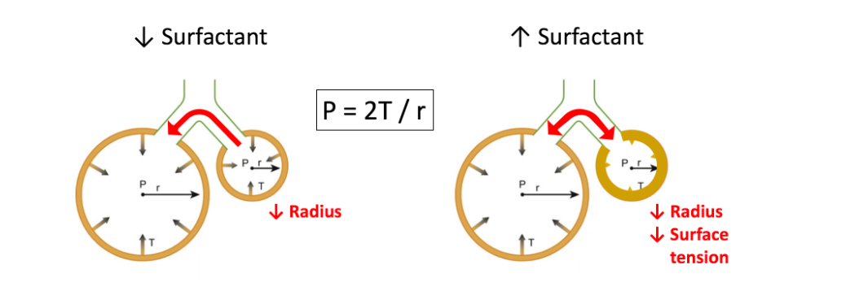
Equations
Daltons Law:
Boyles Law:
Henry’s Law:
Alveolar gas equation:
Laplace law:
Poiseuille's law:
PAO2 = PiO2 – PaCO2/R
The Peer Teaching Society is not liable for false or misleading information…
Notes:
Match them up activity: Arrows fade in one by one
NAME THE LAW AND AN EXAMPLE OF HOW IT APPLIES:
Daltons law – sum of the partial pressure of gasses = the total partial pressure , composition of inspired air, fractions don’t change, pressures do.
Boyle’s Law – P1V1 = P2V2; an increased volume decreases the pressure and vice versa. This applies during inspiration.
Henry’s Law – at high pressure, insoluble gasses are more likely to dissolve. E.g. nitrogen in the joints which diving
Alveolar gas equation - formula used to approximate the partial pressure of oxygen in the alveolus
Poiseuilles law – flow or resistance in a tube is dependent on the radius of the vessel and the viscosity of the fluid
Laplace’s Law – wall tension is proportional to vessel radius for cylindrical vessels, increased surfactant reduces surface tension

Slide 13
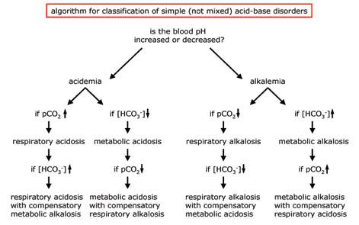
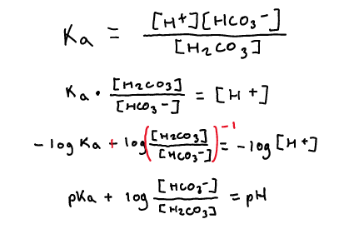
Acid-Base Balance
Carbonic Anhydrase
The Peer Teaching Society is not liable for false or misleading information…
Notes:
Acid-base dissociation equation
Henderson-hasselbalch equation
Respiratory acidosis/alkalosis and compensation
What is the blood pH range? 7.35 – 7.45
So:
if blood becomes acidic, we want to REMOVE H+, so we form more carbonic acid.
If blood becomes alkaline, we want to ADD H+, so we form more bicarbonate and H+
BONUS: Can you name the enzyme – carbonic anhydrase
So if that isn’t enough: we’ll have acidosis/acidemia, or alkalosis/alkalemia.
Should be able to understand the difference between respiratory and metabolic, then how it is compensated.
Talk about the Henderson-Hassleback equation.

Slide 14
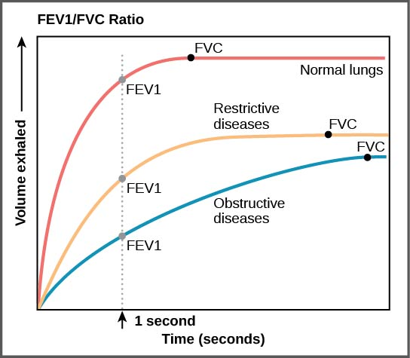
Obstruction or Restriction
MVV
FEV₁
PEF
FVC
FEF₂₅₋₇₅
DL_{CO}
The Peer Teaching Society is not liable for false or misleading information…
Notes:
Commonly used
FEV₁ – forced exp. Volume in 1 second. 80% of vital capacity in healthy person
FVC – forced vital capacity – max air expired under max force after max inspiration
PEF – peak expiratory air flow – highest velocity of air measured during FVC. Flow will then decrease linearly in healthy person after PEF
Might also see..
FEF25-75 – forced expiratory flow at 25/75% - the flow rate at 25% or 75% of the total volume (FVC).
MVV – Maximum Voluntary Ventilation – the volume of gas that can be breathed in 15 seconds when the person breathes as deeply and quickly as possible
DL_{CO} – diffusing capacity of lung for carbon dioxide. Measuring efficiency of gas exchange. Known [CO] inhaled, 10 sec breath hold, expired [CO] measured. Reduced with COPD
Airway obstruction – reduced airflow leading to hyperinflation, decreasing FEV1 but increasing RV & TLC. FVC remains similar, ratio of FEV1/FVC reduced to below 0.7. ‘Scalloped’ flow loop. E.g.: COPD, asthma
Airway restriction – reduced compliance of lungs, reducing both FEV1 and FVC. Ratio remains the same but all other parameters reduced (VC, IC, EC. E.g.: pulmonary fibrosis

Slide 15
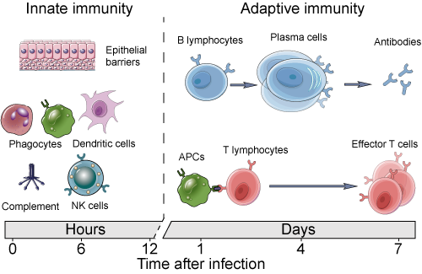
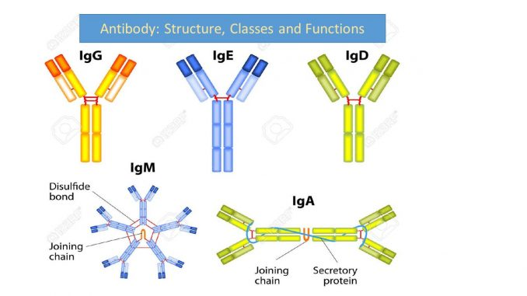
Host Defence (immunology)
Don’t need to know massive depth...
(covered more in 2a)
Innate Immunity
Cell types – monocytes/macrophages, mast cells, dendritic cells, mast cells, NK cells
Adaptive Immunity
Cell types – B cells, T cells (lymphocytes)
Antibodies
5 classes: IgG, IgA, IgM, IgE, IgD
The Peer Teaching Society is not liable for false or misleading information…
Notes:
You have a little bit of immunology teaching during respiratory block, it's the only immunology teaching you get in phase 1 other than WBCs in Cardio/Haem
Quite a difficult topic – lots of great YouTube videos to help as well.
Does sometimes come up in the SAQ.
Talk through the basics of innate and adaptive immunity and what the cells do.
Innate – quick, non-specific, no memory
Adaptive – takes longer, uses lymphocytes, will focus on specific antigens and memory
Talk through the basics of the antibody classes – how do antibodies work?
IgG – most abundant
IgA – in mucosal tracts, like the GI tract, dimer
IgM – found in primary immune system, pentamer
IgE – allergy, basophil/mast cells, very rare
IgD – act as receptors on B cells

Slide 16
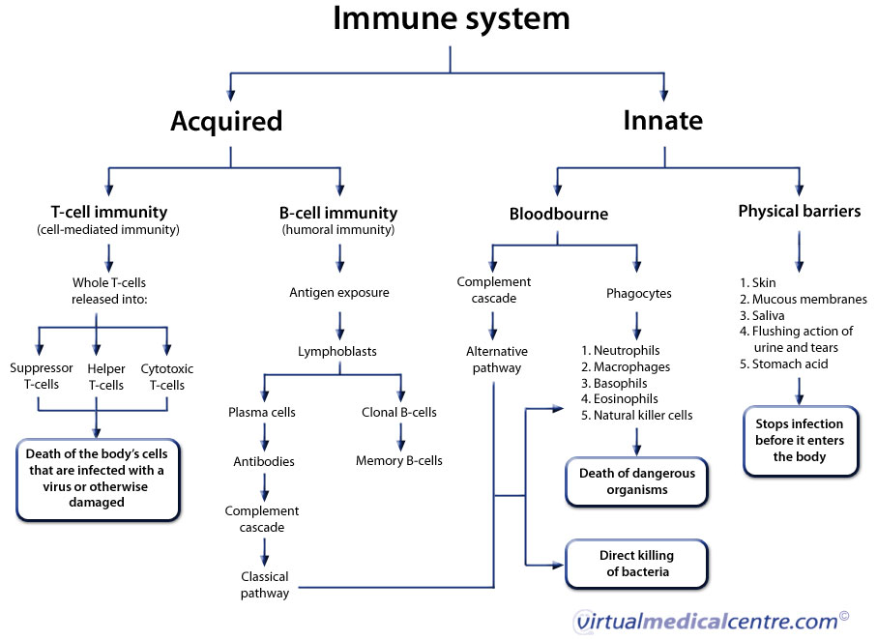
Host Defence (immunology) – Overview
Innate (non-specific) | Adaptive (specific)
First line of defence | Response specific to antigen
Provides barrier to antigen | Learnt behaviour
Present from birth | Memory to specific antigen
Slow response | Quicker response
No memory – resistance not improved by repeat infection | Requires lymphocytes
Integrates with adaptive response | Recognition of range of peptides
Not dependent on lymphocytes | Diversity requires somatic mutation
Effectors humoral and phagocytes | Antibody production of T and B cells
The Peer Teaching Society is not liable for false or misleading information…

Slide 17
Host Defence (immunology) continued
Gell and Coombes Classification
Type 1 – antigens bind to IgE on mast cells/basophils
Examples: allergy, anaphylaxis, asthma
Type 2 – cytotoxic T cells killing
Examples: transfusion mismatch, Goodpasture's syndrome
Type 3 – IgG forms immune complexes
Examples: Lupus, Systemic lupus erthematosus (SLE)
Type 4 – Delayed T helper cells activate macrophages
Examples: Contact dermatitis
The Peer Teaching Society is not liable for false or misleading information…
Notes:
Gel and Coombes classification
Way to memorise: ACID
A – allergic
C – cytotoxic killing
I – immune complexes
D – delayed T helper cells

Slide 18
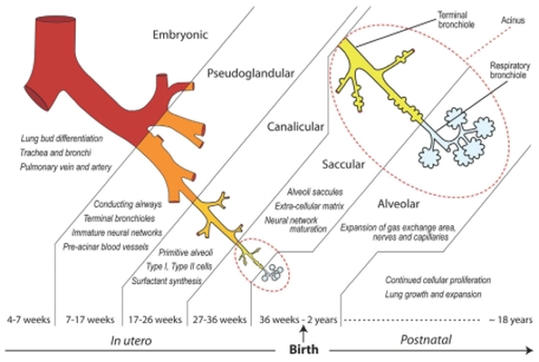
What we haven't covered (less likely to come up)
In-depth Embryology
Genetics – eg: cystic fibrosis, alpha-1 antitrypsin deficiency
Altitude & Depth – eg: high altitude pulmonary oedema, acute mountain sickness, diving reflexes
Can do some further reading around these subjects but focus on the high yield topics!
The Peer Teaching Society is not liable for false or misleading information…
Notes:
Embryology – don't have to worry about more than the basic stages and times, even that is less likely to come up. Focus on the Rochester lectures for embryology as it will be from his spotter questions
Genetics – can almost ignore this lecture, very pathology based which will come up in phase 2a instead
Altitude and Depth – you shouldn't be tested on these specific conditions and the symptoms and management, but having a rough idea about them wouldn't hurt

