Slide 1
Paediatric Peer Teaching
Phoebe Barrett and Natasha Hussain
The Peer Teaching Society is not liable for false or misleading information…

Slide 2
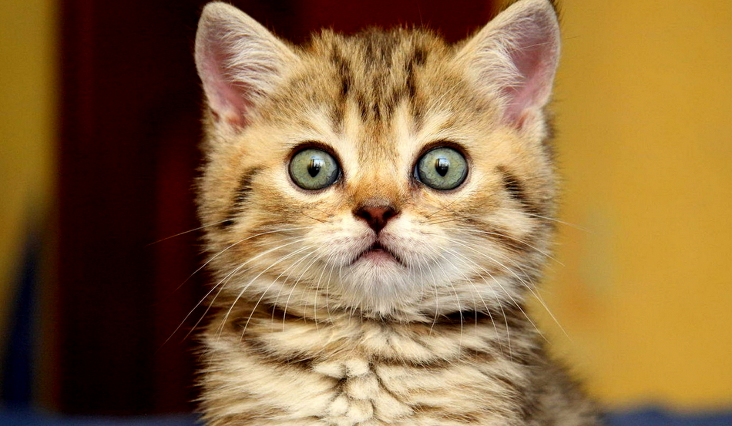
We will ask you lots of questions
The Peer Teaching Society is not liable for false or misleading information…

Slide 3
Parvovirus B19
Paediatrics
Failure to Thrive
Infections
Coeliac
Guthrie
CF
RTI
Strep/Staph Infections
Post-Infection
GI
pyloric Stenosis
GORD
Hirshprung's
Duodenal Atresia
Intussusception
Croup
Bronchiolitis
Acute epiglottitis
Glandular Fever
Impetigo
Scalded Skin
Syndrome
Scarlet Fever
Rheumatic Fever
HSP
Post-Strep GN
Key things we are not covering:
Heart defects, Meningitis, Cerebral palsy, Epilepsy, Strabismus, NEC, Neonatal jaundice, Nephrotic syndrome, UTI, T1DM, DKA, CAH, Congenital hypothyroidism, Asthma, JIA and Rheum
The Peer Teaching Society is not liable for false or misleading information…

Slide 4
Parvovirus B19
AKA
Modes of transmission
Symptoms
What’s the big deal? Which groups of patients do we NOT want to get this?
The Peer Teaching Society is not liable for false or misleading information…

Slide 5
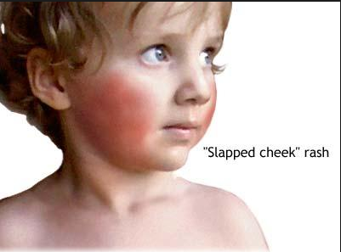
Parvovirus B19
AKA slapped cheek syndrome or 5th disease
Resp, blood, vertical transmission
Flu like symptoms for about a week then the characteristic rash appears which can spread on to mac-pap ‘lace’ rash on trunk and limbs
Infects erythroblastoid RBC precursors in bone marrow – can cause aplastic crisis in sickle cell or fetal demise
The Peer Teaching Society is not liable for false or misleading information…

Slide 6
Parvovirus B19
Paediatrics
Failure to Thrive
Infections
Coeliac
Guthrie
CF
RTI
Strep/Staph Infections
Post-Infection
GI
pyloric Stenosis
GORD
Hirshprung's
Duodenal Atresia
Intussusception
Croup
Bronchiolitis
Acute epiglottitis
Glandular Fever
Impetigo
Scalded Skin
Syndrome
Scarlet Fever
Rheumatic Fever
HSP
Post-Strep GN
Key things we are not covering:
Heart defects, Meningitis, Cerebral palsy, Epilepsy, Strabismus, NEC, Neonatal jaundice, Nephrotic syndrome, UTI, T1DM, DKA, CAH, Congenital hypothyroidism, Asthma, JIA and Rheum
The Peer Teaching Society is not liable for false or misleading information…

Slide 7
Kawasaki’s
What is it?
Who gets it?
The Peer Teaching Society is not liable for false or misleading information…

Slide 8
Kawasaki’s
Idiopathic systemic vasculitis that usually affects children
6m-5years, highest incidence in Japan
The Peer Teaching Society is not liable for false or misleading information…

Slide 9
Kawasaki’s
Diagnostic criteria?
The Peer Teaching Society is not liable for false or misleading information…

Slide 10
Kawasaki’s
Fever for > 5/7 and 4/5 of HEART:
HANDS – erythema, swelling and desquamation
EYES – bilateral conjunctivitis (DDx?)
A NECK PROBLEM – cervical lymphadenopathy
RASH – polymorphous trunchal exanthem
TONGUE – Inflammations of lips, mouth and strawberry tongue (DDx strawberry tongue?)
The Peer Teaching Society is not liable for false or misleading information…

Slide 11
Kawasaki’s
What’s the big deal?
Tx
The Peer Teaching Society is not liable for false or misleading information…

Slide 12
Coronary artery aneurysms
Aspirin and IVIg within first 10/7
The Peer Teaching Society is not liable for false or misleading information…

Slide 13
Parvovirus B19
Paediatrics
Failure to Thrive
Infections
Coeliac
Guthrie
CF
RTI
Strep/Staph Infections
Post-Infection
GI
pyloric Stenosis
GORD
Hirshprung's
Duodenal Atresia
Intussusception
Croup
Bronchiolitis
Acute epiglottitis
Glandular Fever
Impetigo
Scalded Skin
Syndrome
Scarlet Fever
Rheumatic Fever
HSP
Post-Strep GN
Key things we are not covering:
Heart defects, Meningitis, Cerebral palsy, Epilepsy, Strabismus, NEC, Neonatal jaundice, Nephrotic syndrome, UTI, T1DM, DKA, CAH, Congenital hypothyroidism, Asthma, JIA and Rheum
The Peer Teaching Society is not liable for false or misleading information…

Slide 14
Croup
What is it?
Aetiology?
When do kids get it?
The Peer Teaching Society is not liable for false or misleading information…

Slide 15
Croup
Viral laryngotracheobronchitis. An U and LRTI.
95% parainfluenza virus
Peaks around 1-2 years (2nd winter of life)
Symtoms?
The Peer Teaching Society is not liable for false or misleading information…

Slide 16
Croup
Preceded by fever/coryza for a few days
Barking cough
Hoarse cry
Stridor (DDx stridor in a child?)
Symptoms worse at night
Patient looks unwell but able to drink
What do you NOT do?
The Peer Teaching Society is not liable for false or misleading information…

Slide 17
Bronchioloitis
Aetiology?
When do they get it?
Symptoms?
The Peer Teaching Society is not liable for false or misleading information…

Slide 18
Bronchioloitis
80% RSV
1-9 months (1st winter of life)
Preceded by coryzal symptoms, dry cough, increased work of breathing, tachypnoea, fine, end expiratory crackles and wheeze
Why do these babies sometimes get admitted? Tx?
The Peer Teaching Society is not liable for false or misleading information…

Slide 19
Bronchioloitis
Feeding difficulty and very SOB
Tx – supportive, humidified O2, fluids, Palivizumab against RSV can be given to those at high risk (IM monthly)
Bronch v. Croup
The Peer Teaching Society is not liable for false or misleading information…

Slide 20
Parvovirus B19
Paediatrics
Failure to Thrive
Infections
Coeliac
Guthrie
CF
RTI
Strep/Staph Infections
Post-Infection
GI
pyloric Stenosis
GORD
Hirshprung's
Duodenal Atresia
Intussusception
Croup
Bronchiolitis
Acute epiglottitis
Glandular Fever
Impetigo
Scalded Skin
Syndrome
Scarlet Fever
Rheumatic Fever
HSP
Post-Strep GN
Key things we are not covering:
Heart defects, Meningitis, Cerebral palsy, Epilepsy, Strabismus, NEC, Neonatal jaundice, Nephrotic syndrome, UTI, T1DM, DKA, CAH, Congenital hypothyroidism, Asthma, JIA and Rheum
The Peer Teaching Society is not liable for false or misleading information…

Slide 21
Acute Epiglottitis
What is it?
Aetiology
PC
What do you NOT do?
The Peer Teaching Society is not liable for false or misleading information…

Slide 22
Acute Epiglottitis
HiB – incidence now low in children
Ill child, sore throat, sitting upright, drooling saliva, painful swallow, STRIDOR, fever etc
DO NOT examine the throat!
The Peer Teaching Society is not liable for false or misleading information…

Slide 23
Glandular Fever
Tell me about it
Two idiosyncratic facts for yours exams
The Peer Teaching Society is not liable for false or misleading information…

Slide 24
Glandular Fever
EBV infection, sore throat, low grade fever, malaise can last for months
Risk of splenic rupture after it – avoid contact sports for 3/52
Don’t give penicillin!
The Peer Teaching Society is not liable for false or misleading information…

Slide 25
Parvovirus B19
Paediatrics
Failure to Thrive
Infections
Coeliac
Guthrie
CF
RTI
Strep/Staph Infections
Post-Infection
GI
pyloric Stenosis
GORD
Hirshprung's
Duodenal Atresia
Intussusception
Croup
Bronchiolitis
Acute epiglottitis
Glandular Fever
Impetigo
Scalded Skin
Syndrome
Scarlet Fever
Rheumatic Fever
HSP
Post-Strep GN
Key things we are not covering:
Heart defects, Meningitis, Cerebral palsy, Epilepsy, Strabismus, NEC, Neonatal jaundice, Nephrotic syndrome, UTI, T1DM, DKA, CAH, Congenital hypothyroidism, Asthma, JIA and Rheum
The Peer Teaching Society is not liable for false or misleading information…

Slide 26
Gram +
Cocci
Strep
Staph
α
β
Strep pnuemoniae
Lancefield Groupings
Staph aureus
Group A
Group B
Strep pyogenes
What diseases are caused by GAS?
What diseases are caused by staph aureus?
The Peer Teaching Society is not liable for false or misleading information…

Slide 27
S aureus – impetigo, scalded skin syndrome, toxic shock syndrome
GAS – cellulitis, impetigo, necrotising fasciitis, strep throat, toxic shock syndrome – what are the possible post infectious complications with GAS? (x3)
GBS – in vagina therefore causes neonatal infections
The Peer Teaching Society is not liable for false or misleading information…

Slide 28
Impetigo
Mainly staph, can also be caused by GAS
Honey-crusted lesions are the mouth and nose (classically)
Tx – topical mupirocin, oral fluclox if severe and needs systemic treatment
The Peer Teaching Society is not liable for false or misleading information…

Slide 29
Post GAS infections
Scarlet Fever
Post-streptococcal glomerulonephritis
Rheumatic Fever
Henoch-Schӧnlein Purpura (HSP)
The Peer Teaching Society is not liable for false or misleading information…

Slide 30
Post GAS infections – reaction to endotoxins
Scarlet Fever – Fever, sandpaper rash, circumoral pallor and flushed face, strawberry tongue, penicillin
Post-streptococcal glomerulonephritis – nephritic syndrome, coca-cola wee, usually self limiting
The Peer Teaching Society is not liable for false or misleading information…

Slide 31
Post GAS infections
Rheumatic Fever – Modified Jones Criteria
MAJOR (‘CASES’) | MINOR (‘FRAPP’)
Carditis Arthritis Syndenham’s Chorea Erythema marginatum Subcutaneous nodules | Fever Raised ESR/CPR Arthralgia Prolonged PR on ECG Previous Rheumatic Fever
Mitral Stenosis!
The Peer Teaching Society is not liable for false or misleading information…

Slide 32
Post GAS infections
Henoch-Schӧnlein Purpura (HSP) – can also follow other infections
6Ps of HSP:
Preceeding URTI
Palpable, purpuric rash (buttocks and extensors)
Pain and swelling in joints (knees and ankles)
Painful abdomen
Pink urine (GN → haematuria!)
Prednisolone to Tx
The Peer Teaching Society is not liable for false or misleading information…

Slide 33
Parvovirus B19
Paediatrics
Failure to Thrive
Infections
Coeliac
Guthrie
CF
RTI
Strep/Staph Infections
Post-Infection
GI
pyloric Stenosis
GORD
Hirshprung's
Duodenal Atresia
Intussusception
Croup
Bronchiolitis
Acute epiglottitis
Glandular Fever
Impetigo
Scalded Skin
Syndrome
Scarlet Fever
Rheumatic Fever
HSP
Post-Strep GN
Key things we are not covering:
Heart defects, Meningitis, Cerebral palsy, Epilepsy, Strabismus, NEC, Neonatal jaundice, Nephrotic syndrome, UTI, T1DM, DKA, CAH, Congenital hypothyroidism, Asthma, JIA and Rheum
The Peer Teaching Society is not liable for false or misleading information…

Slide 34
The Vomiting Child
A mother comes in to see you with her newborn daughter, who is now 2 weeks old. She tells you that she is worried as she is ‘being sick’. This is her first child and she is not sure if she should be concerned.
What might you want to ask her about the ‘vomiting’?
The Peer Teaching Society is not liable for false or misleading information…

Slide 35
Vomiting
Definitions;
Posseting – small amounts +/- ‘wind’
Regurgitation – larger, more frequent losses
Vomiting – FORCEFUL ejection of gastric contents
Questions – 2 BIGGIES;
? Bile-stained
? Projectile
The Peer Teaching Society is not liable for false or misleading information…

Slide 36
Gastro-Oesophageal Reflux
Functional immaturity of LOS = episodes of inappropriate relaxation
Plus, short intra-abdominal length of oesophagus
Common in 1st year of life - why??
Diagnosis?
Management?
= conservative, medical, surgical
The Peer Teaching Society is not liable for false or misleading information…

Slide 37
Vomiting
She explains that ‘her tummy feels hard’. What might she be referring to?
? Pyloric stenosis
? Hirschsprung’s disease
Etc…(will talk about later)
The Peer Teaching Society is not liable for false or misleading information…

Slide 38
Pyloric Stenosis
Hypertrophy of pylorus = gastric outlet obstruction
2-7 weeks of age
Commoner in boys (4:1), first-borns
May be FH (esp. on maternal side)
Clinical features;
Projectile vomiting
NOT bile-stained
Increases in severity and frequency with time
Constant hunger
Weight loss/poor weight gain (if delayed presentation)
The Peer Teaching Society is not liable for false or misleading information…

Slide 39
Pyloric Stenosis
What is the characteristic electrolyte disturbance?
= hypochloraemic, hypokalaemic metabolic alkalosis
Diagnosis?
= Test feed, USS
Management?
= pyloromyotomy/Ramstedt’s procedure
The Peer Teaching Society is not liable for false or misleading information…

Slide 40
Hirshsprung’s Disease
= Absence of gangion cells from myenteric + submucosal plexuses (part of large bowel)
Narrow, contracted segment -> normally innervated, dilated region proximally
Usually present in neonatal period;
Intestinal obstruction
Failure to pass meconium in first 24h
Abdominal distension
Later, BILE-stained vomit
The Peer Teaching Society is not liable for false or misleading information…

Slide 41
Hirshsprung’s Disease
Important examination?
= DRE
Diagnosis?
= Suction rectal biopsy
Management?
= Surgical
The Peer Teaching Society is not liable for false or misleading information…

Slide 42
Question
We have just mentioned a condition where there is failure to pass meconium – can you think of another?
The Peer Teaching Society is not liable for false or misleading information…

Slide 43
Cystic Fibrosis
Meconium ileus in neonatal period (10-20% of presentations);
Intestinal obstruction = vomiting, abdominal distention & failure to pass meconium in first few days
> 90% = malabsorption and steatorrhoea
Due to pancreatic enzyme insufficiency (lipase, amylase, proteases)
= FTT (but big appetite)
Large, pale, very offensive and greasy stools several times a day
What other major symptom might you be worried about, if she does have CF?
The Peer Teaching Society is not liable for false or misleading information…

Slide 44
Cystic Fibrosis
You explain this possible diagnosis and the parents now have several questions;
What is it?
How would she have got it?
N.B. ?CF in any child with recurrent chest infections, loose stools + FTT
What recent blood test will she have been done that should pick it up?
The Peer Teaching Society is not liable for false or misleading information…

Slide 45
Guthrie Test
Blood sample, usually heel-prick, is taken when feeding is established (day 5-9)
What is tested?
Congenital hypothyroidism
More common, TSH, to prevent cretinism
CF – immunoreactive trypsinogen
Phenylketonuria (PKU)
Rare, error in AA metabolism, can impair brain development
MCADD
SCD (haemoglobinopathies)
Children Can Present More Seriously
The Peer Teaching Society is not liable for false or misleading information…

Slide 46
Screening
What other condition, also screened for in pregnancy, has an associated complication that could cause vomiting??
= Down’s syndrome + duodenal atresia
What might have mum been diagnosed with in pregnancy?
= Polyhydramnios
The Peer Teaching Society is not liable for false or misleading information…

Slide 47
Duodenal Atresia
= Closure of part of the duodenal lumen
Can get;
Abdominal distension
Billous vomiting
What is the characteristic x-ray appearance?
= ‘Double-bubble’
The Peer Teaching Society is not liable for false or misleading information…

Slide 48
Vomiting
If this child was older, e.g. 3 months old, what could the mass be that she is referring to?
What might you want to ask about now?
The Peer Teaching Society is not liable for false or misleading information…

Slide 49
Intussusception
= Invagination of proximal bowel into a distal segment
Most commonly ileum -> caecum + colon, through ileocaecal valve
2 months - 2 years of age
Commonest cause of intestinal obstruction in infant AFTER neonatal period
Presentation;
Paroxysmal, severe, colicky pain (draw up legs during episodes) + pallor (esp. round mouth)
Sausage-shaped mass in abdomen, often palpable
Redcurrant jelly stool (blood-stained mucus) – characteristic, but late sign - ?DRE
Abdominal distention and shock
The Peer Teaching Society is not liable for false or misleading information…

Slide 50
Intussusception
Cause? Investigation?
= ?Viral infection, X-ray
Management?
= E.g. Rectal air insufflation
! IV volume expansion likely to be required immediately as often pooling of fluid in gut, which can = hypovolaemic shock !
The Peer Teaching Society is not liable for false or misleading information…

Slide 51
Funny Stools
Later that day, some other concerned parents comes in. This time it is an 18 month old boy. Mum and dad look at the end of their tether – their son has been ‘really mardy’ and they explain that they are tired of cleaning up his poo, which doesn’t look quite right. They are first time parents and wonder, what does baby poo normally look like?
What is important to ask about/check here?
The Peer Teaching Society is not liable for false or misleading information…

Slide 52
Toddler’s Diarrhoea
‘Peas and carrots syndrome’
Chronic, non-specific diarrhoea
Commonest cause of persistent loose stools in preschool children
Stools of varying consistency
?Due to maturational delay in intestinal motility
Most grow out if it by 5y of age
No treatment usually – ?loperamide
The Peer Teaching Society is not liable for false or misleading information…

Slide 53
Coeliac Disease
Gluten = damaging immunological response = cell loss from villous tips
Normally present in first 2 years of life with;
Failure to thrive following introduction of gluten
General irritability
Abnormal stools
Abdominal distension
Buttock wasting
Occasionally, can present in later childhood;
Anaemia (iron +/or folate deficiency)
Growth failure
Little/no GI symptoms
The Peer Teaching Society is not liable for false or misleading information…

Slide 54
Coeliac Disease
Diagnosis?
Jejunal biopsy = flat mucosa
Gluten withdrawal = symptom resolution + catch-up growth
Serological tests – tissue transglutaminase + ant-endomysial antibodies (IgA)
Management?
= Gluten-free diet!
The Peer Teaching Society is not liable for false or misleading information…

Slide 55
Other important things to remember…
Gastroenteritis (+ post gastro-enteritis syndrome)
Intolerances
Appendicitis (can get vomiting)
IBS
IBDs – Crohn’s and UC
Constipation + treatment
N.B. Infections can = vomiting +/- bowel disturbances
(LOOK IN LISSAUER/SUNFLOWER BOOK FOR THESE!)
The Peer Teaching Society is not liable for false or misleading information…

Slide 56
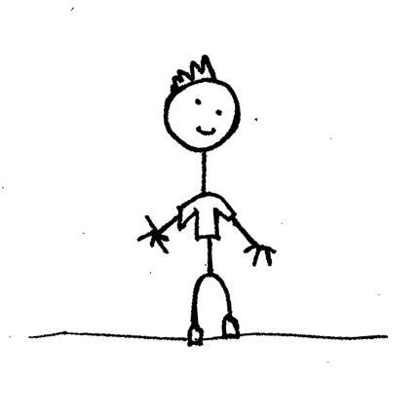
Dehydration
What are the signs of a dehydrated child?
Sunken fontanelle
↓level of consciousness
Eyes sunken, tearless
Dry mucous membranes
↓ CRT
Tachypnoea
Tachycardia, ↓BP
↓ tissue turgor
Sudden weight loss
Oliguria
The Peer Teaching Society is not liable for false or misleading information…

Slide 57
Failure to Thrive (FTT)
= Suboptimal weight gain or growth in infants and toddlers
Plot on centile chart - ?inadequate weight gain;
Mild: fall across TWO centile lines
Severe: fall across THREE
Need repeats
Remember catch-up and catch-down growth
FTT vs. normal, but small/thin baby - ?symptoms, alert, responsive, happy, development etc.
The Peer Teaching Society is not liable for false or misleading information…

Slide 58
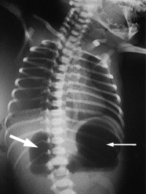
Picture Quiz!
The Peer Teaching Society is not liable for false or misleading information…

Slide 59
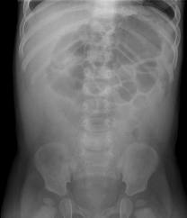
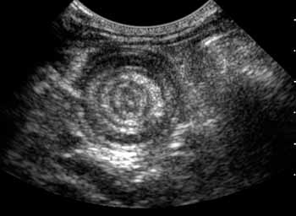
Picture Quiz!
The Peer Teaching Society is not liable for false or misleading information…

Slide 60
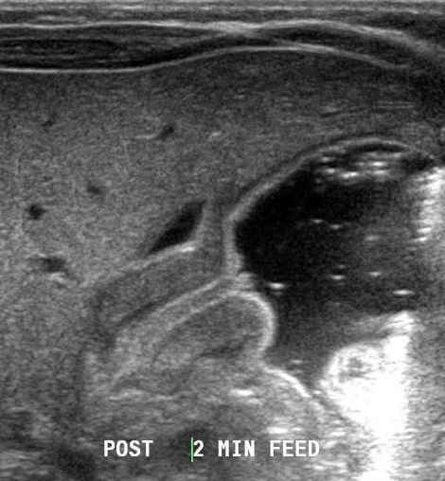
Picture Quiz!
The Peer Teaching Society is not liable for false or misleading information…

Slide 61
Quick Questions
Electrolyte disturbance in pyloric stenosis?
What is screened for on the Guthrie test?
Who has redcurrant jelly?
In which patients will we find an ‘olive-shaped’ mass?
What is the main fear in intussusception?
The Peer Teaching Society is not liable for false or misleading information…

Slide 62
Parvovirus B19
Paediatrics
Failure to Thrive
Infections
Coeliac
Guthrie
CF
RTI
Strep/Staph Infections
Post-Infection
GI
pyloric Stenosis
GORD
Hirshprung's
Duodenal Atresia
Intussusception
Croup
Bronchiolitis
Acute epiglottitis
Glandular Fever
Impetigo
Scalded Skin
Syndrome
Scarlet Fever
Rheumatic Fever
HSP
Post-Strep GN
Key things we are not covering:
Heart defects, Meningitis, Cerebral palsy, Epilepsy, Strabismus, NEC, Neonatal jaundice, Nephrotic syndrome, UTI, T1DM, DKA, CAH, Congenital hypothyroidism, Asthma, JIA and Rheum
The Peer Teaching Society is not liable for false or misleading information…

Slide 63
Any Questions?
Thank you very much!
Best of luck with your exams ☺
The Peer Teaching Society is not liable for false or misleading information…

Slide 64
The Peer Teaching Society is not liable for false or misleading information…

Slide 65
The Peer Teaching Society is not liable for false or misleading information…

Slide 66
The Peer Teaching Society is not liable for false or misleading information…

Slide 67
The Peer Teaching Society is not liable for false or misleading information…

Slide 68
The Peer Teaching Society is not liable for false or misleading information…

