Slide 1
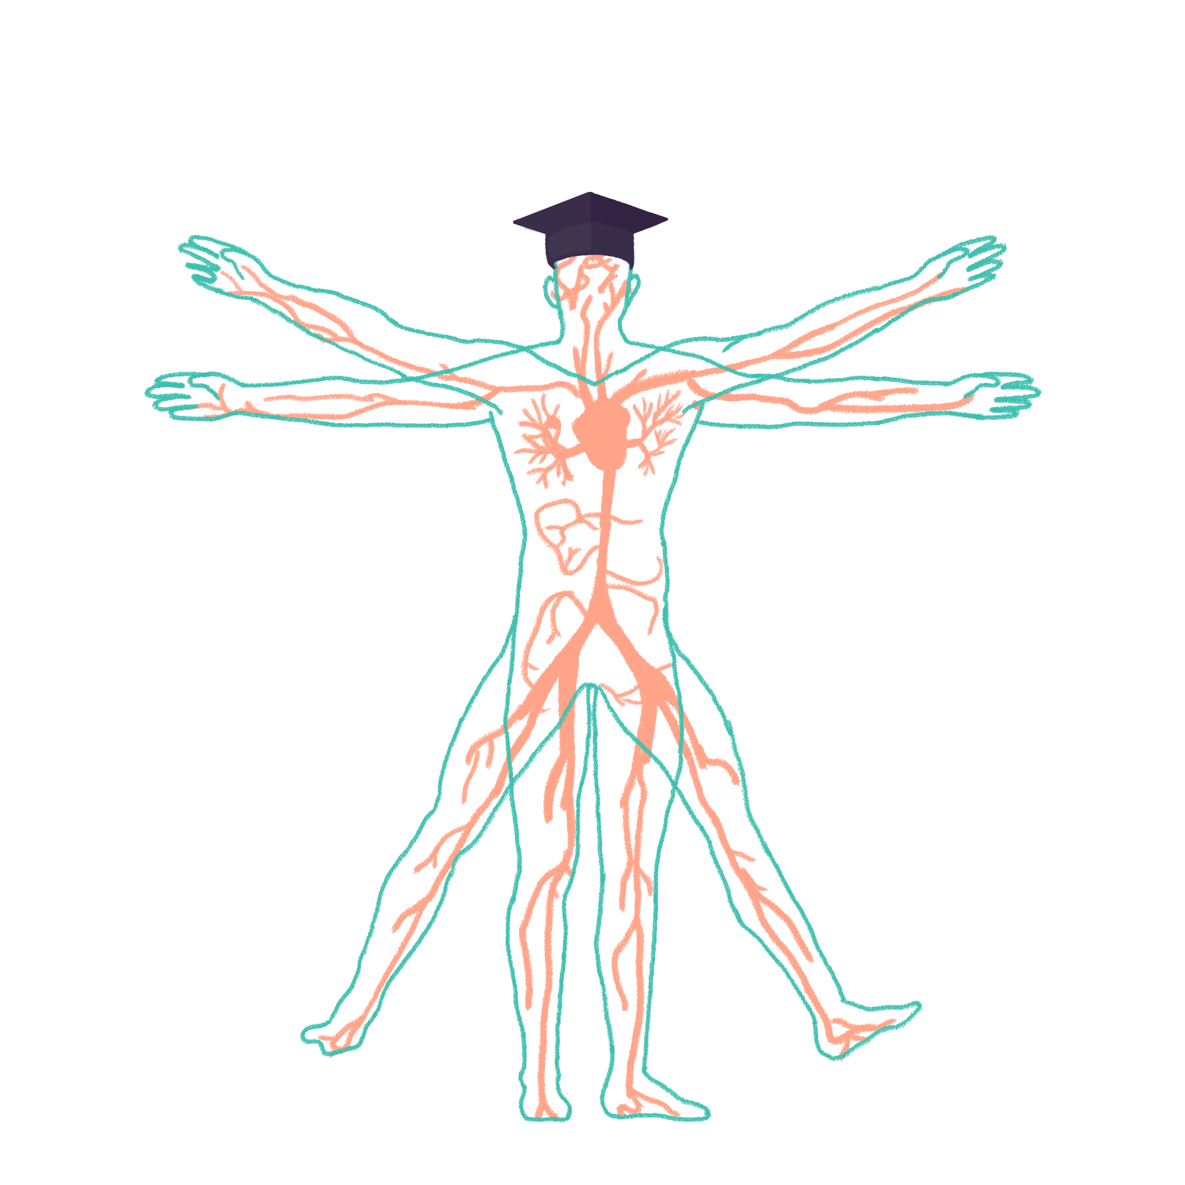
2023/2024

Slide 2
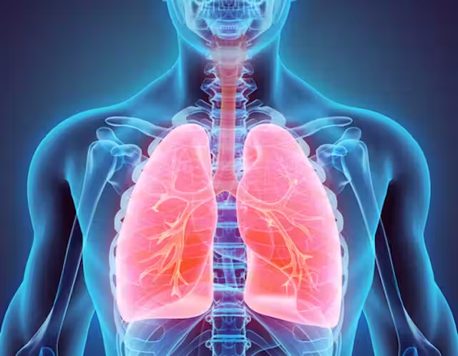
Respiratory Physiology
Phase 1 Revision Session
Sirpi Selvaraju & Andrew Macdonald
23/11/23
The Peer Teaching Society is not liable for false or misleading information…
Notes:
Image:https://images.theconversation.com/files/244828/original/file-20181109-116820-1oqq38v.jpg?ixlib=rb-1.1.0&q=20&auto=format&w=320&fit=clip&dpr=2&usm=12&cs=strip

Slide 3
Recording
This blackboard session will be recorded for use after this session.

Slide 4
Aims and Objectives
Gas Exchange
Gas Transport and O₂ Dissociation
Hypoxia and Hypercapnia
Spirometry
Respiratory Equations
Airway Tone
Hypersensitivity
Questions Throughout
The Peer Teaching Society is not liable for false or misleading information…

Slide 5
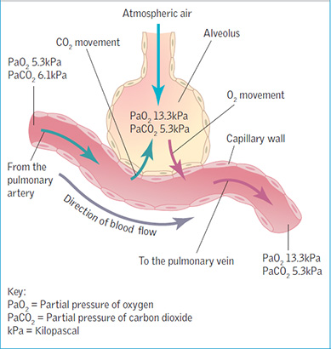
Physiology of Gas Exchange
Oxygen travels from pulmonary alveoli into RBCs through simple diffusion.
PO₂ of pulmonary capillaries < PO₂ of alveoli
PCO₂ of pulmonary capillaries > PO₂ of alveoli
Flow occurs over a concentration and pressure gradient (high → low)
Net diffusion of O₂ from alveoli to pulmonary capillaries to supply tissues.
Net diffusion of CO₂ from pulmonary capillaries to alveoli for expiration.
The Peer Teaching Society is not liable for false or misleading information…
Notes:
PO2 = partial pressure of oxygen
PCO2 = partial pressure of carbon dioxide.
Image: https://www.google.com/url?sa=i&url=https%3A%2F%2Fwww.researchgate.net%2Ffigure%2FFig-2-The-alveolar-capillary-air-blood-barrier-An-electron-micrograph-of-an_fig2_233624729&psig=AOvVaw22VjJyMJFas-BPQ7c0joJW&ust=1699549391218000&source=images&cd=vfe&opi=89978449&ved=0CBIQjRxqFwoTCLCng4DxtIIDFQAAAAAdAAAAABAD

Slide 6
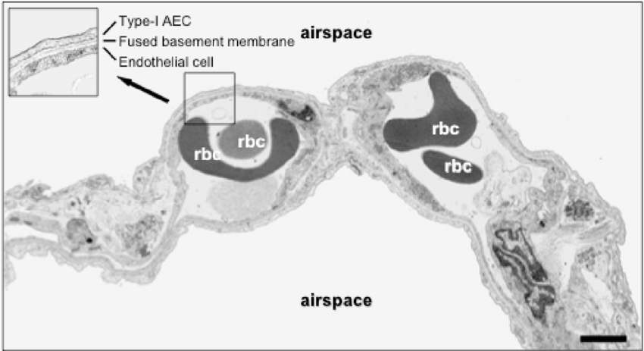
Layers of Gas Exchange
There are many layers involved in the interface between air and the RBC aka the Air-Blood Barrier.
O₂ → Type 1 Pneumocyte → Fused Basement Membrane → Vascular Endothelial Cell → RBC
From Air to RBC
The Peer Teaching Society is not liable for false or misleading information…
Notes:
There are many different ways to answer how many layers there are in the air-blood barrier, as you could even consider the cell membranes and cytoplasm between the cells as barriers. Just know some key components which are listed above.

Slide 7
Oxygen & Carbon Dioxide Transport in the Blood
Oxygen travels in blood in 2 forms:
~ 98% is bound to haemoglobin in RBCs - known as oxyhaemoglobin
~ 2% is dissolved in blood.
Carbon dioxide travels in the blood in 3 forms:
~ 60-65% is present as carbonic acid (H₂CO3)
~ 25-30% is bound to haemoglobin as carbaminohemoglobin
~ 5-10% is dissolved in the blood.
The Peer Teaching Society is not liable for false or misleading information…

Slide 8
Oxygen Dissociation Curve
ODC describes relationship between Hb saturation and PO₂.
Haemoglobin can carry 4 oxygens.
Initial exponential increase because binding of 1 oxygen causes conformational change → increased affinity for further oxygen binding.
Known as cooperativity.
Terminal plateau because haemoglobin is highly saturated with O₂, so further oxygenation = only a minor increase.
The Peer Teaching Society is not liable for false or misleading information…
Notes:
Image: https://www.osmosis.org/learn/Oxygen-hemoglobin_dissociation_curve

Slide 9
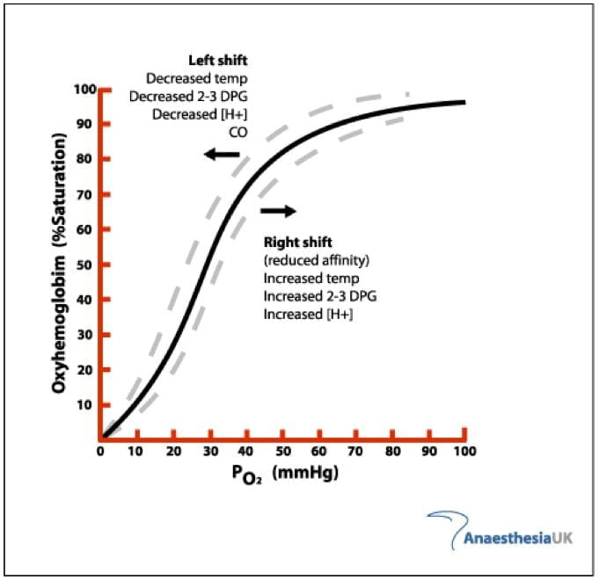
Factors Affecting the Oxygen Dissociation Curve
Factors Affecting ODC
Temperature
Acidity (H⁺)
2,3-diphosphoglycerate (2,3-DPG) levels
PCO₂
Increase in these causes shift to the right.
Decrease in these causes shift to the left.
Right shift = ↓ Hb affinity for oxygen
(right = reduced)
Left shift = ↑ Hb affinity for oxygen.
The Peer Teaching Society is not liable for false or misleading information…
Notes:
Image: https://litfl.com/oxygen-haemoglobin-dissociation-curve/

Slide 10
How These Factors Affect the Oxygen Dissociation Curve
2,3-Diphosphoglycerate (2,3-DPG)
A chemical found in RBCs.
Binds to Hb beta subunits.
Results in less O₂ binding sites.
H⁺ & PCO₂
Causes decreased pH which results in reduced Hb affinity for O₂.
Temperature
Causes a conformational change resulting in reduced Hb affinity for O₂.
How would the ODC shift in a tissue of a person who is exercising vs a person who is at rest?
The Peer Teaching Society is not liable for false or misleading information…
Notes:
Lower affinity for O₂ means it dissociates from haemoglobin and enters tissues - hence in metabolically active tissue such as skeletal muscle, the increase in factors like acidity, PCO2 and temperature result in O₂ dissociation from haemoglobin and entering tissue to aid aerobic respiration.
Image:https://www.google.com/url?sa=i&url=https%3A%2F%2Fhealth.clevelandclinic.org%2Fhow-often-you-should-work-out%2F&psig=AOvVaw1YxyzmjA_SVwzoi9iE1YjO&ust=1699555694454000&source=images&cd=vfe&opi=89978449&ved=0CBIQjRxqFwoTCNDpkr2ItYIDFQAAAAAdAAAAABAD

Slide 11
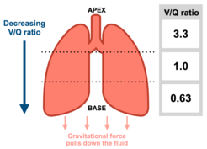
Ventilation & Perfusion
For efficient respiration, the correct proportion of alveolar airflow (ventilation) and capillary blood flow (perfusion) should be available to each alveolus.
Can be expressed as the ventilation (V) to perfusion (Q) ratio - V/Q.
V/Q ratio decreases as you go from apex to base of lungs. (Lower you go, lower the ratio)
Lower down = more blood flow due to gravity (↑Q)
The Peer Teaching Society is not liable for false or misleading information…
Notes:
Image; https://upload.wikimedia.org/wikipedia/commons/thumb/f/f9/V-Q_ratio_regional_variation.png/246px-V-Q_ratio_regional_variation.png

Slide 12
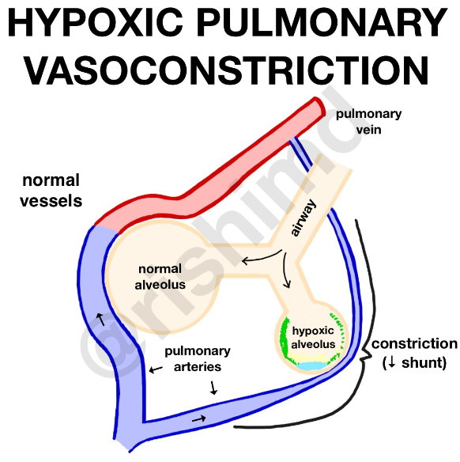
Hypoxic Pulmonary Vasoconstriction
Pulmonary circulation is opposite to systemic in the response to to decreased oxygenation/ventilation (hypoxia).
Normally, arterial vasodilation occurs to increase oxygenated blood flow.
Pulmonary capillaries are initially deoxygenated so issue with O₂uptake.
Pulmonary vessel vasoconstriction occurs to divert blood to better ventilated areas of the lung in order to maintain oxygen transport.
The Peer Teaching Society is not liable for false or misleading information…
Notes:
Image: https://www.google.com/url?sa=i&url=https%3A%2F%2Frk.md%2F2018%2Fhypoxic-pulmonary-vasoconstriction-hpv%2F&psig=AOvVaw3VMNmbiAl5DnJbl0FliRmS&ust=1699556987728000&source=images&cd=vfe&opi=89978449&ved=0CBIQjRxqFwoTCIi9i6qNtYIDFQAAAAAdAAAAABAP

Slide 13
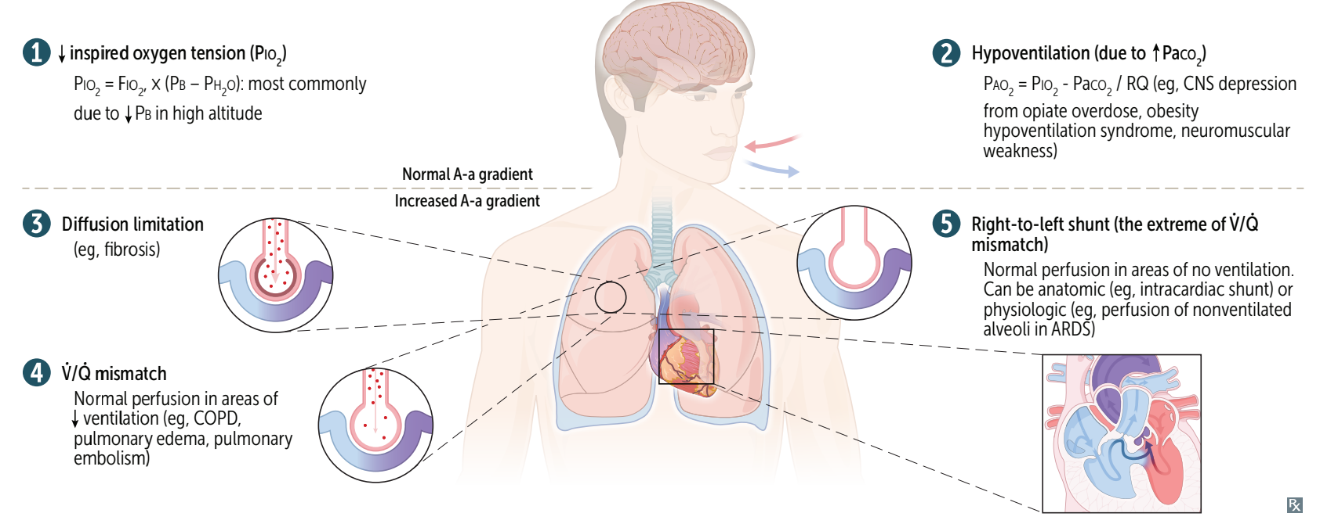
Causes of Hypoxia
Hypoxia: Inadequate oxygen delivery to tissues.
Hypoxaemia: Inadequate oxygenation of blood.
The Peer Teaching Society is not liable for false or misleading information…
Notes:
Image: First Aid for the USMLE Step 1 2023

Slide 14
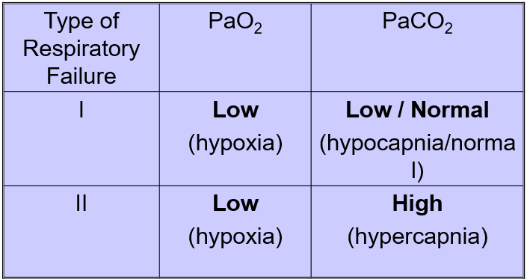
Respiratory Failure
Respiratory Failure: Inability to maintain normal gas exchange and blood gas levels.
Characterized by PaO₂ & PaCO₂ levels.
Type 1 = hypoxia and normo/hypocapnia
(1 value affected)
Type 2 = hypoxia and hypercapnia
(2 values affected)
Hypoxia is < 8kPa (normal:
Hypercapnia > 6.5 kPa (normal:
The Peer Teaching Society is not liable for false or misleading information…
Notes:
Image: First Aid for the USMLE Step 1 2023

Slide 15
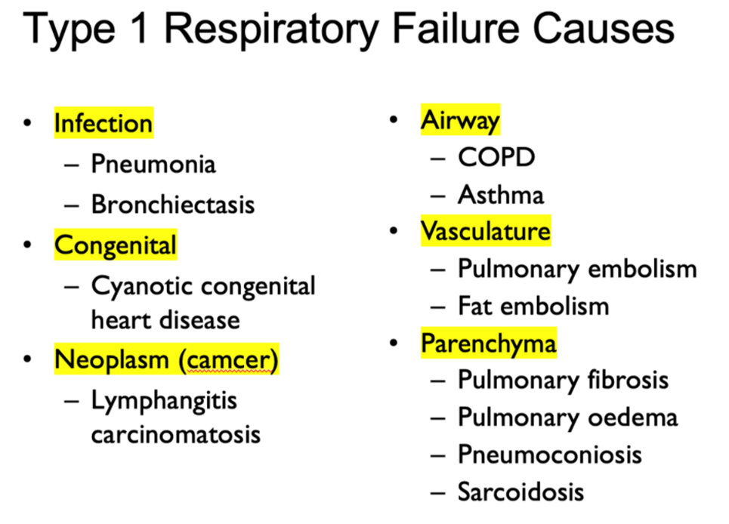
Causes of Type 1 Respiratory Failure
Causes of hypoxia also cause T1RF
Hypoventilation
Diffusion Impairment
Shunting
V/Q Mismatch
The Peer Teaching Society is not liable for false or misleading information…
Notes:
Image: Previous PTS Respiratory Teaching Presentation

Slide 16
Causes of Type 2 Respiratory Failure
Mainly hypoventilation
Less O₂ inspired and CO₂ expired
= higher blood levels.
Airway: Expiratory obstruction e.g COPD
Neuro, Drugs: Reduced resp drive.
Muscle: Resp pump failure.
The Peer Teaching Society is not liable for false or misleading information…

Slide 17
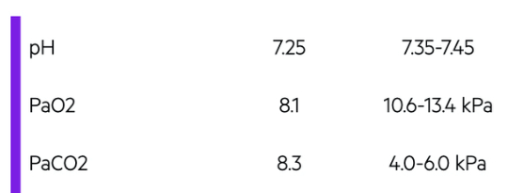
Question
A 68-year old man comes into A & E complaining of shortness of breath. You send a sample for blood gas analysis, the results of which are shown below.
What type of respiratory failure is he in and what could have caused it?
T1RF, asthma D. T2RF, COPD
T2RF, pulmonary fibrosis E. T2RF, pulmonary embolism
T1RF, pneumonia.
The Peer Teaching Society is not liable for false or misleading information…

Slide 18
Question
A 68-year old man comes into A & E complaining of shortness of breath. You send a sample for blood gas analysis, the results of which are shown below.
What type of respiratory failure is he in and what could have caused it?
T1RF, asthma D. T2RF, COPD
T2RF, pulmonary fibrosis E. T2RF, pulmonary embolism
T1RF, pneumonia.
The Peer Teaching Society is not liable for false or misleading information…

Slide 19
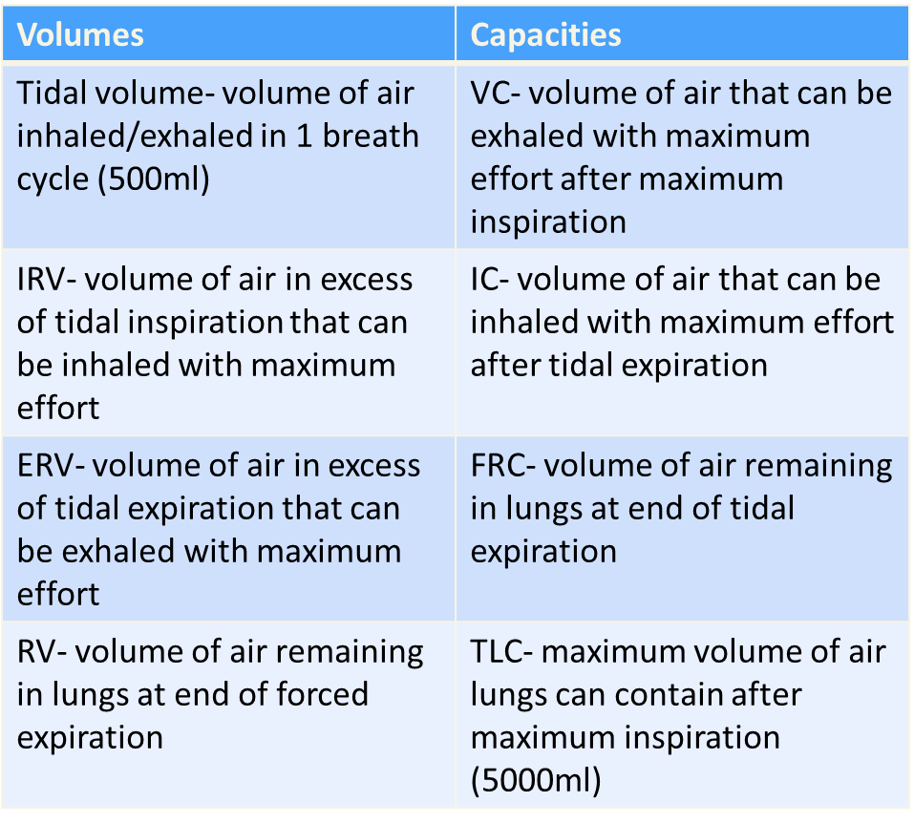
Spirometry
Measure of lung function.
4 capacities and 4 volumes.
Name as many as you can!
The Peer Teaching Society is not liable for false or misleading information…

Slide 20
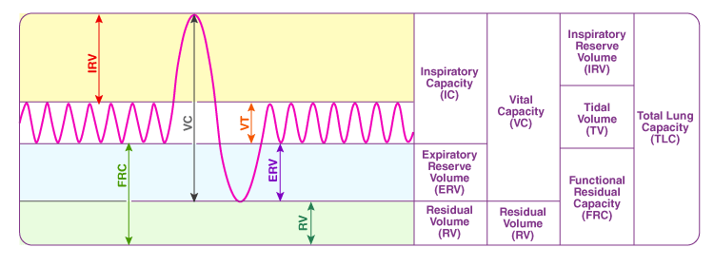
Spirometry Equations
Vital Capacity (VC) = TV + ERV + IRV
Inspiratory Capacity (IC) = IRV + TV
Total Lung Capacity (TLC) = VC + RV
The Peer Teaching Society is not liable for false or misleading information…
Notes:
Image: https://cdn1.byjus.com/wp-content/uploads/2022/06/spirogram-diagram.png

Slide 21
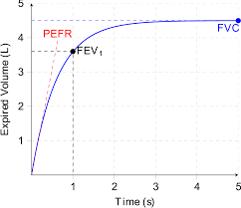
Volume/Time Curves
Method
Breathe in to TLC then exhale forcibly to RV
Values
Amount exhaled is vital capacity (L) - known as forced vital capacity (FVC) - recall that VC = TLC - RV
Forced expiratory volume in 1 second (FEV₁) is also measured.
The volume of air that can be exhaled with maximum effort after maximum inspiration in 1 second.
FEV₁:FVC > 0.7 is normal.
Healthy individuals should forcibly exhale > 70% of total lung capacity in 1 second
The Peer Teaching Society is not liable for false or misleading information…
Notes:
Image: Prof. Fishwick’s Slides

Slide 22
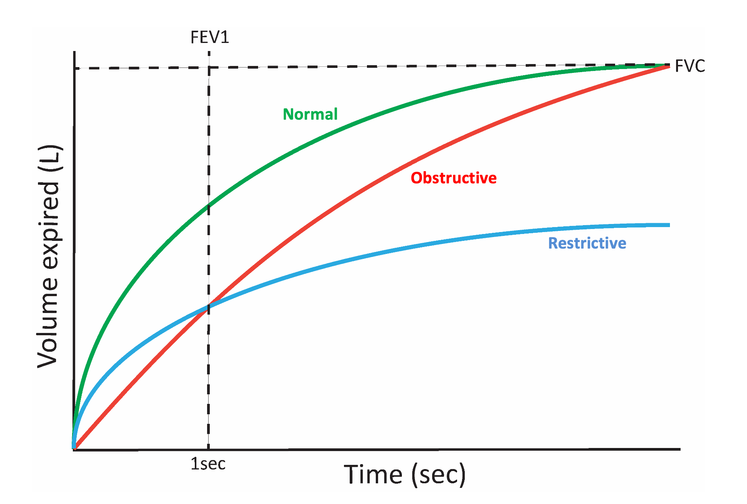
Obstructive & Restrictive Lung Disease
 | Obstructive Lung Disease | Restrictive Lung Disease
Mechanism | Impairment in airflow: Difficulty getting air out of the lungs due to mucus, bronchoconstriction, etc. | Impairment in lung volume: Difficulty getting air in the lungs due to factors like reduced chest expansion, etc.
Causes | Asthma COPD Bronchiectasis | Interstitial Lung Disease Neuromuscular Disorders Obesity
FEV₁: FVC | < 0.7 | Normal
FEV₁ | < 80% of predicted value | Normal
FVC | Normal | < 80% of predicted value
TLC | Normal | Reduced
The Peer Teaching Society is not liable for false or misleading information…
Notes:
Image: Prof. Fishwick’s Slides

Slide 23
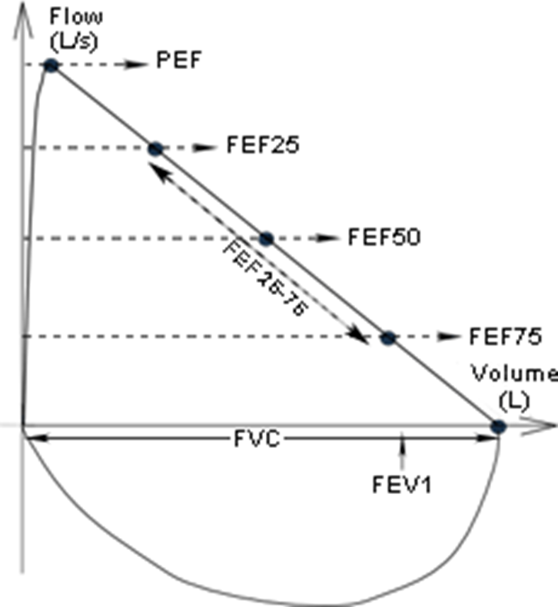
Flow/Volume Curves
Method
Same procedure as volume/time, expect plot flow rate as a function of volume.
Interpretation
Can be seen that there is a linear reduction in the flow rate as you forcibly exhale more air.
PEF: Peak expiratory flow rate (L/min)
Measure of highest flow rate during forced expiration after maximal inspiration - effort dependent.
FEF25: Flow rate at point when 25% of total volume has been exhaled.
The Peer Teaching Society is not liable for false or misleading information…
Notes:
Image: Prof. Fishwick’s Slides

Slide 24
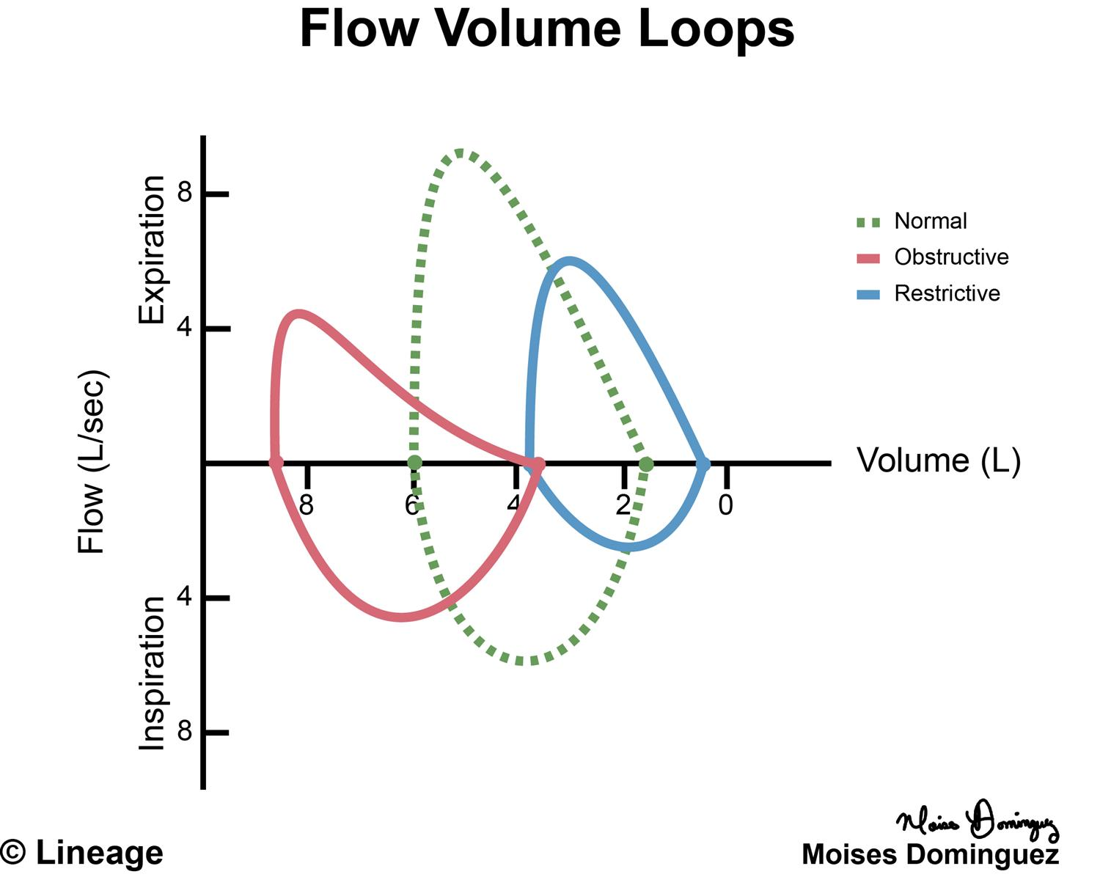
Obstructive & Restrictive Flow/Volume Loops
Obstructive Lung Disease | Restrictive Lung Disease
Shifts Curve Left | Shifts Curve Right (Restrictive = Right)
Width of curve remains same as volumes are not reduced. Concave shape as outflow obstruction disproportionately reduces flow rate. | Initial lung volume is reduced so curve starts at a lesser number. Width of curve is smaller because lung capacities are reduced. Shape remains the same as flow rate still decreases linearly.
The Peer Teaching Society is not liable for false or misleading information…
Notes:
Image: https://upload.medbullets.com/topic/117003/images/071517mdstep1pulmflowvolumeloops.jpg

Slide 25
Question
You work in a GP surgery, and suspect a patient you have seen has developed COPD. Spirometry needs to be performed to confirm your suspicions.
What would you anticipate the FEV1 : FVC ratio would be if this patient has asthma?
A.1.3
B.0.8
C.0.6
D.<80% of predicted.
E. 1
The Peer Teaching Society is not liable for false or misleading information…
Notes:
Image: https://upload.medbullets.com/topic/117003/images/071517mdstep1pulmflowvolumeloops.jpg

Slide 26
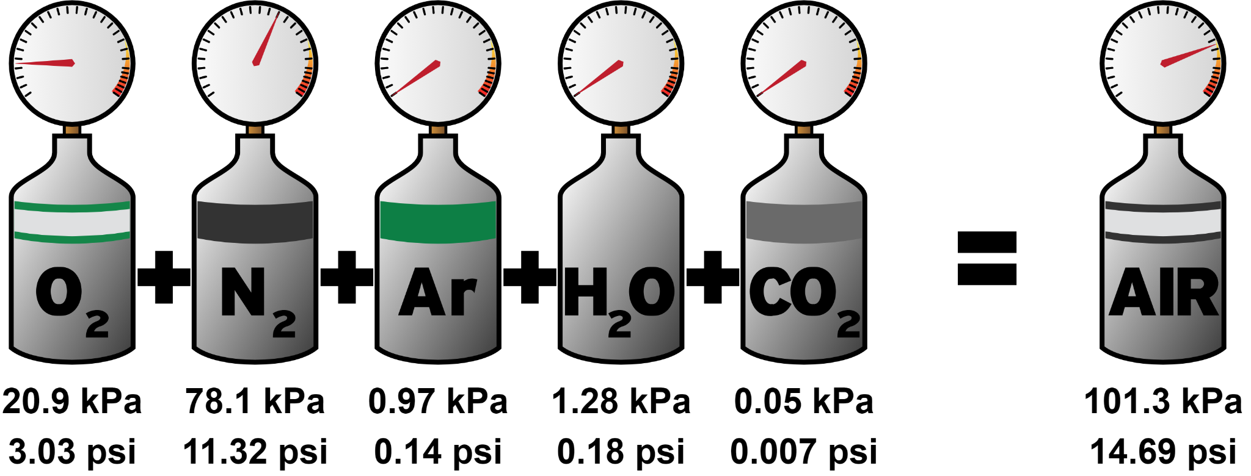
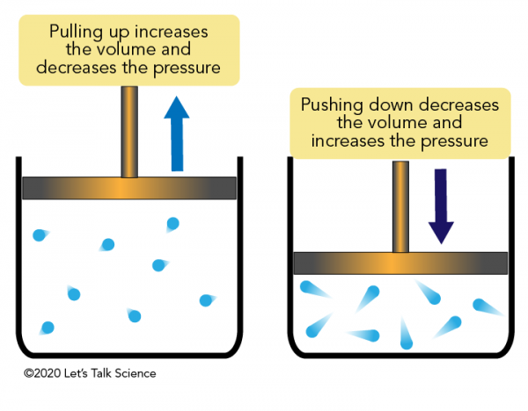
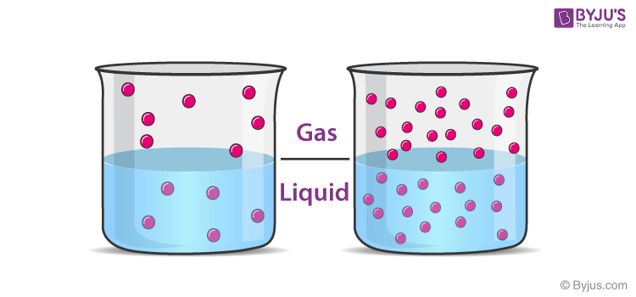
Gas Laws
Dalton's law
Boyle's law
Henry's law
Which diagram represents which law?
The Peer Teaching Society is not liable for false or misleading information…
Notes:
Image: https://www.google.com/url?sa=i&url=https%3A%2F%2Frk.md%2F2018%2Fhypoxic-pulmonary-vasoconstriction-hpv%2F&psig=AOvVaw3VMNmbiAl5DnJbl0FliRmS&ust=1699556987728000&source=images&cd=vfe&opi=89978449&ved=0CBIQjRxqFwoTCIi9i6qNtYIDFQAAAAAdAAAAABAP
Daltons law- top
Boyles law- bottom right
Henrys law- bottom left

Slide 27
Gas Laws
Henry's Law: The amount of gas that is dissolved in a liquid is directly proportional to the partial pressure of gas above the liquid
Dalton's Law (Law of Partial Pressures): Total pressure exerted by a mixture of gases is equal to the sum of the partial pressures of the gases in the mixture.
Boyle's Law: The volume of a gas and pressure are inversely proportional at a given temperature. In other words, when the pressure increases, the volume decreases, and vice versa
Notes:
Images: https://letstalkscience.ca/sites/default/files/styles/x_large/public/2020-01/boyles_law.png?itok=b_PdmQXY
https://i.ytimg.com/vi/RqffPYOoxd8/maxresdefault.jpg

Slide 28
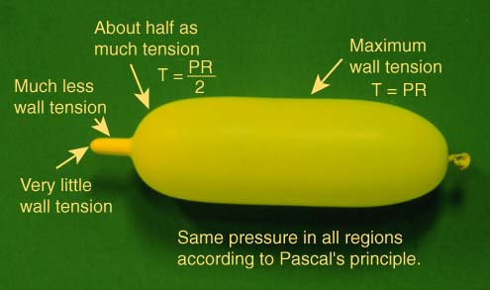
Alveolar Gas Equation & Laplace’s Law
Laplace's Law
Alveolar gas equation
Which diagram represents which law?

Slide 29
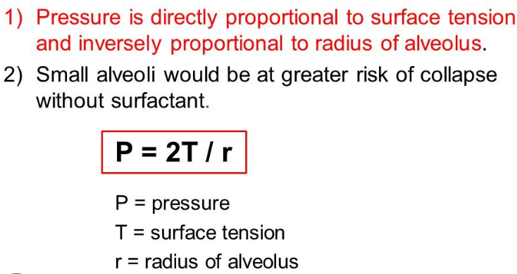
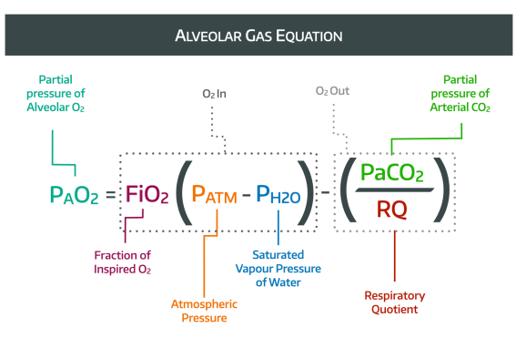
Alveolar Gas Equation & Laplace’s Law
The alveolar gas equation is used to calculate alveolar oxygen partial pressure as it is not possible to collect gases directly from the alveoli. The equation is helpful in calculating and closely estimating the PaO2 inside the alveoli. The variables in the equation can affect the PaO2 inside the alveoli in different physiological and pathophysiological states.
Laplace's law states that the pressure in a bubble or alveoli is proportional to two times the surface tension divided by the radius of the bubble.
Notes:
Images: https://images.hive.blog/0x0/https://cdn.steemitimages.com/DQmVsTjDuMWKoSsFBVH9PKJFdRjxmnYeVHYSM3rttvLLhKK/Law%20of%20Laplace%20formula.jpg
https://i0.wp.com/anaestheasier.co.uk/wp-content/uploads/2022/08/Alveolar-Gas.001.png?resize=660%2C371&ssl=1

Slide 30
Airway Tone - Sympathetic Stimulation
Sympathetic stimulation causes bronchodilation
-Lung receives innervation from T2-T4 ganglia of sympathetic chain
-Ach released at preganglionic synapse binds to N1 receptors
-NAd released from postganglionic neurone acts indirectly by stimulating release of adrenaline from adrenal medulla
-Noradrenaline binds to beta-2 receptors on airway smooth muscle causing bronchodilation
N1
β2
Notes:
Image: https://www.minerva.shef.ac.uk/minerva/med/lecture_resources/phase2a/64355_adrenergic%20&%20cholinergic%20pharmacology.pdf

Slide 31
Airway Tone - Parasympathetic Stimulation
Parasympathetic stimulation causes bronchoconstriction
-Lung receives bilateral innervation from vagus nerves (NB: vagus nerve provides parasympathetic innervation to all organs of thorax and abdomen)
-ACh released at preganglionic synapse binds to N1 receptors
-ACh released from postganglionic neurone binds to M3 receptors on airway smooth muscle causing bronchoconstriction (↑ airways smooth muscle tone)
N2
M3
Notes:
Image: https://www.minerva.shef.ac.uk/minerva/med/lecture_resources/phase2a/64355_adrenergic%20&%20cholinergic%20pharmacology.pdf

Slide 32
Drugs Affecting Airway Tone
Muscarinic receptors in airways are receptive to cholinergic activity resulting in airway constriction. The use of drugs that antagonise muscarinic airway receptors result in bronchodilation.
E.g ipratropium bromide.
Beta receptors in airways (beta 2) respond to the effects of catecholamine such as noradrenaline and adrenaline, to result in airway dilation. Agonism of these receptors with salbutamol results in bronchodilation.

Slide 33
Questions
What branch of the autonomic nervous system causes bronchodilation when activated (and when inhibited)?
Muscarinic receptors are agonised to cause bronchial dilation.
TRUE?
FALSE?

Slide 34
Questions
What branch of the autonomic nervous system causes bronchodilation when activated (and when inhibited)?
Sympathetic
Muscarinic receptors are agonised to cause bronchial dilation.
TRUE?
FALSE?

Slide 35
Hypersensitivity
The Four Reactions:
Type 1. IgE
Acute anaphylaxis, hayfever
Type 2. Ig bound to cell surface antigens
Transfusion reactions, autoimmune disease
Type 3. Immune complexes, activation of complement
SLE, post-streptococcal GN
Type 4. T cell mediated DTH
TB, contact dermatitis

Slide 36
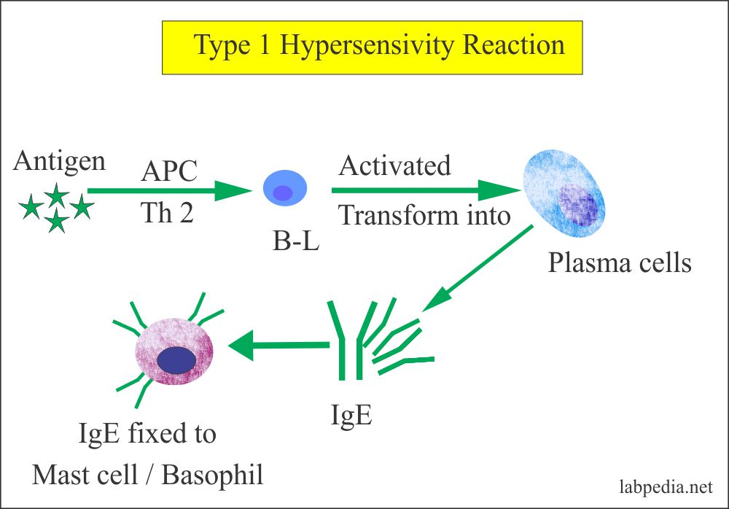
Hypersensitivity: Type 1 Reactions
Immediate reaction mediated by IgE with histamine being a primary mediator.
Subsequent exposure results in IgE cross-linking and degranulation of mast cells and basophils. This is anaphylaxis.
Examples: Asthma, hay fever.

Slide 37
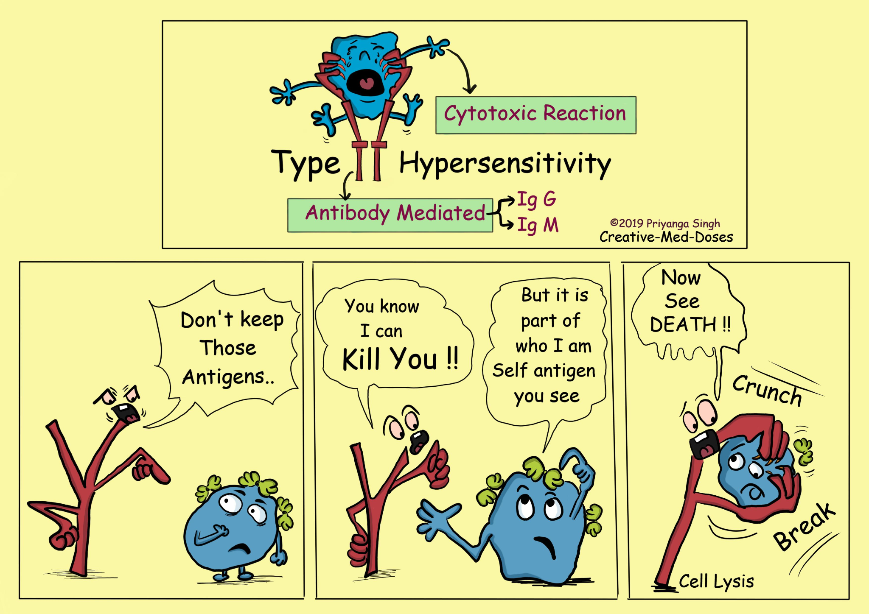
Hypersensitivity: Type 2 Reactions
Occurs due to IgG or IgM mediated cytotoxic reaction occurring hours to days after exposure.
Pathologies such as Goopastures and autoimmune haemolytic anaemia are examples.

Slide 38
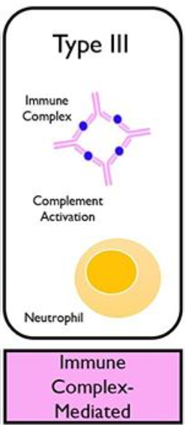
Hypersensitivity: Type 3 Reactions
Antigen-antibody complex deposition which can occur hours to weeks post exposure.
Rheumatoid arthritis, hypersensitivity pneumonitis e.g pigeon fancier’s lung, farmer’s lung, SLE and post-strep nephritis are examples of this.

Slide 39
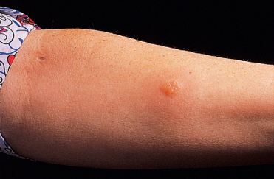
Hypersensitivity: Type 4 reactions
Type IV hypersensitivity is mediated by T lymphocytes and is delayed occurring 24 to 72 hours after antigen presentation.
This is seen in contact dermatitis and tuberculin skin tests to diagnose tuberculosis.

Slide 40
Questions
The binding of WHAT causes mast cell degranulation in type 1 hypersensitivity? What timeframe do these occur over?
What kind of reaction is type 2 hypersensitivity? Over what time frame does it occur?
What time frame does type 3 hypersensitivity occur over and how long does it take to occur?
What disease is type 3 hypersensitivity reaction?
What mediates type 4 hypersensitivity? What is it used to diagnose?

Slide 41
Questions
The binding of WHAT causes mast cell degranulation in type 1 hypersensitivity? Histamine
What timeframe do these occur over? Within 1 hour
What kind of reaction is type 2 hypersensitivity? IgG and IgM mediated cytotoxic reaction
Over what time frame does it occur? Between 2-24 hours

Slide 42
Questions
What time frame does type 3 hypersensitivity occur over and how long does it take to occur? Hours to weeks post exposure
What disease is type 3 hypersensitivity reaction? Post strep nephritis, SLE, pigeon fancies lung
What mediates type 4 hypersensitivity? T lymphocytes
What is it used to diagnose? In tuberculin skin testing for tuberculosis

Slide 43
References
Vander’s Human Physiology
TeachMePhysiology.com
Phase 1 Lectures
PTS Presentations
KP Notes
ZerotoFinals
The Peer Teaching Society is not liable for false or misleading information…

Slide 44
Feedback
https://docs.google.com/forms/d/e/1FAIpQLSdmXgw2NLTKiJyK7xqnHKj5bUVNgu76B4q6Yc2BU9ythjMQuQ/viewform
The Peer Teaching Society is not liable for false or misleading information…

