Slide 1
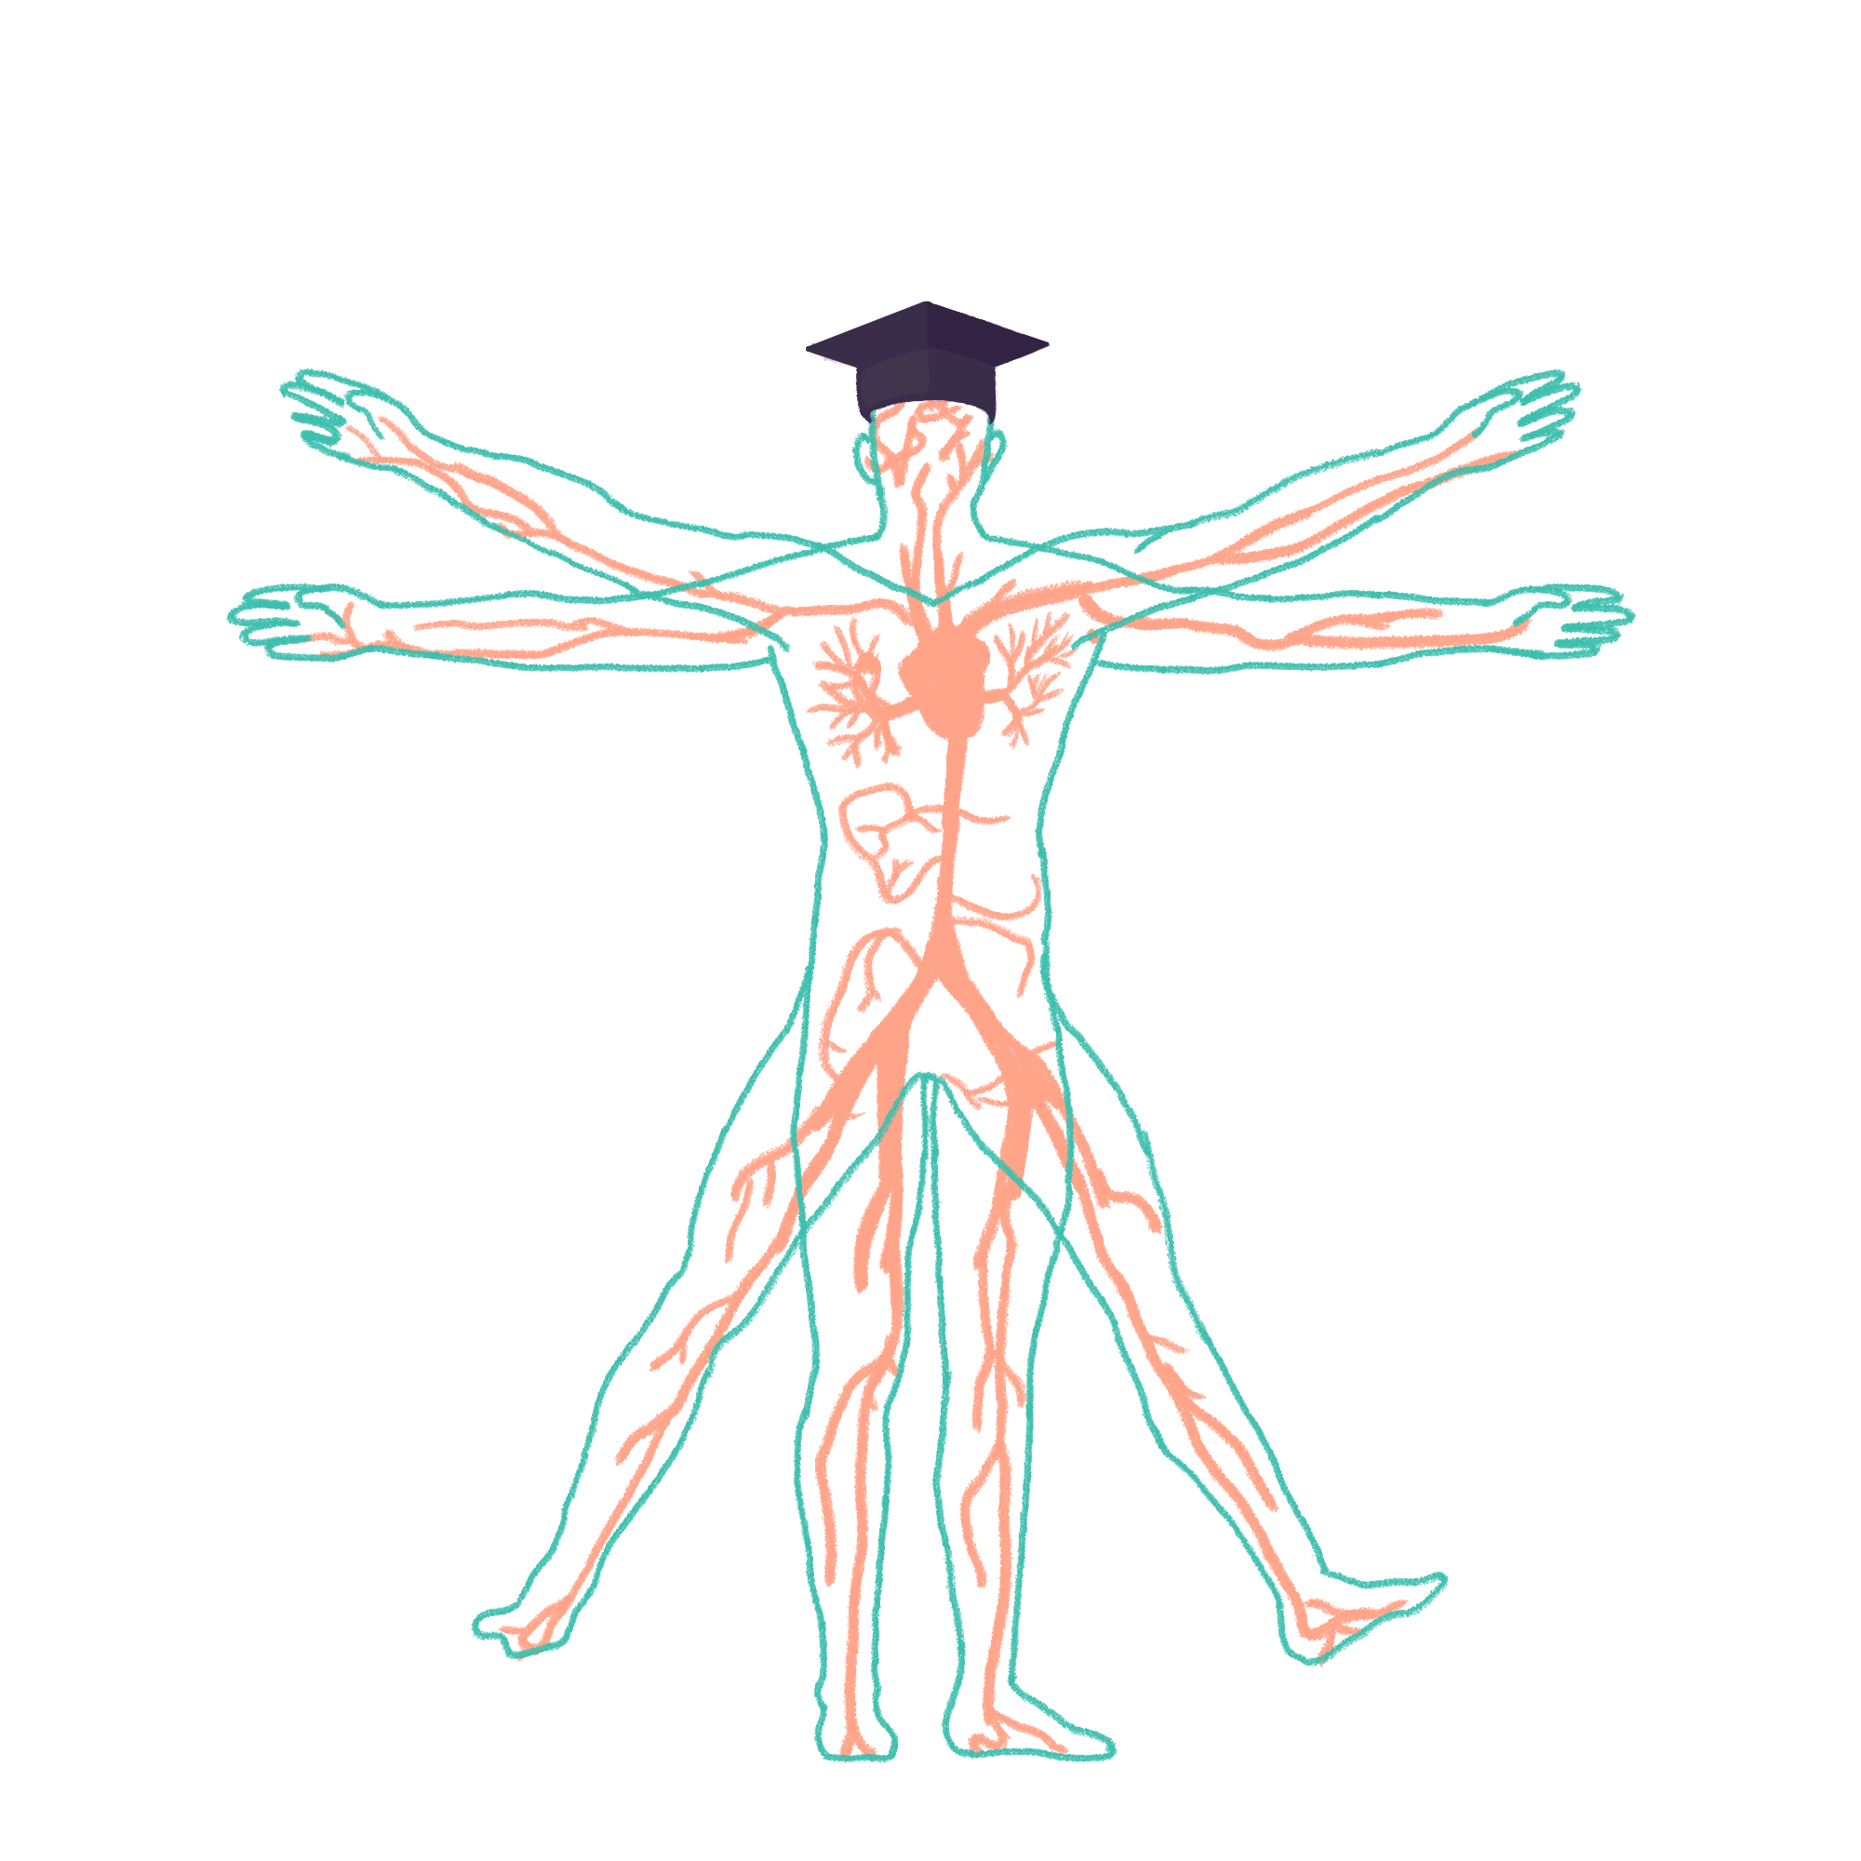
2023/2024

Slide 2
Rheumatology/MSK
Phase 2a Wrap Up
Thursday 21st March
Julia Min & Chai Jin Lim
The Peer Teaching Society is not liable for false or misleading information…

Slide 3
Question
A 66 year old female presents to her GP with pain in her left hip. The pain as slowly gotten worse over the past 2 years. Until recently it only occured after walking a large distance but now it is fairly constant. The pain is worse with walking and feels stiff in the morning for around 10 minutes. The patient has a BMI of 31. On examination, hip flexion is slightly reduced and there are bony swellings on some of the joints in her hands.
Given the most likely diagnosis, what is the most likely radiological finding on an x-ray of the hip?
Bony erosions
Pencil-in-cup deformity
Soft tissue swelling
Osteophytes
Periarticular osteoporosis

Slide 4
Question
A 66 year old female presents to her GP with pain in her left hip. The pain as slowly gotten worse over the past 2 years. Until recently it only occured after walking a large distance but now it is fairly constant. The pain is worse with walking and feels stiff in the morning for around 10 minutes. The patient has a BMI of 31. On examination, hip flexion is slightly reduced and there are bony swellings on some of the joints in her hands.
Given the most likely diagnosis, what is the most likely radiological finding on an x-ray of the hip?
Bony erosions
Pencil-in-cup deformity
Soft tissue swelling
Osteophytes
Periarticular osteoporosis
Osteophytes, also called bone spurs, are bony projections occuring at joint edges in osteoarthritis as new bone is laid down in a disorganised fashion in response to injury. Other x-ray features of osteoarthritis include LOSS - Loss of joint space, Osteophytes, Subchondral sclerosis, Subchondral cysts.

Slide 5
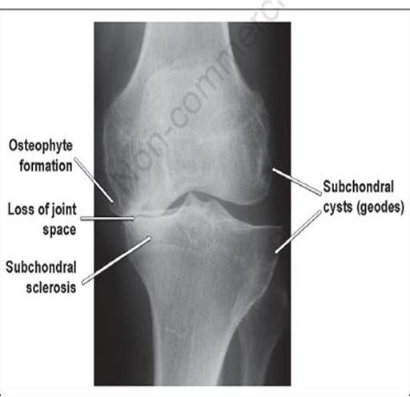
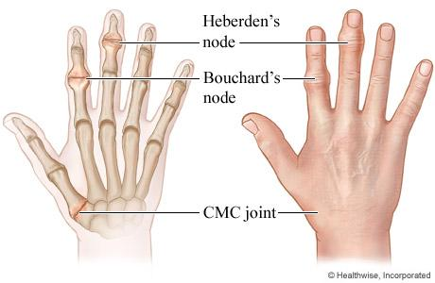
Osteoarthritis
Non-inflammatory, degenerative progressive destruction of cartilage from repeated mechanical forces. Disruption of the chondrocytes prevents rebuilding.
RF: Older age (50+), women, obesity, occupation/sports
Signs: Proximal Bouchard nodes (PIP joints), Distal Heberden nodes (DIP joints)
Symptoms: Painful joints stiff for 30 minutes or less in the morning. Worse throughout the day
Investigations (X-ray): LOSS - (Loss of joint space, Osteophytes, Subchondral sclerosis, Subchondral cysts)
Management: Lifestyle changes, NSAID, analgesia, surgery (last resort)

Slide 6
Question
A 65 year old woman with 20 year history of rheumatoid arthritis presents with 3 month history of recurrent sinopulmonary infections. On examination, she has low grade pyrexia of 37.6. Her hands and wrists are severely deformed with presence of rheumatoid nodules on her elbow. A mass is felt in the left upper quadrant of her abdomen. No lymph node was palpable. Blood tests show low neutrophil count, raised ESR and positive Rheumatoid Factor.
What is the most likely diagnosis?
Cytomegalovirus Infection
Chronic Lymphocytic Leukemia (CLL)
Amyloidosis
Sarcoidosis
Felty Syndrome

Slide 7
Question
A 65 year old woman with 20 year history of rheumatoid arthritis presents with 3 month history of recurrent sinopulmonary infections. On examination, she has low grade pyrexia of 37.6. Her hands and wrists are severely deformed with presence of rheumatoid nodules on her elbow. A mass is felt in the left upper quadrant of her abdomen. No lymph node was palpable. Blood tests show low neutrophil count, raised ESR and positive Rheumatoid Factor.
What is the most likely diagnosis?
Cytomegalovirus Infection
Chronic Lymphocytic Leukemia (CLL)
Amyloidosis
Sarcoidosis
Felty Syndrome
Triad of long standing Rheumatoid Arthritis, idiopathic neutropenia and splenomegaly points towards Felty Syndrome. It tends to affects patients in their 50s to 70s, who have had longstanding, erosive RA. The typical patient has a history of over 10 years of active disease and is strongly associated with a positive rheumatoid factor and HLA DR4. Management includes DMARDs and corticosteroids initially, followed by anti-TNF biologics if these fail.

Slide 8
Rheumatoid Arthritis
Autoimmune destruction of the synovium. Inflammation causes damage to bone cartilage tendons and ligaments.
RF: Female, smoking, family history, other autoimmune diseases, HLA DR4 genetic link
Signs: Swan neck deformity, Ulnar deviation, Boutonniere deformity, Z thumb
Symptoms: Painful, swollen, stiff joints for more than an hour in the morning, better with movement
Investigations:
Bloods: Anti CCP (most sensitive), rheumatoid factor, raised ESR/CRP
X ray: LESS - Lost joint space, Erosion, Soft tissue swelling, Soft bones
Management:
Ibuprofen/NSAIDS + PPI
Steroids - may be used at initial presentation, when initiating a new treatment and during flares to settle the inflammation and control symptoms quickly
DMARDs - Methotrexate, leflunomide, sulfasalazine. Hydroxychloroquine (mildest anti rheumatic drug)
2nd line: two of above in combination, 3rd line: methotrexate + TNF inhibitor, 4th line: methotrexate + Rituximab (biologics)

Slide 9
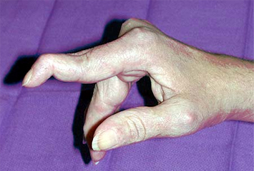
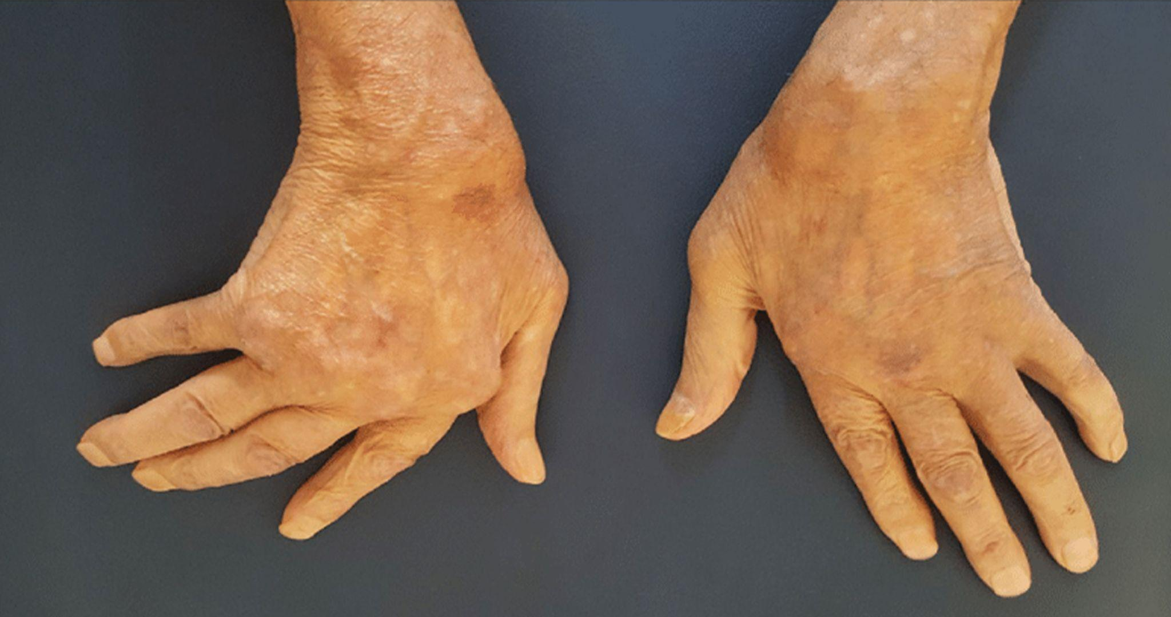
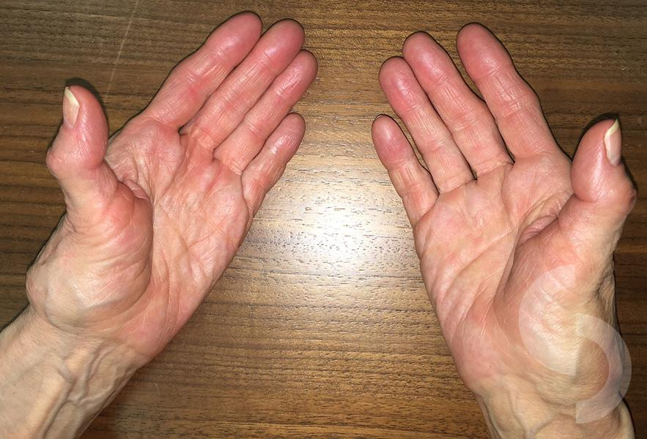
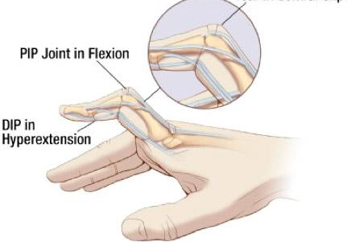

Slide 10
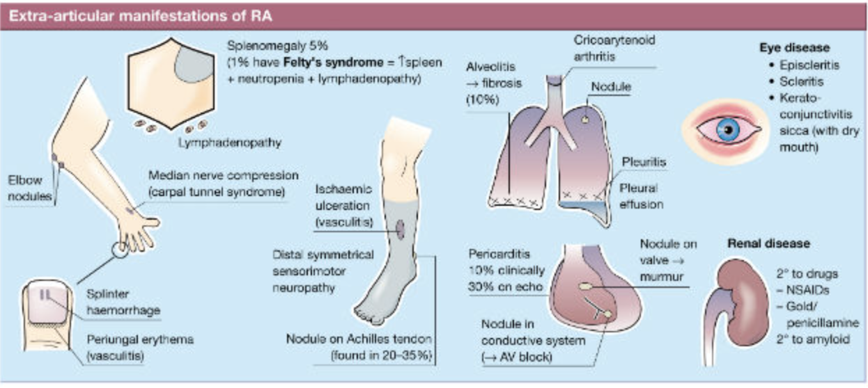
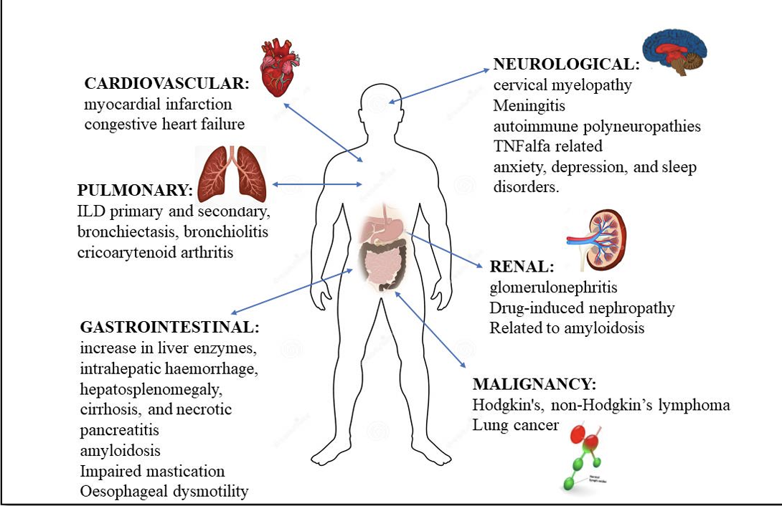
Extra-articular Manifestations!!
Pulmonary fibrosis
Felty’s syndrome (a triad of rheumatoid arthritis, neutropenia and splenomegaly)
Sjögren’s syndrome (with dry eyes and dry mouth)
Anaemia of chronic disease
Eye manifestations - (Dry eye syndrome (keratoconjunctivitis sicca), Scleritis, Keratitis, Cataracts (secondary to steroids), Retinopathy (secondary to hydroxychloroquine)

Slide 11
Question
An 89 year old female presents to the emergency department with severe knee pain and joint swelling. The doctor in the emergency department suspects that he may have pseudogout, and decides to aspirate the joint.
Which of the following is the correct description of crystals which are seen in pseudogout when viewed under polarised light microscopy?
Positively birefringent rhomboid-shaped crystals
Positively birefringent needle-shaped crystals
Negatively birefringent rhomboid-shaped crystals
Negatively birefringent needle-shaped crystals
Positively birefringent oval-shaped crystals

Slide 12
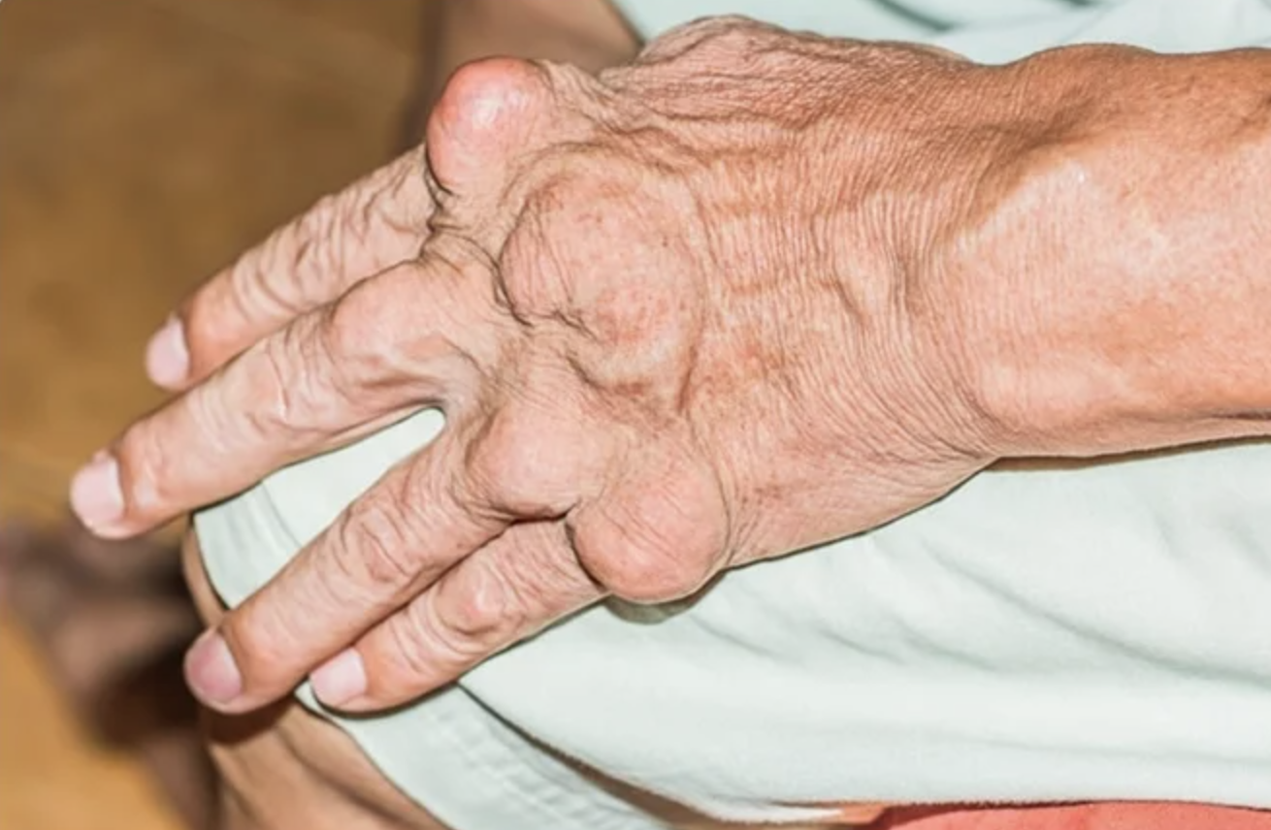
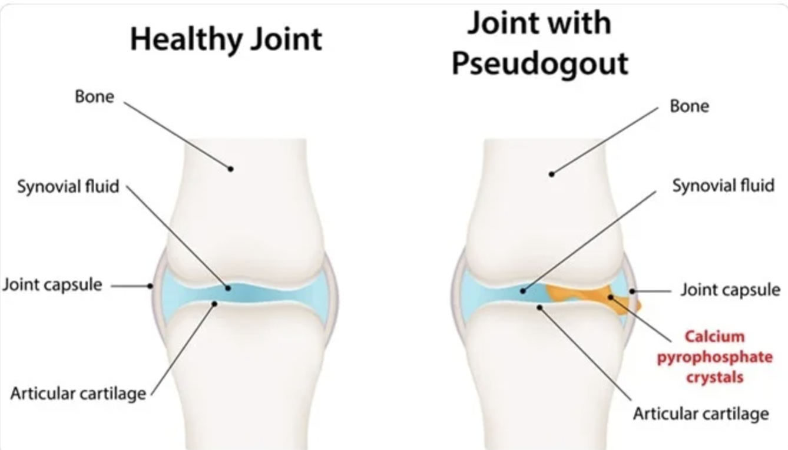
Question
An 89 year old female presents to the emergency department with severe knee pain and joint swelling. The doctor in the emergency department suspects that he may have pseudogout, and decides to aspirate the joint.
Which of the following is the correct description of crystals which are seen in pseudogout when viewed under polarised light microscopy?
Positively birefringent rhomboid-shaped crystals
Positively birefringent needle-shaped crystals
Negatively birefringent rhomboid-shaped crystals
Negatively birefringent needle-shaped crystals
Positively birefringent oval-shaped crystals
Positively birefringent rhomboid-shaped crystals is the correct description of the crystals which are seen on polarised light microscopy in pseudogout

Slide 13
 | Gout | Pseudogout
Risk factors | Middle aged, Overweight, Male, Purine-rich diet (red meat, seafood, BEER) | Elderly female, Diabetes, Metabolic diseases, Osteoarthritis, Hyperparathyroidism, Haemochromatosis
Sites Affected | Monoarticular, typically BIG TOE (metatarsophalangeal joint) | Polyarticular, typically knee
Crystal Type | Monosodium urate | Calcium pyrophosphate
Microscopy Findings | Negatively birefringent needle shaped crystals | Positively birefringent rhomboid shaped crystals
Treatment | 1st line: NSAID 2nd line: Colchicine Prophylaxis: Allopurinol (xanthine oxidase inhibitor, reduces uric acid formation) | 1st line: NSAID 2nd line: Colchicine

Slide 14
Question
A 41 year old woman with a background of long standing severe asthma, poorly controlled diabetes and stage 4 chronic kidney disease undergoes a DEXA scan because of her long term use of steroids. The scan results gives a T score of -2.7. She reports that she is still getting menstrual periods.
What is the most appropriate management of this patient?
HRT
Raloxifene
Bisphosphonate
Denosumab
No action required

Slide 15
Question
A 41 year old woman with a background of long standing severe asthma, poorly controlled diabetes and stage 4 chronic kidney disease undergoes a DEXA scan because of her long term use of steroids. The scan results gives a T score of -2.7. She reports that she is still getting menstrual periods.
What is the most appropriate management of this patient?
HRT
Raloxifene
Bisphosphonate
Denosumab
No action required
A T score <-2.5 indicates osteoporosis. First line in the treatment of osteoporosis would be bisphosphonates. However, these are contraindicated in this patient because of her poor kidney function. Denosumab is therefore a perfectly reasonable first option in this case. It is a monoclonal antibody which acts against RANK ligand on osteoclasts thereby reducing their activity

Slide 16
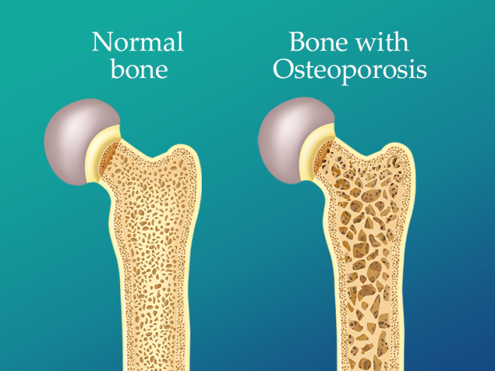
Osteoporosis
Reduction in the density of the bones (T< -2.5).
RF: SHATTERED
Steroid use
Hyperthyroidism, hyperparathyroidism, hypercalciuria
Alcohol + tobacco use
Thin (BMI < 18.5)
Testosterone (low) - women
Early menopause - women after menopause (oestrogen is protective)
Renal or liver failure
Erosive / inflammatory bone disease (e.g., myeloma or RA)
Dietary low calcium / malabsorption or DM1

Slide 17
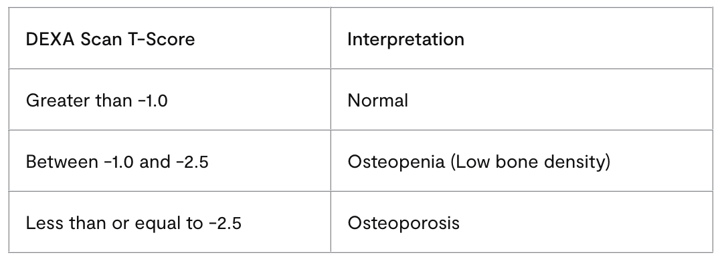
Osteoporosis
Investigations:
DEXA scan (Gold standard) with a T-score of -2.5 or lower indicating osteoporosis
Management:
Lifestyle advice - exercise, maintaining a healthy weight, stop smoking, reduce alcohol.
1st line: Vitamin D + calcium supplementation
Bisphosphonates e.g. alendronate, risendronate, zolendronic acid - (reduces osteoclastic activity).
2nd line: Denosumab - (monoclonal Ab that blocks activity of osteoclasts – binds to RANK-ligand)
HRT - especially for early-menopausal women
Notes:
Bone mineral density (BMD) is measured using a DEXA scan (dual-energy x-ray absorptiometry). DEXA scans are a type of x-ray that measures how much radiation is absorbed by the bones, indicating how dense the bone is. The bone mineral density can be measured anywhere on the skeleton, but the femoral neck reading is most important.
Bone density can be represented as a Z-score or T-score. The Z-score is the number of standard deviations the patient is from the average for their age, sex and ethnicity. The T-score is the number of standard deviations the patient is from an average healthy young adult. The T-score is used to make the diagnosis.
Bisphosphonates: Always take bisphosphonates on an empty stomach with a full glass of water. Stand or sit upright for at least 30 minutes after taking them. To prevent reflux or oesophageal erosions.
Post-menopausal women are an important group where osteoporosis should be considered. Oestrogen is protective against osteoporosis but drops significantly after menopause. Hormone replacement therapy (HRT) is protective against osteoporosis.

Slide 18
Question
A 54 year old female presents to her general practitioner with a 2 week history of left sided headache. It is worse when combing the left side of her head. Today, prior to her appointment, she describes a transient visual defect on in her left eye.
What should be the first course of action undertaken by the GP?
ESR and CRP
Temporal artery biopsy
Refer to next day ophthalmology clinic
Methotrexate
Prednisolone

Slide 19
Question
A 54 year old female presents to her general practitioner with a 2 week history of left sided headache. It is worse when combing the left side of her head. Today, prior to her appointment, she describes a transient visual defect on in her left eye.
What should be the first course of action undertaken by the GP?
ESR and CRP
Temporal artery biopsy
Refer to next day ophthalmology clinic
Methotrexate
Prednisolone
This woman has a history of sub-acute headache with associated visual loss and tender scalp. Given her age and her history, the most important diagnosis not to miss is giant cell arteritis (GCA). Rapid treatment with high dose prednisolone (60mg) has been shown to both treat and reduce further complications of GCA.

Slide 20
Vasculitis (Large) - Giant Cell Arteritis
Affects aorta and/or its major branches (carotid and vertebral arteries) Temporal artery often involved.
Strong link with polymyalgia rheumatica!!
RF: Almost exclusively in >50 yr old, Caucasian, Females 2-3x more affected, Hx of polymyalgia rheumatica
Presentation:
Headache! New onset, typically unilateral over temporal area
Scalp tenderness (hurts to brush hair)
Jaw claudication
Visual disturbances (blurred vision, diplopia, amaurosis fugax)
Investigations:
1st line:↑ESR and/or CRP
GOLD STANDARD: Temporal artery biopsy (show giant cells, granulomatous inflammation)

Slide 21
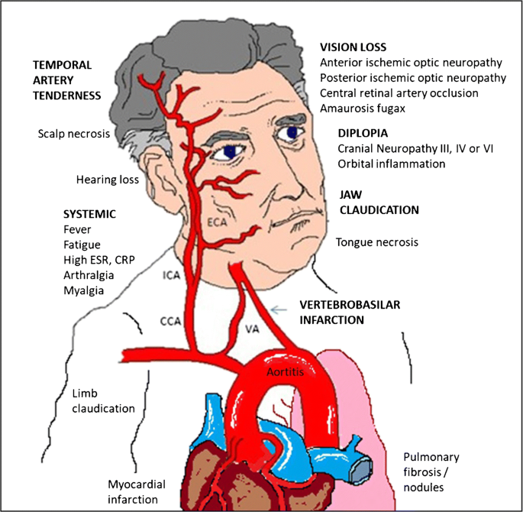
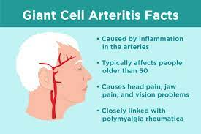
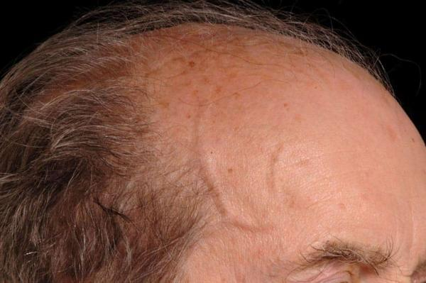
Vasculitis (Large) - Giant Cell Arteritis
Management:
High dose glucocorticoid ASAP! – usually prednisolone 40-60mg
Complication:
Blindness! (SUDDEN PAINLESS VISION LOSS in ONE EYE, optic neuropathy)
If temporary: Amaurosis fugax (typically seen in TIA)
May be permanent if not treated ASAP (HIGH DOSE IV METHYLPREDNISOLONE)

Slide 22
Question
A 50 year old man presents to the Emergency Department with right upper quadrant abdominal pain, nausea and vomiting, pale stools and dark urine. He is a known intravenous drug user and has no history of recent travel. He reports fatigue, generalised muscle and joint pains and a purplish mottled rash over his shins. He also has occasional numbness and tingling in his hands and feet. Blood pressure is 160/100. Blood results show elevated ESR. Anti-smooth muscle antibodies are negative. The doctor starts prednisolone & ramipril.
Which of the following liver conditions is associated with this condition?
Drug-induced hepatitis
Autoimmune hepatitis
Hepatitis A
Hepatitis E
Hepatitis B

Slide 23
Question
A 50 year old man presents to the Emergency Department with right upper quadrant abdominal pain, nausea and vomiting, pale stools and dark urine. He is a known intravenous drug user and has no history of recent travel. He reports fatigue, generalised muscle and joint pains and a purplish mottled rash over his shins. He also has occasional numbness and tingling in his hands and feet. Blood pressure is 160/100. Blood results show elevated ESR. Anti-smooth muscle antibodies are negative. The doctor starts prednisolone & ramipril.
Which of the following liver conditions is associated with this condition?
Drug-induced hepatitis
Autoimmune hepatitis
Hepatitis A
Hepatitis E
Hepatitis B
This patient has presented with symptoms affecting multiple systems (renal, cardiac, and musculoskeletal) so this raises suspicion of a systemic condition- specifically polyarteritis nodosa. Hepatitis B is associated with polyarteritis nodosa and can be deduced from the presentation given the history of intravenous drug use and classic liver symptoms.

Slide 24
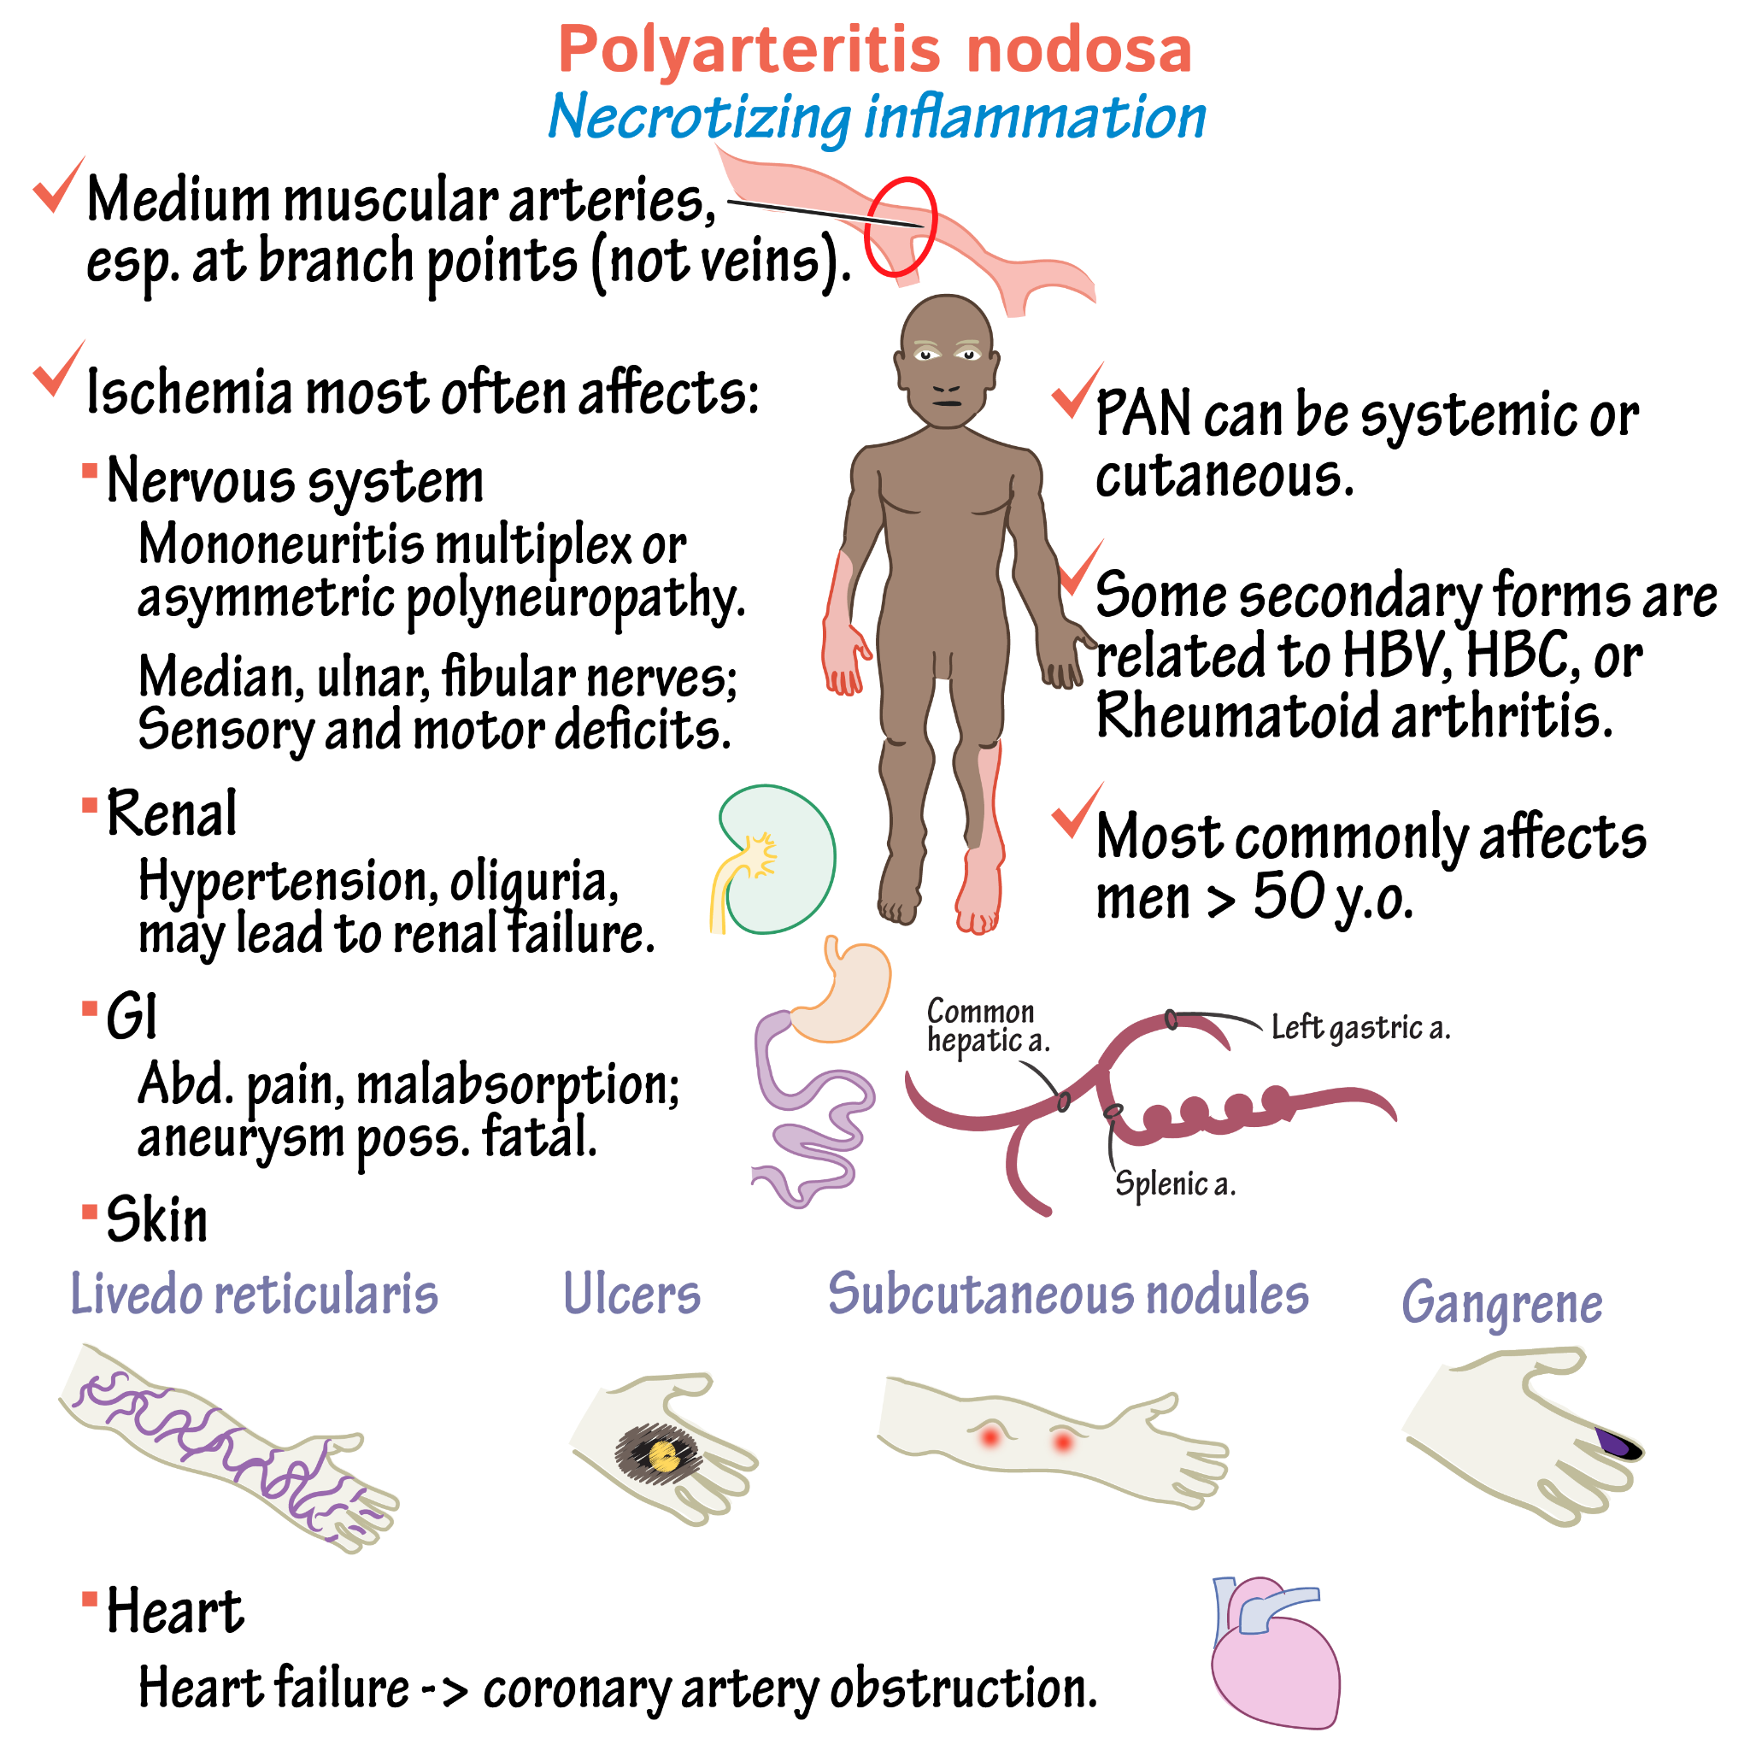
Vasculitis (Medium) - Polyarteritis nodosa
Affects the medium sized vessels in locations such as skin, GI tracts, kidneys and heart
Associated with hepatitis B
Presentation:
Peripheral neuropathy - mononeuritis multiplex
CKD/AKI
Cutaneous/subcutaneous nodules
Unilateral orchitis (characteristic feature)
Livedo reticularis - mottled, purplish, lace like rash
HTN
Investigations:
CT angiogram (“Beads on string”)
Biopsy (transmural fibrinoid necrosis)
Management:
If Hep B negative – corticosteroids + cyclophosphamide
If Hep B positive – antiviral agent, plasma exchange and corticosteroids

Slide 25
Please fill out the feedback form!!

Slide 26
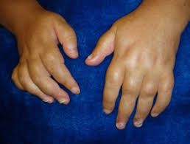
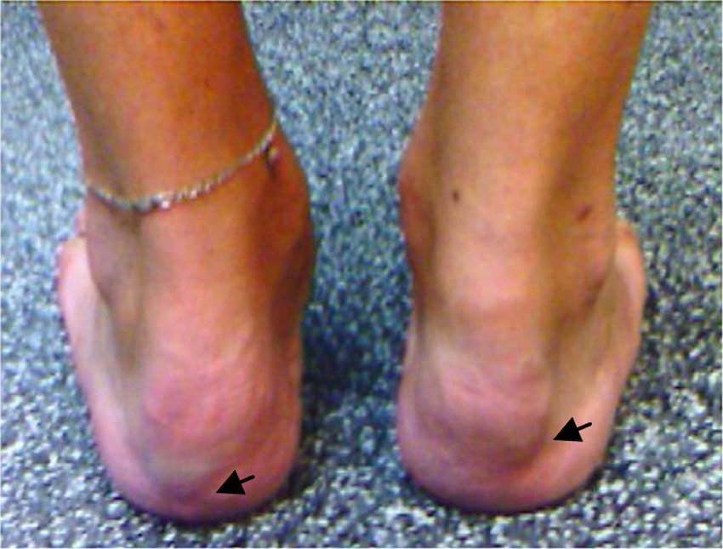
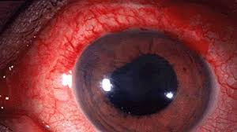
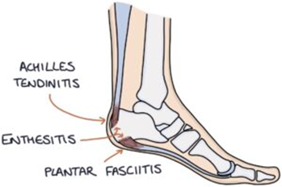
Spondyloarthropathy (SPINEACHE)
Chronic inflammatory diseases that most commonly affect Sacroiliac joints + axial skeleton
Group of conditions that are all associated with HLA B27 gene
Seronegative (RF –ve)
Example: Ankylosing spondylitis, Psoriatic arthritis, Reactive arthritis, Enteropathic arthritis, Juvenile Idiopathic Arthritis
SPINEACHE
O Sausage digit (dactylitis)
O Psoriasis
O Inflammatory back pain
O NSAID → good response
O Enthesitis (heel)
O Arthritis
O Crohn’s/ colitis/ elevated CRP (can be normal)
O HLA B27
O Eye (uveitis)

Slide 27
Ankylosing Spondylitis
Definition and Pathophysiology
•HLA B27 serotype positive
•Autoimmune process
•Causing inflammation, bone erosion and syndesmophyte formation (this is bony growth inside a ligament)
Classic patient
•Young man with back pain and stiffness worse at night
Presentation
•Spine and sacroiliac pain – worse at night and eases with activity
•Reduced spinal movement – especially loss of lumbar flexion
•Peripheral arthritis and dactylitis
•Asymmetrical peripheral joint pain
•Pain across costochondral joints

Slide 28
Ankylosing Spondylitis
Treatment
Physiotherapy, exercise
Medical:
•1st line - NSAIDs
•2nd line – anti-TNF biologics e.g. adalimumab or etanercept
•3rd line - IL-7 biologics e.g. secukinumab
* There is no role for DMARDs in AS.
Tests
•Xray spine
•MRI spine
•CRP and ESR
•Schober’s test - à Mark a point at L5 and put a point 10cm above and 5cm below. If when bending over forwards the distance is less than 20cm this supports a diagnosis of AS
·X-ray of spine + sacrum
Bamboo spine
Squaring of vertebral bodies
Subchondral sclerosis + erosions
Syndesmophytes – bony growth originating from a spinal ligament
Ossification of ligaments, discs + joints
Fusion of facet, SI + costovertebral joints

Slide 29
Ankylosing Spondylitis

Slide 30
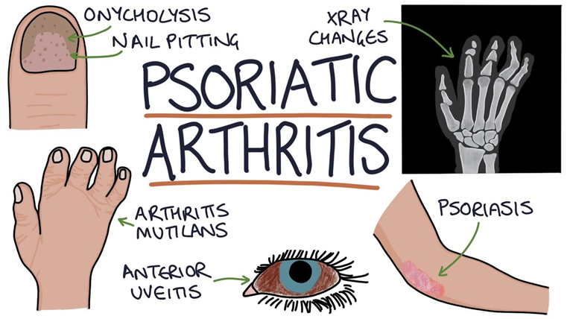
Psoriatic Arthritis
Autoimmune joint disease
From activation of CD8+ T Cells
Presentation
•Joint pain
•Joint stiffness – more than 30 minutes in the morning
•Swollen joints – fingers, toes
•Presence of psoriasis – behind ear, inside ear,umbilicus, scalp
•Joint tenderness, warmth
•Reduced ROM
•Dactylitis
•Enthesitis
•Psoriasis – psoriatic lesions, pitting of nails, onycholysis
Types
•Symmetric polyarthritis – more than 5 joints
•Asymmetric oligoarthritis – less than 4 joints, hands, feets, knee, most common type
•Distal arthritis – DIP joints of hands and feet
•Spondyloarthritis – spine, sacroiliac joints
•Arthritis mutilans – digits of fingers
Tests
•ESR and CRP
•Xray :
•Periostitis
•Ankylosis
•Osteolysis
•Pencil-in-cup appearance
Complications: Arthritis Mutilans
·Most severe form of psoriatic arthritis
·Occurs in phalanxes
·Osteolysis of bones around joints in digits → leads to progressive shortening
·Skin then folds as digit shortens → telescopic finger
Treatment
•NSAIDs, physio, intra-articular steroids
•DMARDs:
•1st = methotrexate
•2nd = sulfasalazine

Slide 31
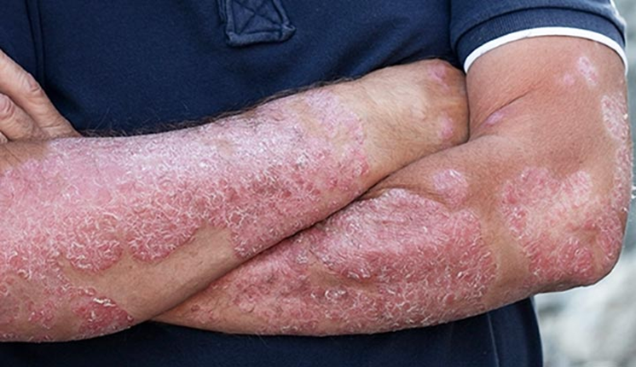
Psoriatic Arthritis

Slide 32
Reactive Arthritis
Pathology
Usually triggered by gastroenteritis or sexually transmitted infection, so it’s all in the history.
(NOT AN ACTIVE INFECTION)
> Gastro cause – Shigella, Salmonella, Campylobacter jejuni
> STI cause – Chlamydia
- Reactive arthritis is a seronegative spondyloarthropathy (seronegative means you won’t find any positive antibodies).
Presentation
•Bilateral conjunctivitis (non-infective)
•Anterior uveitis
•Urethritis (non-infective)
•Circinate balanitis (inflammation of skin at head of the penis)
Remember –
Can’t see, can’t pee, can’t climb a tree (Reiter’s Triad)
…and a non-infective joint aspirate.
Investigation
·ESR + CRP - raised
·ANA - negative
·RF - negative
·X-ray – sacroiliitis (pain in SI joints) or enthesopathy (inflamed ehtheses)
·Joint aspirate (gram staining, culture and sensitivity) - negative (exclude septic arthritis + gout à if sent for crystal examination)

Slide 33
Reactive Arthritis
Management
·Giving antibiotics until possibility of septic arthritis is excluded.
·NSAID
·Steroid injections into the affected joints with systemic steroids being required
particularly when multiple joints are affected
·DMARD or anti-TNF medications - chronic arthritis (if not resolved within 6
months and don’t recur)

Slide 34
Enteropathic Arthritis

Slide 35
Enteropathic Arthritis

Slide 36
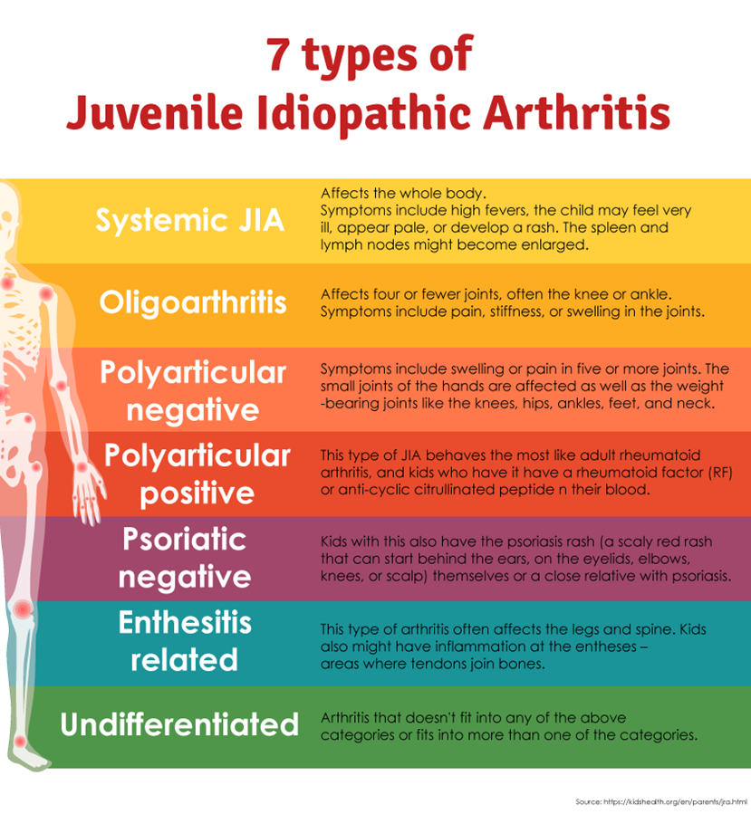
Juvenile Idiopatic Arthritis
Still’s Disease (Systemic JIA)
·Px à Subtle salmon-pink rash, high swinging fevers, enlarged lymph nodes, weight loss, joint inflammation and pain, splenomegaly, muscle pain, pleuritis + pericarditis
·Ix à Antinuclear antibodies + rheumatoid factors are typ negative. Raised CRP, ESR, platelets and serum ferritin
·Think of it if rash, fevers, joint pain and fever for more than 5 days (Kawasaki, Stills, and leukaemia)
·Complications à Macrophage Activation Syndrome (MAS) à acutely unwell, DIC, anaemia, thrombocytopenia, bleeding, non-blanching rash. Key finding (low ESR)
Management:
·NSAIDS (ibuprofen)
·Steroids, oral, IM, intra-articular in oligoarthritis
·DMARDS (methotrexate)
·TNF Inhib (etanercept)

Slide 37
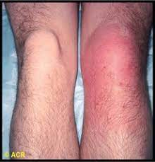
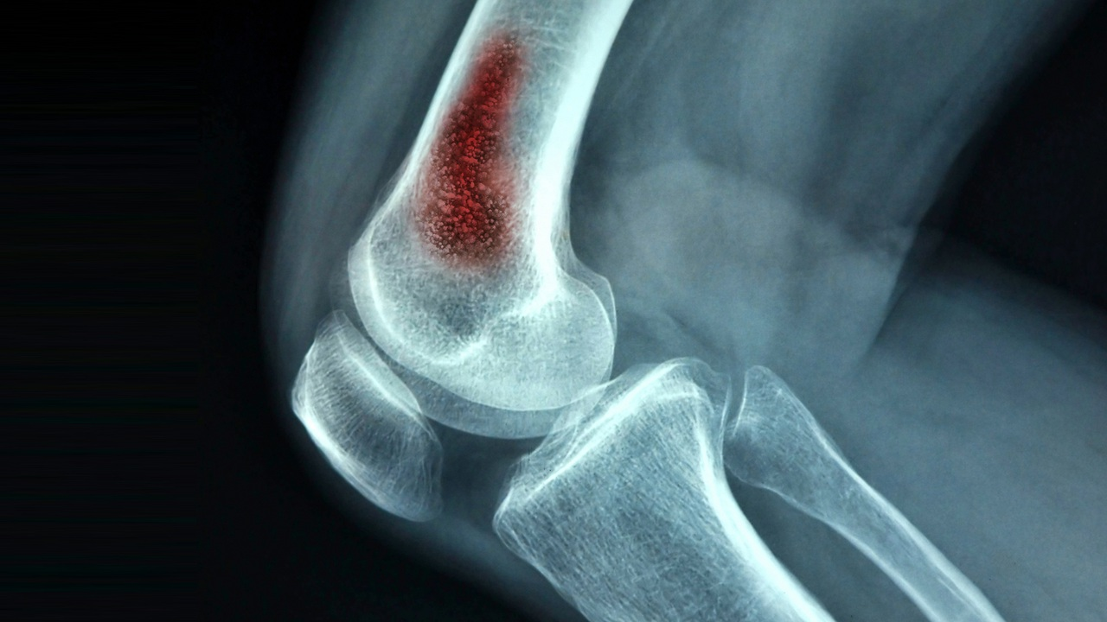
Infective Arthtiris
Septic Arthritis
Osteomyelitis

Slide 38
Septic Arthritis
Risk Factors
•Joint disease – RA, gout, osteoarthritis
•IVDU
•Immunosuppressed
•Prosthetic joint replacement (1% post-op)
Tests
•Joint aspiration – yellow, cloudy, WCC more than 50,000
•Blood cultures
•FBC and CRP
•Xray
Treatment
•This is a medical emergency – 10% mortality
•IV antibiotics for 2 weeks plus oral for 4 weeks after
•1st = flucloxacillin
•If MRSA = Vancomycin
•If Neisseria = Ceftriaxone
•Surgery – laparoscopic washout or surgical debridement
Pathophysiology
•Refers to infection of joint (usually bacterial)
•Staph aureus = most common cause
•Staph epidermidis = prosthetic joints
•Pseudomonas aeruginosa = immunosuppressed, elderly, IVDU
•Haemophilus influenzae = child
N. gonococcus = young, sexually active
Presentation
•Hot, tender, erythematous swollen joint (commonly knee)
•Difficulty weight bearing
•Limited range of movement
•Fever and lethargy
•Signs of sepsis
Complications
•Osteomyelitis – infection gets into the actual bones not just joint structure
•Permanent joint destruction
•Sepsis and death

Slide 39
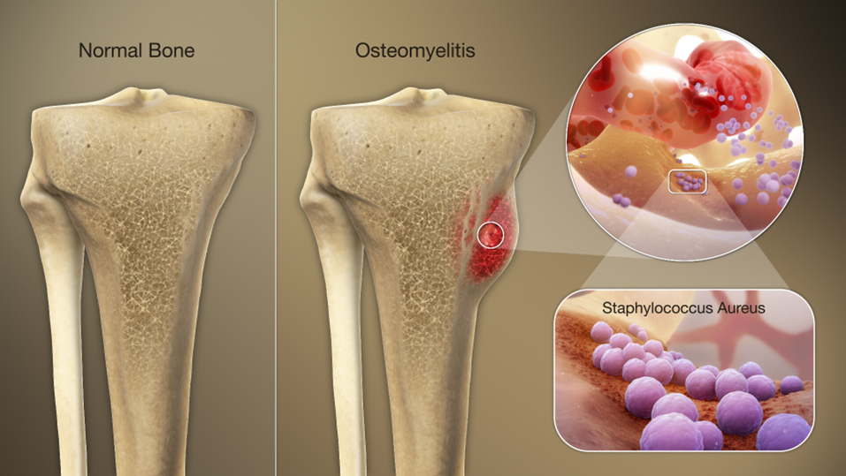
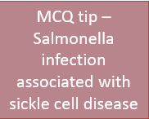
Osteomyelitis
-Osteomyelitis refers to inflammation in a bone and bone marrow, usually caused by bacterial infection with S. aureus.
-This is different to septic arthritis, which is inflammation in the joint that has not got into the bones themselves yet.
Risk Factors:
•Open fractures
•Orthopaedic operations, particularly with prosthetic joints
•Diabetes, particularly with diabetic foot ulcers
•Peripheral arterial disease
•IV drug use – injecting bacteria into blood -> goes to bone
•Immunosuppression
Investigation:
•X-rays not useful – no changes in early disease.
•MRI scans are the best imaging.
•CRP, WCC raised
•Blood cultures
•Bone biopsy cultures to find causative organism and sensitivities.
Management
•6 weeks IV antibiotics – usually flucloxacillin
•Surgical debridement of bone
•If becomes chronic osteomyelitis may need 12 weeks abx
•May require prosthetic joint revision

Slide 40
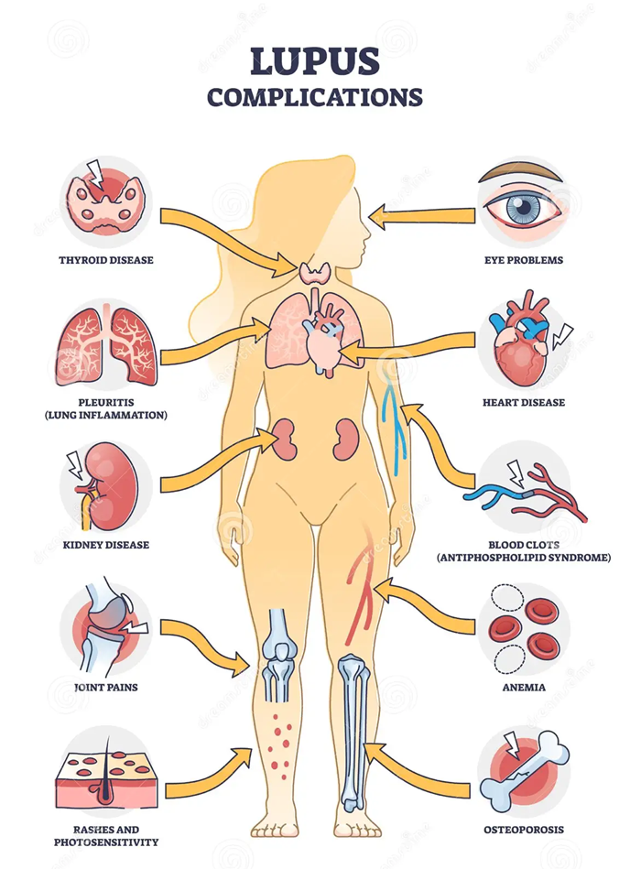
Systemic Lupus Erythemathosus
SLE presents with many non-specific symptoms:
Systemic = affects many systems
Erythematous = red rash on face
•Fatigue
•Weight loss
•Mild arthralgia
•Non-erosive arthritis
•Myalgia (muscle pain)
•Fever
•Photosensitive malar rash
•Lymphadenopathy
•Splenomegaly
•Shortness of breath
•Pleuritic chest pain
•Mouth ulcers
•Hair loss
•Raynaud’s phenomenon
•Oedema (due to nephritis)
SLE is an inflammatory autoimmune connective tissue disorder.
•characterised by anti-nuclear antibodies (ANA) that attack the cell nucleus
•antibodies generate a chronic inflammatory response
Abnormal investigation findings in SLE include:
•80% have the ANA antibodies
•FBC - anaemia of chronic disease, low white cell count and low platelets
•CRP and ESR raised
•C3 and C4 levels may be decreased in active disease
•Urinalysis and urine protein:creatinine ratio shows proteinuria in lupus nephritis
•Renal biopsy may be used to investigate for lupus nephritis

Slide 41
QnA
A 60 year old man limps into A and E. Over the last few days his right knee has become increasingly painful, and you can see from the end of the bed that it appears erythematous and swollen. On examination, the knee is hot to touch, and the range of motion is severely limited by pain and swelling.
There is no history of fall or injury to the knee. Observations show he is febrile.Their past medical history is unremarkable except for total R knee replacement 3 months ago.
Which of the following is the most appropriate initial investigation?
A.USS knee
B.MRI knee
C.Aspiration of knee joint
D.X ray of knee
E.Blood cultures

Slide 42
QnA
A 60 year old man limps into A and E. Over the last few days his right knee has become increasingly painful, and you can see from the end of the bed that it appears erythematous and swollen. On examination, the knee is hot to touch, and the range of motion is severely limited by pain and swelling.There is no history of fall or injury to the knee. Observations show he is febrile. Their past medical history is unremarkable except for total R knee replacement 3 months ago

Slide 43
QnA
A 24 year old man presents to the GP due to pain and stiffness in his back over the last 3 months. He is in good physical shape, but has been feeling increasingly tired lately. He has lacked the motivation to exercise recently, but finds that on days when he does get out for a jog then his back is less sore the following day.
His past medical history is unremarkable, although on further questioning he remembers an episode of painful red eye some years ago.
Which is of the following is the most likely diagnosis?
A. Psoriatic arthritis
B. Ankylosing spondylitis
C. Osteoarthritis
D. Reactive arthritis
E. Enteropathic arthritis

Slide 44
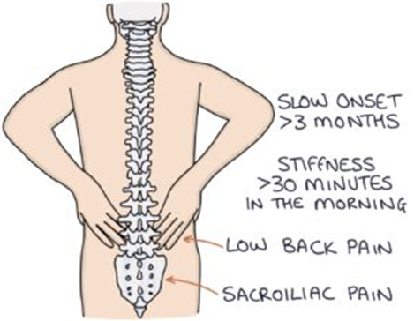
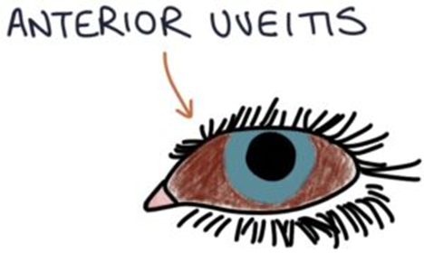
QnA
A 24 year old man presents to the GP due to pain and stiffness in his back over the last 3 months. He is in good physical shape, but has been feeling increasingly tired lately. He has lacked the motivation to exercise recently, but finds that on days when he does get out for a jog then his back is less sore the following day.
His past medical history is unremarkable, although on further questioning he remembers an episode of painful red eye some years ago.
Which is of the following is the most likely diagnosis?
A. Psoriatic arthritis – no history of skin lesions classic of psoriasis (scaly, pink)
B. Ankylosing spondylitis – correct age group, classic inflammatory back pain symptoms and hx of uveitis
C. Osteoarthritis – age group wrong, OA would be exacerbated by physical activity not relieved
D. Reactive arthritis – no history of new sexual partner in stem, no dysuria
E. Enteropathic arthritis – no history of inflammatory bowel disease symptoms

Slide 45
Please fill out the feedback form!!

