Slide 1
Thrombosis and Infarction
2a Teaching
Rebecca Blanshard and Will White

Slide 2
What’s being covered?
What is thrombosis and why does it occur
How atherosclerosis predisposes arterial thrombosis
Difference between arterial and venous thrombosis
Clinical significance of thrombosis

Slide 3
Haemostasis
The normal balance between keeping blood inside vessels fluid and making blood outside of blood vessels clot.

Slide 4
What is a thrombus?
Solid mass of blood constituents
Formed in life (after death = clot)
Physiological - as part of haemostasis (to prevent bleeding outside vessels)
Pathological - when there is an imbalance in the blood coagulation system

Slide 5
Factors predisposing thrombosis: Virchows Triad
Change in vessel wall
Change in blood flow
Change in blood constituents

Slide 6
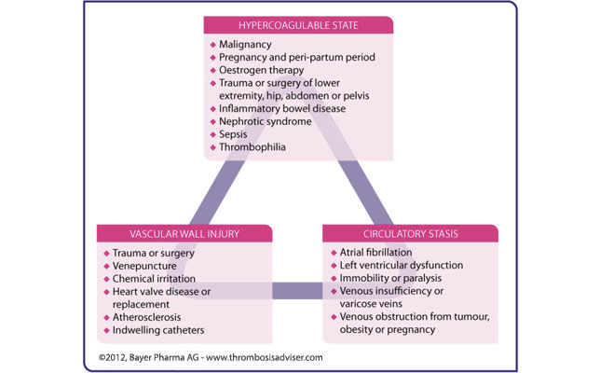

Slide 7
Atherosclerosis
Fatty streak occurs in area of turbulent flow
High levels of LDL in the blood will begin to accumulate in the arterial wall
Phagocytes are attracted to the site of damage and take up lipid to form foam cells
Formation of a lipid core
The activated macrophages will release lots of their own products - cytokines and growth factors
Smooth muscle proliferation around the lipid core and formation of a fibrous cap

Slide 8
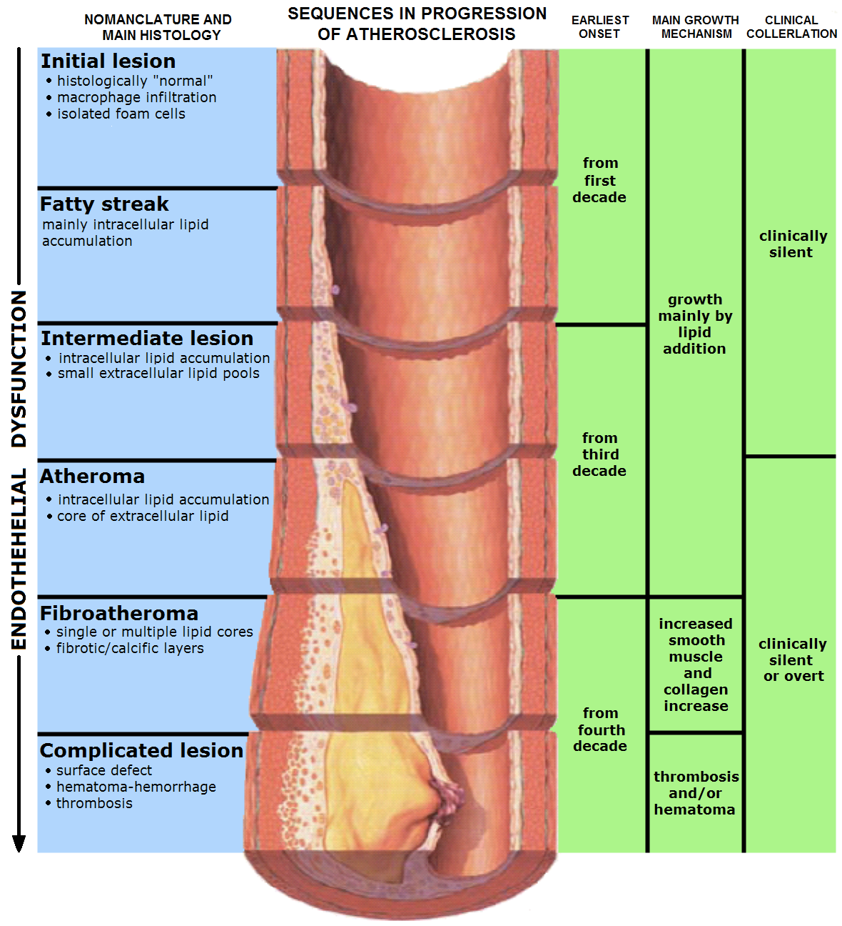

Slide 9
Complications of atheroma
Vulnerable plaques - those in areas of high stress - have a thinner fibrous cap prone to rupture
When the contents of the plaque become exposed to the lumen, this can trigger thrombus formation.
In an artery thrombus can narrow lumen of the vessel and lead to ischaemia
Thrombus can become dislodged and act as an embolus
Plaques can weaken wall of arteries and lead to aneurysm

Slide 10
Arterial Thrombosis
Platelet rich
Occur at high pressure
Associated with atheroma risk factors: smoking, obesity, higher bp, increased age and family history
Lead to myocardial infarction (MI), unstable angina, ischaemic stroke and manifestations of peripheral arterial disease.
Treat with anti-platelet medication

Slide 11
ACS- Acute Coronary Syndrome
Unstable angina, STEMI, N-STEMI.
Presentation - acute chest pain longer than 15 mins - occurs at rest - can radiate to the arms, back or jaw - associated sweating, nausea, vomiting, fatigue, shortness of breath and palpitations.
Differentials: acute pericarditis, myocarditis, aortic stenosis, aortic dissection, pulmonary embolism, pneumonia, pneumothorax, oesophageal spasm, reflux, acute gastritis, cholecystitis, acute pancreatitis or musculoskeletal chest pain.

Slide 12
Investigations: - ECG to see if there is ST-elevation (requires immediate thrombolysis). Other abnormalities include q waves (sign of previous ischaemic damage), wave inversion or ST-segment depression (typically associated with unstable angina). - Troponin I and T become detectable in serum 3-6 hours after infarction, peak at 12-24 hours, and remain raised for up to 14 days. - Other bloods- FBC for anaemia, CRP for inflammation, blood glucose (hyperglycaemia predicts worse outcomes) - Echocardiography often demonstrates wall motion abnormalities - CXR may show complications of ischaemia

Slide 13
Management: 1) Check O2 stats - O2 if less than 94% 2) Pain killers - GTN/Opioid 3) Anticoagulation - Asprin 1st line, clopidogrel 4) In STEMI consider thrombolysis - streptokinase 5) Consider re-vascularisation: - PCI- Percutaneous intervention - CABG - Coronary Artery Bypass Graft

Slide 14
Ischaemic Stroke
Caused by atherosclerosis of the carotid arteries. Thrombi can form here and block downstream arteries that supply the brain
Presentation depends on location and size of arteries affected
Can be treated with thrombolysis.

Slide 15
Venous Thrombosis
Fibrin rich, less platelets than arterial thrombus
Occur at lower pressure
More likely to fragment and form an embolus risk factors: increased age, pregnancy, immobility, dehydration, oestrogen containing medications exposing factors: surgery, cancer treatment, acute illness
Most commonly present as DVT and PE
Treat with anti-coagulants

Slide 16
DVT - Deep Vein Thrombosis
Presentation: - Pain/tenderness along line of deep veins - Unilateral calf swelling - Pitting oedema - Skin warmth and discolouration
WELLS Score for DVT determines management in OP/emergency setting

Slide 18
Investigations: - Proximal leg vein ultrasound - D-Dimer (if US neg or unavailable) Duplex US is the gold standard investigation
Management: - Anti-coagulation - Low molecular weight heparin - Long term consider Warfarin or NOACs such as rivaroxaban - If patient cant have anticoagulant then consider IVC filter to prevent PE - Compression stockings

Slide 19
PE - Pulmonary Embolus
Causes: Thrombus (most common), fat, air
Presentation: - shortness of breath - cough and haemoptysis - pleuritic or retrosternal chest pain - anxiety, impaired consciousness - hypotension and shock
Use WELLS Score for PE to determine likelihood

Slide 20
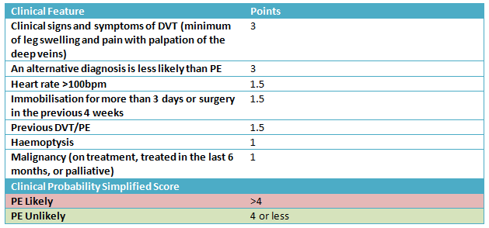

Slide 21
Investigations: - CT-Pulmonary Angiogram is gold standard - Ventilation/Perfusion scan (V/Q SPECT) - D Dimer - Baseline investigations
Management: 1) Oxygen and pain relief 2) Anti-coagulant - LMWH 3) Long term Warfarin or NOAC

Slide 22
What’s being covered?
What is thrombosis and why does it occur
How atherosclerosis predisposes arterial thrombosis
Difference between arterial and venous thrombosis
Clinical significance of thrombosis

