Slide 1
GEM SBA-Style Revision Series
2022/23

Slide 2
UROGENTIAL SBA
Phase 1 Content GEM SBA Revision Session
Abby Todd
10/19/22

Slide 3
Aims and Objectives
Cover SBA Questions on:
Renal physiology
Urogenital physiology
Some endocrine physiology
A small amount of histology and anatomy

Slide 4
Question 1
A 27 year old man presents to the fertility clinic experiencing
problems with his fertility.
Where is the site of sperm maturation?
A – testis
B – epididymis
C – prostate gland
D – vans deferens
E – seminiferous tubulus

Slide 5
Question 1
A 27 year old man presents to the fertility clinic experiencing
problems with his fertility.
Where is the site of sperm maturation?
A – testis
B – epididymis
C – prostate gland
D – vans deferens
E – seminiferous tubulus

Slide 6
Question 1
A 27 year old man presents to the fertility clinic experiencing
problems with his fertility.
Where is the site of sperm maturation?
A – testis (not specific enough)
B – epididymis
C – prostate gland (produces seminal fluid)
D – vans deferens (transportation)
E – seminiferous tubules (site of production)

Slide 7
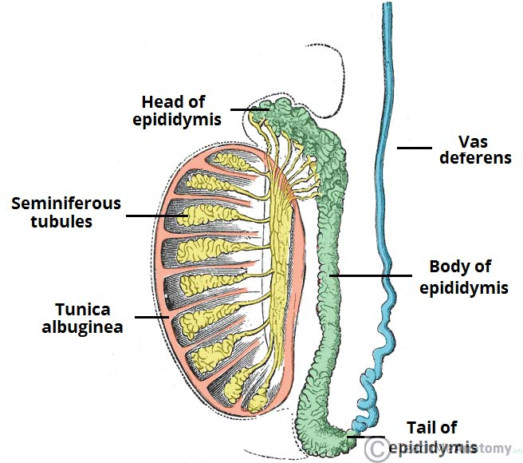
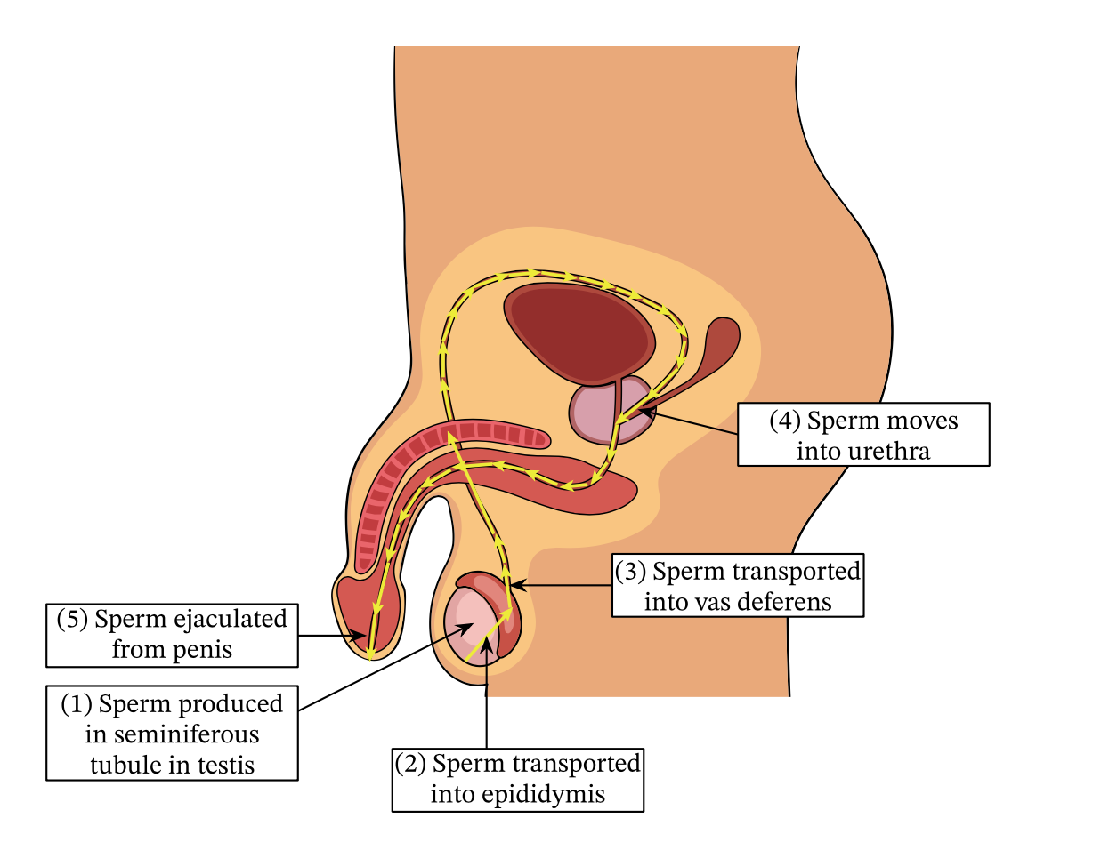
Question 1
B – the site of sperm maturation is the epididymis

Slide 8
Question 2
A 42 year old woman presents to her GP with vision loss. She
is later diagnosed with a pituitary tumour.
Which of the following hormones is produced by the anterior
Pituitary?
A – prolactin
B – triiodothyronine
C – diiodothyronine
D – vasopressin
E – Corticotropin releasing hormone

Slide 9
Question 2
A 42 year old woman presents to her GP with vision loss. She
is later diagnosed with a pituitary tumour.
Which of the following hormones is produced by the anterior
Pituitary?
A – prolactin
B – triiodothyronine
C – diiodothyronine
D – vasopressin
E – Corticotropin releasing hormone

Slide 10
Question 2
A 42 year old woman presents to her GP with vision loss. She
is later diagnosed with a pituitary tumour.
Which of the following hormones is produced by the anterior
Pituitary?
A – prolactin
B – triiodothyronine (thyroid gland)
C – diiodothyronine (thyroid gland)
D – vasopressin (hypothalamus)
E – Corticotropin releasing hormone (hypothalamus)

Slide 11
Question 2
FLAGTOP
–FSH – Follicle Stimulating Hormone
–LH – Luteinizing Hormone
–ACTH – Adrenocorticotropic hormone
–GH – Growth Hormone
–TSH – Thyroid Stimulating Hormone
–O – MelanOcyte stimulating hormone
–Prolactin

Slide 12
Question 3
You are attending a renal clinic as a medical student. The
consultant nephrologist asks you to describe the functions
of the kidneys.
Which answer would be incorrect?
A – control of plasma Ca²⁺ levels using parathyroid hormone
B – stimulate red blood cell production by producing erythropoietin
C – control of blood pressure by producing atrial natriuretic peptide
D – regulate the acid-base balance
E – regulate electrolyte balance and control osmolality

Slide 13
Question 3
You are attending a renal clinic as a medical student. The
consultant nephrologist asks you to describe the functions
of the kidneys.
Which of the following statements is incorrect regarding kidney function?
A – control of plasma Ca²⁺ levels using parathyroid hormone
B – stimulate red blood cell production by producing erythropoietin
C – control of blood pressure by producing atrial natriuretic peptide
D – regulate the acid-base balance
E – regulate electrolyte balance and control osmolality

Slide 14
Question 3
The kidney uses renin to control blood pressure.
ANP is produced by the atria to control blood pressure.

Slide 15
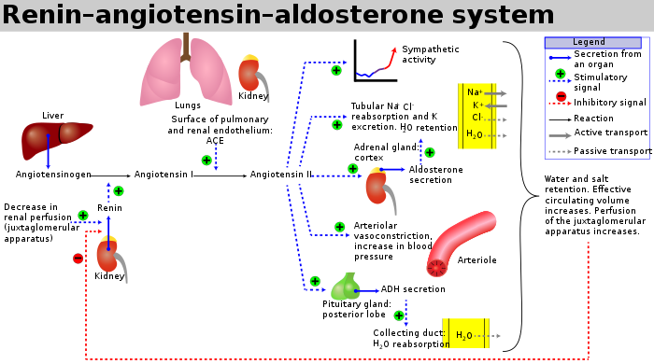
https://en.wikipedia.org/wiki/Renin–angiotensin_system

Slide 16
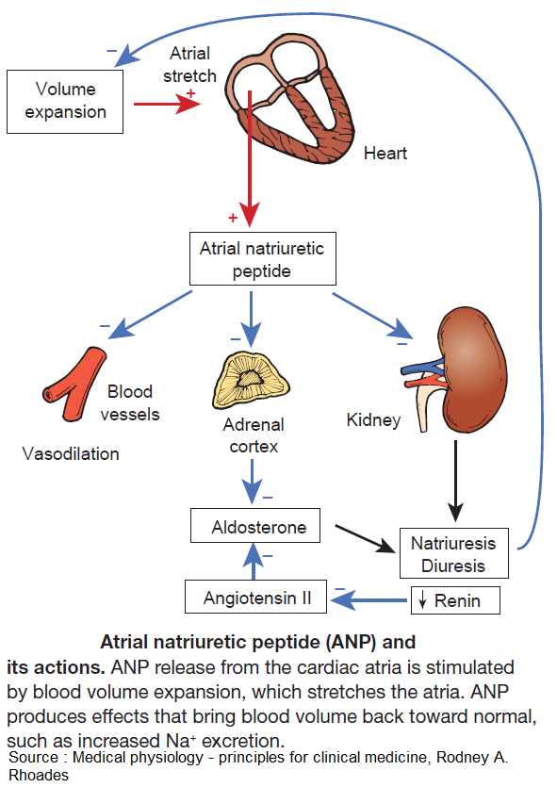
https://twitter.com/manualomedicine/status/1181971312958418947

Slide 17
Question 4
A 37 year old lady has developed urinary incontinence after suffering from a spinal cord injury.
What is the name of the area which when inhibited, reduces sympathetic stimulation to the internal urethral sphincter, and what is the effect of this?
Onuf’s nucleus, causes internal urethral sphincter relaxation and induces micturition
Onuf’s nucleus, causes internal urethral sphincter contraction and induces micturition
Onuf’s nucleus, causes internal urethral sphincter contraction and prevents micturition
Pontine micturition centre, causes internal urethral sphincter relaxation and induces micturition
Pontine micturition centre, causes internal urethral sphincter contraction and prevents micturition

Slide 18
Question 4
A 37 year old lady has developed urinary incontinence after suffering from a spinal cord injury.
What is the name of the area which when inhibited, reduces sympathetic stimulation to the internal urethral sphincter, and what is the effect of this?
Onuf’s nucleus, causes internal urethral sphincter relaxation and induces micturition
Onuf’s nucleus, causes internal urethral sphincter contraction and induces micturition
Onuf’s nucleus, causes internal urethral sphincter contraction and prevents micturition
Pontine micturition centre, causes internal urethral sphincter relaxation and induces micturition
Pontine micturition centre, causes internal urethral sphincter contraction and prevents micturition

Slide 19
Question 4
If its reducing sympathetic stimulation then it must be inducing micturition (as micturition is parasympathetic).
For micturition to occur both the internal and external sphincters must relax.
Onuf’s nucleus is inhibited by the Pontine Micturition Centre. So the PMC does cause all these things but it does so by inhibiting Onuf’s nucleus.

Slide 20
Question 5
Which statement regarding neurological control of the bladder is incorrect?
Hypogastric nerve has the nerve roots T10-L2
Pudendal nerve has the nerve roots S2-S4
Pelvic nerve has the nerve roots S2-S4
Activation of M3 receptors on the detrusor muscle causes it to contract
All of the above are correct

Slide 21
Question 5
Which statement regarding neurological control of the bladder is incorrect?
Hypogastric nerve has the nerve roots T10-L2
Pudendal nerve has the nerve roots S2-S4
Pelvic nerve has the nerve roots S2-S4
Activation of M3 receptors on the detrusor muscle causes it to contract
All of the above are correct

Slide 22
Question 5
Which statement regarding neurological control of the bladder is incorrect?
Hypogastric nerve has the nerve roots T10-L2
Pudendal nerve has the nerve roots S2-S4
Pelvic nerve has the nerve roots S2-S4
Activation of M3 receptors on the detrusor muscle causes it to contract → parasympathetic
All of the above are correct

Slide 23
Question 6
Approximately at what point of filling do afferent nerves in the bladder wall signal the need to void the bladder?
100 mls
250 mls
400 mls
550 mls
700mls

Slide 24
Question 6
Approximately at what point of filling do afferent nerves in the bladder wall signal the need to void the bladder?
100 mls
250 mls
400 mls
550 mls
700mls

Slide 25
Question 6
400 mls
A healthy human bladder can hold between 400 to 500 millilitres of urine before it reaches capacity. A healthy bladder can stretch and accommodate larger volumes of urine.

Slide 26
Question 7
Which of the following will increase GFR?
Dilation of afferent arteriole
Dilation of efferent arteriole
Constriction of afferent arteriole
Constriction of efferent arteriole
None of the above affect GFR
1 and 4
2 and 3
1 and 2
3 and 4
5

Slide 27
Question 7
Which of the following will increase GFR?
Dilation of afferent arteriole
Dilation of efferent arteriole
Constriction of afferent arteriole
Constriction of efferent arteriole
None of the above affect GFR
1 and 4
2 and 3
1 and 2
3 and 4
5

Slide 28
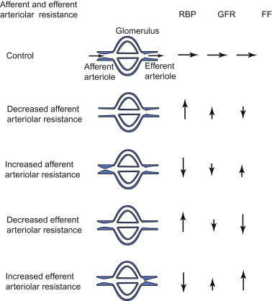
Question 7
Notes:
GFR will be increased if there is increased blood flow to the glomeruli. Not sure how accurate it is but i imagine having constriction of the efferent arterioles allows the blood to hang around a little longer and be as filtered as possible.

Slide 29
Question 8
The loop of Henle has an ascending and descending limb. Which limb is paired with its corresponding permeability?
Descending limb is permeable to salts only
Descending limb is permeable to water only
Descending limb is permeable to water and salt
Ascending limb is permeable to salt and water
Ascending limb is permeable to water only

Slide 30
Question 8
The loop of Henle has an ascending and descending limb. Which limb is paired with its corresponding permeability?
Descending limb is permeable to salts only
Descending limb is permeable to water only
Descending limb is permeable to water and salt
Ascending limb is permeable to salt and water
Ascending limb is permeable to water only

Slide 31
Question 8
The loop of Henle has an ascending and descending limb. Which limb is paired with its corresponding permeability?
Descending limb is permeable to salts only
Descending limb is permeable to water only
Descending limb is permeable to water and salt
Ascending limb is permeable to salt and water
Ascending limb is permeable to water only – salt only
NaCl diffuses out of the ascending limb and thus water moves out of the ascending limb by osmosis.

Slide 32
Question 9
In which cells does vasopressin cause Aquaporin-2 channel insertion?
Intercalated cells
Parietal epithelial cells
Principal cells
Podocytes
Mesangial cells

Slide 33
Question 9
In which cells does vasopressin cause Aquaporin-2 channel insertion?
Intercalated cells
Parietal epithelial cells
Principal cells
Podocytes
Mesangial cells

Slide 34
Question 9
Principal cells are in the collecting duct. ADH causes activates V2 receptors which causes AQP2 channel insertion into the principal cells of the collecting duct.
Intercalated cells are in the collecting duct as well but regulate acid-base balance.
Parietal epithelial cells are squamous cells that make up the structure of the Bowman’s capsule.
Podocytes prevent plasma proteins from entering the urinary ultrafiltrate in the Bowman’s capsule
Mesangial cells are mesenchymal cells that support the glomerular capillary tuft and participate in hemodynamic control. MC contraction induces capillary constriction and reduction of glomerular filtration surface area.

Slide 35
Question 10
Which value is the most ‘normal’ eGFR?
30ml/minute
75ml/minute
100ml/minute
180ml/minute
0.5L/minute

Slide 36
Question 10
Which value is the most ‘normal’ eGFR?
30ml/minute
75ml/minute
100ml/minute
180ml/minute
0.5L/minute
90-120/125 is normal. 180 is abnormally high and so is 500ml a minute. A and B would imply kidney disease.

Slide 37
Question 11
Which statement is true regarding the bladder?
The mucosa of the bladder is folded into villi to allow bladder expansion
The outermost layer of the bladder is the muscularis propria
The bigone of the bladder is smooth walled
It is lined by transitional epithelium
There is a superior and inferior urethral sphincter

Slide 38
Question 11
Which statement is true regarding the bladder?
The mucosa of the bladder is folded into villi to allow bladder expansion
The outermost layer of the bladder is the muscularis propria
The bigone of the bladder is smooth walled
It is lined by transitional epithelium
There is a superior and inferior urethral sphincter

Slide 39
Question 11
Which statement is true regarding the bladder?
The mucosa of the bladder is folded into villi rugae to allow bladder expansion
The outermost layer of the bladder is the muscularis propria adventitia
The bygone trigone of the bladder is smooth walled
It is lined by transitional epithelium
There is a superior external and inferior internal urethral sphincter
Notes:
Transitional epithelium - in the ureters, bladder and urethra. It usually appears cuboidal when relaxed and squamous when stretched. Mucosa folded into rugae.
Trigone of bladder is smooth walled (due to different embryological origin: it is developed by the integration of two mesonephric ducts at the base of the bladder)
There is an external (somatic) and internal (autonomic) urethral sphincter.

Slide 40
Question 12
In cases of severe kidney cancer, a nephrectomy may be indicated. Which statement best describes the anatomy of the kidneys?
They are immediately superior to the adrenal glands
They lie within the peritoneal cavity
They extend from T9-T12
The renal pelvis attaches to the urethra
They have a fibrous outer layer named the renal capsule.

Slide 41
Question 12
In cases of severe kidney cancer, a nephrectomy may be indicated. Which statement best describes the anatomy of the kidneys?
They are immediately superior to the adrenal glands
They lie within the peritoneal cavity
They extend from T9-T12
The renal pelvis attaches to the urethra
They have a fibrous outer layer named the renal capsule.

Slide 42
Question 12
In cases of severe kidney cancer, a nephrectomy may be indicated. Which statement best describes the anatomy of the kidneys?
They are immediately superior inferior to the adrenal glands
They lie within outside of the peritoneal cavity
They extend from T9-T12 T12-L3, although the right kidney is often situated slightly lower due to the presence of the liver
The renal pelvis attaches to the urethra ureter
They have a fibrous outer layer named the renal capsule.

Slide 43
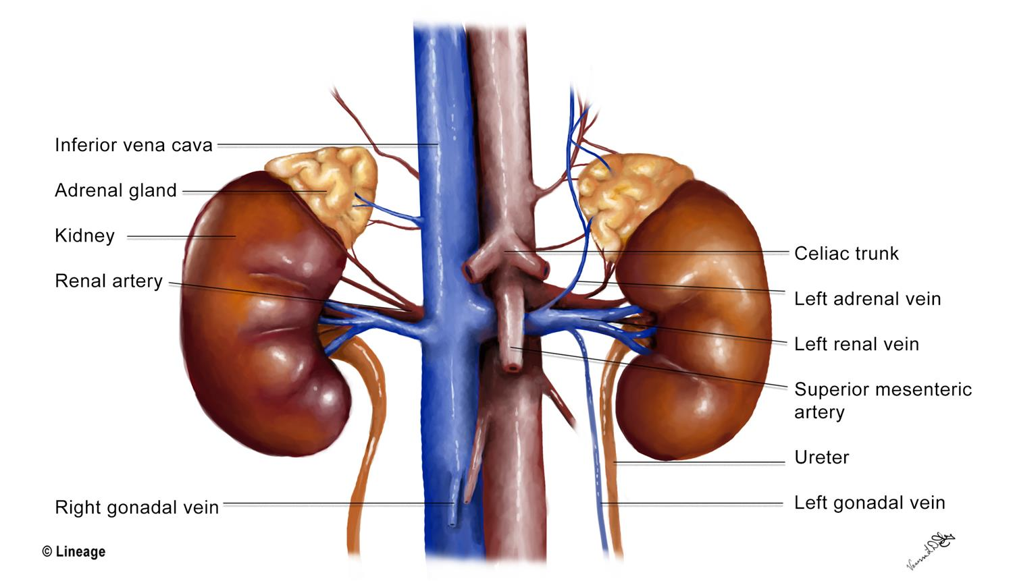
Question 12

Slide 44
Question 13
What word best describes the osmolar concentration of plasma and is proportional to the number of particles per litre of solution expressed as mmol/L?
Osmolality
Osmolarity
Osmotic pressure
Oncotic pressure
Serum concentration

Slide 45
Question 13
What word best describes the osmolar concentration of plasma and is proportional to the number of particles per litre of solution expressed as mmol/L?
Osmolality
Osmolarity
Osmotic pressure
Oncotic pressure
Serum concentration

Slide 46
Question 13
What word best describes the osmolar concentration of plasma and is proportional to the number of particles per litre of solution expressed as mmol/L?
Osmolality: an estimation of the osmolar concentration of plasma and is proportional to the number of particles per kilogram of solvent
Osmolarity
Osmotic pressure: the minimum pressure which needs to be applied to a solution to prevent the inward flow of its pure solvent across a semipermeable membrane
Oncotic pressure: or colloid osmotic-pressure, is a form of osmotic pressure induced by the proteins, notably albumin, in a blood vessel's plasma (blood/liquid) that causes a pull on fluid back into the capillary.
Serum concentration: the amount of a compound in the circulation, both bound to proteins and unbound

Slide 47
Question 14
Which of the following would be an abnormal finding in analysis of someone’s urine?
High Na+ concentration in someone who is dehydrated
Detectable glucose in someone who has not been fasting
Undetectable levels of protein
Urea
Creatinine

Slide 48
Question 14
Which of the following would be an abnormal finding in analysis of someone’s urine?
High Na+ concentration in someone who is dehydrated
Detectable glucose in someone who has not been fasting
Undetectable levels of protein
Urea
Creatinine

Slide 49
Question 15
Where does most of the sodium reabsorption occur in the kidneys?
Bowman’s capsule
Proximal tubules
Loop of Henle
Distal tubules
Collecting duct

Slide 50
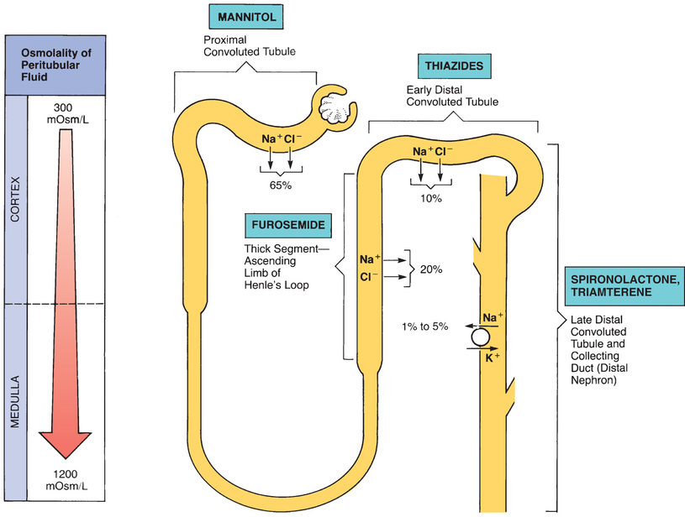
Question 15
Where does most of the sodium reabsorption occur in the kidneys?
Bowman’s capsule
Proximal tubules
Loop of Henle
Distal tubules
Collecting duct

Slide 51
Question 16
What best describes the distribution of water in the body?
60% of the body’s weight is water: 1/3 of the water is intracellular and 2/3 of the water extracellular
60% of the body’s weight is water: 2/3 of the water is intracellular and 1/3 of the water extracellular
60% of the body’s weight is water: 40% of the water is intracellular and 20% of it is extracellular
60% of the body’s weight is water: 20% of the water is intracellular and 40% of it is extracellular
60% of the body’s weight is water: it is evenly distributed between intracellular and extracellular compartments

Slide 52
Question 16
What best describes the distribution of water in the body?
60% of the body’s weight is water: 1/3 of the water is intracellular and 2/3 of the water extracellular
60% of the body’s weight is water: 2/3 of the water is intracellular and 1/3 of the water extracellular
60% of the body’s weight is water: 40% of the water is intracellular and 20% of it is extracellular
60% of the body’s weight is water: 20% of the water is intracellular and 40% of it is extracellular
60% of the body’s weight is water: it is evenly distributed between intracellular and extracellular compartments

Slide 53
Conclusion
We have covered SBA Questions on:
Renal physiology
Urogenital physiology
Some endocrine physiology
A small amount of histology and anatomy
ajtodd1@Sheffield.ac.uk

Slide 54
Feedback
Notes:
https://docs.google.com/forms/d/e/1FAIpQLSeEIuqr1hPiPA34Vr22HwI9HnG7MhCvv-whd6oQJUYOLSC5lQ/viewform?vc=0&c=0&w=1&flr=0

